Slide 1
Structural Biology Methods
Fall 2022
Lecture #3

Slide 2
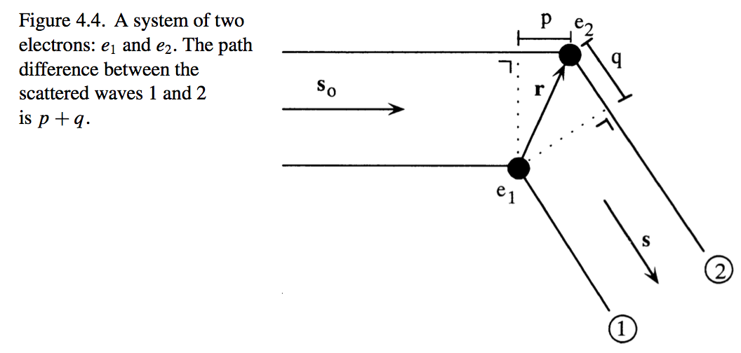





System of two electrons

Slide 3


Slide 4


-s₀

Slide 6

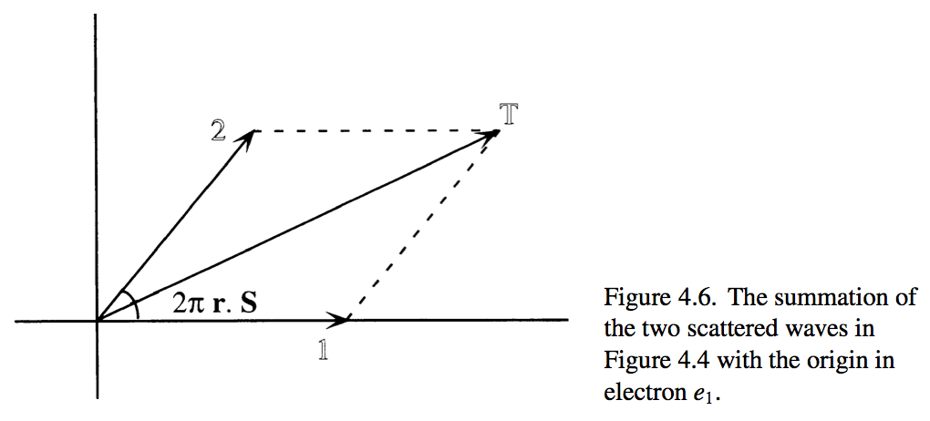

Slide 7
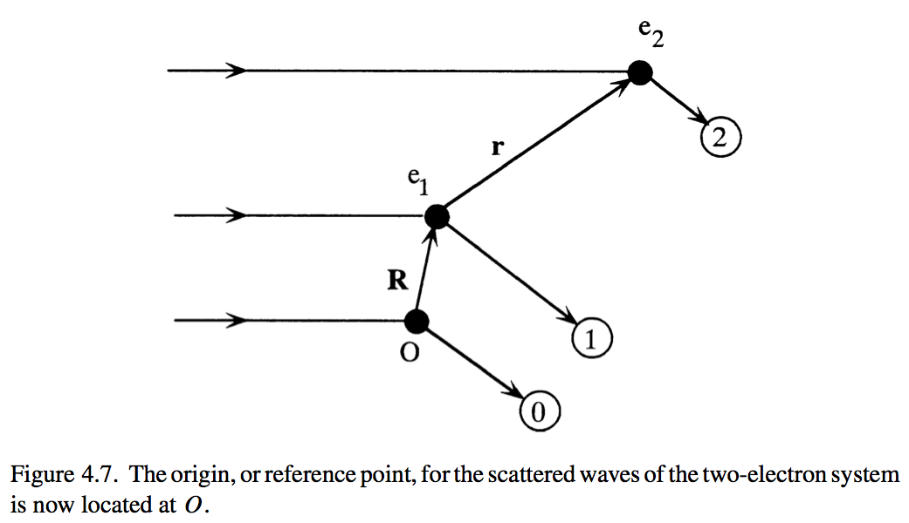
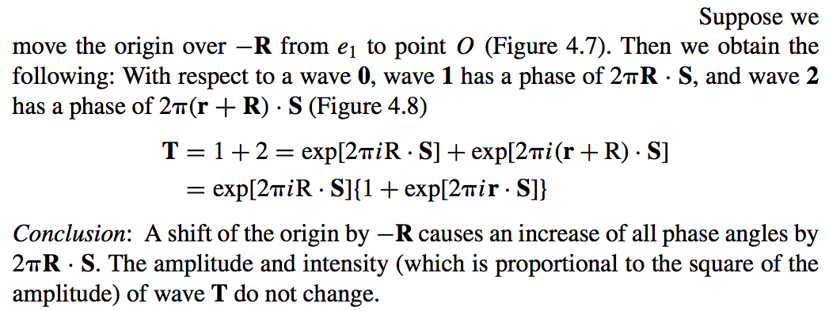

Slide 8
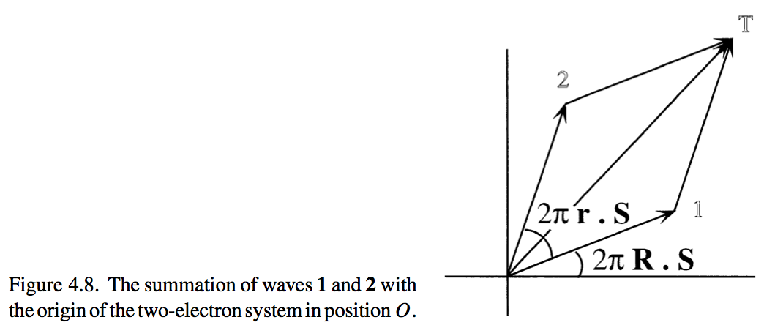

Slide 9
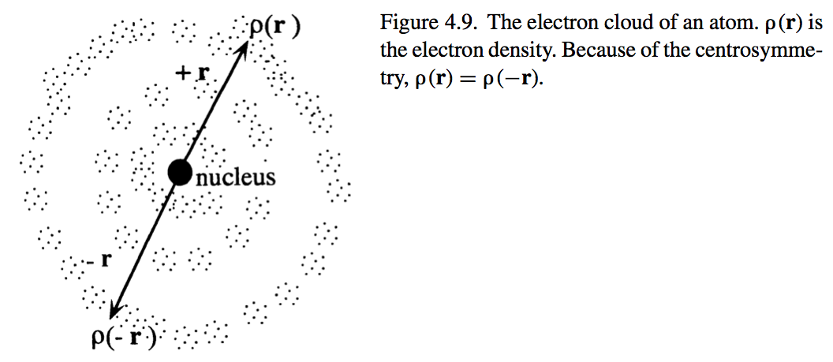

Scattering by an atom

Slide 10
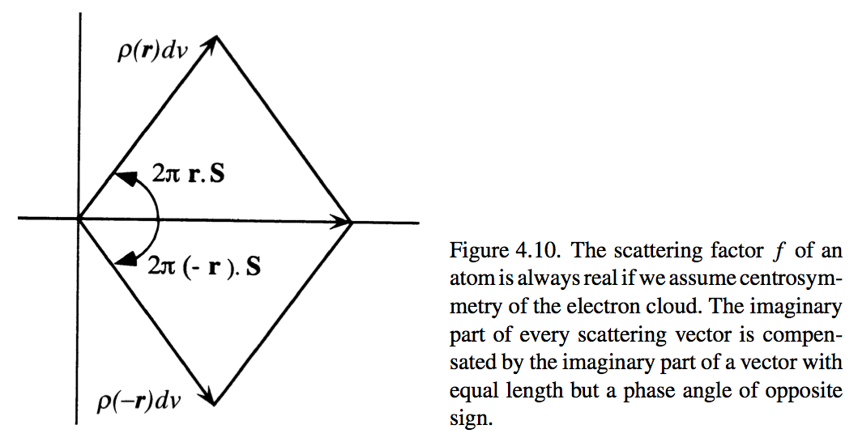
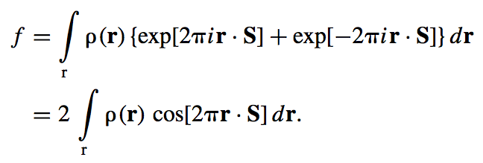

Slide 11
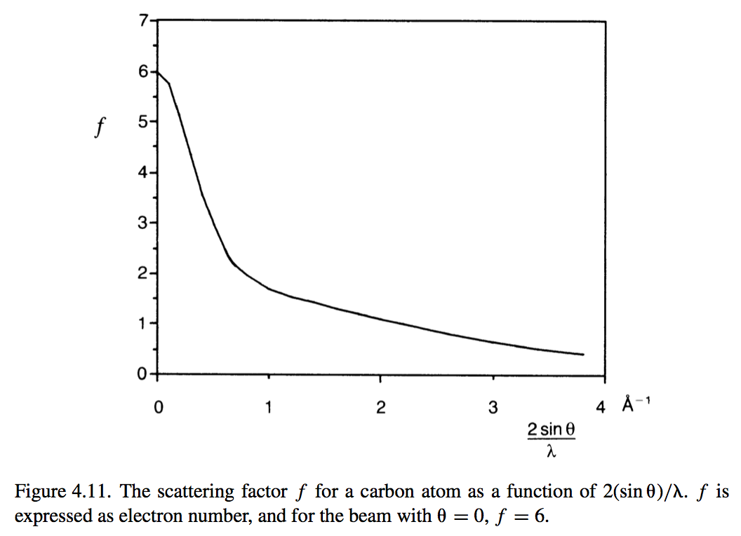
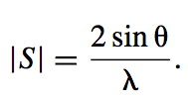
Scattering by an atom depends of the length of |S| (resolution)

Slide 12

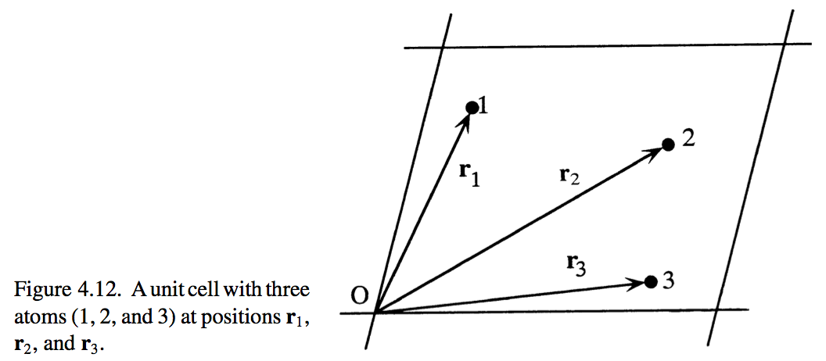
Scattering by a unit cell

Slide 13
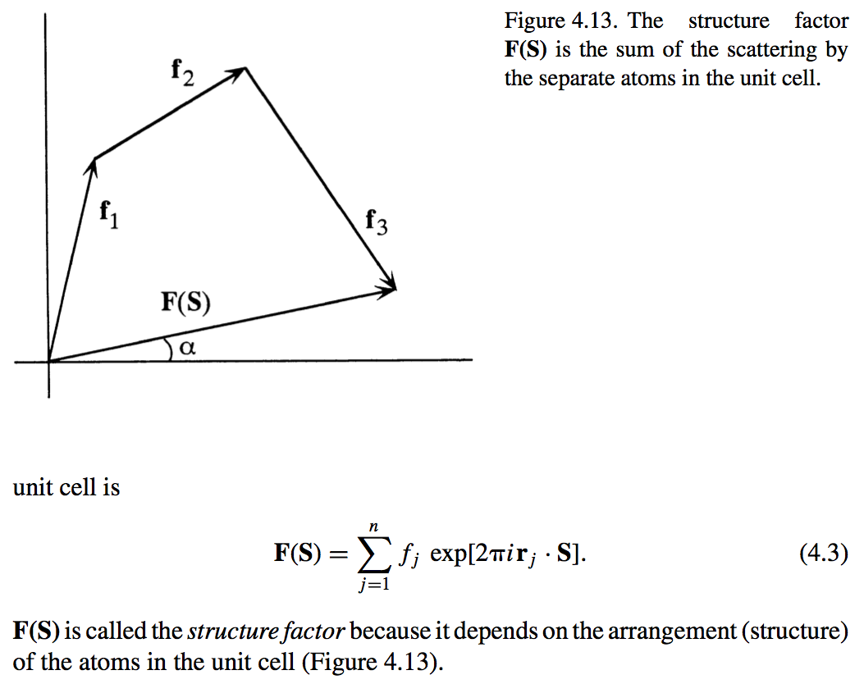

Slide 14

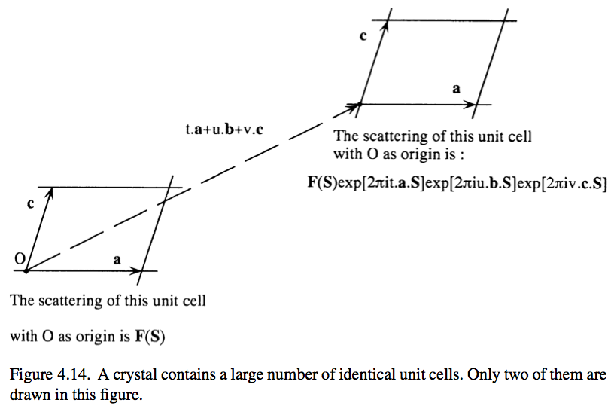
Scattering by a crystal

Slide 15



Slide 16
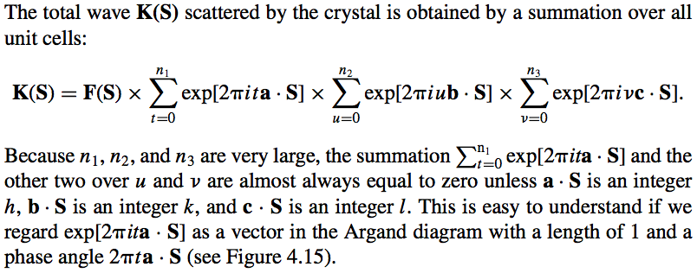
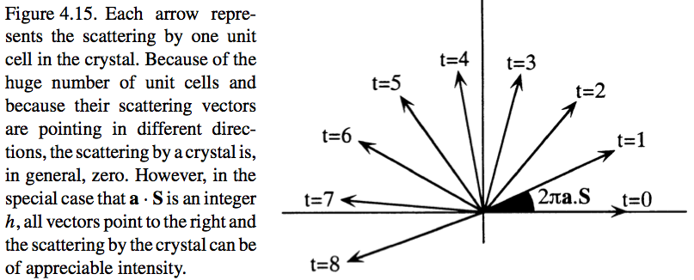

Slide 17
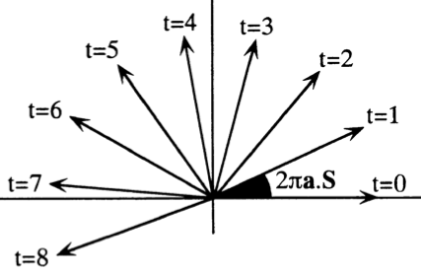
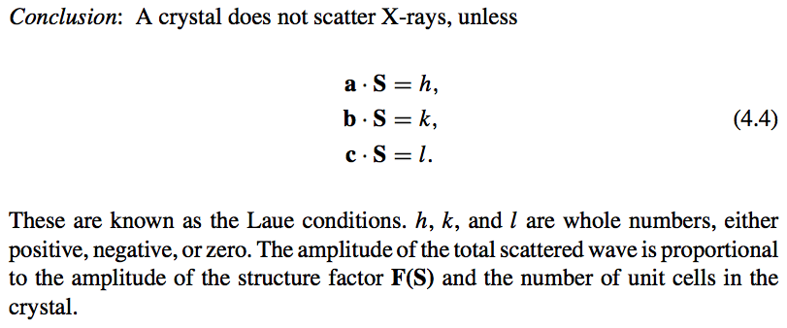

Slide 18



Calculation of electron density
The structure factor is a function of the electron density distribution in the unit cell:

Slide 19
Scattering by a unit cell

Slide 21
Calculation of electron density
The structure factor is a function of the electron density distribution in the unit cell:

Slide 22
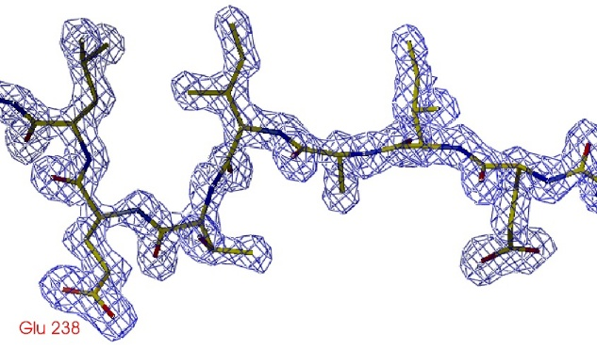
Information from X-ray diffraction experiment
y
z
x
[0;0;0]

Slide 23
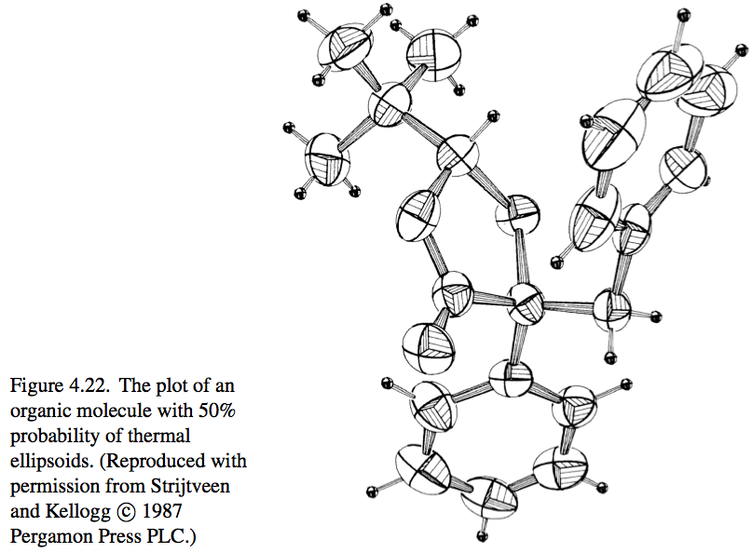
Temperature (B) factor

Slide 24


Slide 25
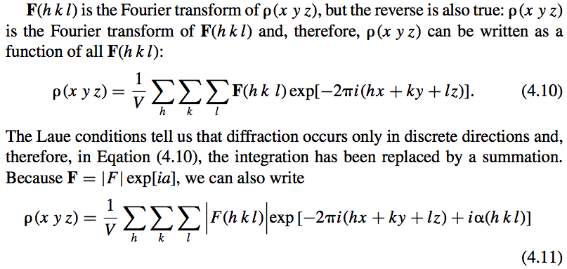

Slide 26

Notes

Slide 28
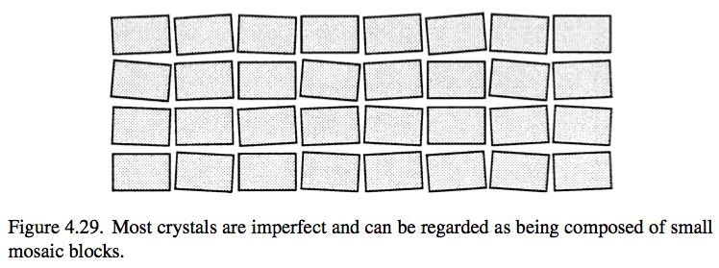
Intensity diffracted by a crystal

Slide 29
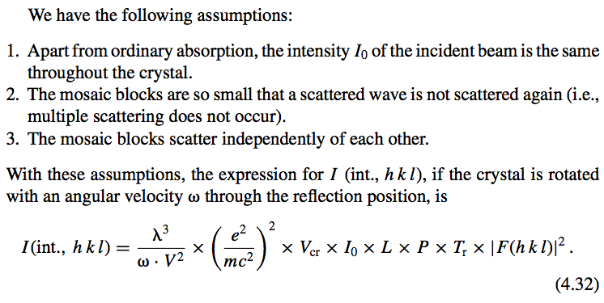
λ – wavelength
ω – angular velocity of crystal rotation
V – unit cell volume
e – electron charge
m – electron mass
c – speed of light
V_{cr} – crystal volume
I₀ – intensity of the excitation beam
L – Lorentz coefficient
P – polarization coefficient
T_{r} – transmission coefficient
|F(hkl)| - structure factor amplitude

Slide 30
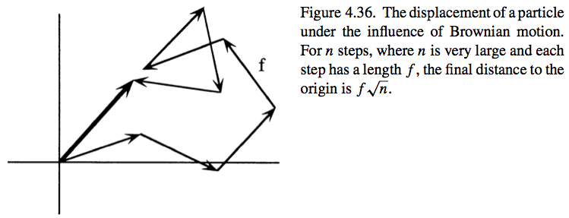

Effect of the unit cell size on the diffraction intensity

Slide 31


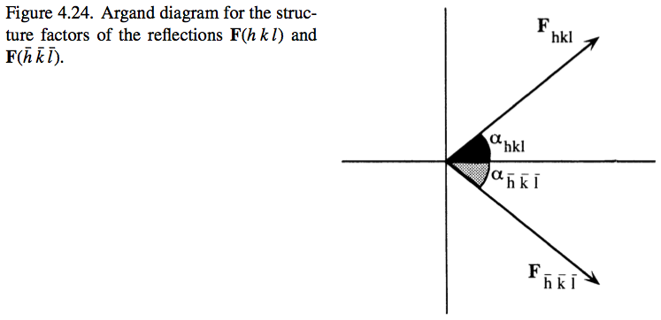

Friedel pairs

Slide 32

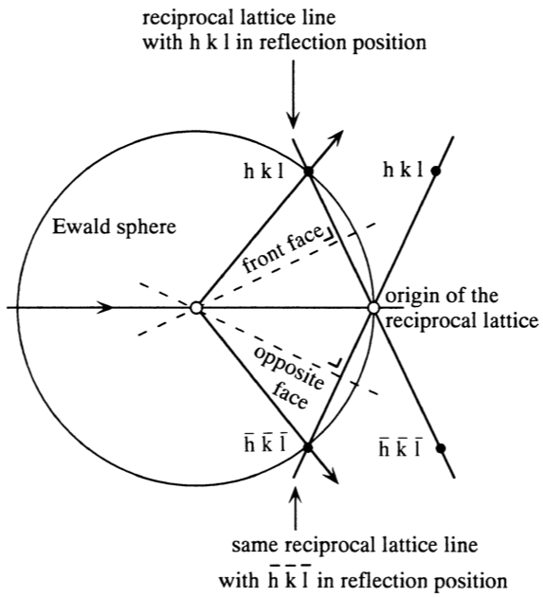
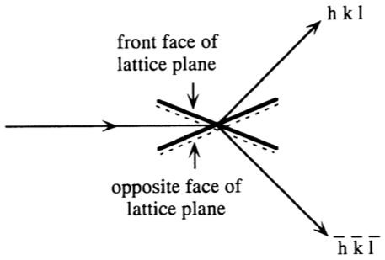

Slide 33
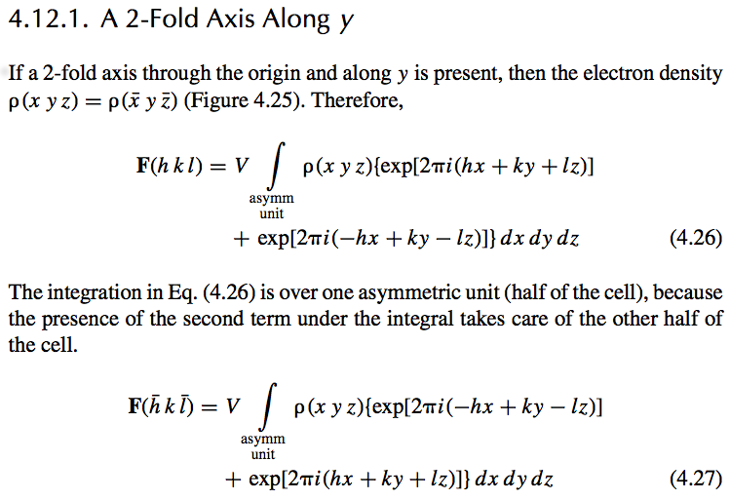
Symmetry in the diffraction pattern

Slide 34
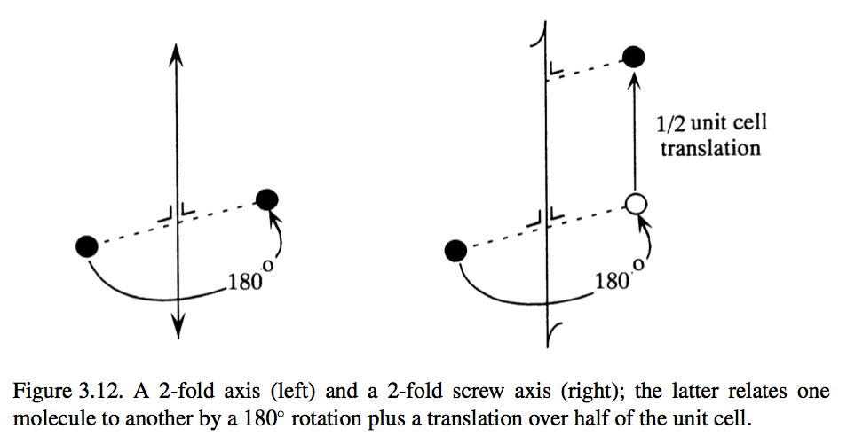

Slide 35
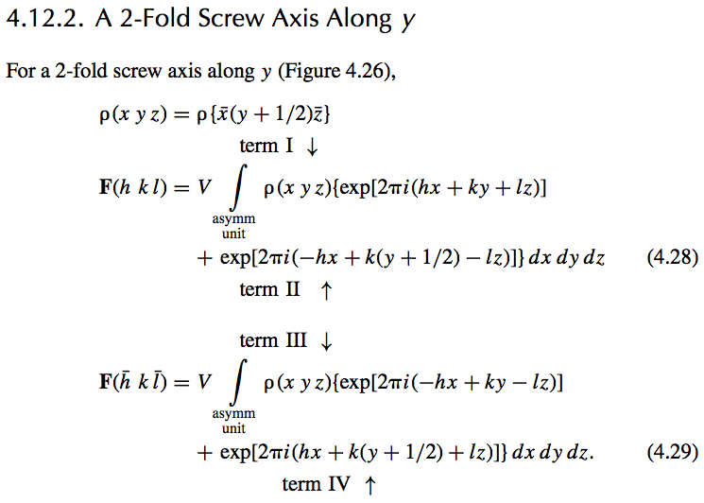

Slide 36


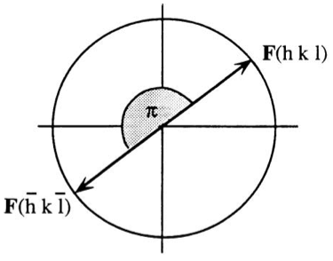
For F(hkl) with k odd:

Slide 38

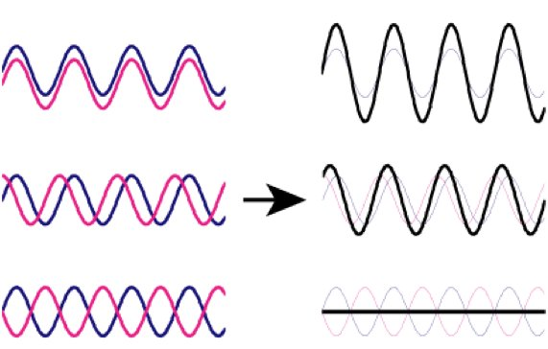
Systematic absences in P2(1)

