Slide 1
Structural Biology Methods
Fall 2022
Lecture #4

Slide 2
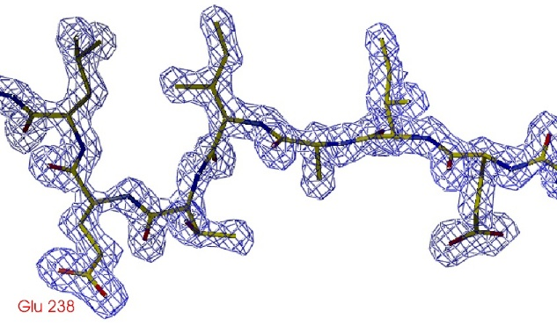
Phase problem
y
z
x
[0;0;0]

Slide 3
Solving the phase problem by:
Multiple/Single Isomorphous Replacement (MIR/SIR)
source of phases – intensity differences between data from native and derivative (heavy atom containing) crystals
Positions of heavy atoms identified from isomorphous difference Patterson maps

Slide 4
Solving the phase problem 3
Multiple/Single-wavelength anomalous diffraction (MAD/SAD)
source of phases – intensity differences between structure factors due to the presence of atom that specifically interacts with X-rays of a given wavelength
Positions of heavy atoms identified from anomalous difference Patterson maps

Slide 5
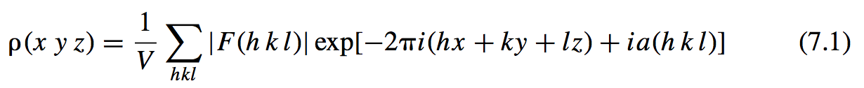
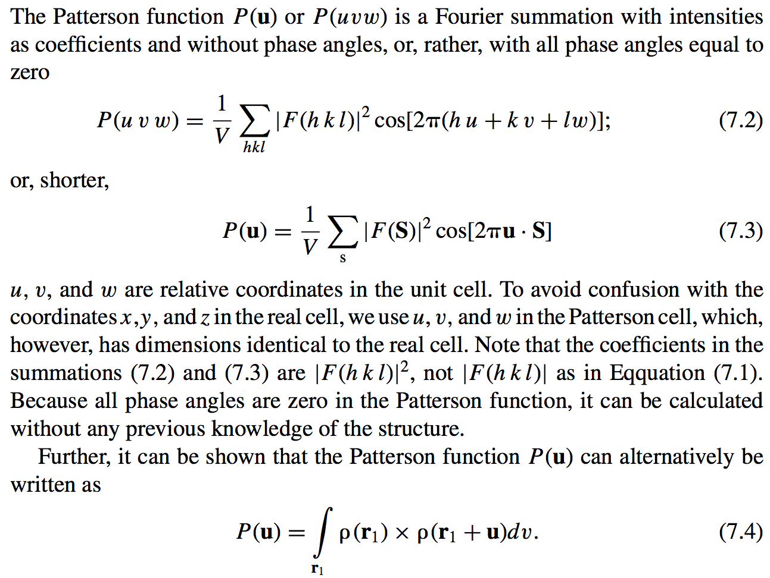

Phase problem
Patterson function

Slide 6
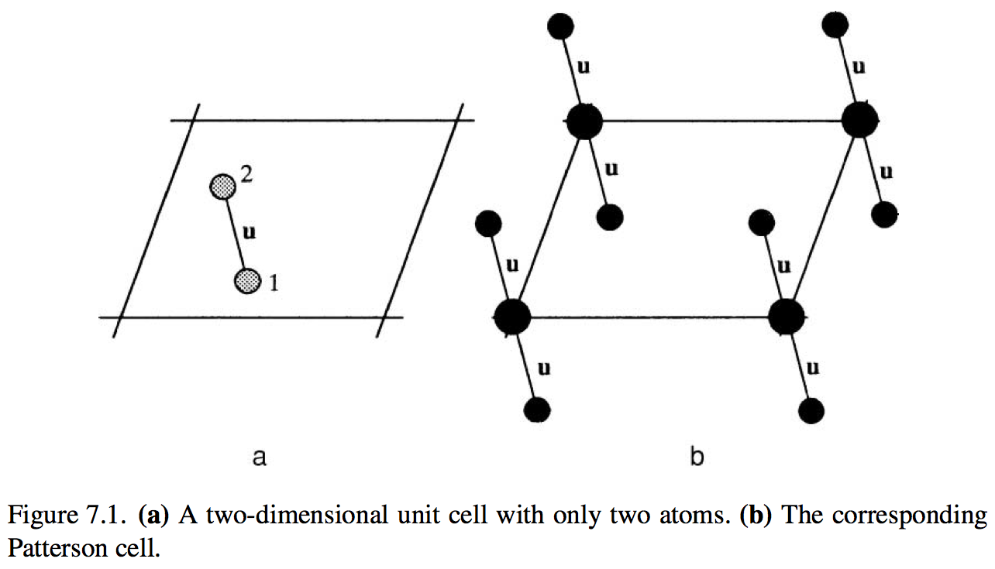

Slide 7
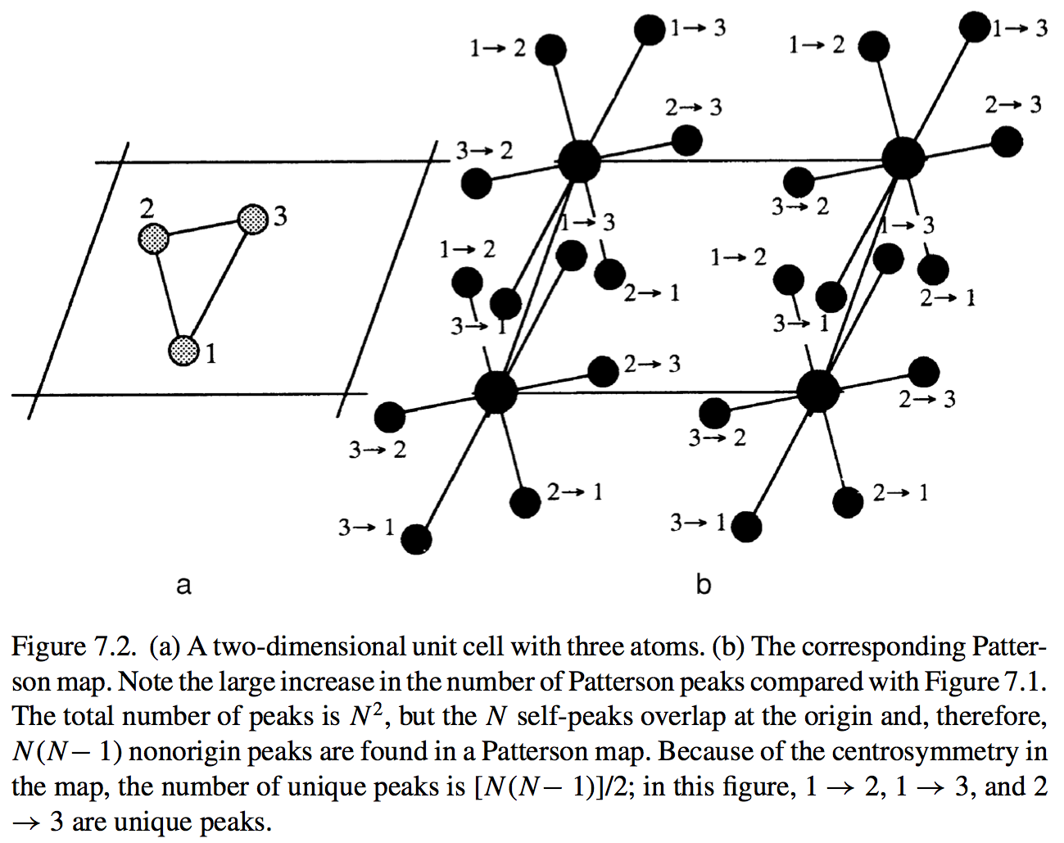

Slide 8
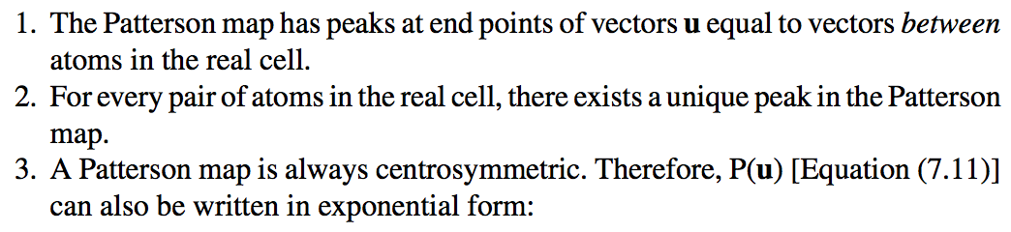
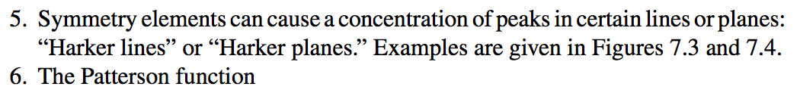
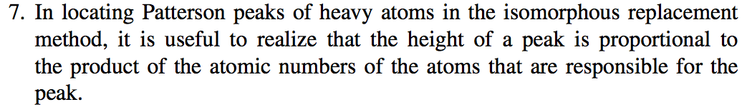
Patterson map of a macromolecule is a mess!

Slide 9
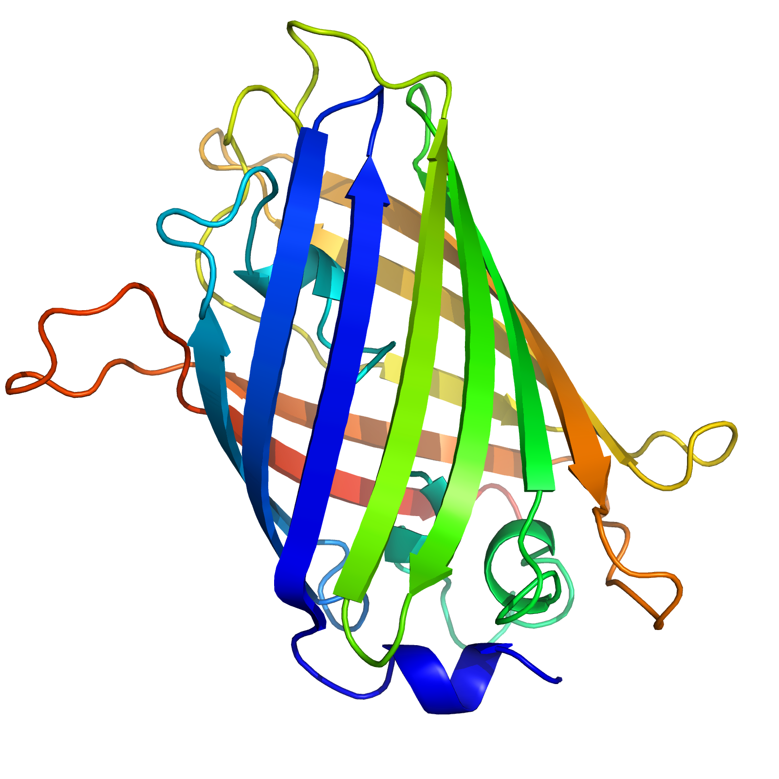
Isomorphous replacement method

Slide 10
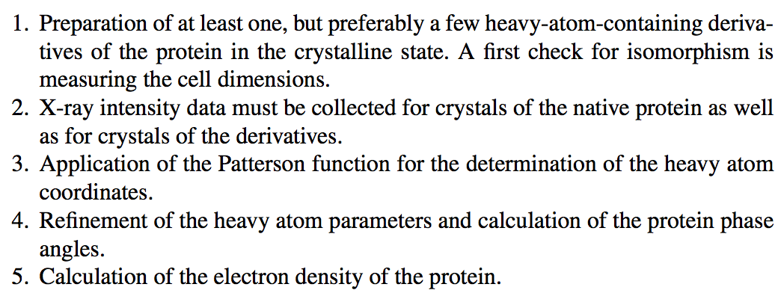

Slide 11
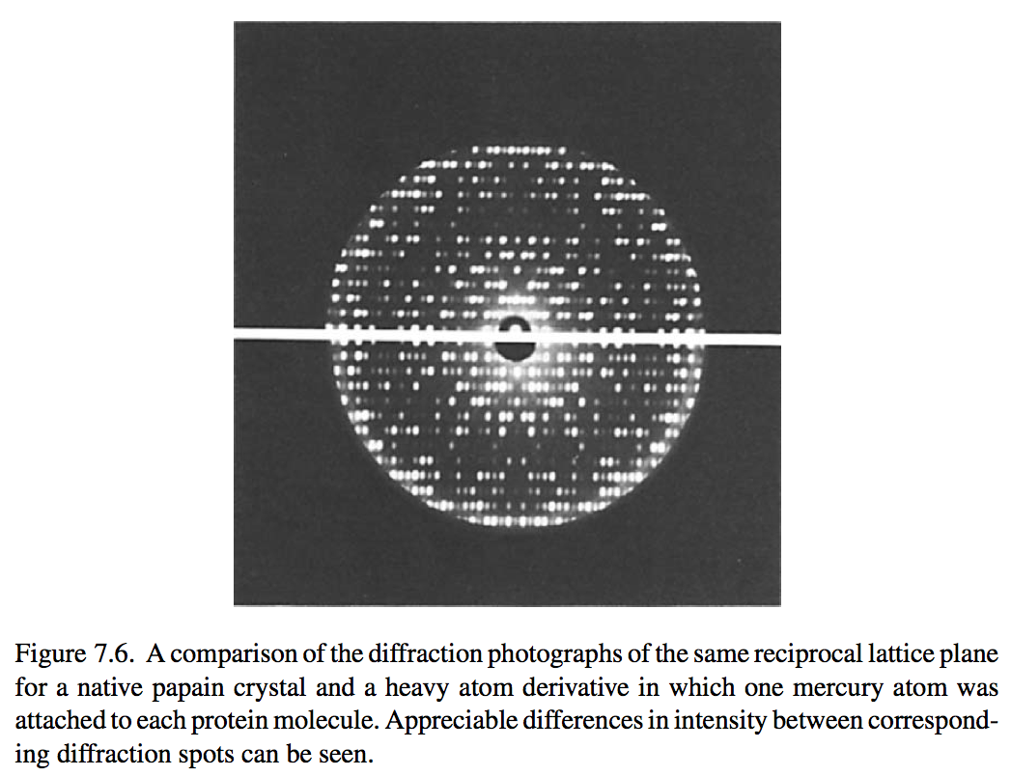
Isomorphous replacement method

Slide 12
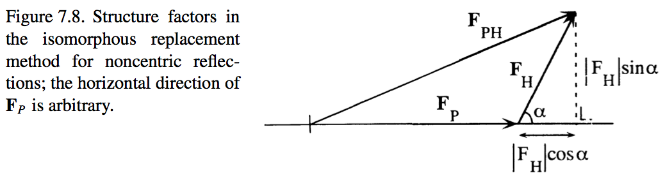
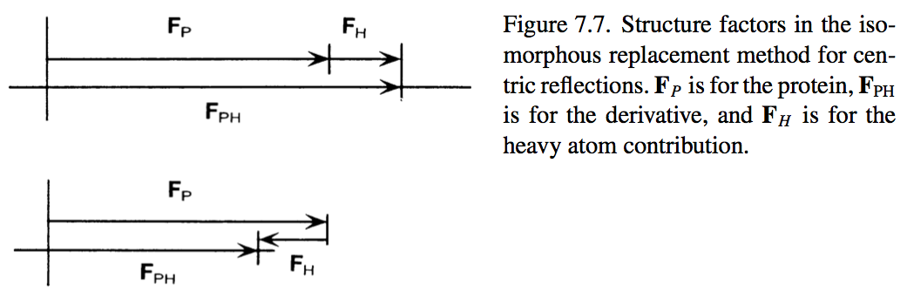

Slide 13
Isomorphous replacement method

Slide 14
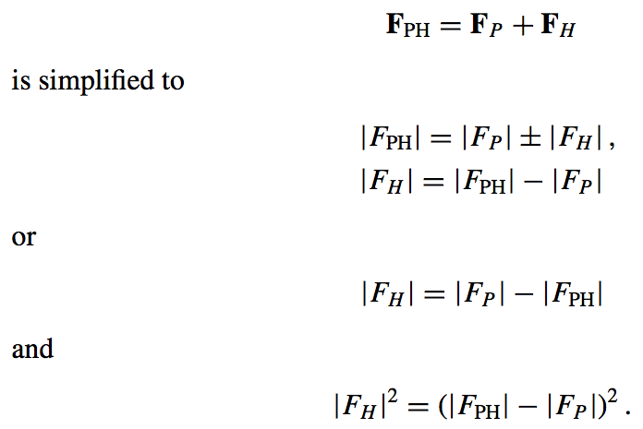
Determination of heavy atom positions from centric reflections (centro-symmetric projections)

Slide 15
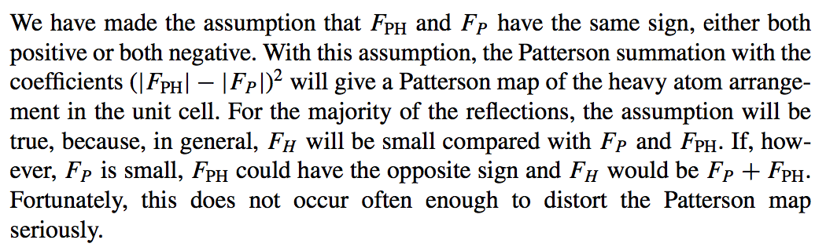

Scale!

Slide 17
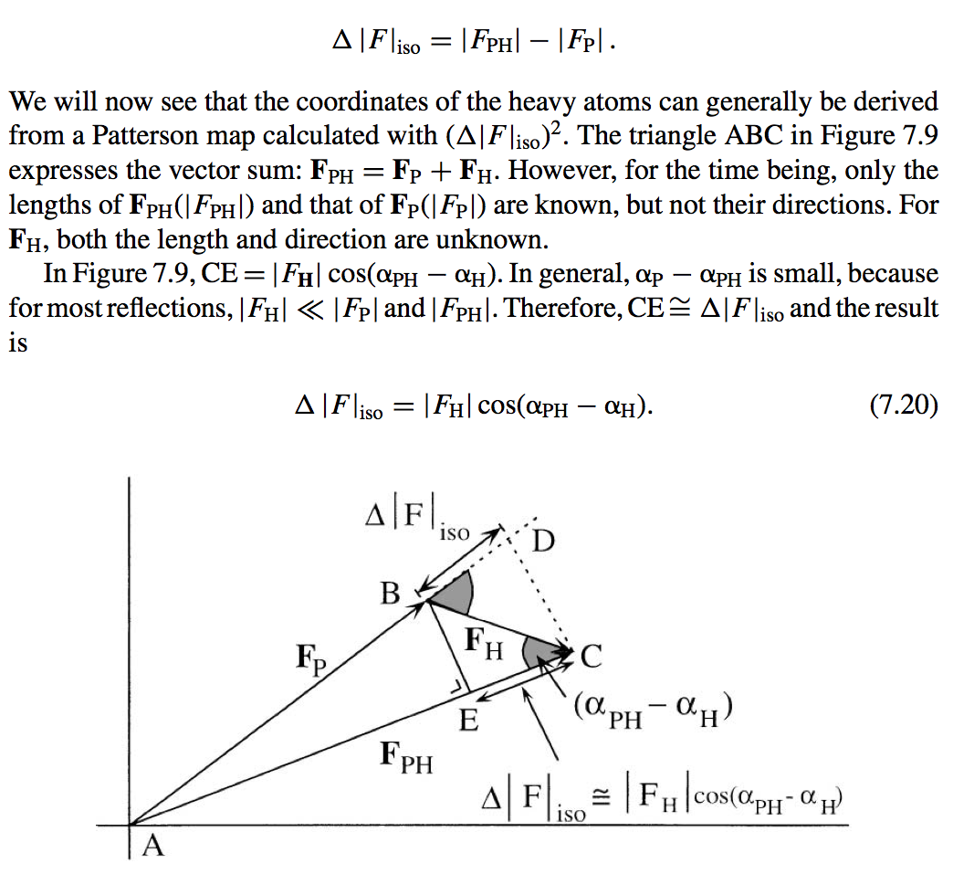
Determination of heavy atom positions from acentric reflections

Slide 18
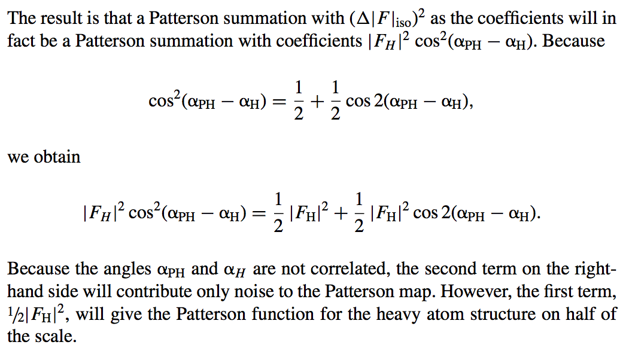

Slide 20
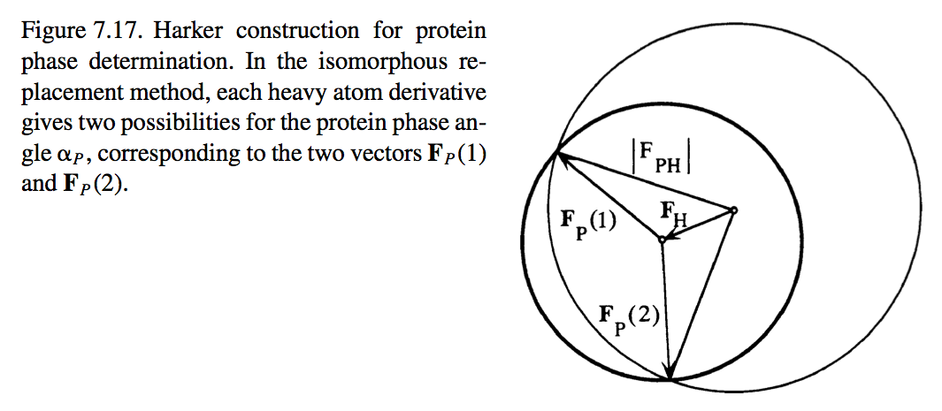
Determination of protein phase angles

Slide 21
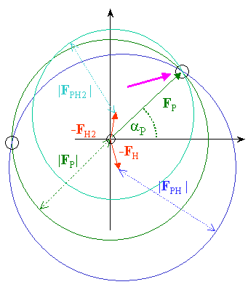

Slide 22
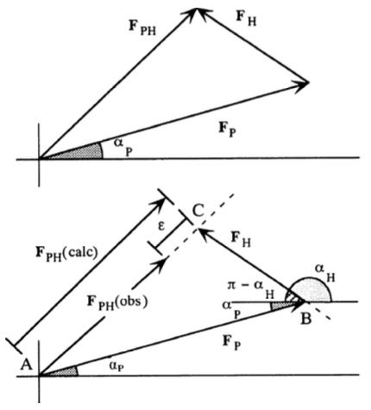
The “lack of closure" error
Ideal:
Real life:

Slide 23
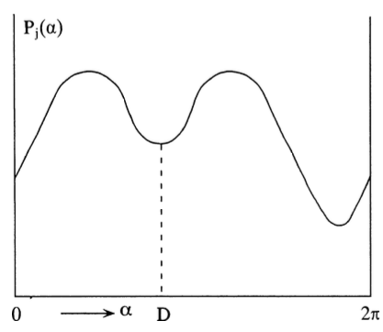
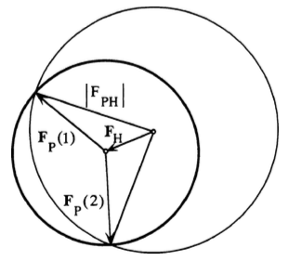
Phase probability

Slide 24
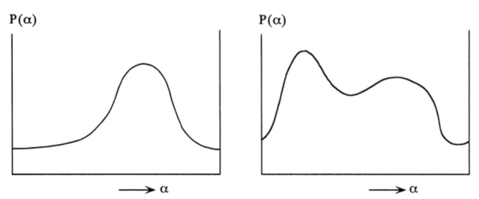


Slide 25
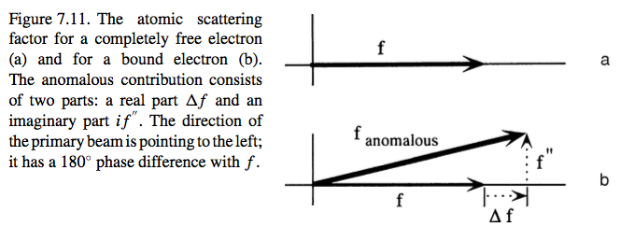
Anomalous scattering

Slide 26
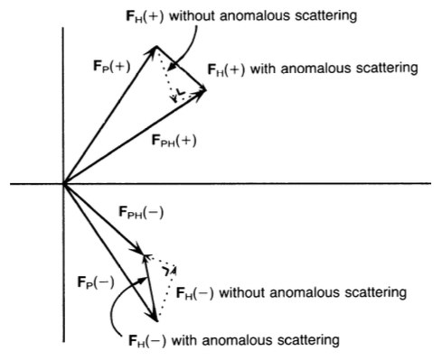

Slide 27
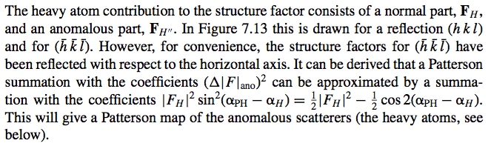
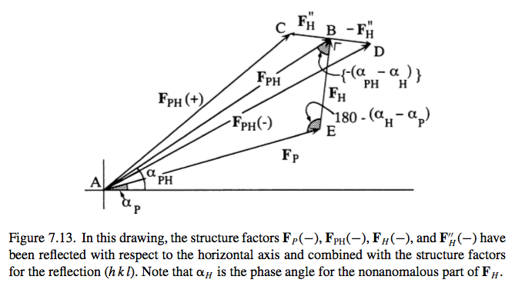
The anomalous Patterson map

Slide 28
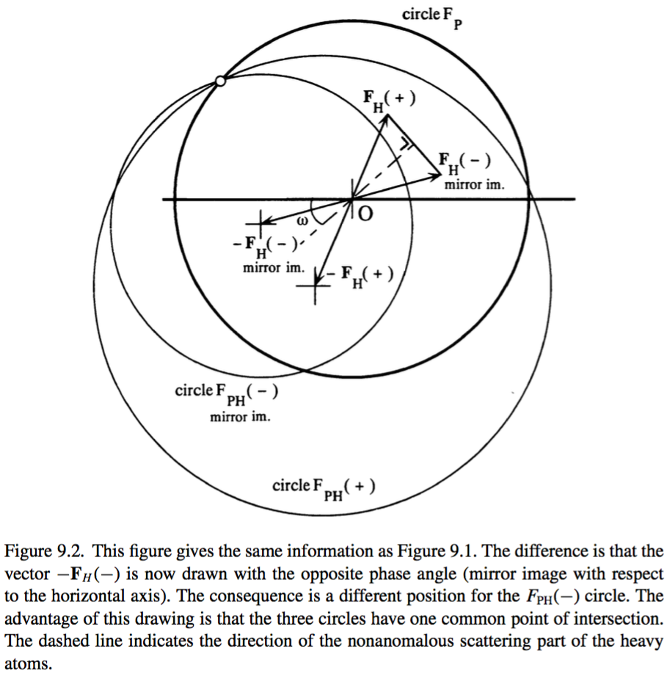

Slide 29
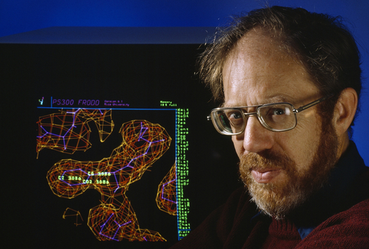
Solving the phase problem by:
Molecular replacement
1. source of initial phases is a model
2. the model is oriented and positioned to obtain the best agreement with the x-ray data
3. phases are calculated from the model
4. The calculated phases are combined with the experimental data
Molecular Replacement was invented by
Michael Rossmann

Slide 30
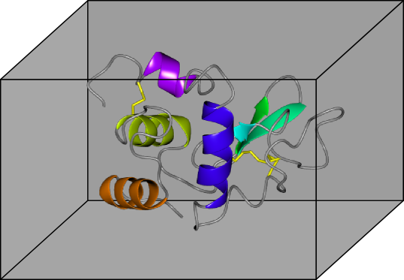
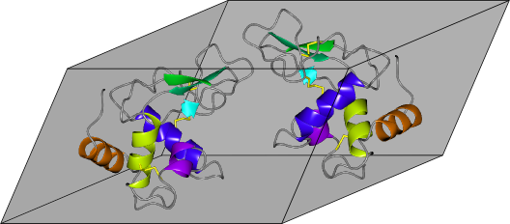
Molecular Replacement
Known crystal structure
New crystal structure
Given: • Crystal structure of a homologue
• New X-ray data
Determine: • The new crystal structure

Slide 31
MR Technique
Known crystal structure
New crystal structure
Search model
Method: • 6-dimensional global optimisation
– one 6-d search for each molecule in the AU
  >> split further to orientation + translation searches = 3 + 3?
Required: • Scoring
– the match between the data and (incomplete) model
– ideally: the highest score = the correct model

Slide 32
ROTATION FUNCTION
First, consider the model Patterson
We put the model in a large P1 box and calculate the Patterson from the structure factors of the model in the P1 box.
model in large P1 box
ROTATION?
“search” model
Patterson of model in large P1 box
Clusters separated by P1 cell dimensions

Slide 33
ROTATION FUNCTION
The Patterson of our unknown structure contains self-vectors and cross-vectors, but because the cell was large, the self-vectors and cross vectors are well separated from one another.
self vector
cross vector

Slide 34
ROTATION FUNCTION
Just as we generated the Patterson for our model in the first orientation, we can generate the Patterson for the model in any orientation in any sized box.
model in same large P1 box
in different orientation
Patterson of model in large P1 box
in different orientation

Slide 35
ROTATION FUNCTION
When the models are in different orientations the Pattersons will not match one another.
=
X

Slide 36
ROTATION FUNCTION
However, when the second model is in the same orientation parts of the Pattersons will match one another, and we can “solve” the rotation function for the model.
=

Slide 37
ROTATION FUNCTION
If the model were in a different sized box, the Patterson of the intramolecular vectors, which are located in a sphere centred on the origin, can be overlaid. We can cut out the peaks corresponding to the inter-molecular vectors from each Patterson and just compare the central parts of the Pattersons.
``
``

Slide 38
ROTATION FUNCTION
Now, the Pattersons of the intra-molecular vectors will match when the model is in the correct orientation.
=
X
=

Slide 39

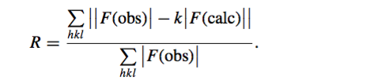
Translation function

Slide 40

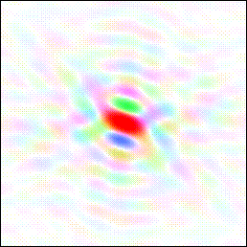

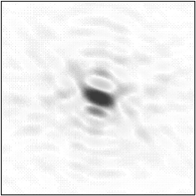
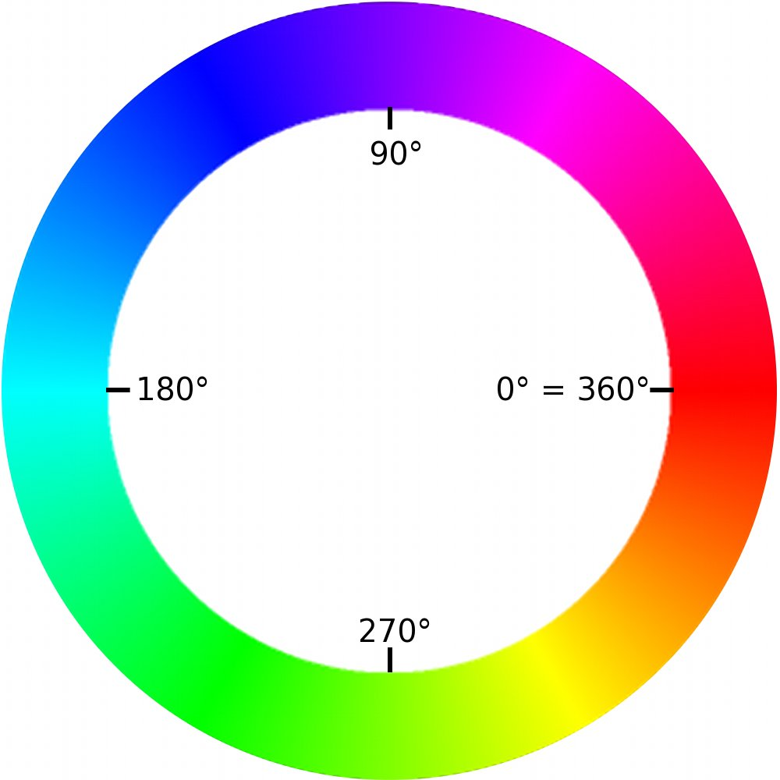

Real space cat
Fourier amplitudes and phases
Fourier transform
Fourier cat
Circular rainbow scale of phases
Linear intensity scale of amplitude size
Observed amplitudes

Slide 41
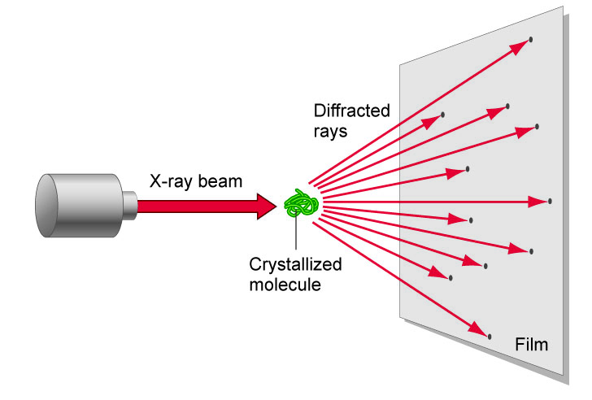
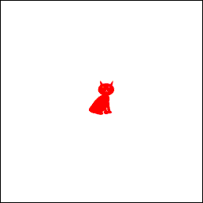
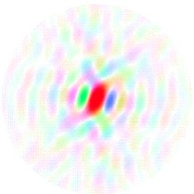
Unknown structure,
unknown orientation
Observed amplitudes Phases unknown!
Diffraction experiment
Cat
Fourier cat
Known structure
Calculated amplitudes and phases
Fourier transform
Manx cat
FT of Manx cat
Wrong orientation!

Slide 42
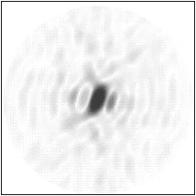
Known structure
Observed amplitudes Phases unknown!
Manx cat
Fourier cat
Fourier transform,
try different orientations
Calculated amplitudes and phases
FT of Manx cat
Wrong orientation!

Slide 43
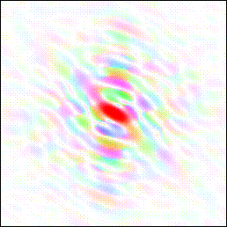
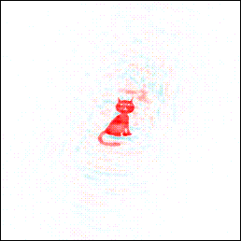
Observed amplitudes (tailed cat), calculated phases (Manx cat)
Inverted Fourier transform
Even the tail becomes visible!

Slide 44

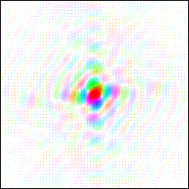
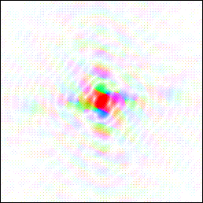
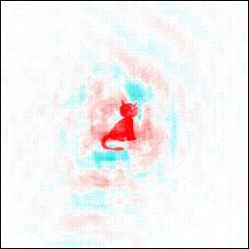
Model Bias
Duck
Fourier transform of duck
Fourier transform
Duck amplitudes + cat phases
Looks like a cat!!
Inverted Fourier transform

Slide 45
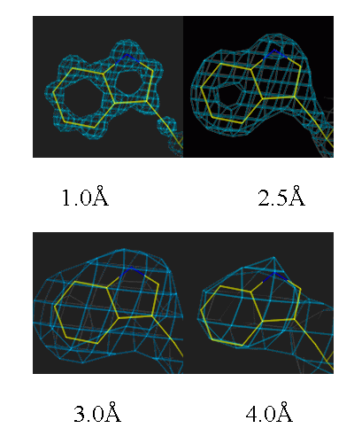
Model building & resolution
Notes:
Fitting of protein sequence in the electron density
Easy in molecular replacement
More difficult if no initial model is available
Unambiquous if resolution is high enough (better than 3.0 Å)
Can be automated, if resolution is close to 2Å or better

Slide 46
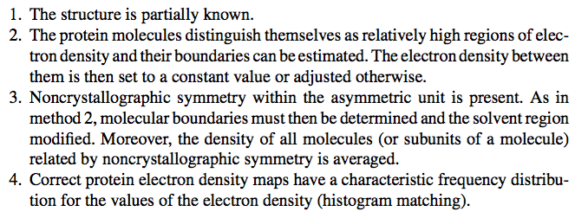
Phase improvement
When to use:

Slide 47

Refinement of the Model Structure
Parameter to measurement ratio – x, y, z, B (anisotropic B-> 8 parameters)
- other data than |Fobs|: stereochemical data (bond lengths and angles)
solvent flattening
NCS

Slide 48
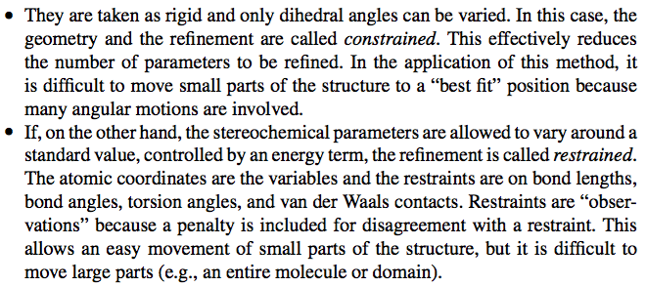
Constrains x Restrains

Slide 49
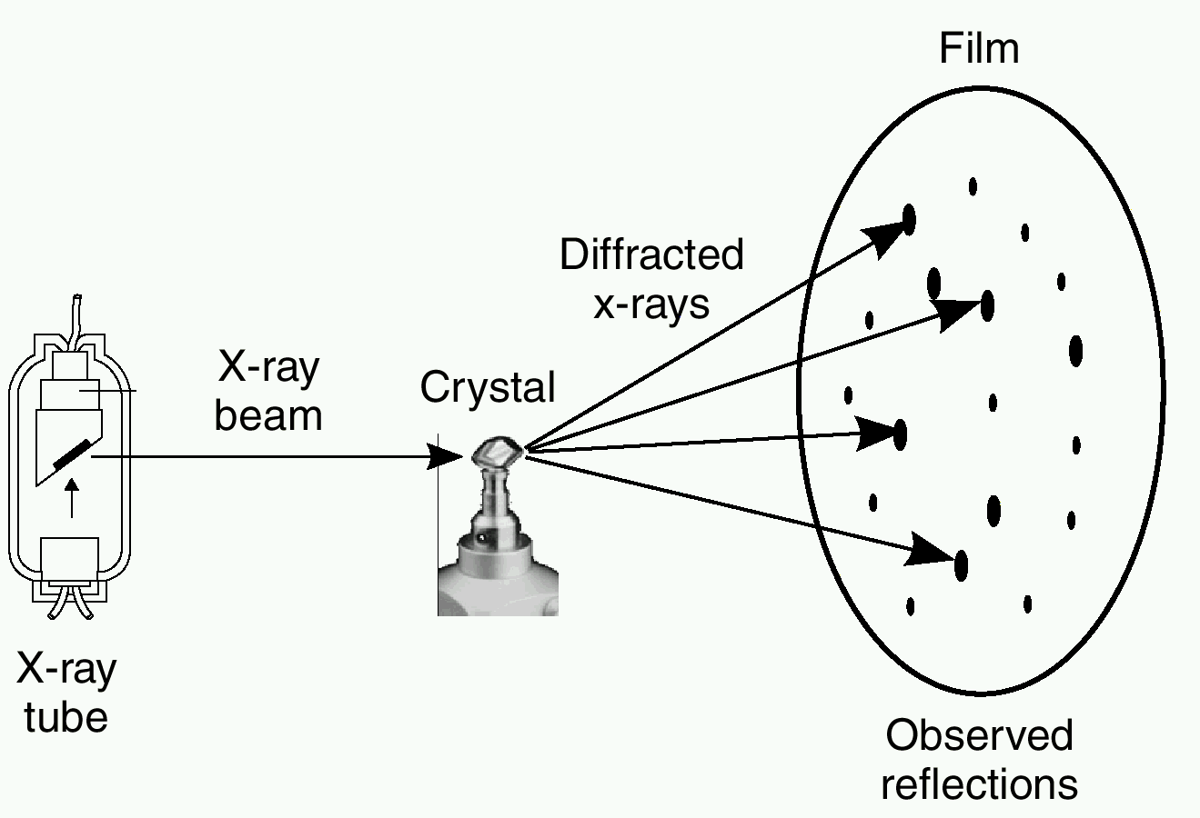
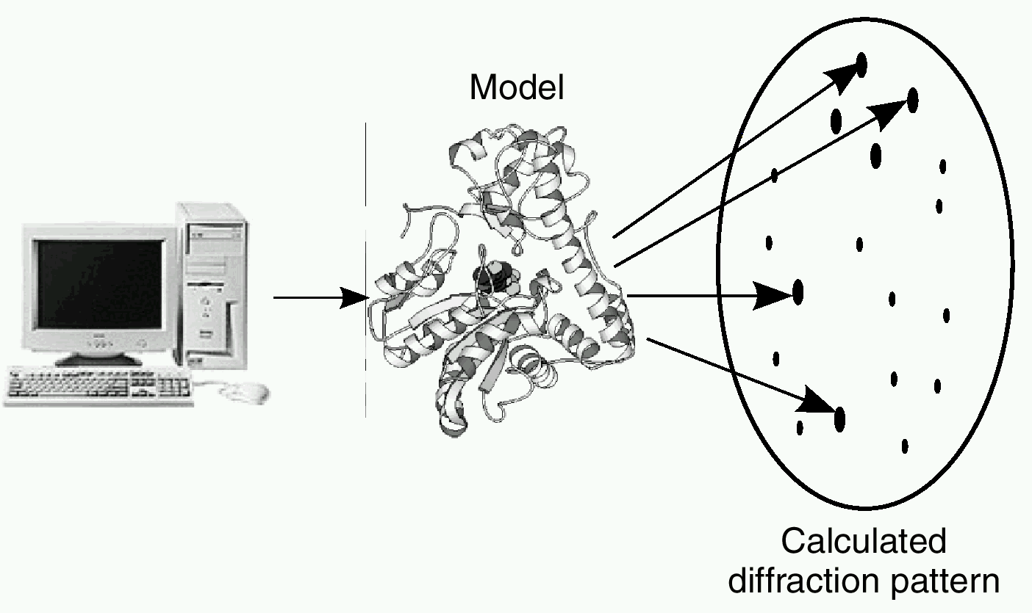
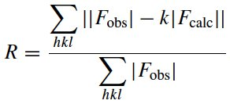

R-factor, R_{free}factor
R-factor
R_{free} factor

Slide 50


Ramachandran plot
ω
Ψ
Ψ
φ
φ

Slide 51

The Ramachandran Plot

Slide 52



Geometry and stereochemistry
Bond lengths
Dihedral angles

Slide 53



Slide 54

Quality of diffraction data

