Slide 1
BIOMARKERS AND TOXICITY MECHANISMS
01 - INTRODUCTION
Luděk Bláha, PřF MU, RECETOX
www.recetox.cz

Slide 2
Course summary
1) Introduction
- Intro and overview of the mechanisms beyond the toxicity
(with special respect to environmental contaminants)
- Intro and concept of biomarkers
2) Details on selected important toxicity mechanisms
- Membrane toxicity, enzyme inhibitions, oxidative stress, genotoxicity, Nuclear Receptors (AhR, ER, AR ….) etc.
- Methods to determine toxicity mechanism
3) Biomarkers
- What it is and how to find (identify) suitable biomarker(s)?
- The overview of the most important biomarker classes
- Methods of biomarker assessment

Slide 3
Suggested reading and other study materials
The content of this class was prepared as a blend of principles of pharmacology, mechanistic (eco)toxicology and effect biomarkers. The content is not reflected in one single textbook.
All slides and presentations are available in IS MUNI
Video records from the lectures are also available in IS
Additional reading is not necessary … following books and materials could be recommended:
VAN GESTEL, K. et al. (2021) Environmental Toxicology, an open online textbook. 2021. URL info
Newman (2020) Fundaments of Ecotoxicology (ISBN: 978-0-8153-5402-4) – chapters 6-9. Also available in MUNI Campus Library: https://katalog.muni.cz/Record/MUB01006503461
Additional popular reading (Environmental toxicology):
https://en.wikipedia.org/wiki/Silent_Spring
https://en.wikipedia.org/wiki/Our_Stolen_Future

Slide 4
The importance of understanding to toxicity mechanisms

Slide 5

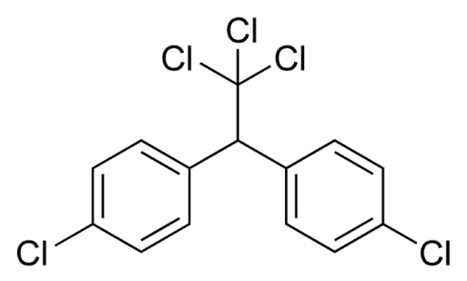
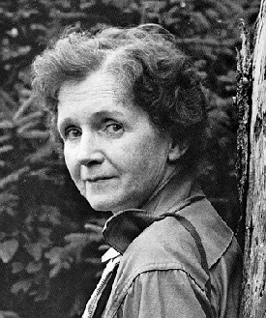
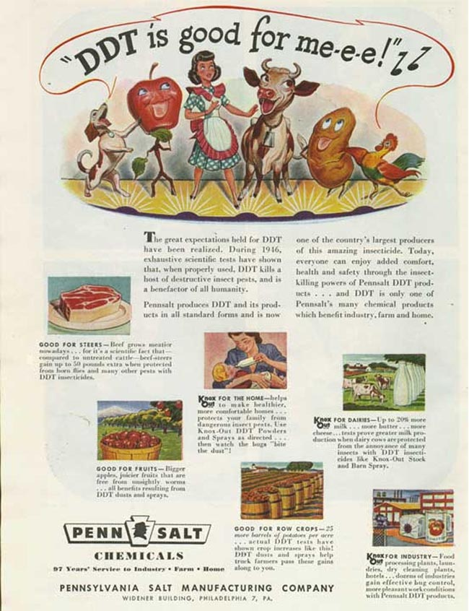
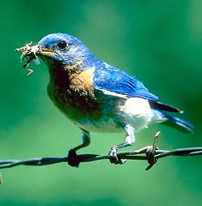
1962
© Patuxent Wildlife
Refuge, MA, USA
http://www2.ucsc.edu/scpbrg/

Slide 6
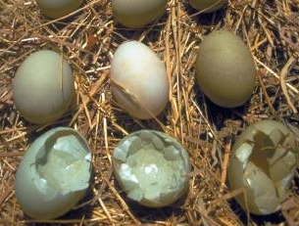
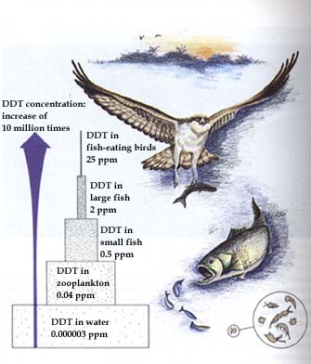
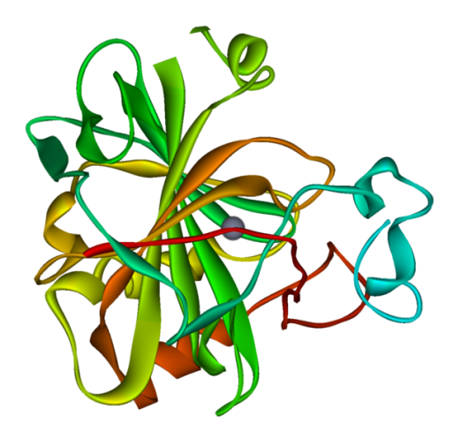

In vivo: shell thinning
In situ: bioaccumulation
-> bird population decline
Biochemistry discovered in 1970s:
Bird carbonate dehydratase
Bitman et al. Science 1970, 168(3931): 594

Slide 7
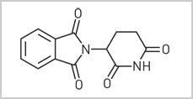
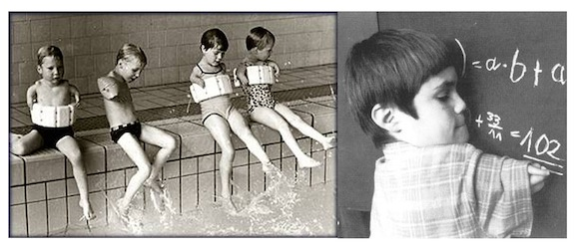
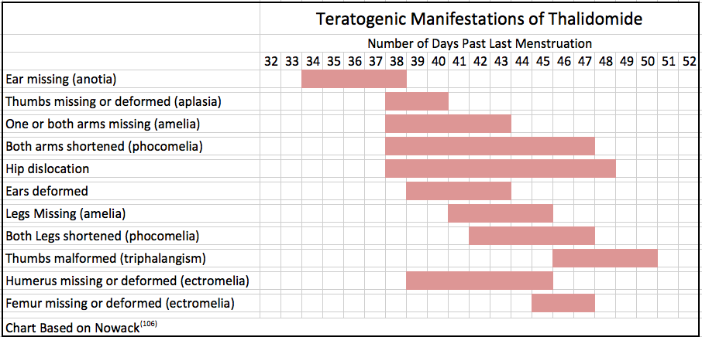
Thalidomide
Originally marketed in 1957 as sedative / hypnotic
  also curing anxiety, gastritis, tension
  against nausea and morning sickness of pregnant
    TERATOGENICITY → Develoment of phocomelia = limb malformations
    (10 000 children worldwide / 40% survived)
Currently still in use - completely different targets
  : anticancer (multiple myeloma), antileprosis, immunosupression

Slide 8
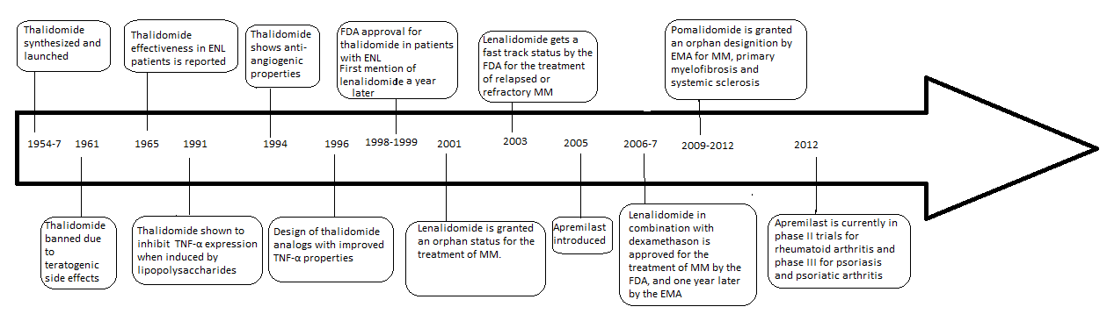
Thalidomide

Slide 9
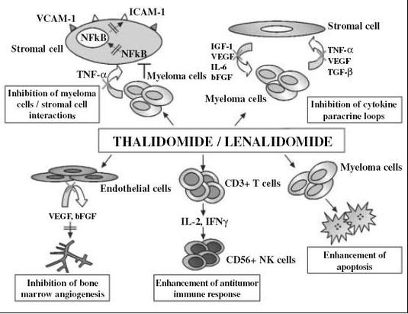
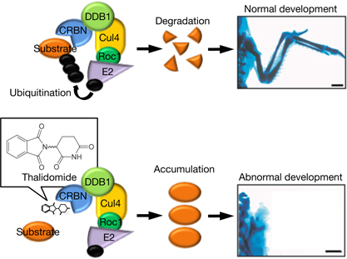
Thalidomide
... mechanisms of action
(1) Sedative effects
... mechanism unknown
(2) Teratogenicity
(3) Anticancer

Slide 10
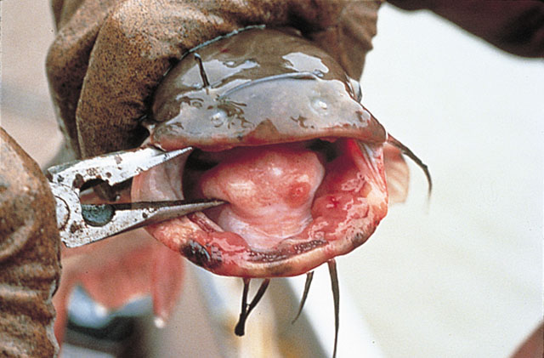
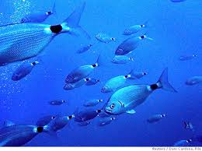
MECHANISMS of chronic toxicity
Various chronic effects have uniform biochemical basis
  principle studies with mechanistically based in vitro techniques
  estimation of in vitro effects of individual compounds
TOXIN
Biochemical
effects
In vivo
effects
RECEPTOR
HORMONE
Understanding MoA ... may predict higher-level effects
Organism
Population & beyond

Slide 11
Basics and keywords from toxicology

Slide 12
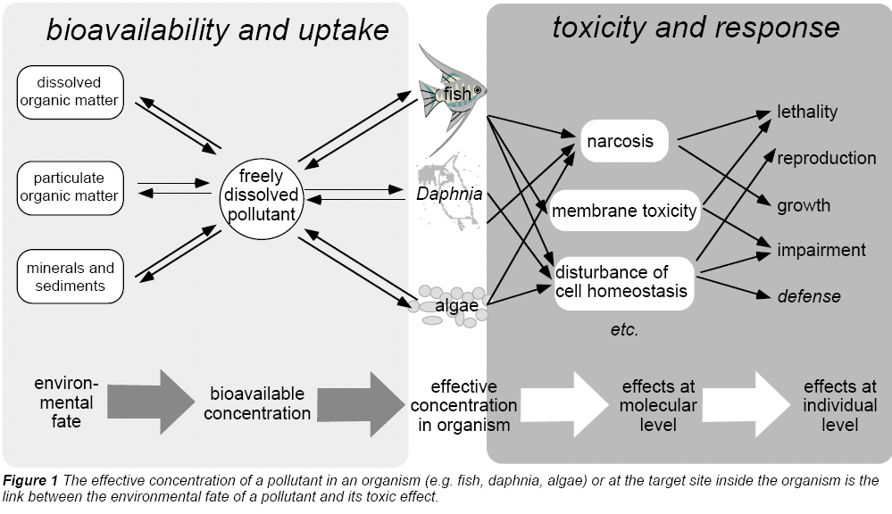
Toxicity - concept
MoA = mode of action
Escher, B. I., Behra, R., Eggen, R. I. L., Fent, K. (1997), "Molecular mechanisms in ecotoxicology:
an interplay between environmental chemistry and biology", Chimia, 51, 915-921.

Slide 13
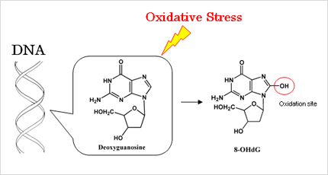
From mechanisms (or modes of action) to biomarkers
Chemical enters organism
+ may be metabolized/detoxified, transported, released ...
Chemical reacts with target (e.g. DNA) and changes a specific nucleotide (e.g. G → de-oxo-G)
Elevated de-oxo-G in blood
→ Toxicokinetics
→ Toxicodynamics
= toxicity mechanisms (MoA) and following toxic effects (e.g. mutation, cancer ...)
→ (Selective) biochemical marker (biomarker)
= information about exposure and/or effect

Slide 14
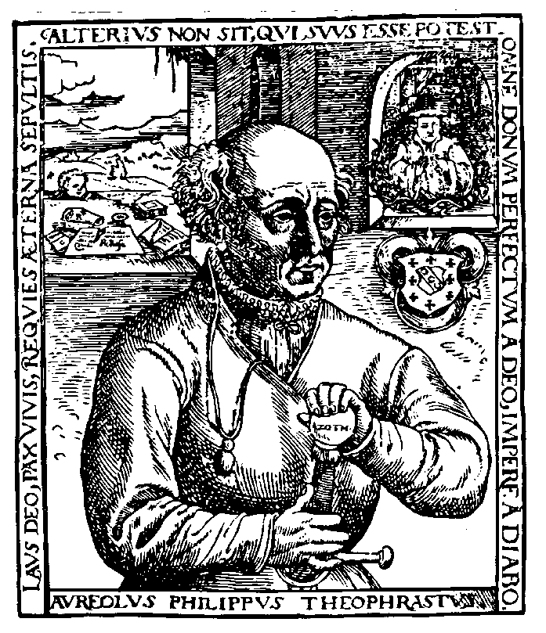
Toxicity – the cause-effect paradigm
Paracelsus (1493 - 1541)
‘What is there which is not a poison?
All things are poison and nothing without poison.
Solely the dose determines that a thing is not a poison.
Toxicology – the science of doses

Slide 15
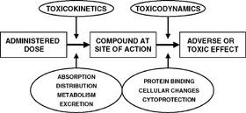
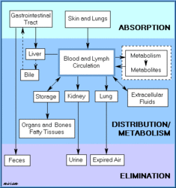
What processes are beyond toxicokinetics?
ADME
Toxicokinetics ...
... EXPOSURE phase → Determines the final dose

Slide 16
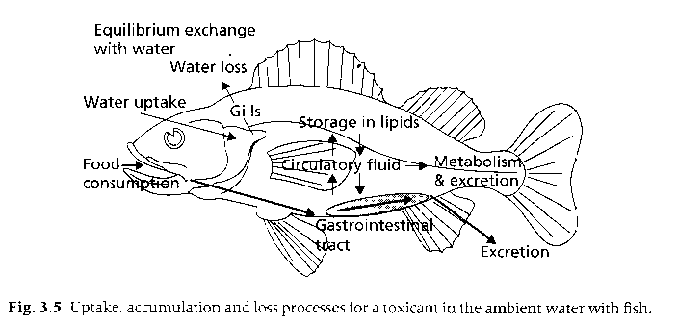
Toxicokinetics in fish

Slide 17
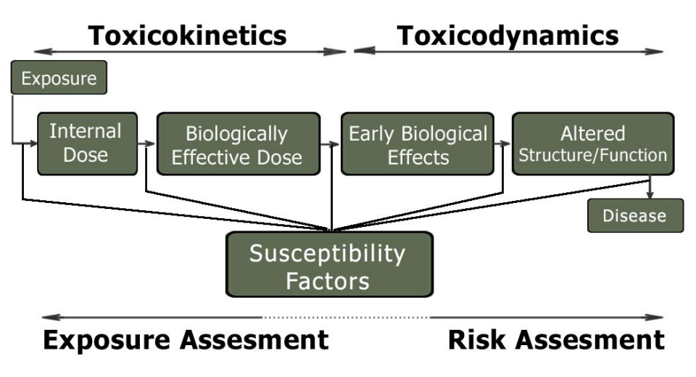
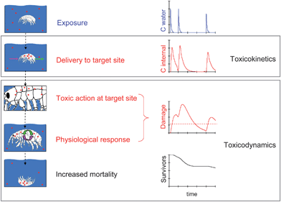
ToxicoDYNAMICS
TARGETS = macromolecules
(DNA/RNA, proteins, membrane lipids)
MoA
... and measurable
EFFECTS

Slide 18
What is toxicity? What are the types of effects?
Toxicity
  degree to which a substance (at certain dose) can damage an organism
Exposure & toxicity
  acute (immediate, high doses, days)
  chronic (sublethal / low doses, long-term)
Effect & toxicity
  lethal (acute)
    mortality – definitive endpoint / high doses
    easy to determine (single endpoint – death)
  nonlethal, sublethal (chronic)
    endocrine disruption, reproduction toxicity, immunotoxicity, tumor induction etc.
    difficult to determine (multiple endpoints)
    more specific – low concentrations / longer exposures
    often reflected by specific biochemical changes (biomarkers)
Systems and organ & toxicity
  Systemic lethal toxicity
  Organ-specific toxicity (neurotoxicity, hepatotoxicity, nefrotoxicity ...)
  Developmental toxicity
  Reproduction toxicity

Slide 19
Principles of toxicity testing
Define and know biological target (molecule, cell, organism, population) and its properties
2) Define and know chemical and its properties
3) Define exposure of biological system to a chemical
  variable concentrations
  defined or variable duration (time)
  conditions (T, pH, life stage ....)
4) Assess effects, i.e. Changes in measurable parameter in relationship to variable doses
5) Dose-response evaluation & estimation of the toxicity value (i.e. concentration or dose):
LDx, ICx, ECx, LOEC/LOEL, MIC ...

Slide 20
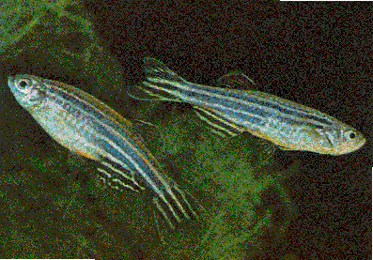
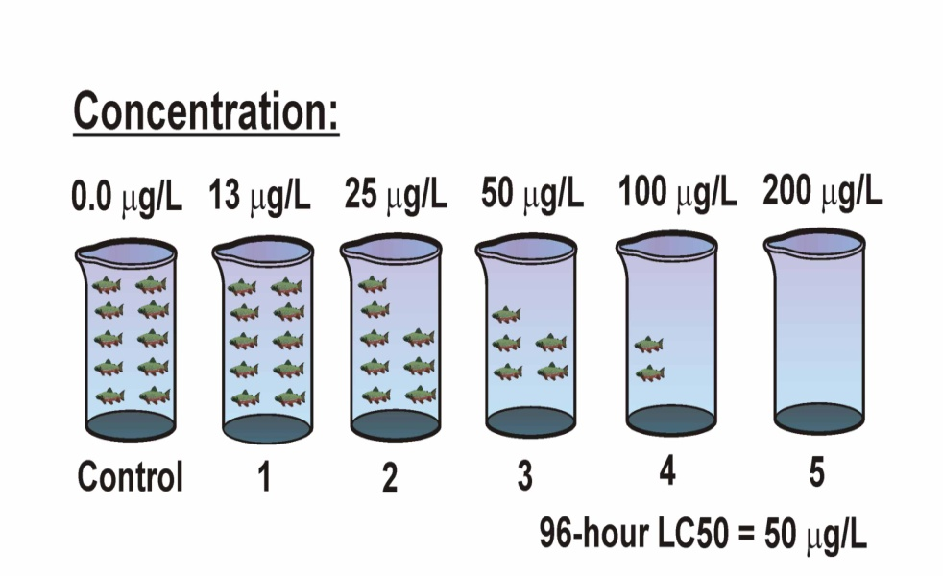
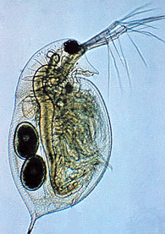
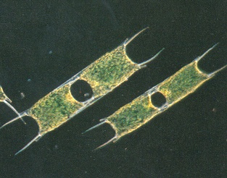
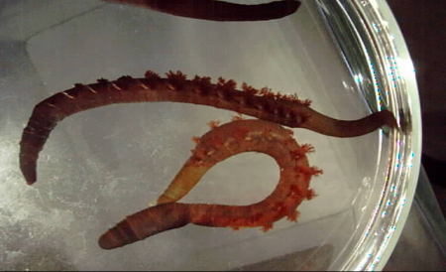
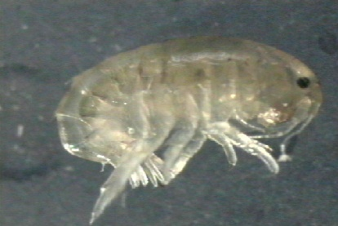
Effect assessment - procedure
Cu addition
Effect concentrations expressed in total/dissolved Cu

Slide 21
How to study (chronic) toxicity ?
In vitro studies (biochemical mechanisms)
  + easy to perform, short-term - ecotoxicological relevancy
  + highly controlled conditions - mostly with vertebrate cells
  + lower amounts of chemicals needed
  (new cmpnds screening)
In vivo biotest testing
  + unique whole organisms - only few (ecologically
  + controlled conditions nonrelevant) organisms used
  + better ecological interpretation - mostly ACUTE assays
  - chronic: long exposures
Field and in situ observations, epidemiological studies

Slide 22
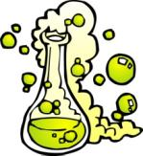
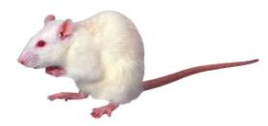
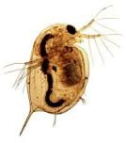
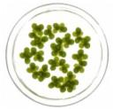

Hazard assessment
Traditionally – Evaluation of adverse effects using the whole organism models
+
Adverse Effects
Death
Altered Reproduction
Inhibition of Growth
Tumorigenicity
Skin irritation
…
Chemical
Organism
REGULATORY FOCUS
(APICAL ENDPOINTS)

Slide 23
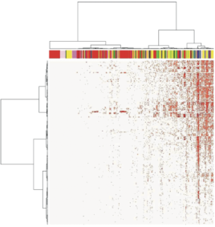
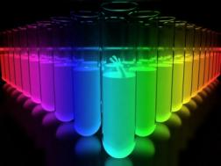
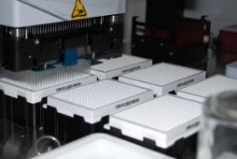
Hazard assessment
Traditionally – Evaluation of adverse effects using the whole organism models
+
Adverse Effects
Death
Inhibition of Growth
Altered Reproduction
Tumor
Skin irritation
…
Chemical
Organism
New – Ex vivo / in vitro / In chemico / In silico Methods
+
10^4 Chemicals
HTS
High-Throughput-Screening
Chemical-biological interactions,
Mechanistic Toxicological Data

Slide 24
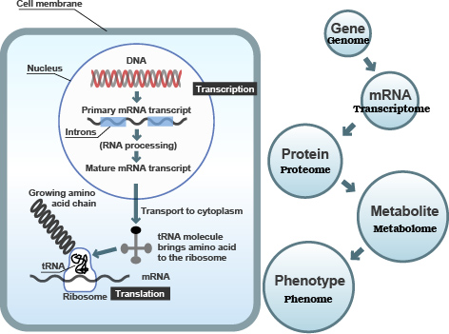
Mode of Action (omics) toxicity testing
And other „omes“
Lipidome
Microbiome …

Slide 25
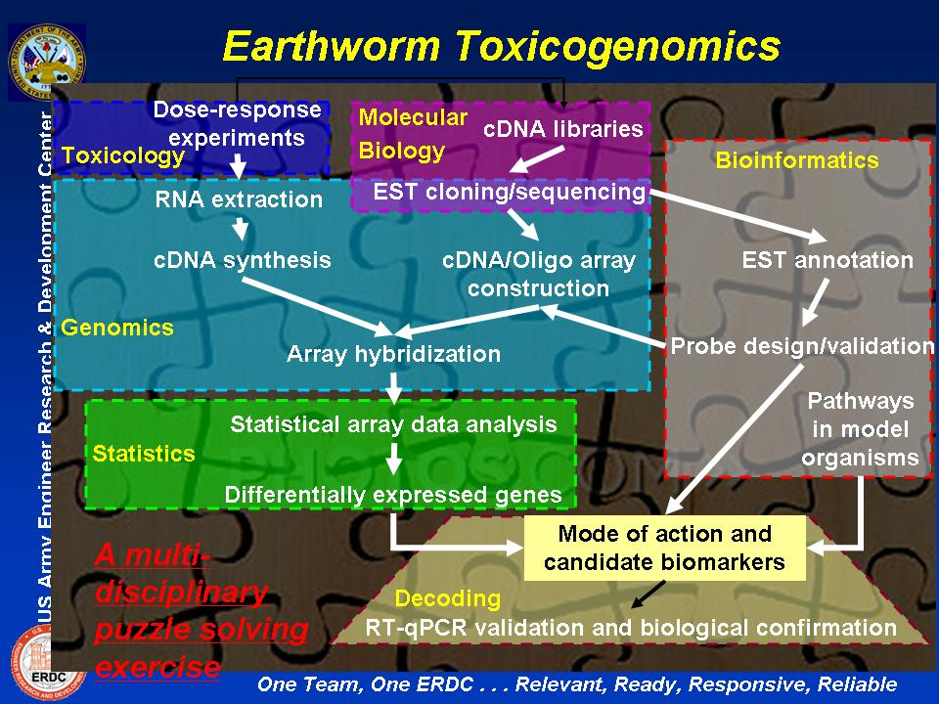
Omes is not only for humans …

Slide 26
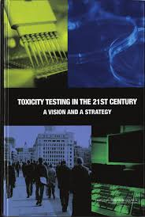
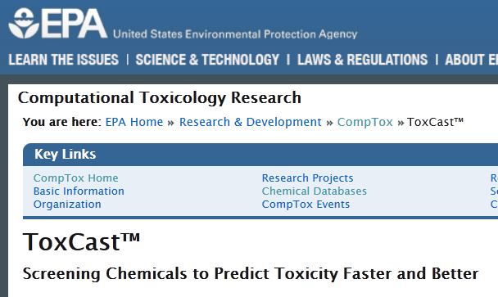
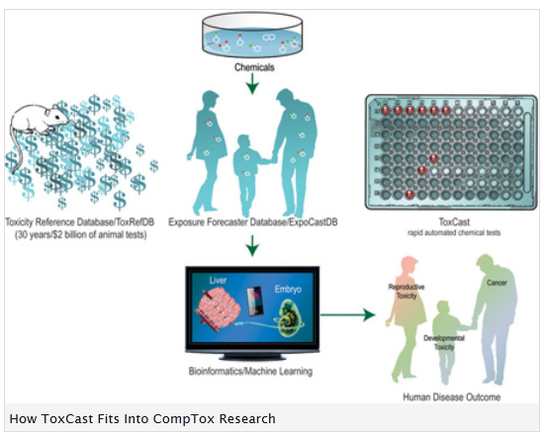
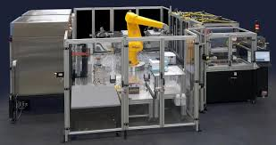
MoA and omics are supported by strategic documents
& organizations
Toxicity Testing in the 21st Century: A Vision and a Strategy
US National Academies of Sciences
http://www.nap.edu/catalog/11970.html

Slide 27
Hazard assessment
Traditionally – Evaluation of adverse effects using the whole organism models
+
Adverse Effects
Death
Inhibition of Growth
Altered Reproduction
Tumor
Skin irritation
…
Chemical
Organism
New – Ex vivo / in vitro / In chemico / In silico Methods
+
10^4 Chemicals
HTS
High-Throughput-Screening
Chemical-biological interactions,
Mechanistic Toxicological Data
Key task/question:
How to link MECHANISTIC INFORMATION with APICAL ENDPOINTS ?

Slide 28
Adverse Outcome Pathways
Adverse Outcome Pathway
Mode of Action
Toxicity Pathway
Chemical
Macro-Molecular Interaction
Cellular Response
Tissue Effect
Organ Response
Organism
Response
Population Response
Molecular Initiating
Event
Key
Event 1
Key
Event 2
Key
Event 3
Adverse Outcome
Chemical Property
Receptor/Ligand
Interactions
DNA Binding
Protein Oxidation
Gene Activation
Protein Production
Altered Signaling
Altered Physiology
Disrupted Homeostasis
Altered Development / Function
Lethality
Impaired Development
Impaired Reproduction
Altered Sex Ratio
Extinction
In silico, In chemico, In Vitro, Ex vivo
In vivo
The EXISTING KNOWLEDGE is used to link the two anchor points: Molecular Initiating Event (MIE) and Adverse Outcome (AO)
via a series of intermediate steps: Key Events
Ankley, G. T., R. S. Bennett, et al. (2010). "Adverse outcome pathways: a conceptual framework to support ecotoxicology research and risk assessment." Environmental Toxicology and Chemistry 29(3): 730-741.

Slide 29
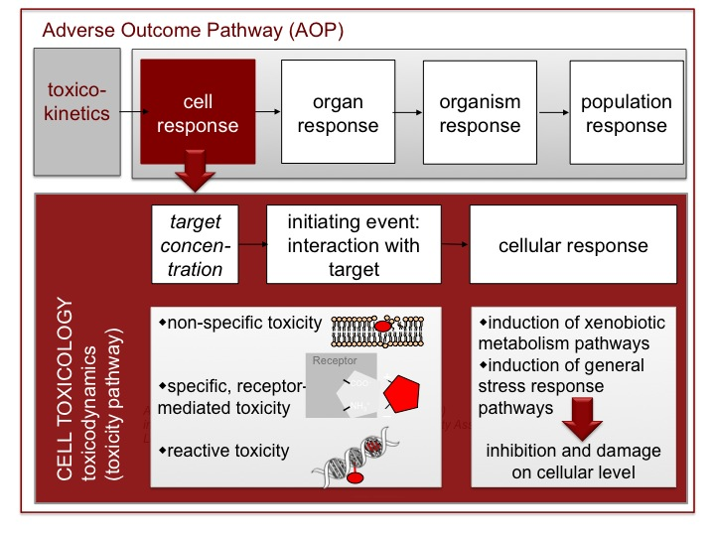
Concept of “Adverse Outcome Pathway” (AOP)
Mechanisms
or modes of action → → Effects

Slide 30
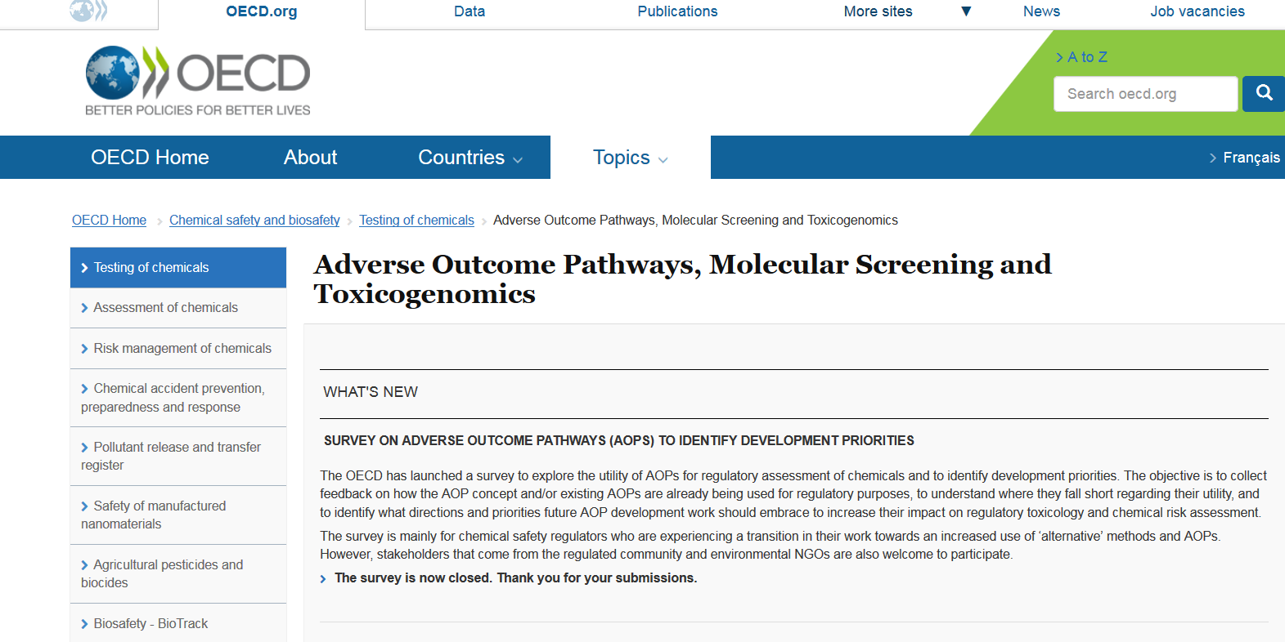
AOP = Global strategy with support from OECD, EU, USA
http://www.oecd.org/chemicalsafety/testing/projects-adverse-outcome-pathways.htm

Slide 31
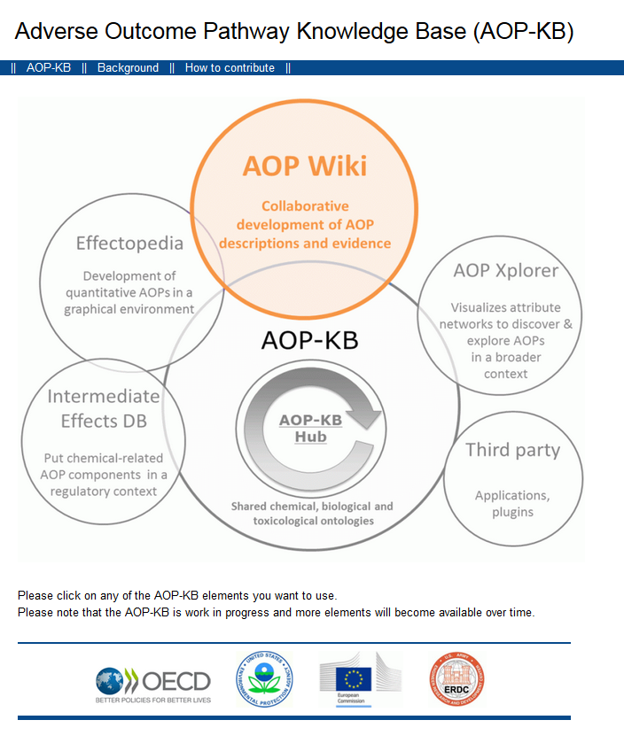
http://aopkb.org/
Key documents
OECD Guidance document and a template for developing and assessing adverse outcome pathways (Series No. 184, Series on Testing and Assessment)
Handbook for AOP developers

Slide 32

AOP Wiki
https://aopkb.org/aopwiki/index.php/Main_Page
Wiki-based platform for development of AOPs
Only members of an OECD AOP development project can create / edit AOPs

Slide 33
What AOPs are
in AOP Wiki – Sept 2022 ?
OECD Endorsed (WNT and TFHA) | 22 | Alkylation of DNA in male pre-meiotic germ cells leading to heritable mutations Aromatase inhibition leading to reproductive dysfunction
EAGMST Under Review & for comments | 22
EAGMST Under Development | 71
AOPs Under Development | Ca 250+
Total 409 AOPs
OECD Extended Advisory Group on Molecular Screening and Toxicogenomics (EAG MST)
The Working Group of the National Coordinators of the Test Guidelines Programme (WNT)
https://aopwiki.org/aops

Slide 34
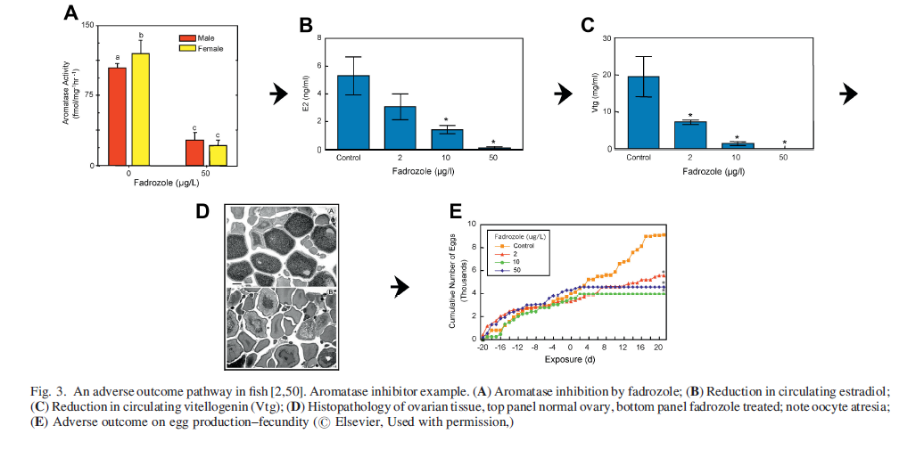
AOP Example: MIE aromatase inhibition
Environmental Toxicology and Chemistry, Vol. 30, No. 1, pp. 64–76, 2011

Slide 35
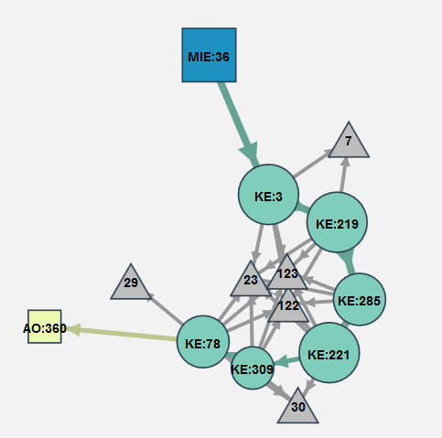
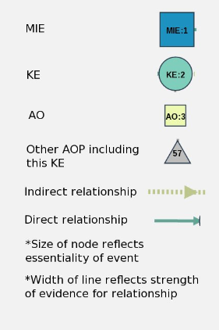
Aromatase inhibition leading to reproductive dysfunction (in fish)
https://aopwiki.org/wiki/index.php/Aop:25

Slide 36
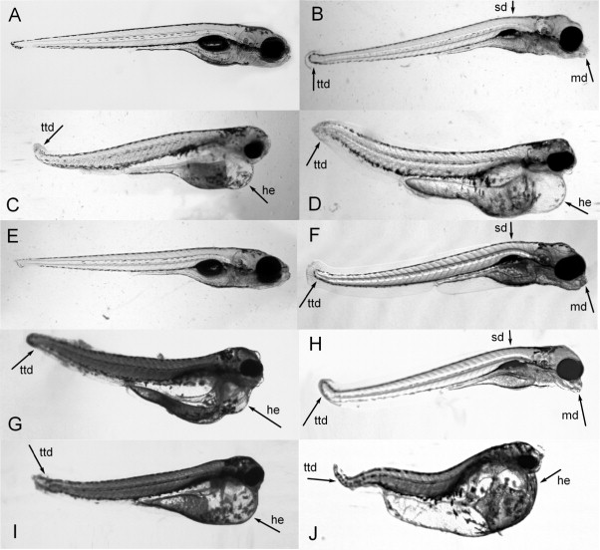
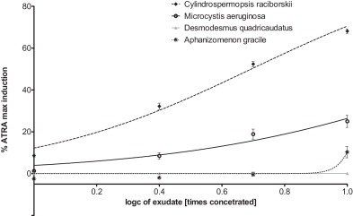



AOP Example from RECETOX:
Modulation of RAR/RXR → developmental toxicity in fish
Activation of RAR/RXR
in P19/A15 cells by atRA and
cyanobacterial metabolites
ZF exposed to ATRA and cyanobacterial (120 hpf) - Control (A), exudates of C. raciborskii 3.3× (B) and 10× (C), M. aeruginosa 10× (D) and D. quadricaudatus 17× (E). ATRA 4 μg/L (13.3 nM) (F), 12 μg/L (40 nM) ((G) and (H)), 36 μg/L (I) and 108 μg/L (J).
atRA
other RAs in cyanos
Jonáš et al. 2014 Aquatic Toxicology
http://dx.doi.org/10.1016/j.aquatox.2014.06.022

Slide 37





Kidd, K.A. et al. 2007. Collapse of a fish population following exposure to a synthetic estrogen. Proceedings of the National Academy of Sciences 104(21):8897-8901
5 ng/L (!)
7 years
Controls +Ethinylestradiol

Slide 38
Keywords to remember and understand
What is meant by the “mechanism of action” (or “mode of action”) in toxicology?
Why is it necessary to understand MoAs? What is the AOP concept?
What is toxicokinetics? What is ADME?
What is toxicodynamics?
What is the relationship between the exposure and the effect?
What are the different types of toxicity?
How can the (toxic) effect be measured / assessed?
What types of “bioassays” are available to study toxicity and/or MoA?
How is the result (i.e. „toxicity“) described in numbers?

