Slide 1
BIOMARKERS AND TOXICITY MECHANISMS
03 – Mechanisms - DNA
Luděk Bláha, PřF MU, RECETOX
www.recetox.cz

Slide 2
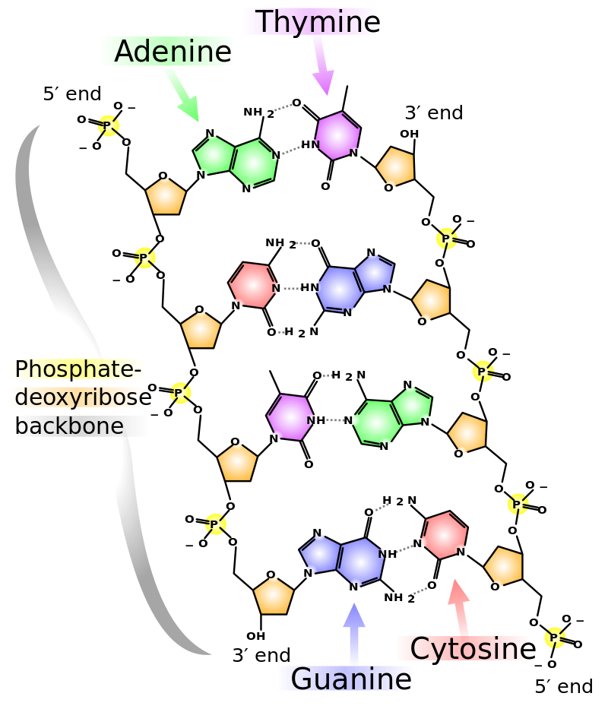
DNA
principal molecule for life
structure and function carefully checked
changes rapidly repaired
irreversible changes → cell death
(physiologically by apoptosis)
Mutagenesis → MUTATIONS
→ variability and evolution
or → damage to DNA
(structure or coding)
… natural mutagenesis
billions of nucleotides/day
→ most are repaired
… stress-induced → toxicity

Slide 3
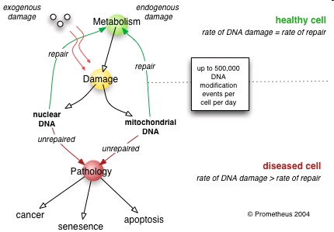
DNA damage and its effects
Cellular changes → Health and evolutionary consequences

Slide 4
DNA repair
Damage of DNA is carefully controlled
constitutively expressed repair systems
Sudden changes in DNA
→ induction of additional repair enzymes
(e.g."SOS-repair“ in bacteria - biomarker of DNA damage)

Slide 5
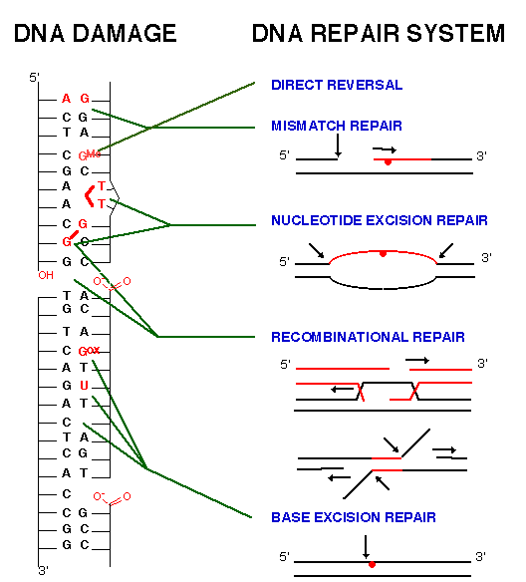
Various types of
molecular changes
in DNA ...
and corresponding
repair systems
Note!
Not all nucleotides
are affected in the
same rate
(mutations occur only at
specific sites due
to physicochemical properties)
Most common patterns:
G - the most frequent target
(highly nucleophilic character)
T=T at the same strand
G=G crosslinks

Slide 6
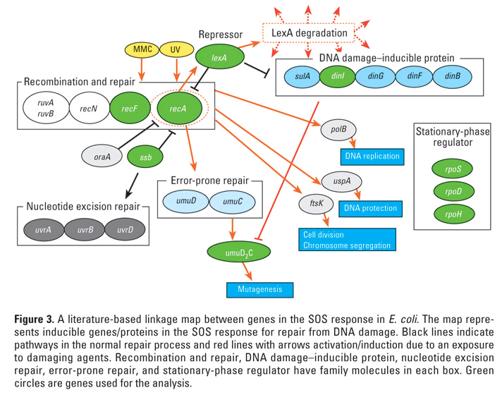
Example:
Complex system of SOS repair proteins induced in E. coli by DNA damage (induction and/or elevated levels of SOS-repair also used as a „biomarker of genotoxicity“)

Slide 7
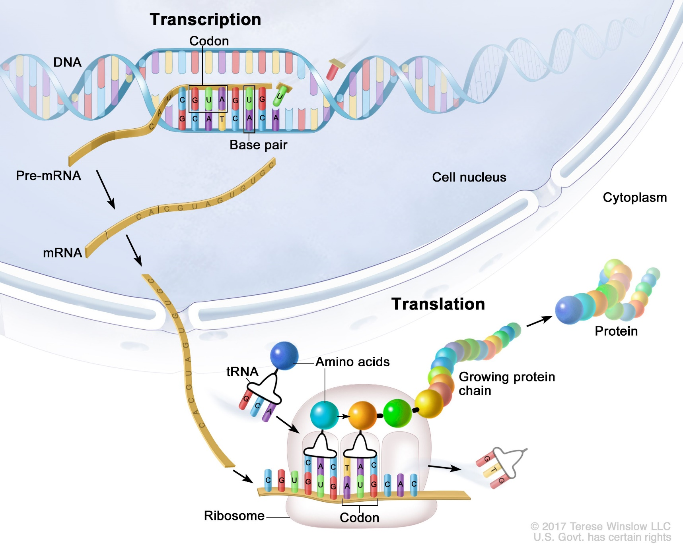
How is the information stored in DNA decoded and used

Slide 8
TYPES of mutations
POINT mutationts
Base exchanges
Deletions / Insertions
→ Impacts of point mutations
(a) silent, (b) missense, (c) nonsense, (d) frameshift
CHROMOSOMAL mutations
→ large scale impact

Slide 9
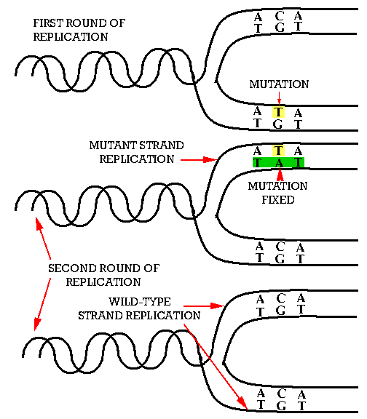
BASE – EXCHANGE
→ Mutation
fixed in
50% of cells
after the first
replication

Slide 10
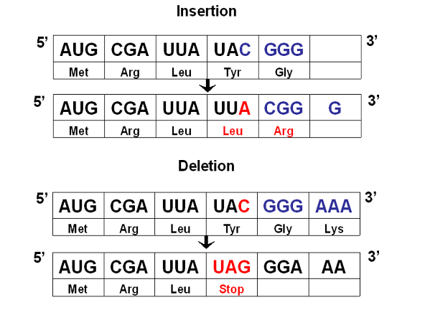
INSERTION
DELETION → shifts in reading frame

Slide 11
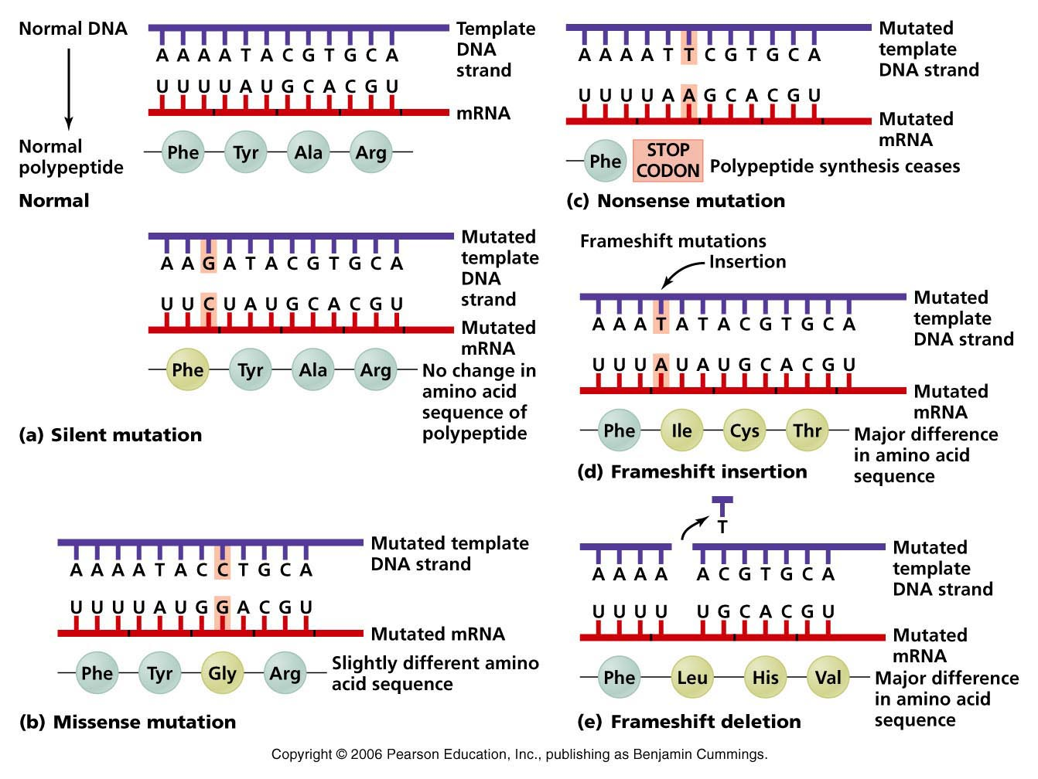
Impacts of point mutations
→ (a) silent, (b) missense, (c) nonsense, (d) frameshift

Slide 12
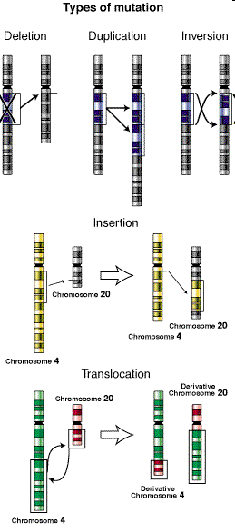
Large – chromosomal mutations

Slide 13
What are the agents inducing mutations? MUTAGENS
PHYSICAL FACTORS
Ionizating radiation
- direct interactions with NA
- interactions with water
→ formation of OH*
(and other oxygen radical species – ROS)
→ Various impacts on bases and strands
UV radiation
- interaction with aromatic cycles (bases)
→ base dimerization (T=T)

Slide 14
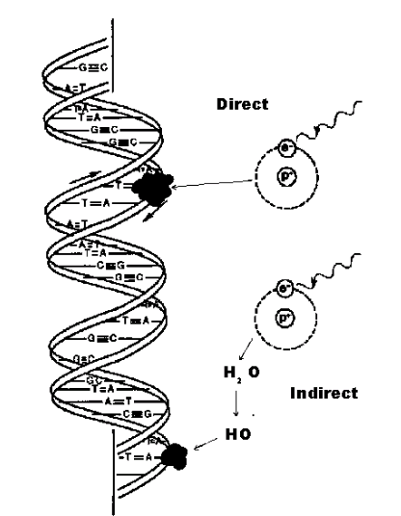
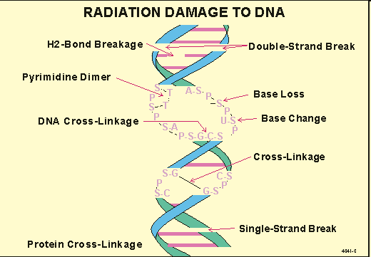
Ionizing radiation effects on DNA

Slide 15
What are the agents inducing mutations? MUTAGENS
CHEMICALS
1) Small electrophilic molecules
(attracted by nucleophilic/basic sites … e.g. in DNA)
2) Other reactive molecules
* alkylating and arylating agents – covalent adducts
* specifically intercalating agents
3) Base analogs
inserted during replication instead of nucleotides
Some compounds may require “activation” by metabolism
pro-mutagen (pro-carcinogen) → mutagen (carcinogen)

Slide 16
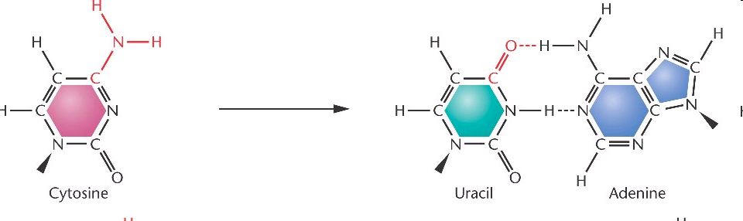
Small molecules → deamination of bases
HNO₂, HSO₃⁻ Hydroxylamine (HO-NH2), Methoxyamine (CH3-O-NH2)
Example: oxidation (deamination)
→ CG to → TA shift

Slide 17
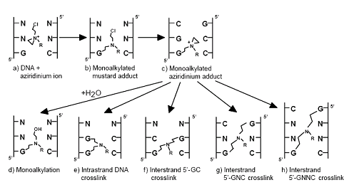

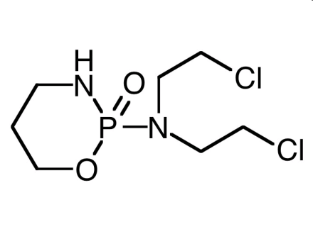
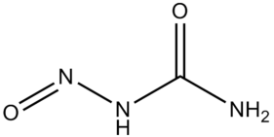
ALKYLating compounds
Covalent binding to NA (alkylation of bases, crosslinks in dsDNA)
Alkylsulphates, Nitro-urea, N-nitroso-alkyles, cis-platinum
cisplatin
cyclophosphamide
Nitrourea

Slide 18
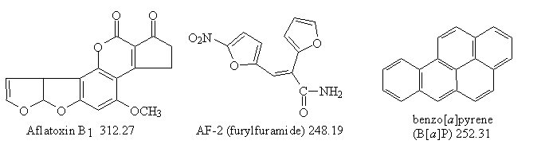
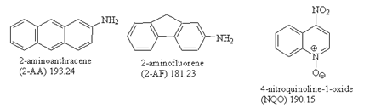
ARYLating compounds
Covalent binding, aromatic „adducts“ with bases
(see also discussion at biomarkers)
Mycotoxins (Aflatoxins) – requires activation
PAHs (benzo[a]pyrene) – requires activation
PAH derivatives
- 2-AA, 2-AF (grill products)
- NQO – model mutagen
in experiments
... many others

Slide 19
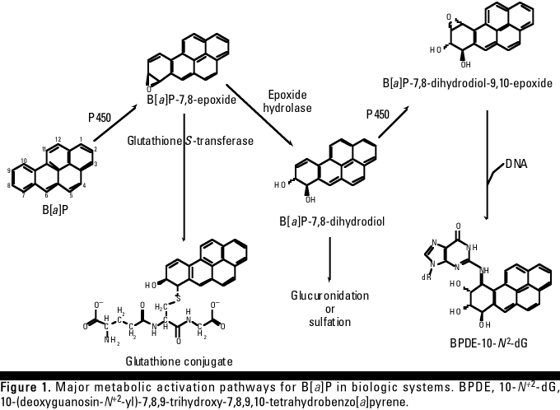
Bioactivation of benzo[a]pyrene → genotoxicity
BaP is oxidized to epoxides and OH-derivatives during detoxification (CYP450)
→ increased reactivity (including binding to bases ... primarily G or A)
(Similar bioactivation e.g. at aflatoxin)

Slide 20
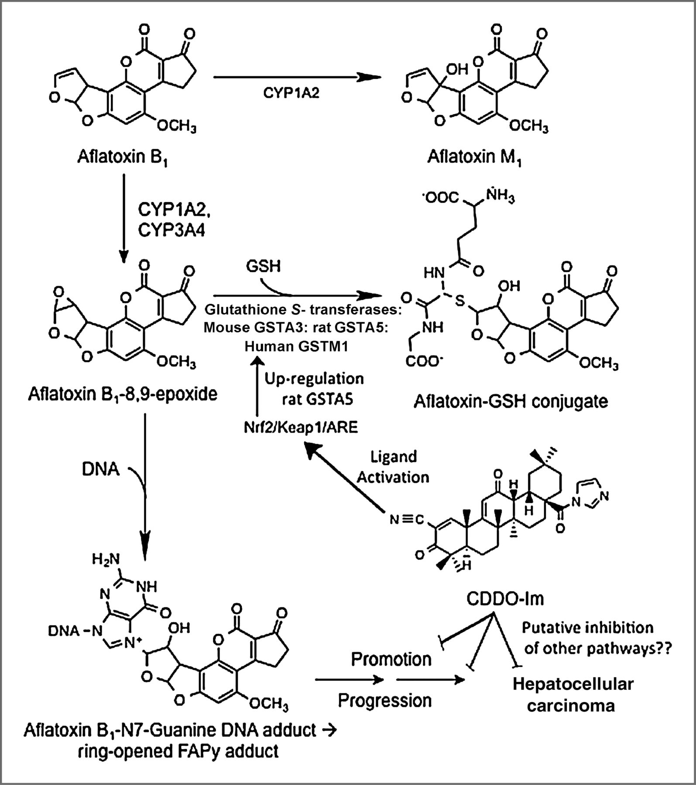
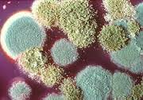
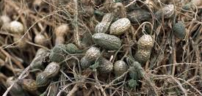
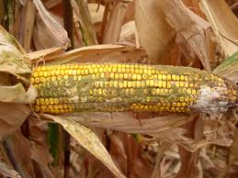
Bioactivation of aflatoxin → genotoxicity
AFLATOXIN sources

Slide 21
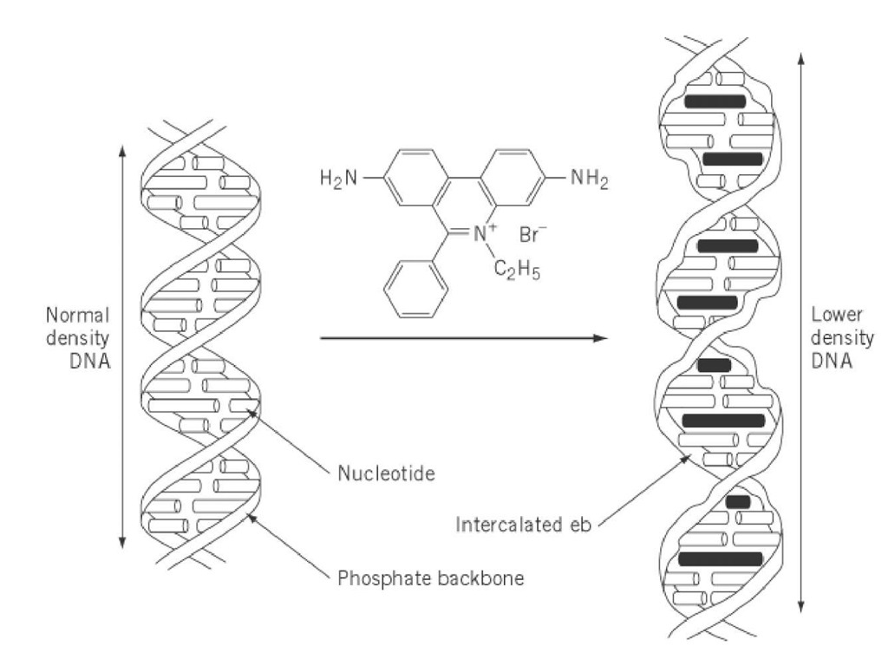
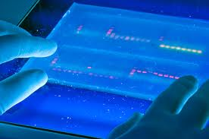
Intercalating agents
INTERCALATORS
Compounds with characteristic structures “fitting” into DNA
→ both noncovalent and covalent intercalation
Example 1 – ETHIDIUMBROMIDE
- experimental dye – visualization of DNA
- intercalation → sharing of electrones with bases → high fluorescence

Slide 22
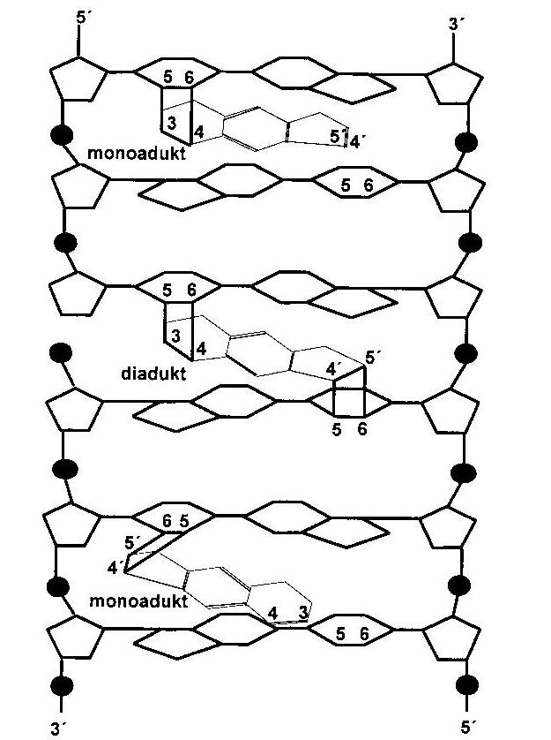
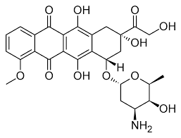

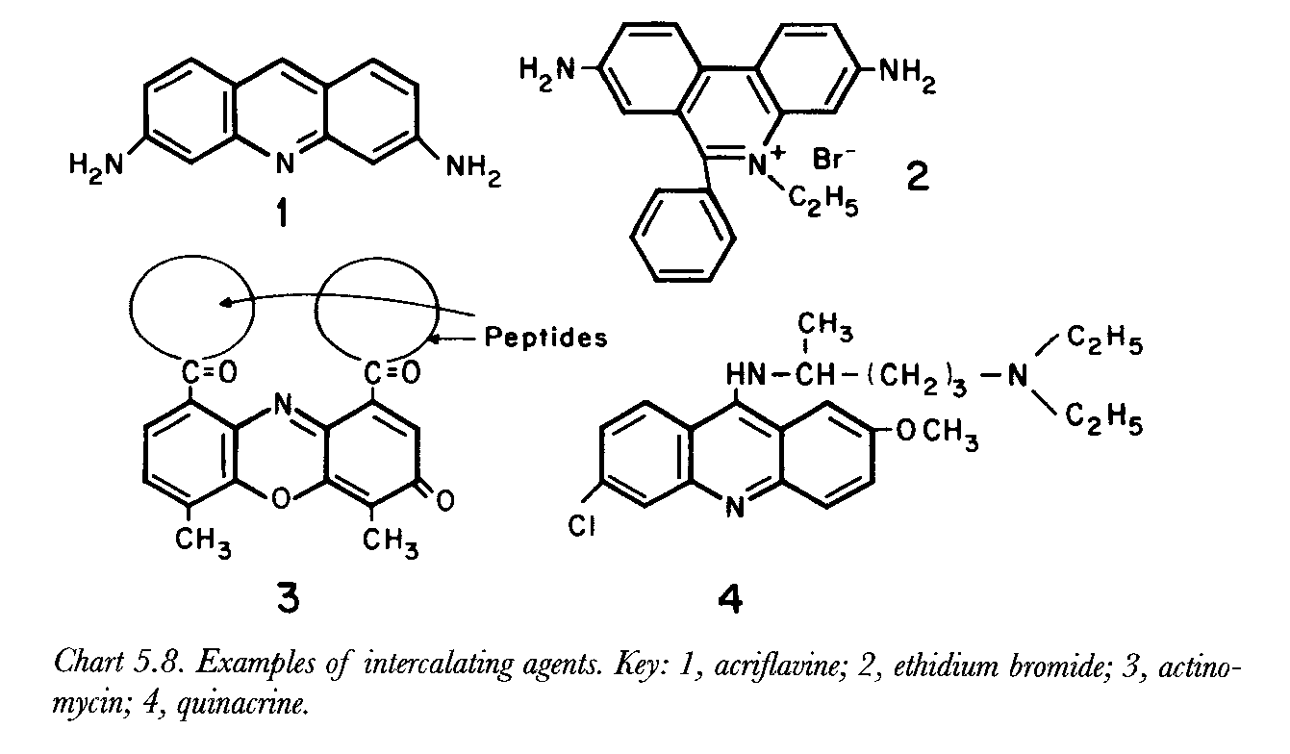
Intercalating agents
Other intercalator examples
Anticancer drug - doxorubicin
Psoriasis treatment – psoralen →
Experimental research compnds (e.g. acriflavine) →

Slide 23
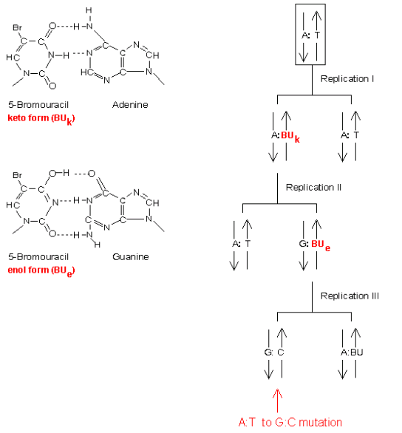
Base analogs
Structure similarity with natural bases
→ Incorporation into DNA during replication
→ Base exchange mutations
Example
5-Br-Uracil (anticancer drug)
  AT → GC shift

Slide 24
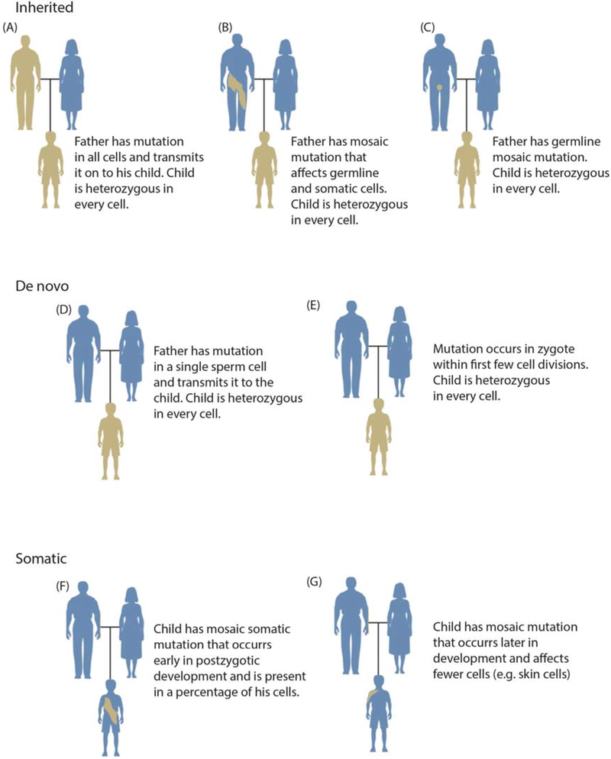
Wrap-up: Mutations and genotoxicity
Mutations can be:
  Inherited (inheritable) or somatic
Impacts of mutations
  Lethal
  Non-lethal
Impacts of point mutations
(a) silent … silent
(b) missense
  Changes in protein structure and then function – various effects - both adverse (disease incl. cancer; lower fitness) or beneficial (evolution)
(c) nonsense and (d) frameshift
  Usually lethal

Slide 25
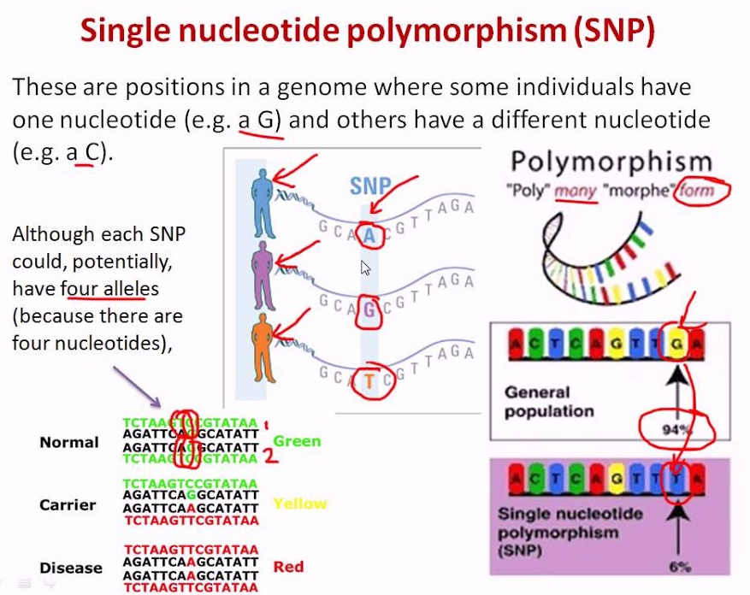
Also further discussed at „biomarkers“ of susceptibility

Slide 26
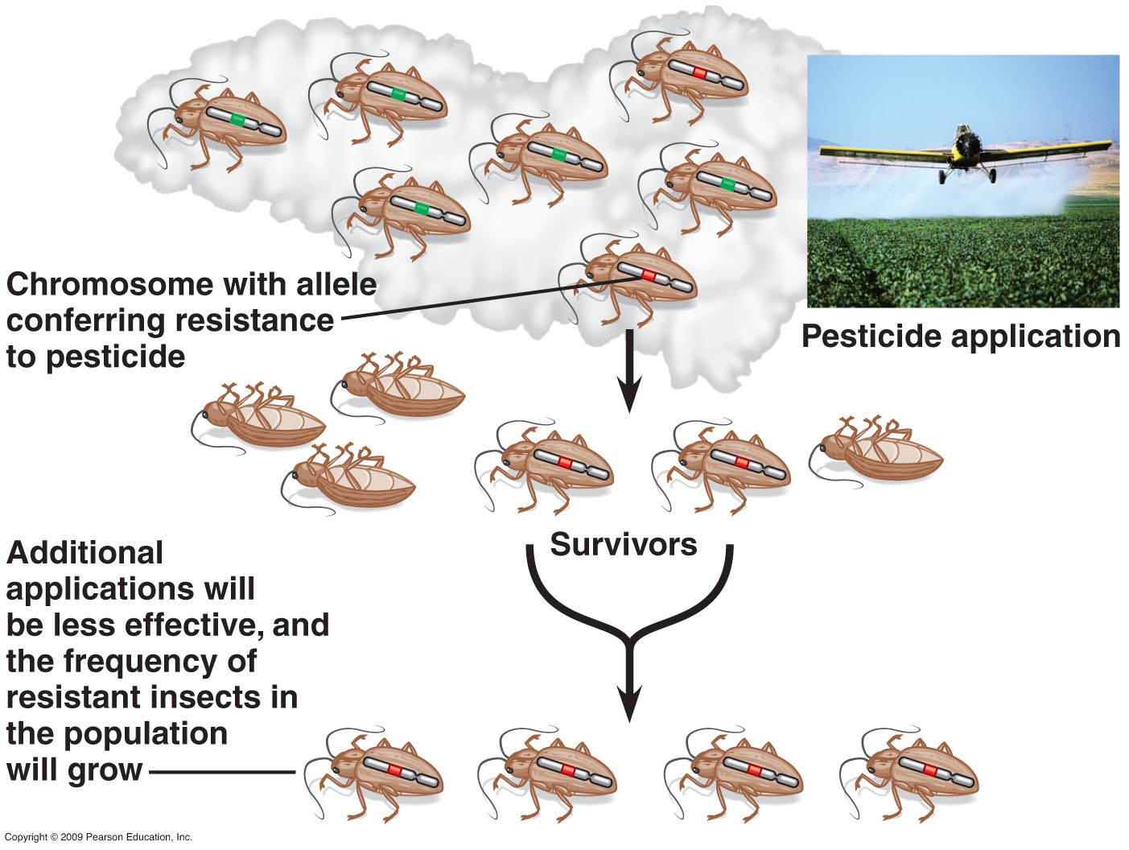
Mutations (alleles) and evolution

