Slide 1
BIOMARKERS AND TOXICITY MECHANISMS
10 – Mechanisms
Nuclear Receptors
Luděk Bláha, PřF MU, RECETOX
www.recetox.cz

Slide 2
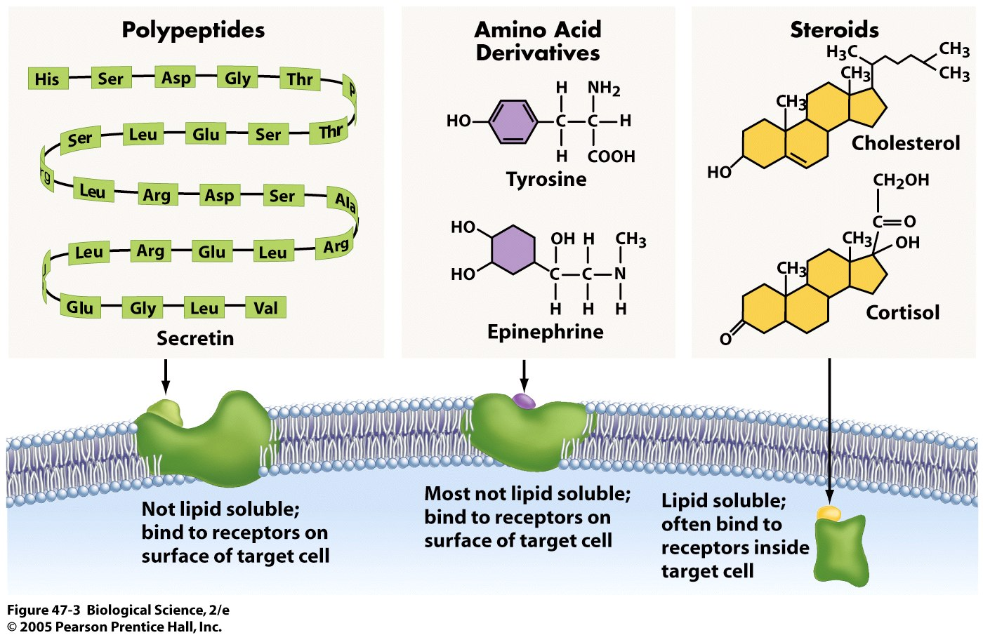
Various signalling types … now focus on nuclear receptors

Slide 3
NUCLEAR (Intracellular) RECEPTORS in summary
Important physiological functions, and
Important roles in pathologies and chemical toxicity
  Endocrine disruption
  Dioxin-like toxicity,etc.
All NRs share similar structure and mechanisms of action
  Act as direct transcription factors on DNA
Natural ligands are small lipophilic hormones (steroids, thyroids, retinoids)
  Role in toxicity – NR are modulated (activated/inhibited) by structurally close xenobiotics

Slide 4
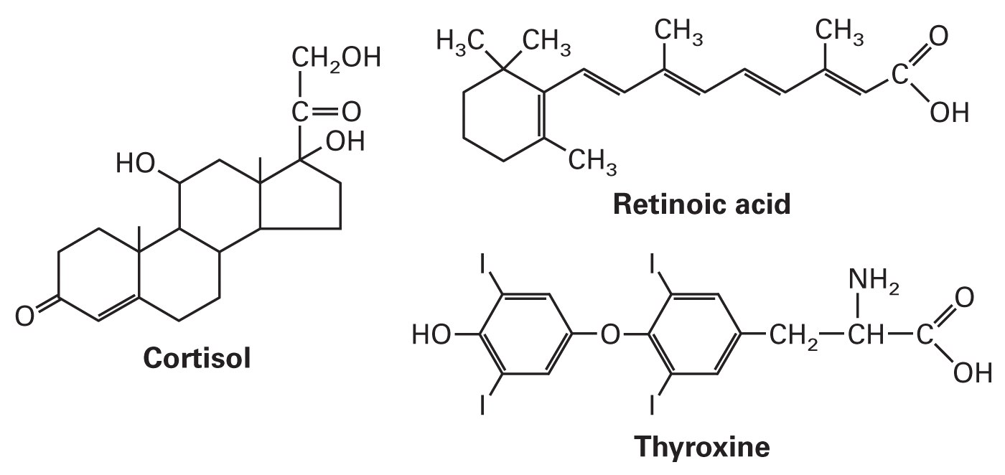
Natural ligands of NR
Small, lipid-soluble molecules
  Diffuse through plasma and nuclear membranes and interact directly with the transcription factors they control.
  STEROID HORMONES:
    sex steroids (estrogen, progesterone, testosterone)
    corticosteroids (glucocorticoids and mineralcorticoids)
  OTHER HORMONES and ligands
  Thyroid hormone, vitamin D3, retinoic acid, ligands of AhR
  Small molecules - gases
  e.g. NO (signaling for immune reactions)

Slide 5
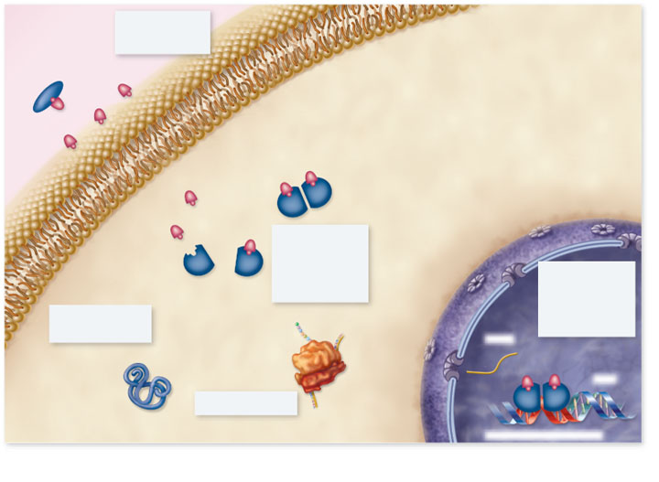
Copyright © The McGraw-Hill Companies, Inc. Permission required for reproduction or display.
Blood
plasma
1. Hormone passes
through plasma
membrane
Lipophilic hormones
Plasma membrane
Cytoplasm
Nucleus
2. Inside target
cell the hormone
binds to a
receptor protein
in the cytoplasm
or nucleus
Receptor
3. Hormone-receptor
complex binds to
hormone response
element on DNA,
regulating gene
transcription
5. Change in protein
synthesis is
cellular response
mRNA
Protein
DNA
4. Protein synthesis
Hormone response element
5
Notes:
5

Slide 6
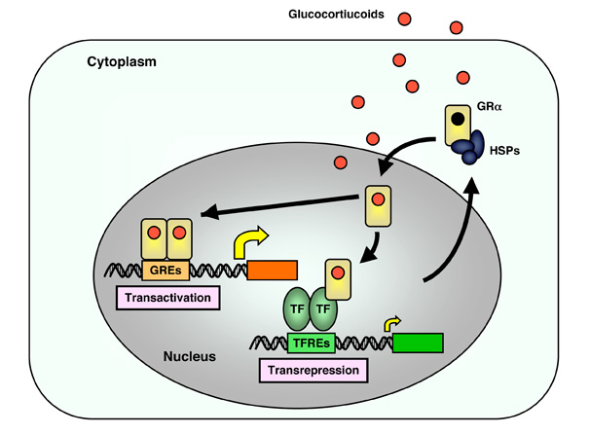
NR signalling is complex … examples of complexity (1)
Receptor activation is dependent not only on „ligand“ (glucocorticoid) but also on „inhibitor“ protein (Heat Shock Proteints - HSPs)
2. Dimerization (after the activation) is often needed for proper action (binding to GREs – glucocorticoid responsive elements)
3. Receptor with ligand can activate its own targets (GREs) as well as „repress“ other binding sites (TFREs)

Slide 7
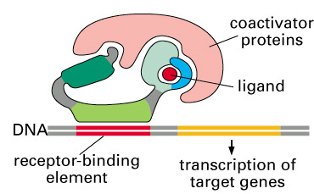
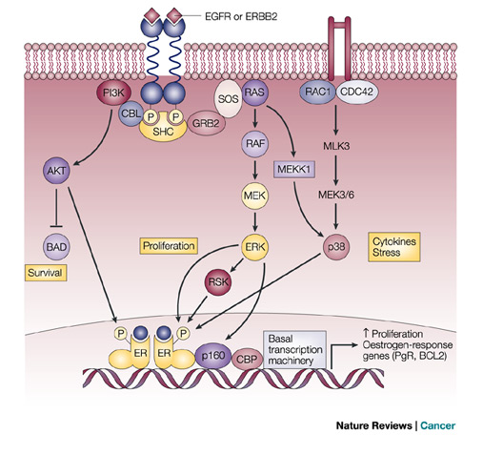
NR signalling is complex … examples of complexity 2
4. „Co-activator“ proteins are needed for proper action on DNA
5. Nuclear receptor action are (also) controlled - stimulated / suppressed - by other signalling pathways (e.g. phosphorylation by protein kinases)

Slide 8
NR signalling is complex … examples of complexity 3
6. Interaction (crosstalk) among various NRs
  “antiestrogenicity” of AhR ligands
  fast clearance of retinoids after AhR activation
  Immunosuprresions after ER activations
RAR
?
ER
AhR
P
P
P
hsp90
hsp90
ER
RAR
P
AhR
hsp90
hsp90
ER
AhR
AhR
RAR
ER
RAR

Slide 9
NR signalling is complex … examples of complexity 4
Regulation of transcription activity - mechanisms may vary
  Steroid receptors often dimerize with a partner to activate gene transcription
  Receptors for vitamin D, retinoic acid and thyroid hormone form heterodimers and then bind to responsive elements on DNA
    Second component of the heterodimer is RXR monomer (i.e, RXR-RAR; RXR-VDR)
NR dimers
  Heterodimeric receptors - exclusively nuclear;
    without ligand represses transcription (by binding to their cognate sites in DNA)
  Homodimeric receptors
    mostly cytoplasmic without ligands → hormone binding leads to nuclear translocation of receptors

Slide 10
Why are NR important?
→ common mediators of Endocrine Disruption

Slide 11
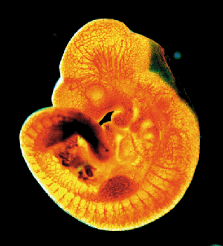
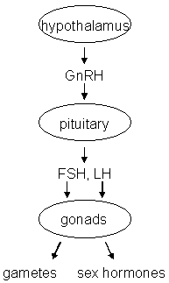
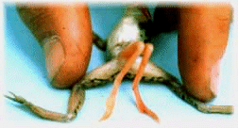
Endocrine disruption
Interference of xenobiotics with normal functioning of hormonal system
Known consequences
→ Disruption of homeostasis, reproduction, development, and/or behavior, and all other hormone-controlled processes:
  Shift in sex ratio, defective sexual development
  Low fecundity/fertility
  Hypo-immunity, carcinogenesis
  Malformations
  etc.

Slide 12
Toxicants interact with hormonal system at different levels
Synthesis
Transport
Interaction with receptors
Metabolization
Consequences (both negative!)
Suppression
Possible mechanisms of endocrine disruption
- Disruption of the „master“ hormones (FSH/LH)
Decrease of HR cellular levels
Nonphysiological activation of hormone receptor (HR)
Binding to HR without activation
Changes in hormone metabolism (clearance)
Stimulation

Slide 13
Fate and action of HORMONES activating NRs
Circulation in the blood bound to transport proteins
Dissociation from carrier at target cells
Passing through cell membrane
Binding to an intracellular receptor (either in the cytoplasm or the nucleus)
Hormone-receptor complex binds to hormone responsive elements in DNA
→ Regulation of gene expression
→ De-regulation at any level described above = TOXICITY
13
Notes:
13

Slide 14
Mechanisms
of toxicant effects
in detail
→ various MoAs
of endocrine disruption
biosynthesis and release of hormones
e.g. steroidogenesis
e.g. modulation of CYP11A and/or CYP19 activities
binding to plasmatic transport proteins
e.g. down-regulation of receptor levels
binding to nuclear hormonal receptor (HR)
Direct interference (activation / inhibition)
activation of HR
(dissociation of associated heat shock proteins, formation of homodimers)
e.g. modulation of other nuclear receptors
(PPAR/RXR, RXR/TR)
binding of the activated receptor complex to specific DNA motifs - HREs
chromatin rearrangement and transcription of estrogen-inducible genes
effects at the cellular, tissue, organ, organism, and/or population level

Slide 15
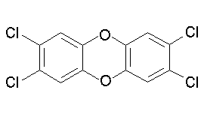
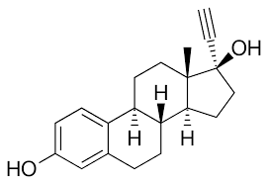
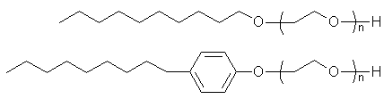
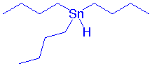
Endocrine disrupters in the environment?
2,3,7,8-TCDD
EDCs...
  Persistent Organic Compounds
  (POPs and their metabolites)
  steroid hormones and their
  derivatives from contraception pills
  alkylphenols
  organometallics (butyltins)
  pharmaceuticals
  Pesticides
  + number of unknowns …
ethinylestradiol
alkylphenols
Tributyl-tin

Slide 16
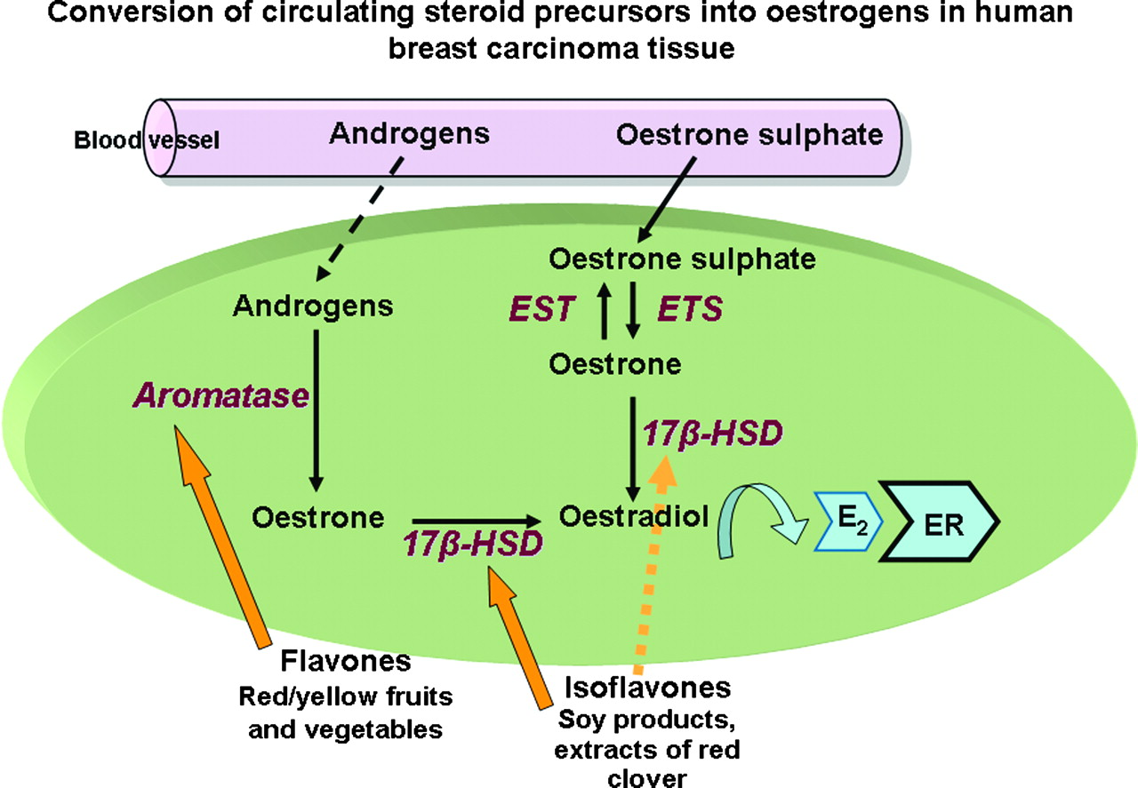
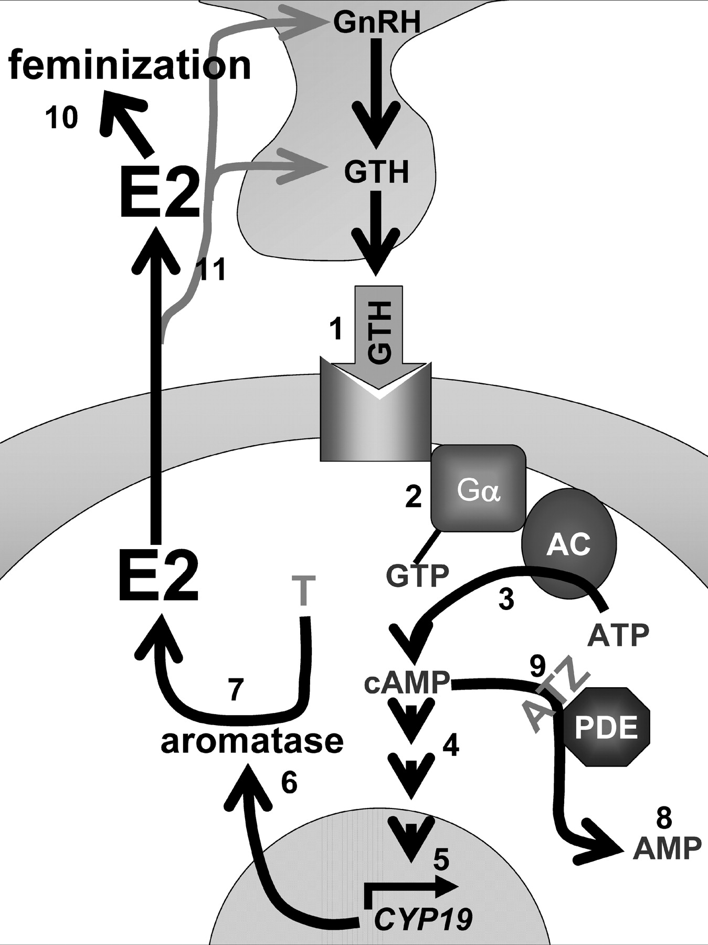
Examples – modulations of (synthetic) enzyme activities
Phytoestrogens promote synthesis of estrogens
→ feminization
Crosstalk with other signalling pathways (such as cAMP), which can be target to toxicants

Slide 17
STEROIDs - most studied ligands detailed view

Slide 18
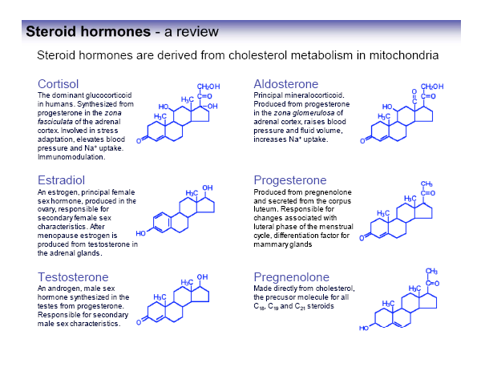

Slide 19
STEROID HORMONE biosynthesis

Slide 20
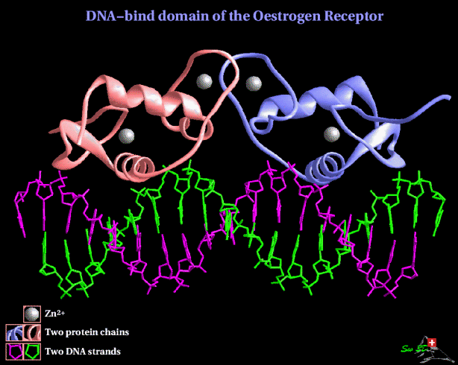
ESTROGEN RECEPTOR – ER the most studied target of EDCs

Slide 21
Estrogens
Synthesis in ovaries
Functions
  key roles in female hormone regulation and signalling
  responsible for metabolic, behavioural and morphologic changes occurring during stages of reproduction
  involved in the growth, development and homeostasis in a number of tissues
  control the bone formation, regulation of homeostasis, cardiovascular system and behaviour
  regulate production, transport and concentration of testicular liquid and anabolic activity of androgens in males
DISRUPTION OF ESTROGEN SIGNALLING
→ many documented effects in aquatic biota & laboratory organisms

Slide 22

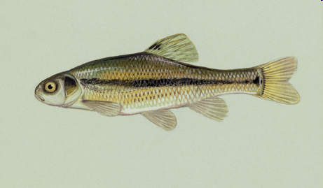
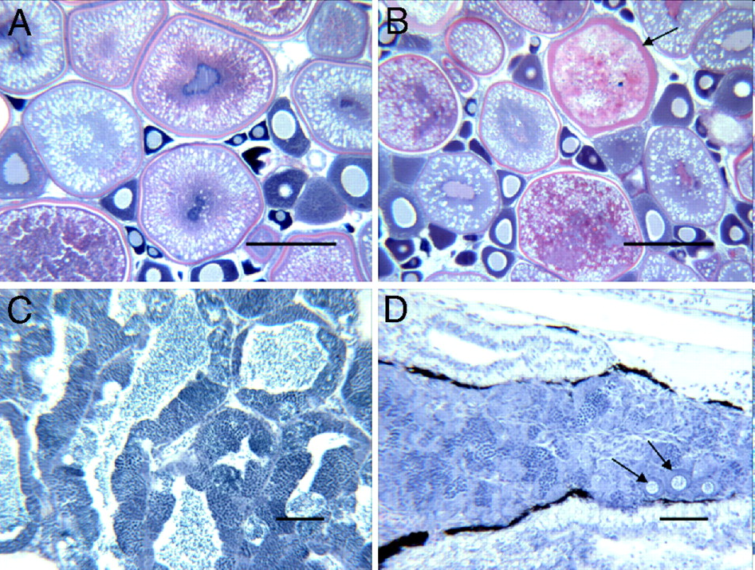
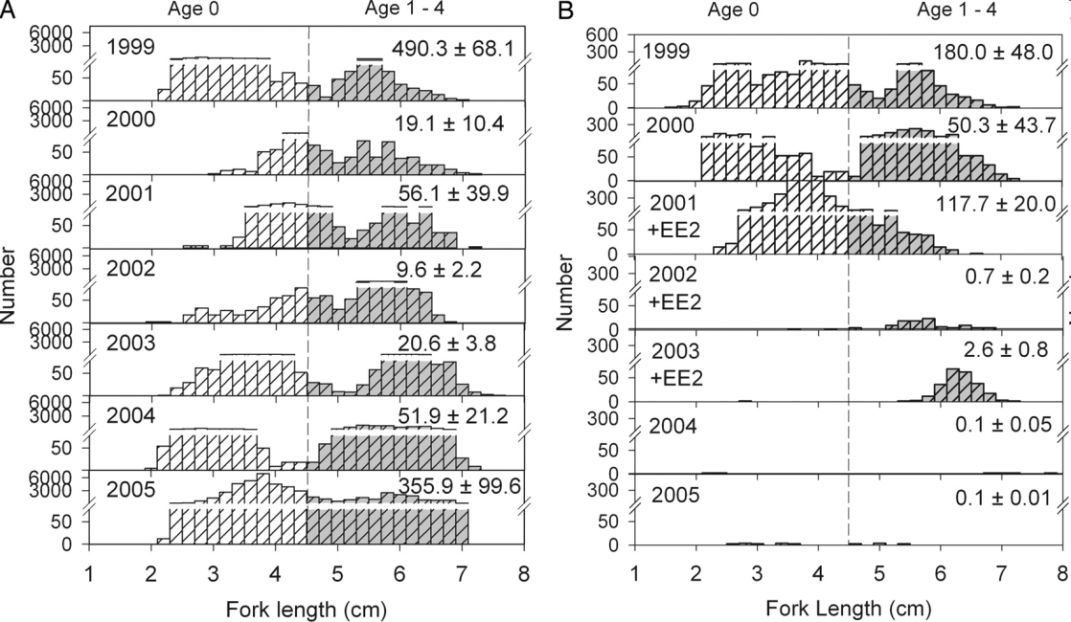
Kidd, K.A. et al. 2007. Collapse of a fish population following exposure to a synthetic estrogen. Proceedings of the National Academy of Sciences 104(21):8897-8901
5 ng/L (!)
7 years
Controls +Ethinylestradiol

Slide 23
ESTROGEN RECEPTORS - subtypes
ER-α (in breast, ovary, brain, liver, bone and cardiovascular system,
adrenals, testis and urogenital tract)
ER-β (in kidneys, prostate and gastrointestinal tract)
(ER-γ in fish)

Slide 24
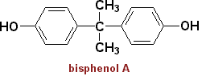

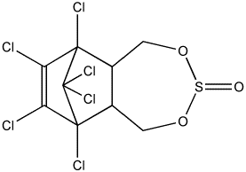
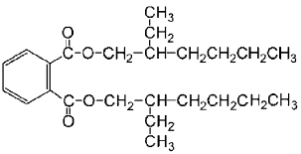
Environmental estrogens (xenoestrogens, exoestrogens)
>> Highly diverse group of substances
>> Do not necessarily share structural similarity to the prototypical estrogen 17β-estradiol
>> may act as AGONISTS and/or ANTAGONISTS (depending on situation and concentration!)
Natural products
genistein
naringenin
coumestrol
zearalenone
Industrial chemicals
Bisphenol A
Nonionic surfactants
Pthalate esters (eg. DEHP)
Endosulfan (pesticide)
Various POPs
DDT
kepone
PCBs/OH-PCBs
PAHs and dioxins
DEHP
Pharmaceuticals
Ethinyl estradiol
Diethylstilbestrol
gestodene
norgestrel

Slide 25
Exoestrogens - Relative Potencies to bind to ERa (REPs)
REP – a measure of toxic potency of a compound (similar also at other NRs)

Slide 26
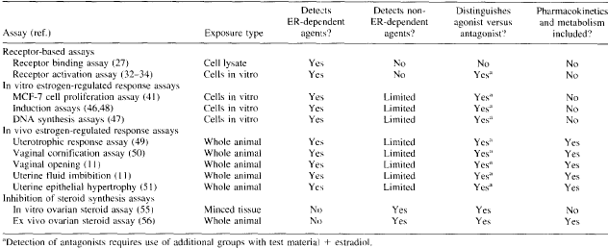
How to assess ESTROGENICITY?
Number of in vivo and in vitro methods available
Janošek, J., Hilscherová, K., Bláha, L., and Holoubek, I. (2006). Environmental xenobiotics and nuclear receptors-Interactions, effects and in vitro assessment. Toxicology in Vitro 20, 18-37.

Slide 27
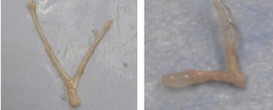
IN VIVO ASSAYS FOR ESTROGENICITY
Rat uterus
Control Estrogen exposure
uterotropic assay
vaginal cornification assay
production of estrogen-inducible proteins
(e.g. vitellogenin and zona radiata protein)
→ also discussed at “biomarkers” part
standard (in vivo) test procedures for reproductive and developmental toxicity
  using mice, rats, fish, amphibians etc.

Slide 28
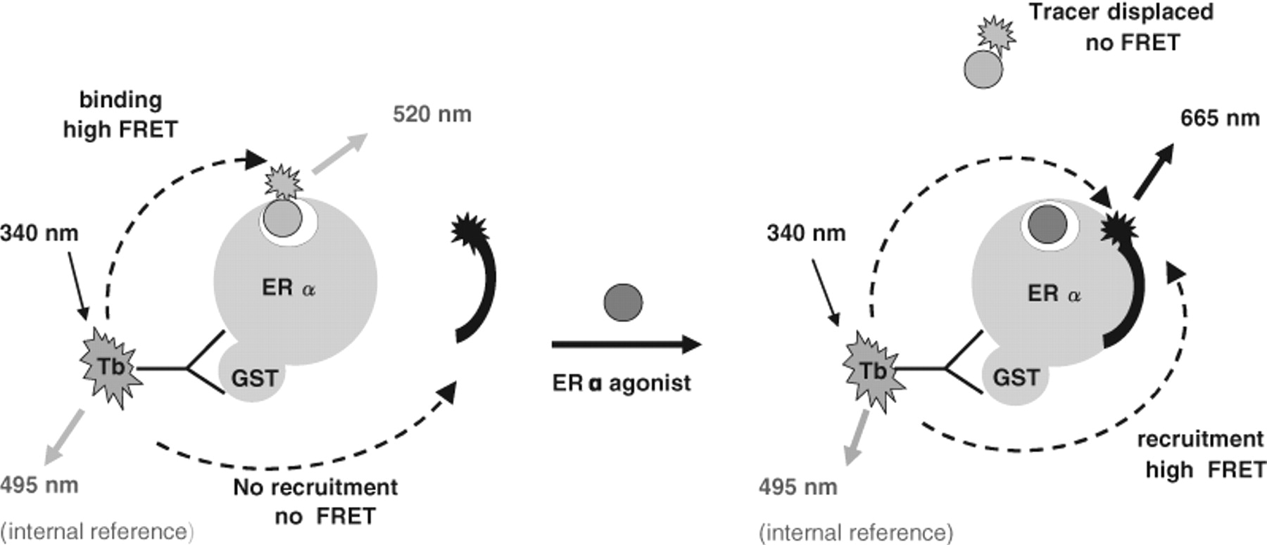
In vitro assays for estrogenicity
Level 1 – interaction of toxicant with the protein (receptor)
  INTERACTION (BINDING) to the receptor
    competitive ligand binding assays
      Various variants (e.g. displacement of radioactive substrate, fluorescence resonance energy transfer (FRET) techniques etc.
    information only about “binding potency” but the effect remains unknown (? Activation / suppression / no effect ?)

Slide 29
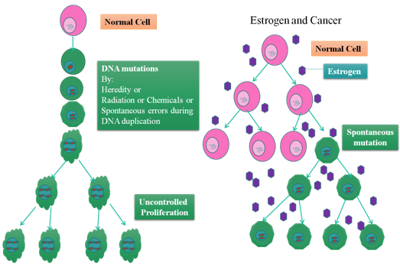
In vitro assays for estrogenicity
Level 2 - effects at cellular level
  → interference with receptor biological activity
Cell proliferation assays
  Estrogens induce proliferation

Slide 30
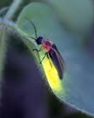
In vitro assays for estrogenicity
Level 2 - effects at cellular level
  → interference with receptor biological activity
Endogenous protein expression (or enzyme activity) assays
  reporter gene assays
Cell assays in vitro
Cells (e.g. breast carcinoma) naturally carrying functional ER.
Genetic modification - stable transfection with firefly luciferase gene: under the control of ER
Estrogens in media → light induction

Slide 31
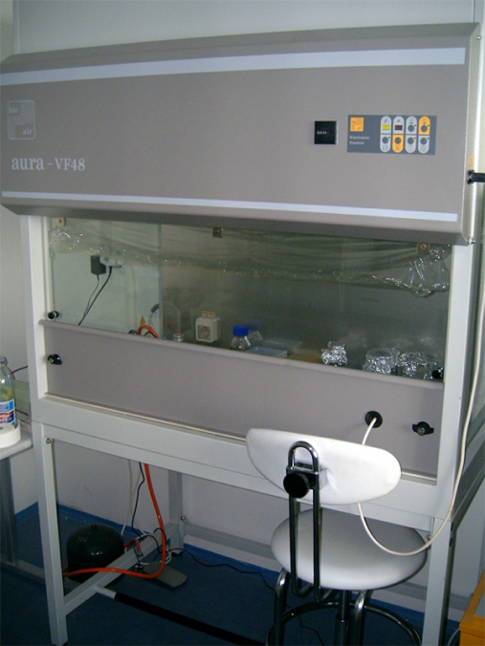
Luciferase reporter assay for estrogenicity in brief
96 microwell plate
cultivation of transgenic cell lines
ER: breast carcinoma MVLN cells
Exposure (6 – 24 h)
standards / samples
Similar principle for other NRs activities
Mammalian cells
* AhR – H4IIE.luc cells (CALUX)
* AR – MDA.kb2 cells
* RAR/RXR - P19/A15 cells
Yeast models
* Luciferase based
* Also beta-galactosidase etc.
Cell lysis
→ extraction of induced luciferase
Luminescence determination
(microplate luminescence reader)
Lumino

Slide 32
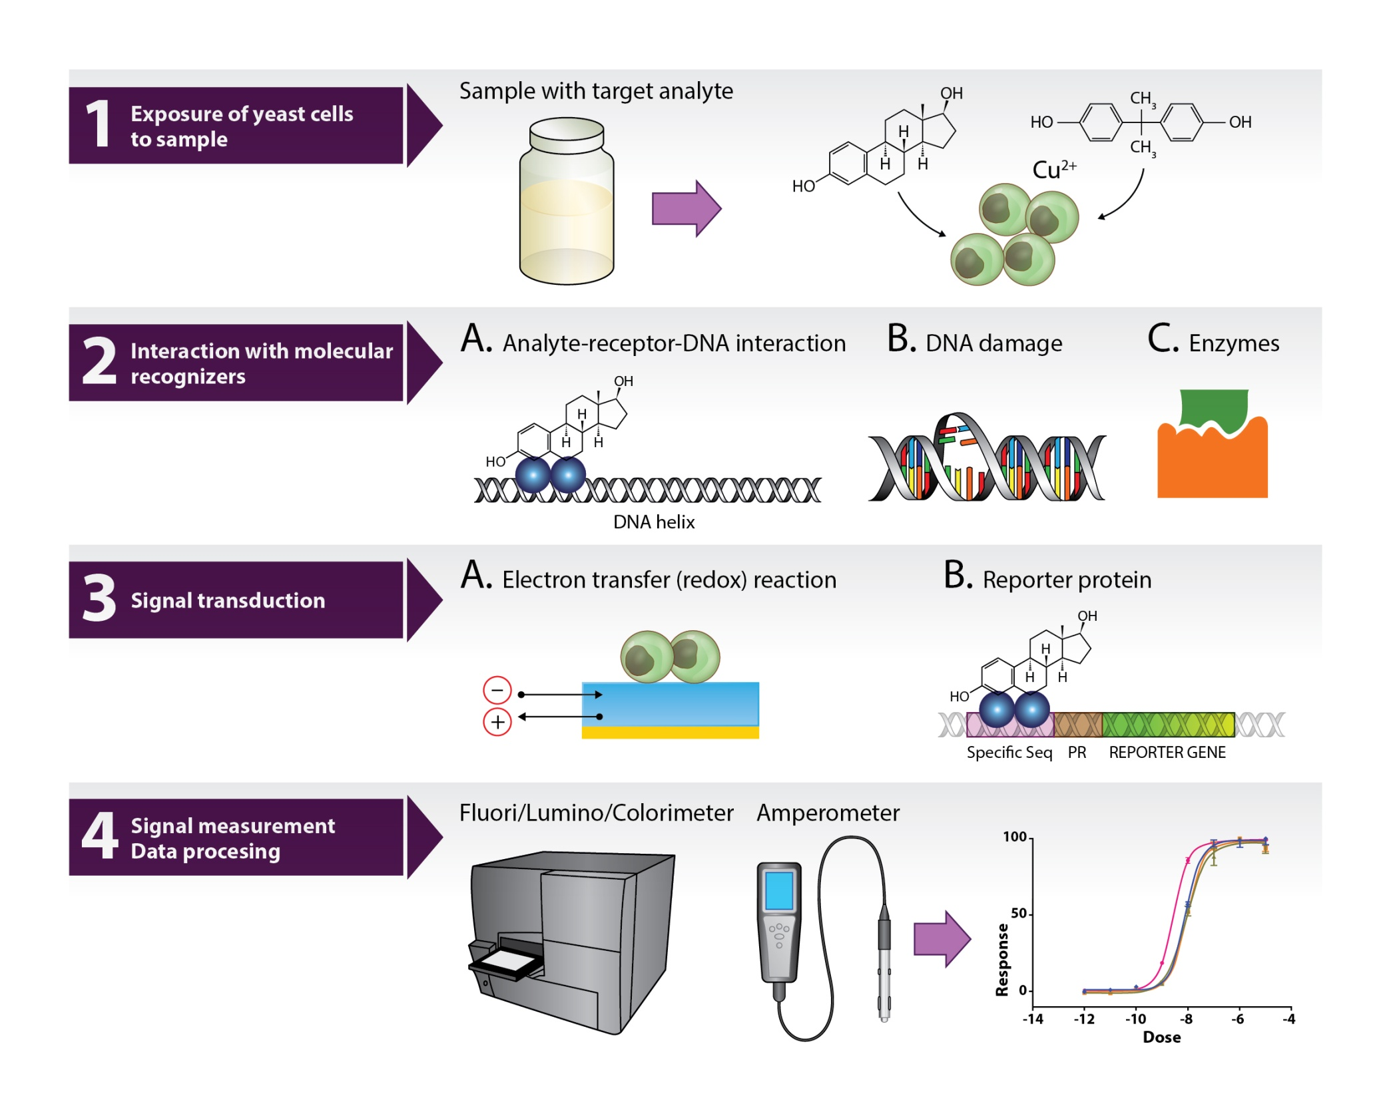
Bioassay (biosensor) for NR-modulator based on yeast cells
Jarque, S., M. Bittner, L. Bláha and K. Hilscherová (2016). "Yeast biosensors for detection of environmental pollutants: current state and limitations." Trends in Biotechnology 34(5): 408-419 (doi:10.1016/j.tibtech.2016.01.007).

Slide 33
ANDROGEN RECEPTOR (AR) role in toxicity confirmed ... but less explored than ER

Slide 34
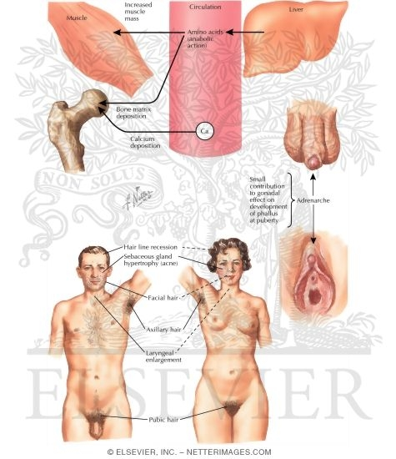
Androgens
Role of androgens in males is similar to that of estrogens in females
  development of male sexual characteristics
  stimulating protein synthesis, growth of bones
  cell differenciation, spermatogenesis
  male type of behaviour

Slide 35
Androgens – endogenous ligands
Endogenous ligands – androgen hormones
  Two key androgens
    testosterone (T)
    dihydrotestosterone (DHT)
  Other androgens – androstanediol,
  dehydroepiandrosterone, androstenedione
T: synthesis in testis (Leydig cells)
  in lesser extent in adrenals
DHT: Formed extratesticulary from T
  In several tissues (seminal vesicles, prostate, skin)
  higher affinity to androgen receptor than T
  Daily production 5-10% of testosterone
Testosterone

Slide 36
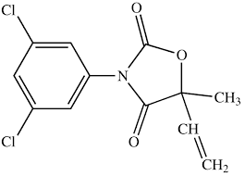
Several mechanisms how „xenoandrogens“ disrupt natural androgen signalling and action
1) Binding to AR
  Mostly competitive inhibition (xenobiotics mostly do not activate AR-dependent transcription)
Only few compounds able to activate AR in the absence of androgen hormones but they are anti-androgenic in the presence of strong androgens like T or DHT
- metabolites of fungicide vinclozoline
- some PAHs
2) FSH/LH (gonadotropins) signalling disruption – less explored
  FSH/LH expression - regulation via negative feedback by testosterone
  Suppression → alterations of spermatogenesis
vinclozoline

Slide 37
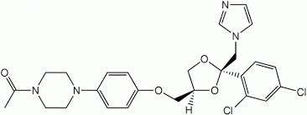
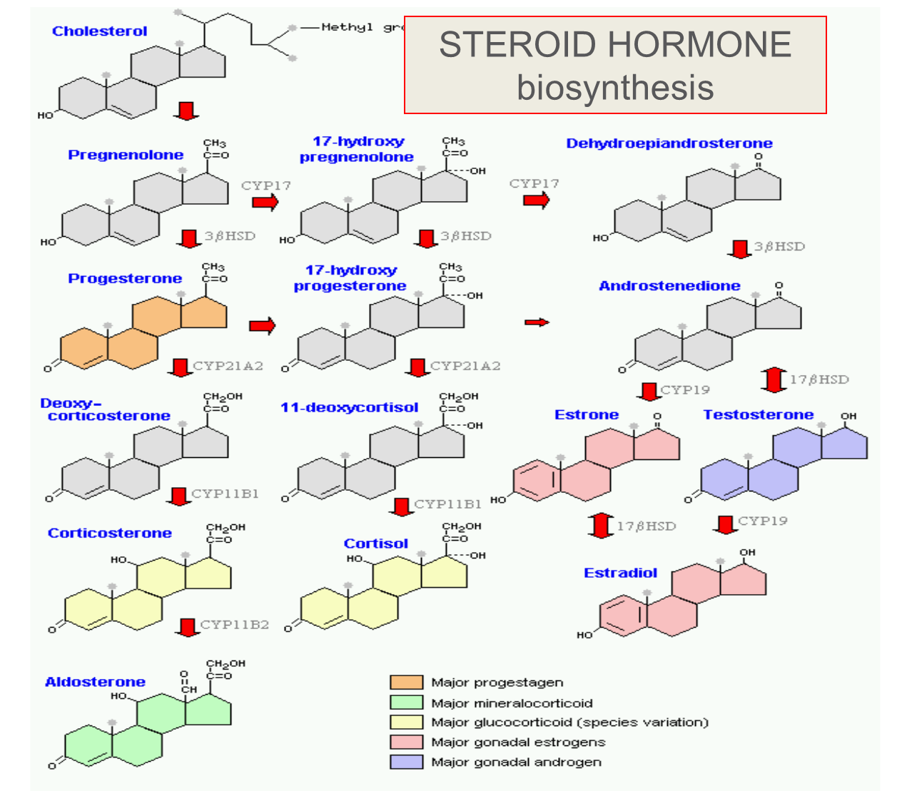
Mechanisms of androgen signalling disruption
3) Alterations of de novo testosterone synthesis
  Inhibition of P450scc needed for side chain cleavage of cholesterol or inhibitions of 17-beta-hydroxylase and other CYPs
    fungicide ketoconazol

Slide 38
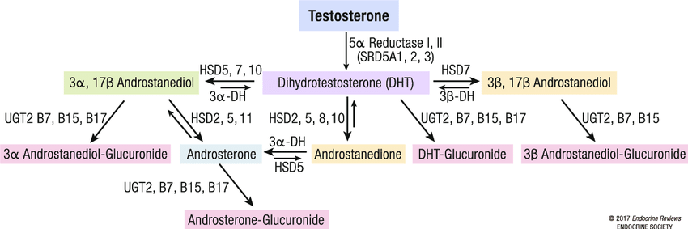
Mechanisms of androgen signalling disruption
4) Testosterone metabolic clearance
  Chemicals inducing detoxification enzymes – for Testosteron – most relevanat are UDP-glucuronosyltransferases (UGTs)
    Documented e.g. for pesticides endosulfan, mirex, o-p´-DDT
    (degradation → lower T concentrations → anti-androgenicity)

Slide 39
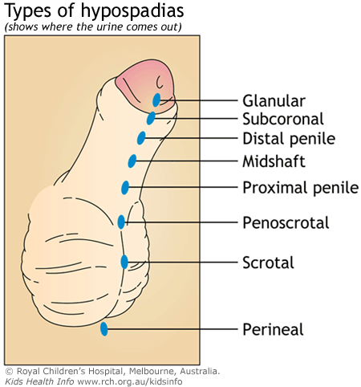
Effects of male exposures to antiandrogens
Exposure during prenatal development:
  malformations of the reproductive tract
    reduced anogenital distance
    hypospadias (abnormal position of the urethral opening on the penis)
    vagina development
    undescendent ectopic testes
    atrophy of seminal vesicles and prostate gland
Exposure in prepubertal age:
  delayed puberty
  reduced seminal vesicles
  reduced prostate
Exposure in adult age:
  oligospermia
  azoospermia
  loss of sexual libido

Slide 40
AR-binding – effective concentrations
Reference: active ligand dehydrotestosteron DHT: EC50 ~ 0.1 µM
Compound
IC₅₀ (µM)
Benz[a]anthracene
3.2
Benzo[a]pyrene
3.9
Dimethylbenz[a]anthracene
10.4
Chrysene
10.3
Dibenzo[a,h]anthracene
activation in range 0.1-10µM
Bisphenol A
5
vinclozolin metabolites
9.7
hydroxyflutamide
5
Aroclor typical values
0.25-1.11
Individual PCBs typical values
64 - 87
tris-(4-chlorophenyl)-methanol
0.2

Slide 41
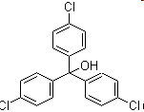
Antiandrogenic compound
tris-(4-chlorophenyl)-methanol
  Ubiquitous contaminant of uncertain origin
  Probable metabolite of DDT-mixtures
  Levels in human blood serum cca. 50nM (antiAR effective EC50 – cca. 200nM)

Slide 42
(Anti)androgenicity assessment
In vivo Hershberger assay
  castrated rats treated with examined substance
  Endpoint – after 4-7 days – seminal vesicles and ventral prostate weight
In vivo measurement of testosterone blood levels
In vitro cell proliferation assays
  cells with androgen-dependent growth: mammary carcinoma cell lines
  prostatic carcinoma cell lines
Receptor-reporter assays
  Gene for luciferase (or GFP) under control of AR
    AR-CALUX (human breast carcinoma T47D)
    PALM (human prostatic carcinoma PC-3)
    CHO515 (Chinese hamster ovary CHO)
  Yeast transfected cells
    beta-galactosidase reporter

Slide 43
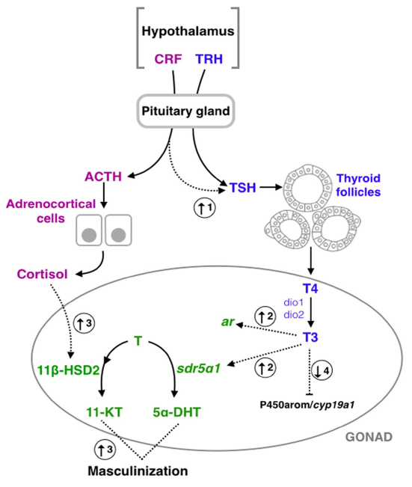
THYROID SIGNALLING

Slide 44
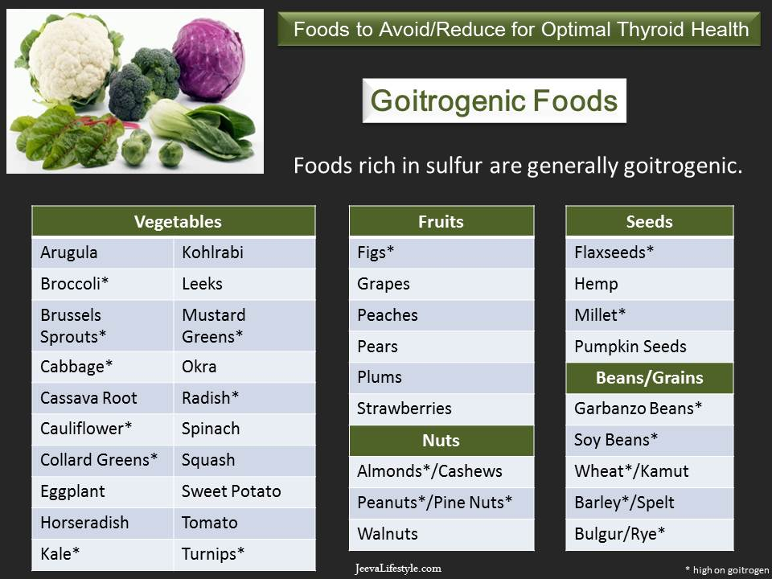


Thyroid hormones
Crucial roles in metabolism, development and maturation
  Regulation of metabolism
    increasing oxygen consumption
    modulating levels of other hormones (insulin, glucagon, somatotropin, adrenalin)
  Important in cell differenciation
  Crucial role in development of CNS, gonads and bones
EDC compounds interfering with thyroid signalling
  “GOITROGENS”
Many food (vegetables) contain goitrogens
HYPOTHYROIDISM
HYPERTHYROIDISM

Slide 45
Thyroid hormones
Thyroxine (T4)
Triiodothyronine (T3)
Contains 3 iodide ions
Most T3 produced
by deiodination
in target tissues (deiodinases)
Also called tetraiodothyronine
Contains 4 iodide ions
T4 – prohormone
5´-deiodination → active form, T3

Slide 46
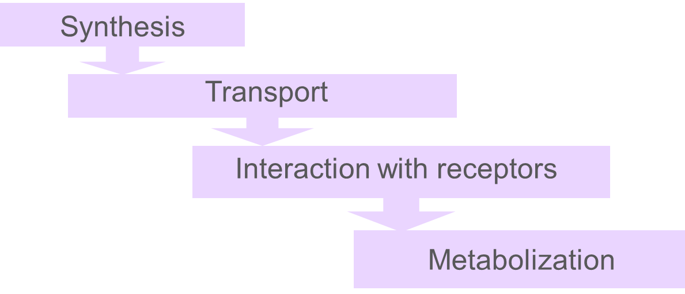
Multiple mechanisms of thyroid signalling disruption
Xenobiotics are known to affect
  Synthesis & activation (deiodinases)
  Transport in blood
  (Direct effects on nuclear receptors - ThR – less important)

Slide 47
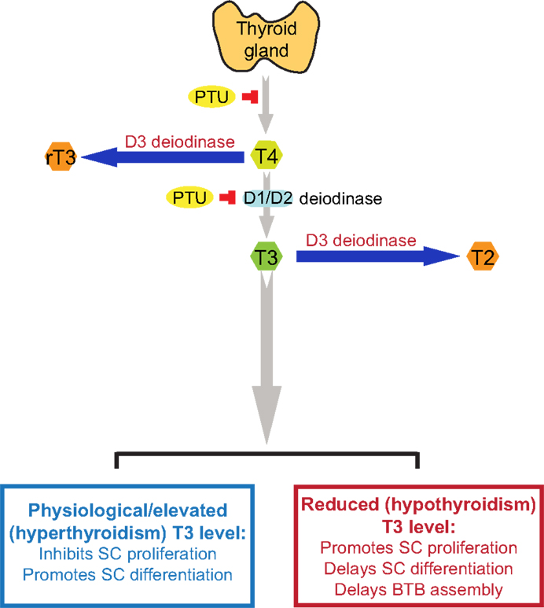
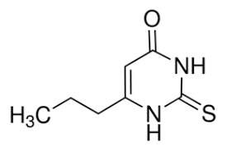
Disruption of enzymes involved in Thyroid metabolism
„outer“
Thyroid peroxidases
  iodination of tyrosyl residues
  coupling of iodinated tyrosyl residues
Thyroid deiodinases
  D1, D2 - activation of T4 into T3 via deiodination on „outer“ ring
  D3 - deactivation into rT3 via deiodination on „inner“ ring
Many goitrogens affect expression, activities and outcomes
of these key enzymes
  PTU – propylthiouracil
  →effect deiodinases
  Thiocyanate ([SCN]⁻) or perchlorate (NaClO₄)
  →effect on iodine uptake
„inner“

Slide 48
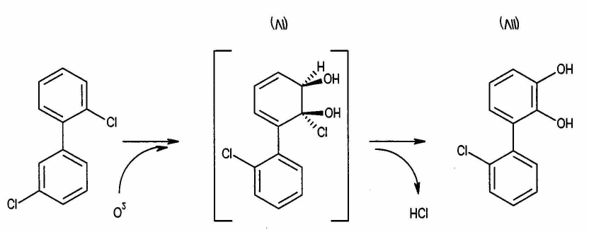
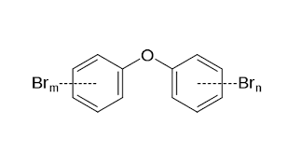
Disruption of transport of thyroid hormones in blood
SPECIFIC TRANSPORTERS in blood
  regulating free T4 and T3 levels
  3 types :
    Thyroid-binding prealbunin (transthyretin) (20-25%)
    Albumin (5-10%)
    Thyroid binding globulin (TBP, 75%)
NUMBER OF EDCs → act on transport proteins
  OH-PCBs, brominated and chlorinated flame retardants, DDT, dieldrin
  OH-PCBs – equal affinity to TBP as T4 and T3 (!!!)
Increased levels of “free T4” in blood
  negative feedback to TSH release
  → increased depletion
  → increased weight, changes in thyroid gland
  Documented after exposures to POPs in vertebrates
Hydroxylated PCB formation
Polybrominated diphenyl ethers
(PBDEs) – flame retardants

Slide 49
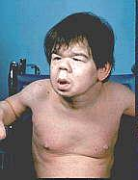
Effects of thyroid disruption
Exposures to goitrogens during prenatal stages
  severe damage of CNS (cretenism, delayed eye opening, cognition)
  Megalotestis
  Histological changes in thyroid gland (goitre)
Exposures during development
  nervous system fails to develop normally
  mental retardation
  skeletal development

Slide 50
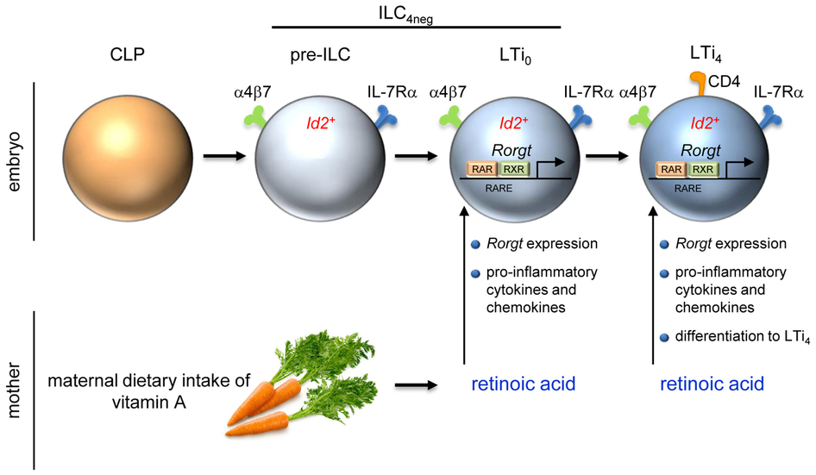
RAR/RXR receptors
- vitamin A and its derivatives: RETINOIDS -
& their role in toxicity

Slide 51
RETINOIDS
Sources: from diet - dietary hormones
Retinyl esters – animal sources
Plant carotenoids
β-karoten
Bond cleavage
Retinol (vitamin A)
atRA – all trans - Retinoic Acid

Slide 52
Retinoids and their functions
Regulation of development and homeostasis in tissues of vertebrates and invertebrates
Development of embryonic, epithelial cells (gastrointestinal tract, skin, bones)
Necessary for vision
Suppressive effects in cancer development
Important for cell growth, apoptosis and differenciation
Antioxidative agent
Affect nervous and immune function

Slide 53
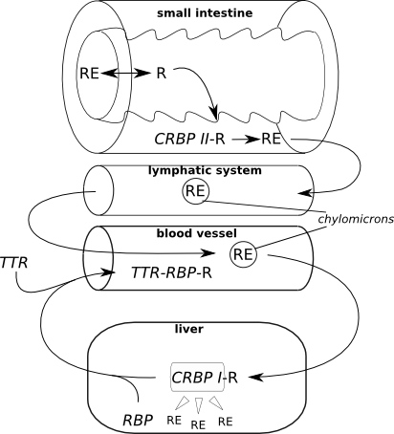
Retinoid transport
RE: Retinol-Ester
R: Retinol
RBP: Retinol Binding
Protein (LMW)
TTR: Transthyrethin
(HMW)

Slide 54
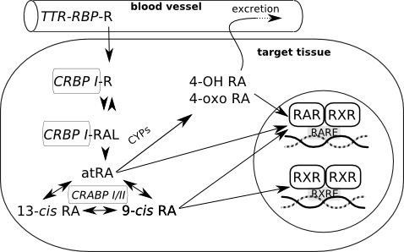
Retinoid fate in the cells
Gene expression
Retinoid binding proteins
CRBP – cellular retinol binding protein
- binding of retinol, immediate decrease of retinol concentration
CRBAP – cellular retinoic acid binding protein
- Controlling the ratio free retinol/free retinoic acid

Slide 55
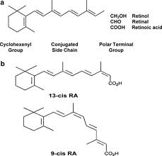
RAR/RXR and RA
Isoforms of RAR a RXR
  Formation of homo- and heterodimers
  48 possible RAR-RXR heterodimers
  → sensitive regulation of gene expression
RXR – heterodimers with other receptors
  VDR, TR, PPAR ... → see crosstalk
RETINOIC ACID (RA)
3 basic subtypes
  all-trans- (ATRA)
  9-cis- and 13-cis-retinoic acid
All-trans RA (ATRA) binds selectively to RAR
Cis RA bind to both receptor types

Slide 56
Disruption of retinoid signalling by xenobiotics
Possible modes of action – disruption of retinoid signalling:
  Metabolization of retinoids by detoxication enzymes
  Disruption of binding retinoids to transport proteins
  Retinoids as antioxidants may be consumed by oxidative stress induced by xenobiotics
  Interference during binding to RAR/RXR
Effects
  Decreased retinoid levels in organisms
    Downregulation of growth factors
    Xerophtalmia, night blindness
    Embryotoxicity, developmental abnormalities
  Increased ATRA concentration
    teratogenic effects

Slide 57
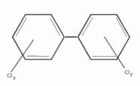

Disruption of retinoid signalling by xenobiotics
Polluted areas
  mostly decrease of retinoid levels
    Documented in aquatic birds, mammals and fish
Disruption of retinoid transport: PCBs
Effects on retinoid receptors:
  RAR, RXR binding and/or transactivation
    pesticides (chlordane, dieldrin, methoprene, tributyltin…)
    Effect on ATRA mediated response – TCDD, PAHs
Disruption of retinoid metabolism:
  PCDD/Fs, PAHs, PCBs, pesticides
  changes of serum concentrations of retinol and RA
  mobilization of hepatic storage forms

Slide 58
AhR (Arylhydrocarbon receptor)
AhR structure
2,3,7,8-TCDD
(dioxin) bound to AhR

Slide 59

AhR
Also known as „dioxin-receptor“ (and its modulation leads to so called „dioxin-like“ activity or toxicity)
Ligand-activated transcription factor
  Similar to all NRs
AhR has effects on many different genes
important mediator of toxicity of POPs – primary target of planar aromatic substances
  regulator of xenobiotic metabolism and activation of promutagens
Crossactivation/crosstalk with other NRs
Strongest known ligand - TCDD
  (not endogeneous !)

Slide 60
AhR regulated genes
Many genes contain xenobiotic response elements (XRE) or dioxin responsive elements (DRE) in their promoter region:
  Detoxification genes phase I enzymes (CYP 1A1, CYP 1A2, CYP 1B1) and phase II enzymes (UDP-glucuronosyltransferase, GST-Ya, NADP(H):oxidoreductase)
    → Detoxification after toxicant exposure
    … also with possible toxic consequences (oxidative stress, activation of promutagens accelerated clearance of hormones)
  Other genes - regulation of cell cycle and apoptosis
    Bax (apoptosis control), p27Kip1, Jun B (MAP-kinase), TGF-b (tumor growth factor)
    → Various adverse toxic effects

Slide 61
Physiological role of AhR
Physiological role for AhR still not known completely (?)
  Most likely – “protection” against toxicants → induction of detoxification
Many adverse effects documented in AhR-deficient mice
  significant growth retardation;
  defective development of liver and immune system;
  retinoid accumulation in liver;
  abnormal kidney and hepatic vascular structures.
  resistant to BaP-induced carcinogenesis and TCDD-induced teratogenesis;
  no inducible expression of CYP 1A1 and 2.
→ this implies presence of natural endogeneous ligand(s)
(not only exogeneous toxicants can bind AhR)

Slide 62


What is the natural (endogenous) physiological ligand of AhR ?
Potential candidate: 6-formylindolo[3,2-b]carbazole (FICZ)

Slide 63

Classical and “non-classical” AhR ligands
Classical = planar structures → direct binding to AhR
Denison & Nagy, Annu. Rev. Pharmacol. Toxicol. 43:309

Slide 64

„Non-classical“ AhR ligands – various structures
“Classical” ligand

Slide 65
Biological responses to TCDD & AhR ligands
Schmidt & Bradfield, Annu. Rev. Cell Dev. Biol. 12:55

Slide 66

Toxic equivalency factors (TEF)/TEQ concept
Toxicity of compounds with similar toxicological properties as TCDD (activating AhR) may be evaluated by TEF/TEQ concept
  TEF = Toxic Equivalency Factor (“characteristic” of the Chemical)
  TEQ = Toxic Equivalent (sum of TEFs x concentrations)
TEFs are consensus values based on REPs (relative potencies) across multiple species and/or endpoints.
  TEFs are based upon a number of endpoints, from chronic in vivo toxicity to in vitro toxicity with the former having the greatest importance in determining overall TEF.
TEQs provide a simple, single number that is indicative of overall toxicity of a sample (water, sediment, food) containing a mixture of dioxins and dioxin-like compounds.
The total potency of a mixture can be expressed in TCDD TEQ concentration
  i.e. TEQ = concentration corresponding to the effect that would be induced by TCDD

Slide 67

Toxic equivalency factors for PCDDs, PCDFs and PCBs:
Eljarrat & Barceló, Trends Anal. Chem.22: 655
Final concentration is expressed as „Equivalents of TCDD“
(e.g. ng TEQ / kg = ng TCDD / kg)

Slide 68
Biomarkers/bioanalytical methods for AhR toxicity
In vivo studies
  liver enlargement, reduction of thymus weight, wasting syndrome, reproductive and developmental disorders
In vivo biomarkers
  EROD activity, CYP 1A1 and 1B1 expression
  (discussed in biomarker section)
in vitro assessment of chemical potencies
  EROD (ethoxyresorufin-O-deethylase activity) in cell cultures;
  CALUX/CAFLUX assays
  (luciferase expression – reporter gene assays)
  GRAB assay (AhR-DNA binding)
  yeast bioassay;
  immunoassays;
  detection of CYP1A mRNA (qPCR) or AhR protein (western blotting)

Slide 69
In vitro CALUX/CAFLUX assays
CALUX – Chemical Assisted Luciferase Expression
DR-CALUX (Dioxin Responsive CALUX)
(i.e. Luciferase Reporter Gene Assay with H4IIE.luc cells)

Slide 70




DETECTION of EROD activity - example

Slide 71
Comparing toxicity of compounds → Application in Risk Assessment
Quantification of effects (EC₅₀)
Comparison with the effect of reference toxicant (2,3,7,8-TCDD)
  → relative potencies (REPs) to TCDD
    (= in vitro “Toxic Equivalency Factors” ~ TEFs)
TCDD: IC₅₀
PAH: IEC₅₀
Relative Potency (REP)
= Induction Equivalency Factor
IEF = IC₅₀ / IEC₅₀
REP interpretation: How many times is the compound "weaker" inducer than TCDD ?
120
TCDD
B[a]P
B[e]P
4´-OH-PCB 79
4´-OH-PCB 3
100
80
AhR-mediated activity (%TCDD-max)
60
40
IEC50 = 2
m
M
20
IC50 = 10 pM
0
1.E-07
1.E-04
1.E-01
1.E+02
concentration (
m
M)

Slide 72

Example - relative potencies of PAHs (two exposure periods)
„CALUX“ assay
Longer period: lower induction due to (partial) metabolization of PAHs (CYPs, oxidation) to products less potent to AhR

Slide 73


Slide 74
Summary – Nuclear receptors
Important physiological functions,
Important roles in pathologies and chemical toxicity (ENDOCRINE DISRUPTION)
NRs with well studied roles in toxicity: ER and AhR
  Other NRs (AR, RAR/RXR, ThR) – important but less explored
All NRs share similar structure and mechanisms of action
  Act as direct transcription factors on DNA
Natural ligands of NRs are small lipophilic hormones
  steroids, thyroids, retinoids
  Various regulatory functions
  Role in toxicity: NR interact with structurally similar xenobiotics
Various mechanisms beyond the toxicity
  Adverse are both STIMULATIONS and INHIBITIONS directly at the receptor site (e.g. “anti-androgenicity)
  Additional mechanisms –in blood (Thyroids), metabolism (Thyroids) clearance (Retinoids), heterodimerization and transport of hormones, “crosstalk” of different NRs
Other key information to remember
  REPORTER GENE ASSAYS (principle, use, what is CALUX?)
  Characterization of chemical “toxic potentials”
    General concept of “REPs” (valid for activation of all NRs)
    Specifically for AhR - concept of TEFs / TEQs

