Slide 1
          Hodnocení a měření zdraví
          Hynek Pikhart
Notes:
The rising expectations of the past 150 years have led to a shift away from viewing health in terms of survival when life expectancy was about 40 years in most countries, through a phase of defining it in terms of freedom from disease, thence to an emphasis on the person’s ability to perform his daily activities, and more recently to an emphasis on positive themes of happiness, social and emotional well-being (pocit pohody), and quality of life.

Slide 2
Outline
What is health and what is population health?
Rate, proportions, incidence and prevalence

Slide 3
What is health?
Health is a multifaceted concept and not easily measurable.
WHO definition:
  Health is a state of complete physical and mental well-being and not merely the absence of disease or infirmity (WHO, 1948)
  stav kompletní fyzické, duševní a sociální pohody a nikoliv pouhé nepřítomnosti nemoci či vady
Notes:
Define ill health, disability,
Hands up if you meet that definition of health?
Is health positive and negative? Can we measure health on a continuum?
Is health different from disease, illness or sickness

Slide 4
Criticisms of the WHO definition
Is it achievable?
Can it be measured?
Change in the burden of health since 1948
But various estimates show that among 70-95% of individuals could be classified as unhealthy on the basis of WHO definition

Slide 5
A better definition?
Bircher (2005): “a dynamic state of well-being characterised by a physical and mental potential, which satisfies the demands of life commensurate with age, culture and personal responsibility”
OR
Huber et al (2011): “the ability to adapt and self manage in the face of social, physical and emotional challenges”
Notes:
Huber: schopnost adaptace tvari v tvar socialnim, fyzickym a emocnim vyzvam.
Vidime, ze ta definice zdravi se stave cim dal vic obecnejsi

Slide 6
What is population health?
“The health outcomes of a group of individuals, including the distribution of such outcomes within the group.” Kinding and Stoddart (2003)
What do we mean by outcomes?
What do we mean by groups?
What do we mean by distribution?

Slide 7
Population health outcomes
Mortality
  Rates of death
  Life expectancy
Morbidity
  Disease: biochemical (e.g. blood glucose), physiological (e.g. blood pressure), and pathological (e.g. tumour size)
  Disability or impairment
  Self-reported and patient-based measures
General and composite measures
Notes:
No single measure can capture the health of the nation
wide array of measures from which to choose.
However, most of the commonly used measures have a shared goal: to meaningfully quantify and summarise some dimension of health or disease in a population.
However, measures such as mortality rates and life expectancy only capture part of a community’s experience of health and disease
- Most health outcome negative, but very few people have these conditions which leaves about 80% population healthy, but we don’t know how healthy.
Have moved on from measuring inputs and throughputs in health systems such as number of people seen within certain time frame because they don’t necessarily mean the population health is better.

Slide 8
Tools of measurement (I)
Numbers – actual number of events
  Example: 100 cases of TB in Camden in 2003

Slide 9
Tools of measurement (II)
Proportion – a type of ratio in which the numerator is included in the denominator, often expressed as a percentage
  Example: proportion of diabetics in the population
Rate – frequency with which an event occurs in a defined population, usually in a specified period of time
  Example: mortality rate in 2014

Slide 10
Numerators and denominators
The number of cancer cases in the UK is 247,667 whereas in Belgium it is 47,948.
The UK has a bigger problem in numerical terms.
But do Belgians have lower risk of getting cancer?
  Numerators alone are meaningless
  We need both numerators AND denominators

Slide 11
Numerators and denominators
The number of cancer cases in the UK is 247,667 whereas in Belgium it is 47,948.
The UK has a bigger problem in numerical terms.
But do Belgians have lower risk of getting cancer?
  Numerators alone are meaningless
  We need both numerators AND denominators
UK: 247 667 / 60 000 000 = 0.00413 = 413 per 100 000
Belgium: 47 948 / 10 000 000 = 0.00479 = 479 per 100 000

Slide 12
Type of rates
Crude rates: apply to the total population in a given area
Specific rates: apply to specific subgroups in the population (e.g. age, sex) or specific conditions
Standardised rates: used to permit comparison of rates in the population in which differ in structure (e.g. age structure)

Slide 13
Population at risk
People who are potentially susceptible to the event
Populations are not static as a result of births, deaths and migration

Slide 14
“Conventional” measures
Prevalence of a disease / exposure
Incidence of a disease
Mortality
  all causes vs. cause-specific rates
  all ages vs. age-specific rates
Life expectancy
  At birth
  At specific age

Slide 15
Prevalence
No. of existing cases / number of persons in study
Per 100 (=%), per 1000 etc

Slide 16
Prevalence
Prevalence
  Frequency of existing cases in a defined population at a given point in time.
  Measure of disease burden
  Can tell us point prevalence: the probability of people with a condition at a given point in time, or over a short period of time, period prevalence
  All person with a condition/total population at risk
  Often expressed per 1000 when frequency is small relative to population

Slide 17

Adult prevalence by BMI status
Health Survey for England (2008-2010 average)
Adult (aged 16+) BMI thresholds
Underweight: <18.5kg/m²
Healthy weight: 18.5 to <25kg/m²
Overweight: 25 to <30kg/m²
Obese: ≥30kg/m²
© NOO 2012
Notes:
Healthy weight prevalence is much lower for men than for women (even though obesity prevalence is marginally higher for women than for men). This is because there is a much higher prevalence of overweight in men than in women.
The published Health Survey for England data used to produce this chart are available from:
http://www.ic.nhs.uk/statistics-and-data-collections/health-and-lifestyles-related-surveys/health-survey-for-england/health-survey-for-england--2010-trend-tables

Slide 18
Incidence
No. of new cases / number of persons in study
Denominator:
  Free of disease at the beginning of follow up
  At risk: can develop the disease (e.g. non-vaccinated)
Per 100 (=%), per 1000 etc.

Slide 19
Incidence
Incidence
  Number of new events in a defined population within a specified period of time.
  Direct measure of risk that healthy people will develop a condition during a specified period of time
  Tells us the rate at which new conditions occur in a defined, previously condition-free group of people
  Number of new cases/ total population at risk
Notes:
Cumulative indicidence and incidence rate

Slide 20
Relationship between prevalence and incidence
The prevalence of a health-related outcome depends both on the incidence rate and the time between onset and recovery or death.
Prevalence = Incidence x Average disease duration
E.g. volume of water in watertank depends on
  Inflow
  Outflow

Slide 21
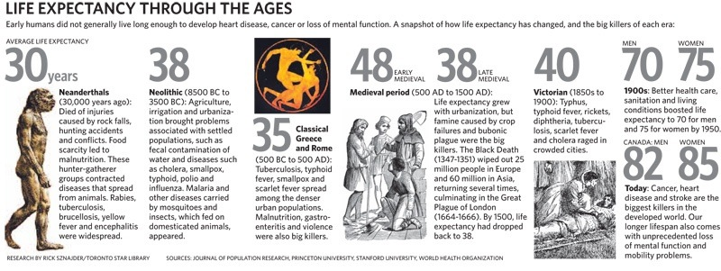
Life expectancy

Slide 22
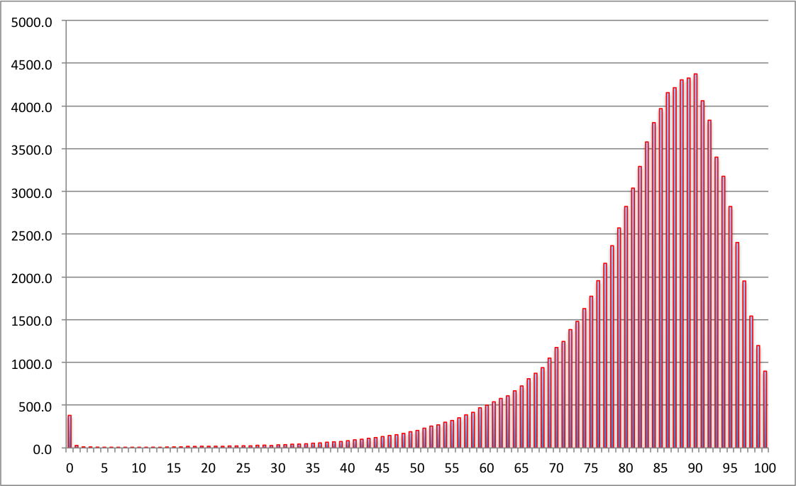
Numbers of women expected to die at each age, out of 100,000 born, assuming mortality rates stay the same as 2010-2012. The expectation is 83 (mean), median 86, the most likely value (mode) is 90.

Slide 23
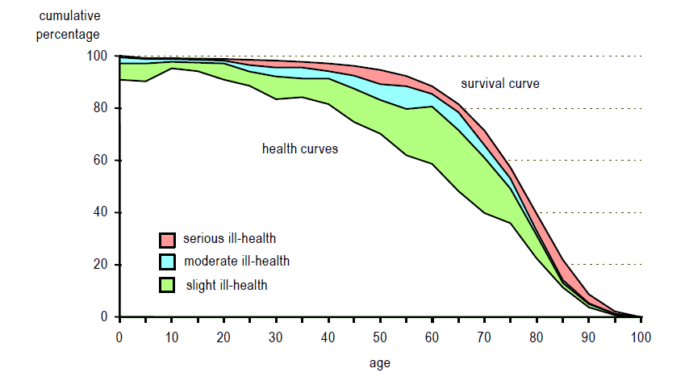
Survival and health curves

Slide 24
Healthy life expectancy (HALE)
Healthy life expectancy (HLE), or health-adjusted life expectancy (HALE) measures the number of years that a person at a given age can expect to live in good health, accounting for mortality and disability
= the average number of years that a newborn can expect to live in "full health"—in other words, not hampered by disabling illnesses or injuries.
Summarises mortality and non-fatal outcomes in a single measure of average population health
Can compare health between countries or measure changes over time
Can inform policy questions dependent on how morbidity changes as mortality decreases

Slide 25
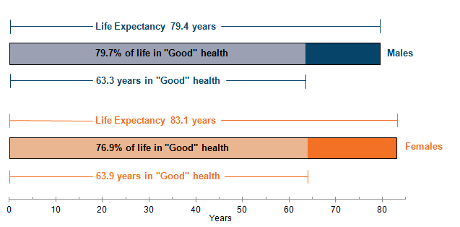
Life expectancy (LE), healthy life expectancy (HLE) and proportion of life in "Good" health for males and females at birth in England, 2011 to 2013 (ONS 2015)

Slide 26
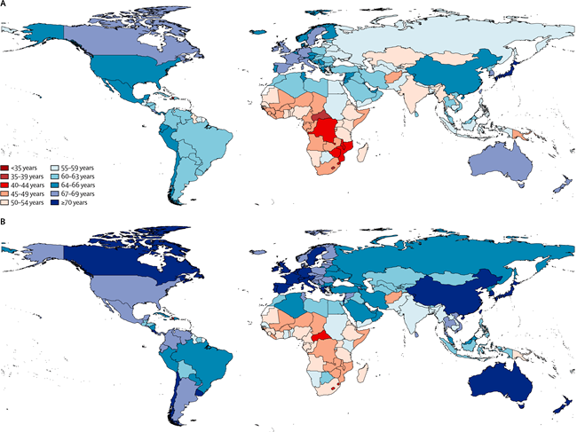
Healthy life expectancy at birth by country, 2010
The Lancet 2012 380, 2144-2162 A – male HALE ; B – female HALE

Slide 27
Epidemiology
The study of the distribution and determinants of the frequency of health-related outcomes in specified populations
Quantitative discipline
Measurement of disease / condition / risk factor frequency is central to epidemiology
Comparisons require measurements

Slide 28
Much of epidemiological research is taken up trying
to establish associations between exposures and disease rates
to measure the extent to which risk changes as the level of exposure changes
to establish whether the associations observed may be truly causal (rather than being just consequence of bias or chance)

Slide 29
Measures of association
Risk of disease, rate of disease in different groups of population
Comparison of risks/rates

Slide 30
Measures of effect
We have 2 groups of individuals:
An exposed group (group with risk factor of interest) and unexposed group (without such factor of interest)
We are interested in comparing the amount of disease (mortality or other health outcome) in the exposed group to that in the unexposed group

Slide 31
Risk ratio
we calculate the risk ratio (RR) as:
RR=r₁/r₀
Risk difference
the absolute difference between two risks (or rates)
RD = r₁ – r₀

Slide 32
Example: cohort study of oral contraceptive use and heart attack
 | Myocardial infarction
 | Yes | No | Total
OC use
Yes | 25 | 400 | 425
No | 75 | 1500 | 1575
Total | 100 | 1900 | 2000
Risk (exposed) = 25/425=0.059
Risk (unexposed) = 75/1575=0.048
Relative risk = 0.059/0.048 = 1.23

Slide 33
Risk or rate difference
Measure of the absolute effect
the absolute difference between two risks (or rates)
RD = r₁ – r₀
Similar for rates = rate difference = incidence rate in exposed – incidence rate in unexposed

Slide 34
Measures of population impact
Population attributable risk (PAR) is the absolute difference between the risk (or rate) in the whole population and the risk or rate in the unexposed group
PAR = r – r₀

Slide 35
Population attributable risk fraction (PARF or PAR%)
It is a measure of the proportion of all cases in the study population (exposed and unexposed) that may be attributed to the exposure, on the assumption of a causal association
It is also called the aetiologic fraction, the percentage population attributable risk or the attributable fraction

Slide 36
If r is rate in the total population
PAF = PAR/r
PAR = r – r₀
PAF = (r-r₀)/r

Slide 37
References
Bircher, Johannes. 2005. “Towards a Dynamic Definition of Health and Disease.” Medicine, Health Care and Philosophy 8(3): 335–41. http://dx.doi.org/10.1007/s11019-005-0538-y.
Huber, Machteld et al. 2011. “How Should We Define Health?” BMJ 343.
Kindig, David, and Greg Stoddart. 2003. “What Is Population Health?” American Journal of Public Health 93(3): 380–83. http://dx.doi.org/10.2105/AJPH.93.3.380.
World Health Organisation (WHO). 1948. Preamble to the Constitution of the World Health Organisation as adopted by the International Health Conference, New York, 19-22 June 1948.

