Slide 1
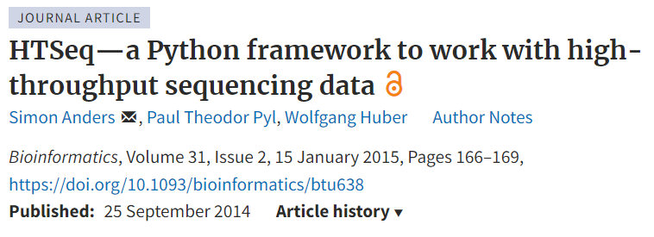


Slide 2
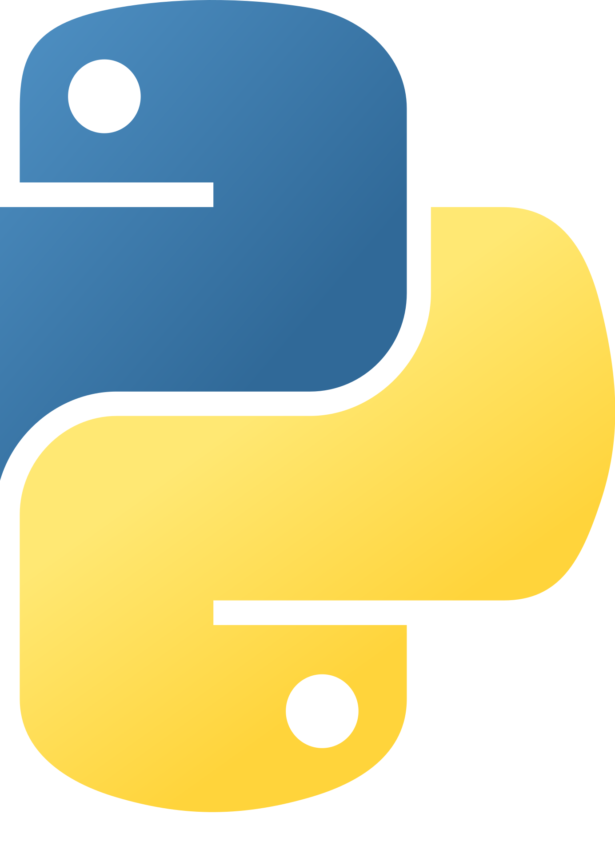

HTSeq – a Python framework
facilitates rapid development of NGS data analysis scripts
initial release in 2010, latest update published 2022
allows users with moderate Python knowledge to create scripts, shields more advanced internals from the user
HTSeq-count – a tool for preprocessing RNA-Seq data for differential expression analysis

Slide 3


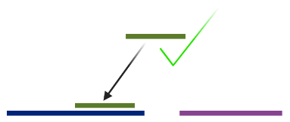
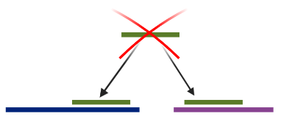
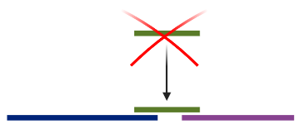
SAM/BAM
GTF/GFF
how many aligned reads overlap exon/union of exons
designed for differential expression analysis
default setting counts unambiguously mapped reads only
discards reads mapping to multiple positions or overlapping multiple features
for pair-end counts fragments, not reads
table with
counts for each feature
special counters (reads that were not counted for any feature)
HTSeq-count
Notes:
Looks like BAM and GFF file types are still an option.
https://htseq.readthedocs.io/en/master/features.html?highlight=gff#HTSeq.GFF_Reader
https://htseq.readthedocs.io/en/master/tutorials/bam_reader.html?highlight=bam

Slide 4
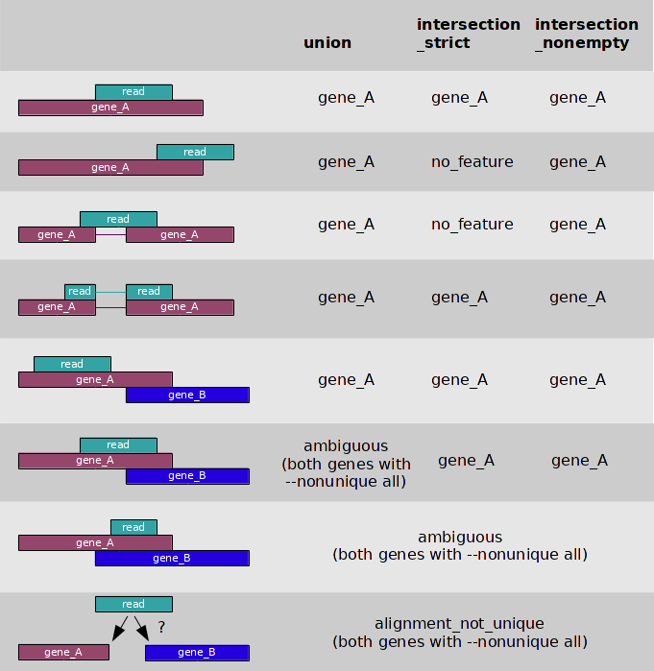
If a read maps on multiple features:
--nonunique none (default)
--nonunique all
--nonunique fraction
--nonunique random

