Slide 1
Cufflinks
Peter Guman

Slide 2
Cufflinks
Open-source software developed by laboratories at UC Berkeley and Johns Hopkins University
Cufflinks may be:
  name of the RNA-Seq workflow: together with read mapper TopHat, tools Cuffmerge, Cuffdiff or Cuffnorm
  name of the standalone tool used for the assembly of mapped reads to assemble transcriptomes and evaluate the expression
  developed mainly in C++ and C languages allowing to have low-level control and optimized performance

Slide 3
What does Cufflinks do?
After the mapping phase of RNA-Seq workflow: assembly of different transcriptions/alternative splicings
Takes input: aligned reads in SAM/BAM file format
Produces output:
  Transcriptome assembly in GTF/GFF format. It has isoforms produced by Cufflink with 7 standard GTF columns with optional information about genes and transcripts.
  Transcript-level expression in FPKM Tracking file format contains isoform-level expressions.
  Gene-level expression in FPKM Tracking file format on the gene level.
Optional: give the Cufflinks tool additional reference annotation. This way, Cufflinks can improve already known references.

Slide 4
Cufflinks algorithm
Creation of tree: Compatible fragments are connected when they are compatible*, and they have overlap in the genome
'incompatible’ fragments must have come from differently spliced isoforms
isoform transcripts are generated, and an estimation of abundance follows. Estimation is based on the assumption that the probability of observing each function is linear to the abundance of transcripts of their origin.
*according the Dilworth's Theorem

Slide 5
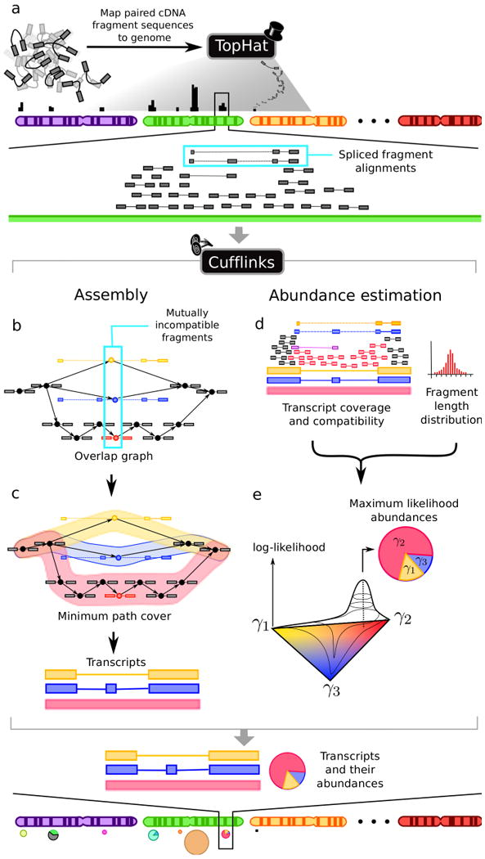

Slide 6
Assembler
Basic Cufflinks assembler creates Directed Acyclic Graph from the reads and finds the shortest path between them (in a maximum parsimony fashion). Does not need a prior reference annotation.
reference annotation-based transcript (RABT) assembly is an improved algorithm. It requires additional annotation of the already known genome.

Slide 7
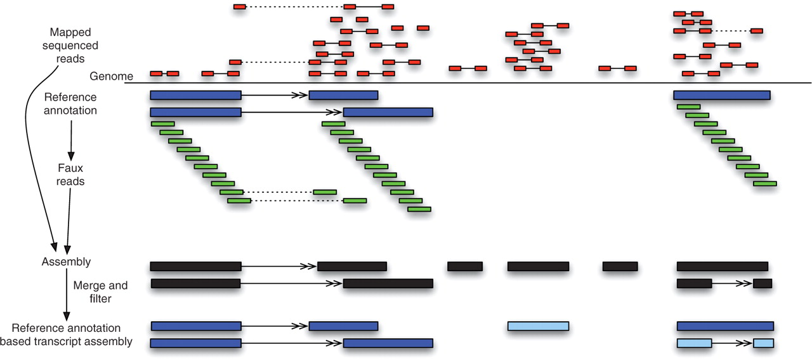
Fig. 2. An overview of our RABT assembly method. First paired-end reads (mates shown connected by solid lines) are ...
Notes:
Fig. 2. An overview of our RABT assembly method. First paired-end reads (mates shown connected by solid lines) are mapped to the genome using a spliced read mapper that can map reads across junctions (shown in dotted lines). The reference annotation (blue) is used to generate faux-read alignments that tile the transcripts (green). The faux-read alignments are used together with the spliced read alignments to generate a reference genome-based assembly (black). This assembly is merged with the reference annotation, and ‘noisy’ read mappings are filtered resulting in all reference annotation transcripts in the output (blue) as well as novel transcripts (light blue).
Unless provided in the caption above, the following copyright applies to the content of this slide: © The Author 2011. Published by Oxford University Press. All rights reserved. For Permissions, please email: journals.permissions@oup.com© The Author 2011. Published by Oxford University Press. All rights reserved. For Permissions, please email: journals.permissions@oup.com

Slide 8
Recources
Adam Roberts, Harold Pimentel, Cole Trapnell, Lior Pachter, Identification of novel transcripts in annotated genomes using RNA-Seq, Bioinformatics, Volume 27, Issue 17, 1 September 2011, Pages 2325–2329, https://doi.org/10.1093/bioinformatics/btr355
Trapnell C, Williams BA, Pertea G, Mortazavi A, Kwan G, van Baren MJ, Salzberg SL, Wold BJ, Pachter L. Transcript assembly and quantification by RNA-Seq reveals unannotated transcripts and isoform switching during cell differentiation. Nat Biotechnol. 2010 May;28(5):511-5. doi: 10.1038/nbt.1621. Epub 2010 May 2. PMID: 20436464; PMCID: PMC3146043.
official site: cole-trapnell-lab.github.io/cufflinks/

