Slide 1
mmquant
Veronika Chalupová & Hana Boháčová

Slide 2
mmquant
A tool to quantify gene expression
Published on: 15 September 2017 by Matthias Zytnicki
Last upload: 8 months and 28 days ago
version: 1.3
Language used: C++
Operating system: Linux; Mac OS X

Slide 3
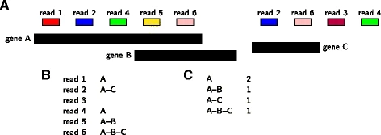
How does it work
- this tool counts with duplicated genes: if read maps to different positions, corresponding genes are duplicated -> this tool then creates a merged gene
- by default, the method supposes that reads have been sorted beforehand
- if not: genes are sorted into a vector, cutted into non-overlapping bins and index is given to the first gene in bin; then for each read genes are scaned starting from first gene in bin

Slide 4
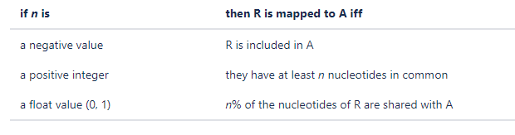
1. step of genes quantification
= searching for reads matching genes
The way a read R is mapped to a gene A depends on the -l n value set by user:
- if read is mapped to several locations, the tool sets NH tag of SAM/BAM file to value >1
  htseq-count: union / intersection-strict / intersection-nonempty
  mmquant: -l 1 / -l -1 / no alternative (ambiguous reads are discarded)

Slide 5
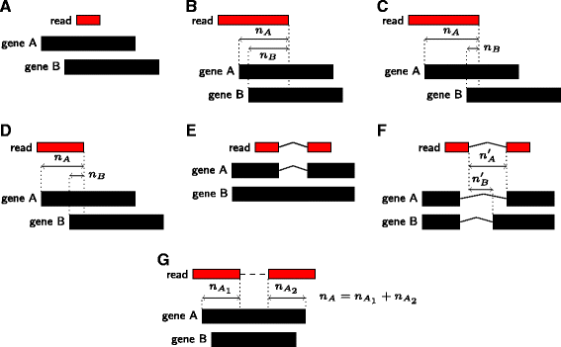
2. step of genes quantification
= resolving ambiguities
- when read matches several genes, some can be discarded depending on number of overlapping base pairs
-d n computes the differences of overlapping nucleotides (N_A, N_B). If N_A ≥ N_B + n, then the read will be attributed to gene A only.
-D m compares the ratio of overlapping nucleotides. If N_A / N_B ≥ m, then the read will be attributed to gene A only.
  - featureCounts: option largestOverlap (assigns to the gene read with largest number of overlapping bases)
  - mmquant: emulates this strategy by –d and –D parameters

Slide 6
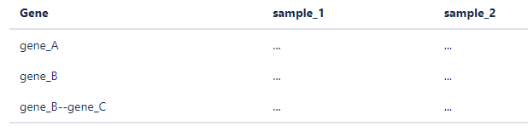
Input Output
Compulsory options:
  annotation file in GTF format
  reads in BAM/SAM format
The output is a tab-separated file. It also provides output stats on hits.

Slide 7
Comparison with other tools
• time:
  the fastest: featureCounts
  also fast: mmquant
  slowest: htseq-count
• number of expressed genes given by each tool is comparable
  but multi-mapping genes could provide up to 25% of new genes
  without them the results could be biased

Slide 8
Thank you for your attention

