Slide 1

Mesozoic

Slide 2
Conodonts – end Triassic extinction.
Actinopterygii
In Triassic Holostei domination. In Jurassic expansion of Teleostei which become the dominant
Fish group. Other groups of actinopterygii retreat. In Cretaceous e.g. Paleoniscida become extinct.
Chondrostei – dominat late Paleozoic fish group
Actinopterygii
Holostei- dominant in Triassic
Teleostei- dominant since Jurrasic
Sharks – In Triassic important hybodonts, button-like teeth, crushing of bivalve test. In Jurassic
expansion. And modern families appear. In Cretaceous 12 of 16 recent families.
Cretoxyrhina was one the largest sharks of its time, reaching lengths of up to 7 metres (23 ft)^{[4]} and was a chief predator in its ecosystem, preying on a variety of marine animals, including marine reptiles like mosasaurs and plesiosaurs, and other large fish
Tertiary – Carcharodon megalodon – 20m.
Megalodon byl v kompetičním vztahu s kytovci lovícími jiné velryby, kteří možná přispěli k jeho vyhynutí. Vzhledem k tomu, že žil primárně v teplých vodách, za jeho vyhynutí mohl i nástup ledové doby či ochlazení oceánů.
Crossopterygii, Dipnoi – Triassic last system in which higher representation
Today – „living fossils“

Slide 3
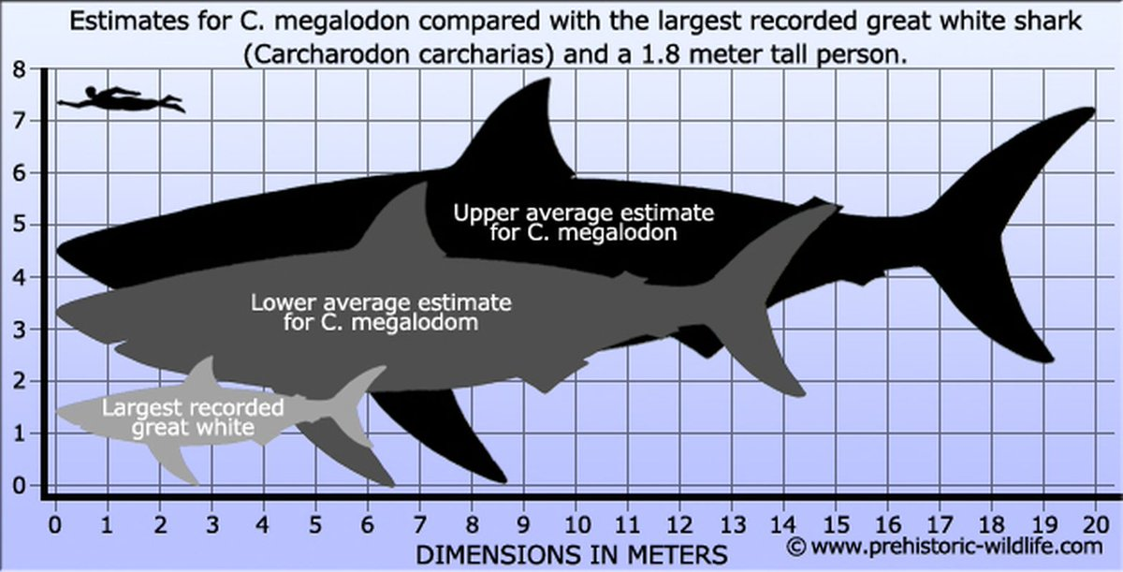

Slide 4
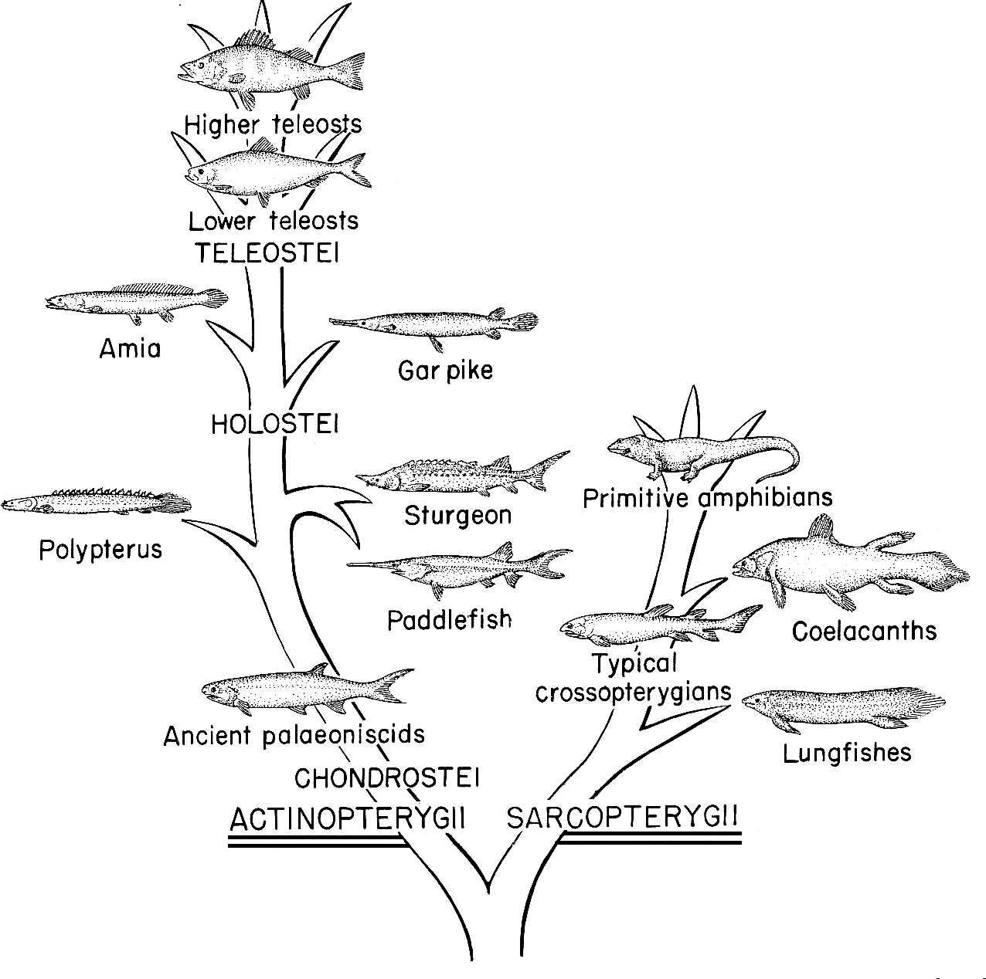
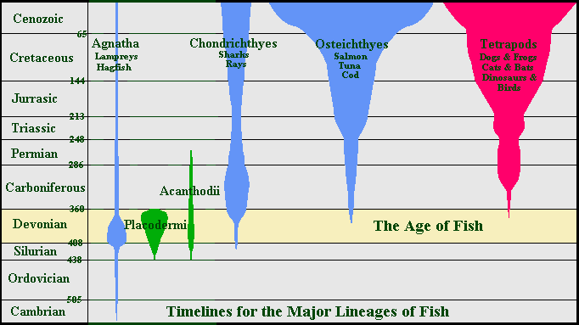

Slide 5
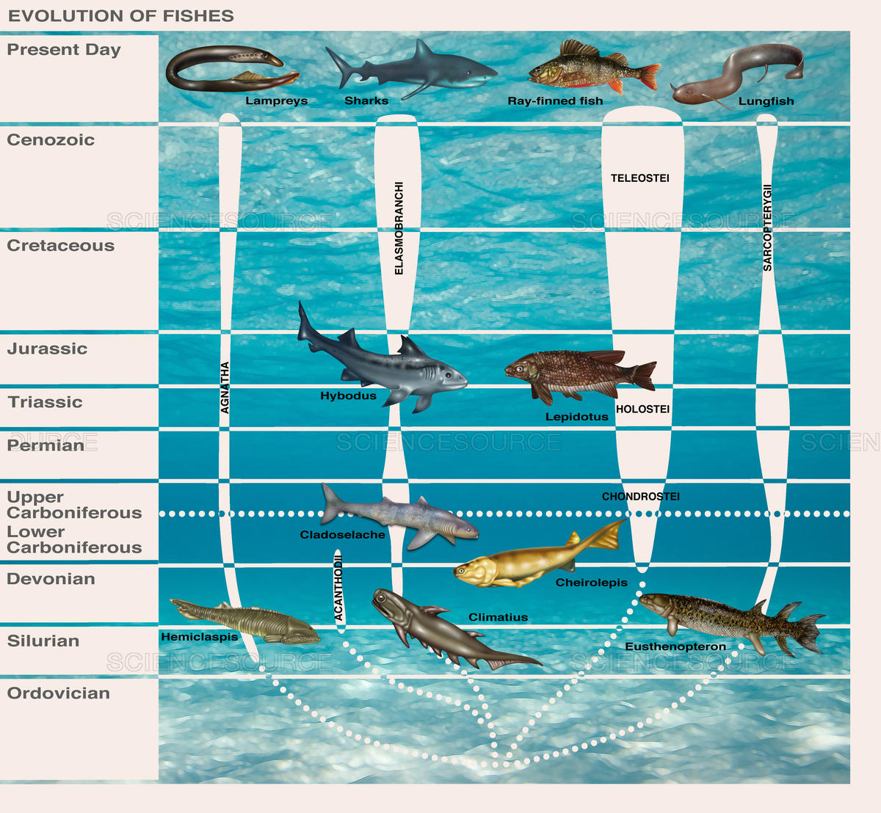

Slide 6
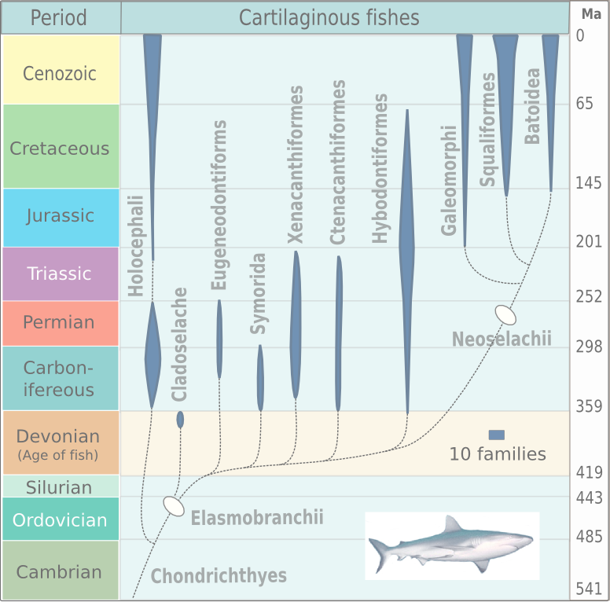

Slide 7
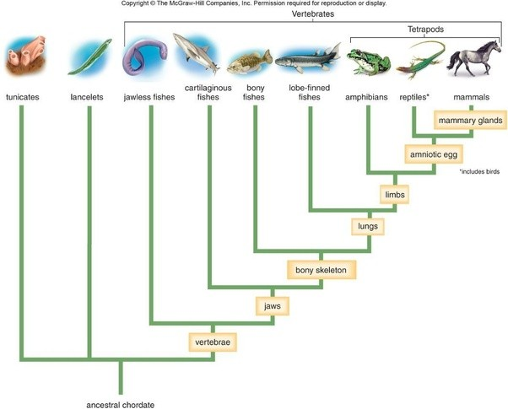

Slide 8
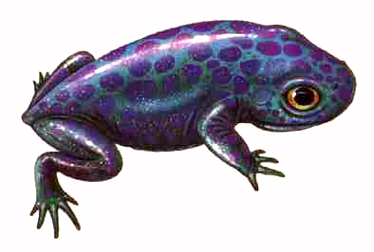
Amphibians – in Triassic still Paleozoic group Temnospondyli, retreat and end Triassic extinction,
reduced survival till mid Jurassic. New modern groups appear in Triassic.
First frogs (Anura)– Triadobatrachus massinoti Gradual entry of other modern groups in Jurassic and
Cretaceous.
Furtehr groups of modern amphibians –Caudata- salamanders (mloci), Gymnophiona (červoři)

Slide 9
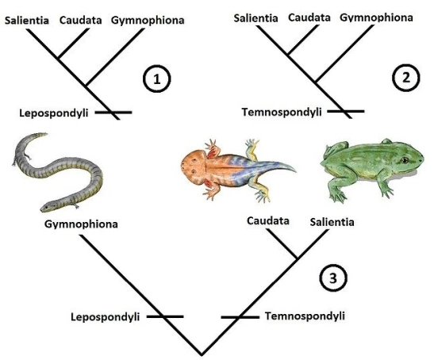
červoři
mloci
žáby

Slide 10
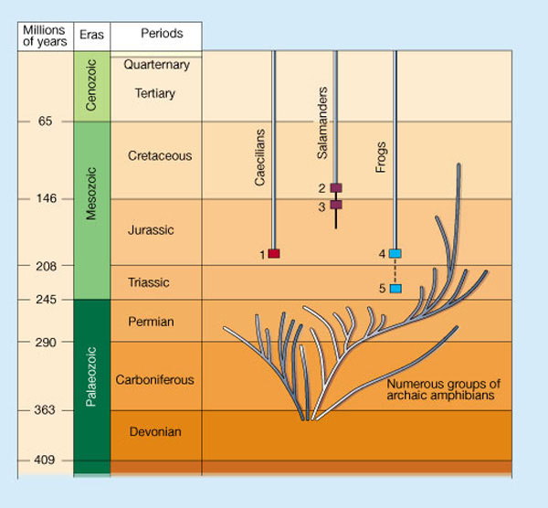
Gymnophiona

Slide 11
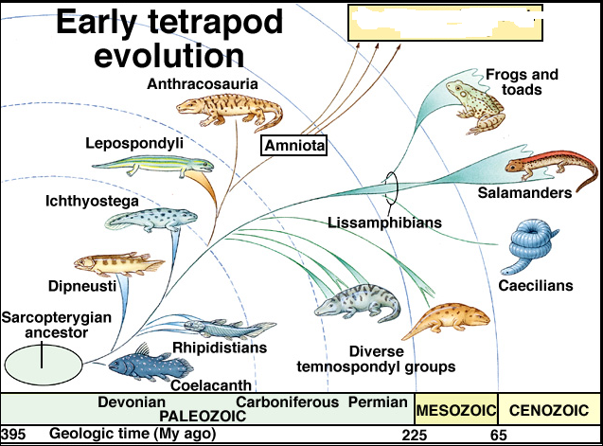
Gymnophiona

Slide 12
Anapsids, diapsids, euryapsids
Reptile Subclasses:
1 – Anapsida
O. Cotylosauria- stem reptiles
O. Chelonia - turtles & tortoises
unchanged for about 175 million years
identified by bony dermal plates to which ribs & trunk vertebrae are fused
2 - Lepidosauria
O. Rhynchocephalia (Sphenodonta) - only living representative is the Tuatara(hatérie)
O. Squamata - lizards, geckos, & snakes
3 -Archosauria
O. Thecodontia – stem archosaurs
O. Pterosauria
O. Saurischia- 2 major groups: sauropods & theropods
O. Ornithischia
O. Crocodilia
4 - Euryapsida - marine reptiles, includes the plesiosaurs & ichtyosaurs
Dinosauria

Slide 13
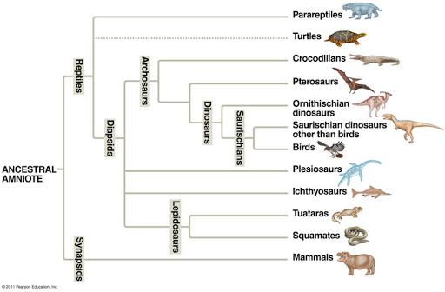
Anapsida
Euryapsids

Slide 14
2 - Lepidosauria
O. Rhynchocephalia (Sphenodonta) - only living representative is the Tuatara
O. Squamata - lizards, geckos, & snakes
3 -Archosauria
O. Thecodontia – stem archosaurs
O. Pterosauria
O. Saurischia- 2 major groups: sauropods & theropods
O. Ornithischia
O. Crocodilia
4 - Euryapsida - marine reptiles, includes the plesiosaurs & ichtyosaurs
Lepidosaurs – radiation at the beginning of Triassic, Small lizard-like reptiles. Predecessors of thecodonts (Permian) and Squamata (Triassic)
Thecodonts – wide expansion in early and middle Triassic. End Triassic extinction (dinosaurs?)
Postosuchus was one of the largest carnivorous reptiles during the late Triassic
Crocodiles – Triassic, thecodont predecessors. Originally land animals, secondary to water environment.
Great expansion in Jurassic, mostly in seas. In Cretaceous gigantic forms as 15m Phobosuchus.

Slide 15
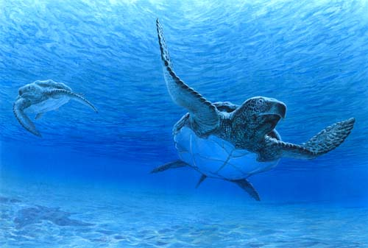
Land Reptiles
Cotylosaurs – end Triassic extinction
Chelonia – originally terrestrial animals, late Jurassic transition tomarine environment.
Cretaceous – 4m Archelon

Slide 16
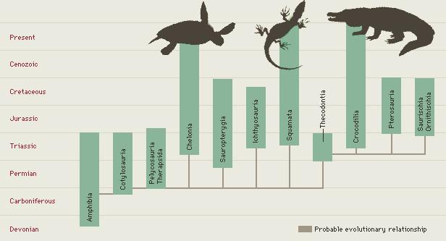

Slide 17
Squamata(šupinatí) - lizards, geckos, & snakes
Snakes
Snakes are thought to have evolved from either burrowing or aquatic lizards, perhaps during the Jurassic period, with the earliest known fossils dating to between 143 and 167 Ma ago.[10] The diversity of modern snakes appeared during the Paleocene epoch (c 66 to 56 Ma ago, after the Cretaceous–Paleogene extinction event).

Slide 18
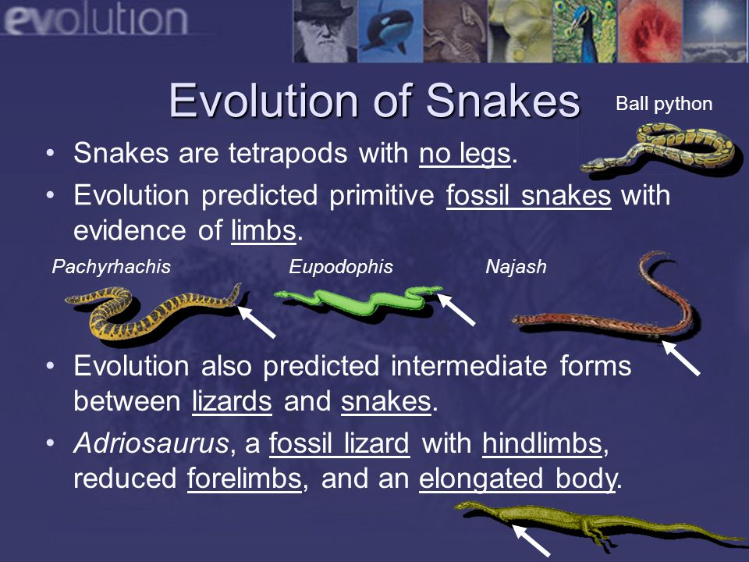

Slide 19
Lizards
The earliest known fossil remains of a lizard date to the Late Triassic. Mosasaurs probably evolved from an extinct group of aquatic lizards known as aigialosaurs in the Early Cretaceous. During the last 20 million years of the Cretaceous period (Turonian–Maastrichtian ages), with the extinction of the ichthyosaurs and pliosaurs, mosasaurs became the dominant marine predators. They became extinct as a result of the K-Pg event at the end of the Cretaceous period, about 66 million years ago

Slide 20
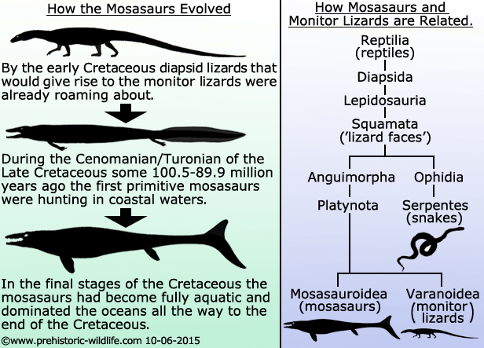

Slide 21
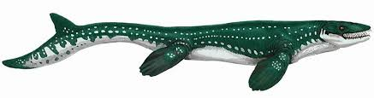
Mosasaurs - Cretaceous
The early ancestors of mosasaurs probably fed in the ocean and returned to land much like the marine iguanas that are found today in the Galapagos Islands. Over a relatively short period of time, however, these ancestral mosasaurs became larger and more specialized, evolving rapidly into several genera of highly successful predators. By the beginning of Coniacian time (about 90 million years ago - mya), there were three major genera (Tylosaurus, Platecarpus and Clidastes) living in the Western Interior Seaway. Tylosaurs - by the Campanian, Tylosaurs were even larger (13-14 meters) and many more species were making their appearance. Within the space of a few more million years, by Maastrichtian time (70 mya), mosasaurs were truly huge, with several lineages (Mosasaurus and Hainosaurus – a close relative of Tylosaurus) reaching nearly 15 meters (50 feet). One giant specimen (Hainosaurus bernardi) found in Europe was 17 meters (almost 55 feet) in length. There was no doubt who were the biggest and baddest predators in the oceans 70 million years ago.
Sea Dragons

Slide 22
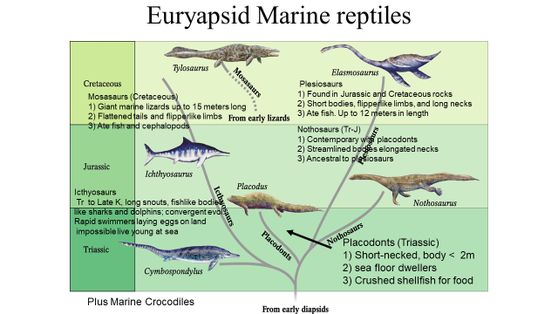

Slide 23
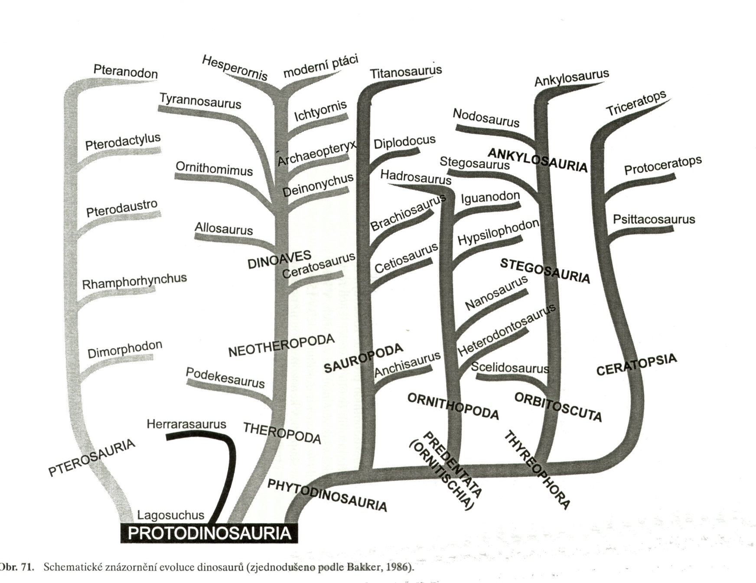
Dinosauria
Saurischia-plazopánví
Ornitischia - ptakopánví

Slide 24
Aves

Slide 25
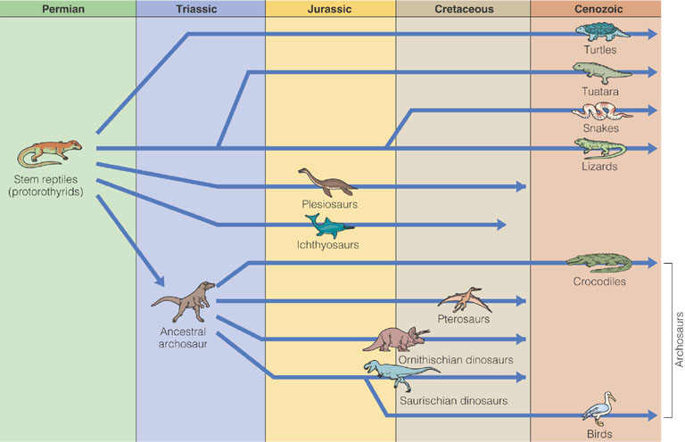
Reptiles and Birds
Relationships among fossil and living reptiles and birds

Slide 26
Sauriurae (oposite birds) - ? Archeopteryx(Jurrasic),Confuciusornis
(Jurrasic-Cretaceous)
Ornithurae (modern birds) – Hesperornis, Ichtyornis (Cretaceous)

Slide 27
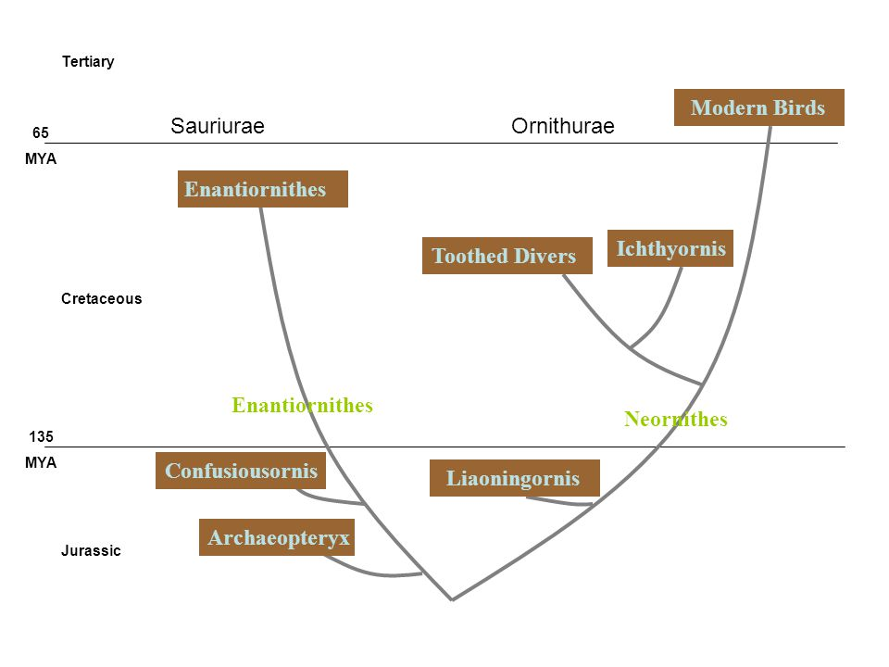

Slide 28
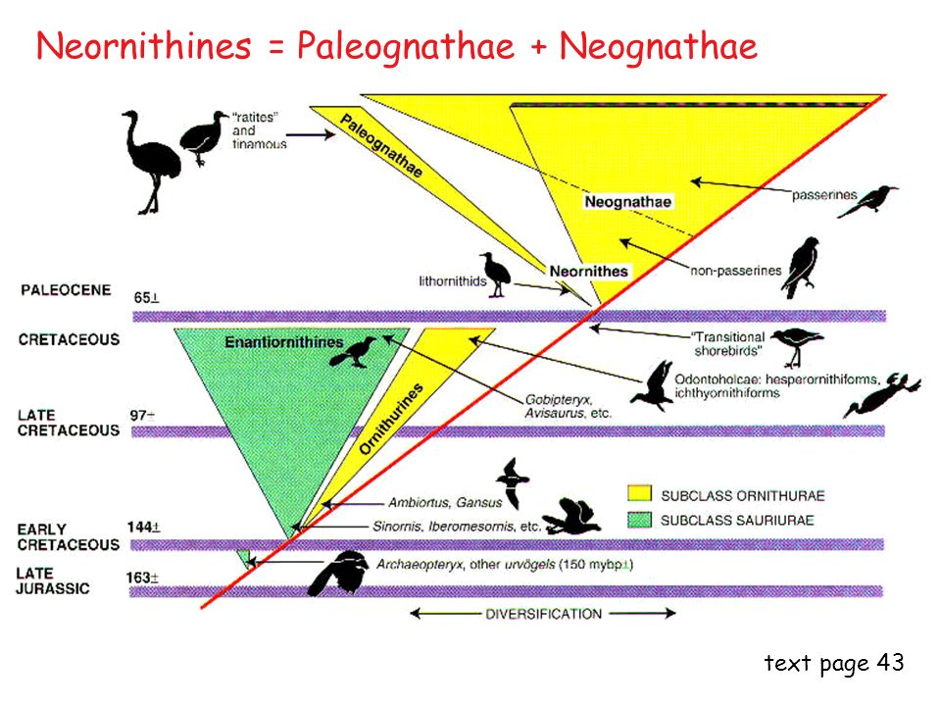

Slide 29
Euryapsids
Euryapsid Include Ichthyopterygia and Sauropterygia (nothosaurs and plesiosaurs). convergence, not common ancestry; derived from diapsid.]
Sauropterygia – Placodontia
Notosauria
Plesiosauria

Slide 30
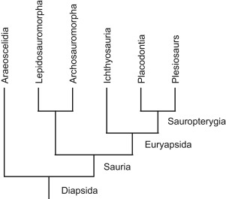

Slide 31
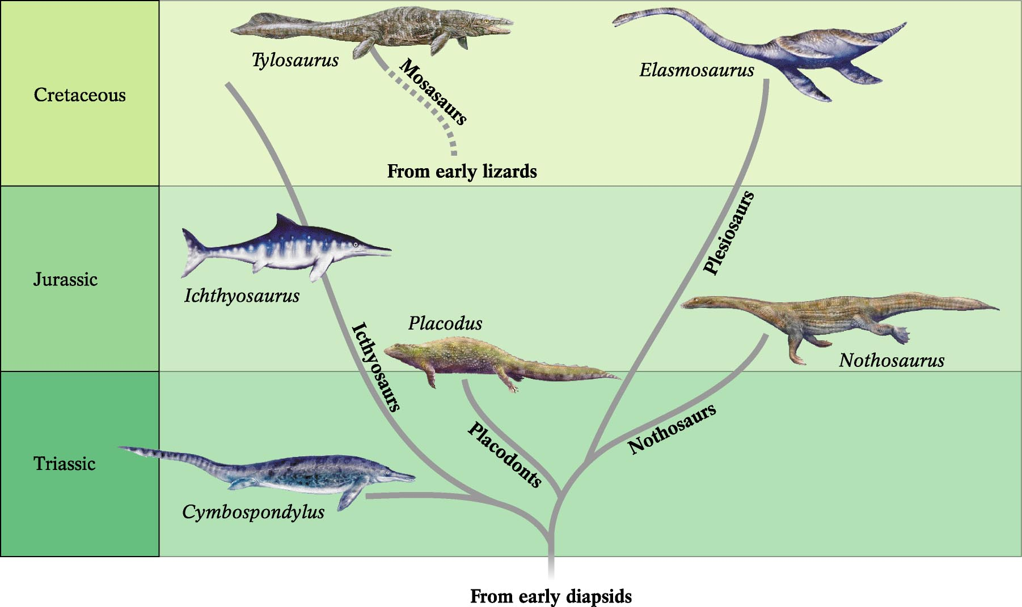
Euryapsid Marine reptiles
Plesiosaurs
1) Found in Jurassic and Cretaceous rocks
2) Short bodies, flipperlike limbs, and long necks
3) Ate fish. Up to 12 meters in length
Mosasaurs (Cretaceous)
1) Giant marine lizards up to 15 meters long
2) Flattened tails and flipperlike limbs
3) Ate fish and cephalopods
Nothosaurs (Tr-J)
1) Contemporary with placodonts
2) Streamlined bodies elongated necks
3) Ancestral to plesiosaurs
Icthyosaurs
Tr to Late K, long snouts, fishlike bodies
like sharks and dolphins; convergent evol.
Rapid swimmers laying eggs on land
impossible live young at sea
Placodonts (Triassic)
1) Short-necked, body < 2m
2) sea floor dwellers
3) Crushed shellfish for food
Plus Marine Crocodiles

Slide 32
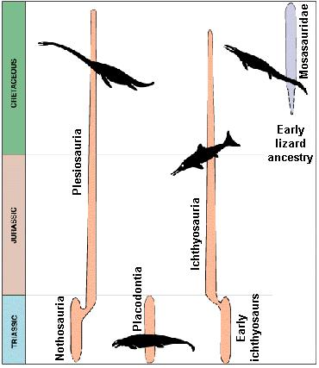

Slide 33
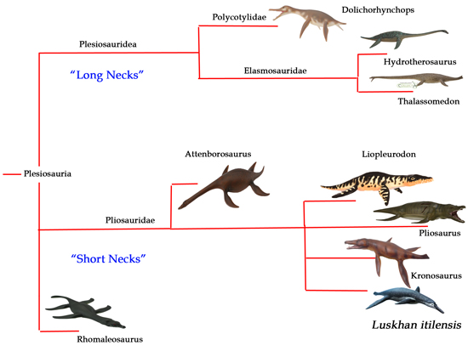

Slide 34
Ichthyosaurs and plesiosaurs had inhabited the oceans since the Triassic, evolving into many diverse forms and surviving several major extinction events. For unknown reasons, ichthyosaurs declined significantly in early Cretaceous and are thought to have been extinct by the time that the earliest mosasaurs re-entered the water. Plesiosaurs were also less numerous in the late Cretaceous than during the Jurassic, and had evolved into some very specialized forms like the long-necked Elasmosaurus (13.7 meters). Even the short-necked plesiosaurs (pliosaurs) were much smaller than their Jurassic cousin, Liopleurodon, and an early Cretaceous relative, Kronosaurus (10m). It is possible that both the ichthyosaurs and the plesiosaurs were losing the evolutionary battle of "who eats who" to faster, giant Ginsu sharks (Cretoxyrhina mantelli). The world-wide domination that mosasaurs in the late Cretaceous.

Slide 35
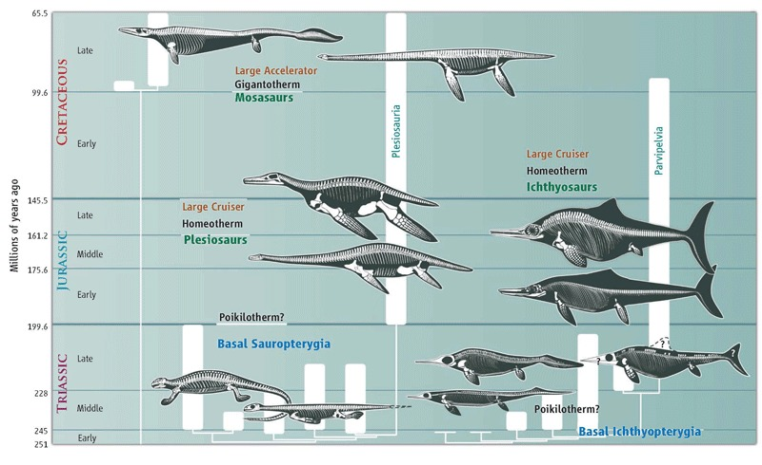

Slide 36
Synapsids
Therapsida
Mammalia

Slide 37
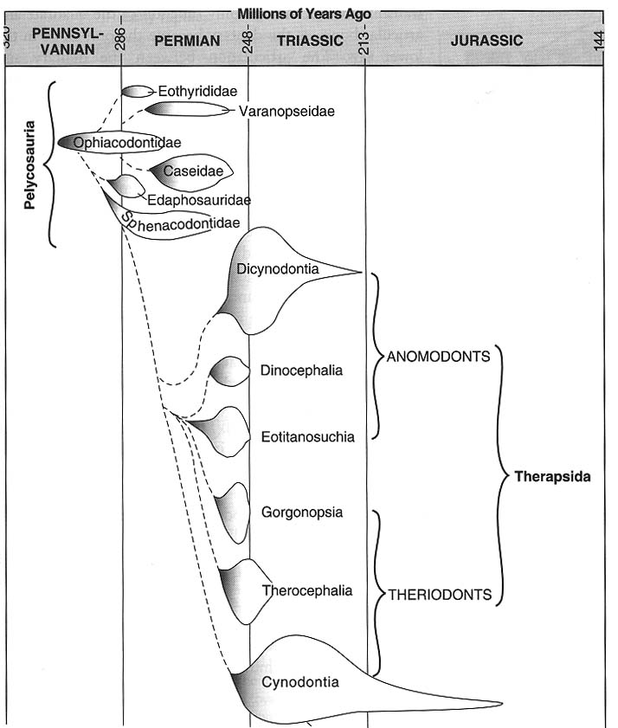
Geological Time
and the
Evolution of
Mammals:
Pelycosaurs
Therapsids
Cynodontia:
the transitional
Infraorder
Mammals
Fig 4.2, Feldhamer

Slide 38
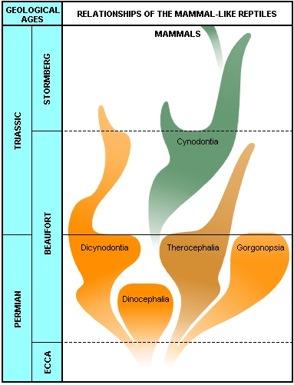
Diagram showing the relationships between the various mammal-like reptiles. Mammal-like reptiles did not survive beyond the end of the Triassic period, but one group, the Cynodontia, gave rise to the first mammals at the end of the Triassic, about 200 million years ago

Slide 39
Mammals

Slide 40
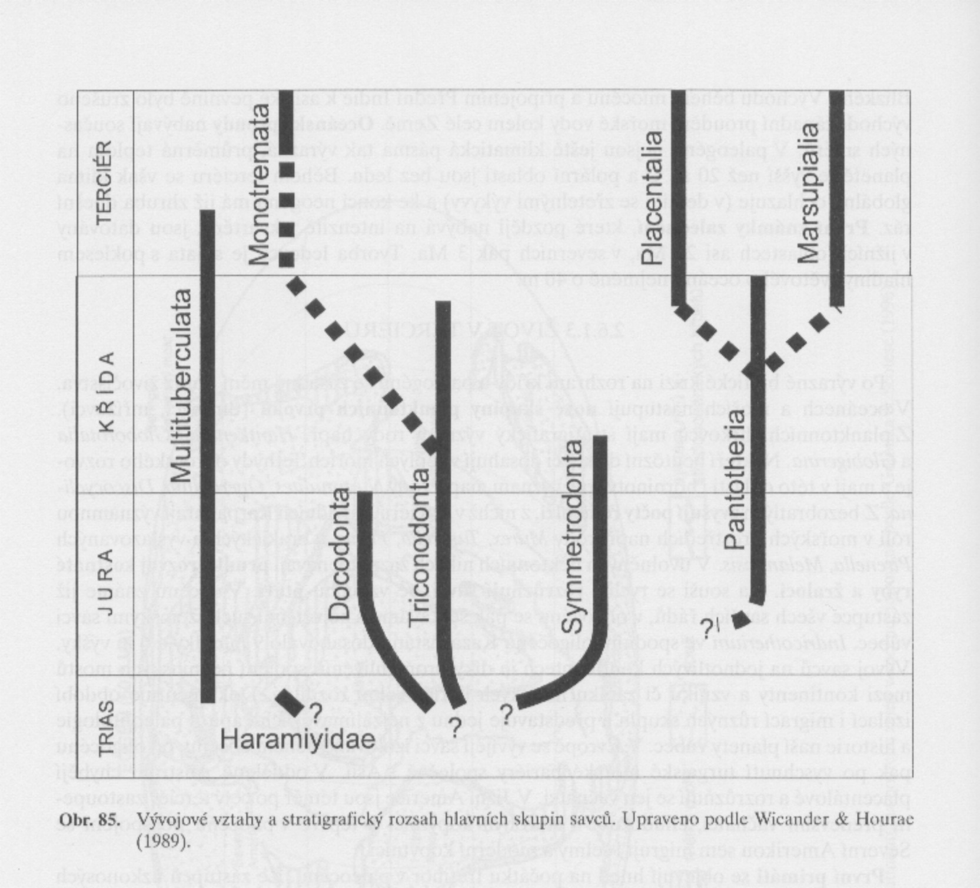
Prototheria
(Vejcorodí)
Theria
(Živorodí)

Slide 41
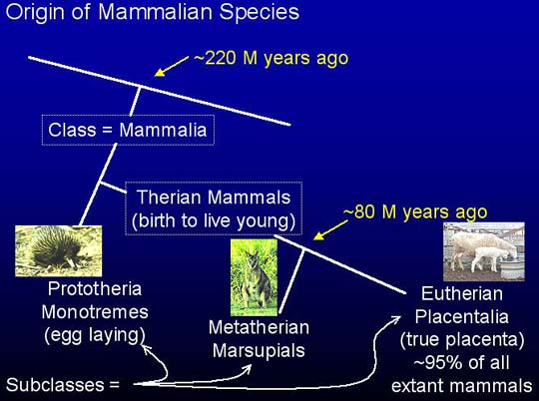
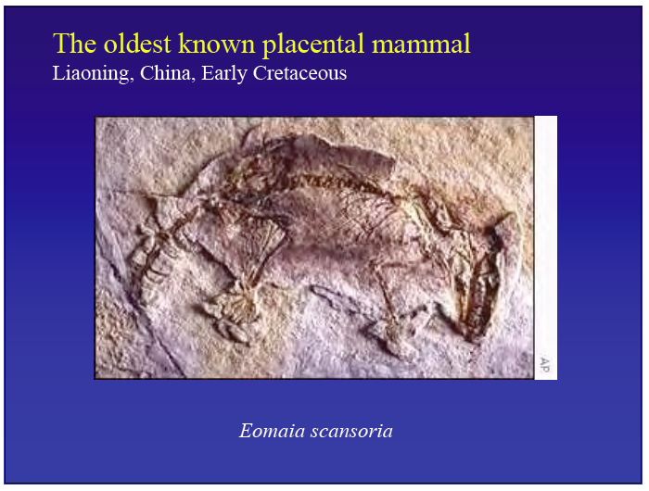

Slide 42
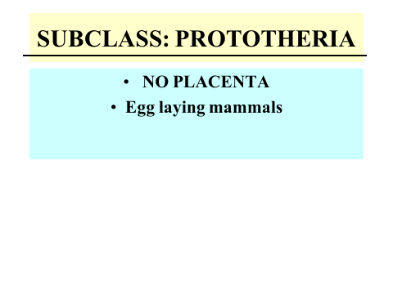

Slide 43
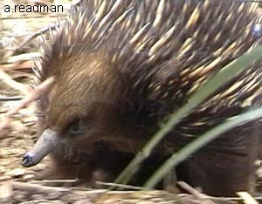
Monotremata
Oviparous egg laying mammals
Only 3 in existence
Duck-billed platypus and two species of spiny anteaters called echidna.
Not completely endothermic (their body temperature is lower and fluctuates more than other mammals)
Ježura
43
Notes:
43

Slide 44
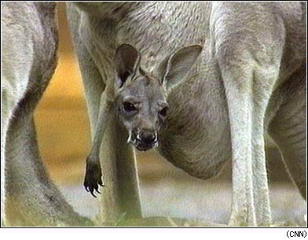
Marsupials
Marsupials give birth to tiny immature young that crawl to a pouch on the mothers belly immediately after they are born.
44
Notes:
44

Slide 45
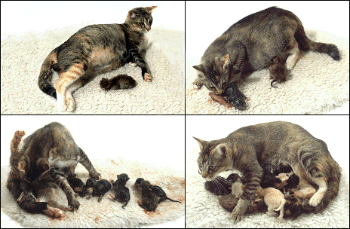
Characteristics of Placentals
Placental mammals carry unborn young in the uterus until young can survive in the wild.
Oxygen and nutrients are transferred from mother’s blood to baby’s blood
45
Notes:
45

Slide 46
