Slide 1
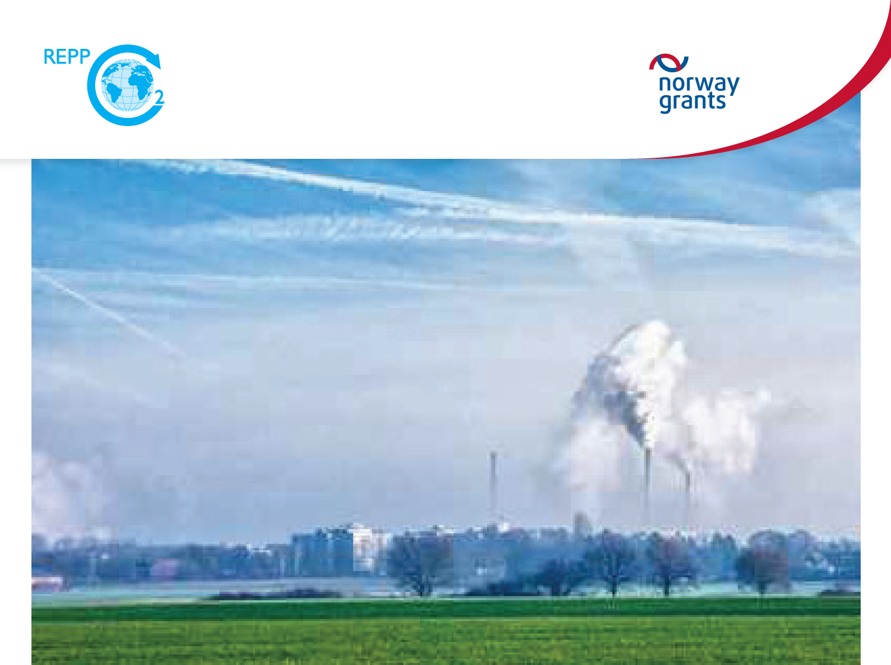

Preparation for a pilot project of CO2 geological storage in the Czech Republic
Baseline monitoring of CO2 and methane for risk assessment of a future pilot CCS site LBr-1: relationship to the residual oil and gas field saturation
J. Francu¹, V. Hladik¹, F. Buzek¹, O. Prokop¹, L. Jurenka¹, V. Kolejka¹, M. Pereszlenyi ¹, and E. Ford²
¹ Czech Geological Survey (CGS), ² International Research Institute of Stavanger (IRIS)
Norway Grants
Trondheim CCS, 13 June, 2017

Slide 2
Principle steps in Soil Gas Baseline Monitoring
Screening soil gas measurements
Finding elevated CO₂ and CH₄
Instalation of automatic stations
4. Meteo data
5. Soil and subsoil clay/sand content
6. Old wells and abandoned oil/gas field
7. Ground water level
8. Isotopes
9. Background values and Anomalies

Slide 3
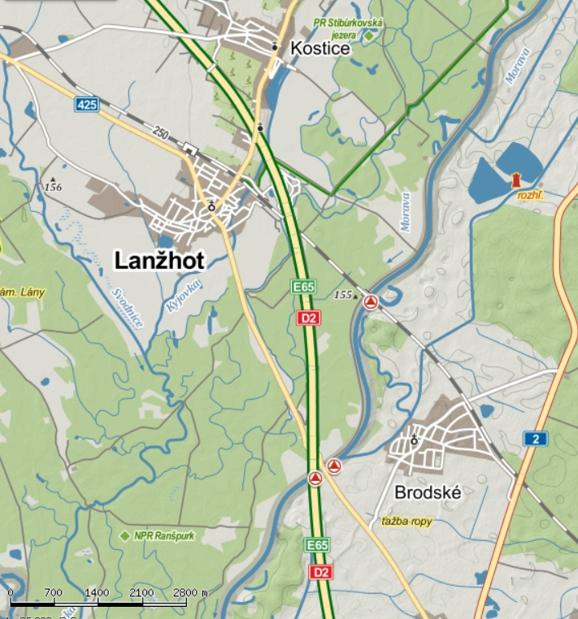
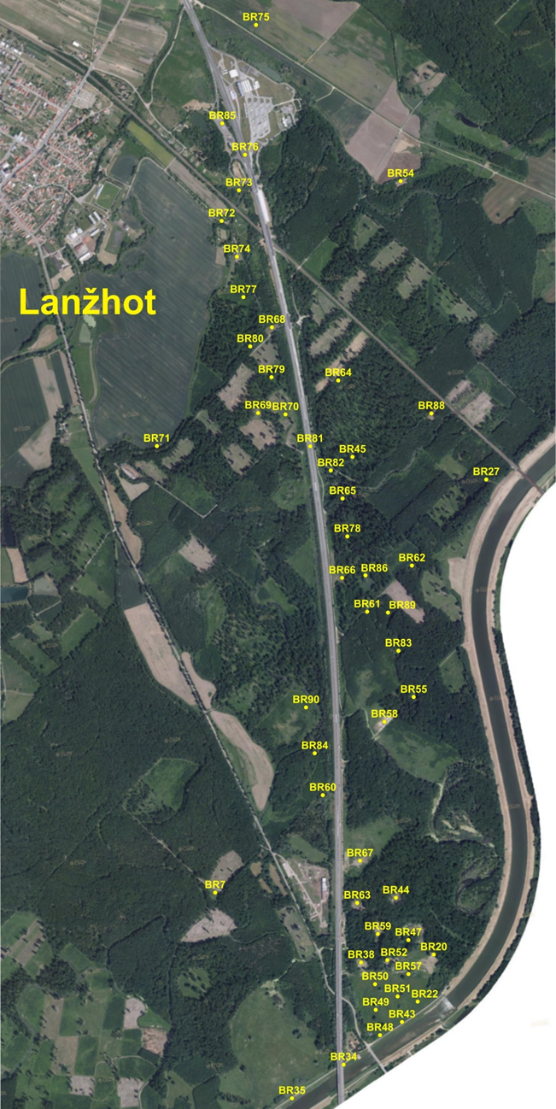
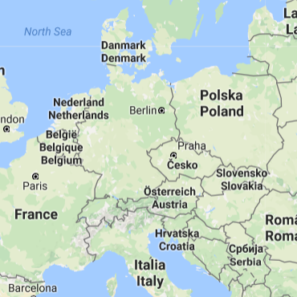
LBr-1 CO₂-Storage Complex Well locations and 3D seismics
Three state borderlines Czech R. – Slovakia - Austria

Slide 4
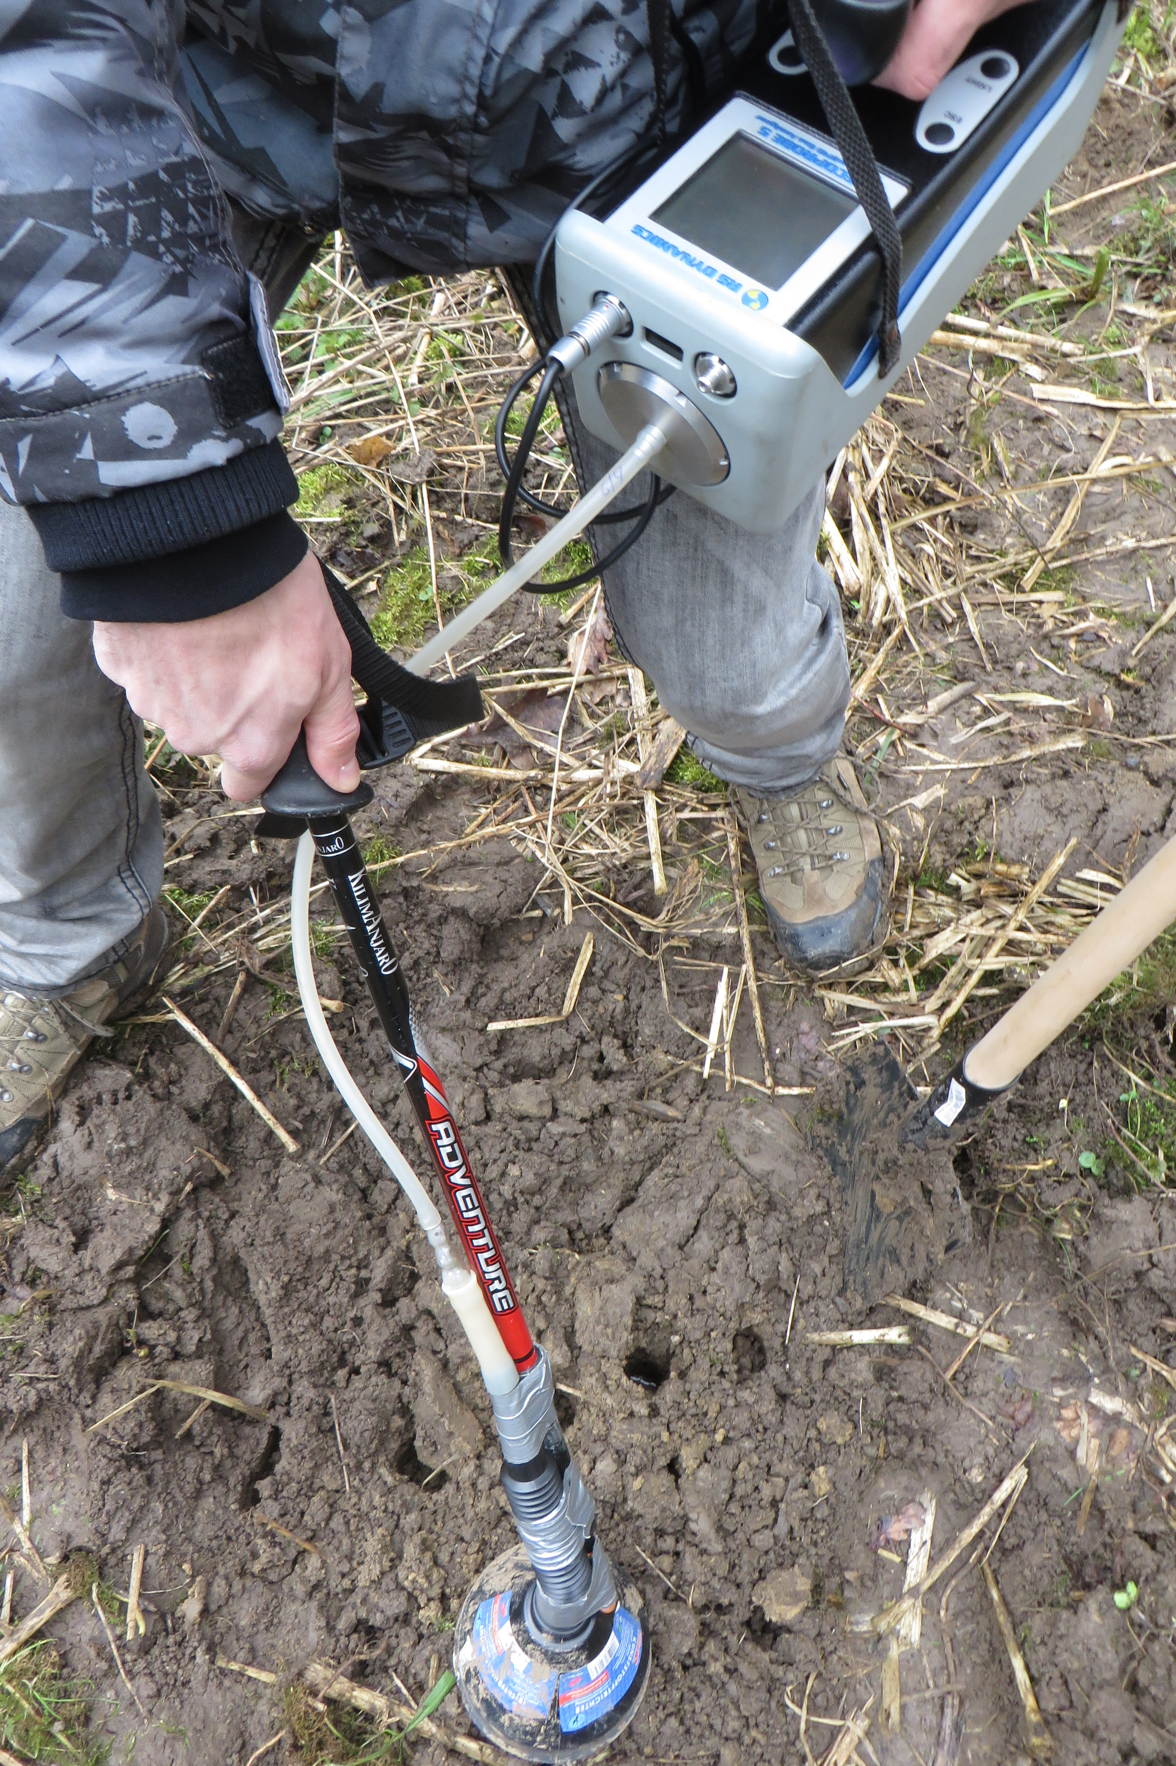
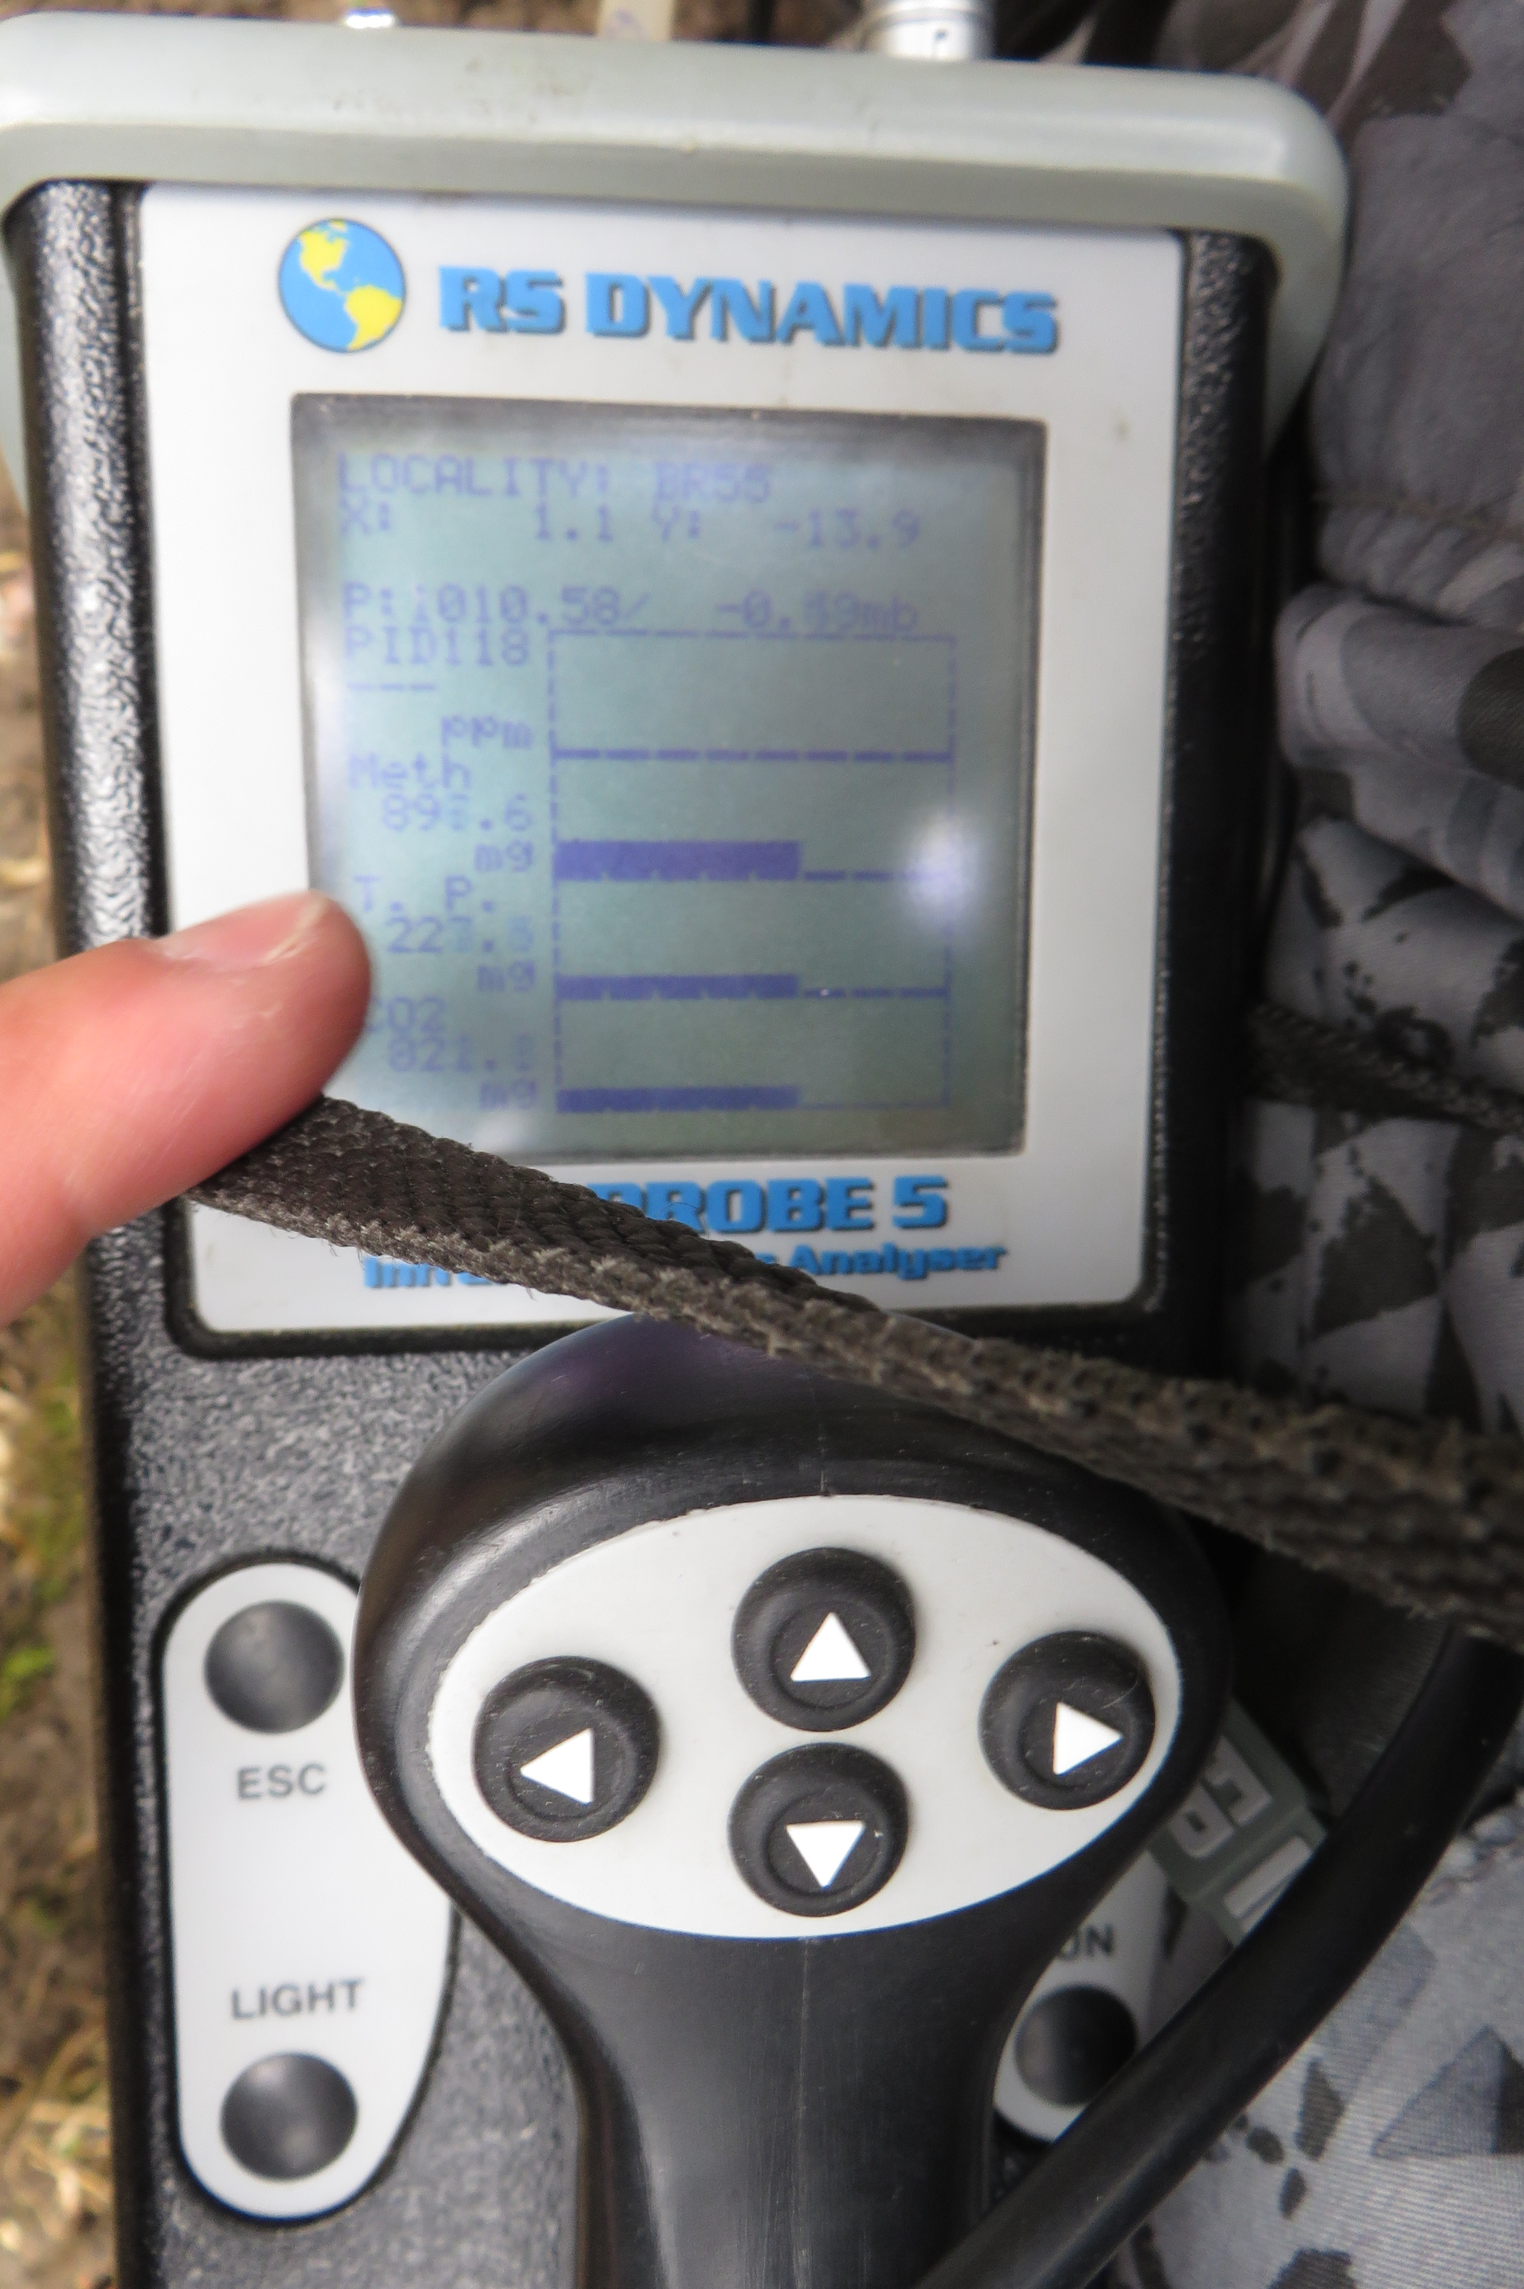
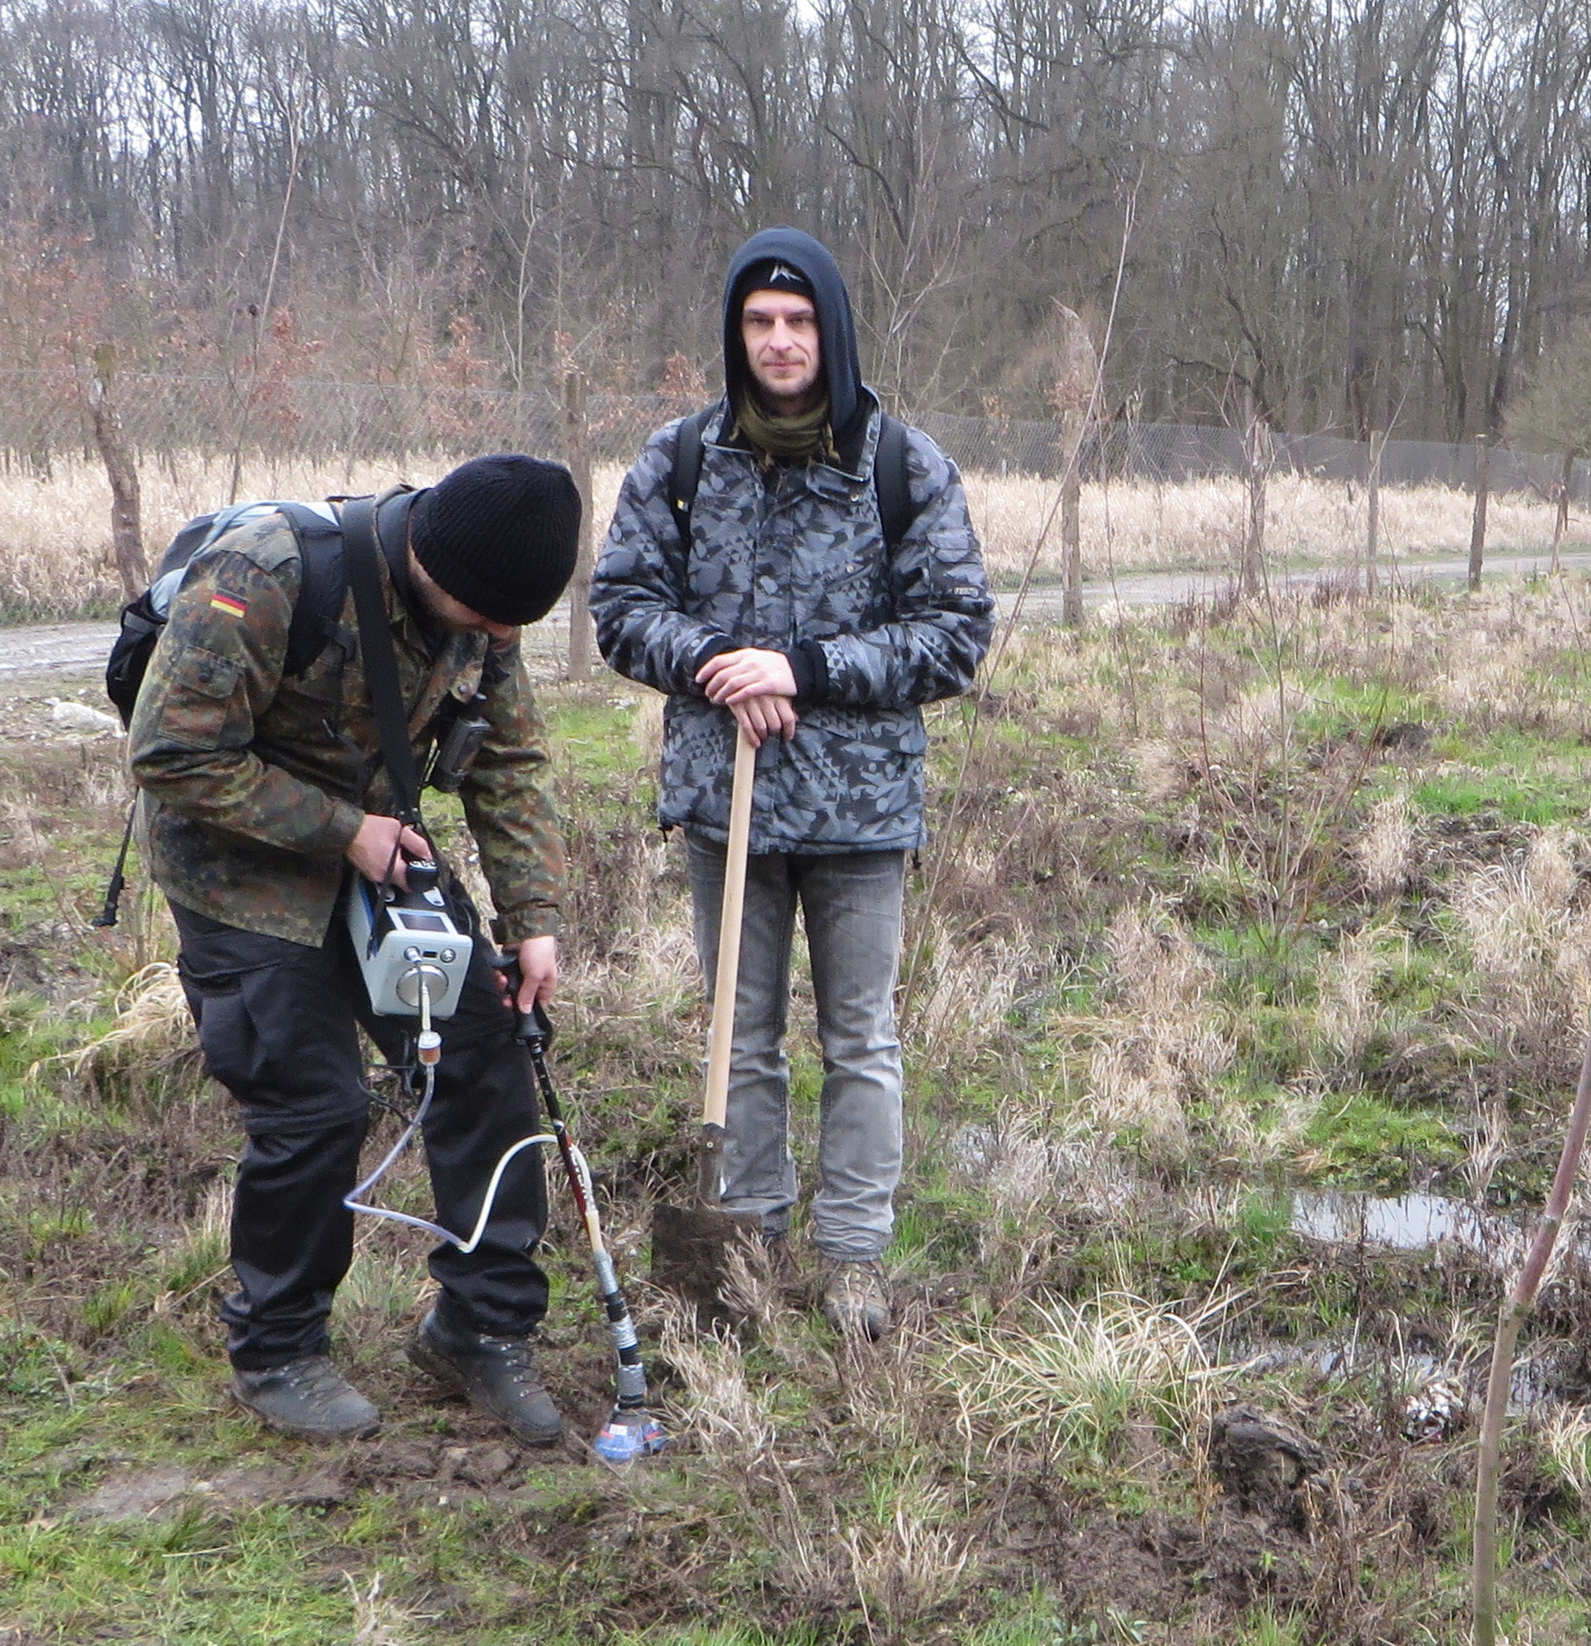
Field screening measurements
Sniffing
Portable
Instrument
Early Spring flooding

Slide 5
Soil profiles & Gs sampling
Soil probe
makes a hole
Soil profile
description
Gas sampling
& measurements

Slide 6
Automatic stations
CO₂ & Methane monitoring
Automatic CO2 / methane
IGS station
Instalation of
the IGS station

Slide 7
Continuous CO₂ measurements

Slide 8
Clay dominated soil profile
Less permeable clay-rich soil and subsoil
Gas inflow limited - Shalow measurements air contaminated
Deeper measurements – higher CO_{2 ,}
further pumping brings air contamination

Slide 9
Sandy-silty soil profile
Permeable sandy soil and subsoil
Gas inflow sufficient - the steeper incipient part of the curve
indicates the gas flux

Slide 10
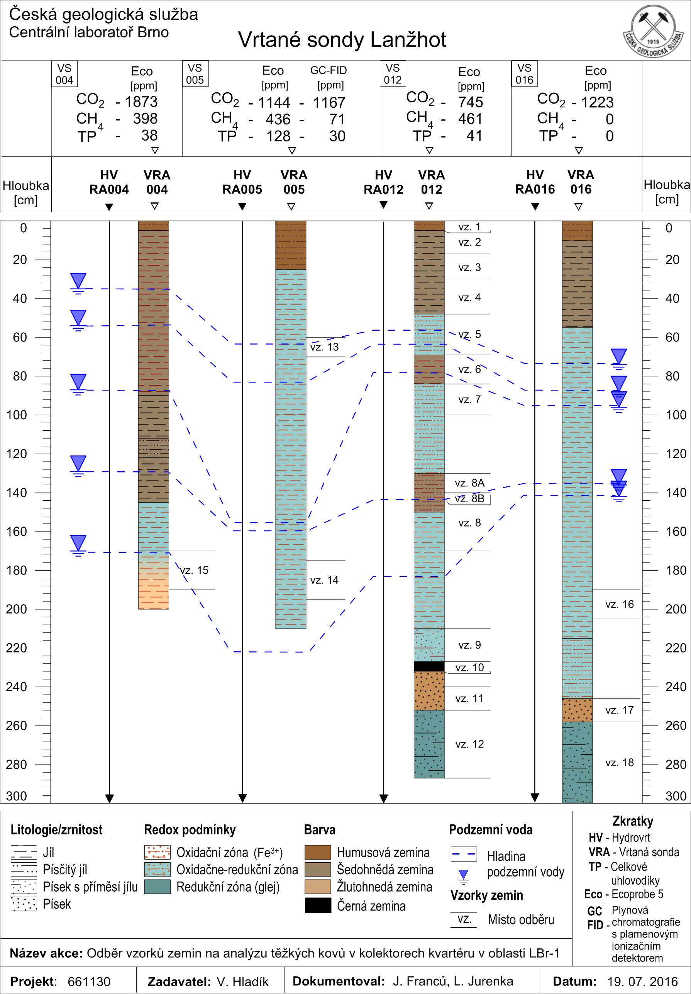
Drilled 2 – 3 m holes
Lithology
Lithological profiles
Of the Soil / Subsoil
Ground Water Level
measurements

Slide 11
Effect of ground water level fluctuation
Winter
Summer
Winter
Summer
Winter

Slide 12
Effect of
soil type
At least once a year
Controled flooding
Gley rich soils form
Quaternary sedim. are poor in CaCO₃
Oxbows meanders
- Sandy channels
- Overbank sed. enriched in clay

Slide 13
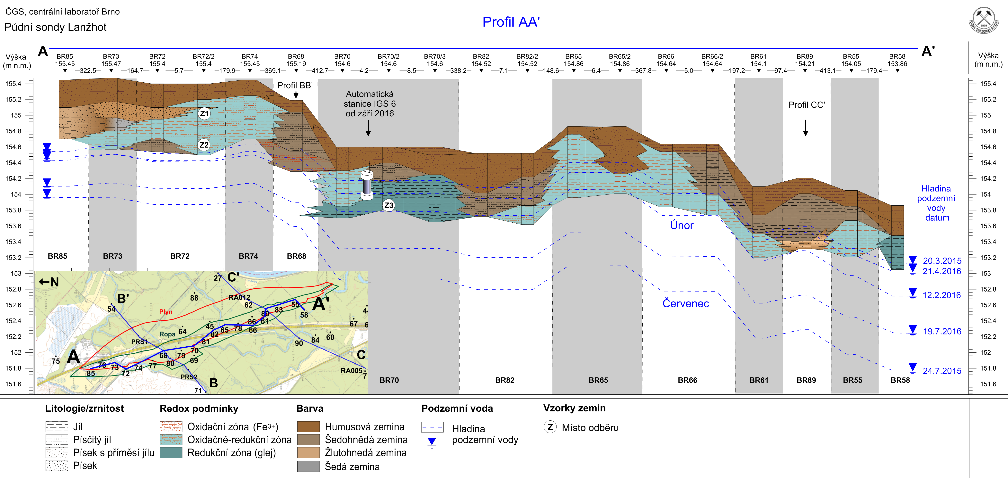
Br
profile
Effect of clay/ sand content
2D Soil Profiles help to understand the regional trends

Slide 14
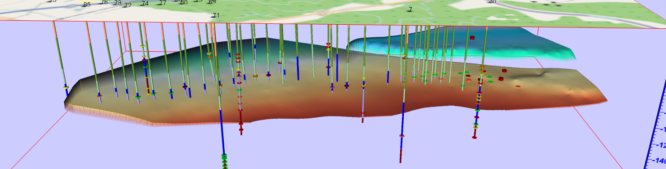
Effect of Oil and Gas accumulation and wells
55 Deep exploration wells, oil and gas field
at depth of 1080-1110 m Mid. Badenian reservoir

Slide 15
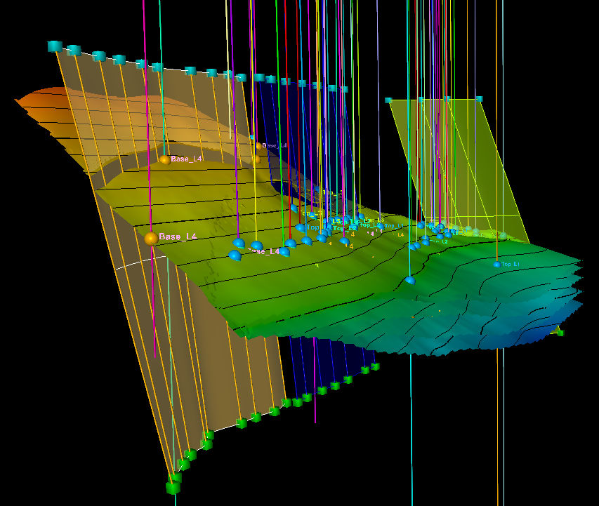
3D Model in Petrel
of the CO₂ Storage Complex
4 tops of the partial layers of the Lab reservoir
L1
L2
L3
L4
Fault 1
Base of the Lab reservoir

Slide 16
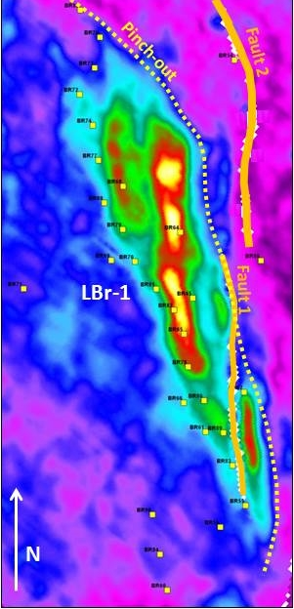
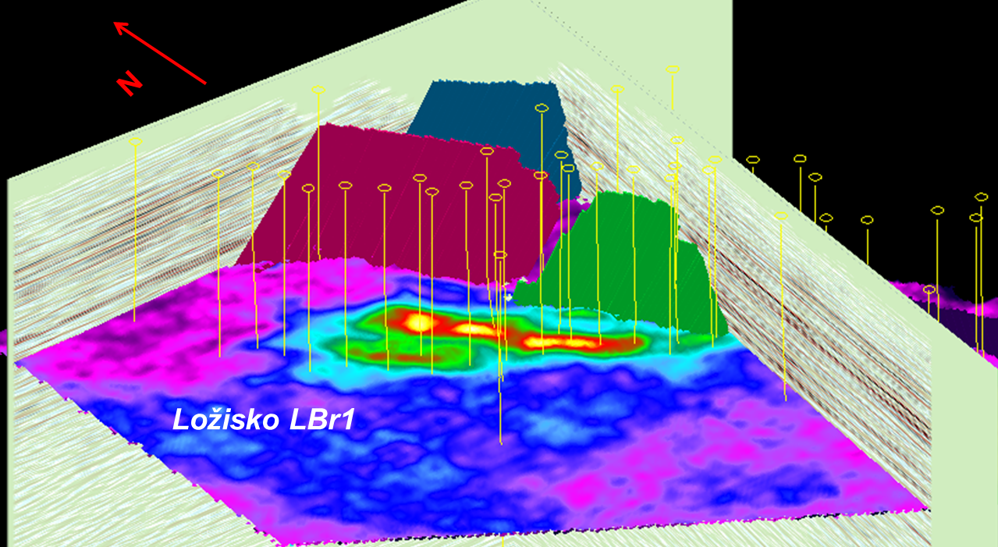
Seismic Attributes Analysis
3D view of the Lab reservoir Attribute: Average Absolute Amplitude
Reveals residual Oil & Gas saturation

Slide 17
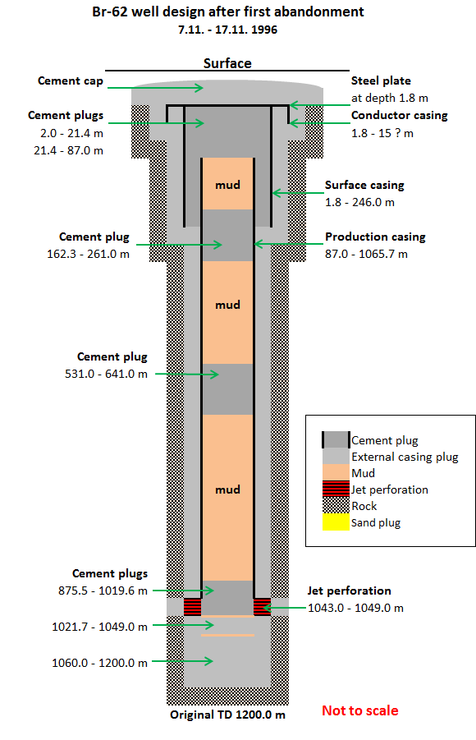
Risk of Methane/ CO₂ Leakage
Abandoned BR Wells Well design
Mud and
Cement Plugs
In spite of plugging
The old wells
Make potential conduits for minor gas migration and often show increased values of methane and CO₂

Slide 18
Maps of CO₂ in Soil Gas
Oil and Gas zones
Warm Season
Cold Season

Slide 19
CO₂ in Soil Gas – 2D Profiles
SW
Warm Season
NE
SW
Cold Season
NE
Gas zone
Oil zone
Relative Distance (m)
Relative Distance (m)
Cold Season
SSE
NNW
Relative Distance (m)

Slide 20
Isotopes – Evidence of
Methane – to – CO₂ oxidation
Soil gas has a surprisingly elevated amount of CO2 when compared to normal forest soil
CO₂ is isotopically very light

Slide 21
Isotopes delta¹³C CO₂
We can distinguish three types of CO₂ :
Normal
Mixed
3. CO₂ from microbial oxidation of methane

Slide 22
Principle steps in Soil Gas Baseline Monitoring
Screening data - > very dependent on p,T, time, daily/ seasonal variations
Maps of CO₂ and CH₄
Every hour sampling - > details
4. Drop in Atm. Pressure - > more gas
5. Soil clay = seal / sand permeable zone
6. Old wells – migration avenues
7. Ground water level rise - > more CO₂ met
8. Isotopes - > Microbial methane oxidation
9. Background 0.5-1% Anomalies 1-8% CO₂

Slide 23
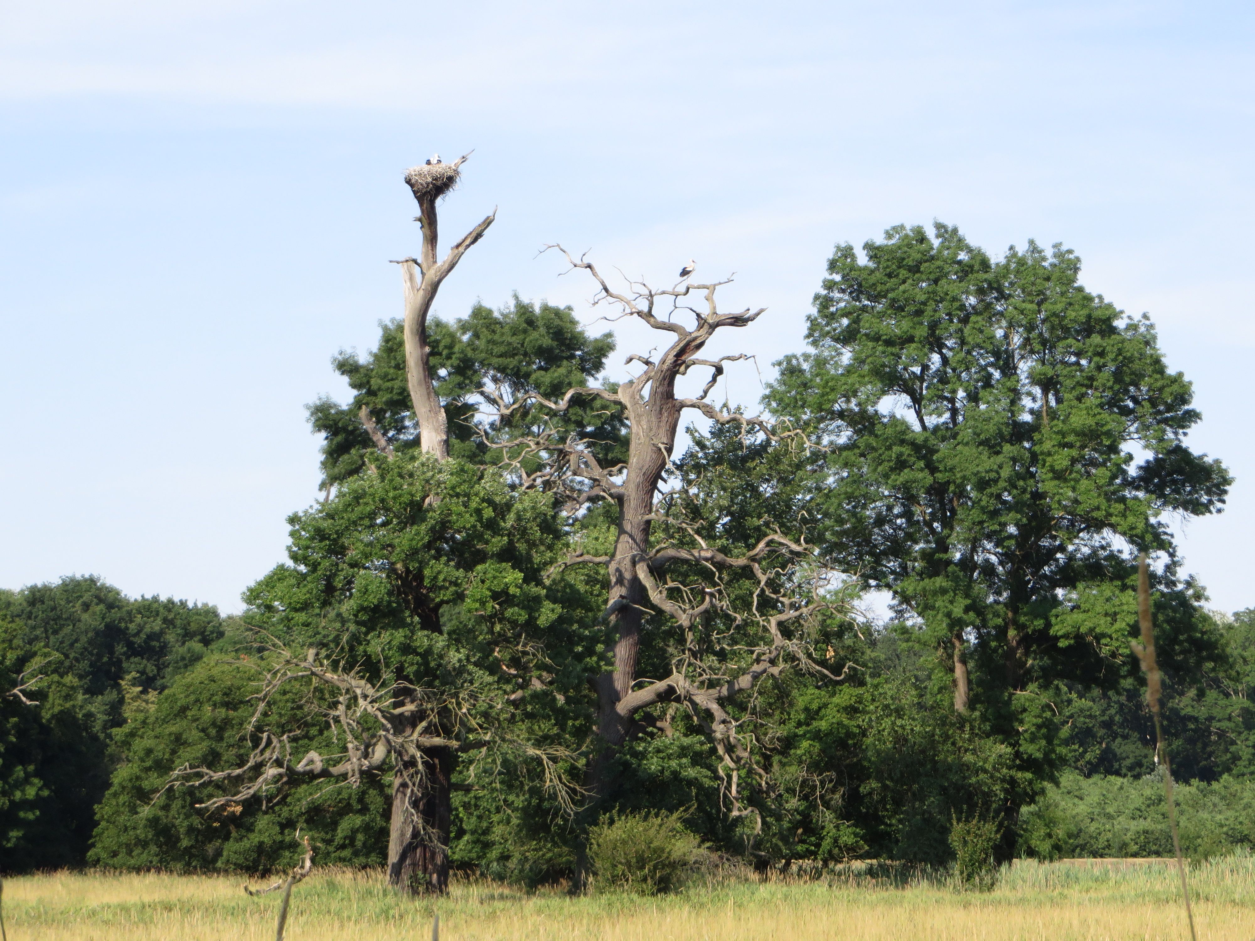
Thank you for your attention
REPP-CO2 team
Acknowledgements: The REPP-CO2 project benefited from the Norway Grants, Proj. No. NF-CZ08-OV-1-006-2015

