Slide 1
GI 251 – Event Stratigraphy
Who am I
Who are you
What the class is about
What you need to know
What you need to do

Slide 2
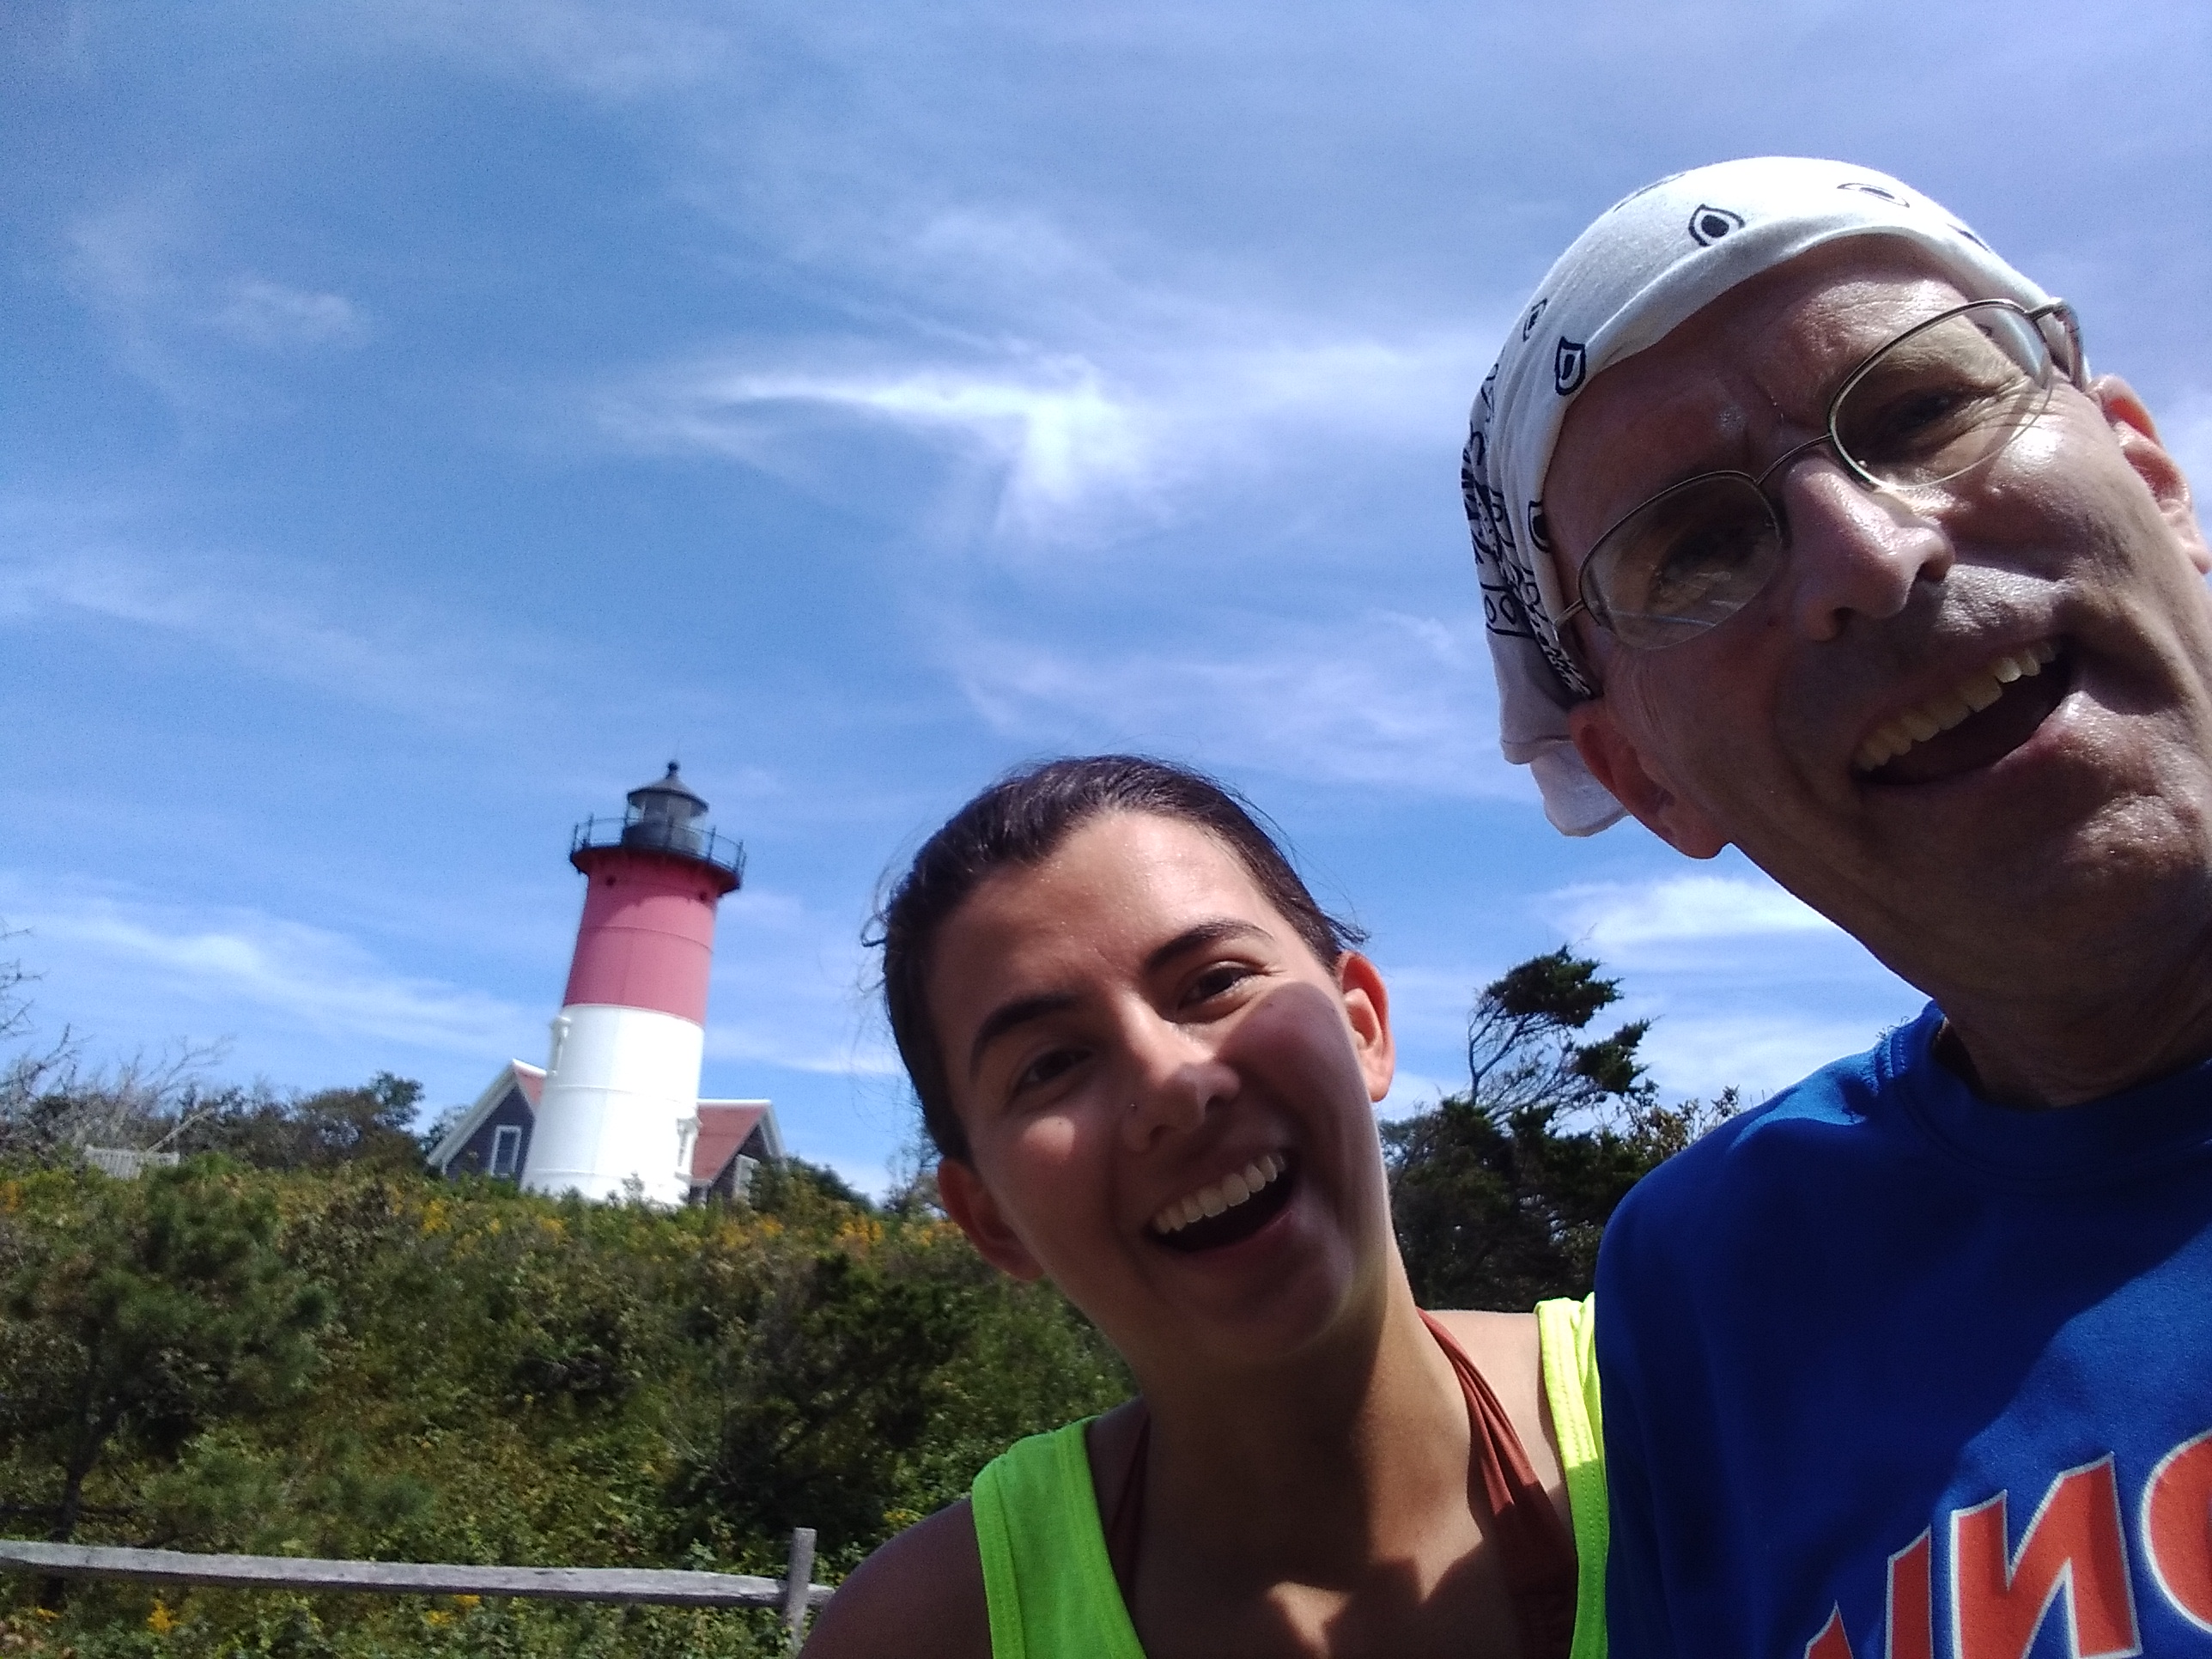

Slide 3
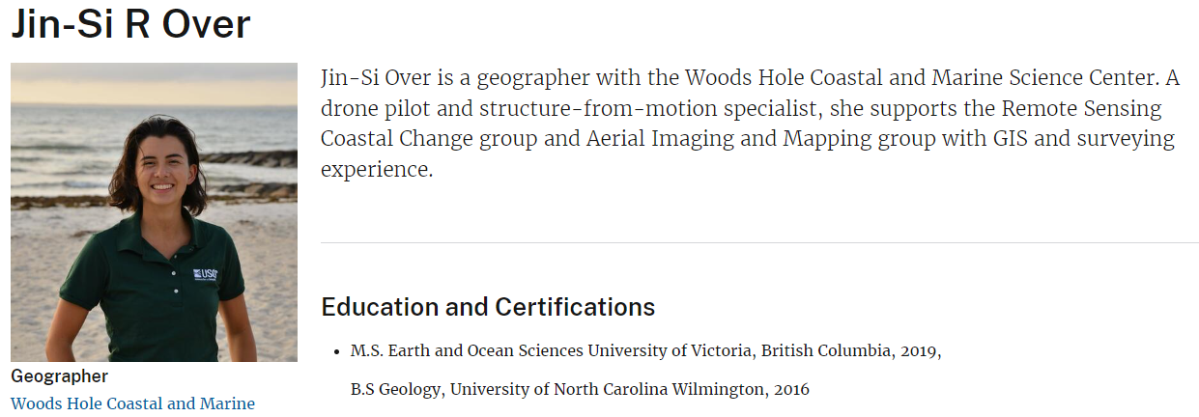
https://www.usgs.gov/staff-profiles/jin-si-r-over
https://www.usgs.gov/news/researcher-spotlight-jin-si-over

Slide 4
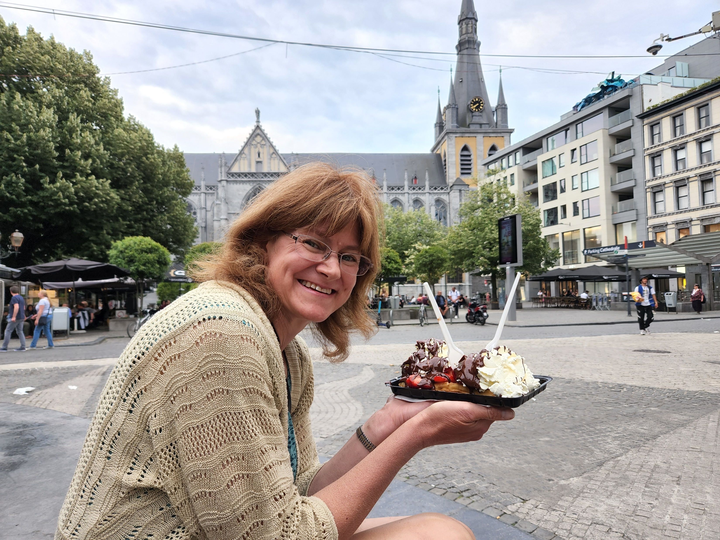

Slide 5
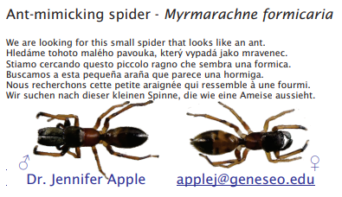
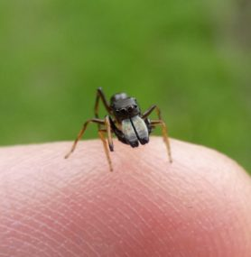

Slide 6
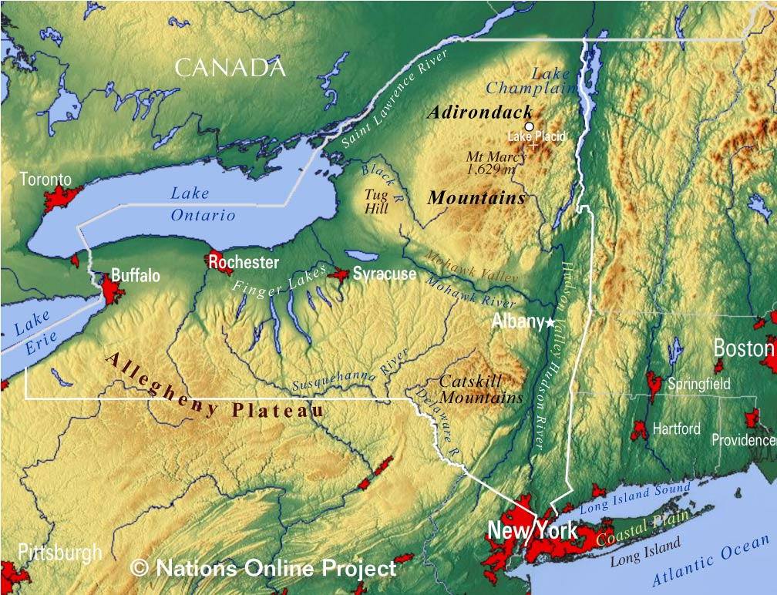
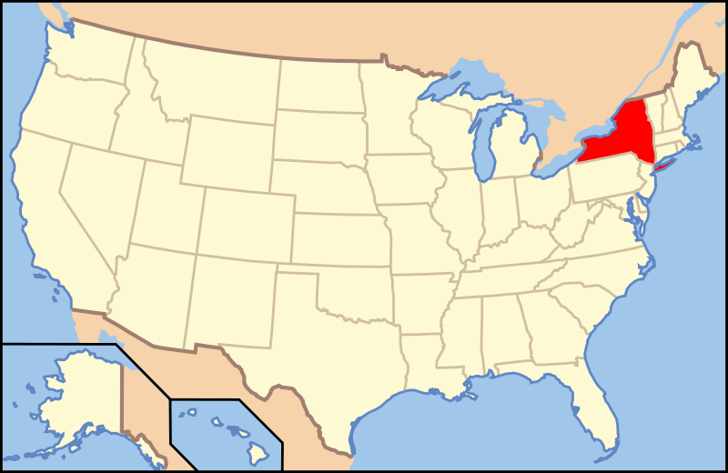
Who am I – map of New York

Slide 7

Who am I – picture of college

Slide 8


Slide 9
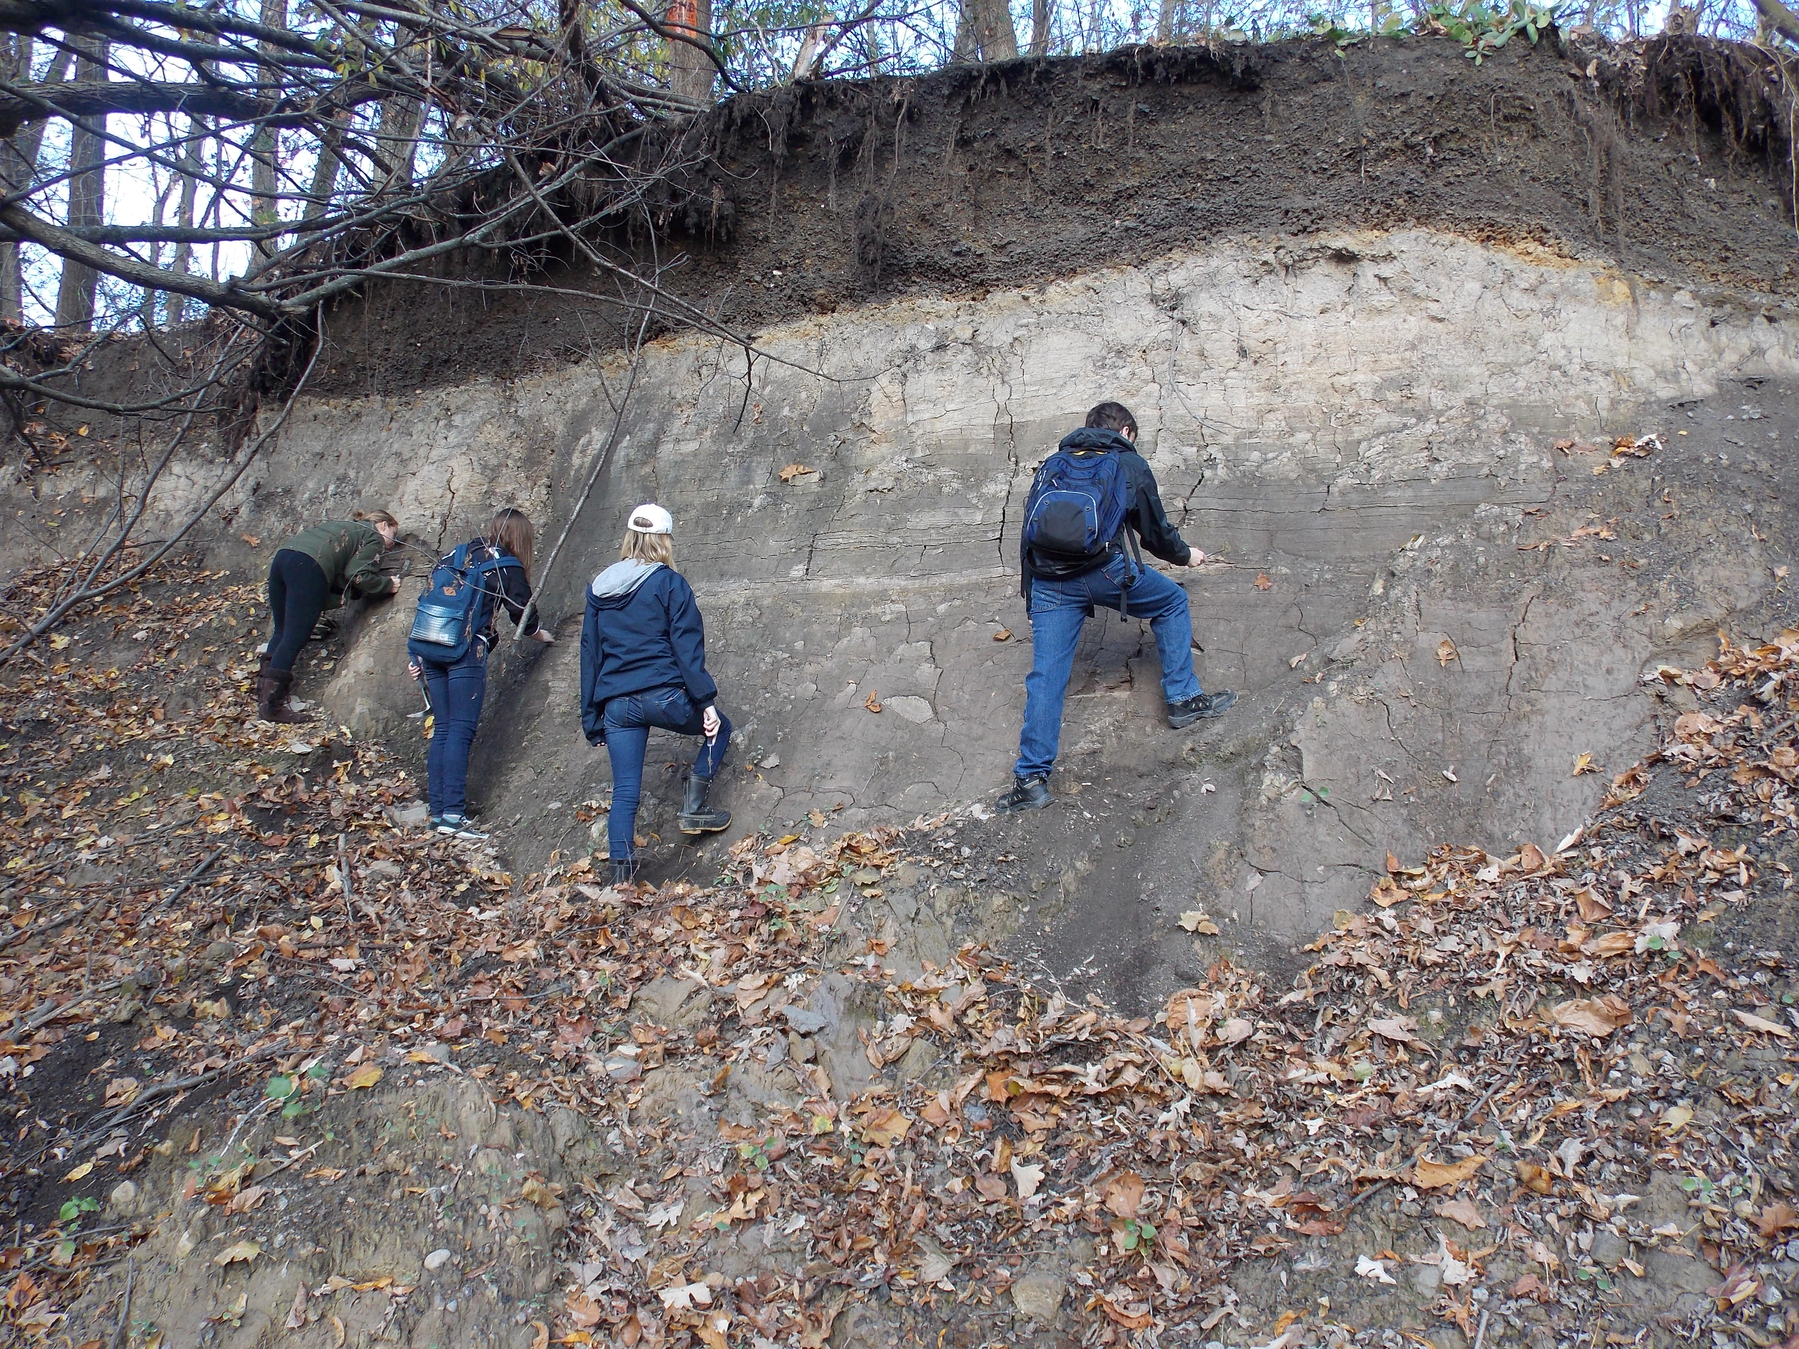

Slide 10
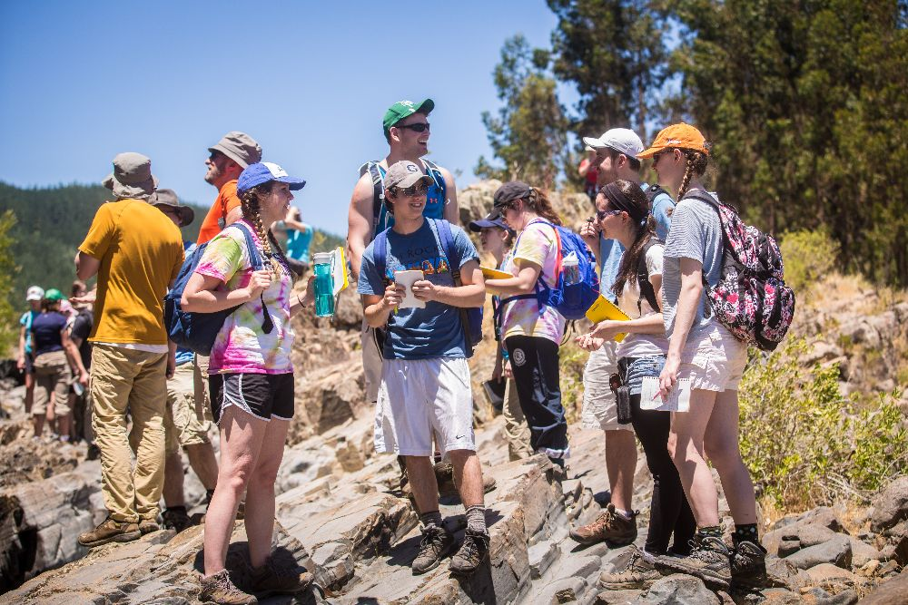

Slide 11
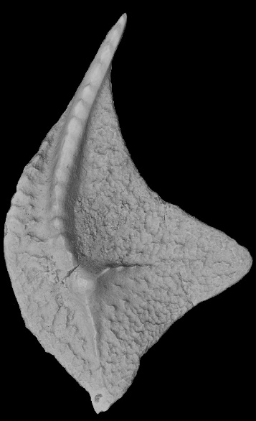
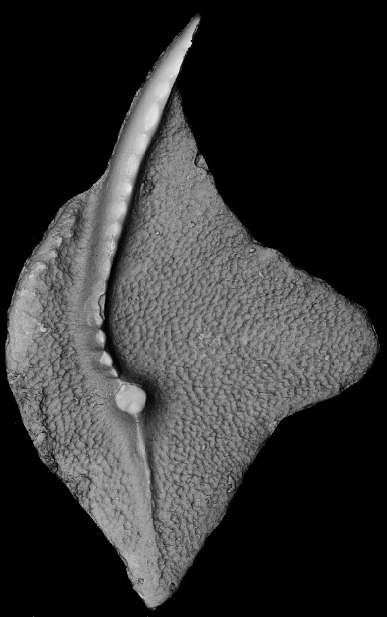
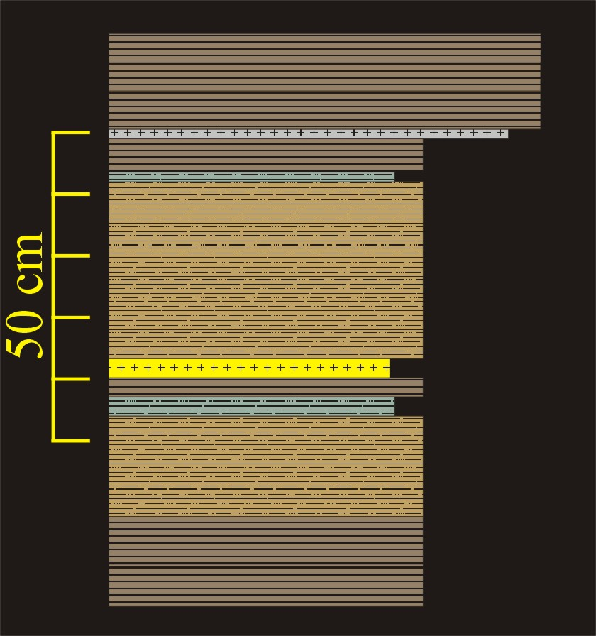
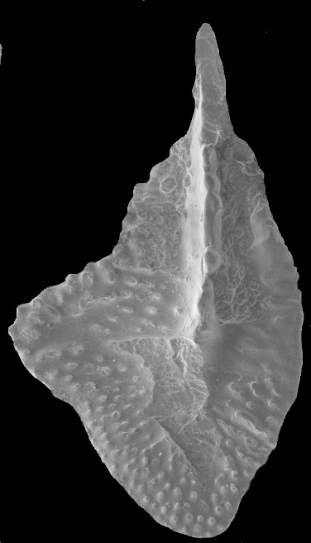
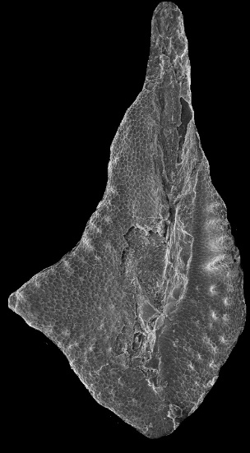
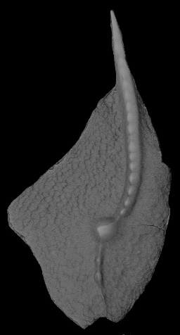
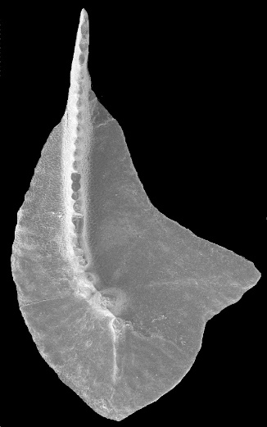
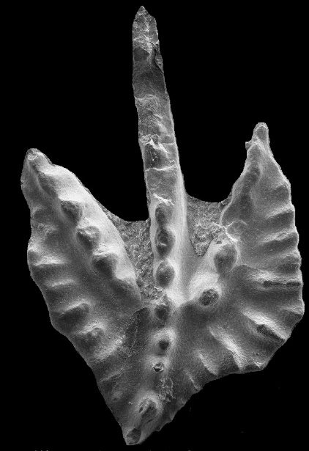
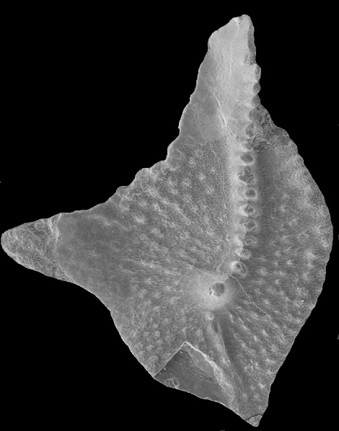
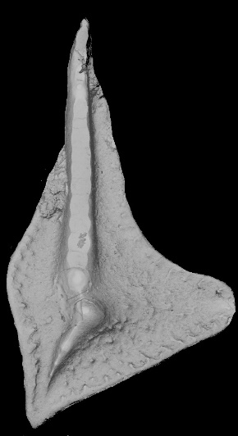
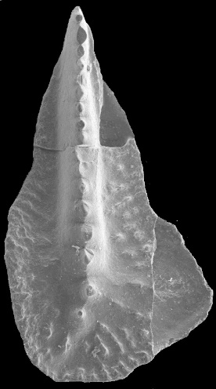
Notes:
Center Hill Tephra at Hurricane Bridge, TN

Slide 12
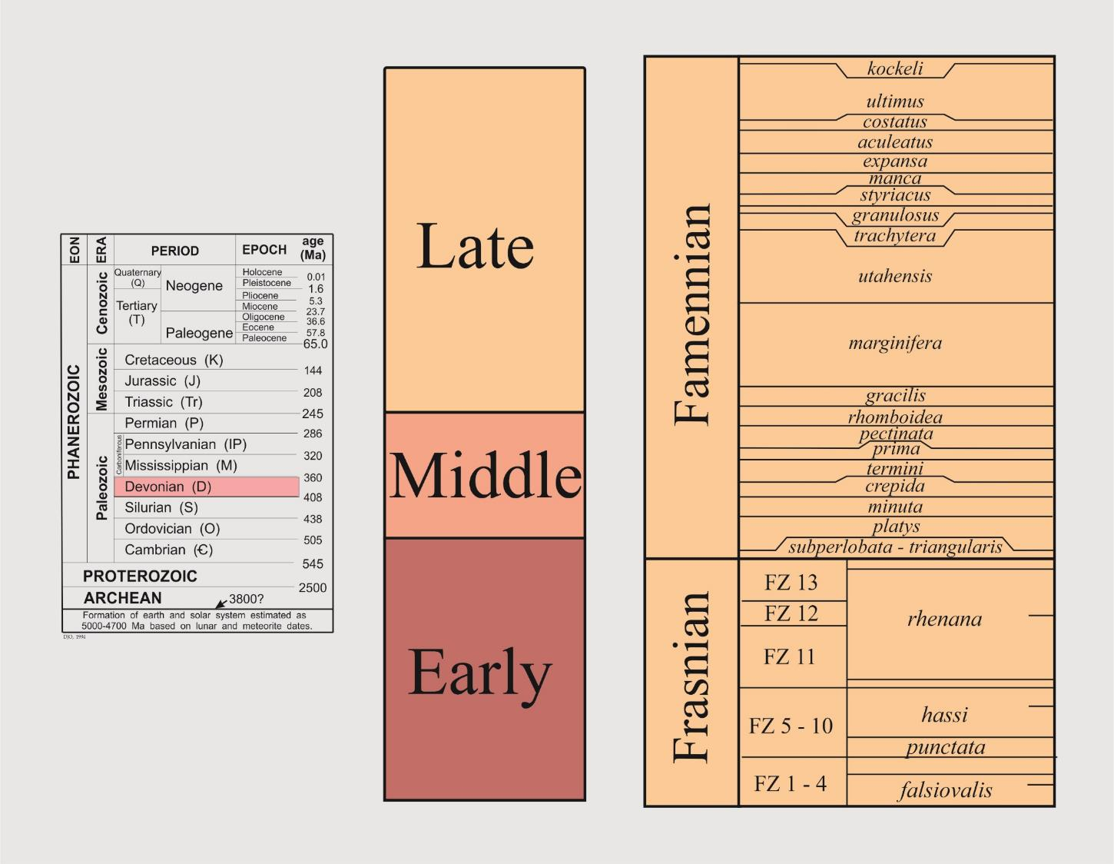
Notes:
12

Slide 13
Notes:
Center Hill Tephra at Hurricane Bridge, TN

Slide 14
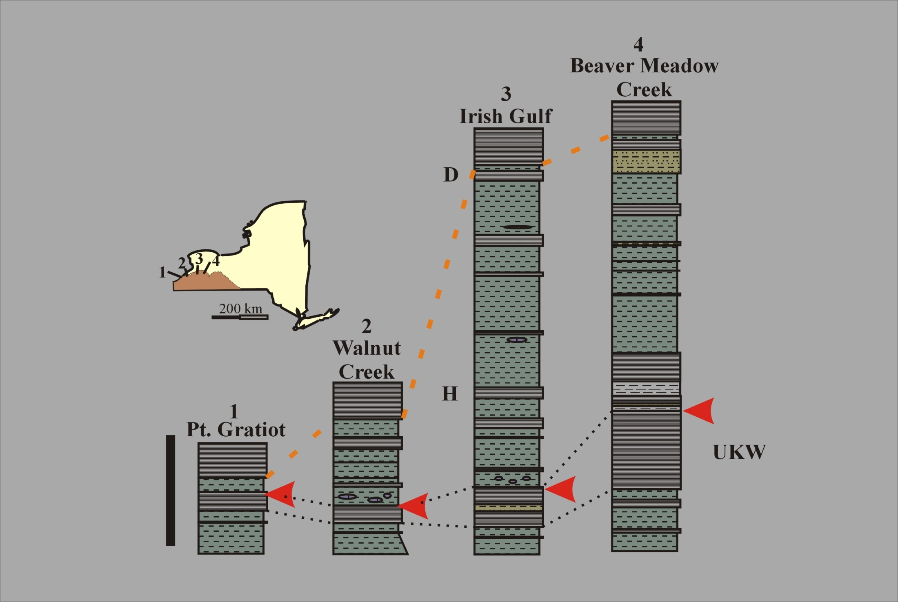

Slide 15
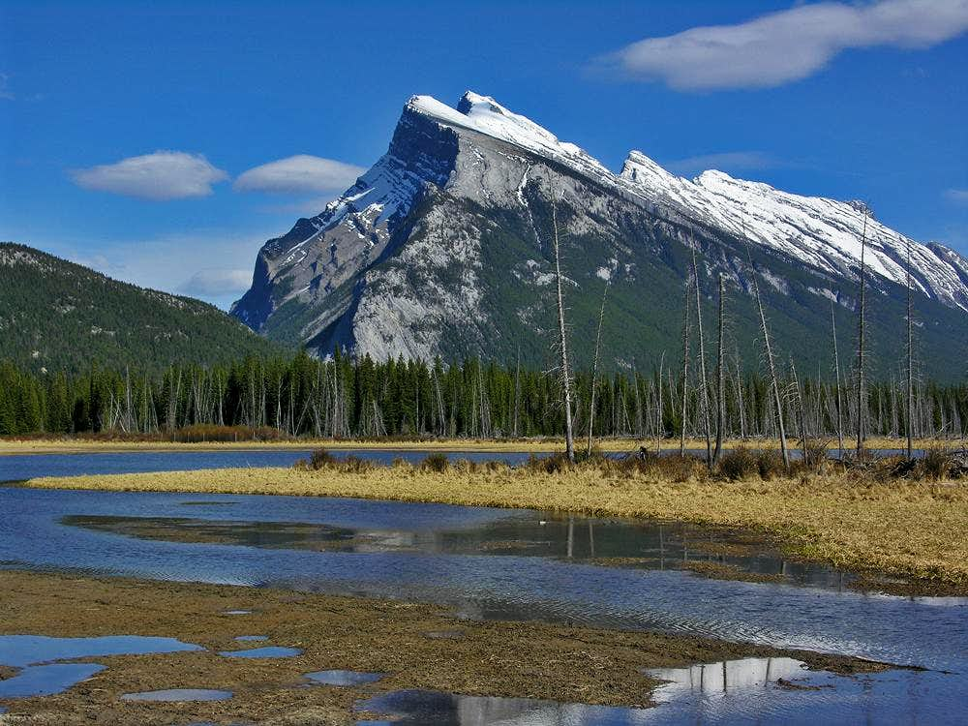
Summit Post

Slide 16
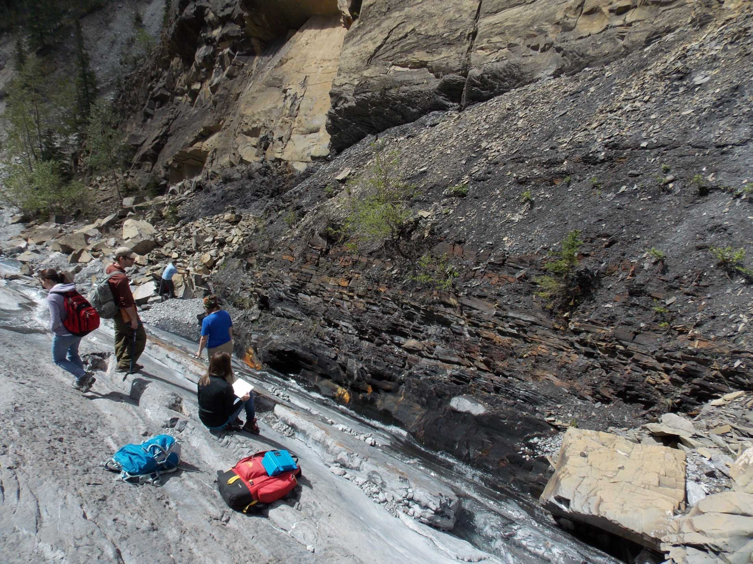
Notes:
Jura Creek

Slide 17
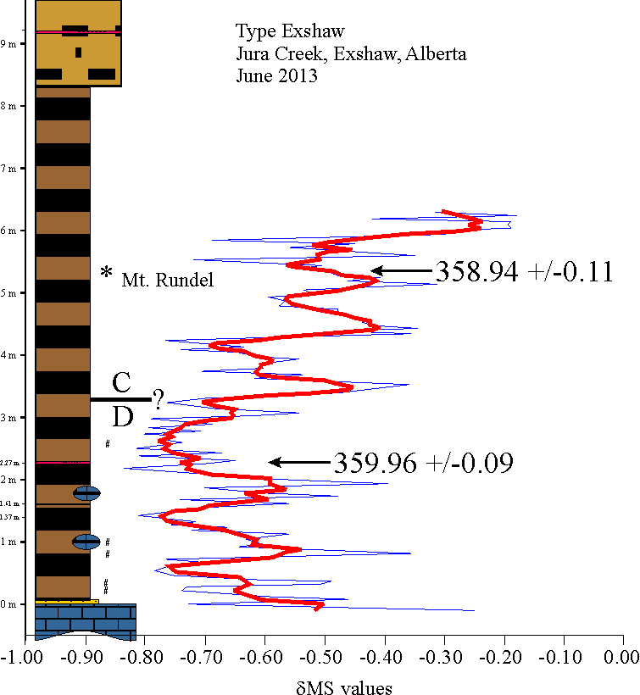
Notes:
Jura Creek

Slide 18
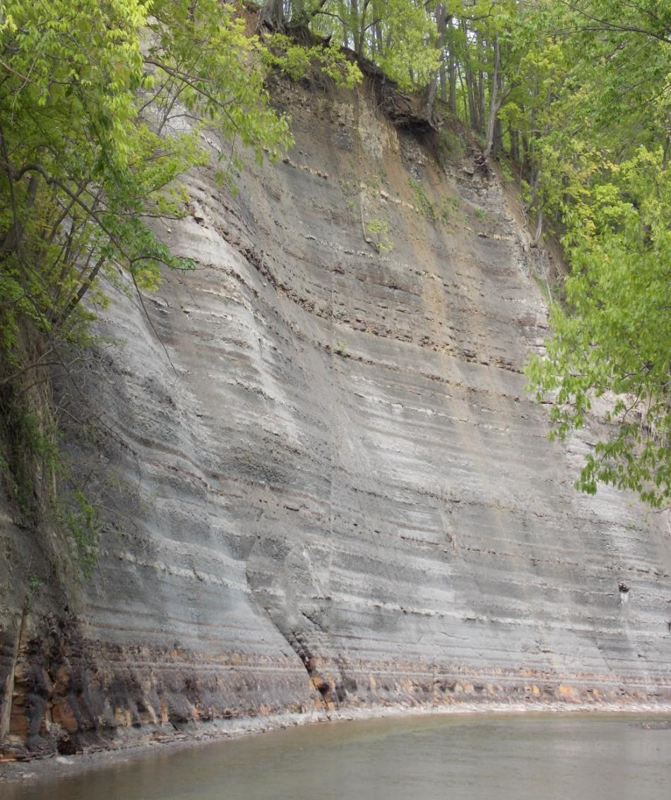

Slide 19
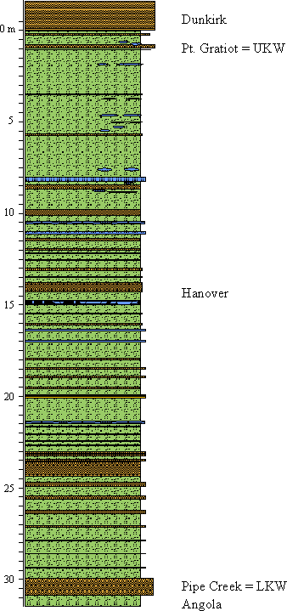
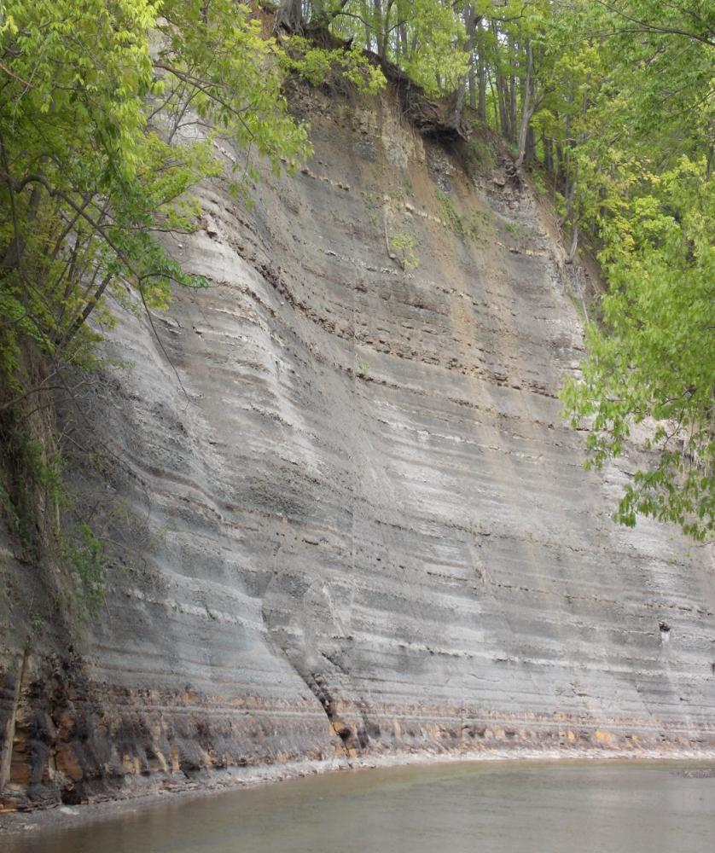
800,000

Slide 20
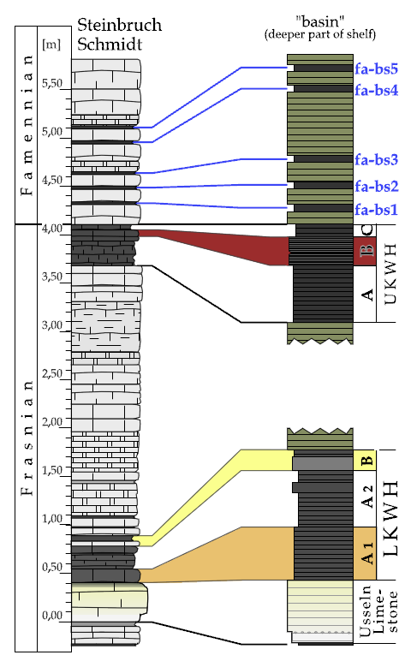
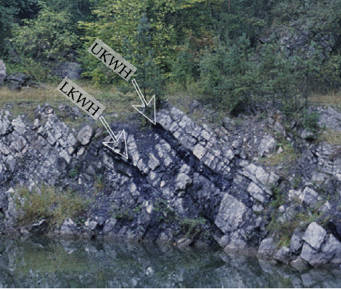
371.85
372.28 +/- 0.15
372.55
Benner Quarry
Gereke and Schindler, 2012
Schmitz pers . comm., 2014

Slide 21
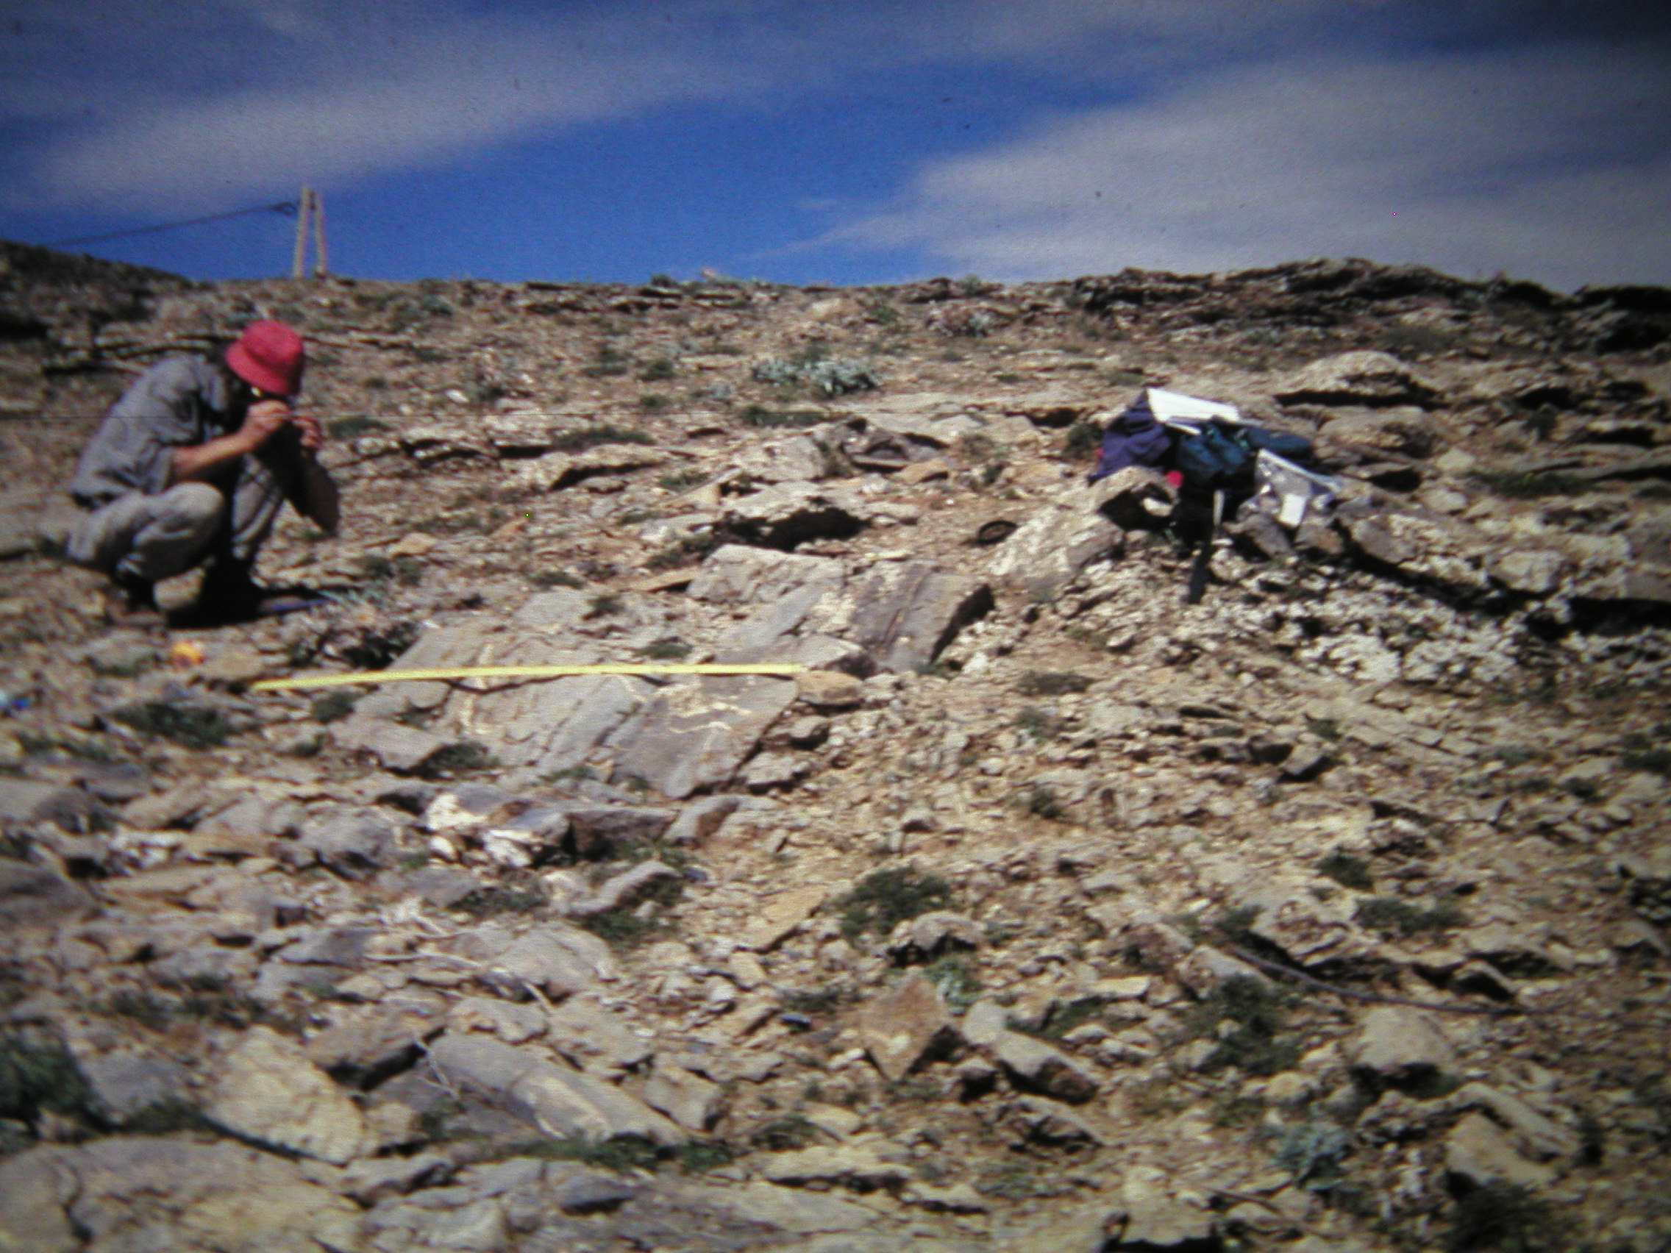

Slide 22
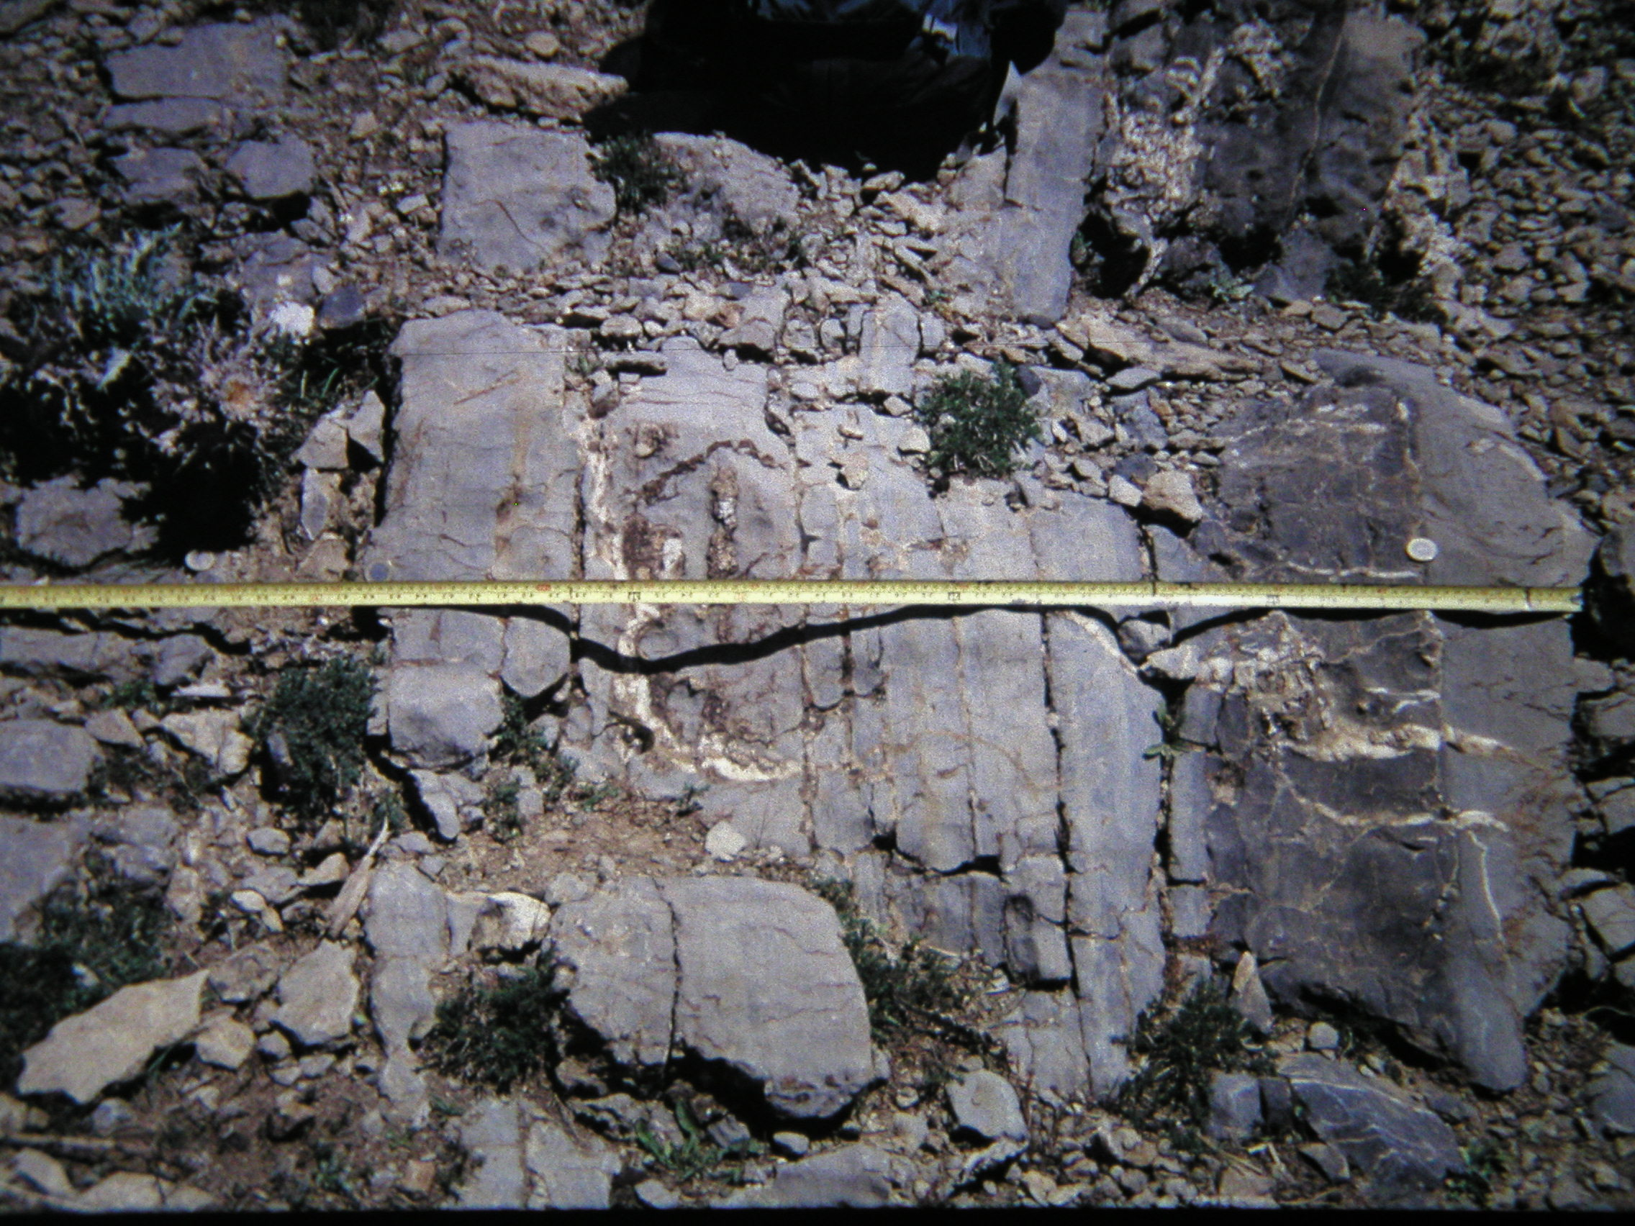

Slide 23
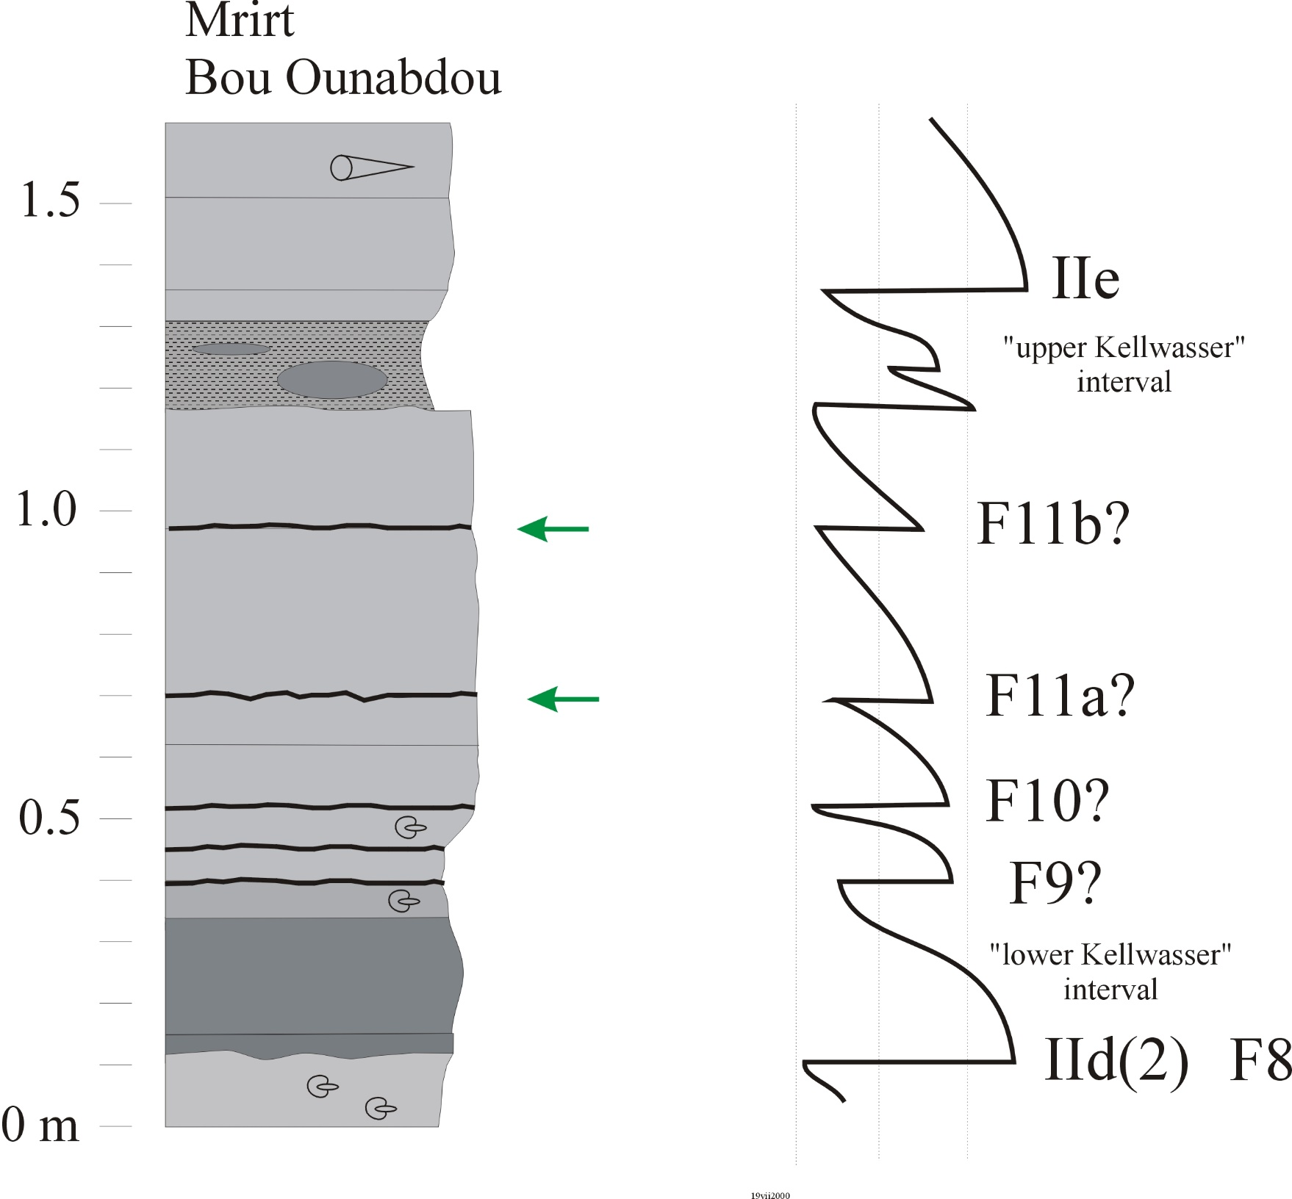

Slide 24
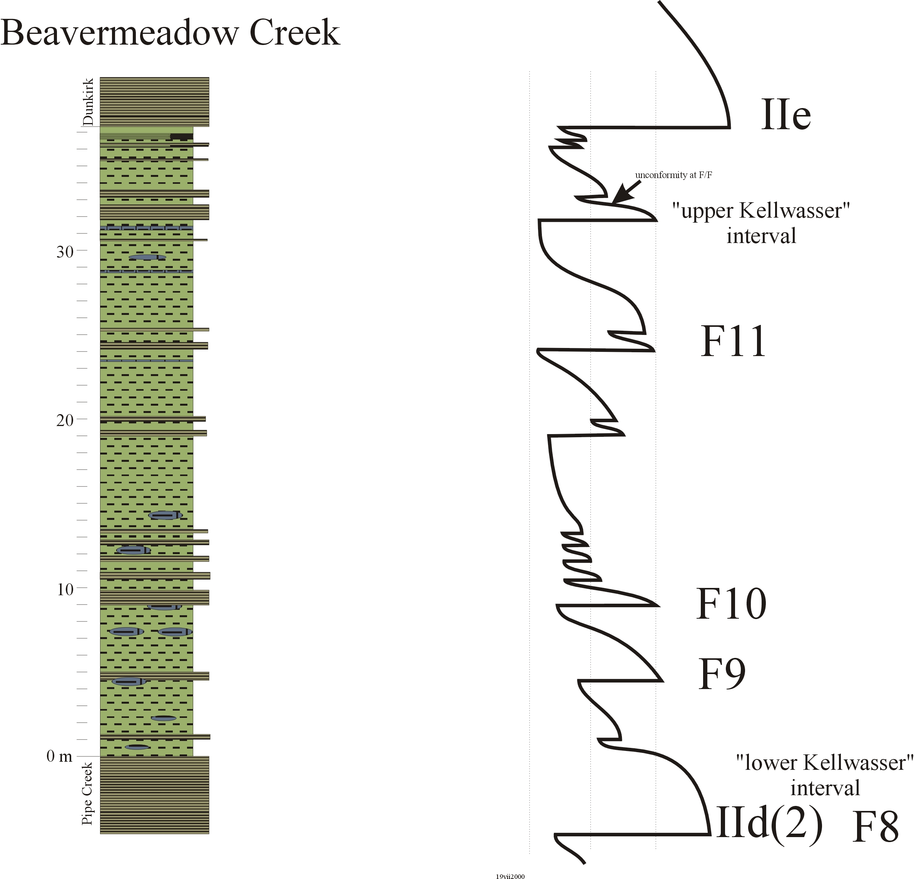

Slide 25
800,000

Slide 26
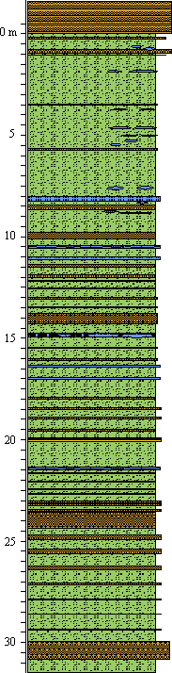
Short Eccentricity cycles: ~5 m
Obliquity cycles:
~2 m
Precession cycles: ~60 cm
Cycles occur with measured accuracy
Dominant cycle can be used to assess deposition rate, latitude, and duration
Haalstaat cycles – subprecession millennial scale ~5cm

Slide 27
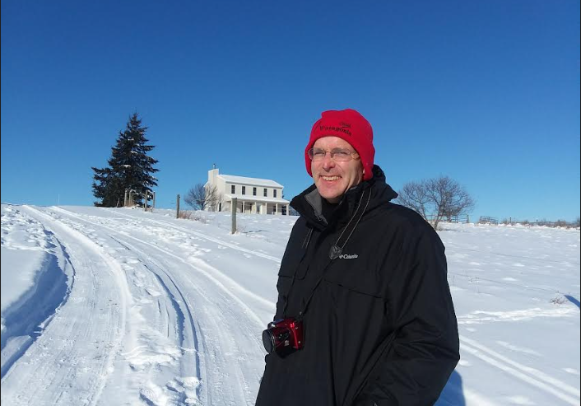

Slide 28
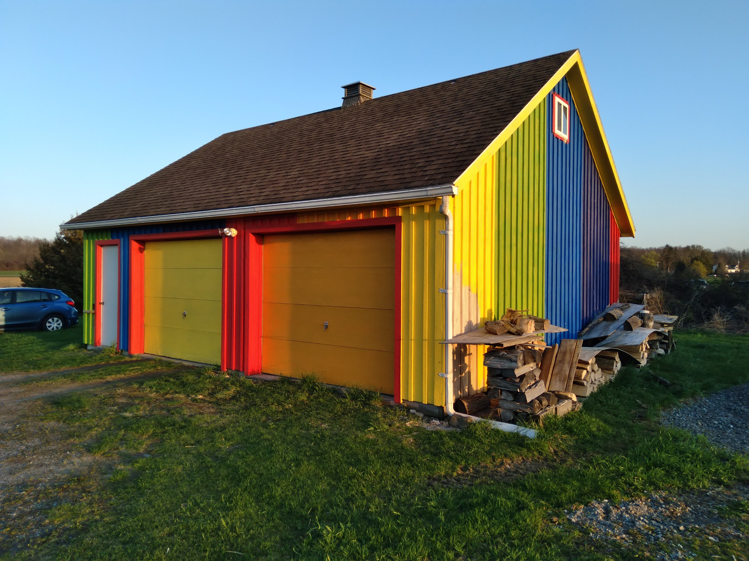

Slide 29


Slide 30
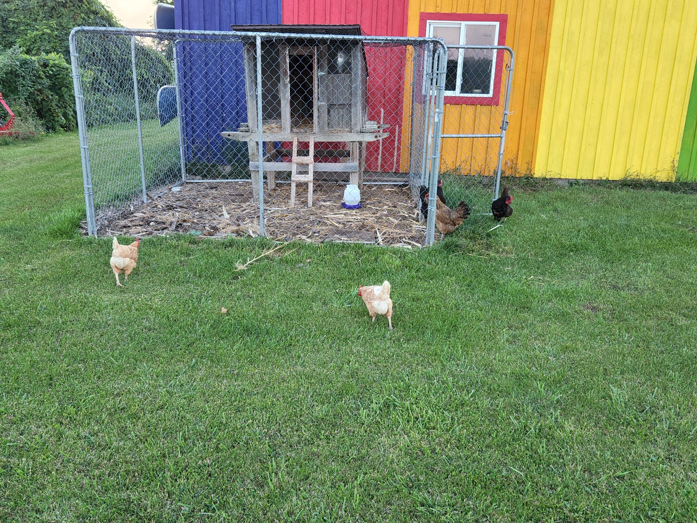

Slide 31
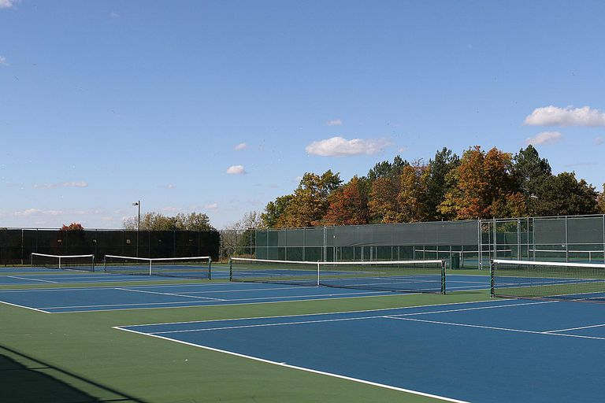
Who am I – trying to figure out how to play tennis here

Slide 32

https://us.fulbrightonline.org/
Who am I – Fulbright scholar – funded by the Congress of the United States.
The idea is that you learn more about the United States, you get to work on your English skills; I get to learn more about Czechia and take this information back to the US, develop Czech language skills, and work with Dr. Kumpan as well as others on collaborative research projects.

Slide 33
Who are you?

Slide 34
What the class is about – Event Stratigraphy
Event stratigraphy is the correlation of sedimentary sequences using prominent marker beds, isochronic horizons such as tephra beds, depositional and biotic changes, or geochemical/isotopic excursions. These are tied to a biostratigraphic framework, but also offer higher resolution than can be resolved by biostratigraphy alone. Event analysis is one of the basic underpinnings for deciphering the entire stratigraphic record.
Kauffman (1988) recognizes four broad categories:
Physical event units
Chemical event units
Biological event units
Composite event units

Slide 35
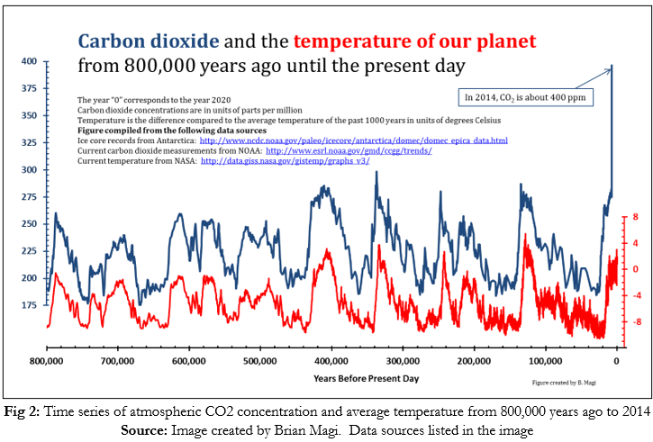
What the class is about – Event Stratigraphy
utility – refined correlation – knowledge of strata for such things as extraction and sequestration industry, agriculture, construction
utility – understanding earth history through investigation of global events and then a predictor for changes in the modern

Slide 36
What you need to know
requires knowledge of stratigraphy
review of stratigraphic principles

Slide 37
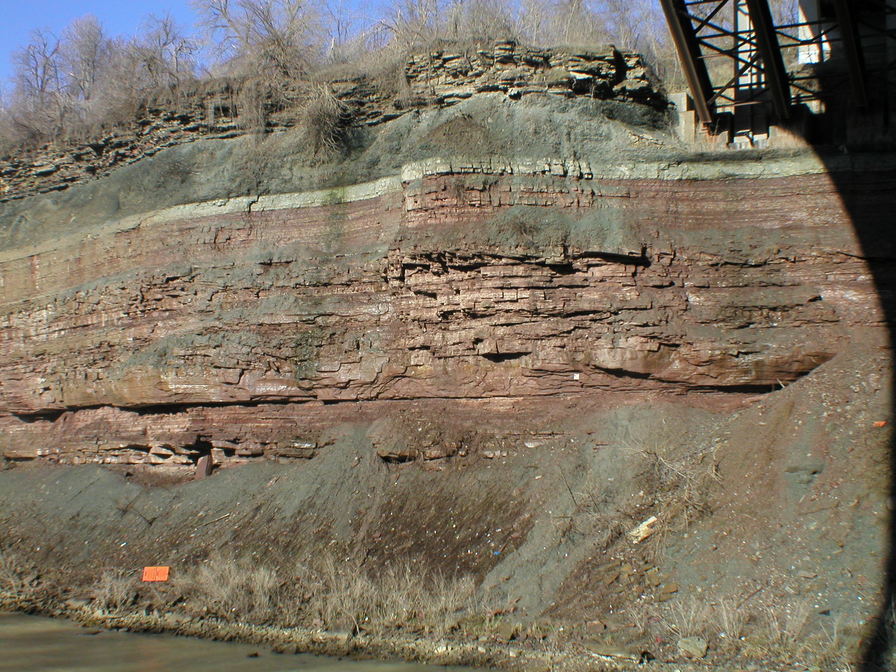
Superposition and Walther’s Law
Notes:
strata in Rochester Gorge at the lower falls

Slide 38
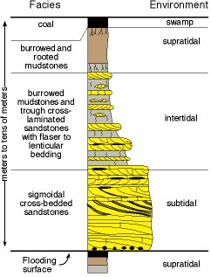

Slide 39
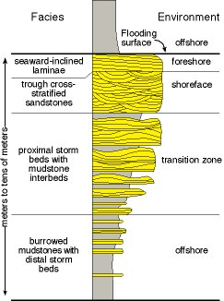

Slide 40
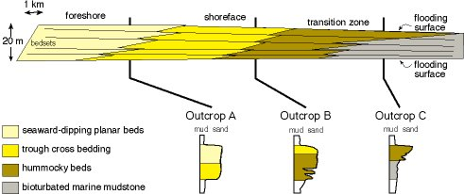

Slide 41
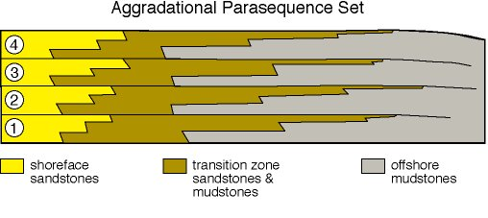

Slide 42
Changes in sea level
autocyclic – local and regional changes due to facies shifts and tectonics vs allocyclic – global changes due to large scale tectonism, oceanic crust dynamics, glaciation, and climate changes
Three most important controls on the volume of sea water are:
glaciation: 10 - 200 m changes over 1 - 100 ky
ground water: 1 - 40 m over 0.1 - 100 ky
ocean temperature: 1 - 10 m over 0.1 - 10 ky
Three other controls on the displacement of sea water are oceanic large igneous provinces, global tectonics, and sediment fill.

Slide 43
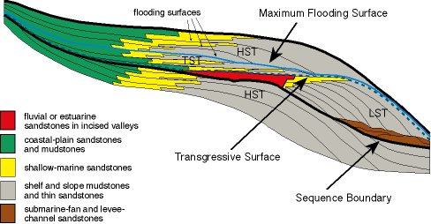
Sequence stratigraphy – recognition of genetically related strata bound by unconformities or their conformable equivalents

Slide 44
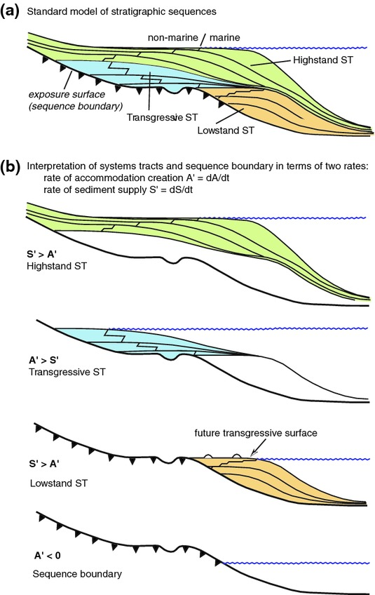

Slide 46
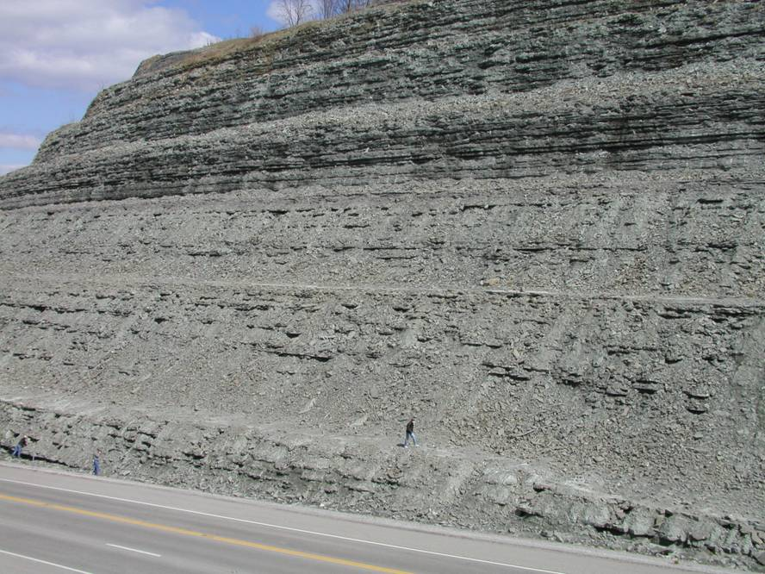
Kope-Fairfield at Maysville, KY

Slide 47
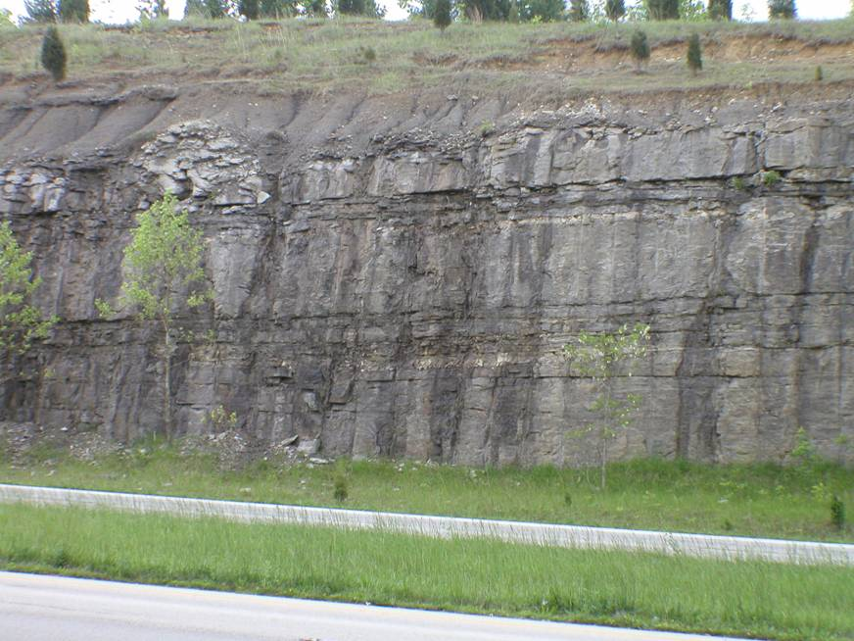
Bisher-Lily on Ohio 32-02

Slide 48
Bisher-Lily on Ohio 32-02

Slide 49
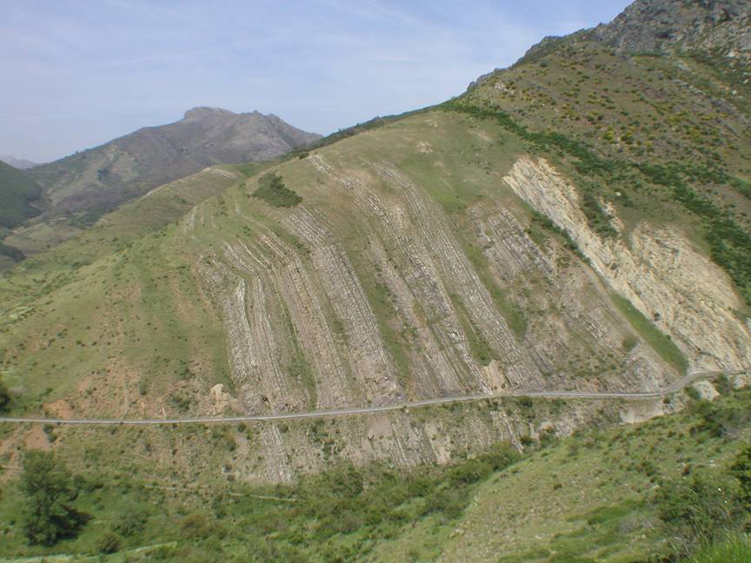
La Vid Group, Bernesga Valley, Cantabrian Zone, NW Spain

Slide 50
La Vid Group, Bernesga Valley, Cantabrian Zone, NW Spain

Slide 51

Frasnian – Mt. Morris Dam, New York

Slide 52
Frasnian – Mt. Morris Dam, New York

Slide 53

Long eccentricity: 405 ky
Short eccentricity: ~ 100 ky
Obliquity: ~ 40 ky
Precesssion: ~ 20 and 16 ky
in deep time the intervals are less certain; 405 ky is stable

Slide 54


Slide 55
What you need to do...
syllabus
readings
discussion
problem sets
research paper – presentation on an event, or some aspect of event stratigraphy; paper, presentation

Slide 56
What you need to do...
For our next meeting you need to read Kaufman (1988) and Simmons et al. (2020) to review event stratigraphy terminology and application.
At our next meeting we will discuss these articles and then plan for the rest of the semester which will involve your presentation of a specific event and review of events in intervals of geologic time.

