Slide 1
GI 261 Cyclostratigraphy and Astrochronology
Examples of cyclostratigraphy given in Strasser et al., 2006

Slide 2
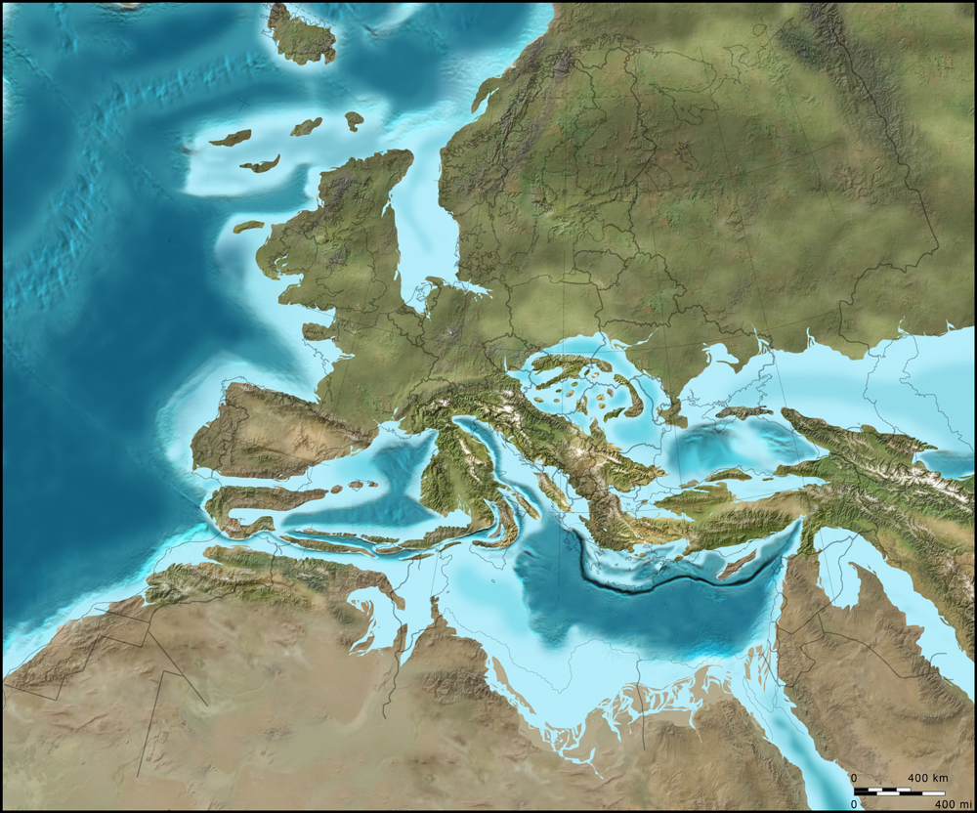
Ron Blakey and Colorado Plateau Geosystems/ with permission

Slide 3
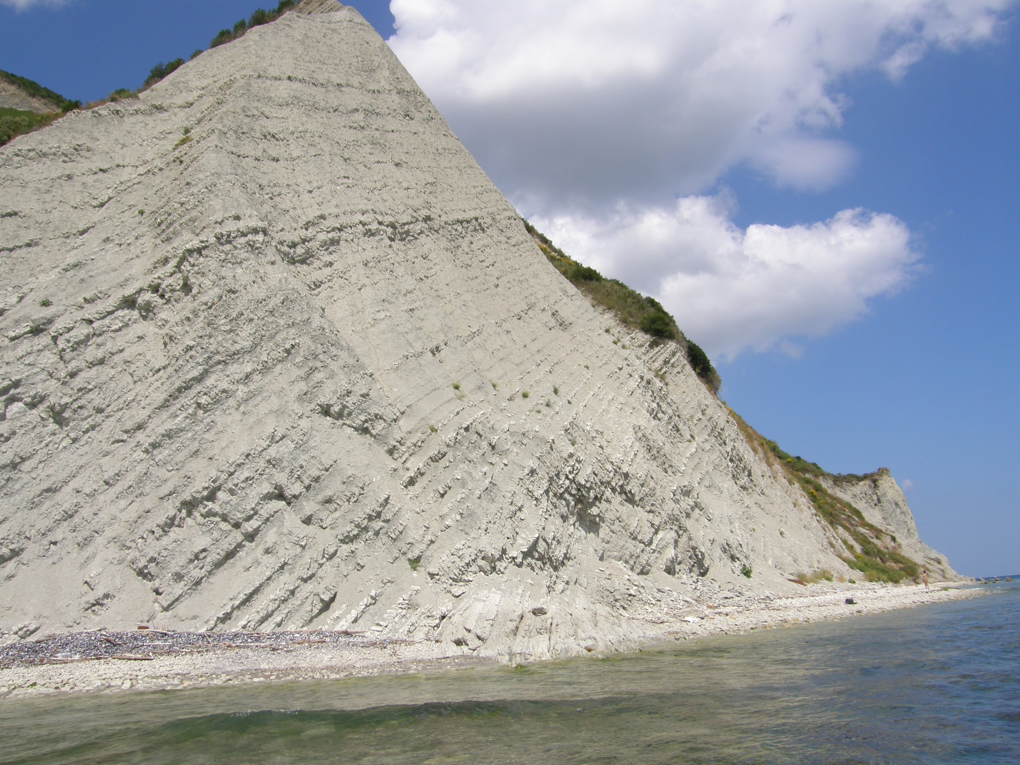
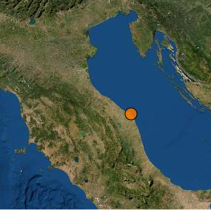
http://sgi.isprambiente.it/gssp/Corvi.aspx

Slide 4
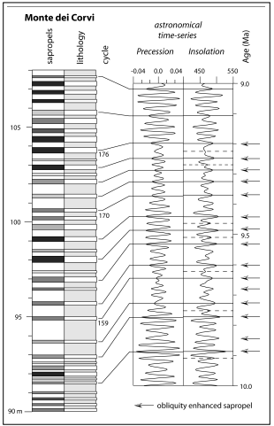
Strasser et al., 2006

Slide 5
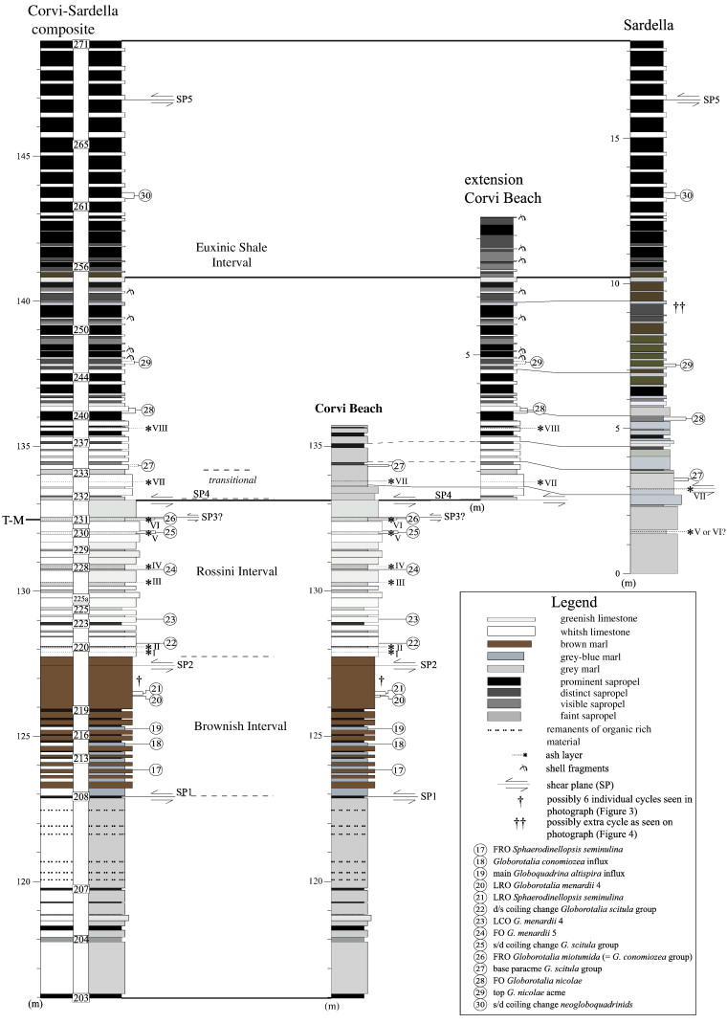
Husing et al., 2009

Slide 6
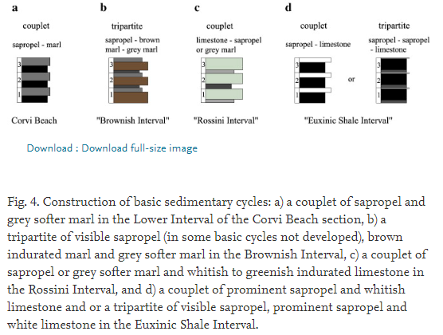
Husing et al., 2009

Slide 7
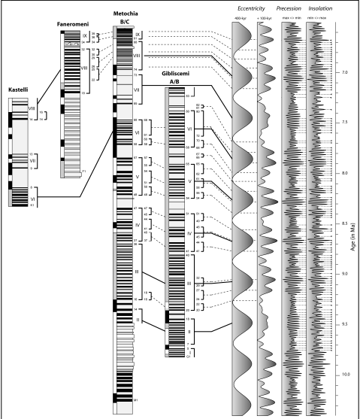
Strasser et al., 2006

Slide 8
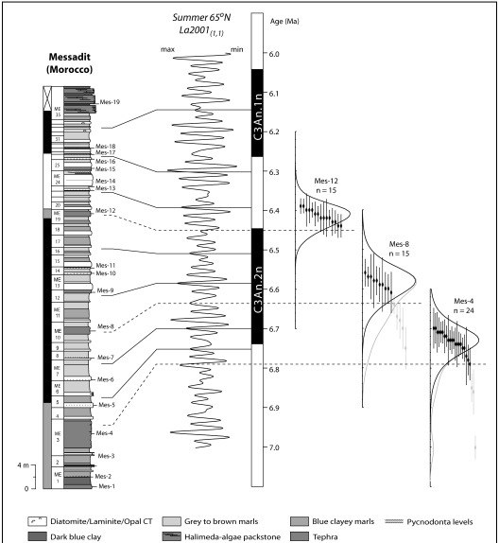
Strasser et al., 2006

Slide 9
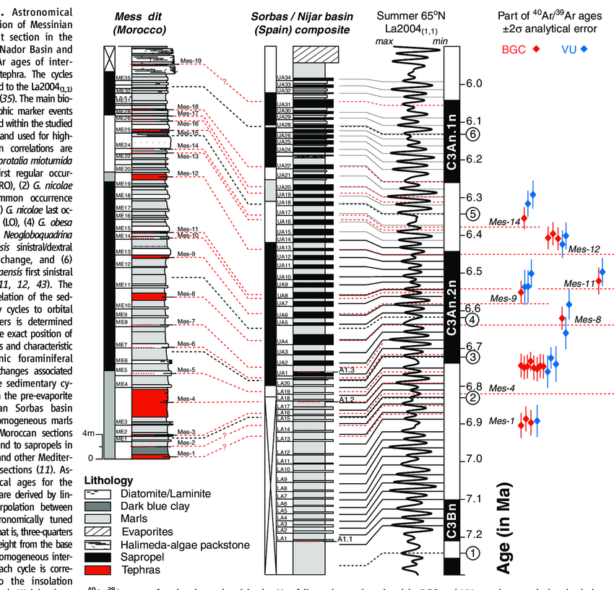
Kuiper et al., 2008

Slide 11
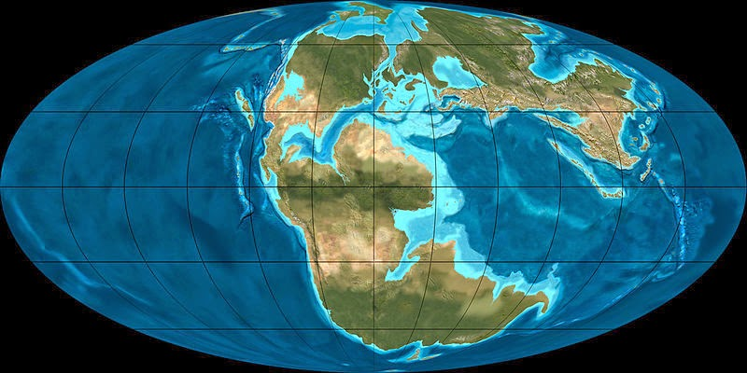
Ron Blakey and Colorado Plateau Geosystems/ with permission

Slide 12
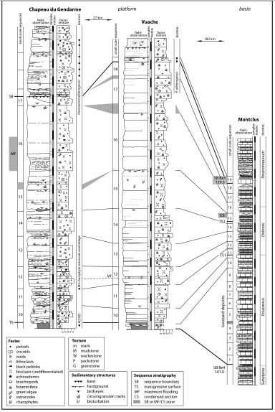
Strasser et al., 2006

Slide 13
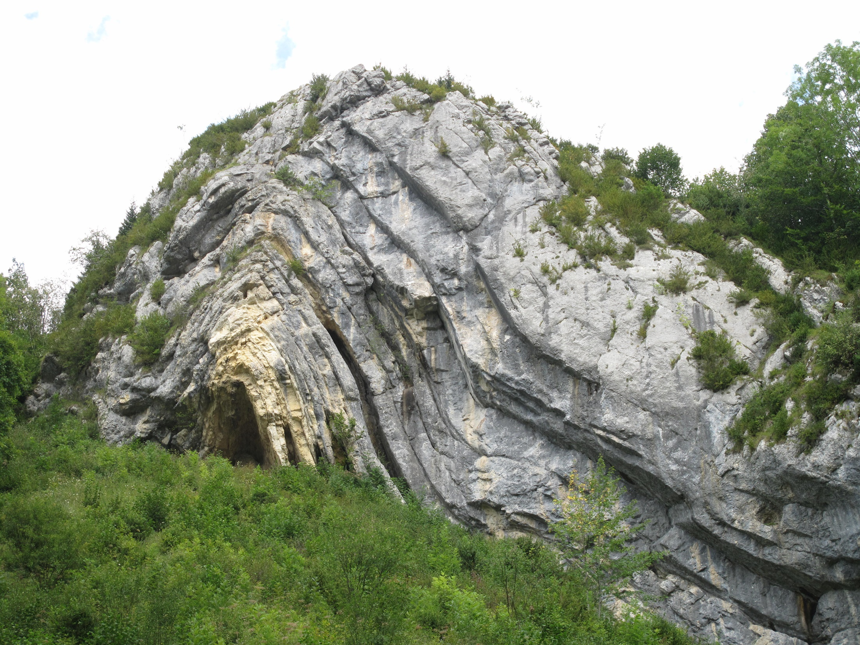
Chapeau de gendarme (Jura); https://fr.m.wikipedia.org/

Slide 14
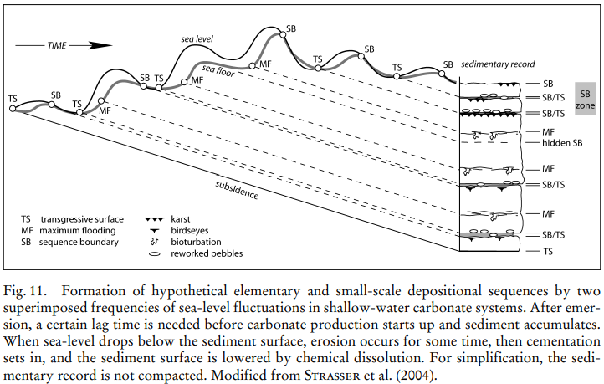
Strasser et al., 2006

Slide 15
Strasser et al., 2006

Slide 16
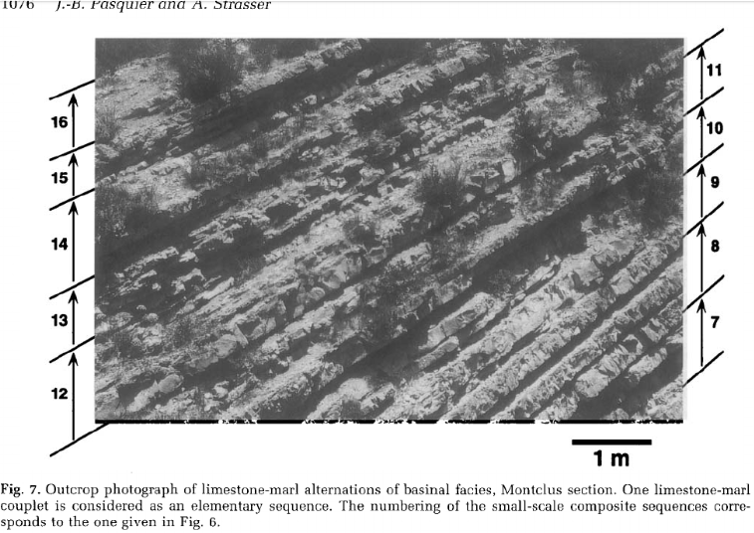
Pasquier and Strasser, 1997

Slide 17
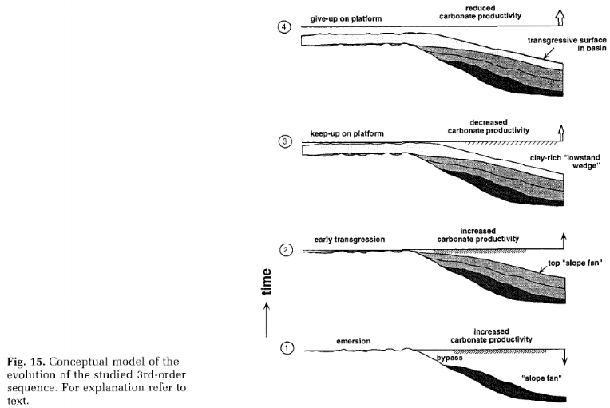
Pasquier and Strasser, 1997

Slide 19
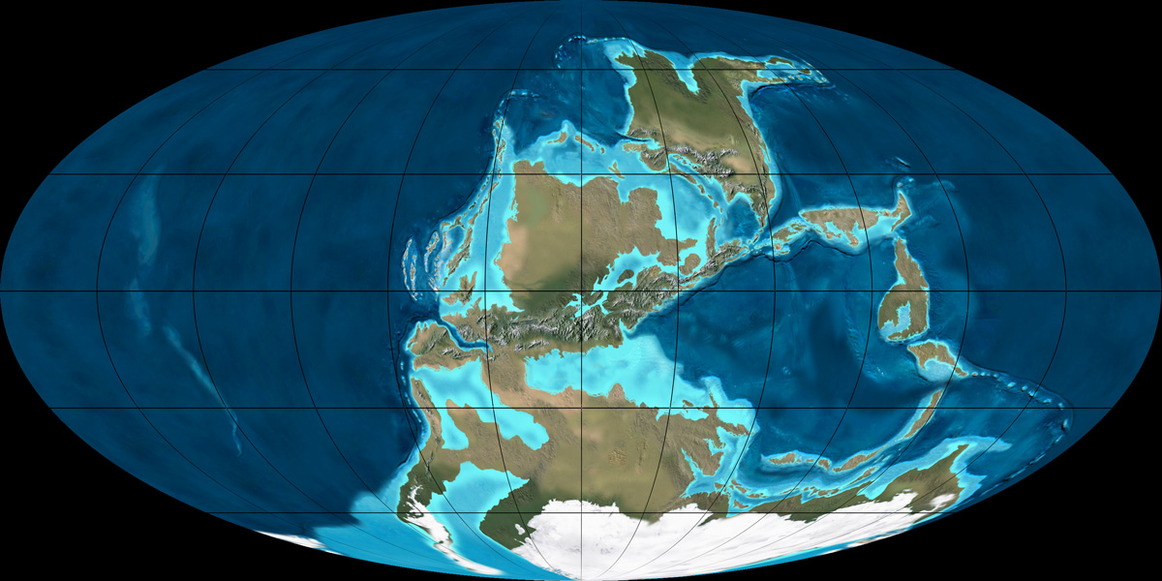

Slide 20
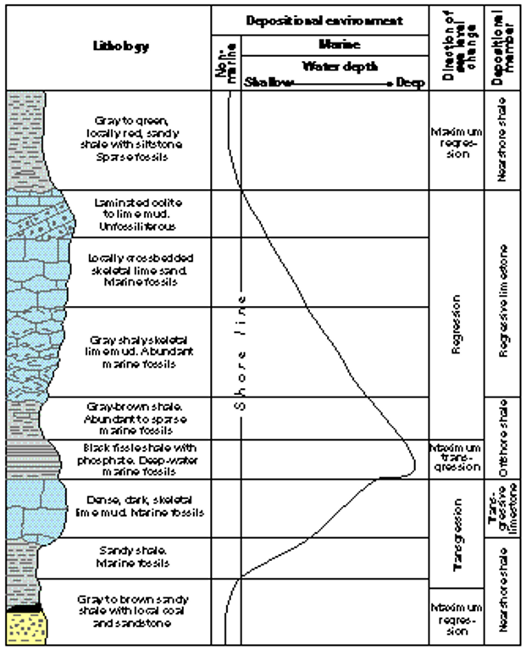
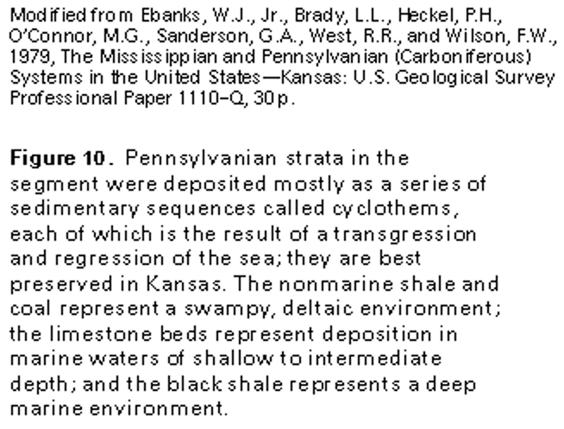

Slide 21
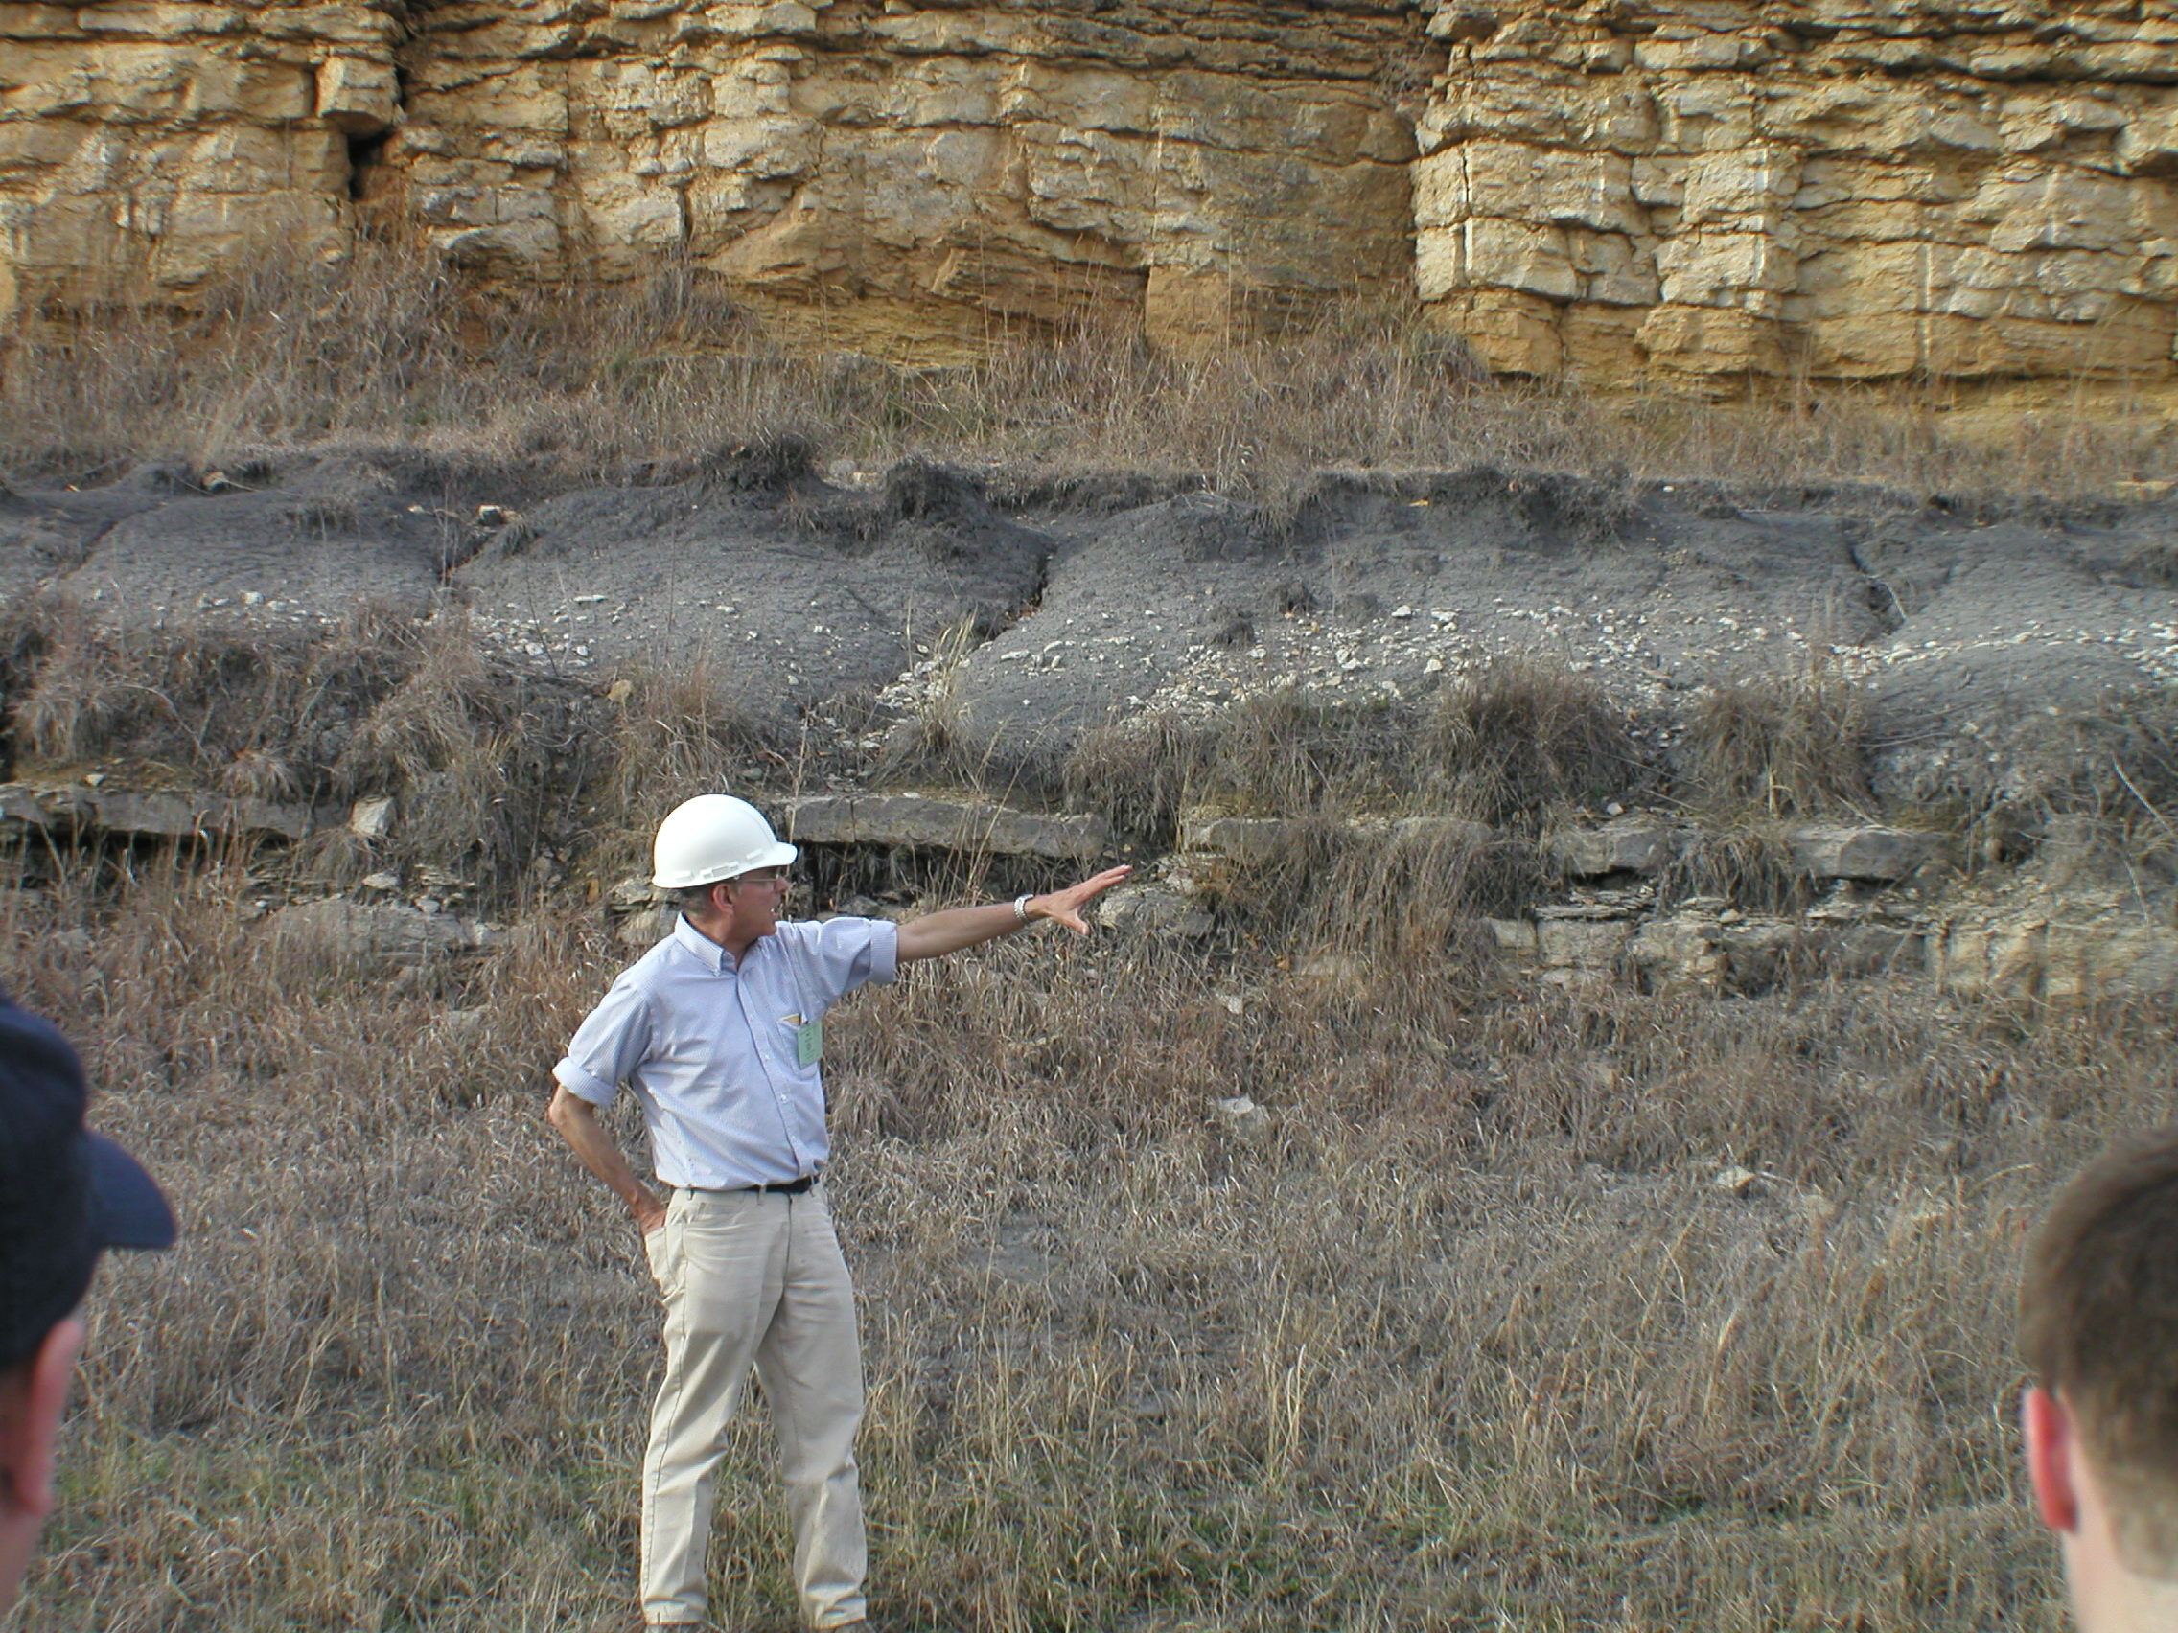

Slide 22
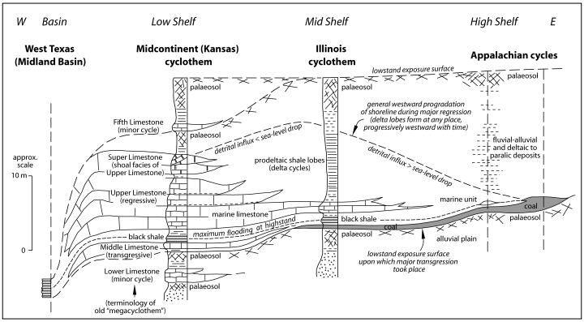
Strasser et al., 2006

Slide 23
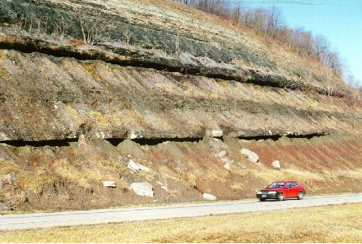
Ames Limestone, top of Glenshaw Formation, Conemaugh Group, Allegheny County, PA

Slide 24
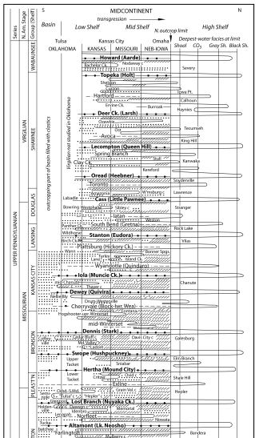
Strasser et al., 2006

Slide 25
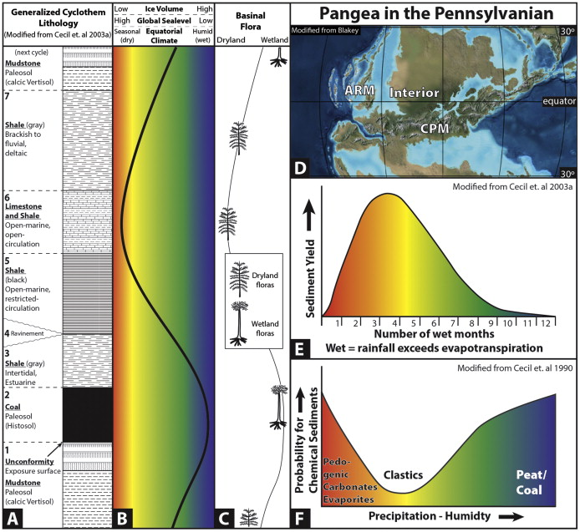
Cecil et al., 2014

Slide 26
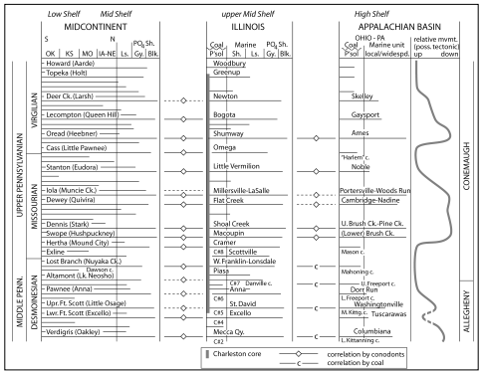
Strasser et al., 2006

Slide 27
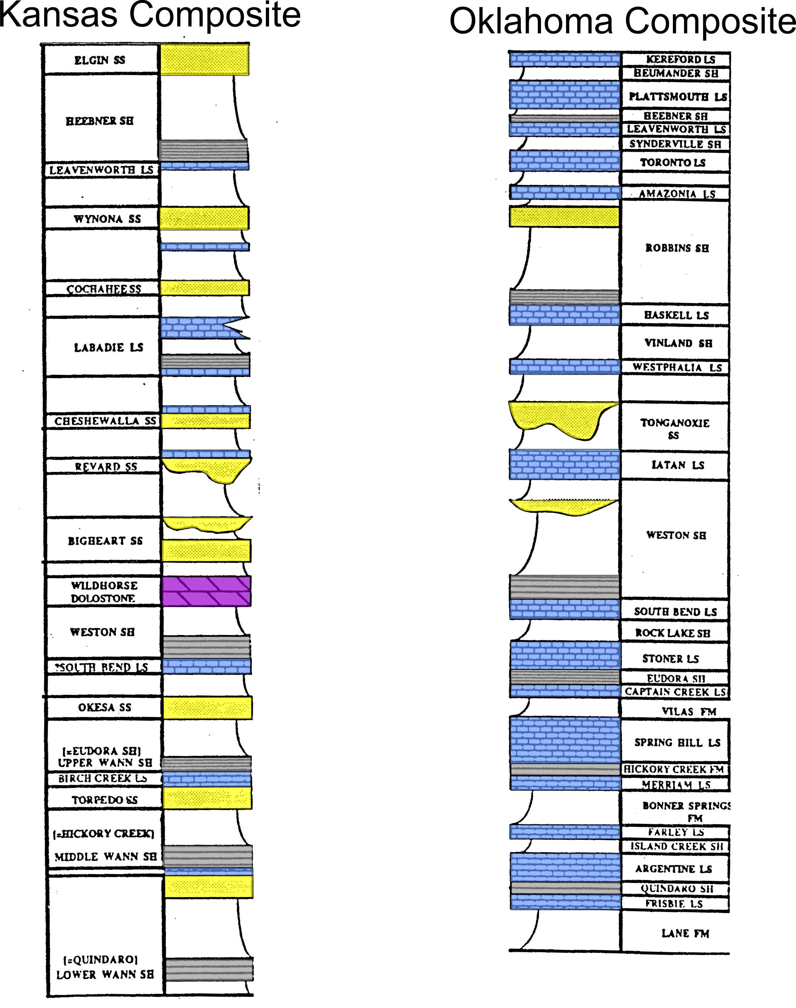
Correlation problem: Carboniferous
strata in Kansas-Oklahoma

Slide 29
