Slide 1
GI 261 Cyclostratigraphy and Astrochronology
Exercise for 2022x06

Slide 2
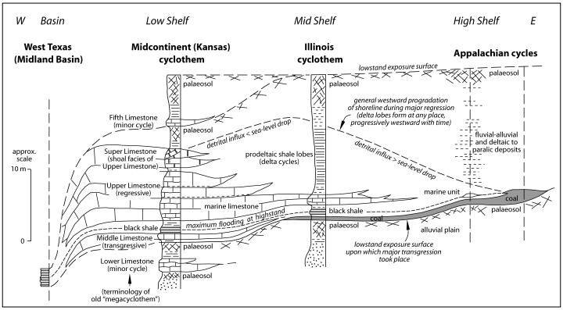
Strasser et al., 2006

Slide 3
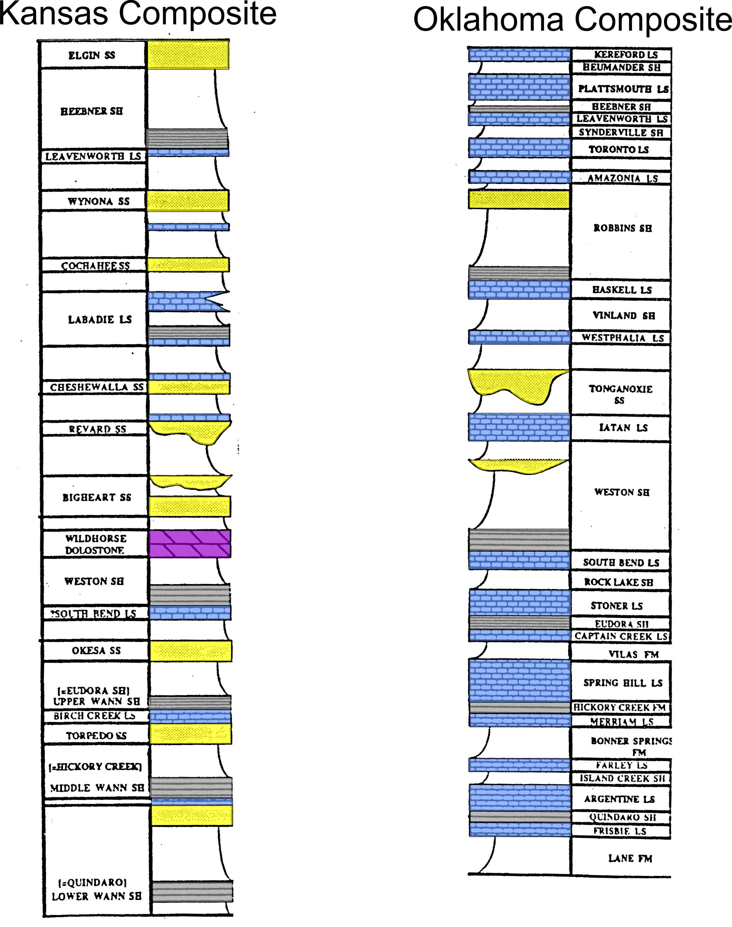
Correlation problem: Carboniferous
strata in Kansas-Oklahoma

