Slide 1
GI 261 – Cyclic Stratigraphy
and Astrochronology
Who am I
Who are you
What the class is about
What you need to know
What you need to do

Slide 2
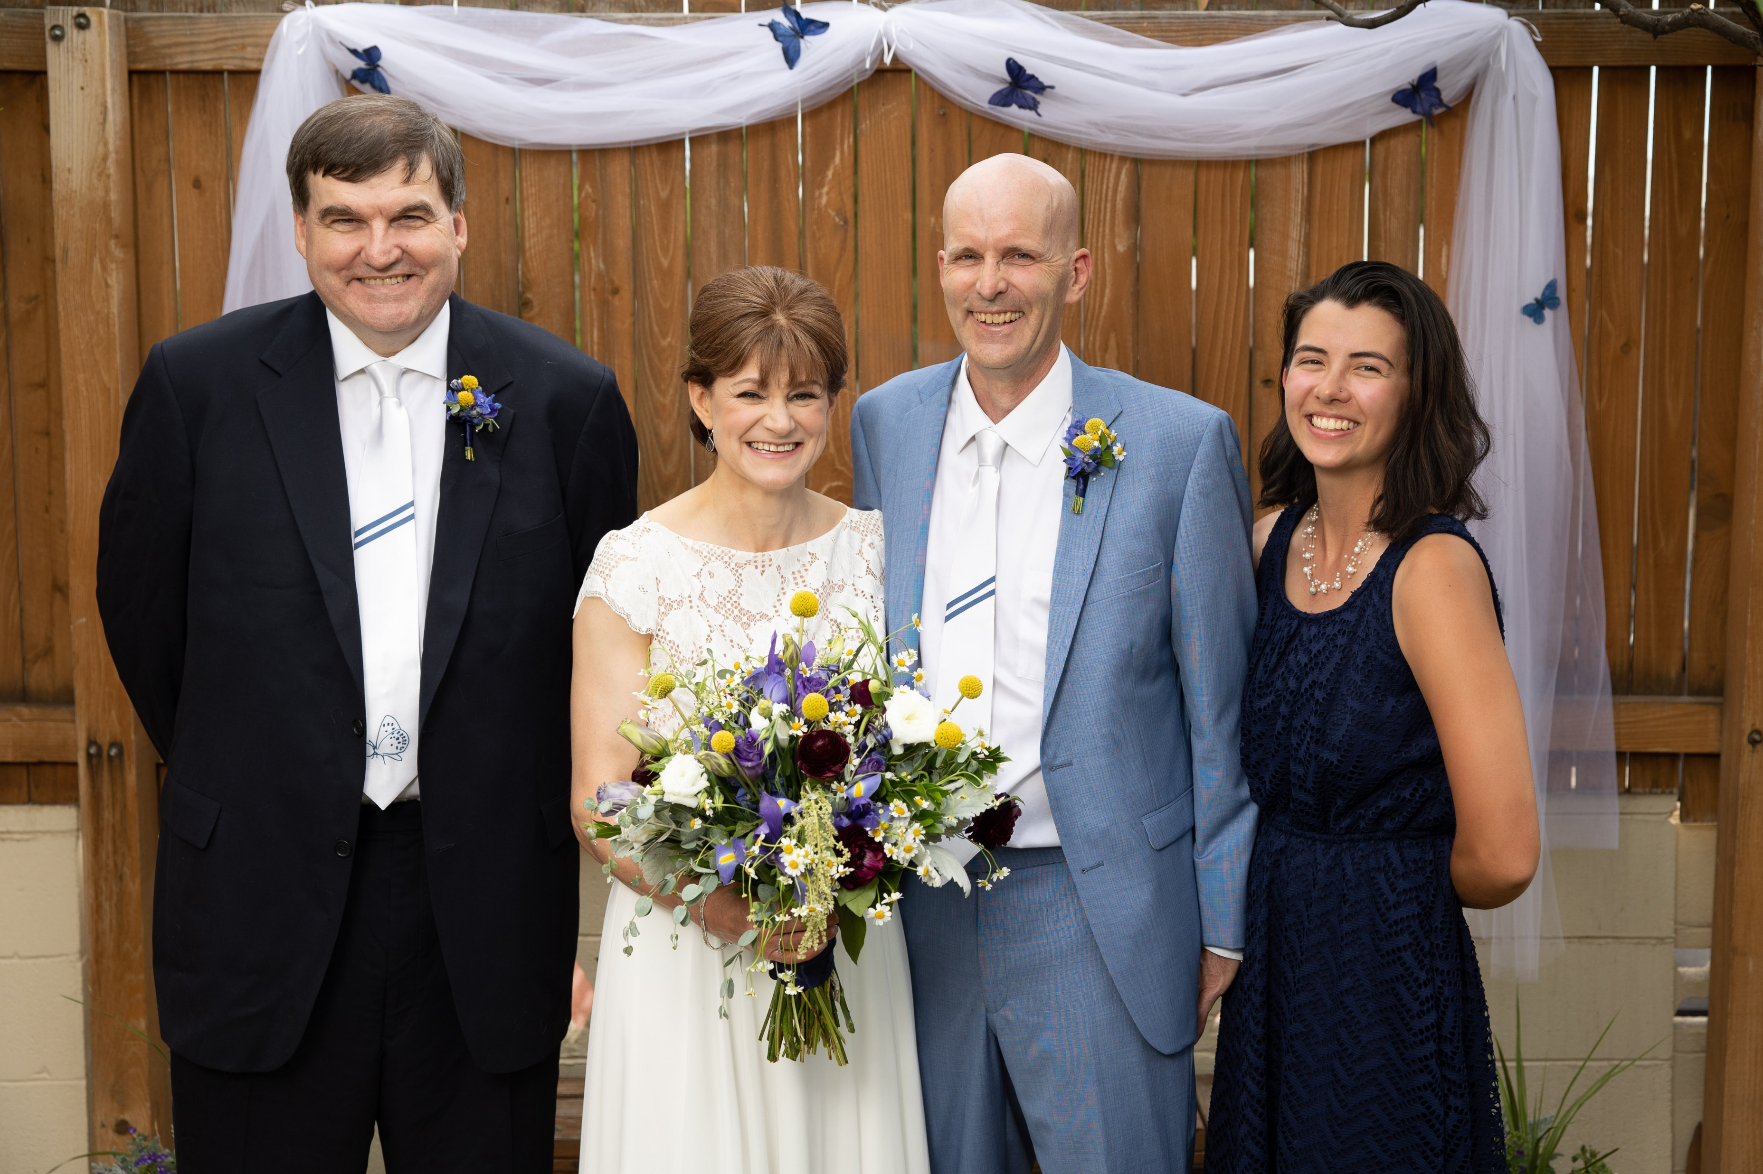

Slide 3
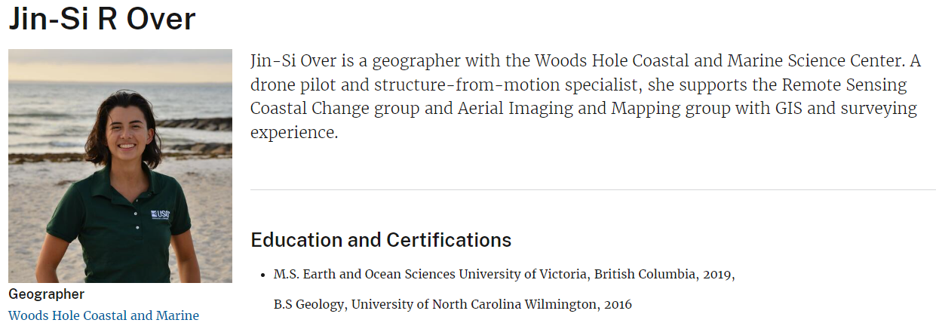
https://www.usgs.gov/staff-profiles/jin-si-r-over
https://www.usgs.gov/news/researcher-spotlight-jin-si-over

Slide 4
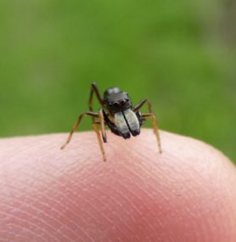

Slide 5
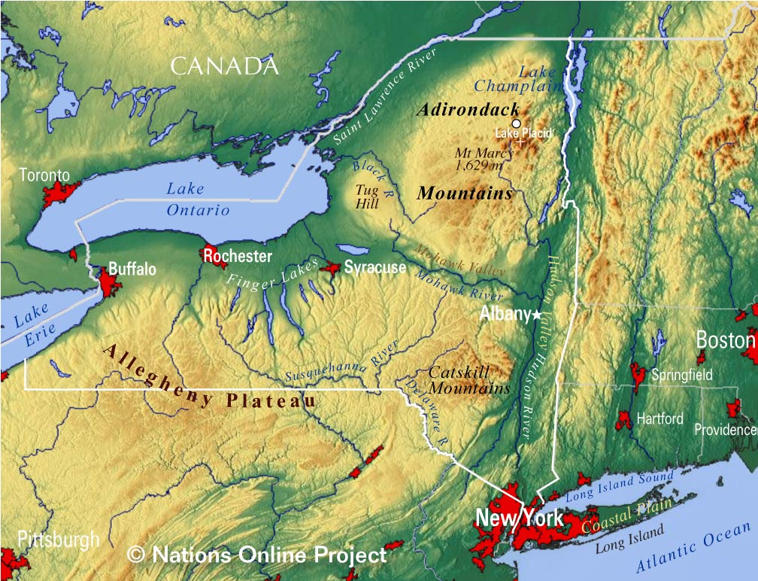
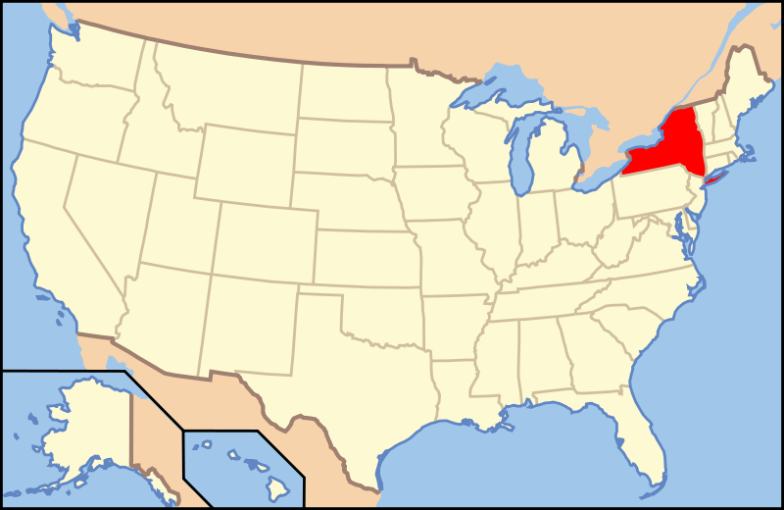
Who am I – map of New York

Slide 6
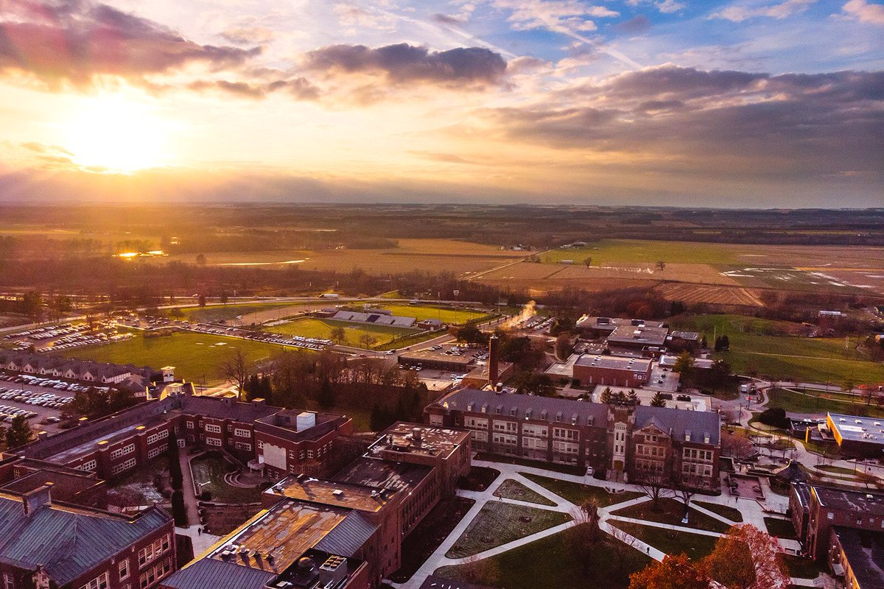
Who am I – picture of college

Slide 8
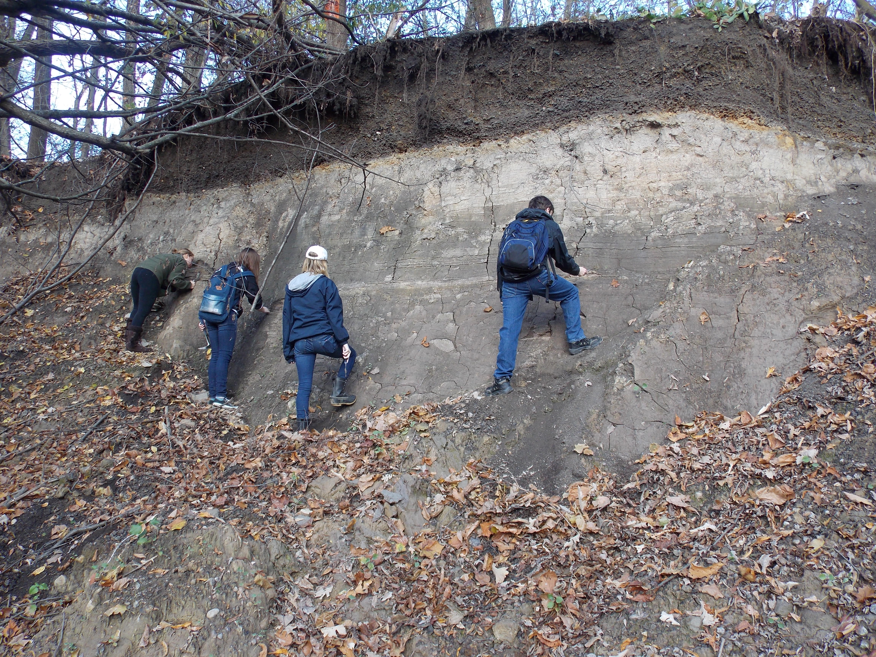

Slide 9
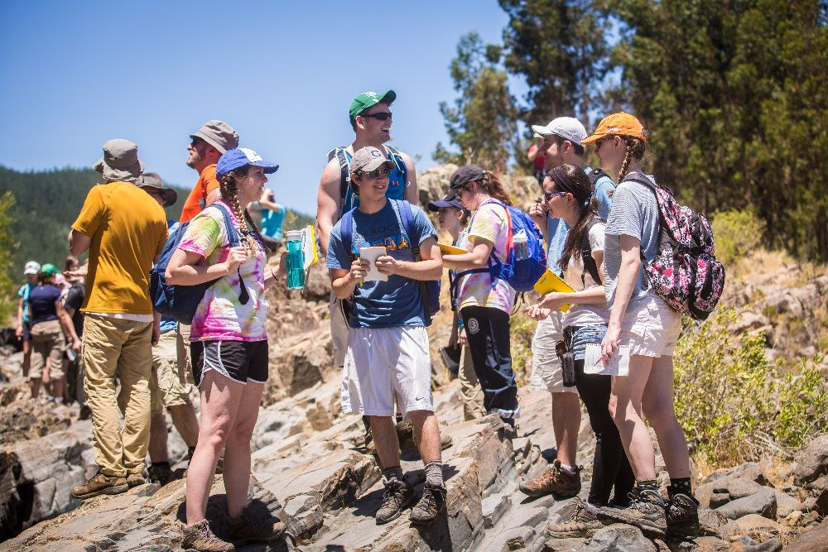

Slide 10
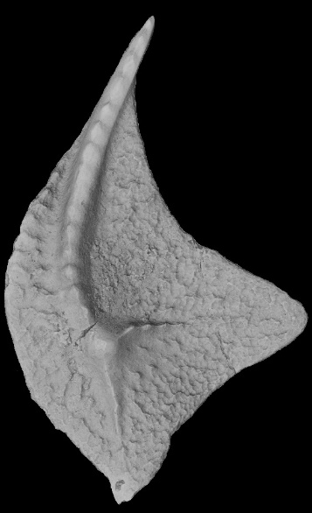
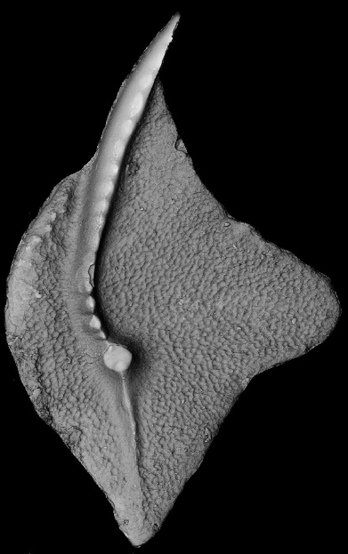
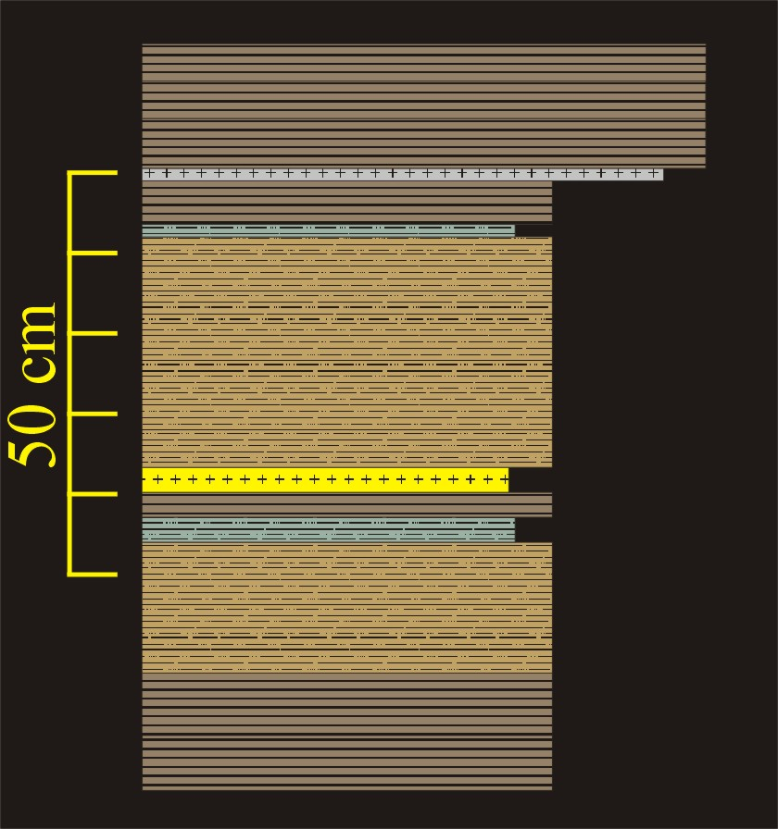
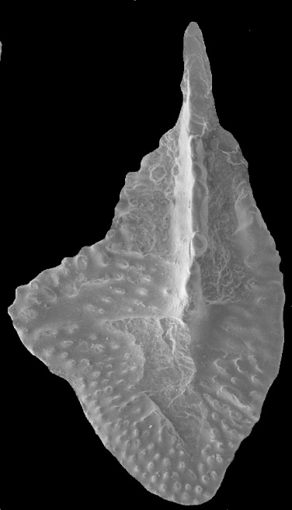
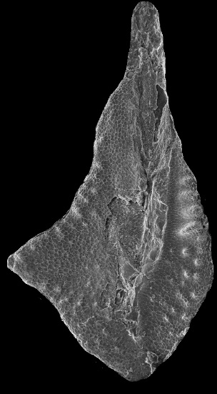
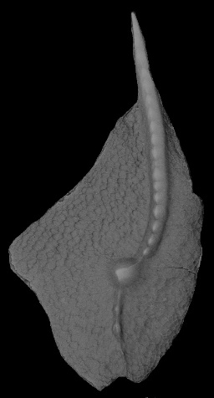
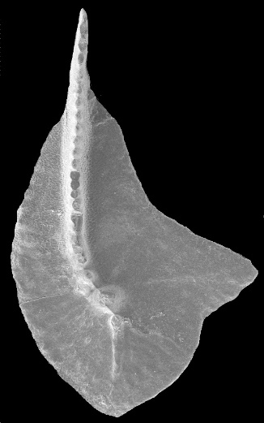
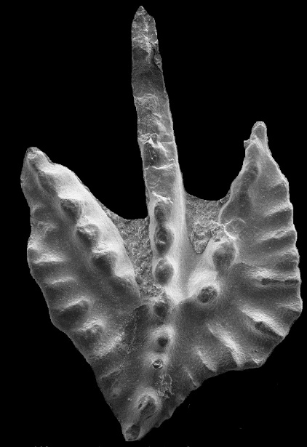
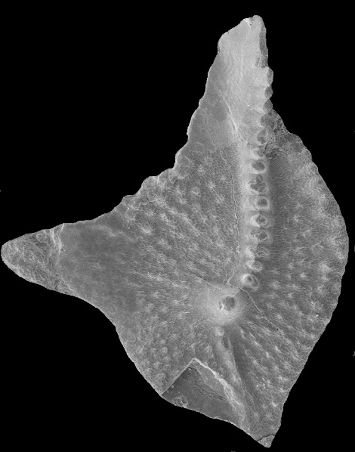
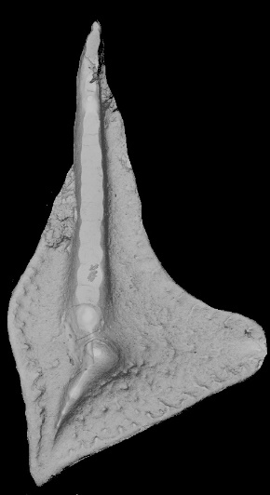
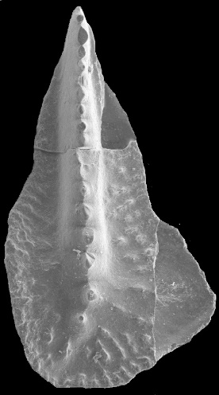
Notes:
Center Hill Tephra at Hurricane Bridge, TN

Slide 11
Notes:
11

Slide 12
Notes:
Center Hill Tephra at Hurricane Bridge, TN

Slide 14
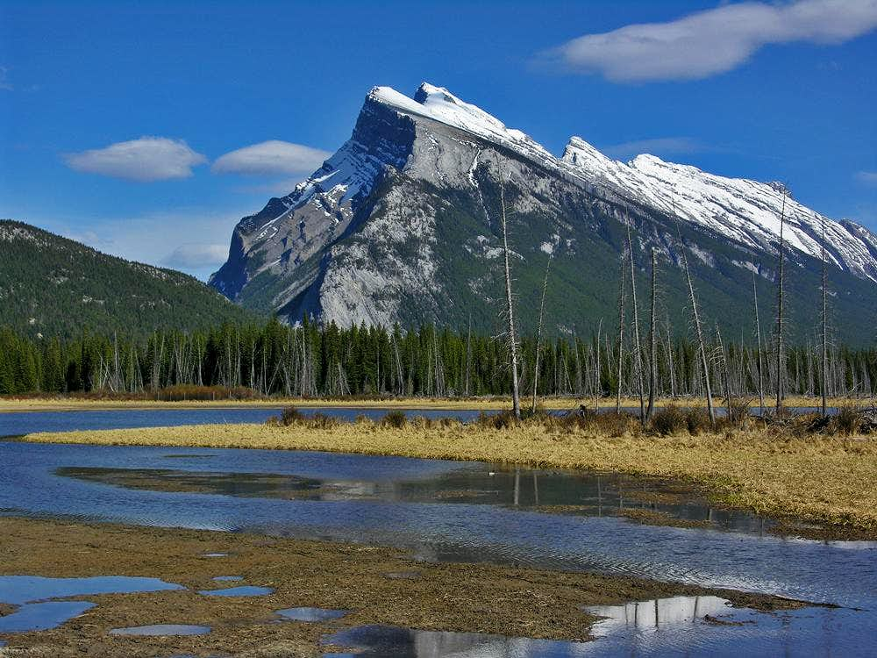
Summit Post

Slide 15
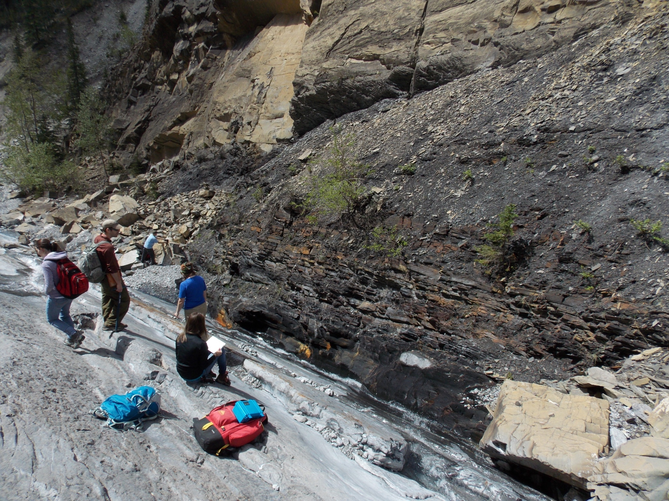
Notes:
Jura Creek

Slide 16
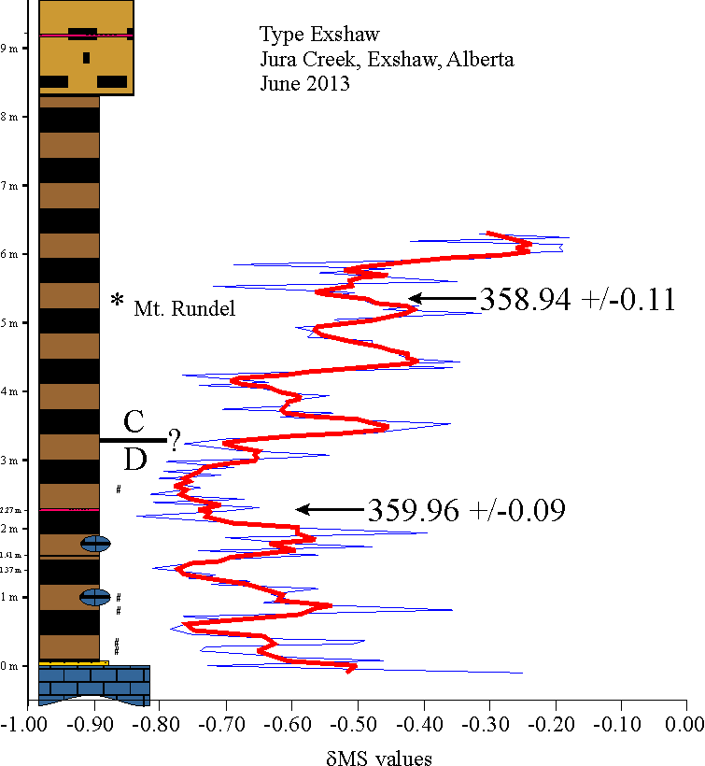
Notes:
Jura Creek

Slide 17
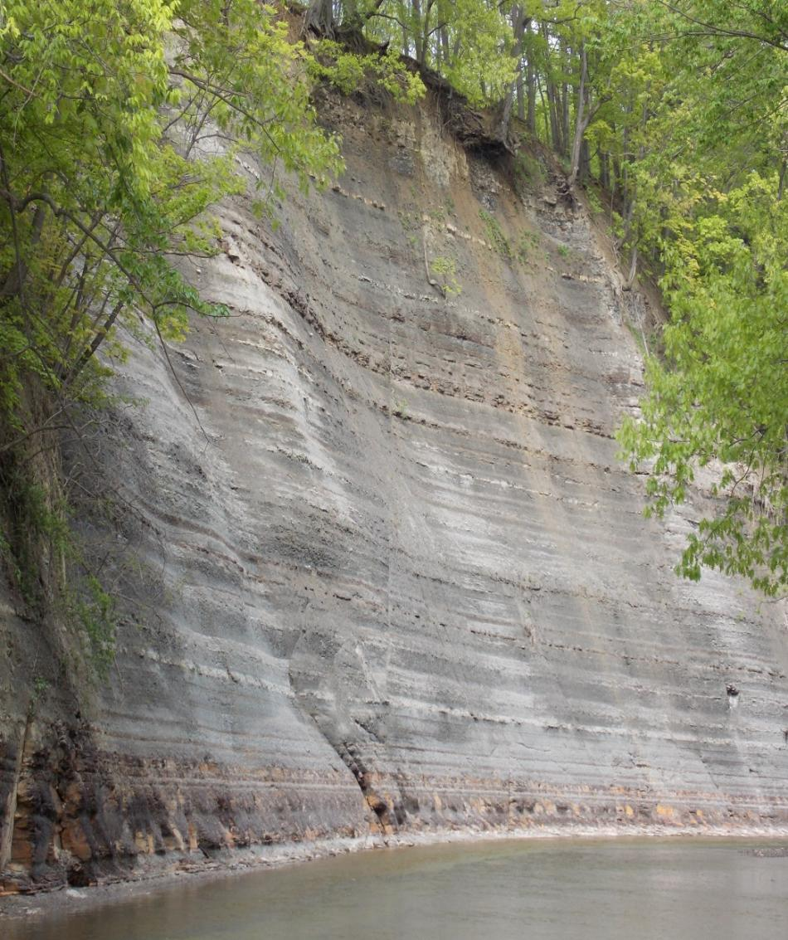

Slide 18
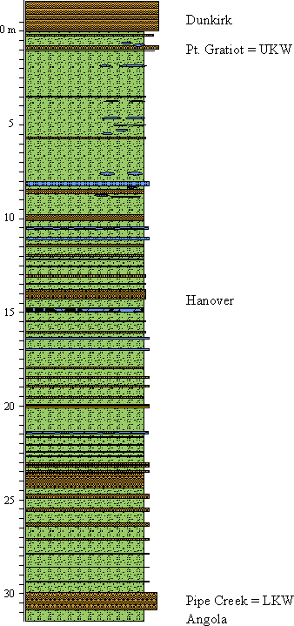
800,000

Slide 19
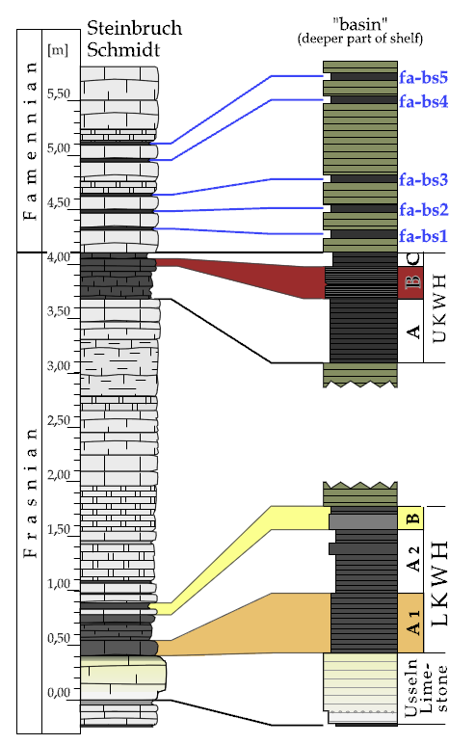
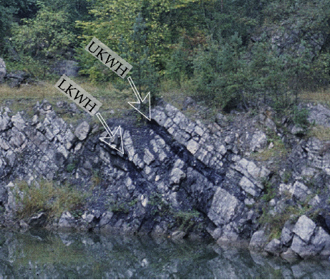
371.85
372.28 +/- 0.15
372.55
Benner Quarry
Gereke and Schindler, 2012
Schmitz pers . comm., 2014

Slide 20
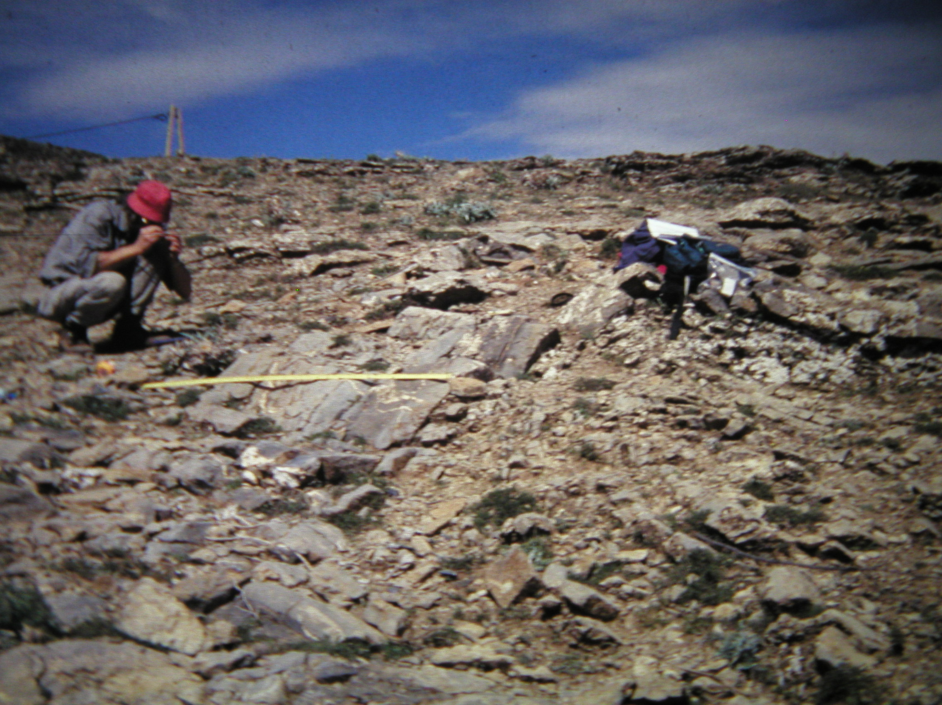

Slide 21
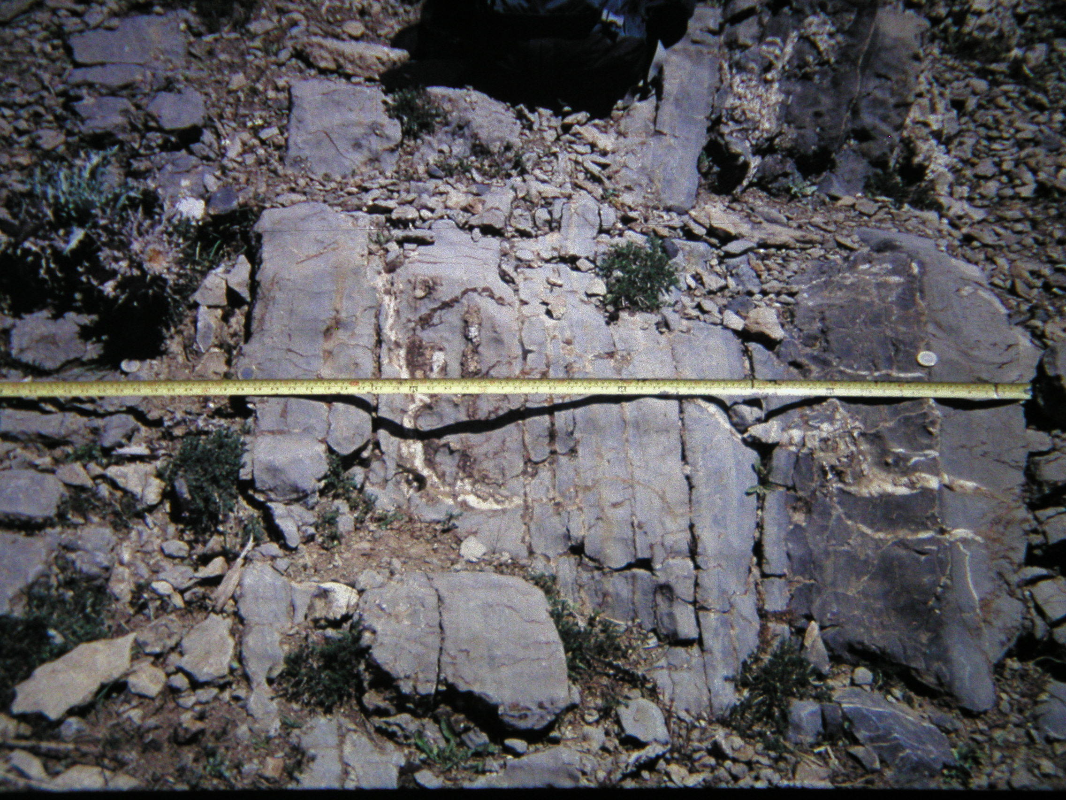

Slide 22
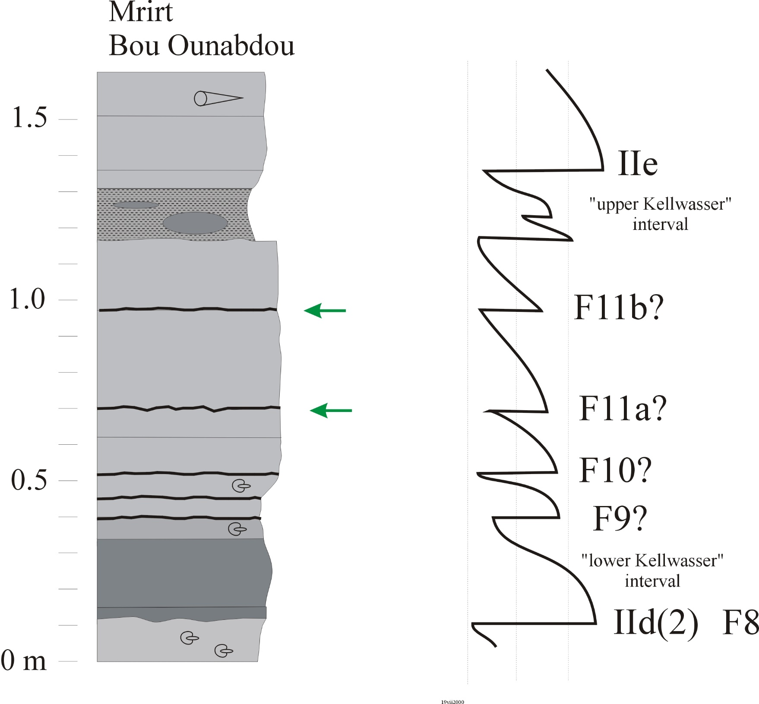

Slide 23
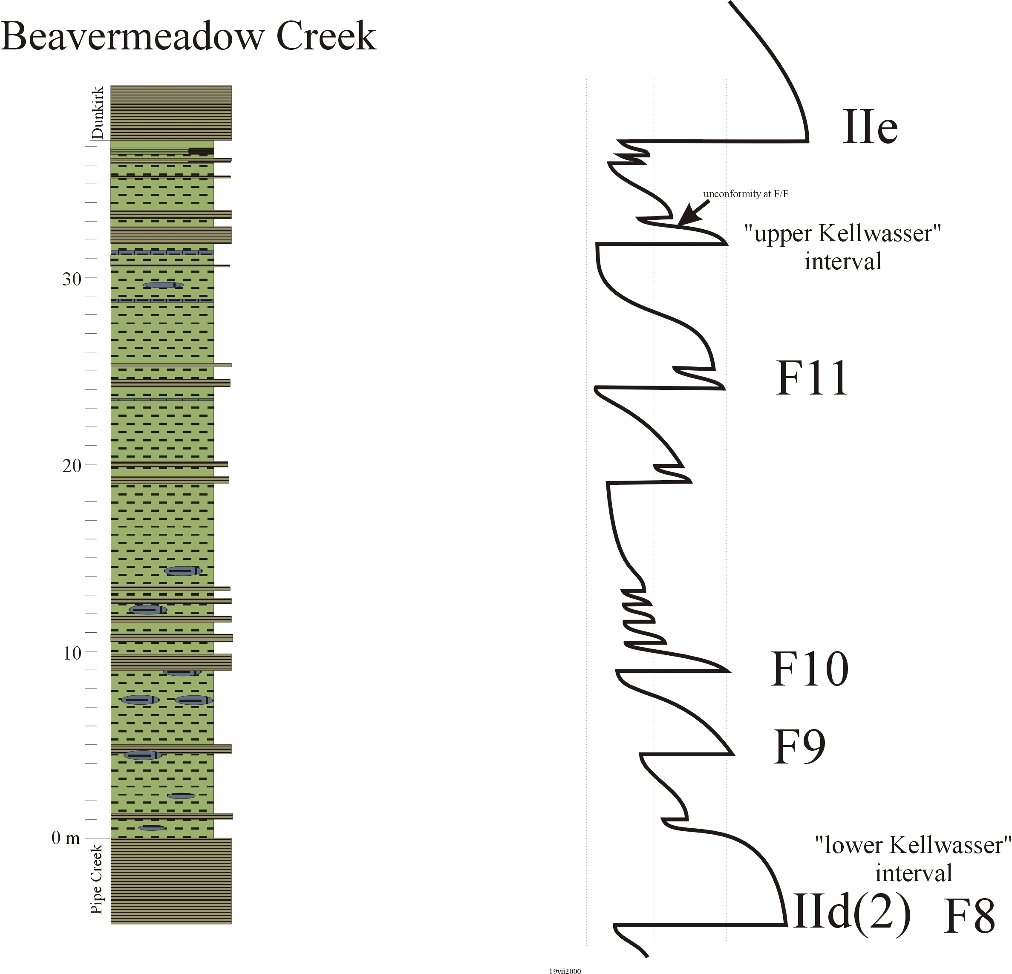

Slide 24
800,000

Slide 25
Short Eccentricity cycles: ~5 m
Obliquity cycles:
~2 m
Precession cycles: ~60 cm
Cycles occur with measured accuracy
Dominant cycle can be used to assess deposition rate, latitude, and duration
Haalstaat cycles – subprecession millennial scale ~5cm

Slide 26
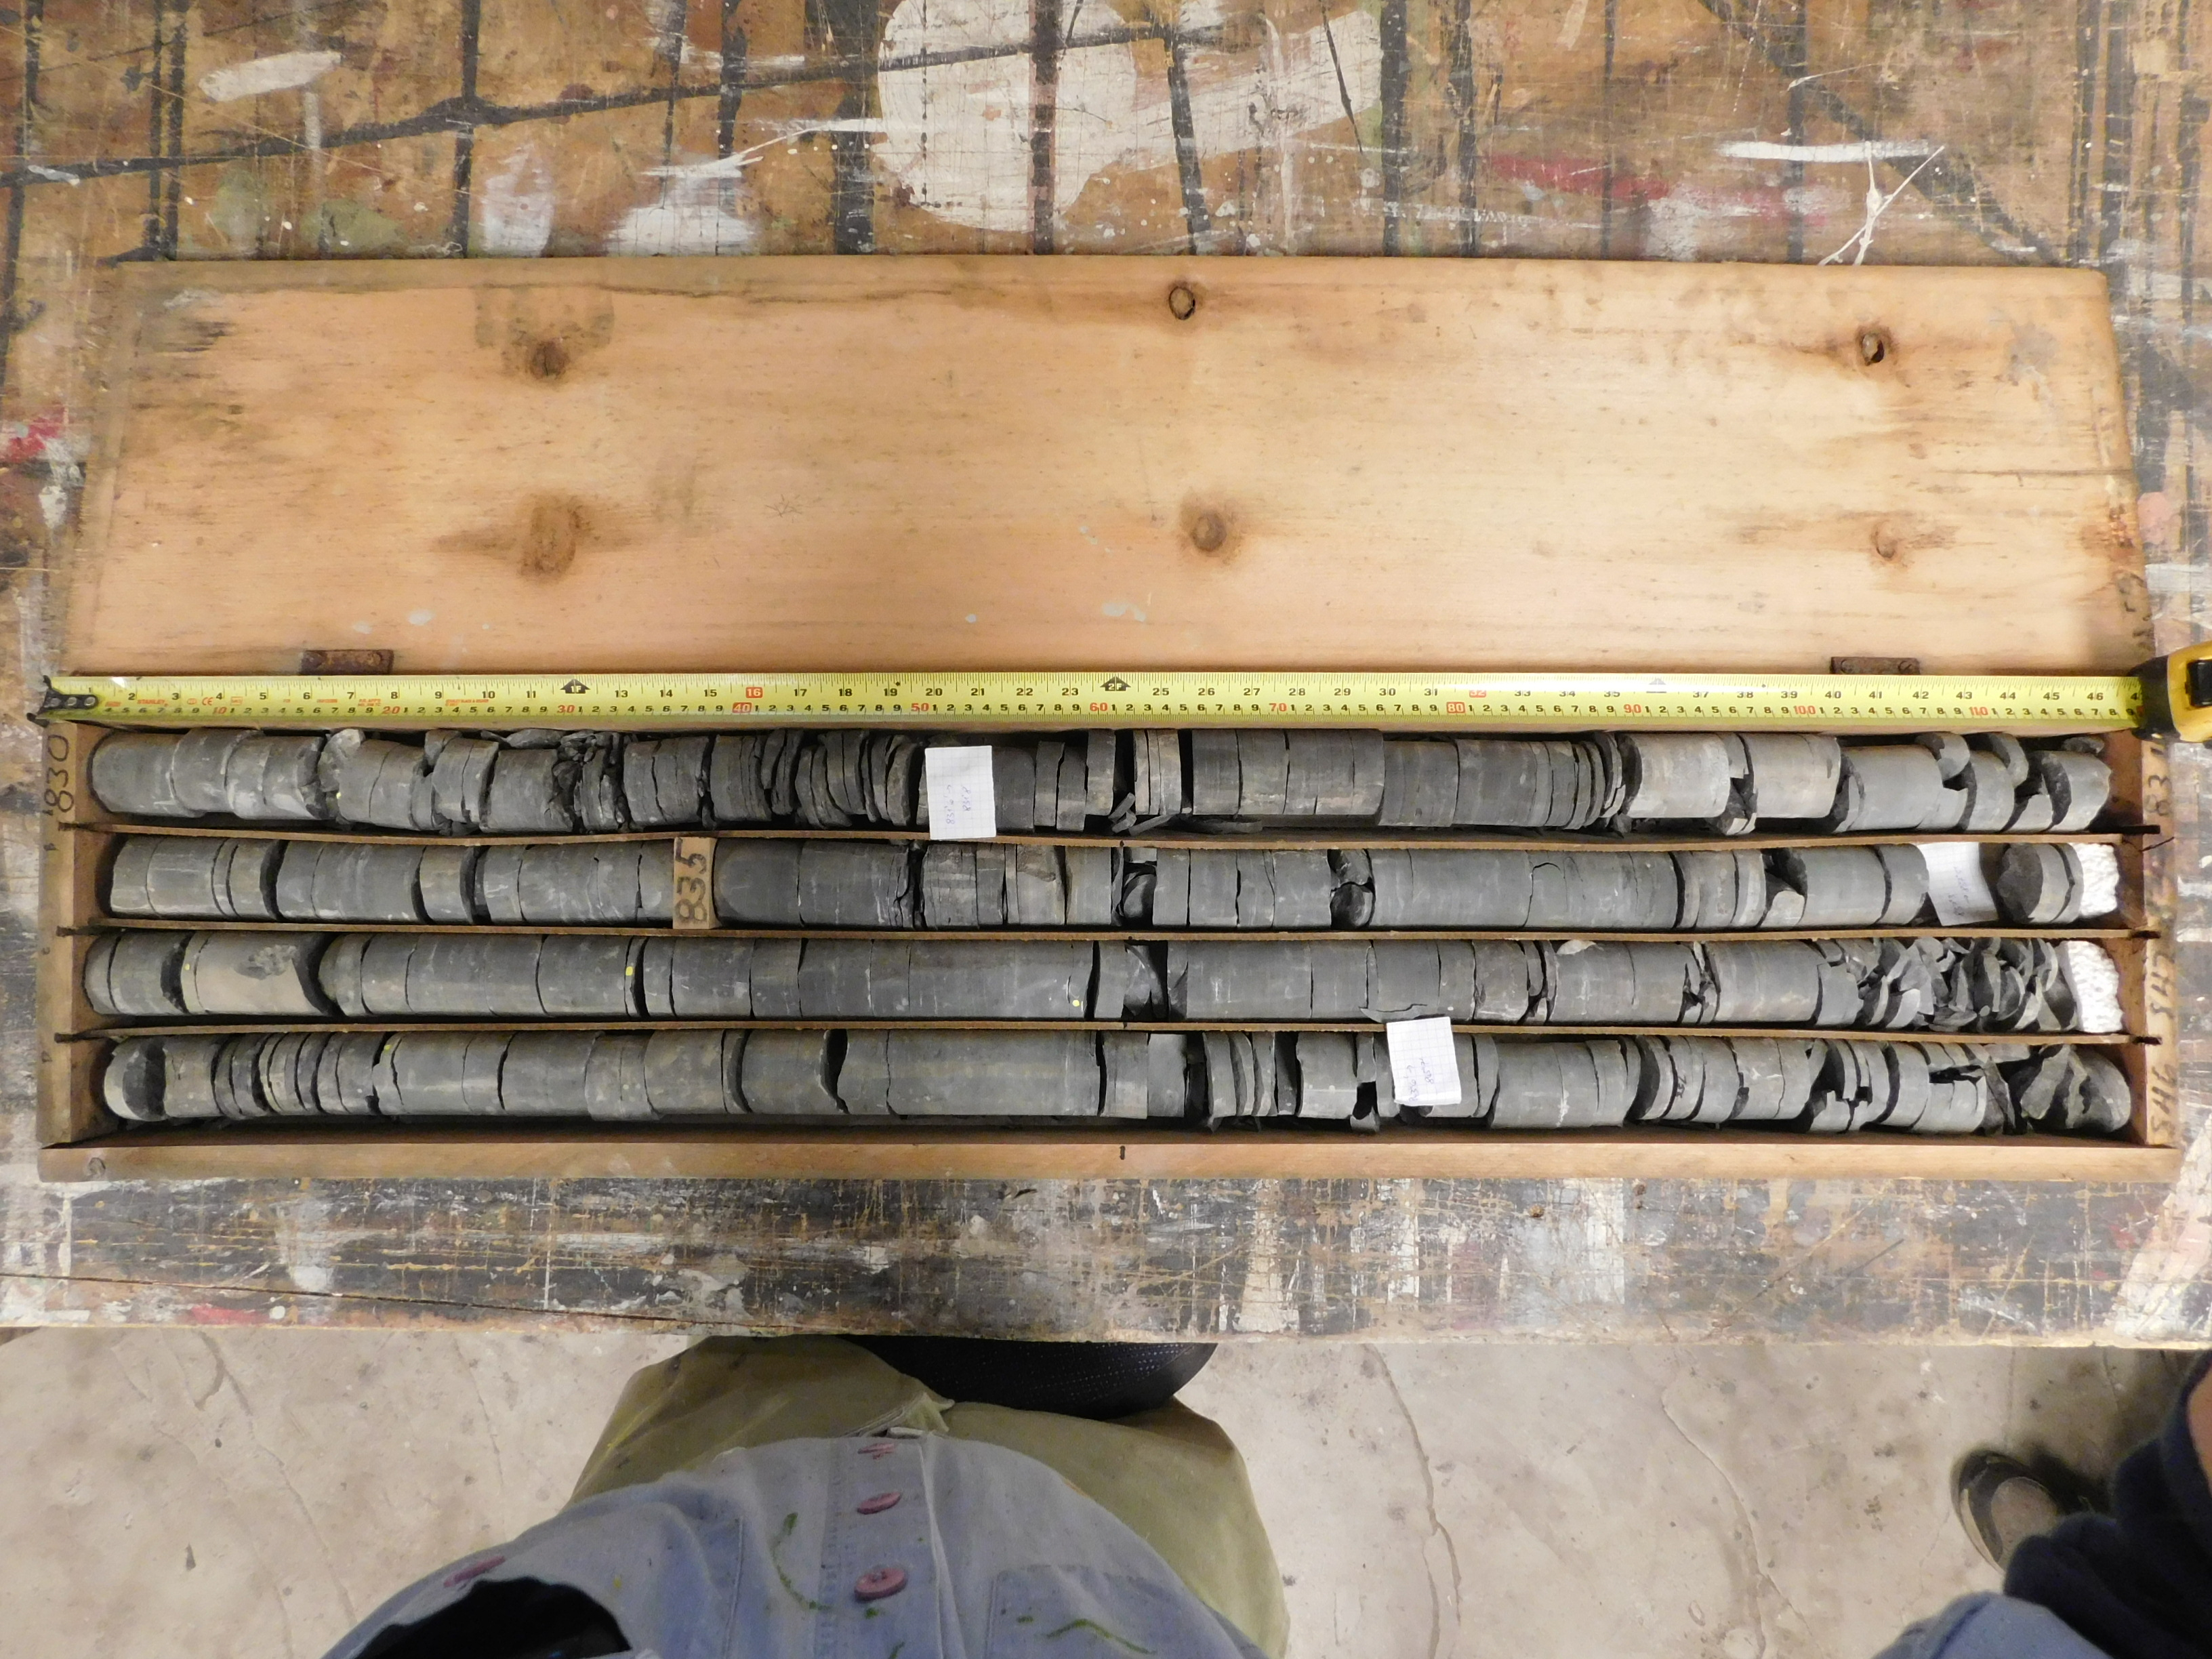

Slide 27
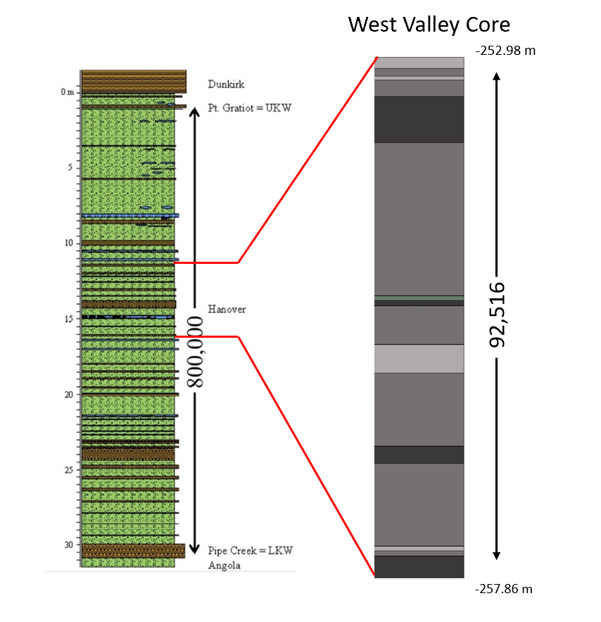

Slide 28
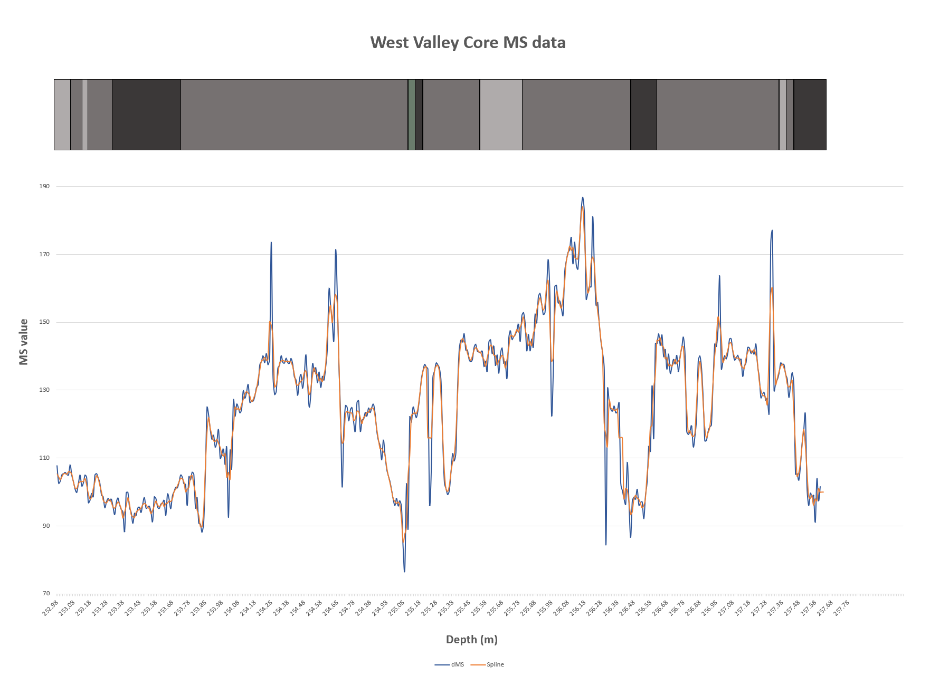

Slide 29
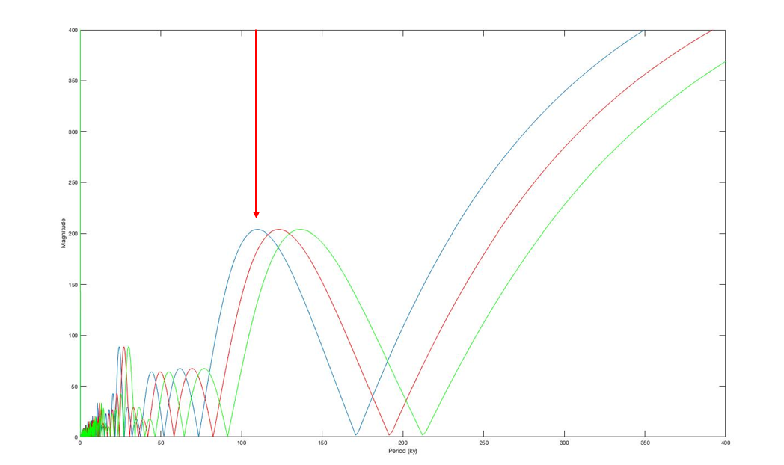
Fourier plot of the delta MS data showing peaks of interest for determination of cycles. A 400 Ky x-axis time limit is used in order to view the big picture of all of the cycles. The red arrow is pointing at a cycle occurring at 100 Ky. The blue line represents the data with an 82,516-year interval. The red line represents the data with a 92,516-year interval. The green line represents the data with a 102,516-year interval.

Slide 30
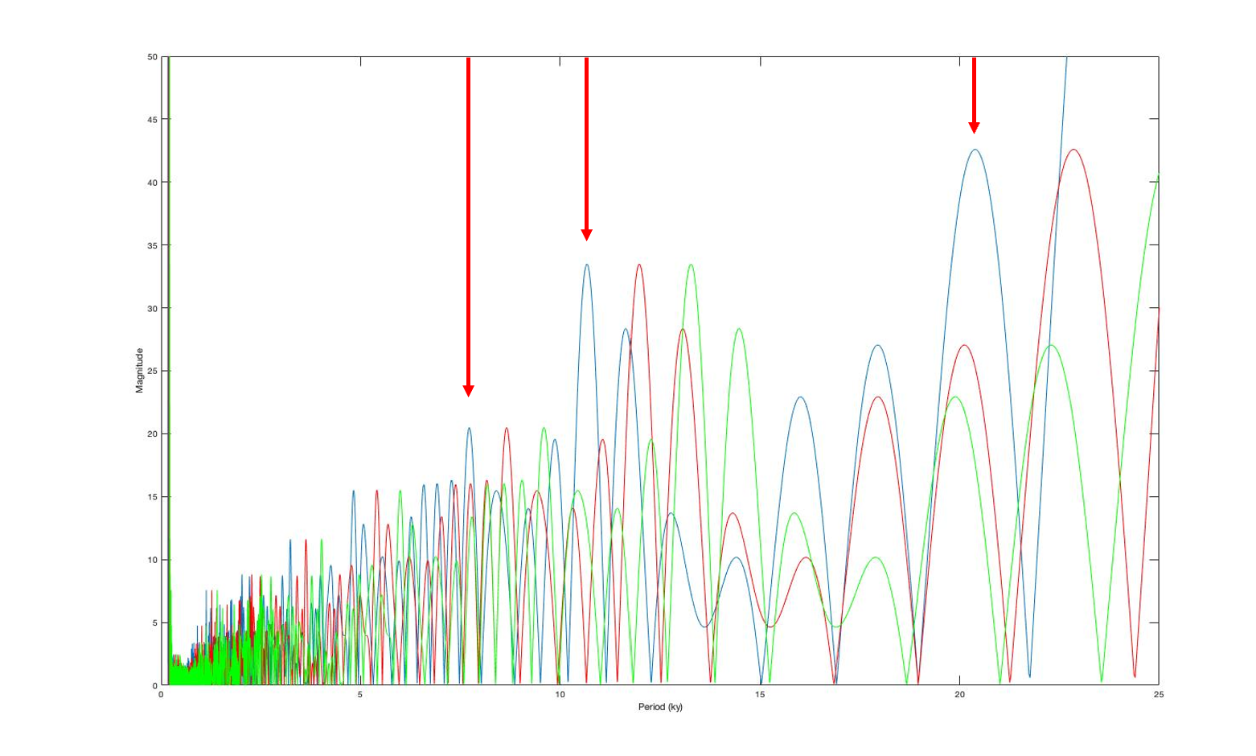
Fourier plot of the delta MS data showing peaks of interest for determination of cycles. A 25 Ky x-axis time limit is used in order to pick out both precession and sub-precession cycles. The red arrows are pointing to cycles occurring at 7 Ky 10-11 Ky and 19-21 Ky. The blue line represents the data with an 82,516-year interval. The red line represents the data with a 92,516-year interval. The green line represents the data with a 102,516-year interval.

Slide 31
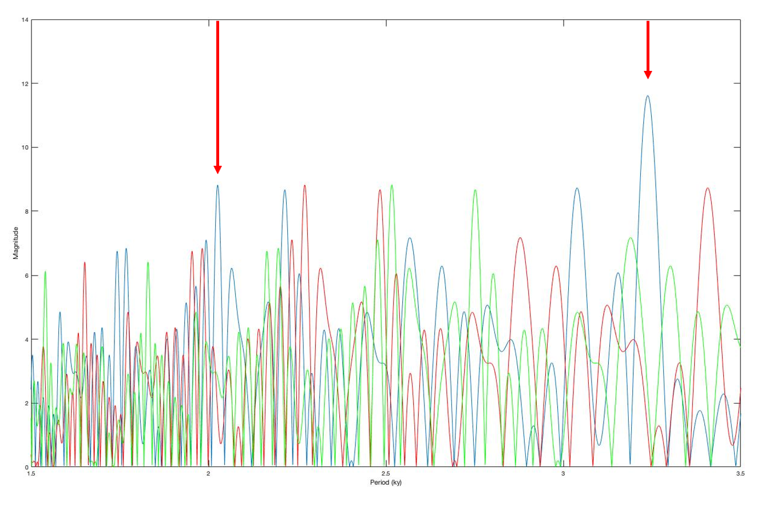
Fourier plot of the delta MS data showing peaks of interest for determination of cycles. A 3.5 Ky x-axis time limit is used in order to view the fine scale sub-precession cycles. The red arrows are pointing to cycles occurring at 2.0-2.05 Ky and 3.2-3.3 Ky. The blue line represents the data with an 82,516-year interval. The red line represents the data with a 92,516-year interval. The green line represents the data with a 102,516-year interval.

Slide 32
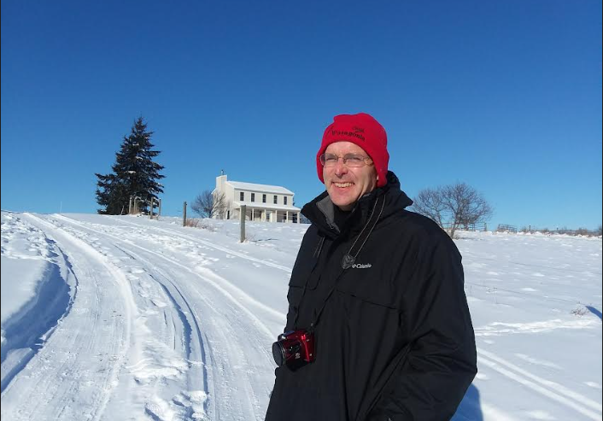

Slide 33
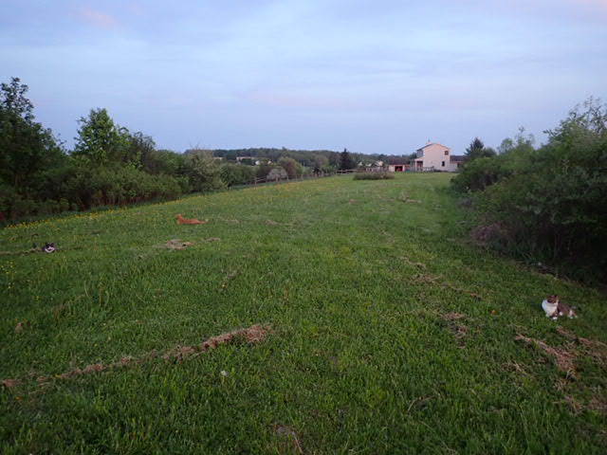

Slide 34
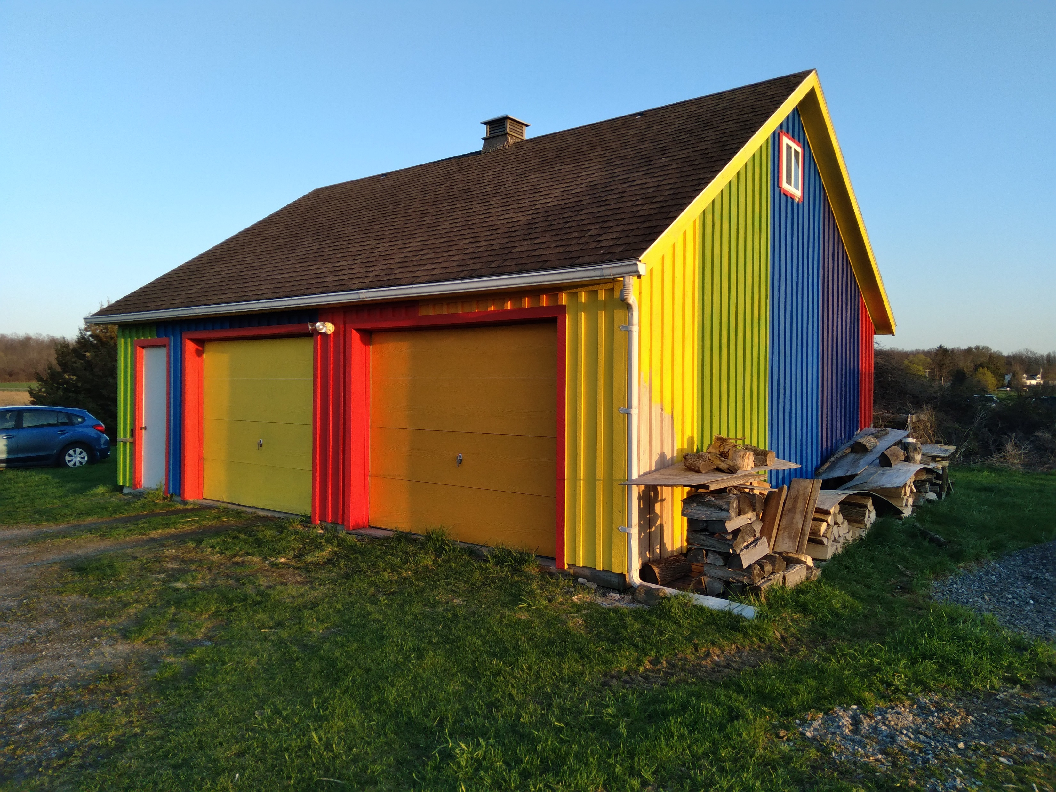

Slide 36
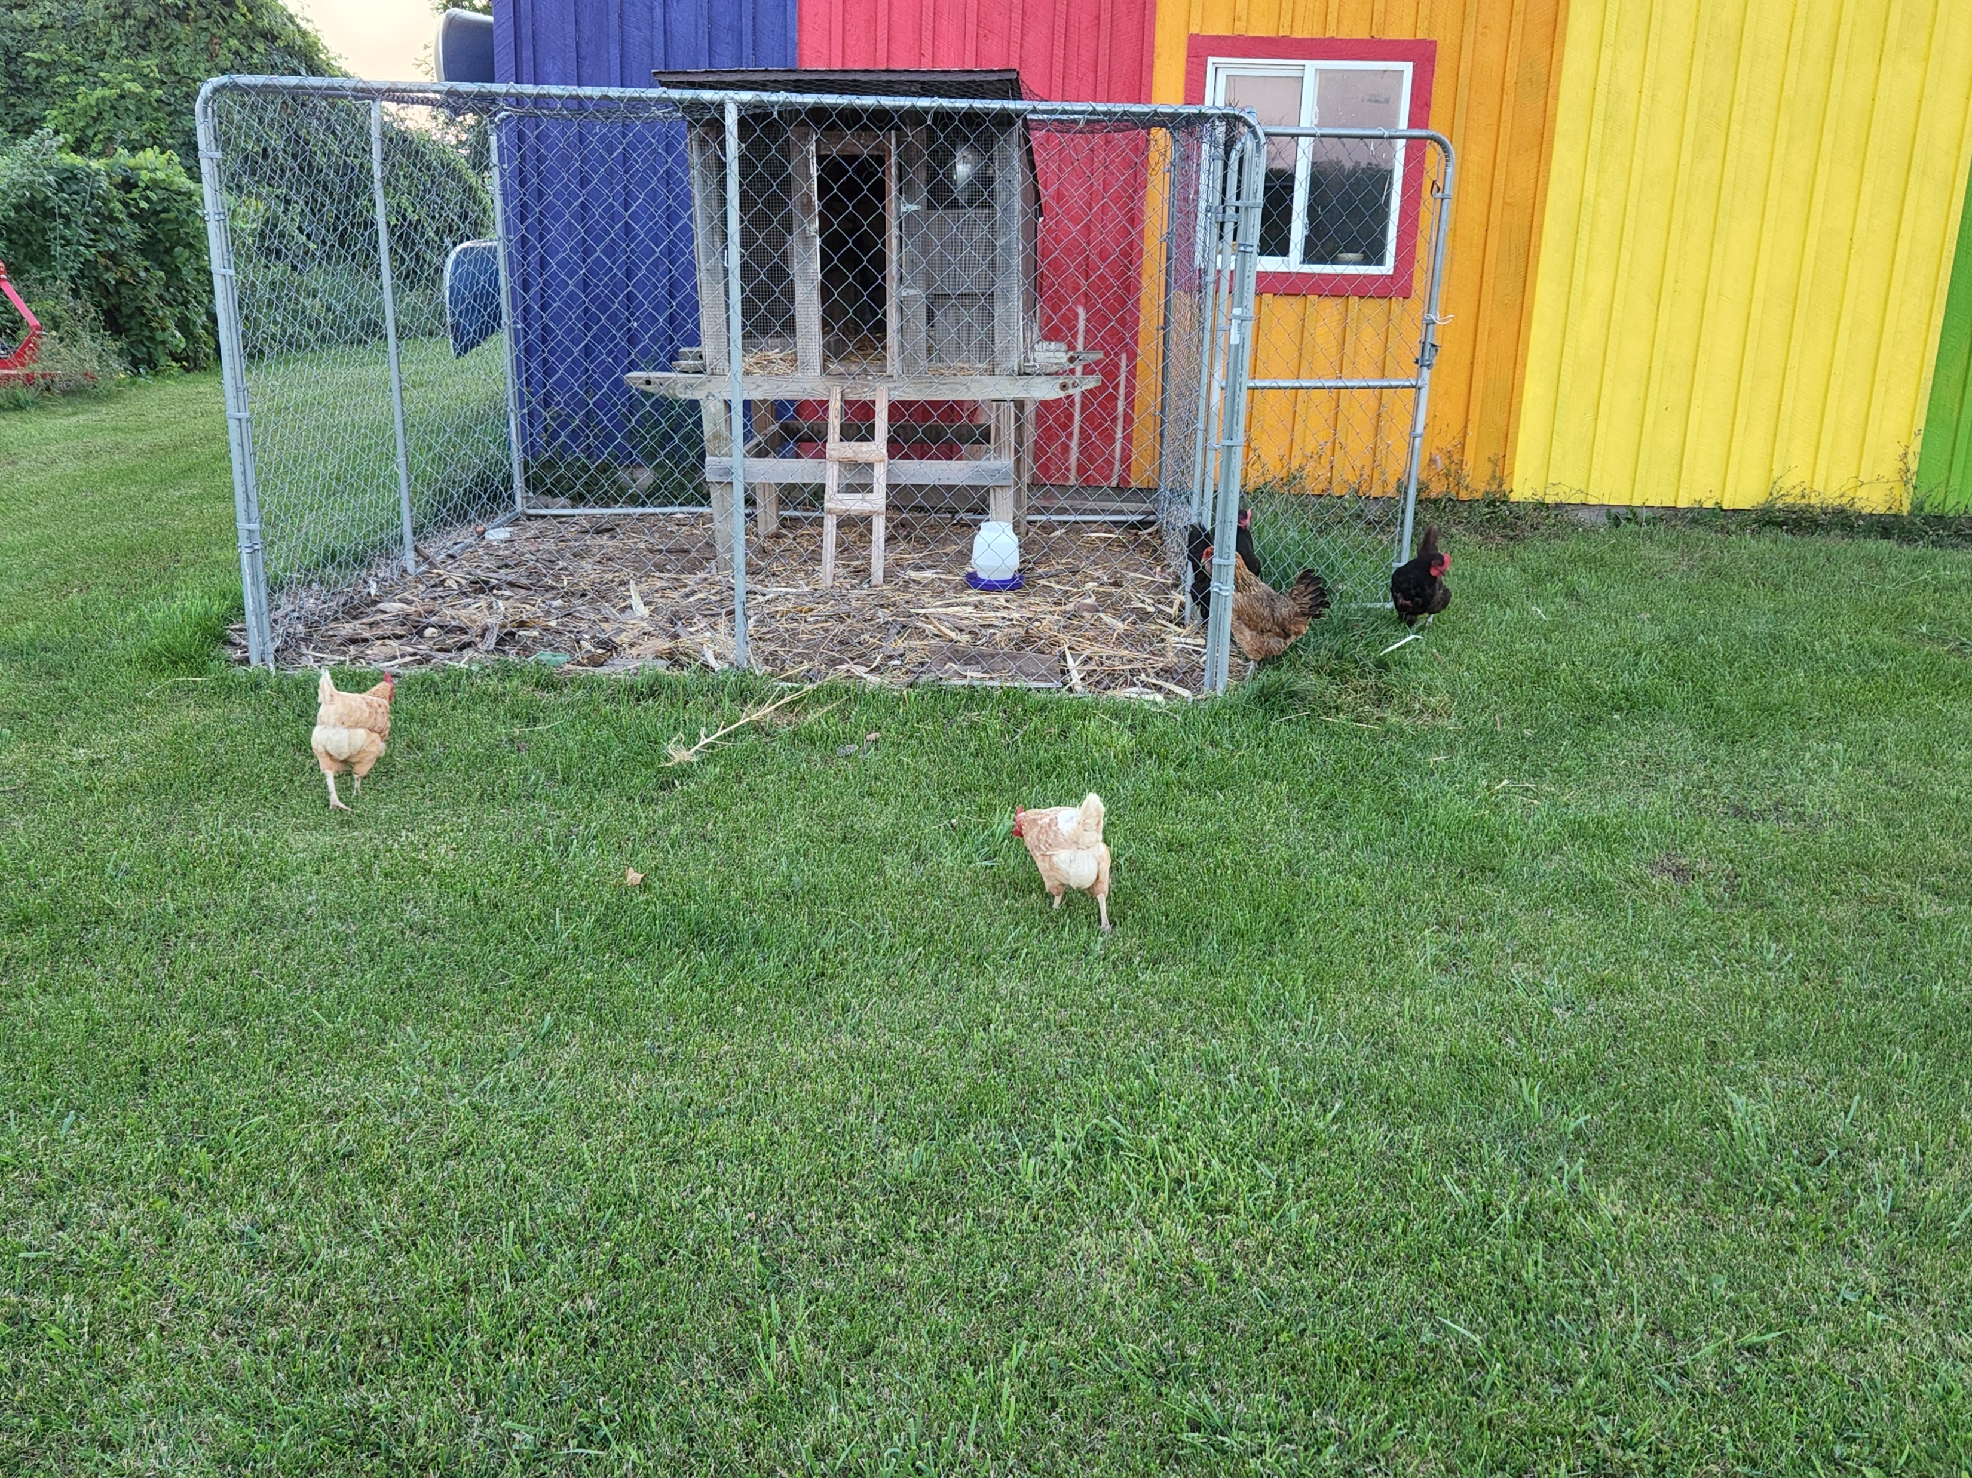

Slide 37
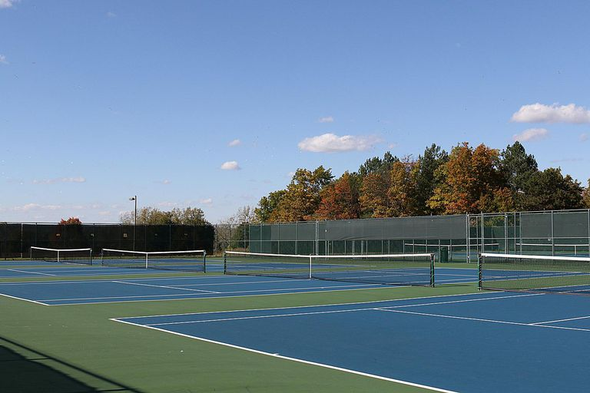
Who am I – trying to figure out how to play tennis here

Slide 38
https://us.fulbrightonline.org/
Who am I – Fulbright scholar – funded by the Congress of the United States.
The idea is that you learn more about the United States, you get to work on your English skills; I get to learn more about Czechia and take this information back to the US, develop Czech language skills, and work with Dr. Kumpan as well as others on collaborative research projects.

Slide 39
Who are you?

Slide 40
What the class is about – Cyclic Stratigraphy and Astrochronology
This course will review and discuss cyclic processes in the stratigraphic record and methodology for interpretation of the duration of the different cycles: Sloss super cycles, First, Second, and Third order sequences - global tectonics; Milankovitch cycles - orbital perturbations; Millennial-scale cycles - orbital perturbations and climate dynamics; and smaller scale cycles. This is a dynamic topic with relevance from Holocene to Archean climate, hydrological, and depositional studies that has implications in all aspects of sedimentary geology as the changes in climate have an impact on the distribution of organisms, weather patterns, and generation of clastic particles.

Slide 41
What the class is about – Cyclic Stratigraphy and Astrochronology
General review and major resources:
Hinnov, L.A., Hilgen, F.J., 2012. Chapter 4. Cyclostratigraphy and Astrochronology. In Gradstein, F.M., Ogg, J., Schmitz, M., Ogg, G. (eds.), The Geologic Time Scale 2012, Elsevier. p. 63–83.
Laskar, J., 2020. Astrochronology. In Gradstein, F.M., Ogg, J.G., Schmitz, M., Ogg, G. (eds.), The Geologic Time Scale 2020. Elsevier, Amsterdam, p. 139-158.
Strasser, A., Hilgen, F.J., Heckel, P.H., 2006. Cyclostratigraphy - concepts, deﬁnitions, and applications. Newsletter in Stratigraphy 42:75–114.

Slide 42
What you need to do...
syllabus
readings
students guide discussion and assign readings

Slide 43
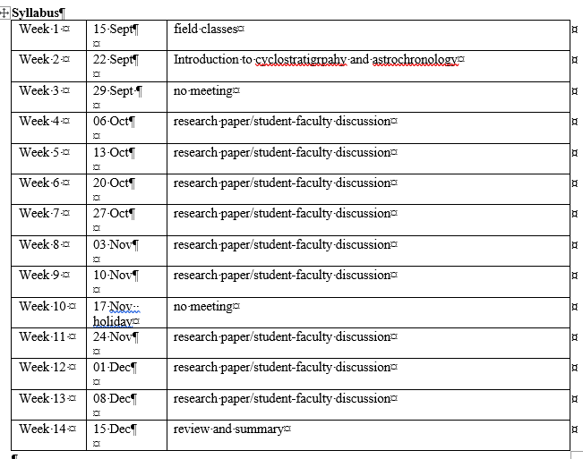

Slide 44
What you need to do...
For our next meeting you need to read Hinnov, L.A., Hilgen, F.J., 2012. Chapter 4. Cyclostratigraphy and Astrochronology. In Gradstein, F.M., Ogg, J., Schmitz, M., Ogg, G. (eds.), The Geologic Time Scale 2012, Elsevier. p. 63–83.
Laskar, J., 2020. Astrochronology. In Gradstein, F.M., Ogg, J.G., Schmitz, M., Ogg, G. (eds.), The Geologic Time Scale 2020. Elsevier, Amsterdam, p. 139-158.
Strasser, A., Hilgen, F.J., Heckel, P.H., 2006. Cyclostratigraphy - concepts, deﬁnitions, and applications. Newsletter in Stratigraphy 42:75–114.
At our next meeting we will discuss these articles and then plan for the rest of the semester which will involve assigning when you will be in charge of discussion.

