Slide 1

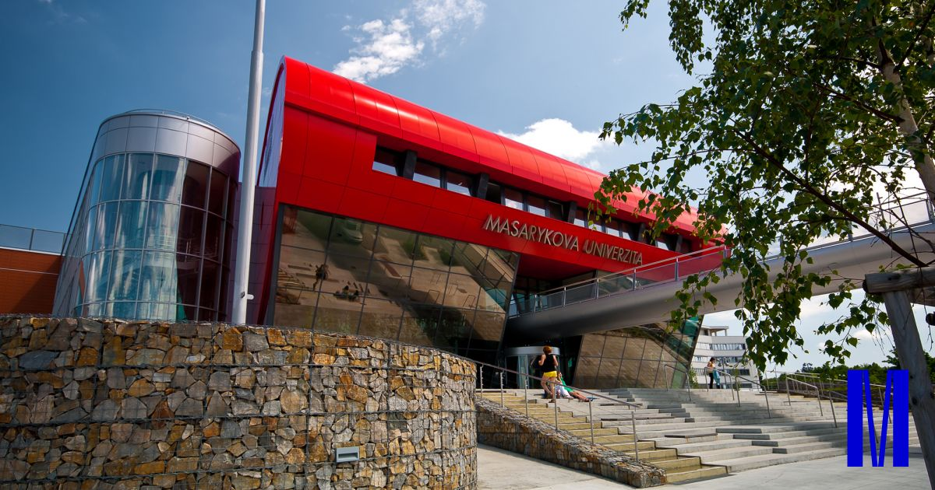


Slide 2
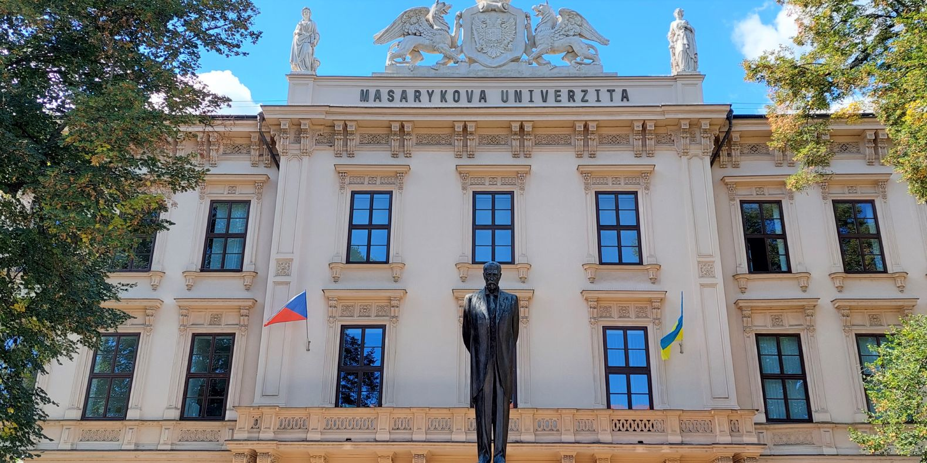

Introduction
Established in 1919 in Brno
One of the 100 top universities in the world
10 faculties:
    Faculty of Law
    Faculty of Arts
    Faculty of Medicine
    Faculty of Science
    Faculty of Social Studies
    Faculty of Economics and Administration
    Faculty of Sports Studies
    Faculty of Education
    Faculty of Informatics
    Faculty of Pharmacy

Slide 3
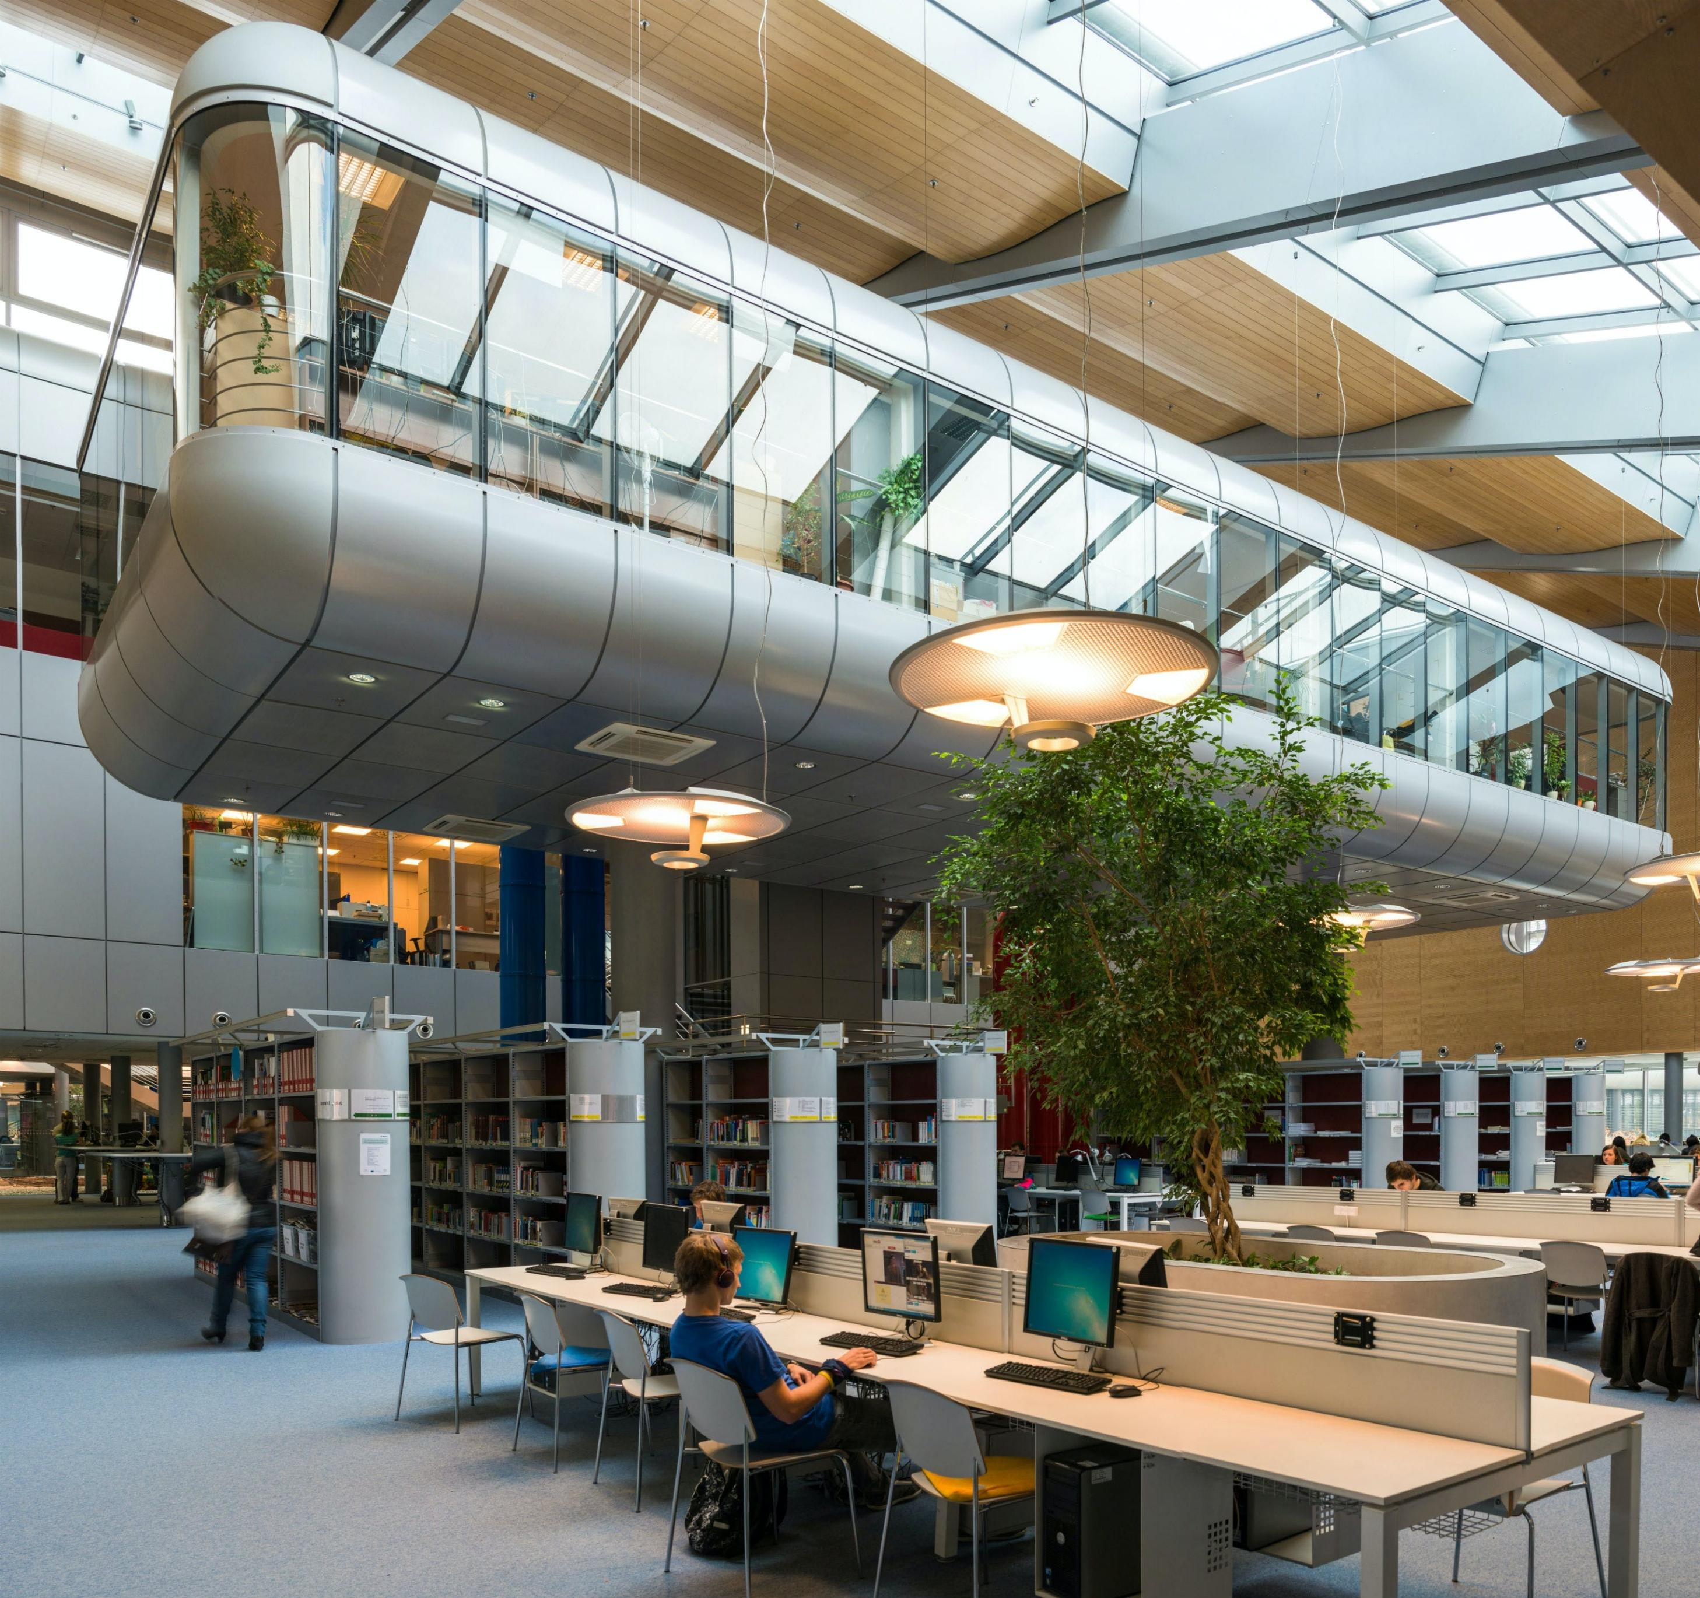
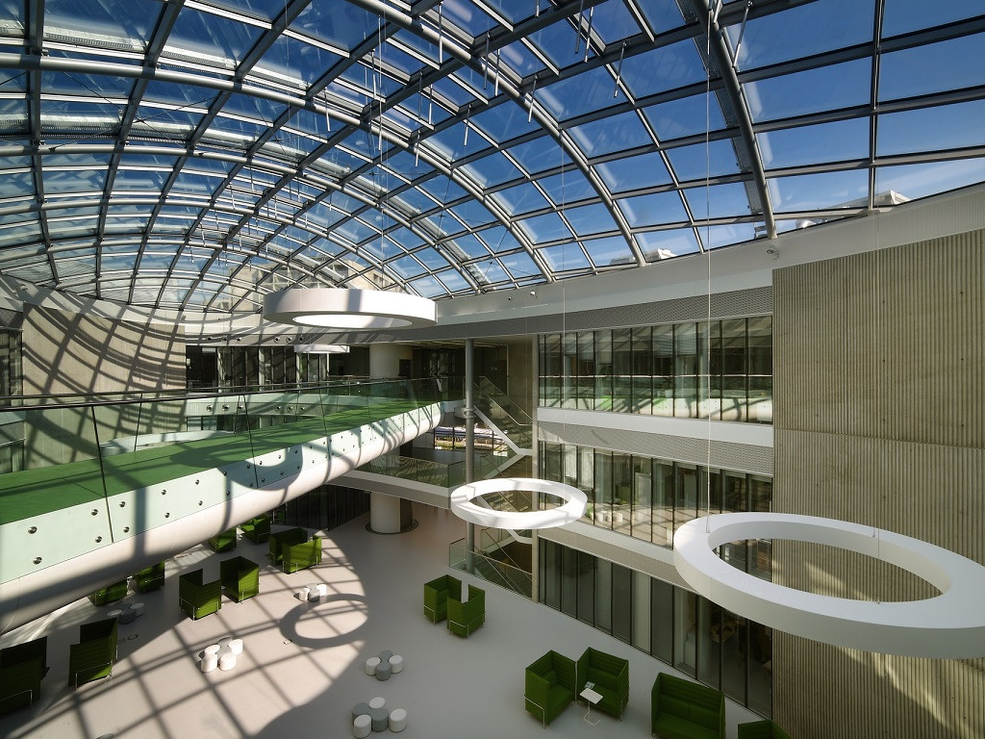

The best features of our university
Research (CEITEC, Loschmidt laboratories)
Modern approach to studying
Wide range of programmes and subjects
Open to international students – some subjects are taught in English
Easy administration - IS
Events, conferences
Encouragement in sports – obligatory PE, hockey tournaments…

Slide 4
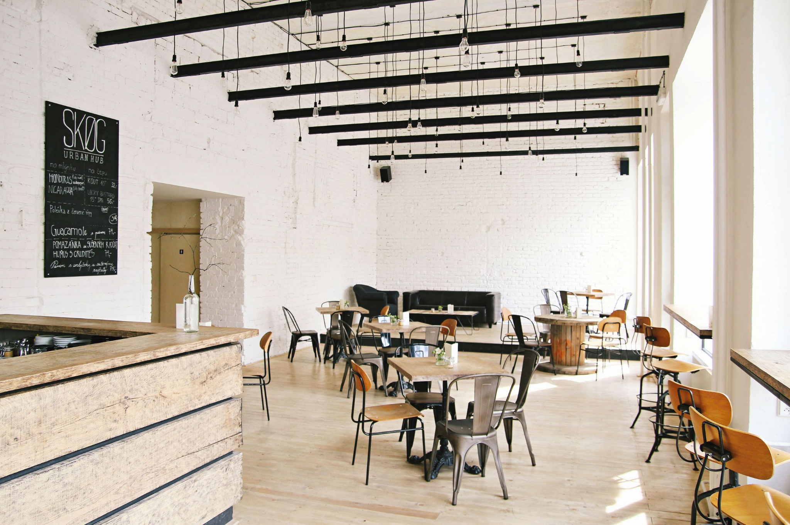
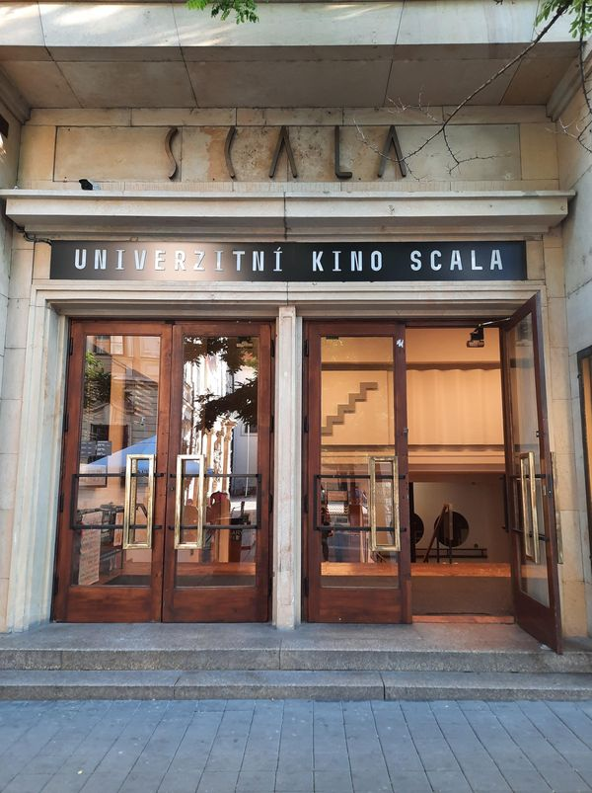
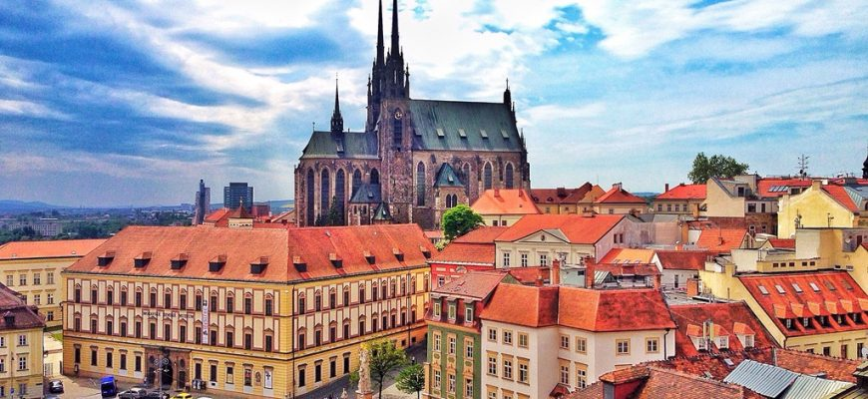


Brno
Great access – public transport
Reasonable prices
Great culture and number of events
Theatres, museums, cinemas (university cinema Scala)
Lots of pubs, cafés and restaurants
www.gotobrno.cz

