Slide 1
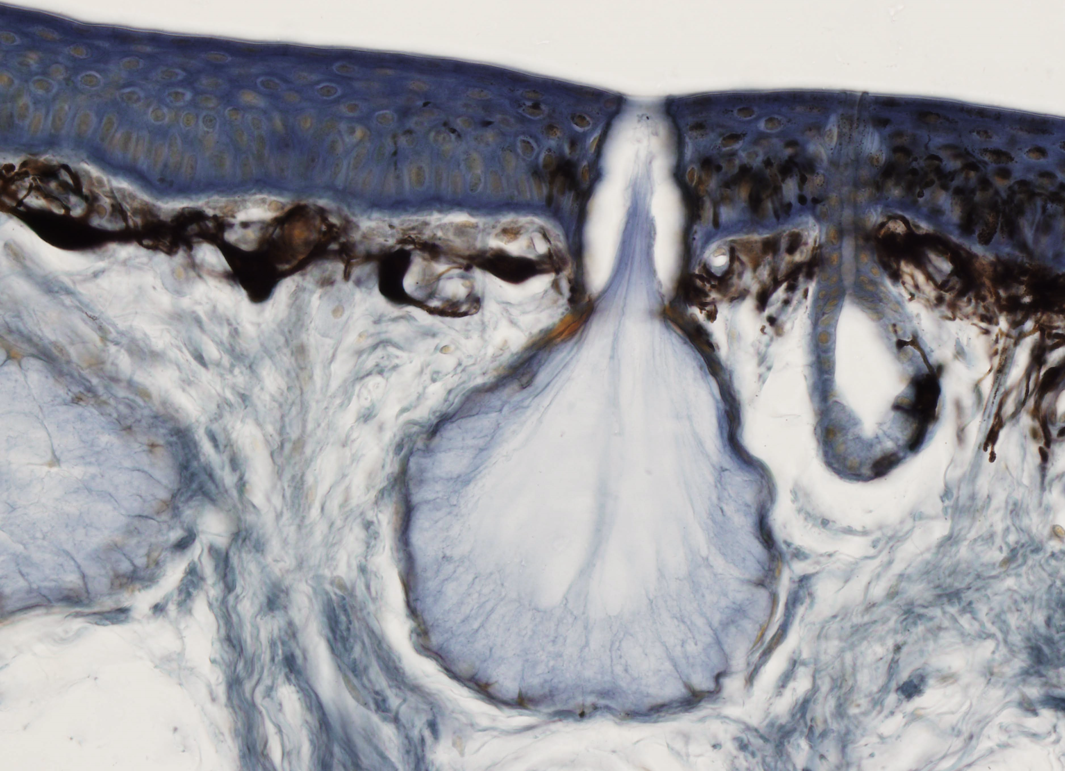
HISTOLOGY AND ORGANOLOGY
Epithelial Tissue

Slide 2
EPITHELIAL TISSUE
GENERAL FEATURES OF ALL EPITHELIAL TISSUES
Highly cellular, epithelial cells vary in shape and size
Numerous intercellular junctions for attachment and anchorage
Avascular
High proliferative capacity (especially in epithelial membranes, to replace continual sloughing of cells from free surface)
Most rest on a basement membrane: extracellular structure that separates epithelial cells from underlying connective tissue. It provides structural support to epithelial tissues and helps anchor the cells in place. is composed of proteins, glycoproteins, and collagen fibers, contributing to the overall stability and integrity of epithelial layers. It also plays a crucial role in regulating the exchange of molecules between the epithelium and the underlying tissue.
The embryological origin: epithelial tissues are derived from all of the embryological germ layers (from ectoderm e.g., the epidermis; from endoderm e.g., the lining of the gastrointestinal tract; from mesoderm e.g., the inner linings of body cavities).
Free and basal surfaces of epithelia
  Basal surface contacts the basal lamina of the basement membrane.
  Free surface interfaces with the external environment or spaces within the body.

Slide 3
EPITHELIAL TISSUE
Polarity – epithelia exhibit functional and morphologic polarity. A polarized cell is one that exhibits contrasting properties or structures on opposite sides of the cell. Because epithelial tissues face a free surface, the function of the apical surface is often very different from that at the base of the cell. This diversification is reflected by the non-homogeneous distribution of organelles.
Function of epithelium:
  Covering of external surfaces
  Lining of internal surfaces
  Protection
  Absorbtion
  Secretion
  Sensory function
  Contraction
Types of epithelium:
  Covering and lining epithelium
  Glandular epithelium

Slide 4
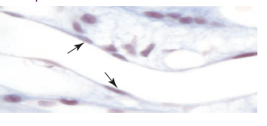
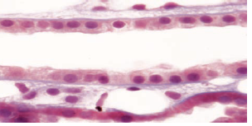

EPITHELIAL TISSUE
CLASSIFICATION OF LINING AND COVERING EPITHELIUM
Shape of superficial cells
Number of cell layers
Presence of specialized structures (cilia, microvili, keratin
Shape of superficial cells
  Squamous
    Cells are much wider than tall.
    Nucleus is highly flattened.
  Cuboidal
    Cells are of equal height and width.
    Nucleus is spherical.
  Columnar
    Cells are much taller than they are wide.
    Nucleus is oval shaped, generally located in the mid to lower portions of the cell.

Slide 5
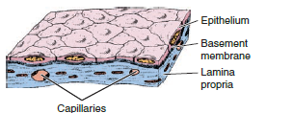
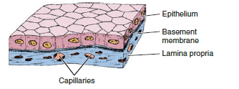
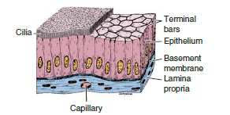
EPITHELIAL TISSUE
CLASSIFICATION OF LINING AND COVERING EPITHELIUM
Number of cell layers
  Simple epithelium
    One cell layer thick
    All cells rest on the basement membrane (basal surface) and all cells face the free surface.
    Simple squamous
      Allows for rapid diffusion across the epithelium
      Forms the lining of blood vessels, alveoli of the lungs, and internal body cavities
    Simple cuboidal
      Lines and absorbs
      Forms the walls of ducts and tubules
    Simple columnar
      Lines and absorbs
      Forms the lining of the intestines and gall bladder

Slide 6
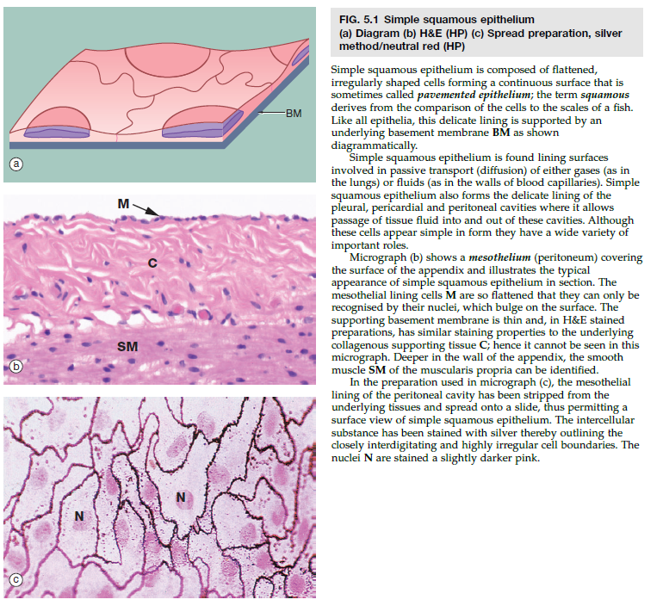

Slide 7
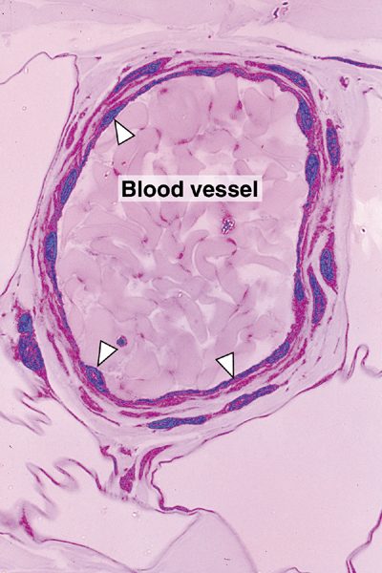
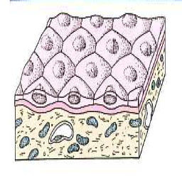
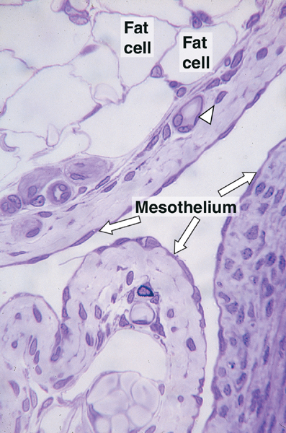
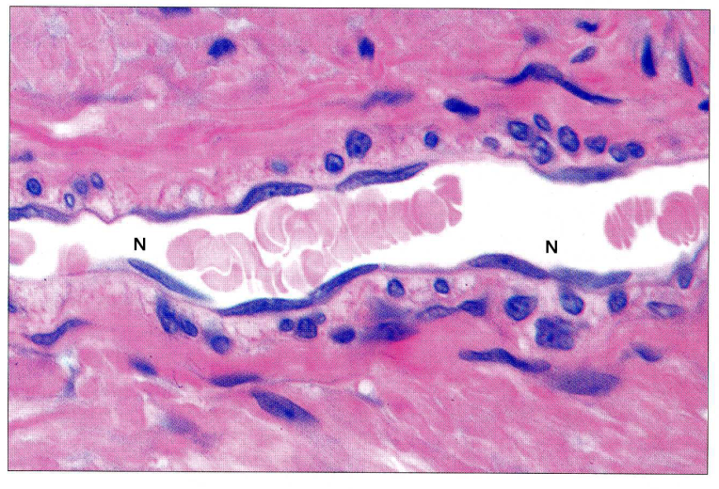

Slide 8
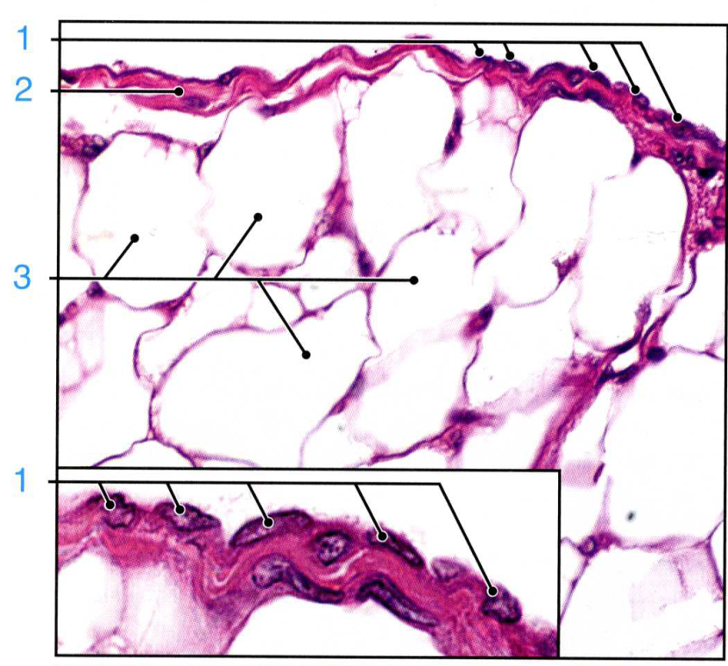
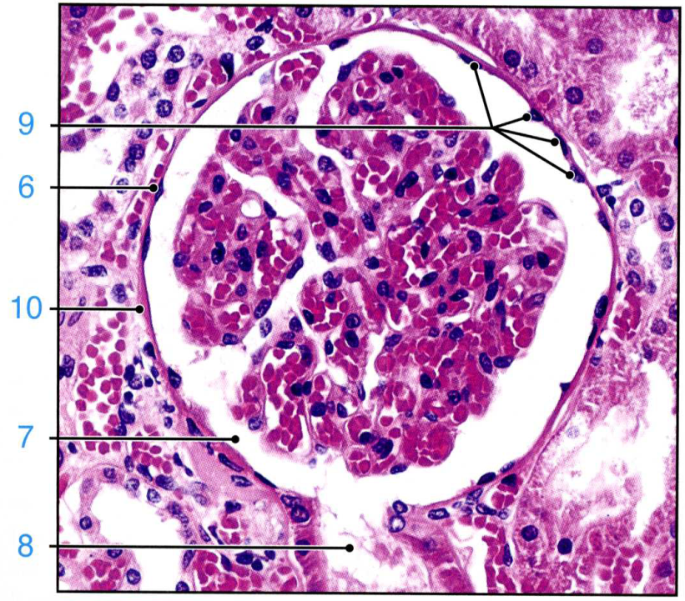
Mesovarium, mesothelium
Kidney, Bowman´s capsule

Slide 9
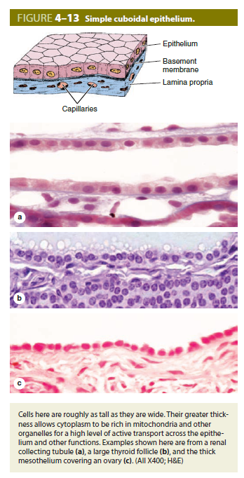
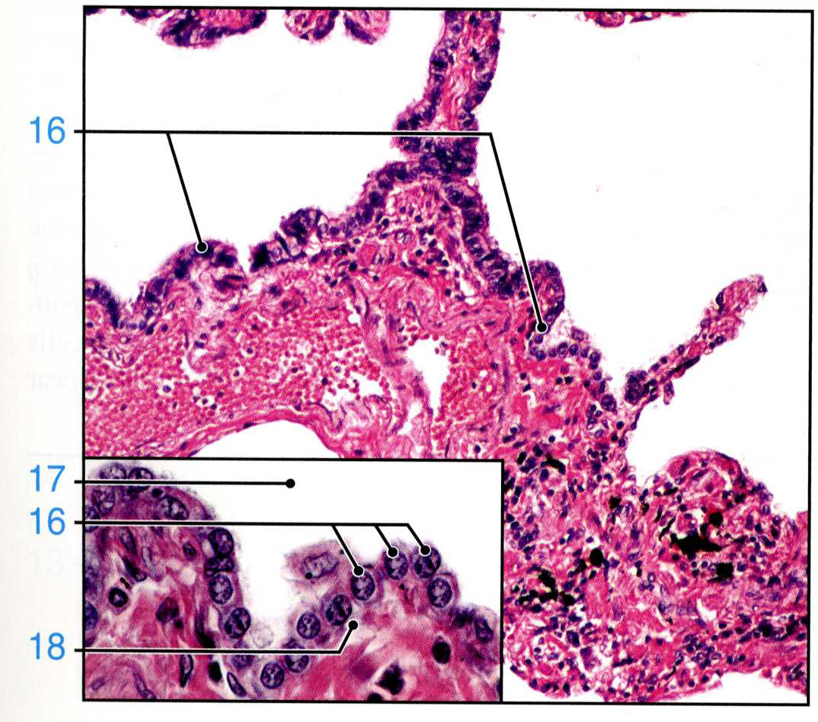

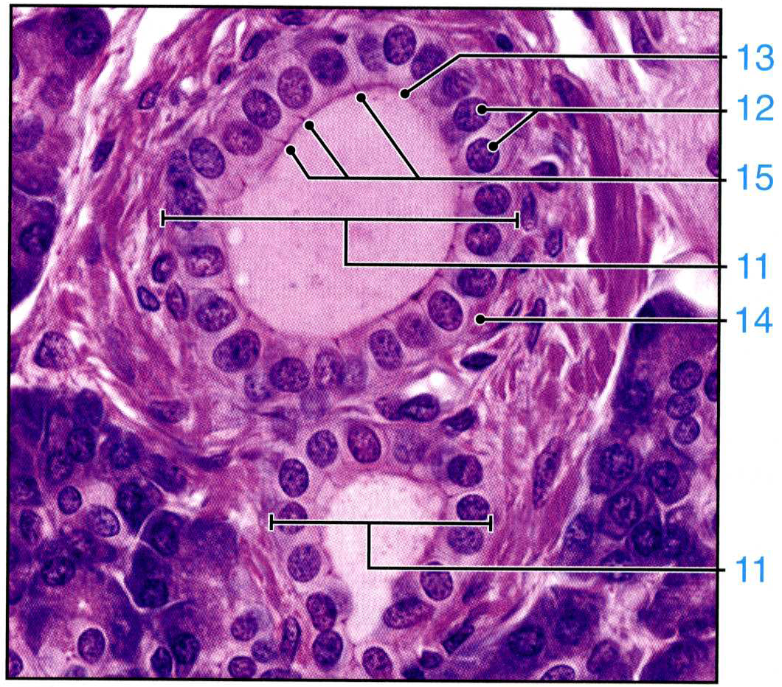


Slide 10
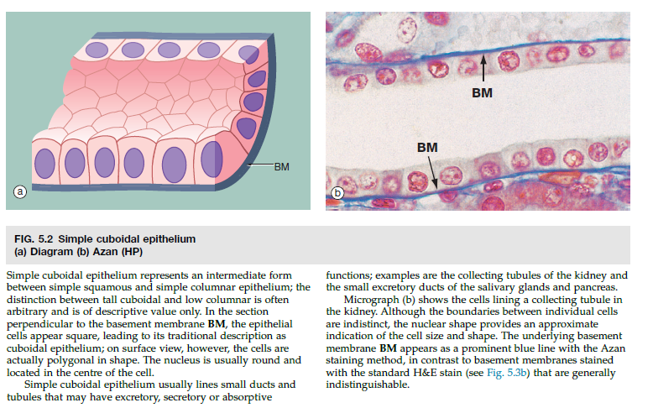

Slide 11
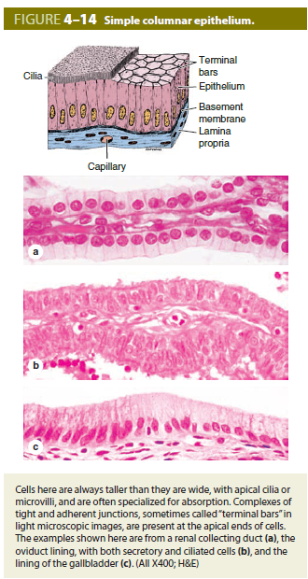
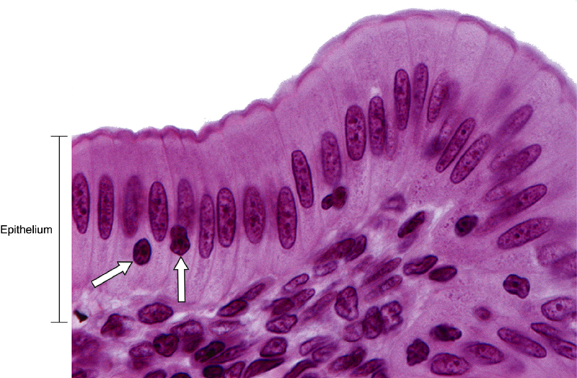
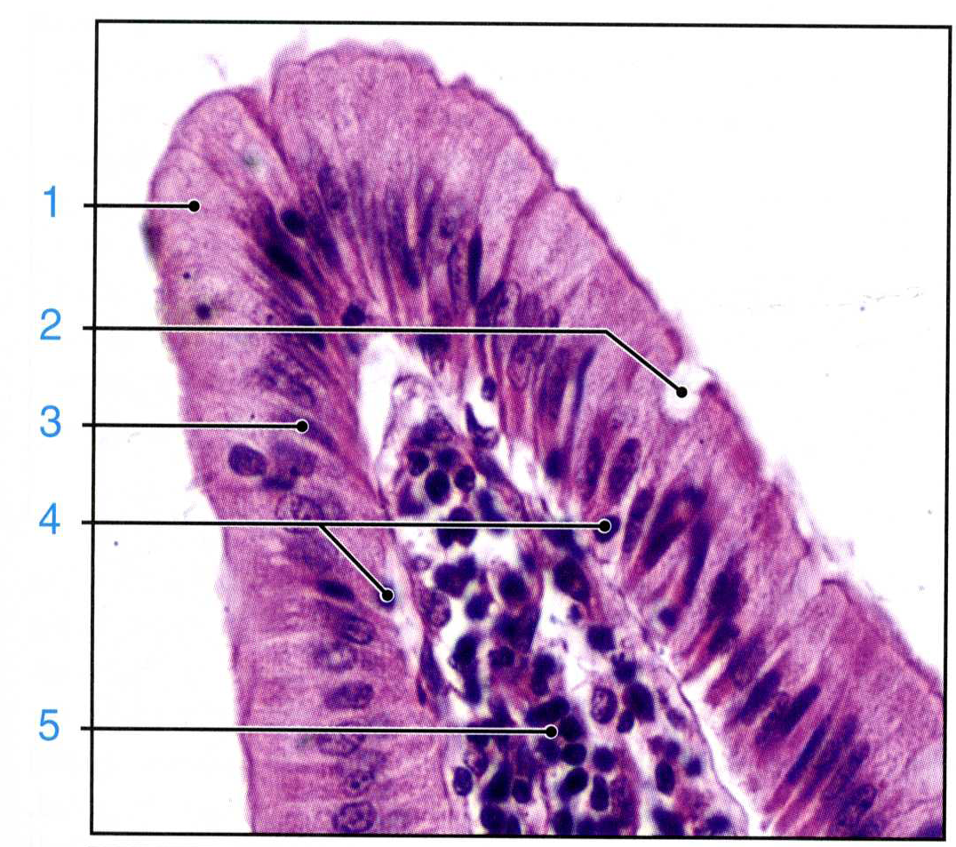

Slide 12
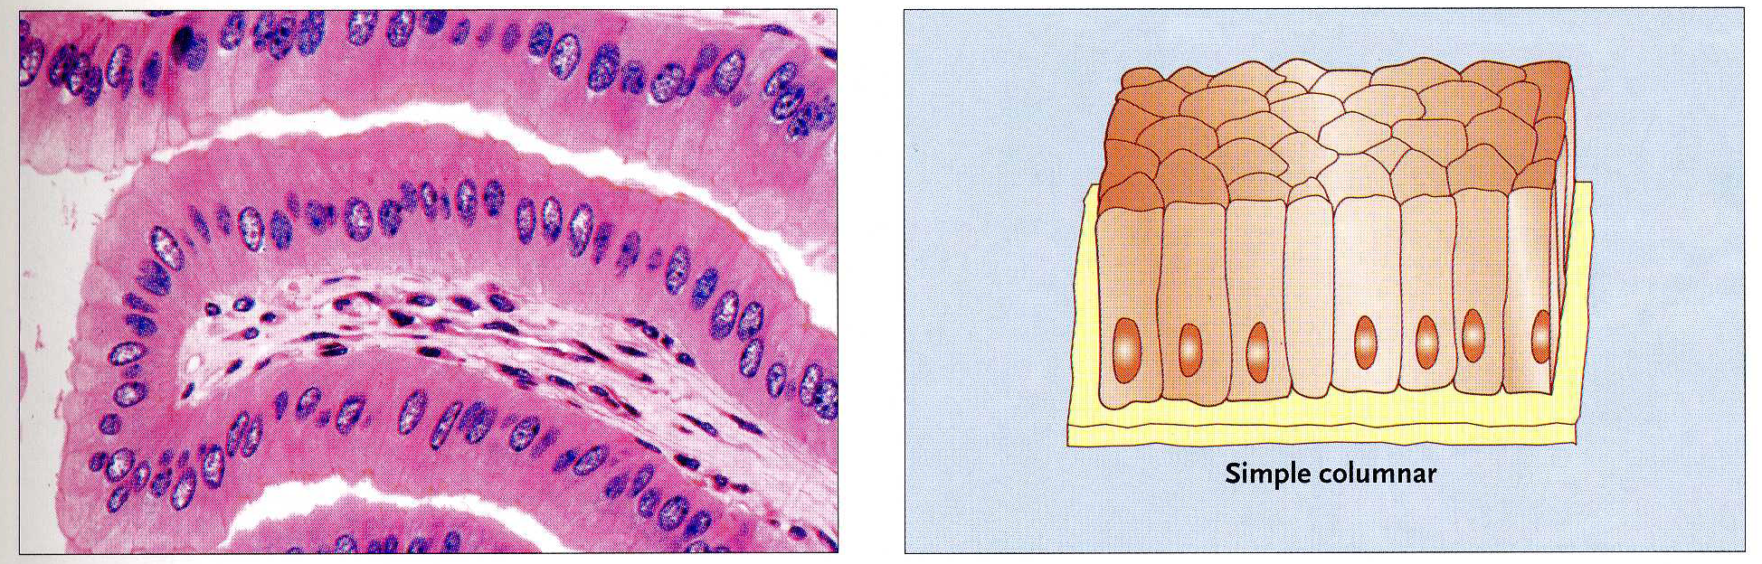
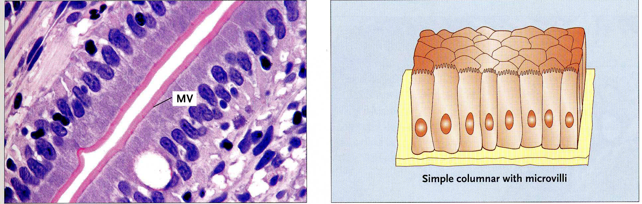

Slide 13
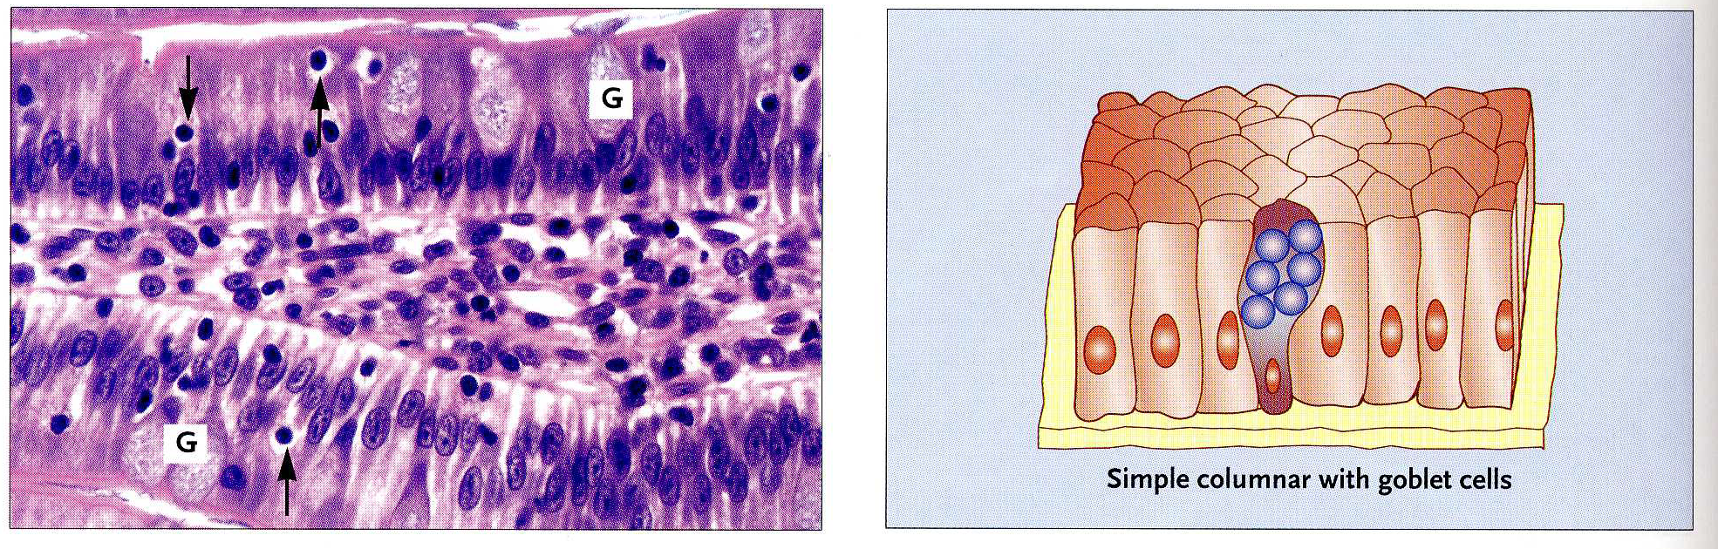
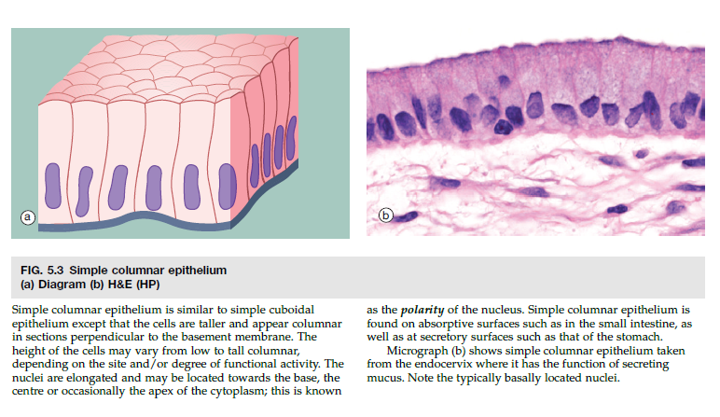

Slide 14
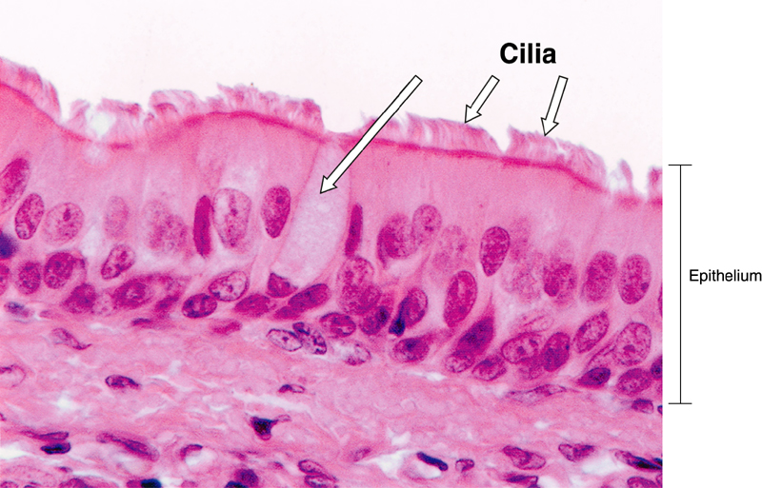
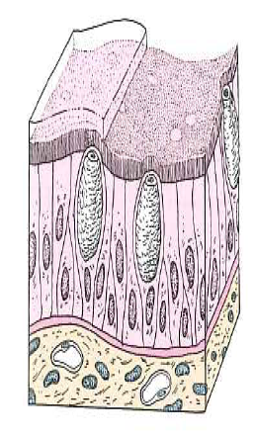
EPITHELIAL TISSUE
CLASSIFICATION OF LINING AND COVERING EPITHELIUM
    Pseudostratified
      Cells are of various heights. It appears stratified. All cells rest on the basement membrane, but only the tallest cells reach the free surface. Variation in height of the cells and the location of nuclei give the appearance of a stratified epithelium. Frequently ciliated.
      Provides protection and surface transport when ciliated.
      Forms the lining of much of the respiratory tract and much of the male reproductive system.

Slide 15
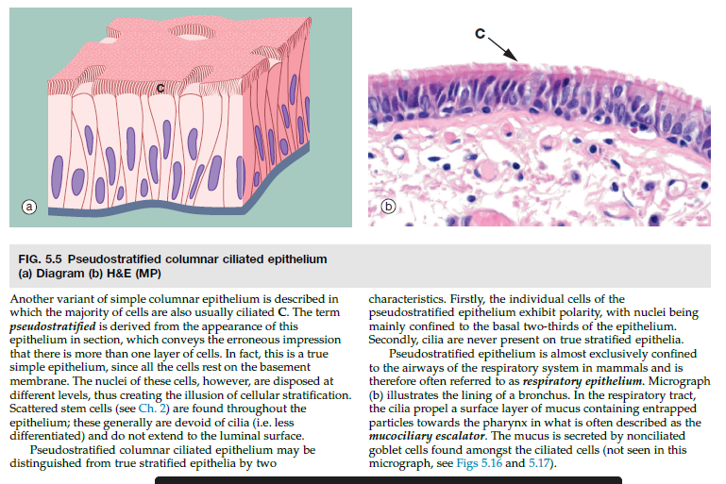

Slide 16
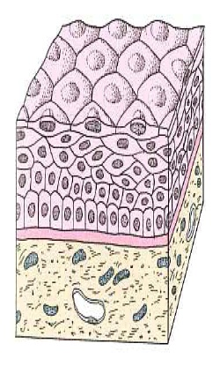
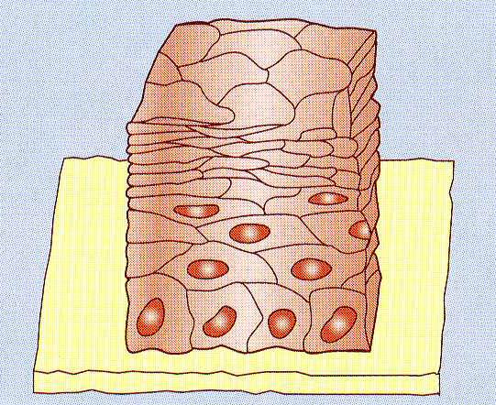
EPITHELIAL TISSUE
CLASSIFICATION OF LINING AND COVERING EPITHELIUM
  Stratified epithelium
    More than one cell layer thick
    Only the deepest layer of cells contact the basement membrane and only the superficial-most cells have a free surface.
    Named according to the shape of the cells at the free surface.
    Stratified squamous
      Protects from physical abrasion and prevents desiccation
      Two types:
        Nonkeratinized (moist). Lining of wet cavities, including the mouth, esophagus, rectum, and anal canal; surface cells are nucleated and living.
        Keratinized (dry). Epidermis of the skin; surface cells are nonliving.

Slide 17
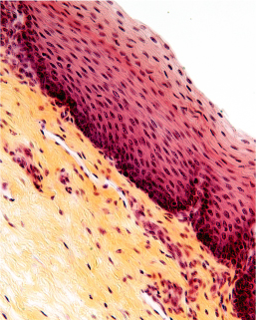
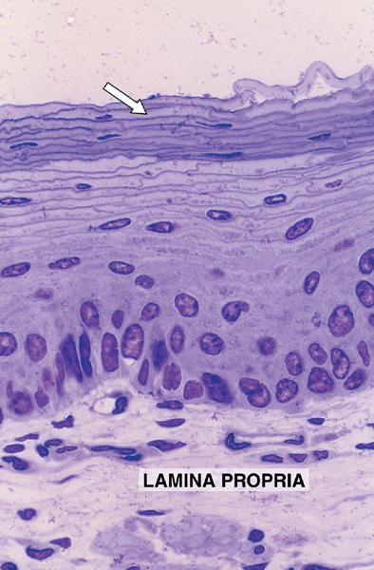
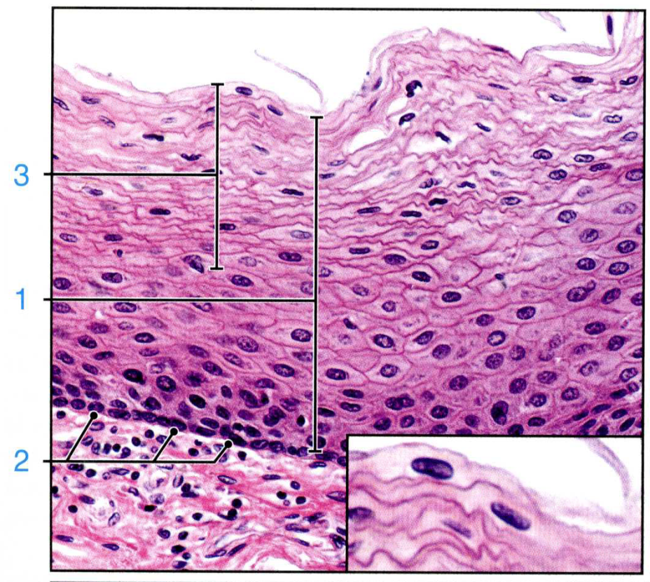
Stratified squamous nonkeratinized epithelium
oesophagus

Slide 18
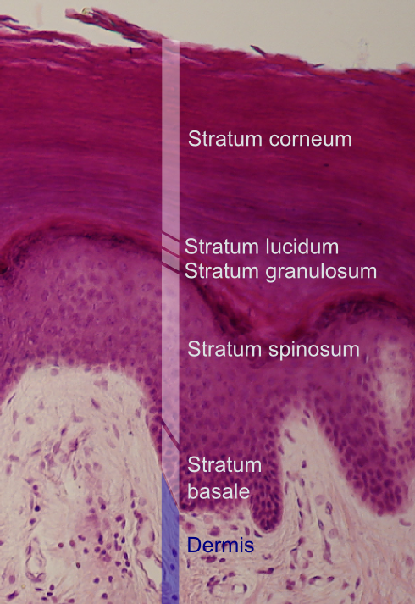
Stratified squamous keratinized epithelium
S. corneum: the keratinised layers of dead cells, filled with densely packed keratin.
S. lucidum: only in thick skin. It is a thin transparent layer, difficult to recognise in routine sections.
S. granulosum: the cells lose their nuclei and organelles and become keratinised. The granules contain a lipid rich secretion, which acts as a water sealant.
S. spinosum: „prickle cells“ with a lot of desmosomes, which anchor the cells to each other, with some amounts of keratin. When the cells shrink during fixation, the desmosomes from neighbouring cells remain bound to each other and look like 'prickles' or 'spines → „prickle cells“.
Stratum basale = s. germinosum: a single layer of cells, closest to the dermis. The cells can divide and some move up to the next layer.
skin

Slide 19
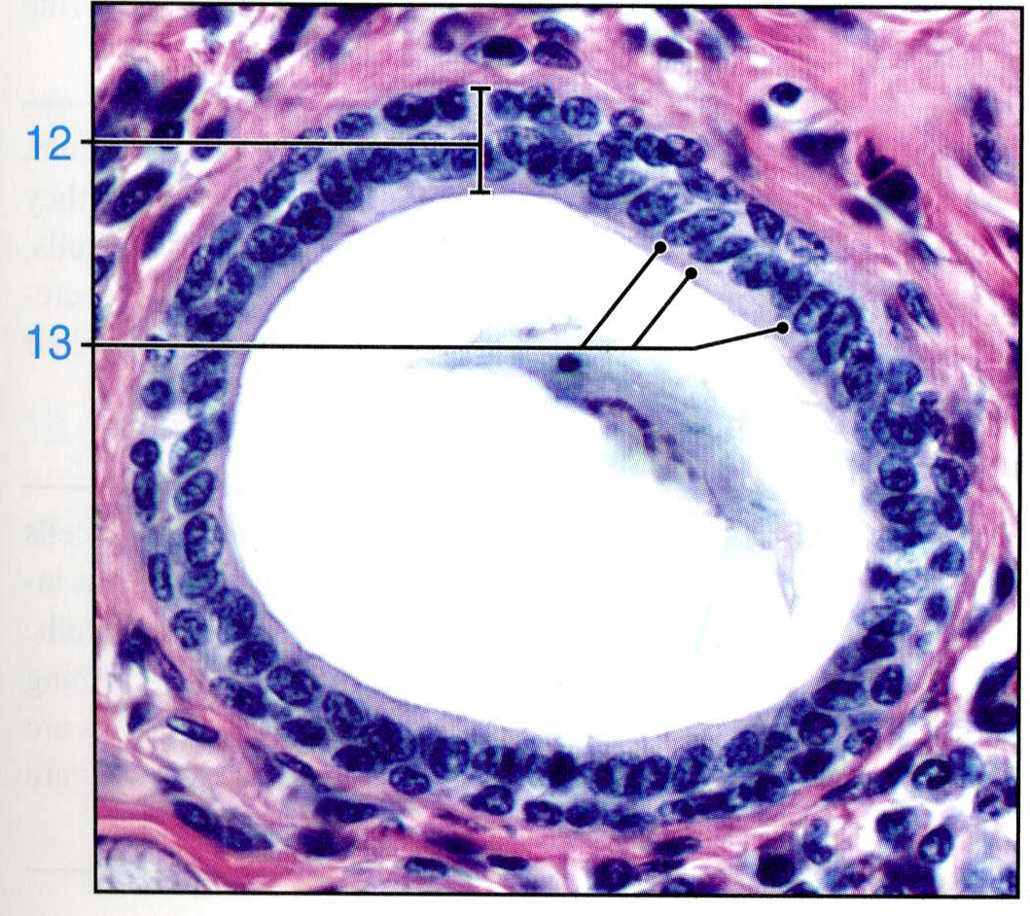
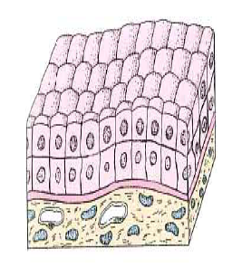
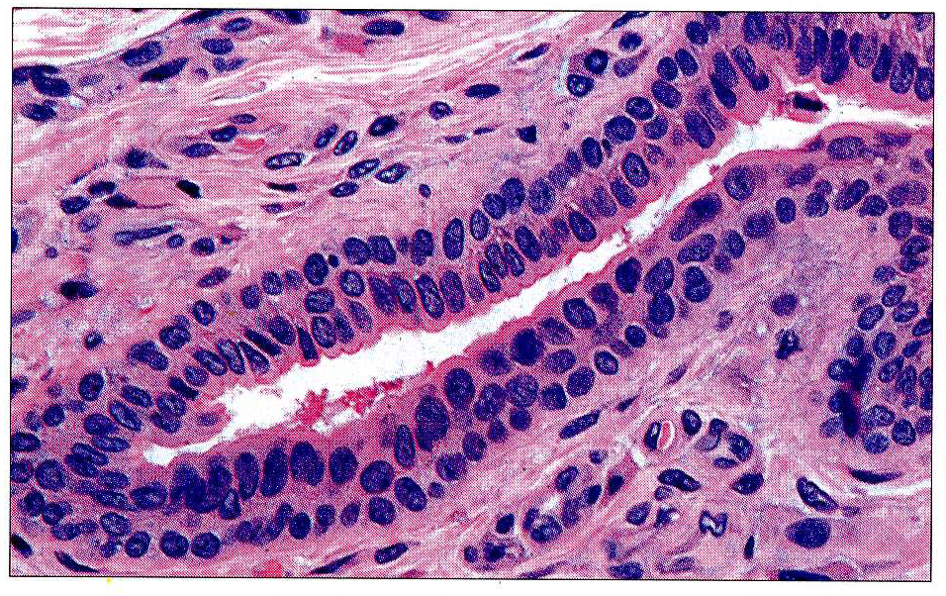
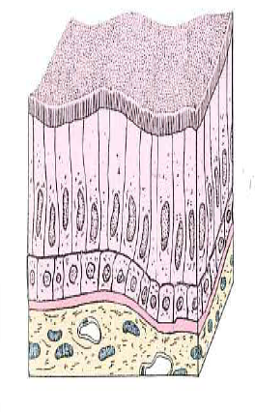
EPITHELIAL TISSUE
CLASSIFICATION OF LINING AND COVERING EPITHELIUM
    Stratified cuboidal/columnar
      Lines the larger ducts of exocrine glands.
Stratified cuboidal epithelium, tongue, duct from salivary gland

Slide 20
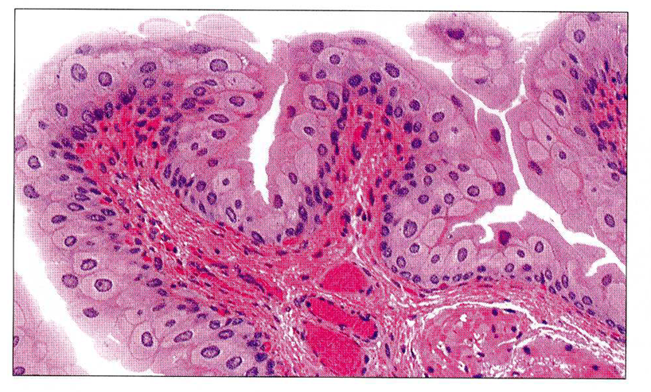
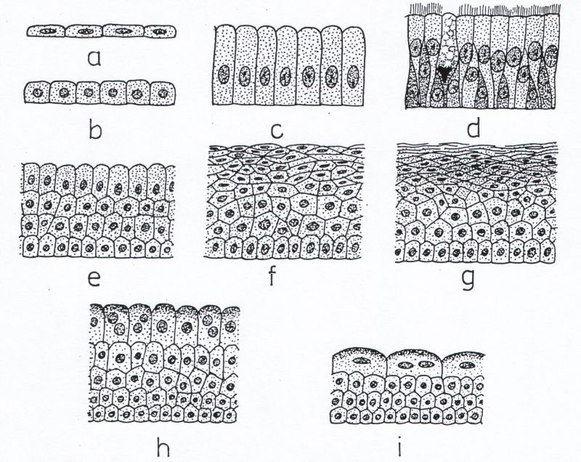
EPITHELIAL TISSUE
CLASSIFICATION OF LINING AND COVERING EPITHELIUM
    Transitional
      Protective function; constructed to expand with distension of the hollow organs it lines
      Unique to the urinary system; lines the urinary bladder and ureter

Slide 21
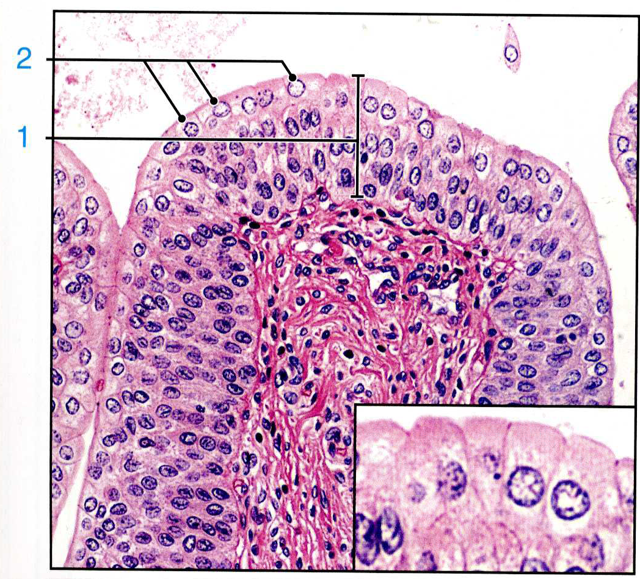
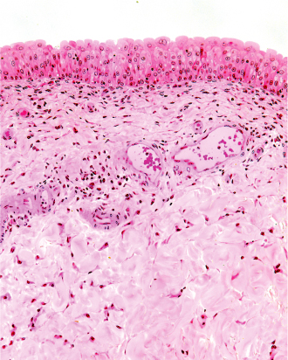
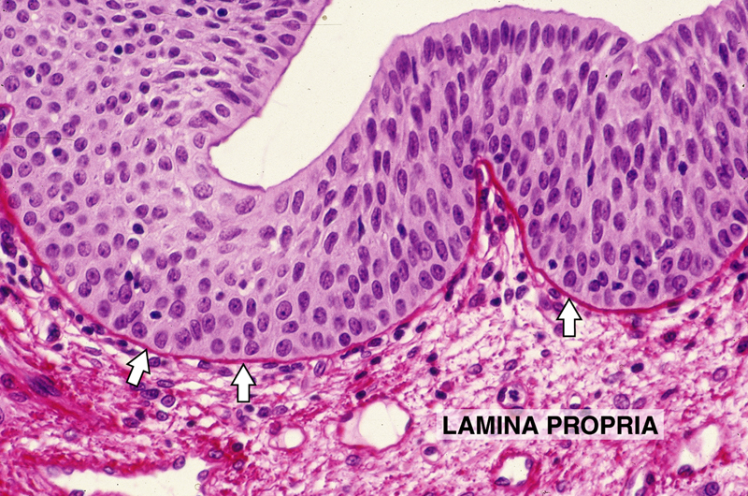

Slide 22
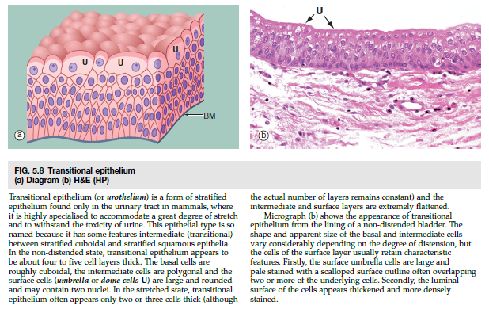

Slide 23
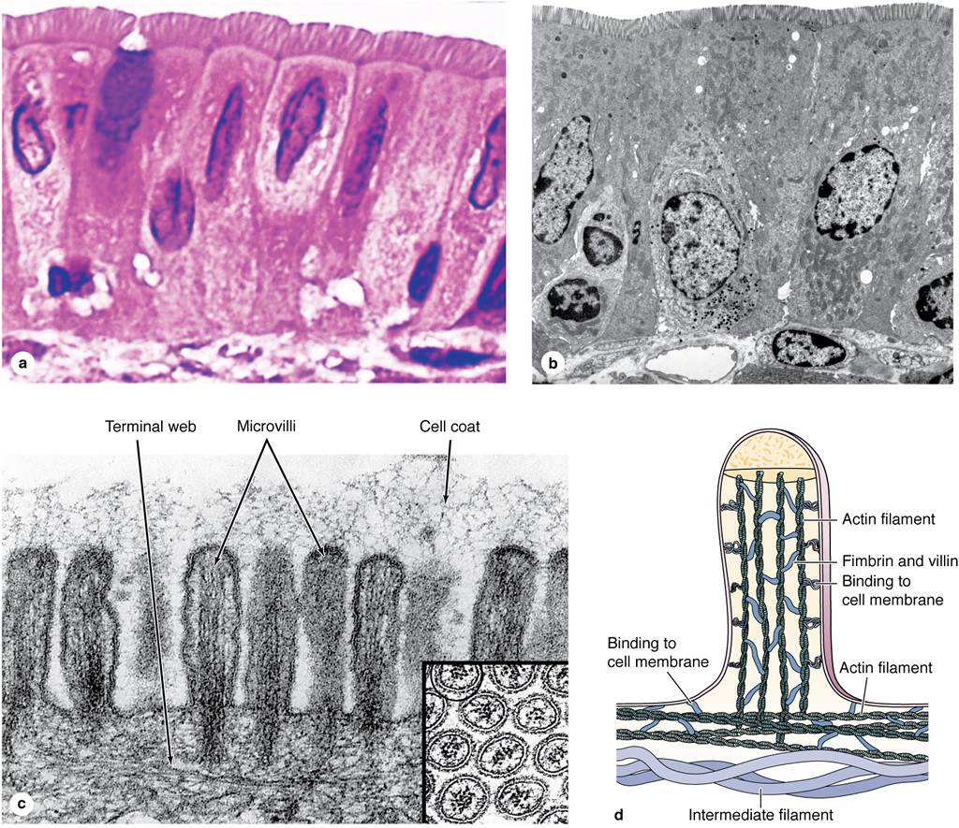
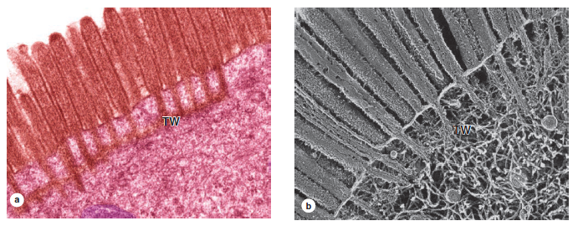
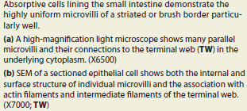
EPITHELIAL TISSUE
SURFACE SPECIALIZATIONS
Apical domain with special structural surface modification to carry our specific function
Microvilli
  Finger-like extensions from the free surface of the cell, about 1 micron in height
  Are usually present in large numbers on each cell and, collectively, are called a brush or striated border
  Contain a core of actin microfilaments
  Are relatively non-motile
  Increase surface area for absorption
  Prominent on cells lining the digestive tract and proximal tubules in the kidney

Slide 24
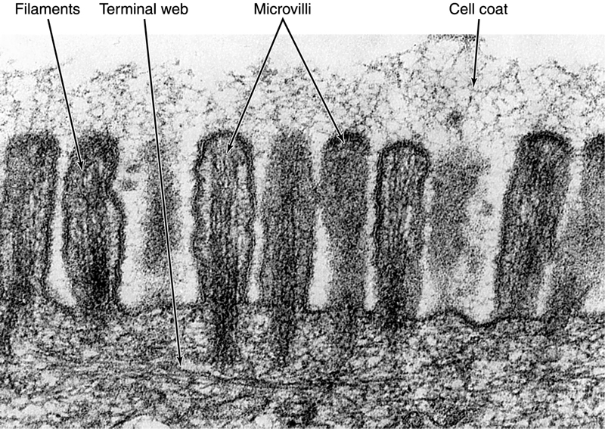
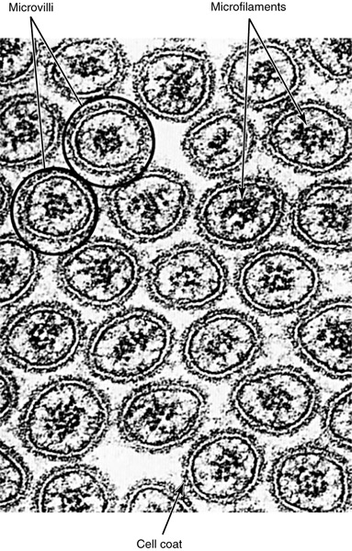


Slide 26
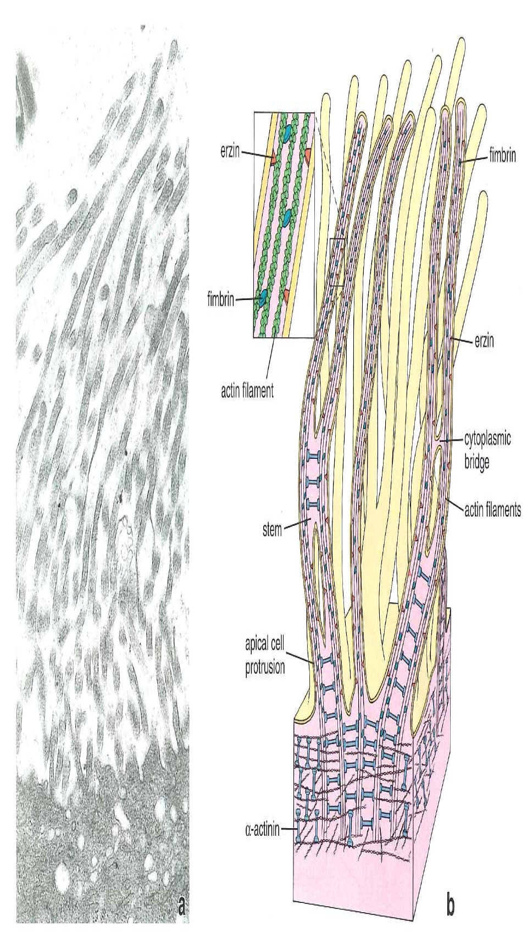
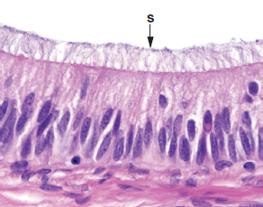
EPITHELIAL TISSUE
SURFACE SPECIALIZATIONS
Stereocilia
  Large, non-motile microvilli; not cilia
  Contain a core of actin microfilaments
  Increase surface area
  Present on cells lining the epididymis and ductus deferens in the male reproductive tract
epididimis

Slide 27



Slide 28



EPITHELIAL TISSUE
SURFACE SPECIALIZATIONS
Cilia
  Multiple hair-like extensions from free surface
  of the cell; 7-10 microns in height
  Highly motile; beat in a wave-like motion
  Function to propel material along the surface
  of the epithelium (e.g., in the respiratory system
  and the oviduct of the female reproductive system)
  Core of a cilium is called the axoneme, in which
  nine pairs of microtubules surround two central, individual microtubules (9 + 2 arrangement).
  The axomene of each cilium originates from
  a basal body that is located at the apex of the cell
  and is composed of nine triplets of microtubules.

Slide 29

Respiratory tract, LM, Mallory trichrome, x400

Slide 30

EPITHELIAL TISSUE
INTERCELLULAR JUNCTIONS
Specialized structures of the plasma membrane that:
  Attach and anchor cells
  Establish apical and basolateral membrane domains by sealing adjacent plasma membranes
  Provide channels for ionic and metabolic coupling
Not restricted to epithelial cells; cell junctions occur, however, in large number in epithelial tissues to resist the physical forces acting on the cells.
Types:
  Ocluding junctions:
  Zonula occludens (tight junction)
  Adhesive and anchoring junctions:
  Zonula adherens (belt desmosome)
  Macula adherens (desmozome)
  Hemidesmosome – in basal part of cell
  Communication between adjacent cells:
  Gap junctions (nexus)

Slide 31


EPITHELIAL TISSUE
Types of intercellular junctions
Tight junction (zonula occludens)
  Belt-like, barrier junction around apex of the cell
  Provides close apposition of adjacent plasma membranes and occludes the intercellular space
  Functions:
    Prevents diffusion of material between the intercellular space and the lumen of the organ
    Establishes apical and basolateral membrane domains in the cell by preventing the lateral migration of proteins in the plasma membrane

Slide 32


Slide 33
EPITHELIAL TISSUE
Types of intercellular junctions
Adherent junctions
  Attach cells to each other or anchor them to the basal lamina; no fusion of the plasma membrane
  Types of adherent junctions:
    Belt desmosome (zonula adherens). Belt-like junction that encircles the apex of the cell like a barrel strap and is located immediately beneath the zonula occludens; serves to attach adjacent cells together; associated with actin filaments.
    Spot desmosome (macula adherens). Disk-like junctions scattered over the surface of the cell, which are paired with similar structures in adjacent cells; associated with intermediate filaments (e.g., keratin filaments in epithelial cells).
    Hemidesmosome. Represents a "half desmosome"; these junctions anchor the basal surface of the cell to the basal lamina.
    Junctional complex. Consists of the zonula occludens, zonula adherens, and desmosomes; because these structures cannot be resolved as separate structures at the light microscopic level, they appear as a single, bar-shaped, dark region at the apical corners of adjacent cells. The term terminal bar was used by early microscopists to define the zonula occludens and zonula adherens at the light microscopic level.

Slide 34

EPITHELIAL TISSUE
Belt desmosome (zonula adherens). Belt-like junction that encircles the apex of the cell like a barrel strap and is located immediately beneath the zonula occludens; serves to attach adjacent cells together; associated with actin filaments.

Slide 35

EPITHELIAL TISSUE
Spot desmosome (macula adherens). Disk-like junctions scattered over the surface of the cell, which are paired with similar structures in adjacent cells; associated with intermediate filaments (e.g., keratin filaments in epithelial cells).

Slide 36

EPITHELIAL TISSUE
Hemidesmosome. Represents a "half desmosome"; these junctions anchor the basal surface of the cell to the basal lamina.

Slide 37


EPITHELIAL TISSUE
Junctional complex. Consists of the zonula occludens, zonula adherens, and desmosomes; because these structures cannot be resolved as separate structures at the light microscopic level, they appear as a single, bar-shaped, dark region at the apical corners of adjacent cells. The term terminal bar was used by early microscopists to define the zonula occludens and zonula adherens at the light microscopic level.

Slide 38


Slide 39


Slide 40



EPITHELIAL TISSUE
Gap junction
  Gap junctions (protein channels connecting plasma membranes) consist of connexons, six transmembrane proteins clustered in a rosette that form a central pore. Connexons from adjacent cells abut one another, forming a continuity between cells.
  Provides metabolic and electrical continuity (coupling) via the pores between cells

Slide 41



Slide 42


EPITHELIAL TISSUE
MORPHOLOGIC SPECIALIZATIONS OF THE LATERAL CELL SURFACE
Cellular interdigitations
  Lateral cell surface folds create interdigitating cytoplasmatic processes of adjoining cells.
  Infoldings increase the lateral surface.
  Electrolyte active fluid transport (intestinal, gallblader epithelium)

Slide 43

EPITHELIAL TISSUE
BASEMENT MEMBRANE
Basement membrane
  The basement membrane is composed of a basal lamina and a reticular lamina.
  The basal lamina is secreted by the epithelial cells and consists of the lamina lucida and the lamina densa. A similar structure is also present in muscle and nervous tissue, where it is referred to as an external lamina.
  The reticular lamina is secreted by fibroblasts located in the underlying connective tissue.
  Functions of the basement membrane:
    Provides support and attachment for the epithelial cells
    Acts as a selective diffusion barrier

Slide 44

Ultrastructural components of the basal lamina. A: Basal lamina, hemidesmosomes (arrows) and underlying reticular fibres of the reticular lamina. B: The basal lamina (BL) is shown to have a dense layer with a clear on each side. The underlying dermis contain anchoring fibrils (arrows) of collagen which help anchor the epithelium to the underlying connective tissue. Hemidesmosome (H) occur at the epithelial-connective tissue junction.

Slide 45


Slide 46




Slide 47


Slide 48


EPITHELIAL TISSUE
MORPHOLOGIC MODIFICATIONS OF THE BASAL CELL SURFACE
Basal Labyrinth
Many cells that transport fluid have infoldings at the basal cell surface.
They significantly increase the surface area of the basal cell domain, allowing for more transport proteins and channels to be present.
Prominent infoldings – cells with active transport of molecules (e.g., in proximal and distal tubules of the kidney)
Mitochondria – typically concentrated, vertically oriented within the folds, energy for active transport

Slide 49

Cell polarity - examples

Slide 50


EPITHELIAL TISSUE
GLANDULAR EPITHELIAL TISSUES
GENERAL CONCEPTS
Develop from or within a lining or covering epithelium
Secretory cells may
  Differentiate but remain in the lining epithelium
  Invaginate into the underlying connective tissue and remain attached to the lining epithelium
  Invaginate into the underlying connective tissue but lose their connection to the epithelium

Slide 51
EPITHELIAL TISSUE
EXOCRINE VS. ENDOCRINE GLANDS
Major classification of glands, which is based on the method by which their secretory product is distributed.
Exocrine glands (retains connection with surface epithelium)
  Secretory products are released onto an external or internal epithelial surface, either directly or via a duct or duct system.
  Secretory cells display polarized distribution of organelles.
Endocrine glands (no connection with surface epithelium)
  No ducts; secretory products are released directly into the extracellular fluid where they can affect adjacent cells (paracrine secretion) or enter the bloodstream to influence cells throughout the body (endocrine secretion).
  No polarization of organelles, except the thyroid gland and enteroendocrine cells of the digestive tract.
  Secretory products are called hormones.

Slide 52
EPITHELIAL TISSUE
GLANDULAR EPITHELIAL TISSUES
METHODS OF PRODUCT RELEASE FROM GLANDULAR CELLS
Merocrine. Secretory product is released by exocytosis of contents contained within membrane-bound vesicles. This method of release is used by both exocrine and endocrine glands. Examples are digestive enzymes from pancreatic acinar cells and insulin from pancreatic islet cells.
Apocrine. Secretory material is released in an intact vesicle along with some cytoplasm from the apical region of the cell. This method of release is used by exocrine glands only. An example is the lipid component of the secretory product of the mammary gland.
Holocrine. Entire cell is released during the secretory process. Cells that are released may be viable (oocyte or sperm) or dead (sebaceous glands). This method of release is used by exocrine glands only.
Diffusion. Secretory product passes through the cell membrane without the formation of secretory granules. Examples are steroid hormones. This method of release is used by endocrine glands only.

Slide 53

EPITHELIAL TISSUE

Slide 54




Slide 55


EPITHELIAL TISSUE
TYPES OF SECRETORY PRODUCTS (Exocrine glands)
Mucus. Thick, viscous, glycoprotein secretion
  Secretory cells are usually organized into tubules with wide lumens.
  Cytoplasm appears vacuolated, containing mucigen that, upon release, becomes hydrated to form mucus.
  Nucleus is flattened and located in the base of the cell.
Serous. Thin, watery, protein secretion
  Secretory cells are usually organized into a flask-shaped structure with a narrow lumen, called an acinus.
  Cytoplasm contains secretory granules.
  Nucleus is round and centrally located in the cell.

Slide 56


Slide 57


Slide 58


EPITHELIAL TISSUE
CLASSIFICATION OF EXOCRINE GLANDS
Unicellular glands
  Individual cells located within an epithelium, such as goblet cells that secrete mucus

Slide 59

EPITHELIAL TISSUE
CLASSIFICATION OF EXOCRINE GLANDS
Multicellular glands
  Sheet gland. Composed of a surface epithelium in which every cell is a mucus-secreting cell. A sheet gland is unique to the lining of the stomach.

Slide 60
EPITHELIAL TISSUE
CLASSIFICATION OF EXOCRINE GLANDS
The remaining multicellular glands are classified according to:
  The shape(s) of the secretory units
    Presence of tubules only
    Presence of only acini (singular, acinus) or alveoli (singular, alveolus) (these two terms are synonymous), which are flask-shaped structures
    Presence of both tubules and acini
  The presence and configuration of the duct
    Simple. No duct or a single, unbranched duct is present.
    Compound. Branching duct system

Slide 61

EPITHELIAL TISSUE
CLASSIFICATION OF EXOCRINE GLANDS
Classification and types of multicellular glands
  Simple tubular. No duct; secretory cells are arranged like a test tube that connects directly to the surface epithelium (e.g., intestinal glands).
  Simple, branched tubular. No duct; tubular glands whose secretory units branch (e.g., fundic glands of stomach)
  Simple, coiled tubular. Long unbranched duct; the secretory unit is a long coiled tube (e.g., sweat glands).
  Simple, branched acinar (alveolar). Secretory units are branched and open into a single duct (e.g., sebaceous glands).

Slide 62



Slide 63


Slide 64


Slide 65

EPITHELIAL TISSUE
CLASSIFICATION OF EXOCRINE GLANDS
Classification and types of multicellular glands
  Compound tubular. Branching ducts with tubular secretory units (e.g., Brunner's gland of the duodenum)
  Compound acinar (alveolar). Branching ducts with acinar secretory units (e.g., parotid salivary gland)
  Compound tubuloacinar (alveolar). Branching ducts with both tubular and acinar secretory units (e.g., submaxillary salivary gland)

Slide 66


Slide 67


Slide 68

EPITHELIAL TISSUE
SPECIAL FEATURES OF SOME EXOCRINE GLANDS
Serous demilunes
Consist of a "cap" of serous cells around the end of a mucous tubule; appear half-moon shaped in section
Seromucous, compound tubuloacinar gland. The submandibular salivary glands have both mucous and serous secretory units, typicaly shaped as acini and tubules respectively.

Slide 69



EPITHELIAL TISSUE
SPECIAL FEATURES OF SOME EXOCRINE GLANDS
Myoepithelial cells
Resemble smooth muscle cells in their fine structure but are of epithelial origin; prominent in sweat and mammary glands, they surround secretory units, lying inside the basement membrane, and aid in the expulsion of secretory products from the gland.

Slide 70

EPITHELIAL TISSUE
DUCT SYSTEM OF COMPOUND, EXOCRINE GLANDS
Intralobular ducts. Contained within a lobule; simple cuboidal to columnar epithelium
Interlobular ducts. Receive numerous intralobular ducts; located in the connective tissue between lobules; stratified columnar epithelium
Excretory (main) duct. Macroscopic duct draining the entire gland

Slide 71


Slide 72
EPITHELIAL TISSUE
ENDOCRINE GLANDS
No ducts; generally, cells are not polarized
Occurrence:
  Unicellular (e.g., enteroendocrine cells of the digestive tract); these cells do show polarity because they are located within an epithelium and secrete away from the free surface of the epithelium.
  Small clusters of cells (e.g., islet of Langerhans in pancreas)
  Organs (e.g., thyroid gland, adrenal gland)
Secretory cells of multicellular glands are usually arranged as plates or cords. The thyroid gland, where the cells form fluid-filled spheres, is an exception to this pattern.
Highly vascular with fenestrated capillaries
Secretory products are called hormones. Hormones can be:
  Derived from amino acids (e.g, thyroxine and epinephrine)
  Peptides and proteins (e.g., insulin and oxytocin)
  Steroids (e.g., testosterone and cortisol); steroid-secreting cells display mitochondria with tubular cristae and contain large amounts of lipid droplets and smooth endoplasmic reticulum.
Secrete by the merocrine or diffusion methods only

Slide 73


Slide 74



  Steroid-secreting cells display mitochondria with tubular cristae and contain large amounts of lipid droplets and smooth endoplasmic reticulum

Slide 75

EPITHELIAL TISSUE
EXAMPLES OF GLANDULAR EPITHELIAL CELLS
Ion transporting cells
Serous secretory cells
Mucous secretory cells
Neuroendocrine cells
Myoepithelial cells

Slide 76


Ion-transporting cells
Deep invaginations of basal cell membranes
Zonula occludens
Mitochondria in basal cytoplasm provide energy for ion transport
Examples: proximal tubules in kidney

Slide 77



EPITHELIAL TISSUE
Serous secretory cells
Large rounded nucleus and abundant rough ER, Golgi and secretory granules
Examples: pancreatic acinar cells, serous cells in salivary glands

Slide 78


EPITHELIAL TISSUE
Mucous secretory cells
Abundant rough ER, Golgi and secretory granules
Produce mucins (protective, lubricant glycoproteins)
Examples: mucous cells in stomach, goblet cells in small and large intestine, and mucous cells in salivary glands

Slide 79

Goblet cells in small intestine

Slide 80

Mucous secretory cells, oesophagus

Slide 81


EPITHELIAL TISSUE
Neuroendocrine cells
Dense secretory granules in cytoplasm contain polypeptides and/or amines (like epinephrine and norepinephrine)
Scattered throughout the body
Myoepithelial cells
Spindle-shaped cells found in glandular epithelial between basal lamina and basal cytoplasm
Embrace gland acini
Contain actin: contract and squeeze out secretory product

