Slide 1
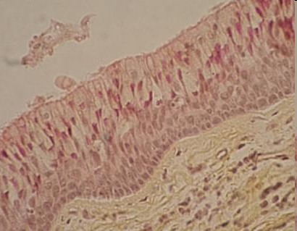
Connective tissue
matrix that supports and connects other tissues and cells together
major constituent of connective tissue is the extracellular matrix
Comparison of epithelium and connective tissue:
In the epithelium - the cells are close to each other, it is difficult to distinguish the number of layers and membranes of individual cells.
In connective tissue - there is a large amount of intercellular matrix and relatively few cells.

Slide 2
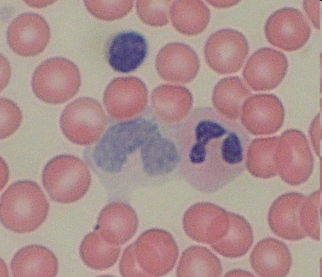
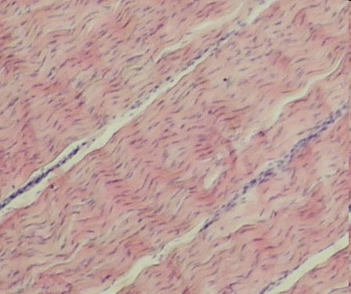
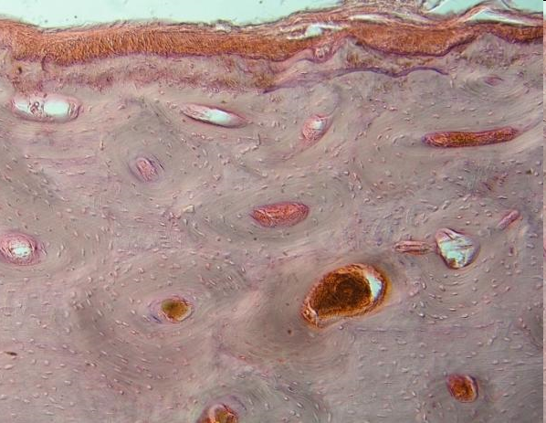
Connective tissue
Extracellular matrix includes:
protein fibers - three main types: collagen, reticular and elastic fibers
ground substance - proteoglycans, glycosaminoglycans,
multiadhesive glycoproteins – fibronectin, laminin
The ground substance contains a certain amount of water which allows the exchange of nutriens between cells and blood in vessels.
Extracellular matrix may have a thin, semi-solid or solid consistency.
Components and consistency of the intercellular matrix, determine the properties of connective tissue
Blood smear
Tendon
Bone

Slide 3
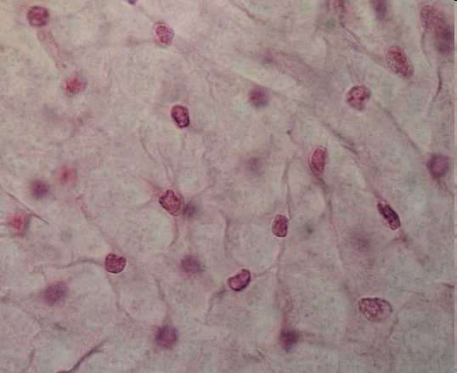
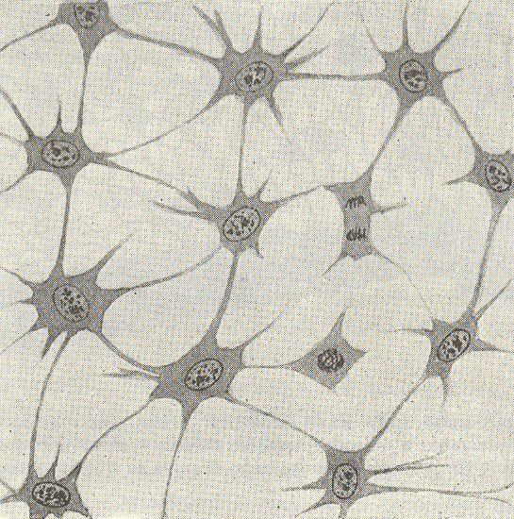
Embryonic origin of connective tissues
All connective tissue originate from embryonic mesenchym
(develop from the middle layer of the embryo, the mesoderm)
Tissues developing from the mesenchyme:
connective tissue proper, cartilage, bone, blood, vascular endothelium, muscle
Mesenchymal cells:
undifferentiated
large euchromatic nuclei with prominent nucleoli, fine chromatin
high level of syntetic activity
spindle- shaped with cytoplasmic processes (protrusions)

Slide 4
Cells of connective tissue
Two types of cells are generally found in connective tissues:
permanent or fixed or resident cells (still present in tissue). These cells produce and maintain extracellular matrix (groung substance and fibers). For example, it belongs here fibroblast, chondrocyt, osteocyt.
transient or (wandering) cells (blood leucocytes, macrophages, mast cells). These type of cells perform various function here for a period as needed and then usuually die by apoptosis. The main function of these cells is immune protection. These cells belong to the mononuclear phagocytic system

Slide 5
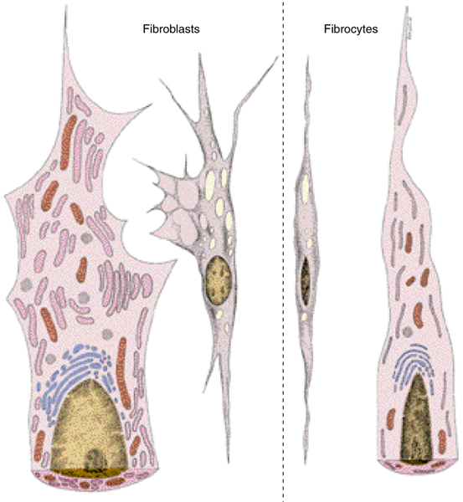
Cells of connective tissue
Fibroblasts, Fibrocytes
most common cells in connective tissue proper
produce and maintain all compounds of extracellular components
Fibroblast - metabolically more active form of this cell
more abundant cytoplasm, rough endoplasmatic reticulum,
well develop Golgi apparatus,
large euchromatic nukleus and prominent nucleolus
Fibrocytes - a highly differentiated, less metabolically active cell
smaller than an active fibroblast, ussually spindle shaped, much less rough ER, dark, heterochomatic nucleus
In adults, rarely undergo division.
Some growth factors can act on fibroblasts and influence their metabolism.
Stimulated by growth factors, they can divide - tissue reparation, wound healing
Myofibroblast – fibroblast involved in wound healing, have contractile function and
are enriched with actin

Slide 6
Cells of connective tissue (fibroblast, fibrocyte)

Slide 7
Cells of the mononuclear phagocytic system

Slide 8
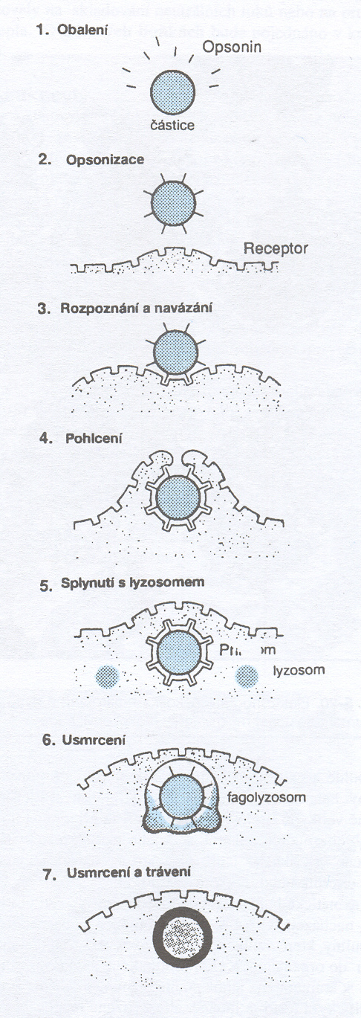
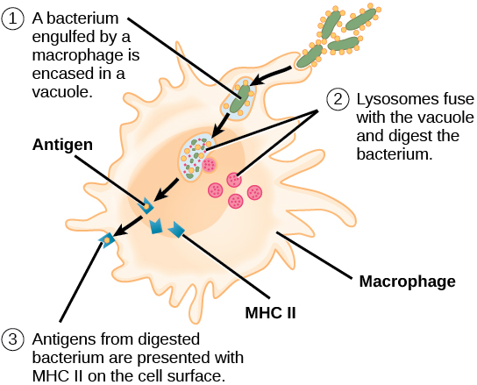
Cells of connective tissue
Macrophages
Highly developed phagocytic activity, active in removal of dead cells, tissue debris or patogens, are especially abundant at sites of inflammation
Size 10-30 𝜇m, excentically localed oval or kidney-shaped nukleus
Sometimes referred as histiocytes
They differentiate from monocytes that are in the blood and can pass through the walls of small venules into the tissues.
opsonisation
recognition
binding
absorption
fusion with
the lysosome
killing
degradation

Slide 9
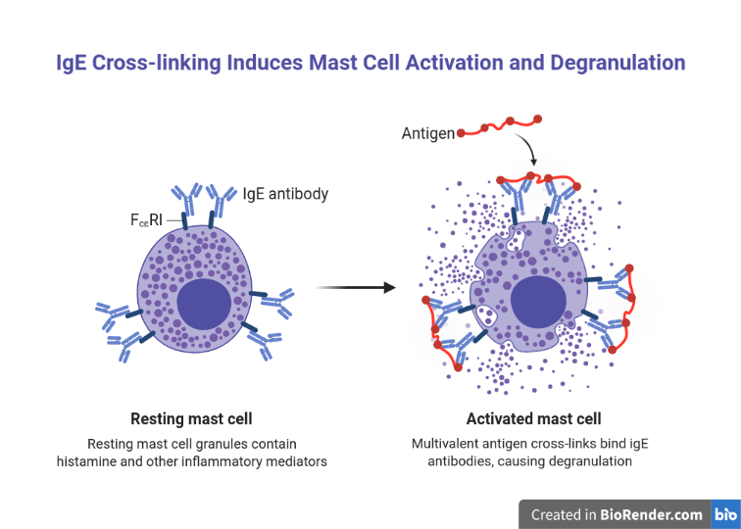
Cells of connective tissue
Mast cells
oval or irregular shaped, filled with basophillic secretory granules, which can obscure nukleus
secretory granules contain these substances: heparin (anticogulant), histamine (increase vascular permeability), serine proteases (activate mediators of inflammation), cytokines (affect leukocyte), chemotactic factors (attract leukocytes)
Mast cells are abundant around blood vessels in the skin and in the tissues of the digestive and respiratory tracts - in places with a higher risk of pathogen occurrence.
Mast cells bind IgE antibodies on their surface and in pathological conditions can participate in type I hypersensitive reactions

Slide 10
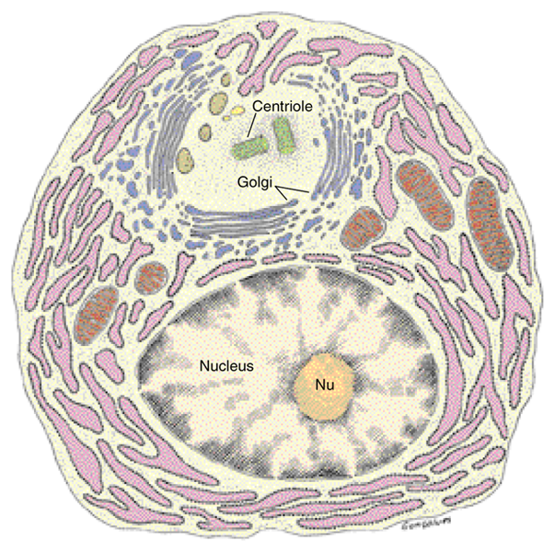
Cells of connective tissue
Plasma cells lymphocide-derived, antibody producting cells, ovoid, large cells, basophilic cytoplasm, rich in proteosynthetic apparatus, the nucleus contains both heterochromatin and euchromatin, darker and lighter areas.
Other types of leukocytes can also be found in the connective tissues,
their number increases during inflammation
neutrophils, eosinophils, several types of lymphocytes)

Slide 11
Fibers
Three types of fibers are found in connective tissues..
Collagen, elastic and reticular fibers
Reticular and collagenous fibers are composed of collagen, elastic are of elastin.
Fibers occur in different amounts according to the type of connective tissue.
The amount and type of fibers determines the properties of the tissue.
Collagen
most abundant protein in the human body
representing 30% of the dry weight
mainly produced by fibroblast
there are 28 (5 the most important) types of collagen
Collagen fibrils forming a collagen fiber (next is bundle of collagen fibers) in a scanning electron microscope image. The basic structural units of collagen (three-helix size 300 nm) partially overlap during aggregation. This creates striations

Slide 12
Fibers, Collagen synthesis
Collagen synthesis is catalyzed by several different enzymes.
These enzymes must first be created in the cell by the process of proteosynthesis.
The formation of collagen is therefore a very complicated process.
There are a number of pathological conditions associated with collagen synthesis disorders (scruvy – lack of vit C, which acts as cofactor of prolyl oxidase)
There is a so-called turnover of collagen in the tissues. Its intensity varies according to the type of tissue (low in tendons, high in periodontal ligaments of teeth). The degradation of collagen is initiated by enzymes called collagenases (matrix metaloproteinases).

Slide 14
Fibers
Elastic fibers
are thinner than collagen fibers
typically in organs where volume changes occur (aorta, lung tissue)
the main protein here is elastin
they are also called yellow due to the coloring of the tissues that contain them

Slide 15
Fibers
Reticullar fibers
consist of collagen type III, forms a network
typically occur in the immune organs, also in the reticular lamina of basement membrane and surround adipocytes, smooth muscle cells, nerve fibers, small blood vessels
are stained black by impragnation with silver salt.

Slide 16
Types of connective tissue
Connective tissue proper:
1. Loose (areolar tissue)
consist of cells, ground substance and fibers in equal parts
forms the layer below the epithelium (including the epithelium of the skin),
filling space between fibers of muscle and nerve
is flexible and nor very resistent to stress
2. Dense
Higher proportion of collagen fibers – irregular or regular according to fiber arrangement
Irregular:
resistant to stress from all directions
deep dermis layer of skin, capsules around the organs
Regular:
consists of fibroblasts and type I collagen bundles (minimum of ground substance)
resistant to stress from the same direction
tendons, aponeurosis, ligaments

Slide 17
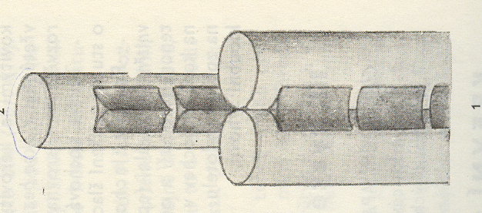
L loose, D dense irregular
connective tissue
Dense irregular
connective tissue
Dense regular connective tissue, tendon
Longitudinal section
Fibrocyte between bundles of collagen fibers on a transverse section of tendon, The cytoplasm forms a protrusion in the spaces between the fiber bundles.
In Czech, the name winged cells is used

Slide 18
Types of connective tissue
Reticular tissue
Consist of type III collagen fibers (also known as reticullin) - produced by modified fibroblasts, called reticular cells
Occurs in hematopoietic and lymphoid organs (bone marrow, lymph nodes, spleen), where it forms a network-like basic structure
Contains many free cells, especially lymphocytes, as well as macrophages and dendritic cells
Mucoid tissue
Component of fetal umbilical cord,
Is called Wharton‘s jelly
Contain fibroblasts, mesenchymal cells, few fibers,
A lot of ground substance

Slide 19
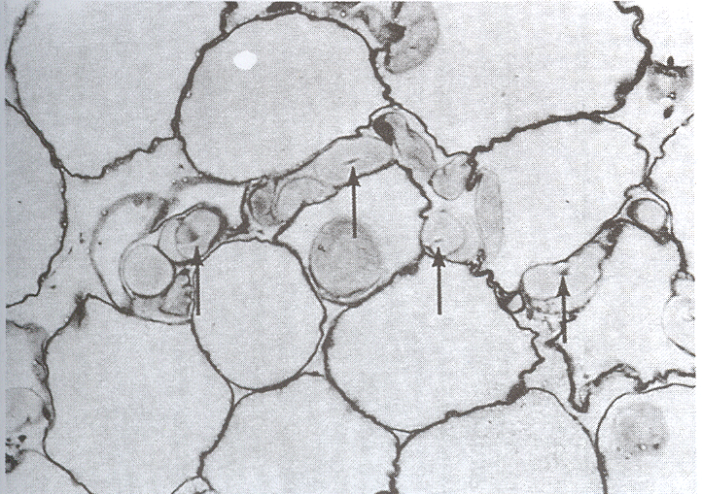
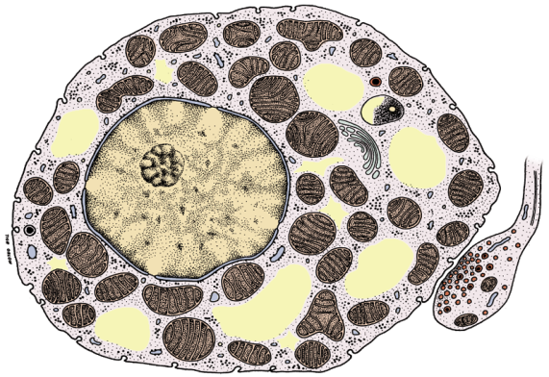
Types of connective tissue
Adipose tissue
There are two major types: white and brown adipose tissue
White:
cells – adipocytes, size 50 – 150 µm, signet ring shape, one cytoplasmic droplet of fat-specialized for fat storage
Brown:
contain multiple lipid droples and abundant mitochondria, witch give this tissue a dark color.
adipocytes can produce heat by non-shivering thermogenesis.
They contain a special protein thermogenin, which disconnects the electron transport chain from oxidative phosphorylation. Protons accumulate in the intermembrane space of the mitochondria and their energy is converted into heat.

Slide 20
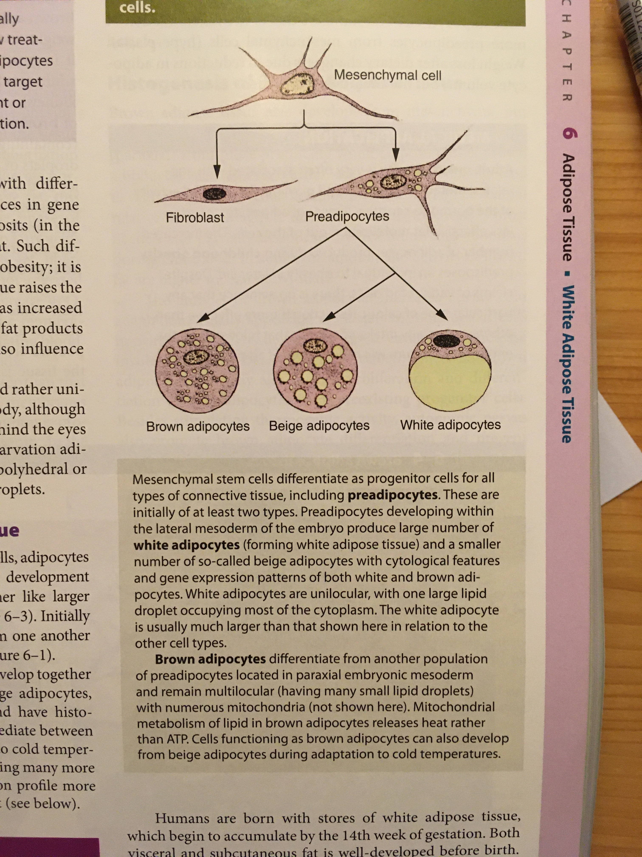
Types of connective tissue
Development of adipocytes:
The precursor is the mesenchymal stem cell.
First a preadipocyte is formed, from which white and beige and brown adipocytes develop.
Beige adipocytes have some characteristics of both white and brown. When the organism adapts to the cold, they can produce heat. They were discovered recently.

Slide 21
Cartilage
The intercellular mass has a solid consistency, flexible, smooth on the surface, does not deform
Important for the development of bones – ossification
On the surface is dense connective tissue - the perichondrium (except of articular cartilage of joints). There are blood vessels in the perichondrium that do not penetrate the cartilage.
Nutrition is realized by diffusion. For this reason cartilage is usually in thin layers so that diffusion is sufficient. Cells have small protrusions that increase the surface area for substance exchange.
Cartilage contains a relatively large amount of bound water. Glycosaminoglycans that bind to core proteoglycans have many negatively charged groups. Na⁺ ions, which are abundant in the tissues, bind to these negative charges. Water molecules than bind to sodium cations thanks to their free electron pairs.

Slide 22
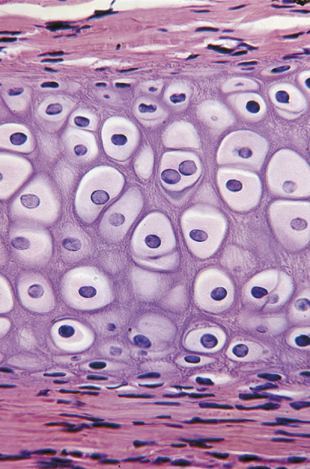
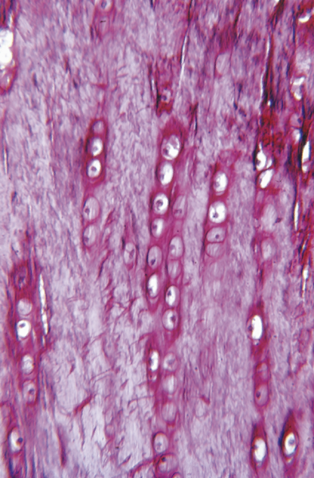
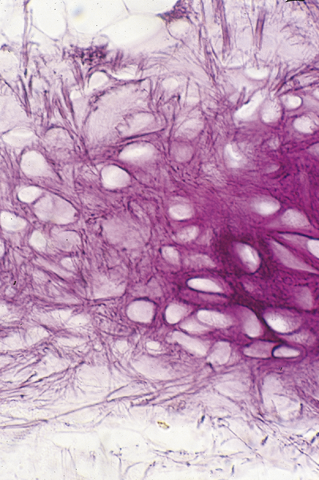
Cartilage
Cells – chondroblasts - near the perichondrium, they divide and differentiate into chondrocytes – produce matrix components, located in matrix cavities called lacune.
Cells originate from divisions of a single chondroblast - isogenous groups .
Matrix contains type II collagen, hyaluronan and proteoglycans, glycoproteins, around the chondrocytes contains less collagen - territorial matrix.
Cartilage growth is possible in two ways:
interstitial (by mitotic division of chondrocytes in the inner part of the cartilag and appositional (by chondroblast differentiation from cells in the perichondrium)
Cartilage repair is possible only in children, in adults is very limited, due to avascularity and low metabolism.
Hyaline
Fibrocartilage
Elastic

Slide 23
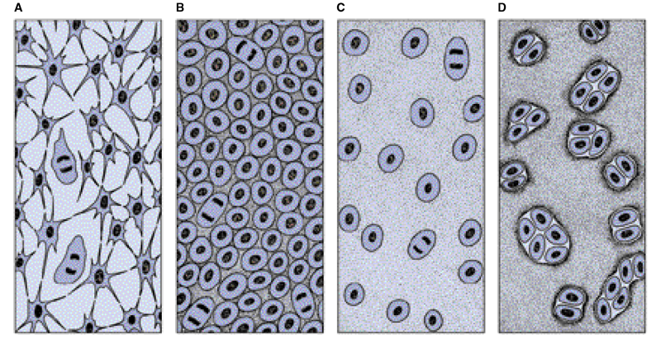
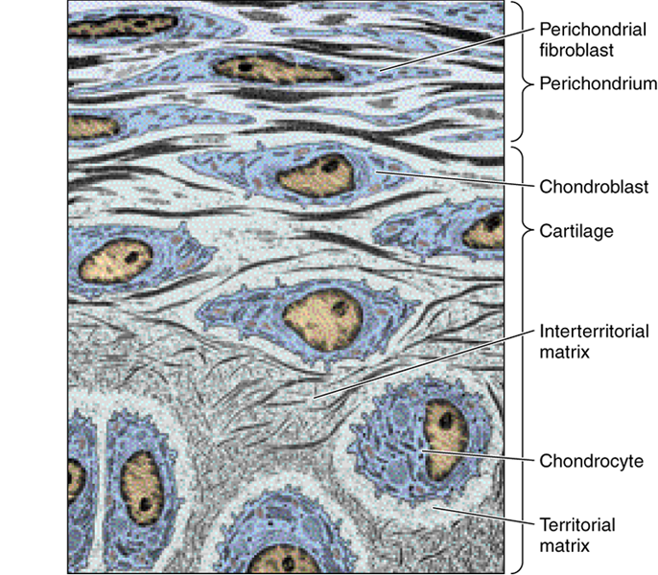
Chondrogenesis

Slide 24
Cartilage
Types of cartilage:
Hyaline: most common, located in the articular surface, in certain parts of the respiratory system, junction of ribs and sternum, and epiphyseal plates of long bones (make possible bone growth).
Fibrocartilage: transitional type between dense connetive tissue and cartilage, typically found in intervertebral discs, also contains fibroblasts, cells are axially arranged
Elastic: similar to hyaline, but more flexible, contain an abundant network of elastic fibers, more resistant to degenerative processes, in auricule of the ear, external auditory canal, epiglottis, Eustachian tube.

Slide 25
Bone
The intercellular mass is calcified by an inorganic compound – calcium hyproxyapatit is the most abundant.
Cells
Osteocytes: in lacunae, between bone matrix layers (lamelle), have cytoplasmatic processes
Osteoblasts: produce the organic component of the intercellular matrix and control the process of mineralization
Osteoclasts: large multinucleated cells involved in removing bone matrix and remodelation of bone tissue
Periosteum:
on the outside, dense connective tissue. Bundles of collagen fibers called Sharpey fibers penetrate the bone and bind the periosteum tightly to the bone.
The inner layer contains osteoprogenitor cells, with the potential to divide and differentiate into osteoblasts. Important in fracture healing.
Endosteum:
thin layer of osteoprogenitor and covering cells and a small amount of collagen fibers

Slide 26
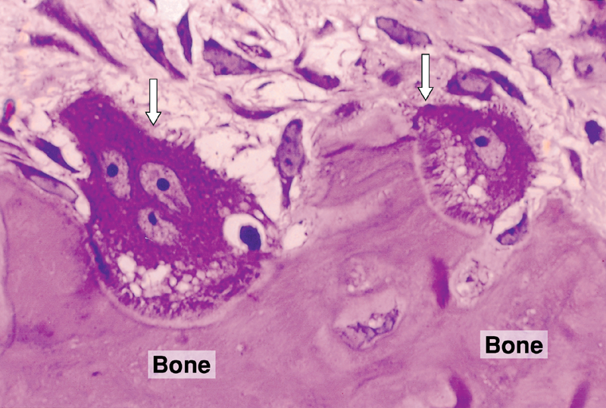
Bone
Bone can be observed as groung bone (after grinding) or on decalcified, stained sections.
Decalcification is realized by maceration of the bone in acid.
Arrows indicate osteoclasts
P - Volkmann canals
I – Intersticial lamellae

Slide 27
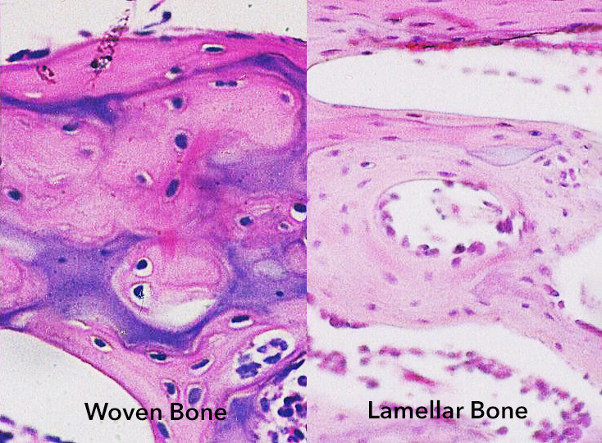
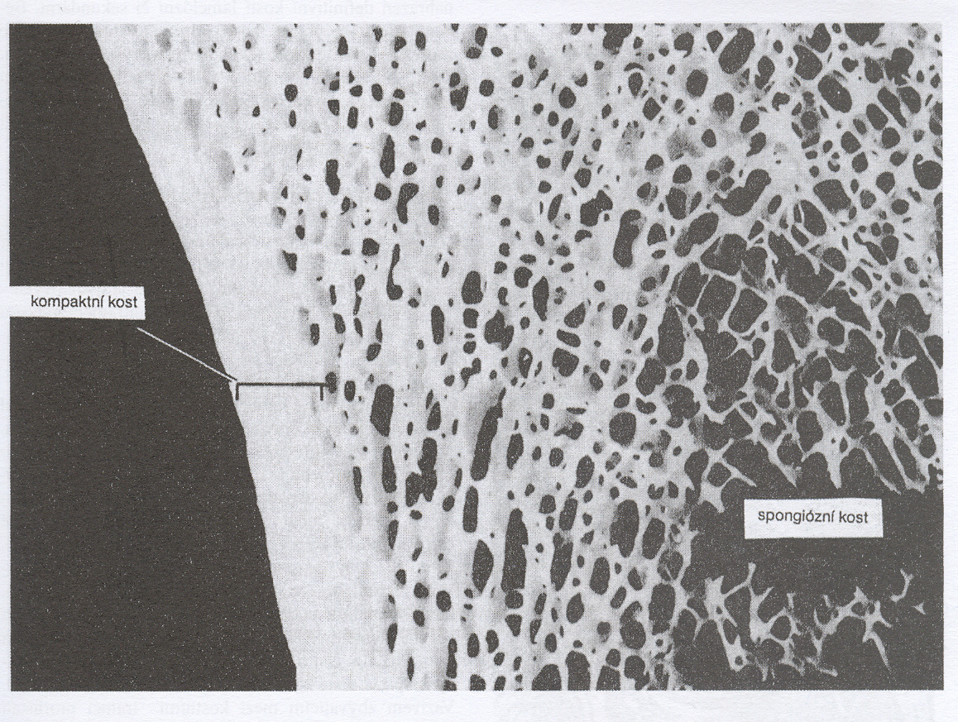
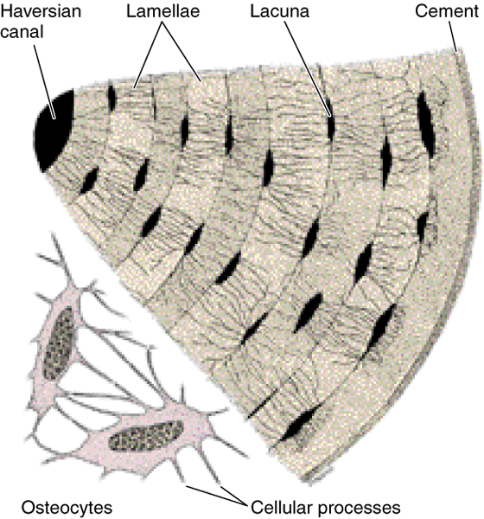
Types of bone
Woven (Fibrous) bone:
random disposition of colagen I fibers and lover mineral content
it appears first during embryonic development and during reparative processes, and is then replaced by lamellar bone
Lamellar bone:
consists of lamellae 3-7 µm in size, organized as:
parallel sheets - cancellous or spongy bone
concentrically around a central canal – compact bone
Compact bone
Spongy bone

Slide 28
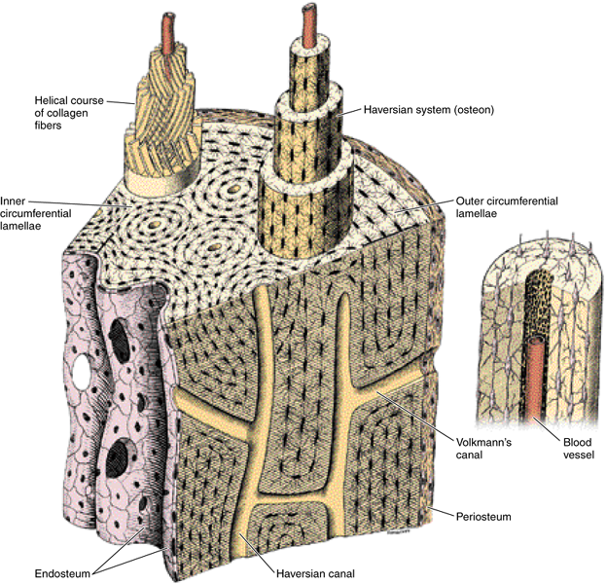
Compact bone structure

Slide 29
Summary of bone types

Slide 30
Bone
Fracture healing: osteoprogenitor cells in the periosteum and endosteum are important in fracture healing. First, an undifferentiated highly cellular mass is formed (callus). Callus is similar to fibrocartilage. Blood vessels grow into this tissue and osteoblasts differentiate. Then woven bone is formed, which is then remodeled into lamellar type bone.

Slide 31
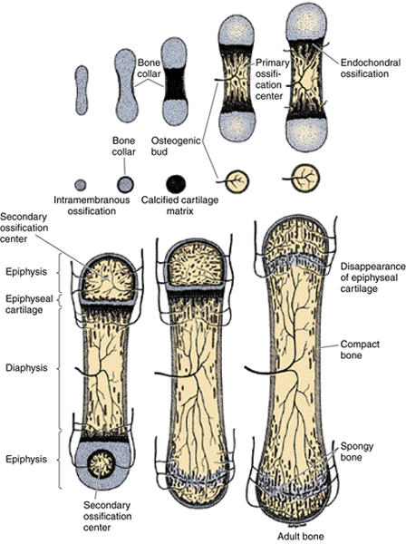
Ossification
Bone development occurs by one of two processes:
Intramembranous ossification – osteoblasts differentiate directly from mesenchyme
Enchondral bone develops from the hyaline cartilage that forms the base of the bone
This process has several steps:
First a bone model is created from cartilage. Further, a bone collar and a primary ossification center in the diaphysis are formed. Cartilage in this place begins to degenerate due to lack of oxygen and nutrients. Cavities are created in it, into which blood vessels and osteoprogenitor cells from the periosteum penetrate. These differentiate into osteoblasts and form the intercellular bone mass. In the same way bone is formed in secondary ossification centers in the epiphyses. In this way, primary bone (woven) is created, which is later remodeled into a secondary type.

Slide 32
Epiphyseal plate
The area between the diaphysis and the epiphysis, where even after birth there is cartilage and bone growth takes place here.
At the same time the cartilage is transformed into bone.
Cartilage remains here, until human growth is completed. This cartilage gradually ossificated in the same way as ossification occurs in embryonic development. At the same time, bone growth takes place in the longitudinal direction by the division of chondrocytes. We can therefore study the ossification process on this plate even after birth.

Slide 33
Literature and image sources
Mescher A.L.: Junqueira‘s Basic Histology, Text and Atlas, 14th Edition,
Junqueira L. C., Carneiro J.: Základy histologie, H+H, 1997
Kerr J. B.: Atlas of Functional Histology, Elsevier, 1999
Knoz J.: Obecná zoologie I a II, SPN, 1984
http://www.emc.maricopa.edu/faculty/farabee/BIOBK/BioBookcircSYS.html
http://rocek.gli.cas.cz/Courses/courses.htm
http://www.sci.muni.cz/ptacek/
https://www.sciencedirect.com/topics/veterinary-science-and-veterinary-medicine/epiphyseal-plate
https://microbeonline.com/immunoglobulin-e-ige-antibodies/
https://biogennix.com/bone-healing/bone-anatomy-bone-fracture-repair-3-ways-to-categorize-bone/

