Slide 1
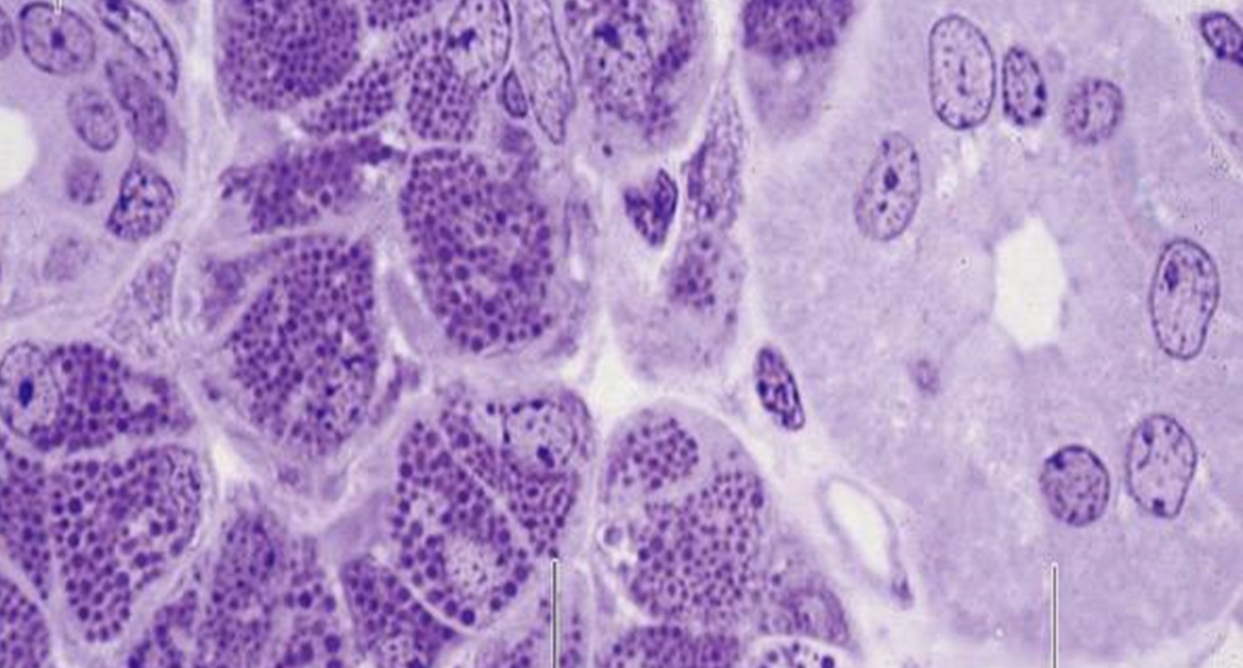
DIGESTIVE SYSTEM

Slide 2
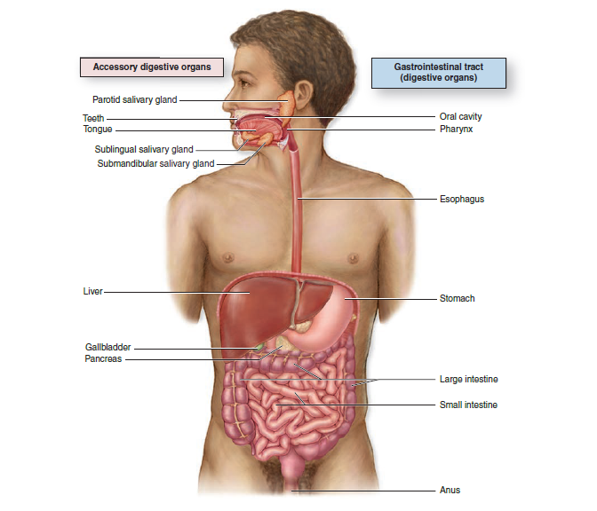
DIGESTIVE SYSTEM
COMPONENTS OF THE GI TRACT
The digestive tract consist of:
Oral cavity
Esophagus
Stomach
Small and large intestines
Organs associated with the digestive tract:
Salivary glands
Pancreas
Liver
Gallbladder
FUNCTION of the GI tract:
To obtain from ingested food nutrients and energy
Ingestion, fragmentation, digestion, absorption, elimination fo waste products
Protective barrier

Slide 3
DIGESTIVE SYSTEM
BASIC HISTOLOGICAL ORGANIZATION
Glands
Exocrine glands, aiding in digestion and/or lubrication, are located in:
  Epithelium (e.g., goblet cells throughout the intestines)
  Lamina propria (e.g., gastric glands)
  Submucosa (e.g., Brunner's glands in the duodenum)
  Glands located external to the digestive tract that open into the system (e.g., liver and pancreas)
Endocrine and paracrine cells, belonging to the diffuse neuroendocrine system (DNES), are located throughout the mucosa of the gastrointestinal tract, influencing the secretion of glands and the motility of the gut

Slide 4
DIGESTIVE SYSTEM
ORAL CAVITY
In the oral cavity starts the digestive process with ingestion, fragmentation and moistening of food.
Oral cavity is involved in speech, facial expression, sensory reception and breathing.
Major structures:
  lips
  teeth
  tongue
  oral mucosa
  hard and soft palate
  associated salivary glands
Oral mucosa
Oral mucosa, the protective mucous membrane (mucosa) lining the oral cavity, is continuous with external skin and with the mucous membrane of the pharynx.
Composition:
  Epithelium. Stratified squamous keratinized or nonkeratinized depending on location
  Lamina propria. Collagenous tissue
  Muscularis mucosae is not present.
  Although not part of the oral mucosa, a submucosa of dense connective tissue, containing the minor salivary glands, underlies much of the oral mucosa.

Slide 5
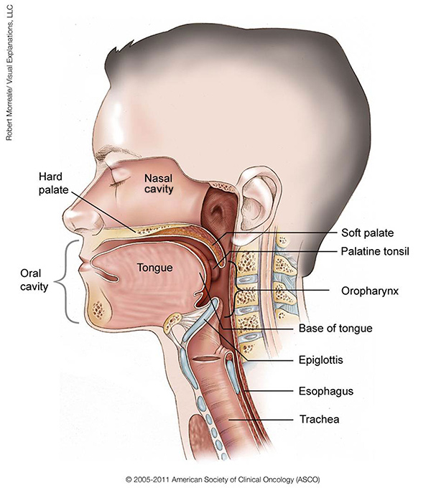

Slide 6
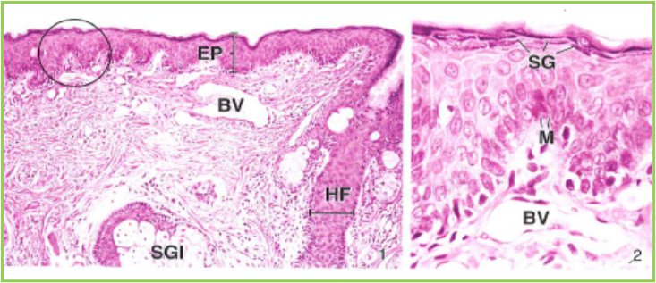
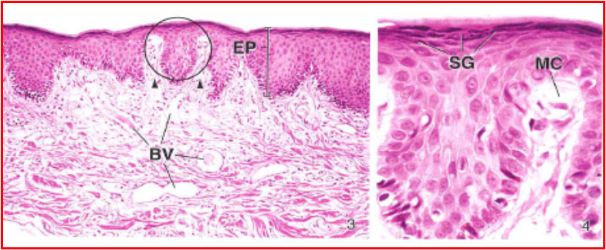
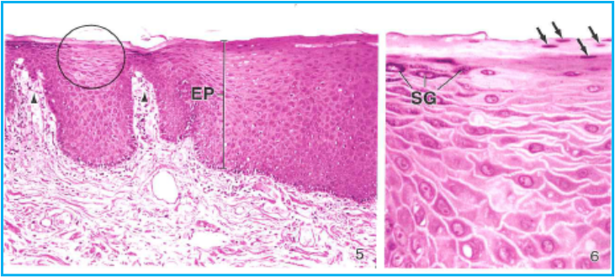
DIGESTIVE SYSTEM
LIPS
Forms the anterior boundary of the oral cavity, the space between the inner surfaces of the lips and cheeks and the outer surface of the teeth and gingiva
Regions:
  Exterior surface
    Covered by thin skin
    Hair follicles and sebaceous glands are present
  Vermilion zone
    Forms the red-colored portion of the lip
      Covered by a thin, stratified squamous keratinized epithelium
      Mucosa contains numerous, densely packed dermal papillae
      Papillae allow blood vessels close access to the surface
    Lacks hair follicles
  Inner surface
    Lined by oral mucosa, stratified squamous moist epithelium
    Minor salivary glands (labial glands) in the submucosa secrete both mucous and serous products.

Slide 7
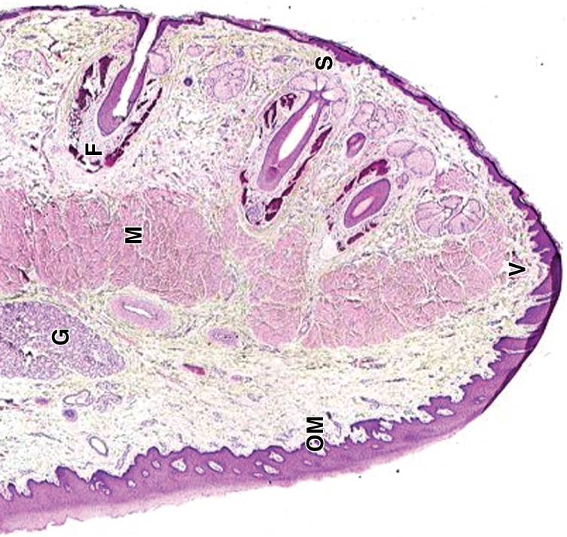
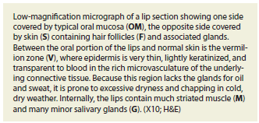
Notes:
OM – oral mucosa
S – skin
F – hair follicles a přídatné žlázy
V – vermilion zone – rumělka
M – žíhaná svalovina
G- malé slinné žlázy

Slide 8
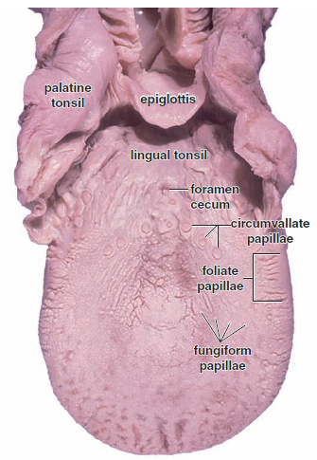
DIGESTIVE SYSTEM
TONGUE
Composition:
Mucosa:
  Dorsum of the tongue is covered by a specialized oral mucosa, modified to form papillae.
  The ventral surface of the tongue is covered by a lining mucosa.
The submucosa possesses minor salivary glands that are mucus-secreting except for those associated with the circumvallate papillae, which are serous-secreting.
Intrinsic tongue muscles. Skeletal muscle bundles are arranged in three separate planes, with connective tissue bands from the lamina propria separating the bundles and firmly anchoring the muscle to the mucous membrane.

Slide 9
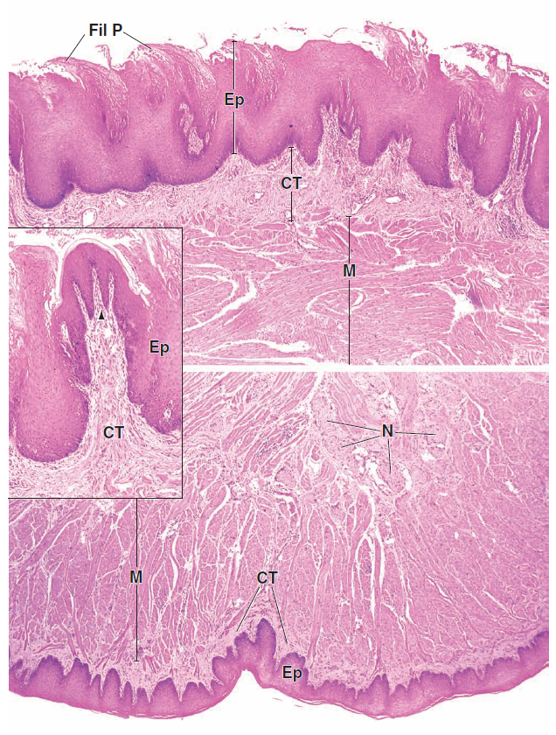
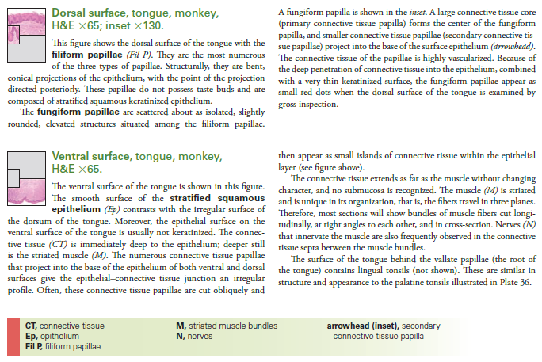

Slide 10
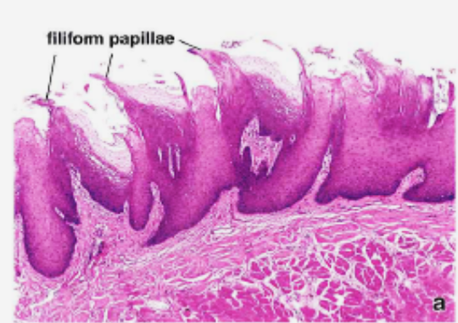
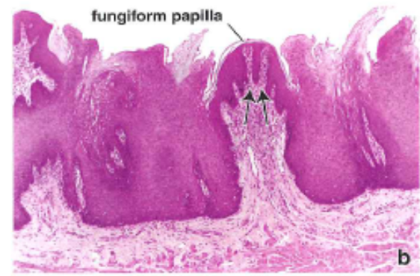
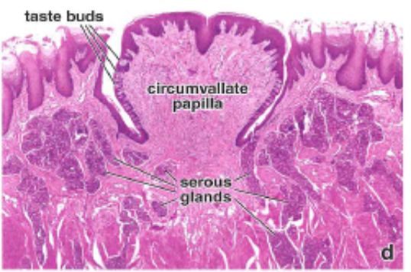
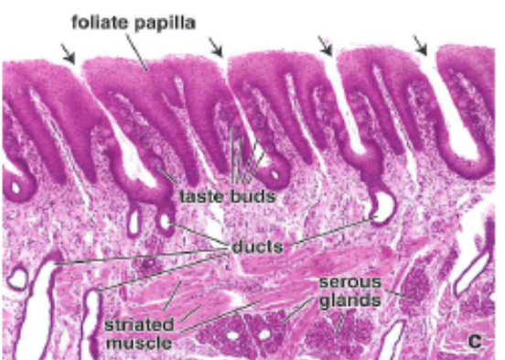
DIGESTIVE SYSTEM
TONGUE
Papillae
Each consists of a connective tissue core covered by a stratified squamous epithelium.
Filiform
  Most numerous; cover body of tongue
  Cone-shaped protrusions angled so that they aid in movement of food toward the pharynx
Fungiform
  Less numerous than filiform but also located on anterior two-thirds of tongue
  Mushroom shaped, possess taste buds on superior surface
Circumvallate
  Eight to twelve papillae located just anterior to the sulcus terminalis
  Mushroom shaped and surrounded by a narrow moat; lateral wall of each papilla possesses taste buds
  Serous glands of von Ebner open into the base of the moat and flush the moat for reception of new tastes.
Foliate
  Parallel folds on the posterolateral surface of the tongue; not well developed in humans

Slide 11
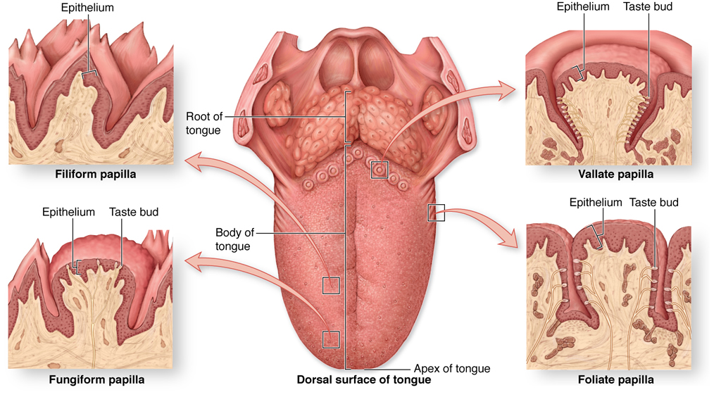

Slide 12
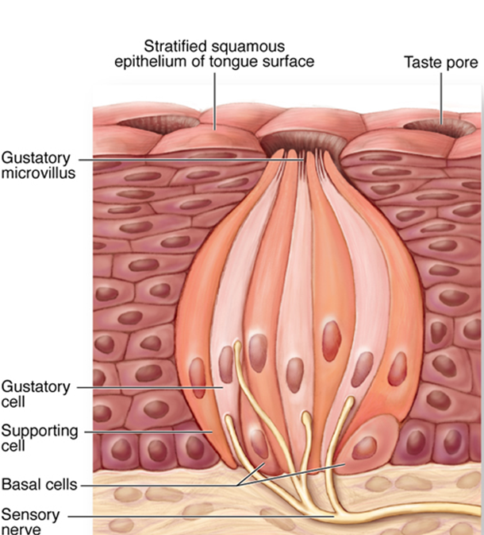
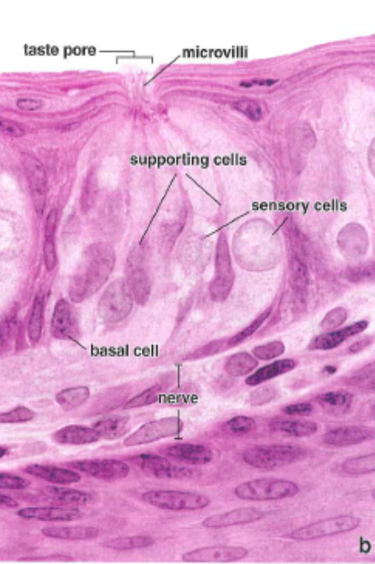
DIGESTIVE SYSTEM
TONGUE
Taste buds are onion-shaped structures embedded in the surface of the fungiform and circumvallate papillae. Taste buds contain taste-receptor cells (gustatory) that communicate with the surface of the papilla through a taste pore. Other cells are supportive cells and basal stem cells. Depolarization of the taste cells leads to the stimulation of gustatory nerve fibers and the discrimination of sweet, salty, bitter, and sour sensations.

Slide 13
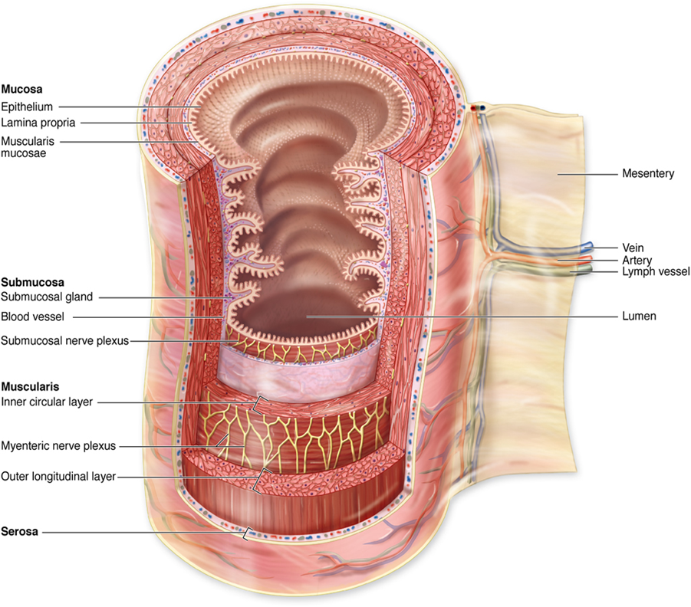
DIGESTIVE SYSTEM
BASIC HISTOLOGICAL ORGANIZATION
Muscular tube with a lumen of variable diameter and wall made up of four main layers:
Mucosa (mucous membrane). Innermost layer facing the lumen
  Epithelium. Either a stratified squamous moist or a simple columnar epithelium
  Lamina propria. Loose connective tissue; usually possesses digestive glands
  Muscularis mucosae of smooth muscle is usually present.
Submucosa. Denser connective tissue than the lamina propria. The submucosa possesses Meissner's nerve plexus that supplies innervation to the muscularis mucosae and to digestive glands in the mucosa and submucosa. The submucosa possesses glands in the esophagus and duodenum.
Muscularis externa of smooth muscle is usually arranged into inner circular and outer longitudinal layers. Auerbach's nerve plexus is located between the two muscle layers and provides innervation to this smooth muscle.
Serosa (serous membrane) is present if the organ protrudes into the peritoneal cavity, or an adventitia (only the connective tissue portion of the serosa) is present if the organ is retroperitoneal.

Slide 14
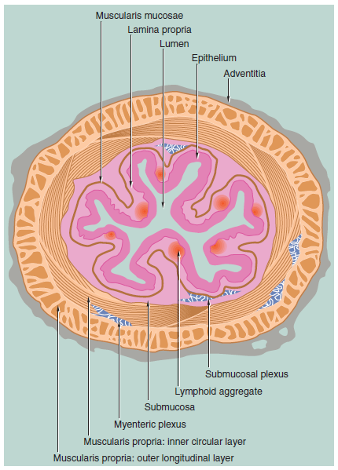

Slide 15
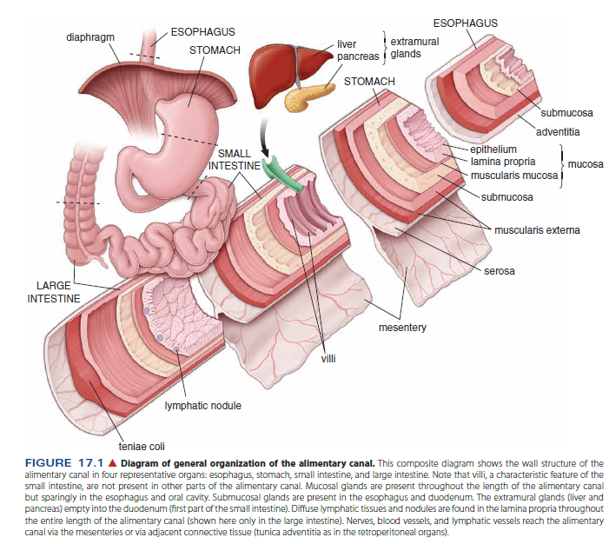

Slide 16
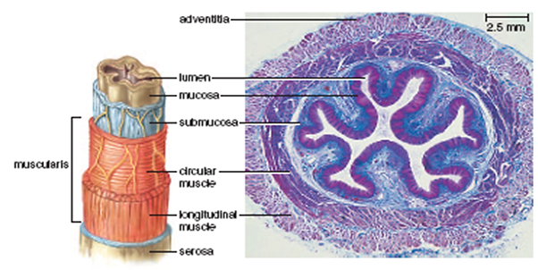
DIGESTIVE SYSTEM
Esophagus
Mucosa:
  Epithelium. Stratified squamous nonkeratinized epithelium
  Lamina propria possesses esophageal cardiac glands that resemble the mucus-secreting glands of the cardiac portion of the stomach. These glands are particularly prominent near the junction of the esophagus with the stomach and are sometimes located in the beginning of the esophagus.
  Lamina muscularis mucosae.
Submucosa has mucus-secreting, esophageal glands proper.
Muscularis externa is composed of striated muscle in the upper portion of the esophagus, skeletal, and smooth muscle in the middle portion, and smooth muscle in the lower portion.
Adventitia. Composed of loose connective tissue.

Slide 17
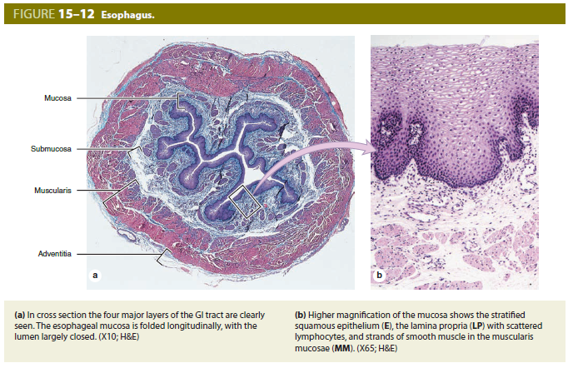

Slide 18
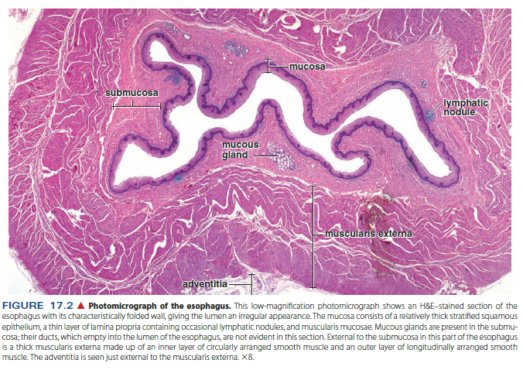

Slide 19
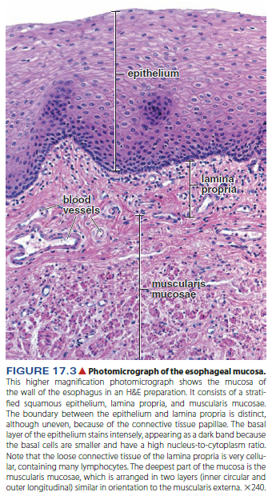
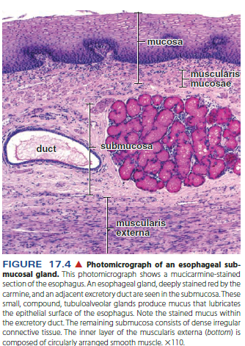

Slide 20
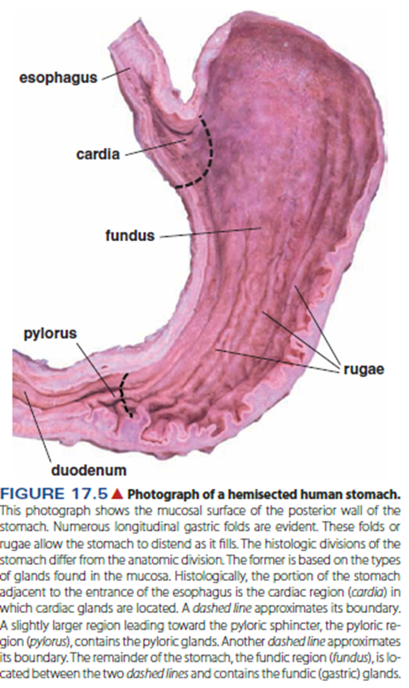
DIGESTIVE SYSTEM
Stomach
Function of the stomach
  Mixed exocrine (digestion) and endocrine organ (hormones secretion)
  To continue the digestion of carbohydrates initiated in the mouth, add an acidic fluid to the ingested food, mixes food to produce chyme
  Initial digestion of proteins with enzyme pepsin
  Gastric lipase – digestion of triglycerides
  Produces intrinsic factor for absorption of vitamin B12
  Absorbs a few nutrients
Four regions:
  Cardia
  Fundus
  Body
  Pylorus
Wall of the stomach:
  Tunica mucosa (epithelium, lamina propria, lamina muscularis mucosae)
  Tunica submucosa
  Tunica muscularis
  Tunica serosa
Rugae. Longitudinal folds of the mucosa and submucosa in the undistended stomach allow for expansion.
fundus
body

Slide 21
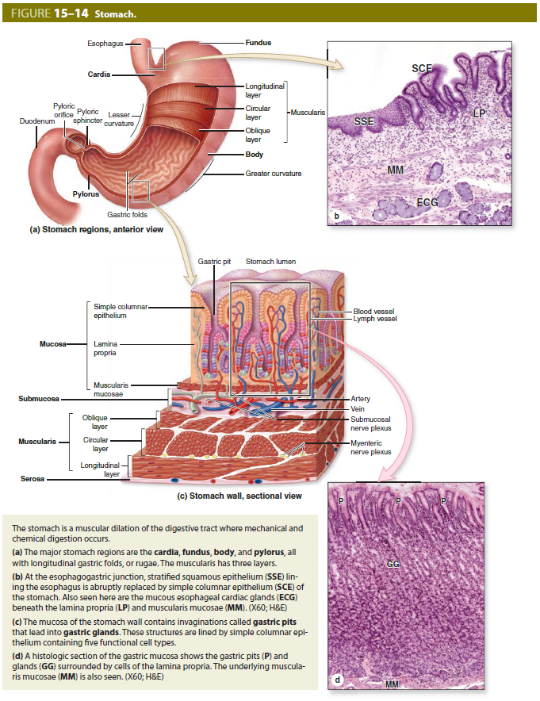

Slide 22
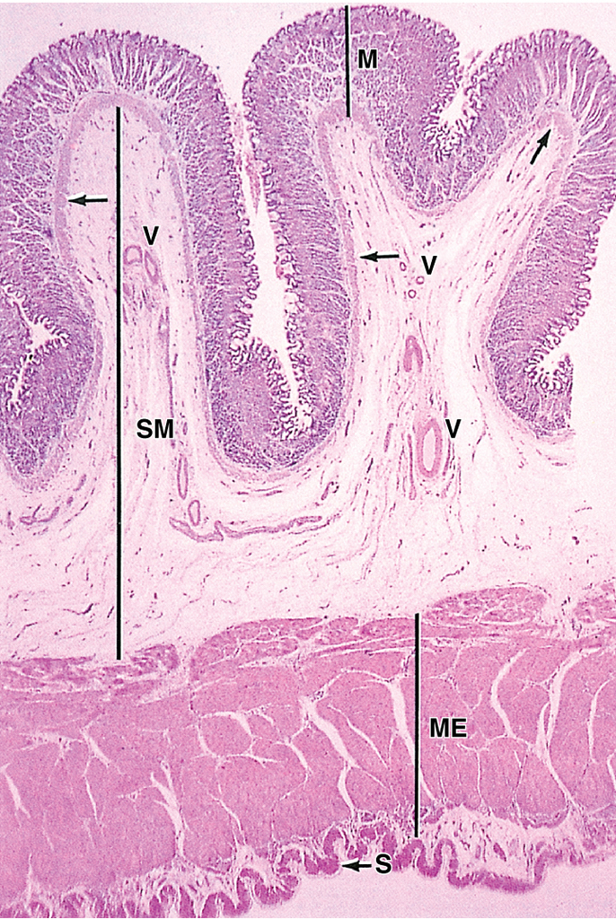
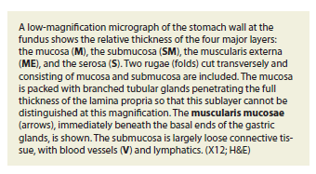

Slide 23
DIGESTIVE SYSTEM
Stomach
Structures present throughout the stomach
  Surface epithelium
    Simple columnar epithelium facing the lumen is modified so that all cells secrete mucus, forming a sheet gland that protects the stomach from its acidic environment.
    Gastric pit. A channel formed by the invagination of the surface epithelium into the underlying lamina propria; connects the sheet gland with the gastric glands. The length of the gastric pit varies with each stomach region.
  Gastric glands
    Simple, branched tubular glands begin at a gastric pit and extend through the lamina propria to the muscularis mucosae.
    The region of the gland that attaches to the gastric pit is called the neck region; the base region of the gland is located adjacent to the muscularis mucosae.
    Secretory cells in these glands vary in each region of the stomach.
  Muscularis externa. Subdivisions of this smooth muscle layer frequently interdigitate, making it difficult to distinguish one layer from another.
    Internal oblique layer
    Middle circular layer that is modified in the pyloric region to form the pyloric sphincter
    Outer longitudinal layer is separated from the inner circular layer by Auerbach's plexus, nerve fibers from the autonomic nervous system that supply
  Serosa

Slide 24
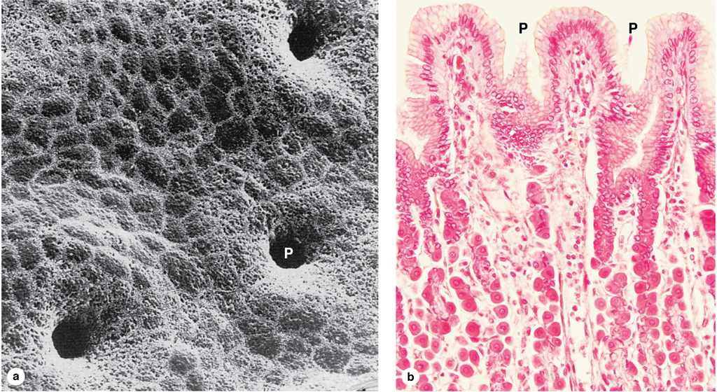
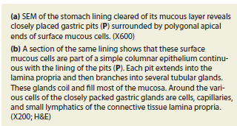

Slide 25
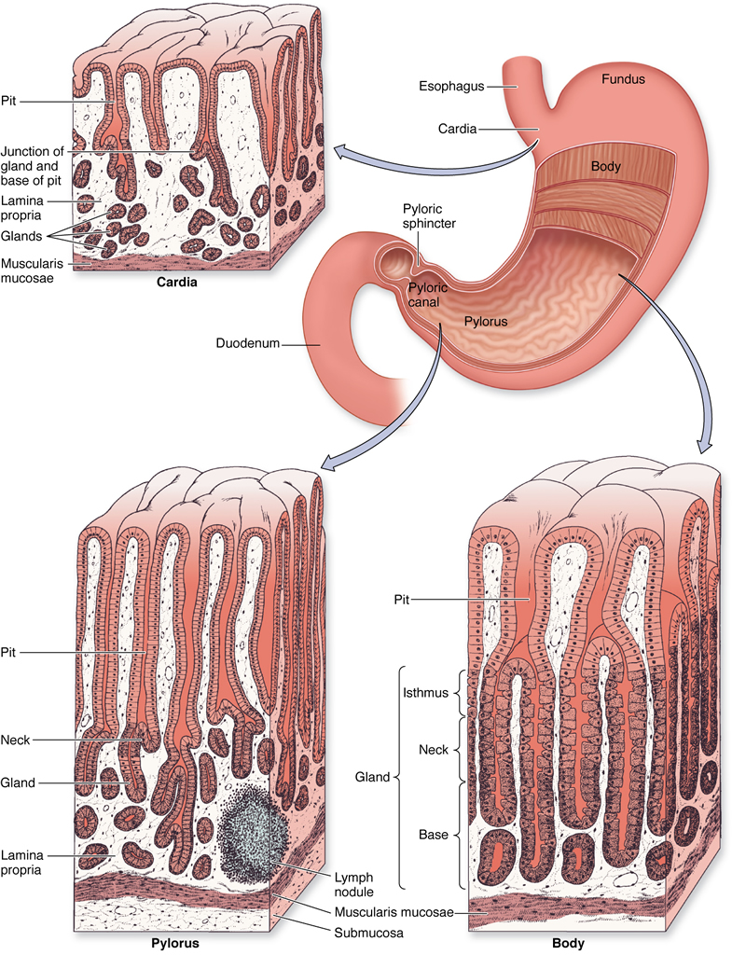

Slide 26
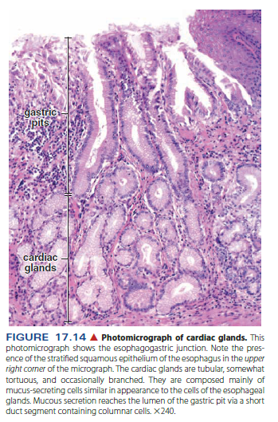
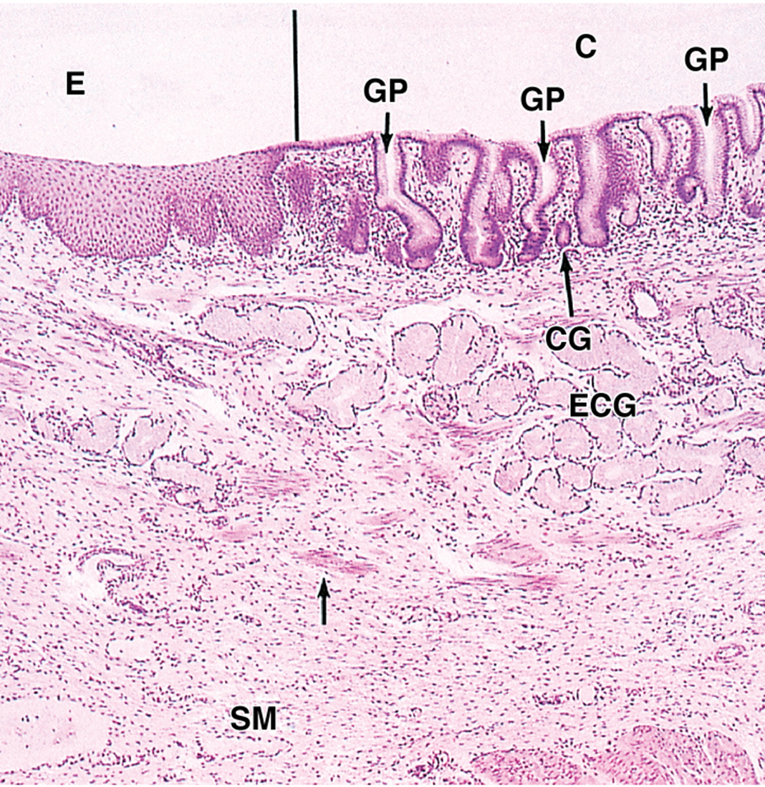
DIGESTIVE SYSTEM
Stomach
Variations specific to the cardiac region (narrow region adjacent to the esophagus)
  Abrupt transition of epithelium from stratified squamous moist of the esophagus to a sheet gland lining the cardiac stomach
  Length of gastric pits is about equal to the length of cardiac glands
  Cardiac glands primarily secrete mucus, although other products are also produced. Glands are frequently coiled.
  Cardiac glands of the stomach extend into the lower esophagus, forming the esophageal cardiac glands.
Esophagogastric junction

Slide 27
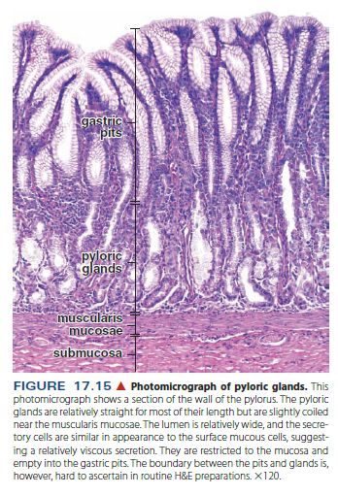
DIGESTIVE SYSTEM
Stomach
Variations specific to the pyloric region
  Pits are longer in pylorus than in the cardiac region.
  Pyloric glands, not as coiled as in the cardiac region; primarily secrete mucus.
  Enteroendocrine cells are also present here.
  Circular layer of muscularis externa is greatly thickened to form the pyloric sphincter.

Slide 28
DIGESTIVE SYSTEM
Stomach
Variations specific to the fundic and body regions (Glands in both regions are called fundic glands.)
  Fundic glands are about twice as long as their gastric pits.
  Cell types present in fundic glands:
    Stem cells replenish both the surface epithelial cells and cells of the glands. Stem cells are located in the neck region.
    Mucous neck cells are irregular in shape and stain basophilically. They secrete protective mucus and are located in the neck region.
    Parietal cells are large, spherical, eosinophilic cells that secrete hydrogen and chloride ions and gastric intrinsic factor. They possess numerous mitochondria. An umbrella-shaped canaliculus indents the luminal surface, increasing surface area. Although present throughout the gland, parietal cells are more numerous in the upper regions.
    Chief or zymogen cells, typical protein-producing cells, predominate in the bases; stain blue with hematoxylin(due to rough ER) and secrete pepsinogen (which is converted into pepsin by HCl).
    Enteroendocrine cells (part of the diffuse neuroendocrine system, DNES) are located on the basement membrane and do not usually reach the lumen of the gland. This population of cells secretes a variety of hormones (e.g., gastrin) with endocrine and paracrine influences on digestive activity. Secretory granules cluster toward the basement membrane for their subsequent release into the lamina propria. Most common at the bases of the glands.

Slide 29
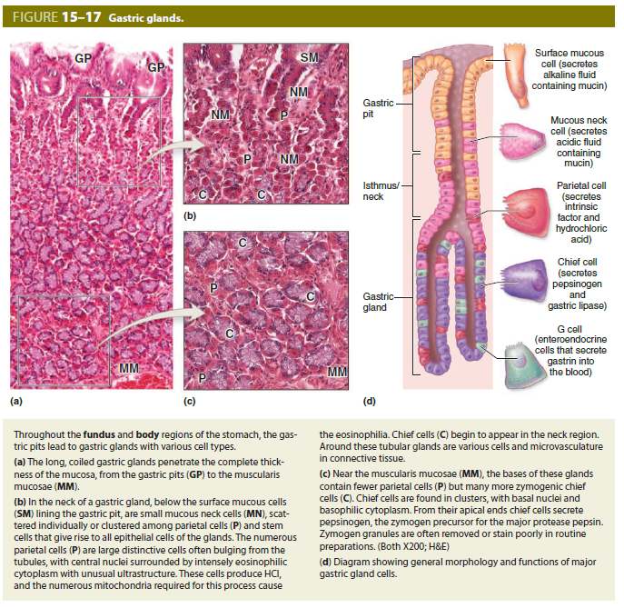

Slide 30
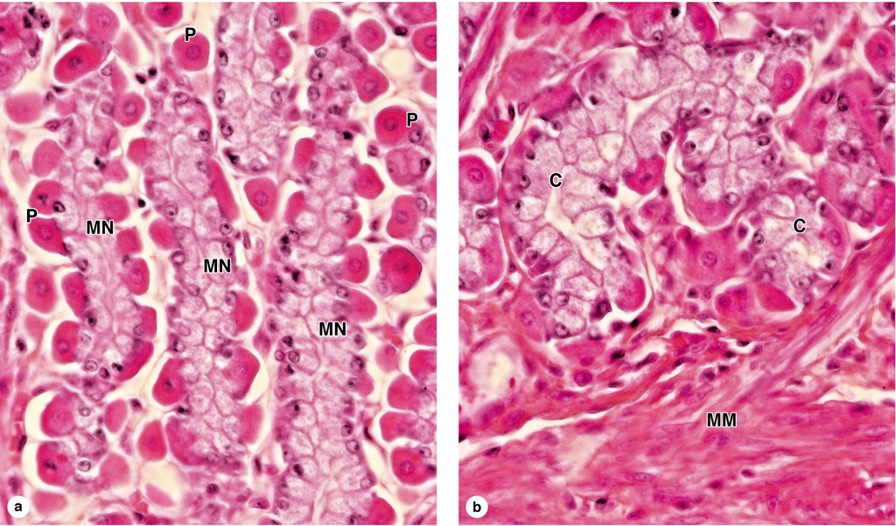
Gastric glands
Neck
Basal part of glands
Notes:
Popis!!!!!

Slide 31
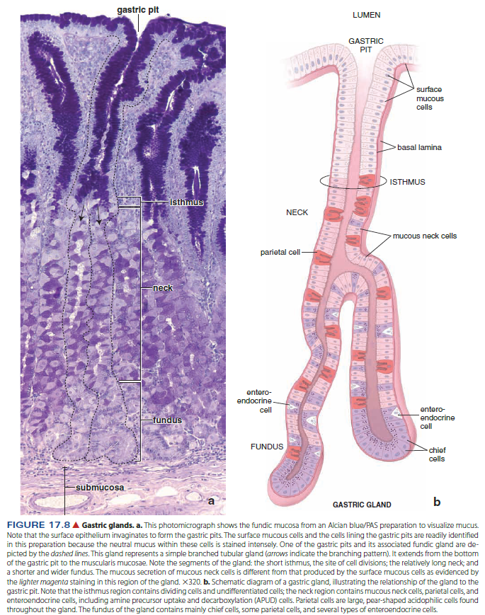

Slide 32
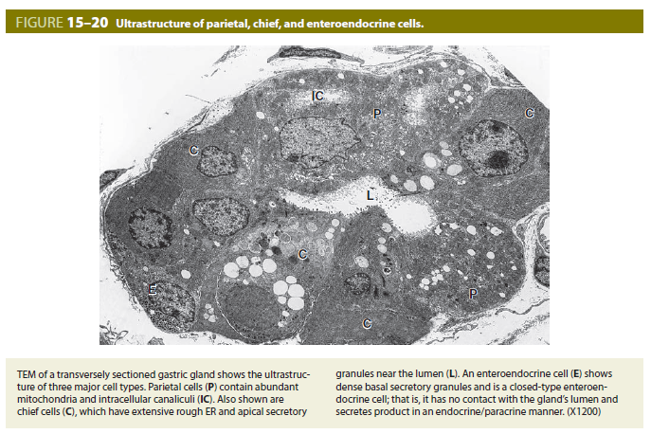

Slide 33
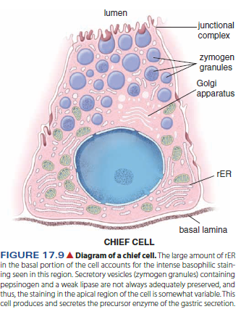
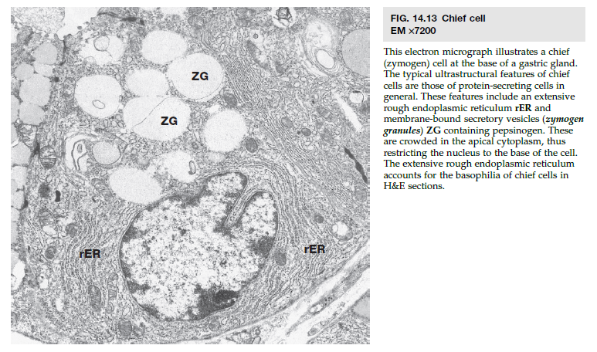

Slide 34
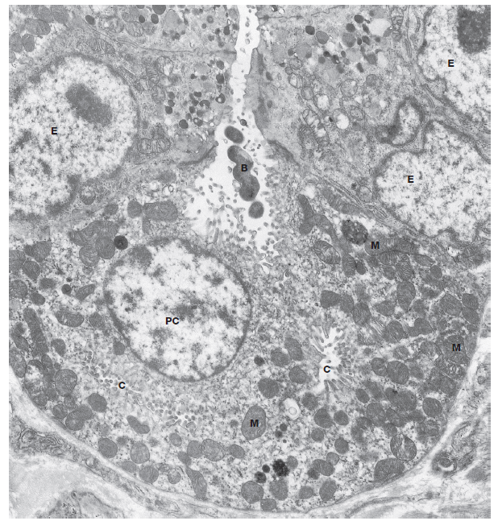
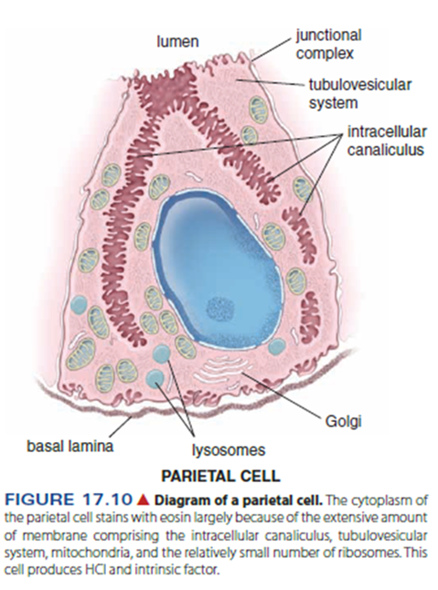

Slide 35
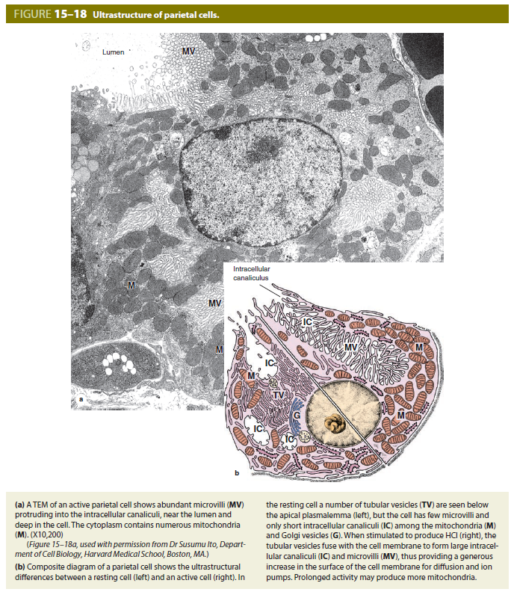

Slide 36
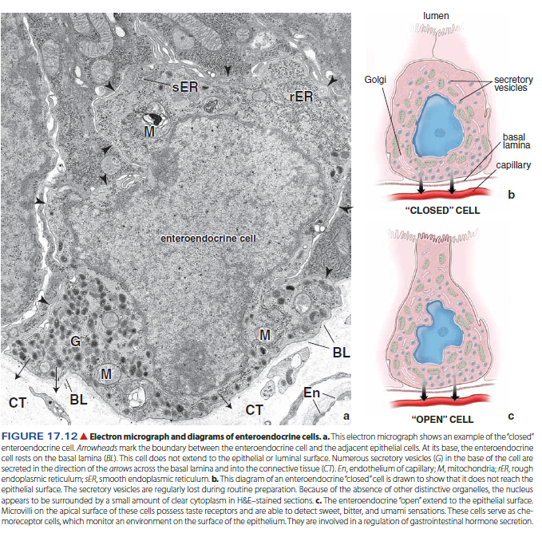

Slide 37
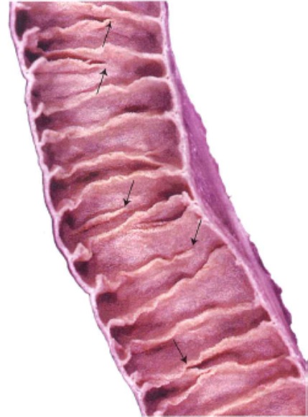
DIGESTIVE SYSTEM
Small intestine
Complete digestion of food
Absorb final products of digestion (amino acids, monosaccharides, fatty acids, etc.)
Secrete protective mucus
Secrete hormones
Subdivided into duodenum (immediately distal to pylorus of stomach), jejunum (distal to duodenum), and ileum (most distal region)
Common features of the small intestine
  Structures that increase the surface area of the small intestine:
    Plicae circulares. Permanent circular folds formed by an up-welling of the submucosa and its overlying mucosa into the lumen. Villi protrude from the plicae.
    Villi. Finger-like protrusions of the lamina propria and overlying epithelium into the lumen
      Villi assume different shapes in each of the three intestinal subdivisions.
      A lacteal (blind-ending lymphatic capillary) is located in the center of each villus to absorb digested fat.
      Individual smooth muscle cells lie parallel to the long axis of each villus, "milking" the lacteal contents to the periphery.
    Microvilli. Increase surface area of absorptive cells and, collectively, form a brush or striated border

Slide 38
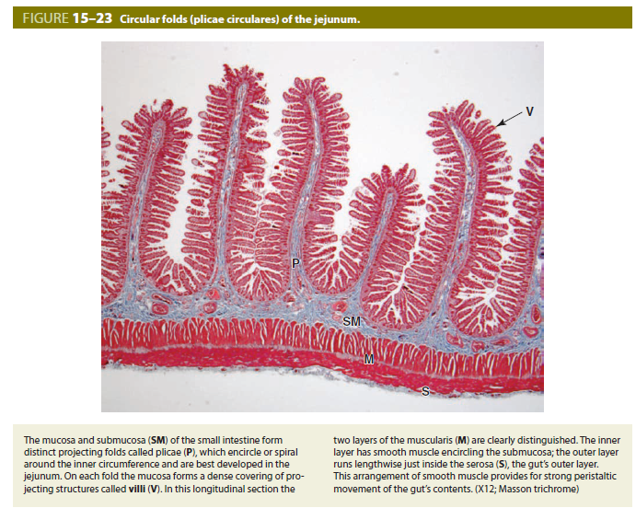

Slide 39
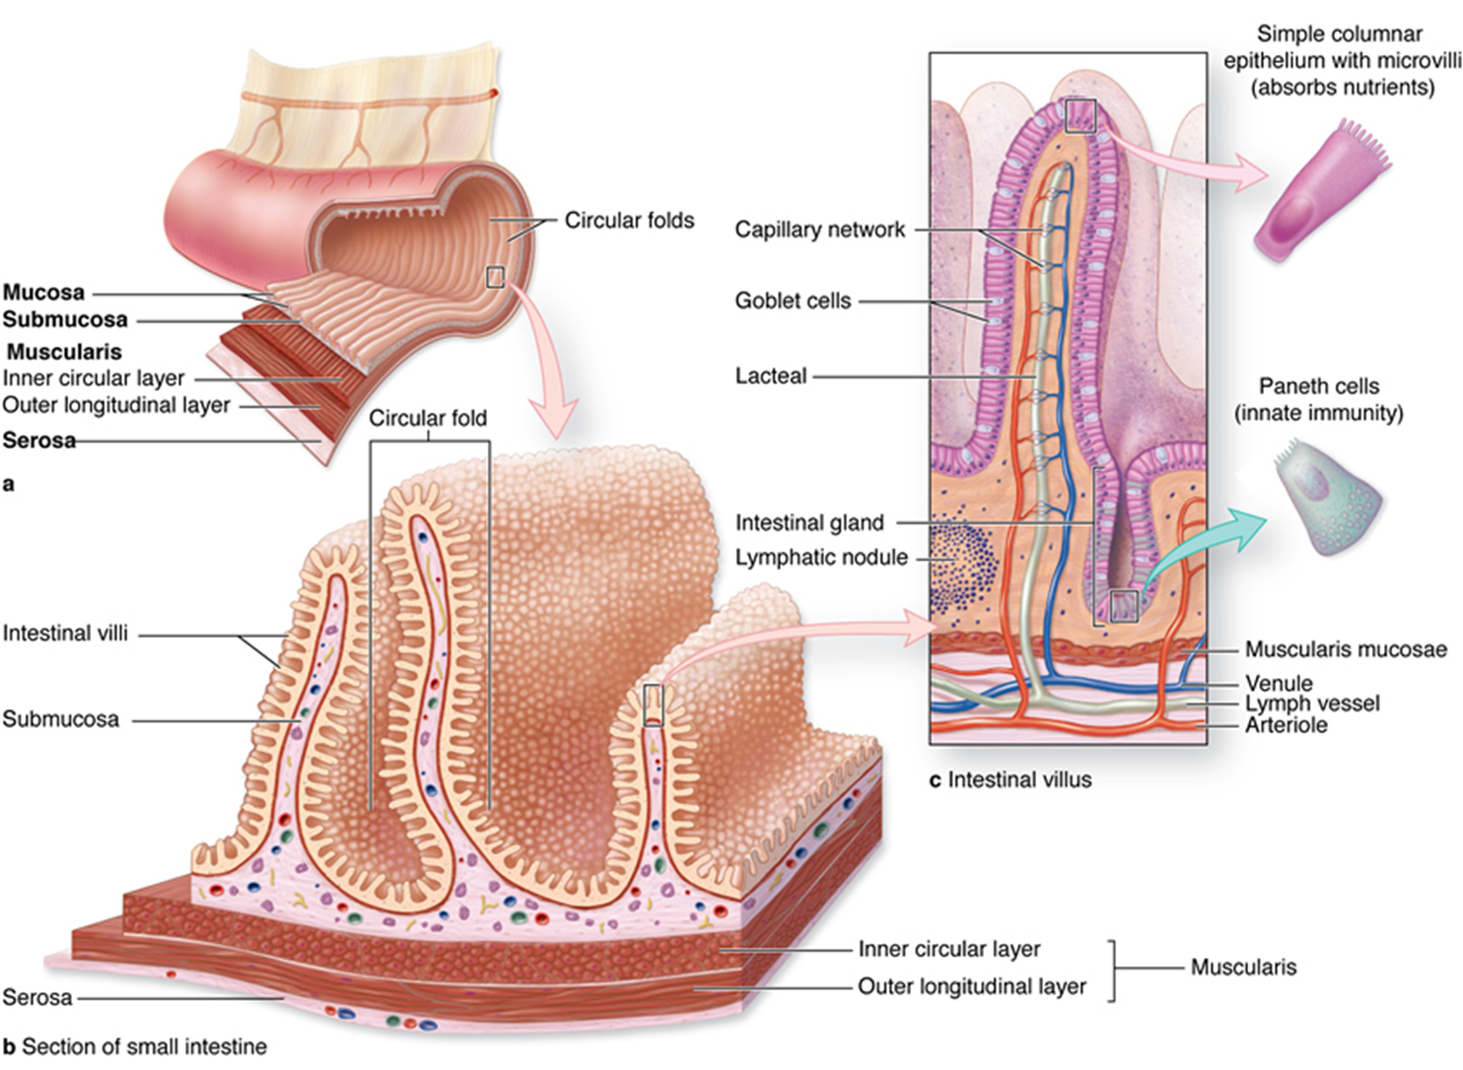
DIGESTIVE SYSTEM
Small intestine
Common features of the small intestine
  Intestinal glands (Crypts of Lieberkühn) are invaginations of epithelium into the lamina propria
  Epithelium covering the villi and lining the crypts is continuous (with different cell types in different part)
Small intestine: layers
  Mucosa
    Epithelium
    Lamina propria
    Lamina muscularis mucosae
  Submucosa
  Muscularis externa
    Inner circular layer
    Outer longitudinal layer
  Serosa

Slide 40
DIGESTIVE SYSTEM
Small intestine
Mucosal epithelium is composed of:
  Absorptive cells (enterocytes), forming a simple columnar epithelium with microvilli – „brush border“, absorb digested food
  Goblet cells (unicellular glands) are interspersed among absorptive cells and secrete mucus for protection. These cells increase in number from duodenum to rectum.
Intestinal glands (crypts of Lieberkühn) are simple tubular glands that begin at the bases of the villi in the mucosa and extend through the lamina propria to the muscularis mucosae.
Possess:
  Absorptive cells
  Goblet cells
  Paneth cells possess large, eosinophilic granules whose contents, e.g, lysozyme, digest bacterial cell walls. Deep in crypts.
  Enteroendocrine cells – secrete hormones (e.g., cholecystokinin) related to digestion
Muscularis externa of inner circular and outer longitudinal layers with an intervening Auerbach's nerve plexus.
Serosa covers small intestine.

Slide 41
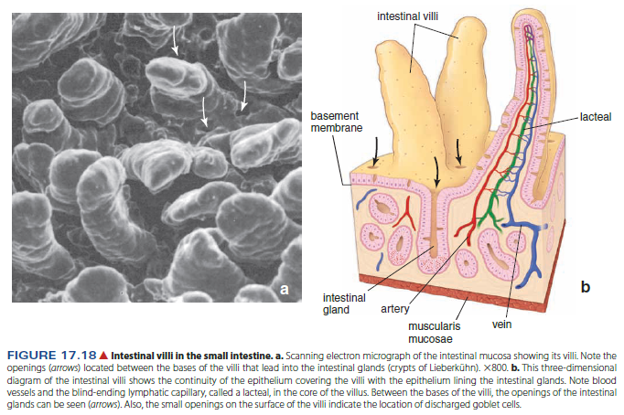


Slide 42


Slide 43


Slide 44


Slide 45


Slide 46



Slide 47


DIGESTIVE SYSTEM
Small intestine
Variations specific to the intestinal subdivisions
Brunner's glands in the submucosa are present only in the duodenum. These compound tubular glands open into the bases of the intestinal glands and secrete an alkaline mucus to neutralize the acidity of the stomach contents.
Peyer's patches are clusters of 10-200 lymphoid nodules located primarily in the lamina propria of the ileum. Each cluster is positioned on the side of the intestine away from the mesentery and forms a bulge that may protrude into the lumen as well as into the submucosa.

Slide 48

Notes:
Absorpční buňka v různých stádiích, absorpce tuků

Slide 49


Slide 50

Notes:
Lymfatická céva - chylová

Slide 51
 | Duodenum | Jejunum | Ileum
Villi | yes | yes | yes
Microvilli on absorptive cells | yes | yes | yes
Goblet cells | some | more | most
Paneth cells | yes | yes | yes
Brunner’s glands | yes | no | no
Peyer’s patches | no | no | yes

Slide 52

DIGESTIVE SYSTEM
Large intestine (colon)
Function:
  Absorption of water
  Secretion of mucus to lubricate dehydrated feces
Regions:
  Ascending colon. Rises on the right side of the abdominal cavity.
  Transverse colon. Horizontal region that passes across the abdomen from right to left below the stomach.
  Descending colon. Descends on the left side of the abdominal cavity.
  Sigmoid colon. “S”-shaped
  Rectum is a 12-cm-long tube continuing from the sigmoid colon. The mucosa of the rectum is similar to that of the majority of the large intestine. The rectum narrows abruptly to become the anal canal.

Slide 53


Slide 54

DIGESTIVE SYSTEM
Large intestine (colon)
Layers and structures forming the wall of the large intestine:
  Mucosal epithelium:
    Absorptive cells form a simple columnar epithelium with microvilli.
    Goblet cells increase in number toward the rectum and provide lubrication.
    A reduced number of enteroendocrine cells is present.
      Intestinal glands (crypts of Lieberkühn) are very straight in the large intestine.
      No villi or plicae circulares are present in the large intestine.
  Muscularis externa
    Inner circular layer is complete around the circumference of the tube
    Outer longitudinal layer is segregated into three longitudinal bands, the taeniae coli, that are placed equidistantly around the tube. The contraction of the taenia produces permanent sacculations in the large intestine, termed haustrae.
  Either an adventitia or a serosa is present, depending on the particular portion of the large intestine.

Slide 55


Slide 56



Slide 57




Slide 58



DIGESTIVE SYSTEM
Large intestine (colon)
Anal canal. The terminal portion of the intestinal tract is about 4 cm long.
  The intestinal glands disappear and the epithelium undergoes an abrupt transition from simple columnar to stratified squamous with sebaceous and apocrine sweat glands.
  The inner circular portion of the muscularis externa expands to form the internal anal sphincter. The external anal sphincter is composed of skeletal muscle.
The anus is located at the level of the external anal sphincter and is covered by stratified squamous keratinized epithelium (skin).

Slide 59

DIGESTIVE SYSTEM
Appendix
Attached to cecum
No taenia coli
Lots of lymphatic tissue (diffuse and in nodules) present in lamina propria and submucosa

Slide 60


Slide 61

DIGESTIVE SYSTEM
MAJOR SALIVARY GLANDS
All major salivary glands are compound, exocrine glands, and all open into the oral cavity.
Glandula parotis, glandula submandibularis, glandula sublingualis
Functions:
  Produce saliva to wet, lubricate, and buffer the oral cavity and its contents
  Produce amylase for the initial digestion of carbohydrates
  Produce lysozyme to control bacteria in the oral cavity

Slide 62
DIGESTIVE SYSTEM
MAJOR SALIVARY GLANDS
Major cell types
Serous cells
  Synthesize, store, and release a thin, protein-rich secretion containing digestive enzymes, primarily amylase
  Are pyramidal in shape and possess all organelles necessary for protein production and secretion (e.g., basal rough endoplasmic reticulum, Golgi, and apical secretory granules)
  Are arranged into either:
    Acini (singular, acinus) or alveoli (singular, alveolus). Flask-shaped sacs with tiny lumens
    Serous demilunes. Half moon–shaped caps positioned over the ends of mucous tubules
Mucous cells
  Synthesize, store, and release mucus, a viscous, thick, glycoprotein secretion that protects and lubricates epithelia
  Have flattened nuclei that are located at the bases of the cells along with the rough endoplasmic reticulum. Abundant mucigen droplets are located in the apex of each cell, giving it a frothy, vacuolated appearance.
  Are organized in test tube–shaped tubules with relatively wide lumens
Myoepithelial cells are stellate-shaped epithelial cells with contractile functions that lie between the secretory or duct cells and the basement membrane. These cells contract to aid in movement of the secretory product.

Slide 63


Slide 64
DIGESTIVE SYSTEM
MAJOR SALIVARY GLANDS
Duct system conducts secretions to oral cavity.
Ducts are more numerous with serous acini than with mucous tubules because the tubules can act as their own ducts.
Intralobular ducts
  Intercalated ducts exit from secretory acini and are smaller in diameter than the acini they drain. These ducts are lined by simple cuboidal epithelia.
  Striated ducts continue from intercalated ducts and are larger in diameter than the secretory units they drain. They are lined by simple columnar epithelia. Numerous mitochondria and infoldings of the plasma membrane in the basal region of the cells give the duct a striated periphery. Striated ducts alter the content and concentration of the saliva.
Interlobular ducts form by the anastomosis of striated ducts and are located in the connective septa between lobules. Interlobular ducts are lined with simple columnar to stratified columnar epithelia.
The main excretory duct(s) is formed by the union of interlobular ducts. An excretory duct (s) is lined by a stratified epithelium that becomes stratified squamous moist just prior to its junction with the epithelium of the oral cavity.

Slide 65
DIGESTIVE SYSTEM
MAJOR SALIVARY GLANDS
Major salivary glands
Parotid glands
  Compound acinar glands producing only serous products; their secretions account for 25% of the saliva
  Possess the most highly developed duct system of the major salivary glands
Submandibular glands
  Compound tubulo-acinar glands producing both serous and mucous products, although serous acini predominate. Their secretions account for 70% of the saliva.
  Serous cells are present as both acini and serous demilunes.
Sublingual glands
  Secrete approximately 5% of the saliva.
  These are compound tubulo-acinar glands, producing both mucous and serous products, although mucous tubules predominate.

Slide 66



Glandula submandibularis

Slide 67


Slide 68

Glandula sublingualis

Slide 69

DIGESTIVE SYSTEM
PANCREAS
Located in the abdomen in the curve of the duodenum and divided into a head, body, and tail
Is both an exocrine and an endocrine gland
  The exocrine portion produces an alkaline secretion containing digestive enzymes that empties into the duodenum.
  The endocrine portion secretes insulin, glucagon, and somatostatin that regulate blood glucose levels.

Slide 70


Slide 71

DIGESTIVE SYSTEM
PANCREAS
Exocrine pancreas
Compound acinar gland; the acinar cells secrete numerous digestive enzymes that break down proteins (trypsin), carbohydrates (carbohydrates), lipids (lipase), and nucleoproteins (nucleases).
Cells show polarity with basal rough endoplasmic reticulum and apical secretory granules.
Duct system
  Ducts begin as centroacinar cells located within the acini.
  Intercalated ducts are lined with simple cuboidal epithelium. Centroacinar cells and cells of the intercalated ducts secrete bicarbonates to neutralize the acidity of the stomach contents (chyme) entering the duodenum.
  Striated ducts are not present.
  Interlobular ducts lead into one or more excretory ducts that empty into the duodenum.
Resembles the parotid gland except the pancreas has centroacinar cells and fewer ducts.
Secretion is regulated by cholecystokinin and secretin from enteroendocrine cells in the small intestine

Slide 72


Slide 73



Slide 74

DIGESTIVE SYSTEM
PANCREAS
Endocrine pancreas (islets of Langerhans)
Small clusters of cells, richly supplied by fenestrated capillaries, are scattered throughout the exocrine pancreas; these clusters show no orderly arrangement of secretory cells within the cluster.
Predominate cell types and secretions
  A cell (alpha cell). Secretes glucagon, which elevates glucose levels in the blood
  B cell (beta cell). Secretes insulin, which lowers blood glucose levels; predominant cell type
  D cell (delta cell). Secretes somatostatin, which modulates release of the other two major hormones
Individual cell types cannot be distinguished with routine hematoxylin and eosin staining.

Slide 75

DIGESTIVE SYSTEM
LIVER
Located in right, upper quadrant of abdominal cavity under the diaphragm; the biggest organ, weight about 1,5 kg; large right (lobus dexter) and smaller left (lobus sinister) lobe, lobus quadratus, lobus caudatus
Both an exocrine and an endocrine gland
  Exocrine secretion (bile) is stored in the gall bladder and released into the duodenum. This secretory product contains bile acids that aid in the emulsification of lipids, bilirubin (the breakdown product of hemoglobin), phospholipids, and cholesterol.
  Endocrine function is the synthesis of plasma proteins, including albumin, clotting factors, and lipoproteins that are released into the liver sinusoids.
Additional functions include the metabolization of digested food, storage of glucose as glycogen, and detoxification of hormones and drugs.

Slide 76


DIGESTIVE SYSTEM
LIVER
ARCHITECTURE OF THE CLASSIC LIVER LOBULE
The classic liver lobule resembles a column of wheels. Polyhedral shape. Structural and functional unit of the liver.
Spokes of the wheels are cords or plates of hepatocytes radiating out from a central axis.
Spaces between the spokes are occupied by liver sinusoids (discontinuous sinusoidal capillaries).
Central axis of the lobule is a central vein into which sinusoids drain (i.e., blood is flowing from the periphery of the lobule to the center). The central vein runs parallel to the long axis of the lobule.
The perimeter of the lobule is denoted by the position of three to six hepatic portal triads situated at intervals around the lobule.
  Portal triad run parallel to the long axis of the lobule.
  Portal triad contain branches of the
    Hepatic portal vein. Lined with simple squamous epithelium; has the largest diameter of the three structures
    Hepatic artery. Lined with simple squamous epithelium and two-three layers of smooth muscle
    Bile duct. Lined with simple cuboidal epithelium; multiple branches may be present

Slide 77



Slide 78



Slide 79


Slide 80


Slide 81


DIGESTIVE SYSTEM
LIVER
FUNCTIONAL MICROANATOMY
Hepatocytes (liver cells)
Arranged as walls one to two cells thick that radiate out from the central vein like the spokes of a wheel
Histology
  Cells are polyhedral in shape.
  Cells possess one or two nuclei.
  Cells contain abundant smooth and rough endoplasmic reticulum, Golgi apparatus, mitochondria, and lysosomes. They also contain large accumulations of electron-dense glycogen granules that stain strongly with PAS. Numerous peroxisomes, along with smooth endoplasmic reticulum, carry out detoxification.
  At intervals between adjacent cells, the plasma membranes bulge inward to form a bile canaliculus, the beginning of the bile transport system.
  Microvilli project into the space of Disse, increasing surface area of the cells.

Slide 82


Slide 83

DIGESTIVE SYSTEM
LIVER
FUNCTIONAL MICROANATOMY
Sinusoids
  A variation of discontinuous capillaries, in that gaps exist between endothelial cells and the fenestrations lack diaphragms
  The basal lamina is lacking beneath the fenestrations.
  Fenestrations open into a subsinusoidal space, the space of Disse, separating the sinusoids from the hepatocytes beneath the space.
  Kupffer cells, liver macrophages, span the sinusoids, filtering debris from the blood.

Slide 84


Slide 85

DIGESTIVE SYSTEM
LIVER
BLOOD SUPPLY AND DRAINAGE OF THE LIVER
Blood supply is from two sources:
  Hepatic portal vein
    Supplies about 75 % of the blood
    Carries blood drained directly from the gastrointestinal tract, which, therefore, is deoxygenated and high in absorbed nutrients.
  Hepatic artery. 35 % of the blood. Supplies oxygenated blood
Branches from both vascular sources continue into smaller branches located in the portal triad. Portal triad branches supply the hepatic sinusoids that drain into a central vein. Multiple central veins anastomose to eventually form the three hepatic veins that empty into the inferior vena cava.
IN hepatic artery, portal vein
OUT hepatic vein, bile ducts

Slide 86


DIGESTIVE SYSTEM
LIVER
FLOW OF BILE FROM LIVER
Bile is produced by hepatocytes in the liver and released into bile canaliculi located between two adjacent hepatocytes.
Bile canaliculi form a meshwork configuration that continues into bile ducts lying in portal canals. These bile ducts anastomose to form the left and right hepatic duct.
The hepatic ducts exit from the liver and fuse to form the common bile duct.
  The bile it contains can either:
  Travel directly to the duodenum
  Be transported via the cystic duct to the gall bladder where it is stored until needed

Slide 87


Slide 88


Slide 89

DIGESTIVE SYSTEM
GALL BLADDER
Stores and concentrates bile produced in the liver by reabsorbing water
Connects, via the cystic duct, with the hepatic duct from the liver to form the common bile duct that empties into the duodenum
Mucosa
  Composed of:
    Simple columnar epithelium with short microvilli. Accumulations of mitochondria and glycoprotein-filled secretory vesicles, particularly in the apices of the cells, are prominent.
    Lamina propria
    Muscularis mucosae is not present.
  Is thrown into complex, irregular folds that are particularly evident when the gall bladder is empty.
Submucosa
Smooth muscle is arranged in an irregular network surrounding the gall bladder.
A serosa covers most of the gall bladder; an adventitia surrounds the portion that is attached to the liver.

