Slide 1
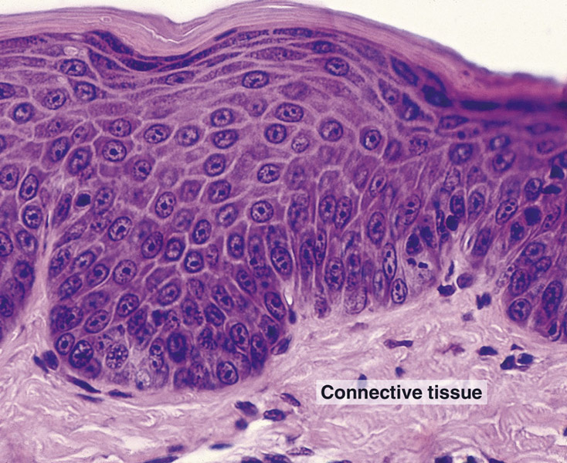
SKIN (INTEGUMENTARY SYSTEM)

Slide 2
SKIN
SKIN (INTEGUMENTARY SYSTEM)
Skin – the largest organ of the body, 15-20 % of total body weight, area 1,5-2 m²
FUNCTIONS OF SKIN
Barier protecting against physical abrasion, chemical irritants, pathogens, UV radiation, and desiccation
Prevents water entry and loss
Thermoregulation
Reception of pressure and touch sensations
Production of vitamin D
Excretion (glands)

Slide 3
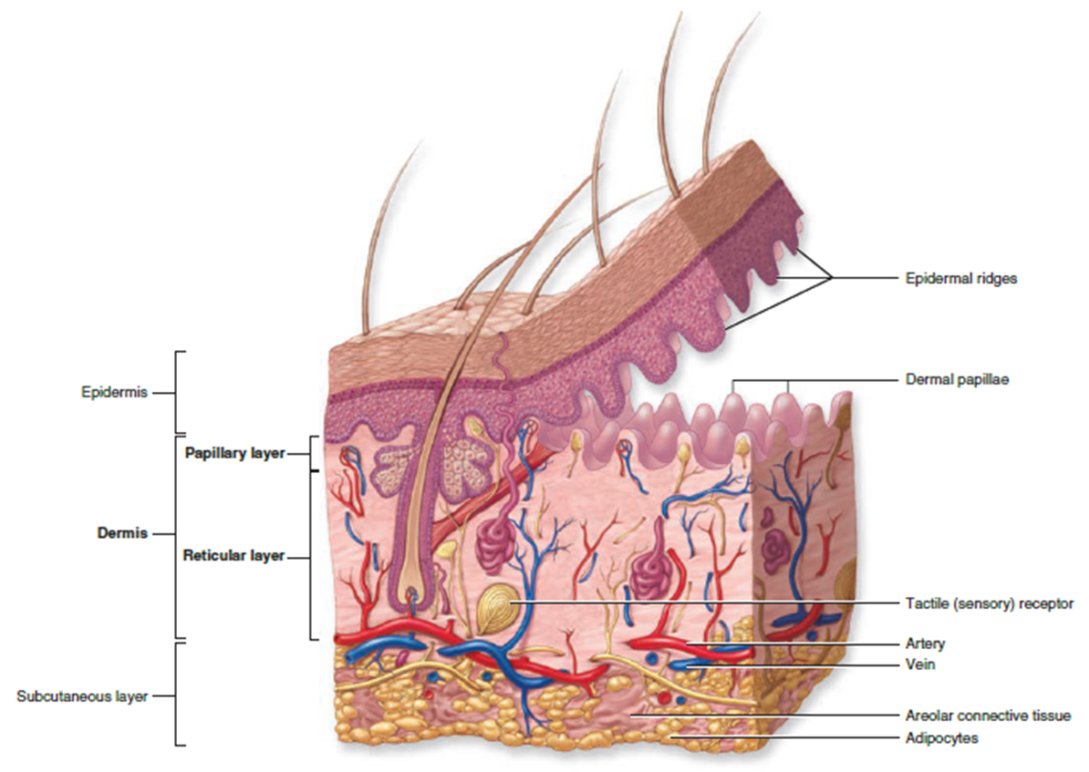
SKIN
COMPONENTS OF SKIN
Epidermis. Stratified squamous keratinized epithelium
Dermis. Composed of two layers of connective tissue containing blood vessels, nerves, sensory receptors, and sweat and sebaceous glands. Beneath the dermis is a layer of loose connective and adipose tissues that forms the superficial fascia of gross anatomy termed the hypodermis (subcutis). This layer is considered along with the skin, though technically it is not part of the integument.
Epidermal-dermal junction
Scalloped margin at the interface of the epidermis and dermis, formed by interdigitations of:
  Epidermal pegs. Downward projections of the epidermis
  Dermal papillae. Upward, finger-like protrusion of connective tissue from the dermis
This junction strengthens the attachment of the epidermis to the underlying dermis.

Slide 4
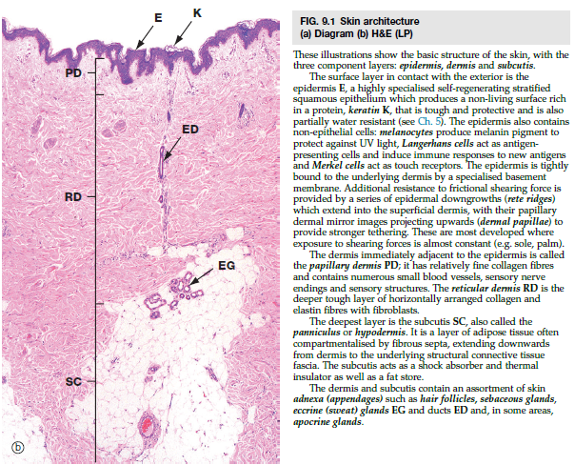
SKIN
Subcutaneous tissue
Also called hypodermis (subcutis)
Not considered part of skin!
Consists of loose connective tissue and adipose tissue, which can accumulate in large fatty deposits
Loosely binds the skin to underlying structures
May contain the bases of sweat glands and hair follicles
Many sensory receptors, especially Pacinian corpuscles, are present.

Slide 5
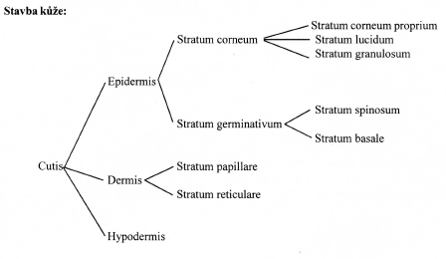
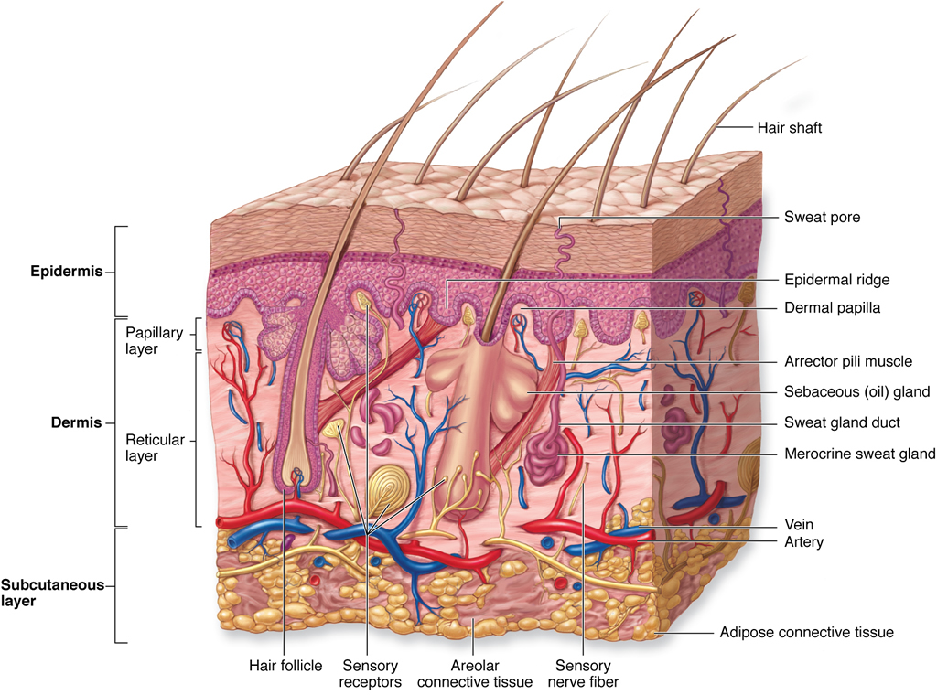
Notes:
Tela subcutanea
V hypodermis – může být i husté bez tuku, není posun kůže po podkladu – nos, ušní boltec,…
Řvp – volně pohyblivá kůže – penis, vičko, tuk chybí
Jinak lalůčky tukového vaziva oddělené hustým kolagenní vazivem (síťovitě pospojované provazce – v okách tukové buňky)
U prsní bradavky v areole,…– hladká svalovina

Slide 6
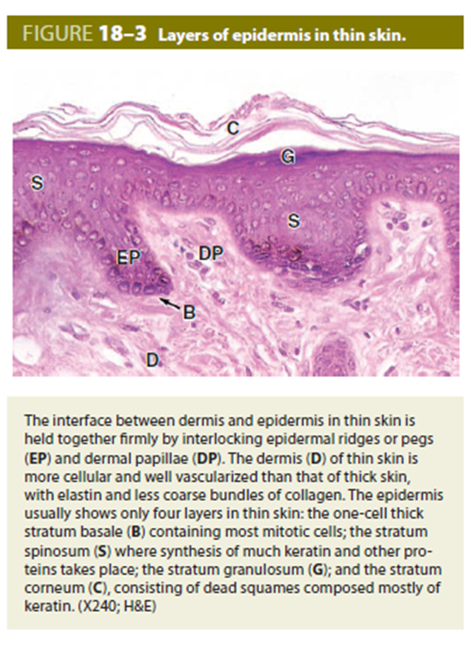
SKIN
CLASSIFICATION OF SKIN (Based epidermal thickness)
Thin skin
  Covers entire body except palms and soles; 0.5 mm thick on the eyelid, 5 mm thick on the back and shoulders
  Epidermis is thin, 0.075-0.15 mm thick, but the dermis varies from thin to very thick, depending on location.
  Possesses hair with sebaceous glands
  Sweat glands are present
  Epidermis has not stratum lucidum
  S. granulosum and s. corneum are much thinner

Slide 7
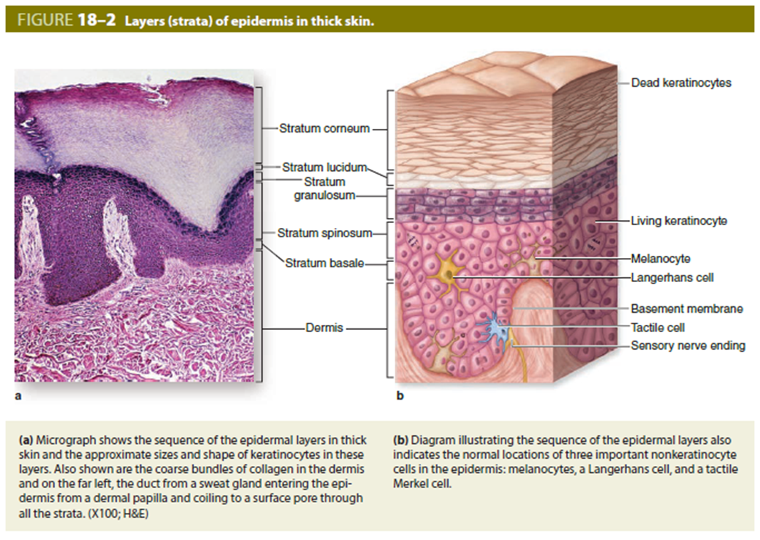
SKIN
CLASSIFICATION OF SKIN (Based epidermal thickness)
Thick skin
  Located on palms of the hands and soles of the feet; 0.8-1.5 mm thick
  Epidermis is 0.4-0.6 mm thick
  Hairless, no sebaceous glands
  Sweat glands are present

Slide 8
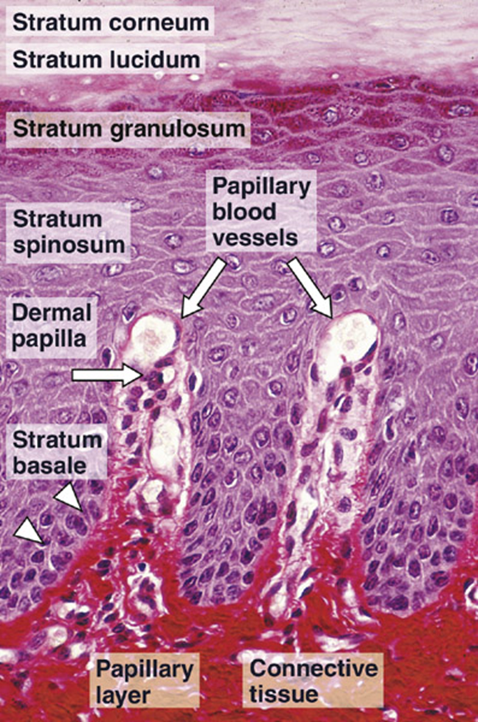
SKIN
Layers of the epidermis and keratinization
The epidermis is a stratified squamous, keratinized (dry) epithelium. It is continually renewed every 15-30 days. Rapid cell proliferation occurs primarily in the deepest layer (stratum basale) and daughter cells differentiate as they migrate toward the surface. This differentiation involves a process called keratinization, which results in a variably thick layer of nonliving cellular husks at the surface of the epidermis. All cells in the epidermis that undergo the keratinization process are called keratinocytes.
Layers of the epidermis:
Stratum basale (germinativum)
  A single layer of cuboidal to columnar shaped cells (keratinocytes) that rest on the basement membrane and undergo rapid cell proliferation. These cells contain intermediate filaments composed of cytokeratin (keratin proteins) (tonofilaments).

Slide 9
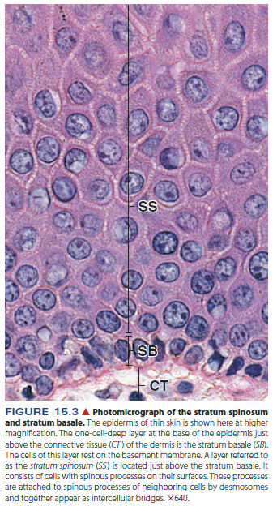
SKIN
Layers of the epidermis:
Stratum spinosum
  Spiny cell layer; 3-10 cells thick. This layer is so-called because the cells are attached to one another by desmosomes, and the cellular shrinkage resulting from fixation produces the spine-like structures. These cells accumulate bundles of tonofilaments called tonofibrils.

Slide 10
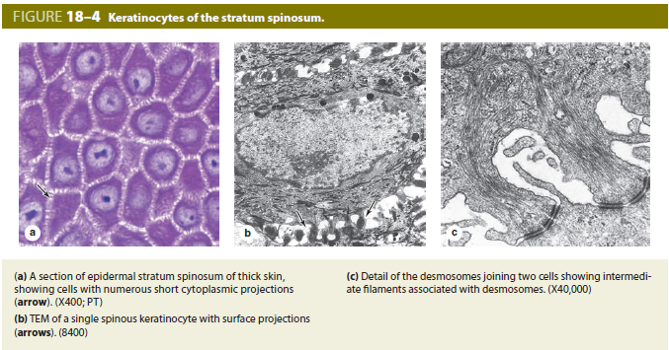

Slide 11
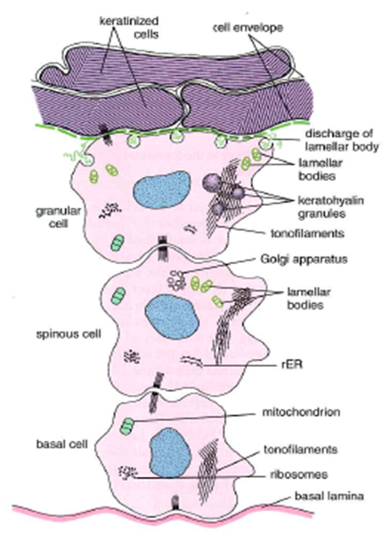
SKIN
Layers of the epidermis:
Stratum granulosum
  two to four cells thick
  cells synthesize basophilic, keratohyalin granules, which associate with the tonofibrils
  Cells also accumulate lamellar bodies, which contain a lipid material that is secreted and serves as a sealant and penetration barrier between cells.
  Cells also begin to lose other organelles.

Slide 12
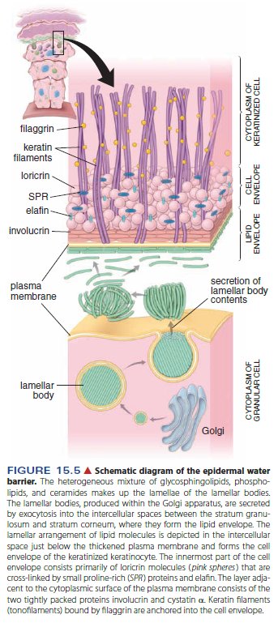

Slide 13
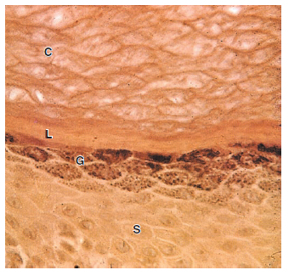
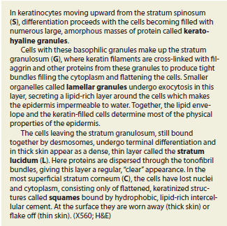
SKIN
Layers of the epidermis:
Stratum lucidum
  A clear layer of non-nucleated, flattened cells that is only visible as a distinct layer in thick skin. In this region, the proteins contained in the keratohyalin granules mediate the aggregation of tonofibrils. This process occurs whether or not a distinct stratum lucidum is visible.
Stratum corneum
  Variably thick layer of extremely flattened, cornified scales containing aggregated tonofibrils surrounded by a thickened plasma membrane. These cell remnants are sloughed off without damage to the underlying, living epidermal cells.

Slide 14
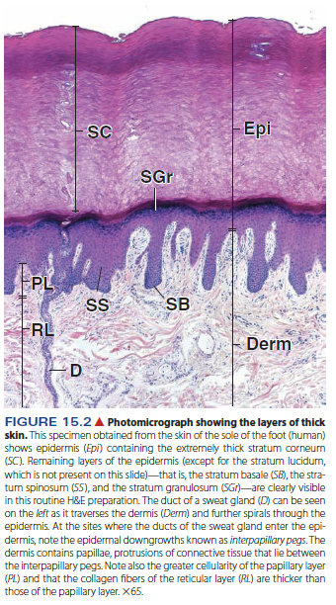
Notes:
Lysozymální hydrolytické enzymy – odbourávání organel
ZVÝŠENÉ ODLUPOVÁNÍ – HYPERKERATÓZA
Nefyziologická deskvamace – souvislé lamely – nadměrné slunění, popáleniny, odřeniny, otlaky – akutní mechanické namáhání kůže

Slide 15
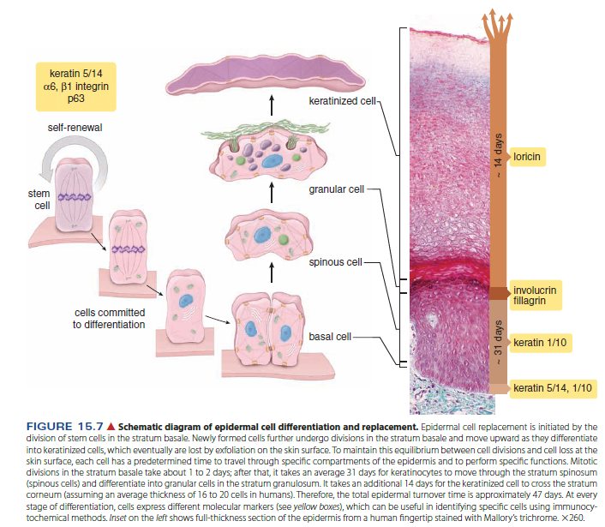

Slide 16
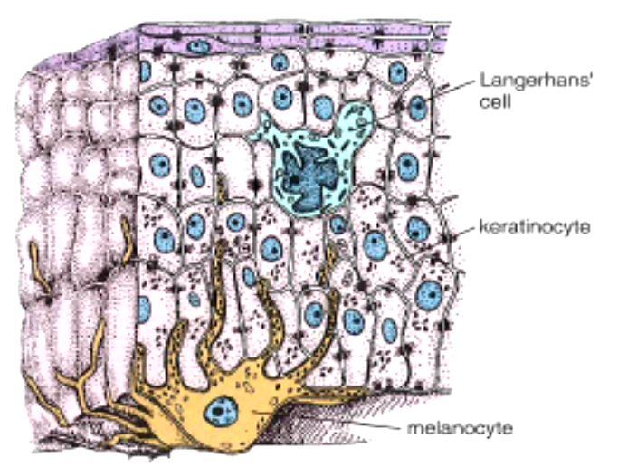
SKIN
EPIDERMIS
Cell types:
Keratinocytes
  Keratinizing epidermal cells, major cell type in the epidermis
  Function is to produce intermediate filaments composed of keratins
  Amout of keratin filaments increases as the cells move upword
Melanocytes
Langerhans cells
Merkel’s cells

Slide 17
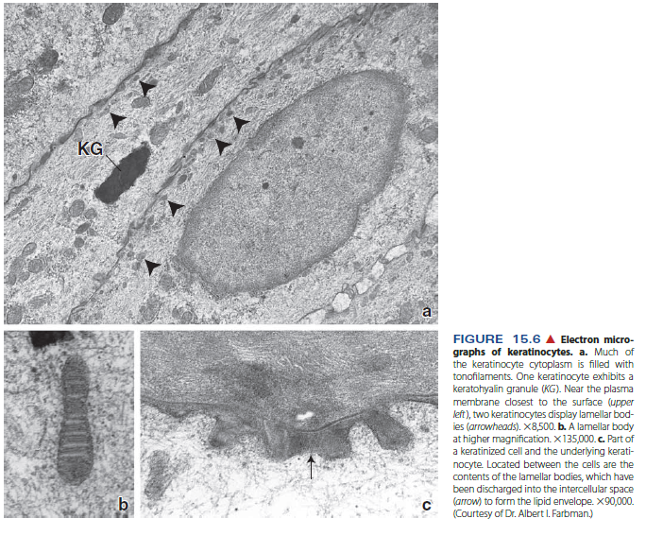

Slide 18
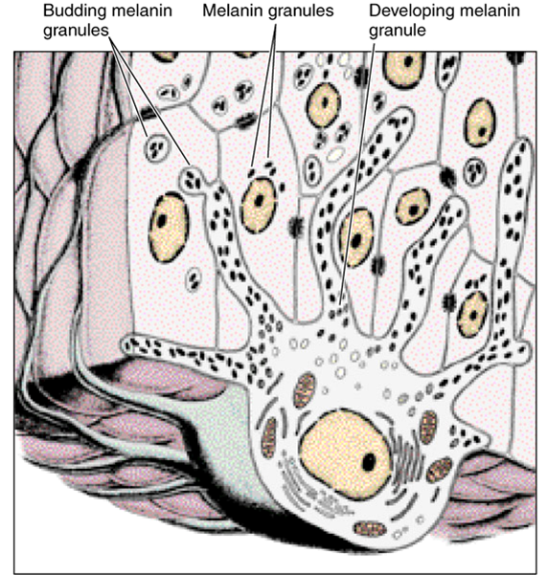
SKIN
EPIDERMIS
Cell types:
Keratinocytes
Melanocytes. Melanin pigment-producing cells
  Present in stratum basale and stratum spinosum
  Rounded cell bodies with clear cytoplasm. Numerous "dendrite-like" processes insinuate themselves between the keratinocytes
  Synthesize melanin, a dark brown pigment that is packaged into melanosomes and injected into keratinocytes
  Melanin caps the keratinocyte nucleus, reducing damage from solar radiation.
Langerhans cells
Merkel’s cells

Slide 19
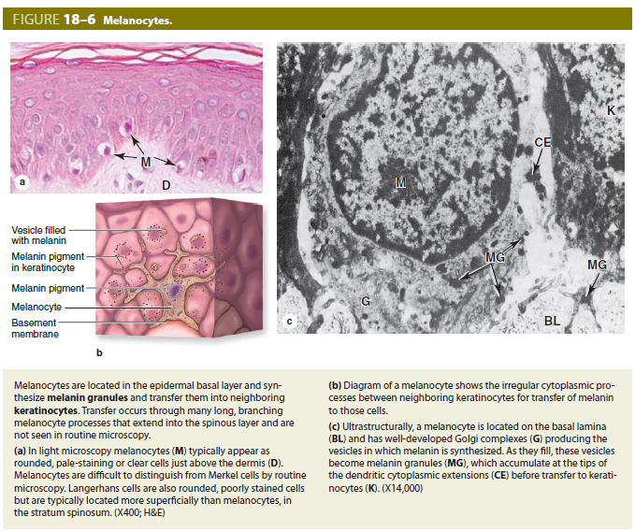

Slide 20
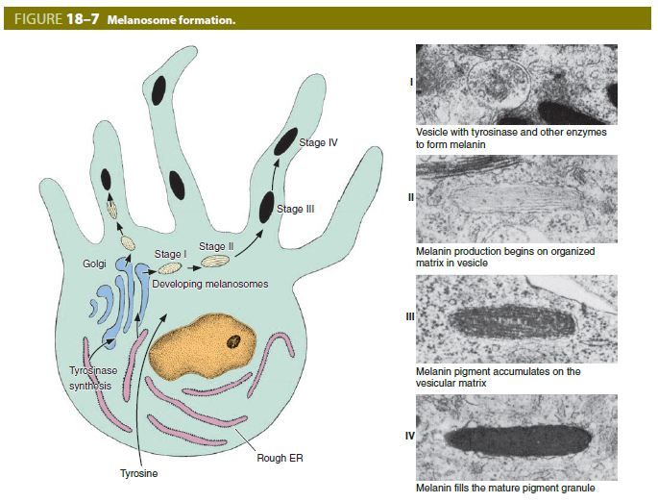
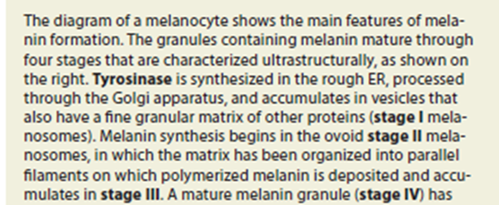


Slide 21
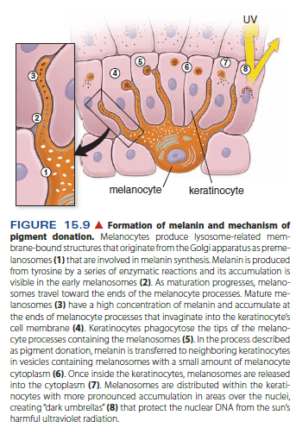
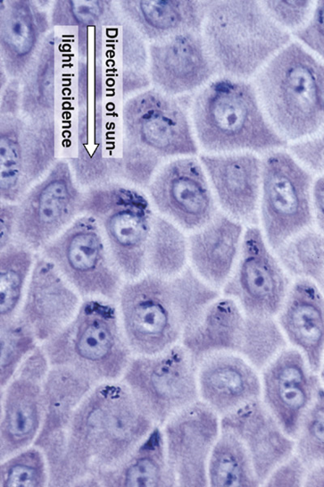

Slide 22
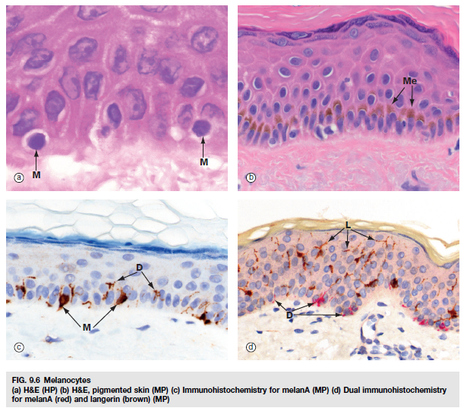

Slide 23
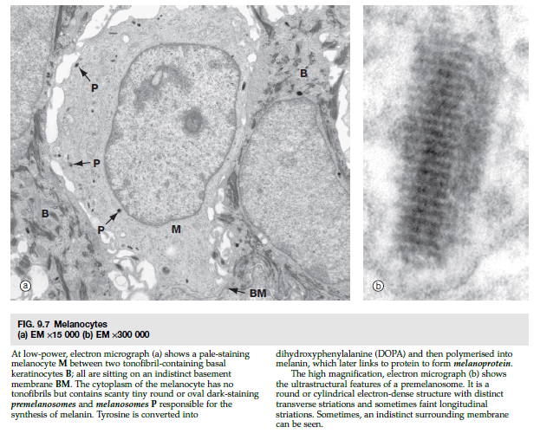

Slide 24
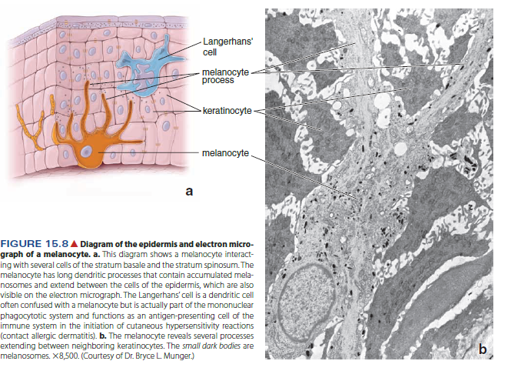

Slide 25
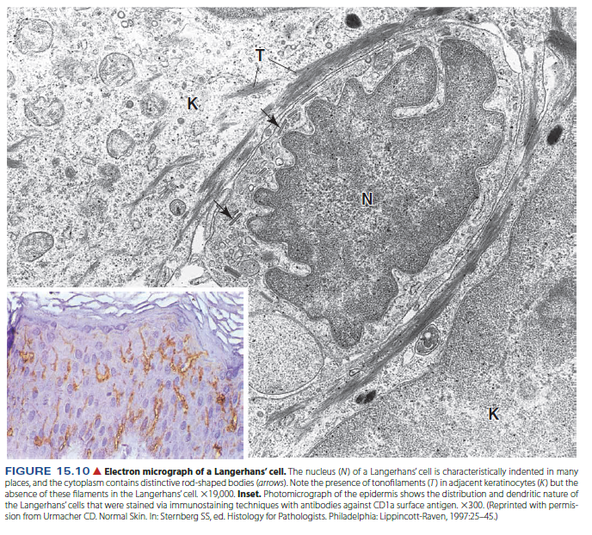
SKIN
EPIDERMIS
Cell types:
Keratinocytes
Melanocytes
Langerhans cells. Macrophages that function in immunological skin reactions.
Merkel’s cells

Slide 26
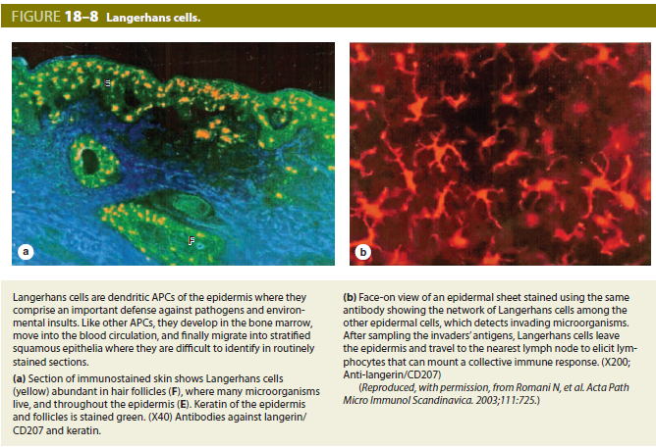

Slide 27
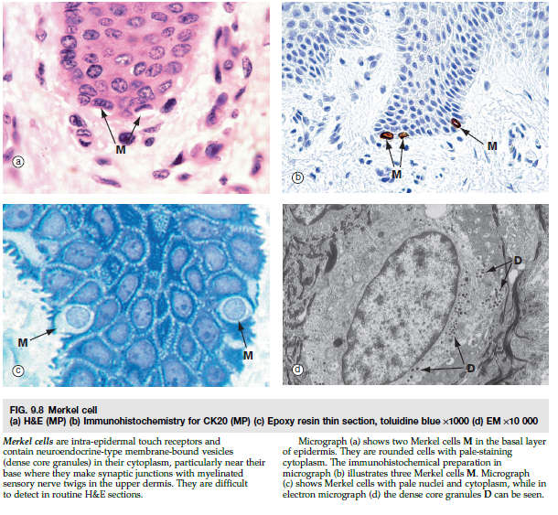
SKIN
EPIDERMIS
Cell types:
Keratinocytes
Melanocytes
Langerhans cells
Merkel’s cells. Touch receptors.

Slide 28
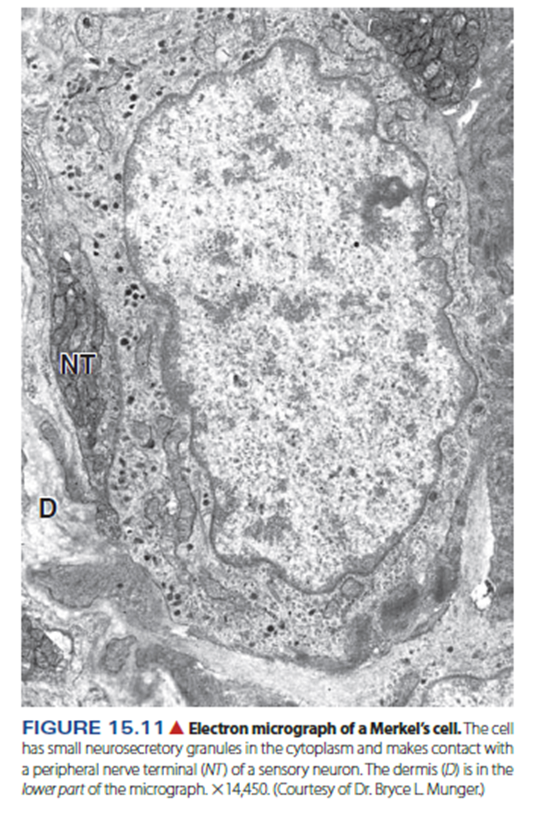
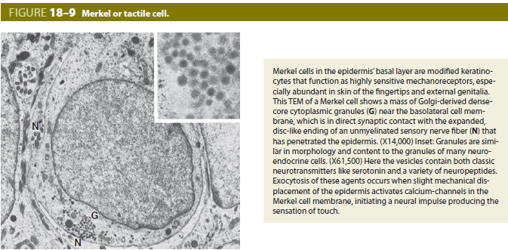

Slide 29
SKIN
DERMIS
Composition:
Papillary layer
1. Located immediately beneath the basement membrane of the epidermis, forming the dermal papillae
2. Thin layer composed of loose connective tissue
Contains small blood vessels, nerves, lymphatics, and the sensory receptors, Meissner's corpuscles
Reticular layer
  Located between the papillary layer and the hypodermis
  Thick layer composed of dense, irregular connective tissue
  Contains larger nerves and blood vessels, glands, hair follicles, and the sensory receptors, Pacinian corpuscles and Ruffini end organs
Vasculature of the dermis:
Papillary plexus located in the dermal papillae
Cutaneous plexus located in the reticular layer of the dermis
Arteriovenous anastomoses allow shunting of blood between papillary and cutaneous plexuses for temperature regulation.

Slide 30
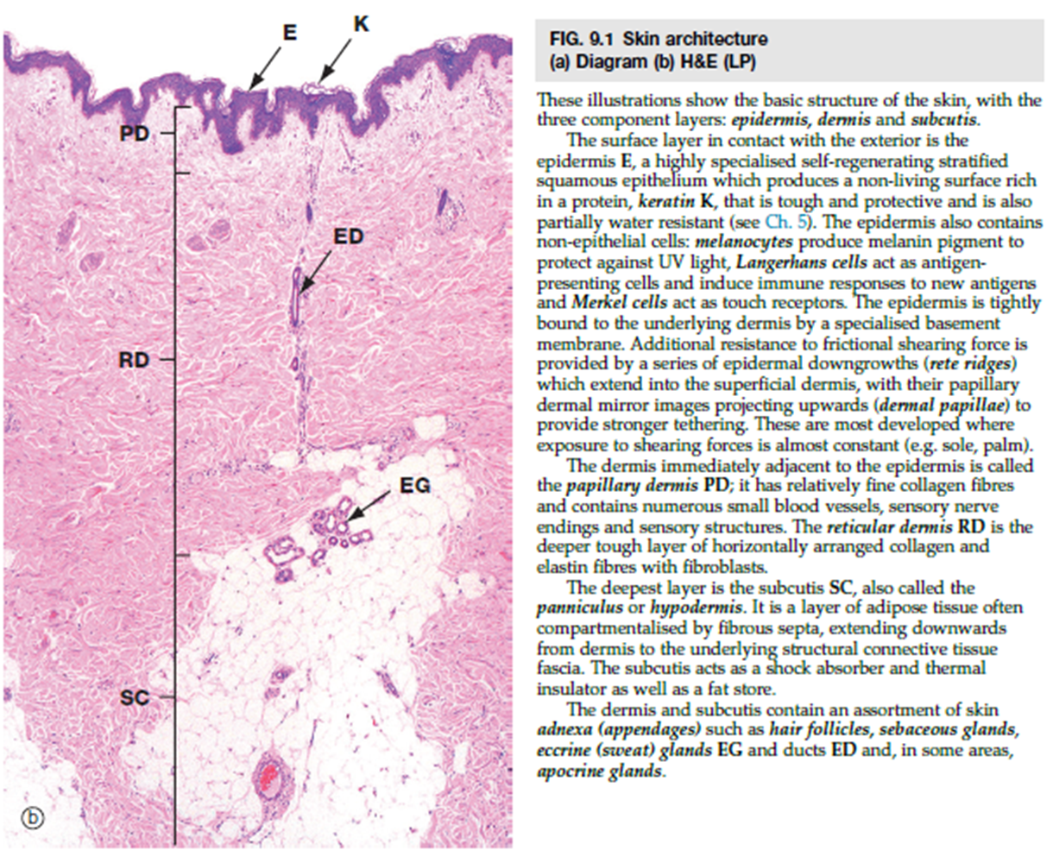

Slide 31
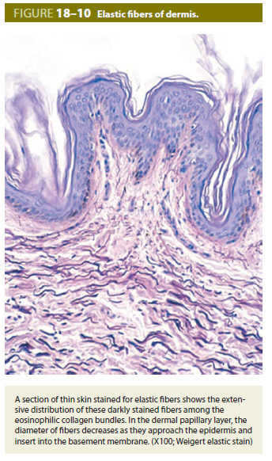

Slide 32
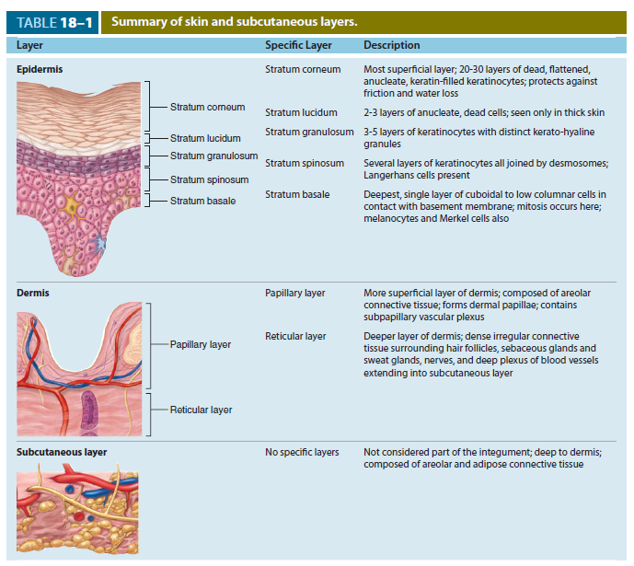

Slide 33
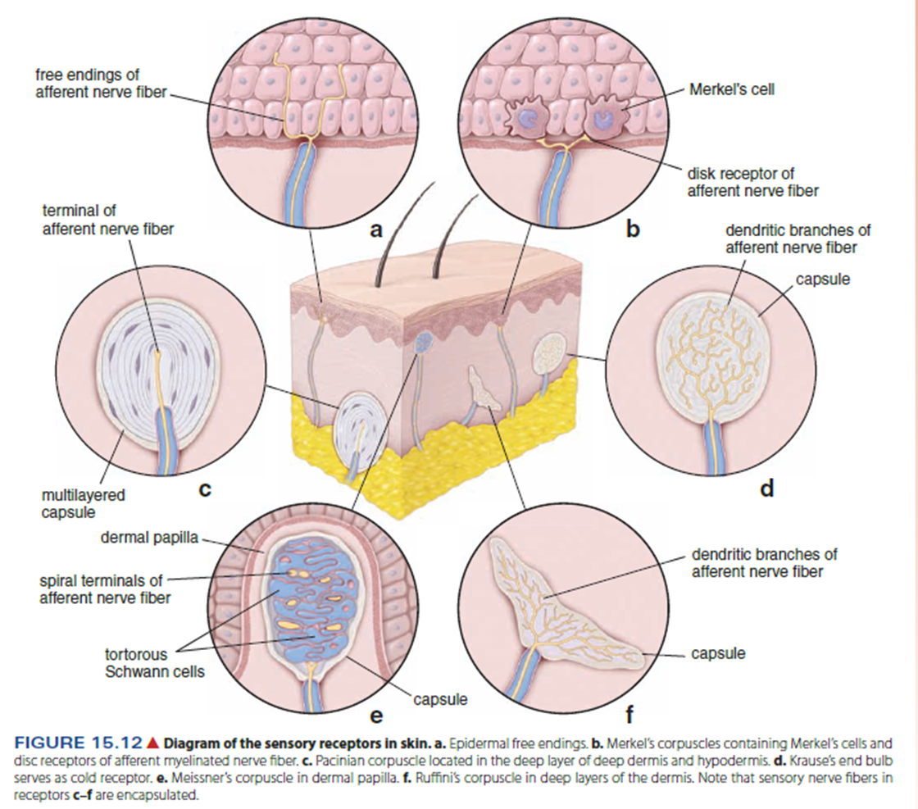
SKIN
STRUCTURES ASSOCIATED WITH THE SKIN
Sensory structures
  Nonencapsulated. Free nerve endings in the epidermis, responsive to touch, pressure, heat, cold, and pain
  Encapsulated pressure receptors
    Meissner's corpuscle
      Located at the apex of a dermal papilla
      Consists of a coil of Schwann cells around a nerve terminal
      Responds to light touch
    Pacinian corpuscle
      Located in the dermis and hypodermis
      Consists of concentric layers of endoneurial cells around a nerve terminal
      Responds to vibration and deep pressure
    Ruffini ending
      Located in the dermis
      Consists of groups of nerve terminals surrounded by a thin connective tissue capsule
      Responds to touch and pressure

Slide 34
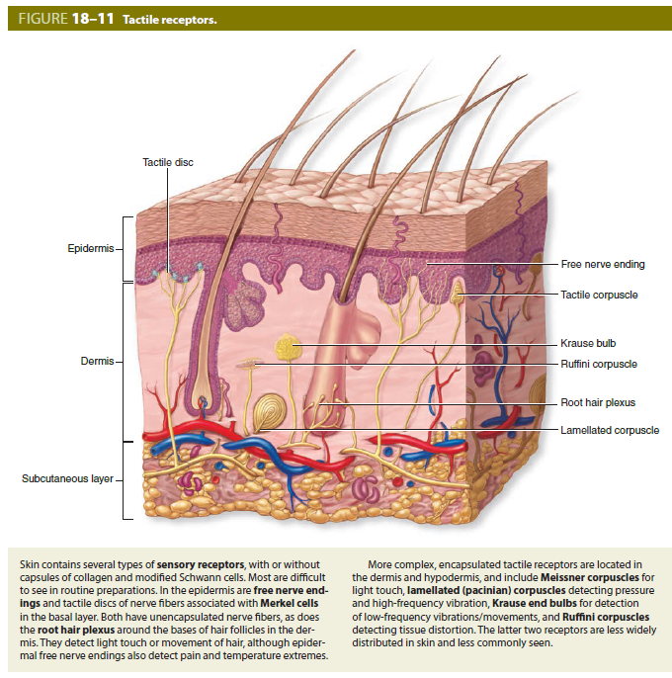

Slide 35
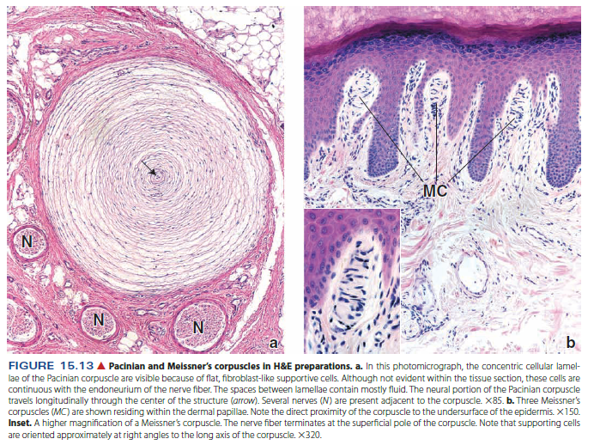

Slide 36
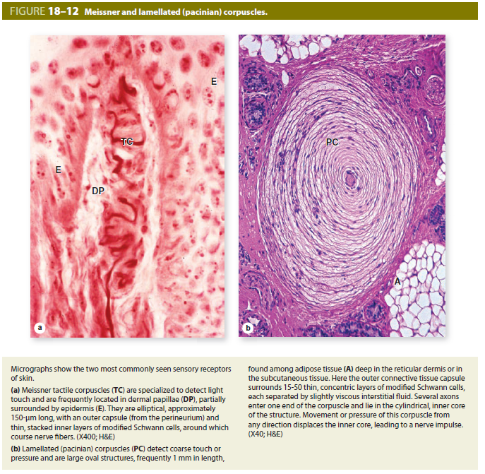

Slide 37
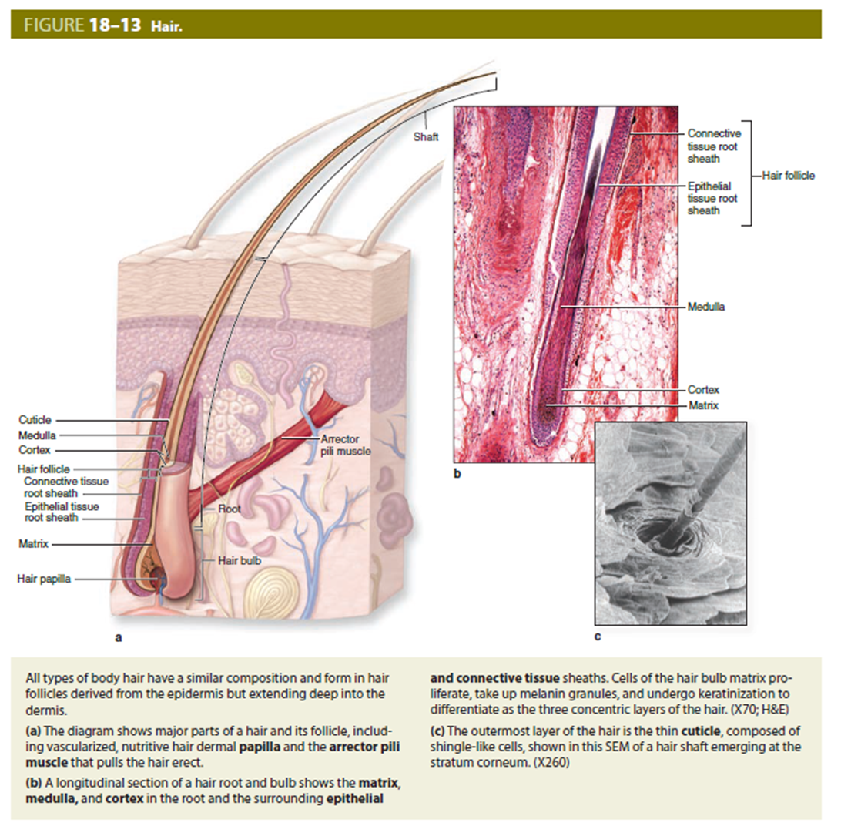
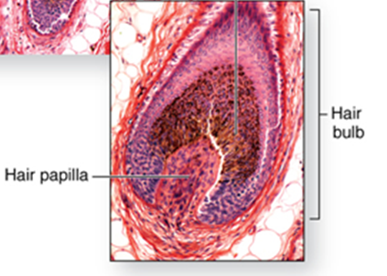
SKIN
STRUCTURES ASSOCIATED WITH THE SKIN
Hair follicles
  Hairs are elongated keratinized structures derived from invaginations of the epidermis (hair follicules)
  Consist of a bulb at the base of the follicle that is located in the hypodermis or in the deep layers of the dermis. Internal and external sheaths surround the growing hair shaft as it passes though the dermis and epidermis.
  An arrector pili muscle attaches a hair follicle to the papillary layer of the dermis. Contraction provides elevation of the hair, forming "goose-bumps."

Slide 38
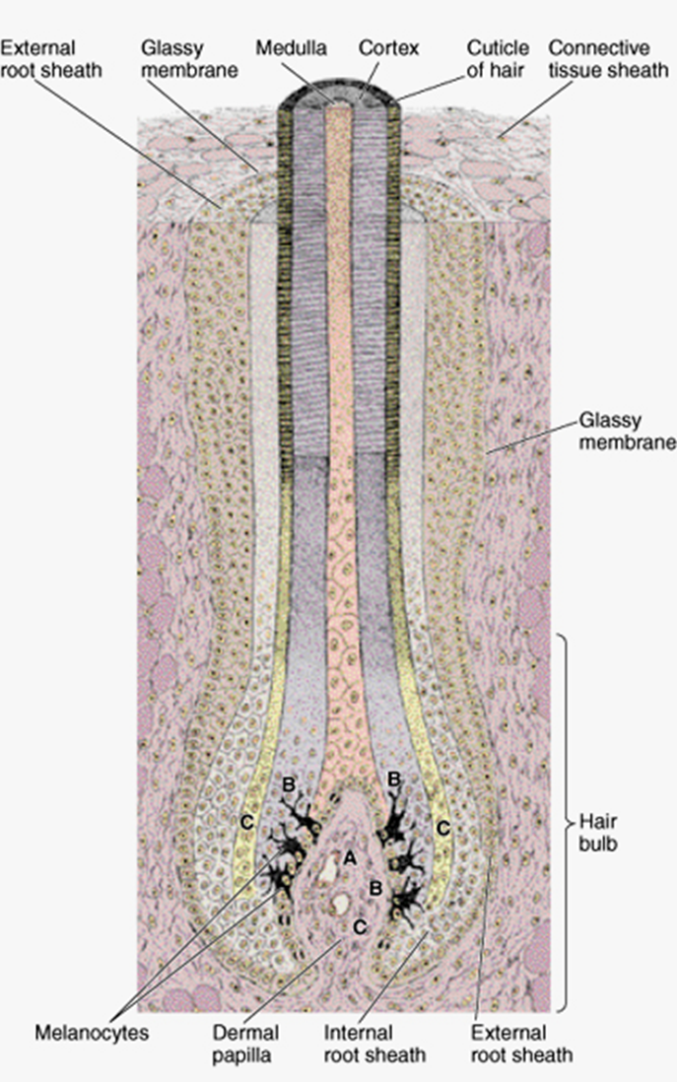
SKIN
STRUCTURES ASSOCIATED WITH THE SKIN
Anagen – growth periods
Catagen – regression of follicle
Telogen – inaktivity
Hair follicule
Epithelial tissue root sheath
Connective tissue root sheath
Shaft (beyond epidermis)
Root
Hair bulb (terminal dilatation)
Dermal papila (with capillary network)
Papila is covered by cells that form the hair root and develop into the hair shaft.
A – the central cells produce large, vacuolated, moderately keratinized cells that form the medulla of the hair
B - laterally located cells, produce the cortex of the hair
C – cells forming hair cuticle
Peripheral epithelial cells develop into the internal and external root sheaths.
The external root sheath is continuous with the epidermis
The cells of the internal root sheath disappear at the level of the opinings of the sebaceous gland ducts.
Melanocytes
  in the hair bulb
  among the keratinocytes
  transfer melanin granules into the epithelial cells
Glassy membrane
  Separating the hair follicle from the dermis
  An acellular hyaline layer, the thickened basement membrane

Slide 39
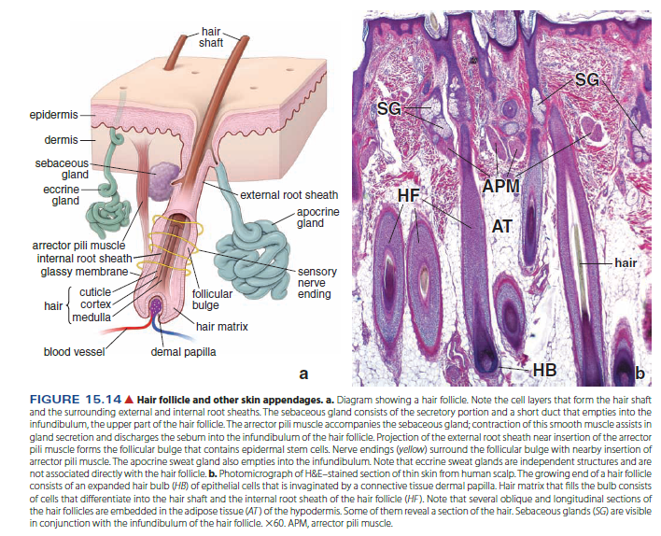

Slide 40
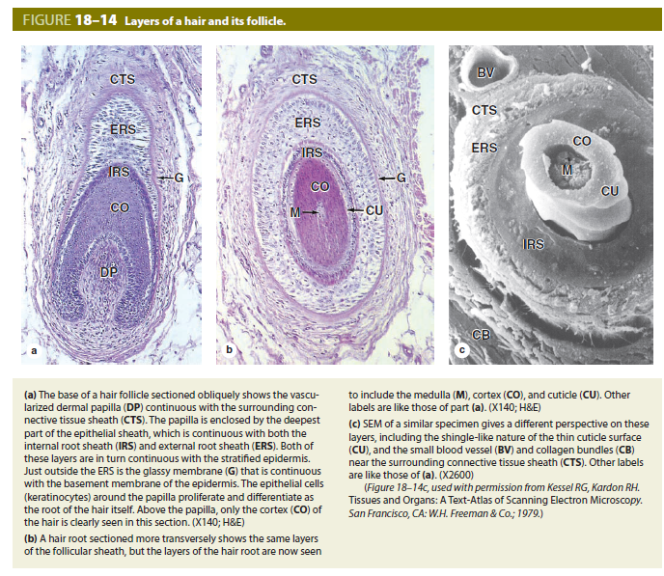

Slide 41
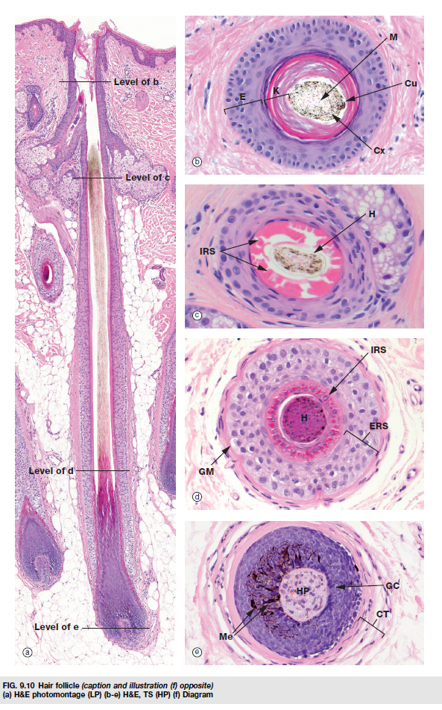
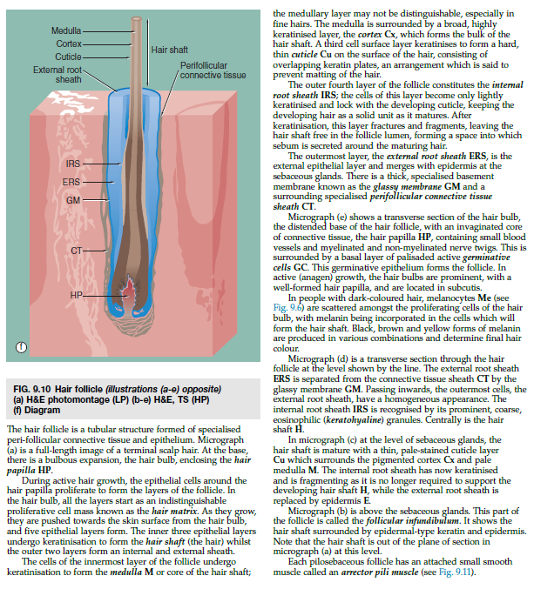

Slide 42
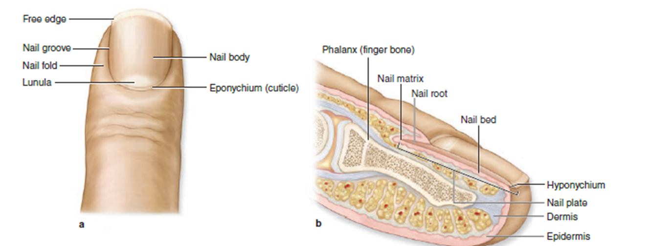
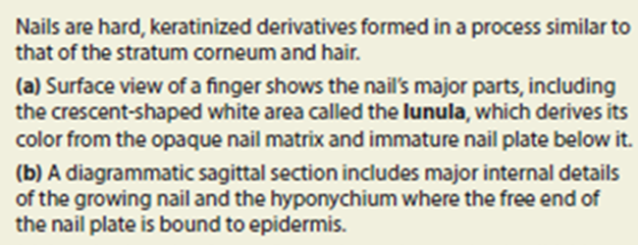
SKIN
STRUCTURES ASSOCIATED WITH THE SKIN
Nails
  Keratinized epithelial cells on the dorsal surface of the fingers and toes
  Consist of a nail plate that corresponds to the stratum corneum of the epidermis. This plate rests on the nail bed, consisting of cells corresponding to the stratum spinosum and stratum germinativum.
  Nail root lies in an epidermal fold, whose stratum corneum forms the eponychium (cuticle)
  Nail matrix lies beneath the nail root and is the germinative portion of the nail.
  The hyponychium, a thickened epidermis, secures the nail at the fingertip

Slide 43
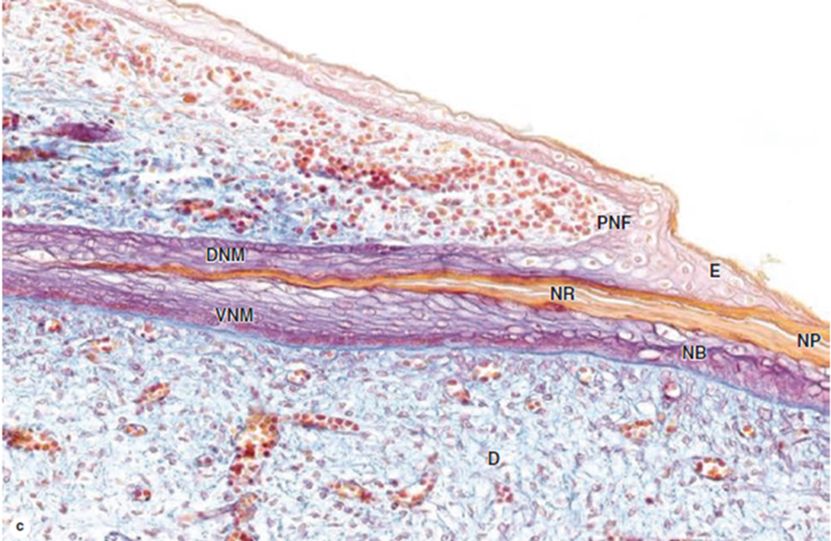
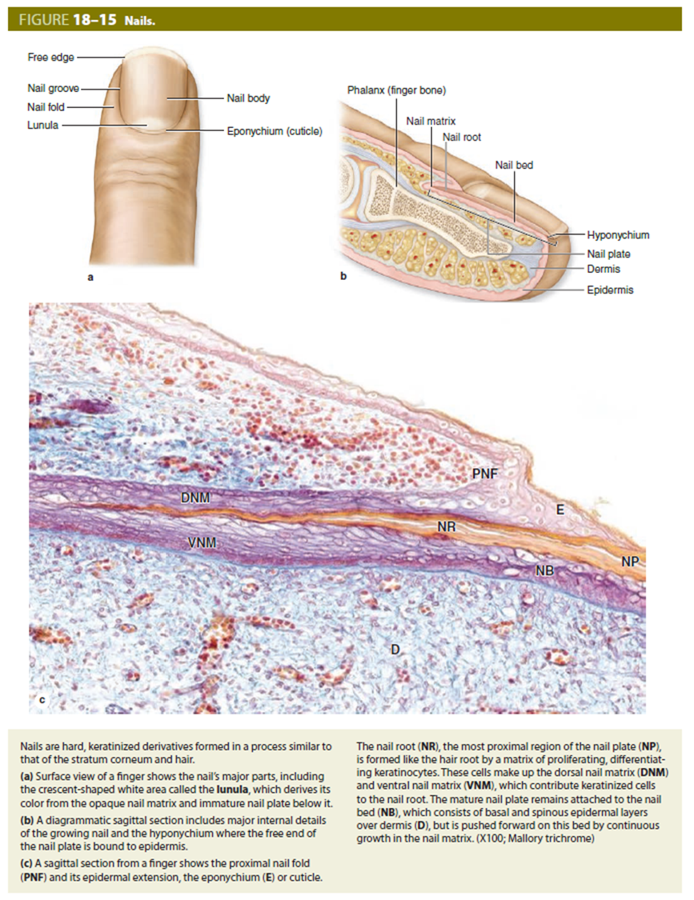

Slide 44


Slide 45


Slide 46

SKIN
STRUCTURES ASSOCIATED WITH THE SKIN
Sebaceous glands
  Simple, branched acinar glands
  Usually secrete into a hair follicle
  Produce sebum, an oily secretory product, released by the holocrine mode of secretion
  Absent from thick skin
Sweat glands
  Simple, coiled tubular glands
  Contain myoepithelial cells, which are specialized cells that contract to aid in the expulsion of the sweat
  Types of sweat glands
    Merocrine or eccrine. Located in all regions of the body except the axillary and anal regions; produce a watery secretion that empties onto the surface of the epidermis
    Apocrine. Restricted to the axillary, areolar, and anal regions; much larger than eccrine sweat glands with a broader lumen. Produce a viscous secretion that empties into the hair follicle.

Slide 47



Slide 48


Slide 49



Slide 50

Notes:
V pubertě vlivem hormonů plný vývoj, více vyvinuty u žen, ve stáří regrese

Slide 51


Slide 52


Sweet gland, simple coiled tubular gland. H&E stain
Sweet gland; the duct lined by stratified cuboidal epithelium; myoepithelial cells surround the secretory portion (contraction helps tho discharge the glandular secretion). H&E stain

Slide 53



Notes:
V pubertě vlivem hormonů plný vývoj, více vyvinuty u žen, ve stáří regrese

Slide 54


Slide 55


