Slide 1




Vývoj samčího a samičího gametofytu, opylení, oplodnění, embryogeneze u nahosemenných
Mgr. Hana Cempírková, Ph.D.,
Rostlinná embryologie, podzimní semestr 2022

Slide 2
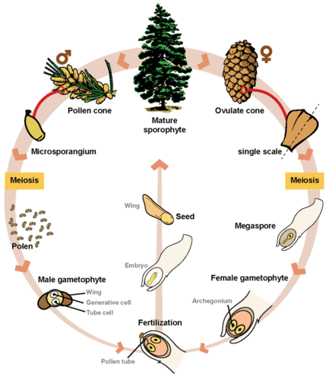
Notes:
Z vřetena šišky vyrůstají šupiny.

Slide 3
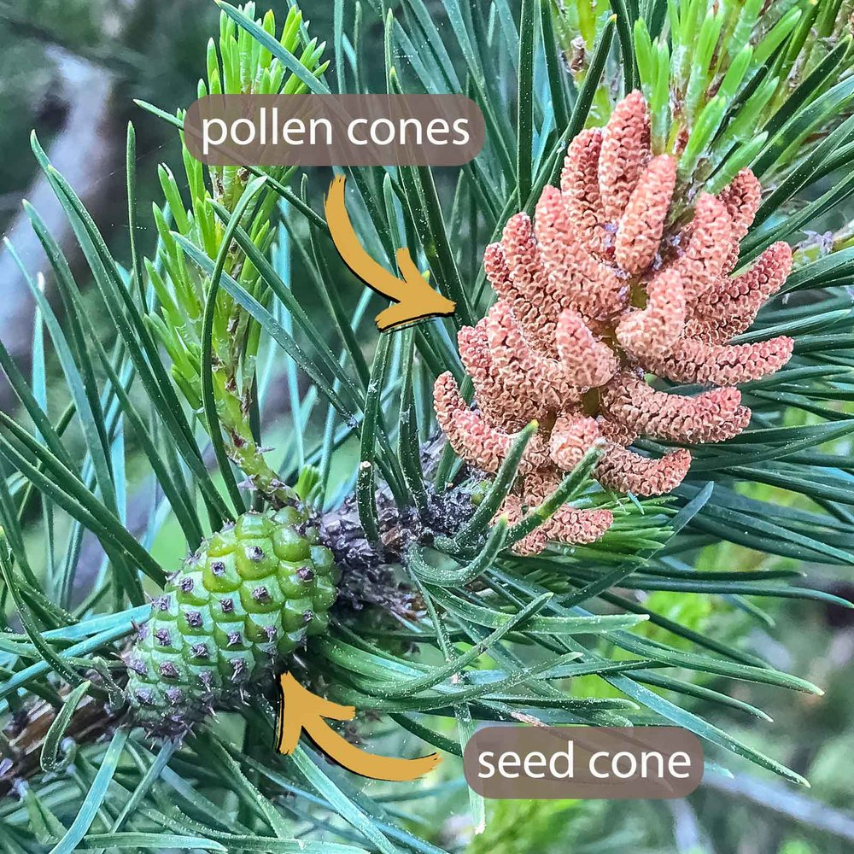
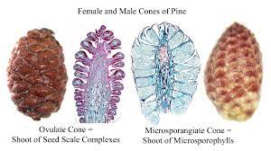
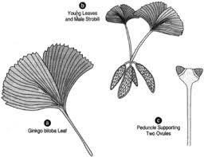
Šištice (strobilus) – místo vývoje gamatofytů a embrya
Notes:
Většina jehličnatých nese na jednom stromu oba typy šištic. Jinan je ale dvoudomá rostlina (oblíbené jsou samčí stromy, protože neprodukují plody s páchnoucí a jedovatou dužinou.

Slide 4
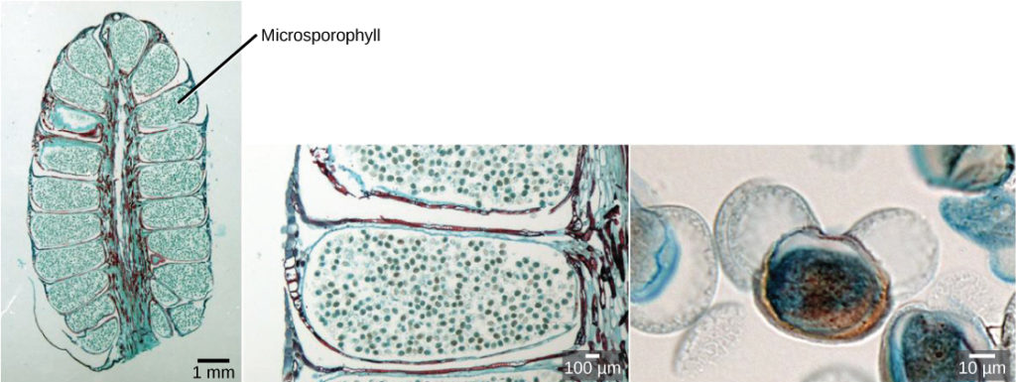
Samčí gametofyt
Mikrosporocyty v mikrosporangiu → mikrospory → pylové zrno (samčí gametofyt)
Notes:
A male cone has a central axis on which bracts, a type of modified leaf, are attached. The bracts are known as microsporophylls (Figure 2) and are the sites where microspores will develop. The microspores develop inside the mikrosporangium (2 or more, on the microsporophyll). Within the microsporangium, cells known as microsporocytes divide by meiosis to produce four haploid microspores. Further mitosis of the microspore produces two nuclei: the generative nucleus, and the tube nucleus. Upon maturity, the male gametophyte (pollen) is released from the male cones and is carried by the wind to land on the female cone.

Slide 5
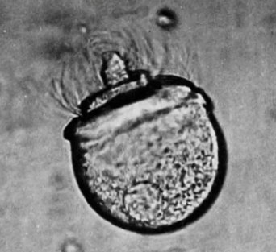
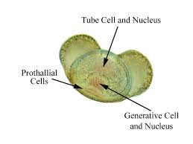
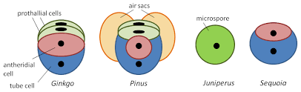
Vývoj pylového zrna nahosemenných
Proklové buňky
Generativní b.
Vegetativní b.
4 až 5 mitóz v různých stádiích (před a po opylení)
Mikrospora → prothalliové (proklové) buňky (degenerují) a antheridiová buňka
Antheridiová buňka → vegetativní a generativní buňka
Generativní buňka (po opylení) → dvě spermatické buňky
Notes:
The male gametophyte of gymnosperms is generally more complex than that of flowering plants; it develops and germinates more slowly; and it is formed through three to five mitoses, which in different groups taxa occur at different stages—before or after pollination. In this regard, pollen released from microsporangia consists of different number of cells : four cells in pine and ginkgo (two prothallial cells, generative cell and tube cell), two in sequoia, and one in juniper. Male gametes in all cases are formed after pollination.
U primitivních nahosemenných jsou pohyblivé spermatické buňky (ale pylová zrna jako taková klíčí a až před oplodněním dojde k uvolnění obrvených pohyblivých spermatic. buněk).

Slide 6
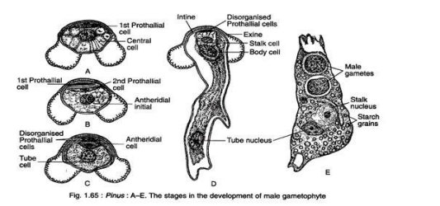
Vývoj pylového zrna borovice (Pinus)
Podrobnosti na: http://adpcollege.ac.in/online/attendence/classnotes/files/1624597770.pdf

Slide 7
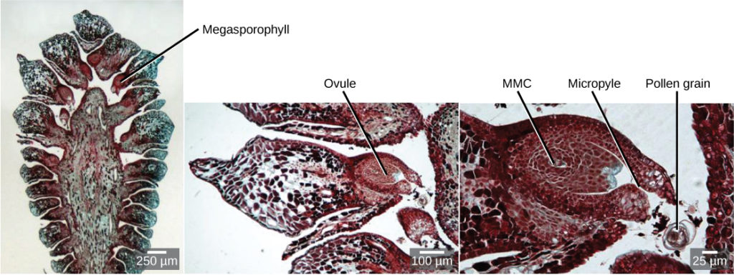
Samičí gametofyt
Notes:
The female cone also has a central axis on which bracts known as megasporophylls (Figure 3) are present. In the female cone, megaspore mother cells are present in the megasporangium. The megaspore mother cell divides by meiosis to produce four haploid megaspores. One of the megaspores divides to form the multicellular female gametophyte, while the others divide to form the rest of the structure. The female gametophyte is contained within a structure called the archegonium.

Slide 8
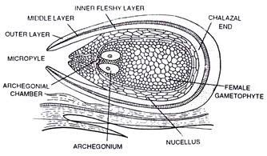
Zralé vajíčko borovice

Slide 9
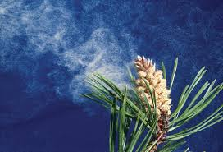
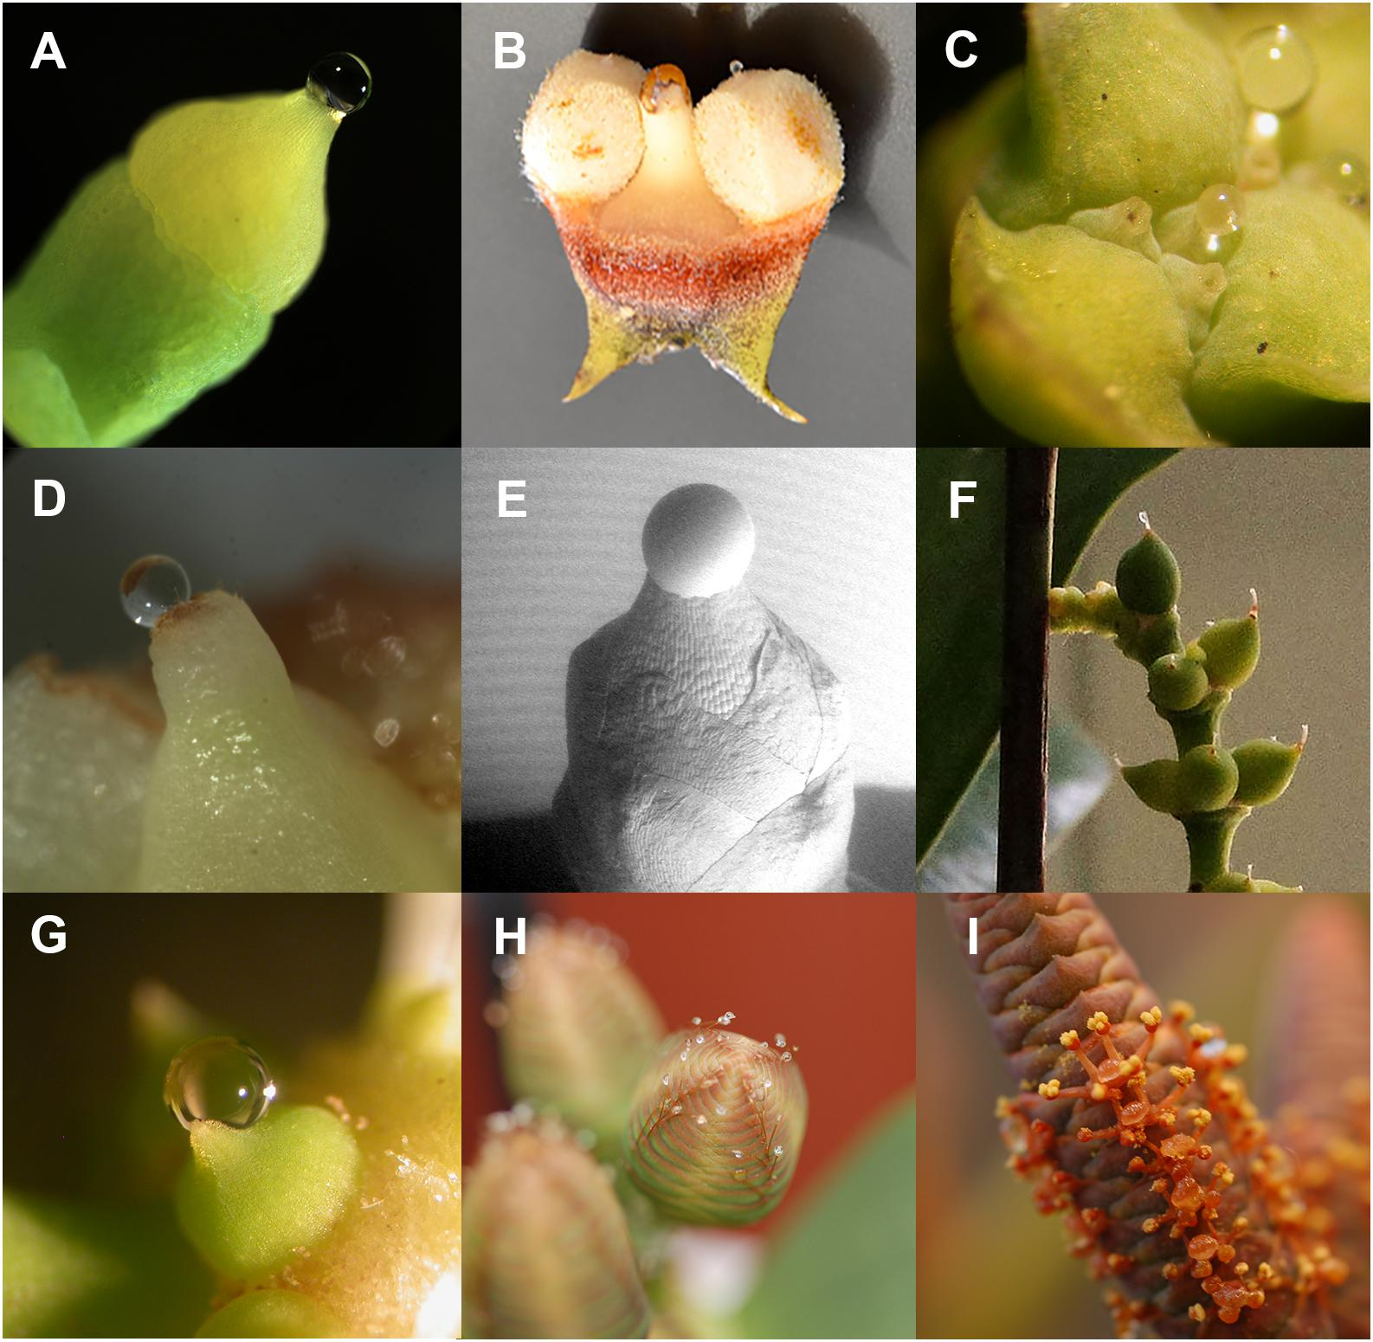
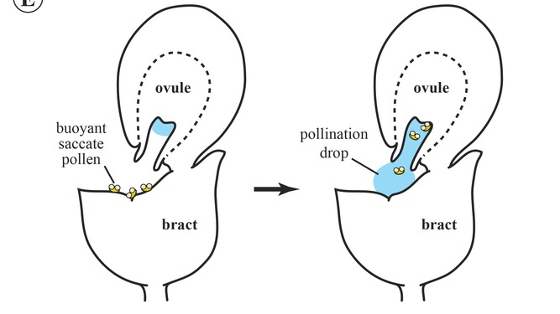
Opylení u nahosemenných
Polinační kapky
Notes:
Different pollination strategies are found in conifers. Saccate pollen of Pinus and Picea floats on the surface of the pollination drop and with it is transferred to the nucellus, where it germinates. In Abies, an analogue of a pollination drop is formed from moisture collected after rain or dew. Pollen often germinates in the micropilar canal and the tube grows towards the nucellus. In Larix, the pollination drop is absent, but the micropilar canal is filled with ovular secretion. Surrounded by this secretion, pollen hydrates, swells, and sheds exine. In this form, it floats to the nucellus, where forms a pollen tube. This usually happens a few weeks after pollination. In some Tsuga species and all Araucariaceae species, there is no pollination drop—pollen lands on the conical surface next to the ovule and may remain there for several weeks. It then germinates and forms a long tube that grows through the micropyle into the ovule and reaches the nucellus.
4 funkce polinační kapky: zachycení pylu, doprava mikropylárním kanálem, klíčení a ochrana vajíčka. Později během evoluce další fce: odměna hmyzu = vývoj nektaru.

Slide 10
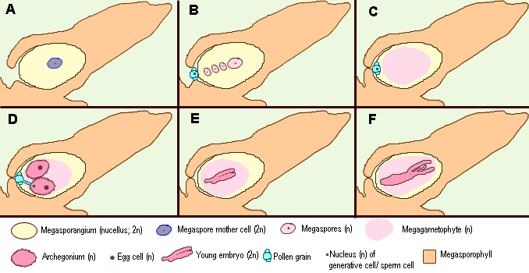
Opylení a oplodnění
krátká vzdálenost mezi opylením a oplozením
dlouhá doba mezi opylením a oplozením
Notes:
A Megasporangium with megaspore mother cell (2n), B After meiosis of the megasporocyte: only one of the four haploid cells persists. The pollen grain is germinated, C The megagametophyt develops within the megaspore. D The megagametophyt contains two (or three) archegonia, each with one egg cell. The pollen tube is grown allowing the sperm cell to reach the archegonium . The nucleus of the sperm cell fuses with that of the egg cell: fertilization! E An embryo develops, surrounded by rests of the megasporophyte and there around nucellus tissue F The seed is nearly ripe.
For different plant groups, the time from pollination to fertilization varies from several weeks (most species of Cupressaceae and Pinaceae) to a year (Pinus and some Araucariaceae)

Slide 11
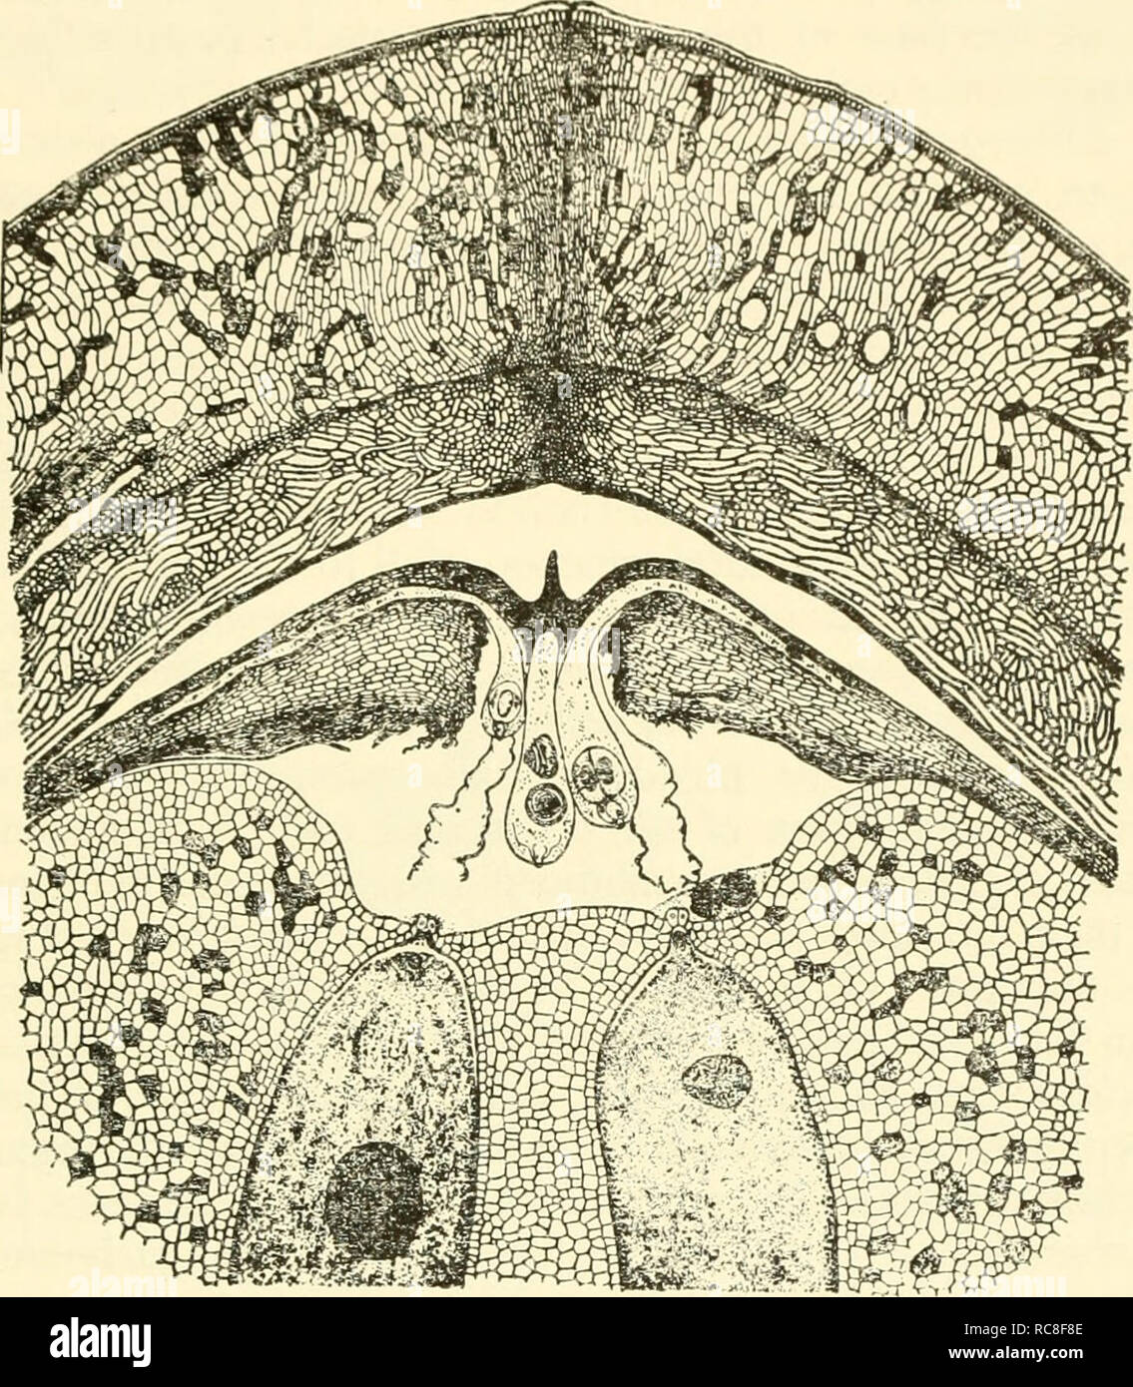
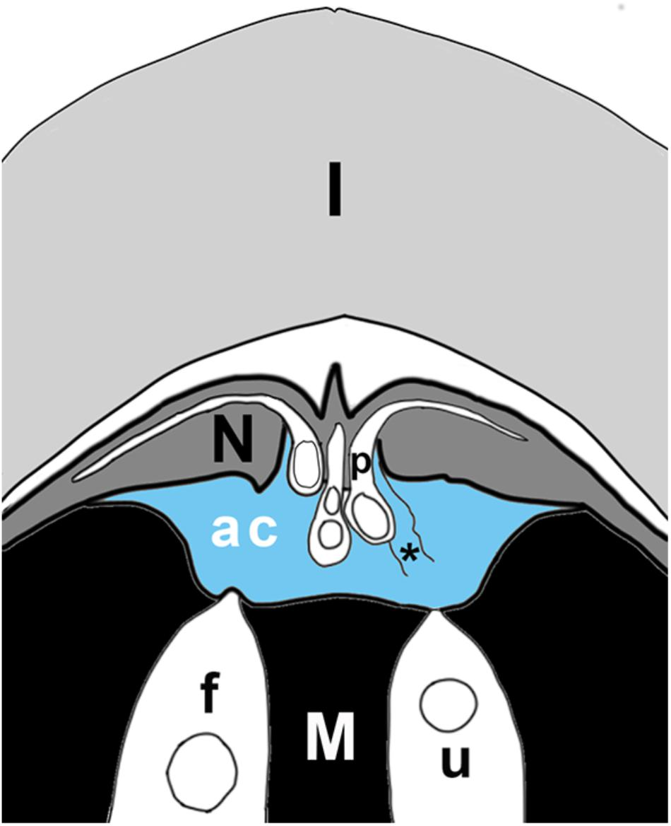
Oplození
I = integument
N = nucellus
M = megagametofyt
f, u = oplodněné (fert.) a neoplodněné (unfert.) archegonium
ac = archegoniální komůrka
p = pylová láčka
Notes:
Schematic of ovule tip at time of fertilization, showing layers of integument (I), nucellus (N), megagametophyte (M), with two archegonia (in white), of which one is fertilized (f), the other unfertilized (u). Pollen tubes (p) have grown into the nucellus; the sulcus end of the tube hangs over the archegonial chamber (ac). The archegonial chamber may be filled with fluid (blue) that originates either from ruptured pollen tubes (asterisk), from cells of the megagametophyte that line the chamber, and/or from archegonia.

Slide 12
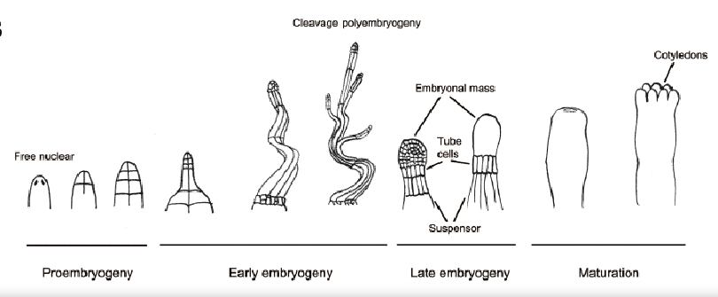
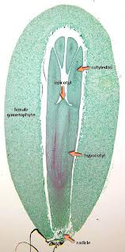
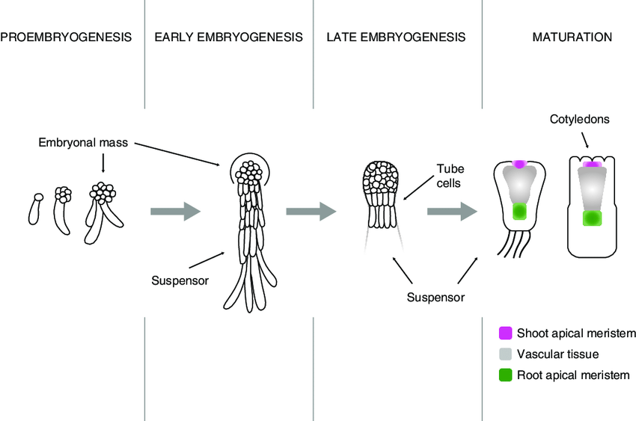
Vývoj embrya
Notes:
Vývoj embrya velmi dlouhý – od opylení po zralá semena to může trvat i 3 roky! (od opylení k oplození to může trvat jeden rok).
V borovici: four independent embryos are formed . This phenomenon is known as polyembryony, because more than one embryo is formed from a zygote . As the polyembryony occurs due to the splitting of a zygote, it is called cleavage (=štěpení) polyembryony. Only a single deep-seated proembryo develops into an embryo and the growth of other embryos is arrested at different stages of development

Slide 13
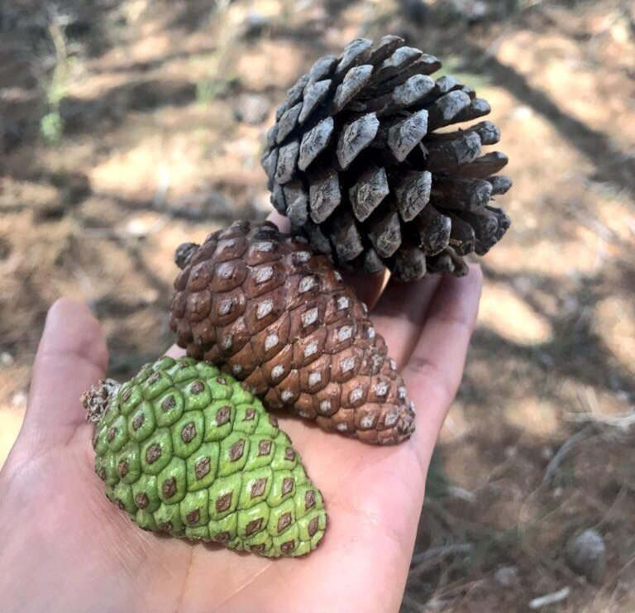
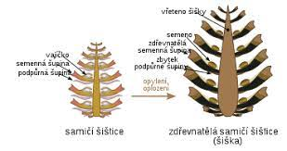
Dozrávání semen v šiškách

Slide 14
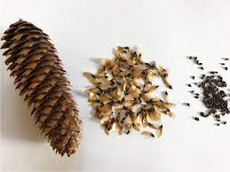
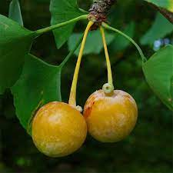
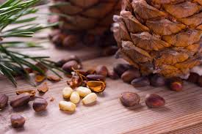
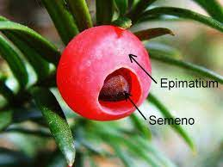
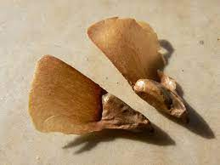
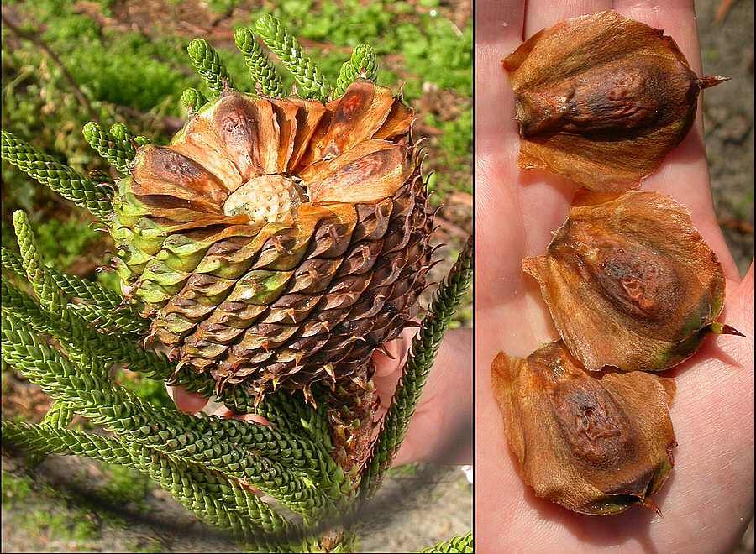
Semena
Smrk
Ginkgo biloba
Piniové oříšky
Tis
Jedle
Araucarie
Notes:
Asi dvacet druhů borovice pinie (Pinus pinea) s velkými semeny vhodnými ke sklízení: nejčastější borovice mexická, Colorado, italská a čínská.
Sarkotesta kolem semene jinanu obsahuje butyric acid – smrdí. Syrové plody obsahují 4-methoxypyridoxine, což je látka, která v těle ničí vitamín B6 (spolehlivě ji likvidujeme tepelnou úpravou). Semena zbavená dužiny se dají jíst (v Číně po opražení). Oplození je oddálené, dochází k němu až po opadu plodu na zem.
Epimatium (dužnatý nepravý míšek) je jediný z rostliny tisu nejedovatý.

Slide 15
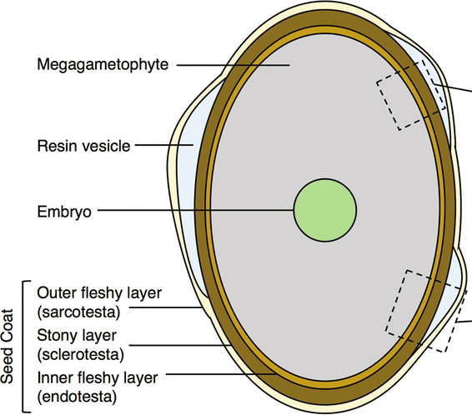
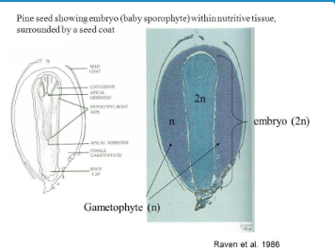
Stavba semene

Slide 16
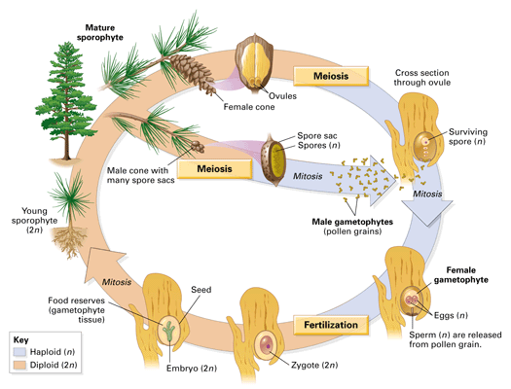
Shrnutí

