Slide 1
Medical genetics II
Microdeletion syndromes

Slide 2
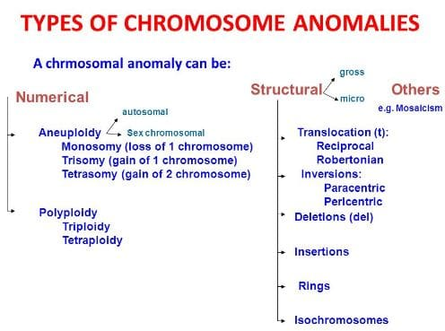
Standard karyotype 46,XX or 46, XY
https://readbiology.com/wp-content/uploads/2020/04/aberration.jpg

Slide 3
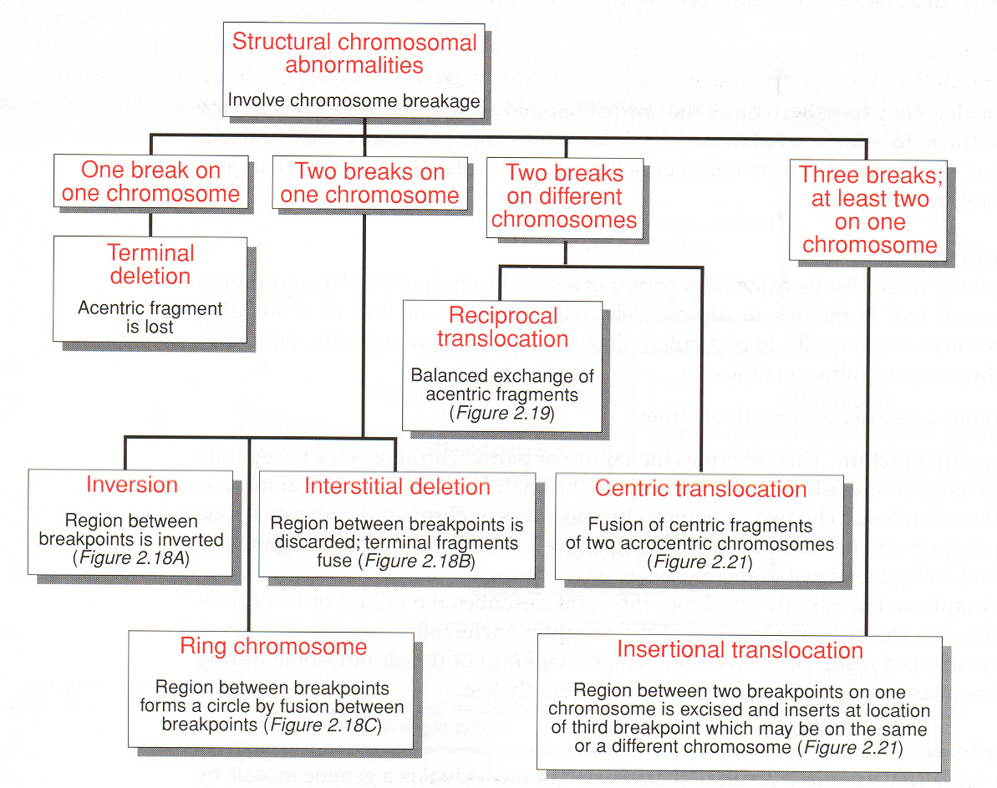

Slide 4
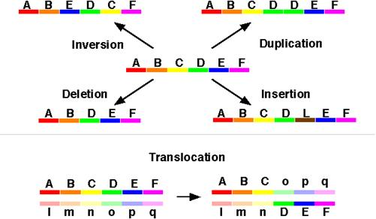
Structural chromosomal abnormalitites
Weckselblatt et Rudd, 2015

Slide 5
Structural variability of chromosomes
Changes in genome greater than 1000 bases (1 kb)
= submicroscopic changes, microscopic changes, changes in the number of individual chromosomes, changes in genomes...
a) Quantitative - copy number variation (CNVs) - deletion, duplication, insertion
b) Positional - translocations
c) Orientation - inversion
Copy number variation (CNVs) - segments of DNA greater than 1 kb present in a variable copy number compared to the reference genome

Slide 6
Congenital chromozomal abberations (CHAs)
For every child conceived, there is a general genetic risk of 3 - 5% of being born with a congential disorder !!!
Congenital CHA: 50 - 60% of first trimester abortions
0.56% of live births have CHA
of which 0.1% trisomy 21, 0.1% Robertsonian translocation or other balanced translocation, 0.1% XXX,XXY, or XYY, 0.05% unbalanced change, 0.01% trisomy 18 or 13
NDD, psychomotor retardation, sterility, testicular hypoplasia, amenorrhea, obesity, autism, etc.
CHAs - responsible for about 100 clinically defined syndromes

Slide 7
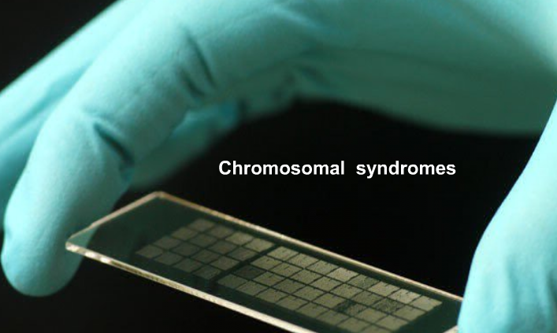
Designation
According to: discoverer.....Down Syndrome
by symptoms .....cat cry syndrome
by location..... del 1p36 syndrome

Slide 8
General origin of chromosomal aberations
A) spontaneous (DNA damage + replication, replication, recombination, segregation defects...)
B) induced by clastogens (ionizing radiation, UV radiation, chemicals, viruses...DNA damage)
Congenital aberrations
Acquired aberrations
Structural aberration - the crucial lesion is a double-stranded DNA break (DSB)!
unrepaired = lethal
incorrectly repaired = aberration

Slide 9
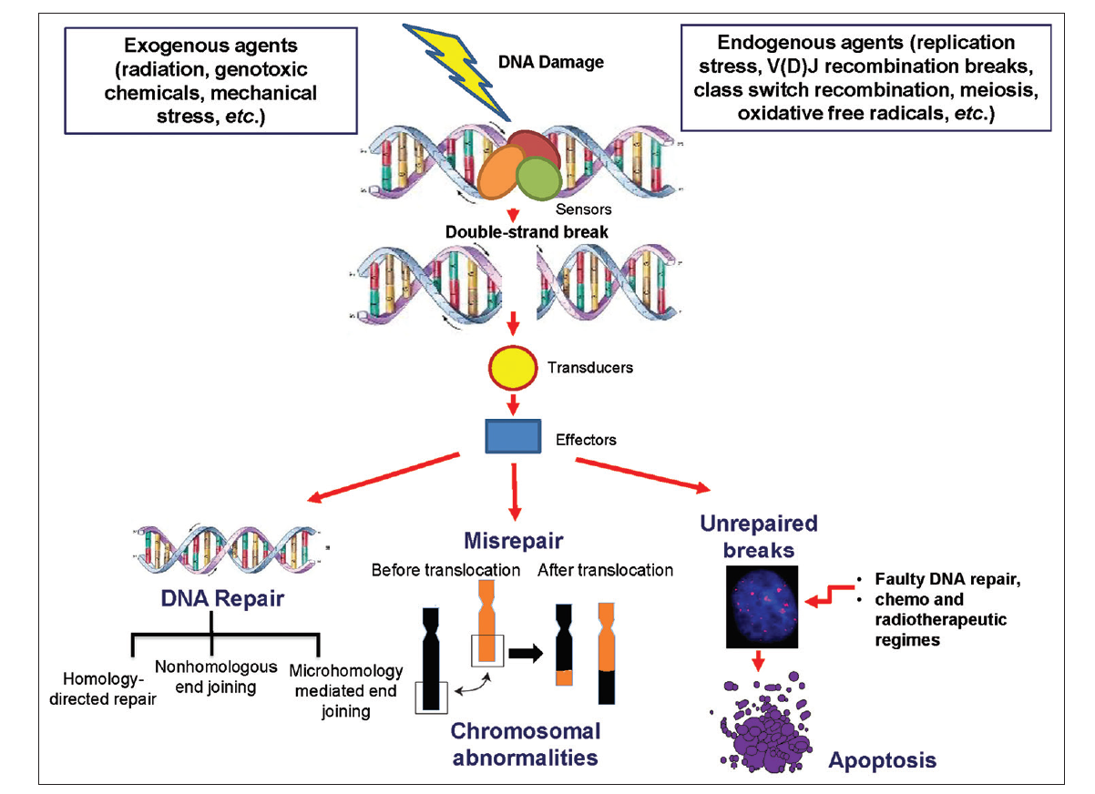
DSB effects on DNA
Pandey and Raghavan 2018

Slide 10
Molecular mechanisms of creation of structural chromosomal aberrations
DNA damage and lack of repair
formation of a double-strand break (DSB) + new telomeric sequences - terminal deletion
DSB + telomere loss - breakage-fusion-bridge cycle
DNA damage and repair failures:
DSBs and repair defects via homologous recombination (HR)
DSB and non-homologous end joining (NHEJ) and microhomology mediated end joining (MMEJ)
Replication disorders:
Replication fork stalling and jumping to a different template (FoSTeS)
Replication induced by DNA microhomology breaks (MMBIR)
Recombination disorders:
non-allelic homologous recombination (NAHR) - unequal crossing over

Slide 11
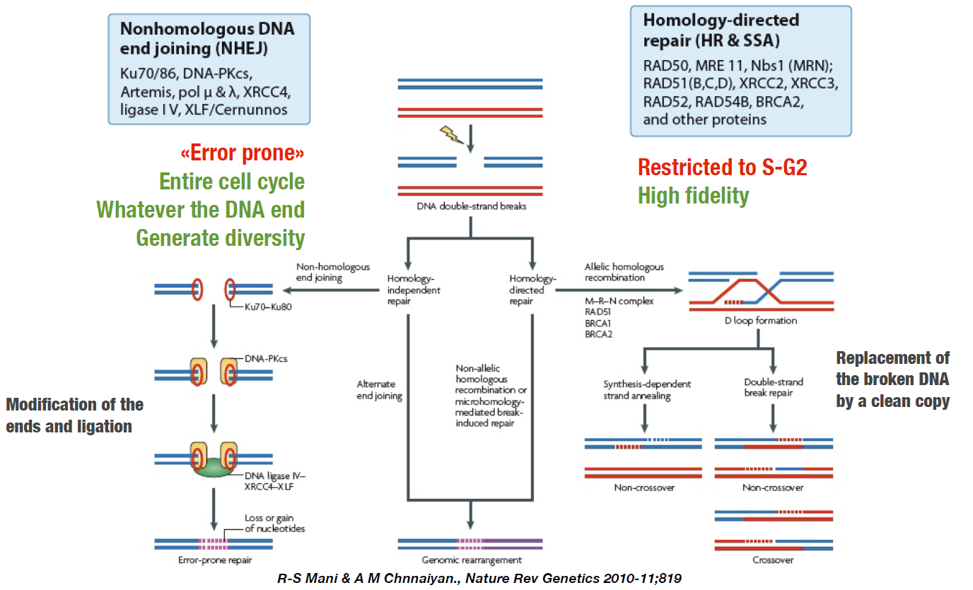
Reparation of DSBs – mechanism of homologous / non-homomologous repairs (NHEJ, MMEJ)
NHEJ
MMEJ
5-25 bp
homologie

Slide 12
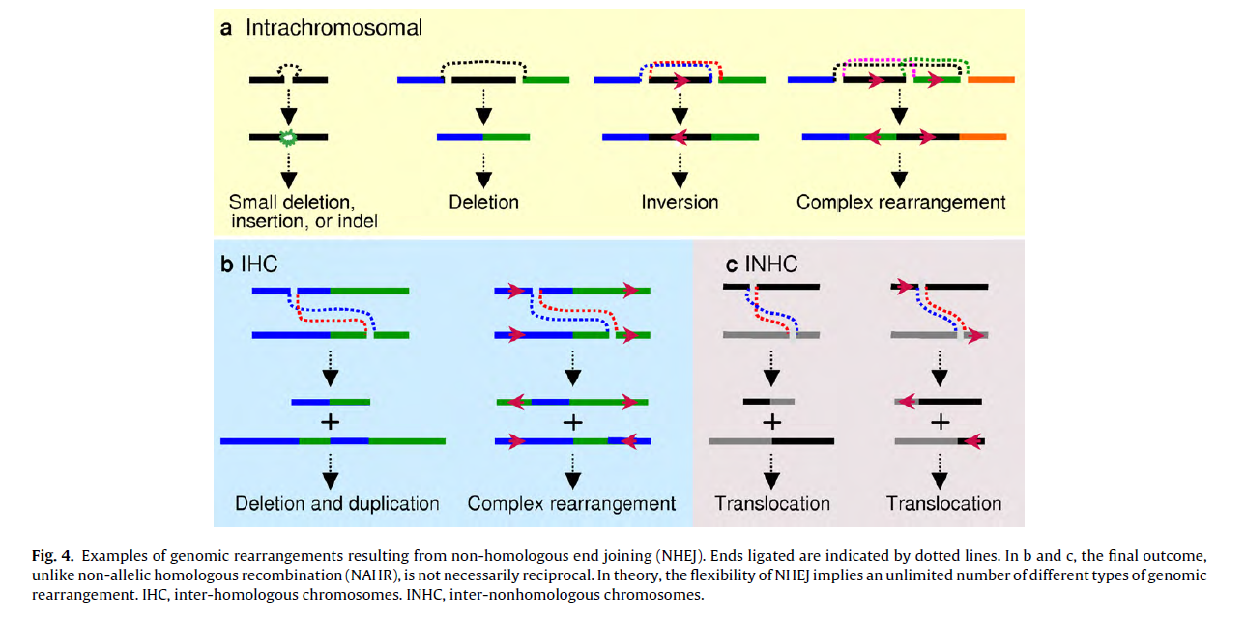
Examples of CHAs created by by non-homologous end joining (NHEJ)
Chen at al. 2010

Slide 13
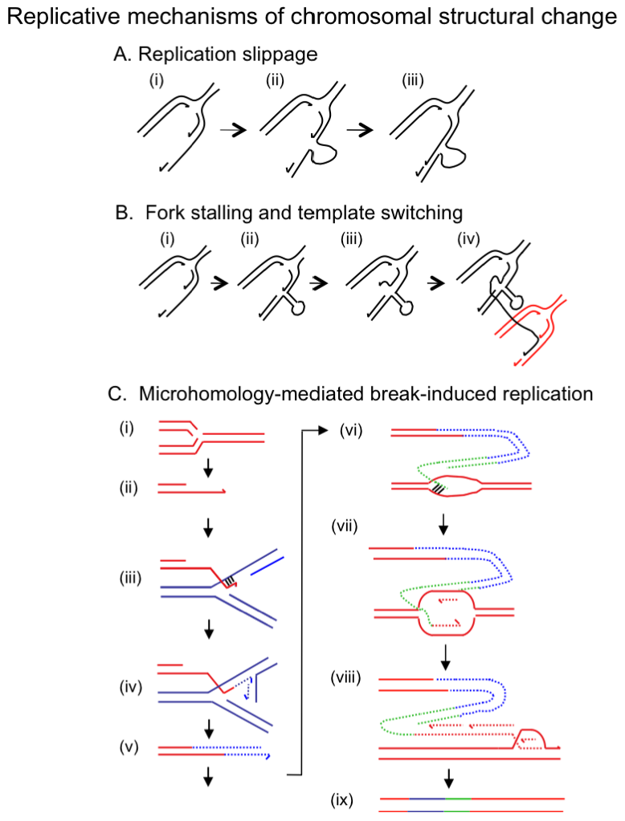
Failures of replication and chromosomal aberrations
FoSTeS - stopping the replication fork and jumping to a different template -
during replication, the replication fork is blocked (single strand break or secondary structure formation), the lagging DNA strand is released and jumps to another replication fork that shares the microhomology region - deletion, duplication
MMBIR - replication induced by DNA microhomology breaks - initiated by a break in a template strand, skipping and restarting replication on another template - temporary replication fork on another chromosome or sister chromatid - complex changes - deletion, duplication
Hastings et al. 2010

Slide 14
Duplications in genome – „hot spots“ for chromosomal aberrations
more than 5.4% of the human genome is covered by duplications (>1 kb with >90% sequence homology), average 18.5 kb
1%-14% of each chromosome contains SDs (segmental duplications)
3.4% to 10.7% of genes may be duplicated
The human genome consists
low copy number repetitive sequences (LCRs) - intrachromosomal duplications of >10 kb with >97% sequence identity
segmental duplications (SDs) - segments >1 kb in size with >90% sequence identity
retrotransposons LINE sequences (L1 6 kb - 516,000 copies), SINE (Alu sequences - 300 bp - 1 to 1.5 million copies)
Zhang et al. 2004

Slide 15
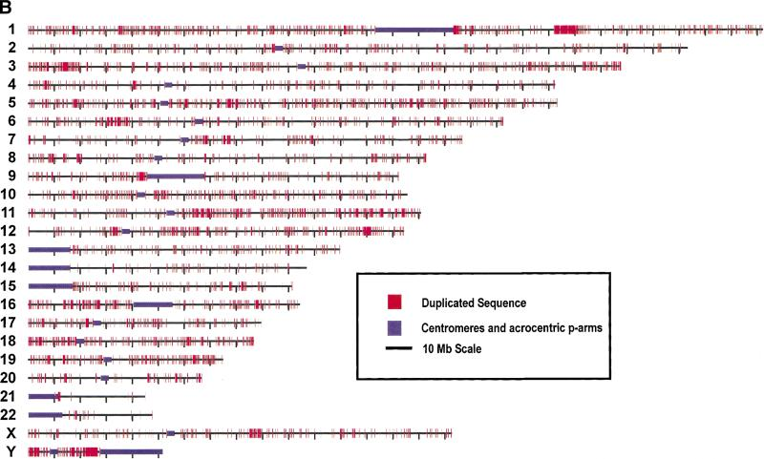
Intrachromozomové oblasti SDs v lidském genomu
duplications (90%-98%; ≥1 kb) cover 3.6% of all sequences
Accumulation in pericentric and subtelomeric regions of chromosomes
interstitial regions
chromosomes
"hot-spot" for NAHR (169 ?)
Genome-wide view of segmental duplications. The positions of alignments are depicted in red for each of the 24 chromosomes. Panels separate alignments on the basis of similarity: (B) 98%–100% identity. Purple bars depict centromeric gaps as well as the p-arms of acrocentric chromosomes (13, 14, 15, 21, and 22).Because of scale constraints, only alignments >5 kb are visible. Views were generated with the program PARASIGHT (J.A. Bailey, unpubl.), a graphical pairwise alignment viewer.
Bailey et al 2001

Slide 16
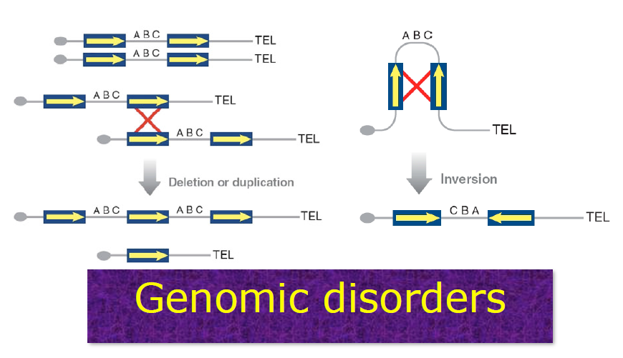
Non-allelic homologous recombination (NAHR) recurent deletions / duplications / inversions
defective meiotic recombination between repetitive sequences (SDs or LCRs)

Slide 17
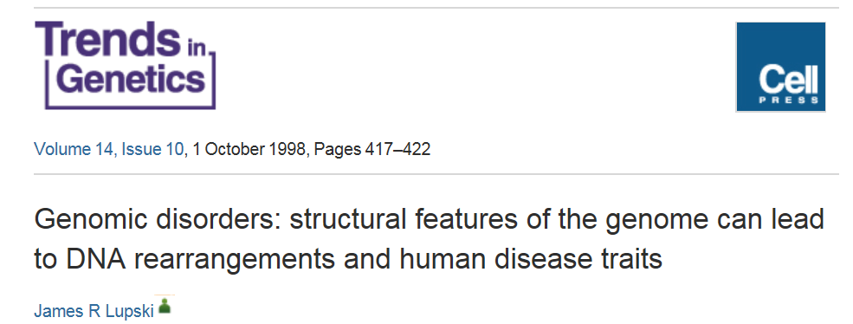
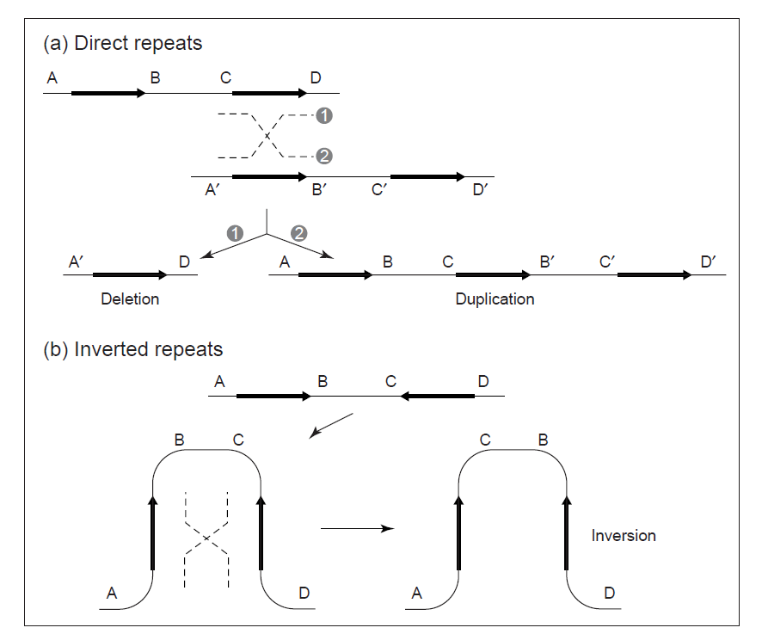
Genomic disorders
Genomic disorders - diseases resulting from genomic rearrangements causing gene gain or loss (CNVs)
The genome architecture creates suitable conditions for non-allelic homologous recombination, which can result in chromosomal rearrangements (NAHR)
Microdeletion/duplication syndromes
Genomic rearrangements resulting from recombination between repeated sequences.

Slide 18
Mikrodeletion syndromes - pathological CNVs
a group of genetically determined diseases caused by small microdeletions of DNA segments (2-4 Mb) that are not detectable by classical cytogenetic methods
patients share specific clinical symptoms...previously described by phenotype ("phenotype first"...)
now "genotype first" approach ...first finding, size comparison, genes - influence on phenotype
subset of CNVs....pathogenic CNVs !
recurrent - arise repeatedly at the same location on the chromosome ...e.g. del 22q11....areas with LCRs...
non-recurrent - can arise anywhere in the genome ...

Slide 19
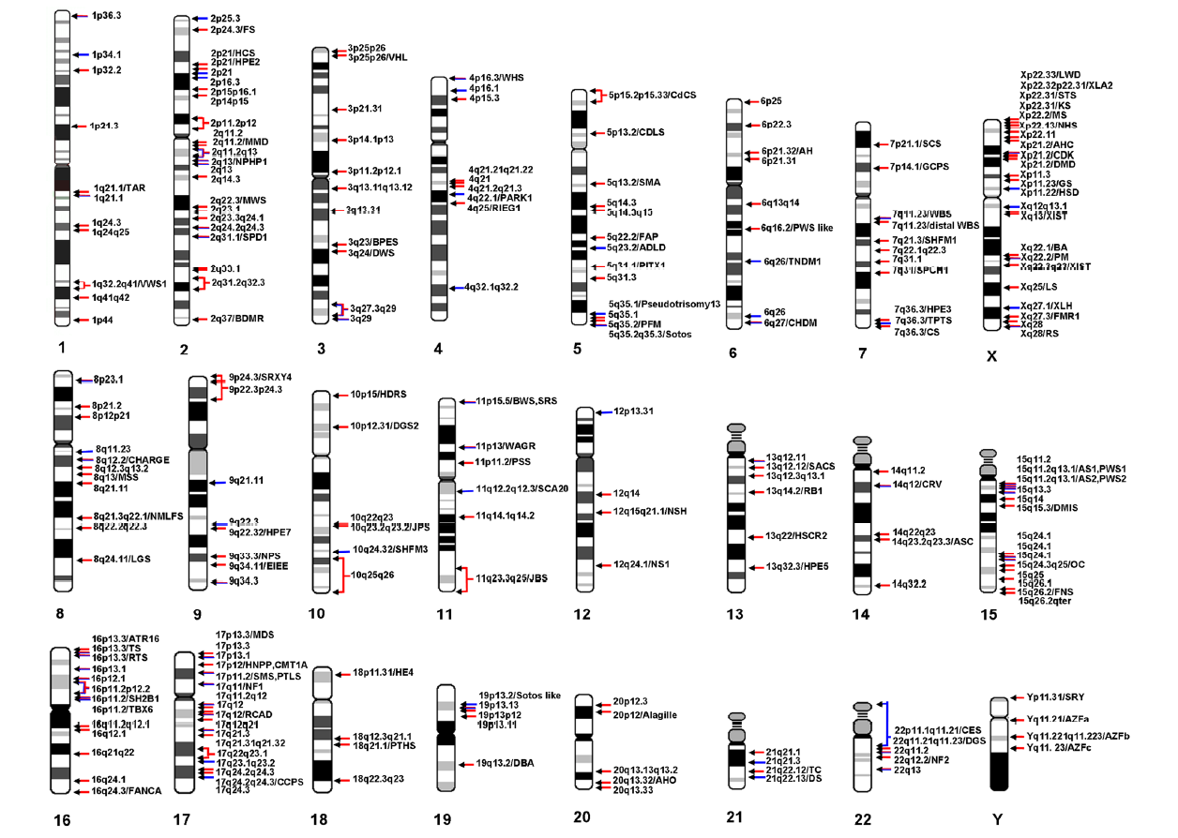
Incidence of microdeletions / microduplications in human genome
Weise et al. 2012

Slide 20
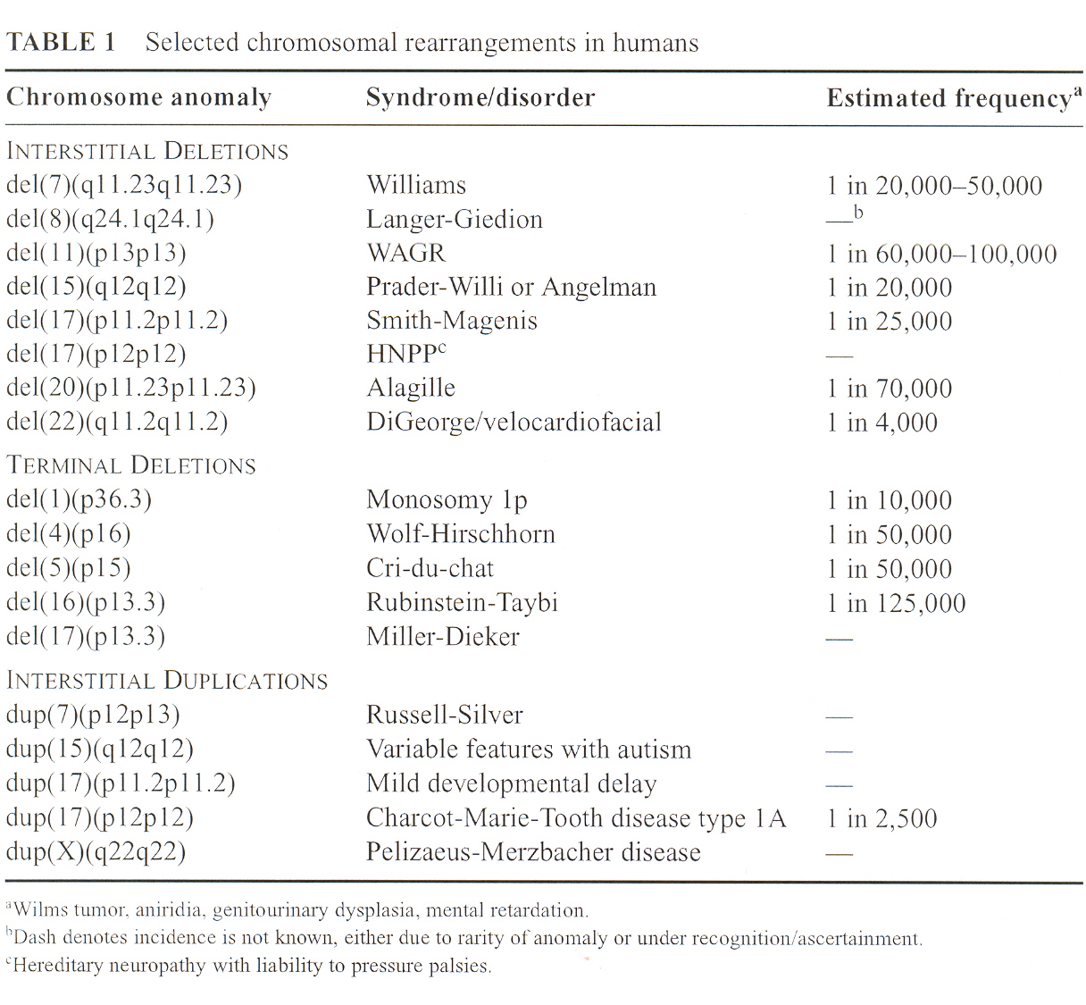
Recurent microdeletions

Slide 21
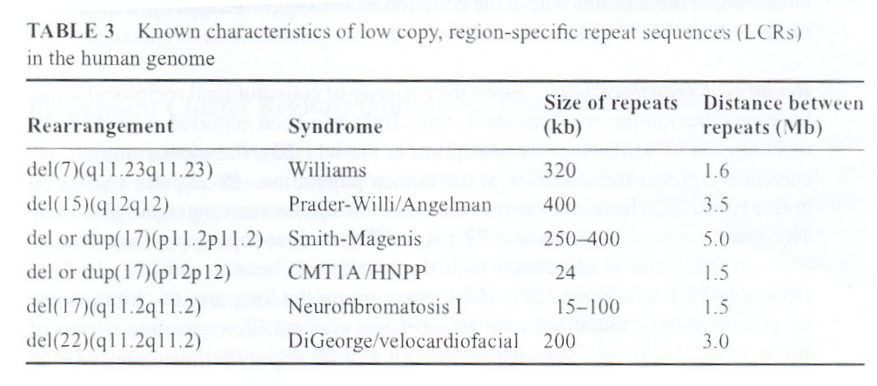
Examples of LCRs in known syndromes

Slide 22
Genetic effects of microdeletions
AD heritability - haploinsufficiency - inability of one copy of the genetic material to maintain the functions that are provided by both copies
heterozygote - monosomy for that part of the genetic information that is located on the corresponding segment of the normal chromosome
loss of heterozygosity - LOH (loss of the dominant allele.....)
deletion of multiple genes - „contiguous gene syndromes“
Pathological effects of the patient are connected to the size of the microdeletion.....
incomplete penetrance and variable expressivity.....

Slide 23
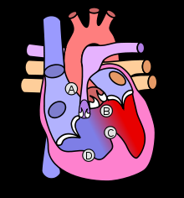
Mikrodeletion 22q11 DiGeorge (VCFS) syndrome
autosomal dominant with variable expressivity
discovered in 1965 by pediatric endocrinologist Angelo DiGeorge
frequency 1:4000 to 1:6000 live births
also referred to as Velo-Cardio-Facial Syndrome (VCFS) or CATCH 22
typical congenital heart defects (also detected
prenatally !)
Facial dysmorphia
hypoplasia - thymus aplasia (Tbx1 gene)
or parathyroid glands -
calcium deficiency, cramps
immunodefects
(absence of T-lymphocytes)
Fallotova tetralogie: A: stenóza plicnice B: dextropozice aorty C: defekt komorového septa D: hypertrofie pravé komory

Slide 24
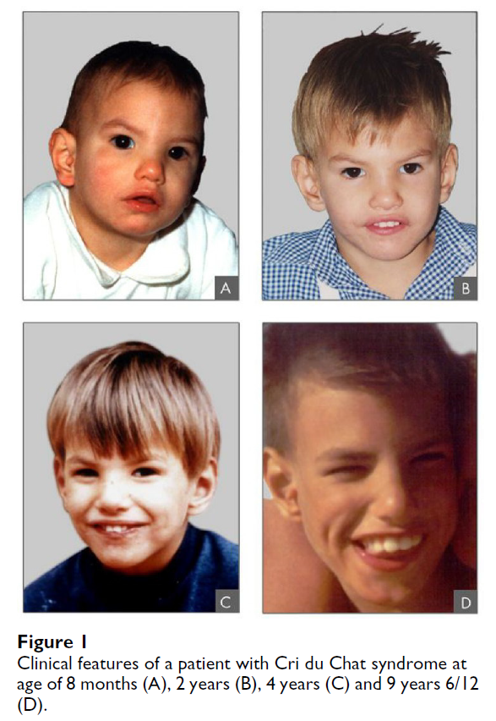
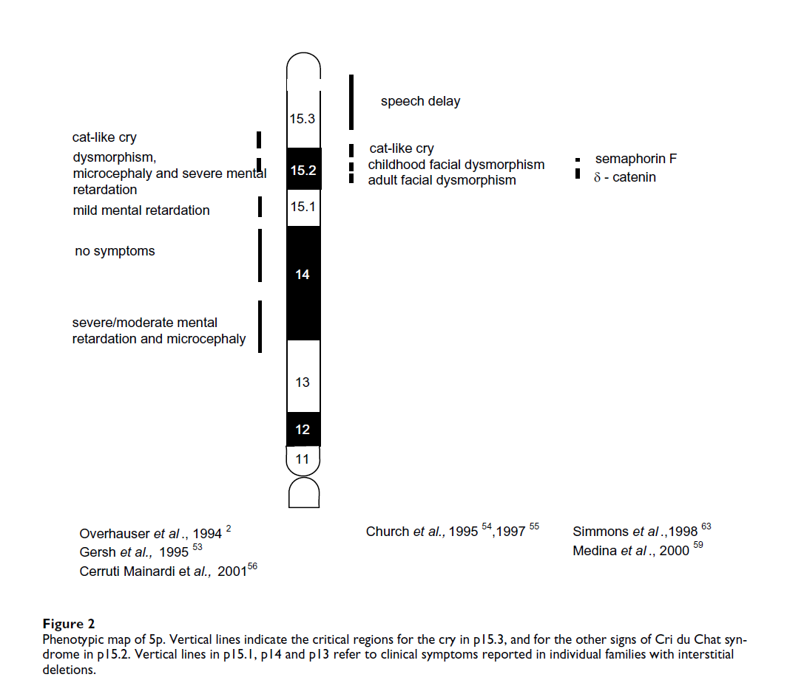
Cri-du-chat (cat's cry) syndrome
Comparison of sizes of 5p deletions - phenotypy - candidate genes
Mainardi CP, 2006

Slide 25
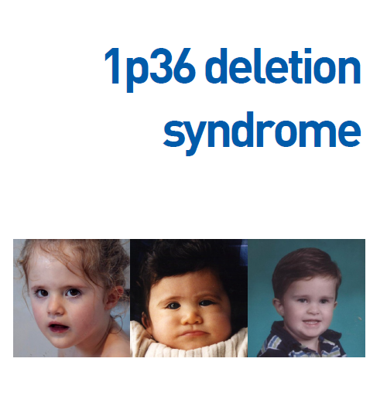
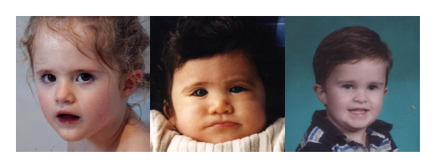
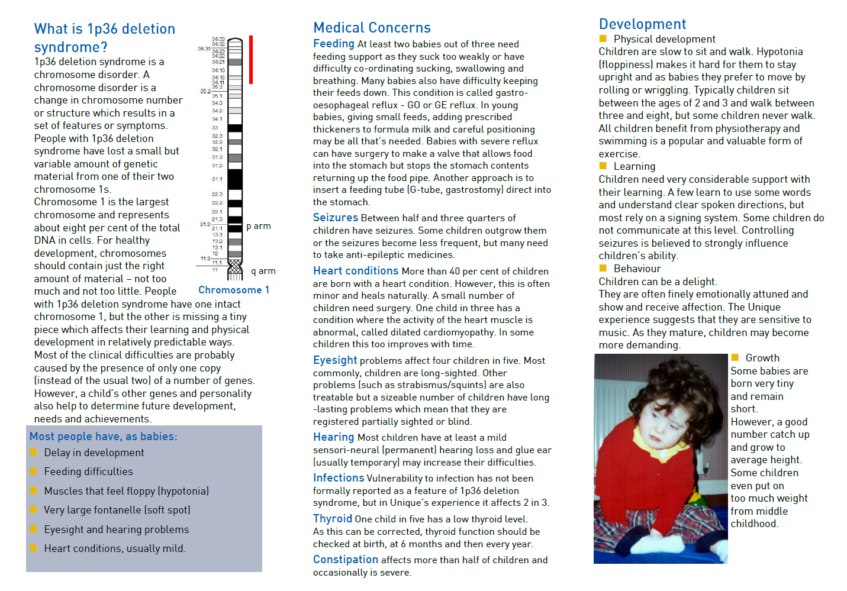
1: 5000

Slide 26
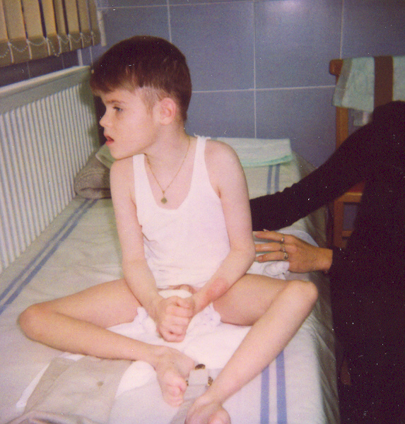
Microdeletion syndrome 1p36 - patient OLG FN Brno
Proband - 4 year old boy
severe PMR
facial dysmorphia
Autism
tendency to self-harm
karyotype normal
microdeletion 1p36 - 3.2 Mb

Slide 27
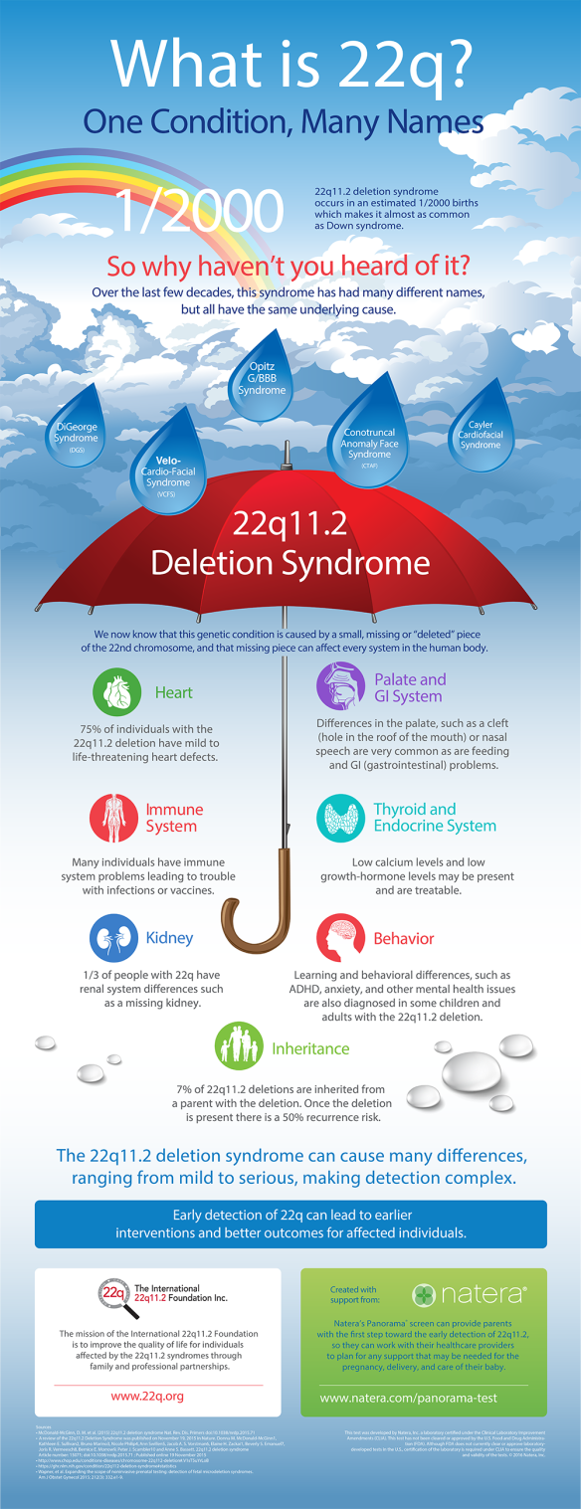
Microdeletion 22q11 DiGeorge (VCFS) syndrome
autosomal dominant with variable expressivity
discovered in 1965 by pediatric endocrinologist Angelo DiGeorge
frequency 1:4000 to 1:6000 live births
also referred to as Velo-Cardio-Facial Syndrome (VCFS) or CATCH 22
typical congenital heart defects (also detected
prenatally !)
Facial dysmorphia
hypoplasia - thymus aplasia (Tbx1 gene)
or parathyroid glands -
calcium deficiency, cramps
immunodefects
(absence of T-lymphocytes)

Slide 28
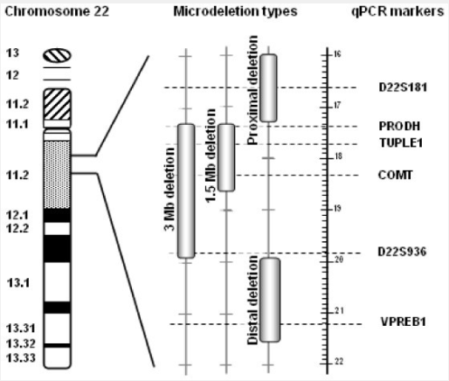
CATCH 22 - del(22)(q11)
Cardiac defect - typical heart defects
Abnormal faces - chin
Thymic hypoplasia - immune disorders, infections
Cleft palate - cleft palate
Hypocalcemia - convulsions
microdeletion size 22q11 1,5 - 3 Mb
rarely - deletion 10p
(DiGeorge II)
10 % 80% of patients

Slide 29
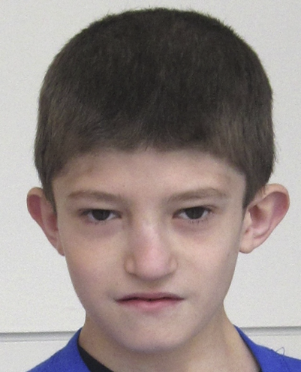
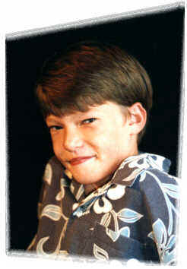
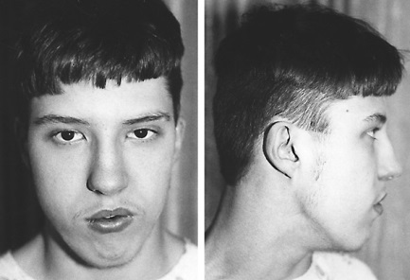
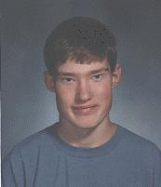
Photos of DG/VCFS patients prominent chin, low set ears, prominent nose....
...developmental delay - mild mental retardation, schizophrenia, autism....
...speech disorders, especially slurring of speech, articulation disorders, speech fluency....

Slide 30
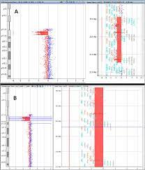
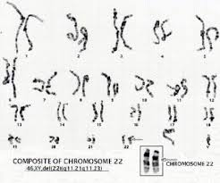
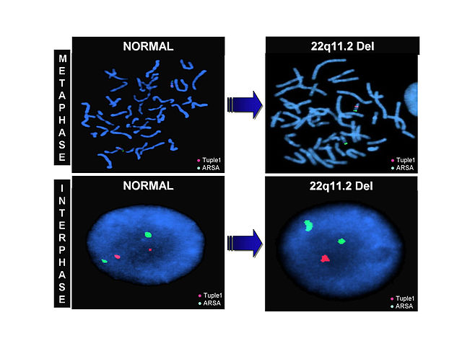
DG/VCFS and detection techniques
(general approach foe all microeletion syndromes)
Approximately 90% of probands have de novo deletion of 22q11, about 6% have familial transmission
cytogenetic analysis of karyotype detects only 10-20% of 22q11 microdeletions
a small percentage of patients may have a translocation or monosomy of chromosome 22
microdeletion testing is performed by FISH, MLPA or aCGH
always starting with the karyotype !

Slide 31
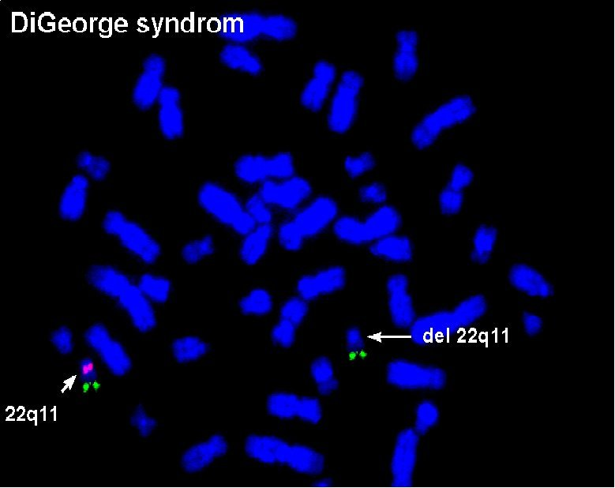

Slide 32
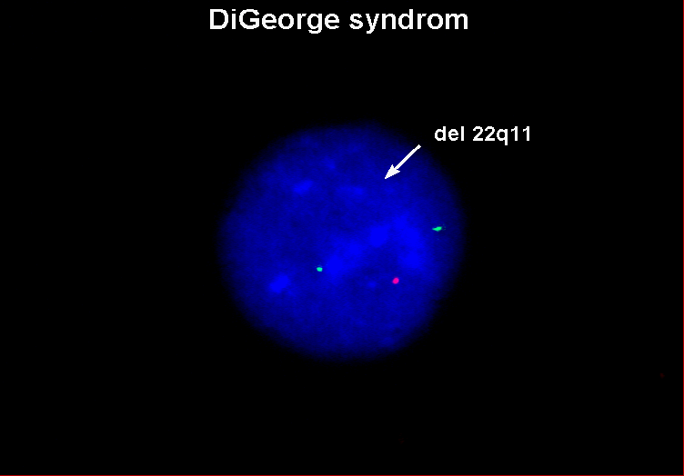
I-FISH

Slide 33
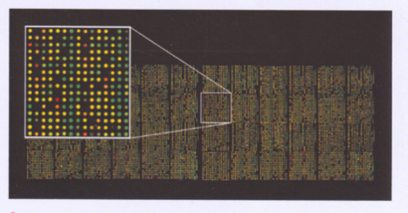
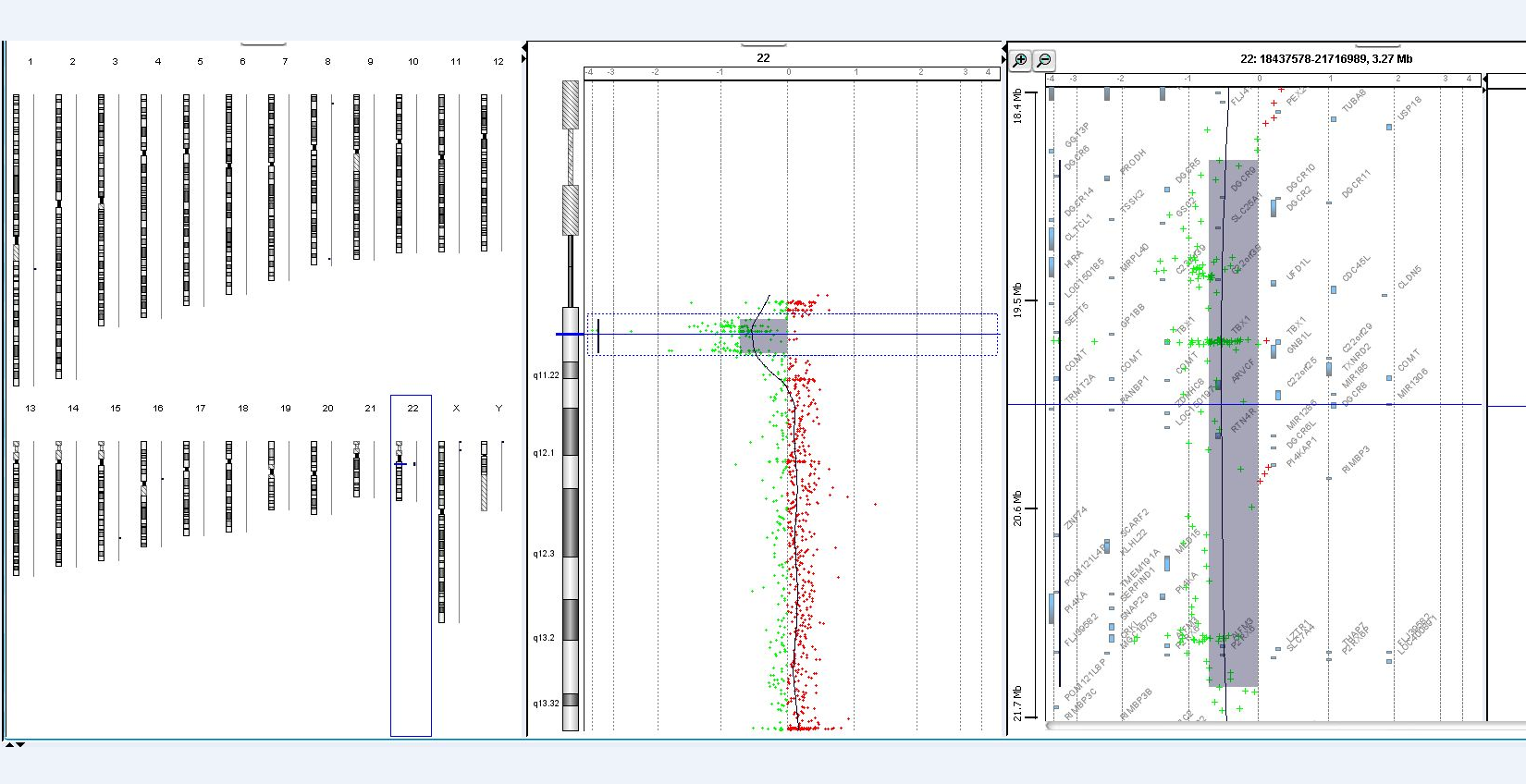
Array –CGH – size of microdeletion
Array-CGH profile of patient with microdeletion 22q11 of size 2,72 Mb
ISCN: arr[GRCh37] 22q11.21(18818376_21540347)x1

Slide 34
Case report - child with DG/VCFS
microdeletions can also arise secondarily
result of abnormal chromosome segregation with balanced translocations or inversions
E.g. healthy parent with balanced translocation - affected child with deletion or duplication

Slide 35
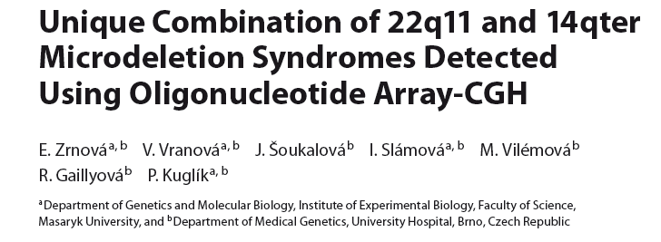
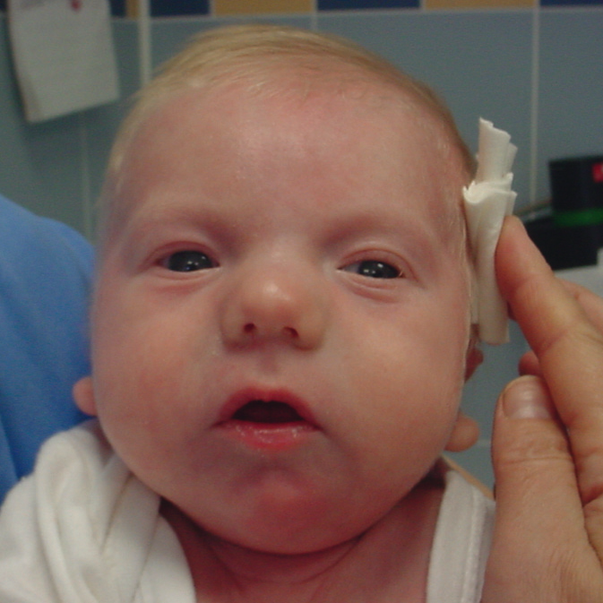
Photo of the proband at 2 months of age showing micrognathia, hypertelorism,
prominent tubular nose, dysplastic lowset
ears, thin lips, carp-shaped mouth, and
a short neck.
Translocation and two different microdeletions in one patient!

Slide 36
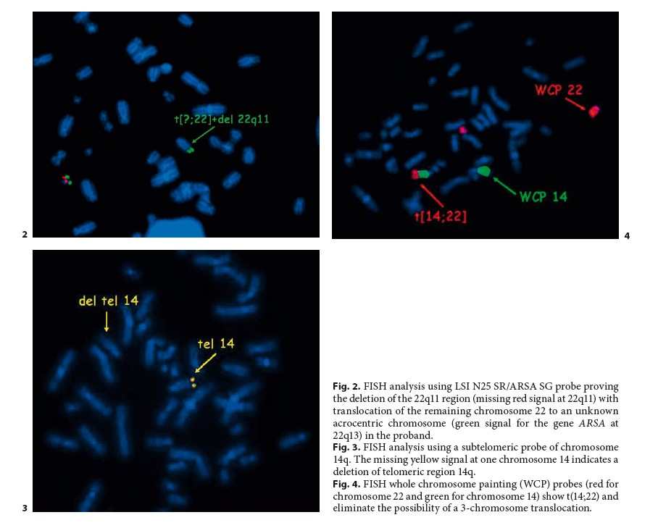
Moleclary-cytogenetic investigation of proband
Translocation t(14;22)
Deletion 22q11
Deletion 14q

Slide 37
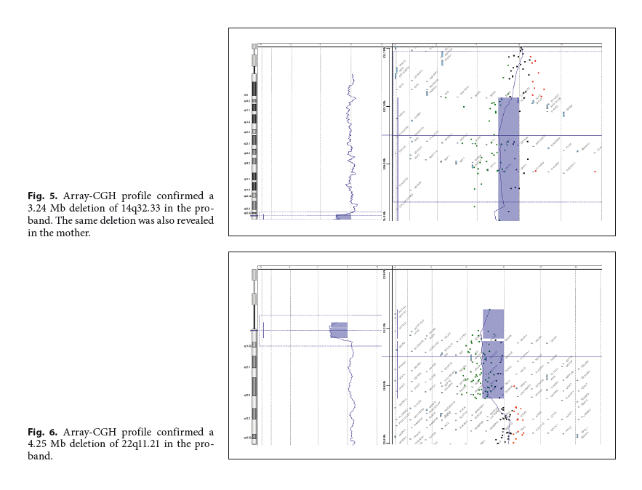
..but mother was healthy..?
Penetrance ?

Slide 38
Prader-Willi Angelman syndrome
(microdeletion + uniparental disomy)
abnormalities in
chromozome 15
in 15q11-q13
clinically different
syndromes!!
Juan Carreño de Miranda (1680)
„The nude monster“
PW syndrome?

Slide 39
Genetické příčiny vzniku PWS a AS
Prader-Willi syndrome
1. Deletion on paternal
chromosome 15
(70%)
2. Maternal uniparental
disomy on chromosome 15 (20-25%)
3. Change in imprinting
(2 - 4 %)
4. Different chromosomal
rearrangements
( less than 5%)
Angelman syndrome
Deletion on the maternal
chromosome 15 (70 %)
2. Paternal uniparental
disomy on chromosome
15 (4 %)
3. Change in imprinting 1 %)
4. Various chromosomal
rearrangements (2 %)
5. Mutations in the UBE3A
gene (3-5 %)

Slide 40
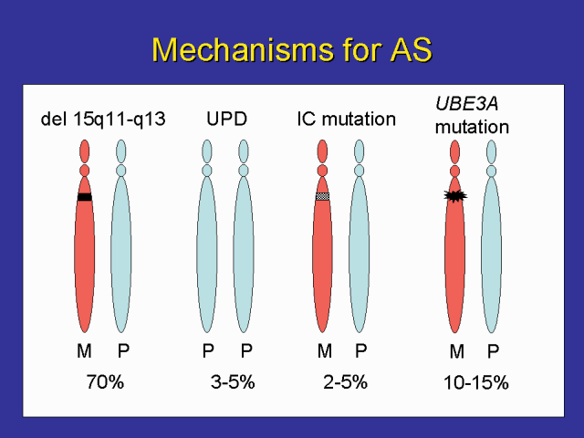
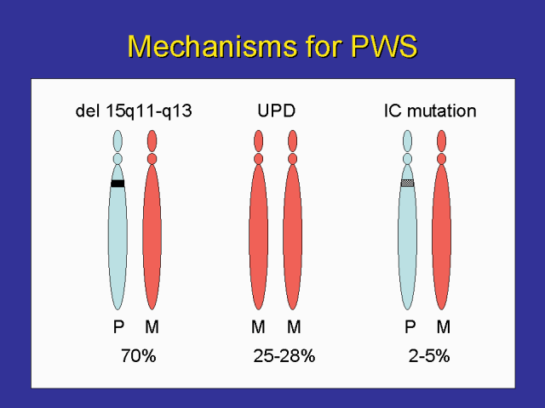
GENOMIC IMPRINTING
Prader –Willi/Angelman syndrome
a reversible process whereby sex-specific modification of genes in the parental generation leads to functional differences between the paternal and maternal genomes (alleles) in the offspring
epigenetic form of gene regulation that leads
to functional haploidy:
parent-specific monoallelic expression of !
loss of expression of paternal (PWS) or maternal (AS) genes causes disease

Slide 41
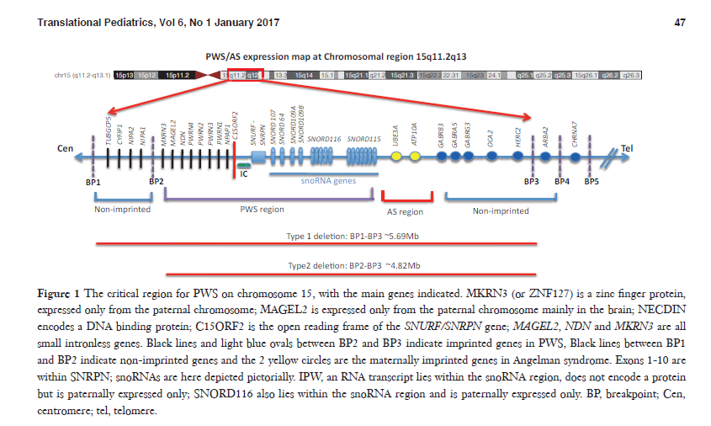
Critical region for PW / AS in chromozome 15
Smith and Hung, 2016

Slide 42
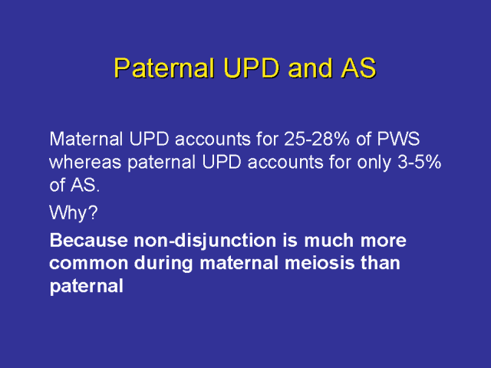

Slide 43
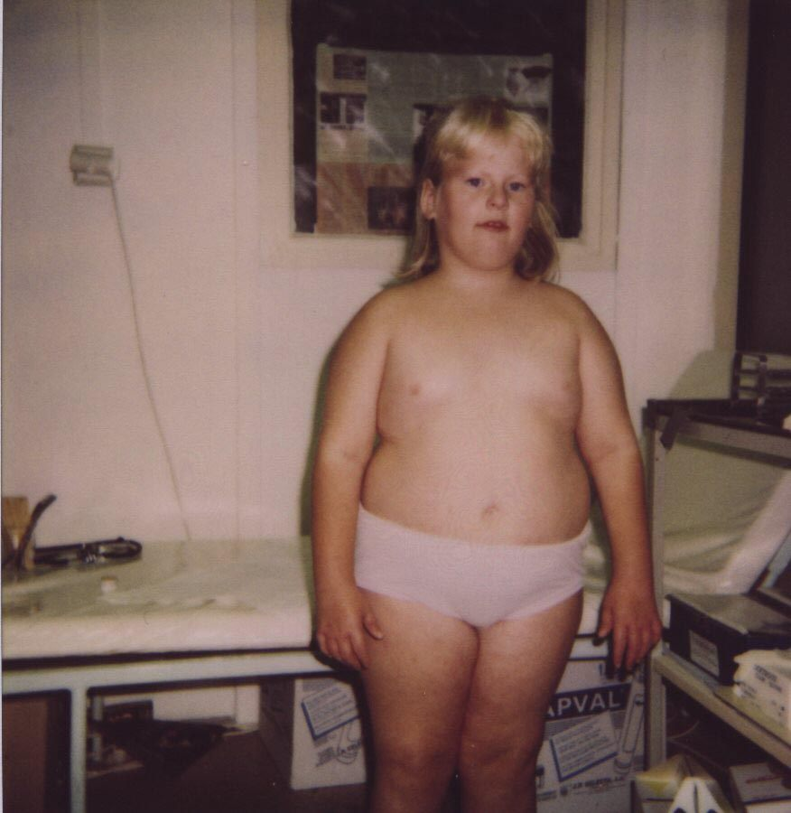
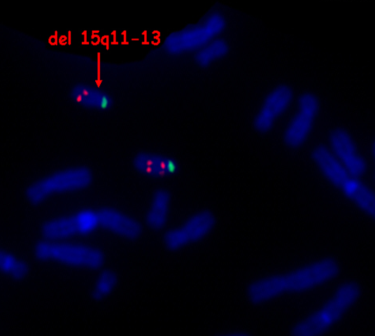
Prader-Willi syndrome (del 15q11-q13)
paternal deletion
low fetal activity
hypotonia
excessive weight gain, hyperphagia
short stature
hypogonadism
mental retardation
hypopigmentation
skeletal development delay (acromicria)

Slide 44
Angelman syndrom
( happy puppet syndrome)
Harry Angelman (1965) – first description
Occurrence: frequency not exactly known
estimate about 1:15,000- 1:30,000
in both sexes and all races

Slide 45
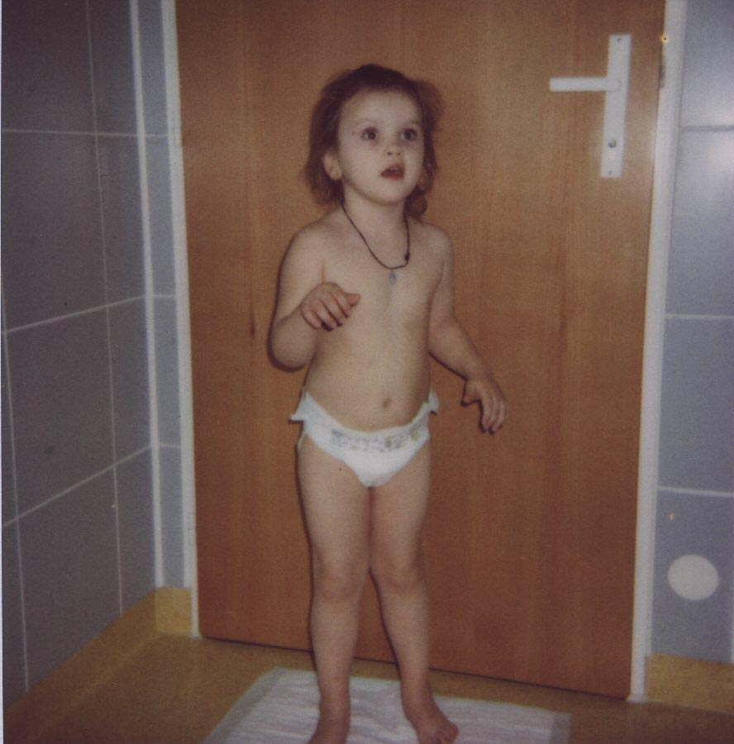
Angelman syndrome (del 15q11-q13)
„Happy Puppet“
maternal deletion
hard mental retardation
hypotonia
epilepsia, seizures
hypopigmentation
hyperactivity
speech absence
prominent scull shape (mandibul, microcephaly, flat back of head..)
„happy character“
movement or balance disorder

Slide 46
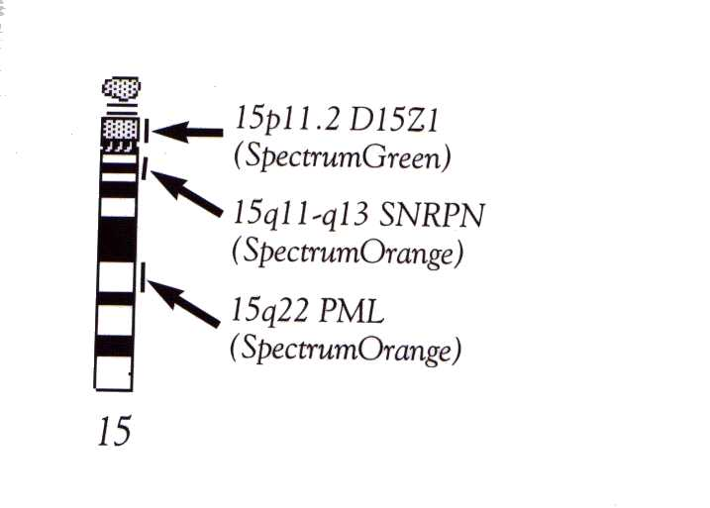
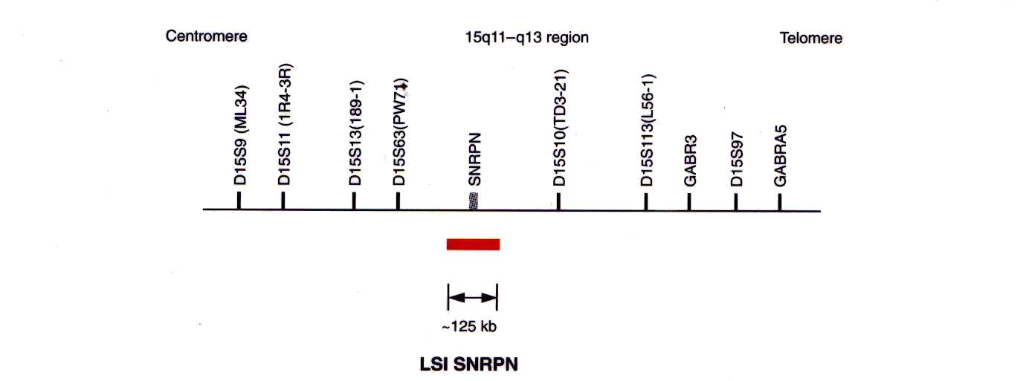
FISH probe - Vysis
Locus SNRPN
PW syndrom
Control probe

Slide 47
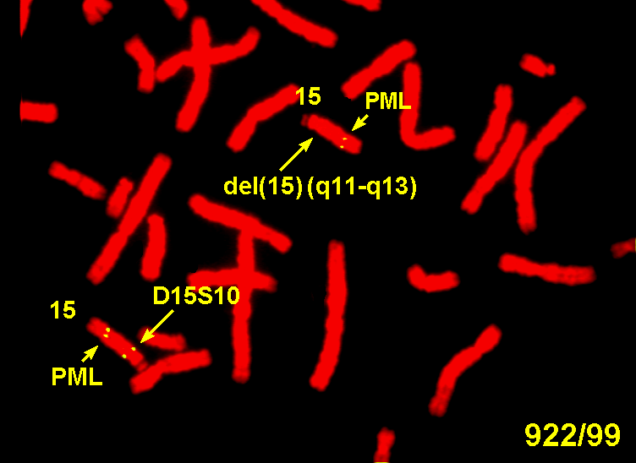

Slide 48
William-Beuren syndrome
autosomal dominant disease with variable expressivity, usually de novo
risk of the same disability is 50% for children of probands
incidence 1:20 000 live births
cause: del (7)(q11.23), the deletion region of about 1.5 Mb includes at least 17 genes, the most important being the ELN gene encoding elastin
detekce: FISH sonda Vysis – LSI Elastin gene 7q11.23 Spectrum Orange/ 7q31 Spectrum Green control probe DNA
MLPA, aCGH

Slide 49
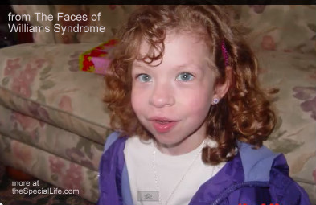

Williams Beuren syndrome (del 7q11)
developmental delay
mental disability
failure to thrive
heart defects (heart murmur, narrowing of main blood vessels)
flattened nasal bridge
widely spaced teeth
hypercalcemia
gastrointestinal problems
urinary difficulties
https://www.google.cz/search?q=williams+beuren+syndrome&source=lnms&tbm=isch&sa=X&ei=MimGUvDpC4GctQaJhYGwCg&ved=0CAcQ_AUoAQ&biw=1920&bih=989#facrc=_&imgdii=_&imgrc=MdTDkcoWBwg-WM%3A%3BTKKZzTKDfniYlM%3Bhttp%253A%252F%252Fwww.thespeciallife.com%252Fimages%252F
https://www.google.cz/search?q=williams+beuren+syndrome&source=lnms&tbm=isch&sa=X&ei=MimGUvDpC4GctQaJhYGwCg&ved=0CAcQ_AUoAQ&biw=1920&bih=989#facrc=_&imgdii=_&imgrc=HTjyFEuSnZo4JM%3A%3BkqK81uaGRtKPIM%3Bhttp%253A%252F%252Fgeneticsf.laba

Slide 50



Williams – Beurenův syndrome: case report
Birth: 2010
Phenotype: NDD, stigmatizatio
Cause: del 7q11.23 (1,4 Mb)

Slide 51


Slide 52

Výsledek vyšetření – profil array-CGH s mikrodelecí 7q11.23

