Slide 1

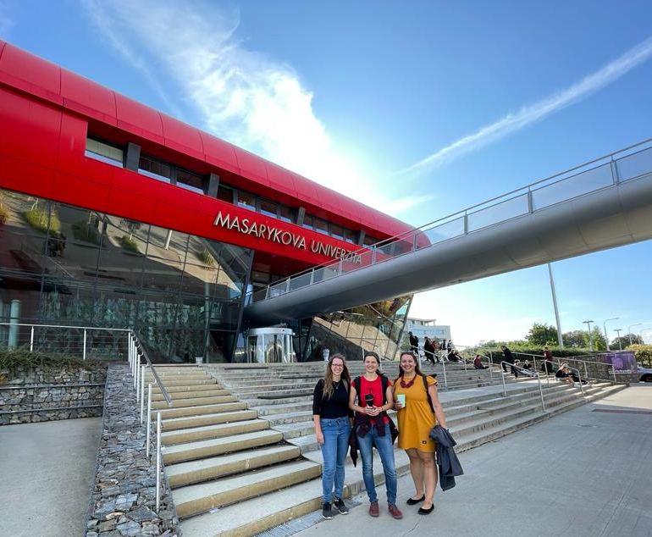
CYI representatives
Ivča
Verča
Barča

Slide 2


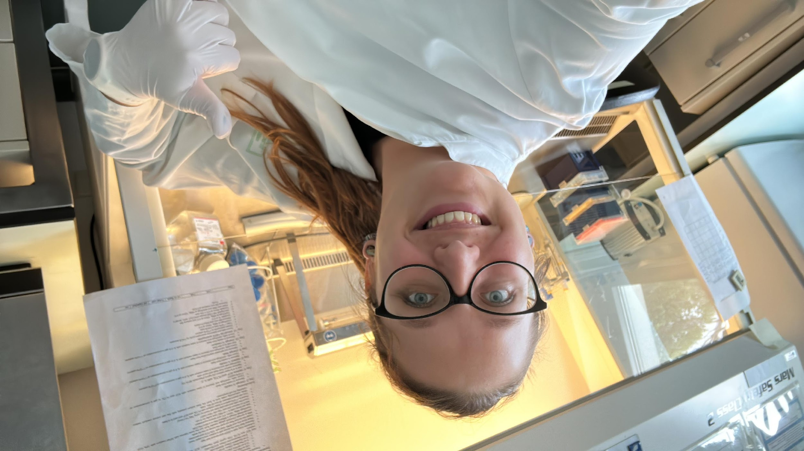
Barbora Šmídová
Parasitology (focused on host immunology)
Rocky road of parasite immunology

Slide 3
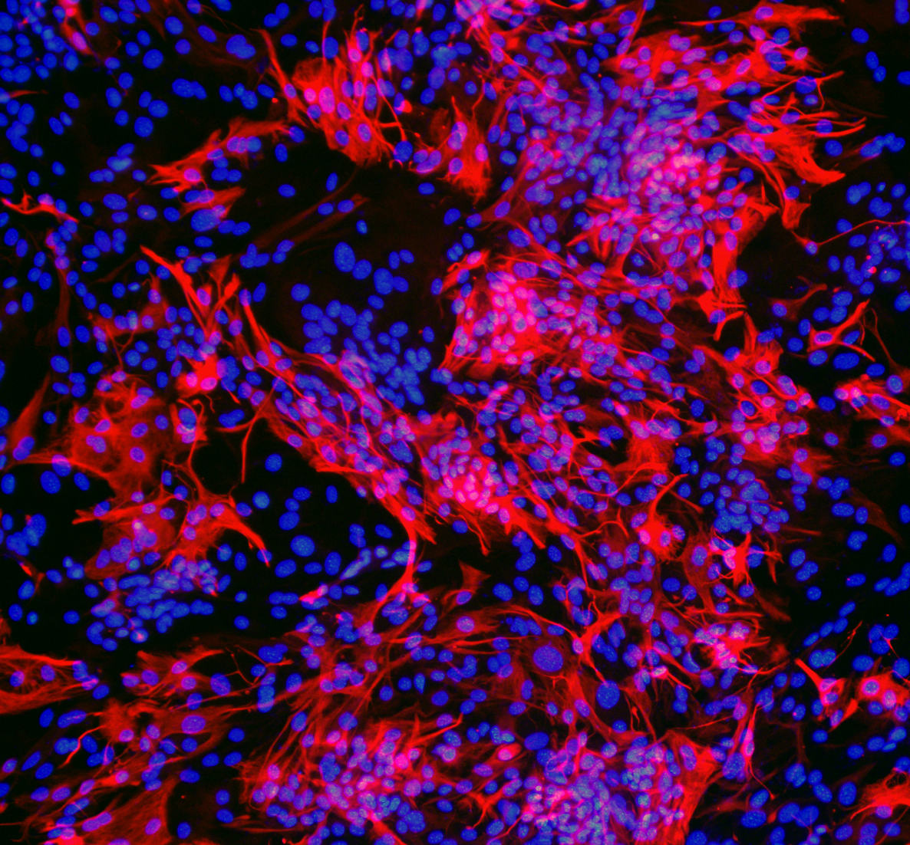
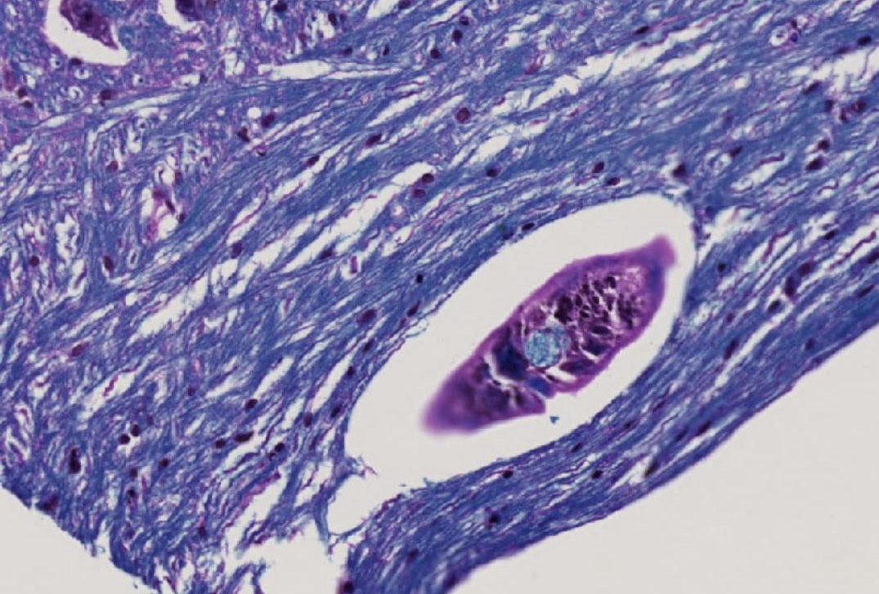

How I got where I am
Parasites are amazing!
Wait, they can influence immunity of the host?
Why does Trichobilharzia regenti survive in ducks but not in mice? Could nitric oxide play a role?
Not NO, but what about myeloid cells?
The parasite stimulates M2 response!
Could it alleviate multiple sclerosis symptoms?

Slide 4
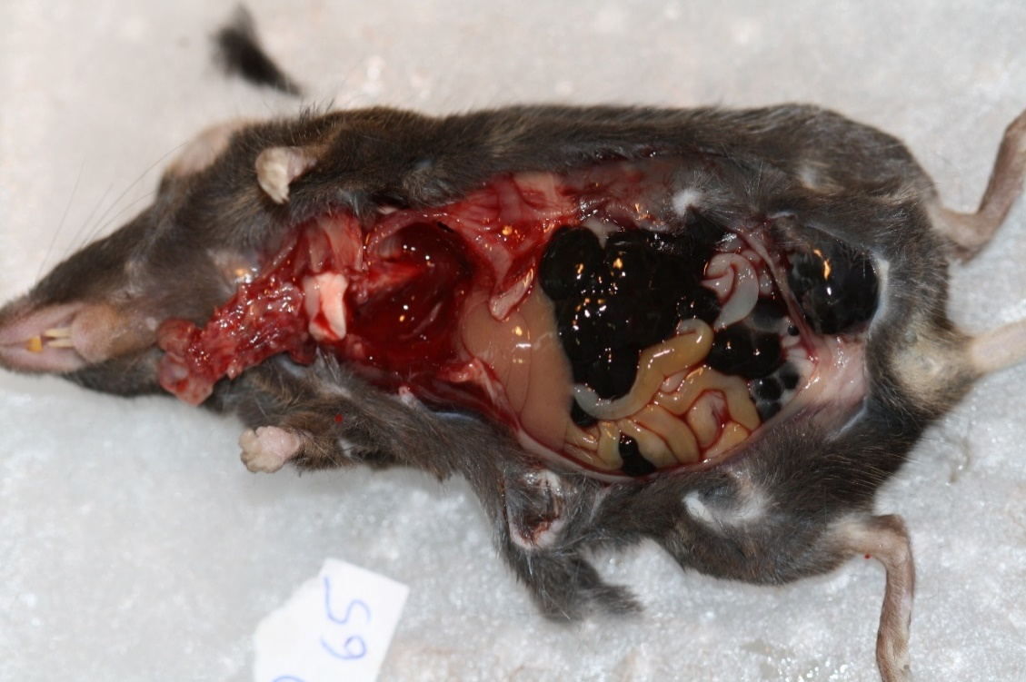
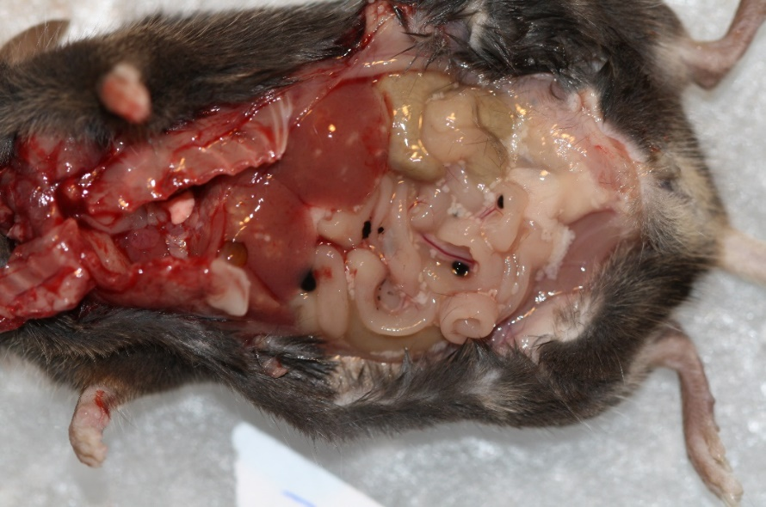
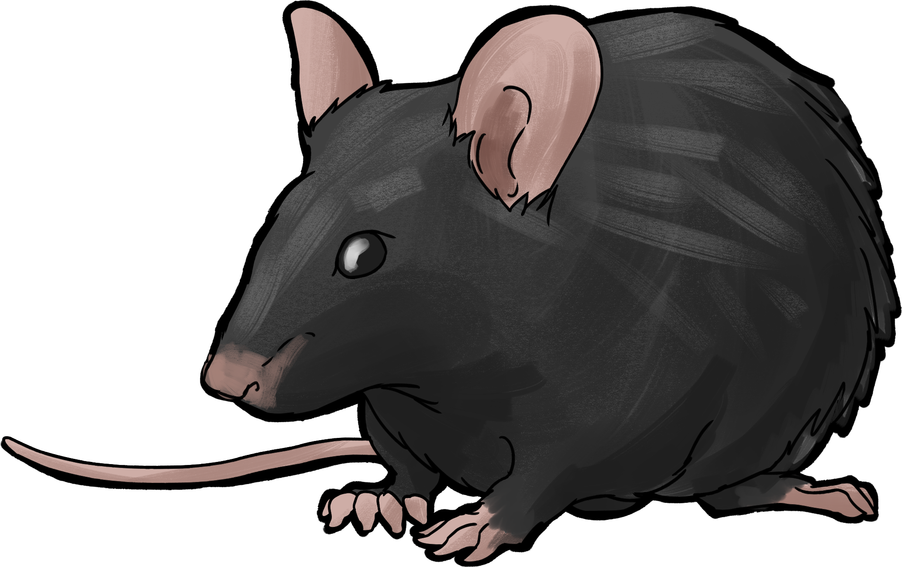

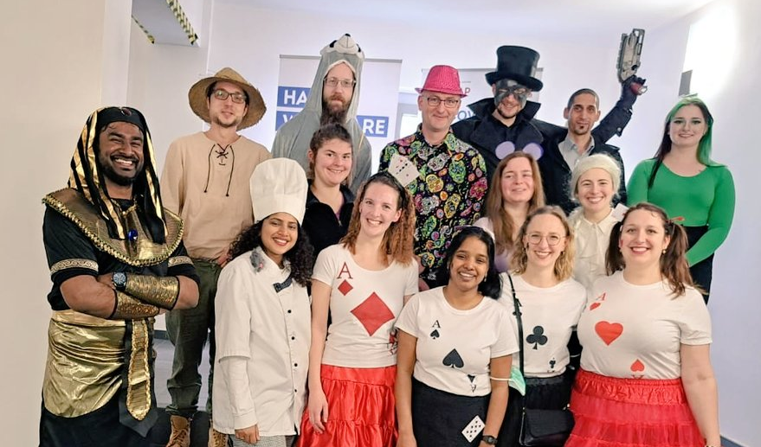
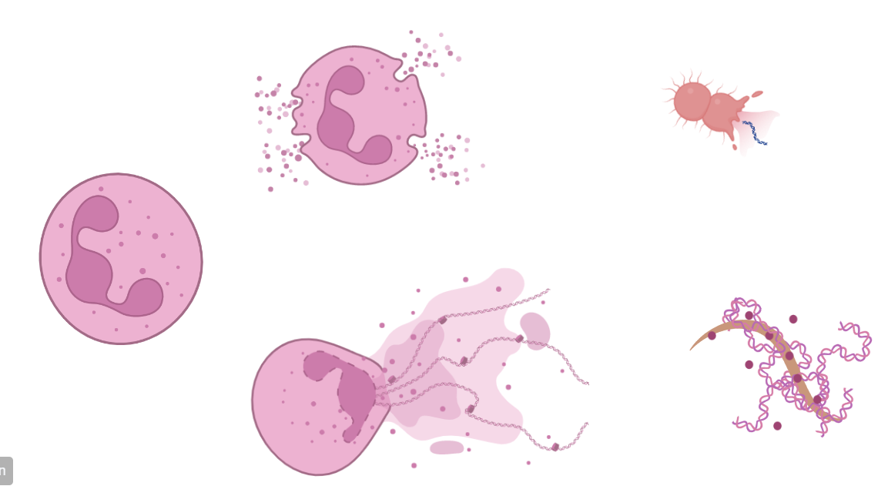
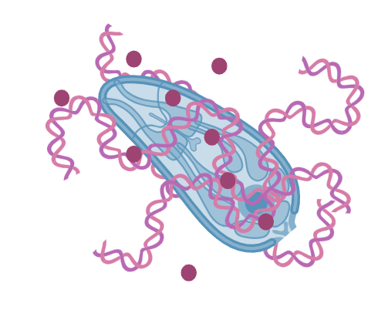
Side projects
Myeloid cells in tapeworm-cancer model
Eosinophil fun!

Slide 5


Non-lab side projects
Organizing events for freshmen
Pedagogy minimum
Teaching Microscopy techniques
CYI
Zeptej se vědce! (Ask a scientist)

Slide 6
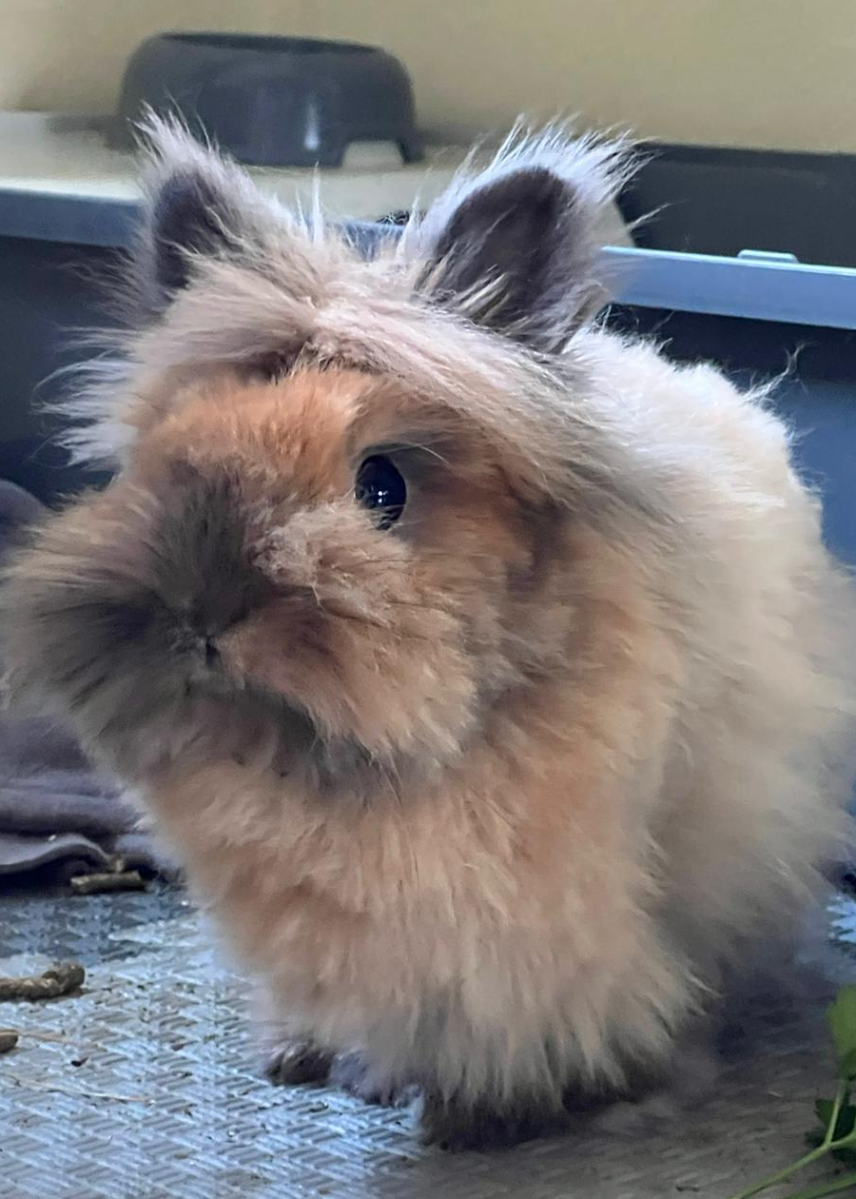
Take home message
Science is awesome but if you‘re not careful, it can lead to burn-out
Side projects can increase happiness
Conferences are great for networking
Internship abroad can really open your eyes
Academy is not the only way

Slide 7
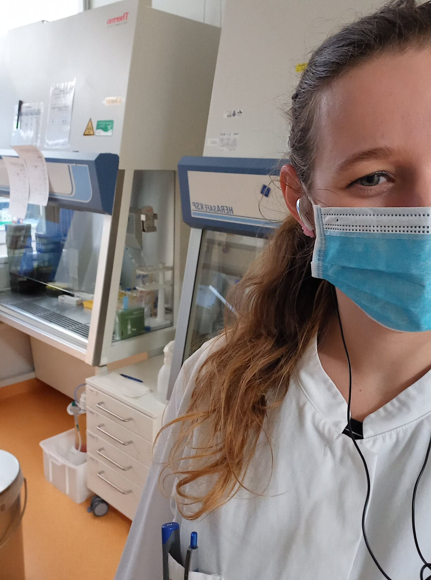
Two internships in Germany during my master´s studies
Unveiling the challenges and lessons I´ve learned
Iva Benešová

Slide 8
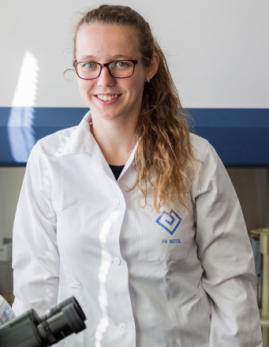
Basic info
Bachelor: Biology at the Faculty of Science, Charles University
        Mesenchymal stem cells & their effects on apoptosis of leukocytes (prof. Vladimír Holáň)

Slide 9
Basic info
Bachelor: Biology at the Faculty of Science, Charles University
        Mesenchymal stem cells & their effects on apoptosis of leukocytes (prof. Vladimír Holáň)
Master: Immunology at the Faculty of Science, Charles University
        Microbiota as a modulator of carcinogenesis (MUDr. Miloslav Kverka)
      2 internships in Germany – cancer immunology (Leibnitz Institute in Regensburg, prof. Philipp Beckove and TU Dresden, prof. Marc Schmitz)

Slide 10
Basic info
Bachelor: Biology at the Faculty of Science, Charles University
        Mesenchymal stem cells & their effects on apoptosis of leukocytes (prof. Vladimír Holáň)
Master: Immunology at the Faculty of Science, Charles University
        Microbiota as a modulator of carcinogenesis (MUDr. Miloslav Kverka)
      2 internships in Germany – cancer immunology (Leibnitz Institute in Regensburg, prof. Philipp Beckove and TU Dresden, prof. Marc Schmitz)
2nd year Phd student at the Second Faculty of Medicine and University hospital Motol
        Cancer immunology, especially soft tissue sarcomas (doc. Zuzana Ozaniak Střížová)
CYI core member

Slide 11
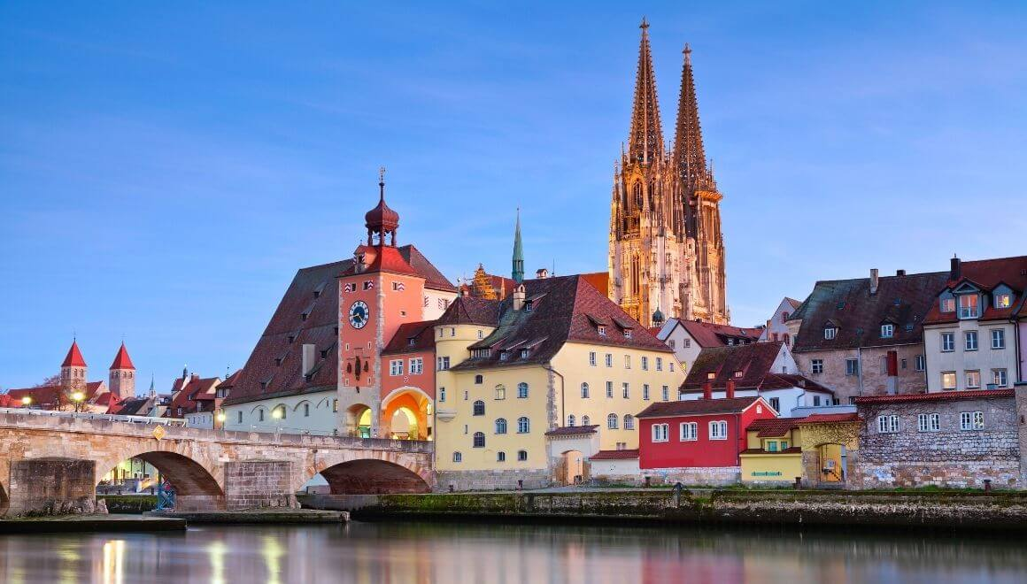
First stay abroad – when everything goes wrong…
2nd year of my master´s

Slide 12
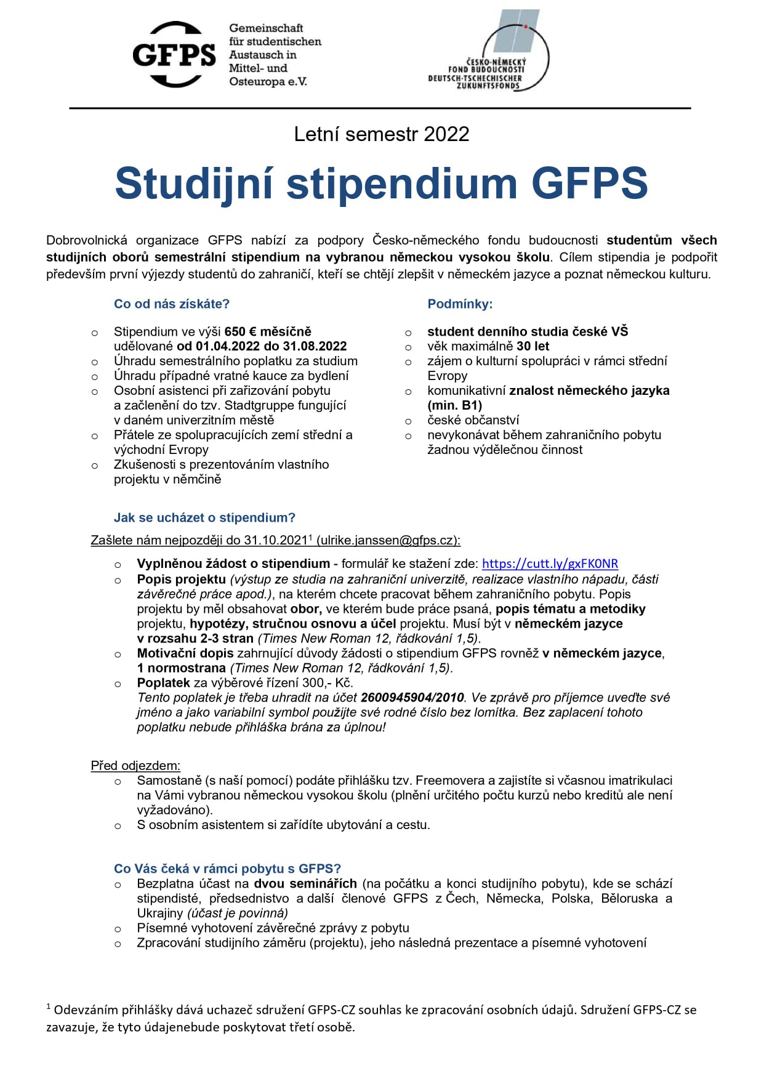
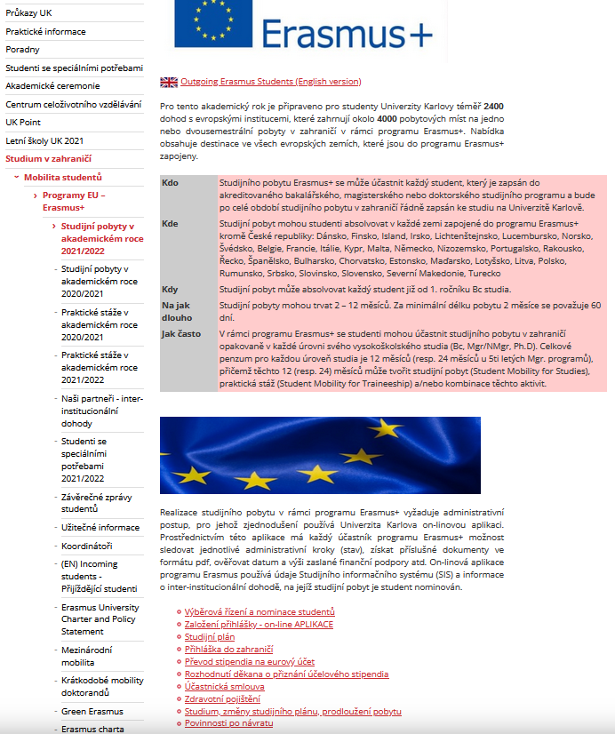
I need money!

Slide 13
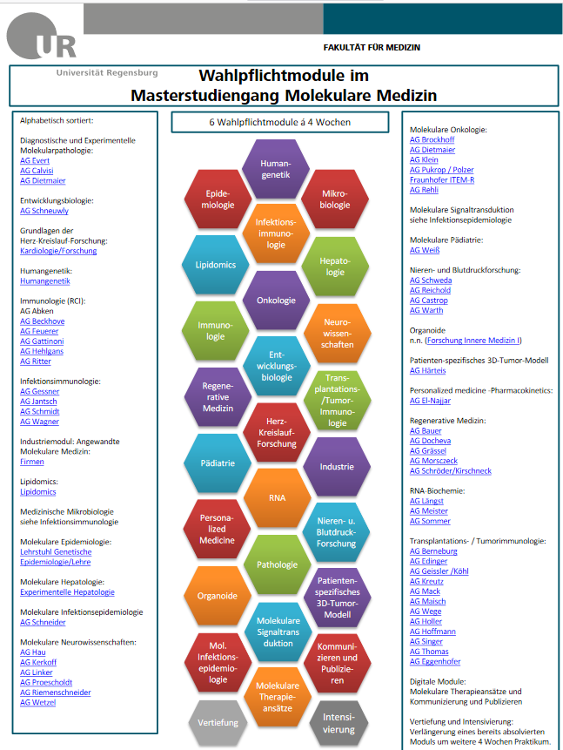
Application: GFPS
Initial target: Integrated Immunology (Erlangen)
At the end: Molecular medicine (Regensburg)
Study coordinator + tutor from GFPS
1 – 2 months practical courses (possibility to extend up to 3 months)
  Immunological courses shouldn´t be problem :P

Slide 14
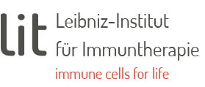
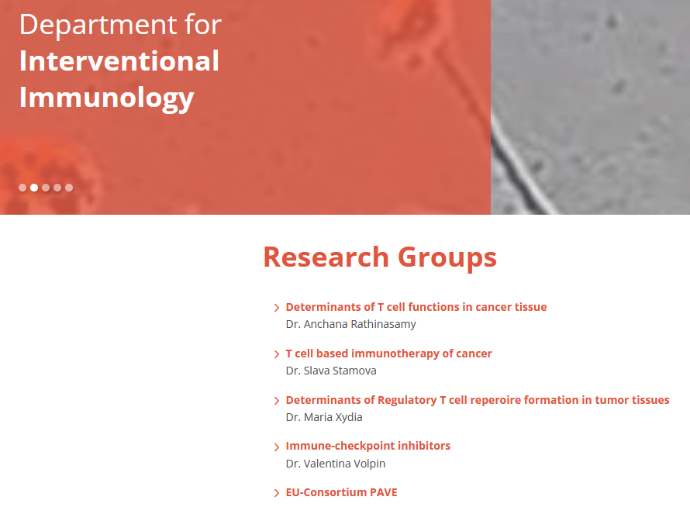
AG Beckhove
CV + motivation letter + letter of recommendation
Online interview
Vaccination! (anti-HBsAb ≥ 100 IU/L) + covid quarantine for 5 days
8-12 working hours per day
Work under a supervision of PhD student (hierarchy), well organized
They strictly followed the rules
My project: human samples (mostly blood samples) – isolation, stimulation, flow cytometry

Slide 15
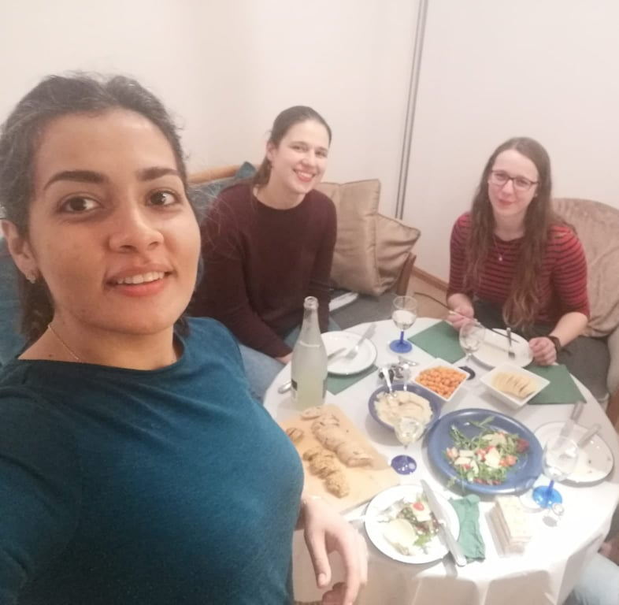
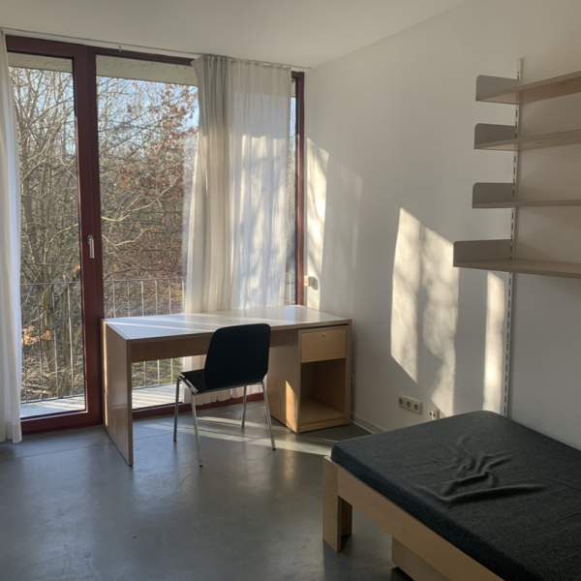
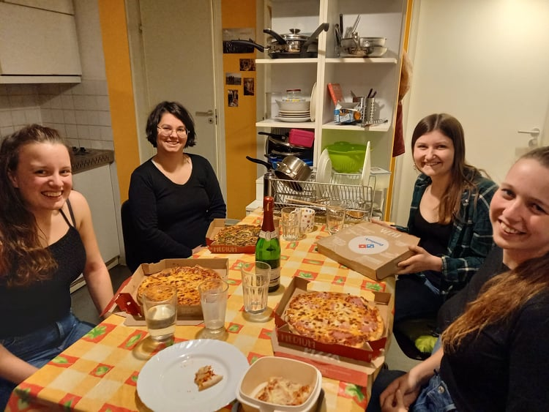
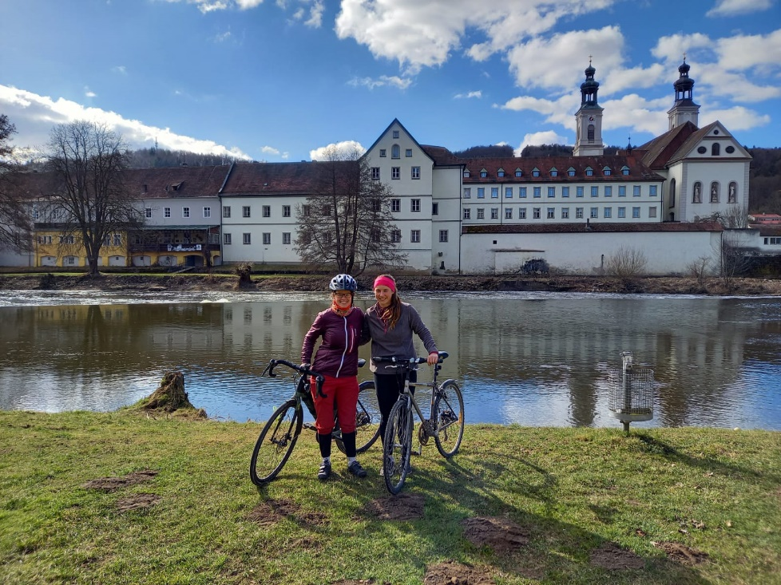
Accommodation & free time

Slide 16

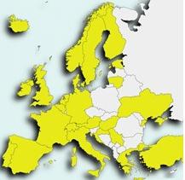
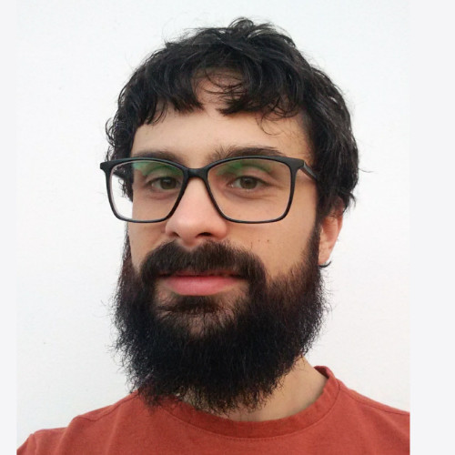
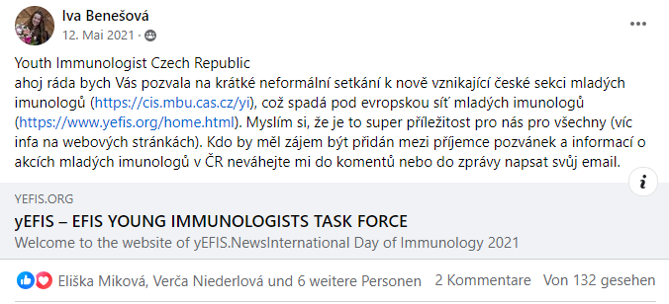
Very strong restrictions in Bavaria…
So I was a little bored
Marco De Zuani
International Clinical Research Center, St. Anne's University Hospital, Brno
Currently core members ☺

Slide 17
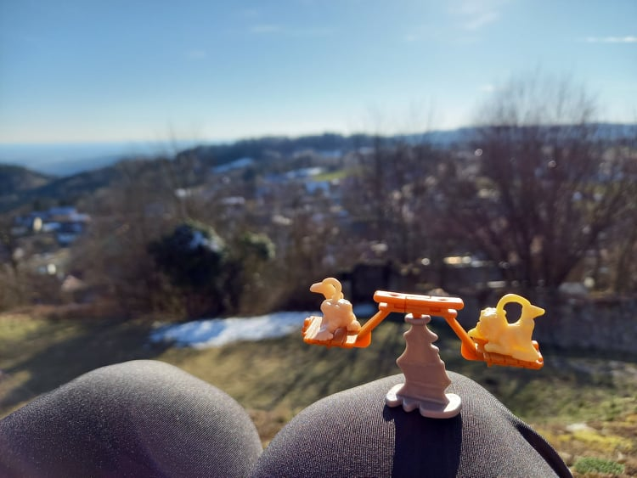
What I have gained from it?
Slowing down
Time to think
  What is really important for my satisfaction
Stress resistance (COVID, lot of work)
→ personal strength
CYI family
But what to do now?

Slide 18
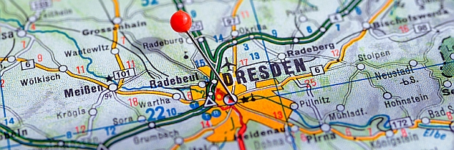
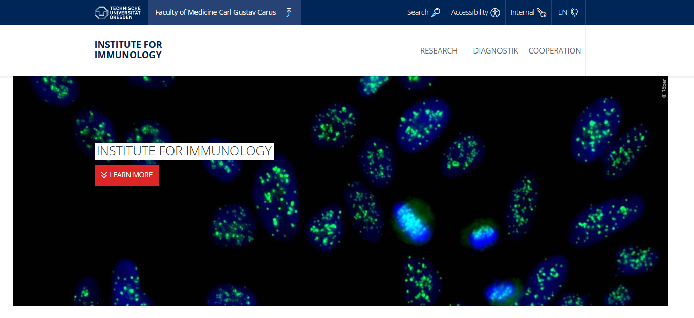
One year extension of my master studies
Arrangement of everything in Germany was much easier
Arrangement of scholarship (Erasmus+) was much more complicated :D
CV + motivation letter
Great advantage of previous internship in Germany (especially in a well-known lab)
Initially for 3 months (2 months extension with contract)
Personal goals: state-of-the-art technology + arrange possible cooperation for my PhD studies

Slide 19
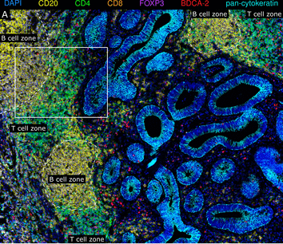
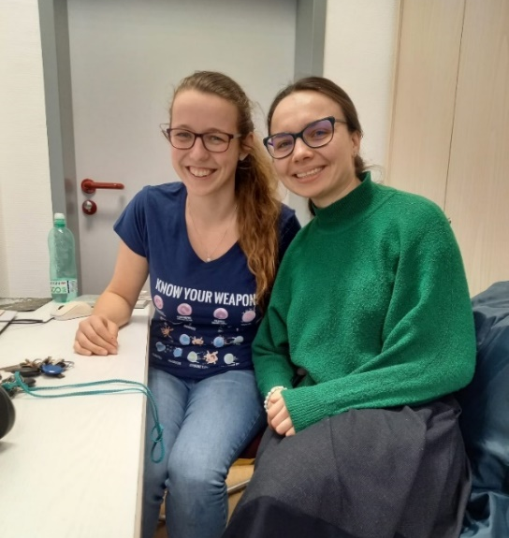
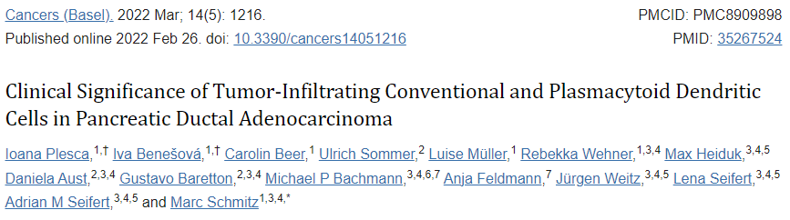
AG Schmitz
Work under a supervision of a PhD student
Great team members
Caring boss
Multiplex immunohistochemistry

Slide 20
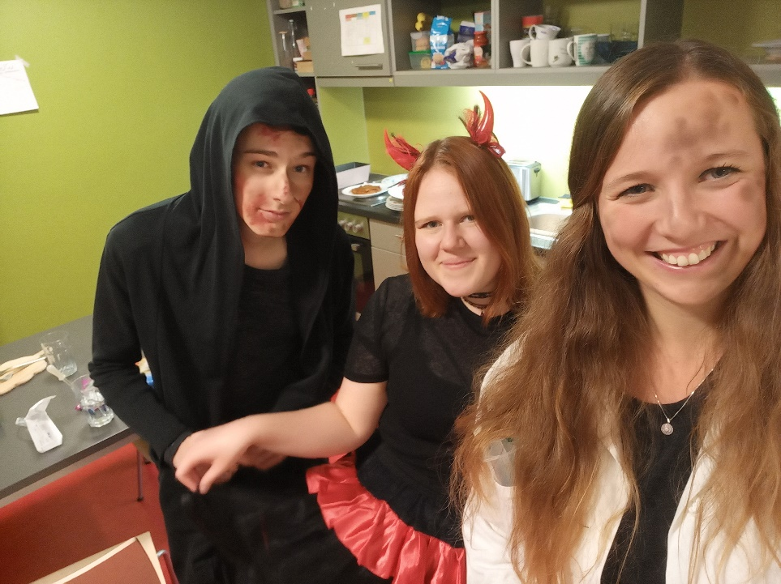
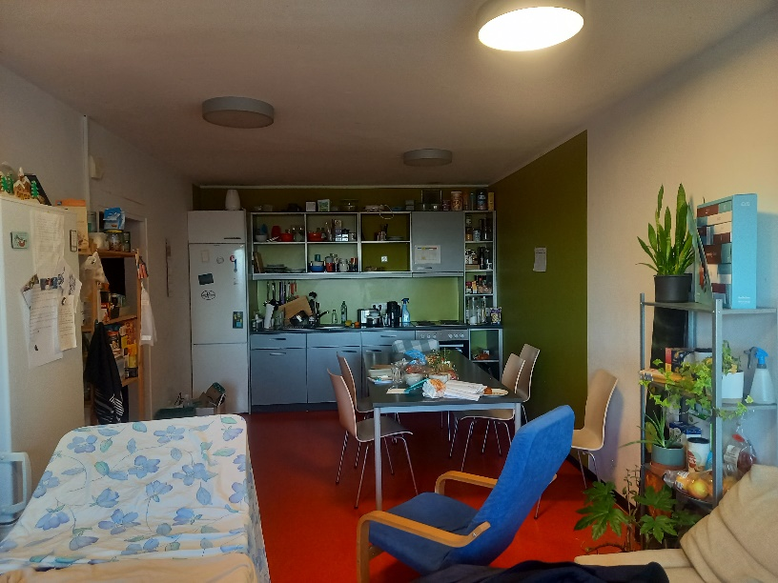
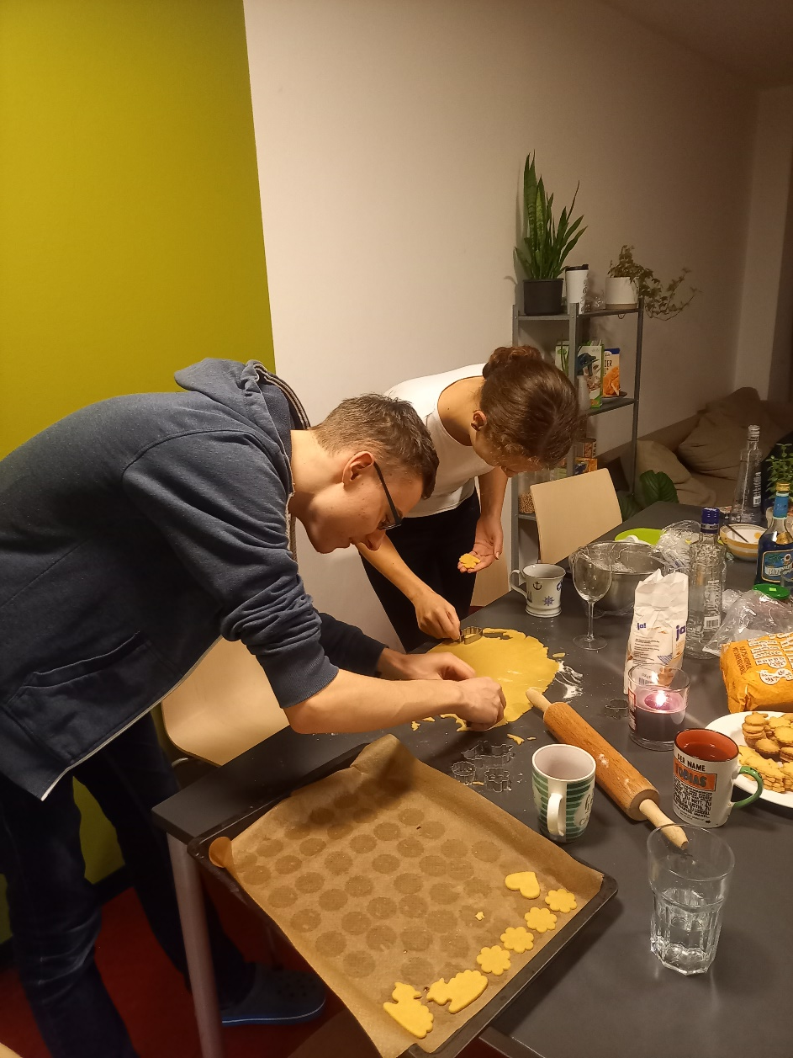
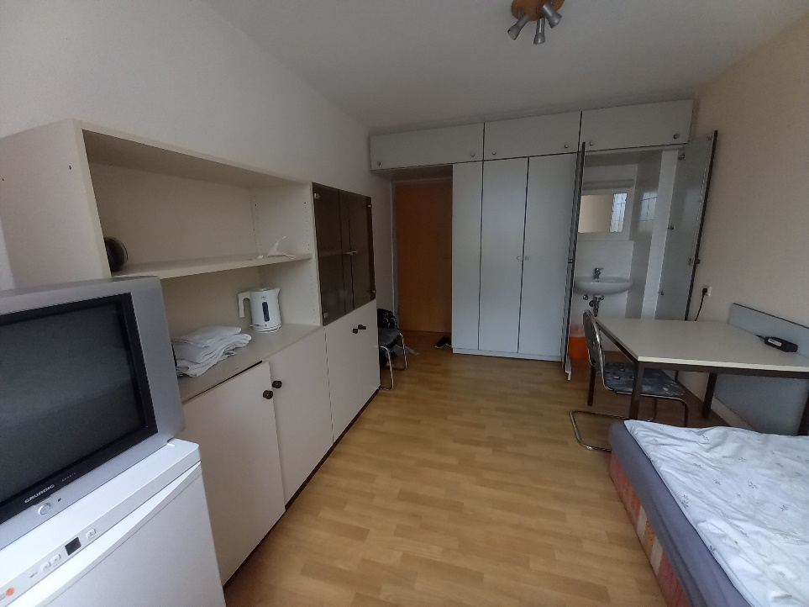
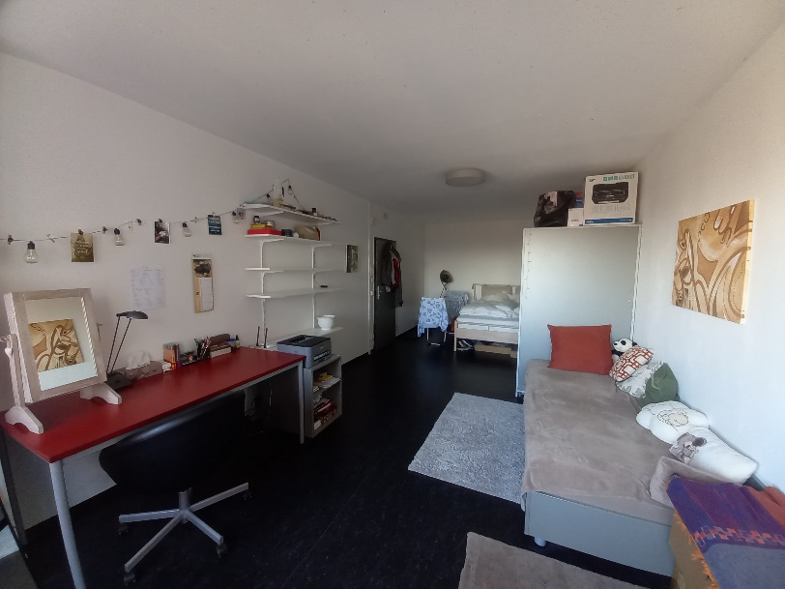
Accommodation & free time

Slide 21
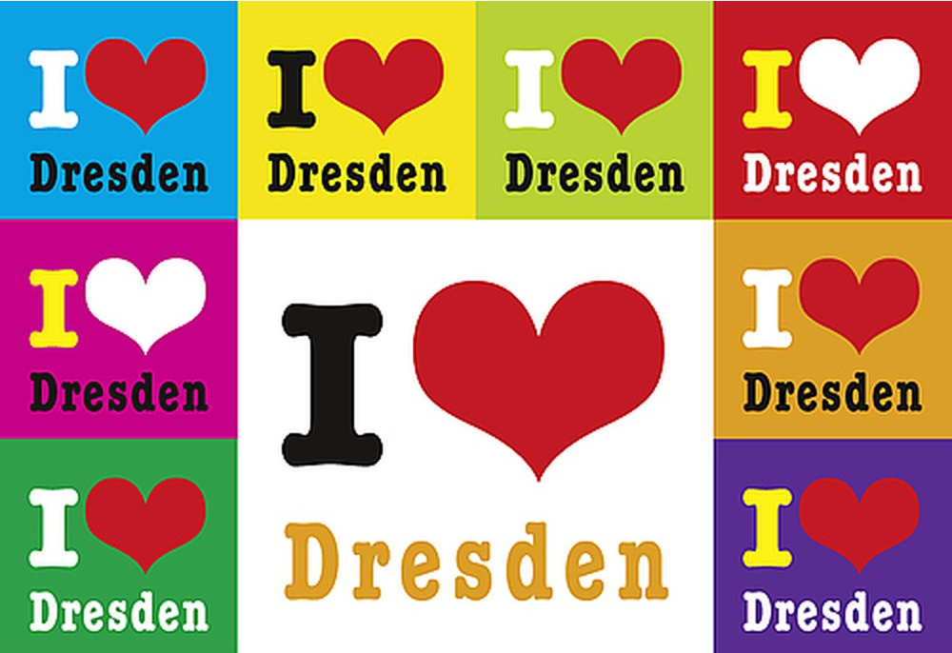
Benefits?
Scientific experience
Inspiration
Learning of the state-of-the-art technology
Great people but making sure I want to do my PhD in Czechia
So what next?

Slide 22
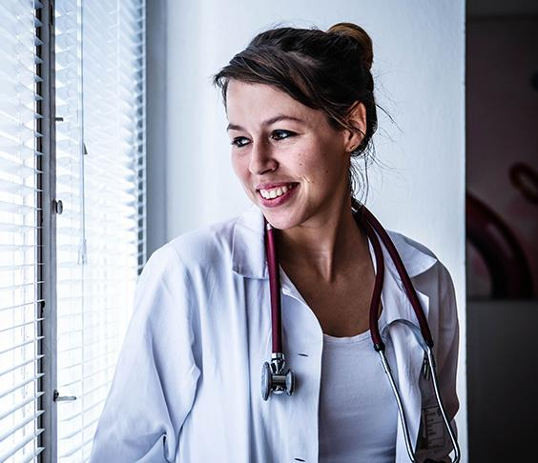
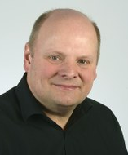

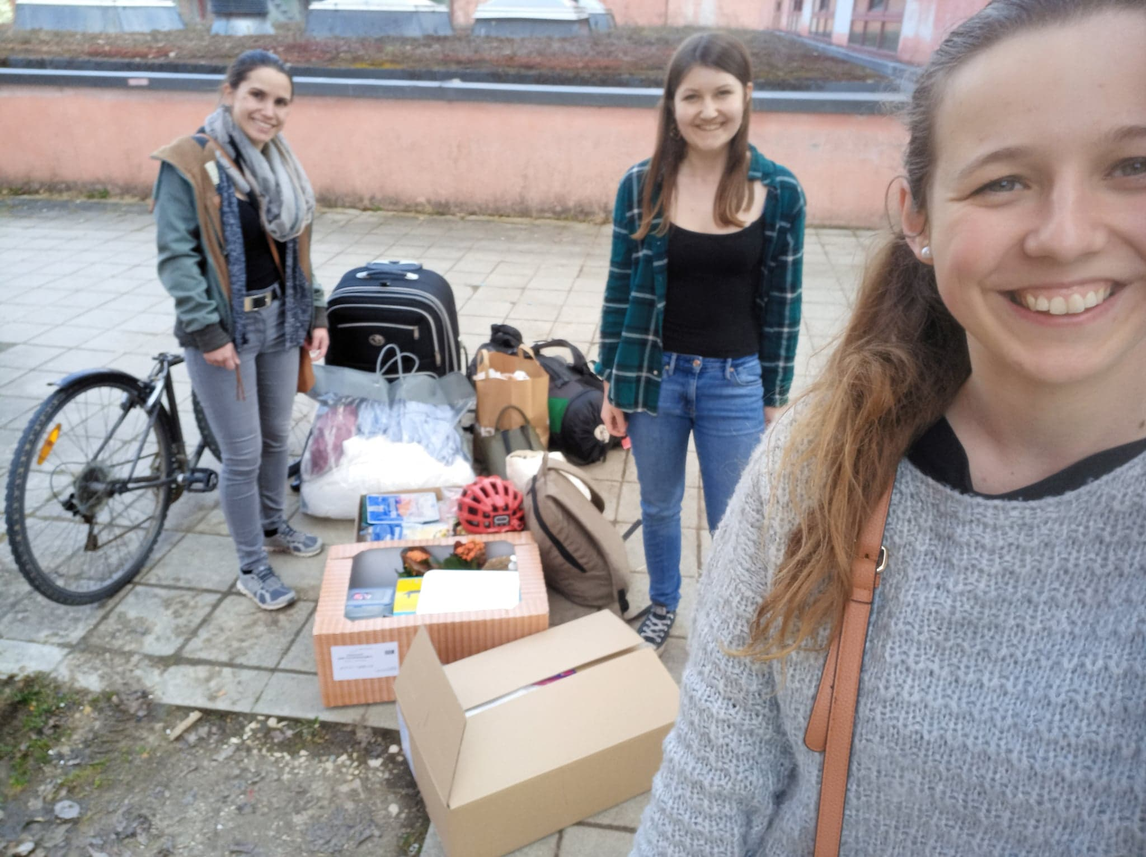
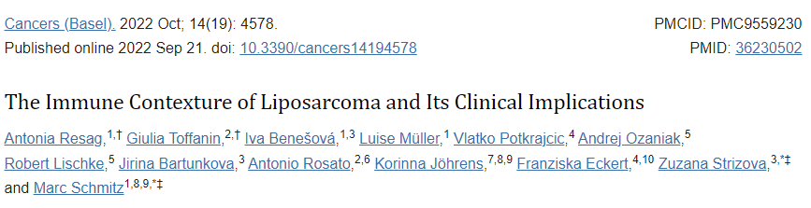
GAUK

Slide 23
Stay resillient & what doesn´t kill you makes you stronger

Slide 24
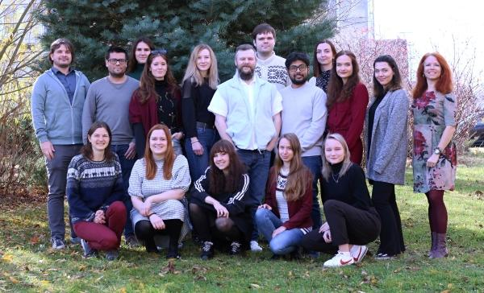


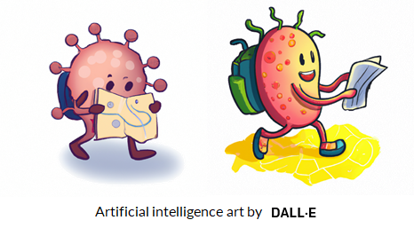
Find your way to science!
Veronika Niederlová
PhD Student - Immunology
Institute of Molecular Genetics
Czech Academy of Sciences

Slide 25
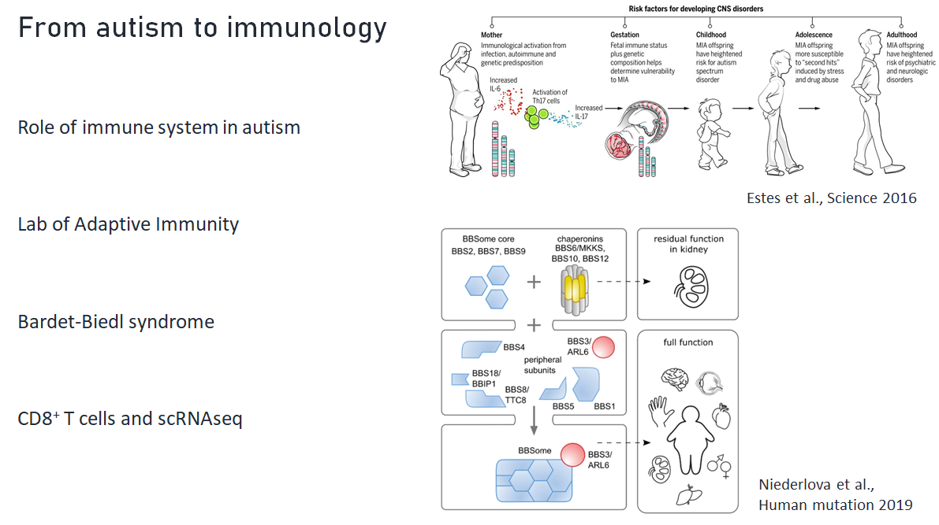

Slide 26
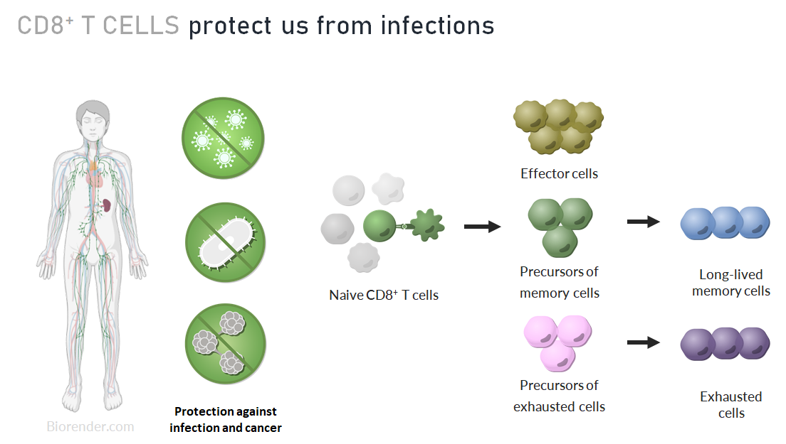

Slide 27
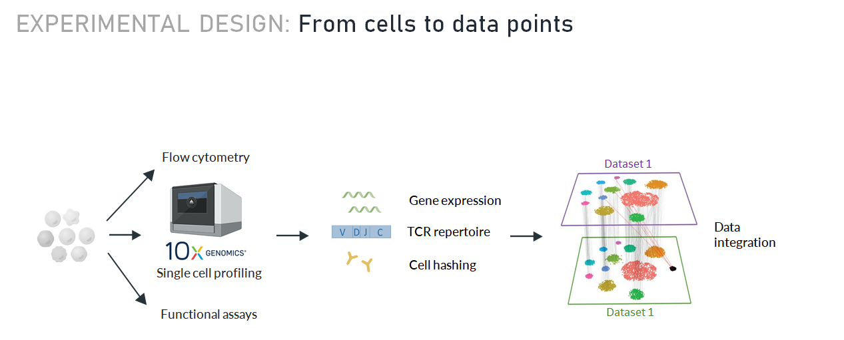

Slide 28
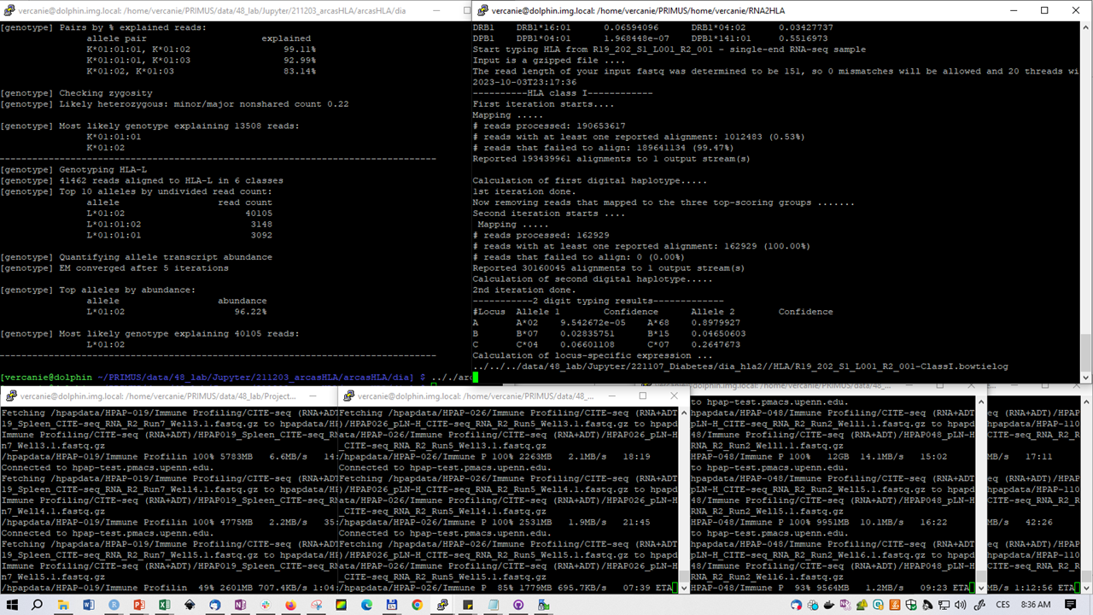

Slide 29
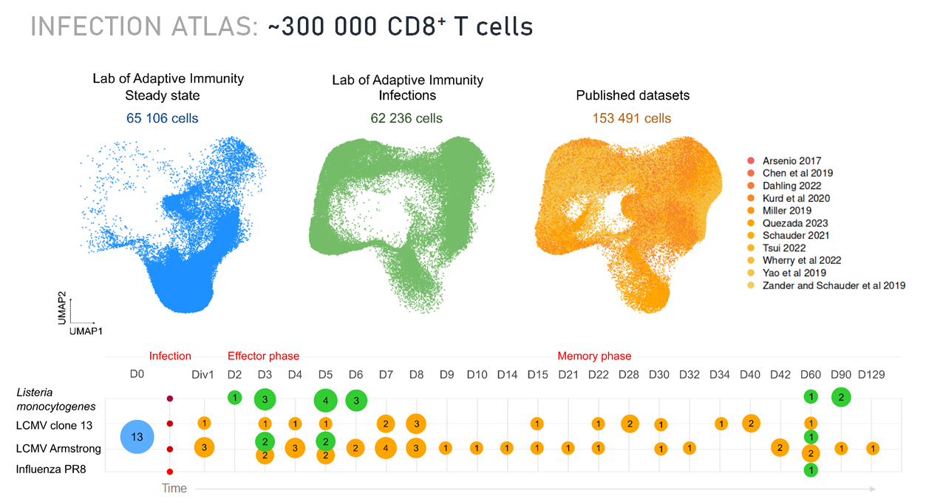

Slide 30


Slide 31
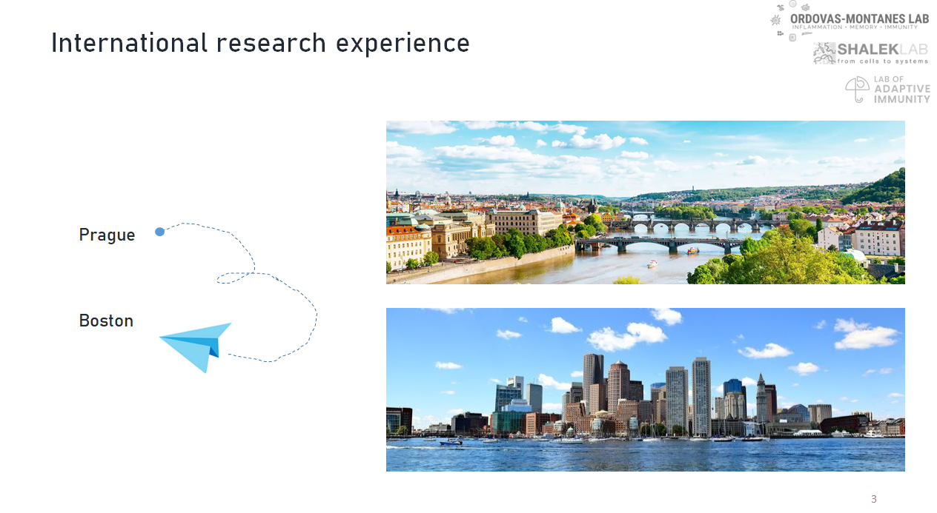

Slide 32


Slide 33







Slide 34


4.10.2023
Brno
Iva Benešová; Veronika Niederlová; Barbora Šmídová

Slide 35


Slide 36


Czech Young Immunologists (CYI)
Early career researchers
- up to 10 years of research experience
Established in June 2021
- part of Czech Immunological Society (CIS)
Part of yEFIS & EFIS

Slide 37

Let’s expand and connect!

Slide 38


CYI members
CYI mailing list
105
Registered CYI members
55
Registered CIS
members
35
Core
members
10
3 new core members from Brno

Slide 39










CYI events
Shared travel to yEFIS symposium
In-person meetings
CYI Mixer (2022, 2023)
Outdoor weekend (2023)
T cell workshop (2021,2022)
CYI Mikulášská (2022)
20 young immunologists from CZ
Next yEFIS symposium 2024, Dublin
Online meetings
Journal clubs
Working in a lab abroad
Work life balance
Scientific failures etc.

Slide 40


CYI Mixer
Annual get-together on the occasion of International day of Immunology
Lectures, panel discussion, networking

Slide 41



Outdoor weekend

Slide 42

T cell workshop
Annual workshop with lectures, hands-on sessions and networking

Slide 43

Mikulášská
Informal meeting before Christmas
Games, mulled wine, gifts, Christmas cookies

Slide 44



Want to know more about CYI? Read our paper in EJI

Slide 46

yEFIS - Goals
Represent all early career researchers (ECR) working on Immunology in Europe
ECR = less than 10 years of working experience
Promote national YI groups
Improve collaboration between YI
Bring visibility to YI:
International congresses
Promote their research
Connect YI and experienced scientists to shape the next generation of immunologists in Europe

Slide 47


Young national societies

Slide 48

> 700 members
1833 Twitter followers

Slide 49




Working Groups
Interest Groups
European Journal of Immunology
Infectious diseases
Equity &
Diversity
Autoimmunity
Career dev. & Education
Cancer Immunology
Rep. of EFIS affiliated societies
Communication
Immunometabolism
+14 young national societies
Mucosal Immunology
yEFIS symposium
Mentoring
New idea ?
Mental health
New idea ?

Slide 50

yEFIS - Network

Slide 51

Our future activities
Weinar

Slide 52




@y_efis
Want to be involved ?
yEFIS
yefis@efis.org
Become a yEFIS member and subscribe to our newsletter < www.yefis.org >
Are you interested in representing and organising young immunologists in your country?
Join the YI Group of your country –> Don’t have one yet? We will help you to create one!
Are you interested in working on specific projects at a European level?
Join an active Working Group, or suggest your own idea and we’ll support you to set it up

Slide 54

Your next steps in CYI
Follow us on social networks
Subscribe to our newsletter
Become a member of CIS and yEFIS
Join us in our future events:
12.10. - online seminar Jan Věcek
25.10. - online discussion after Global Immunotalks (Jenny Mjosberg)
30.11. - online seminar Srdjan Grusanovic
7.12. - St. Nicolas Christmas party

Slide 56


How can you participate?
https://tinyurl.com/becomecyi

