Slide 1
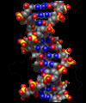
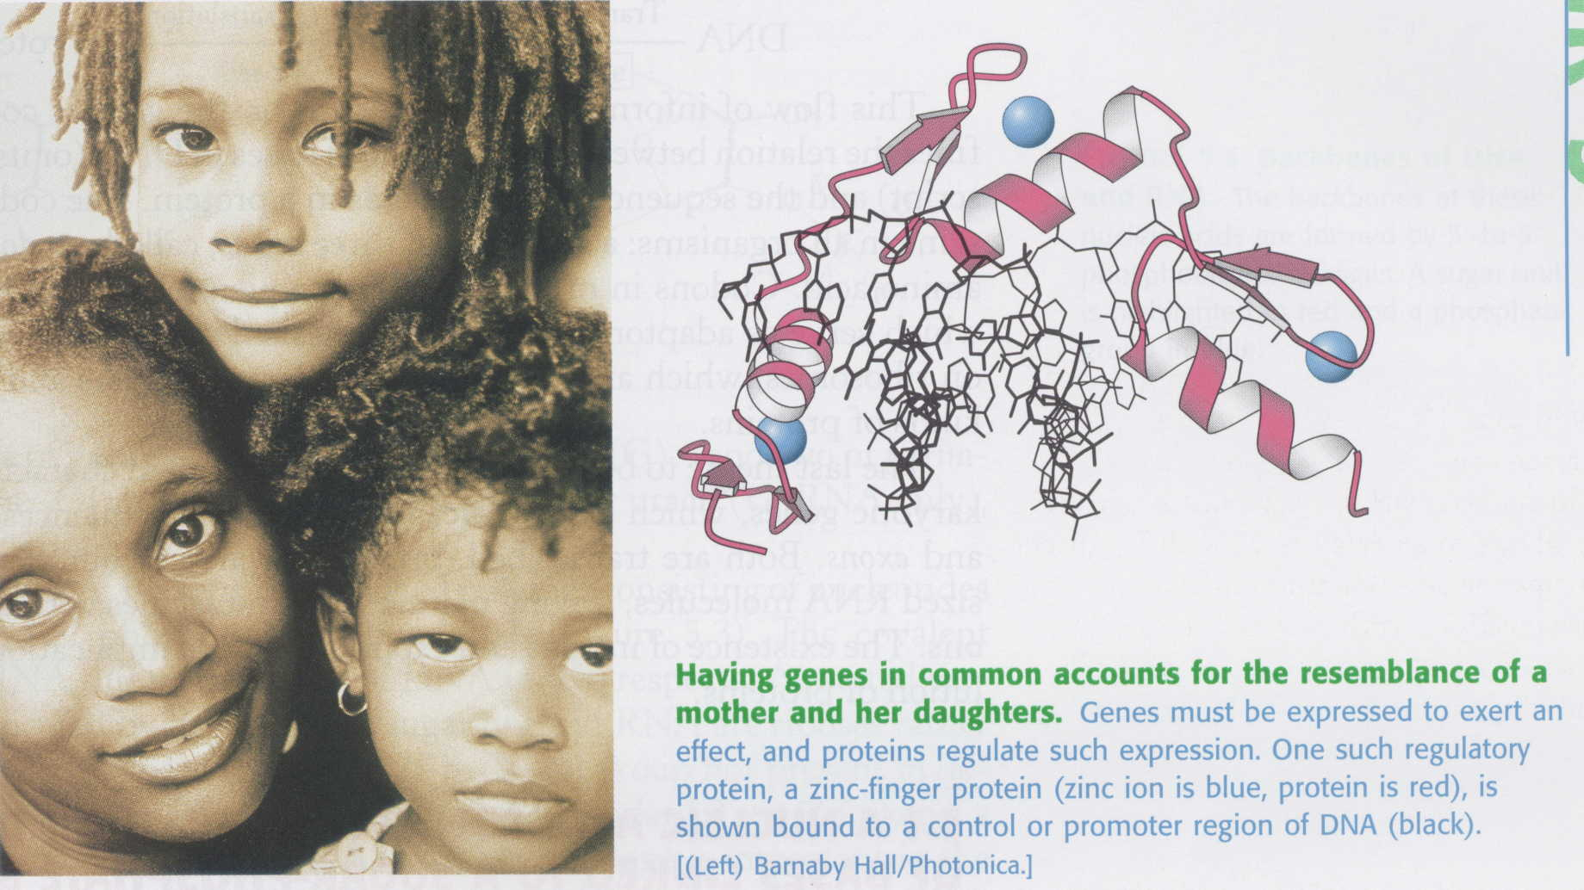
Nucleic acids

Slide 2
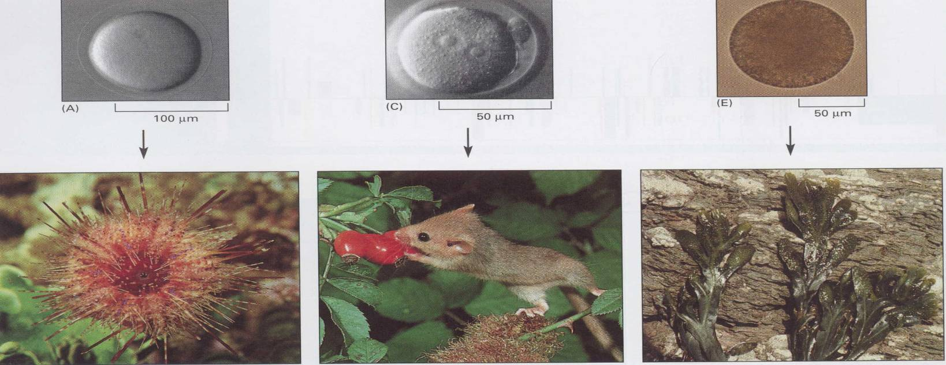
DNA determines the nature of the future organism
Sea urchin egg
Mouse egg
Seaweed Fucus egg
Sea urchin
Mouse
Seaweed Fucus
The hereditary information in the egg cell determines the nature of the whole multicellular organism (mouse egg---mouse)
Each species is different, and each reproduces itself faithfully, yielding progeny that belong to the same species; the parent organism hands down information specifying, in extraordinary detail, the characteristics that the offspring shall have
Heredity is a central part of definition of life: it distinguishes life from other processes (the growth of crystals, the burning of a candle, the formation of waves on water), in which orderly structures are generated but without the same link between the peculiarities of parents and peculiarities of offspring
Notes:
Sea urchin egg
Mouse egg
Seaweed Fucus egg

Slide 3
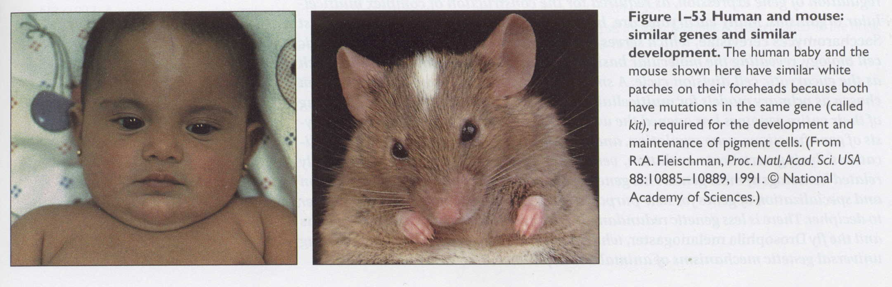
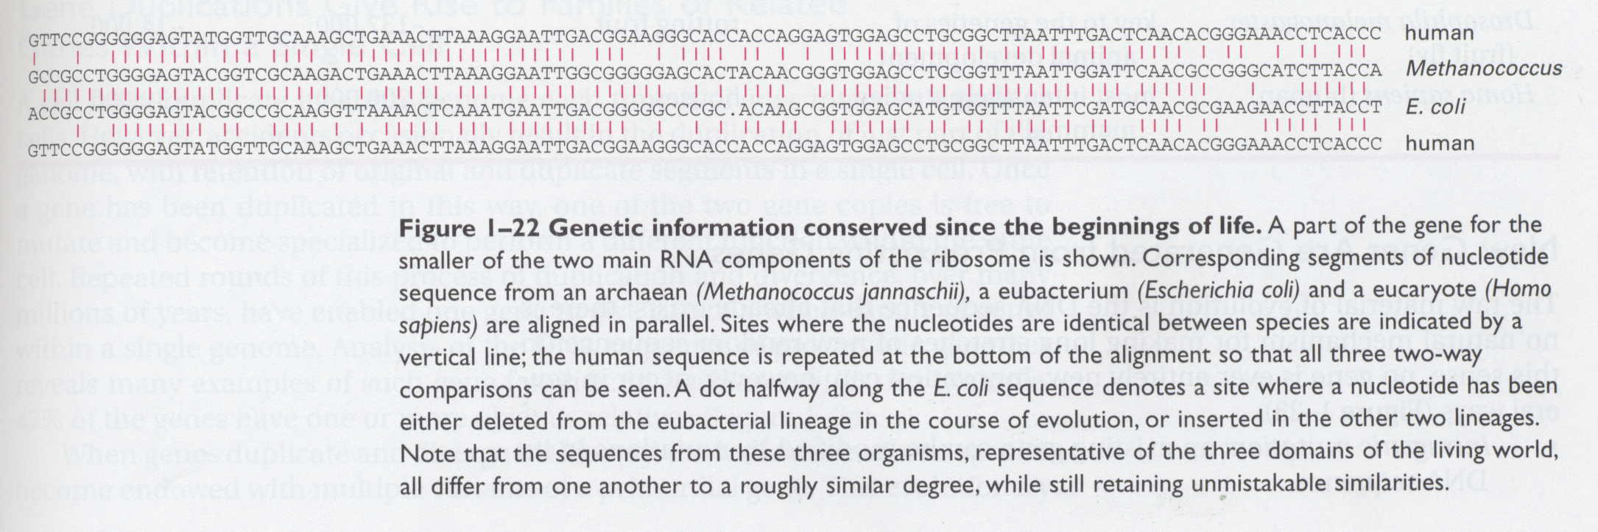

Slide 4
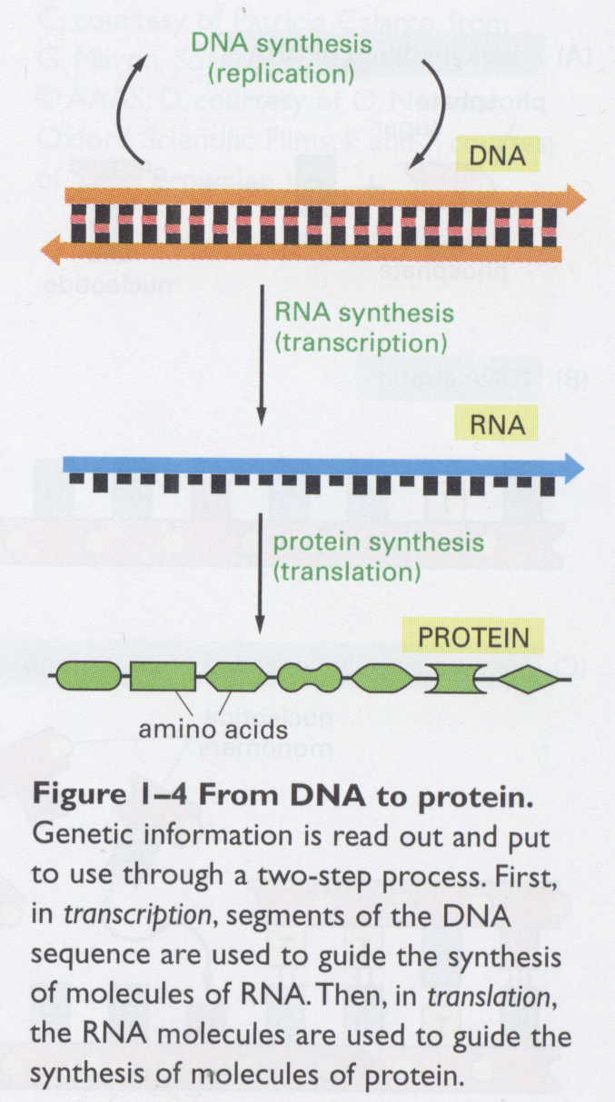
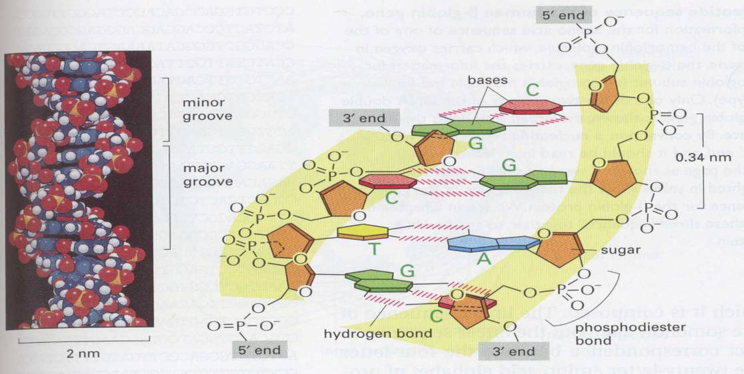
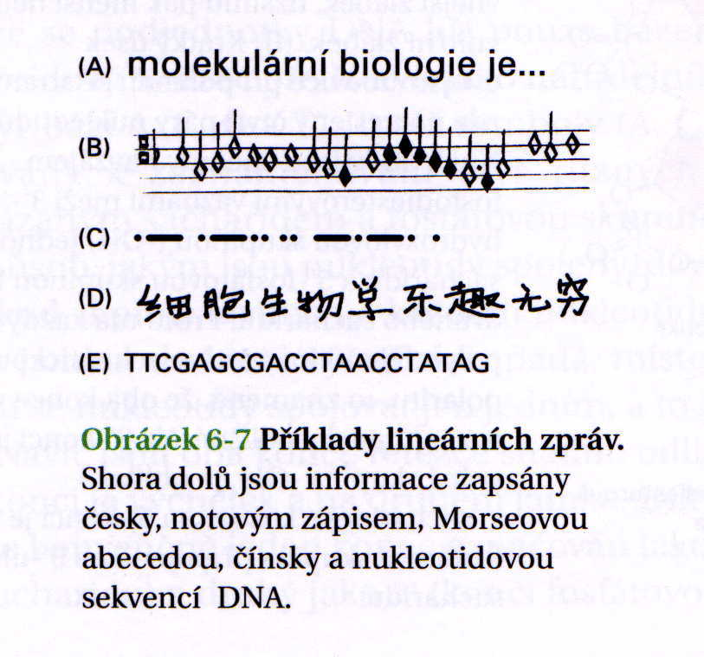
All cells store their hereditary information in the same linear chemical code (DNA)
All cells replicate their hereditary information by templated polymerization
All cells trnscribe portions of their hereditary information into the same intermediary form
All cells use proteins as catalysts
All cells translate RNA into protein in the same way
In all cells: one gene = one protein

Slide 5
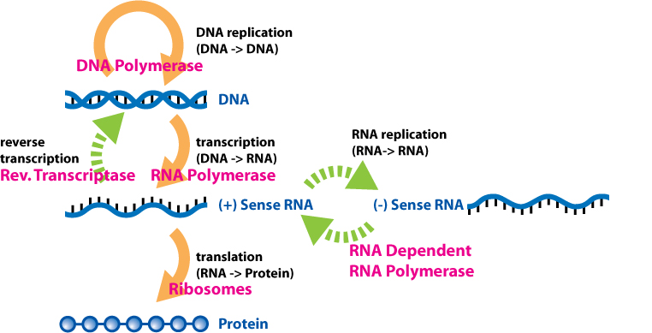
Central dogma of molecular biology
https://es.m.wikipedia.org/wiki/Archivo:Extended_Central_Dogma_with_Enzymes.jpg

Slide 6
Basic principles of molecular biology
The information encoded within DNA, which directs the functioning of living cells and is transmitted to offspring, consists of a specific sequence of nitrogenous bases.
The physiological and genetic function of DNA requires the synthesis of relatively error-free copies. DNA synthesis involves the complementary pairing of nucleotide bases.
The mechanism by which genetic information is utilized to direct cellular processes involves the synthesis of another type of nucleic acid called ribonucleic acid (RNA).

Slide 7
Basic principles of molecular biology
RNA synthesis occurs through the complementary pairing of ribonucleotide bases with the bases in a DNA molecule.
Several types of RNA are responsible for the synthesis of the enzymes, structural proteins, and other polypeptides, that are required for organismal function.
Central dogma of molecular biology“ describes the flow of genetic information from DNA through RNA and eventually to proteins.
DNA synthesis = replication; DNA-dependent RNA synthesis = transcription, protein synthesis = translation

Slide 8
Proof of DNA as a carrier of genetic information
Indirect evidence:
DNA is localized on chromosomes, RNA and proteins are in cytoplasm
The amount of DNA in somatic cells is in correlation with number of chromosomes, sex cells carry half of the DNA amount
DNA is more stable than RNA or proteins
Direct evidence:
Transformation in Streptococcus pneumoniae – change of v virulence
Analysis of Enterobacteria phage T2 – into the bacterial cell comes only DNA, not proteins
RNA viruses: the carrier of genetic information is RNA (coronaviruses, HIV)

Slide 9
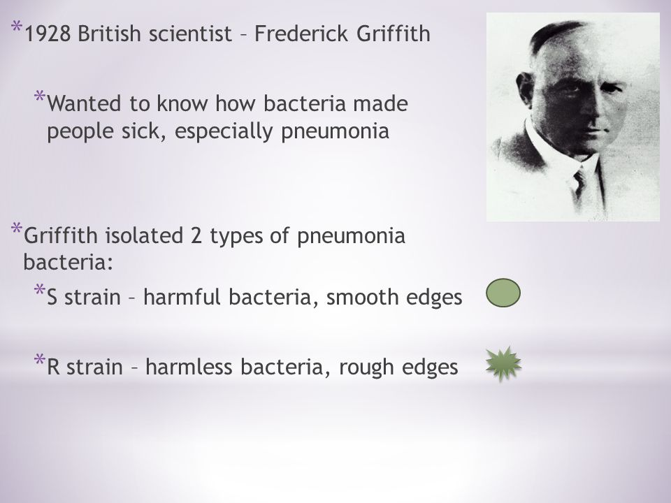

Slide 10
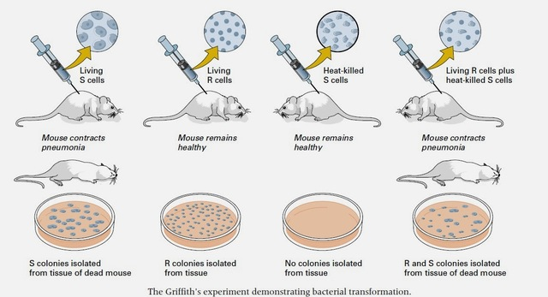
Transformation in Streptococcus pneumoniae (Griffith 1928) – „transforming factor“
https://byjus.com/biology/griffith-experiment-genetic-material/

Slide 11
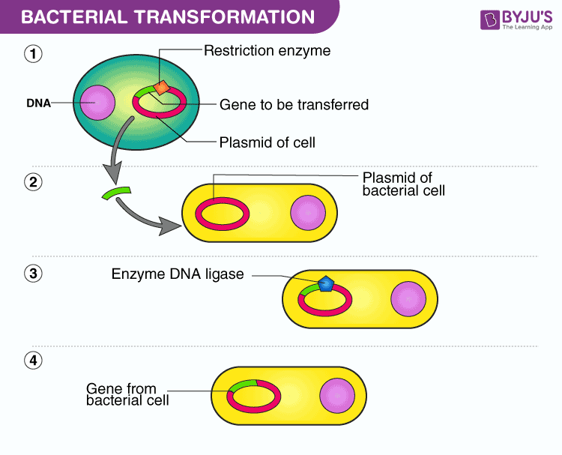

Slide 12
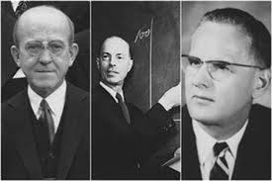
What substance is the transforming factor?
(O. Avery, C. Mac Leod, M. McCarty 1944)

Slide 13
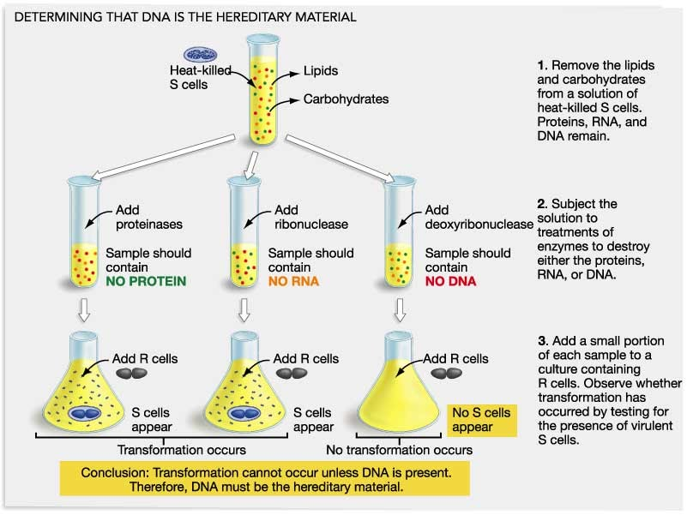

Slide 14
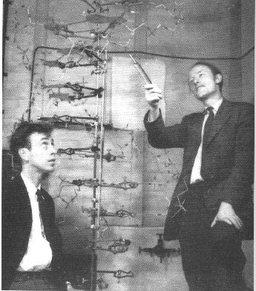
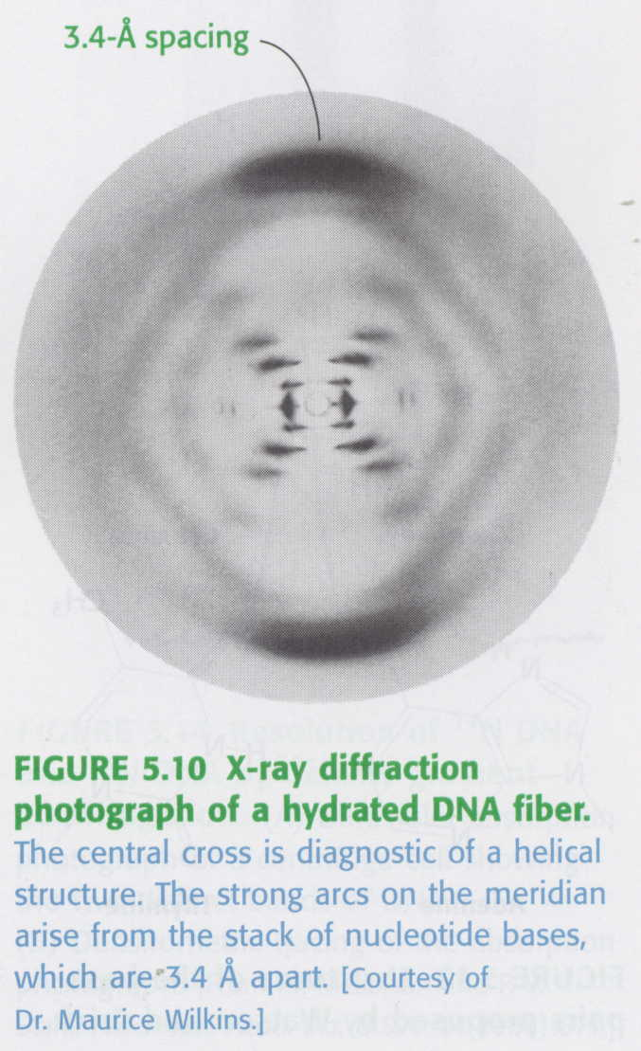
1953 - J. Watson; F. Crick; M. Wilkins, R. Franklin (1962 – the Nobel Prize)
Notes:
Genetická informace je zakódována v DNA

Slide 15
The information used to construct the Watson-Crick model included the following
The chemical structures and molecular dimensions of deoxyribose, the nitrogenous bases and phosphate
The 1:1 ratios of adenine:thymine and guanine:cytosine in the DNA isolated from a wide variety of species investigated by Erwin Chargaff - Chargaff´s rules
Superb X-ray diffraction studies performed by Rosalind Franklin indicating that DNA is a symmetrical molecule and probably a helix
The diameter and pitch of the helix estimatd by Maurice Wilkins and his colleague Alex Stokes from other X-ray diffraction studies

Slide 16
Deoxyribonucleic acid - structure
The antiparallel orientation of the two polynucleotide strands allows the formation of hydrogen bonds between the nitrogenous bases that are oriented toward the helix interior
There are two types of base pair (bp) in DNA:
A-T (adenine-thymine), G-C (guanine-cytosine)
Because each base pair is oriented at a right angle to the long axis of the helix, the overall structure of DNA resembles a twisted staircase

Slide 17
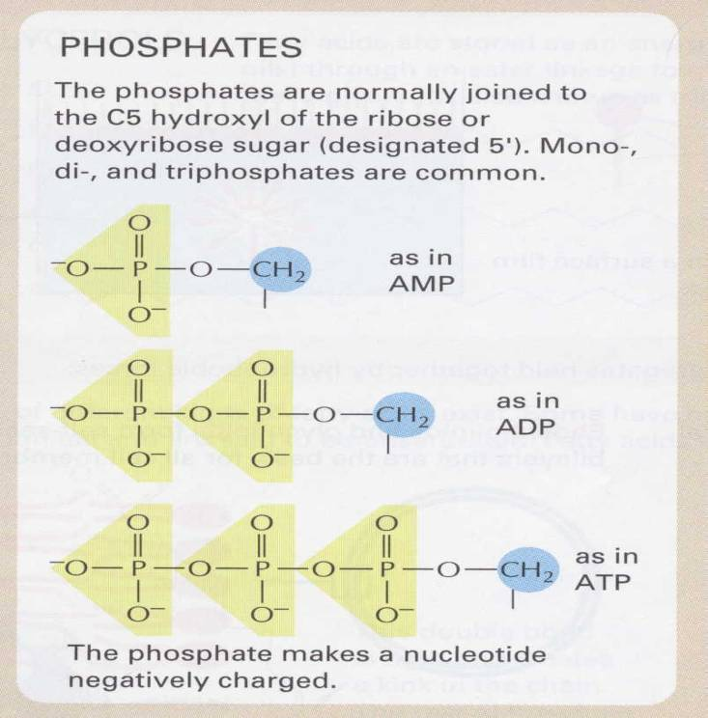
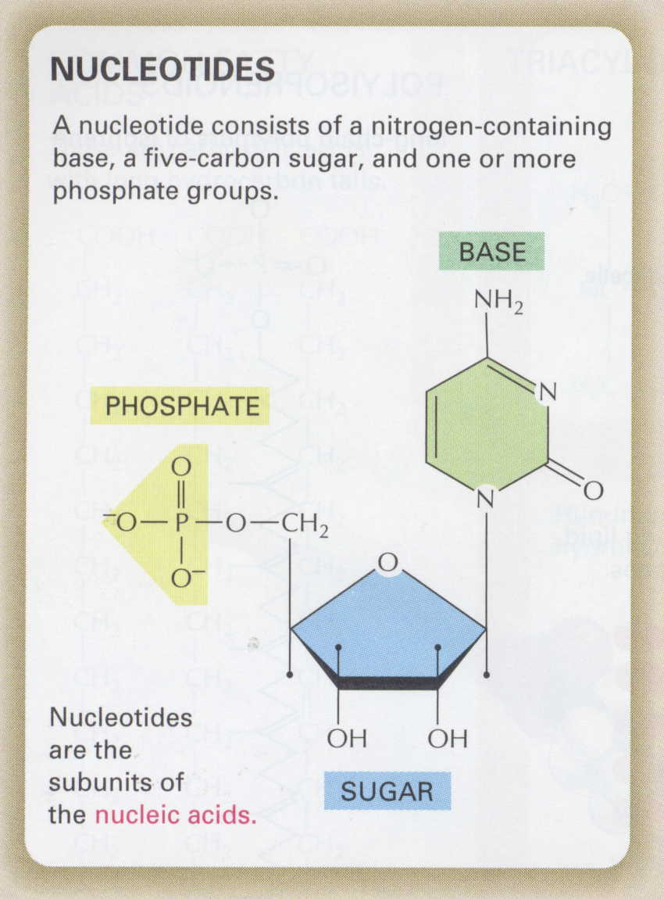
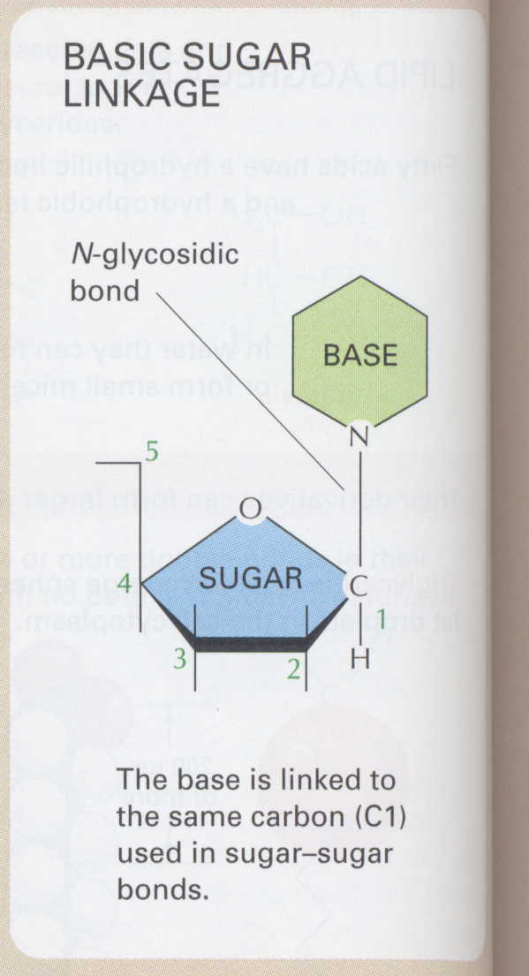
Nucleotides

Slide 18
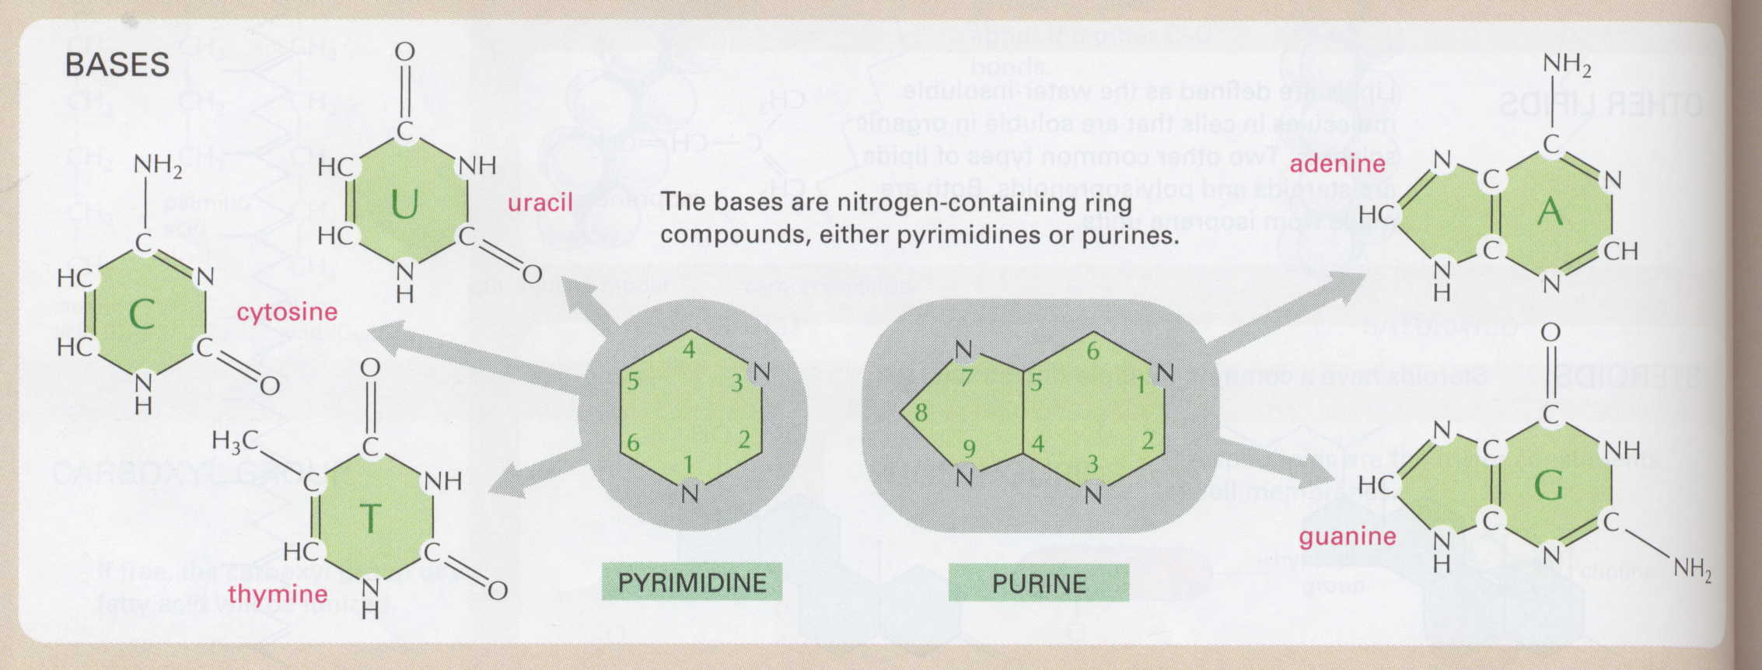
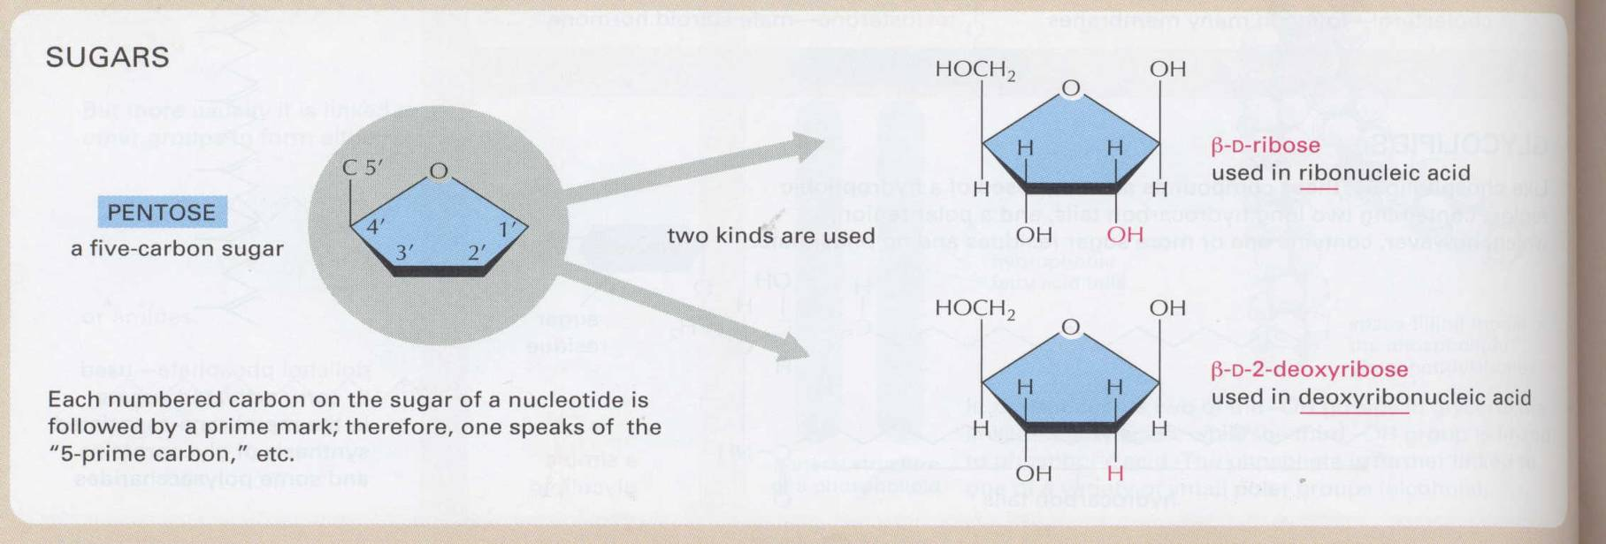

Slide 19
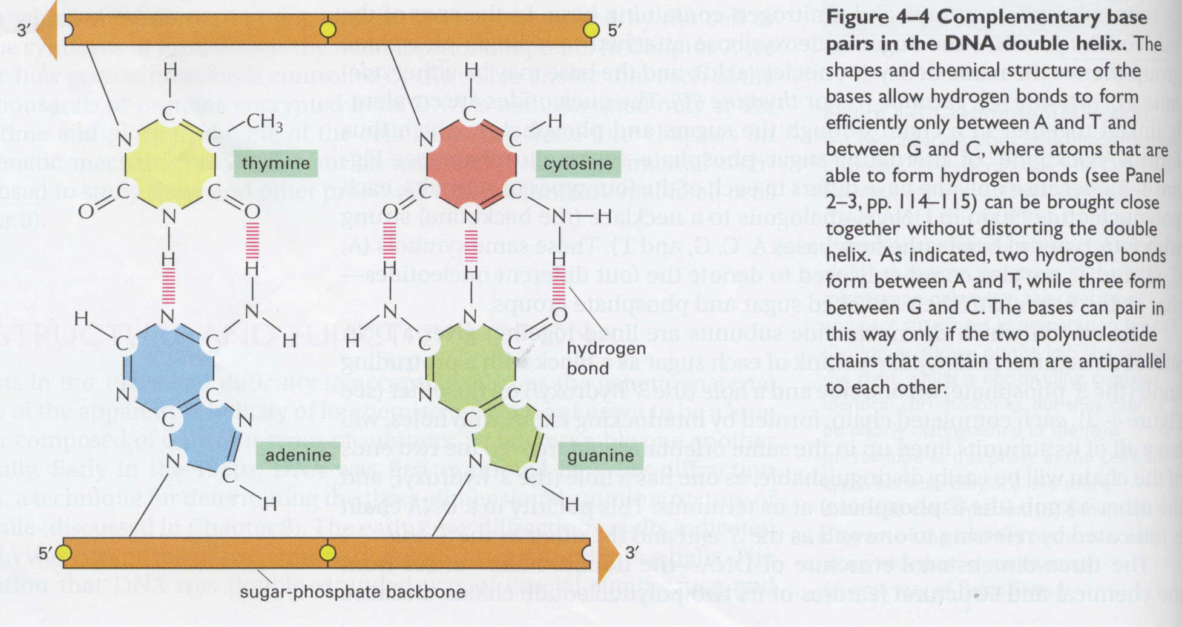

Slide 20
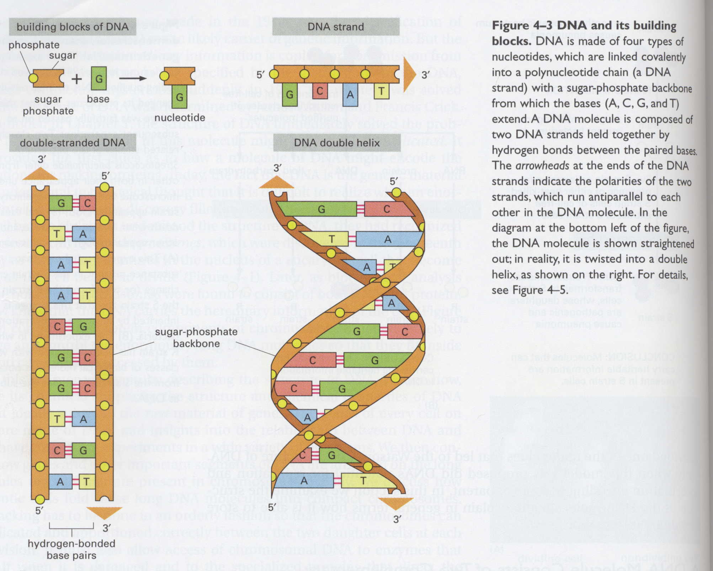

Slide 21
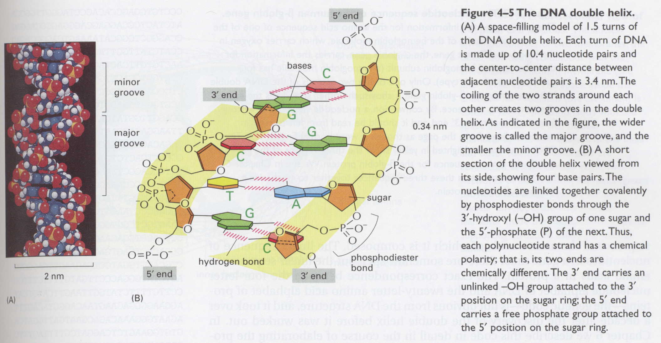

Slide 22
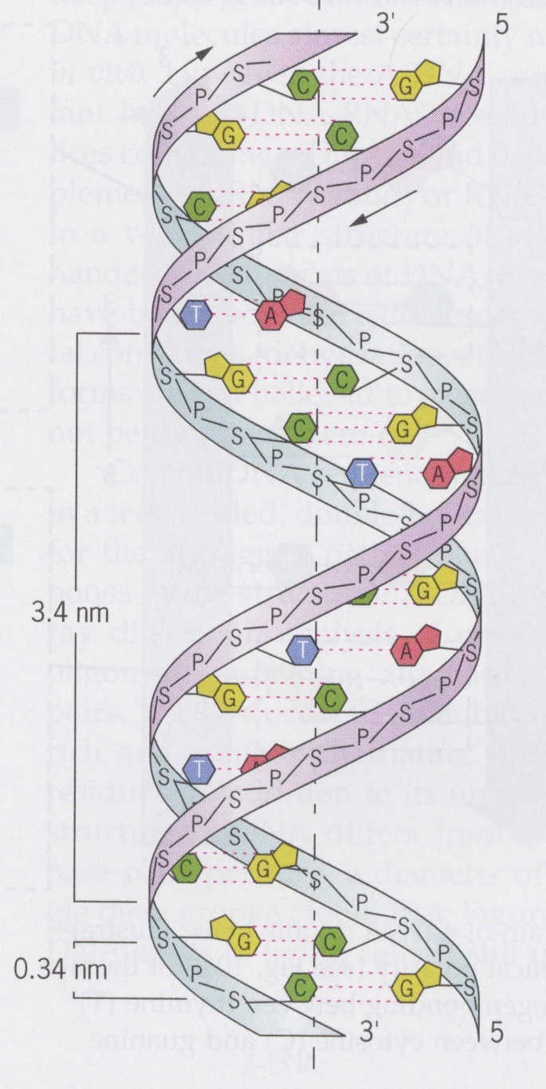
The dimensions of crystalline DNA have been precisely measured
One turn of the double helix spans 3.4 nm and consists of approximately 10.4 bp
The diameter of the double helix is 2 nm; there is sufficient space in the double helix interior only for base pairing between a purine and a pyrimidine
The distance between adjacent base pairs is 0.34 nm

Slide 23
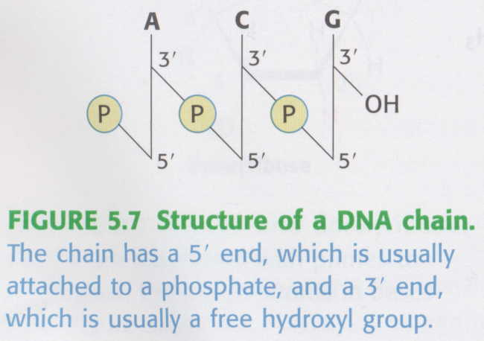
DNA stability
DNA is relatively stable molecule
Several types of noncovalent bonding contribute to this stability:
  Hydrophobic interacions beween he sacked base pairs in the double helix – an imporant (but poorly understood) role in stabilizing DNA: p-p interactions
  Sugar-phosphate backbone is hydrophilic and therefore DNA´s external surface is solvated with water
  Hydrogen bonding between complementary bases promotes stability as well as providing a mechanism for accurate pairings between the bases

Slide 24
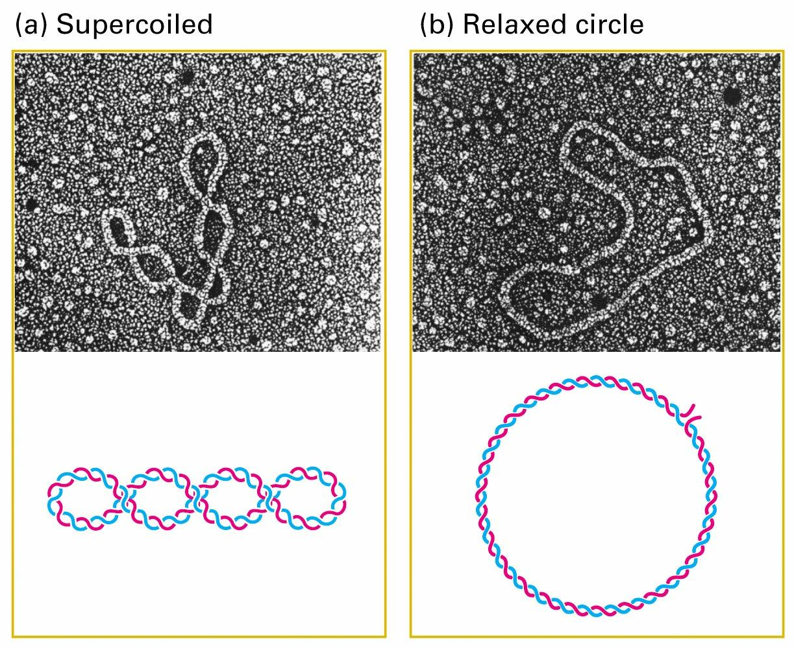

Slide 25
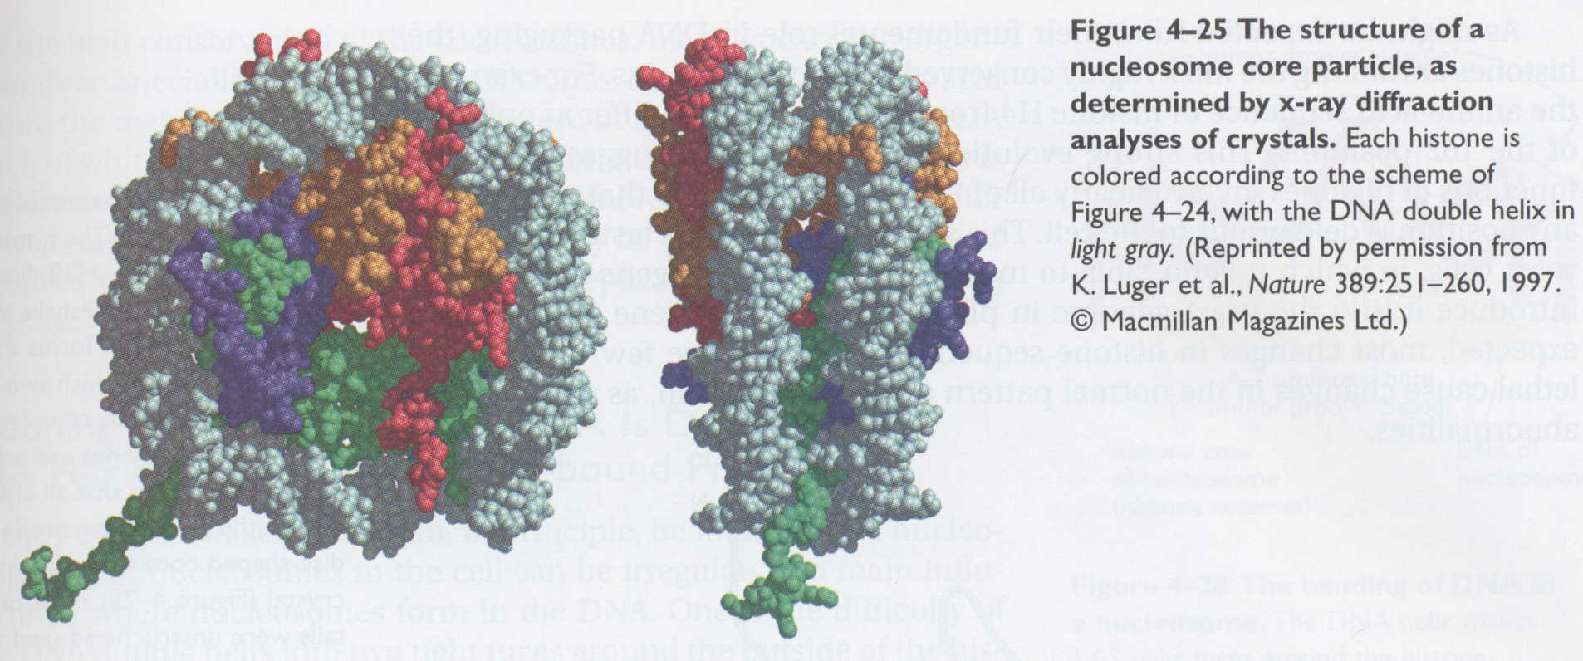
„Quarternary structure“ of DNA – nucleosome, chromatin

Slide 26
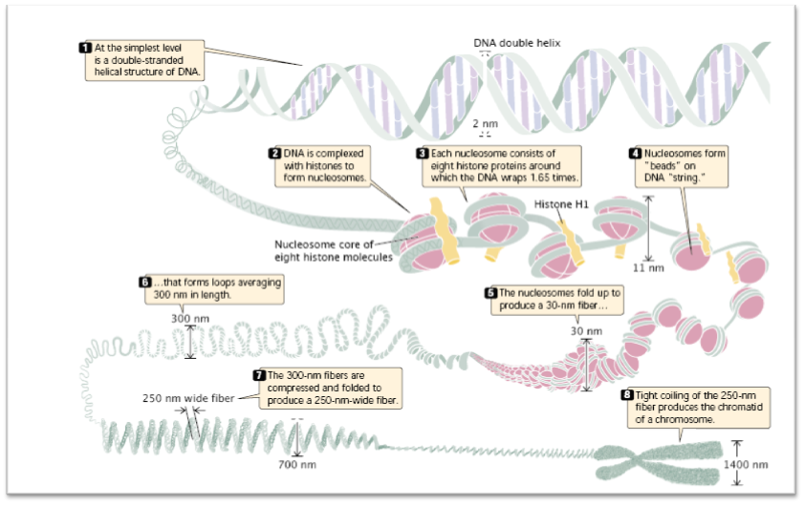
Packaging of DNA

Slide 27
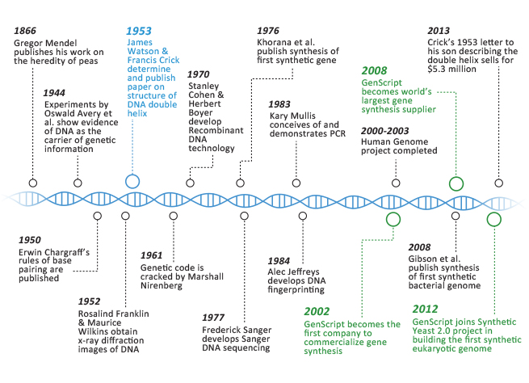
Analysis of DNA

Slide 28
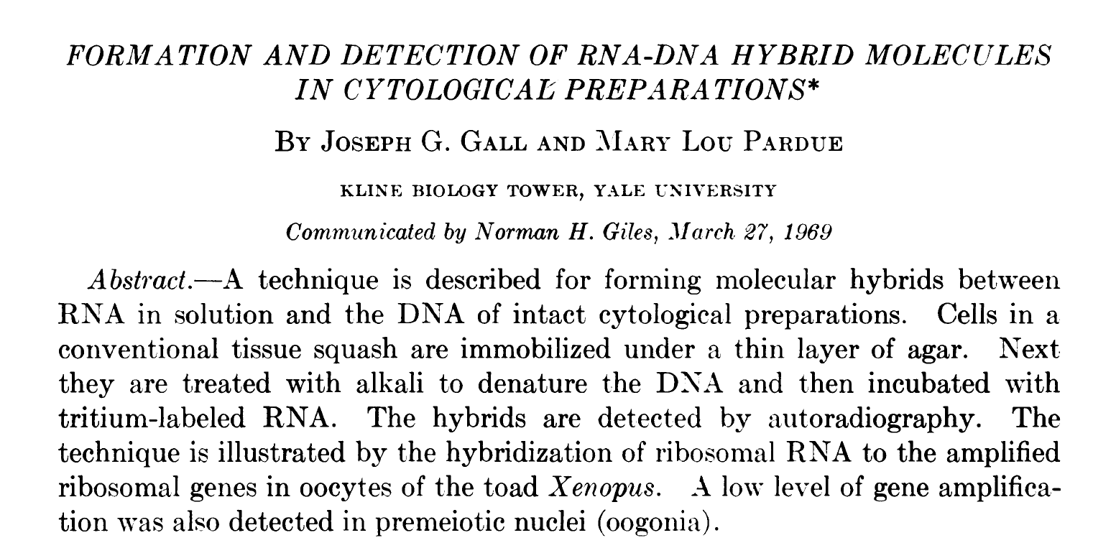
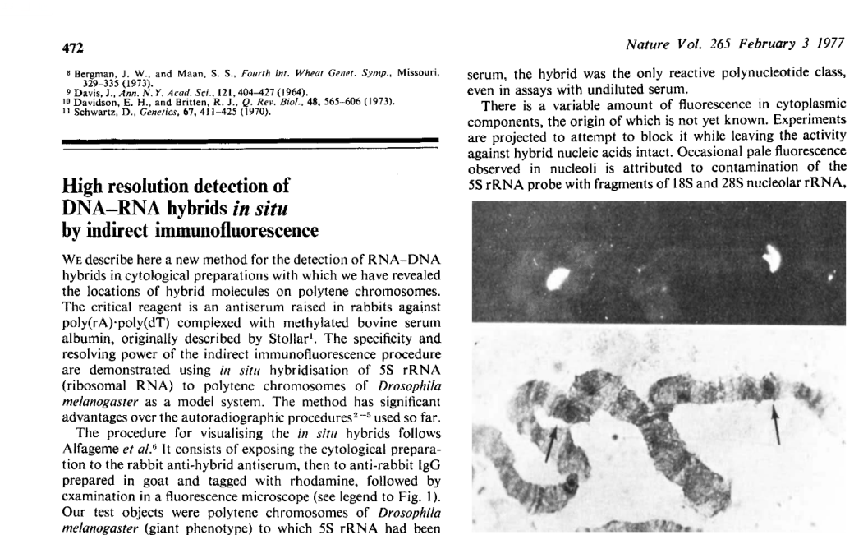
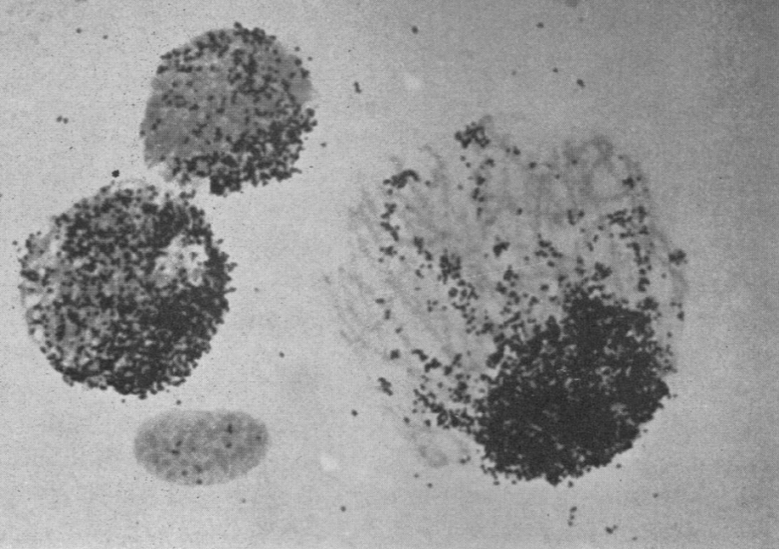
In situ hybridization
.
Rudkin GT, Stollar BD. High resolution detection of DNA-RNA hybrids in situ by indirect immunofluorescence. Nature. 1977 Feb 3;265(5593):472-3.

Slide 29
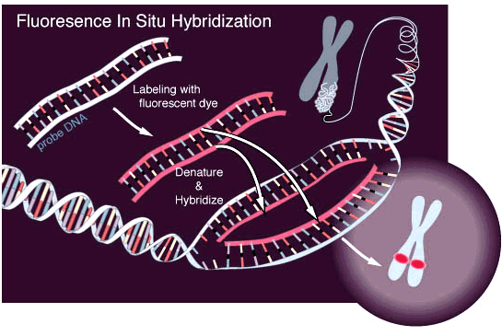
70´s – fluorescenční in situ hybridizace

Slide 30
DNA sequenicng
proces of determination of the order of nucleotides in DNA
Idea – to vizualize the bases of DNA in ammner that they can be sorted and identified
70´s - 2 ways - „chemical“ and radioactive

Slide 31
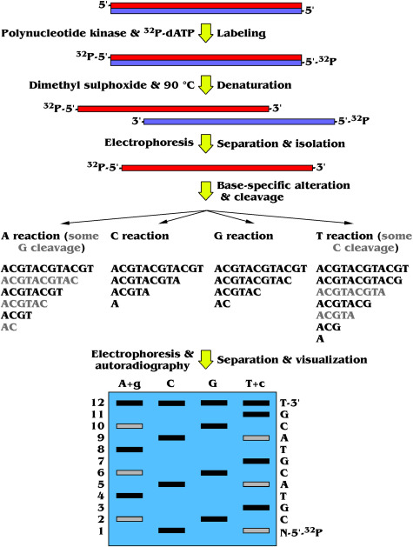
Chemical sequencing (1976)
A. Maxam, P. Gilbert
based on chemical modification of DNA and subsequent cleavage at specific bases
the method requires radioactive labelling at one end
cchemical treatment generates breaks at a small proportions of one or two of the four nucleotide based in each of four reactions (G,A+G, C, C+T)
series of labelled fragments is generated, from the radiolabeled end to the first ‘cut’ site in a molecule
the fragments in the four reactions are arranged side by side in gel electrophoresis for size separation
the gel is exposed to X-ray film for autoradiography, yielding a series of dark bands each corresponding to a radiolabeled DNA fragment, from which the sequence may be inferred.

Slide 32
Sanger (dideoxy termination) sequencing
1977 – F. Sanger and colleagues, Cambridge
based on the random incorporation of chain-terminating dideoxynucleotides (ddNTPs) by DNA polymerase during in vitro DNA replication
Enzymatic (DNA polymerase), cost effective, less handwork, AUTOMATIZATION!

Slide 33
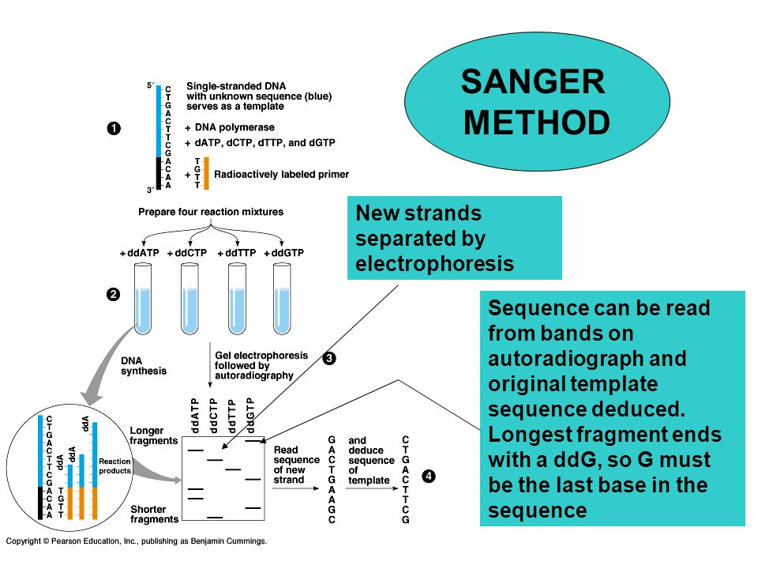
https://www.onlinebiologynotes.com/sangers-method-gene-sequencing/

Slide 34
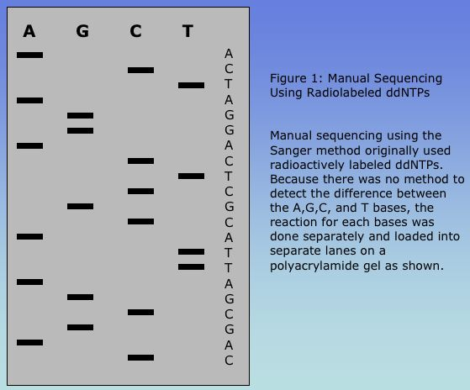

Slide 35
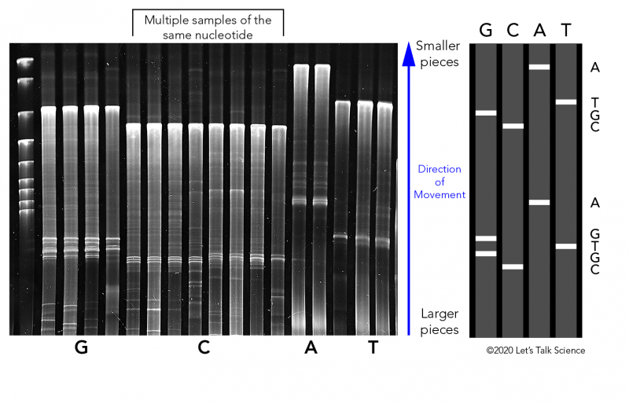

Slide 36
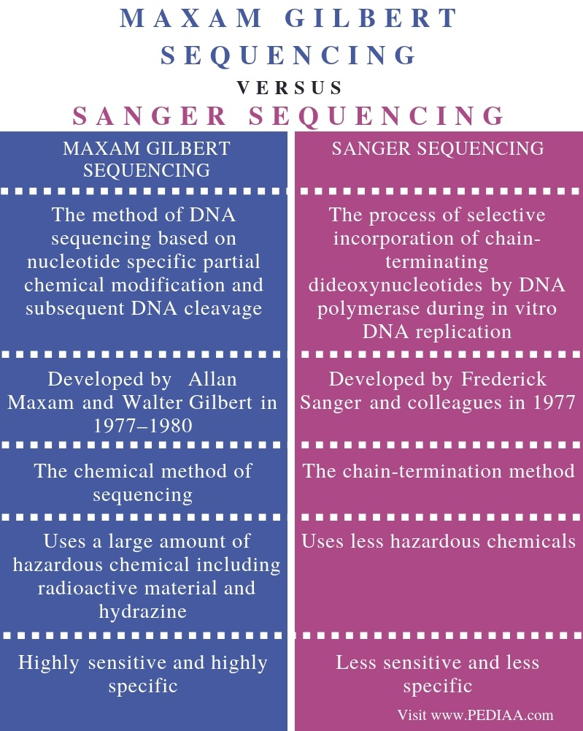

Slide 37
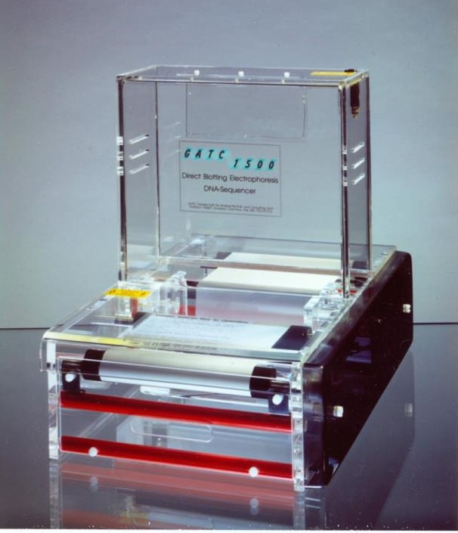
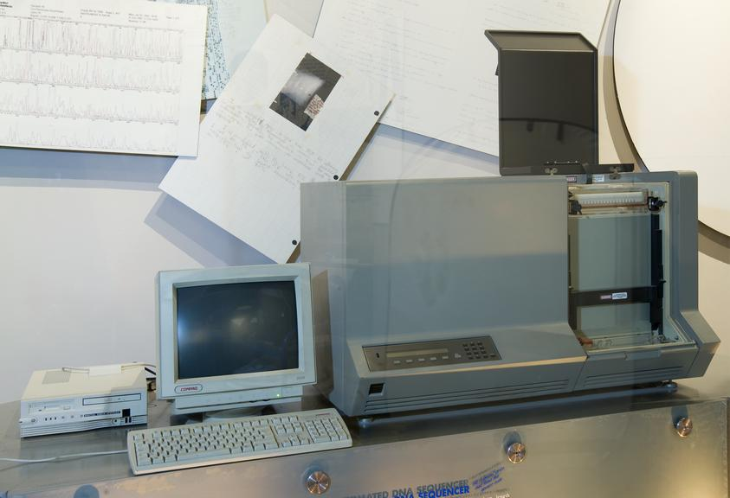
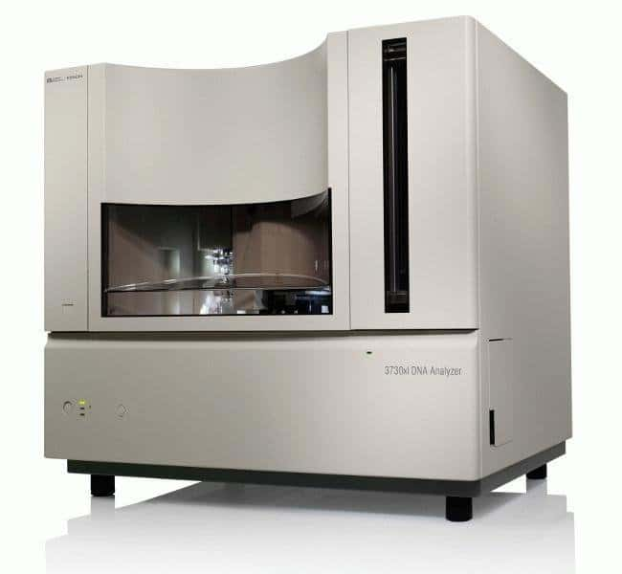
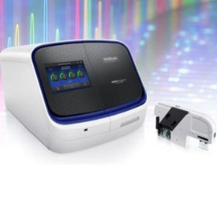
The direct blotting electrophoresis system GATC1500 (1984)
Applied Biosystems 370A Prototype Automated DNA Gene Sequencer (Hood, Hunkapiller 1987)
Applied Biosystems SeqStudio Genetic Analyzer
ABI 3730xl DNA Analyzer (384 well plate, 2010)

Slide 38
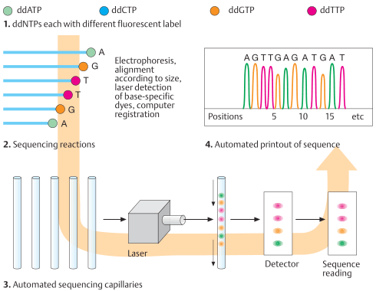

Slide 39
PCR – polymerase chain reaction
Method widely used to rapidly make millions to billions of copies (complete or partial) of a specific DNA sample
Discovery of DNA polymerase (1957 – Kornberg, mechanism of DNA replication
Development of synthetic DNA oligonucleotides (early 60´s Khorana studying a genetic code)
Thermostable DNA polymerase from Thermus aquaticus was isolated (1969 –Brock)
PCR involves using short synthetic DNA fragments called primers to select a segment of the genome to be amplified, and then multiple rounds of DNA synthesis to amplify that segment
Developed in CETUS Corparation by Kary B. Mullis in 1983 (Nobel prize 1993)

Slide 40
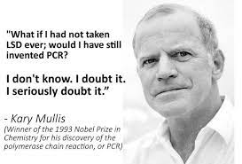
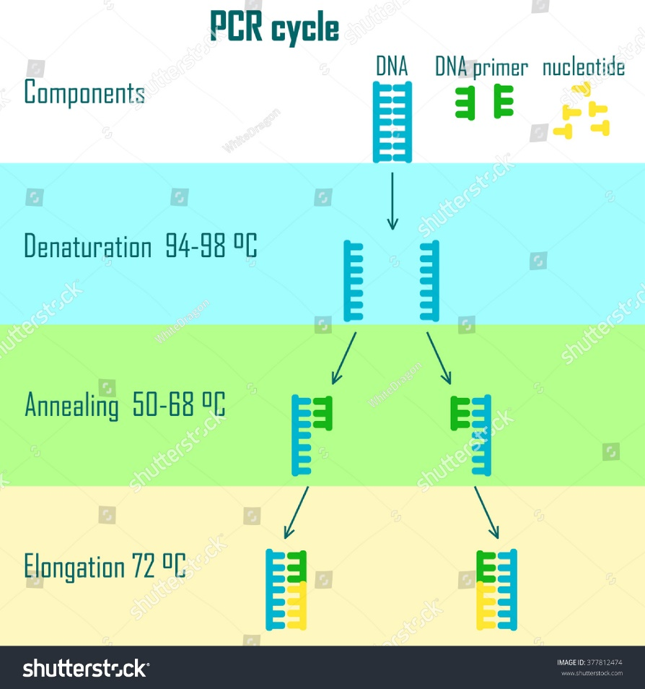

Slide 41
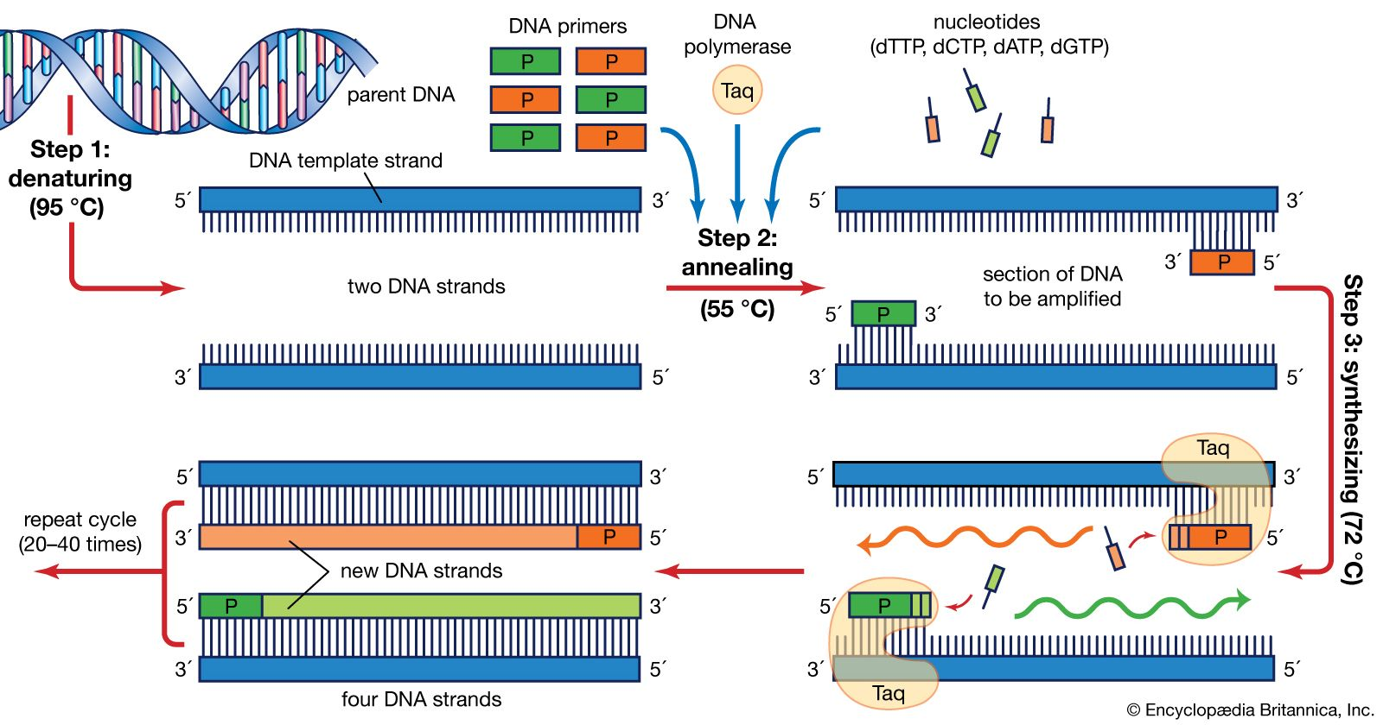
PCR – polymerase chain reaction

Slide 42
Next generation sequencing (NGS)
Massive parallel (shotgun) sequencing
Used for – analysis of large number of genes in one experiment
Effective cost per base ratio
Utilization of computer proccessing of data and bioinformatics

Slide 43
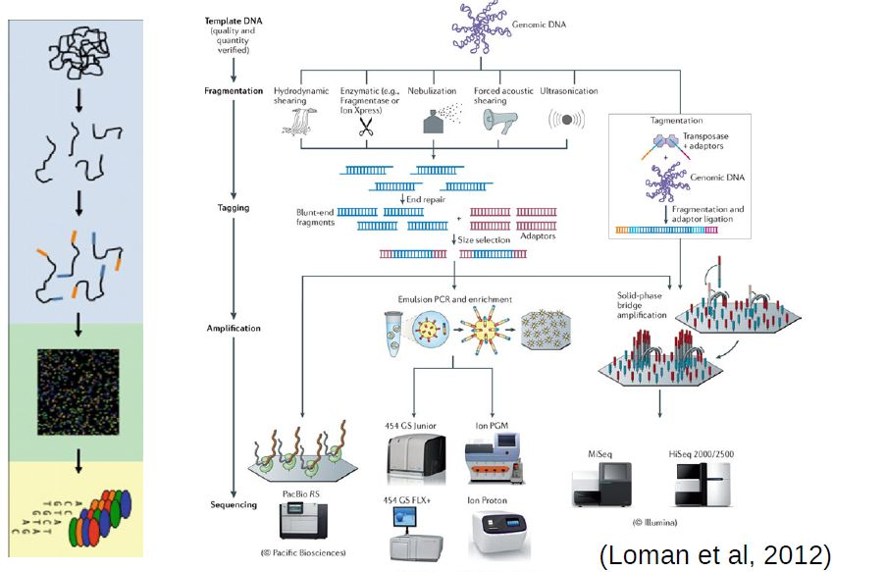
NGS workflow

Slide 44
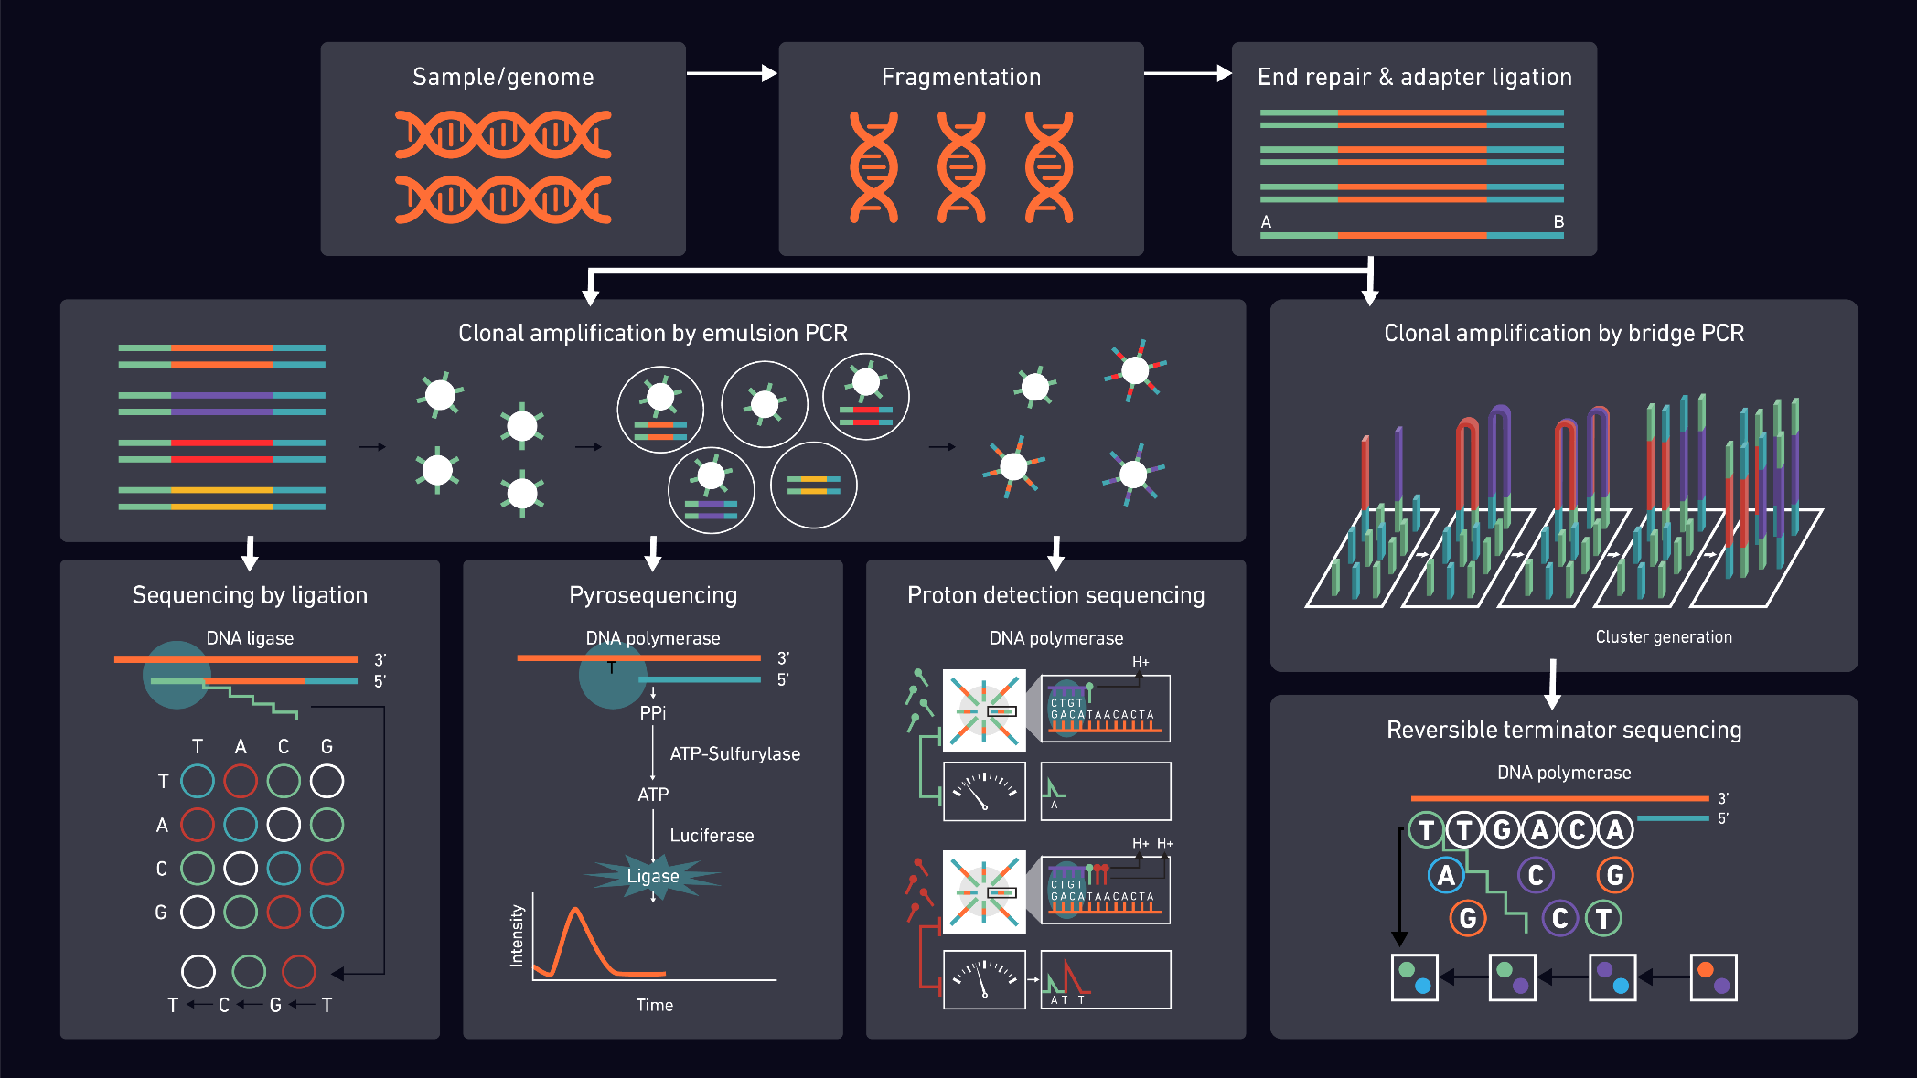
NGS technologies
ABI SOLiD
(Life )
454 Life Science (Roche Inc)
Semiconductor sequencing (Life)
Sequencing by synthesis (SBS) Illumina Inc.

Slide 45
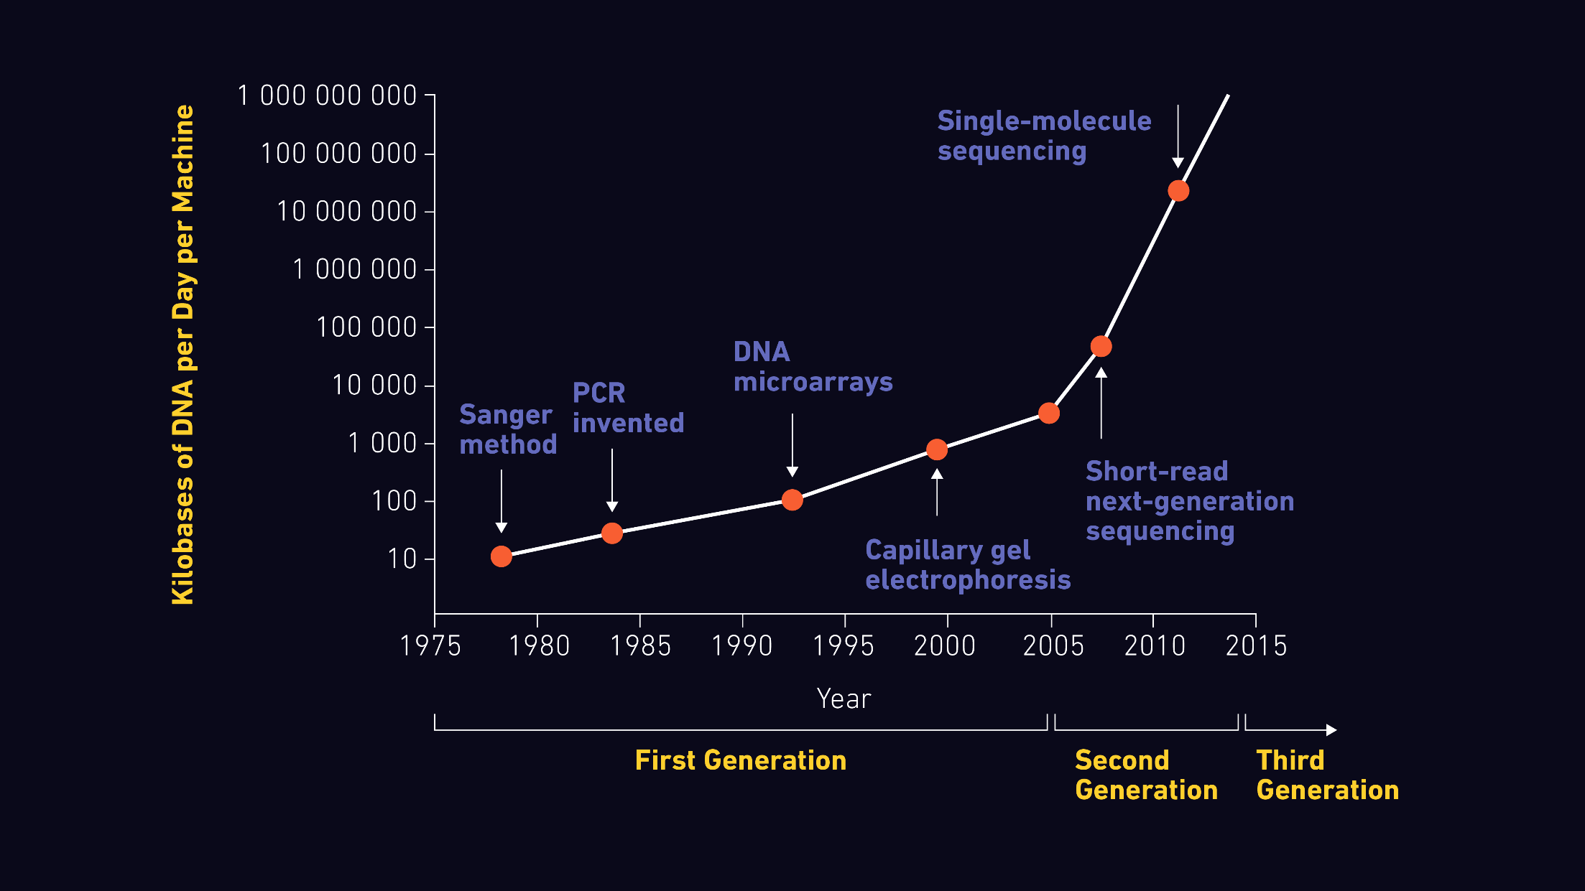
NGS technologies – sequencing capaicity

Slide 46


Nowadays…NovaSeq 6000 (Illumina)
48 human genomes in 2 days
Very variable and robust (2 flowcell port = cost effective)
WGS, WES, panels, RNA seq…
the most powerful high-throughput Illumina sequencing system to date

Slide 47


3rd generation of NGS
“single molecule NGS“
SMRT (Single Molecule, Real-Time Sequencing)
Oxford Nanopore

Slide 48

Historiy of whole genome sequencing
Gianni et al., Computational and Structural Biotechnology Journal, 2019

Slide 49
Historiy of whole genome sequencing

Slide 50

Human genome project (HGP) 1990-2003

Slide 51


Slide 52



Human genome project - origin
E. Southern
G. Church

Slide 53
HGP - backgronud
1984 – 1986 The U.S. Department of Energy (DOE) and the International Commission for Protection against Environmental Mutagens and Carcinogens (ICPEMC) initiatee the early meetings assess the feasibility of a Human Genome Project
1988
  The National Institutes of Health (NIH) assembles scientists, administrators and science policy experts to plan for a possible Human Genome Project
  Two published reports recommend creating an effort to sequence the human genome (National Research Council; he U.S. Congress Office of Technology Assessment)
1989
The National Center for Human Genome Research (NCHGR) is established to carry out the United States Human Genome Project. The center's first director is James D. Watson
1990 The Human Genome Project begins with an initial five-year plan
  NIH allocates the first funds to research grants aimed at developing the scientific approaches, technologies, and resources needed to map and sequence the human genome
  (expected 3 billions dollars for 15 years)

Slide 54
The National Center for Human Genome Research (NCHGR)
The Whitehead Institute/MIT Center for Genome Research, Cambridge, Mass., U.S.
The Wellcome Trust Sanger Institute, The Wellcome Trust Genome Campus, Hinxton, Cambridgeshire, U. K.
Washington University School of Medicine Genome Sequencing Center, St. Louis, Mo., U.S.
United States DOE Joint Genome Institute, Walnut Creek, Calif., U.S.
Baylor College of Medicine Human Genome Sequencing Center, Department of Molecular and Human Genetics, Houston, Tex., U.S.
RIKEN Genomic Sciences Center, Yokohama, Japan
Genoscope and CNRS UMR-8030, Evry, France
GTC Sequencing Center, Genome Therapeutics Corporation, Waltham, Mass., USA
Department of Genome Analysis, Institute of Molecular Biotechnology, Jena, Germany
Beijing Genomics Institute/Human Genome Center, Institute of Genetics, Chinese Academy of Sciences, Beijing, China
Multimegabase Sequencing Center, The Institute for Systems Biology, Seattle, Wash.
Stanford Genome Technology Center, Stanford, Calif., U.S.
Stanford Human Genome Center and Department of Genetics, Stanford University School of Medicine, Stanford, Calif., U.S.
University of Washington Genome Center, Seattle, Wash., U.S.
Department of Molecular Biology, Keio University School of Medicine, Tokyo, Japan
University of Texas Southwestern Medical Center at Dallas, Dallas, Tex., U.S.
University of Oklahoma's Advanced Center for Genome Technology, Dept. of Chemistry and Biochemistry, University of Oklahoma, Norman, Okla., U.S.
Max Planck Institute for Molecular Genetics, Berlin, Germany
Cold Spring Harbor Laboratory, Lita Annenberg Hazen Genome Center, Cold Spring Harbor, N.Y., U.S.
GBF - German Research Centre for Biotechnology, Braunschweig, Germany

Slide 55


NCHGR - hierarchical shotgun method

Slide 56

HGP – major achievements
1995 - complete physical map of human genome ( =physical locations of identifiable landmarks on chromosomes backbone for genome assembly)

Slide 57
HGP – major achievements
1996 - The Bermuda principles
„all human genomic sequence information should be made freely available and placed in the public domain within 24 hours of being generated by federally funded large-scale human sequencing centers“
Automatic release of sequence assemblies larger than 1 kb (preferably within 24 hours).
Immediate publication of finished annotated sequences.
Aim to make the entire sequence freely available in the public domain for both research and development in order to maximise benefits to society

Slide 58


HGP-The Celera story
established in May 1998 by Dr. J. Craig Venter (former HGP) from The Institute for Genomic Research (TIGR)
TIGR - „shotgun“ sequencing genome of H. influenzae,
HGP - $300 million of private funding for 3 years (whole genome in 2001)
intended to sell subscriptions to its database, release data quarterly, and obtain patents on genes and related technologies.
Political pressure - joint effort, draft of human genome published in 2001 in same time

Slide 59

HGP-The Celera story
Whole genome shotgun sequnecing
two independent data sets together with two distinct computational approaches
Celera 27.27 million DNA sequence reads, each with an average length of 543 base pairs, derived from five different individuals
Bactigs - DNA from HGP (GeneBank) 16.05 million sequence reads
Whole genome assembly from 43.32 million sequence reads

Slide 60

Whole genome assembly
In whole-genome assembly, the BAC fragments (red line segments) and the reads from five individuals (black line segments) are combined to produce a contig and a consensus sequence (green line). The contigs are connected into scaffolds, shown in red, by pairing end sequences, which are also called mates. If there is a gap between consecutive contigs, it has a known size. Next, the scaffolds are mapped to the genome (gray line) using sequence tagged site (STS) information, represented by blue stars (Venter, C. et al. The sequence of the human genome. Science 291, 2001)

Slide 61

NCHGR
Celera

Slide 62
HGP – major achievements
1999 - 1st human whole chromosome sequence obtained – chromosome 22

Slide 63



HGP – major achievements
On Feb. 12, 2001 HGP and Celera announced a working draft of the sequence of the human genome — the genetic blueprint for a human being announced (HGP – Nature; Celera – Science)
President Bill Clinton holds a ceremony at the White House to announce this achievement.
15 February 2001
16 February 2001

Slide 64

HGP – major achievements
On April 14, 2003, the IHGSC announced the successful completion of the Human Genome Project
Project finished more than two years ahead of schedule with $2.7 billion total budget

Slide 65
HGP - results
The human genome contains roughly 3.2 billion base pairs,
The human genome contains 97% repetitive junk DNA content, only 2 to 3% portion of the genome encodes proteins
There are round 25,000 to 30,000 genes protein coding genes,
The average human gene consists of 3,000 nucleotide bases, but sizes vary greatly (largest gene is the dystrophin having 2.4Mb in size)
Gene-rich areas of the genome are predominantly made up of G and C bases, whereas gene-poor regions are mainly composed of A and T bases
Chromosome 1 has the most genes (2968), whereas the Y chromosome has the least (231)
The order of 99.9% of nucleotide bases is exactly the same in all people
The genome of us has 1.4 million known SNPs.

Slide 66
HGP- outcomes
Area | Goal | Achieved | Date
Genetic Map | 2- to 5-cMresolution map (600 - 1,500 markers) | 1-cM resolution map(3,000 markers) | September 1994
Physical Map | 30,000 STSs | 52,000 STSs | October 1998
DNA Sequence | 95% of gene-containing part of human sequence finished to 99.99% accuracy | 99% of gene-containing part of human sequence finished to 99.99% accuracy | April 2003
Capacity and Cost of Finished Sequence | Sequence 500 Mb/year at < $0.25 per finished base | Sequence >1,400Mb/year at <$0.09 per finished base | November 2002
Human Sequence Variation | 100,000 mapped human SNPs | 3.7 million mapped human SNPs | February 2003
Gene Identification | Full-length human cDNAs | 15,000 full-lengthhuman cDNAs | March 2003
Model Organisms | Complete genome sequences of E. coli, S .cerevisiae, C. elegans, D. melanogaster | Finished genome sequences of E. coli, S. cerevisiae, C. elegans, D. melanogaster, plus whole-genome drafts of several others, including C. briggsae, D. pseudoobscura, mouse and rat | April 2003
Functional Analysis | Develop genomic-scale technologies | High-throughput oligonucleotide synthesis DNA microarrays Eukaryotic, whole-genome knockouts (yeast) Scale-up of two-hybrid system for protein-protein interaction | 1994 1996 1999 200

Slide 67
HGP - outcomes
Ethical, legal and social implications (ELSI)
  5% of the annual budget of the NHGRI was dedicated to develop ELSI
  Genes can’t be patented
  Informed consent that should be guaranteed to those who have a genetic test
  Issues related to privacy and confidentiality of genetic information of a person must be taken care of
  The ELSI program at NHGRI now serves as a model for large, publicly funded science efforts

Slide 68

“Every dollar we invested to map the human genome returned $140 to our economy — every dollar,” (B. Obama, 2013)
https://link.springer.com/book/10.1007/978-90-481-3261-4

Slide 69

https://www.genome.gov/about-genomics/fact-sheets/Sequencing-Human-Genome-cost

Slide 70

Following projects – HapMap (2003)
https://slideplayer.com/slide/3053410/

Slide 71


Following projects – 1000Genomes
(2008-2015)
The goal of the 1000 Genomes Project was to find common genetic variants with frequencies of at least 1% in the populations studied
WGS of 2,504 individuals from 26 populations
Creation of global human genome reference Sudmant et al., 2015, Nature

Slide 72



+1 Million Genomes
22 EU countries, the UK and Norway signed Member States’ declaration on stepping up efforts towards creating a European data infrastructure for genomic data and implementing common national rules enabling federated data access

Slide 73

Local population genome projects
Kovanda et al., 2021, Hum. Genomics
Worldwide, there are 86 or more project focused on improve genetic diagnostics and to pave the way for the integration of precision medicine into health systems

