Slide 1
Bi9325 Molekulární genetika člověka
Mgr. Jiří Kohoutek, Ph.D.

Slide 2
Lecture 7
Regulation of gene expression in prokaryotes and eukaryotes.

Slide 3
Why to regulate gene expression?
The products of all genome genes are not necessary at every moment of a cell's life - mechanisms to ensure gene expression at the right time and in the right place (spatiotemporal regulation).
Variability of the external environment. Responses to signals from the environment (e.g. temperature, osmotic pressure, nutrient availability,..) and signals from other cells, tissues and organs (e.g. developmental processes, injuries,..).
Variability of the internal environment of the cell during the cell cycle, cell commitment, differentiation and etc.
Gene expression is highly energetic process.

Slide 4
Regulation of gene expression in the eukaryotes.

Slide 5
Eukaryotic gene expression
Eukaryotic gen expression (like us!) can be controlled at various stages, from the availability of DNA to the production of mRNAs to the translation and processing of proteins.
Different genes are regulated at different points, and it’s not uncommon for a gene (particularly an important or powerful one) to be regulated at multiple steps.
Chromatin accessibility.
Transcription.
RNA processing.
RNA stability.
Translation.
Protein activity.
https://www.khanacademy.org/science/ap-biology/gene-expression-and-regulation/regulation-of-gene-expression-and-cell-specialization/a/overview-of-eukaryotic-gene-regulation

Slide 6
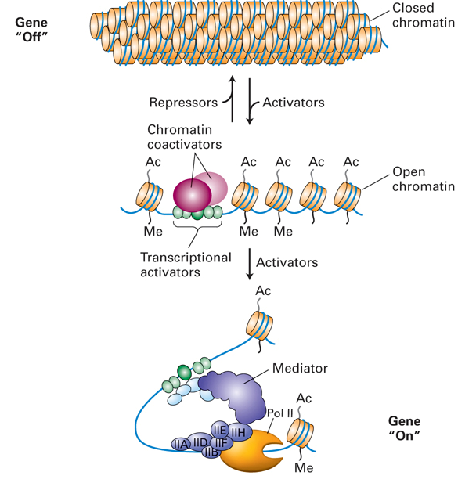
Components of eukaryotic gene expression
Enhancer/Silencer – DNA control element far from or close a gene or intron.
Activators – bind to enhancers to turn on transcription of a gene.
Transcription factors.
Needed for transcription to begin.
Repressors – bind to silencers.
Turn off transcription.
Block activators from binding to enhancers.
https://www.uwyo.edu › 13-miller-chap-7c-lecture

Slide 7
Components of eukaryotic gene expression
Co-activator and Co-repressor - the distinction between an activator/co-activator and repressor/co-repressor is based on whether or not the protein binds specifically to DNA.
Namely, activators/repressors have DNA binding domains that allow them to bind to DNA.
Co-activators/co-repressors typically don’t bind to specific sequences in DNA.
They typically exert their effects on transcription initiation via protein-protein interactions within transcription initiation complexes at promoters, or by modifying histone tails.
https://www.uwyo.edu › 13-miller-chap-7c-lecture

Slide 8
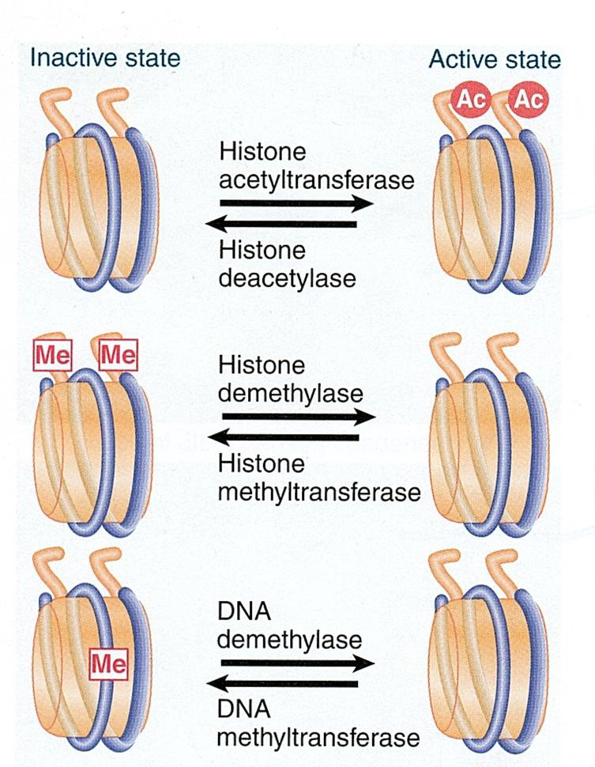
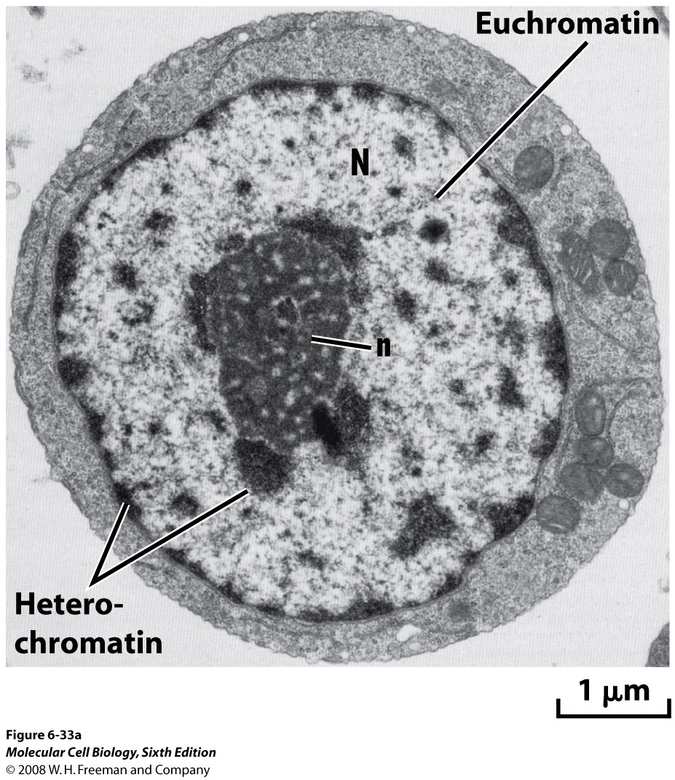
Chromatin accessibility
Chromatin accessibility - the structure of chromatin (DNA and its organizing proteins) can be regulated. More open or “relaxed” chromatin makes a gene more available for transcription.
Interphase chromatin exists in two different condensation states.
Heterochromatin is a condensed form that has a condensation state similar to chromatin found in metaphase chromosomes. Heterochromatin typically is found at centromere and telomere regions, which remain relatively condensed during interphase.
Euchromatin is considerably less condensed. Most transcribed genes are located in regions of euchromatin.
https://www.uwyo.edu › 13-miller-chap-7c-lecture

Slide 9
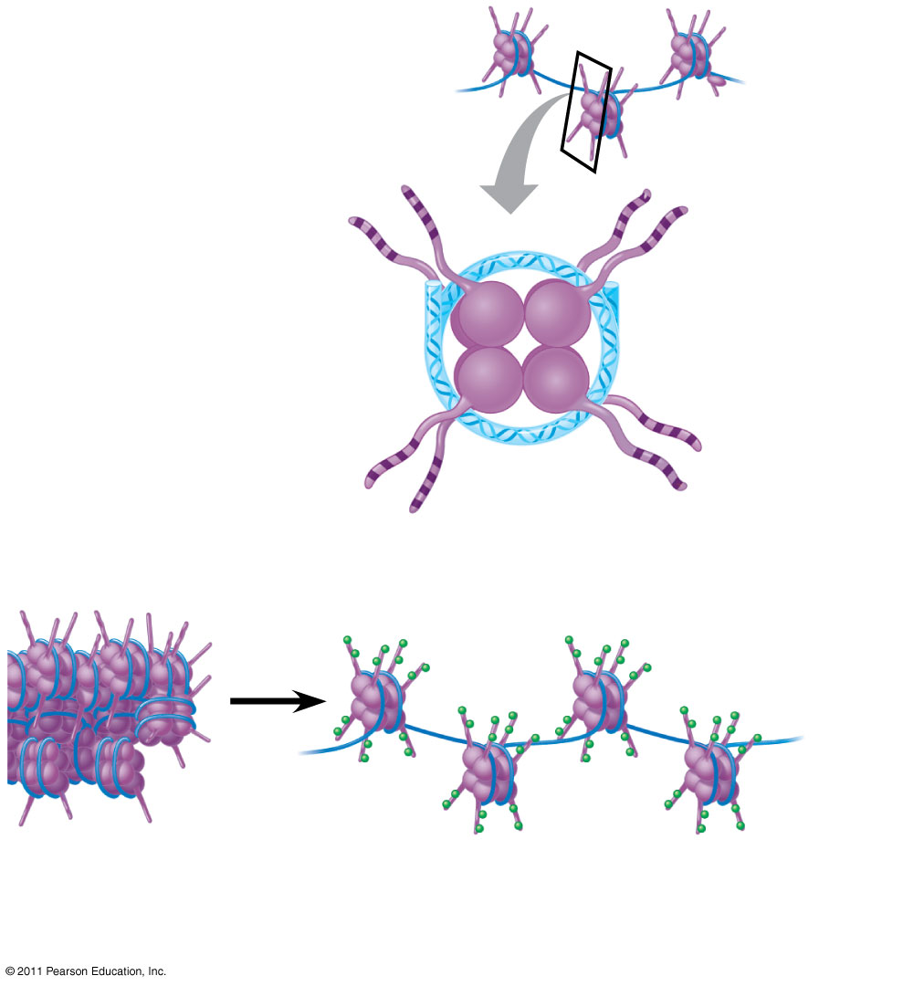
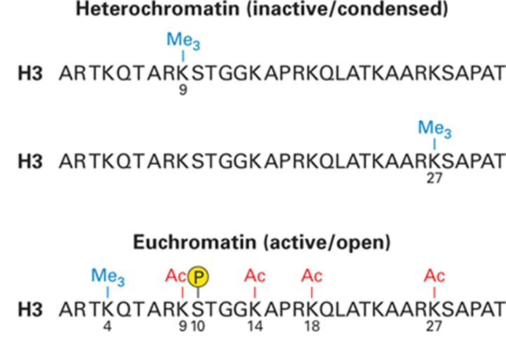
Chromatin accessibility
Transition is between state of hetero- and euchromatin is mediated by various modifications of histones.
Histone tails
DNA double helix
Amino acids available for chemical modification
Nucleosome (end view)
(a) Histone tails protrude outward from a nucleosome
Unacetylated histones
Acetylated histones
(b)
Acetylation of histone tails promotes loose chromatin structure that permits transcription
Department of Experimental Biology
https://www.sciencedirect.com/topics/engineering/peptide-bond

Slide 10
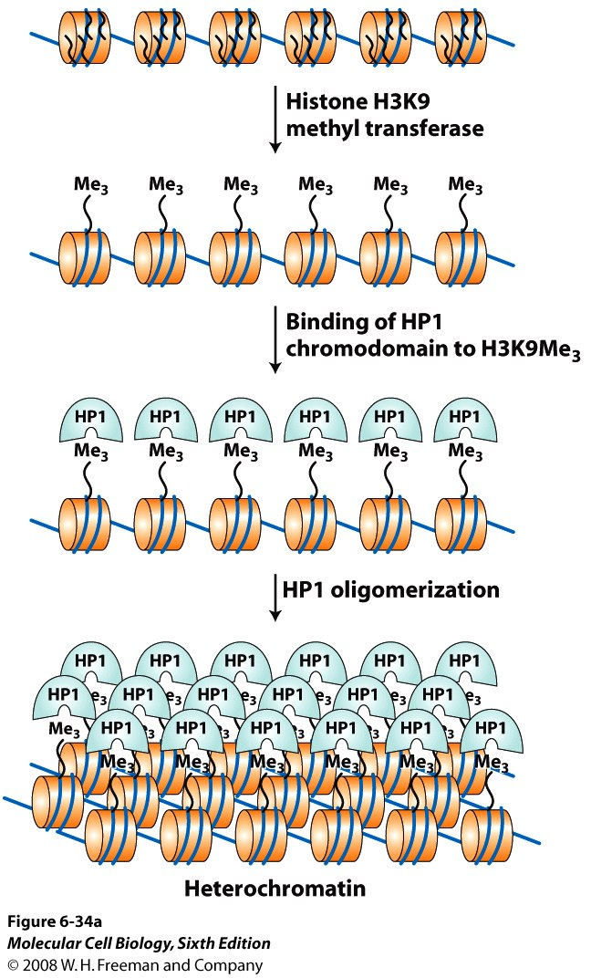
Euchromatin to heterochromatin transition
The trimethylation of histone H3 at lysine 9 (H3K9Me3) plays an important role in promoting chromatin condensation to heterochromatin.
Trimethylated sites are bound by heterochromatin protein 1 (HP1) which self-associates and oligomerizes resulting in heterochromatin. Heterochromatin condensation is thought to spread laterally between “boundary elements” that mark the ends of transcriptionally active euchromatin.
Recruitment of the H3K9 histone methyl transferase (HMT) to HP1 sites promotes heterochromatin spreading by catalyzing H3 methylation.
Department of Experimental Biology
https://www.uwyo.edu › 13-miller-chap-7c-lecture

Slide 11
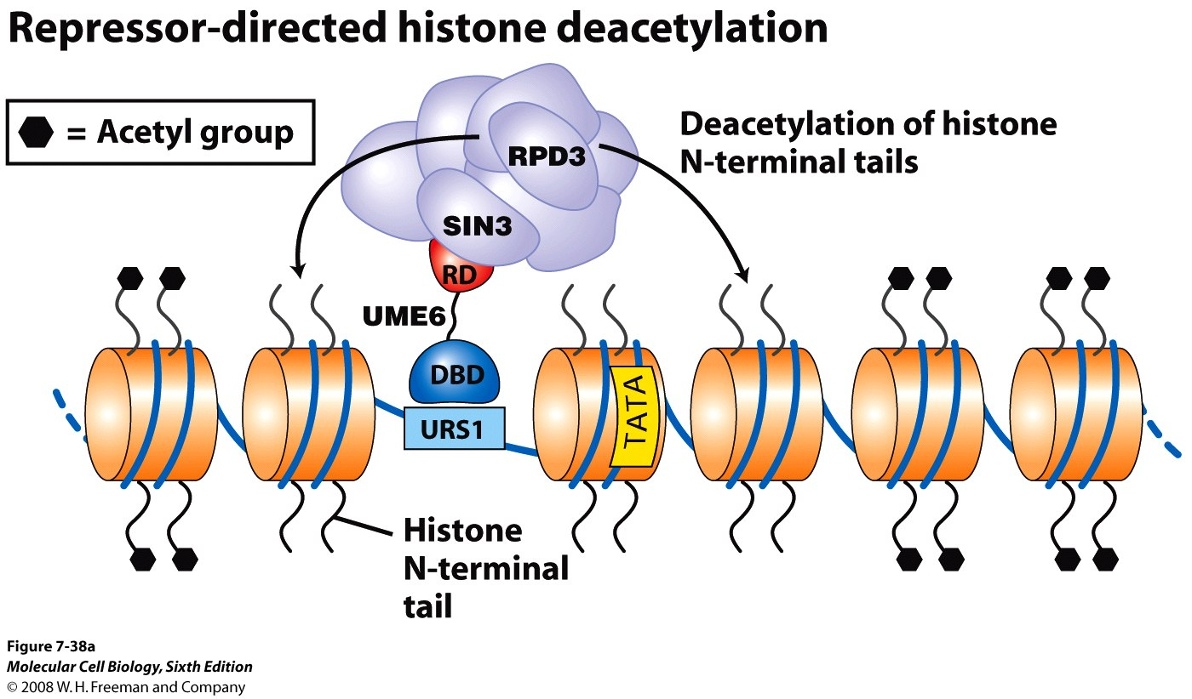
Euchromatin to heterochromatin transition
Another mechanism involved in heterochromatin formation from euchromatin is direct histone deacetylation.
The UME6 repressor binds to URS1 control elements and recruits a co-repressor complex containing SIN3 and RPD3 to these sites.
RPD3 is a histone deacetylase, an enzyme removing acetyl groups from histones in the vicinity of the URS1 sequence. The nucleosomes bound to DNA in this region (which contains a TATA box promoter) subsequently condense, and expression of the gene is repressed.
https://www.uwyo.edu › 13-miller-chap-7c-lecture

Slide 12
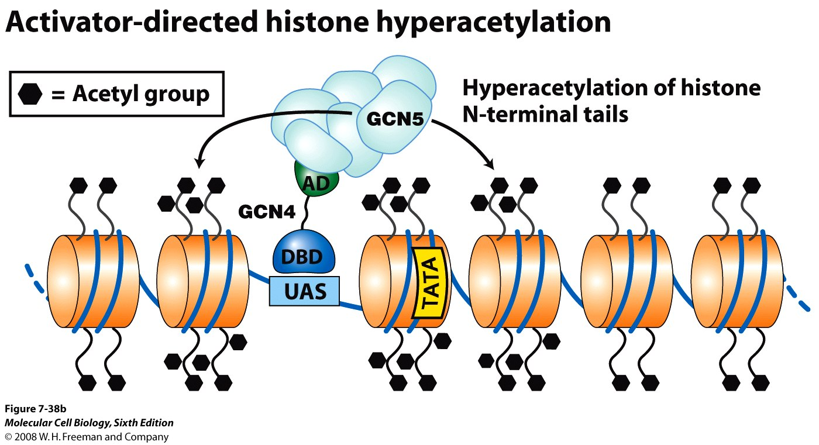
Histone acetylation
In general, the genes can be turned on by histone acetylation and chromatin decondensation.
For instance, GCN4 activator first binds to its UAS upstream of the TATA box of a regulated gene and recruits a co-activator complex containing the GCN5.
The GCN5 acetylates histone N-terminal tails.
Hyperacetylation of histones leads to chromatin decondensation.
General TFs and RNA Pol II are then able to interact with the promoter, and the gene is transcribed.
https://www.uwyo.edu › 13-miller-chap-7c-lecture

Slide 13
DNA Methylation
Cytosine methylation in higher eukaryotes: 10-30%.
Mediated by DNA methyltransferases (DNMTs).
Targeted sequence is short: GC in animals and GNC in plants.
DNA methylation typically weakens gene expression.
Genes with continuous transcription mostly do not have GC methylated islands.
Methyl groups protrude into a large DNA groove „ thus preventing proper binding of transcription factors“.

Slide 14
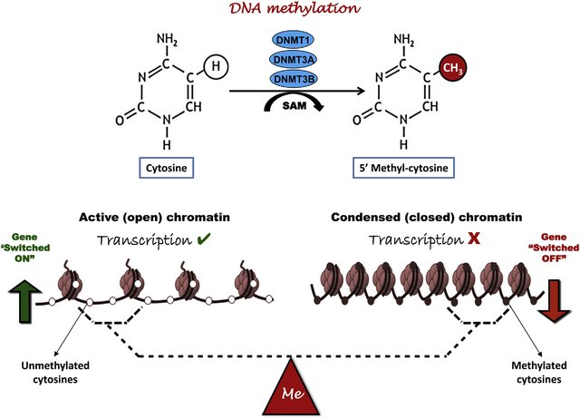
DNA Methylation
The process of DNA methylation involves the transfer of methyl group from S-adenosylmethionine (SAM) to the C-5 position of cytosine, catalyzed by DNA methyltransferases.
DNA methylation is an "epigenetic switch" that regulates the balance between "open" and "closed" form of chromatin by changing the interactions between DNA and protein.
Pharmacology & Therapeutics (2018), https://doi.org/10.1016/j.pharmthera.2018.02.006

Slide 15
Transcription - activity of eukaryotic cell
Transcription is a key regulatory point for many genes. Sets of transcription factor proteins bind to specific DNA sequences in or near a gene and promote or repress its transcription into the RNA.
Unlike prokaryotes, eukaryotic genes are not completely turned on or off, but there is modulation of transcription.
Basal transcription - with the participation of basal TF, transcriptional levels, minimum level of transcription.
Constitutive transcription - with the participation of basal and constitutive TFs, allowing different transcription rates of different gene.
General TF = basal + constitutive, activate operational genes
Induced transcription - transcription regulated by inducible specific TFs which activity is influenced by stimuli from the external or internal environment.
Specific TF= cellular and time-specific regulatory proteins.

Slide 16
Requirements for transcription initiation
Putting RNA-polymerase in the active state.
Binding of TF to the promoter (with the participation of activators and coactivators, necessary to create a pre-initiation complex.
Binding of specific (inducible) TFs to transcription enhancers with unique response sequences (RE).
TF interaction allowing the transcription promoter and enhancer to interact.
Active RNA polymerase state.
https://www.khanacademy.org/science/biology/macromolecules/proteins-and-amino-acids/a/orders-of-protein-structure

Slide 17
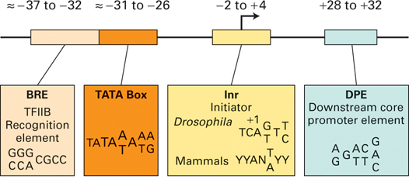
Promoter structure
The promoter of a eukaryotic gene can be defined as a sequence that sets the transcription start site for RNA polymerase.
Strong RNA Pol II promoters contain an A/T rich sequence known as the TATA box located 26-31 bp upstream of the start site.
Other genes have alternative sequence elements known as initiators (Inr) which also serve as promoters that set the RNA Pol II start site.
Finally, CG-rich repeat sequences (CpG islands, BRE) are used by RNA Pol II as promoters in 60-70% of genes. Most of these genes are weakly expressed.
https://view.officeapps.live.com/op/view.aspx?src=http%3A%2F%2Fwww.hixonparvo.info%2FTranscriptionslide.ppt&wdOrigin=BROWSELINK

Slide 18
RNA polymerase lI require five types of proteins
Basal (general) transcription factors.
Architectural regulators to facilitate DNA looping.
Transcription factors, transcription activators.
Proteins that bind to upstream or downstream activator sequences (UASs).
Chromatin modification/remodeling proteins.
Coactivators
Act indirectly (with other proteins, not with DNA).

Slide 19
Transcription initiation by RNA Pol II
RNA Polymerase II (RNA Pol II) requires general TFs in addition to tissue-specific transcription factors for transcription of most genes in vivo.
General transcription factors, TFs, position RNA Pol II at start sites and assist the enzyme in melting promoter DNA. General TFs are highly conserved across species. The general TFs used at TATA box.
Architectural regulators facilitates DNA looping. Such as, TFIID consists of TBP (TATA box binding protein) and 13 TBP-associated factors (TAFs).
https://view.officeapps.live.com/op/view.aspx?src=http%3A%2F%2Fwww.hixonparvo.info%2FTranscriptionslide.ppt&wdOrigin=BROWSELINK

Slide 20
Characteristics of transcription factors (TF)
Provide a response to various extracellular or intracellular stimuli indicating the need to turn on one or more genes.
Unlike most proteins, they are able to enter the nucleus.
Recognize and bind to specific DNA sequences.
Make contact with the transcription apparatus, either directly or indirectly.

Slide 21
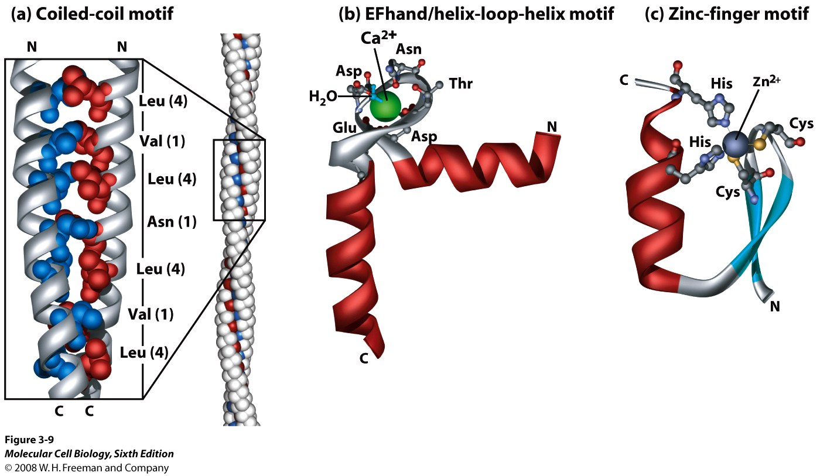
Characteristics of transcription factors (TF)
DNA-binding domains of several transcription factors employ similar tertiary structure – motif.
DNA- binding motifs are evolutionarily conserved AA sequence which have a defined conformation since AA sequence ultimately determines structure.
A given DNA-binding motif can occur in a number of proteins where it carries out the same or similar functions.
For examples of the coiled-coil, EF hand/helix-loop-helix, and zinc-finger motifs.
https://view.officeapps.live.com/op/view.aspx?src=http%3A%2F%2Fwww.hixonparvo.info%2FTranscriptionslide.ppt&wdOrigin=BROWSELINK

Slide 22
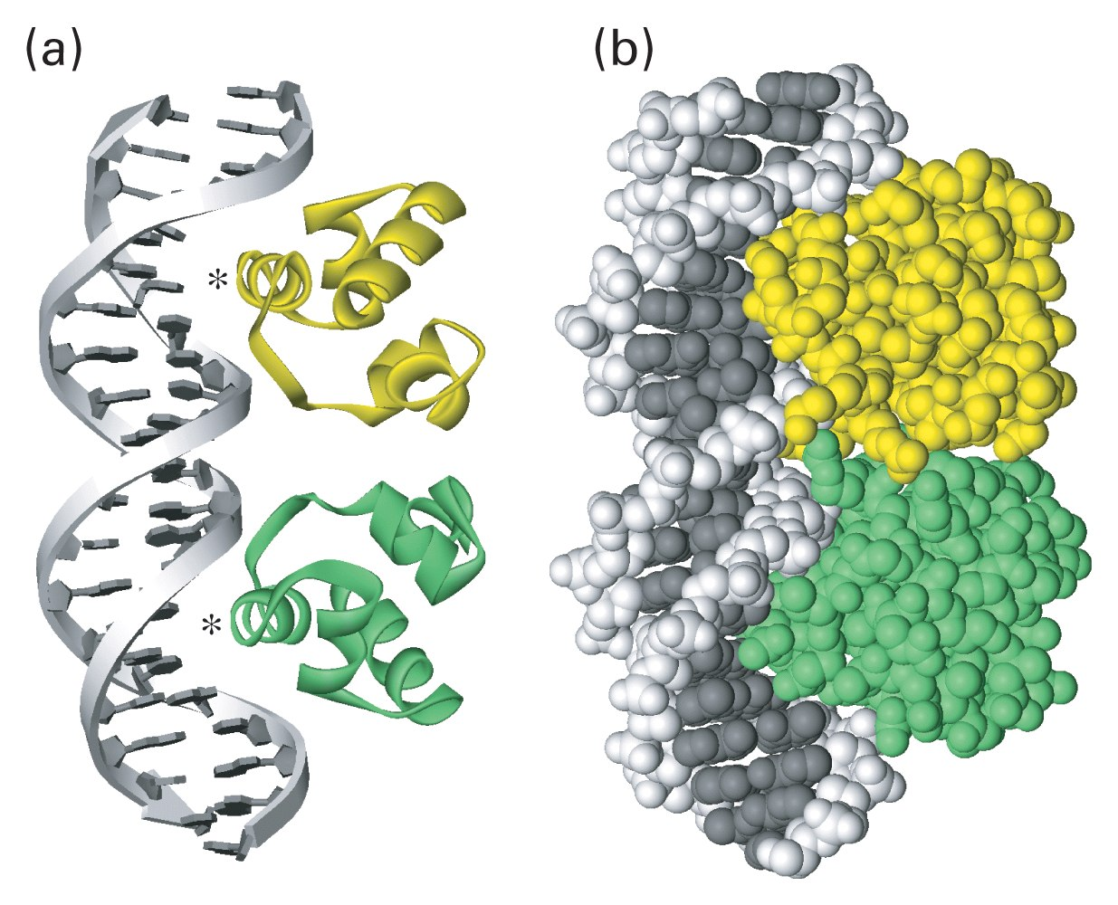
DNA-binding motifs in TFs
DNA-binding motifs bind specifically to DNA via non-covalent interactions.
Helix – Turn – Helix. The second helix in this motif (the DNA recognition helix) typically binds to a specific sequence of bases in DNA.
Alpha-helices are one of the most common types of DNA-binding sequences. The side-chains of residues within the α-helix often bind to the surfaces of bases exposed in the major groove of double-helical DNA. Binding to phosphates and bases in the minor groove typically is less important.
Helix-turn-helix TFs are common in bacteria.
https://view.officeapps.live.com/op/view.aspx?src=http%3A%2F%2Fwww.hixonparvo.info%2FTranscriptionslide.ppt&wdOrigin=BROWSELINK

Slide 23
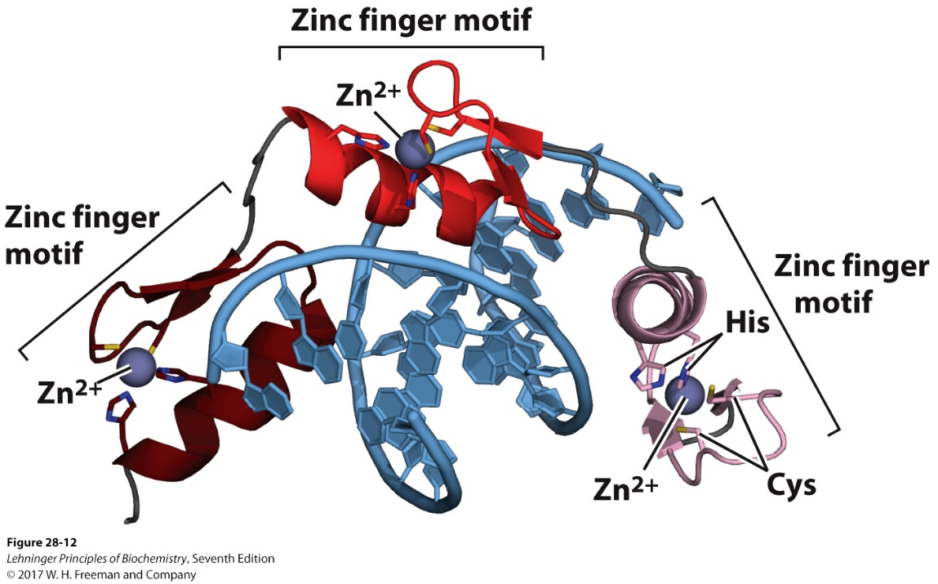
DNA-binding motifs in TFs
Zinc finger - most common DNA-binding motif in human and multicellular animal.
Two types of zinc finger TFs:
C2H2 zinc finger TFs - its 2 cysteine and 2 histidine residues bind to zinc ions (Zn²⁺) and the α-helix containing the 2 histidines binds to bases in the major groove.
C4 zinc finger TFs is much less common.
Most TFs containing this motif are dimeric. Nuclear receptors, which bind steroid hormones and other compounds, contain this motif. Zinc ions are bound to the DNA recognition helix of this motif, which contacts bases in the major groove.
Department of Experimental Biology
https://www.coursehero.com/Lehninger_Ch28.ppt - 28, Regulation of Gene Expression

Slide 24
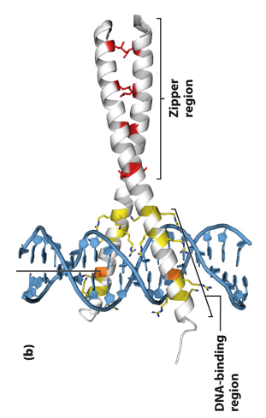
DNA-binding motifs in TFs
Leucine-zipper TFs
Contain extended a-helices wherein every 7th amino acid is leucine. This periodicity creates a nonpolar face on one side of the helix that is ideal for dimerization with another such protein via a coiled-coil motif.
So-called basic zipper (bZip) TFs have a similar structure except that some leucines are replaced by other nonpolar amino acids.
The N-terminal ends of both leucine-zipper and bZip proteins contain basic amino acids that interact with bases in the major groove.
Basic residues
https://view.officeapps.live.com/op/view.aspx?src=http%3A%2F%2Fwww.hixonparvo.info%2FTranscriptionslide.ppt&wdOrigin=BROWSELINK

Slide 25
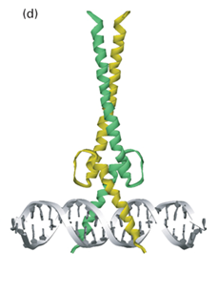
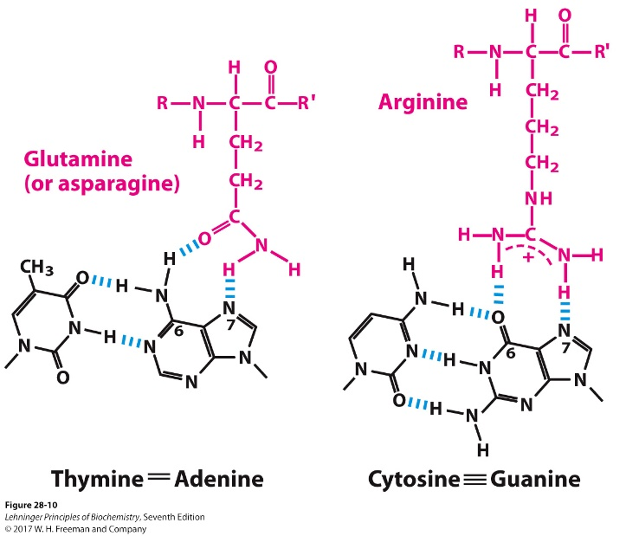
DNA-binding motifs in TFs
Helix – Loop – Helix TF
Another class of TF, the basic helix-loop-helix (bHLH) proteins are similar to bZip proteins, but contain a loop between the DNA recognition helix and the coiled-coil region. bZip and bHLH proteins commonly form heterodimeric TFs.
Basic residues
https://view.officeapps.live.com/op/view.aspx?src=http%3A%2F%2Fwww.hixonparvo.info%2FTranscriptionslide.ppt&wdOrigin=BROWSELINK
https://www.coursehero.com/Lehninger_Ch28.ppt - 28, Regulation of Gene Expression

Slide 26
RNA Pol II preinitiation complex formation
The sequential steps leading to the assembly of the RNA Pol II pre-initiation complex.
1. TBP binds to the TATA box and bends (DNA looping) DNA near the promoter.
2. TFIIB binds, and then a complex between Pol II and TFIIF loads onto the promoter.
3. TFIIF positions the Pol II active site at the mRNA start site and helps maintain chromatin at the promoter in an uncondensed state.
4. TFIIE then binds creating a TFIIH docking site.
https://view.officeapps.live.com/op/view.aspx?src=http%3A%2F%2Fwww.hixonparvo.info%2FTranscriptionslide.ppt&wdOrigin=BROWSELINK

Slide 27
RNA Pol II preinitiation complex formation
5. With the addition of TFIIH, the assembly of the pre-initiation complex is complete.
6. Subsequently, one subunit of TFIIH melts DNA at the promoter, obtaining energy by ATP hydrolysis. RNA Pol II then begins transcribing the mRNA.
Another subunit of TFIIH phosphorylates the RNA Pol II CTD, making RNA Pol II highly processive.
Tissue-specific TFs bound to enhancers and promoter-proximal elements also play important roles in transcription initiation in vivo.
https://view.officeapps.live.com/op/view.aspx?src=http%3A%2F%2Fwww.hixonparvo.info%2FTranscriptionslide.ppt&wdOrigin=BROWSELINK

Slide 28
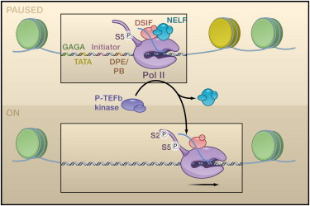
Transcription – elongation phase
Right after transcription initiation the RNA polymerase II is paused typically 30–50 nucleotides after transcription initiation site.
Negative transcription elongation factors DSIF, NELF.
RNA Pol II undergone promoter escape and contains phosphorylation of serine 5 (Ser5) in the C-terminal domain (CTD).
Recruitment of P-TEFb (positive transcription elongation factor b) causes phosphorylation of Ser2 in the CTD, resulting in RNA Pol II transcription elongation.
Cell, 2011, Levine M., May 13, 145

Slide 29
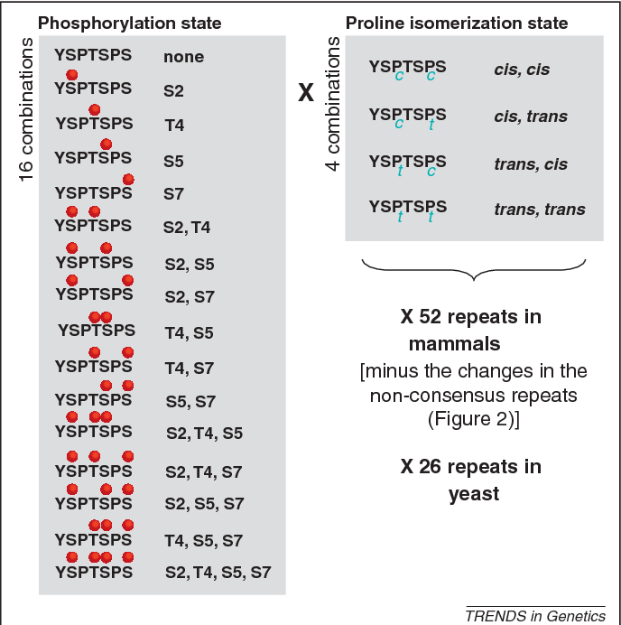
Transcription – elongation phase
Posttranslational modification, phosphorylation in particular, of CTD of RNA Pol II corresponds with specific phase of transcription.
Other modification of CTD of RNA Pol II.
Acetylation
Proline isomerization.
We talk about CTD code.
Trends Genet. 2012 Jul;28(7):333-41.

Slide 30
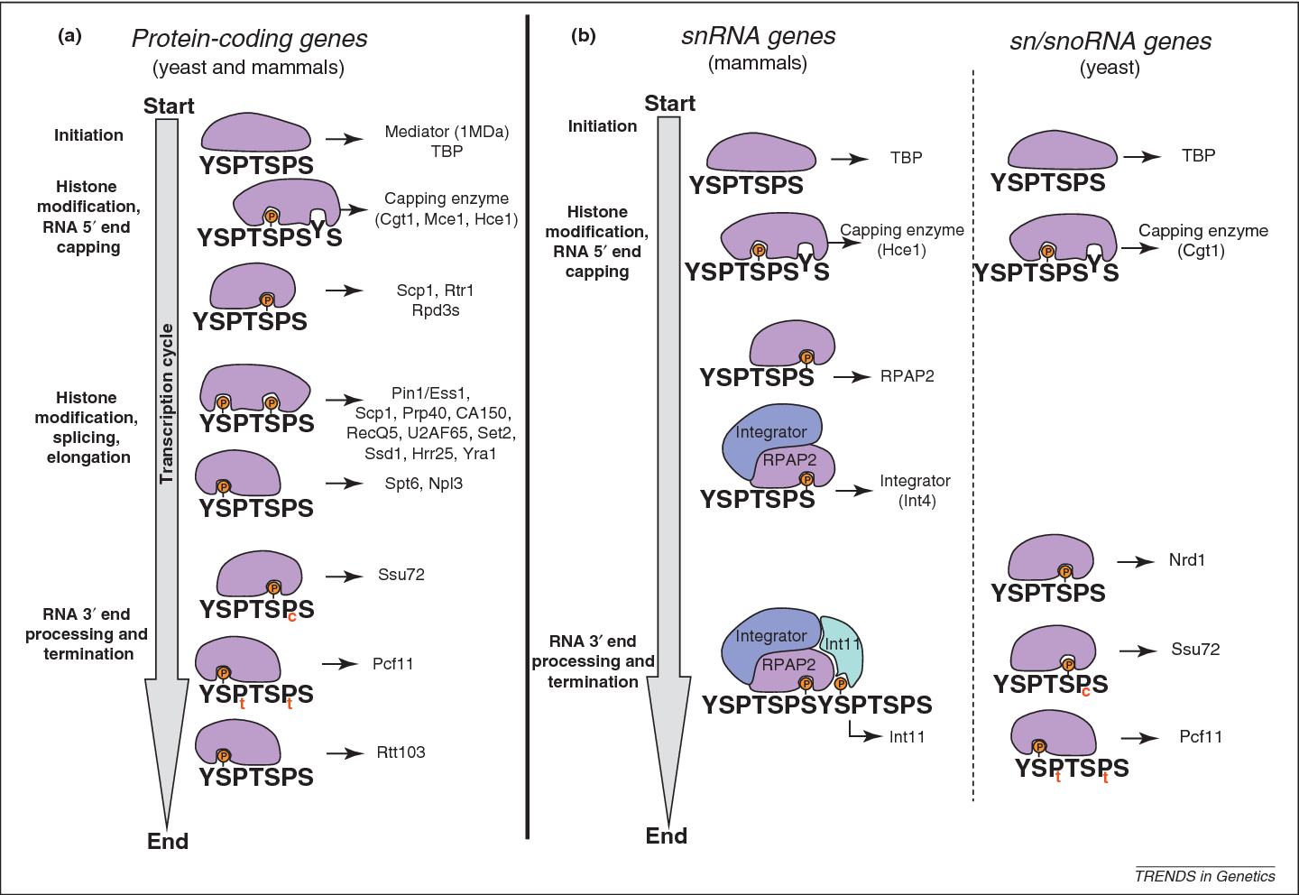
Transcription – elongation phase
Modification of CTD of RNA Pol II coincides with various steps in transcription.
DNA and chromatin remodeling.
Histone modifications.
DNA processing.
Transcription termination and polyadenylation.
Trends Genet. 2012 Jul;28(7):333-41.

Slide 31
Enhancers and Activators
Distal control DNA elements, which are called enhancers, may be far away from a gene or even located in an intron.
Enhancers can be thousands of nucleotides away from the TATA box of the promoter.
Can be bound by activators.
Activators have two domains DNA-binding, protein-binding, and/or signal molecule-binding domains coupled with transcription activating domain.
Facilitate a sequence of protein-protein interactions that result in transcription of a given gene.
Some regulate a few genes; some regulate many hundreds of genes.
https://www.camphillsd.k12.pa.us/ short chap 18.ppt
https://ww2.chemistry.gatech.edu/Lehninger_Ch28.ppt

Slide 32
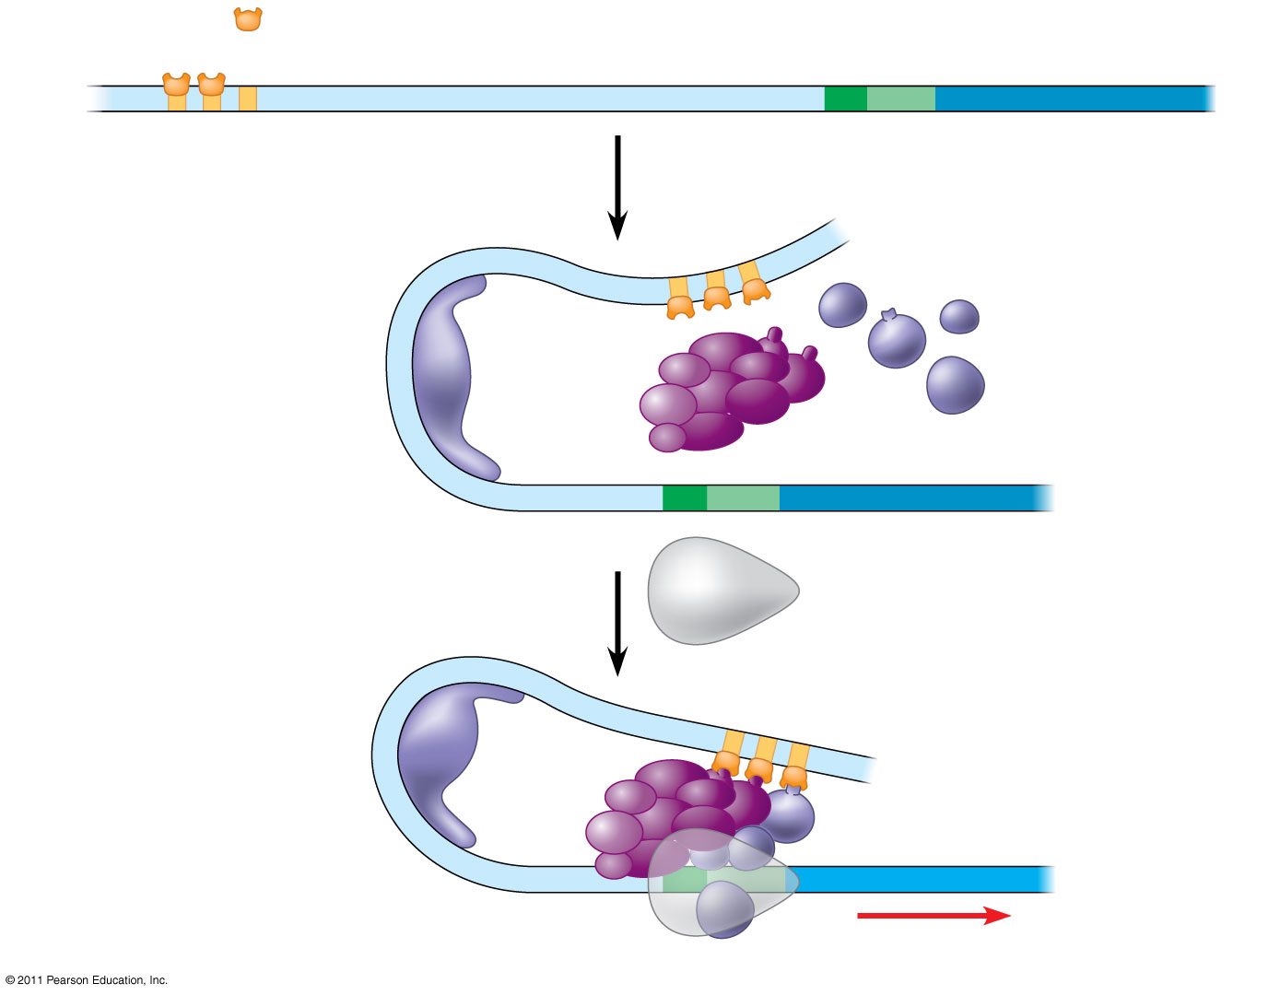
Enhancers and Activators
Activators
Promoter
Gene
DNA
Enhancer
Distal control element
TATA box
General transcription factors
DNA- bending protein
Group of mediator proteins
RNA polymerase II
RNA polymerase II
Transcription initiation complex
RNA synthesis
https://www.camphillsd.k12.pa.us/ short chap 18.ppt

Slide 33
Chromatin remodeling complexes
CRE - cAMP response element.
CREB - (cAMP response element-binding protein/CRE-binding protein).
Specific transcription factor.
Transcription of genes regulated by CREB: somatostatin, c-fos, tyrosine hydroxylase, neuropeptides, enkephalin, genes involved in circadian rhythm control, and more.
CBP–CREB binding protein.
Histon acetyltransferase.
Coactivator CREB.
Many other transcription factors (c-myb, c-fos, p53, E2F, NF-κB,...).
Department of Experimental Biology

Slide 34
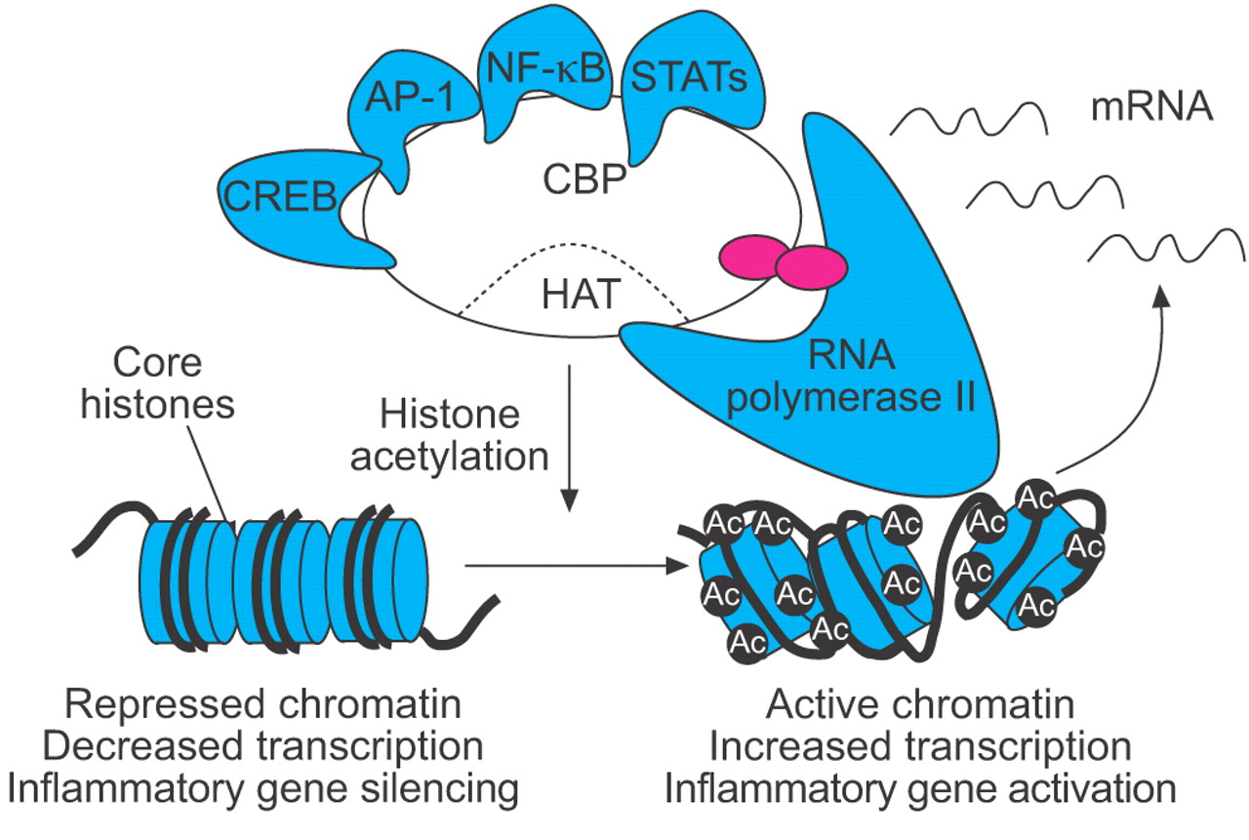
Chromatin remodeling complexes
Department of Experimental Biology
European Respiratory Journal 2005 25: 552-563

Slide 35
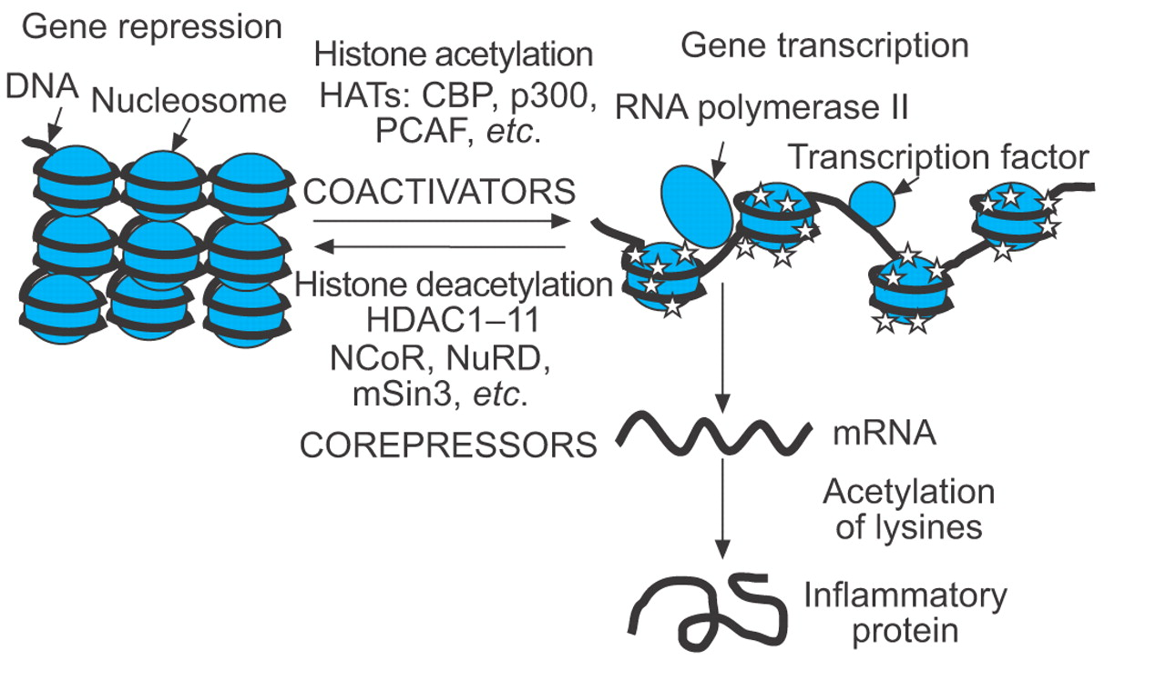
Chromatin remodeling complexes
European Respiratory Journal 2005 25: 552-563

Slide 36
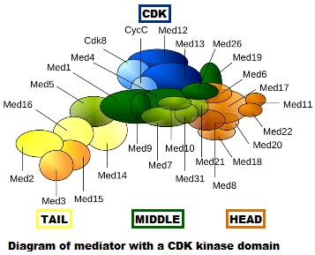
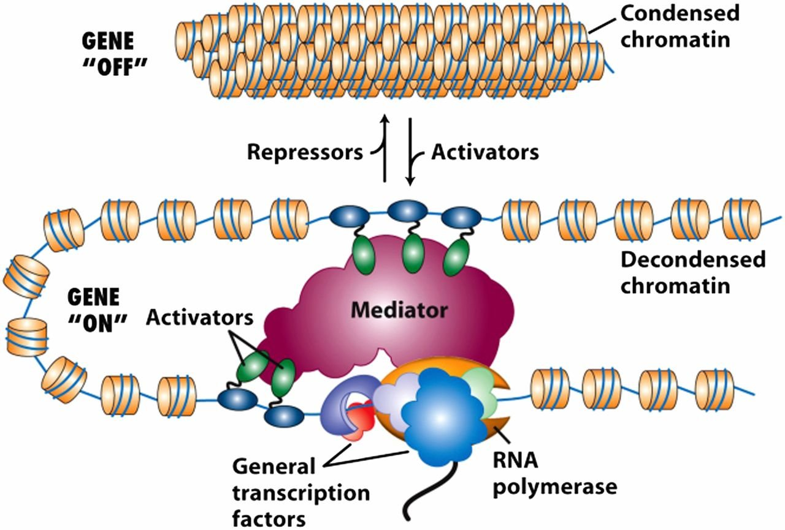
Mediator complex
Mediator is an ∼30-subunit multiprotein complex.
Mediator functions as a molecular bridge between RNA Pol II and transcription factors bound to enhancers and promoter proximal transcription control sequences.
Mediator influences all stages of transcription – from initiation to elongation.
Non-coding RNA interacts directly with Mediator to influence transcription.
PNAS, 2012, 109 (48) 19519-19520
https://en.wikipedia.org/wiki/Mediator_(coactivator)

Slide 37
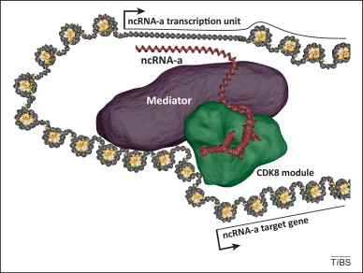
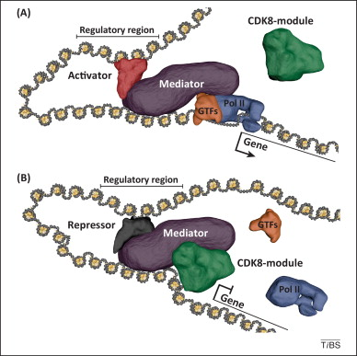
Mediator complex
It can activate or repress transcription.
The mammalian Mediator complex interacts directly with a subset of long noncoding RNAs termed lncRNA-activating (ncRNA-a), which activate neighboring genes using a cis-mediated mechanism.
Trends in Biochemical Sciences, Nov 2013, Vol. 3, Is. 11, P531-537

Slide 38
RNA processing
Splicing, capping, and addition of a poly-A tail to an RNA molecule can be regulated.
Different mRNAs may be made from the same pre-mRNA by alternative splicing.
https://courses.lumenlearning.com/wm-biology1/chapter/reading-post-translational-control-of-gene-expression/

Slide 39
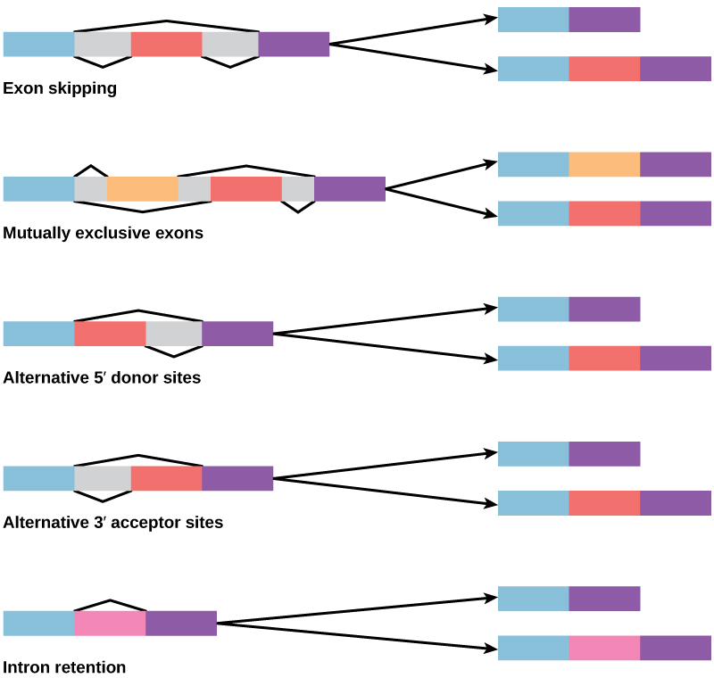
Alternative splicing
Alternative RNA splicing is a mechanism that allows different protein forms to be produced from one gene when different combinations of introns, and sometimes exons, are removed from the transcript.
It is a common mechanism of gene regulation in eukaryotes; according to one estimate, 70 percent of genes in humans are expressed as multiple proteins through alternative splicing.
The cause of many genetic diseases is improper alternative splicing rather than mutations in a sequence.
https://courses.lumenlearning.com/wm-biology1/chapter/reading-post-translational-control-of-gene-expression/

Slide 40
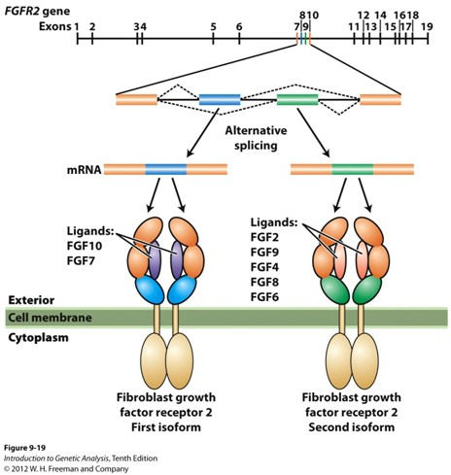
Splicing Produces Related but Distinct Protein Isoforms
Department of Experimental Biology
https://slideplayer.com/slide/5746723/

Slide 41
RNA stability
RNA stability. The lifetime of an mRNA molecule in the cytosol affects how many proteins can be made from it.
Capping.
Degradation of mRNA.
Small regulatory RNAs called miRNAs can bind to target mRNAs and cause them to be chopped up.
Small nuclear RNA – 7SK RNA, U1snRNA.
Long noncoding RNA.
https://open.lib.umn.edu/evolutionbiology/chapter/5-8-using-the-genetic-code-2/

Slide 42
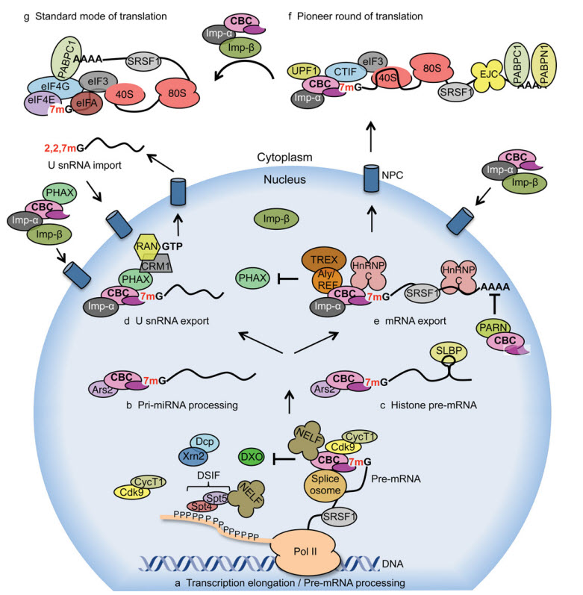
Regulation of 5´- CAP
The 5′ cap has four main functions:
Regulation of nuclear export of RNA is regulated by the cap binding complex (CBC), which binds to 7-methylguanylate-capped RNA. The CBC is then recognized by the nuclear pore complex and the mRNA exported.
Prevention of degradation by exonucleases.
Promotion of translation.
Promotion of 5′ proximal intron excision.
https://wou.edu/chemistry/courses/online-chemistry-textbooks/ch450-and-ch451-biochemistry-defining-life-at-the-molecular-level/chapter-10-transcription-and-rna-processing/

Slide 43
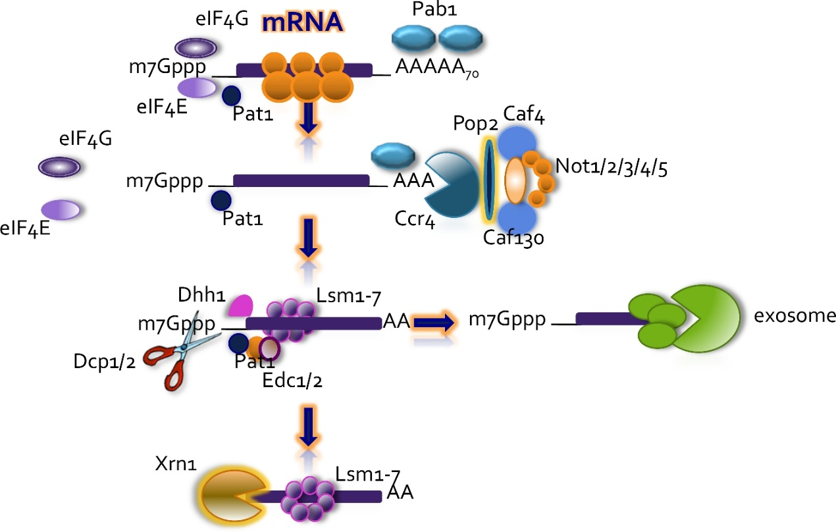
Degradation of RNA
The first step of untranslated mRNA degradation is deadenylation, removal of polyA tail.
Deadenylated mRNAs are degraded in the 3΄-to-5΄ direction by the exosome complex or, mainly, are transferred to P-bodies for decapping.
In P-bodies the m7Gppp cap is removed by Dcp1/2 – dipeptydil carboxypeptidase 1 and 2.
RNA without cap is degraded in the 5΄-to-3΄ direction by the Xrn1- 5´-3´exoribonuclease 1.
FEMS Yeast Research, Volume 18, Issue 6, September 2018, foy050,

Slide 44
MicroRNA
miRNA
18-25 nt, single-strand molecules.
Post-transcriptionally regulate gene expression.
2694 human miRNAs (miRBASE in 22, March 2018).
Evolutionarily conserved and transcribed by RNA Pol II.
1-2 % of the genome.
Genes for miRNAs on all human chromosomes except Y.
Regulation of the expression of up to 50% of protein-coding genes.
One miRNA can regulate tens to hundreds of target mRNAs.

Slide 45
Biogenesis of miRNA
A miRNA is first transcribed as a long RNA molecule, which forms base pairs with itself and folds over to make a hairpin.
Next, the hairpin is chopped up by Drosha enzymes, releasing a small double-stranded fragment of about 22 nucleotides and processed by Dicer.
One of the strands in this fragment is the mature miRNA, which binds to a specific protein to make an RNA-protein complex RISC – RNA-induced silencing complex.
Targeting of mRNA
mRNA cleavage.
Translation repression.

Slide 46
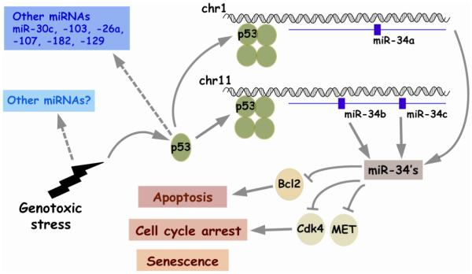
Function of miRNA
Physiological function
Proliferation.
Differentiation.
Apoptosis and etc.
Tumorigenesis.
https://cen.acs.org/articles/89/web/2011/04/Pyrrolysine-Synthesis-Revealed.html

Slide 47
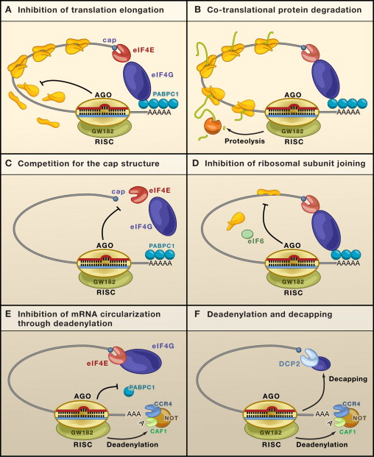
Mechanism of miRNA-mediated gene silencing
Postinitiation mechanisms (A).
Cotranslational protein degradation (B).
Initiation mechanisms. MicroRNAs interfere with a very early step of translation, prior to elongation.
Argonaute proteins compete with eIF4E for binding to the cap structure (C).
Argonaute proteins recruit eIF6, which prevents the large ribosomal subunit from joining the small subunit (D).
Argonaute proteins prevent the formation of the closed loop mRNA configuration by an ill-defined mechanism that includes deadenylation (E).
MicroRNA-mediated mRNA decay. MicroRNAs trigger deadenylation and subsequent decapping of the mRNA (F).
Cell, Jan 2008, Vol. 132, Is. 1, P9-14.

Slide 48
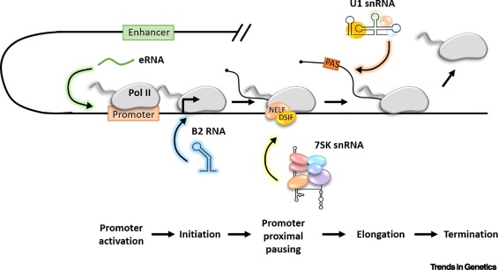
Small nuclear RNA
Small nuclear RNA (snRNA) is one of the small RNA with an average size of 150 nt.
Eukaryotic genomes code for a variety of non-coding RNAs.
snRNA is a class of highly abundant RNA, localized in the nucleus with important functions in intron splicing and other RNA processing.
Trends in Genetics, Mar 2021, Vol. 37, Is. 3., P279-291.

Slide 49
Long noncoding RNA – lncRNA
Longer than 200 nt; encoded by genes on different chromosomes (in non-coding regions, even in gene introns).
Usually transcribed RNA polII (III), often have a cap at the 5'-end and a poly(A) at the 3'-end, subject to splicing; do not have ORF, cannot be translated.
Often tissue-specific and developmental stages specific.
Some lncRNA found in specific DNA locus.
Changes in the expression of lncRNAs associated with various diseases (cancer, Alzheimer's, atherosclerosis), can also serve as markers.
Present in body fluids, possibility of non-invasive diagnostics.
In humans about 50,000 -100,000 genes for lncRNA, up to 270,000 different transcripts lncRNAs.

Slide 50
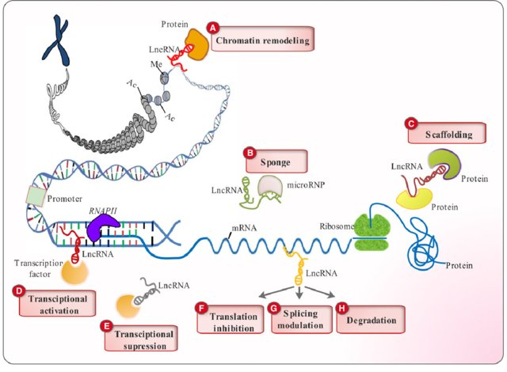
Effect of lncRNA on gene expression
J Cell Mol Med. 2017 Dec;21(12):3120-3140.

Slide 51
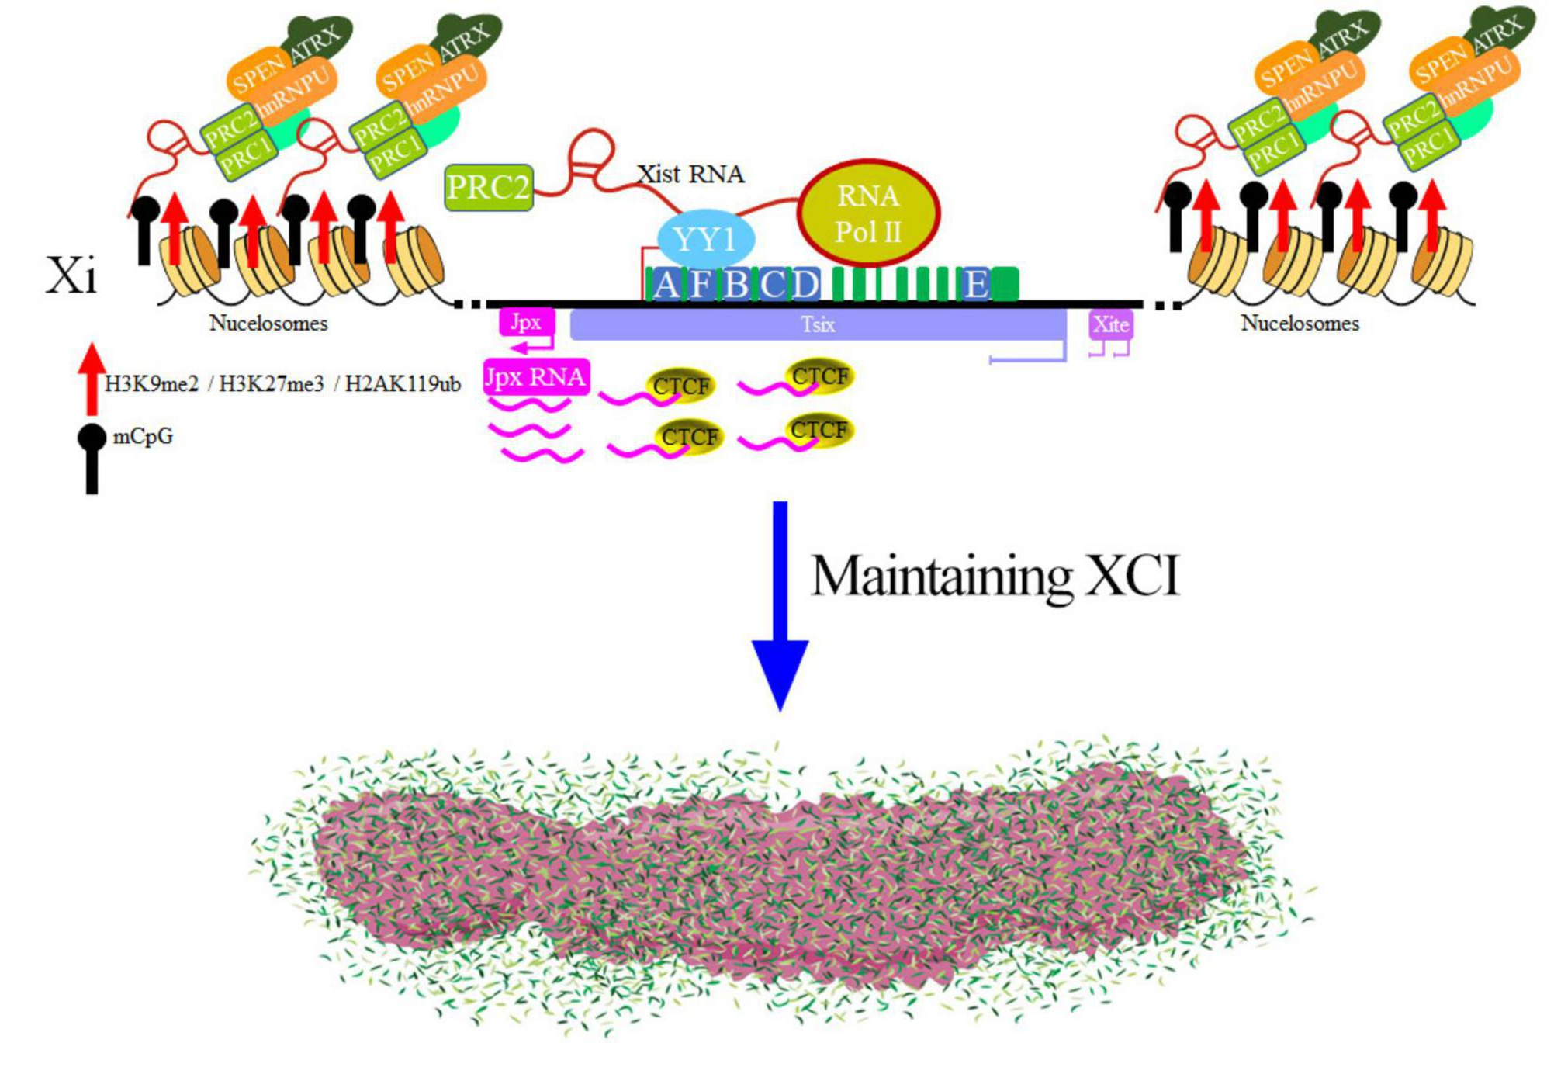
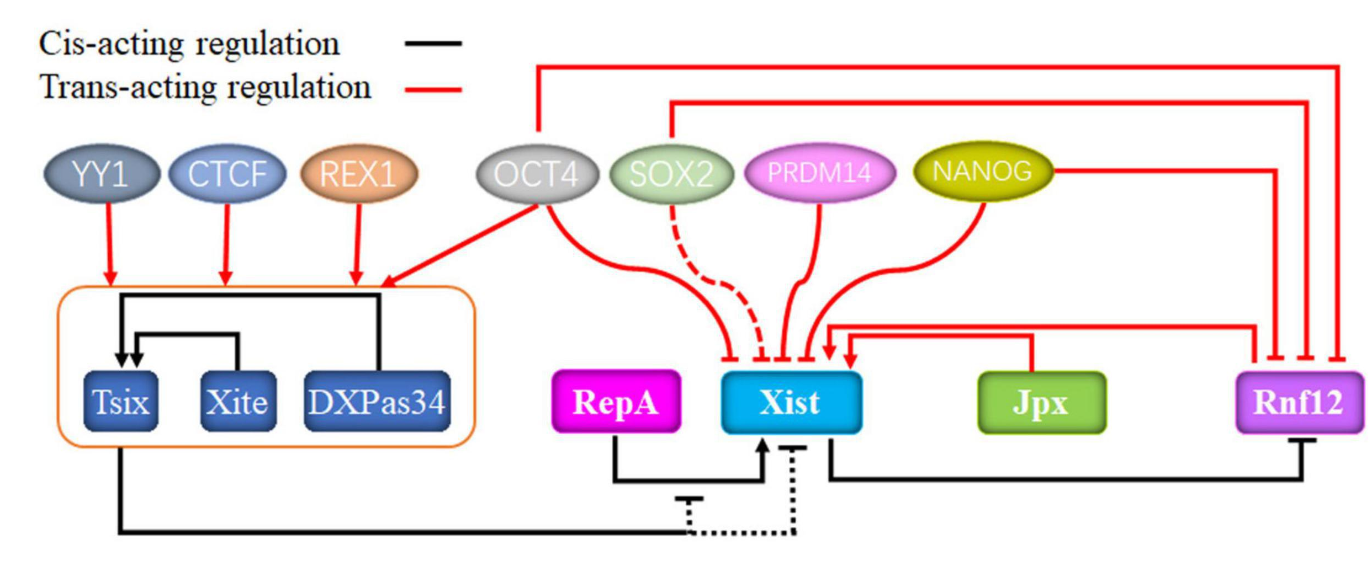
Effect of lncRNA on gene expression
lncRNAs Xist regulates process of X-chromosome inactivation (XCI).
lncRNA Xist recruits protein complexes to initiate, establish, and maintain the XCI state by histone modifications, DNA methylation, and H4 hypoacetylation.
LncRNA Xist regulation network of genetic interactions.
Front. Cell Dev. Biol., 10 June 2021

Slide 52
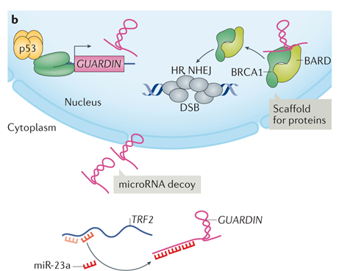
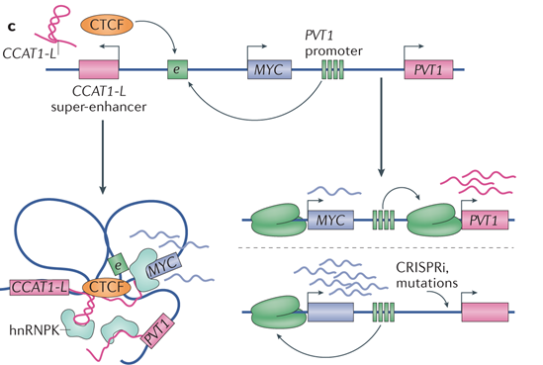
Role of lncRNA in tumorigenesis
Myc transcription.
Guardin – induced by p53 during DNA damage.
Cytoplasm - sponge – stabilizes TRF2 mRNA
Nucleus – enables interaction of BRCA1 and BARD to help recruit DSB machinery.
Nature Reviews Molecular Cell Biology volume 22, pages96–118 (2021)

Slide 53
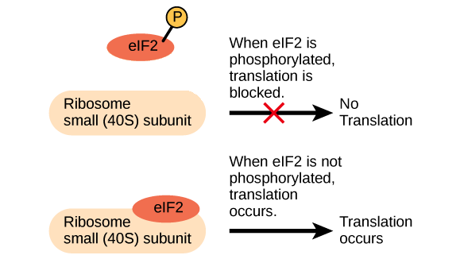
Regulation of translation
Translation of mRNA involves many “helper” proteins, which make sure the ribosome is correctly positioned.
Elongation initiation factor-2 (eIF-2) binds to a part of the ribosome called the small subunit.
When eIF-2 is phosphorylated, it's turned "off„ - it undergoes a shape change and can no longer play its role in initiation, so translation cannot begin. When eIF-2 is not phosphorylated, in contrast, it's "on" and can carry out its role in initiation, allowing translation to proceed.
In this way, phosphorylation of eIF-2 acts as a switch, turning translation on or off.

Slide 54
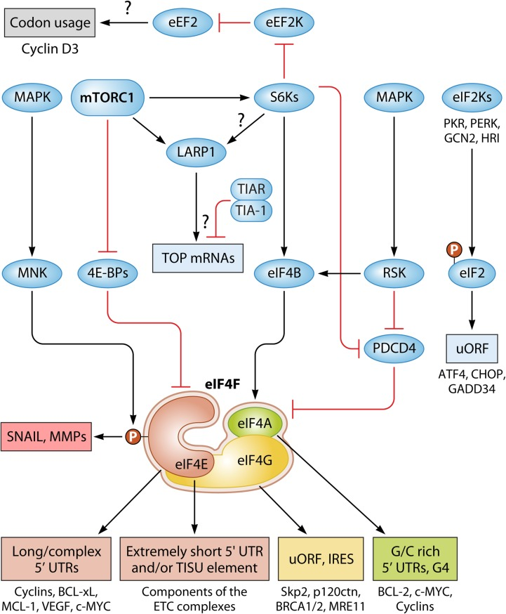
Signaling pathways in regulation of translation
The mTOR and MAPK pathways affect the translatome by modulating the expression of specific subsets of mRNAs.
Phosphorylation of the 4E-BPs by mTOR leads to their dissociation from eIF4E, which stimulates the interaction of eIF4E with eIF4G and assembly of the eIF4F complex.
Phosphorylation of eIF4E also seems to bolster the translation of mRNAs encoding proteins involved in tumor dissemination.
Also eIF4A promotes the translation of mRNAs with G/C-rich 5′ UTR sequences, such as the 12-nucleotide guanine quartet (CGG)4 motif, which can form RNA G-quadruplex structures.
Department of Experimental Biology
https://www.ncbi.nlm.nih.gov/pmc/articles/PMC5974435/

Slide 55
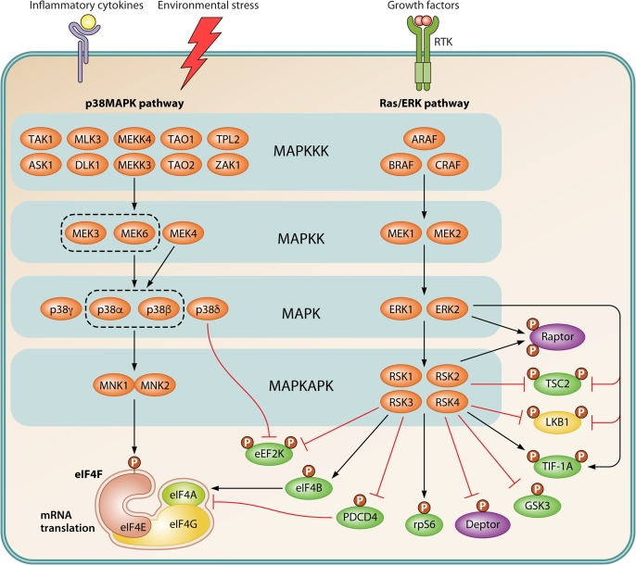
Signaling pathways in regulation of translation
The Ras/ERK and p38MAPK pathways are activated by a wide range of stimuli, including cytokines, growth factors, and diverse environmental stresses.
MNK interacts with eIF4G and phosphorylates eIF4E on Ser²⁰⁹, a site that increases its oncogenic potential and facilitates the translation of specific mRNAs.
RSK phosphorylates rpS6, eIF4B, PDCD4, and eEF2K, which are important regulators of translation.
ERK and RSK also collaborate in the regulation of ribosome biogenesis by promoting TIF-1A phosphorylation.
https://www.cell.com/fulltext/S0960-9822(02)01135-1

Slide 56
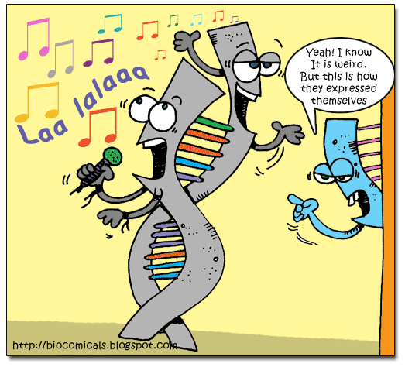
THANK YOU FOR YOUR ATTENTION.
https://steemit.com/science/@pjheinz/control-of-gene-expression-part-ii

