Slide 1
Ramanova spektroskopie

Slide 2
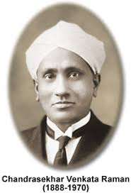
Ramanova Spektroskopie
Prof. Chandrashekhara Venkata Raman
Discovered the "Raman Effect“ – a light scattering effect in 1928, won the Noble Prize in 1930 for Physics
Ramam spectroscopy is the measurement of the wavelength and intensity of inelastically scattered light from molecules
The Raman scattered light occurs at wavelengths that are shifted from incident light by the energies of molecular vibrations
It is govern by the polarizability of electron cloud around the molecule

Slide 3
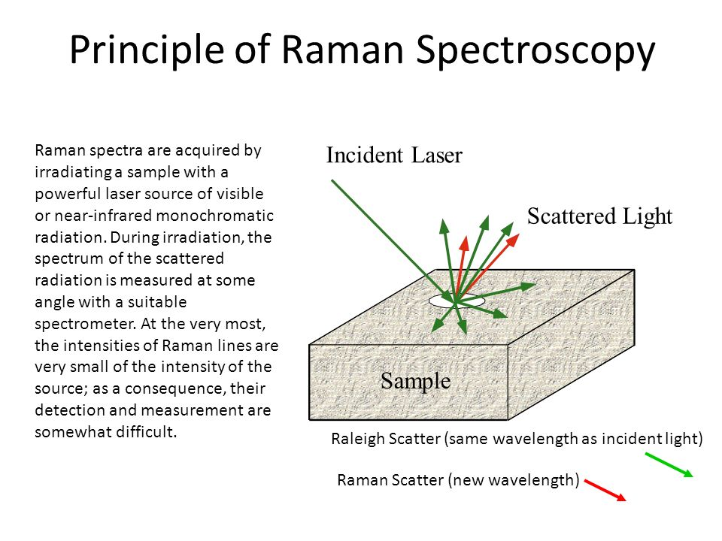

Slide 4
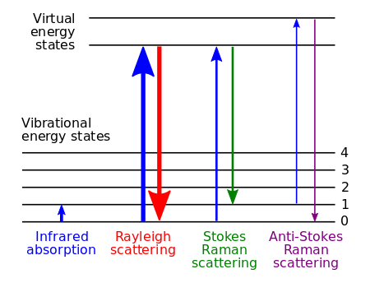

Slide 5
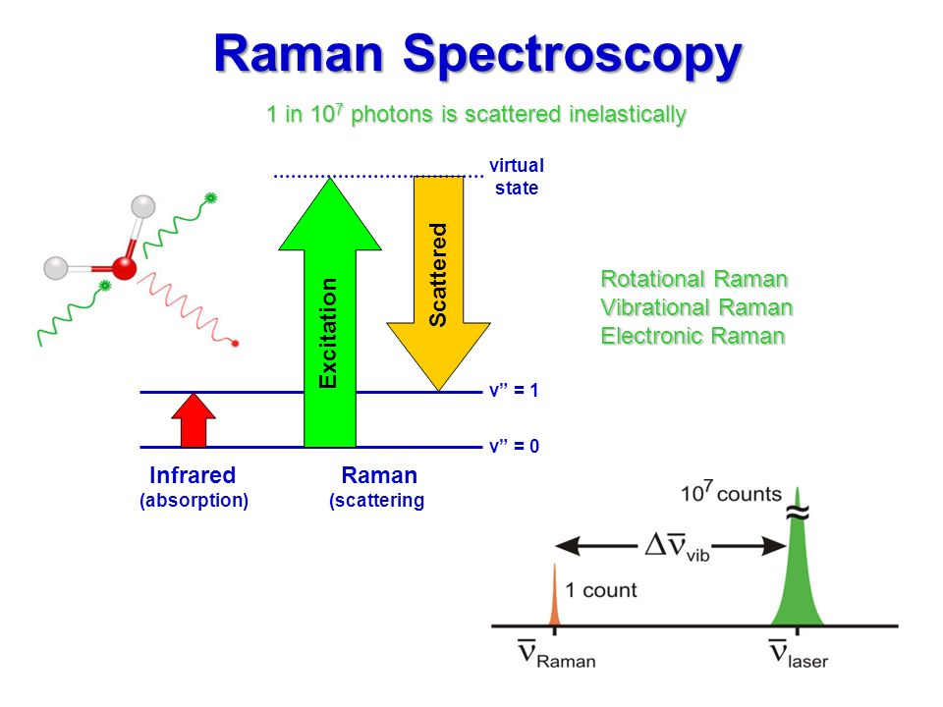

Slide 6
Conditions of Raman Spectroscopy
Vibrational modes that are more polarizable are more Raman-active:
  N₂ (symetric stretch): cause no change in dipole moment – IR-inactive, but cause a change of the bond length (change the polarizability of the bond) - Raman-active.
  CO₂ (asymetric stretch): cause a change in dipole moment (IR-active), polarizability change by bond lengthering is canceled by asymmetric strecth (Raman-inactive).
  Some bonds may be both IR and Raman active/inactive.

Slide 7
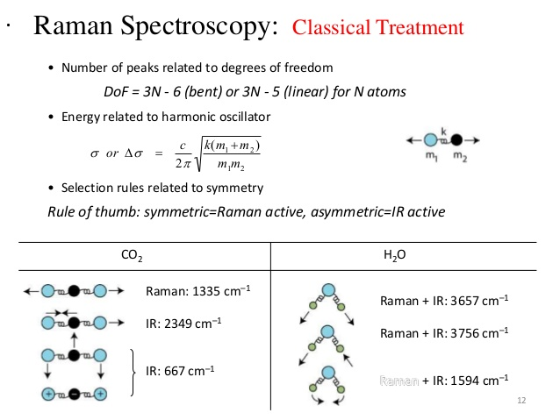

Slide 8
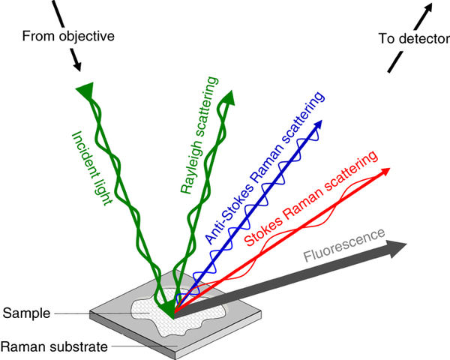
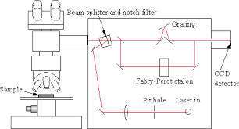
laser | UV 325 nm | VIS 532 nm | IR 785 nm
Excitation efficiency | high | medium | low
Fluorescence | high | medium | low
Heat absorption | low | medium | high

