Slide 1
“Deathly beautiful”, or Shocking History of the Use of Radium in Cosmetics in the 20th Century
Siluianova Iuliia
Biochemistry

Slide 2
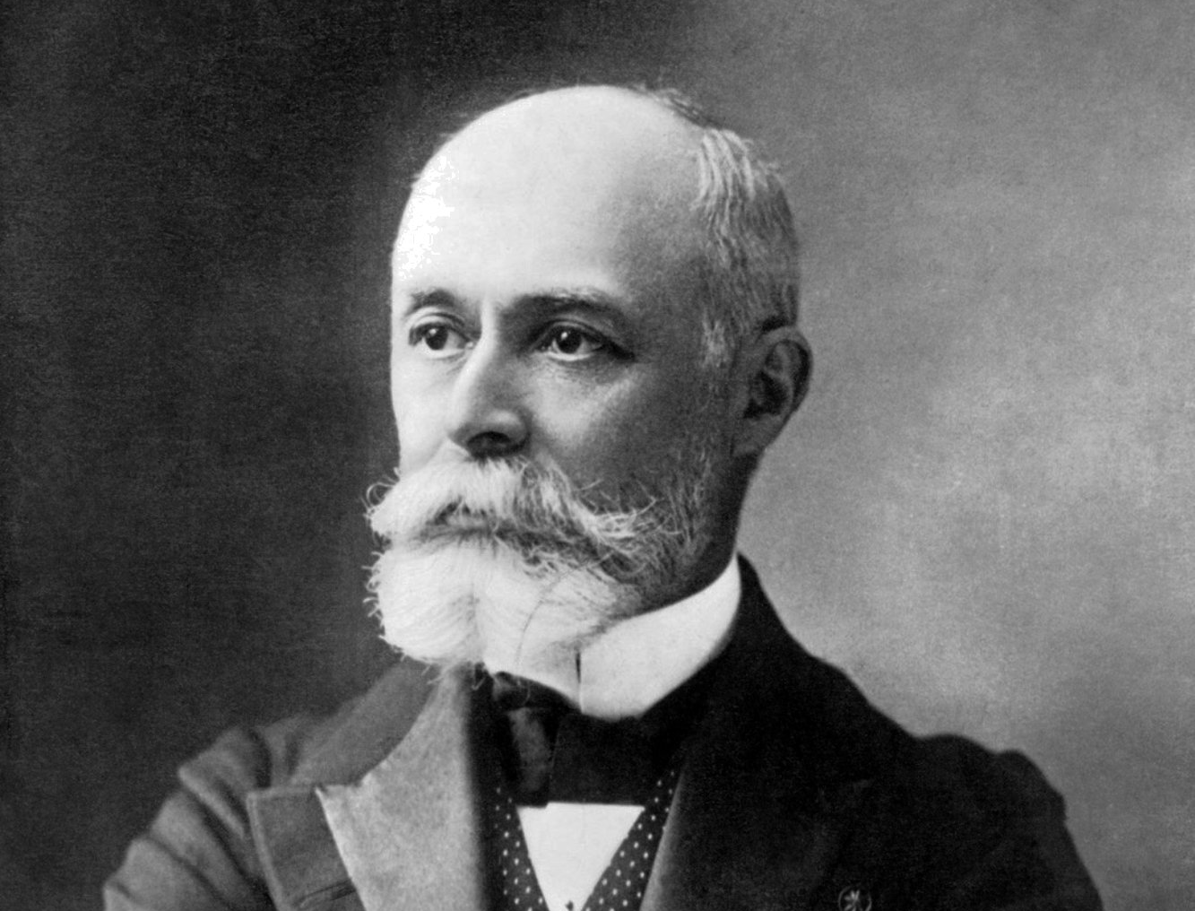
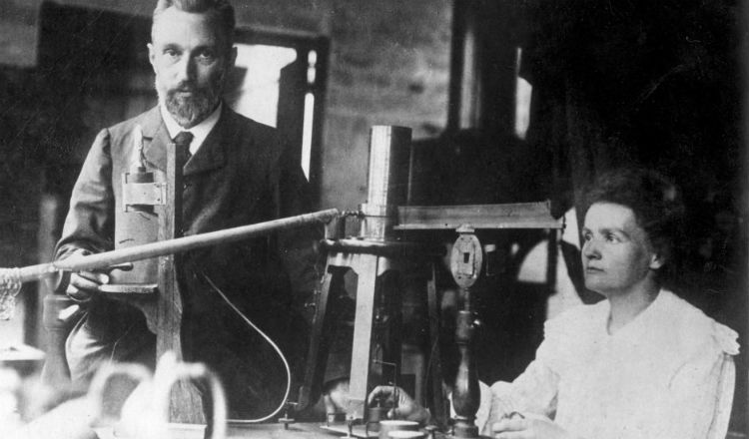
Henri Becquerel
Marie and Pierre Curie
Received the 1903 Nobel Prize in Physics

Slide 3
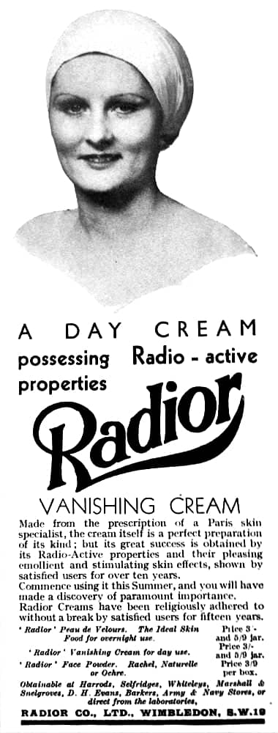
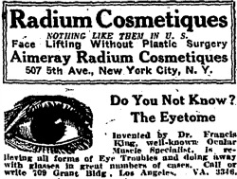
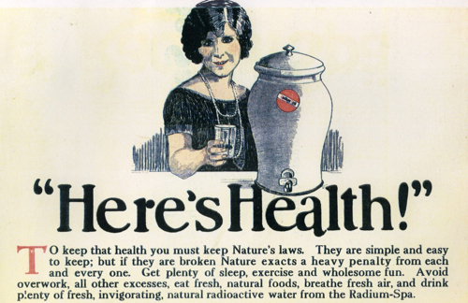
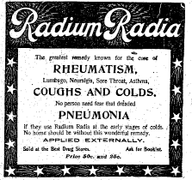

Slide 4
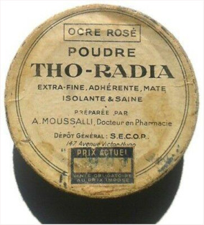
THO-RADIA
was founded in 1932 by the Parisian pharmacist Alexis Moussalli;
Moussalli brought the physician Alfred Curie - a doctor who had no relation to the discoverers of radium despite his name;
the company’s signature product was Tho-Radia cream which was supposed to activate the circulation, firm the tissue, remove grease, remove wrinkles, etc.
100 grams of Tho-Radia cream contained:
0.233 ug of radium bromide
0.5 g of thorium chloride
100 grams of Tho-Radia powder contained:
0.01 ug of radium bromide
0.1 g of thorium sulfate
4 g of titanium oxide

Slide 5
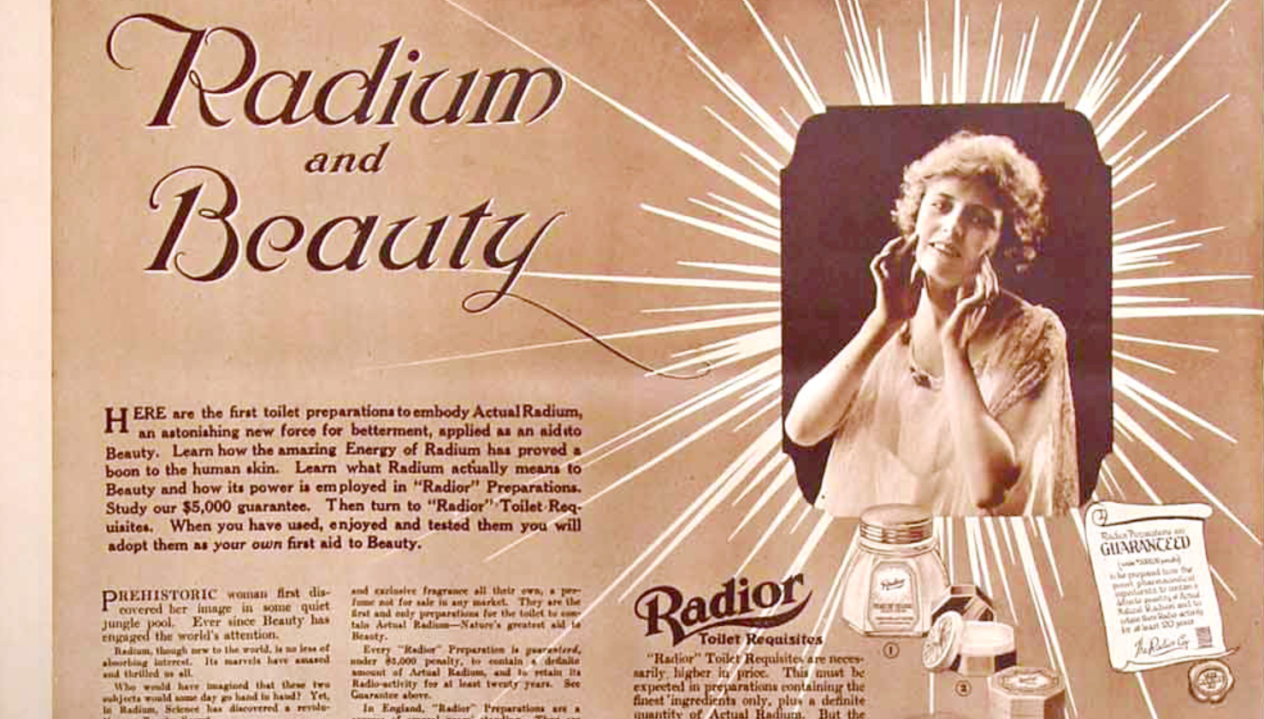
RADIOR

Slide 6
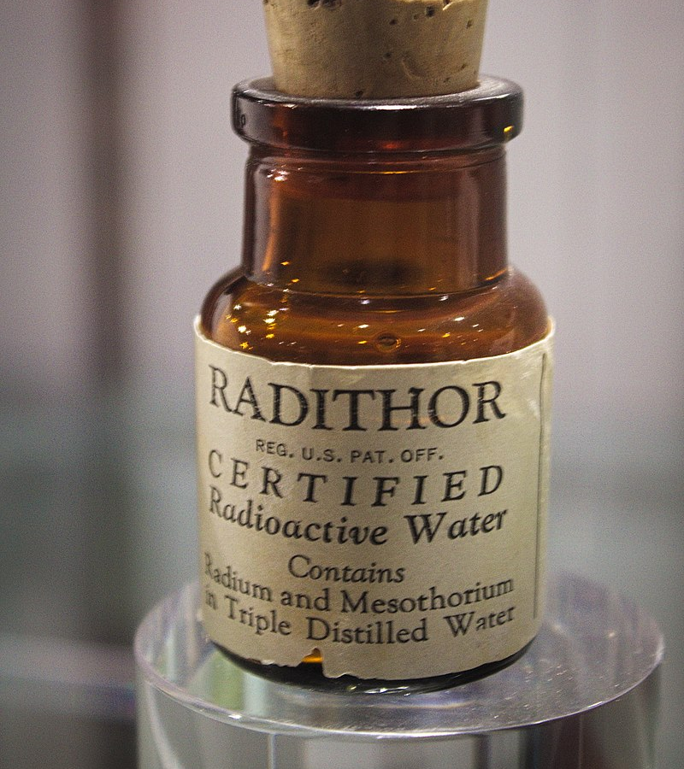
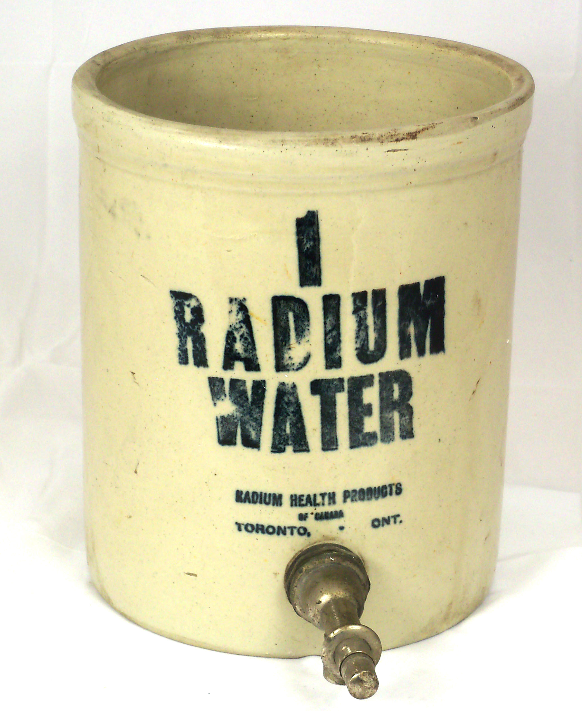
Radithor – “A Cure for the Living Dead”
consisted of triple-distilled water containing at least 1 microcurie each of Ra-226 and Ra-228
excessively broad and pseudoscientific application of the principle of radiation hormesis
manufactured from 1918 to 1928 by the Bailey Radium Laboratories, Inc. of East Orange, New Jersey.
The owner of the company and head of the laboratories was William J. A. Bailey, who was not a medical doctor.

Slide 7
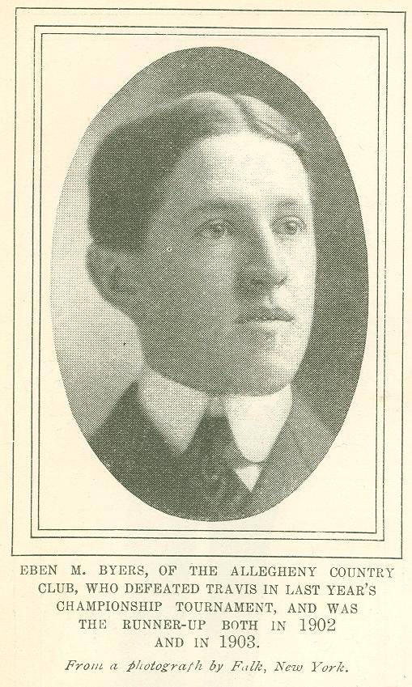
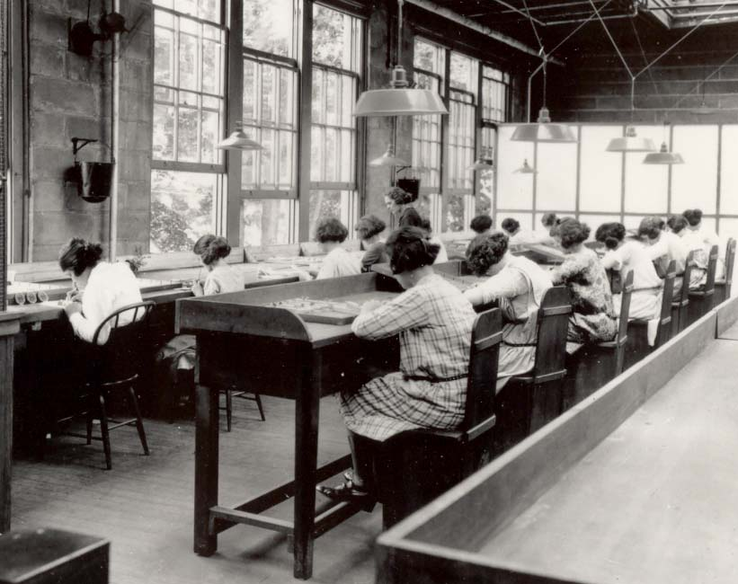
On the Path to Reveal the Dangers of Radium
2. The “Radium Girls”
1. Eben Byers

Slide 8
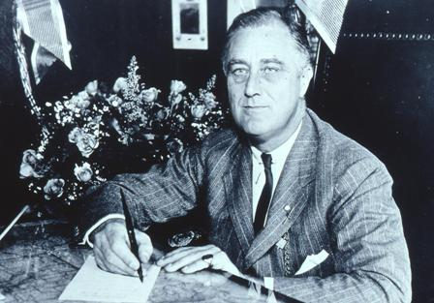
Federal Food, Drug, and Cosmetic Act (FFDCA)
Draft year: 1938
Amendment years: 1954 and 1958
National
Franklin D. Roosevelt signing the Federal Food, Drug, and Cosmetic Act

Slide 9
The sources
https://lithub.com/a-revolutionary-beauty-secret-on-the-rise-and-fall-of-radium-in-the-beauty-industry/
Radioactive Cosmetics and Radiant BeautyCosméticos radioactivos. La belleza «radiante». R.M. Díaz Díaz, C. Garrido Gutiérrez, P. Maldonado Cid. Actas Dermo-Sifiliográficas (English Edition). Volume 111, Issue 10, December 2020, Pager 863-865
https://orau.org/health-physics-museum/collection/radioactive-quack-cures/pills-potions-and-other-miscellany/tho-radia-items.html
https://en.wikipedia.org/wiki/Radithor

