Slide 1
BIOMARKERS AND TOXICITY MECHANISMS
06 – Mechanisms
Oxidative stress
Luděk Bláha, PřF MU, RECETOX
www.recetox.cz

Slide 2
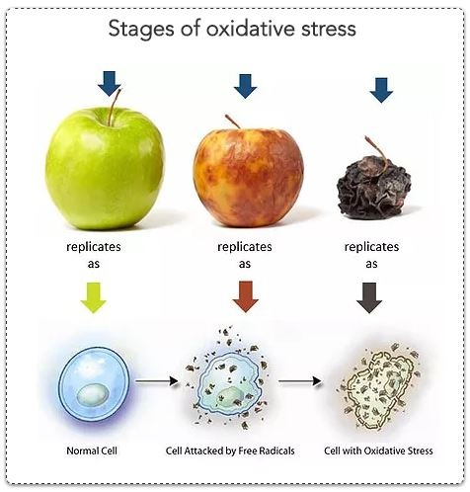
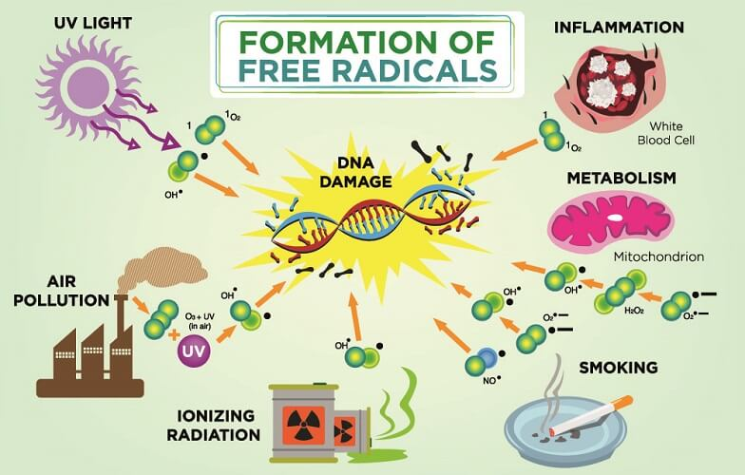

Slide 3
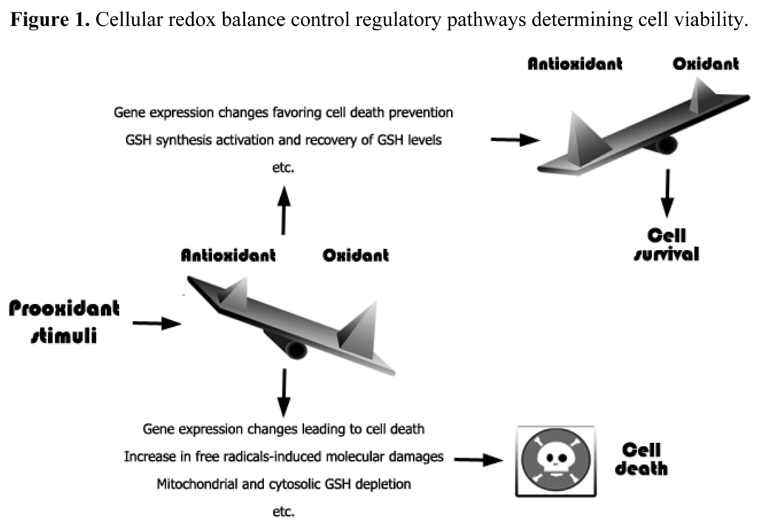
Importance of redox (oxido-reduction) homeostasis
Traditional view – “too much oxidants” is bad
Prooxidants (Oxidative stress) → damage to macromolecules → death

Slide 4
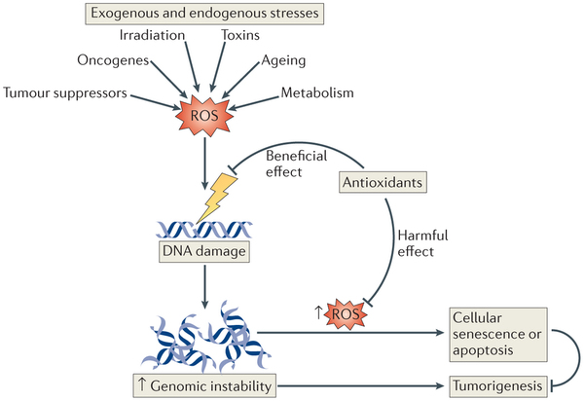
Importance of redox (oxido-reduction) homeostasis
Modified view (2014) – “too much of anything is bad”
http://www.nature.com/nrm/journal/v15/n6/full/nrm3801.html

Slide 5
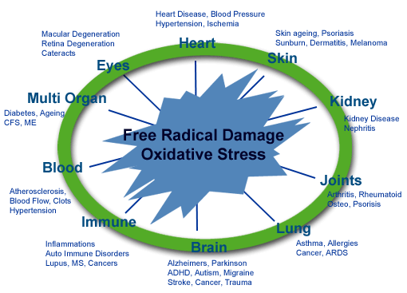
Importance of redox (oxido-reduction) homeostasis
Redox homeostasis
  natural homeostatic levels of prooxidants and antioxidants
  keeping cell metabolism and signalling balanced
Disruptions of homeostasis
  → depletion of oxygen
    Change in metabolism, acidosis in tissues, signalling (e.g. TUMORS)
    Less studied – new field – REDOX SIGNALLING
  overproduction of prooxidants = oxidative stress
    GENERAL MECHANISM OF TOXICITY AND AGING

Slide 6
Pro oxidants
Oxygen (O2)
  principal molecule in living organisms
    terminal acceptor of electones
  highly reactive molecule
    formation of reactive derivatives → ROS → toxicity
Other reactive molecules and ROS sources
  (details follow)
    production in mitochondria (byproducts of metabolism)
    redox-cycling (quinones of xenobiotics)
    Fenton-reaction (metals)
    oxidations mediated via MFOs (CYPs)
    depletion of antioxidants (reactive molecules)

Slide 7
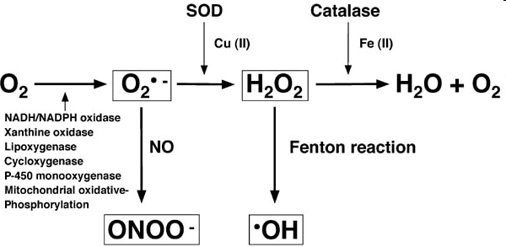
Key Reactive Oxygen Species (ROS)
SOD = Superoxide dismutase

Slide 8
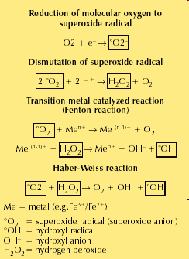

TERMS, NAMES, REACTIONS
Fenton reaction
(from organic chemistry classes)
Fe3+/2+
But also OTHER METALS (!)

Slide 9
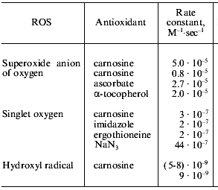
Reactivity of ROS (short rate → instability = reactivity)

Slide 10
Sources or ROS

Slide 11
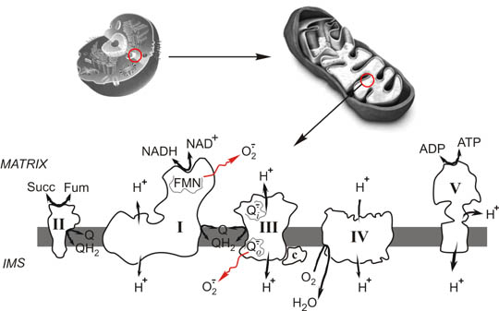
Mitochondria (= metabolism!)
Superoxide production in oxidative respiration

Slide 12
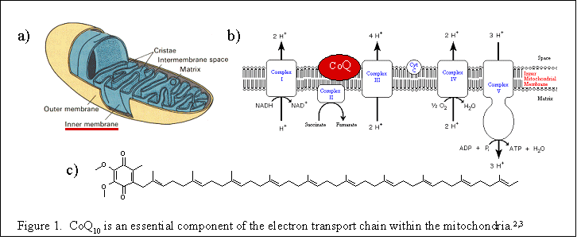
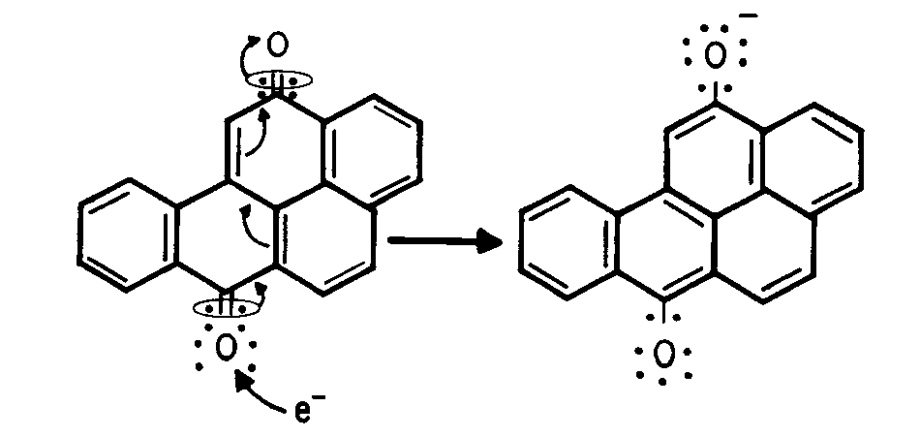
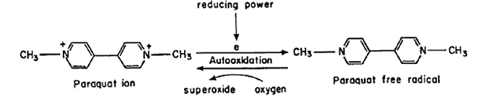
Redox cycling compounds and ROS production
Toxicity =
Interference with
“xeno”quinones
and similar compounds
Example 1 – BaP quinone
Natural cycling
quinone ←→ semiquinone
Example 2 – Paraquate pesticide

Slide 13
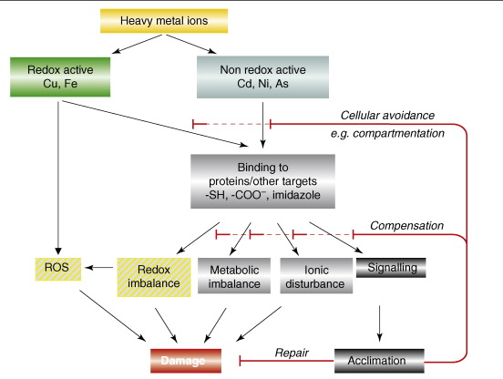
Metals and impacts on redox homeostasis
(* direct ROS production / * binding to proteins)
, Cr
+ H₂O₂
(Fenton reaction)

Slide 14
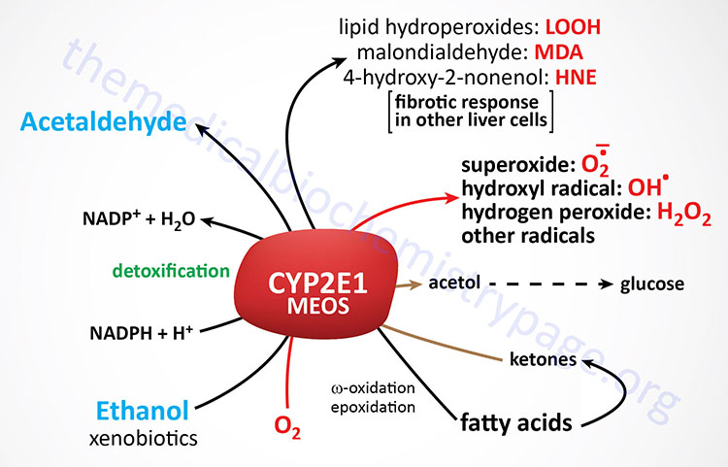
CYP450 as ROS source
(example CYP2E1, MEOS – microsomal ethanol oxidising system)

Slide 15
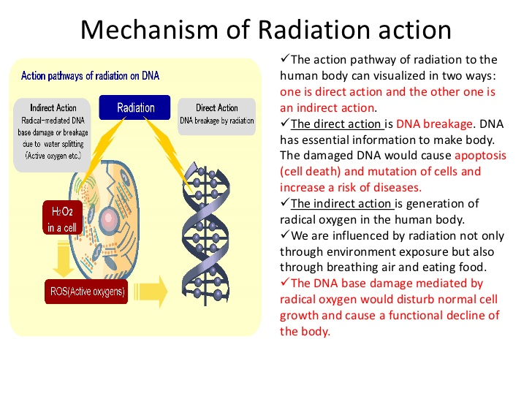
Irradiation as a source of ROS and oxidative damage
(reminder – check lectures on toxicity towards DNA)
ROS

Slide 16
Protection against ROS-induced damage

Slide 17
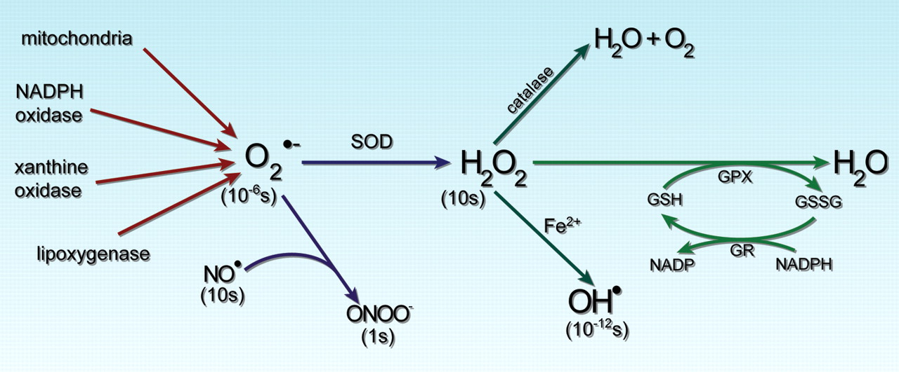
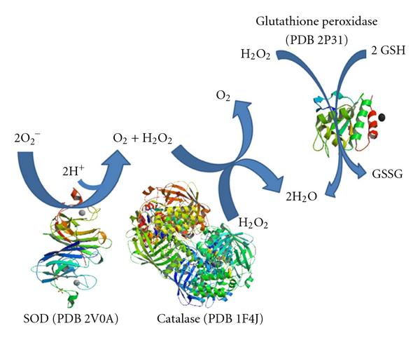
Antioxidant responses 1 - enzymatic
Highlighted enzymes
discussed further
within the „biomarker“ part

Slide 18
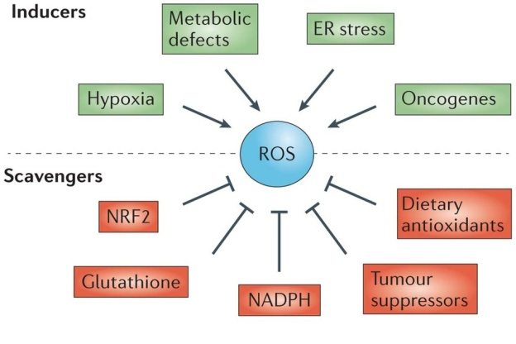
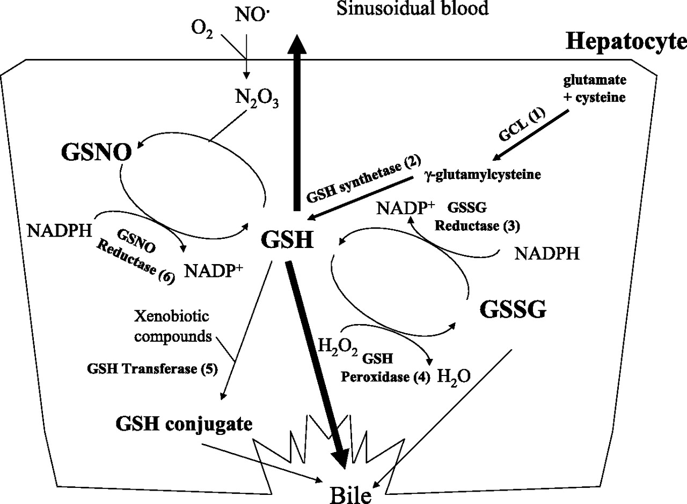
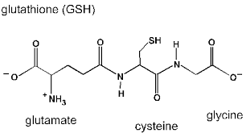
Antioxidant responses 2 – small molecules: GSH
Highlighted are discussed further
within the „biomarker“ part

Slide 19
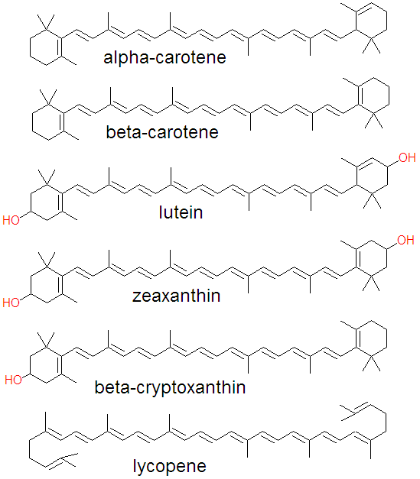
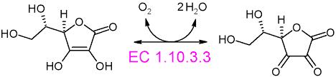
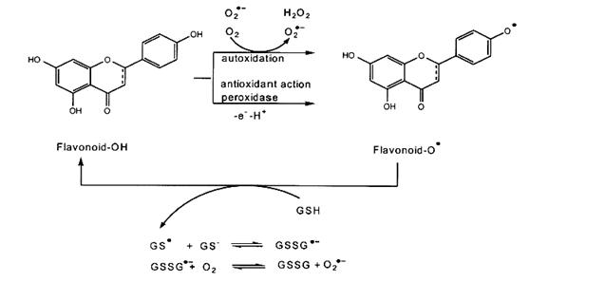
Antioxidant responses 2 – small molecules: dietary antioxidants
Carotenoids
Ascorbate
Flavonoids
Flavonoids

Slide 20
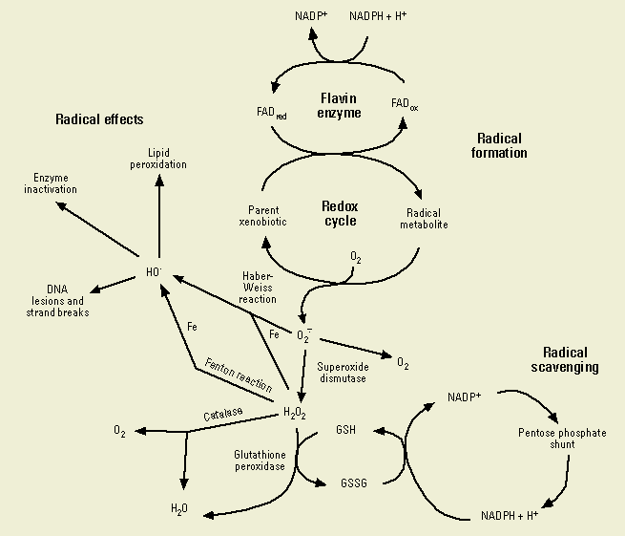
EFFECTS Enzymes & DNA
        Other lectures
Lipid peroxidation
→ Following slide

Slide 21
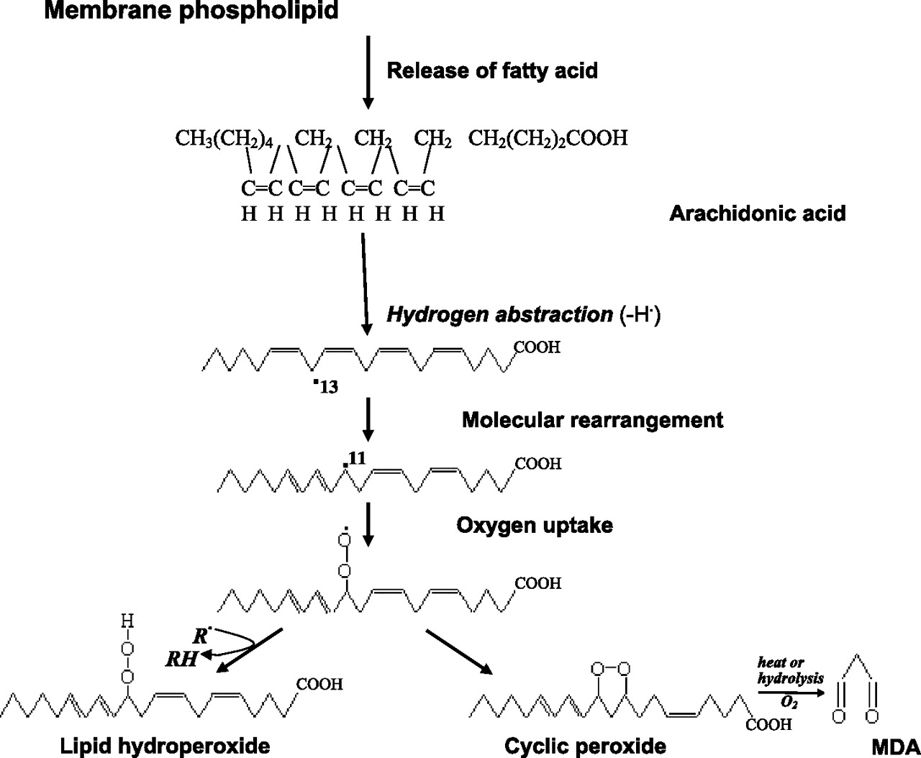
Lipid peroxidation = radical reaction → fast propagation
MDA as a biomarker

Slide 22
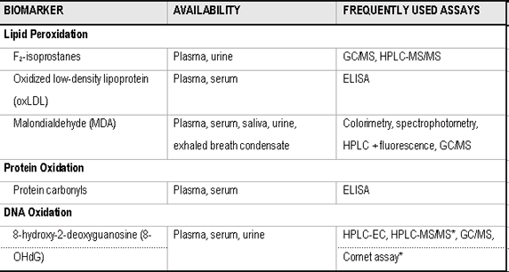
Biomarkers of oxidative damage
(will be discussed later)

Slide 23
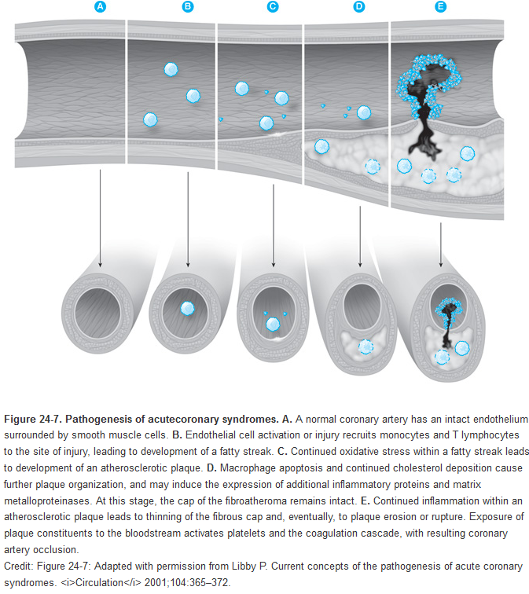
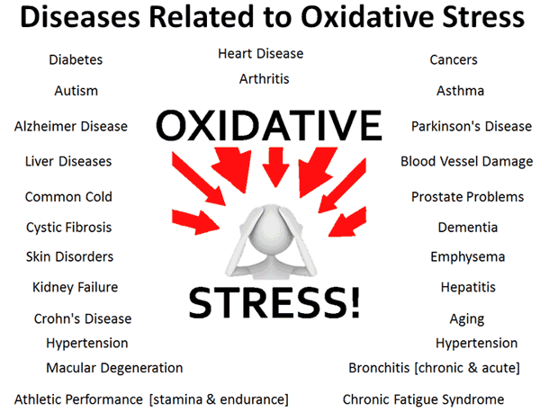
Health effects of oxidative stress … multiple
e.g. acute coronary syndrome (ACS) → myocardial infarction

