Slide 1
BIOMARKERS AND TOXICITY MECHANISMS
07 – Mechanisms
Metabolism & Detoxification
Luděk Bláha, PřF MU, RECETOX
www.recetox.cz

Slide 2
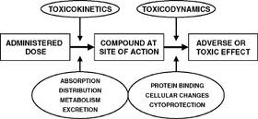
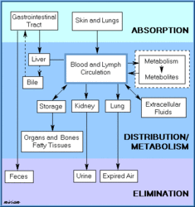
What processes are beyond toxicokinetics?
ADME
Toxicokinetics ...
EXPOSURE → Determines the final dose & eventual toxicity

Slide 3
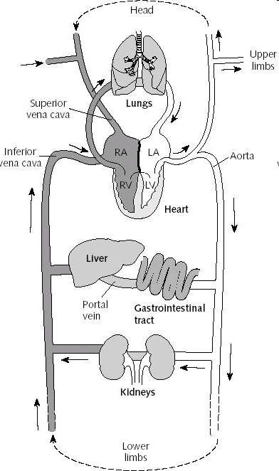
Metabolism and detoxification
Chemicals enter body
... mostly via food
Pass directly
through liver
→ main metabolism organ

Slide 4
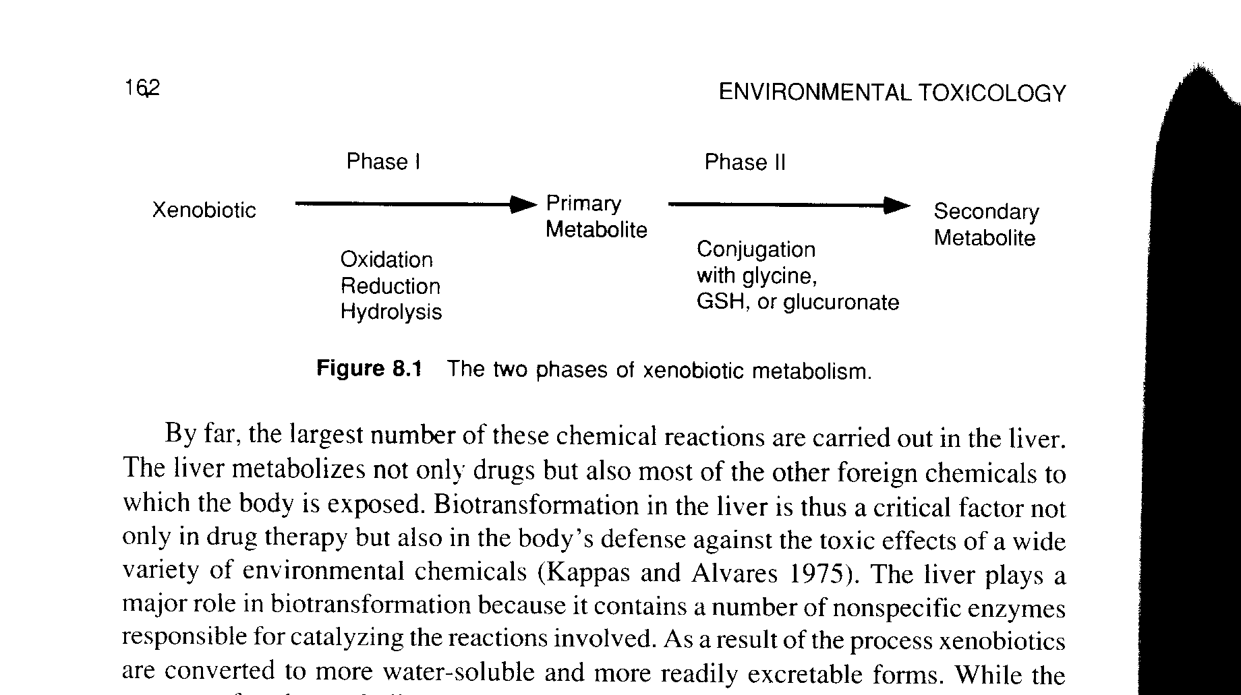
Detoxification
Basic principle of detoxification
  elimination of hydrophobic compounds from body→ formation of more polar & soluble products
Two principal phases in metabolism (Phase I & II)
  well studied in vertebrates (mammals)
  liver: major organ involved in detoxification
Plants
  similar oxidating enzymes as described
  (cytochrom oxidase, phenol oxidase, peroxidase...)
Phase III - elimination - both from cell & body

Slide 5
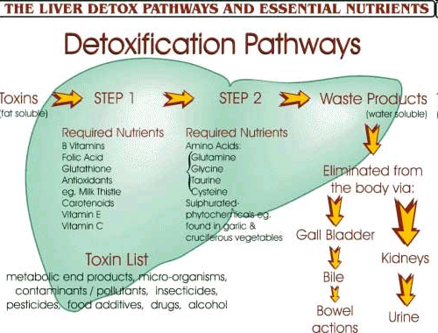
Importance of nutrients and vitamins in detoxification

Slide 6
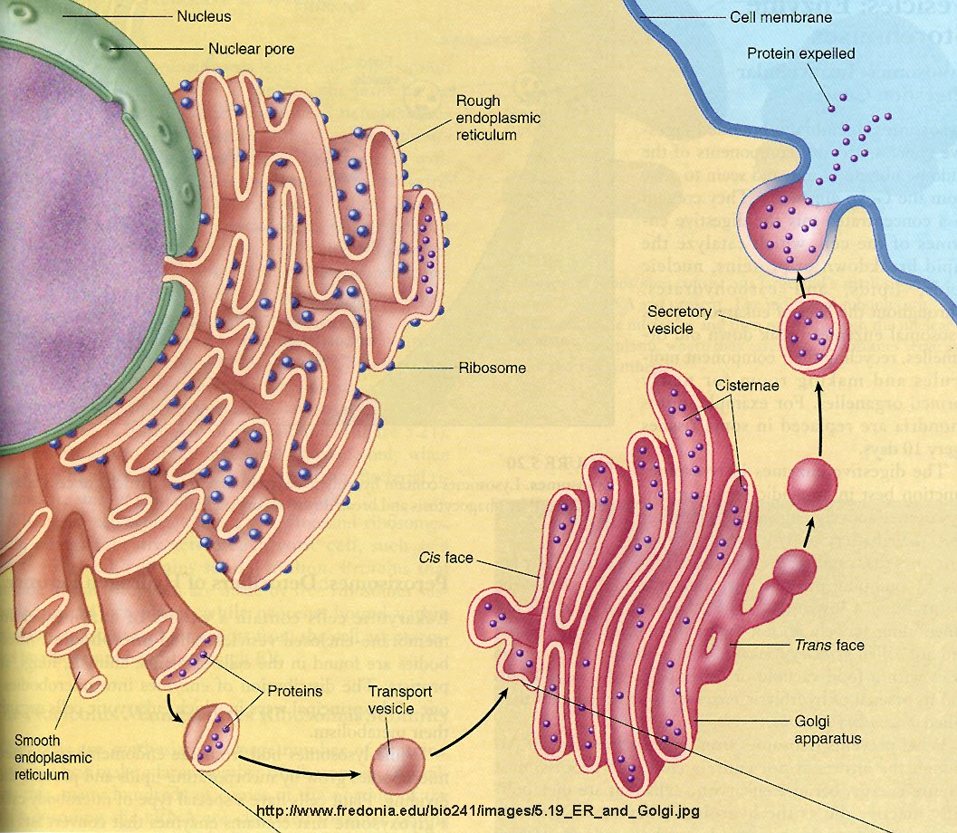
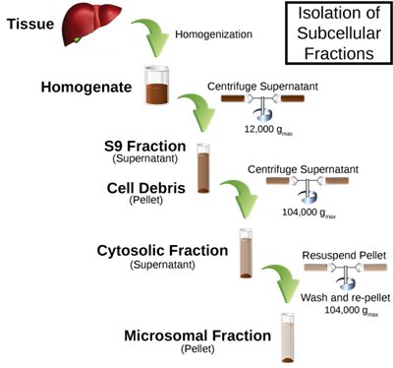
Phase I
Key enzymes – MFOs = mixed function oxidases / oxygenases
Membrane bound to Endoplasmic Reticulum
  membrane vesicles "microsomes" = S-9 fraction can be extracted from cells
S9 microsomes
used for in vitro metabolization
(e.g.during genotoxicity testing)

Slide 7
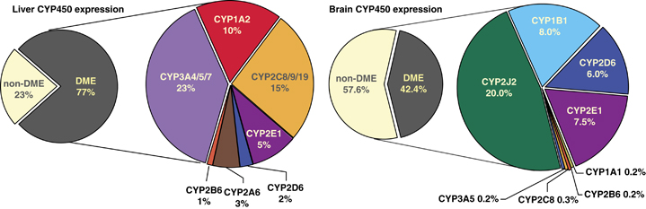
Detoxification - Phase I
Key principle enzymes are cytochromes P450 (CYPs)
  Haem (porfyrin) - containing enzymes
  superfamily of more than 150 genes - several classes and subclasses
    different substrate specificity; structure ...
Some examples ... Diverse functions
  Cytochrome P450 1A (CYP1A)
    basic for detoxification of hydrophobic environmental contaminants
  Cytochrome P450 19A (CYP19)
    "aromatase" involved in synthesis of estradiol (aromatization of testosterone)
DME
= Drug Metabolism Enzymes

Slide 8
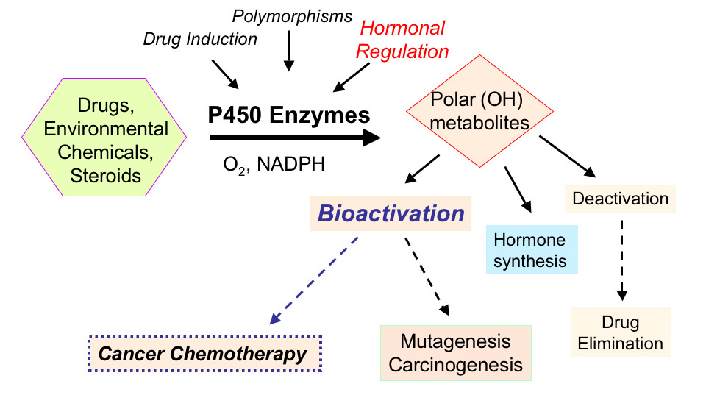
  CYPs and their functions

Slide 9
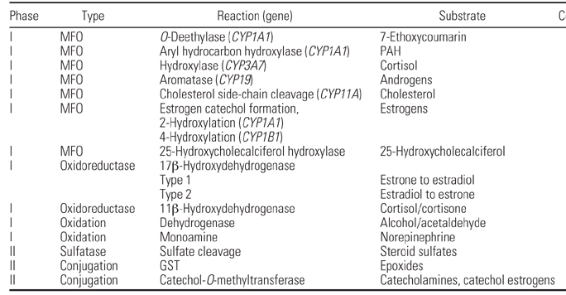
Types of reactions catalyzed by CYPs (and Phase II enzymes)
Highlighted = will be discussed also later

Slide 10
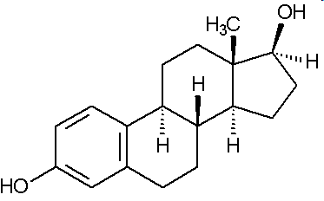
  CYPs - example: steroid hormone synthesis

Slide 11
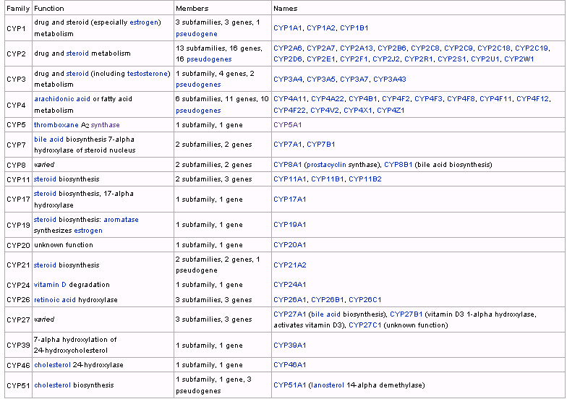
CYP450 overview

Slide 12
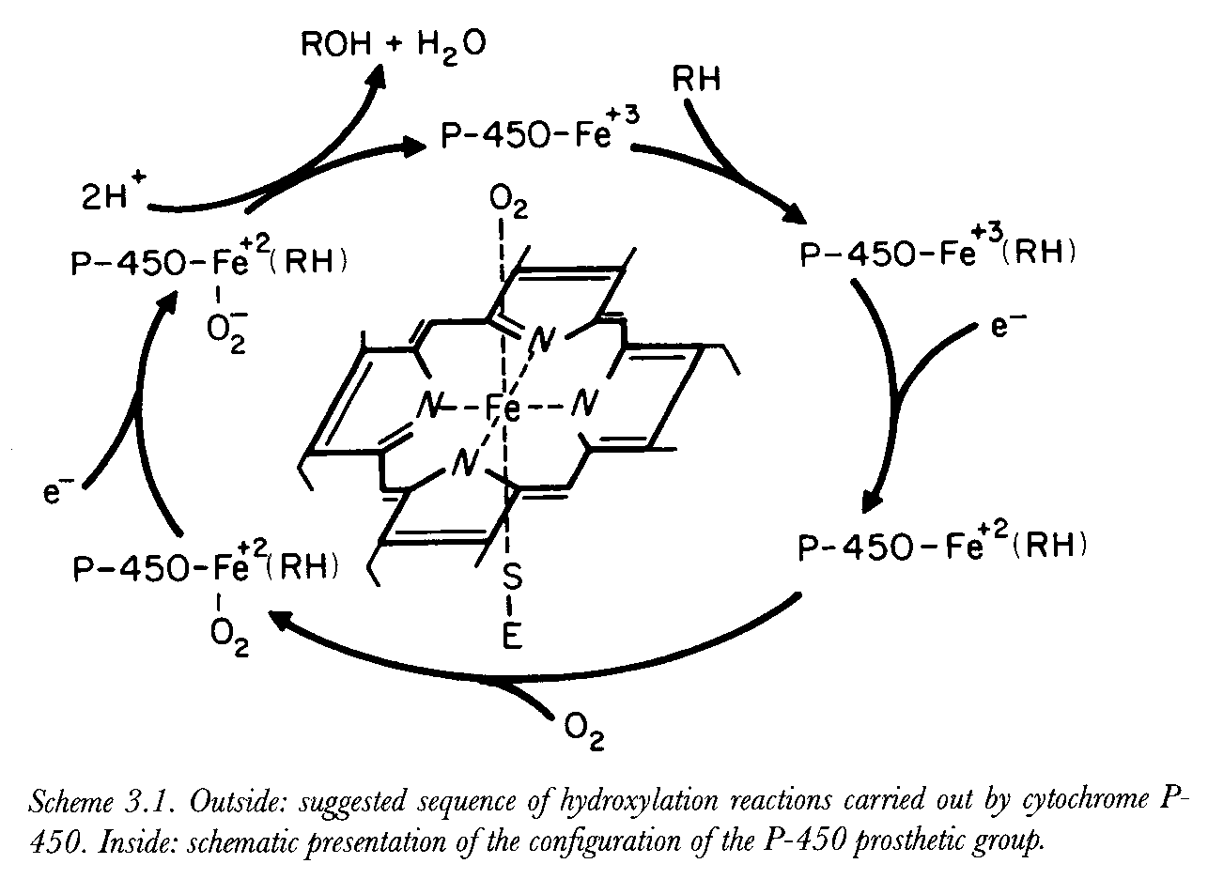
Hydroxylation (oxidation) mechanism – key in “detoxification”

Slide 13
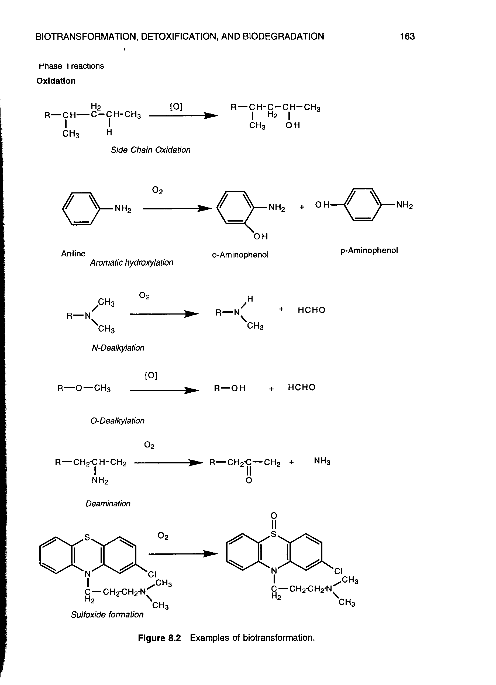
Examples of CYP mediated reactions

Slide 14
Examples of CYP mediated reactions

Slide 15
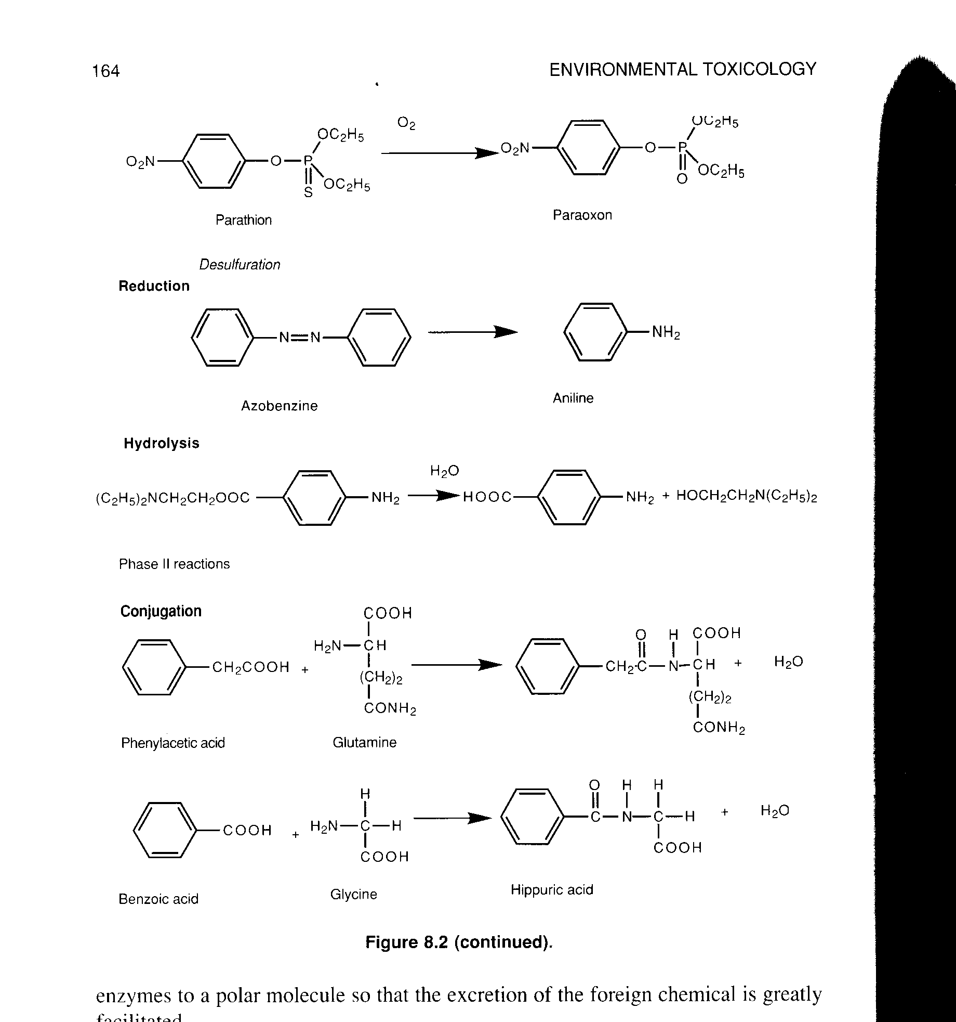
Examples of CYP mediated reactions

Slide 16
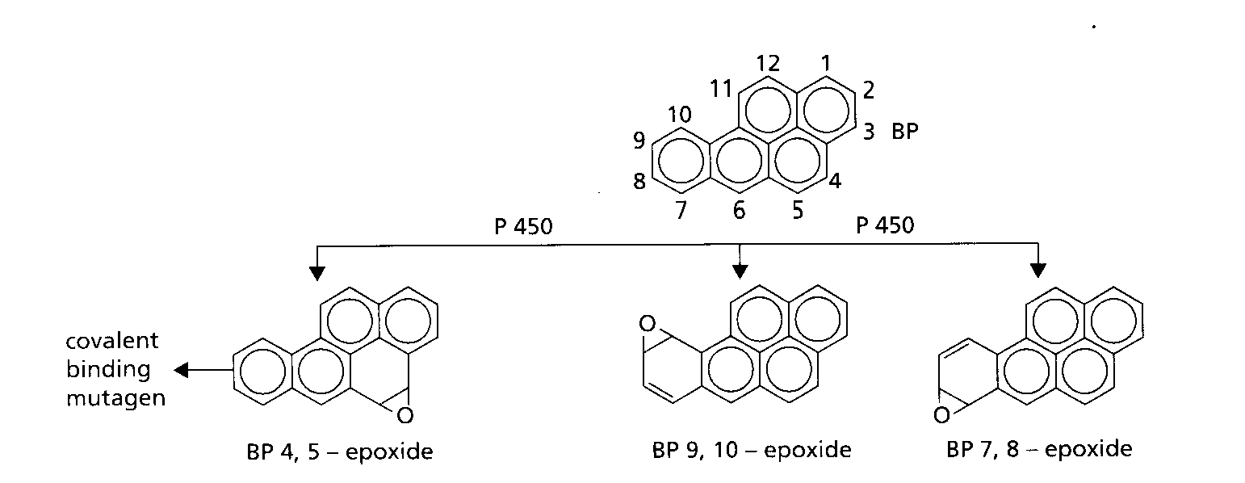
CYPs and BIOACTIVATION pro-mutagen (procarcinogen) → mutagen (carcinogen)
Benzo[a]pyrene

Slide 17
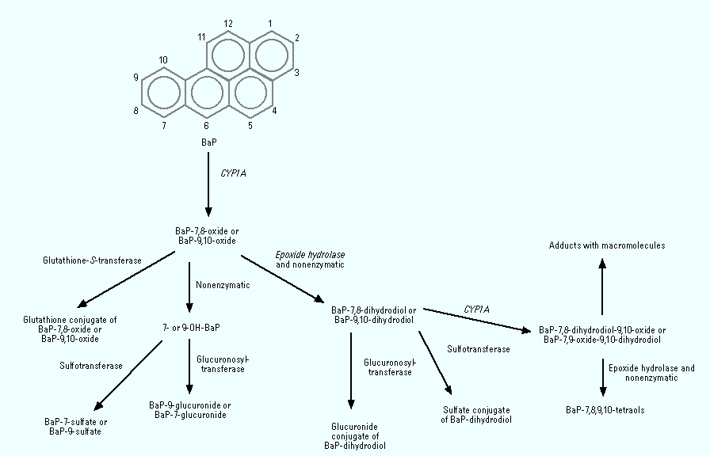
CYPs and BIOACTIVATION of procarcinogen

Slide 18
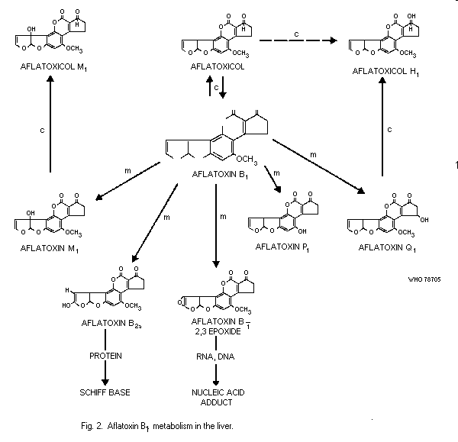
CYPs and BIOACTIVATION – AFLATOXIN-A

Slide 19
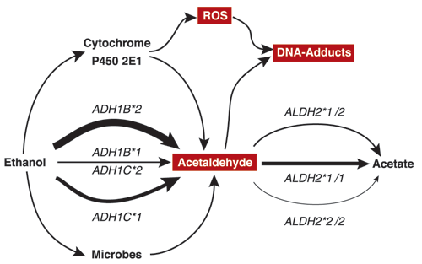
CYPs and BIOACTIVATION – ethanol

Slide 20
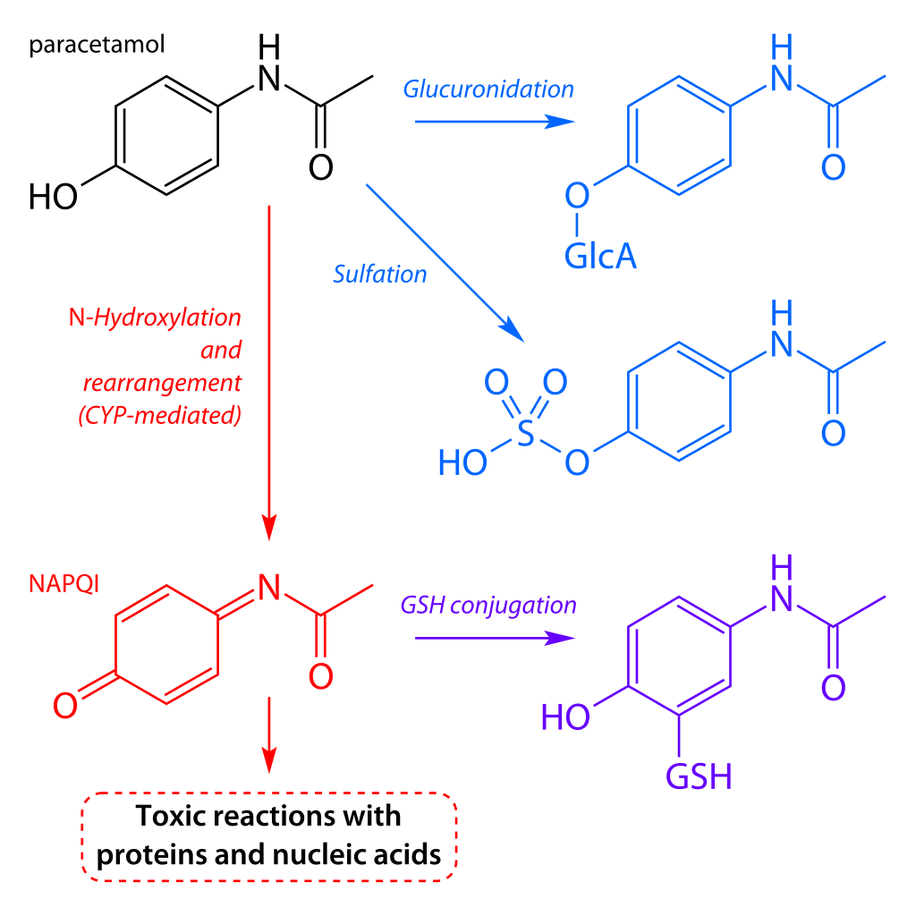
CYPs and toxicity of drugs
Example - PARACETAMOL toxicity

Slide 21
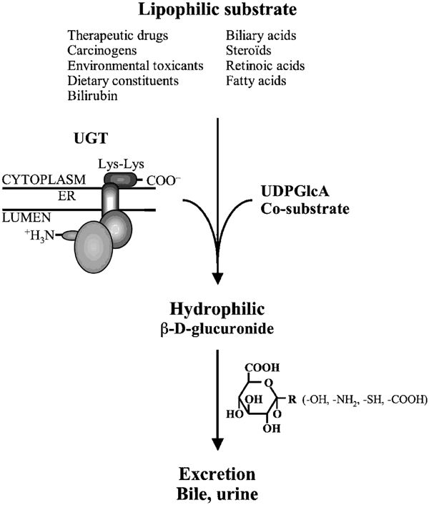
Detoxification – Phase II
Key reactions = conjugations
  Reactive xenobiotics or metabolites formed in phase I
  with endogeneous substrates
    saccharides and their derivatives – glucuronic acid,
    aminoacids (glycine)
    peptides: glutathione (GSH)
Forming water soluble AND “nontoxic” products (conjugates)
Phase II enzymes (“transferases”):
  glutathion S-transferase (GST)
  UDP-glucuronosyltransferase (UDP-GTS)
  epoxid hydrolase (EH)
  sulfotransferase (ST)

Slide 22
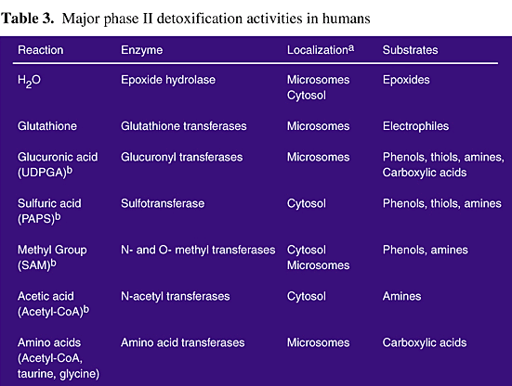

Slide 23
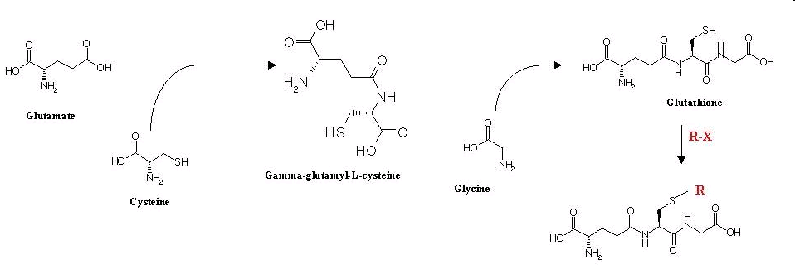
Glutathione
major donor of SH (thiol) groups in cells (MW ~ 300 g/mol)
- concentrations in tissues and blood up to 5 mM (1.5 g/L)

Slide 24
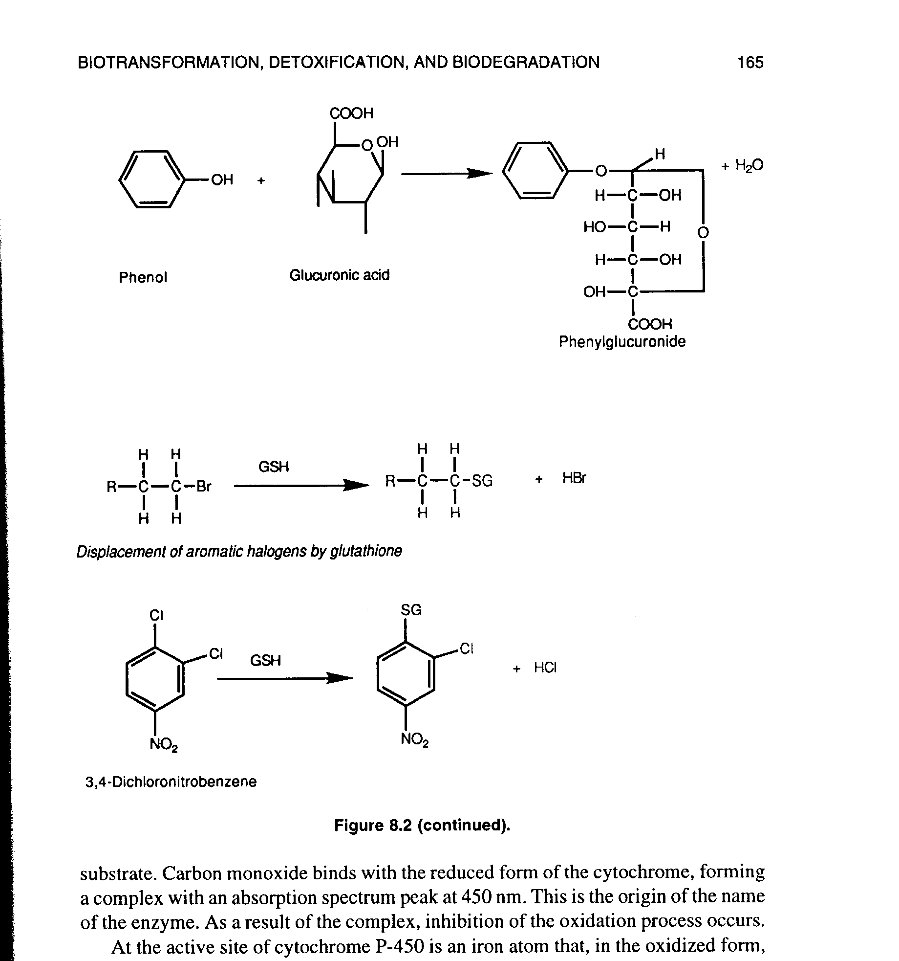
Examples of conjugation reactions

Slide 25
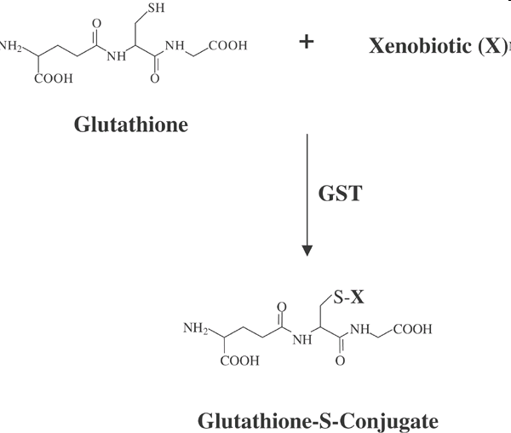
Xenobiotic conjugations with GSH

Slide 26
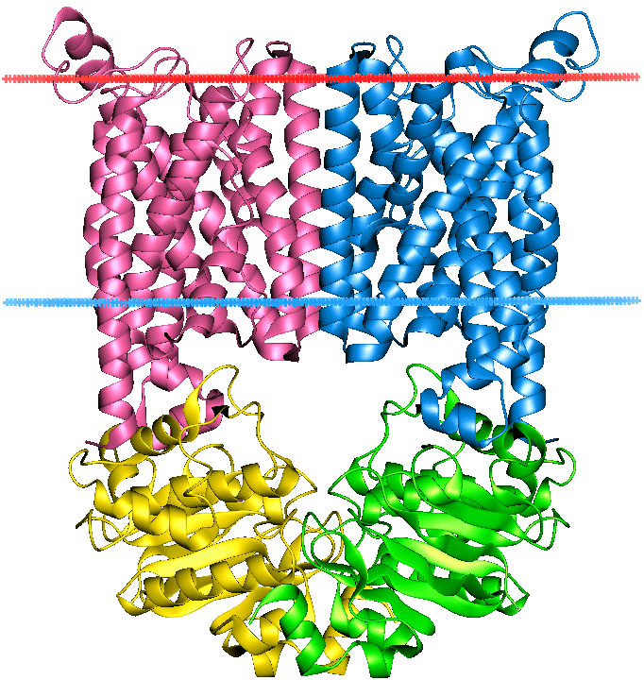
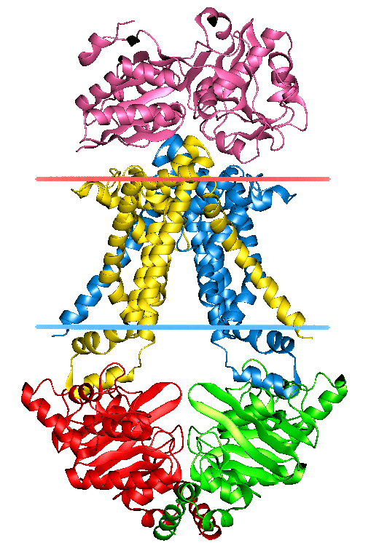
Phase III – elimination / membrane transport
Phase III transporters
  ATP-binding cassette transporters (ABC transporters)
  protein superfamily (one of the largest, and most ancient in all extant phyla from prokaryotes to humans)
  transmembrane proteins - transport across extra- and intracellular membranes (metabolic products, lipids, sterols, drugs)

Slide 27
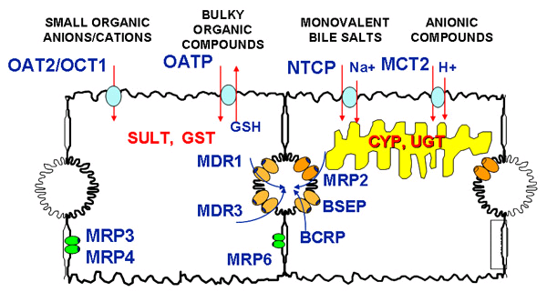
ABC transporters - examples
- MRP (MDR) - multidrug resistance-associated protein family
- OATP - Organic Anion Transporting Polypeptide
- P-glycoprotein

Slide 28
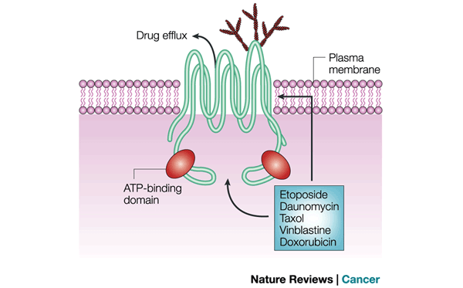
ABC one of the resistance mechanisms of tumour cells to anticancer drugs

Slide 29
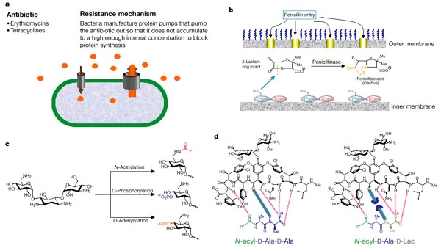
ABC: one of the resistance mechanisms of bacteria to antibiotics
[both via Physiological and Evolutionary adaptation mechanisms]

Slide 30
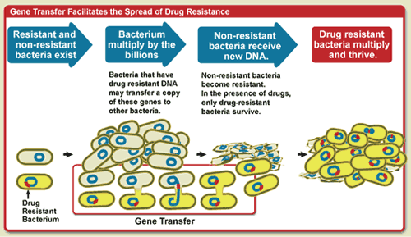
Mechanism of evolutionary adaptation
1. Random mutation → 2. Population change (selection) by the environment

Slide 31
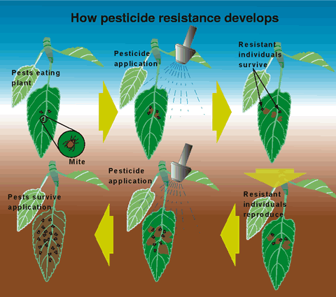
Example of evolutionary adaptation:
Development of resistance to pesticides

Slide 32
Constitutive vs Induced detoxification
Detoxification enzymes expression
  Constitutive – low background levels (always present)
  Presence of substrates → INDUCTIONS of levels/activities
    CYP1A – inductin via Ah-receptor (AhR)
      Substrate: hydrophobic organochlorine compounds (PCDDs/Fs, PAHs PCBs ...)
      [see also: lectures on nuclear receptors]
    Other CYPs
      Drugs → inductions of specific CYP classes
    Phase II enzymes
      Substrates = reactive toxicants, metabolites from Phase I
    ABC transporters
      Induction by respective chemicals (drugs etc)
INDUCED DETOXIFICATION:
  „Physiological adaptation“ to toxicants
  Measurements used as „Biomarkers“ (of exposure, susceptibility, effect)

Slide 33
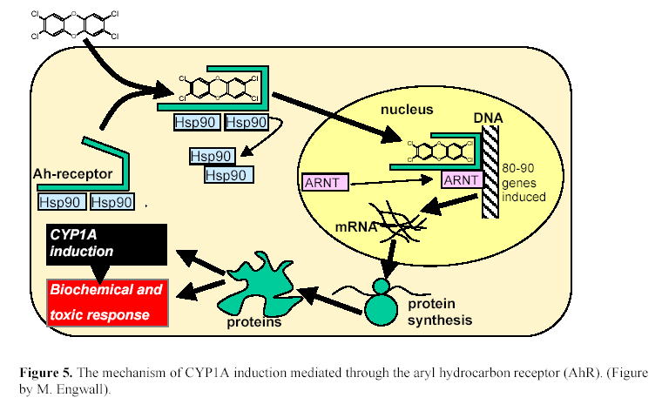
CYP1A induction – role of AhR (discussed later)

Slide 34
Summary – “toxic consequences” of detoxification
BIOACTIVATION
  activation of pro-mutagens/pro-carcinogens etc.
  increasing side adverse effects of certain drugs
Increase in oxidative reactions – oxidative stress
  production of Reactive Oxygen Species (ROS)
    (see oxidative damage and stress lectures)
Side toxic effects (see nuclear receptor lectures)
  e.g. increased degradation of endogeneous compounds
  (retinoids – regulatory molecules degraded by CYP1A
  Crosstalk with other mechanisms & receptors
Energy (ATP) depletion
  chronic inductions of detox enzymes
  → permanent extra energetic demand
Development of resistence - physiological adaptation or evolutionary adaptation to toxic compounds
  Loss of efficiency of anticancer drugs, antibiotics etc.
  Resistance of pests

Slide 35
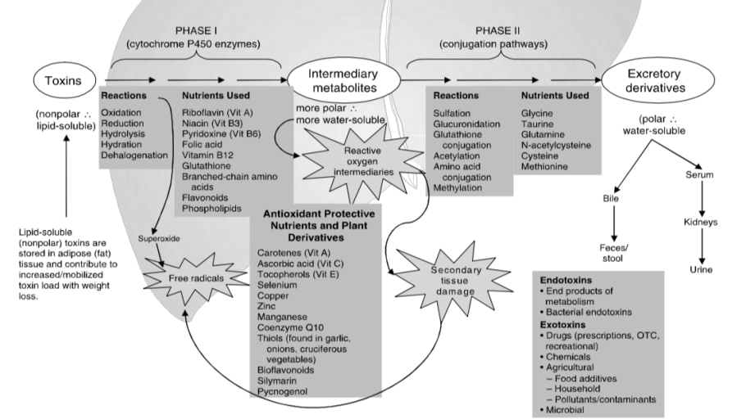
Toxic effects associated with increased detoxification (metabolism)

