Slide 1

Human biomonitoring for the protection of health
E3040: Public Health Protection
November 2, 2023
Kasia Kordas, PhD

Slide 2
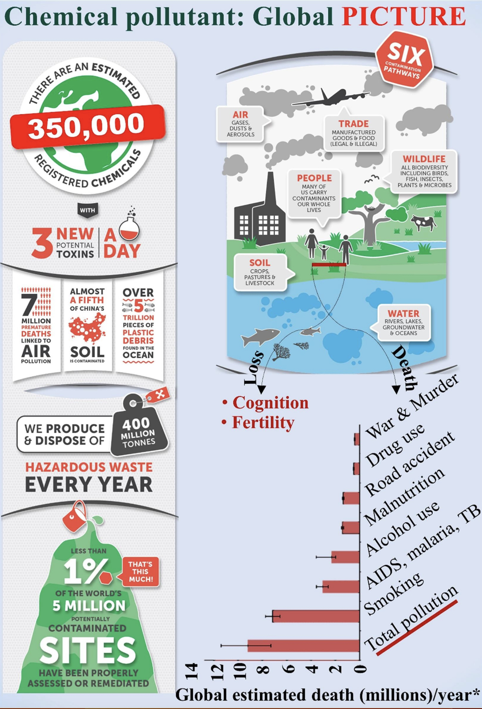
Exposure assessment plays a crucial role in understanding the potential harm to human health from environmental chemicals.
Individual studies by academic researchers, advocacy groups
  Small-scale
  Not systematic
  Focused on specific/vulnerable population groups
Human biomonitoring.
Naidu R et al. Chemical pollution: A growing peril and potential catastrophic risk to humanity. Environment International 2021; 156:106616.

Slide 3
What is human biomonitoring (HBM)?
“systematic and continuous or repetitive activity for collection of biological samples for analysis of concentrations of pollutants and its metabolites, with the objective to assess exposure, changes after specific interventions and standardized protocols that allow to compare the data observed over time and with reference levels and—if necessary— leading to corrective actions”.
Angerer J, Ewers U, Wilhelm M. Human biomonitoring: state of the art. Int J Hyg Environ Health. May 2007; 210(3–4): 201–28

Slide 4
Systematic
Methodology
Rigorous implementation
Continuous or repeated
Regular
Biological samples
Blood
Urine
Pollutants or their metabolites
Organized
Inorganic
Organic
Long-term monitoring
Study of trends
Comparison to reference values
Take corrective actions

Slide 5
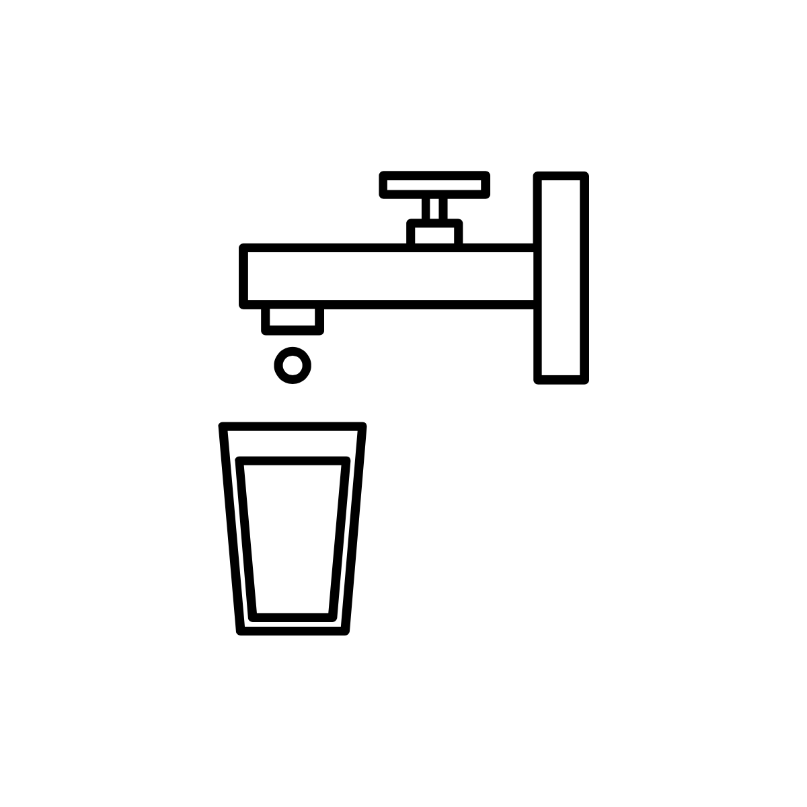








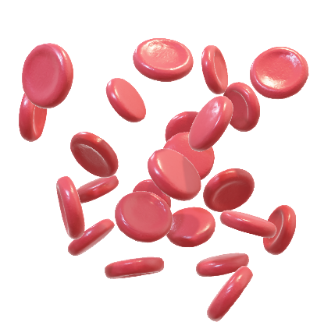
HBM reflects the internal dose of chemicals taken up from any or all sources in the environment

Slide 6
Ambient monitoring is complementary but different
Measurement of chemicals in environmental samples, including air, water, soil and food.

Slide 7
Human health risk assessment process
Hazard identification
Dose response assessment
Risk characterization
Exposure assessment
Planning
https://www.epa.gov/risk/conducting-human-health-risk-assessment#tab-1

Slide 8
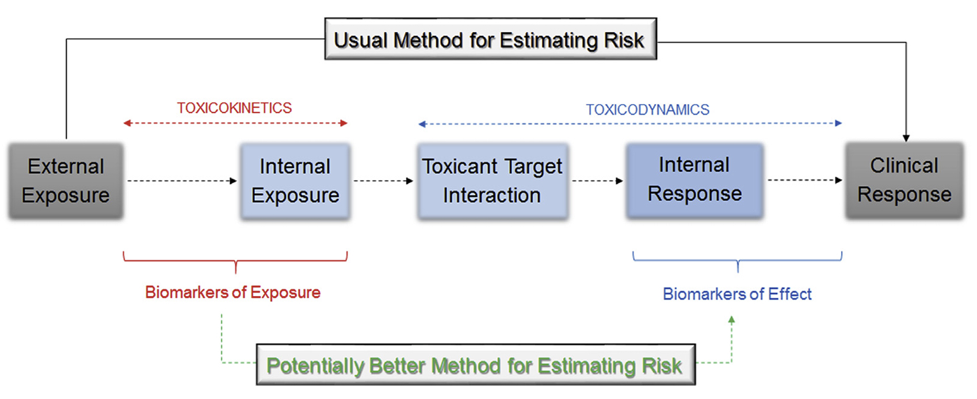
How HBM fits with risk assessment process
Luoro H et al. Human biomonitoring in health risk assessment in Europe: Current practices and recommendations for the future. International Journal of Hygiene and Environmental Health 2019: 222: 727-37.

Slide 9
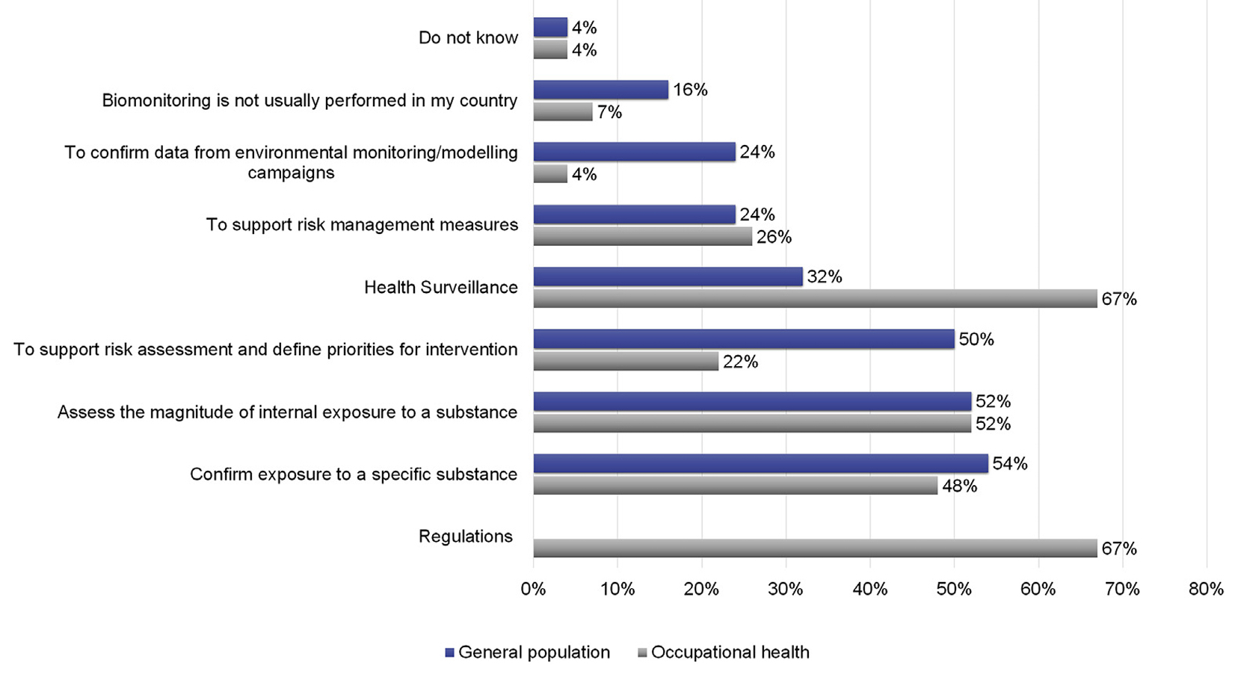
Why is HBM for risk assessment conducted?
Luoro H et al. Human biomonitoring in health risk assessment in Europe: Current practices and recommendations for the future. International Journal of Hygiene and Environmental Health 2019: 222: 727-37.

Slide 10
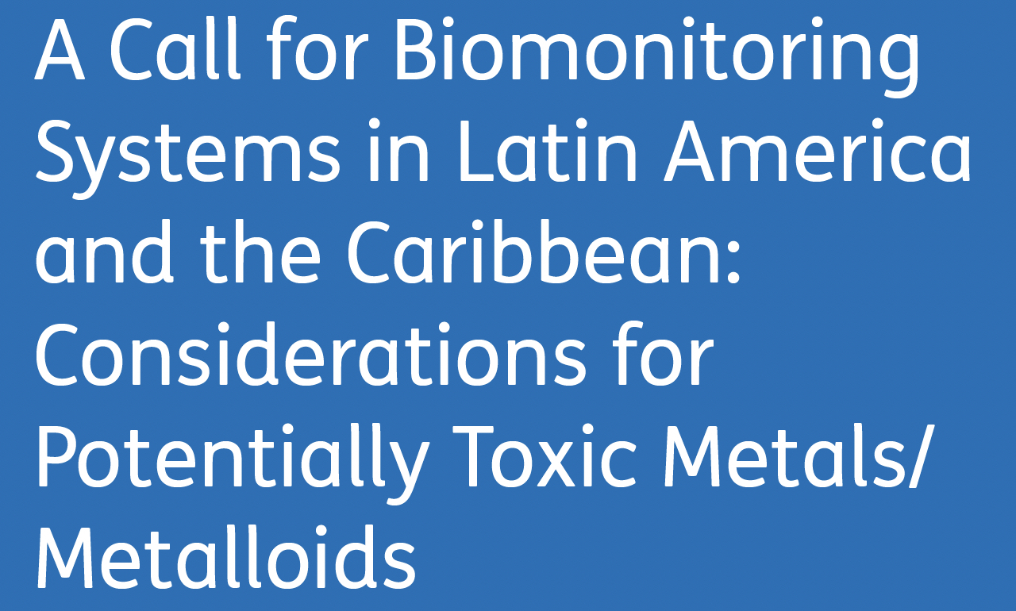
HBM is not universally implemented
HBM is very costly – mostly rich countries or regions do it
  USA, Canada
  EU
  (China)
Not in Latin America & Caribbean
Tamayo-Ortiz M et al. Annals of Global Health. 2022; 88(1): 80, 1–11.

Slide 11
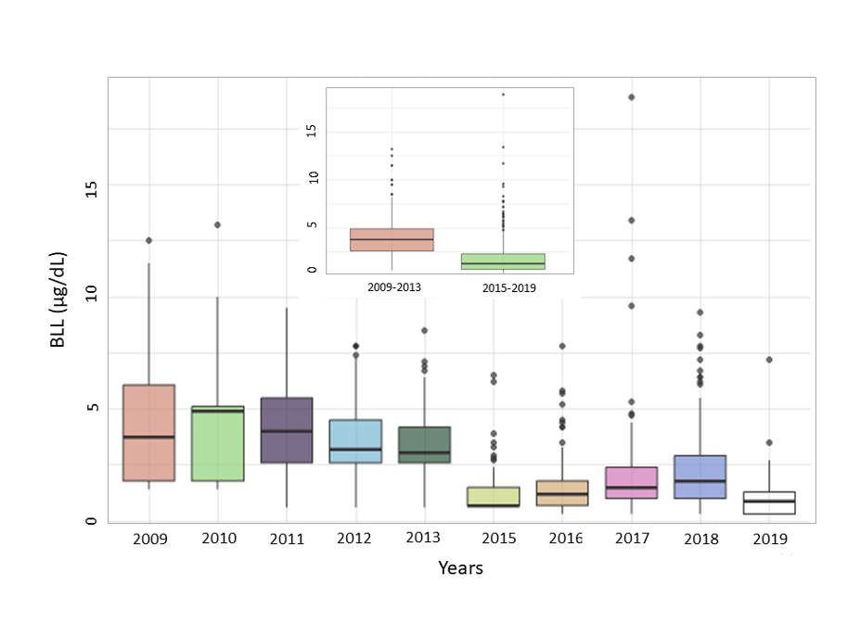
Secular trends in blood Pb, 2009-19, n=759
Leaded gasoline phased out
2004
Queirolo, Kordas, Martínez, Barg, Mañay. Secular trends in blood lead concentrations of school-age children in Montevideo, Uruguay from 2009 to 2019 (under review).

Slide 12
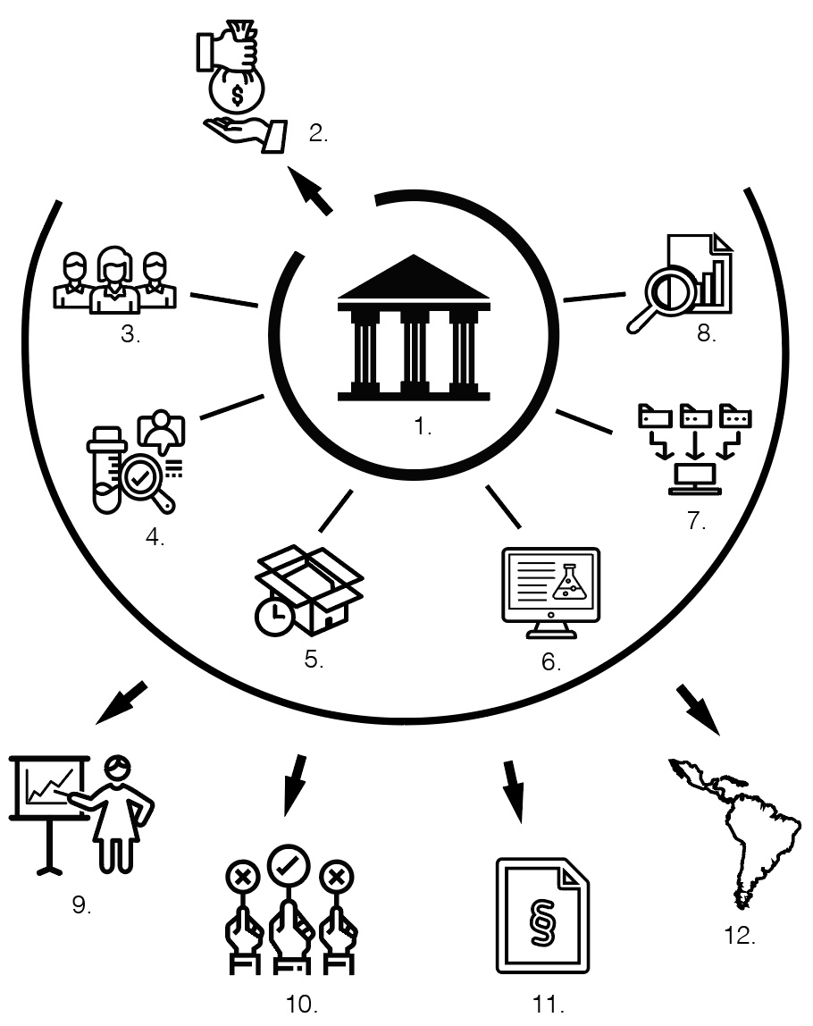
Enormous effort to develop & implement HBM
Government needs to recognize that HBM is important for population health.
Funding is essential – start-up costs & sustained investment.
Human resources with appropriate expertise and adequate level of training.
Laboratory set-up capable of handling samples
  Standard operating procedures
  Method validation
  Implementation of QC/QA
Tamayo-Ortiz M et al. Annals of Global Health. 2022; 88(1): 80, 1–11.

Slide 13
Enormous effort to develop & implement HBM
5. Logistics related to sample collection, transport, storage and processing.
6. Development and updating of data collection forms & data entry systems. Regular data checks.
7. Design and maintenance of (centralized) database system for long-term data storage and sharing.
8. Staff with appropriate data management skills needed.
Tamayo-Ortiz M et al. Annals of Global Health. 2022; 88(1): 80, 1–11.

Slide 14
Additional considerations
9. Regular data sharing with scientific community.
10. Institutional accountability is required to ensure appropriate/efficient use of resources and data release to inform policy.
11. Regular measurement of pollutants should result in policies and regulations.
12. Regional cooperation may reduce costs, and harmonize protocols, data sharing, and cross-country comparisons.
Tamayo-Ortiz M et al. Annals of Global Health. 2022; 88(1): 80, 1–11.

Slide 15
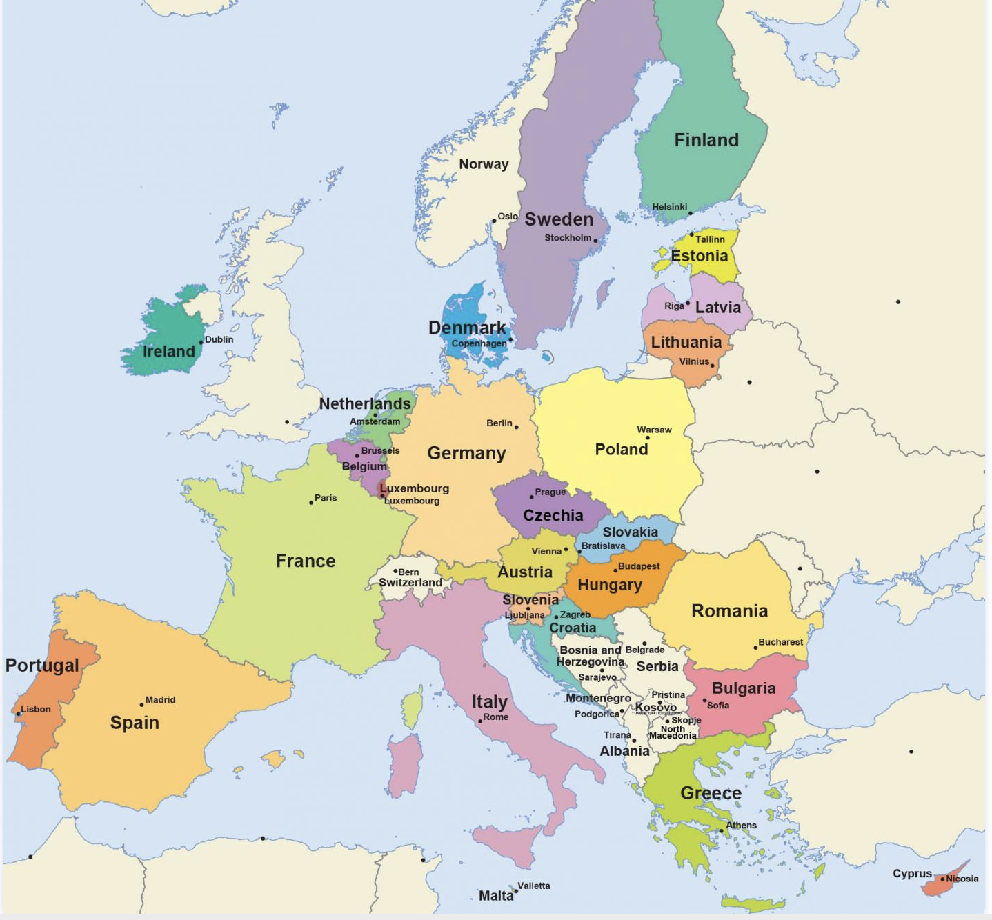
European programs, 1
Human biomonitoring for Europe (HBM4EU)
  Joint initiative of 28 countries – the 24 EU member states plus Norway, Switzerland, Iceland and Israel – and the European Environment Agency.
  €74 million in funding under Horizon 2020 (European Commission).
  Jointly implemented by 120 partners.
  Aimed to measure Europeans’ exposure to chemicals and their health effects and develop human biomonitoring (HBM) as an exposure assessment method.
  Program ended in June 2022.
https://www.hbm4eu.eu/

Slide 16
European programs, 2
PARC - Partnership for the Assessment of Risks from Chemicals
  Launched in May 2022, with €400 million in funding (50% from EC & 50% from member states).
  200 partner institutions, 3 EU authorities
  European Chemical Agency (ECHA), European Food Safety Authority (EFSA), European Environment Agency (EEA)
  Program aims to develop next-generation chemical risk assessment to protect human health and the environment.
  Results are intended to help launch European and member state strategies to reduce health risks from hazardous chemicals.
https://www.eu-parc.eu/

Slide 17

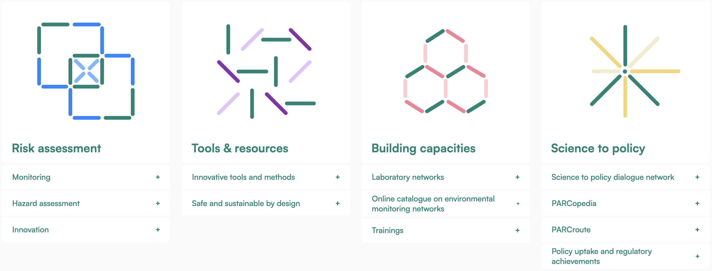
https://www.eu-parc.eu/

Slide 18

Overview of HBM4EU & PARC

Slide 19
Outputs

Slide 20
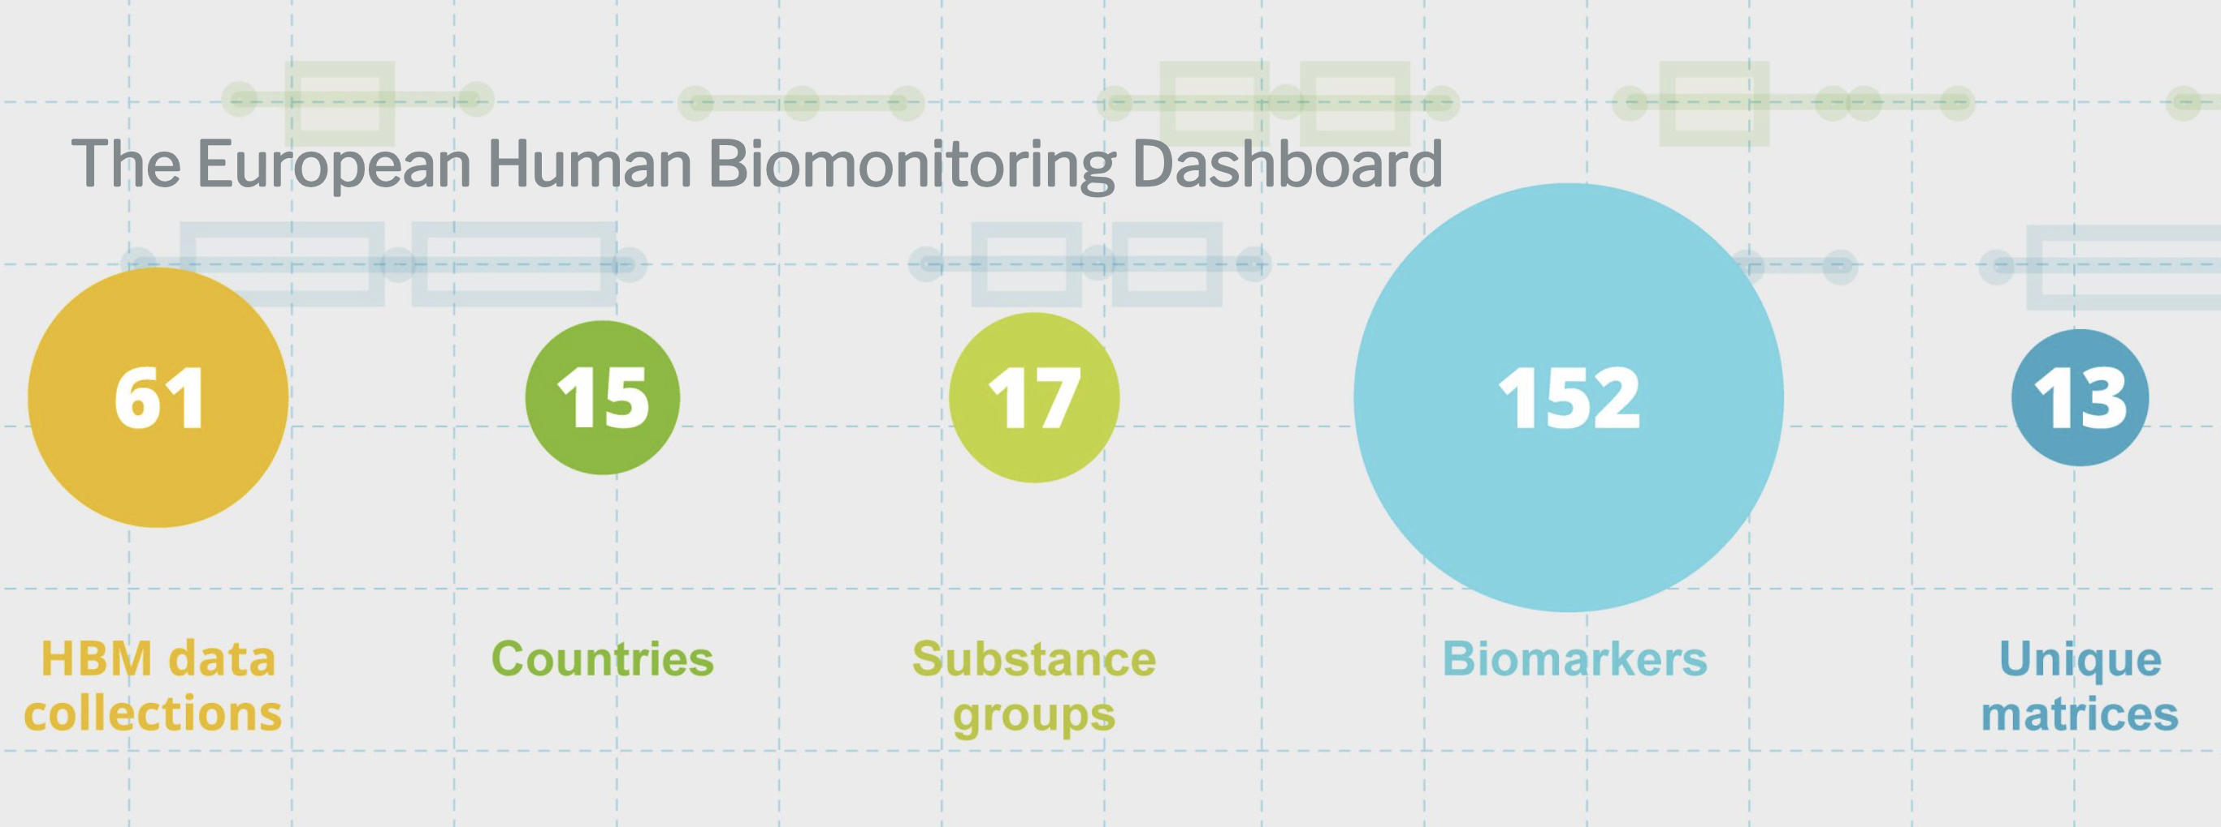
What’s being monitored?
https://www.hbm4eu.eu/

Slide 21
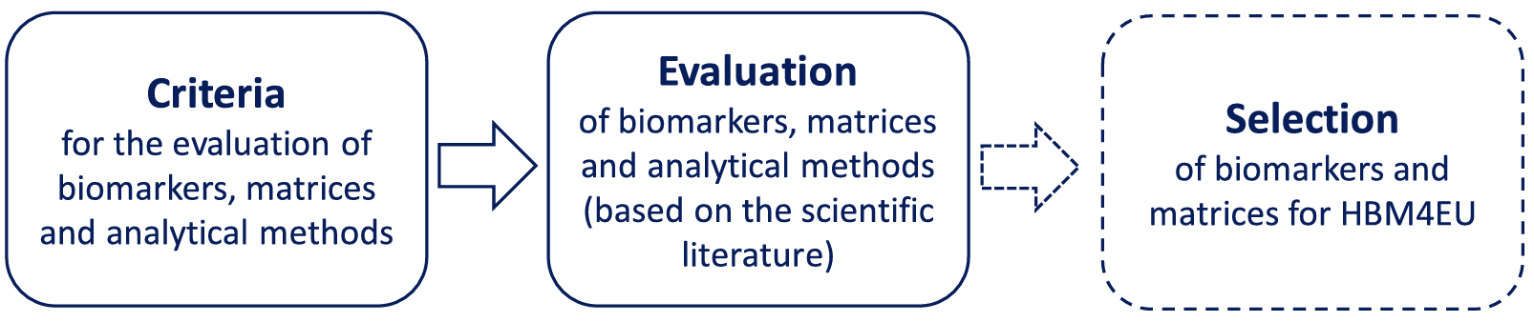
Lengthy process for compound & biomarker selection
Vorekamp K et al. Biomarkers, matrices and analytical methods targeting human exposure to chemicals selected for a European human biomonitoring initiative. Environment International 2021: 146: 106082.

Slide 22
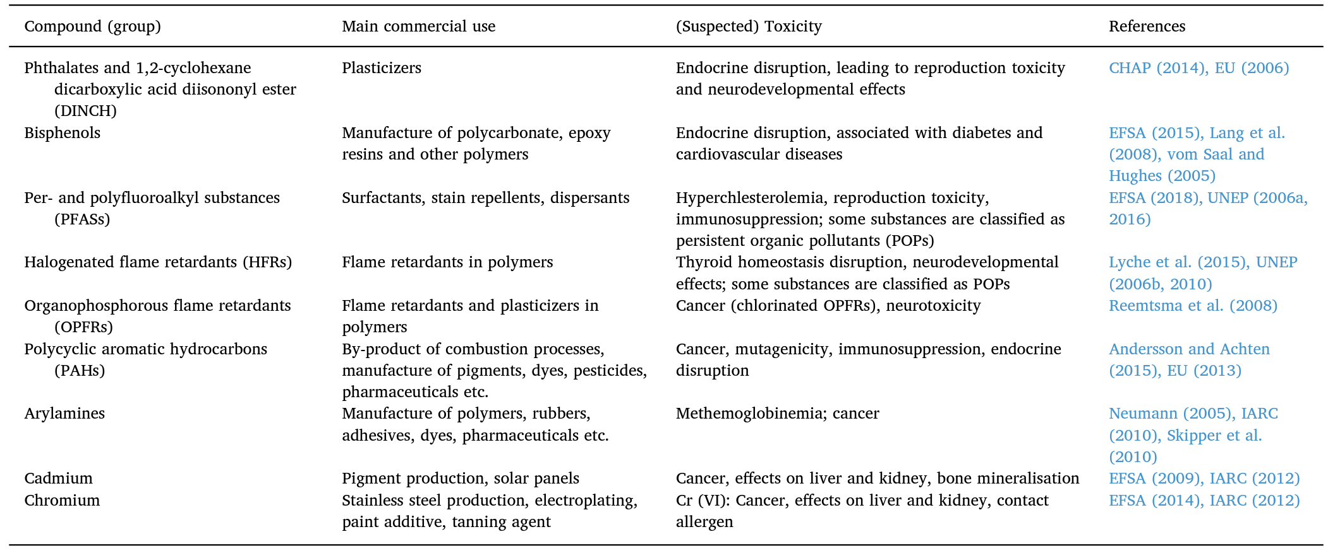
Summary of substances prioritized for HBM
Vorekamp K et al. Biomarkers, matrices and analytical methods targeting human exposure to chemicals selected for a European human biomonitoring initiative. Environment International 2021: 146: 106082.

Slide 23
Biomonitoring in the US in conjunction with the National Health and Nutrition Examination Survey (NHANES)
Conducted by the Centers for Disease Control and Prevention through National Center for Environmental Health
Monitors >400 chemicals and >80 nutritional biomarkers in human blood and urine
Periodically publishes the National Report on Human Exposure to Environmental Chemicals & Updated Tables
Data publicly available on NHANES website

Slide 24
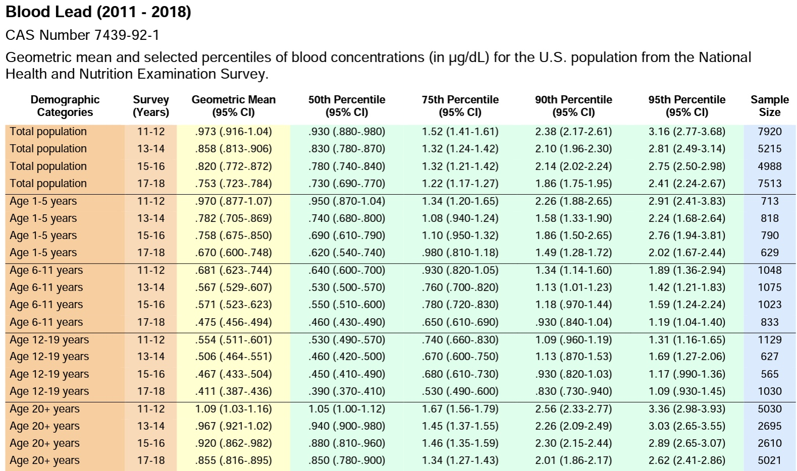

Slide 25
How are chemicals selected for analysis & inclusion in National Exposure Report?
Scientific data that suggested exposure in the U.S. population
Seriousness of health effects known, or thought to result from some levels of exposure
Need to assess the efficacy of public health actions to reduce exposure to a chemical
Availability of an analytical method that is accurate, precise, sensitive, specific, and rapid
Availability of adequate blood or urine samples from the National Health and Nutrition Examination Survey (NHANES) survey
Analytical cost to perform the analysis

Slide 26
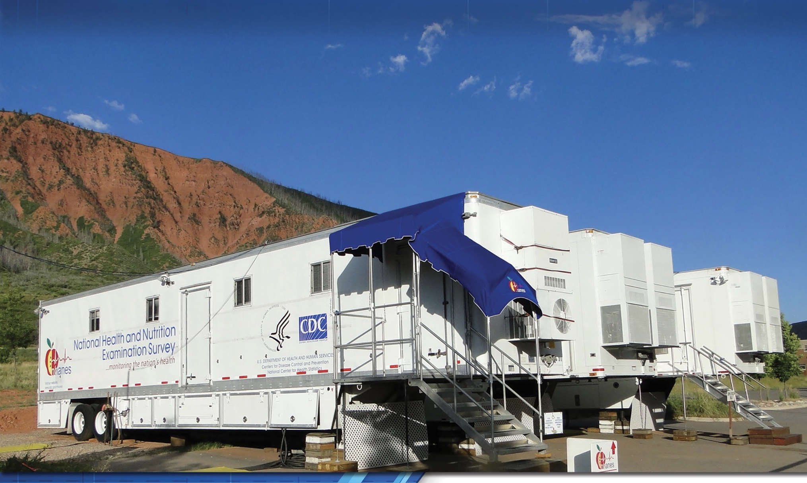
A little about NHANES

Slide 27
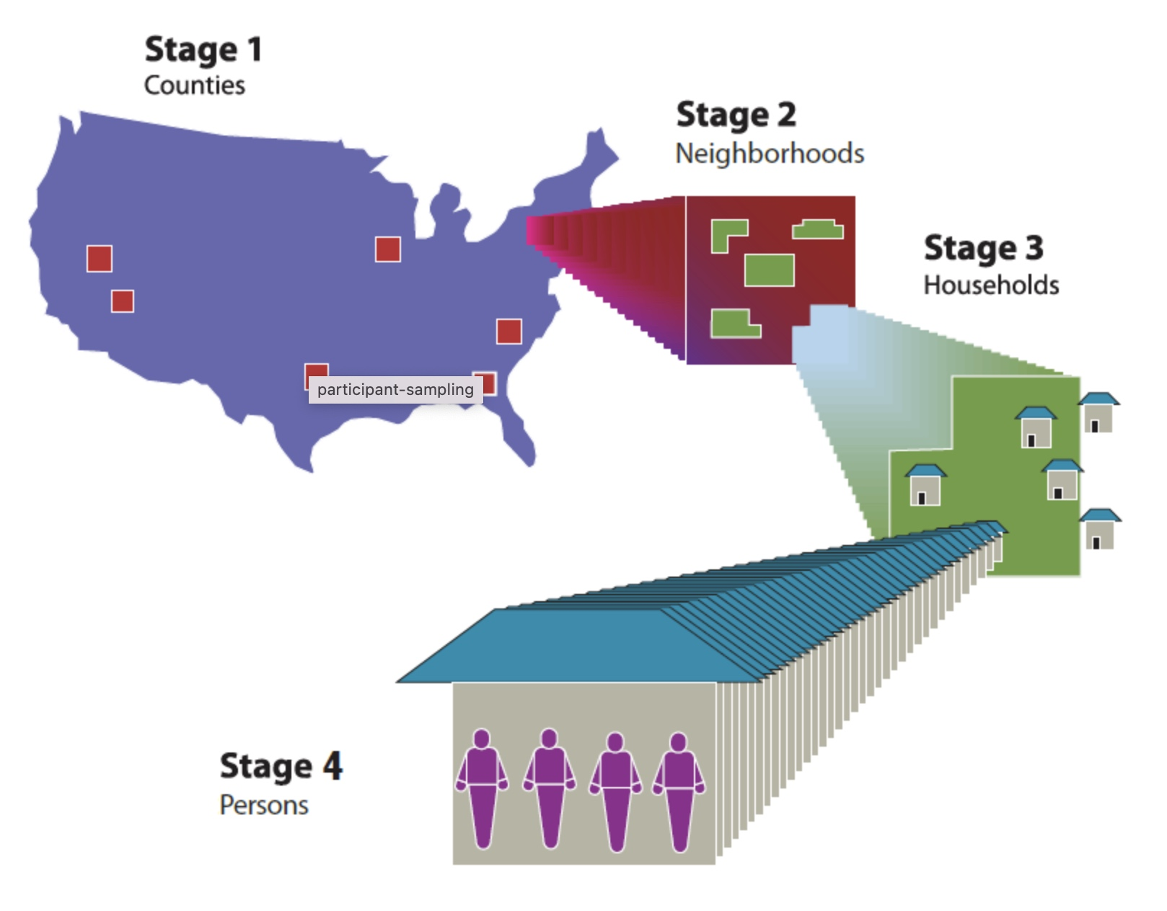
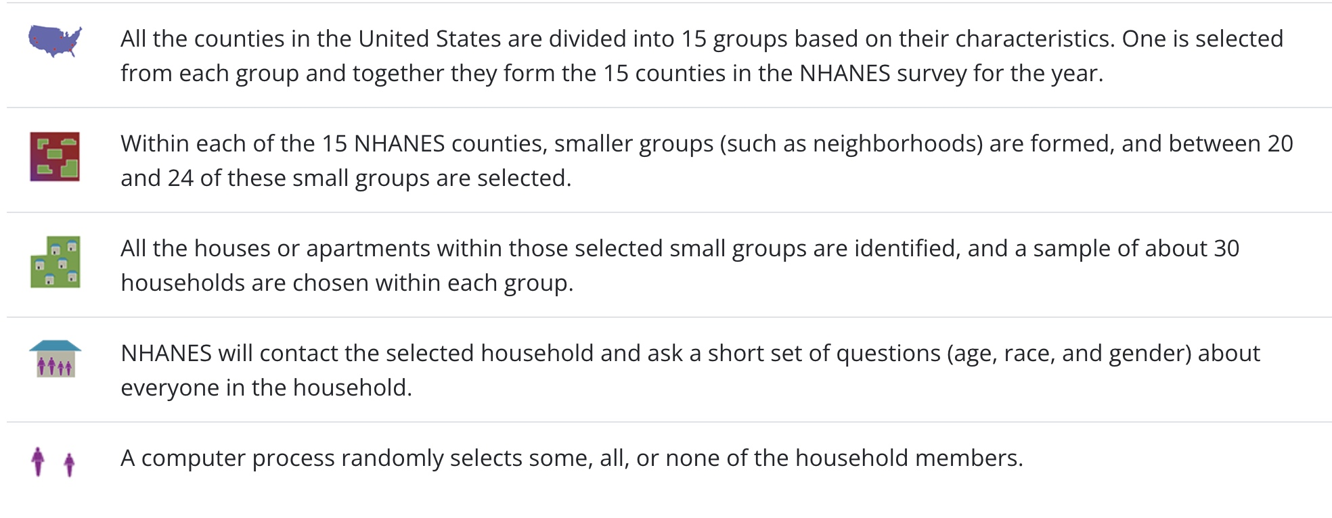
Nationally representative survey
Operating since 1959
  Periodic at first
  Continuous since 1999 – 2-year cycles
Complex – survey design
https://www.cdc.gov/nchs/nhanes/participant/participant-selected.htm

Slide 28
Survey components
Telephone interview @ home
  Head of household & some targeted participants (>16 y)
  Survey questions
  Sleep
  Diet
  Mood, behavior, etc.
Mobile Examination Center
  Height, weight, waist circumference
  Blood pressure
  Body composition scan
  Balance test
  Liver function scan
  Blood draw

Slide 29
Participants get some results back
Glucose test
Cholesterol
Nutritional status
Kidney function tests
Infectious diseases
Exposure to environmental chemicals

Slide 30
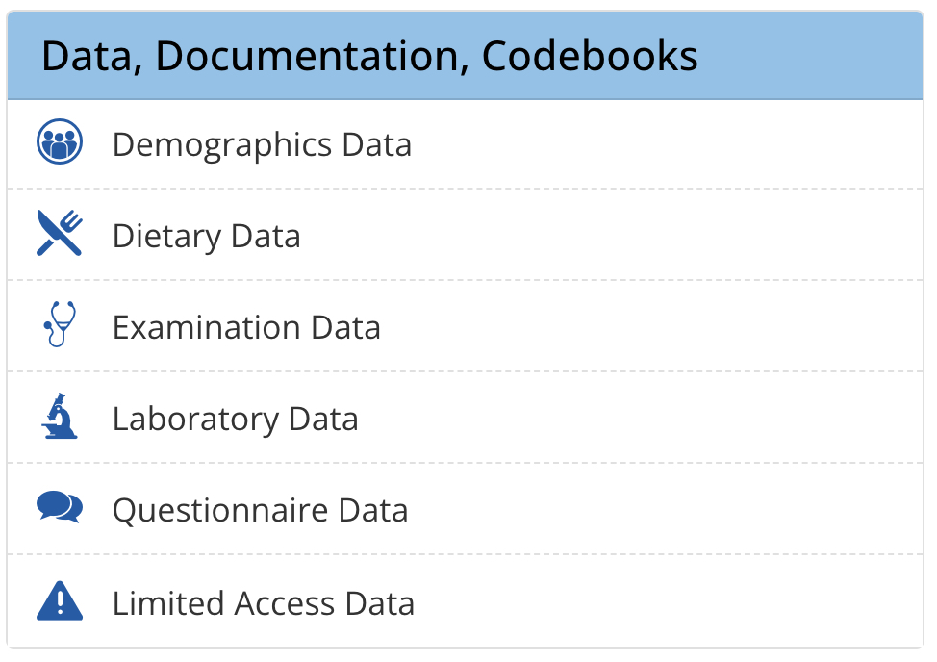
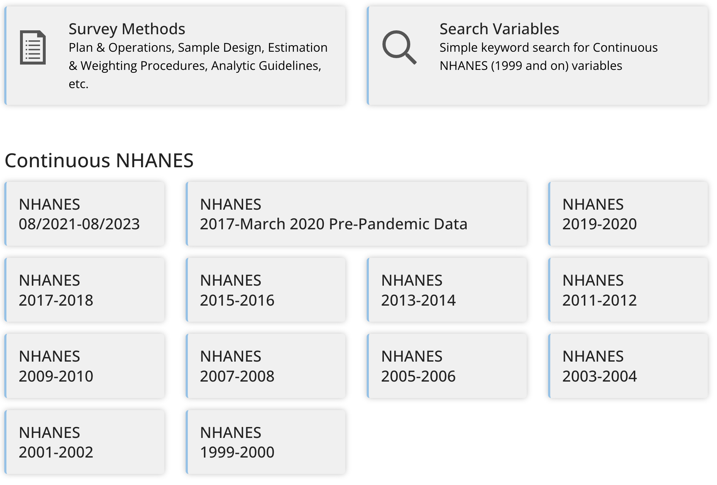
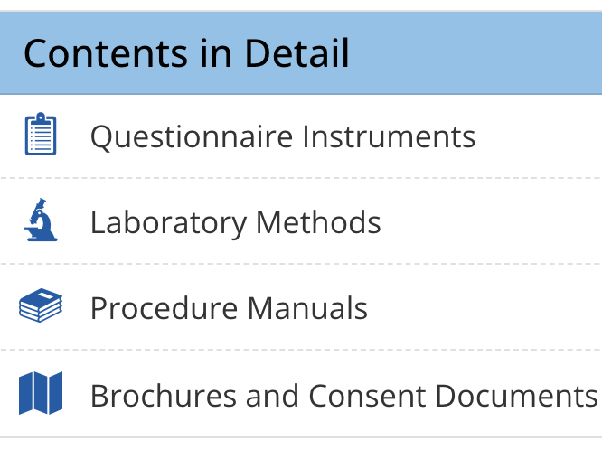
Data are publicly available

Slide 31
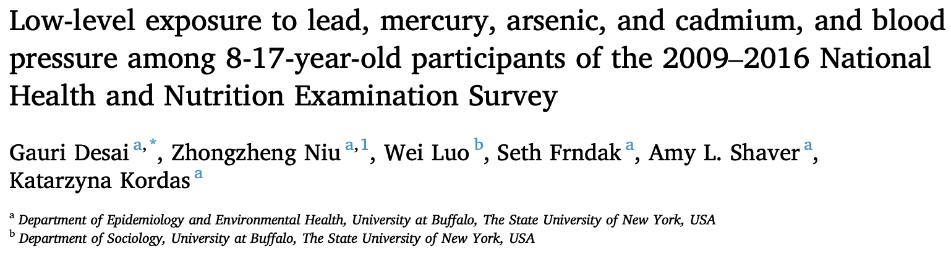
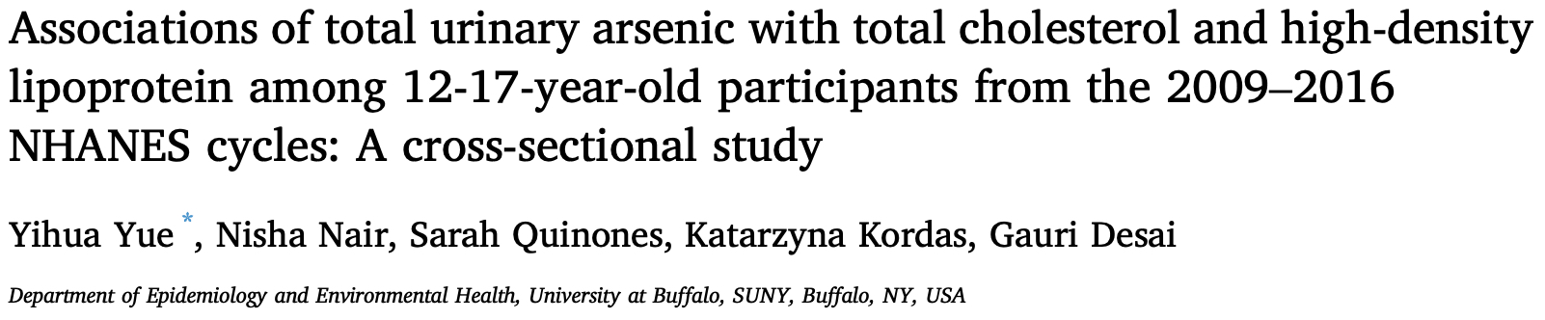
Feeds into scientific publications

Slide 32
Targeted HBM—biomonitoring for specific purpose
The Stockholm Convention on Persistent Organic Pollutants was adopted on 22 May 2001 and entered into force on 17 May 2004
Persistent Organic Pollutants (POPs)
remain intact for long periods of time (many years);
become widely distributed throughout the environment through natural processes involving soil, water and, most notably, air;
accumulate in living organisms including humans, and are found at higher concentrations at higher levels in the food chain;
are toxic to both humans and wildlife.
https://chm.pops.int/TheConvention/ThePOPs/tabid/673/Default.aspx

Slide 33
Targeted HBM—biomonitoring for specific purpose
Initial 12
  Pesticides: aldrin, chlordane, DDT, dieldrin, endrin, heptachlor, hexachlorobenzene, mirex, toxaphene;
  Industrial chemicals: hexachlorobenzene, polychlorinated biphenyls (PCBs);
  By-products: hexachlorobenzene; polychlorinated dibenzo-p-dioxins and polychlorinated dibenzofurans (PCDD/PCDF), and PCBs.

Slide 34
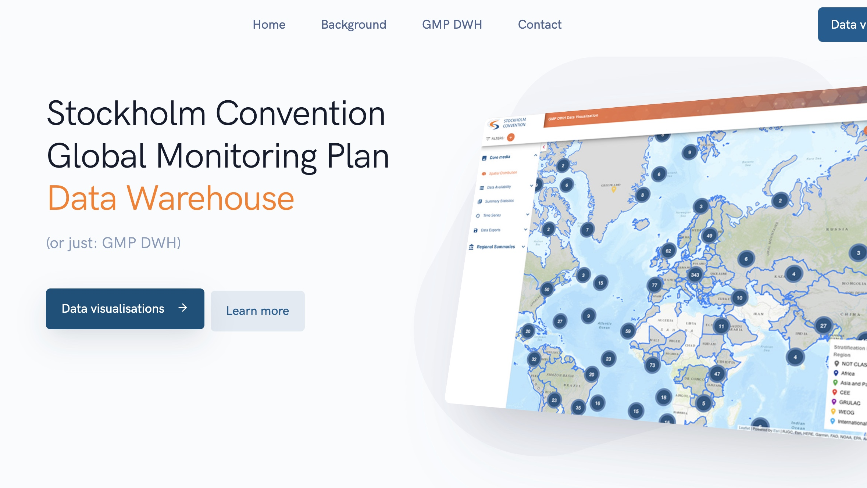
Data warehouse

Slide 35
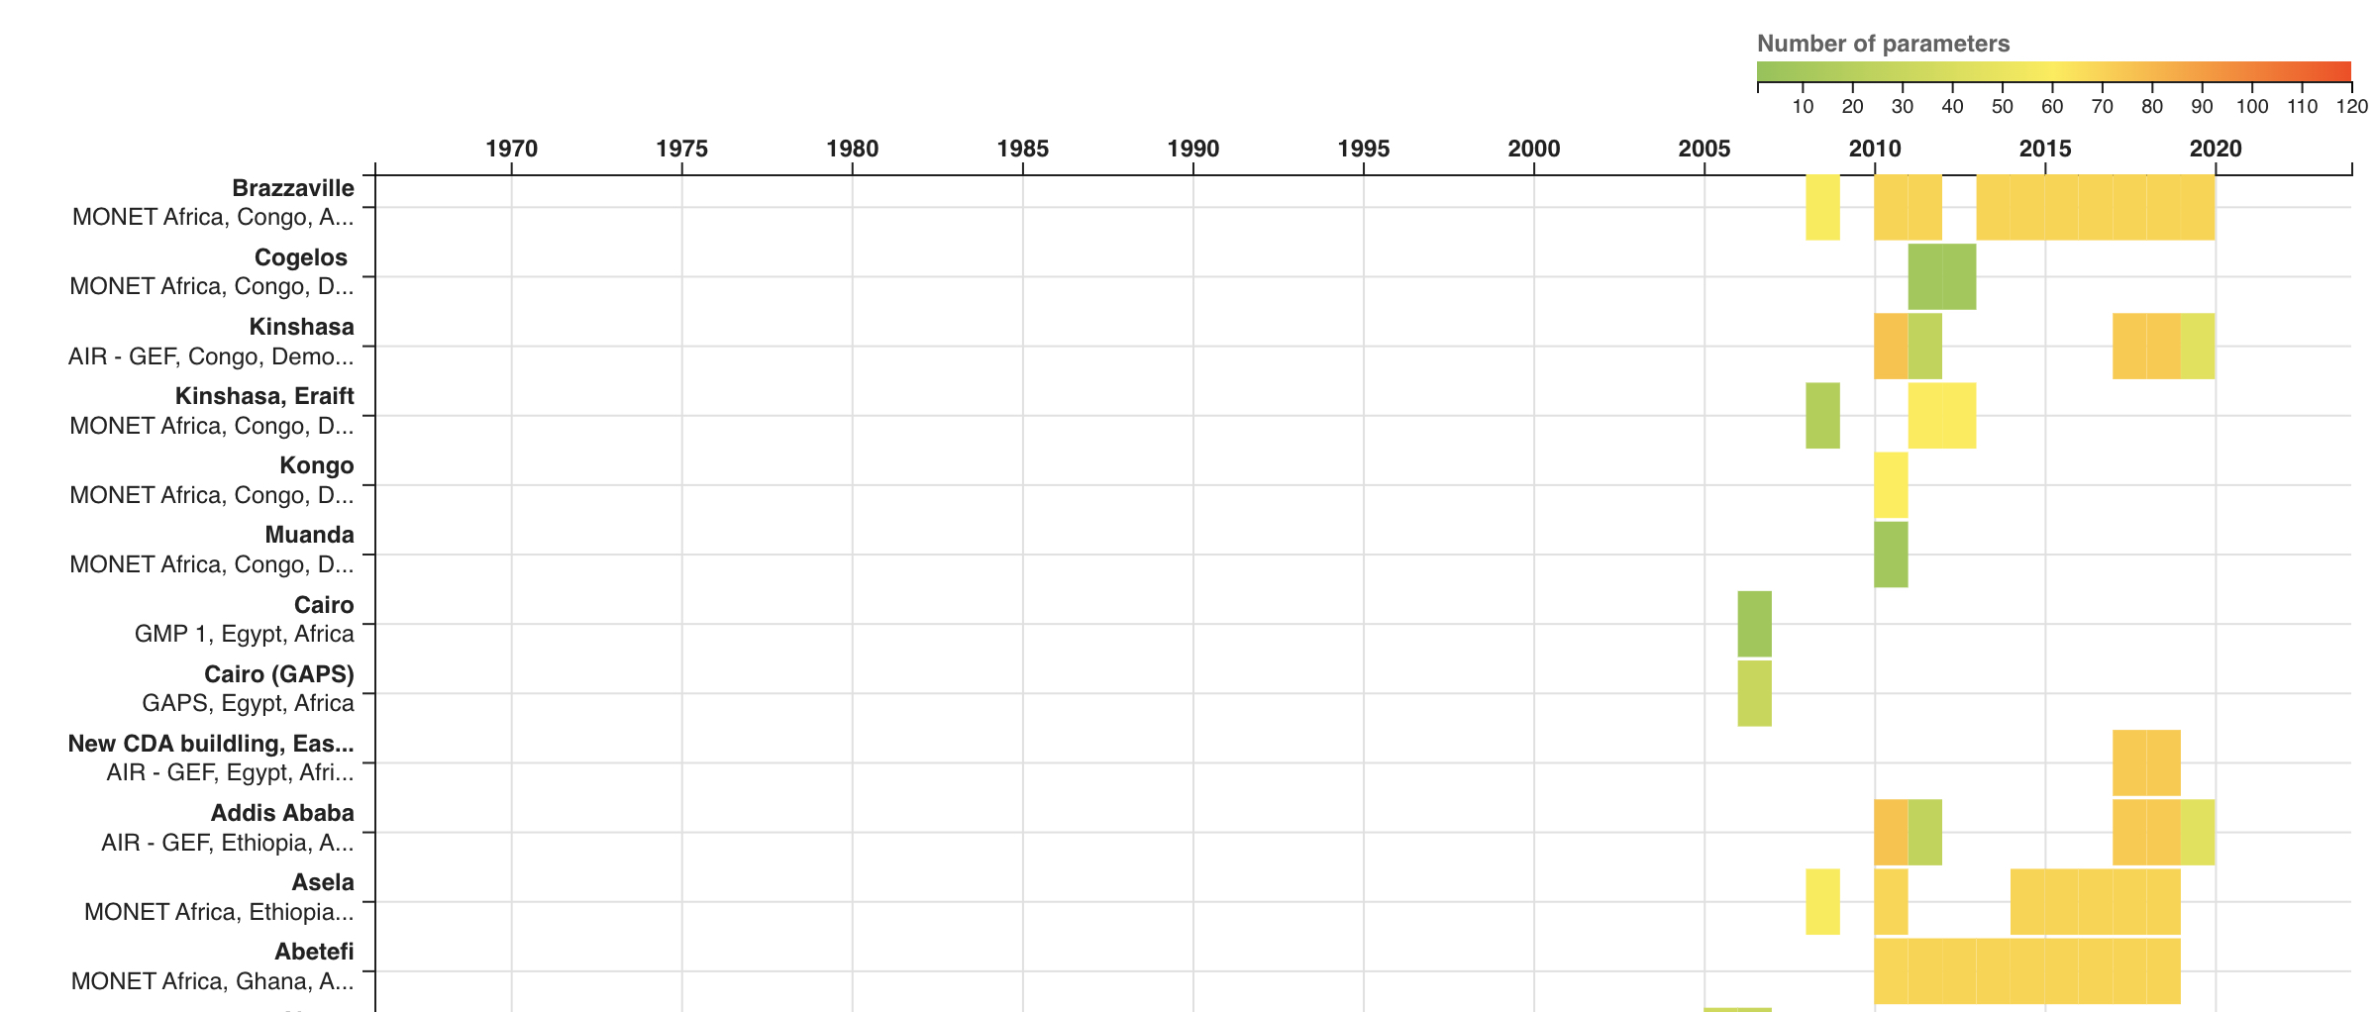
https://www.pops-gmp.org/index.html

Slide 36
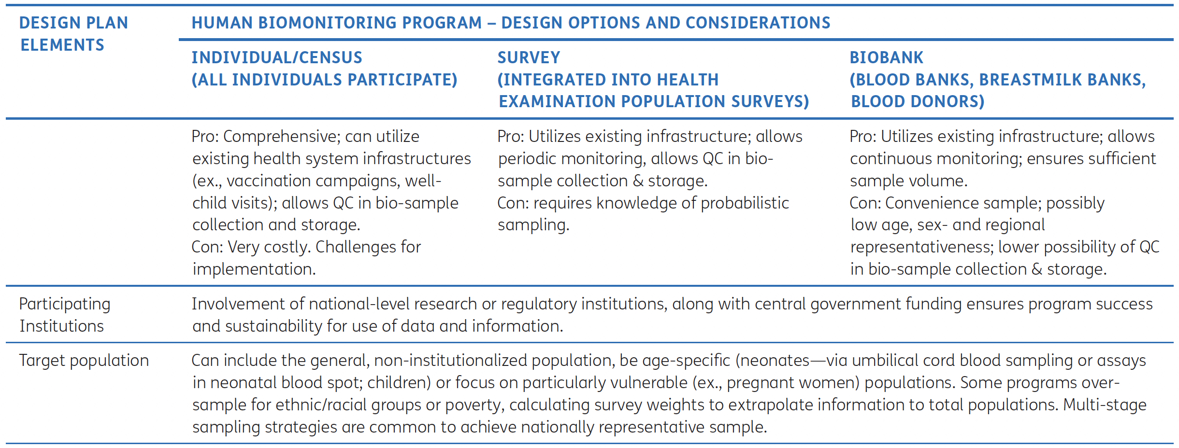
Designing HBM programs
Tamayo-Ortiz M et al. Annals of Global Health. 2022; 88(1): 80, 1–11.

Slide 37
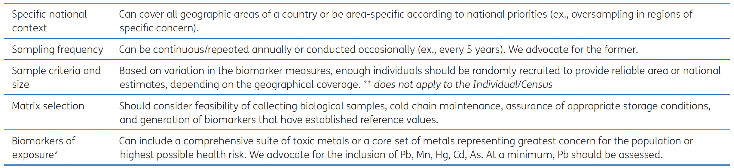
Designing HBM programs
Tamayo-Ortiz M et al. Annals of Global Health. 2022; 88(1): 80, 1–11.

Slide 38
How would you design a biomonitoring program?
Design type
  Census
  Survey
  Biobank
Target population?
Geographic coverage?
Frequency
Biological amples collected
Chemicals

