Slide 1
Toxicokinetics
Luděk Bláha, SCI MUNI

Slide 2
Take home messages of this lecture
What processes can a chemical compound undergo inside the ORGANISM?
What is TOXICOKINETICS and what processes does it describe?
  ADME
    Absorption - Uptake
    Distribution
    Metabolism (transformations)
    Excretion

Slide 3
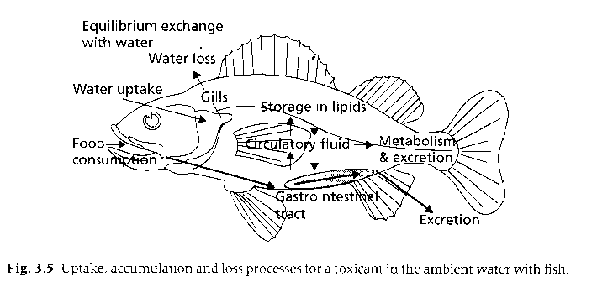
TOXICOKINETICS
Fate of compounds inside an organism
(uptake / transformations / excretion)

Slide 4
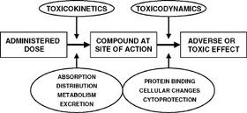
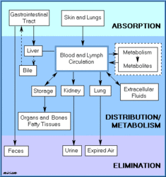
Processes in toxicokinetics = ADME
ADME
Absorption
Distribution
Metabolism
Elimination
Toxicokinetics ...
... EXPOSURE phase → Determines the final dose

Slide 5
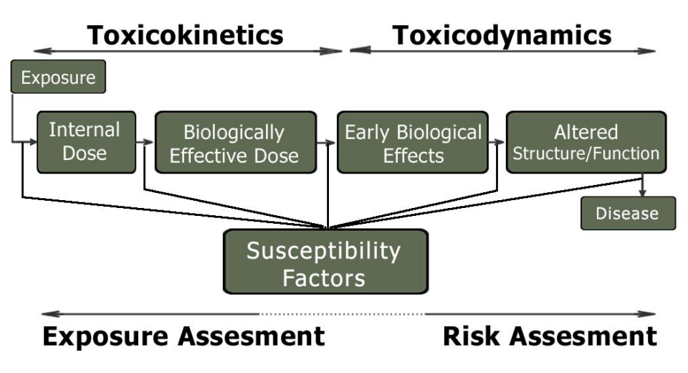
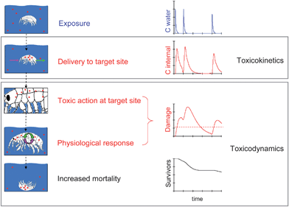
Toxico“kinetics“ vs „dynamics“
TARGETS = macromolecules
(DNA/RNA, proteins, membrane lipids)
Interaction with
target molecules
(Mode of Action)
... Measurable
EFFECTs

Slide 6
Toxicity = imbalance between UPTAKE and EXCRETION
UPTAKE ~ ELIMINATION (equilibrium, homeostasis)
- compound is maintained in the body in a concentration lower than harmful
- organism has to invest energy to maintain this equilibrium
(elimination processes, metabolism ...)
UPTAKE > ELIMINATION
- the concentration of the compound increases
- it is a matter of time until it exceeds the threshold level
When limits of homeostatic processes are exceeded
→ transition of an individual from the state of resistance (or adaptation) to the state of detectable negative effects
→ negative effects at higher levels of organization
(tissue, organism, etc.)

Slide 7
TOXICOKINETICS 1: uptake of compounds into the organism
Uptake of compounds in various organisms
1) unicellular organisms
- passive diffusion through a membrane
- „selective“ input through present transport systems
2) multicellular organisms / algae
- diffusion of the toxicant through membrane and between the cells
3) terrestrial plants
- compounds dissolved in water/soil – uptake via roots/leafs
- gaseous toxicants – uptake via leaf stomata
- lipophilic compounds (some herbicides) – penetration of the waxy cuticle
- into the cell → through the membrane

Slide 8
TOXICOKINETICS 1: uptake of compounds into the organism
Uptake of compounds into the organism:
4) animals - 3 main uptake pathways
- food/drinking water
- passage through the digestive system, changes/transformation dependent on pH, gut microflora, e.g. cycasin: nontoxic – conversion in the gut → strong mutagen)
- via respiration
- tracheae of insect, gills of aquatic organisms, lungs
- large surface for exchange/entry of compounds (often 25times larger than body surface)
- via body surface
higher importance for smaller organisms (relatively larger area) and aquatic organisms
in any case → transfer through membranes

Slide 9
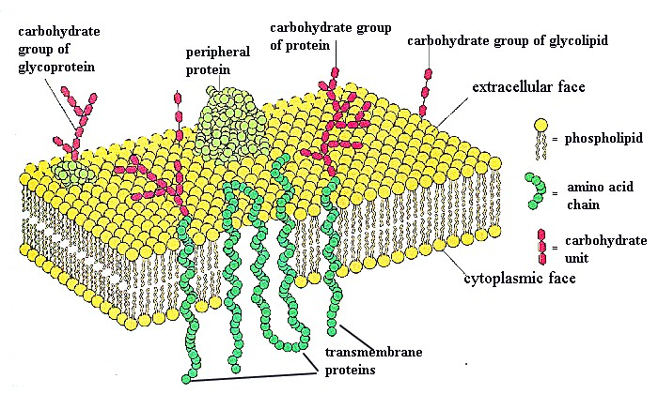
Membranes – essential barrier for toxic compounds
Regardless of the type of the organism or uptake pathway (into higher organisms) the toxicant has to cross the plasmatic membrane barrier (or as well the cell wall).

Slide 10
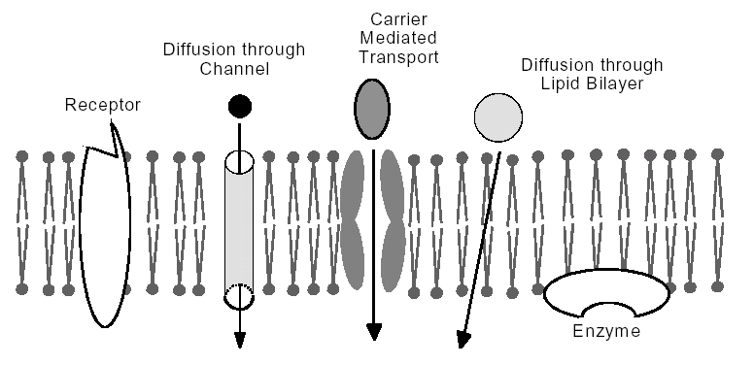
Toxicants crossing the membranes
Most common (all compounds) - passive diffusion
Selected ompounds with special/certain properties (e.g. alike to nutrients or natural compounds)
– co-transport / active transport
Large molecules + particles - pinocytosis

Slide 11
TOXICOKINETICS 1
- uptake of compounds into the organism -
Toxicants crossing the membranes
PASSIVE DIFFUSION
random movement of molecules down a concentration gradient
process characterized by the first order kinetics
- depends on:
- concentration gradient
- membrane and cell wall area and thickness
- compound‘s solubility in fat and its ionization
- lipophilic and neutral compounds – good diffusion
- charged compounds – diffusion more difficult
- molecular weight:
- small molecules (<0.4 nm) water soluble (CO, HCN, N2O, NO) good diffusion

Slide 12
TOXICOKINETICS 1
- uptake of compounds into the organism -
Toxicants crossing the membranes
CO-TRANSPORT
- transmembrane proteins bind extracellular compounds and facilitate transmembrane transport : toxic compound - interference
(Ca²⁺ / calmodulin, Fe^{2/3+} / transferrin)
ACTIVE TRANSPORT
- „pumps“ down/up the concentration gradient
- compound binds to a receptor / ATP powered membrane transport
coupled transports Na+/K+ ATPases - toxic compounds/ interference
These special biological processes occur rarely with xenobiotics – exceptionally with compounds alike to nutrients and such (e.g. cyanobacterial toxins: peptides)

Slide 13
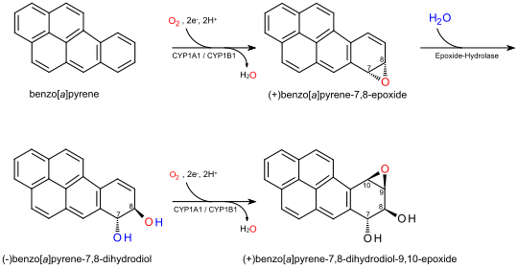
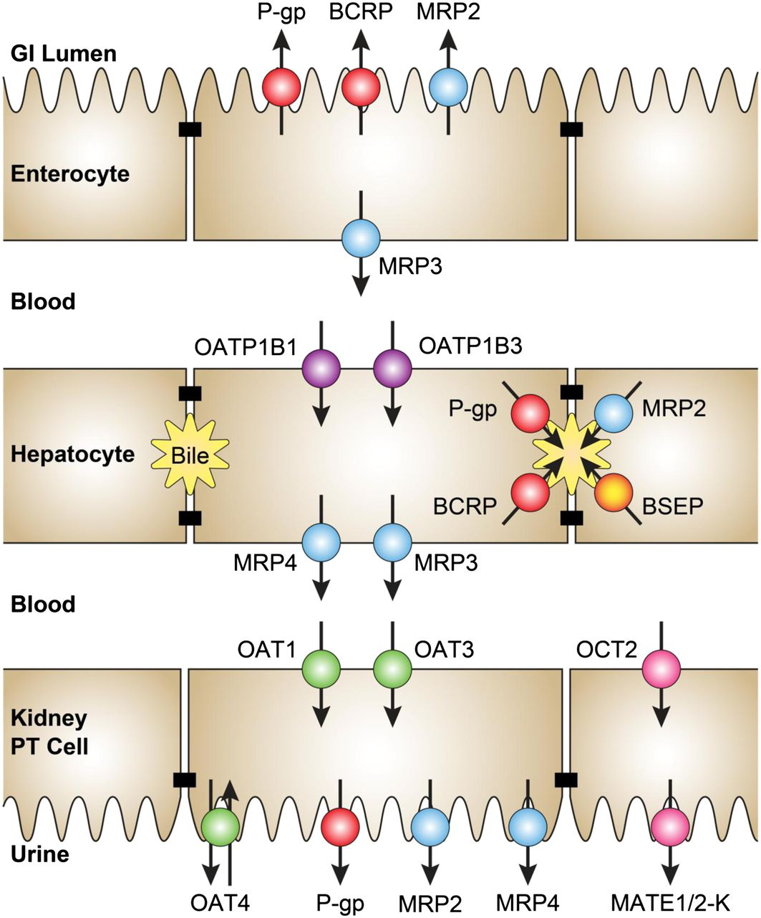
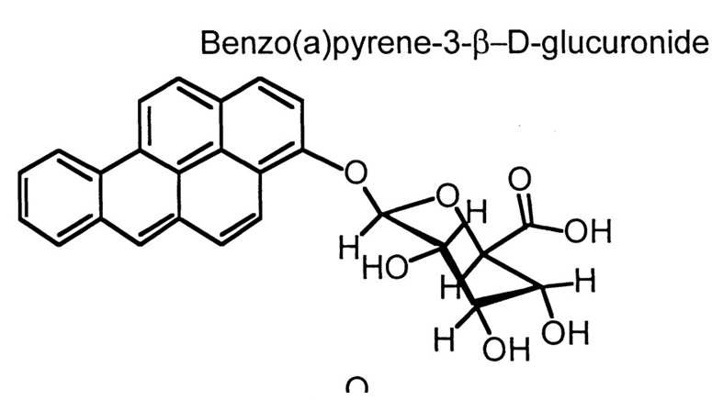
„Fate“ (transport) of a chemical through body
(from gut, through blood / organ (liver) / blood again to kidney/urine
Figure shows transporters
involved in the transfer (including excretion)
of structurally specific compounds to and from the organism
Alternative (passive diffusion) route for benzo(a)pyrene is added

Slide 14
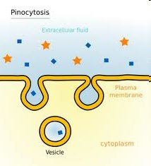
TOXICOKINETICS 1
- uptake of compounds into the organism -
PINOCYTOSIS
- transport of larger molecules via endocytosis
- e.g. entry of airborne toxicants with dust particles (< 1 μm) into alveolar cells, entry of asbestos fibers into alveolar macrophages
Notes:
entry of airborne toxicants with dust particles
into alveolar cells, entry of asbestos fibers into alveolar macrophages

Slide 15
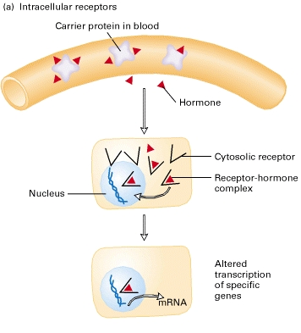
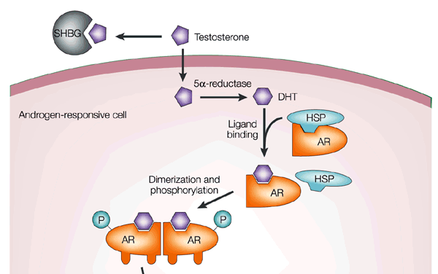
TOXICOKINETICS 2
- transport of compounds in the organism -
Transport in animals
- blood, lymph, haemolymph
- transport of dissolved compounds
- transport after binding to proteins (albumin, specific proteins)
! Many organic (nonpolar) compounds can be bound

Slide 16
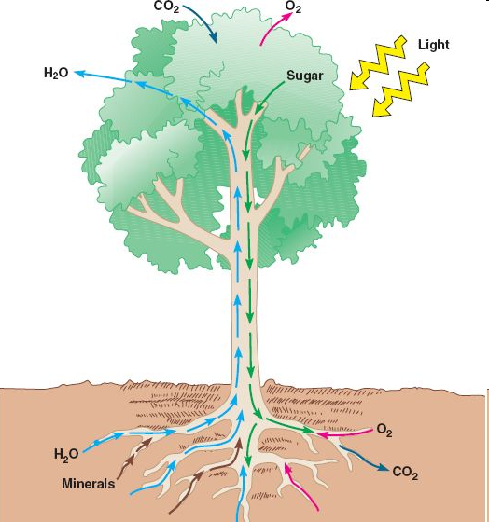
TOXICOKINETICS 2
- transport of compounds in the organism -
Transport in plants
water stream in xylem
plasmodesms in phloem
processes dependent on
environmental conditions
(t, humidity, light...)

Slide 17
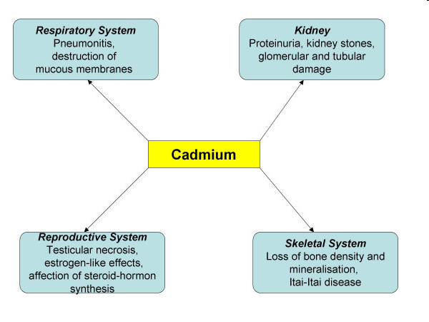
TOXICOKINETICS 2
- Distribution of compounds in the organism -
Affinity to different tissues
- affinity is determined by chemical properties -> target tissues - bioconcentration
seashells - Cd/Pb - gonads
mammals Cd – brain/bones, Pb – kidneys/bones
Hg – in mammals: kidneys > liver > spleen > gut > heart...
lipophilic compounds -> fatty tissues (liver, brain)

Slide 18
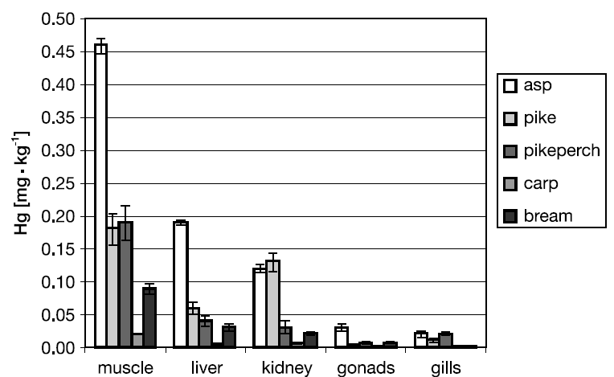
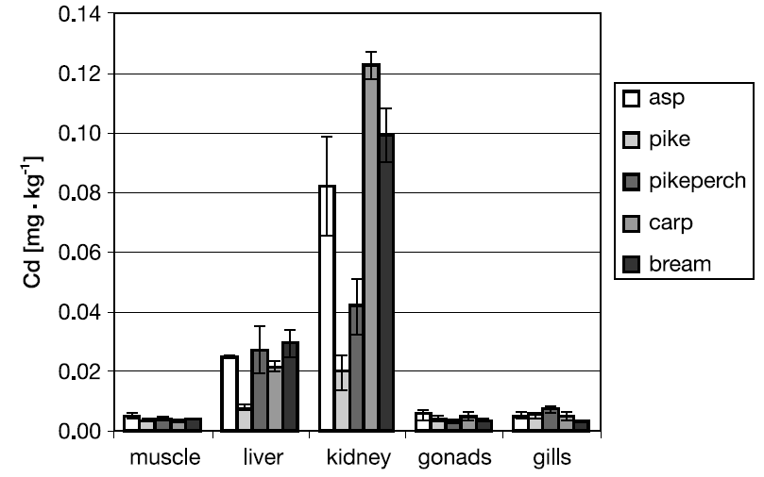
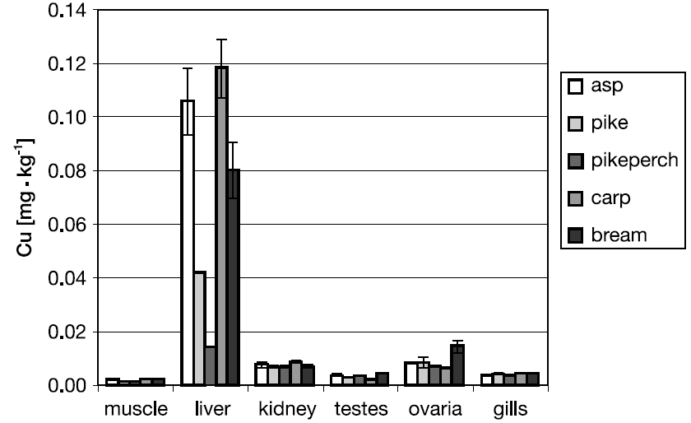
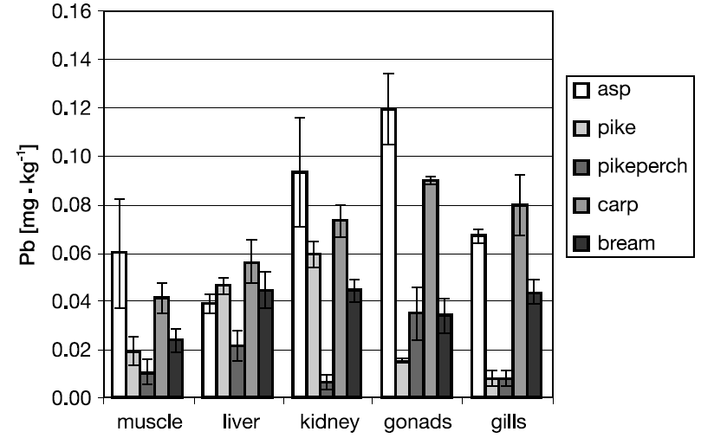
Example – metals in tissues of fish: Nové Mlýny
(Kenšová et al. ACTA VET. BRNO 2010, 79: 335-345)

Slide 19
TOXICOKINETICS 3
- transformation of compounds in the organism -
Transformation of xenobiotics in organisms
- all organisms have genetically fixed old conservative systems for transformation of xenobiotics:
- in the past
- transformation of biotoxins (moulds, plants, bacteria...)
- combustion products (PAHs)

Slide 20
TOXICOKINETICS
- transformation of compounds in the organism -
Basic detoxification strategy
- Removal from the organism = exposure limitation
- Most excretion organs: aqueous solutions
:transformation = increasing water solubility
- production of more polar, less hydrophobic (more hydrophilic) products
- Two (2) … or 3 with elimination … main phases of detoxification
- well examined in animals (mammals)
Note: in vertebrates (esp. mammals – warm-blooded = higher speed of reactions)
  >> detoxication more active than in fish or invertebrates
  (➔ bivalves accumulate PAHs x mammals less: oxidation/excretion)
In plants – transformation with oxidative enzymes: cytochrome oxidase, phenol oxidase, peroxidase, ascorbate oxidase
Notes:
production of more polar, less hydrophobic / more hydrophilic products

Slide 21
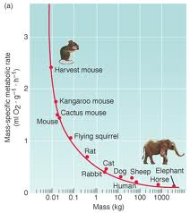
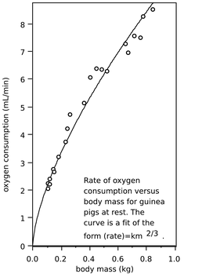
TOXICOKINETICS – rate of detoxification reactions
Rate of transformations depends on
overall metabolic rate (indirectly also on body size)
temperature (the higher the temperature – the higher the rate of reactions)

Slide 22
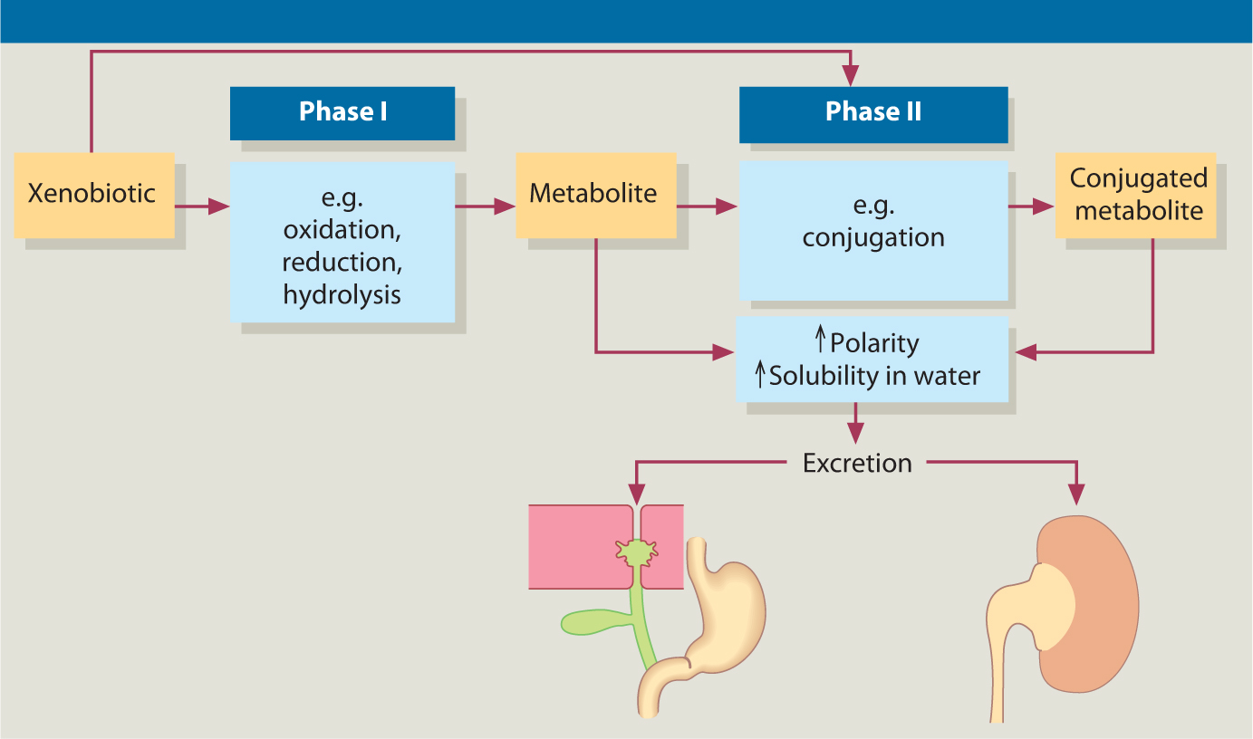
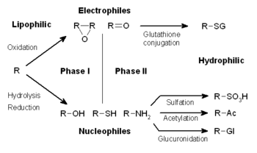
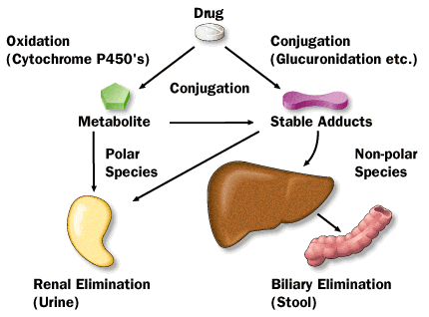

Slide 23
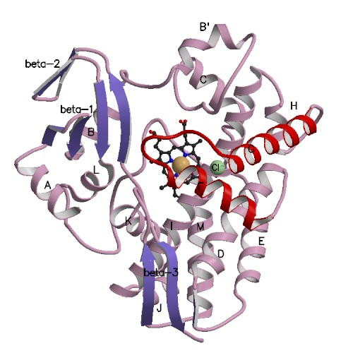
TOXICOKINETICS - transformation – PHASE I
- MFO enzymes (mixed function oxidase, mixed function oxygenase)
- membrane enzymes bound to ER, extractable as membrane vesicles (= microsomes = S-9 fraction = microsomal oxidase)
- Conserved – in all plants and animals

Slide 24

TOXICOKINETICS
Phase I transformation – CYP450
- based on enzymes containing heme as cofactor = cytochromes P450 (CYP) = superfamily with more than 150 genes
- in vertebrates mostly in liver parenchyma = main detoxifying organ (but also in – gut epithelium, gills...)
- in invertebrates in hepatopancreas and digestive glands
main reaction – reaction with oxygen
+ other reactions (hydrolysis / epoxidation / dehalogenation / hydroxylation / deamination / dealkylation)
Notes:
based on enzymes containing heme as cofactor = cytochromes

Slide 25
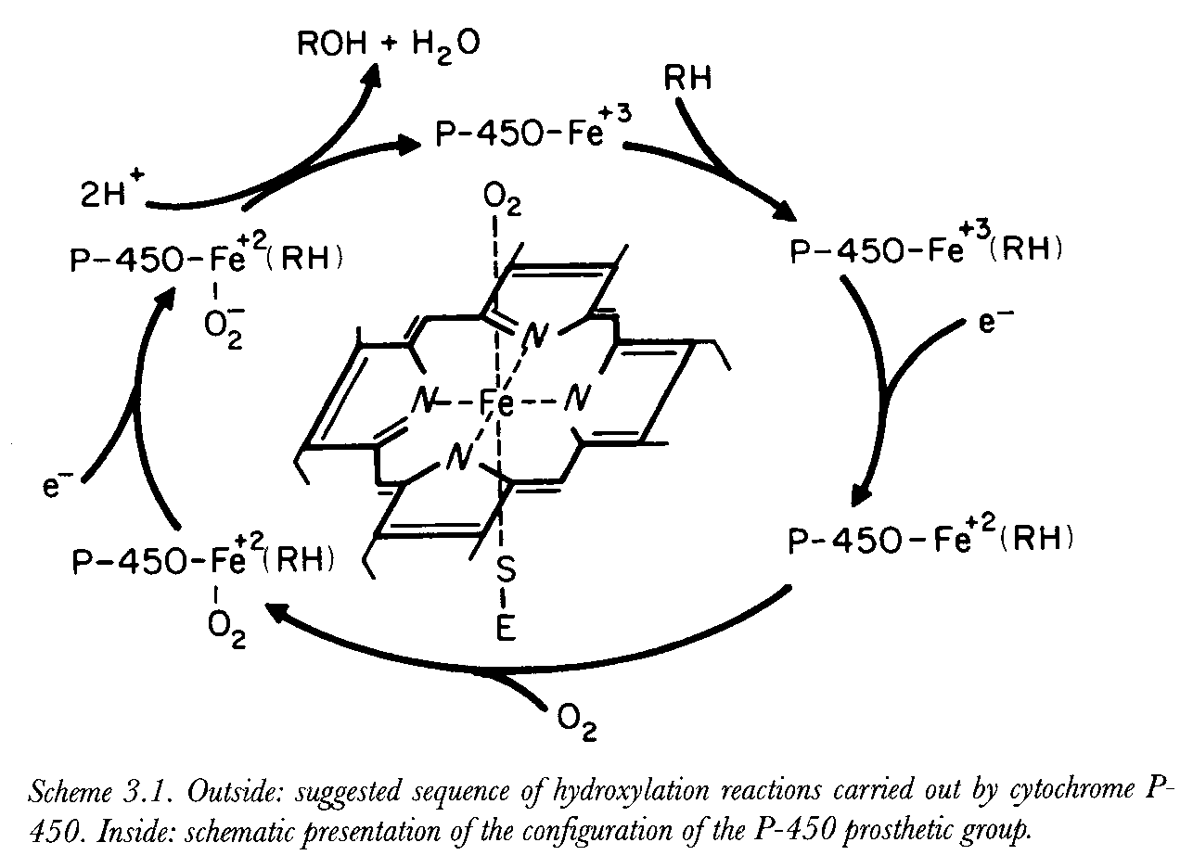

Slide 26
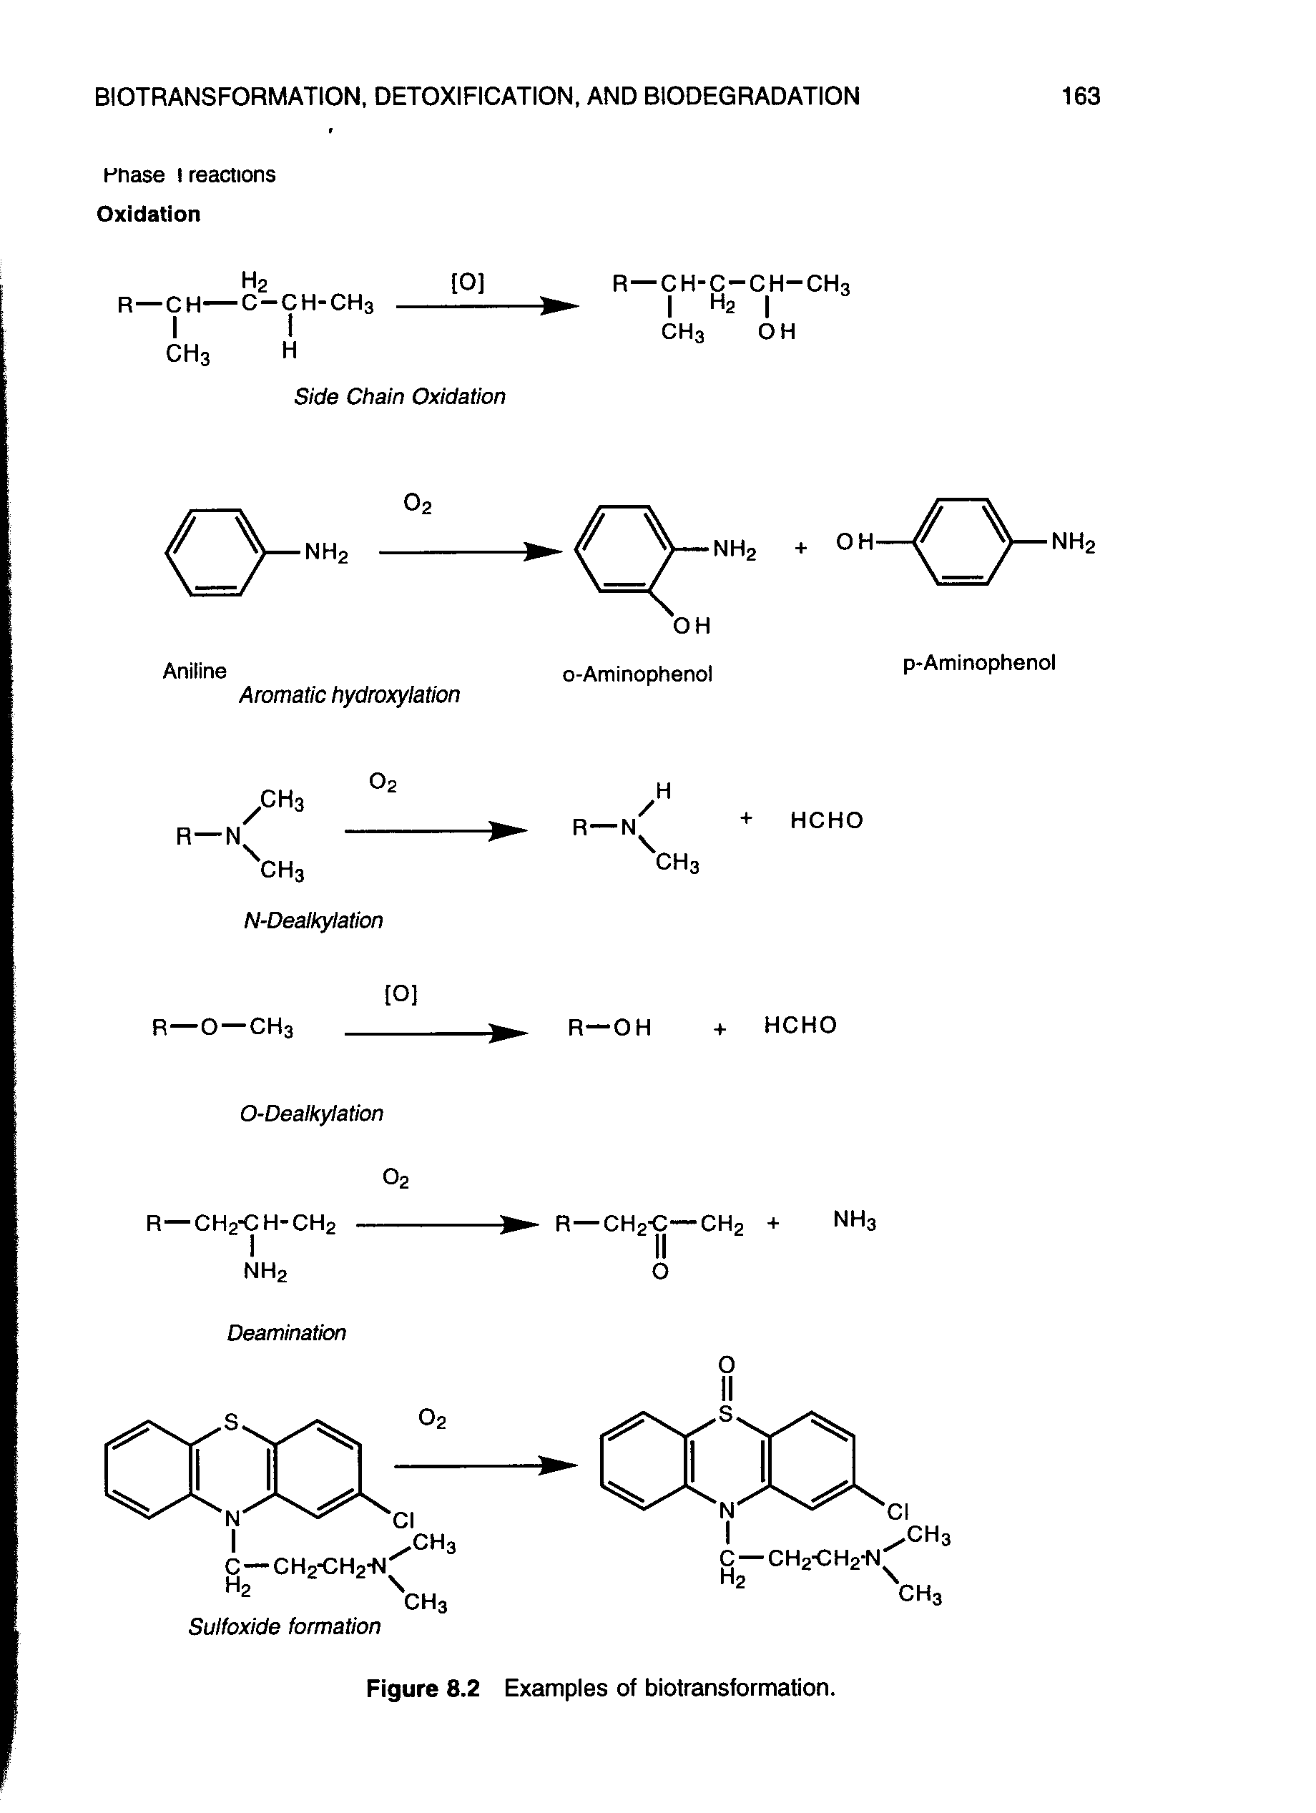
Phase I biotransformation reactions – examples 1

Slide 27
Phase I biotransformation reactions – examples 2

Slide 28
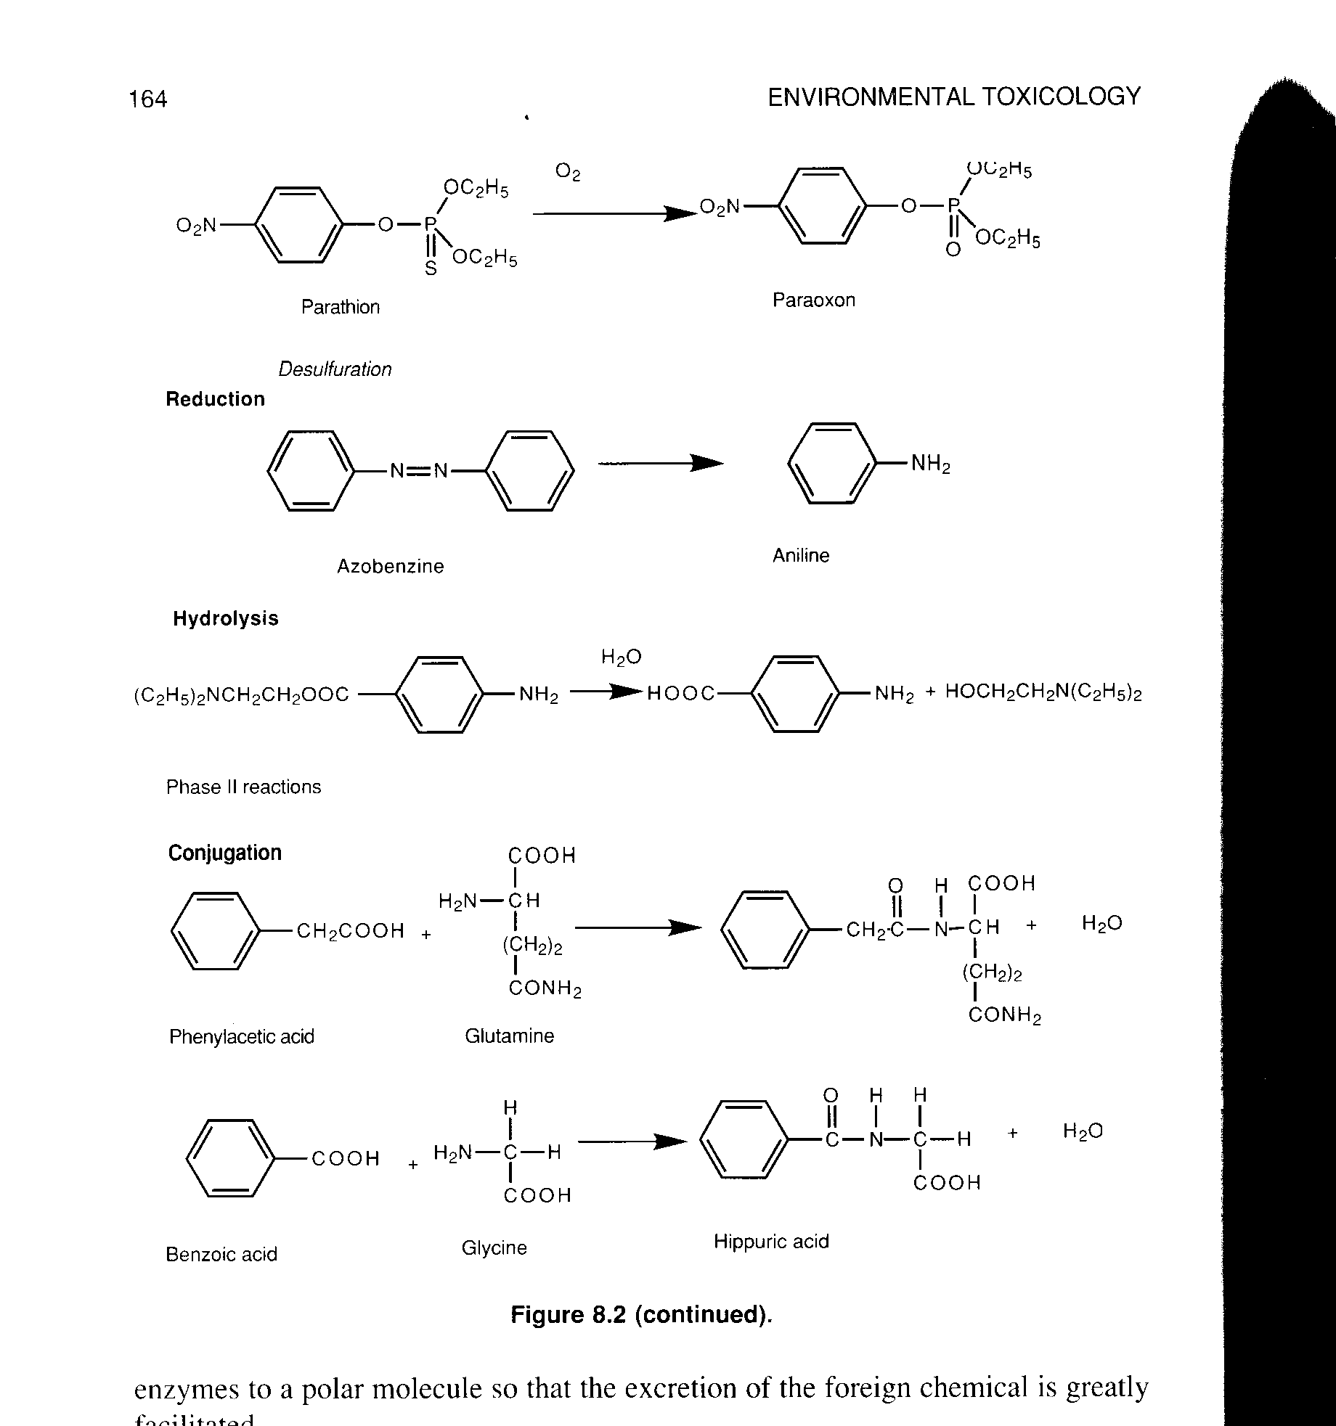
Phase I biotransformation reactions – examples 3

Slide 29
TOXICOKINETICS: Detoxification → (BIO)ACTIVATION
- many compounds after metabolization with detoxification enzymes turn into more toxic metabolites = BIOACTIVATION
(simplified as Procarcinogen → Carcinogen activation; the process is GENERAL – not only carciongens(!))
Example – POLYCYLIC AROMATIC HYDROCARBONS
E.g. epoxidation of benzo[a]pyrene (BaP)
-> reaction with guanosine residues in DNA
- mutation / activation of oncogenes
BUT BaP without activation -> acutely nontoxic compound
- strong induction of detoxification enzymes after exposition to xenobiotics can have also other negative effects (dioxin type toxicity – see further)

Slide 30
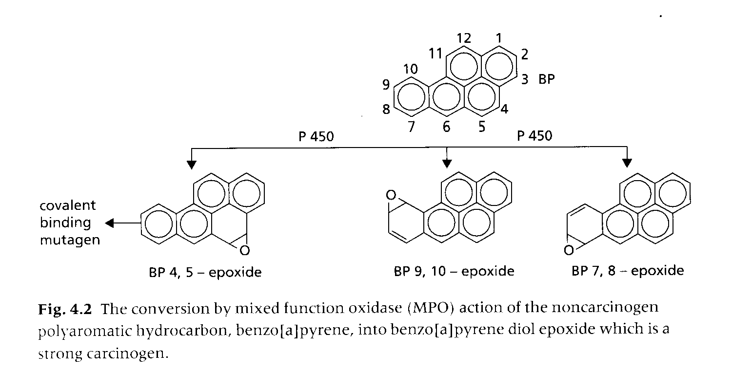
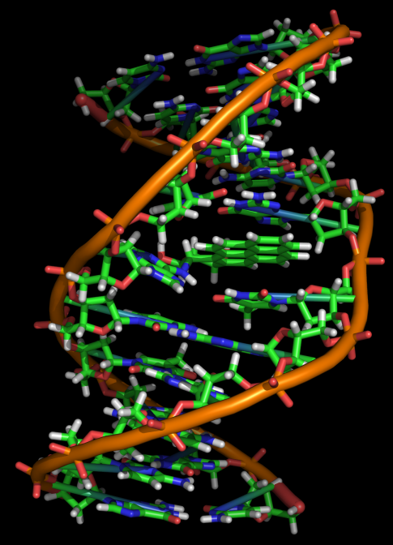
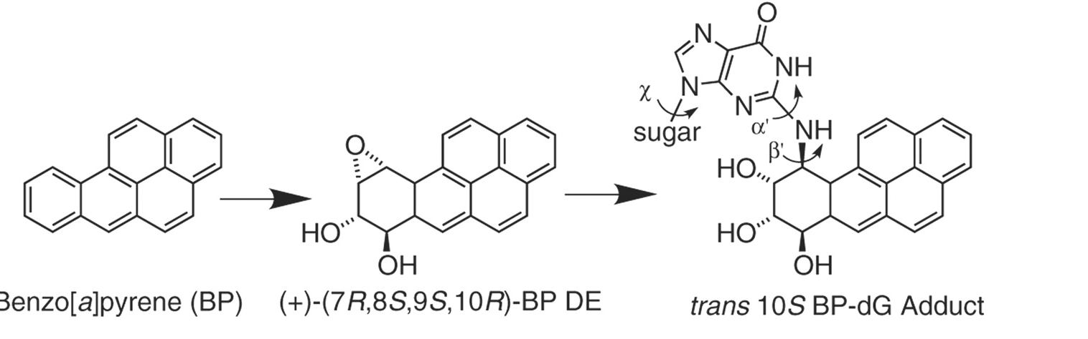
TOXICOKINETICS – Bioactivation of Procarcinogen
Metabolism/oxidation → formation of more toxic/carcinogenic products
BaP intercalated in
DNA

Slide 31
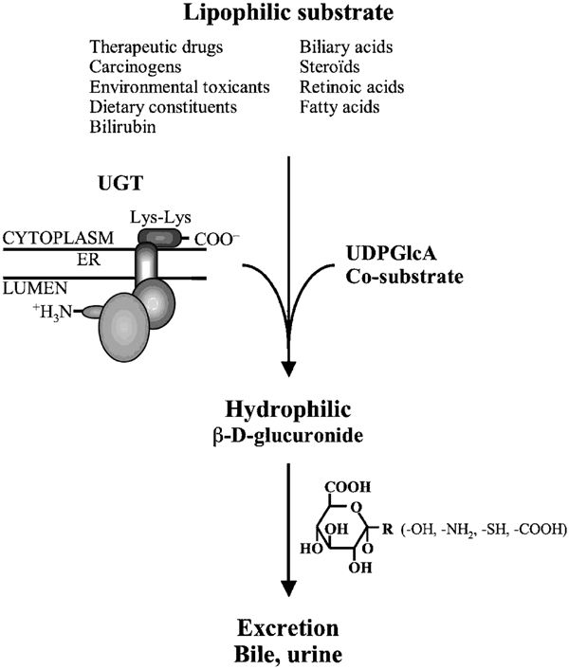
Detoxification – Phase II
Key reactions = conjugations
  Reactive xenobiotics or metabolites formed in phase I
  with endogenous substrates
    saccharides and their derivatives – glucuronic acid,
    aminoacids (glycine)
    peptides: glutathione (GSH)
Forming water soluble AND “nontoxic” products (conjugates)
Phase II enzymes (“transferases”):
  glutathion S-transferase (GST)
  UDP-glucuronosyltransferase (UDP-GTS)
  sulfotransferase (ST)

Slide 32
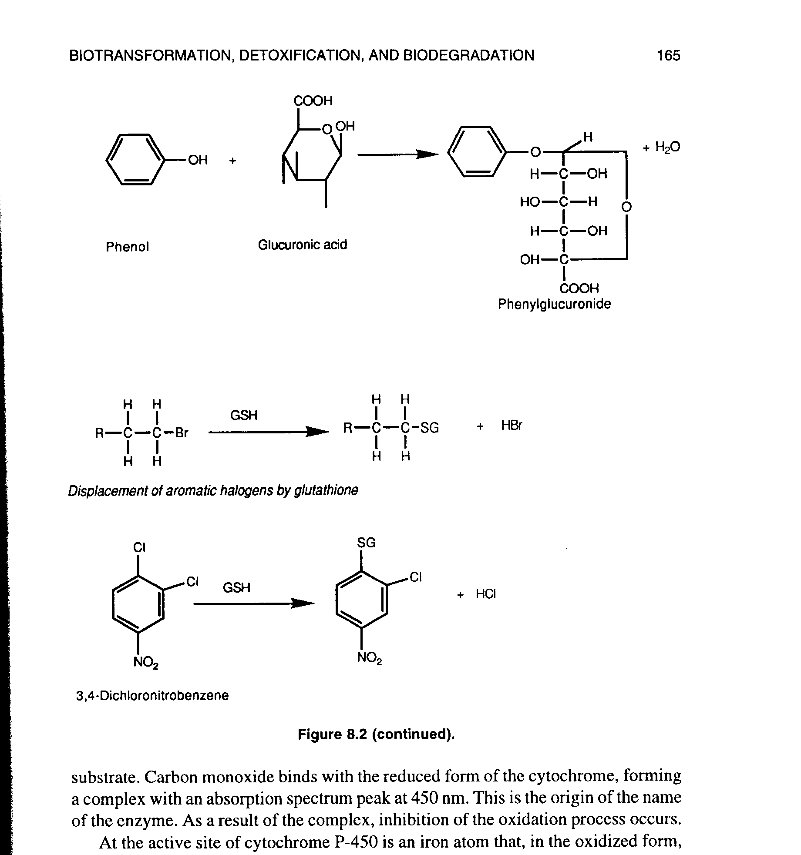
Phase II - Examples of conjugation reactions

Slide 33
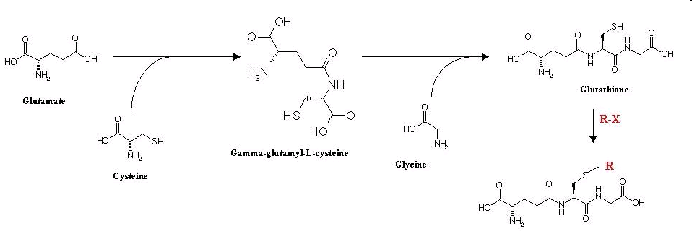
Glutathione (GSH)
tripeptide structure
Phase II conjugation reactions + general scavenger/antioxidant
major donor of SH (thiol) groups in cells (MW ~ 300 g/mol)
- concentrations in tissues and blood up to 5 mM (1.5 g/L)
- the major „antioxidant“ which can be synthesized by animals
(other antioxidants – e.g. vitamin C, E - food antioxidants)

Slide 34
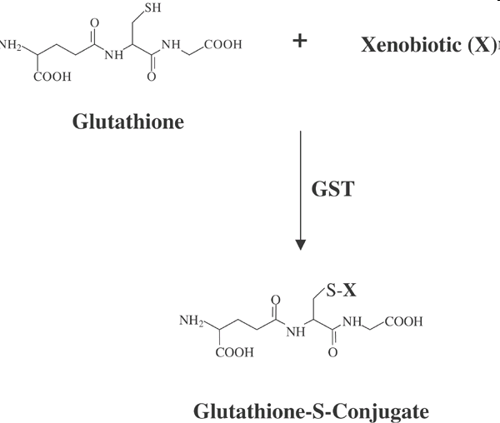
Xenobiotic conjugations with GSH

Slide 35
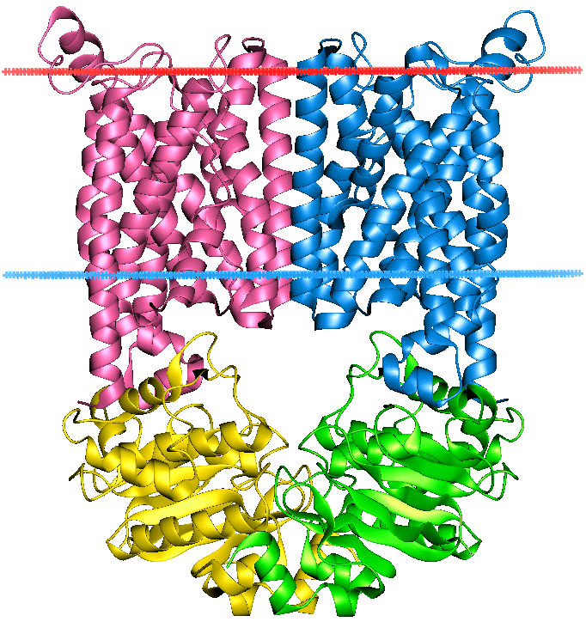
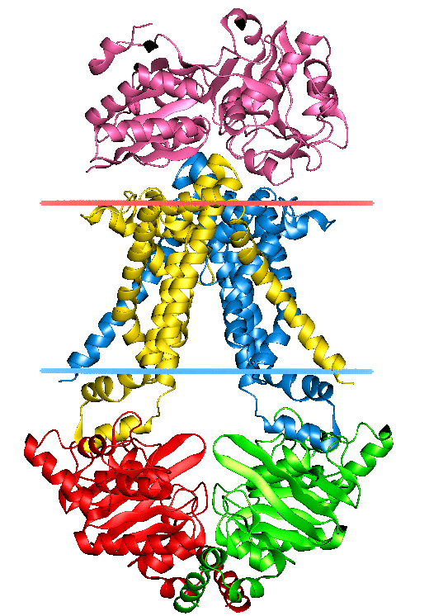
Phase III – elimination / membrane transport
Phase III transporters
  Transporting toxic molecules / metabolites / intermediates / conjugates from inside the cell to extracellular matrix (blood etc)
  ATP-binding cassette transporters (ABC transporters)
  protein superfamily (one of the largest, and most ancient in all extant phyla from prokaryotes to humans)
  transmembrane proteins - transport across extra- and intracellular membranes (metabolic products, lipids, sterols, drugs)

Slide 36
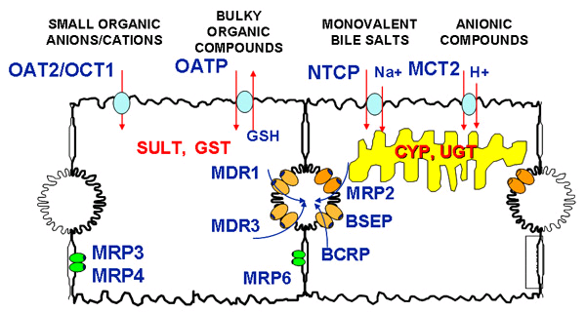
ABC transporters - examples
- MRP (MDR) - multidrug resistance-associated protein family
- OATP - Organic Anion Transporting Polypeptide
- P-glycoprotein
Bile channel in the liver → GIT

Slide 37
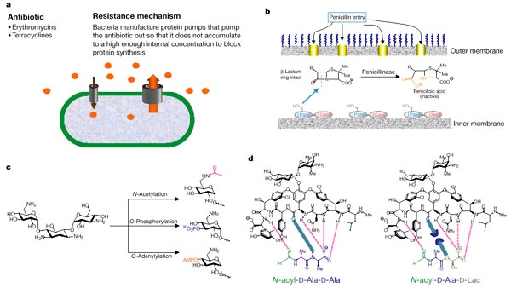
ABC one of the resistance mechanisms of bacteria to antibiotics

Slide 38
EXCRETION
Extent of xenobiotic elimination → extent of possible toxicity
longer exposure > higher probability of effects
TERRESTRIAL ORGANISM
- most soluble non-gaseous and nonvolatile compounds - urine
glomerulus : filtration / active transcellular excretion / transcellular diffusion / also resorption (!)
- significant/relevant excretion also - bile
active transport of conjugates at excretion / further transformation by microflora in the gut / event. resorption
- gaseous compounds (NH3) and volatiles (alcohols) – lungs/breathing

Slide 39
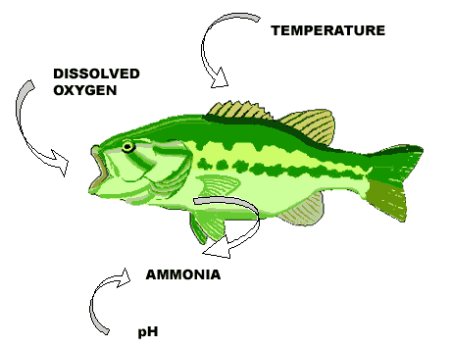
EXCRETION
AQUATIC ANIMALS
- main excretion organ are gills (NH₃) + bile (kidneys to a lesser extent)
PLANTS → SEQUESTRATION
– storage in vacuoles (leaves), excretion of gaseous toxicants

Slide 40
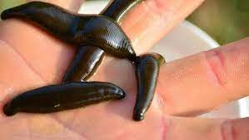
SEQUESTRATION
Sequestration of xenobiotics in inert tissues
→ limits circulation in a body (reduction of internal exposure)
Plants - vacuoles, leafs, bark (→ autumn fall off)
Animals - fat (organochlorine compounds)
- teeth, hair, horns (metals)
- in invertebrates: for example metals (Zn-granules) gut of leech
Release from storage later during life
PCBs and other organochlorine compounds stored in fat during life
Rapid energy demand (egg production in fish, starvation, milk production)
→ release from storage → rapid peak exposure
(Also – exposures of babies from milk stored in mothers: but(!) – benefits of breastfeeding overweight temporal risks!)

Slide 41
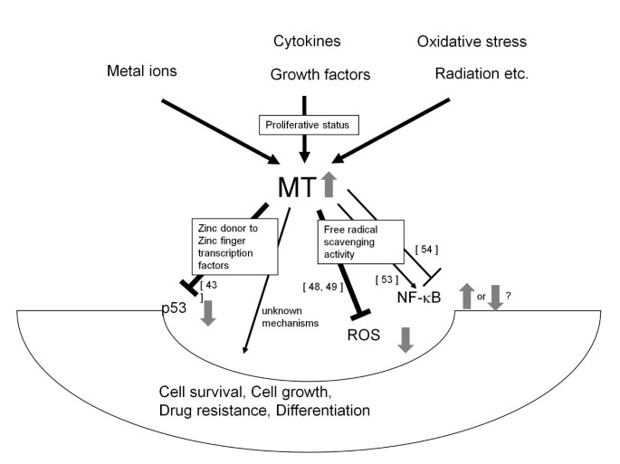
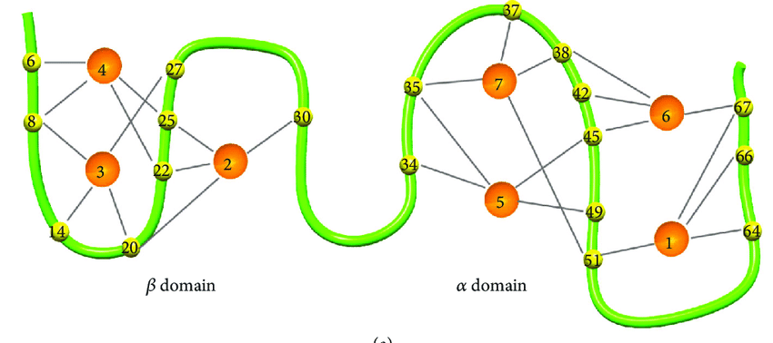
SEQUESTRATION – example mechanism
Metallothioneins (MTs, MT-like proteins)
- cytoplasmic low molecular weight proteins (6-10 kD) rich on Cys
- recognized in most eukaryotes
- bind metals: Zn, Cd, Hg ... => reduce exposure and toxicity
- long half-life of proteins (~ 25 days)
Structure of MT
(1-7: metal atoms bound to the structure)

Slide 42
INDUCTION OF transformation / metabolism / elimination
„Physiological“ adaptation to toxicants
TK processes (Phase I – MFO / Phase II - Ts / Phase III) are inducible
Presence of substrates (of enzymatic reactions)→ de novo synthesis (induction) of enzymes / proteins
- MFO enzymes are induced by a number of (lipophilic/toxic) compounds
- organochlorine compounds, PCDDs/Fs, PAHs, PCBs ...
Phase II and Phase III enzymes/proteins are induced by
  increased metabolites („activated“ substrates from the Phase I)
  occurrence of oxidants and reactive toxicants in cells (ROS, ox. stress)
long-term exposure to sublethal doses
  → induction of detoxification enzymes
→ increase of tolerance to toxicant (physiological adaptation)
→ too long exposure: energy depletion → death

Slide 43
Induction of TKs: biomarker of exposure and effects
- previous exposure to xenobiotics can be deduced from the measurement of activity of detoxification enzymes = biomarkers
(up to 100+ times increase compared to background activities)
- often discussed is the induction of CYP1A (cytochromes P450 1A1)
- after binding and activation of AhR (aryl hydrocarbon receptor) → transcription and translation of new CYP enzymes
experimental assessment of AhR/CYP1A1activation –EROD (ethoxyresorufin-O-deethylase)
  good correlation with organic (+ chlorine) pollution
(Note: AhR is also very important mediator of toxicity → discussed elsewhere during the course)

Slide 44
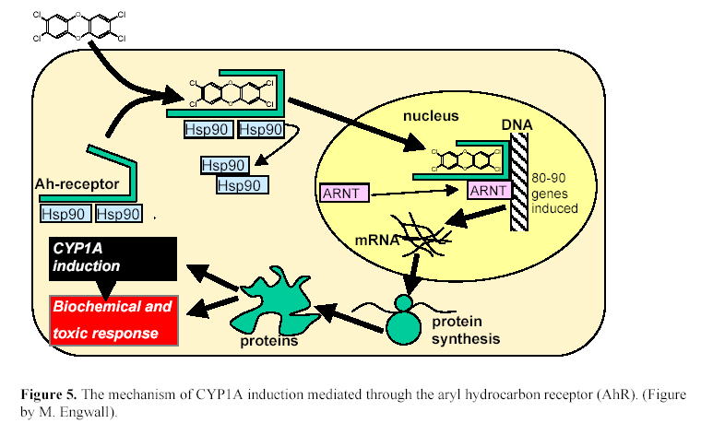

Slide 45
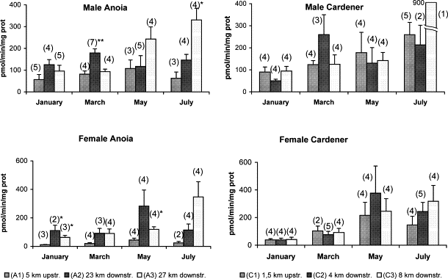
Seasonal changes in EROD activity of fish / carps (males vs. females) from two rivers (Anoia, Cardener) upstream and downstream (2 stations) from the waste water treatment plants outlets.

Slide 46
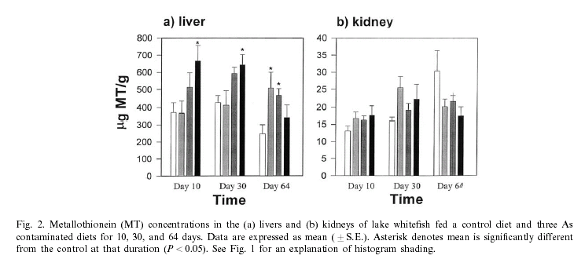
Induction of MTs in fish exposed to arsenic (As)

Slide 47
Wrap up questions
What are the main processes that a compound undergoes in the organism?
What are the main products formed during the metabolism?
What enzymes are involved in different phases of the biotransformation?
What chemical reactions are the most common during biotransformation processes?
What is glutathione?
What is the first and the second phase of detoxification?
In which organism will the biotransformation (detoxification) processes be faster? In fish or in human?
What would be the most probable products of transformation in an organism exposed to benzene?
Name a model compound that can be “bioactivated” in the organism. Explain bioactivation.
In what form and by which organ(s) fish excrete toxic compounds and their metabolites?

