Slide 1

Ecotoxicology
Populations & Communities
Ludek Blaha + ecotox colleagues

Slide 2
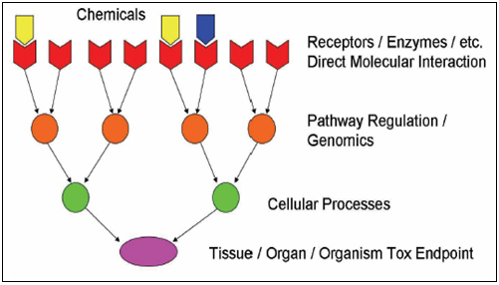
1) From molecules to individuals
MECHANISMS OF TOXICITY

Slide 3
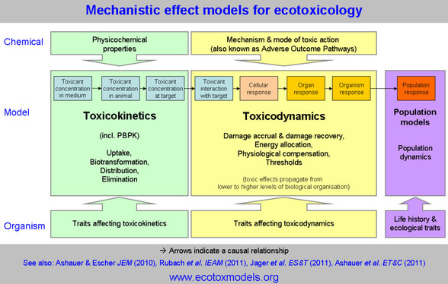
2) From molecules to individuals - AOPs
ADVERSE OUTCOME PATHWAYS

Slide 4
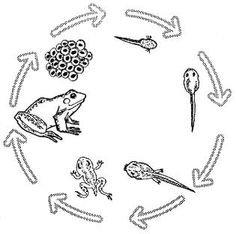
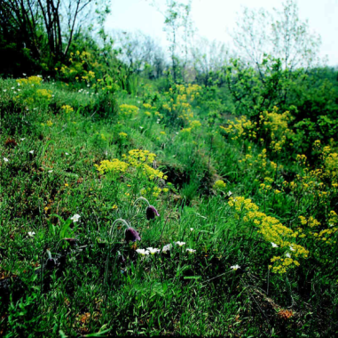
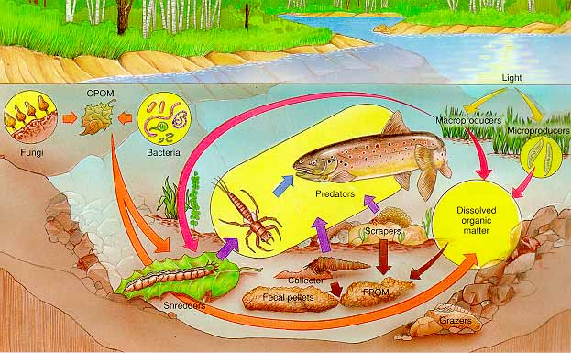
The ultimate objective of ECOTOXICOLOGY
→ to understand and protect populations, communities, ecosystems
Populations
Communities
(interacting populations)
Ecosystems
(communities
interacting with
abiotic environment)

Slide 5
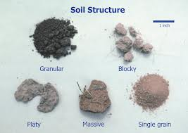
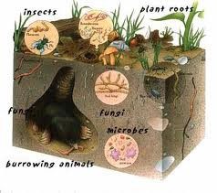
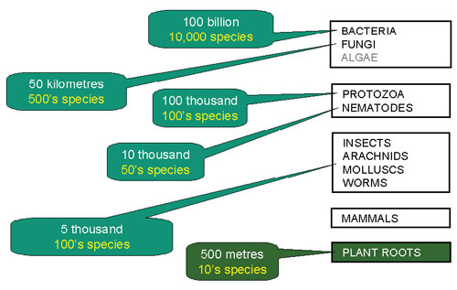
Ecosystems are
  not only more complex than we think
  but more complex than we can think *
  * FRANK E. EGLER, THE NATURE OF VEGETATION: ITS MANAGEMENT ANDMISMANAGEMENT (1977).

Slide 6
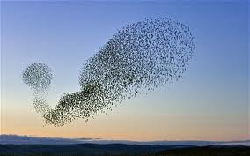
Effects at different levels
Population
  … all the individuals that belong to the same taxonomic group or species, they can sexually reproduce, and they live within the same time and within the same geographical area
Toxicants have …
  effects on structure (→ we can measure structural parameters)
    elderly vs. young, males vs. females
  effects on functioning (→ we can measure functional parameters)
  (~ maintenance & growth)
    Natality, mortality, reproduction fitness

Slide 7
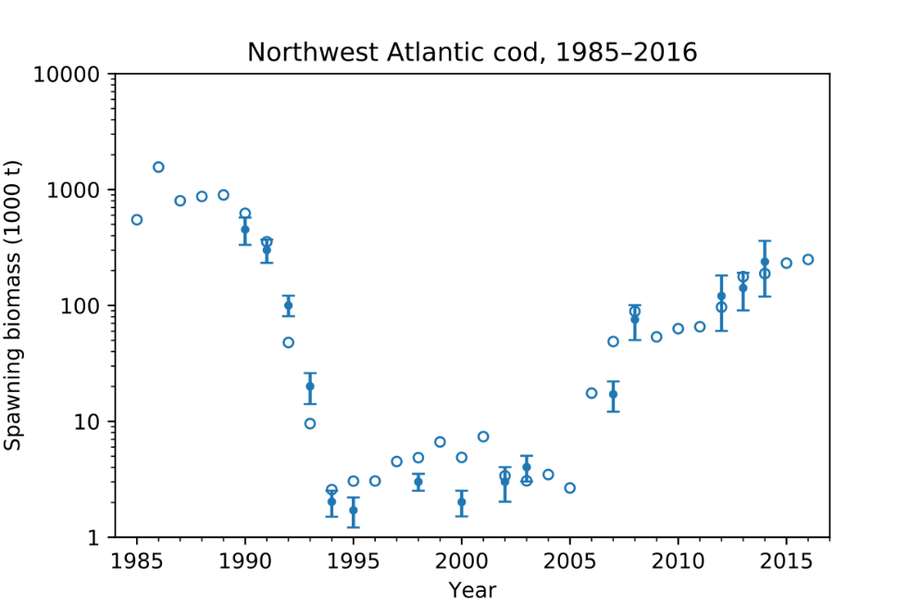
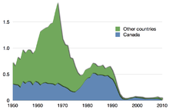
STRUCTURAL PARAMETERS of populations
(„demographic parameters“)
Primary parameters
  • size (performance) – number of individuals (animals), surface coverage (plants), amount of biomass (algae)
  • natality – increase of population size: numbers of organisms per unit of time
  • mortality – decrease of size: numbers of organisms per unit of time
Temporal variability in population of fish (due to overfishing)
Capture of the Atlantic northwest cod stock in million tonnes, with Canadian capture in blue^{[8]}

Slide 8
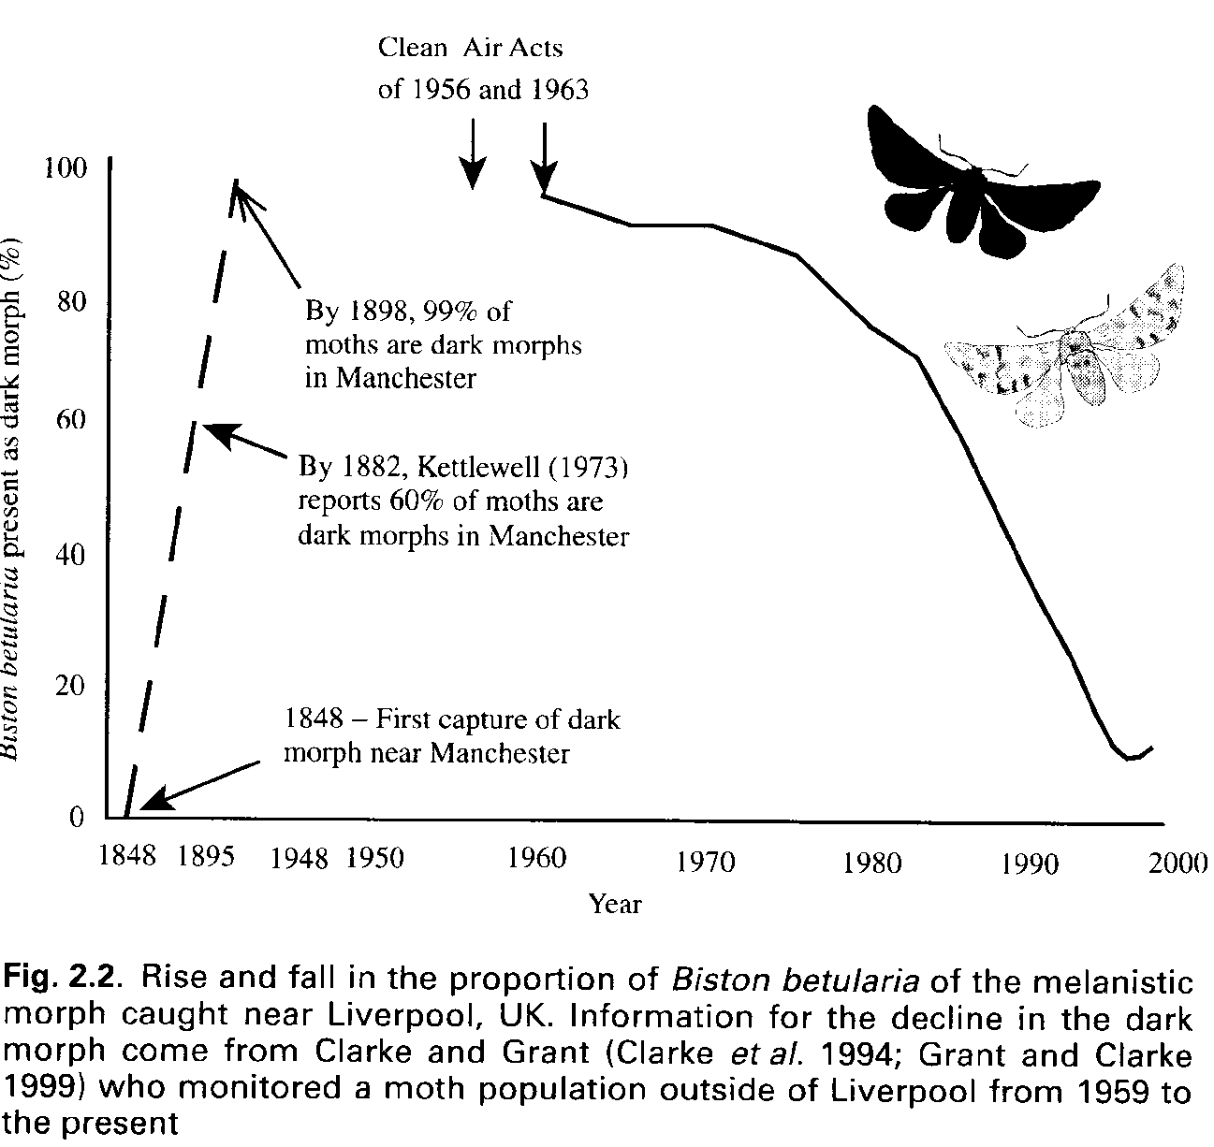
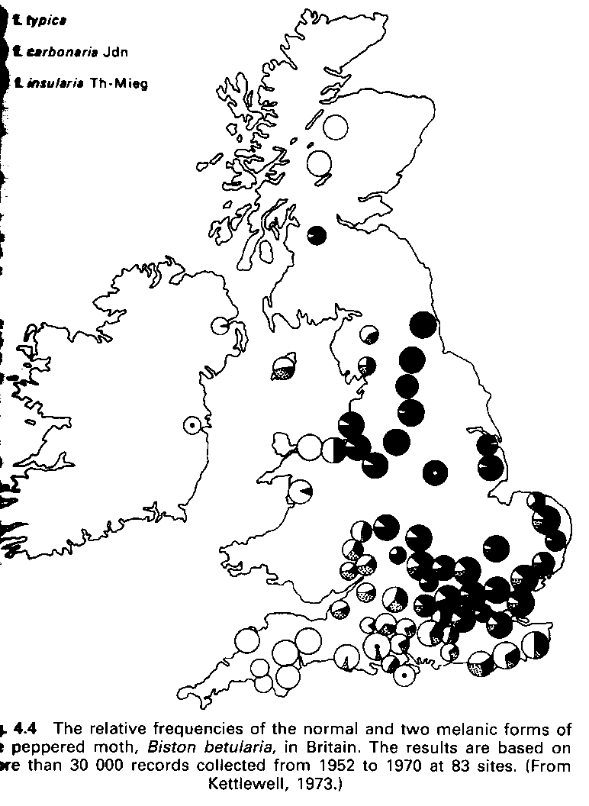
Air contamination effects on populations
(evolutionary adaptation, natural selection of genetic & phenotypic variants)

Slide 9
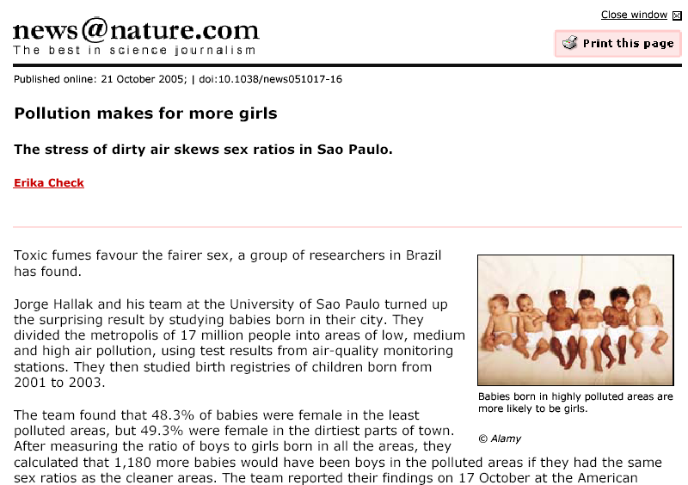
Air contamination effects on populations
(evolutionary adaptation, natural selection of genetic & phenotypic variants)

Slide 10
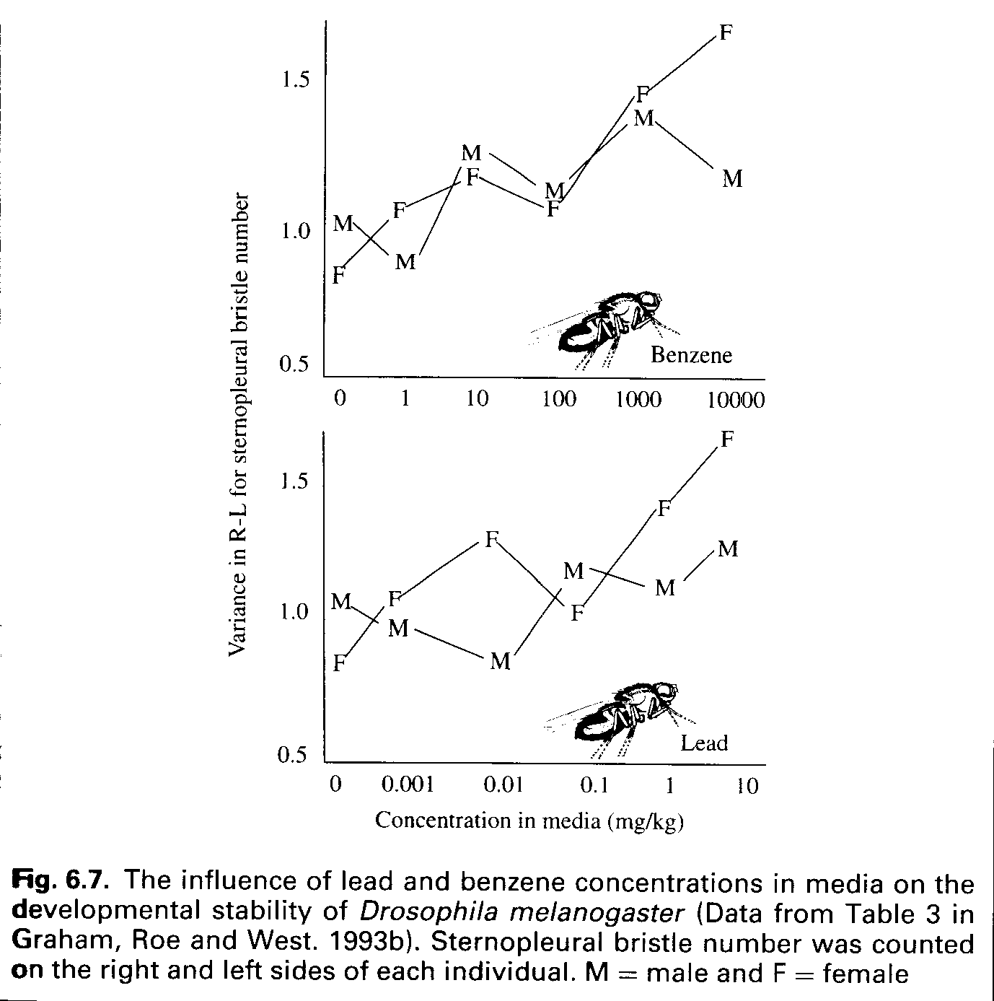
Effects of benzene and lead (Pb)
on sex ratio in Drosophila
Generic effect:
HIGHER STRESS
→ more FEMALES
(F are more „resistant“ also
to assure survival of the population
during the crisis)

Slide 11
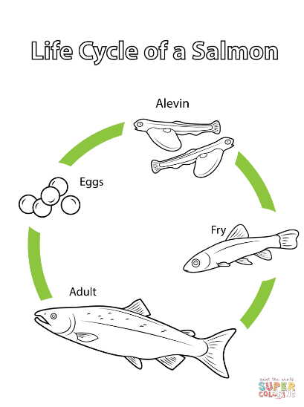
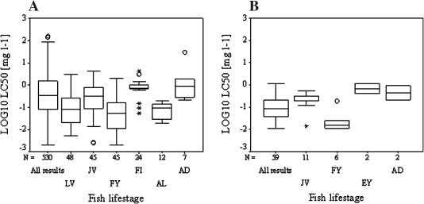
Population = individuals at all life stages
Higher sensitivity of juveniles → less adults → aging population
All fish species
O. mykiss only
Fry
Fry
Aduit
Aduit
Fig. 2. Log LC50 variability for all available test results and for the five most frequently used fish life stages (larvae (LV), juvenile (JV), fry (FY), fingerling (FI), alevin (AL), eyed egg (EY) and adult (AD) life stage) for CuSO4 - sulphuric acid, copper(2+) salt (1:1) (CAS 7758-98-7).
Test results for all reported fish test species (A) and for Oncorhynchus mykiss (B) were compared.
http://www.sciencedirect.com/science/article/pii/S0273230009000956

Slide 12
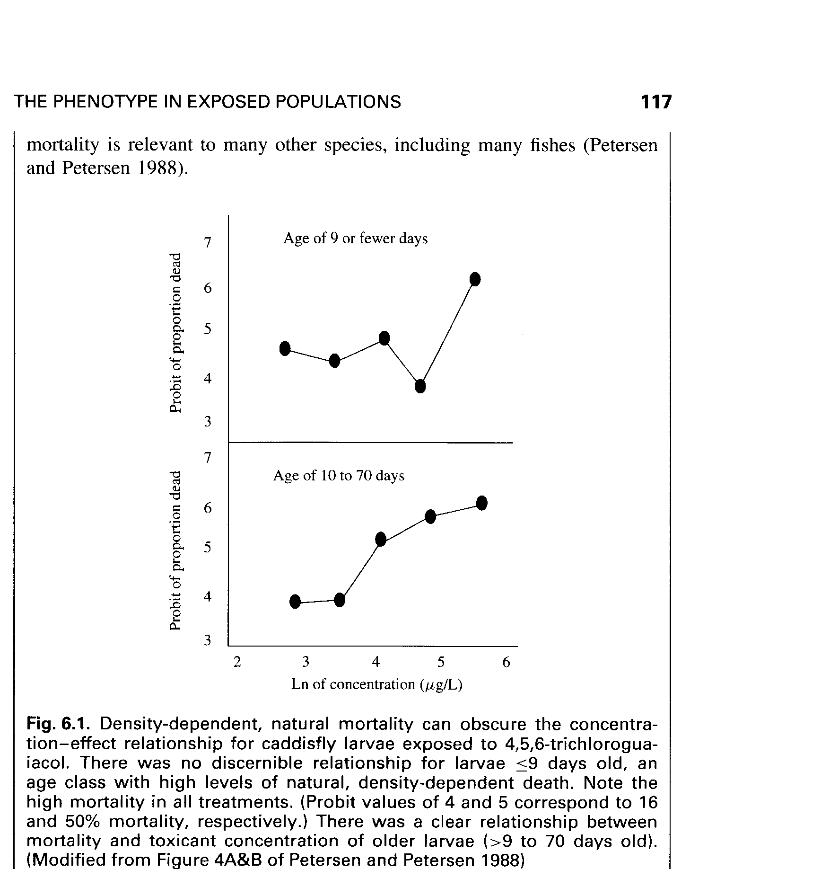
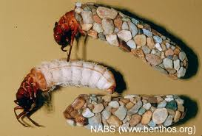
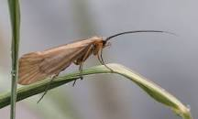
Population = individuals at all life stages
Higher sensitivity of elderly individuals
Mortality (%)
Caddisfly larvae
Higher mortality at elderly
at the same concentration
Mortality (%)

Slide 13
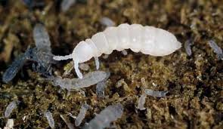
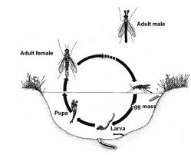
How to study effects on populations?
Reproduction toxicity assays
  - D. magna – 21-day reproduction
  - Earthworms – several weeks: reproduction tests
  - Folsomia candida (springtails) – reproduction tests
2) Whole life cycle toxicity test
  - E.g. Chironomus (nonbiting midges)
  (OECD guideline 233)
3) Modelling
(např. Distribution of
energy –the „Enth“ example)

Slide 14
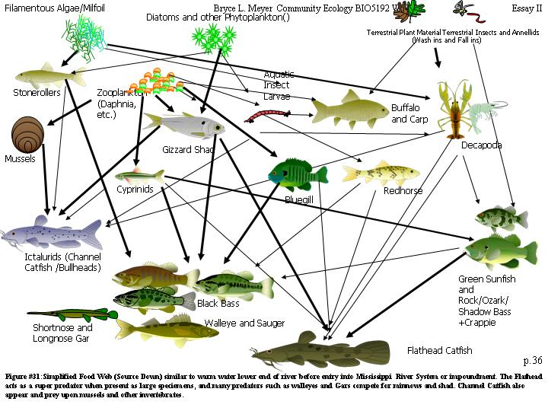
Communities … interacting populations
  Toxicants (stressors) may have
  … effects on structure of communities
    Loss of species, loss of biodiversity
  … effects on functioning

Slide 15
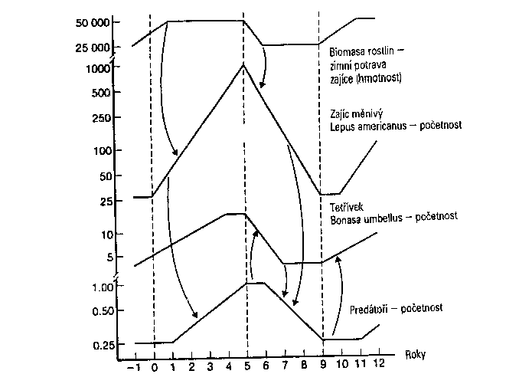
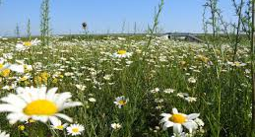
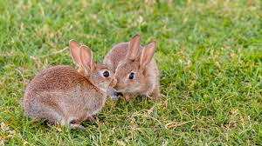
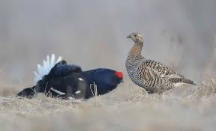
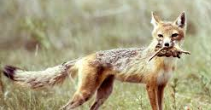
Natural variability in community (food web)
Changes in populations (biomass / numbers of animals) during 12 years

Slide 16
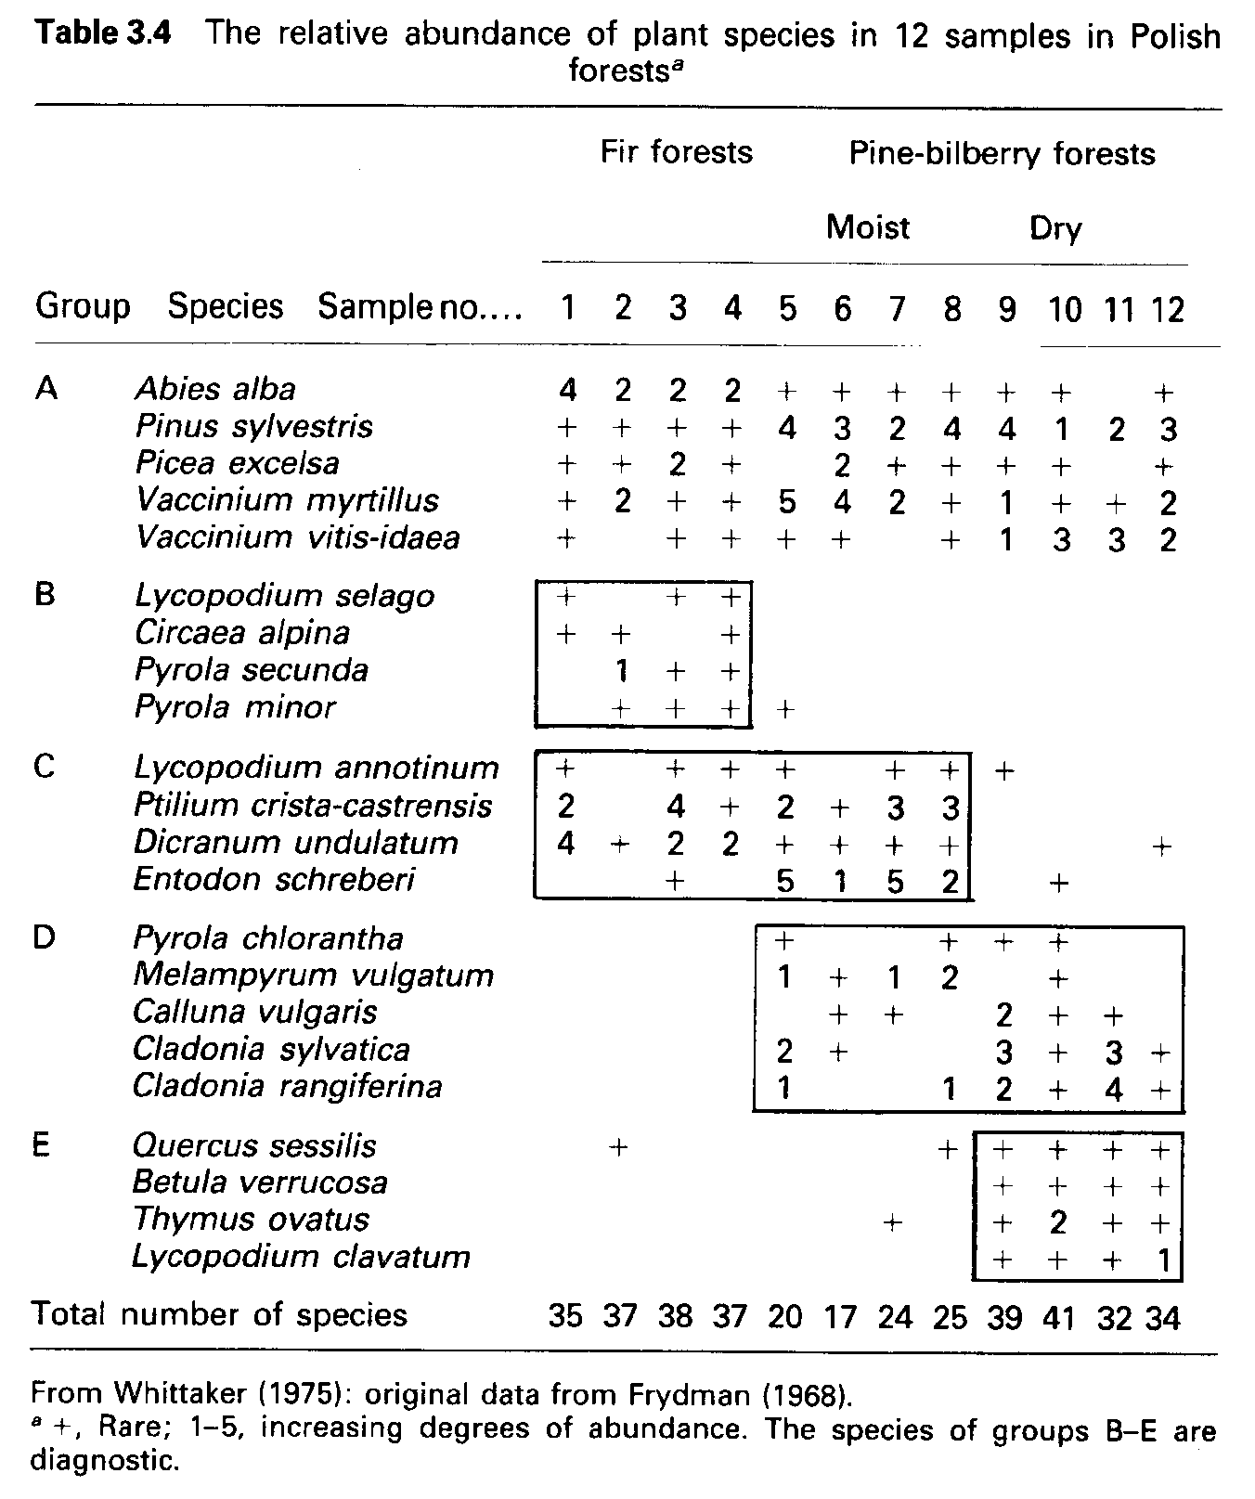
Community
STRUCTURE
characterization
-- example --
Floristic record
Occurrence of species
(+ < 1 < 2 < 3 < 4 < 5)
in relationship to
„stressor“ (conditions)
MOIST vs DRY
➔ B vs D are very different
communities

Slide 17
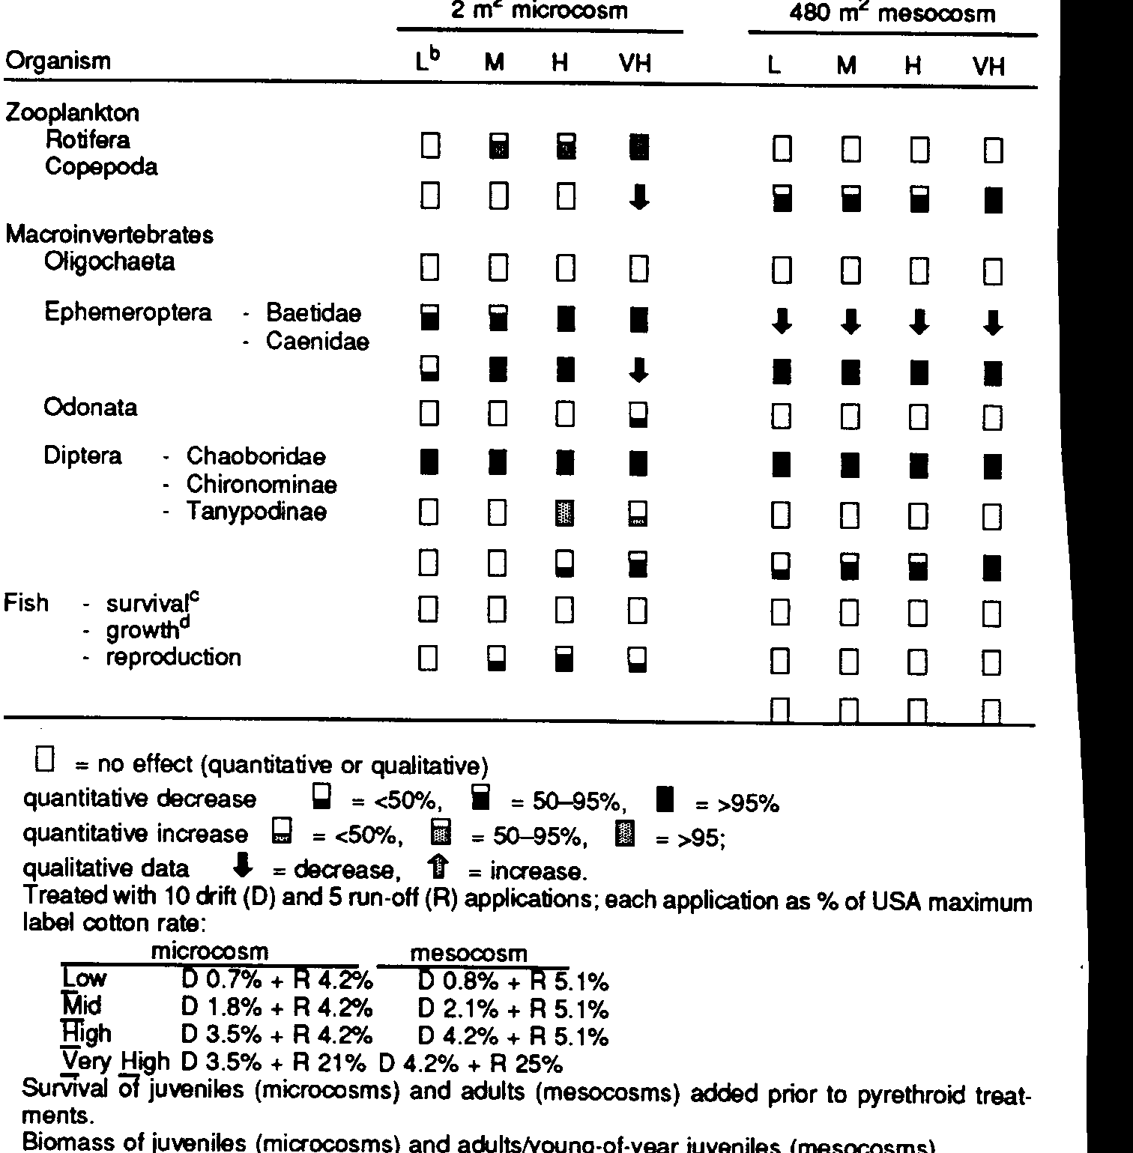
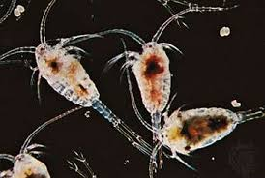
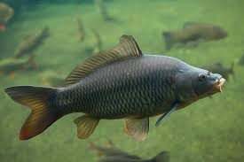
Ecotoxicology
example
Changes in
community treated
with three doses and
control
(L-low, M-medium,
H-high, VH-vehicle/solvent)
Same exposures
but different responses
in two different set-ups
Microcosm << Mesocosm
(highlighted)

Slide 18
How to simplify complexity of community characterization?
Use index / indices
Ni – Number of individuals of one species
N – Total number of individuals in community
S – Number of species
Diversity indices
Shannon-Wiener (H´ = - Σ Ni/N ln (Ni/N) )
    Higher H´ → Higher diversity
  Shannon’s index of eveness (E = H´ / lnS)
    Higher E → higher „eveness of community“
  … and many others (Margalef’s e.g. D = (S-1) / lnN )

Slide 19
Which of the following three communities
has the highest Biodiversity? Which has the highest Eveness?
Homework task(!)
(see ROPOT in IS MUNI)
Identify community with the highest diversity
& highest eveness
Example of H´ calculation for locality A:
H’ = - (6/9 . ln (6/9) turtles
+ 1/9 . ln (1/9) donkeys
+ 2/9 . ln (2/9) rabbits = ……
E = …. ?
A
B
C

Slide 20

How to compare communities?
c – number of shared (common) species
A – number of species at locality A
B – number of specieas at locality B
INDICES … for example …
  Jaccard’s similarity index = [c / (A + B - c)] x 100%
    Higher J-index – higher similarity
Homework (see ROPOT in IS MUNI): Which communities are the most similar? AxB or AxC or BxC?
(Ecotoxicology: A = control; B and C – different pesticides … which pesticide has „strongest“ effect?)
A
B
C

Slide 21
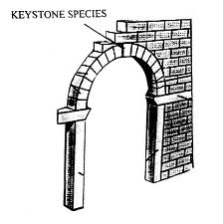
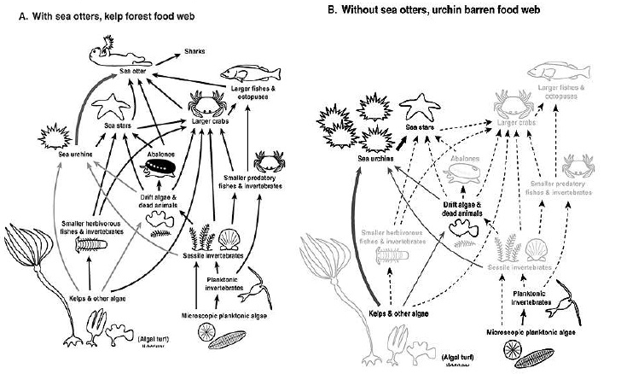
Key / Keystone species
  Effects on keystone species → dramatic changes on all community
    Usually predators (low numbers = high sensitivity to disruption)

Slide 22
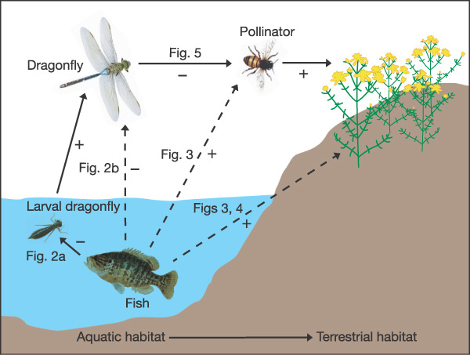
Fish as keystone species
affecting also yields on nearby fields
Knight et al., NATURE (2005) 437: 880

Slide 23
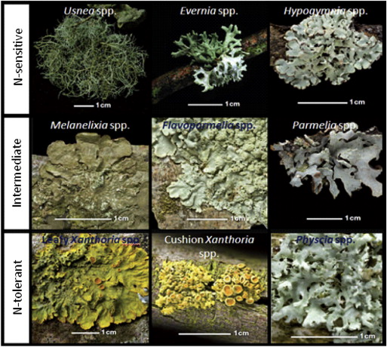
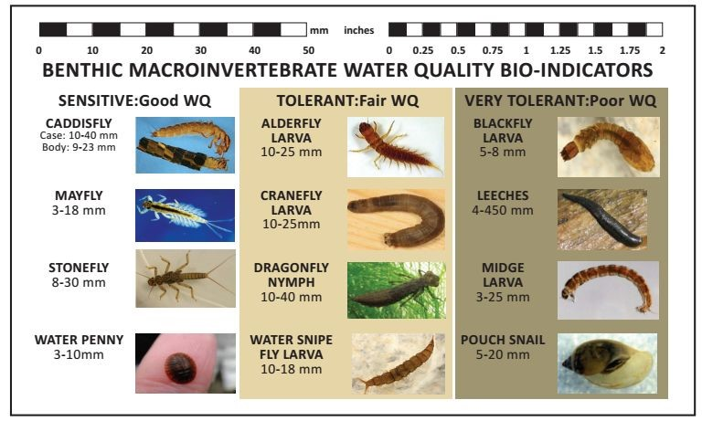
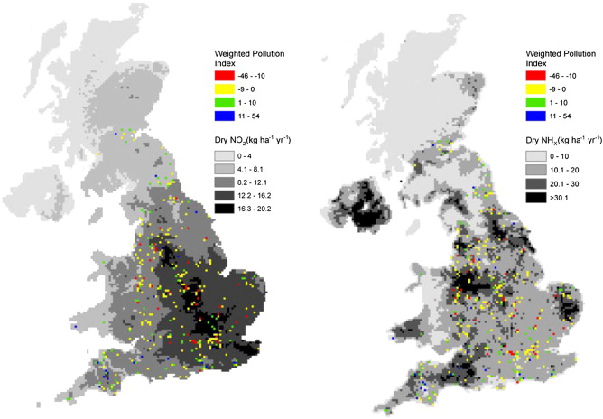
INDICATOR SPECIES (bioindicators)
Species for which (not)presence indicate
certain parameter of the environment
  Sensitive or tolerant species
  Ocurrence in community → INDICES
LICHENS – air quality
Dry deposition of nitrogenous pollutants across the UK overlaid with dots showing the value of the lichen-based Weighted Pollution Index
https://doi.org/10.1016/j.envpol.2013.07.045

