Slide 1

Ecotoxicology
New topics and future issues
Ludek Blaha + ecotox colleagues

Slide 2
Take home messages from this presentation
Traditional (eco)toxicity testing (based on simple standardized bioassays) and related chemical risk assessment is likely to change in this century…
… towards the use of mechanistic data and knowledge (omics) – through – for example - Adverse Outcome Pathways, (AOPs) and mathematical models
  The paradigm shift is strongly promoted by fluential players – OECD, US EPA, European Commission (example shown – OECD AOPWiki)
  Also in line with minimizing use of animals and implementation of „3R“ policies (examples shown)
  Toxicological predictions = computational (AI) models are becoming more and more advanced

Slide 3
Current approaches
(black box of apical endoints)
vs
Future
(mechanistic understanding & AOPs)

Slide 4

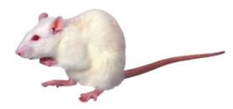
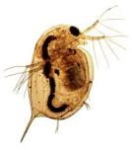
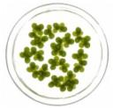

Hazard assessment
Traditionally – Evaluation of adverse effects using the whole organism models
+
Adverse Effects
Death
Altered Reproduction
Inhibition of Growth
Tumorigenicity
Skin irritation
…
Chemical
Organism
REGULATORY FOCUS
(APICAL ENDPOINTS)

Slide 5
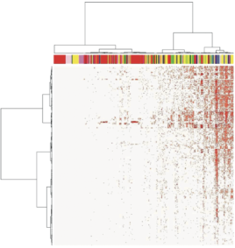

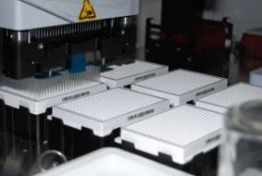
Hazard assessment
Traditionally – Evaluation of adverse effects using the whole organism models
+
Adverse Effects
Death
Inhibition of Growth
Altered Reproduction
Tumor
Skin irritation
…
Chemical
Organism
New – Ex vivo / in vitro / In chemico / In silico Methods
+
10^4 Chemicals
HTS
High-Throughput-Screening
Chemical-biological interactions,
Mechanistic Toxicological Data
Key task/question:
How to link MECHANISTIC INFORMATION with APICAL ENDPOINTS ?

Slide 6
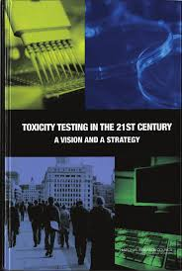
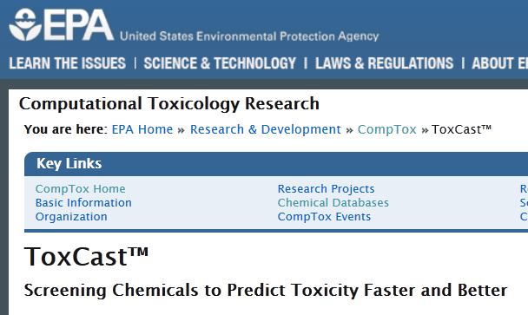
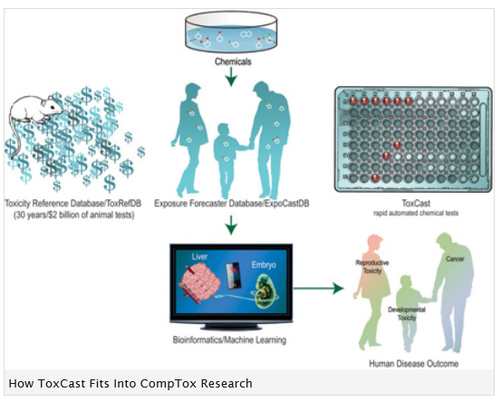
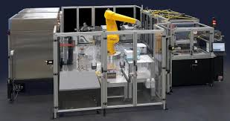
MoA and omics are supported by strategic documents
Toxicity Testing in the 21st Century: A Vision and a Strategy
US National Academies of Sciences
http://www.nap.edu/catalog/11970.html

Slide 7
Adverse Outcome Pathways
Adverse Outcome Pathway
Mode of Action
Toxicity Pathway
Chemical
Macro-Molecular Interaction
Cellular Response
Tissue Effect
Organ Response
Organism
Response
Population Response
Molecular Initiating
Event
Key
Event 1
Key
Event 2
Key
Event 3
Adverse Outcome
Chemical Property
Receptor/Ligand
Interactions
DNA Binding
Protein Oxidation
Gene Activation
Protein Production
Altered Signaling
Altered Physiology
Disrupted Homeostasis
Altered Development / Function
Lethality
Impaired Development
Impaired Reproduction
Altered Sex Ratio
Extinction
In silico, In chemico, In Vitro, Ex vivo
In vivo
The EXISTING KNOWLEDGE is used to link the two anchor points: Molecular Initiating Event (MIE) and Adverse Outcome (AO)
via a series of intermediate steps: Key Events
Ankley, G. T., R. S. Bennett, et al. (2010). "Adverse outcome pathways: a conceptual framework to support ecotoxicology research and risk assessment." Environmental Toxicology and Chemistry 29(3): 730-741.

Slide 8
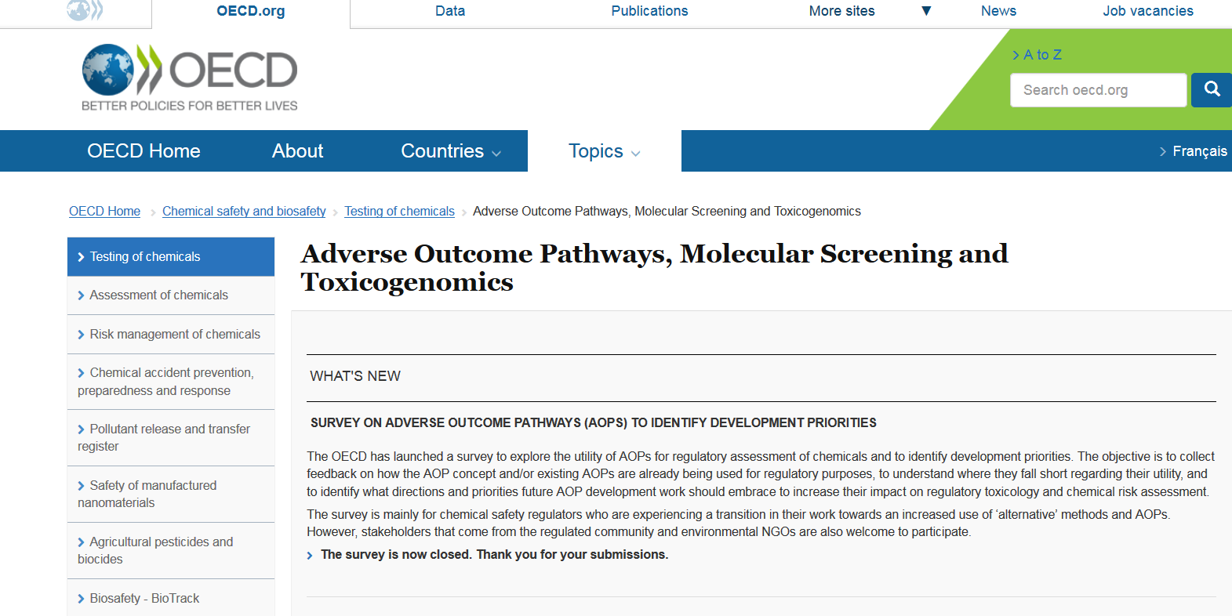
AOP = Global strategy with support from OECD, EU, USA
http://www.oecd.org/chemicalsafety/testing/projects-adverse-outcome-pathways.htm

Slide 9
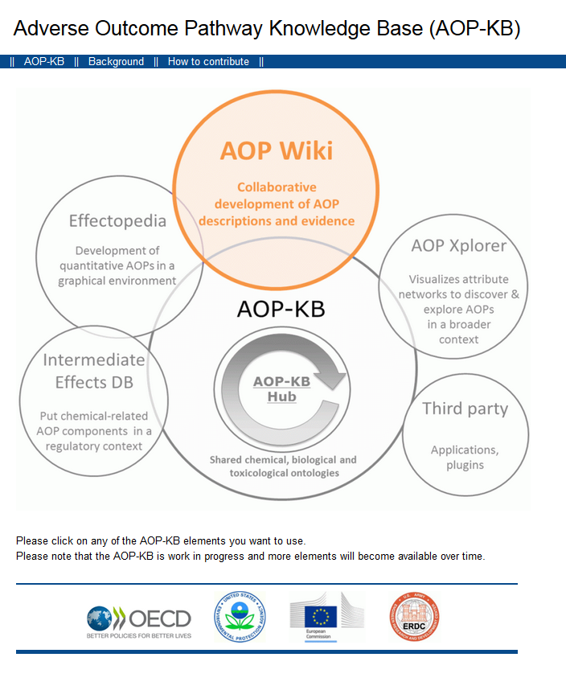
http://aopkb.org/
Key documents
OECD Guidance document and a template for developing and assessing adverse outcome pathways (Series No. 184, Series on Testing and Assessment)
Handbook for AOP developers

Slide 10

AOP Wiki
https://aopkb.org/aopwiki/index.php/Main_Page
Wiki-based platform for development of AOPs
Only members of an OECD AOP development project can create / edit AOPs

Slide 11
What AOPs are now
in AOP Wiki (autum 2023) – total 456
OECD Endorsed (WNT and TFHA) | 34 | 1x ecotoxicology: Aromatase inhibition leading to reproductive dysfunction (in fish)
EAGMST Approved | 1 | Substance interaction with the pulmonary resident cell membrane components leading to pulmonary fibrosis
Status: EAGMST Under review | 14
Status: Under Development | 84
(No status: working versions) | 323
Check online:
https://aopwiki.org/aops
OECD Extended Advisory Group on Molecular Screening and Toxicogenomics (EAG MST)
The Working Group of the National Coordinators of the Test Guidelines Programme (WNT)

Slide 12
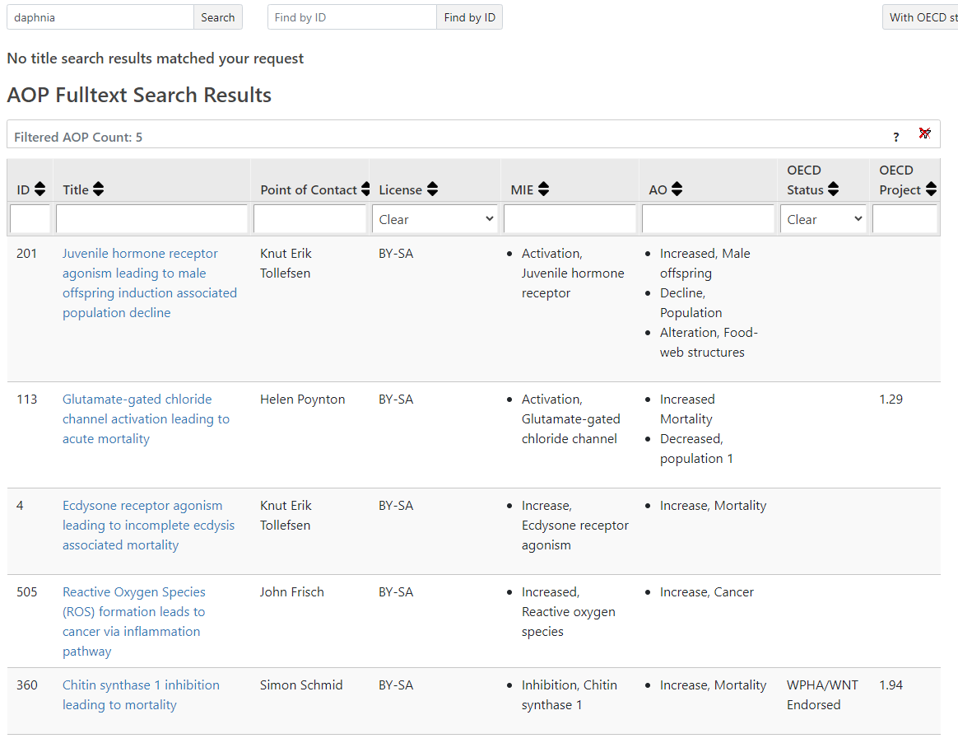

Slide 13
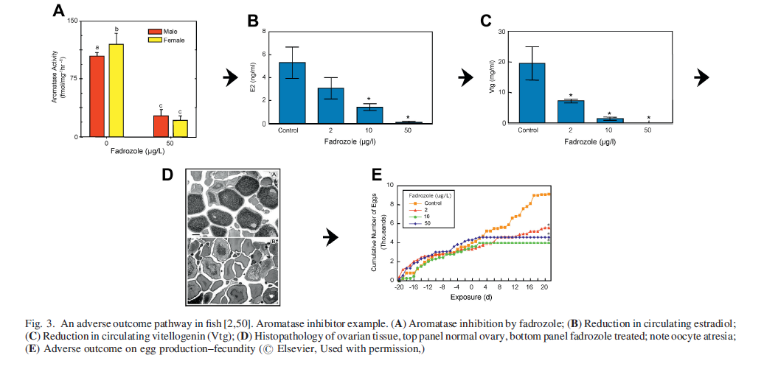
AOP Example: MIE aromatase inhibition
Environmental Toxicology and Chemistry, Vol. 30, No. 1, pp. 64–76, 2011

Slide 14
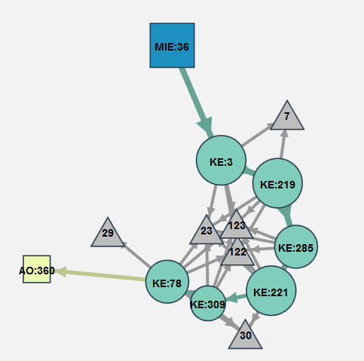
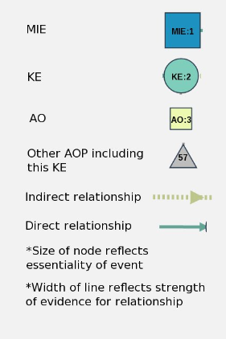
Aromatase inhibition leading to reproductive dysfunction (in fish)
https://aopwiki.org/wiki/index.php/Aop:25

Slide 15
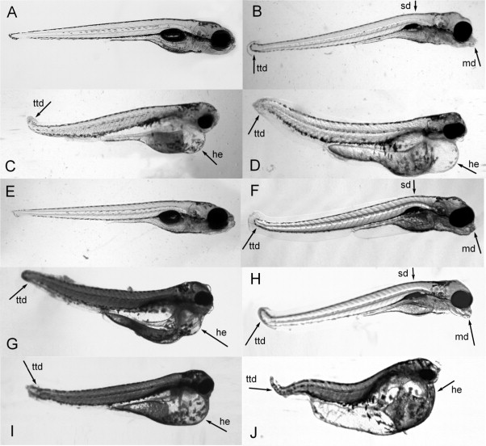
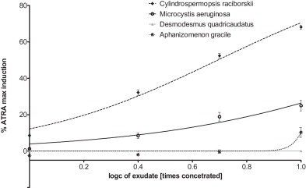
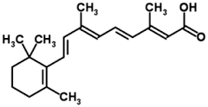
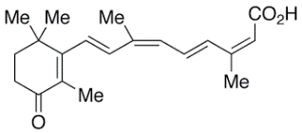

AOP Example from RECETOX:
Modulation of RAR/RXR → developmental toxicity in fish
Activation of RAR/RXR
in P19/A15 cells by atRA and
cyanobacterial metabolites
ZF exposed to ATRA and cyanobacterial (120 hpf) - Control (A), exudates of C. raciborskii 3.3× (B) and 10× (C), M. aeruginosa 10× (D) and D. quadricaudatus 17× (E). ATRA 4 μg/L (13.3 nM) (F), 12 μg/L (40 nM) ((G) and (H)), 36 μg/L (I) and 108 μg/L (J).
atRA
other RAs in cyanos
Jonáš et al. 2014 Aquatic Toxicology
http://dx.doi.org/10.1016/j.aquatox.2014.06.022

Slide 16

http://www.effectopedia.org/ -> link to program download
Visually Expresses AOPs in their biological context:
  Life-stage, Taxonomy, Gender, Time-to-effect..
Quantitative Relationships
ADME (Absorption, Distribution, Metabolism, Excretion)
Open-knowledge, crowd-sourcing
Formal approval not required to enter / modify
Credit to authors / reviewers
Even fragments of information are welcome (any contribution)
Export<->Import from/to AOP Wiki & others

Slide 17
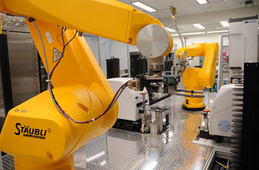
Related Projects & Studies & Databases
TOXNET - http://toxnet.nlm.nih.gov/
  searching databases on toxicology, hazardous chemicals, environmental health, and toxic releases
Tox21 - http://www.epa.gov/ncct/Tox21/
  10,000 chemicals
  14 concentrations, 4 logs, 3 replicates
  1536 well plates, 2-8 uL volumes
  50+ assays
ToxCast - http://www.epa.gov/ncct/toxcast/
  App. 2000 chemicals
  700+ assay, 300 signaling pathways
  DATA AVAILABLE iCSS Dashboard
    http://actor.epa.gov/dashboard
    http://ww.epa.gov/ncct/toxcast/data.html

Slide 18
Related Projects & Studies & Databases
ToxRefDB (Toxicity Reference Database)
  in vivo toxicological data
  http://actor.epa.gov/toxrefdb/faces/Home.jsp
ExpoCast
  information on human exposures
  http://www.epa.gov/ncct/expocast/
Human Toxome Project
  information on human exposures
  http://www.ewg.org/sites/humantoxome/
Agriculture Health Study
  Occupational Exposure to Pesticides – a cohort study
  http://aghealth.nih.gov/

Slide 19
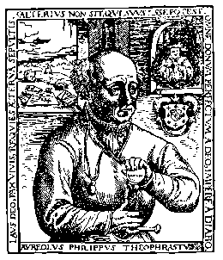


Summary
Toxicology is about doses
  The goal is LD(LC)50 or NOAEL/NOEC
Legislation defines
… what assays and how to do them
  About 30 assays
  The most widely used standard - OECD Guidelines for Testing of Chemicals
Replacing „black box“ in traditional testing
  Synthesis of mechanistic and omics data
  Adverse Outcome Pathways
  Strategically supported by OECD, EU, USA

Slide 20
Do we need testing with animals?
Are there alternatives?

Slide 21
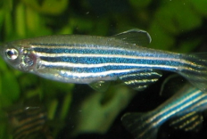
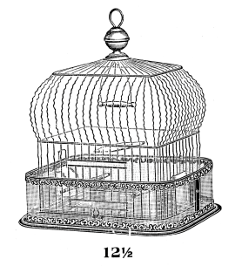
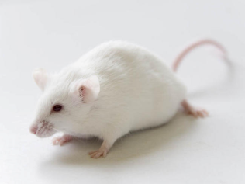
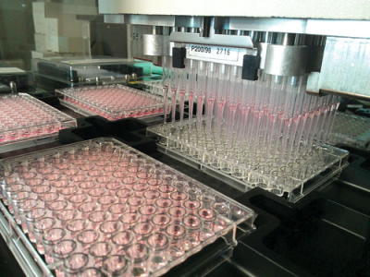

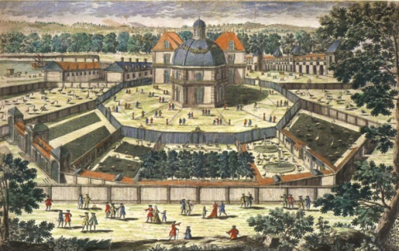
„Alternatives“ to toxicity testing … 3R rules
3Rs
REPLACEMENT
REFINEMENT
REDUCTION

Slide 22

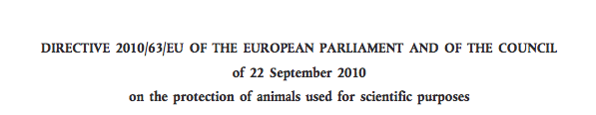
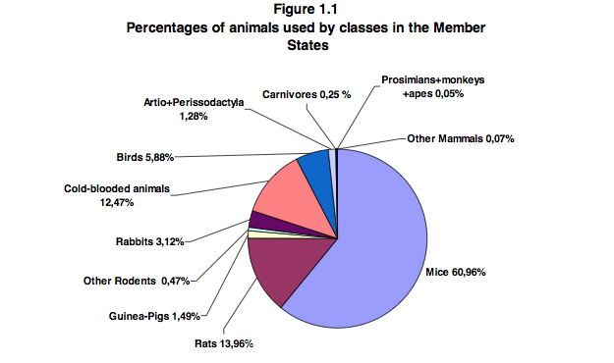
European Policies on 3Rs

Slide 23
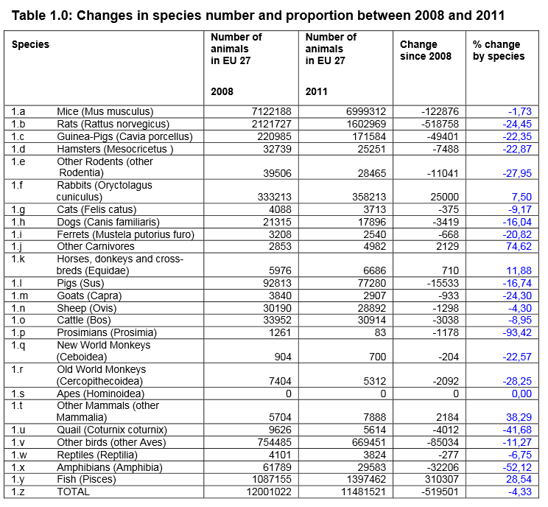
Use of animals in EU (2011)

Slide 24
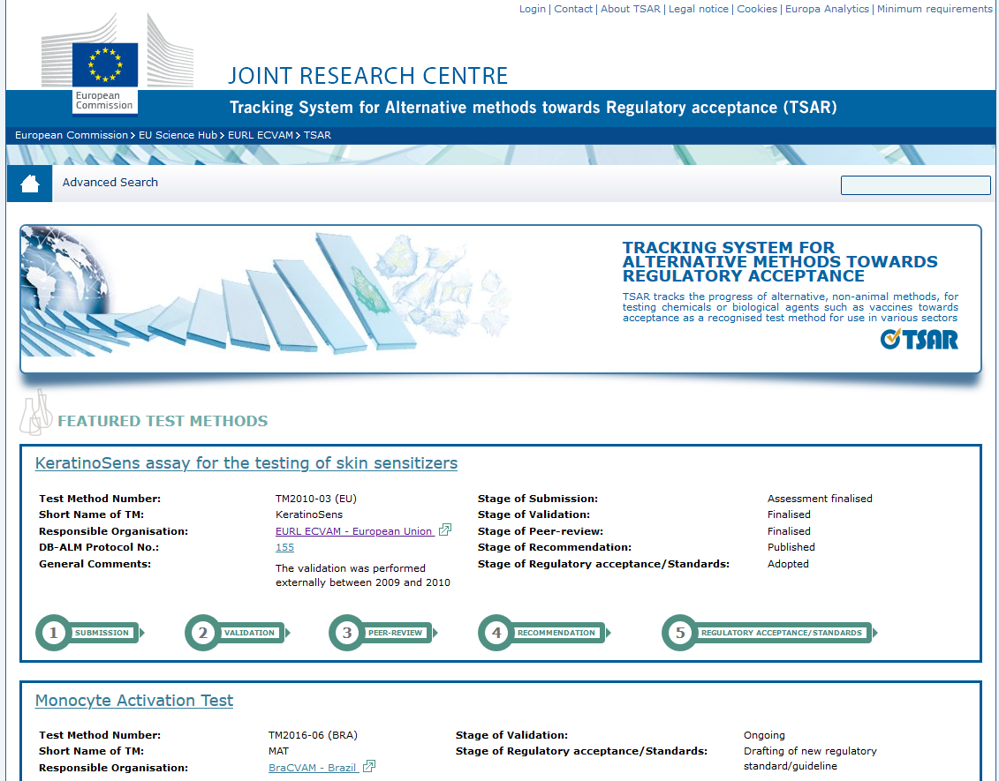
https://tsar.jrc.ec.europa.eu/
>60 3Rs Tests submitted to ECVAM since 2008 (update 01/2015)
10 validated or ongoing validation => Prioritisation!

Slide 25

Alternative Methods – R&D to Implementation
Research
Implementation
Development
Regulatory Acceptance
Prevalidation
Independent Review
ESTAF
ESAC
Industry
Academia
Validation
Regulators
Demanding process:
7-8 YEARS
PARERE

Slide 26
COMPUTATIONAL
(ECO)TOXICOLOGY
?

Slide 27
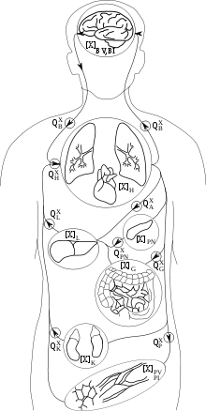
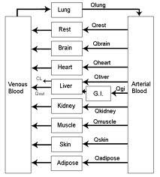
PBPK models
PBPK (PBTK)
Physiologically based pharmacokinetic (toxicokinetic) models
Fragmentation of
a complex systém
to „boxes“
→ All Processes
described by arrows
(mathematical
equations)

Slide 28
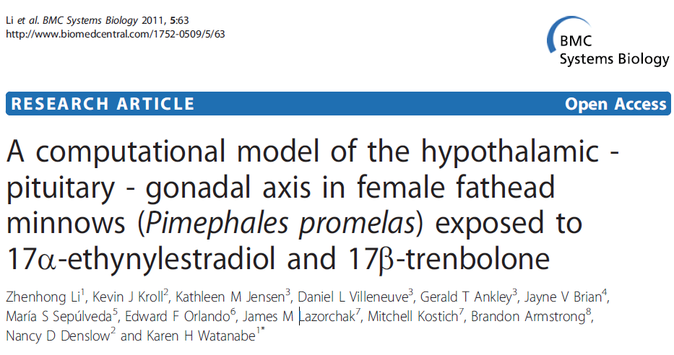
Example – computational toxicology for EDCs

Slide 29
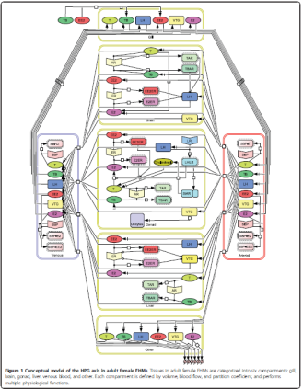
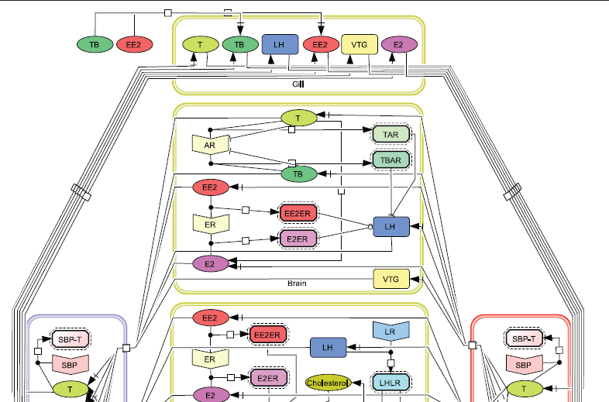
Li (2011) BMC Systems Biology
EE2 – ethinylestradiol
ER, AR atd. – receptors
VTG – vitellogenin
(marker of toxicity)
Arrows – differential
equations
Conceptual
model

Slide 30
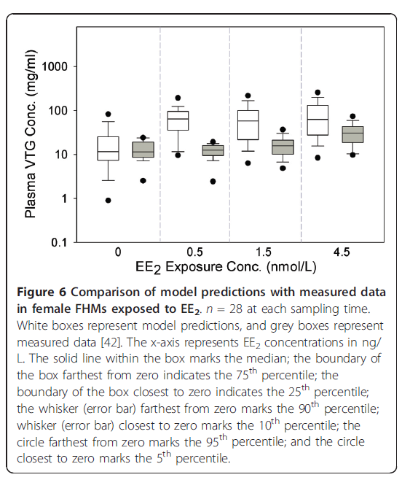
Li (2011) BMC Systems Biology
Results:
MODELLED (white)
Vs
MEASURED (grey)
…good comparable

Slide 31
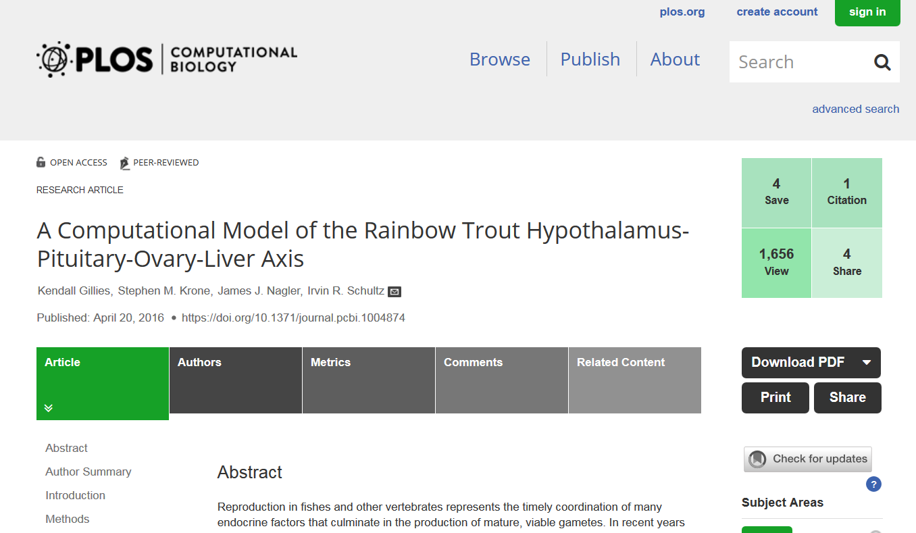
Update – quantitative mechanistic/computational toxicology
PLoS Comput Biol. 2016 Apr 20;12(4):e1004874.

Slide 32
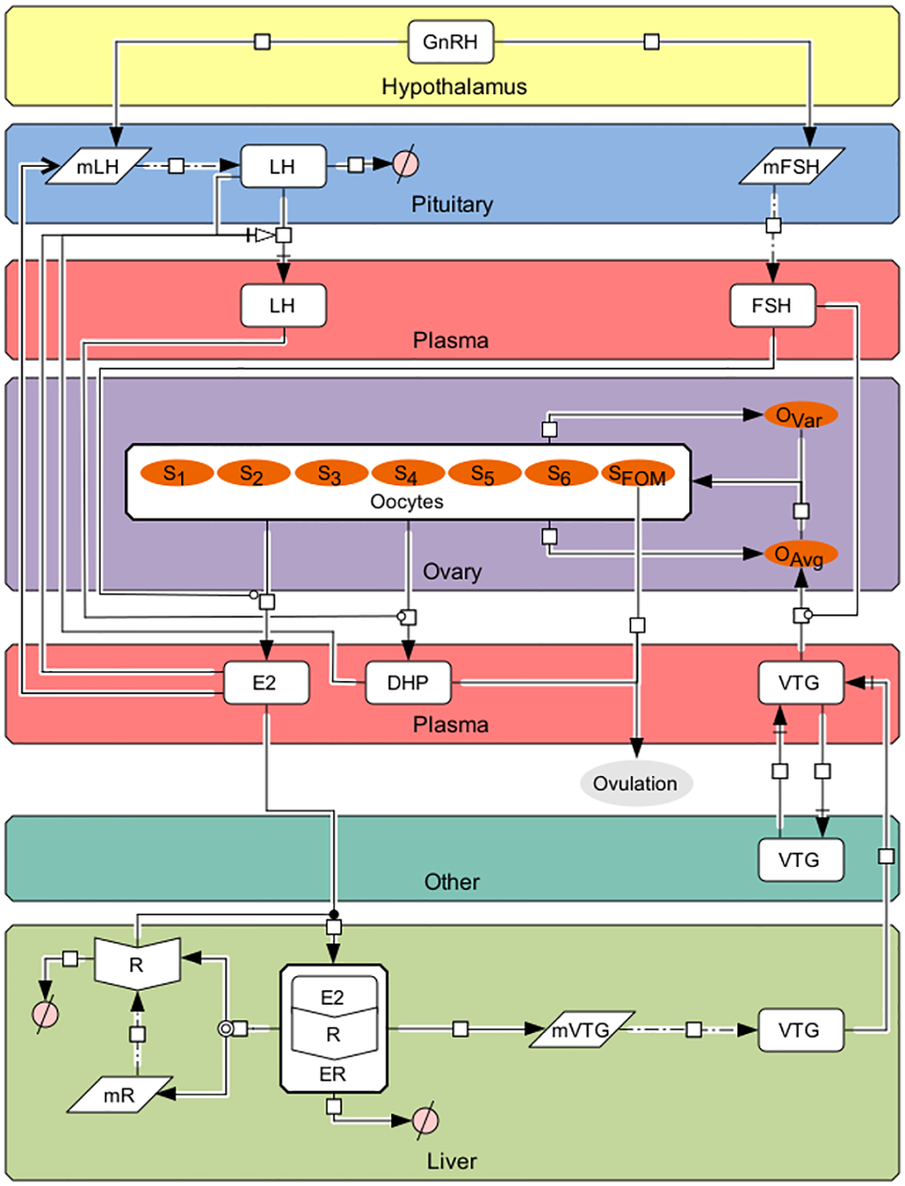
Update – quantitative mechanistic/computational toxicology
Fig 1. The HPOL signaling network in rainbow trout as formulated in our model.
Arrows and symbols on graph follow CellDesigner vs. 4.4 notation (www.celldesigner.org). GnRH is secreted from the hypothalamus into the pituitary stimulating the production of mFSH and mLH, which then leads to formation of FSH and LH, respectively. FSH, which is being continuously secreted from the pituitary, travels to the ovaries to stimulate production of E2. E2 then travels to the liver to bind with E2 receptors (R; translated from mR) to form ER. ER then stimulates the production of mVTG, which produces VTG_{L}. Secreted VTG then travels from the liver to the ovaries via the plasma (VTG_{P}) where it is absorbed by follicles in stages 3 through 6 (the proportion of follicles in these stages are denoted by S_{j}, j = 3, 4, 5, and 6) during vitellogenesis, the rate of which is affected by FSH_{P}, to promote oocyte growth (O_{Avg}). Oocyte growth then progresses the oocytes through the stages using a Weibull distribution created from O_{Avg} together with O_{Var}. In the later stages LH_{P} stimulates the oocytes to produce DHP. Finally, oocytes undergo final maturation (S_{FOM}) and combined with DHP, determine when the fish ovulates
PLoS Comput Biol. 2016 Apr 20;12(4):e1004874.

Slide 33
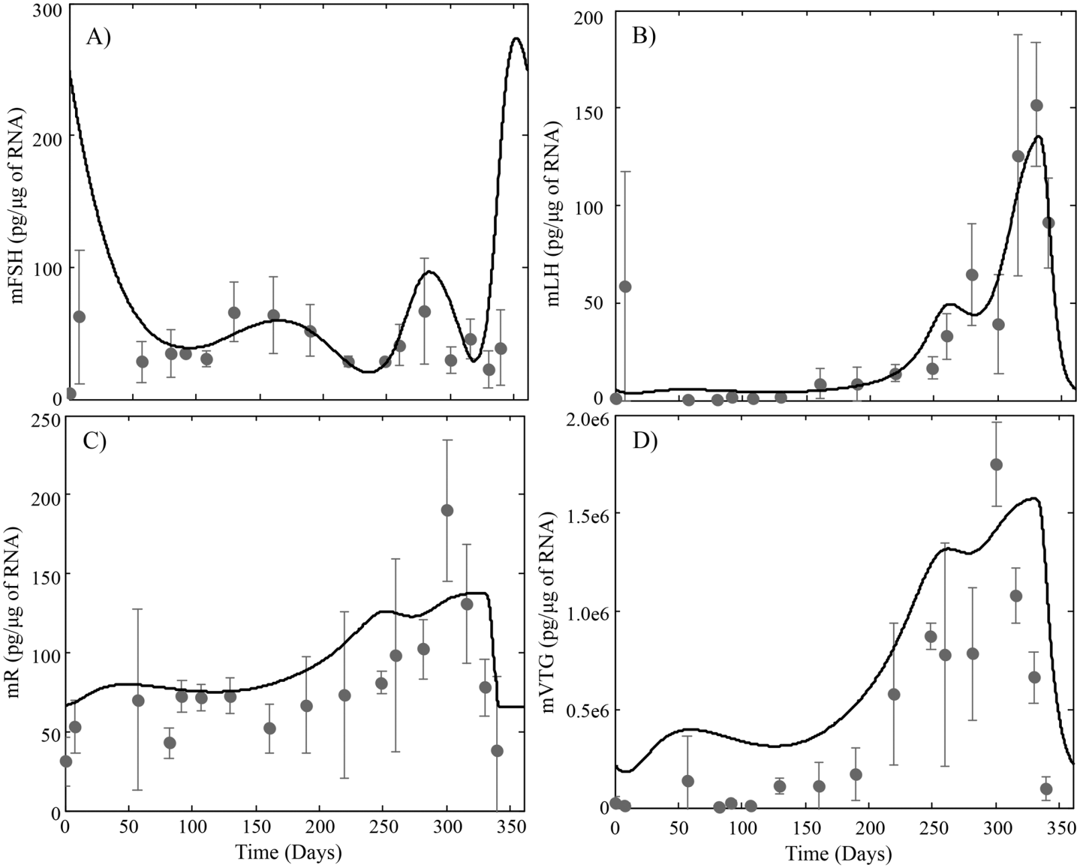
Update – quantitative mechanistic/computational toxicology
Fig 3. HPOL model predictions for (A) pituitary levels of FSH_{β} subunit mRNA, (B) pituitary levels of LH_{β} subunit mRNA, (C) Hepatic levels of E2 receptor mRNA and (D) Hepatic levels of VTG mRNA
Observed data (dark grey circles; mean ±TG mRn = 3)
PLoS Comput Biol. 2016 Apr 20;12(4):e1004874.

Slide 34
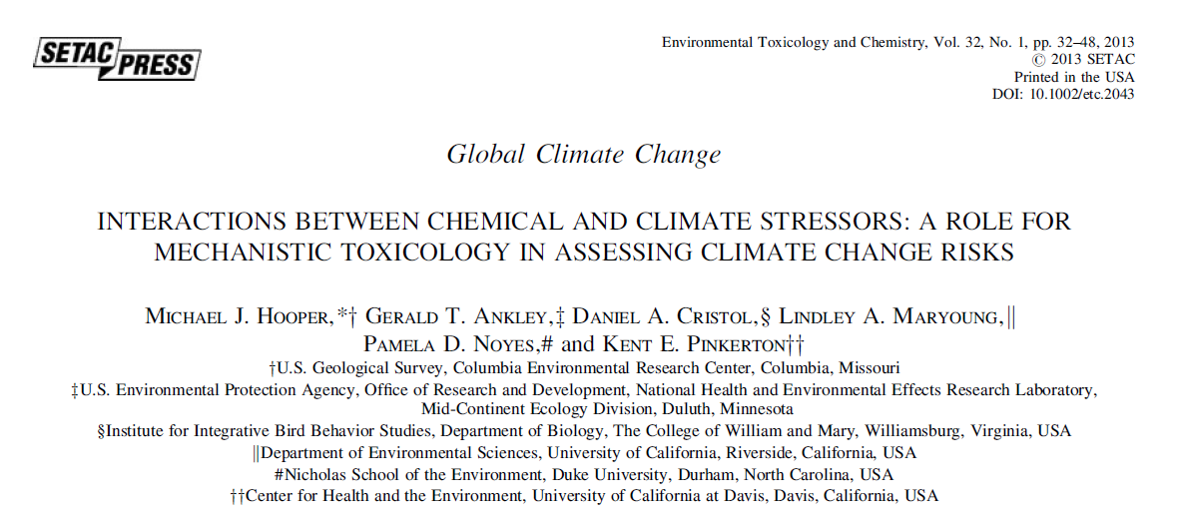
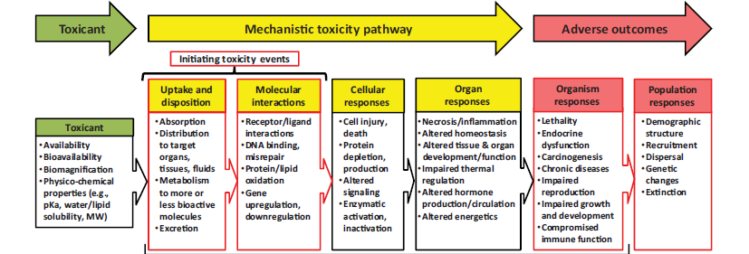
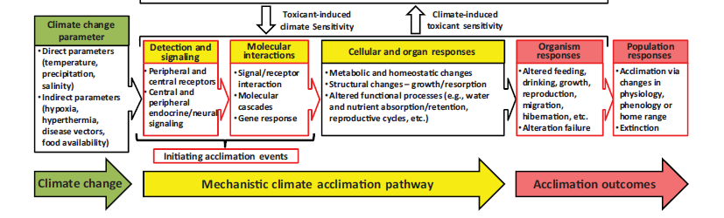

Slide 35
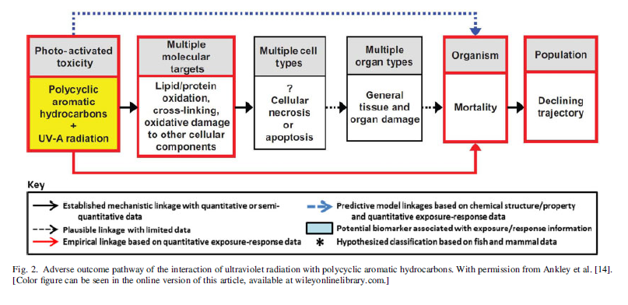

Slide 36

Closing remarks
Ecotoxicology is exciting science!
Interface: science and society
Many opportunities
Sometimes hard work
  10% inspiration and 90% „perspiration“
Be creative: move frontiers
Keep the purpose in mind
Be critical: do not accept perceptions as facts
Do not hesitate to speak up ..

