Slide 1
F1190: Proteiny
doc. Mgr. Karel Kubíček, Ph.D.

Slide 2
Proteiny
I] Doporučená literatura
Whitford, D.: Proteins – Structure and Function, John Wiley & Sons, Ltd. 2005
Cotterill, R.: Biophysics: An Introduction, John Wiley & Sons, Ltd. 2002
Voet, D, and Voetová, J.G.: Biochemie, Victoria Publishing
Murray, R.K., Granner, D. K., Mayes, P., A., Rodwell, V., W.: Harper’s Illustrated Biochemistry, Lange Medical Books, 2003
Schuenemann, V.: Biophysik: Eine Einfuehrung, Springer, 2005
Garrett, R.H., Grisham, C.M.: Biochemistry, 2nd ed., 1999
II] Aminokyseliny
Tvoří monomerní jednotky peptidů a proteinů
20 L-α-aminokyselin
Všechny aminokyseliny složeny ze tří částí – NH2- (amino) skupina, -COOH (karboxylová) skupina, -C_{α}-R (alfa uhlík s postranním řetězcem)
4) Esenciální a neesenciální kyseliny – organismus si je umí syntetizovat nebo je potřeba je přijímat v potravě
5) Označujeme třípísmennými nebo jednopísmennými zkratkami (zápis Val-Thr-Ile-Pro nebo VTIP – u jednopísmenného zápisu bez pomlčky)

Slide 3
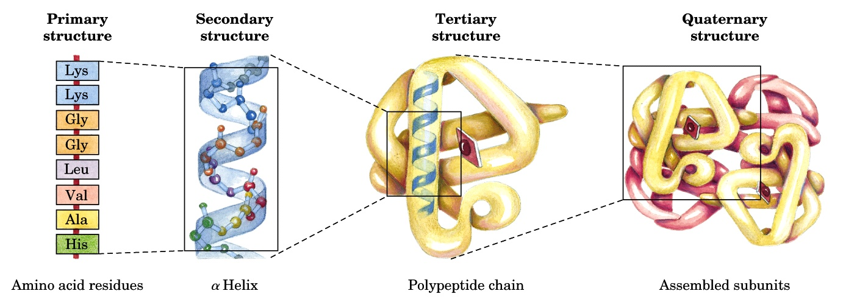
Levels of Protein Structure

Slide 4
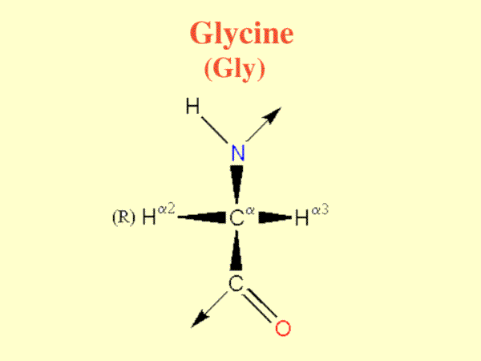
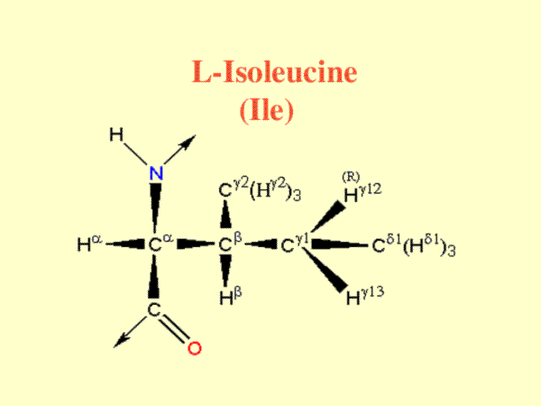
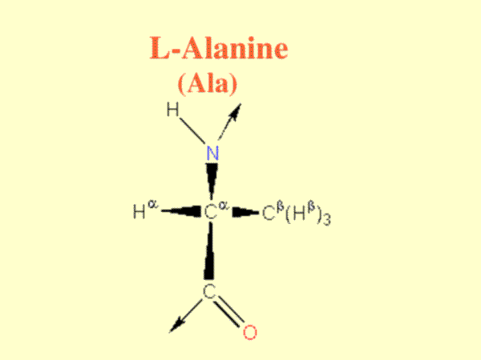
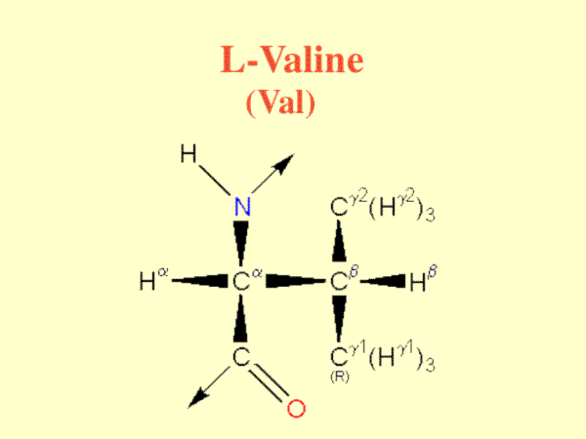
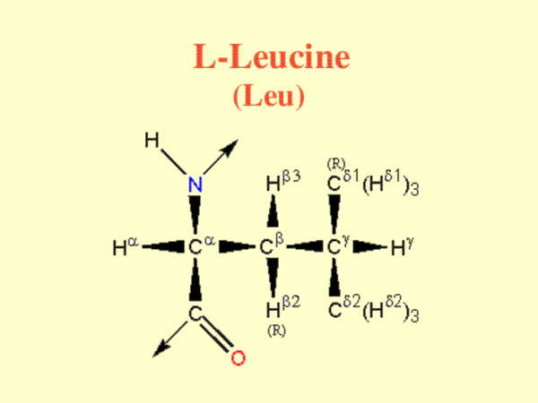
6) Aminokyseliny s alifatickým postranním řetězcem

Slide 5
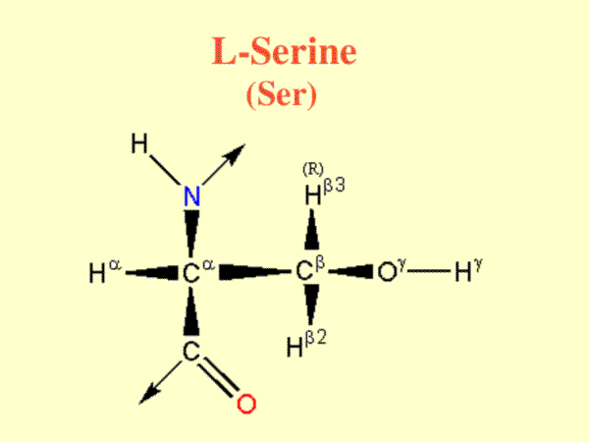
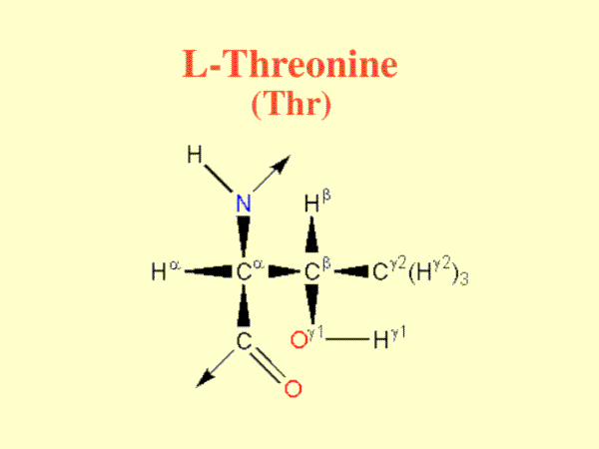
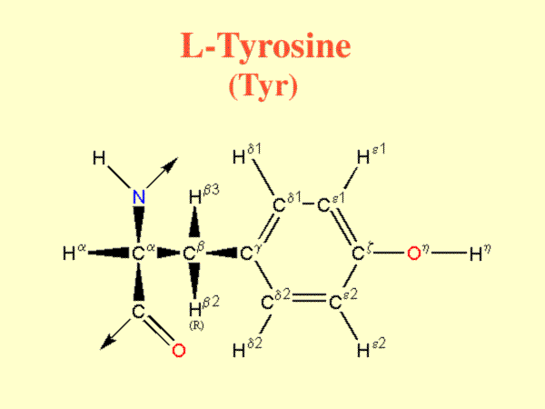
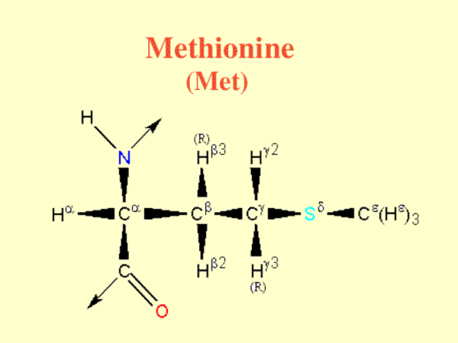
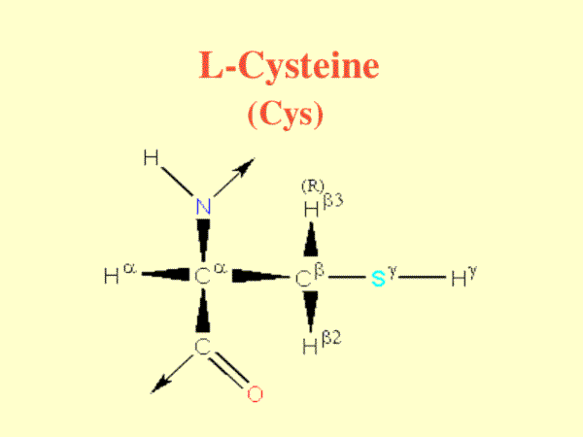
7) Aminokyseliny s hydroxylovou (OH) skupinou
8) Aminokyseliny s atomem síry

Slide 6
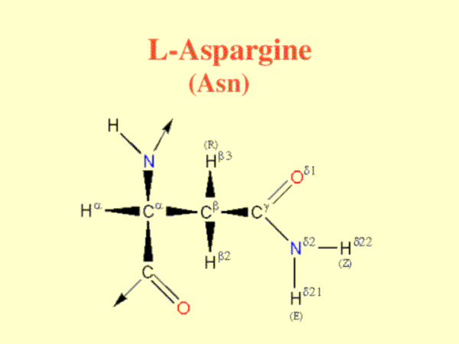
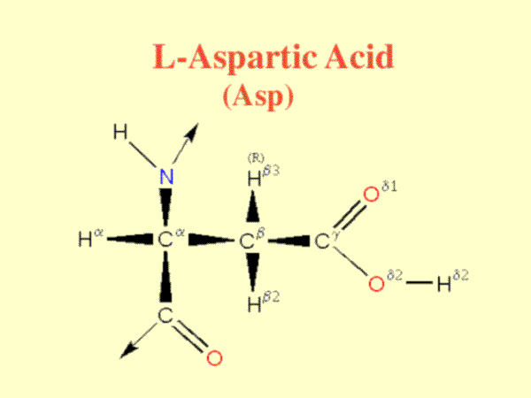
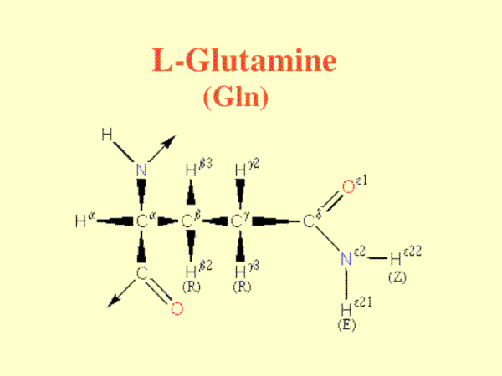
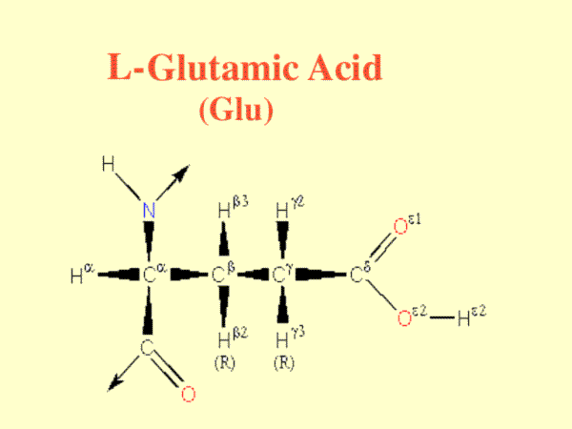
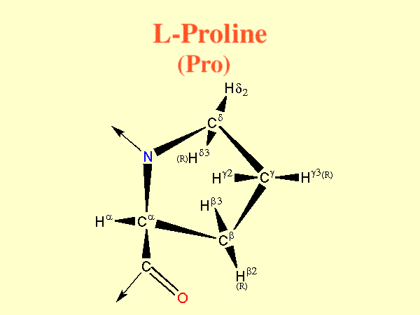
9) Aminokyseliny s acidickými skupinami nebo jejich amidy
10) Imino kyselina

Slide 7
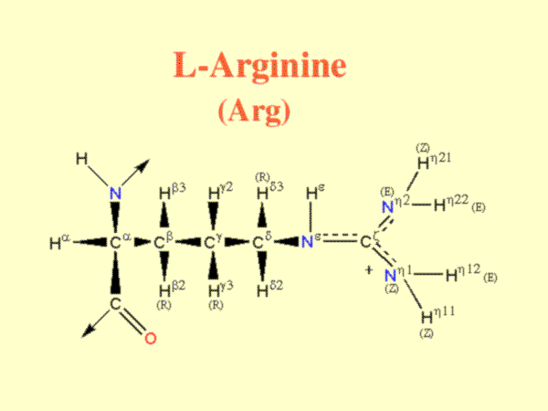
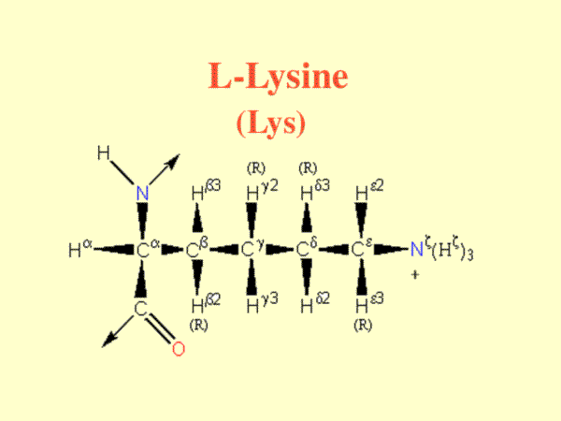
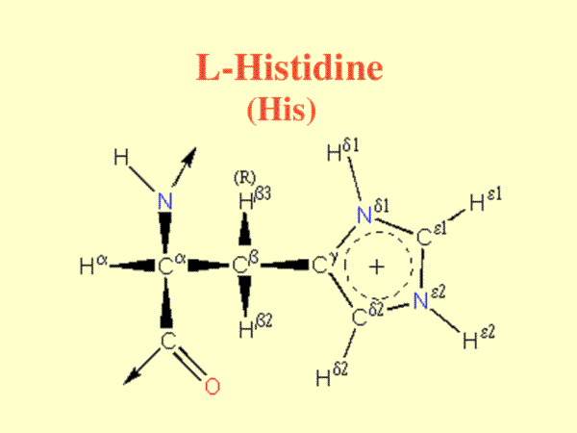
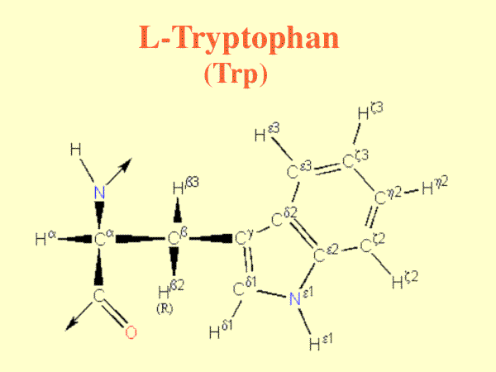
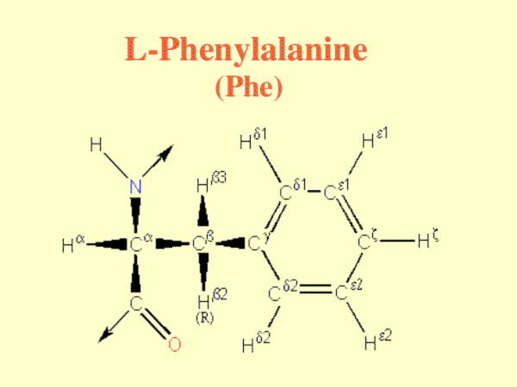
11) Aminokyseliny s basickými skupinami
12) Aminokyseliny s aromatickými kruhy

Slide 8
A
R
N
D
C
Q
E
G
H
I
L
K
M
F
P
W
Y
V
S
T

Slide 9
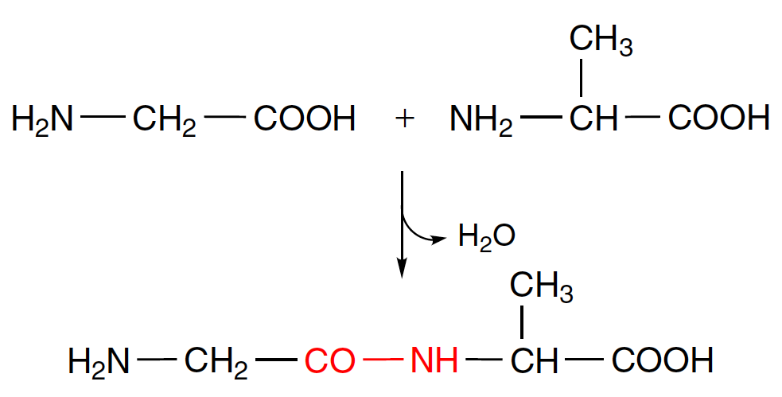
III] Peptidy, proteiny – vznik polymerů polymerizační reakcí

Slide 10
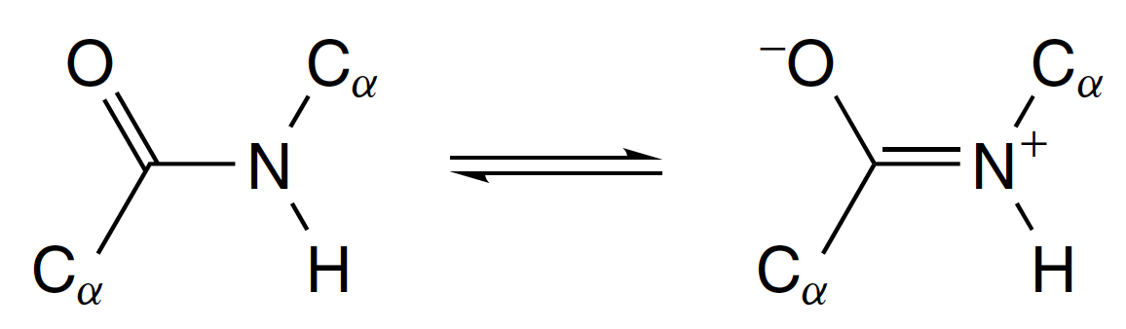
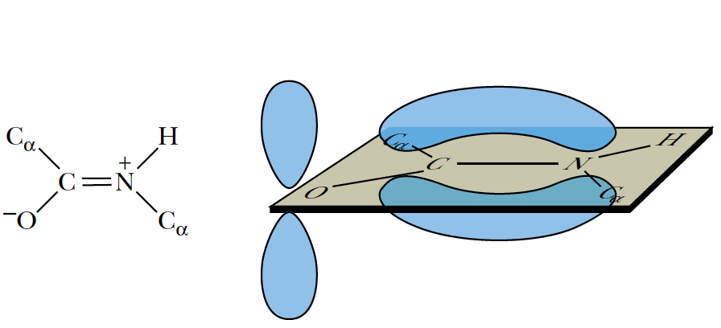
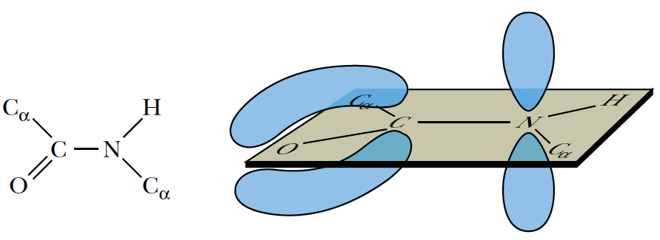
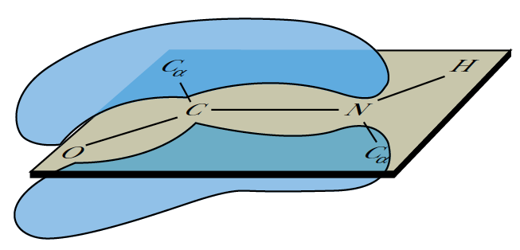
IV] Peptidová vazba – pseudo dvojitá vazba => amidová rovina

Slide 11
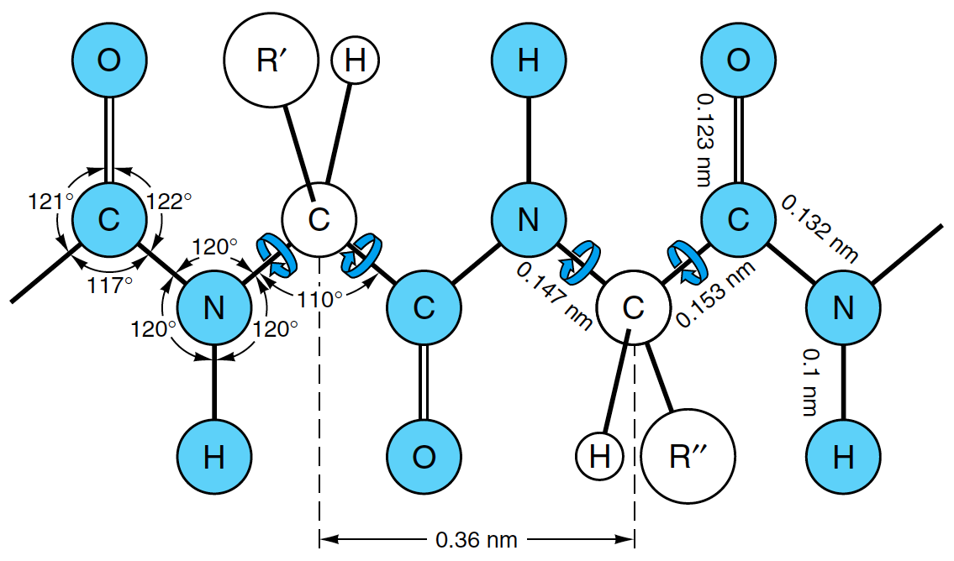
V] Proteinová páteř, primární struktura, číslování od N-konce (terminu) směrem k C-konci

Slide 12
Informace o 3D (proteinové) struktuře jsou zapsány v kartézských souřadnicích
Nejrozšířenější formát PDB (ProteinDataBank, www.pdb.org )
ATOM 128 N HIS O 18 20.321 6.124 17.761 1.00 11.40
ATOM 129 CA HIS O 18 21.097 5.169 18.563 1.00 13.62
ATOM 130 C HIS O 18 22.581 5.413 18.454 1.00 17.00
ATOM 131 O HIS O 18 23.031 5.592 17.321 1.00 15.45
ATOM 132 CB HIS O 18 20.883 3.747 18.034 1.00 16.68
ATOM 133 CG HIS O 18 19.557 3.103 18.437 1.00 11.72
ATOM 134 ND1 HIS O 18 19.252 2.806 19.725 1.00 11.66
ATOM 135 CD2 HIS O 18 18.479 2.751 17.657 1.00 16.32
ATOM 136 CE1 HIS O 18 18.021 2.238 19.730 1.00 14.91
ATOM 137 NE2 HIS O 18 17.552 2.185 18.473 1.00 17.58
HETATM 1633 NC HEM O 104 15.182 3.191 16.831 1.00 21.22
HETATM 1634 C1C HEM O 104 15.433 3.334 15.488 1.00 17.49
HETATM 1635 C2C HEM O 104 15.046 4.605 15.145 1.00 31.21
HETATM 1636 C3C HEM O 104 14.623 5.242 16.323 1.00 14.38
HETATM 1637 C4C HEM O 104 14.661 4.346 17.360 1.00 14.50
HETATM 1638 CMC HEM O 104 15.299 5.349 13.850 1.00 15.54
HETATM 1639 CAC HEM O 104 14.314 6.707 16.409 1.00 31.67
HETATM 1640 CBC HEM O 104 13.170 7.262 15.615 1.00 10.23
HETATM 1609 FE HEM O 104 15.801 1.483 17.954 1.00 9.37
ftp://ftp.wwpdb.org/pub/pdb/doc/format_descriptions/Format_v33_A4.pdf

Slide 13
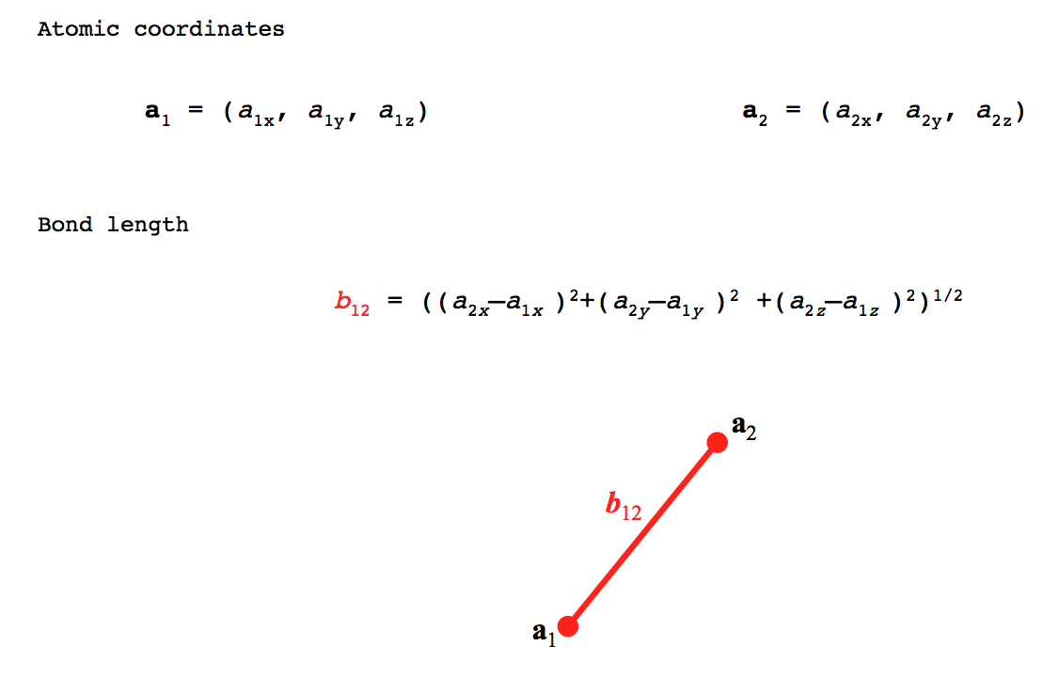

Slide 14
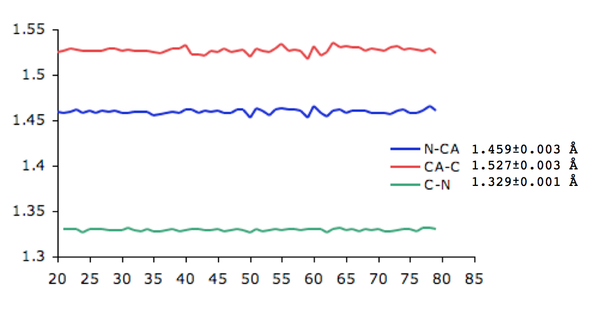

Slide 15
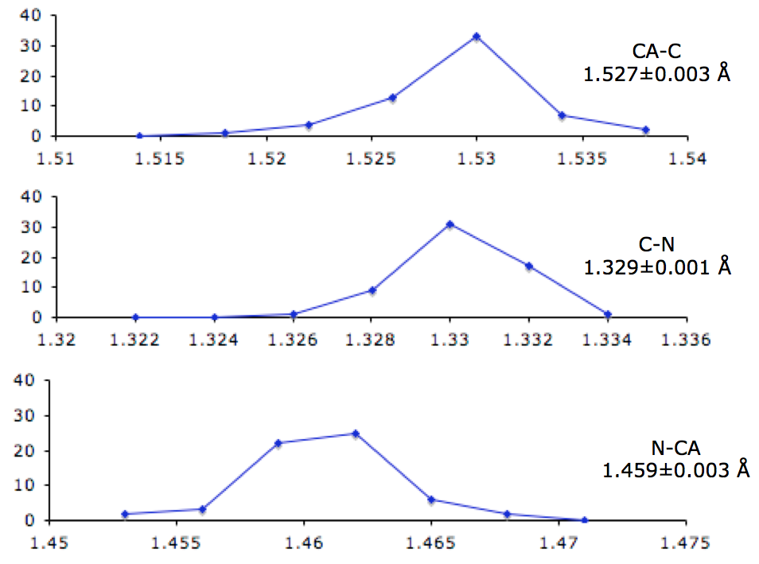

Slide 16
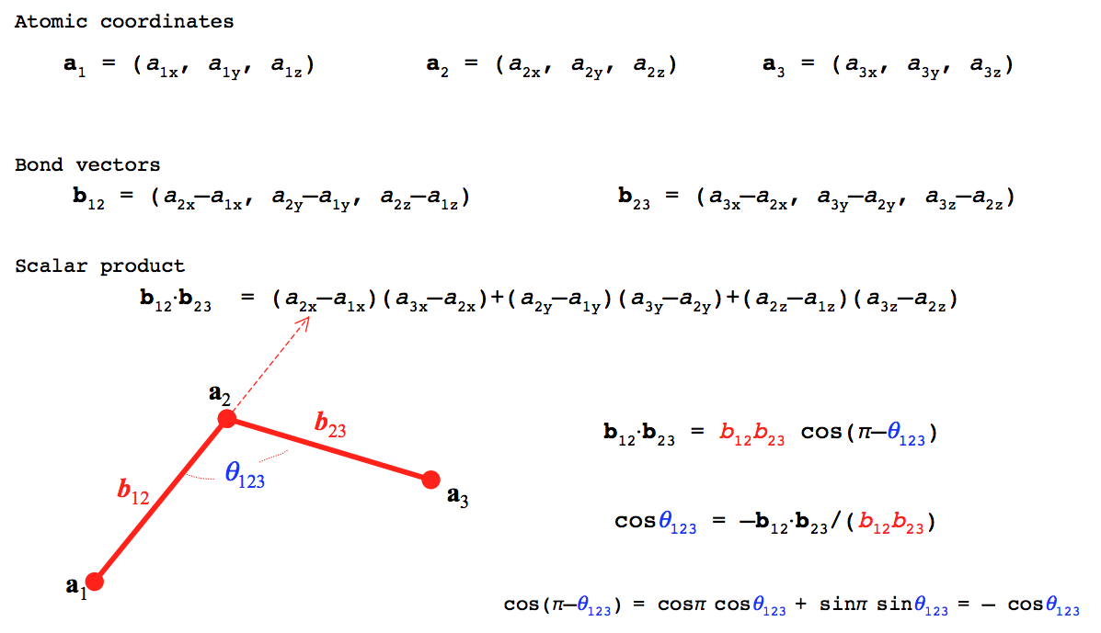

Slide 17
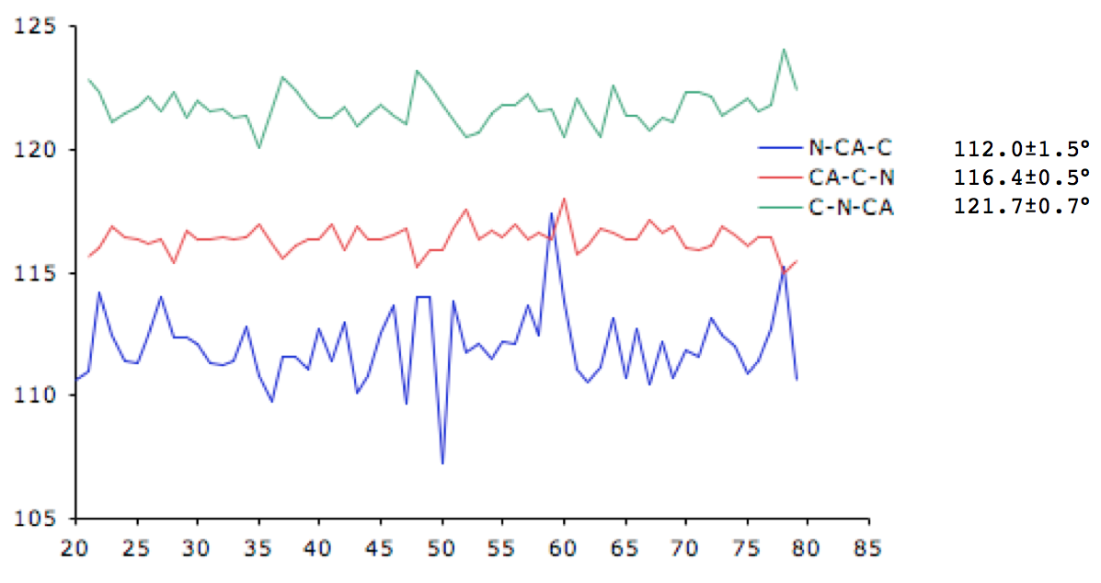

Slide 18
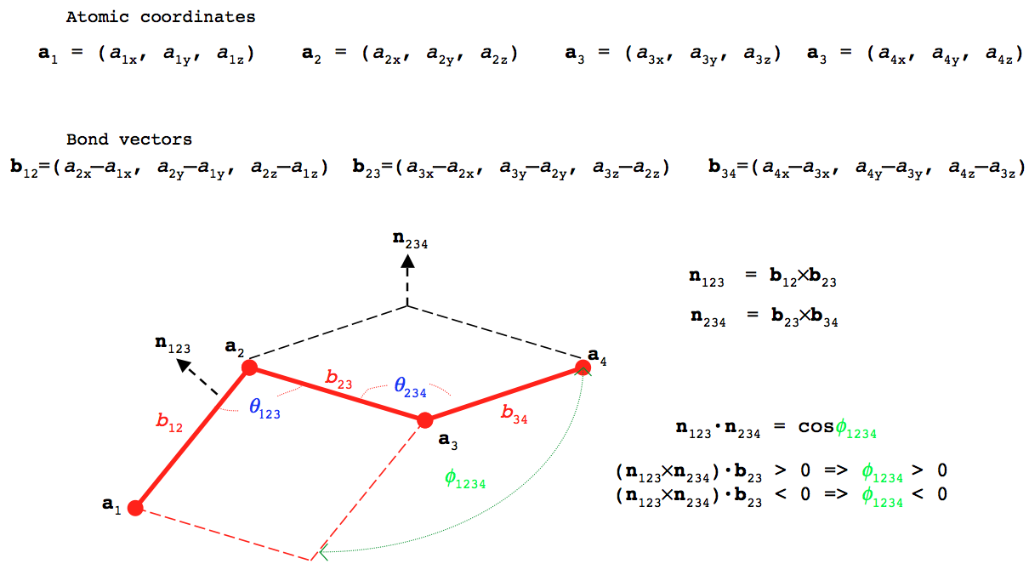

Slide 19
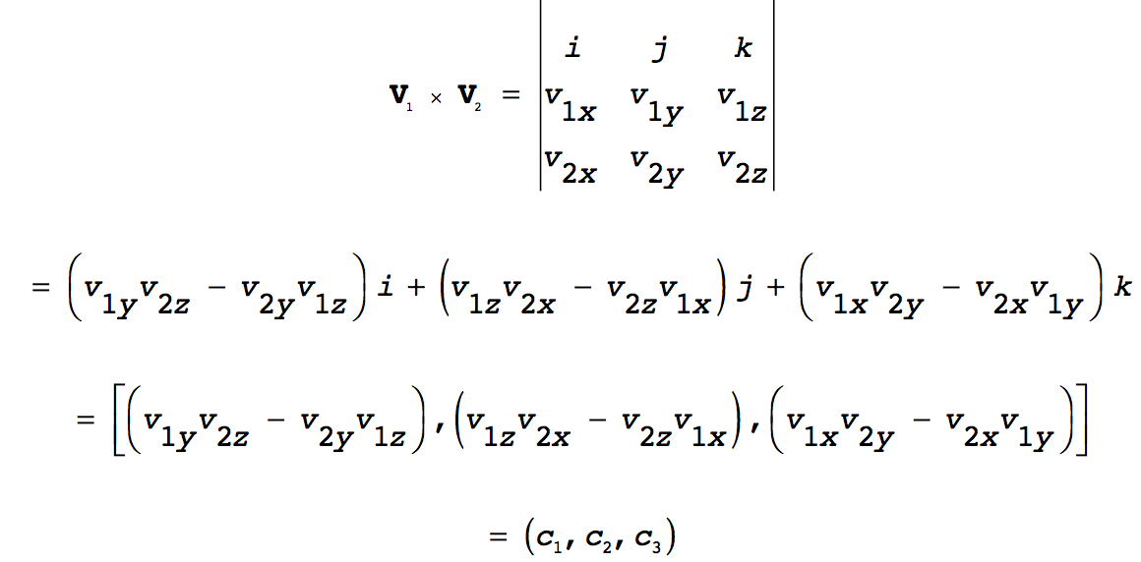

Slide 20
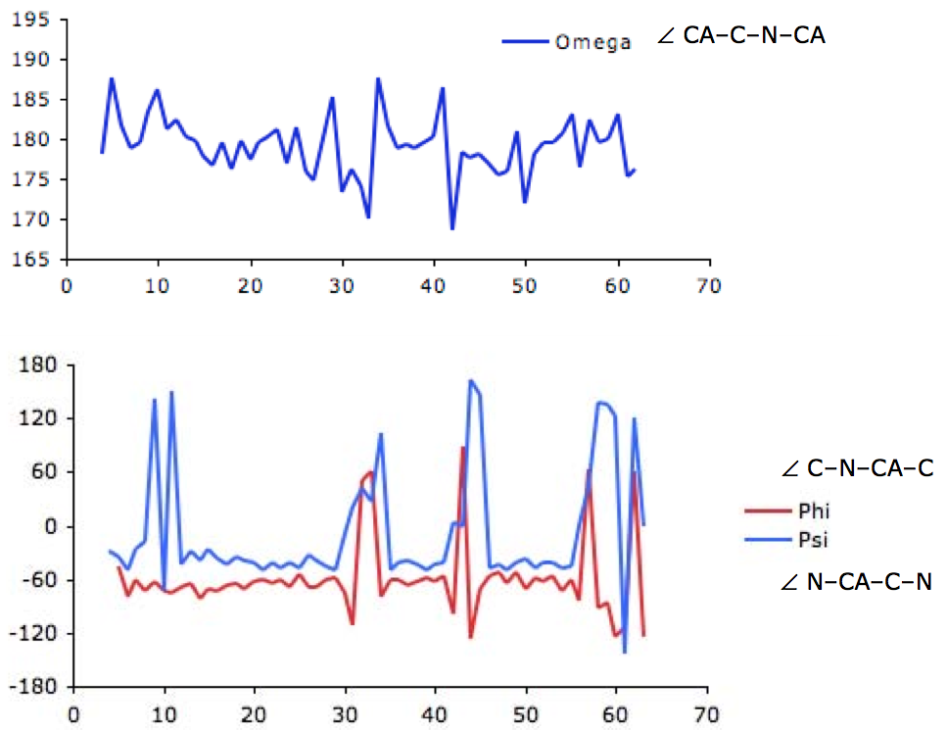

Slide 21
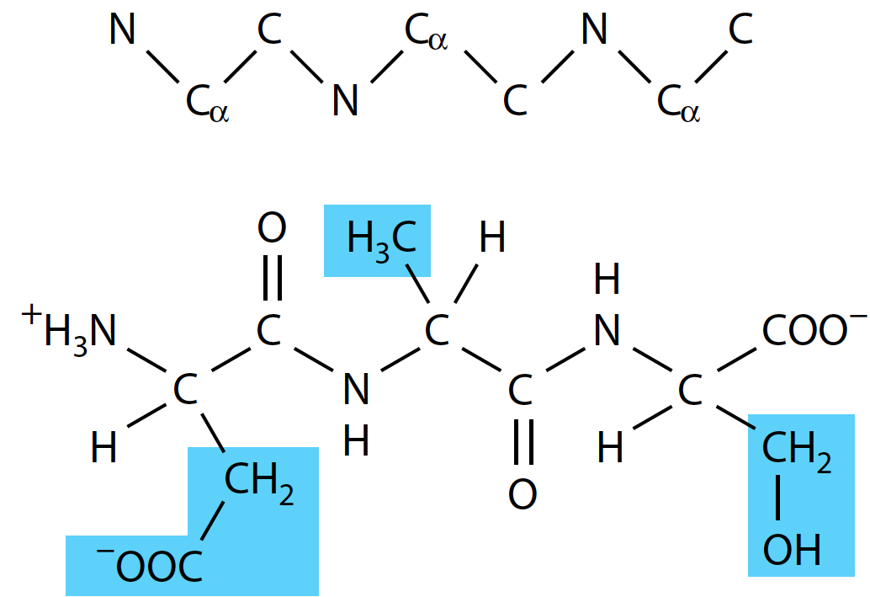
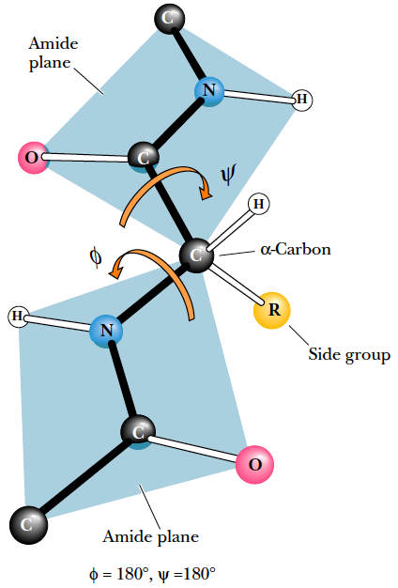
− CO, N, C_{α}, CO (CO někdy značeno C’)
ψ − N, C_{α}, CO, N

Slide 22
Structural parameters for protein secondary structures
Structural element | φ | ψ | n | d | p
α-helix | -57 | -47 | 3.6 | 1.5 | 5.5
3₁₀-helix | -49 | -26 | 3.0 | 2.0 | 6.0
β-helix | -57 | -70 | 4.4 | 1.1 | 5.0
Polyproline II helix | -79 | +149 | 3.0 | 3.1 | 9.4
Parallel β-strand | -119 | +113 | 2.0 | 3.2 | 6.4
Antiparallel β-strand | -139 | +135 | 2.0 | 3.4 | 6.8
and ψ are the conformational angles of the mainchain, with ω ~180°(trans conformation)
n = number of residues per turn
d = displacement between successive residues along the helix/strand axis
p = the pitch of helix/strand, the distance along the helix/strand axis of a complete sec. struct. element. Note that p=n x d (equation is exact, error is in rounding of n and d)

Slide 23
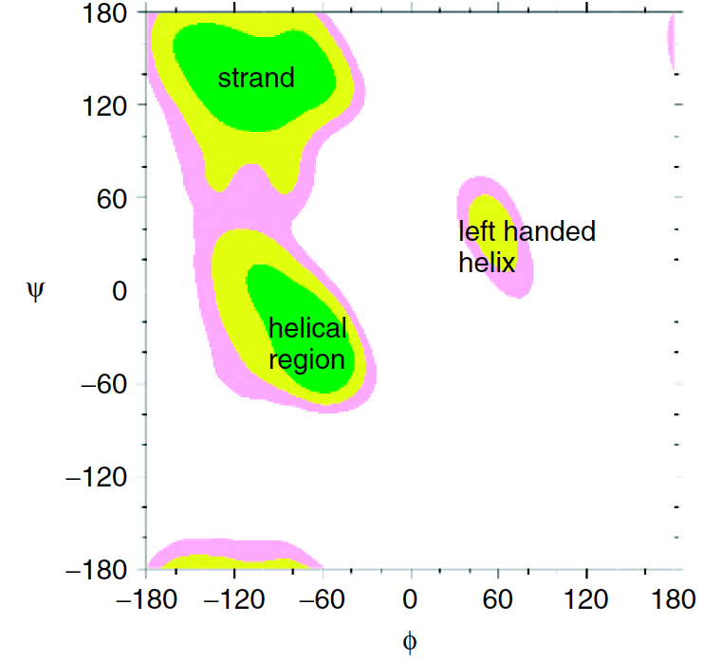
VI] Ramachandranův diagram

Slide 24
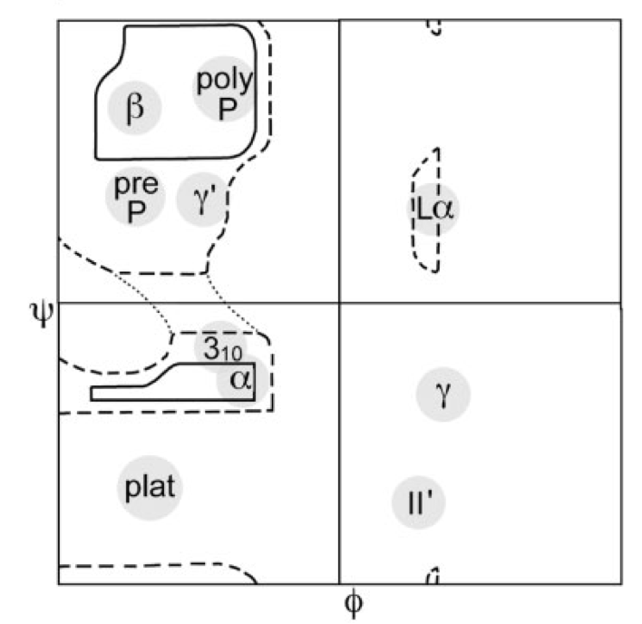
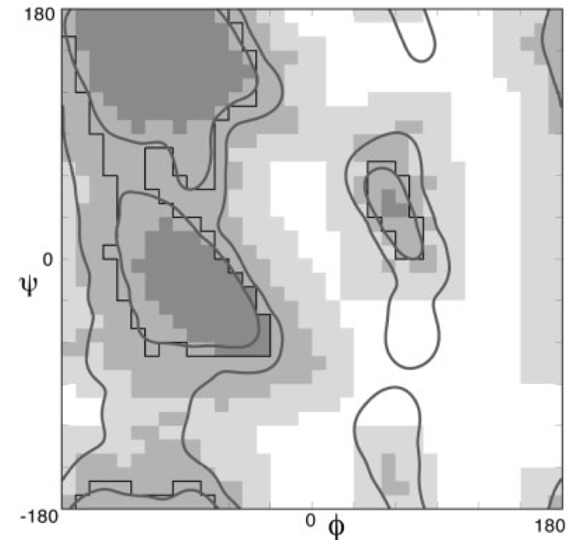
Ramachandranův diagram – komplet

Slide 25
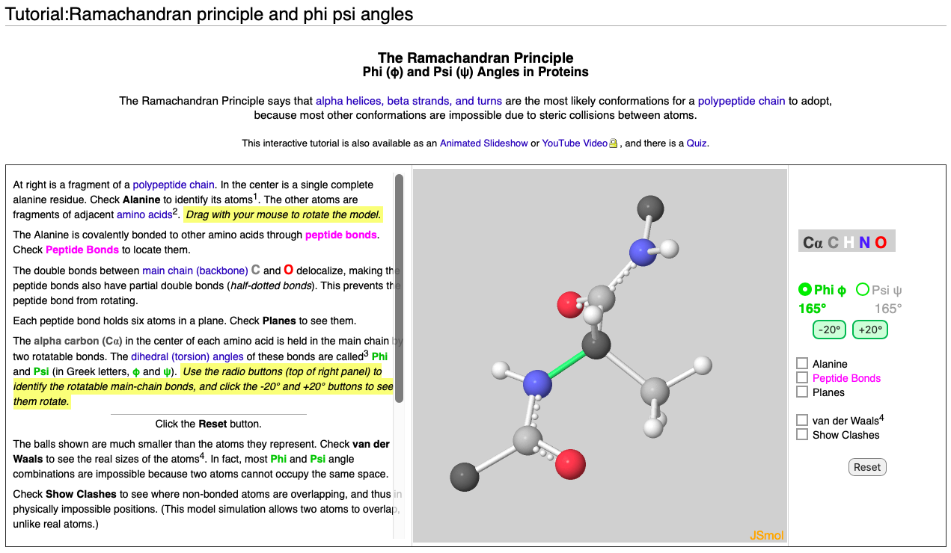
https://proteopedia.org/wiki/index.php/Tutorial:Ramachandran_principle_and_phi_psi_angles

Slide 26
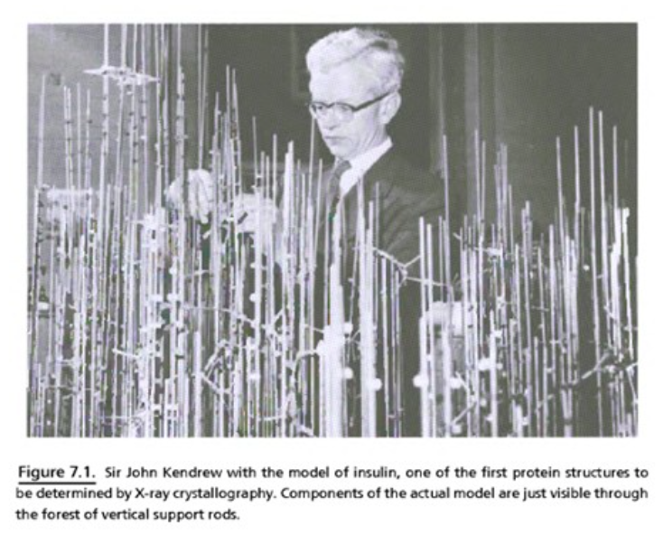

Slide 27
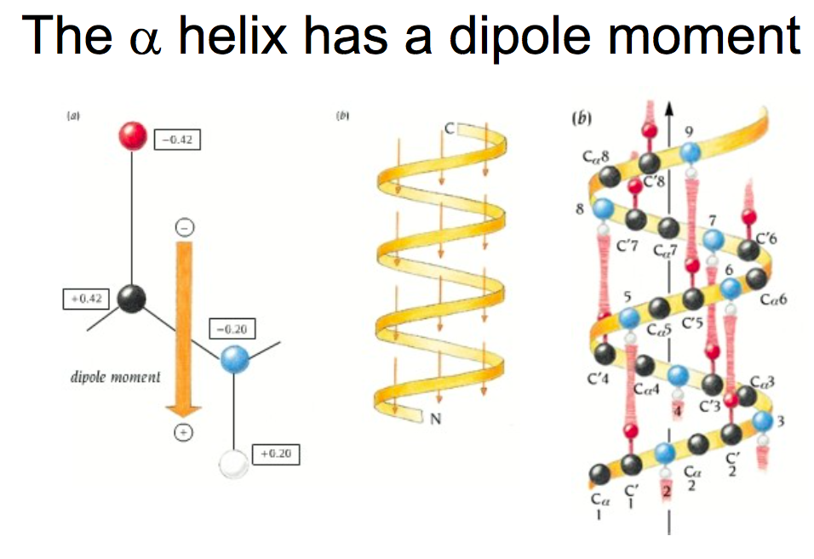

Slide 28
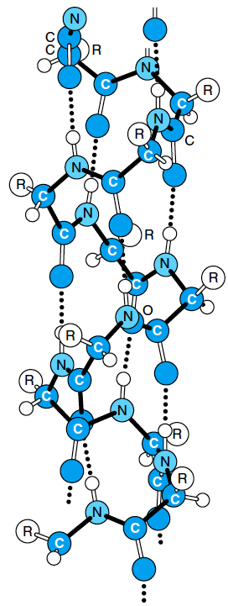
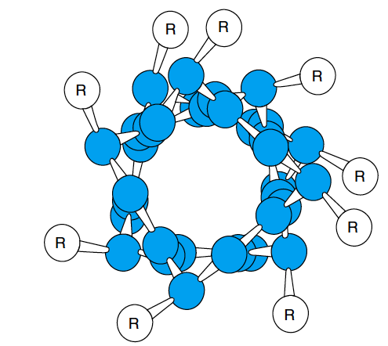
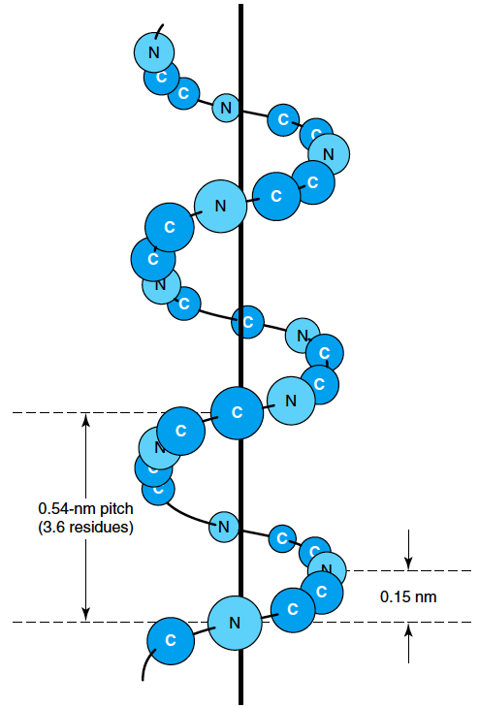
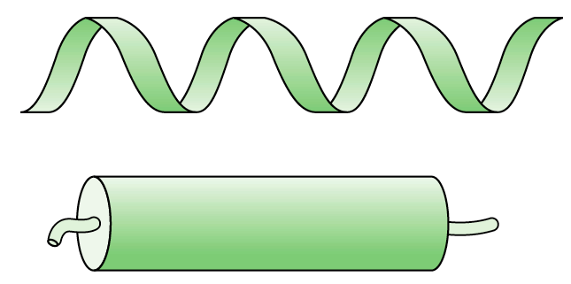
VII] Sekundární struktura
α-šroubovice (α-helix)
β-skládaný list (β-sheet)
Ohyb, smyčka (loop/turn)

Slide 29
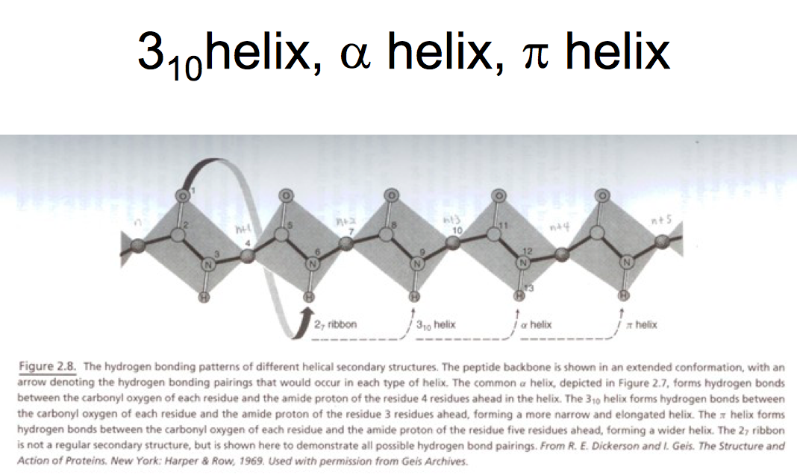

Slide 30
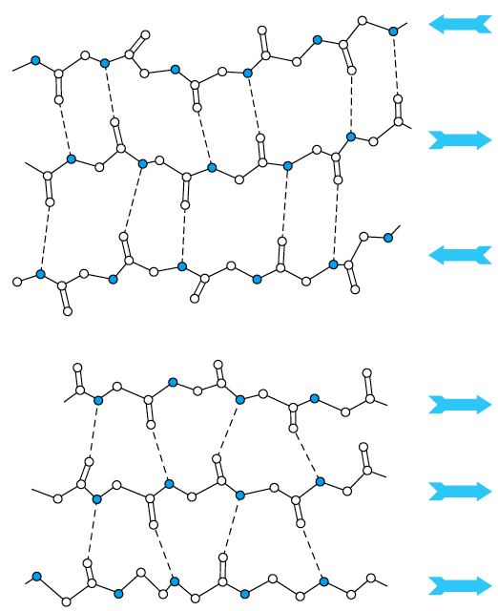
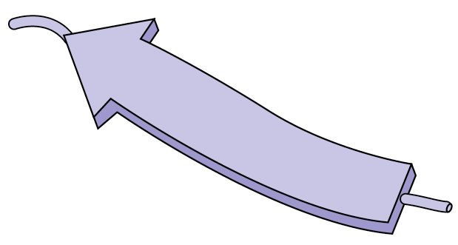
VII] Sekundární struktura
α-šroubovice (α-helix)
β-skládaný list (β-sheet)
Ohyb, smyčka (loop/turn)
antiparalelní uspořádání
paralelní uspořádání
antiparalelní
paralelní

Slide 31


VII] Sekundární struktura
α-šroubovice (α-helix)
β-skládaný list (β-sheet)
Ohyb, smyčka (loop/turn)
γ-smyčka/ohyb (3 residua)
β-smyčka/ohyb (4 residua)

Slide 32

Ostatní motivy sekundární struktury :
polyprolinová šroubovice I & II – levotočivá, 3.3 nebo 3 (PPI, PPII, v uvedeném pořadí) aminokyseliny/otočku
šroubovice 3₁₀ (srovnej s 3.6₁₃)– pravotočivá, 3 aminokyseliny/otáčku, 10 atomů vytváří kruh uzavřený vodíkovou vazbou, např. poly-Ala
π-šroubovice – pravotočivá, 4.1 aminokyseliny/otáčku
β-šroubovice – vzniká uspořádáním β-skládaných listů do pravo- i levotočivé šroubovice.
8
9
10
7
6
5
1
4
2
3

Slide 33
Primary sequence reveals important clues about a protein
One sequence keeps silent about its three-dimensional structure
Two aligned sequences whisper
But tables of many aligned sequences shout out loud

Slide 34
Primary sequence reveals important clues about a protein
• Evolution conserves amino acids that are important to protein structure and function across species. Sequence comparison of multiple “homologs” of a particular protein reveals highly conserved regions that are important for function.
• Clusters of conserved residues are called “motifs” -- motifs carry out a particular function or form a particular structure that is important for the conserved protein.
motif
DnaG E. coli
...EPNRLLVVEGYMDVVAL...
small hydrophobic
DnaG S. typ
...EPQRLLVVEGYMDVVAL...
large hydrophobic
DnaG B. subt
...KQERAVLFEGFADVYTA...
polar
gp4 T3
...GGKKIVVTEGEIDMLTV...
positive charge
gp4
T7
...GGKKIVVTEGEIDALTV...
negative charge
:::: ** :* .

Slide 35
Some motifs in protein sequences
Structure of function identified | Motif
Nucleotide-binding site | G*G**G
N-glycosylation site | N*S or N*T
Nuclear protein transit sequence | KKKRKV
Factor IX proteinase cleavage site | IEGR
Serine proteinase active site | GDSGG
Acid proteinase active site | FDTGS
Fibronectin cell adhesion sequence | RGDS
Copper binding site | H***H…H or H****H…H
* = any single amino acid (AA)
*** = several AAs
... = any number of AAs

Slide 36

Charged and polar R-groups tend to map to protein surfaces

Slide 37
Protein folding
The Levinthal paradox states that if an averaged sized protein would sample all possible conformations before finding the one with the lowest energy, the whole process would take billions of years.
Proteins typically fold within 0.1 and 1000 seconds, therefore the protein folding process must be directed some way through a specific folding pathway.

Slide 38
Protein folding
Anfinsen's Classic Experiment: The "Protein Folding Problem" asks a very simple question:
"How does the primary structure of a protein determine its 2ｰ and 3ｰ structure?".
We have known for many decades that proteins fold into their correct 3-D structures inside the cell. But correct folding during synthesis on the ribosome or later with assistance from unknown cellular factors could explain the in vivo results.
In the 1960's, Anfinsen and his coworkers performed a series of seminal experiments in vitro that answered a key part of the problem. The original work led Anfinsen to propose his "Thermodynamic Hypothesis", which states that the native conformation of a protein is adopted spontaneously. In other words, there is sufficient information contained in the protein sequence to guarantee correct folding from any of a large number of unfolded states. A schematic diagram of Anfinsen's experiment is shown below in two parts:

Slide 39


Slide 40


Slide 41

VII] Terciární struktura proteinů
1) Kolagen
Primární struktura:
Sekundární struktura:
Terciární struktura:

Slide 42


2) Disulfidický můstek: 2-SH (z cysteinu)-> -S-S-
Disulfidické můstky v imunoglobulinu G

Slide 43

3) Strukturní motivy v proteinech
β-meandr Řecký klíč Swiss/Jelly roll

Slide 44


Slide 45

VIII] Kvartérní struktura proteinů
Multimery
Homo-/hetero-
-mery

Slide 46



Examples of other quaternary structures
Tetramer Hexamer Filament
SSB DNA helicase Recombinase
Allows coordinated Allows coordinated DNA binding Allows complete
DNA binding and ATP hydrolysis coverage of an extended molecule

Slide 47

Grigoryan and Keating, 2008

Slide 48


Slide 49


Slide 50


Slide 51


Slide 52
Confidence in structural features of proteins determined by
X-ray crystallography
(estimates are very rough and strongly depend on the quality of the data)
Structural feature |  |  | Resolution
 | 5 Å | 3 Å | 2.5 Å | 2 Å | 1.5 Å
Chain tracing | - | Fair | Good | Good | Good
Secondary structure | Helices fair | Fair | Good | Good | Good
Sidechain conformations | - | - | Fair | Good | Good
Orientation of peptide planes | - | - | Fair | Good | Good
Protein hydrogen atoms visible | - | - | - | - | Good

Slide 53
XII] Metody pro určování třídimenzionální struktury (bio)molekul na atomární úrovni
NMR – nukleární (=jaderná) magnetická rezonance – měření (také) v kapalném prostředí
Rentgenová krystalografie - (měření především v krystalu)
Kryo-elektronová mikroskopie

Slide 54

J Mol Graph Model 19, 2001, 26-59

Slide 55

BiochimBiophysActa 1804, 2010, 1231-64

Slide 56
IX] Funkce proteinů:
Enzymy – katalyzátory biologických reakcí
Transportní proteiny (hemoglobin)
Regulační proteiny (např. hormon insulin)
Skladovací (storage) – např. ovalbumin – zdroj dusíku pro vyvíjející se ptačí embryo
“Pohybové” proteiny – actin, myosin, tubulin, dynein, kinesin
Strukturní proteiny – zajišťujicí vytvoření a udržení biologické struktury – α-keratin, kolagen, elastin, fibroin etc.
Ochranné – imunoglobuliny, fibrinogen, thrombin

Slide 57
X] Proteinová databáze – PDB
WWW.RCSB.ORG
XI] Vizualizační programy
PyMol
Chimera
VMD
MolMol
RasMol
Insight II

