Slide 1
DNA coby polyelektrolyt:
Manningova teorie kondenzace protiiontů
F5351 Základy molekulární biofyziky
Masarykova Univerzita
Podzimní semestr 2023
24.11.2023
Prof. Jiří Kozelka, Biofyzikální Laboratoř, Ústav fyziky kondenzovaných látek, PřF MU, Kotlářská 2, kozelka.jiri@gmail.com
Manning, G. S. (1978). "The molecular theory of polyelectrolyte solutions with aplications to the electrostatic properties of polynulceotides." Quart. Rev. Biophys. 11: 179-246.

Slide 2
Double-stranded DNA can be considered as a linear long rod composed of segments, each carrying one unit charge. The segments repel each other. The repulsion is diminished if positively charged counter-ions associate with each segment on the DNA surface.
1 segment: charge -1e
DNA double helix
b = 1.7 Å
The distance b between segments harboring a unit charge (1 q_{e}=1.60x10⁻¹⁹ C) defines the charge density of the polymer.
For single-stranded DNA, b = 3.4 Å
For double-stranded DNA, b =1.7 Å

Slide 3
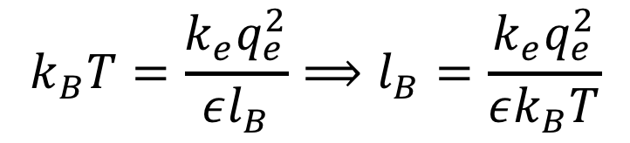

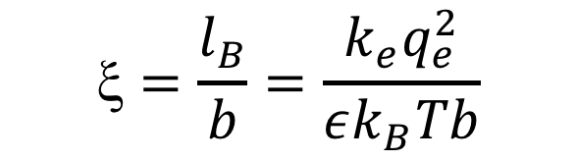
Before we continue, let us learn about two definitions:
Bjerrum* length l_{B}: the distance between two elementary charges (q_{e})
at which their repulsion energy is equal to the thermal energy k_{B}T
$$k_{B}T=\frac{k_{e}q_{e}^{2}}{εl_{B}}⟹l_{B}=\frac{k_{e}q_{e}^{2}}{εk_{B}T}$$
*Niels Jannicksen Bjerrum (1879-1958), dánský chemik
Manning** structural parameter ξ: the ratio between l_{B} and b, that is, the product of the Bjerrum length (a constant [Å]) and the linear charge density ([Å⁻¹]). It is thus a dimensionless parameter proportional to the charge density.
$$\text{x}=\frac{l_{B}}{b}=\frac{k_{e}q_{e}^{2}}{εk_{B}Tb}$$
** Gerald S. Manning, professor emeritus, Rutgers University, New Jersey, USA

Slide 4
Univalent salt in water (e.g., NaCl)
+
+
+
+
+
At each segment, a fraction θ of positive counterions „condenses“ within a volume V_{P}
V_{P}
+
DNA double helix
+
The charge of 1 segment is reduced to (-1+θ)e
+
Gain in enthalpy ΔH, since repulsion between segments is diminished
+
Loss in entropy ΔS, since order increases
Nature will „choose“ such a θ fraction, that ΔG = ΔH – TΔS is minimal
+
⇓
δΔG/δθ = 0
1 equation
2 unknowns
+
+
δΔG(θ, V_{P} ) /δθ = 0

Slide 5
Calculation of the electrostatic repulsion term ΔG_{el}
Phosphate N°: 1 2 3……………..s………………………n_{p}
Charge:
q_{net}
q_{net}
q_{net}
q_{net}
q_{net}
q_{net}
q_{net}
q_{net}
b
2b
efekt soli
q_{net} = q_{e}(1- θ)
Each pair contributes:
efekt vody
if n_{p}>> s
Coulomb
Debye-Hückel
screening factor
|i-j| = 1: number of pairs = n_{p}-1
≈ n_{p}
r_{D} = „Debye screening length“
proportional to c^{-1/2}
c: concentration of univalent salt
|i-j| = 2: number of pairs = n_{p}-2
≈ n_{p}
All pairs contribute:
.
.
|i-j| = s: number of pairs = n_{p}-s
≈ n_{p}
|i-j| > s: interaction negligible
ΔG_{ij}≈ 0

Slide 6
Simplifying the sum over pairwise electrostatic repulsion terms
Looks like a Taylor series….
Cvičení 1: odvoďte Taylorův rozvoj pro funkci f(x)=ln(1+x)
(vyžadováno je řešení, nikoliv jen výsledek)
Taylorův rozvoj :
f(x) =

Slide 7
f(x) =
with a=0:
series converges
for x<0
with

Slide 8




List of Taylor series of some common functions
http://en.wikipedia.org/wiki/Taylor_series

Slide 9
Simplifying the sum over pairwise electrostatic repulsion terms
Cvičení 2: vypočtěte sumu
=
Cvičení 3: zjednodušte
(r_{D}>>b)

Slide 10
Simplifying the sum over pairwise electrostatic repulsion terms
Sum has become a simple
logarithmic term!
ξ is the dimensionless «Manning structural factor» proportional to charge density

Slide 11
Cvičení 4: Vypočtěte ξ pro dvojšroubovicovou DNA (b = 1.7 Å)
při 25 °C
ξ = 4.2 (single-stranded DNA: ξ = 2.1)
k = 1.38x10⁻²³ J.K⁻¹ T = 298 K
k_{e} = 9.0x10⁹ Nm²C⁻² ε = 78 q_{e} = 1.60x10⁻¹⁹ C

Slide 12
c_{bulk}
+
+
c_{local}= n_{P}θ(n_{P}V_{P})⁻¹ = θV_{P}⁻¹
+
+
+
A fraction θ of positive counterions „condenses“ within a volume V_{P}
V_{P}
+
DNA double helix
+
+
Loss in entropy ΔS, since order increases
+
+
+
+

Slide 13
Mixing entropy term dependent on θ∗
number of moles of couterions that is confined from c_{bulk} to c_{local}
c_{bulk} = c = concentration [mol/L] of univalent salt KNOWN
V_{P} [L/mol] = volume to which the θ counterions/phosphate are confined
V_{p} UNKNOWN → HOPELESS CALCULATION???
Let‘s minimize the total free energy with respect to θ
∗ i.e., loss in entropy when the fraction θ of counterions associates with each segment

Slide 14
Cvičení 5: Vypočtěte první derivaci následují funkce podle x :

Slide 15
Minimizing total free energy
Cvičení 6: vypočtěte derivaci. Naznačte postup výpočtu.
Dependence of ΔG_{mix} on c
Dependence of ΔG_{el} on c
From Debye-Hückel Theory of electrolytes

Slide 17
→Singular terms containing ln c
must vanish!
We want to know θ at the low concentration
limit, c→0
ξ(1− θ) ln c
↓
-∞
ln c
↓
-∞
Now we have got a second equation!
k Boltzmann‘s constant ξ dimensionless charge density of polymer
k_{e} electrostatic constant c concentration of univalent electrolyte
q_{e} electron charge ε dielectric coefficient of electrolyte
ε₀ vacuum permittivity T absolute temperature
L_{AV} Avogadro‘s number θ fraction of counterions condensed
V_{P} volume to which θ counerions condense
knowns
unknowns

Slide 18
→Singular terms containing ln c
must vanish!
We want to know θ at the low concentration
limit, c→0
ξ(1− θ) ln c
↓
-∞
ln c
↓
-∞
Now we have got a second equation!
76% of the negative charge of the phosphates is neutralized by condensed counterions!
ξ < 1 → θ < 0 no association of counterions
ξ > 1 → θ > 0 association of counterions

Slide 19
Now we can determine V_{P}, the volume to which the
θ counterions/nucleotide condense in double-stranded DNA
base of natural logarithms
=1
=0

Slide 20
= 6.46x10²⁶L_{AV}⁻¹ Å³/nucleotide = 1073 Å³/nucleotide
k = 1.38x10⁻²³ J.K⁻¹ ε₀ = 8.85x10⁻¹² C²N⁻¹m⁻² DNA in water at 25°C
k_{e} = 9.0x10⁹ Nm²C⁻² L_{AV} = 6.02x10²³ mole⁻¹ ξ = 4.2
q_{e} = 1.60x10⁻¹⁹ C e = 2.718 ε =78
T = 298 K
θ = 0.76

Slide 21
The volume to which the condensed univalent counter-cations
are confined, V_{P}
Per mole: 646 cm³
Per nucleotide: 1073 Å³
This corresponds to a layer of ~7 Å around the DNA double-helix
(which corresponds ~to a cylinder with a diameter of 20 Å)
7 Å
20 Å
7 Å
Counterion Condensation Theory: Manning, G. S. (1978) Quart. Rev. Biophys. 11: 179-246

Slide 22
Experimental and theoretical results supporting the Counterion Condensation Theory
1. Titration of Carboxymethylcellulose (CMC) with different hydroxides monitored by ultrasonic absorption
CMC
Titration with XOH; X = Na, K, Li, N(CH₃)₄…….
Upon titration, the COOH groups are successively deprotonated, become COO⁻, and the negative charge density increases. This modifies the structure of the water layer at the surface of the polymer, which can be monitored by measuring the absorption of ultrasound. If there is no association of cations with the polyanion, the structure of the water layer should be independent of the cation.

Slide 23
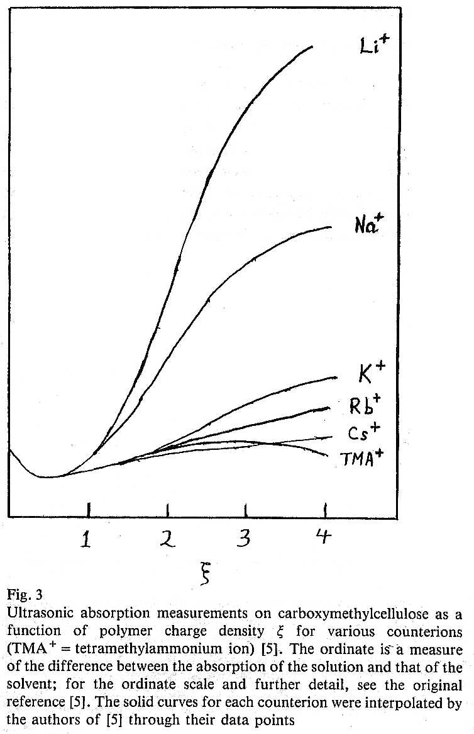
ξ > 1: great differences between the various hydroxides ⇒ association between the counterions and the polymer, as predicted by the Manning theory
ξ < 1: no difference between the various hydroxides ⇒ no association between the counterions and the polymer
R. Zana et al., J. Chim. Phys, 68, 1258-1266 (1971)

Slide 24
2. Molecular dynamics simulations of a solvated DNA duplex
% phosphate
charge
7 Å
20 Å
7 Å
[Å]
Radial distribution of Na⁺ counterions around a DNA duplex 12 base-pairs long,
from a molecular dynamics simulation (Yang et al., J. Am. Chem. Soc. 1997,
119, 59-69). The calculation predicts 82% of the phosphate charge to be neutralized,
with cations moving within a radius of 15 Å from the helix axis. Manning theory
predicts 76% of cations within 17 Å from the helix axis.

Slide 25
Remember:
In a diluted solution of counterions,
θ is concentration-independent!
= fraction of monovalent cations predicted by Counterion
Condensation Theory to condense on each unit charge of the poly-anion
If ξ > 1 then a fraction of 1-ξ⁻¹ counterions condense at each unit charge
If ξ <1 , there is no counterion condensation.
duplex DNA in H₂O at 298 K: ξ = 4.2 single-stranded DNA: ξ = 2.1

Slide 27
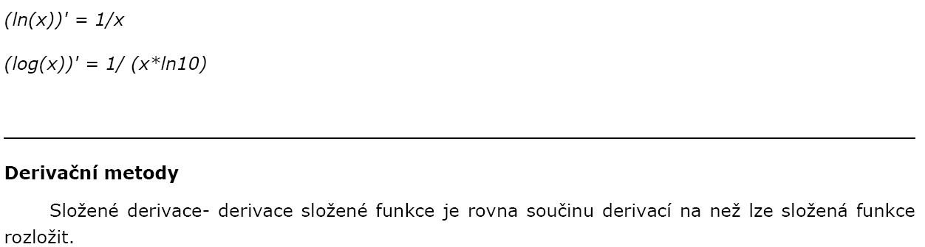
(a^{x}) * lna
http://matematika-online-a.kvalitne.cz/derivace-funkce.htm

