Slide 1
Programming essentials to survive university

Slide 2
Where’s it help?

Slide 3
Working with data

Slide 4
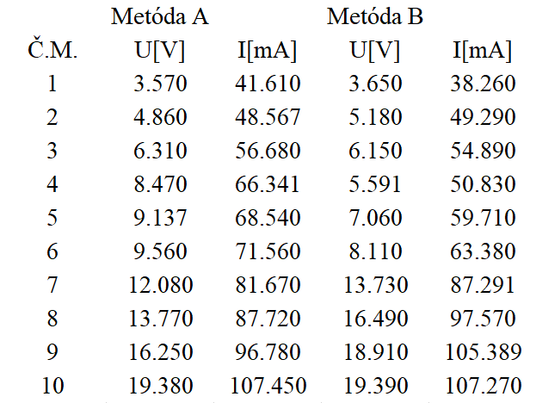

Slide 5
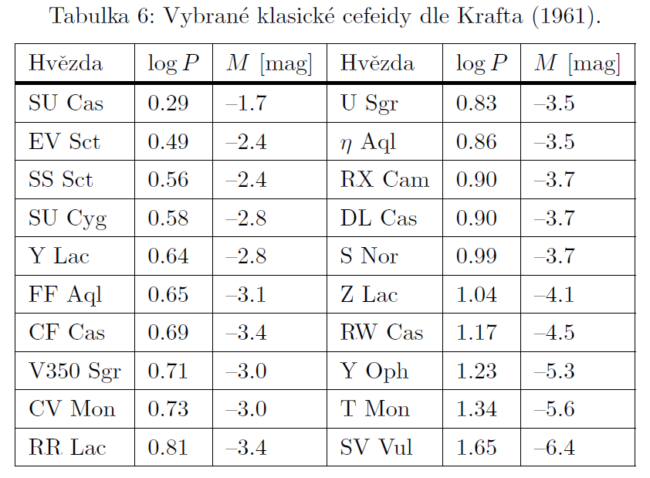

Slide 6
Analysing data

Slide 7
🔍 Sorting
🧹 Reduction
🛠️ Transformation

Slide 8
Visualise data

Slide 9
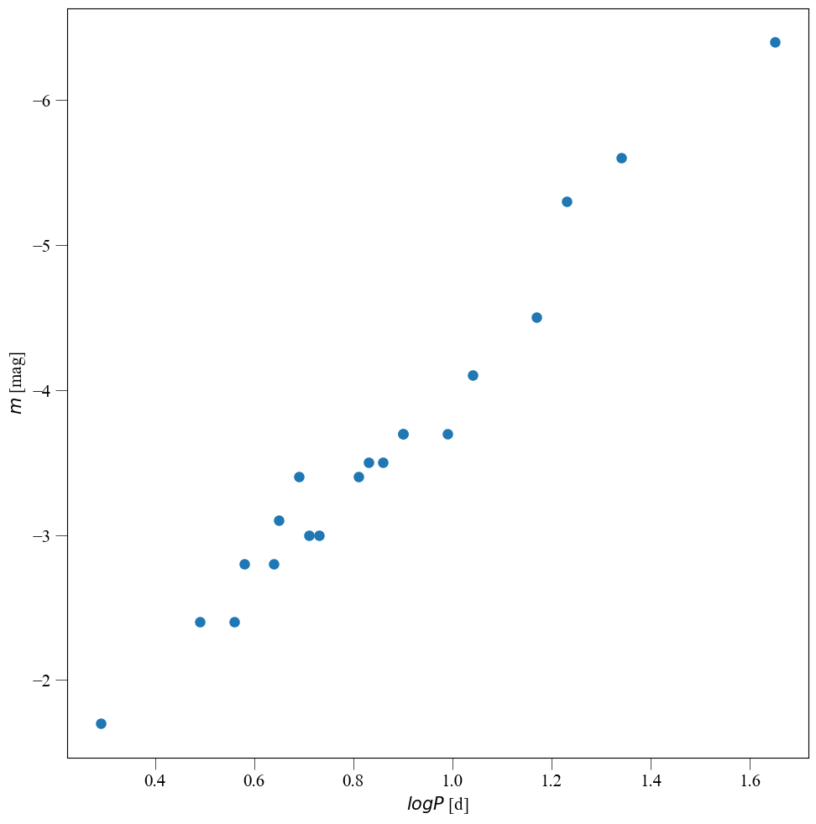
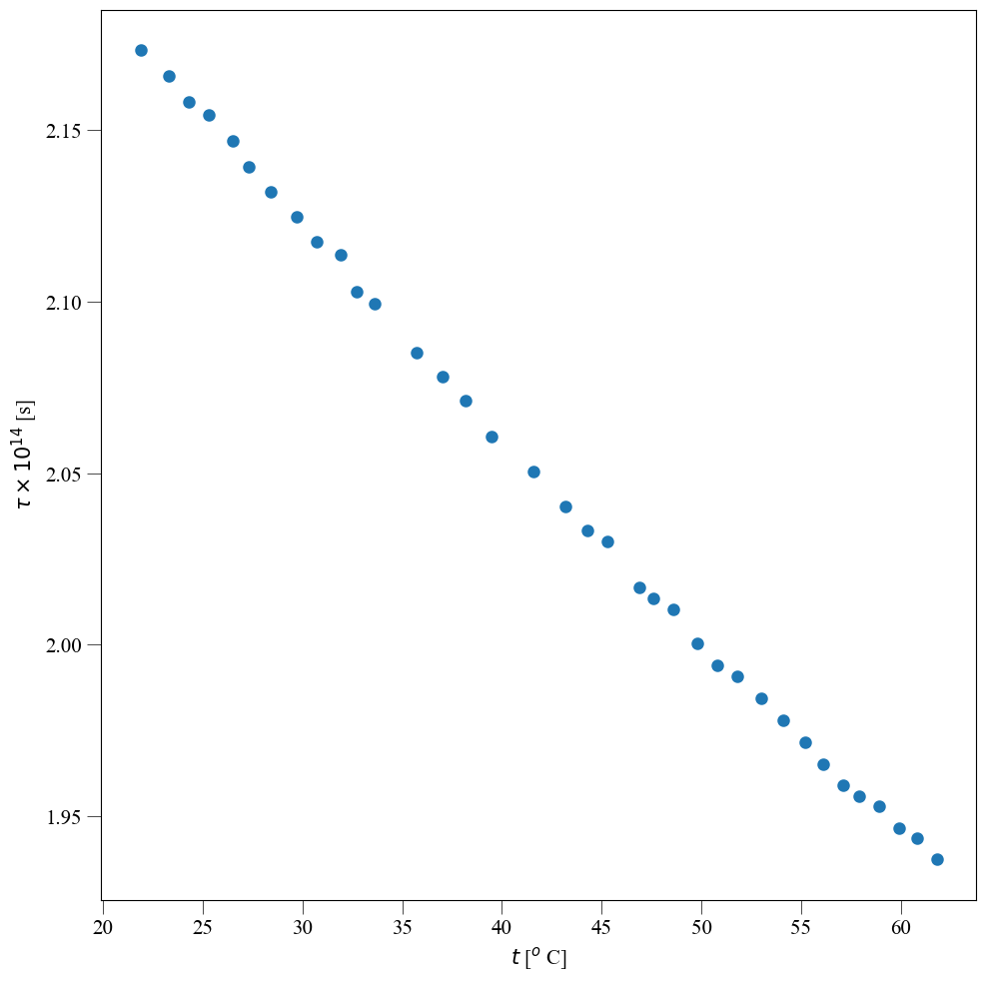

Slide 10
What do you need for that?

Slide 11
📝 Code editor
👀 Some useful stuff

Slide 12
Links
VS Code Insiders : code.visualstudio.com/insiders
Python: python.org/downloads
Notepad++: notepad-plus-plus.org/downloads

Slide 13
Extensions
GitHub Copilot
GitHub Copilot chat
Jupyter
Python

Slide 14
Libraries
matplotlib
numpy
pip install
pandas
scipy
uncertainties

Slide 15
Hands-on

Slide 16
FP
☠️
⚰️

Slide 17

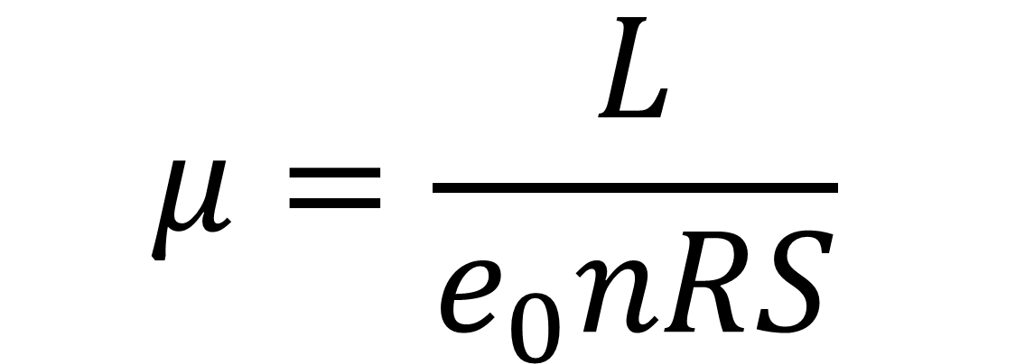
$$μ=\frac{L}{e_{0}nRS}$$
mobility of charge carriers
$$τ=\frac{e_{0}μ}{m_{e}}$$
mean electron collision times

Slide 18
Astronomy
🪐
🌒

Slide 19
Copilot

Slide 20
More links
Github: github.com
Github education: education.github.com
Git: git-scm.com/downloads

Slide 21
What next?

Slide 22
Recommended subjects
F1400 Programování
F4500 Python pro fyziky
F5611 Machine learning in Python

Slide 23
poruchik_rzhevsky@physics.muni.cz
Artem Gorodilov
github.com/PoruchikRzhevsky

Slide 24
Thx!

