Slide 1
Ethics of Scientific Conduct

Slide 2
Today’s programme
--- Copyright and authorship
Which results are covered by copyright?
Authorship and Co-Authorship
Author and his Employer
Plagiarism – difference between scientific plagiarism and copyright plagiarism
---- IP Rights to software
Computer programme as IP, rights to other elements of software
License and right to use the software
Adaptation and De-Compilation of a computer program
Open source software
----- Data and database rights
Rights to primary and secondary data
Database as IP
Protection of information
----- General responsibility towards society
Fundamental human right to knowledge and access to information
Duty to disclose publicly funded research
Open access vs Proprietory means of distribution
Open repositories, Open data, , Open-Access, Open-Source, Public Licenses

Slide 3
Copyright and Authorship

Slide 4
Copyrighted work
Creative substance
Objective expression
Unique result
Creative element
Natural person
Expressed in a way that can be percieved

Slide 5
Copyright
Moral rights to the work
Part of your „personality“ cannot be sold (in some European countries)
right to claim authorship
object to any distortion, modification of, or other derogatory action which would be prejudicial to the author's honor or reputation
Economic rights to the work
Rights to benefits from your creativity
Prevent anybody else to use work

Slide 6
What is copyrighted?
It really depends on the nation
Harmonisation through international treaties
Berne Convention, WIPO Copyright treaties, WTO

Slide 7
WIPO gives examples of what is protected in most countries
literary works (novels, poems, newspaper articles)
computer programs, databases;
films, musical compositions, artistic works, drawings, photographs,
architecture
advertisements, maps, and technical drawings.

Slide 8
Berne convention (mother of all copyright treaties) - 1886
Minimum standards of protection
works, protection must include "every production in the literary, scientific and artistic domain, whatever the mode or form of its expression“
National treatment
Each state grants foreign works same treatment as national works
Copyright is the need to require authorisation to „use“ the work
„Use“ is a technical term, has to be defined by law
Positive list of „uses“ that require authorisation

Slide 9
What does it mean to „USE“, (typical examples)
the right to translate,
the right to make adaptations and arrangements of the work,
the right to perform in public dramatic, dramatico-musical and musical works,
the right to recite literary works in public,
the right to communicate to the public the performance of such works,
the right to broadcast,
the right to make reproductions in any manner or form,
the right to use the work as a basis for an audiovisual work

Slide 10
Summary
Each country has at least two „positive“ lists:
What is considered as „protected work“
What is considered as „use“
Most countries have the third list
Exceptions

Slide 11
International treaties
Berne convention
TRIPS
WCT
WPPT

Slide 12
European framework
Directive 2009/24/EC on the legal protection of computer programs
Directive 96/9/EC on the legal protection of databases
Directive 2001/29/EC on the harmonisation of certain aspects of copyright in the Information society
Directive 2019/790/EU on copyright and related rights in the Digital Single Market
Directive 87/54/EC protection of semiconductor topographies
Directive 93/83/EEC satellite and cable
Directive 2001/84/EC on the resale right
Directive 2006/115/EC on rental right and lending right and on certain rights related to copyright
Directive 2011/77/EU on the term of protection of copyright and certain related rights
Directive 2012/28/EU on certain permitted uses of orphan works

Slide 13
Authorship

Slide 14
Author
Originator – the one who gives existence
Creative input + effort
If two autors reach the same work independently the Copyright belongs to the first in line (usually).
One work cannot have two authors, but can have co-authors

Slide 15
Co-Authors VS Collection of works
Co-Authorship means that the contributions to the final result cannot be percieved independently
Collection of independent elements does not equal to co-authorship
The person who collects many works can get a separate right to a collection
Both/all co-autors recieve equal rights to the final work

Slide 16
Collection of works (not co-authorship)

Slide 17
Rights of an employer/investor
Employee keeps Moral rights
Employer/Investor utilizes Economic rights

Slide 18
Authorship and Plagiarism
Academic and Legal perspective

Slide 19
What cannot be copyrighted
Laws of nature (Discovery)
Mathematical principles
Abstract ideas
Scientific theories
Factual Information
Anything that has not been expressed.

Slide 20
The fundamental difference
Copyright protects the „expression“
Ethics protects the „IDEA“

Slide 21
Who is the Author?
According to law – the person who wrote (typed) the text
According to Research ethics- the person who had an idea and contributed effort

Slide 22
What is Plagiarism?
According to law
Using someones work without authorisation
According to Research ethics-
Not giving credit

Slide 23
Citation
Copyright
Using (unsubstantial) part of someone’s work
It is allowed for research and teaching purposes
Must be proportionate and not detrimental to the Author’s interests
Research ethics
Giving somebody credit for the contribution on which you build your research

Slide 24
Right to software and computer programs
Module 2

Slide 25
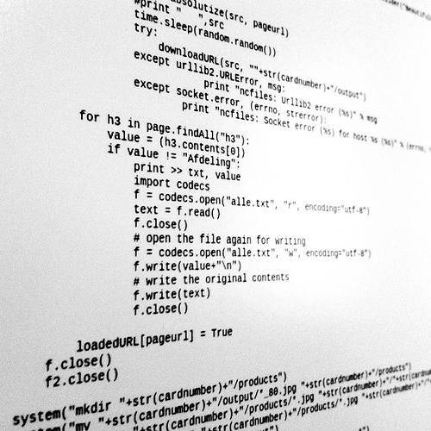
Introduction to ……
Software

Slide 26
Computer program
machine-readable instructions
direct a computer to perform specific operations

Slide 27
Software vs. Program
Software
Broader definition
Program, Data, Documentation,
Program
Machine language
Low level programming language (i.e. Assebler)
High level programming language
Compiler

Slide 28
Coding, Programming, Engineering
System engineering
discipline concerned with Hardware and Software
Software engineering
discipline that is concerned with all aspects of software production
Programming
comprehensive process from formulation of a problem to executable programs
Coding
A specific activity during implementation of a program

Slide 29
Required Legal tools
What does market need?

Slide 30
What to protect ?
IDEA
FUNCTION
GUI
BRAND

Slide 31
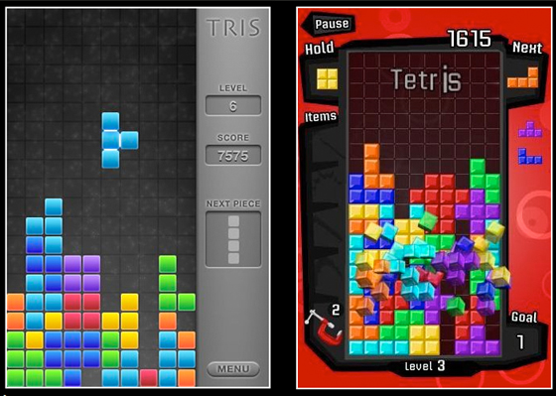
What to protect ?
IDEA
FUNCTION
GUI
BRAND

Slide 32
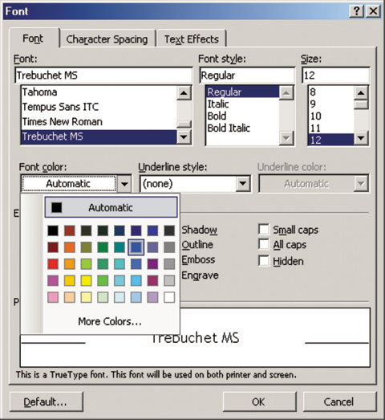
What to protect ?
IDEA
FUNCTION
GUI
BRAND

Slide 33
What to protect ?
IDEA
FUNCTION
GUI
BRAND

Slide 34
What to protect ?
IDEA
FUNCTION
GUI
BRAND

Slide 35
Main objectives:
Create a market
Sofware as a „product“ or „service“
Renumerate software producers
Software as intellectual property
Promote rights of a customer/consumer
Software as a liability
Promote progress in creative art?
Software as a greater good

Slide 36
Software market
How to communicate value in a market?
Further Issues
Trade secret
Contract law
Property
Intellectual propety
Employee-employer relations
Agency agreements

Slide 37
Remuneration of software producers
Incentive
Protection of
License fee vs. Salary
Company vs. programmer
Code
Graphic user interface
Idea

Slide 38
Legal tools for producers
Copyright
Patent
Trade secret
DRM – software protection tools?
Other specific IP rights?

Slide 39
Further questions
Protection of confidentiality and source code
Software patents
Distinction between individual countries
EU perspective
Free software concept and rules
Practical skills in contract writing EULA, SLA
Competition law perspective

Slide 40
Software Market
Generic copy/Service in cloud/Individual solution

Slide 41
Software Products
Generic products
Customized products

Slide 42
Four Fundamental activities
Software specification
Software development
Software validation (testing)
Software evolution (maintenance)

Slide 43
Computer programs Directive (EU)

Slide 44
computer program
shall include programs in any form:
generic software
customized software
incorporated into hardware
preparatory design work

Slide 45
Architecture of software - law does not make this distinction
Platform software
Application software
User Written software

Slide 46
How is the program protected?
by copyright,
as literary works within the Berne Convention
Applies to expression in any form

Slide 47
Copyright to computer program

Slide 48
What is protected?
YES
No
the expression of a computer program
Binary Code
Source code
Ideas
Principles
Logic,
Algorithms
Programming languages

Slide 49
Author
Originator – the one who gives existence
Creative input + effort
If two autors reach the same work independently the Copyright belongs to the first in line (usually).
One work cannot have two authors, but can have co-authors

Slide 50
Original Work?
A computer program shall be protected if it is original
no tests as to the qualitative or aesthetic merits
Author
Individual
Group
Company

Slide 51
Co-Authors VS Collection of works
Co-Authorship means that the contributions to the final result cannot be percieved independently
Collection of independent elements does not equal to co-authorship
The person who collects many works can get a separate right to a collection
Both/all co-autors recieve equal rights to the final work

Slide 52
Cooperation – Who owns the work ??
Joint cooperation
Joint ownership
Collective work
Usually the leading person
Employee
Employer

Slide 53
What is the benefit of the authorship to a program?

Slide 54
Right to …
Authorise
???????
???????
??????

Slide 55
Right to …
Authorise
Reproduction
Alteration
Distribution

Slide 56
Rights for geeks – adapting the computer program to your needs
The unauthorised adaptation is an infringement
Exemption - to achieve the interoperability with other program
Back-up copy is permitted
Right to observe, study or test the functioning of the program

Slide 57
Decompilation When it is permitted
Right to use a copy program
Needs it for interoperability
It is necessary (not available otherwise)
Not for purposes of creating similar product

Slide 58
Decompilation is possible when
Right to use a copy program
Needs it for interoperability
It is necessary (not available otherwise)
Not for purposes of creating similar product

Slide 59
Exhaustion of rights
The first sale in the Community of a copy of a program by the rightholder … shall exhaust the distribution right within the Community of that copy,
with the exception of the right to control further rental of the program or a copy thereof.
http://whatculture.com/wp-content/uploads/2012/05/UsedGames.jpg

Slide 60
CASE LAW

Slide 62
SAS software - C‑406/10

Slide 63
SAS software - C‑406/10
SAS INSTITUTE
developer of analytical software
Base SAS – enables users to write their own programs
WPL
Competitor
Programmed something identical to Base SAS
the same inputs would produce the same outputs
Says it is OK to study programme
Says it is OK to emulate functionality

Slide 64
Argument of the SAS
WPL did not have the right to acess the source code !
WPL violated copyrights in manuals
WPL copied certain „components“ if not the whole program

Slide 65
Court of justice (SAS software)
to accept that the functionality of a computer program can be protected by copyright would amount to making it possible to monopolise ideas, to the detriment of technological progress
protection covers only the individual expression of the work and thus leaves other authors the desired latitude to create similar or even identical programs provided that they refrain from copying
WPL did not make a decompilation, they reproduced functionality

Slide 66
Conclusion no. 1
Neither the functionality of a computer program nor the programming language and the format of data files used in a computer program … constitute a form of expression of that program
and
as such, are not protected by copyright in computer programs for the purposes of that directive.

Slide 67
CJEU – Licence to explore
A licensee is entitled to observe, study or test the functioning of a computer program in order to determine the ideas and principles which underlie any element of the program.
It is enough to have a license to use
Does not need an expressed license to observe, study and test

Slide 68
Discussion
If the functionality is not protected by software (comp. Programme directive), is it protected by something else?

Slide 69
Legal protection of data and databases

Slide 70
What is the difference
Data
Information
Database

Slide 71
WHO OWNS THE DATA ?
Is a very inaccurate question
Ownership is possession of the storage medium
Does not grant the exclusive rights
Better question is “who owns IP rights to the data”

Slide 72
IP RIGHTS TO THE DATA
Database Authorship
Protects creative input to collection of the data
Sui generis database rights
Protects the investment

Slide 73
Database

Slide 74
DATABASE – legal definition
1) Collection of independent elements
2) systematically or methodically arranged
3) Individually accessed

Slide 75
DATABASE AS A COPYRIGHTED WORK

Slide 76
What about …

Slide 77
Sui generis protection
Awarded by European regulation no 96/9/EC
The aim was also to safeguard the investment of database makers
To ensure that the legitimate interests of users of information contained in databases were secured.

Slide 78
What is protected/rewarded?
Creative input
Sweat of the brow?

Slide 79
There are two kinds of databases
Original
Enjoy copyright protection
Have creative element
Non-Original
Lack creative element
Require substantive investments to produce
Need sui generis protection

Slide 80
What do we protect
Copyright to the database
Sui generis database right

Slide 81
Scope
This Directive concerns the legal protection of databases in any form.
Electronic
Non-electronic
Without prejudice to provisions relating to:
the legal protection of computer programs;
rental right, lending right and certain rights related to copyright in the field of intellectual property;
the term of protection of copyright and certain related rights.

Slide 82
Object of protection
Databases which, by reason of the selection or arrangement of their contents, constitute the author's own intellectual creation shall be protected as such by copyright.
The copyright protection of databases provided for by this Directive shall not extend to their contents and shall be without prejudice to any rights subsisting in those contents themselves.

Slide 83
Author
The author of a database shall be the natural person or group of natural persons who created the base or, where the legislation of the Member States so permits, the legal person designated as the rightholder by that legislation.

Slide 84
expression of the DB protectable by COPYRIGHT
The author of a database shall have the exclusive right to carry out or to authorize:
temporary or permanent reproduction by any means and in any form, in whole or in part;
translation, adaptation, arrangement and any other alteration;
any form of distribution to the public of the database or of copies thereof.
any communication, display or performance to the public;

Slide 85
Co-Authorship
Where collective works are recognized by the legislation of a Member State,
In respect of a database created by a group of natural persons jointly,
the economic rights shall be owned by the person holding the copyright.
the exclusive rights shall be owned jointly.

Slide 86
In addition, with respect to online materials, protected databases include: (T. Alexander Kley - The European Database Directive In Perspective )
collections of company registers,
movie schedules,
news articles and headlines,
real estate information,
job records and markets,
financial information,
poems, medical lexicons,
weblinks,
ticketing event data,
advertisements,
addresses, and sporting event information.
websites in general, as collections of webpages, are presumptively protected under the Directive so long as there was substantial investment in their content.
collections of self-help groups,
public exhibition catalogues, collective bargaining agreements, hit music titles, and magazines. F
inally, in the case of electronic materials, protection may extend to collections of email addresses, demographic information, and map derivations. ADV-Firmenbuch, Austrian Supreme Court (Oberste Gerichtshof) (Apr. 9, 2002).

Slide 87
Sui generis Rights
NON original databases

Slide 88
Right for the maker of a database which shows that:
substantial investment
qualitatively and/or
quantitatively
in either the:
obtaining,
verification or
presentation of the contents

Slide 89
Content of the right
prevent extraction
shall mean the permanent or temporary transfer of the contents of a database to another medium by any means or in any form
prevent re-utilization
any form of making available to the public all or a substantial part of the contents of a database by the distribution of copies, by renting, by on-line or other forms of transmission.

Slide 90
Sui generis right can be exhausted
The first sale of a copy of a database within the Community by the rightholder or with his consent shall exhaust the right to control resale of that copy within the Community;

Slide 91
Difference between original and non-original protection

Slide 92
Term of protection
Copyright
Regular copyright
Sui generis right
fifteen years from the first of January of the year following the date when the database was first made available to the public or
15 years after the completion (if never made public)
What about any update of the database ?

Slide 93
Commercialization
Sale/transfer
License
Only sui generis.
Sui generis right
Copyright

Slide 94
Computer program associated with the database
Protection under this Directive shall not apply to computer programs used in the making or operation of databases accessible by electronic means.

Slide 95
Trade secret
Information with commercial value
Protected by law
Employees

Slide 96
Confidential information
Contractual clause
Non disclosure agreement
At the beginning of cooperation

Slide 97
Taksk no. 1: what is google search?

Slide 99
EXCEPTIONS
The maker of a database which is made available to the public in whatever manner may not prevent a lawful user of the database from extracting and/or reutilizing insubstantial parts of its contents, evaluated qualitatively and/or quantitatively, for any purposes whatsoever.

Slide 100
Database and software
Almost every software contains certain database
Files, libraries, data, fonts, images
Could be either copyrighted if they are unique and expressed
Could be protected by sui generis, if they are acommpanied by sufficient investment
Future
Big data applications, data analytics applications

Slide 101
Questions

Slide 102
Module 4
Sharing your work and building on the works of others

Slide 103
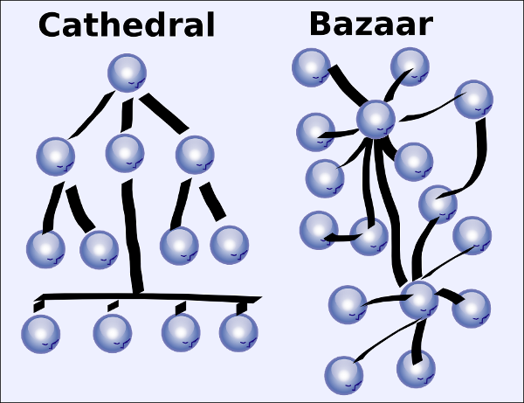
How to share information and knowledge

Slide 104
The lessons for data-sharing infrastructure
BOTTOM UP
TOP DOWN
Central authority organises the repository
User fills the data he/she consideres relevant
The central authority seeks, selects and chooses content
Organizes it for the convenience of end user

Slide 105
Data sharing design and law
IP law and DP law is predominantly based on the presumption of “top down” design
It is easy to identify person with responsibility/liability
It is easy to attribute “ownership”

Slide 106
Bottom up approach is a challenge

Slide 107
Possible outcomes
1+1=1 – desired outcome – merging two databases into one „joint database “
1+1=0 – merging two databases without substantial investment might create dataset without „database right protection“
1+1=2 – mere process of merging two databases does not constitute a substantial investment or original element. Therefore the two database rights exist independently
1+1=3 – the newly created database gains protection but the two original databases are still protected
0+0=1 – ideal situation – the datasets which would not be protected individually are protected as a whole

Slide 108
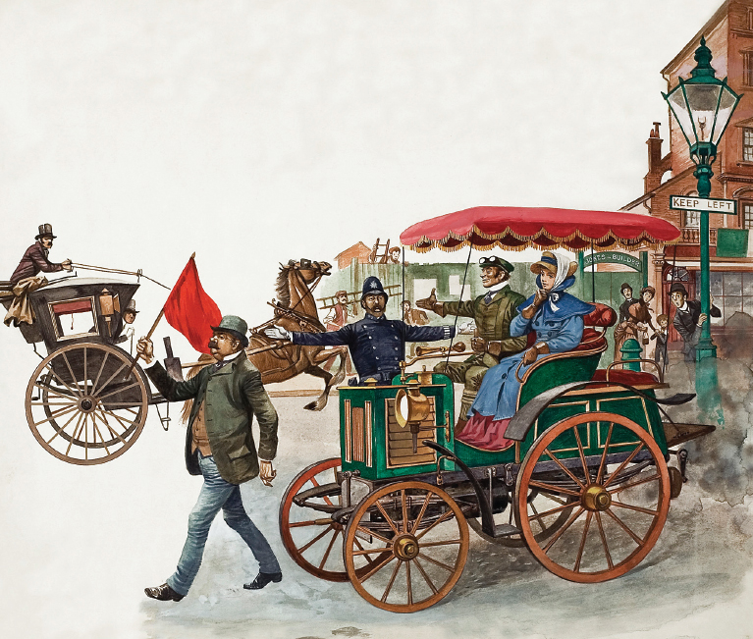

Slide 109
The emergence of “bottom up” in IT brings us new tools, that we are still learning to use
Safe harbor regimes
Codes of conducts
Free licenses

Slide 110
Main legal issues in data-sharing
Intellectual property rights
Authorship of database
Sui generis database rights
Rights to primary data (maybe in the future)
Data protection rights, Privacy
GDPR, general privacy rules
Right to access to information
Public sector information
Knowledge rights
Data-mining exceptions

Slide 111
Right to know (?) and information access

Slide 112
There are other rights that have to be balanced towards “restrictive rights”
Freedom of speech
Freedom of information
Freedom of the arts and sciences
Transparency of public sector

Slide 113
It is not desirable to monopolize rights to mere information.

Slide 114
Free software
The freedom to run the program, for any purpose (freedom 0).
The freedom to study how the program works, and change it so it does your computing as you wish (freedom 1).
The freedom to redistribute copies so you can help your neighbor (freedom 2).
The freedom to distribute copies of your modified versions to others (freedom 3).
Acces to source code?

Slide 115
Open software
1. Free Redistribution
2. Source Code
3. Derived Works
4. Integrity of The Author's Source Code
5. No Discrimination Against Persons or Groups 6. No Discrimination Against Fields of Endeavor
7. Distribution of License
8. License Must Not Be Specific to a Product
9. License Must Not Restrict Other Software
10. License Must Be Technology-Neutral

Slide 116
Legal typology • Strongly protective licences – “viral licences” – GNU General Public License • Weakly protective licences – Lesser General Public License (LGPL) • Permissive licences – Author’s crediting – BSD License, MIT License

