Slide 1
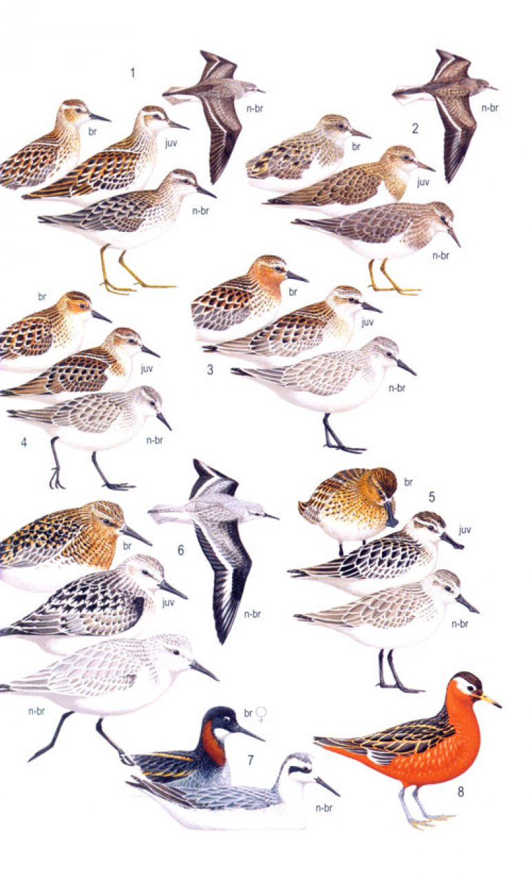


Molecular identification
Species, individual, sex

Slide 2

Identification of species
DNA barcoding

Slide 3
WHAT THE SPECIES IS AND DO WE NEED THEM?

Slide 4
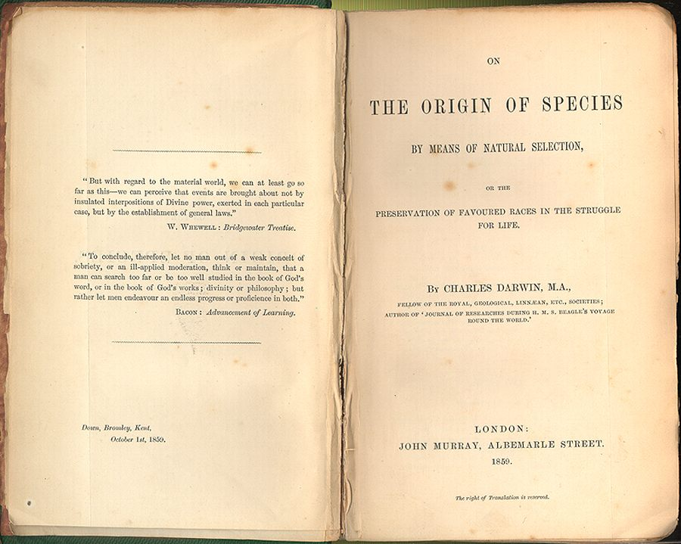
Is it possible to define a species?
It is really laughable to see what different ideas are prominent in various naturalists minds, when they speak of „species“; ... It all comes, I believe, from trying to define the indefinable.
C. Darwin, 24 Dec 1856
(Letter to J.D. Hooker)

Slide 5
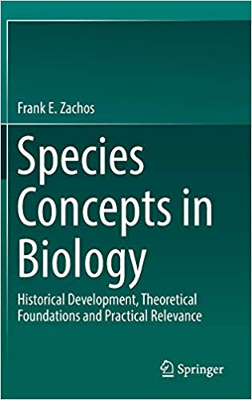
Species concepts in biology
Agamospecies
Biological
Biosimilarity
Cladistic
Cohesion
Compilospecies
Differential Fitness
Ecological
Evolutionarily Significant Unit
Evolutionary
Genealogical
Genealogical Concordance
General Lineage
Genetic
Genic
Genoypic cluster
Hennigian
Internodal
Least Inclusive Taxonomic Unit
Morphological
Non-dimensional
Nothospecies
Phenetic
Phylogenetic (Diagnosability Version)
Phylogenetic (Monophyly Version)
Phylo-Phenetic
Pragmatic
Recognition
Reproductive Competition
Successional
Taxonomic
Unified

Slide 6
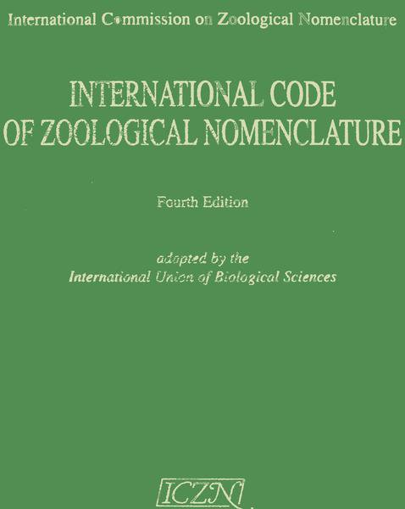
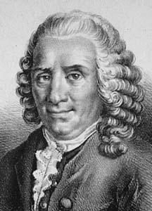
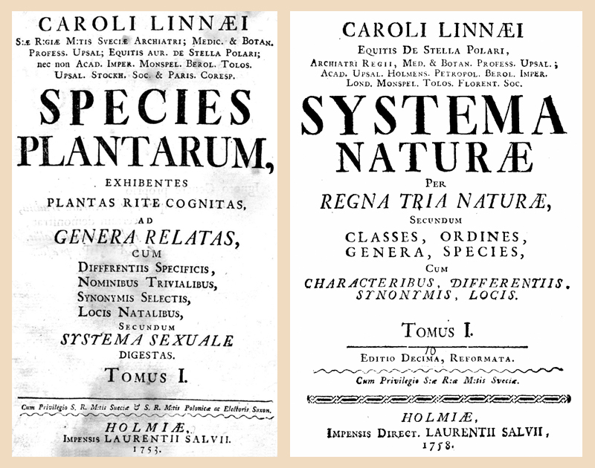
Morphological Species Concept
= the smallest groups that are consistently and persistently distinct, and distinguishable by ordinary means
Aristoteles → Linnaeus → rules of zoological nomenclature
does not take evolution into account
Linnaeus, Carolus (1707 - 1778)

Slide 7
Biological Species Concept
= interbreeding natural populations reproductively isolated from other such group
reproductive isolation mechanisms (RIM) = post- or prezygotic barriers of reproduction
most popular – it is intuitive and it was promoted most successfully (e.g. by influential evolutionary biologists of the 20th century as main concept of Modern Synthesis)
problems: allopatric and allochronic populations/species, ...
Mayr, 1942

Slide 8
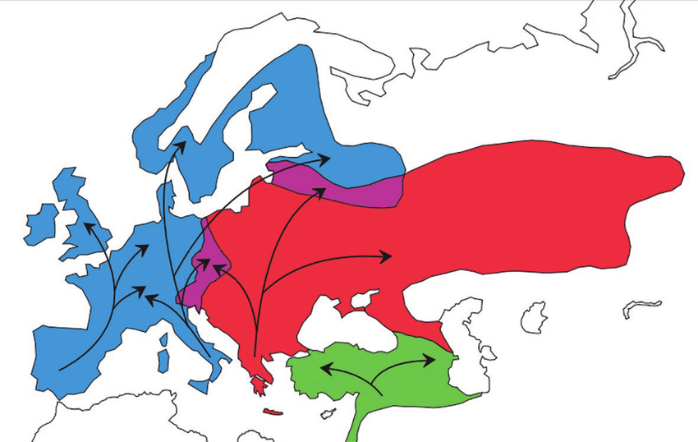
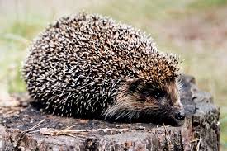
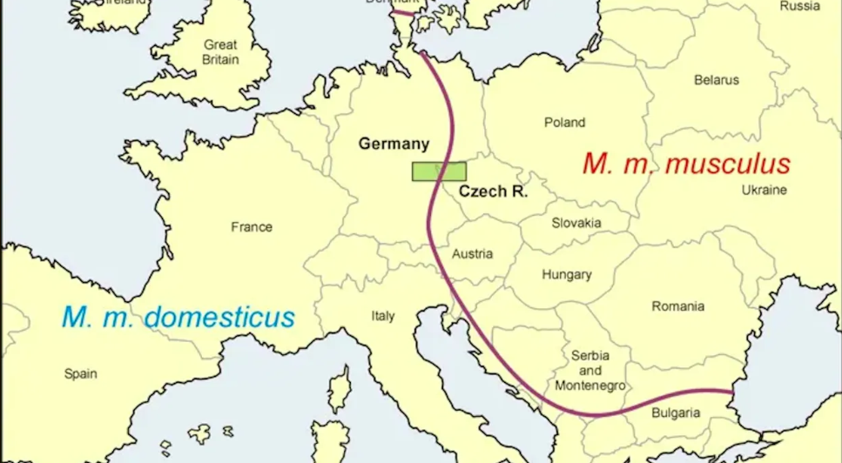
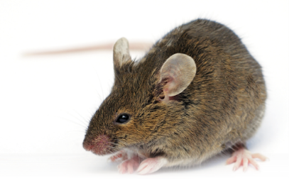
Complications: Parapatric contact zones
Erinaceus – distinct species (minimal hybridization)
house mice – distinct subspecies (substantial hybridization)
E. roumanicus
E. europaeus
Bolfiková and Hulva 2012
Macholán et al. 2008

Slide 9
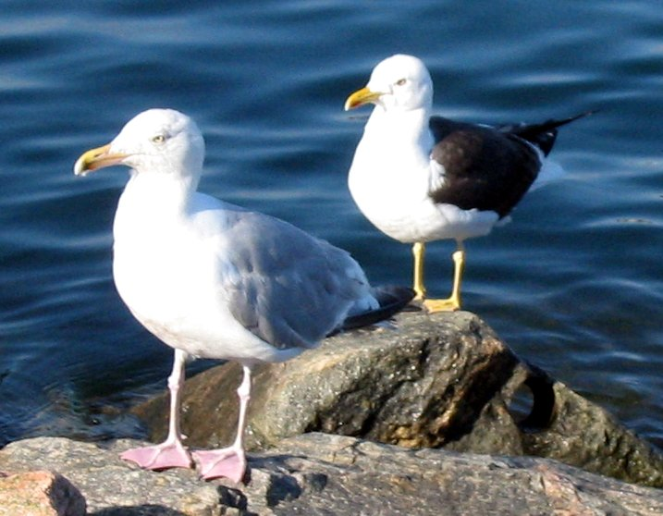
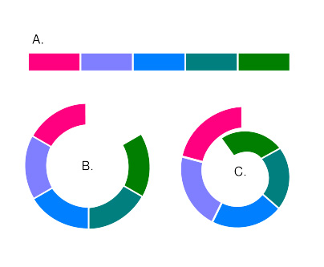
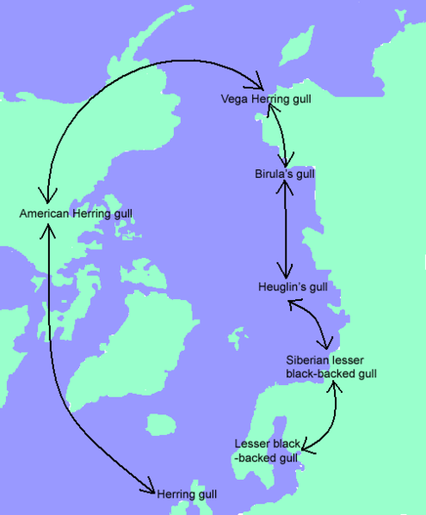
Complications: Ring species
Larus

Slide 10
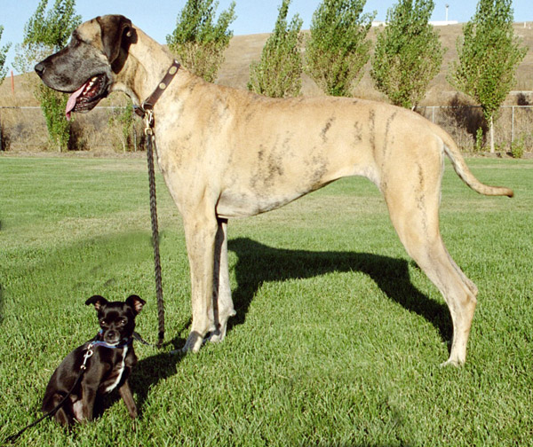
Complications: Physical constraints

Slide 11
Phylogenetic species concept (Diagnosability Version)
= the smallest population or group of populations, within which there is a parental pattern of ancestry and descent
two populations are considered species if they are 100% diagnostic (e.g. discriminant analysis of morphometric data or allele frequency data)
recent paradigmatic shift from the Biological Species Concept to Phylogenetic Species Concept
extreme cases: descendants of a single mother with a mutation at mtDNA can be 100% diagnosed (i.e. should be considered species)
Cracraft, 1983, Cracraft 1997

Slide 12
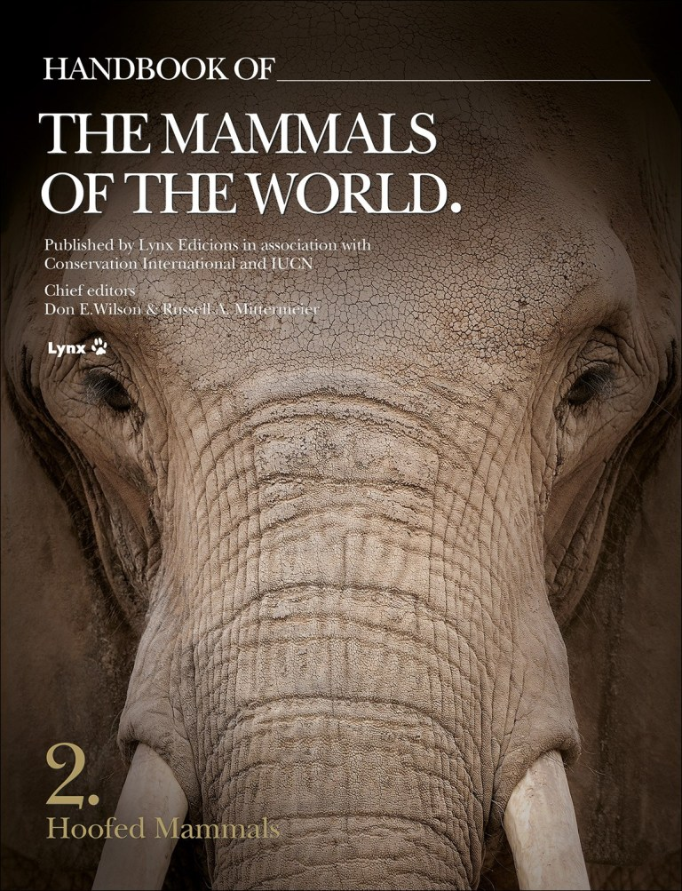
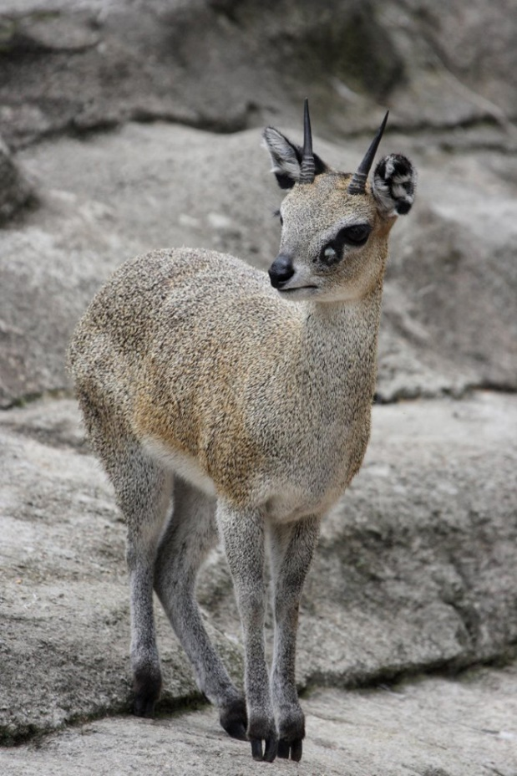
Example: Taxonomy of ungulates
increase from 143 (Grubb 2005) to 279 (Groves and Leslie 2011 -Handbook of the Mammals of the World) species of bovid ungulates
klipspringers Oreotragus – from one to 11 species

Slide 13
Consequences intensively debated
„pros“papers
„cons“ papers

Slide 14
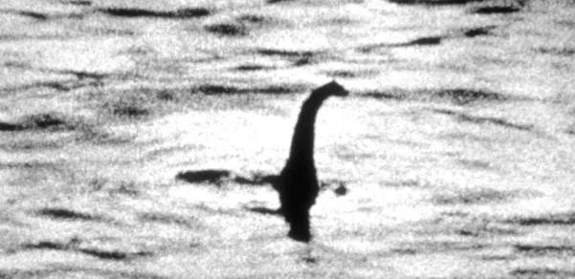
Why does it matter? The power of names!
description of Nessiteras rhombopteryx in Nature
„the Loch Ness monster“ – if indeed it does exist, it exists in small numbers and deserves protection
to be protected it must have a taxonomic name
Rinnes and Scott 1975, Nature

Slide 15
Why does it matter? Taxonomic inflation.
inflation leads to devaluation
tigers (Panthera tigris) have been split into two species based on 3 diagnostic bp in the mitochondrial cytochrome b (P. tigris and P. sumatrae) (Cracraft et al. 1998)
genetic drift of some other populations in India has already led to the fixation of unique haplotypes
„The fact that tigers are dwindling towards extinction will thus cause a multitude of new tiger „species“ – before they all vanish“ (Zachos 2016)
PSC → increase of threatened species – many species will have low population sizes and distribution ranges (IUCN RED List criteria) – e.g. US Endangered Species Act – increase from US$4.6 billion to US$7.6 billion for full recovery of all species

Slide 16
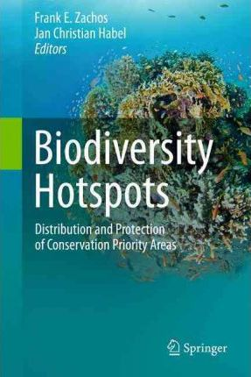
Why does it matter? Biodiversity research.
species richness is a function of the underlying species concept
often comparing „apples and oranges“
36 biodiversity hotspots (at least 1500 endemic vascular plants species and 70% of primary vegetation has been destroyed)
more than US$1 billion for conservation in biodiversity hotspots
Mittermeier et al. 2011

Slide 17
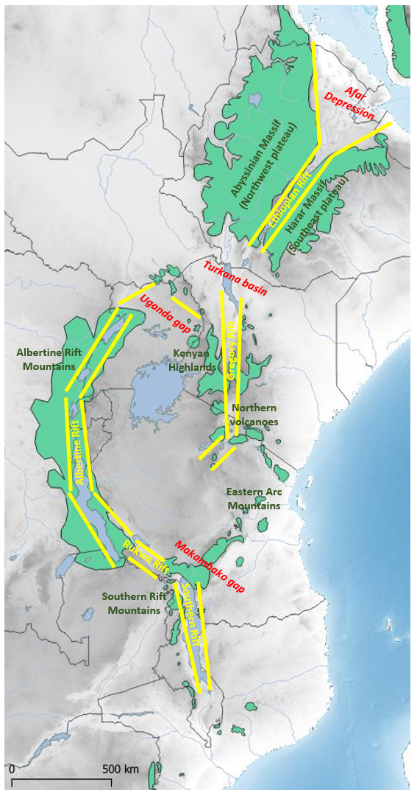
Eastern Afromontane Biodiversity Hotspot (EABH)
ARABIAN
PLATE
NUBIAN PLATE
SOMALIAN PLATE
Albertine Rift – considered as the most diverse part of EABH
Ethiopian Highlands – the most neglected part of EABH despite the large area and geomorphological diversity
examples from rodents

Slide 18
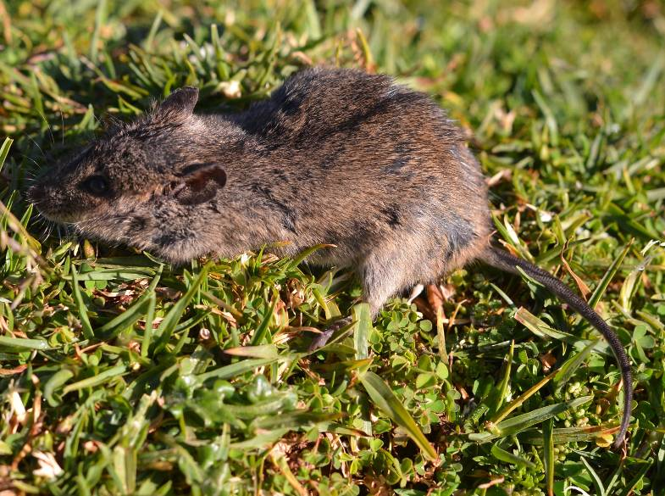
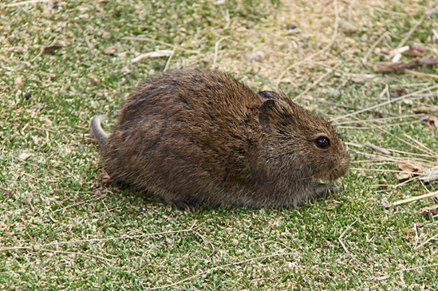
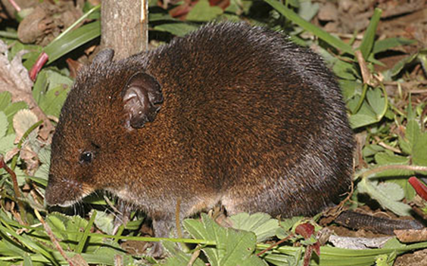
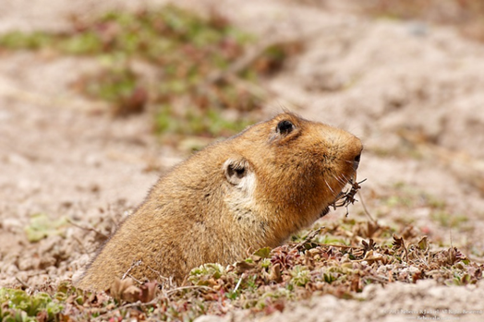
„Ethiopian craddle“
ARABIAN
PLATE
Mus (Nannomys)
NUBIAN PLATE
SOMALIAN PLATE
Otomys typus group
Lophuromys flavopunctatus group
Tachyoryctes
e.g. Bryja et al. 2019, Folia Zoologica

Slide 19
„out of Ethiopia“
root rats (Tachyoryctes)
T. macrocephalus (ETH)
T. „splendens“ (1 sp. in Ethiopia, 12 spp. in Kenya and Albertine rift )
the highest evolutionary diversity in Ethiopia (5 species using PSC)
a single colonization of Kenyan Highlands and Albertine Rift Mts.
Šumbera, ..., Bryja 2018, Mol Phyl Evol

Slide 20
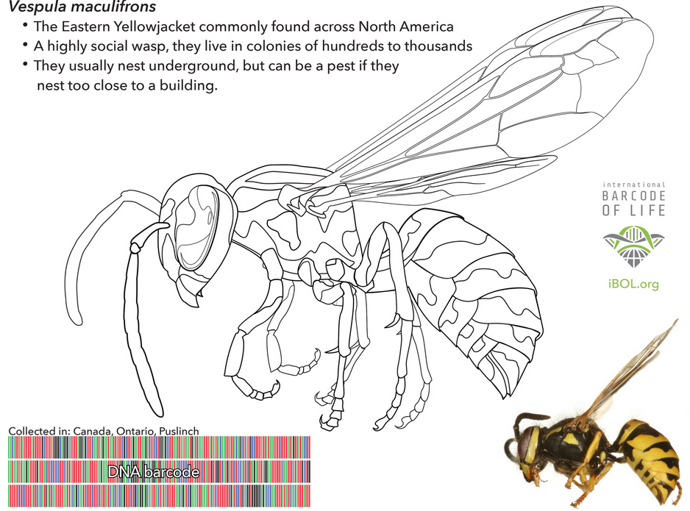
HOW CAN GENETICS BE HELPFUL IN SPECIES IDENTIFICATION?

Slide 21
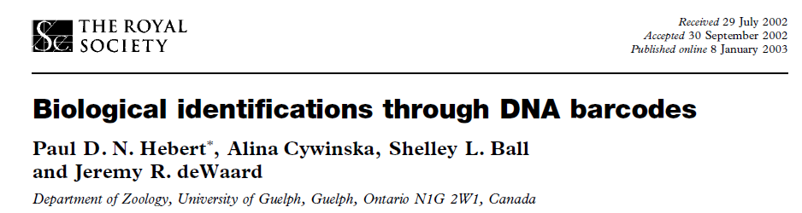


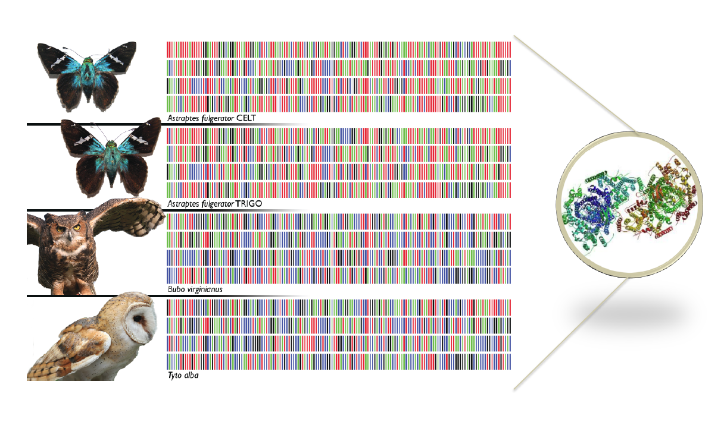
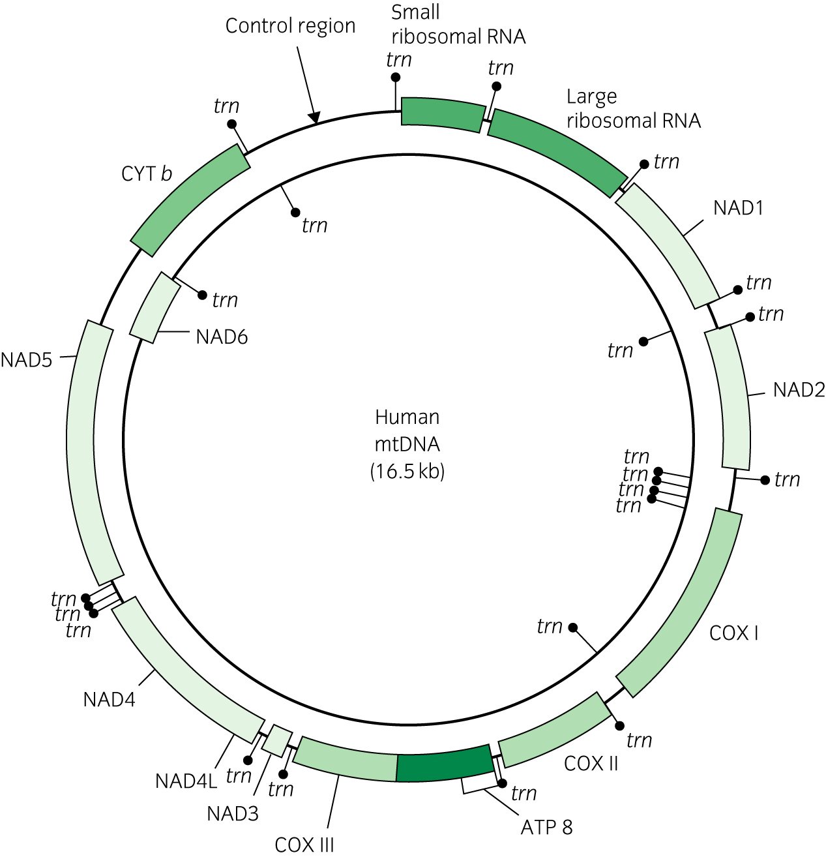
CBOL in 2005
iBOL 2010-2015
first idea in 2003
500 000 species barcoded in 2015
„DNA barcode“ – short fragment of mitochondrial DNA

Slide 22


Slide 23
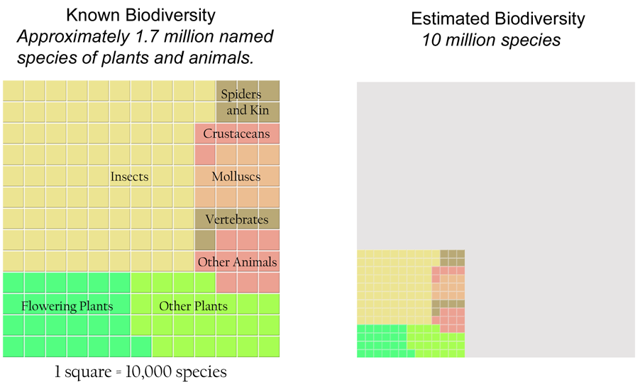
Why barcode animal and plant species?

Slide 24
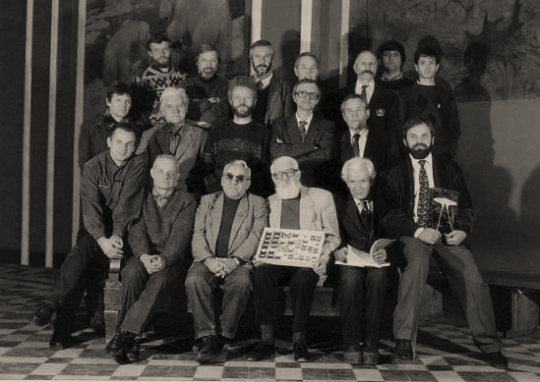
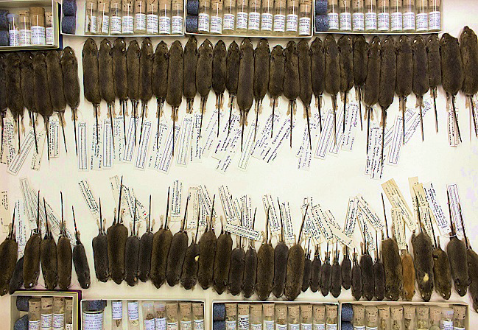

Crisis of biodiversity and classical taxonomy
DNA barcoding is important part of „integrative taxonomy“

Slide 25
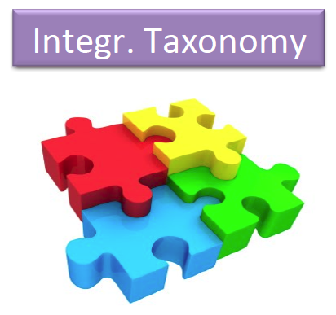
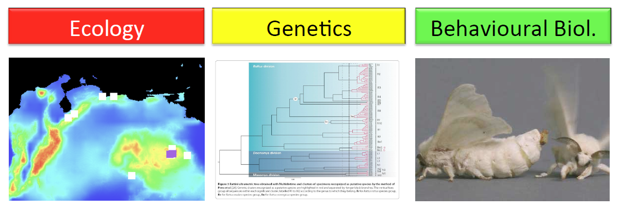
Integrative taxonomy

Slide 26
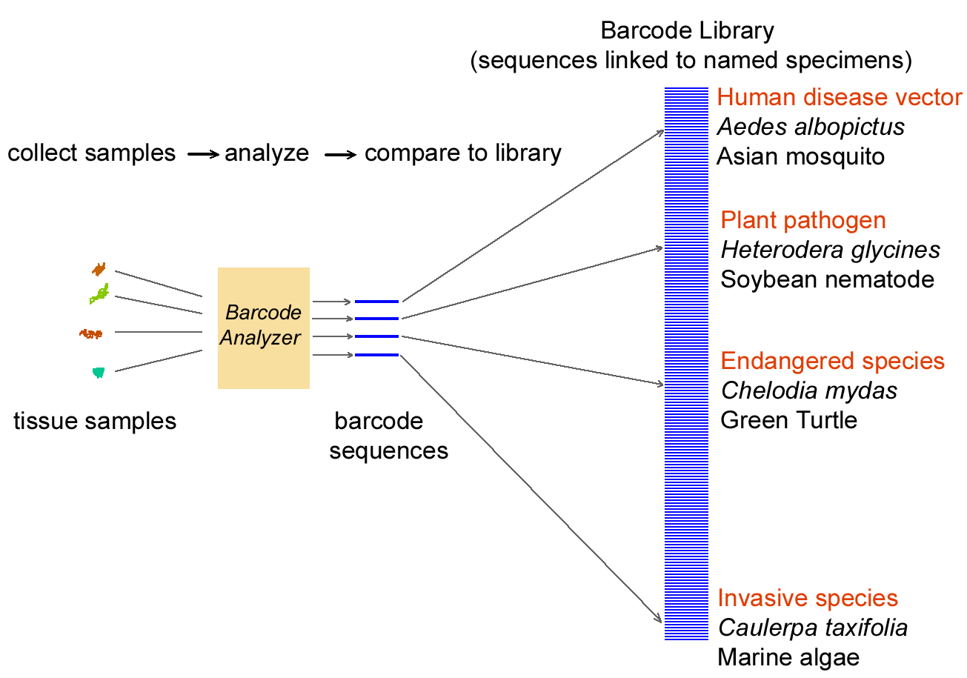
What are the benefits of standardization?
Suitable standard for animals → mtDNA

Slide 27
Why barcode animals with mitochondrial DNA?
Four properties make mitochondrial genomes especially suitable for identifying species

Slide 28
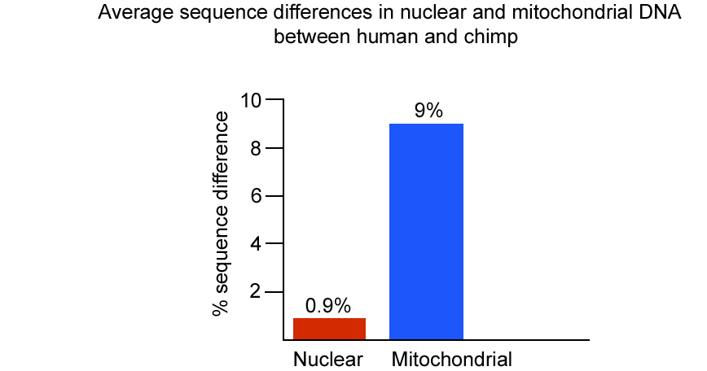
1. Greater differences among species, on average 5- to 10-fold higher in mitochondrial than in nuclear genes (lower N_{e} for mtDNA). Thus shorter segments distinguish among species, and because shorter, less expensively.

Slide 29
2. Relatively few differences within species in most cases. Small intraspecific and large interspecific differences signal distinct genetic boundaries between most species, enabling precise identification with a barcode.
3. Copy number There are 100-10,000 more copies of mitochondrial than nuclear DNA per cell, making recovery, especially from small or partially degraded samples, easier and cheaper.
4. Introns, which are non-coding regions interspersed between coding regions of a gene, are absent from mitochondrial DNA of most animal species, making amplification straightforward. Nuclear genes are often interrupted by introns, making amplification difficult or unpredictable.

Slide 30
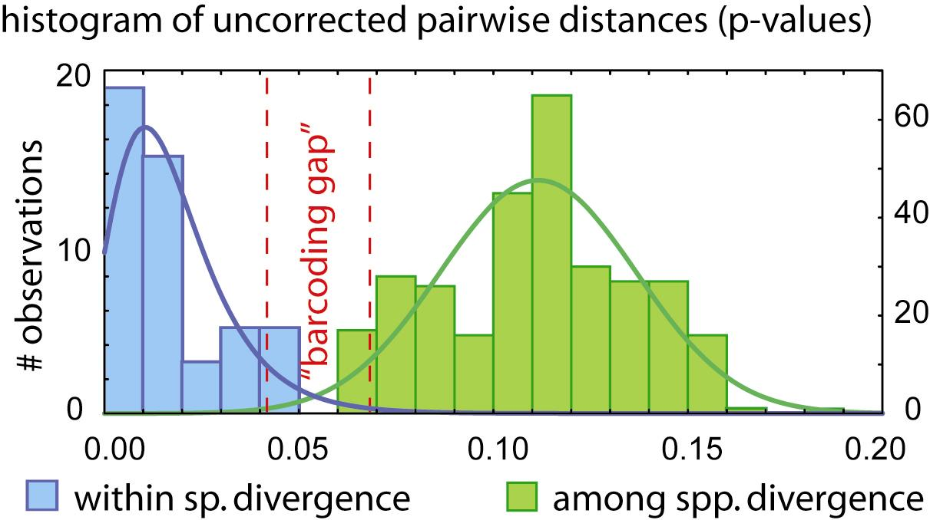
Barcoding principle

Slide 31
Barcoding principle

Slide 32
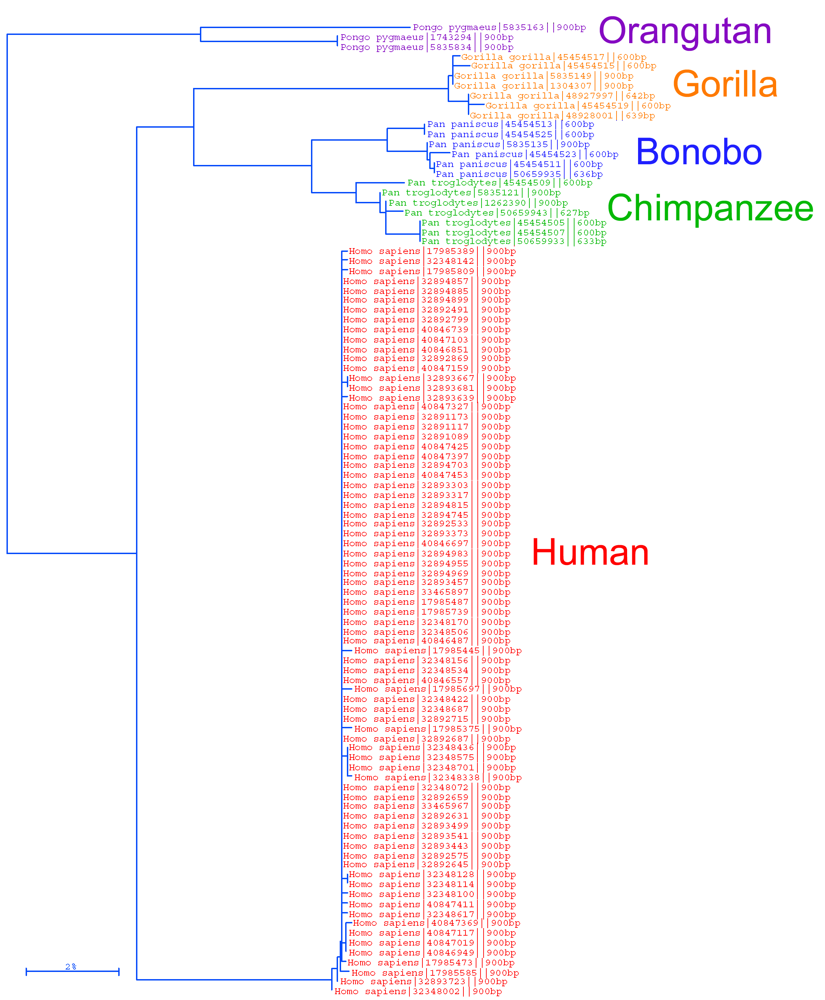
Barcodes affirm the unity of the species Homo sapiens
Comparisons show we differ from one another by only 1 or 2 nucleotides out of 648, while we differ from chimpanzees at 60 locations and gorillas at 70 locations.
For animals, a 658 base-pair fragment of the mitochondrial gene, cytochrome oxidase subunit I (mtCOI) – consensus for iBOL consortium
for particular taxonomic groups, also other barcodes are widely used - e.g. cytochrome b for mammals

Slide 33
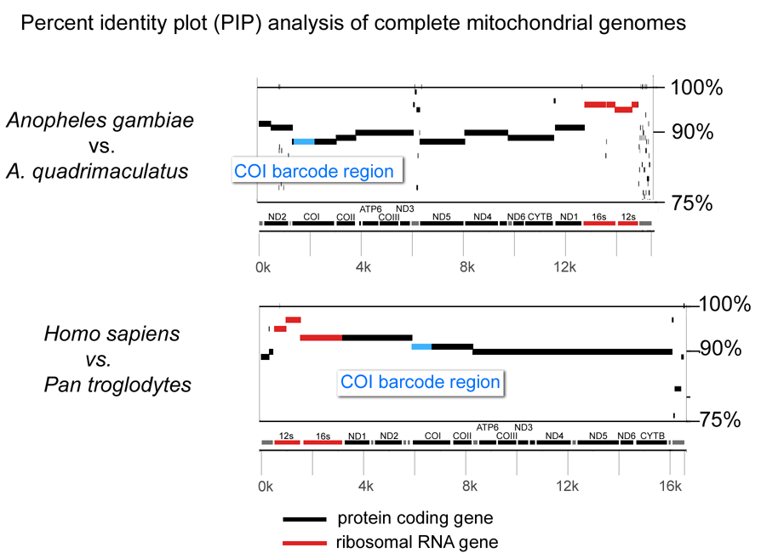
Cytochrome c oxidase I (COI or CoxI) contains differences representative of those in other protein-coding genes
Possible gains in accuracy or cost using a different protein-coding gene would likely be small.

Slide 34
Focus to date
For animals, a 658 base-pair fragment of the mitochondrial gene, cytochrome oxidase subunit I (mtCOI) – consensus for iBOL consortium
For plants, mitochondrial genes do not differ sufficiently to distinguish among closely related species. Promising markers are genes on cpDNA: matK and rbcL
For bacteria, a 16S-rDNA emerges as very useful marker (especially when using next-generation sequencing)

Slide 35
What do barcode differences among and within animal species studied so far suggest?
barcodes identify most animal species unambiguously
approximately 2-5% of recognized species have shared barcodes with closely-related species - many of them hybridize regularly
in all groups studied so far, distinct barcode clusters with biological co-variation suggest cryptic species

Slide 36
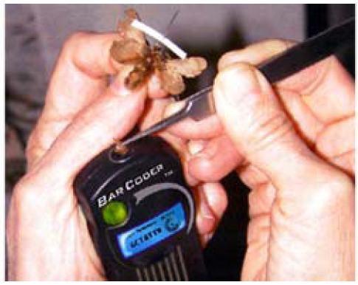

A barcoder?

Slide 37
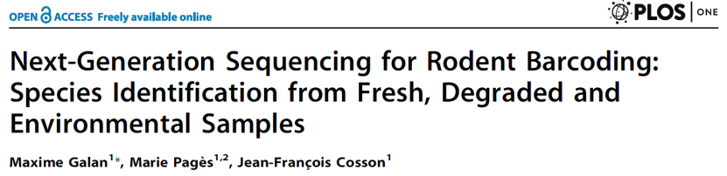
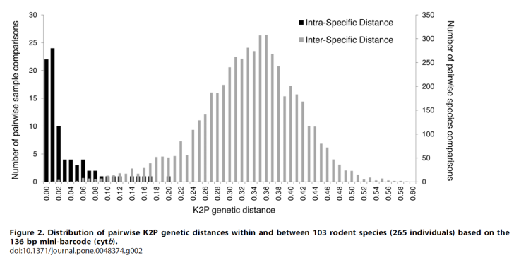
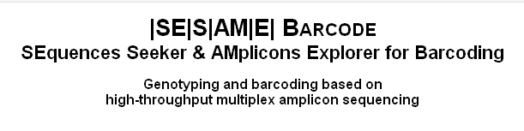
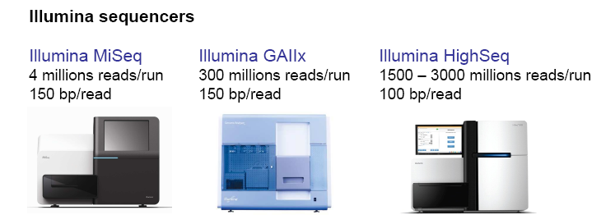
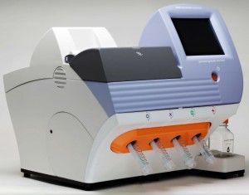
Next generation sequencing of amplicons
Metagenomics
community of microorganisms
PCR of 16S (18S) rRNA
it is also possible to quantify (to some extent)
3. Analysis of contaminated samples
2. Diet composition
COI barcoding (carnivores)
chloroplast (cp)DNA (herbivores)

Slide 38
A barcoder? ... COMING SOON

Slide 39
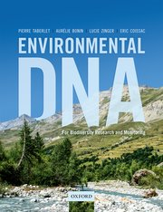
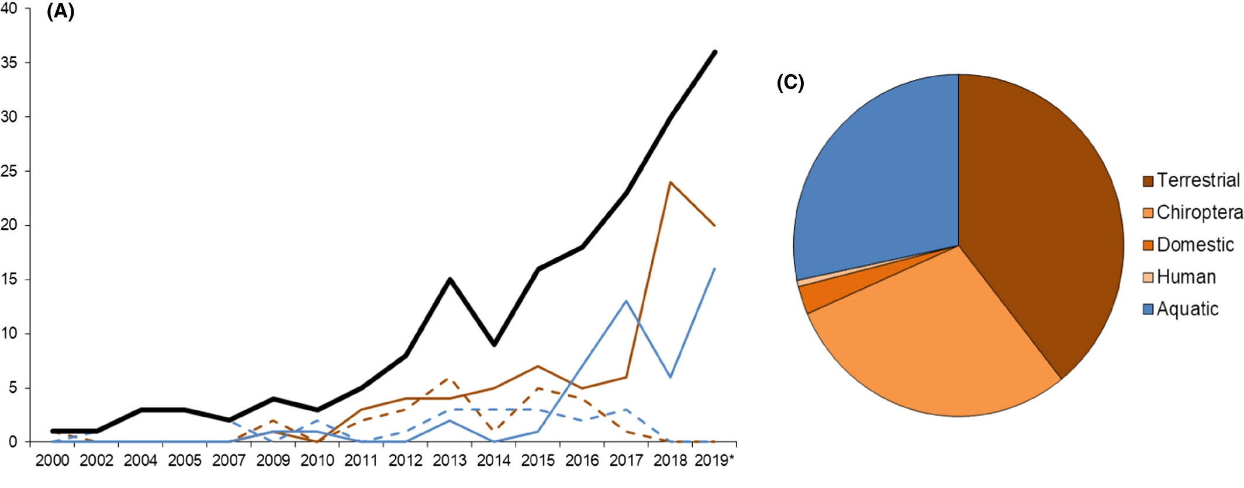
Metabarcoding/eDNA
Diet analysis
Bold black line = Total number of studies per year; thin straight lines: high‐throughput next‐generation sequencing techniques; thin dashed lines: Sanger sequencing method or other traditional molecular technique, e.g., RFLP)
identification of MOTUs („molecular operational taxonomic units“)

Slide 40
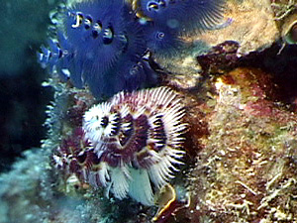
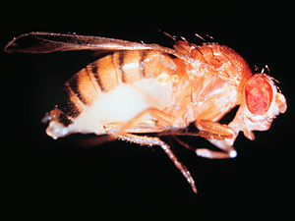
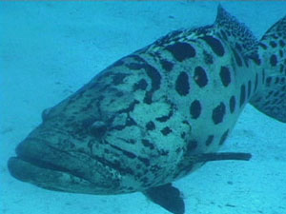
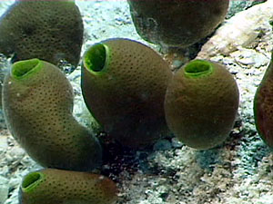
What isn’t DNA Barcoding?
it is not intended to, in any way, supplant or invalidate existing taxonomic practice
it is not DNA taxonomy; it does not equate species identity, formally or informally, with a particular DNA sequence
it is not intended to duplicate or compete with efforts to resolve deep phylogeny (e.g., Assembling the Tree of Life, ATOL)

Slide 41
What are the main limits to barcoding encountered so far?

Slide 42
What are the main limits to barcoding encountered so far?
horizontal gene transfer
nuclear pseudogenes
heteroplasmy (paternal leakage)
gene tree vs. species tree
hybrids – mtDNA introgression

Slide 43
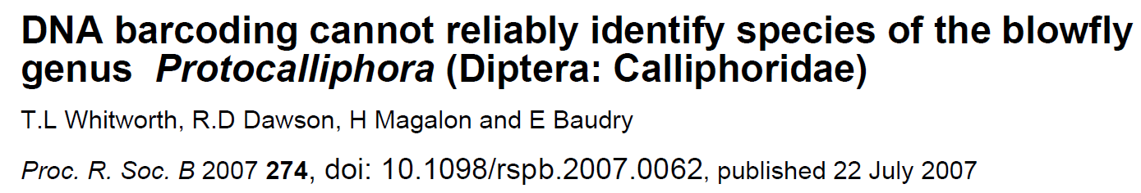


1. Horizontal gene transfer
Wolbachia within an insect cell
(25-70% species of insects)

Slide 44


Results of nuclear and mitochondrial DNA do not match
AFLP
mtDNA
Ellipses = candidates for horizontal gene transfer
Horizontal transfer of mtDNA through Wolbachia
(among closely related species, at the level of genera the barcoding is OK)
Symbols correspond to the type of Wolbachia infection

Slide 45




2. Pseudogenes
Heterozygotes in mtDNA → be careful!
NUMTS = „nuclear copy of mtDNA sequences
Relatively often for cytochrome b

Slide 46

How to recognize numt?
- ultracentrifugation (fresh samples required)
- the use of tissues with high proportion of mitochondria (e.g. muscles)
- long-range PCR (or sequence complete mtDNA)
- RT-PCR (pseudogenes are not transcribed)
- indels, stop codons
- cloning
cryptic numts

Slide 47
number of suggested barcoded taxa based on 3% divergence on COI with/without numts (identified by stop-codons and indels)

Slide 48

3. Heteroplasmy
paternal leakage
well studied mitochondrial disorders in human
low N_{e} of mtDNA → usually fast fixation of new mutations – mitochondrial bottleneck

Slide 49
Paternal leakage
allele-specific real-time quantitative PCR (RT-qPCR) → heteroplasmie je asi častý jev
14 % jedinců, ale velmi nízká frekvence druhého haplotypu
paternal leakage 6 %
- mtDNA transmission from both parents occurs regularly in certain bivalves (Bivalvia)

Slide 50
4. GENE TREES VS. SPECIES TREES
STATISTICAL MULTI-LOCUS SPECIES DELIMITATION
(see lecture of O. Mikula)

Slide 51
Allopatric speciation model
time
Mayr 1942

Slide 52
Dobzhansky-Muller incompatibility
a
B
a
B
a
B
A
B
a
B
A
B
A
b
A
B
A
b
A
b
A
B
genetic incompatibility
(negative epistatic interaction)
A
b
Dobzhansky 1936, Muller 1942

Slide 53


Phylogeny at the level of populations and species
Species are metapopulation lineages > new methods for DNA-based species delimitation
Gene trees
Vital to understanding the process of speciation
Span intraspecific and interspecific evolution
gene tree (e.g. mtDNA)
species tree
>>
A
B
C
Notes:
The idea that species are metapopulation lineages has led to the development of new DNA-base species delimitation methods.
Genes that show variation within species will be phylogenetically informative below and above the species level.
Gene trees are vital to understanding the process of speciation because they span intraspecific and interspecific evolution.
When we think about a phylogeny, we typically think about species relationships in a tree. But within the branches of this tree there is population genetics going on, which can be modeled as a coalescence process.

Slide 54


Multilocus data, multi-species coalescence
A
B
C
A
B
C
locus 1
locus 2
Notes:
Now what this figure shows is that although gene genealogies below and above the species level are different in nature, young lineages reside within a zone where both processes meet.
Therefore species delimitation should incorporate aspects of both population genetics and phylogenetics.

Slide 55
5. MITOCHONDRIAL INTROGRESSION AND A UNIFYING SPECIES CONCEPT (?)

Slide 56
Dobzhansky-Muller incompatibility
genetic incompatibility
(negative epistatic interaction)
„MAGIC TRAITS“
a
B
A
B
a
B
a
B
A
b
X
A
B
A
b
A
b
a
a
m
m
A
M
a
A
X
A
M
a
M
A
A
A
Hill, 2019
mitonuclear incompatibility

Slide 57
Oxidative phosphorylation (OXPHOS) by electron transport system (ETS)
red = mt genes blue = N-mt genes
(mtDNA) (nDNA)
Rand et al. 2004

Slide 58
Co-adaptation of mt and N-mt genes
mitonuclear incompatibility
Hill 2019

Slide 59

Mitonuclear coevolution as the genesis of speciation
Hill 2016, 2017

Slide 60
Mitonuclear compatibility species complex
= a species is a population that is genetically isolated from other populations by incompatibilities in uniquely coadapted mt and N-mt genes
the need of mitonuclear coadaptation is universal among eukaryotes
species boundaries become objective and defensible
determining species boundaries would no longer be an esoteric intellectual exercise
„species“ is exclusively a eukaryotic concept
Hill 2016, 2017, 2018, 2019

Slide 61
CBOL in 2005
iBOL 2010-2015
first idea in 2003
500 000 species barcoded in 2015
„DNA barcode“ – short fragment of mitochondrial DNA

Slide 62


Introgression/replacement of mtDNA in Myotis
Myotis blythii - Asia
Myotis myotis - Europe
Berthier et al. 2006

Slide 63
Myotis blythii vs. Myotis myotis
- mtDNA replacement
male
M. myotis - Europe
M. blythii - Asia

Slide 64
Myotis blythii vs. Myotis myotis
- mtDNA replacement
male
M. blythii - Asia
M. myotis - Europe
Tendency to back-crosses with males of M. blythii led to increase of proportion of M. blythii in Europe
Colonizing (invasive) species often adopt mtDNA of original speices (Currat et al. 2008)

Slide 65
Hares in Spain and Portugal
three species of Lepus in Iberia have often mtDNA of L. timidus
but L. timidus dissappeared from Iberia at the end of last glacial period
neutral process – consequence of spatial expansion

Slide 66

Interspecific mtDNA introgressions in Lophuromys
ddRADseq
mtDNA
100
100
menangeshae
2n = 70
96
100
100
100
chercherensis
96
100
97
100
pseudosikapusi
82
93
100
simensis
96
100
89
100
100
flavopunctatus
100
2n = 68
100
99
100
100
brunneus
88
100
100
brevicaudus
100
100
100
100
melanonyx
100
100
2n = 60
100
2n = 54
97
chrysopus
15 623 informative loci
cytochrome b (1140 bp)
Komarova, Kostin, Bryja et al., Mol. Ecol., 2020

Slide 67
Interspecific mtDNA introgressions in Lophuromys
ddRADseq
mtDNA
100
100
menangeshae
96
100
100
100
chercherensis
96
100
97
100
pseudosikapusi
82
93
100
simensis
96
100
89
100
100
flavopunctatus
100
100
99
100
100
brunneus
88
100
100
brevicaudus
100
100
100
100
melanonyx
100
100
100
97
chrysopus
15 623 informative loci
cytochrome b (1140 bp)

Slide 68

Interspecific mtDNA introgressions can be surprisingly frequent
Borena Saynt National Park (central Ethiopia)
Photo: D. Mizerovská

Slide 69



Stenocephalemys
(Ethiopian endemics)
(A) anchored phylogenomics
(388 nuclear loci)
(B) complete mitogenomes
Mizerovská et al. 2020, J. Vert. Biol.

Slide 70



Borena Saynt NP
Lake Tana
Borena Saynt NP
Blue Nile
Awash
Stenocephalemys
Distribution of S. sokolovi sp. nov.

Slide 71



Borena Saynt NP
3500 m a.s.l.
sokolovi
Lake Tana
Borena Saynt NP
Blue Nile
albipes
2800 m a.s.l.
Distribution of S. sokolovi sp. nov.
Stenocephalemys
Distribution of S. albipes

Slide 72


Borena Saynt NP
anchored phylogenomic
ddRADseq
ddRADseq
sokolovi
simensis
sp. B
albipes
menageshae
yaldeni
Stenocephalemys
Lophuromys
Crocidura
(Mizerovská et al. 2020)
(Komarova et al. 2021)
(Konečný et al. 2020)

Slide 73
Possible evolutionary explanations
Non-adaptive explanation
rodents have male-biased dispersal – expanding males captures mtDNA of local species (see examples of hares or bats)
expansion due to climate change → low-elevation species should move up and capture high-elevation mtDNA
♂

Slide 74
Possible evolutionary explanations
Adaptive explanation no. 1
advantageous OXPHOS genes of low-elevation taxon
→ studies of energetic metabolism and co-introgression are required
co-introgression of N-mt genes (?)
climate change → increase of temperature
„speciation in reverse“

Slide 75
Possible evolutionary explanations
Adaptive explanation no. 2
„mutational erosion“ - replacement of non-functional high-elevation mtDNA (accumulation of mutations in small populations in fragmented Afroalpine habitats) – „best of bad options“
higher mutation rate (UV?)
lower N_{e} – higher fixation rate
lower mutation rate
higher N_{e}

Slide 76
CONCLUSIONS

Slide 77
Conclusions
species concepts and species delimitations are crucial parts of biodiversity studies
enormous value in applied conservation biology
genomics can be useful tool for species delimitation (analytical approaches still in development) – once they will be able to discriminate between population- and species-level structuring
mitonuclear compatitibility species concept is a good candidate for a unifying species concept

