Slide 1


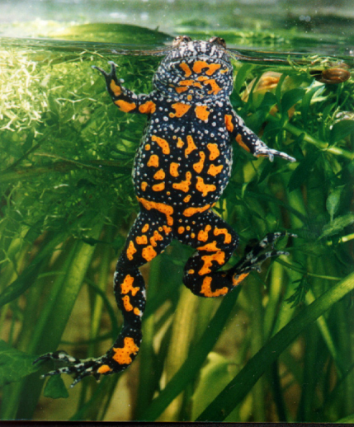
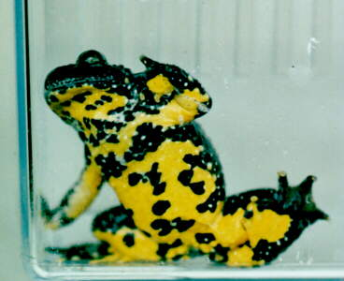
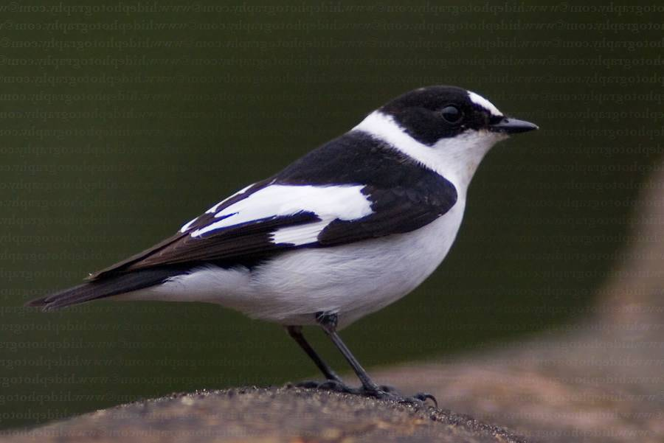
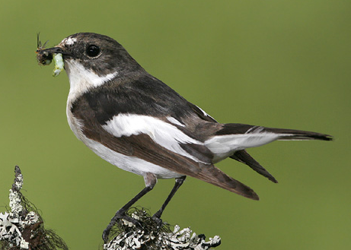
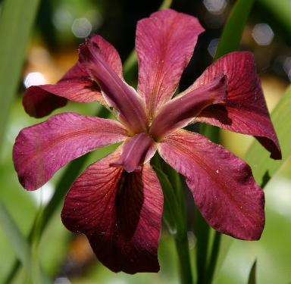
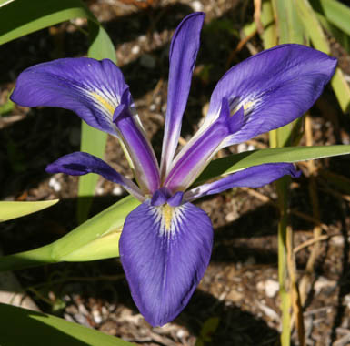
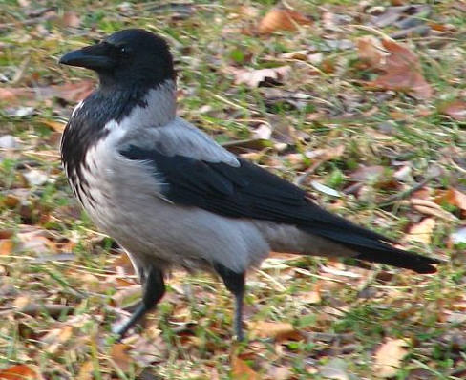
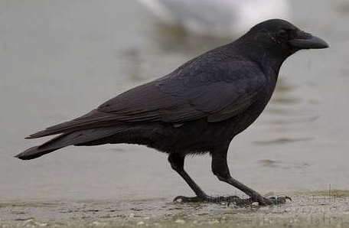

MODULARIZACE VÝUKY EVOLUČNÍ A EKOLOGICKÉ BIOLOGIE
CZ.1.07/2.2.00/15.0204
HYBRIDIZATION AND
HYBRID ZONES

Slide 2
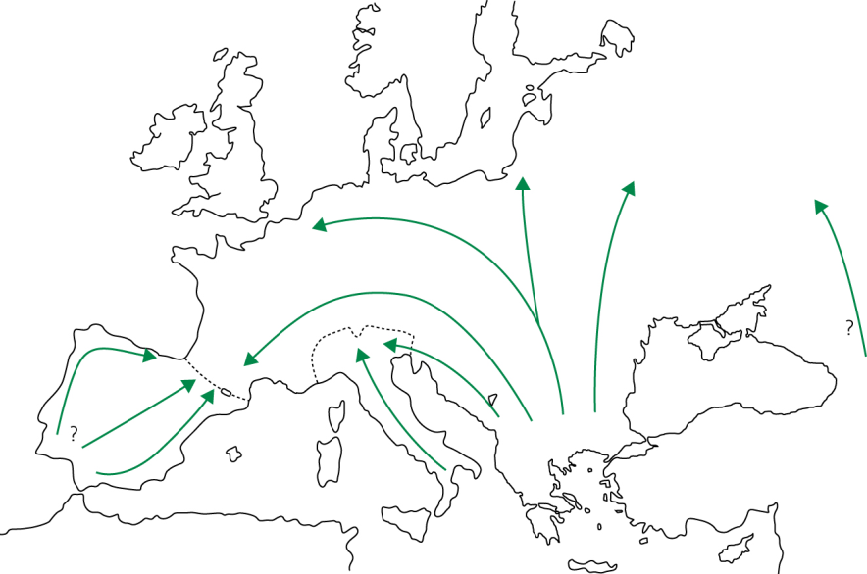
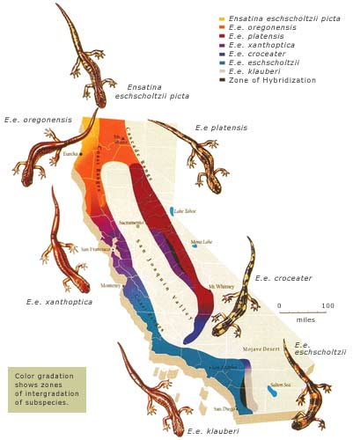
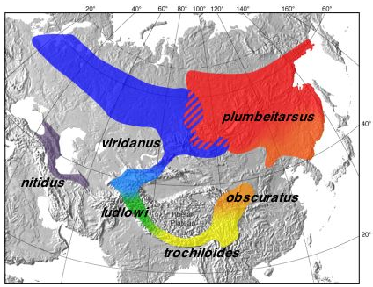
Secondary contact
Chorthippus
parallelus
ring species:
postglacial expansion
greenish warbler (Philloscopus trochiloides)
Ensatina eschscholtzii - klauberi

Slide 3
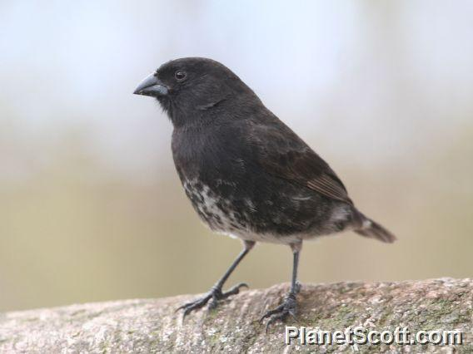
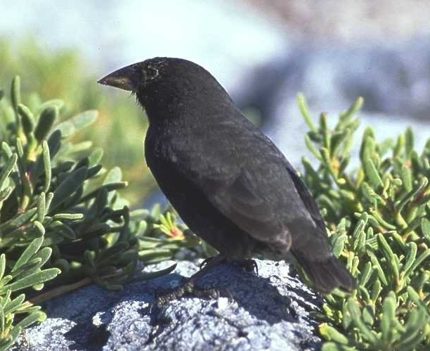
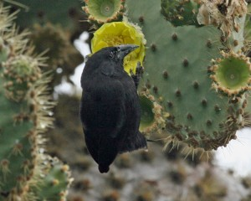
Hybridization:
25% species of vascular plants
10% species of animals
probably underestimation (only conspicuous species: ducks,
birds of paradise, butterflies)
often result of environmental disturbance:
eg. „Darwin’s finches“ Geospiza fuliginosa, G. fortis and
G. scandens after El Niño event
Geospiza fuliginosa
G. fortis
G. scandens

Slide 4
Possible outcomes of hybridization
hybrid zone
hybrid swarm
hybrid taxon

Slide 5
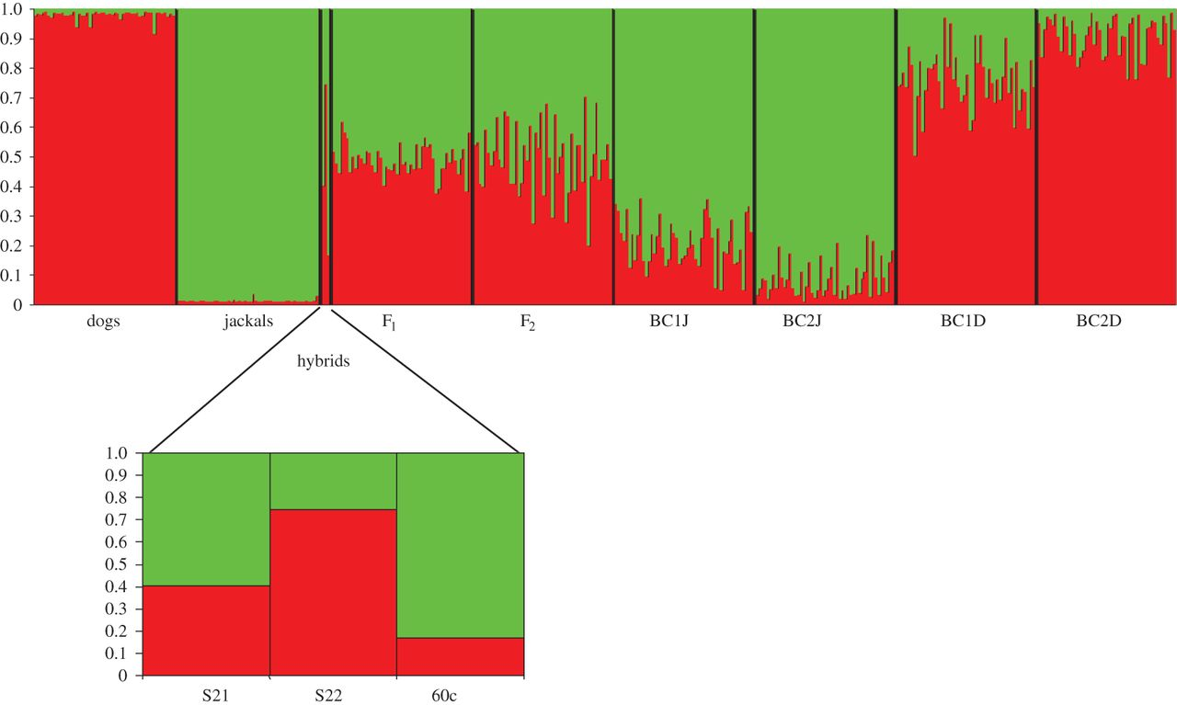
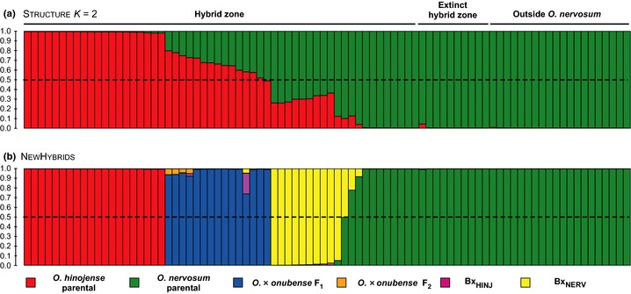
STRUCTURE
ADMIXTURE

Slide 6
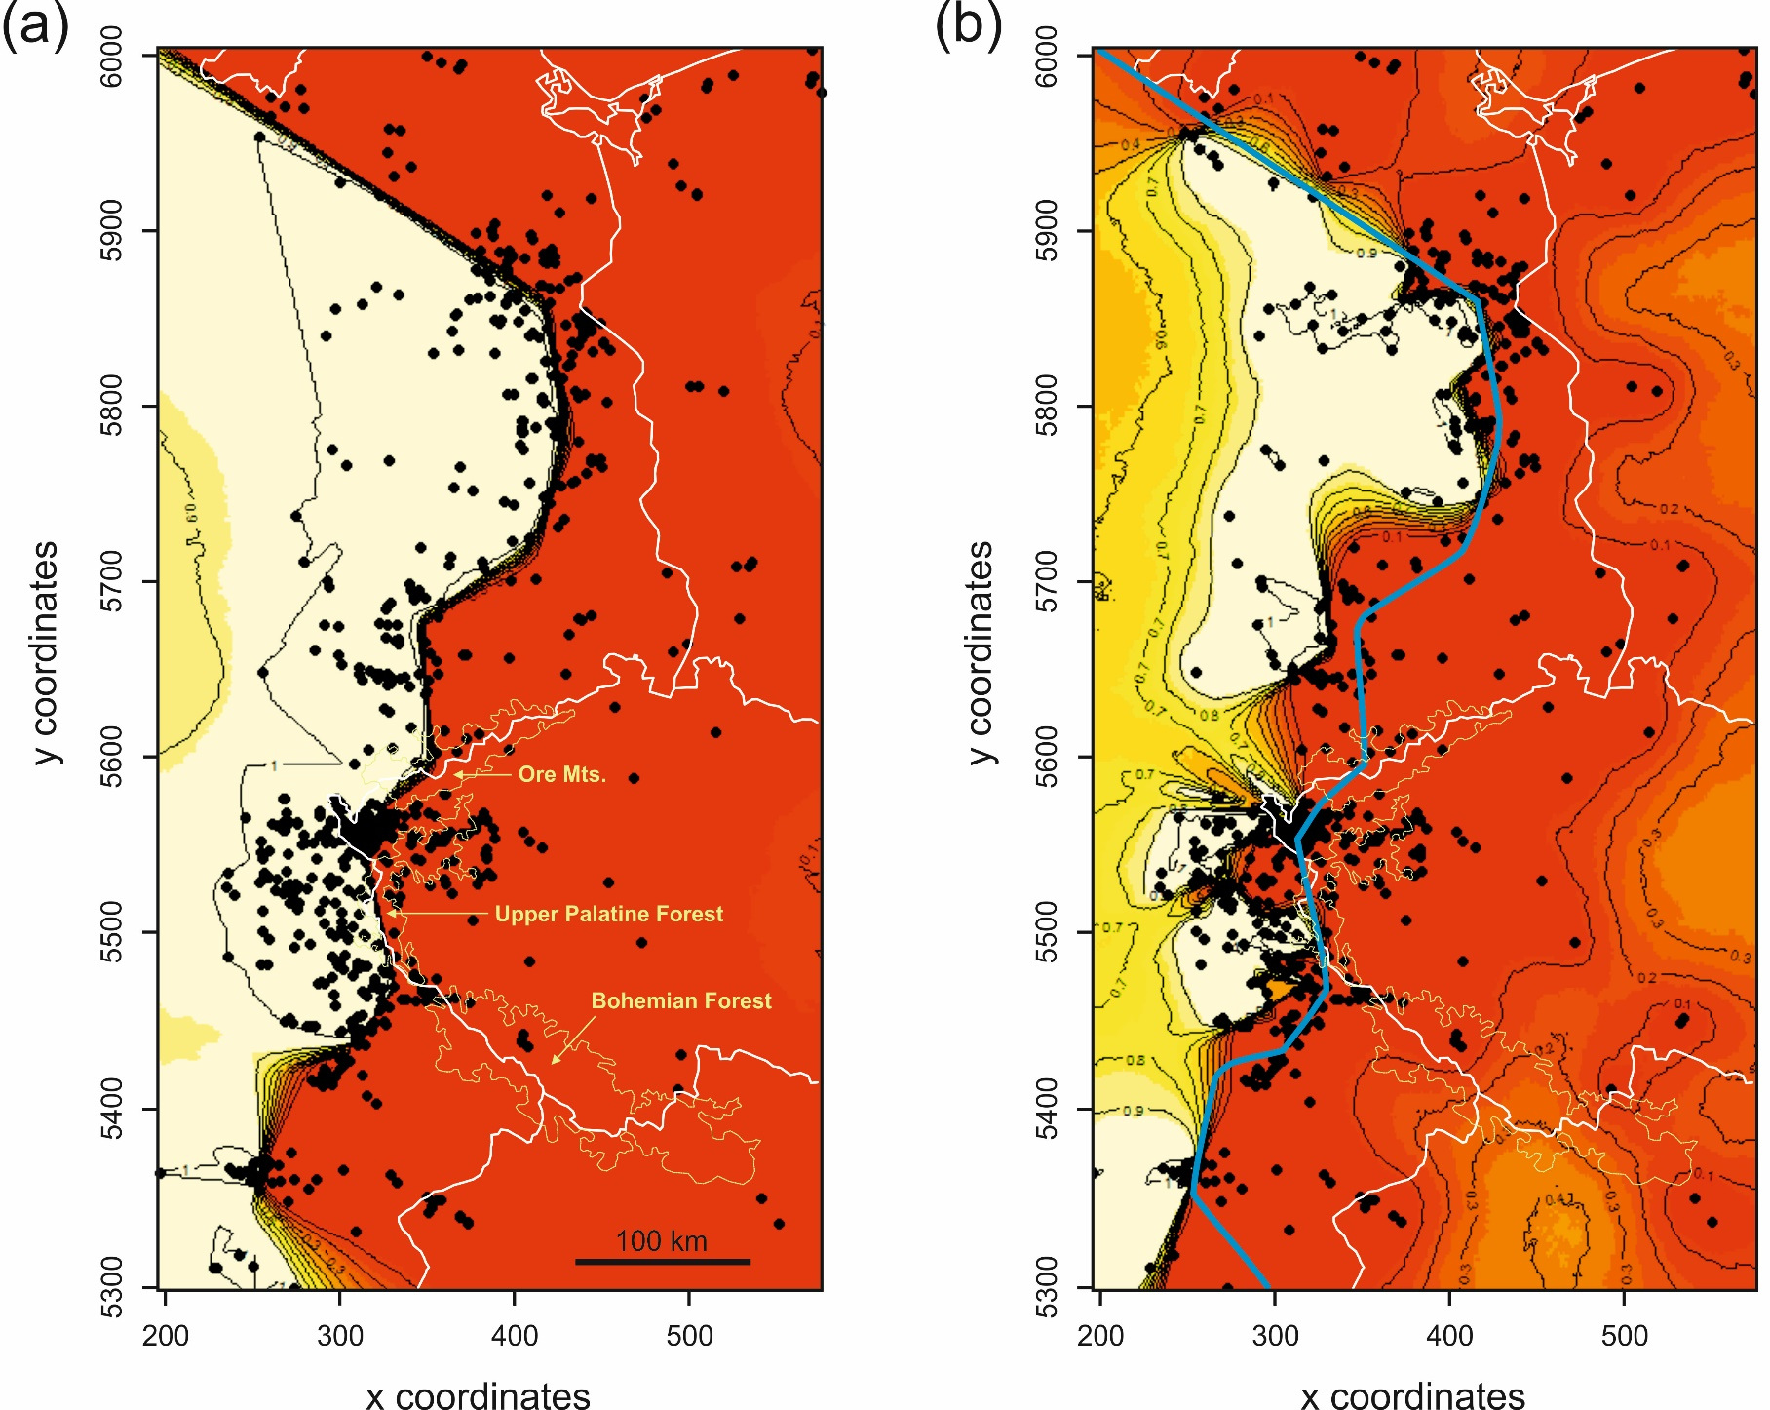
Geneland

Slide 7
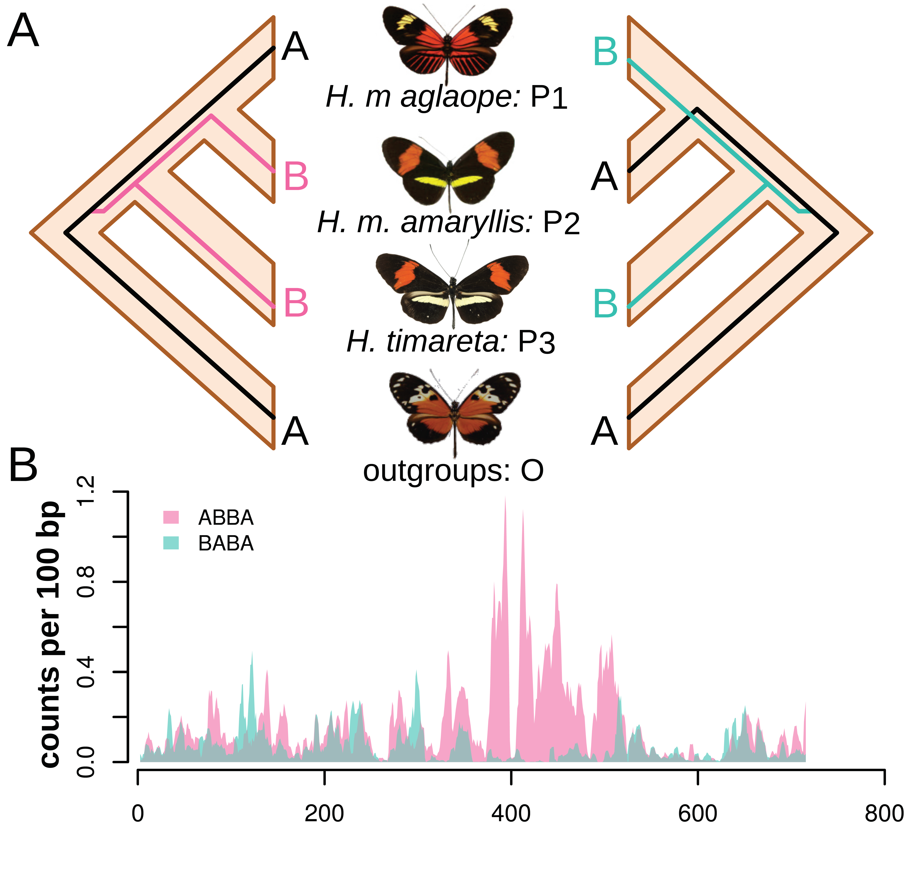
Nick Patterson: D-statistika (ABBA/BABA test):
mutace
mutace
D > 0
D < 0
Martin et al., bioRxiv

Slide 8
lokus HmB
Martin et al., bioRxiv

Slide 9
SJE Baird: diem
whole-genome
sequences
Mus m. domesticus
blue: immunity genes
warfarin resistence
gene
red: olfactory/
vomeronasal genes
Mus spretus

Slide 10
Hybrid zone (Barton a Hewitt 1985)
= area, where genetically different populations meet, mate and give rise
at least some hybrid offspring
Hybrid zones may be classified as:
primary
secondary
tension, mosaic, staggered, „mottled“ ...
extrinsic selection (external environment)
intrinsic selection (prezygotic or postzygotic barriers)

Slide 11
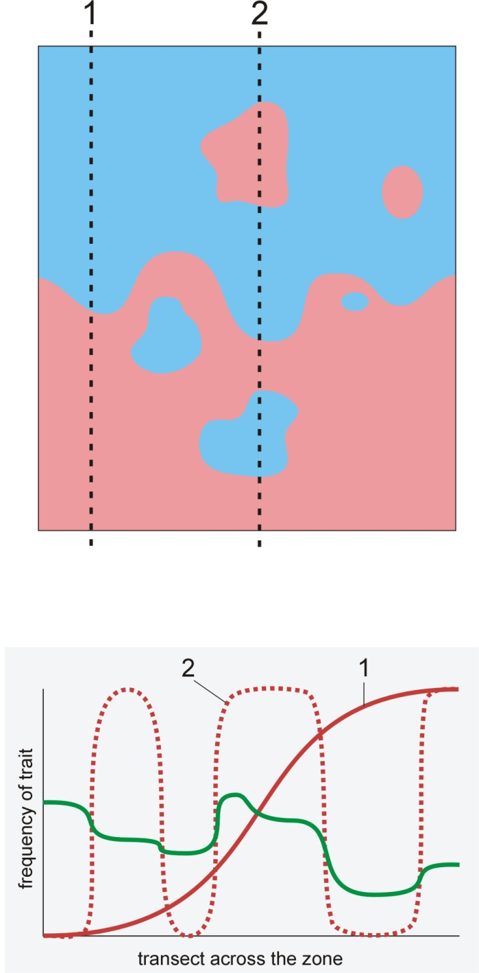
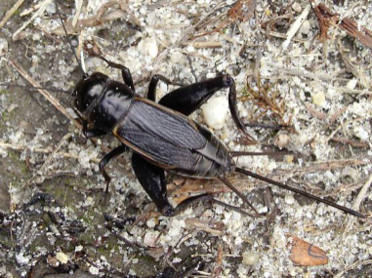
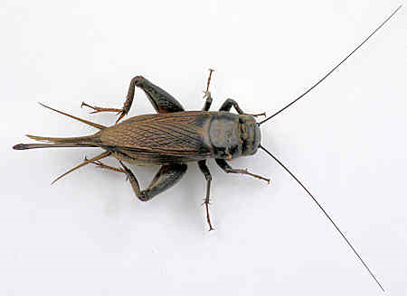


Mosaic hybrid zone:
influence of environment
in fact a set of several hybrid zones
eg.: Gryllus firmus x G. pennsylvanicus (NE USA)
sandy x clayish soils
Iris fulva x I. brevicaulis:
I. fulva is limited to more forested sites

Slide 12
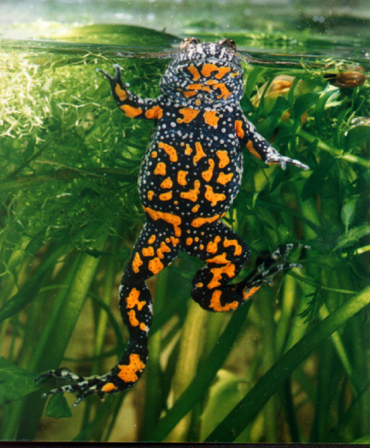
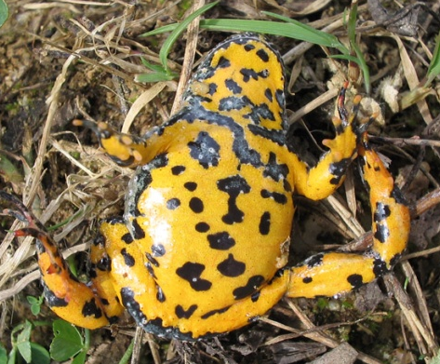
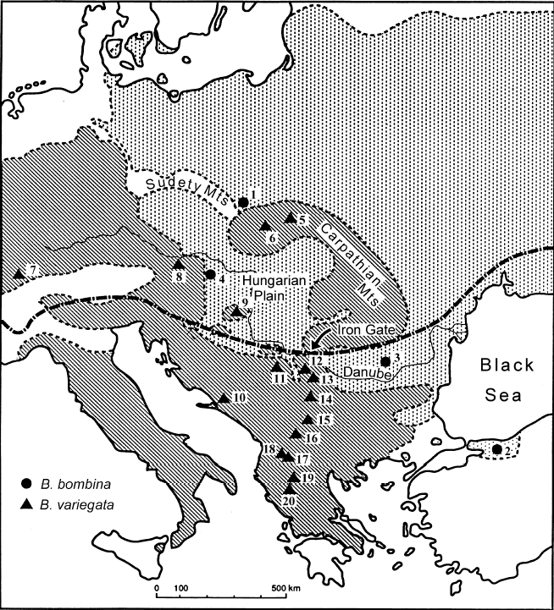
Bombina:
mosaic HZ in Croatia, not in Poland
fire-bellied toad
B. bombina:
lowlands
mostly in water
larger water surfaces
thiner skin
territorial
530 Hz
longer development
yellow-bellied toad
B. variegata:
hills, highlands
terrestrial
mating in puddles
thick skin
nonterritorial
580 Hz
shorter development

Slide 13

Most hybrid zones are
tension zones.
Nick Barton
... i.e., they are maintained by balance between dispersal and selection (Barton & Hewitt, 1985)

Slide 14


Tension zone is when…

Slide 15
Tension zone is when…
dispersal
⇒ zone widening

Slide 16
Tension zone is when…
×
♂
♀
selection
against
hybrids!
⇒ zone narrowing
Tension zone is maintained by dynamic equilibrium
between dispersal and selection

Slide 17
tension zone moves along the gradient of population density
Tension zone is independent of external conditions (intrinsic selection)
⇒ its movement ends at a geographical barrier or in the area
of the lowest population density („population/density trough“)

Slide 18
„population trough“

Slide 19
Tension zone moves along a population gradient ...

Slide 20
... ⇒ it tends to shorten its length.

Slide 21
Theory of cline:
secondary contact:
coincident and concordant clines
Cline = gradient of trait(s) (eg. allele frequency or mean
of quantitative trait) across spatially continuous habitat
Notes:
According to theory, secondary contact will produce a set of parallel coincident and concordant clines CLICK → it means that these clines have the same position and the same shape or at least the width. CLICK →

Slide 22
clines
coincidence = same positions of zone centres
concordance = same cline shapes
(in practice usually same widths)

Slide 24
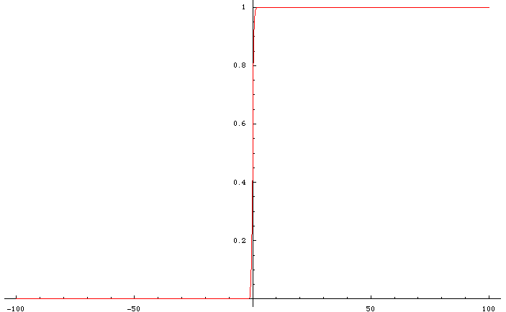
secondary contact
cline
Geographic scale
Notes:
24

Slide 25
Theory of cline:
neutral vs. selected loci
neutral locus
selection against hybrids
Notes:
But as the time is passing, clines for neutral loci get wider in comparison with loci under selection CLICK → so concordance diminishes; conversely, selection against hybrids tends to maintain the clines at the same place. CLICK →

Slide 26
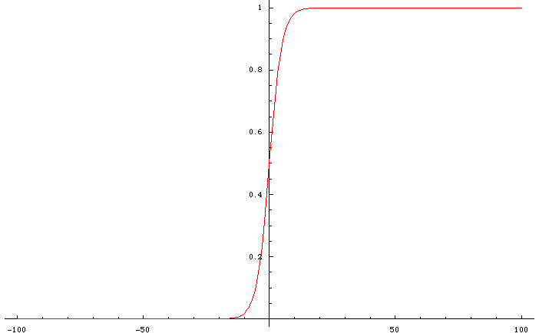
diffusion of neutral marker
Geographic scale
Notes:
26

Slide 27
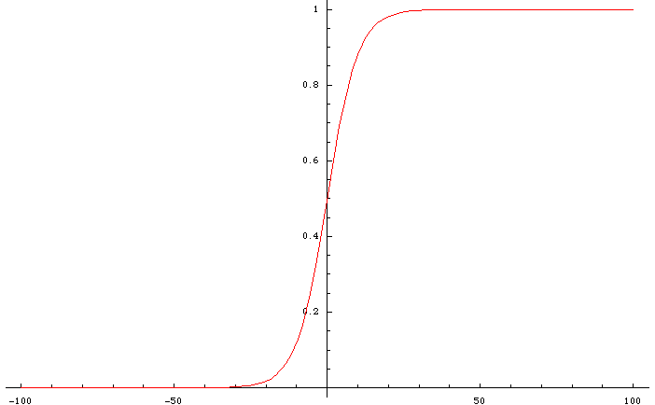
diffusion of neutral marker
Geographic scale
Notes:
27

Slide 28
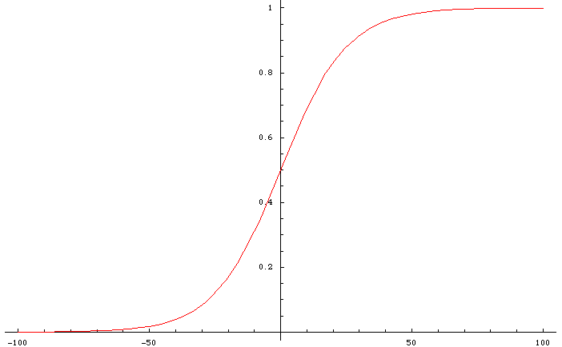
diffusion of neutral marker
Geographic scale
Notes:
28

Slide 29
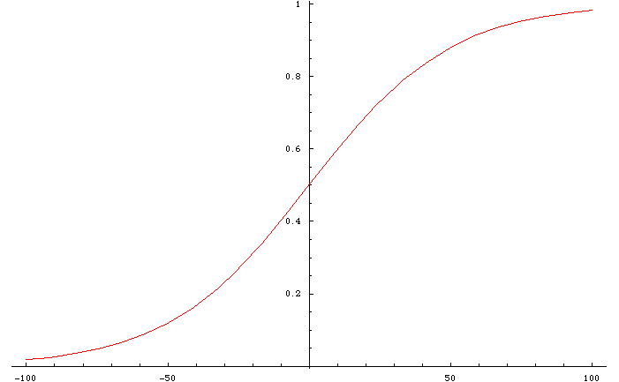
diffusion of neutral marker
Geographic scale
Notes:
29

Slide 30
neutral vs. selected loci
with time, concordance is disappearing ...
locus 1
locus 2
... but (in tension zone) selection pushes clines for individual loci to each other
⇒ maintains coincidence
Notes:
But as the time is passing, clines for neutral loci get wider in comparison with loci under selection CLICK → so concordance diminishes; conversely, selection against hybrids tends to maintain the clines at the same place. CLICK →

Slide 31
sometimes ...
locus 1
locus 2
... but clines still parallel
Notes:
Sometimes we can see one or more clines which are not coincident so we have to find some explanation for the pattern CLICK → but still it holds that the clines are parallel
CLICK →

Slide 32
cline models (diffusion approximation etc.), linkage disequilibrium,
evolutionary parameters
??
problem, how to analyse
Notes:
So even in this case we can use cline models – either based on diffusion approximation – or any other model, and to estimate cline parameters. CLICK → But what to do when the clines are not parallel? CLICK → Clearly, in this case one of the basic assumptions of cline theory is violated and it is not obvious what should we do in such a case CLICK →

Slide 33
Hybrid zone study
Sampling along linear or 2D transect, geographic coordinates
of localities
Genetic (morphological, behavioural etc.) analysis
… problem of sample independence (F_{ST}, F_{IS} … effective No. alleles)
Geographic clines
Estimation of dispersal, selection, and other parametres
Alternative approaches:
monotonic clines
2D analysis
genomic clines
concordance analysis

Slide 34
Case study: house mouse hybrid zone

Slide 35
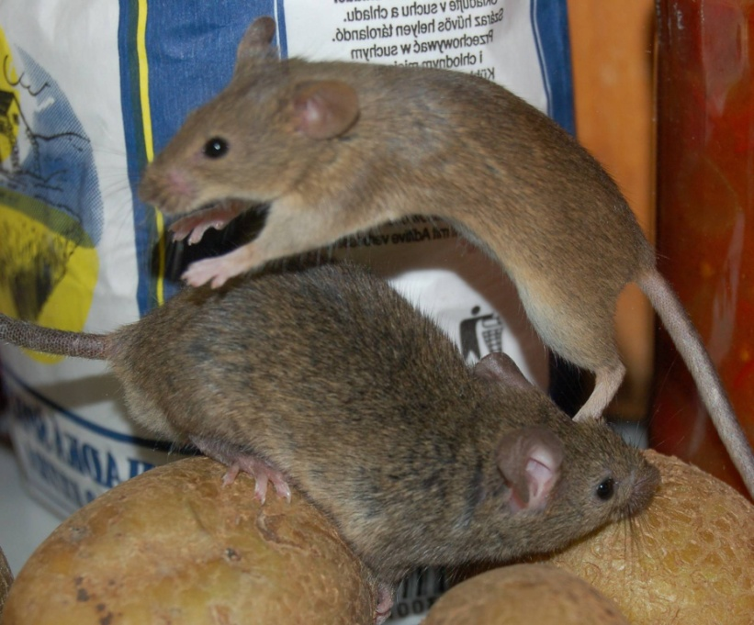
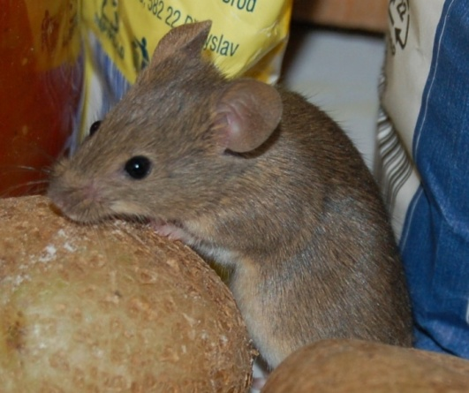
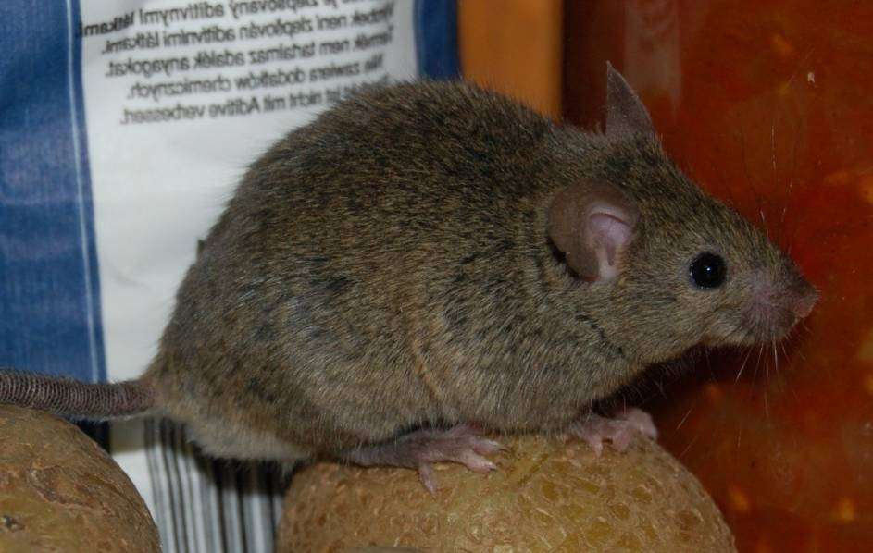
domesticus
musculus

Slide 36
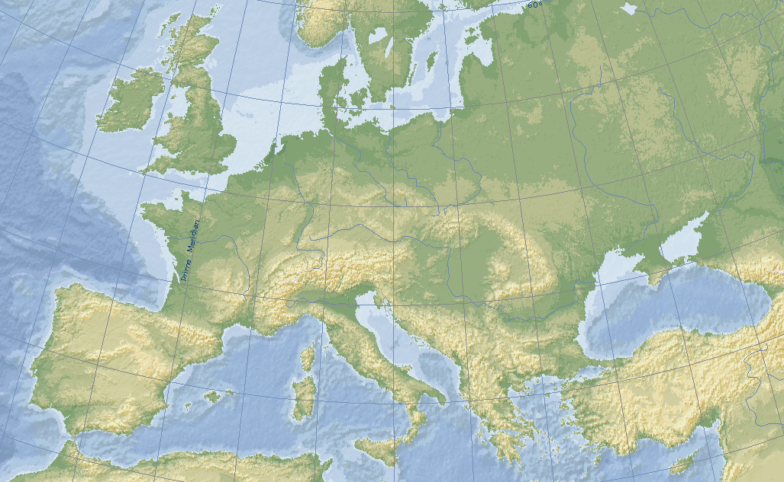
Hybrid zone in Europe
musculus
time of origin unknown…
domesticus

Slide 37
Hybrid zone in Europe
... but NW part younger
... than SE part

Slide 38
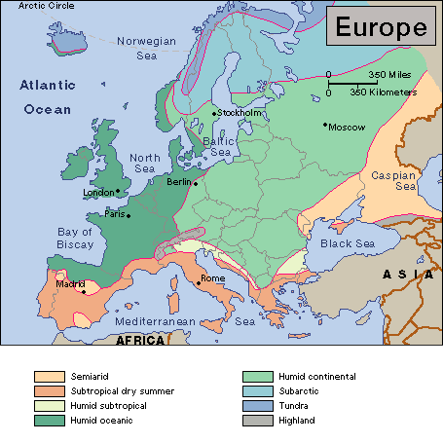
continental climate
oceanic climate

Slide 39
Hybrid zone in Europe
Most hybrid zones are „tension zones“
Nick Barton
also the mouse hybrid zone?

Slide 40
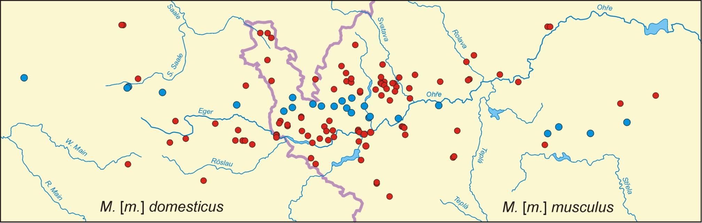
hybrid zone course may be complex....
... moreover, usually we don’t know a priori, or we extrapolate from global direction

Slide 41
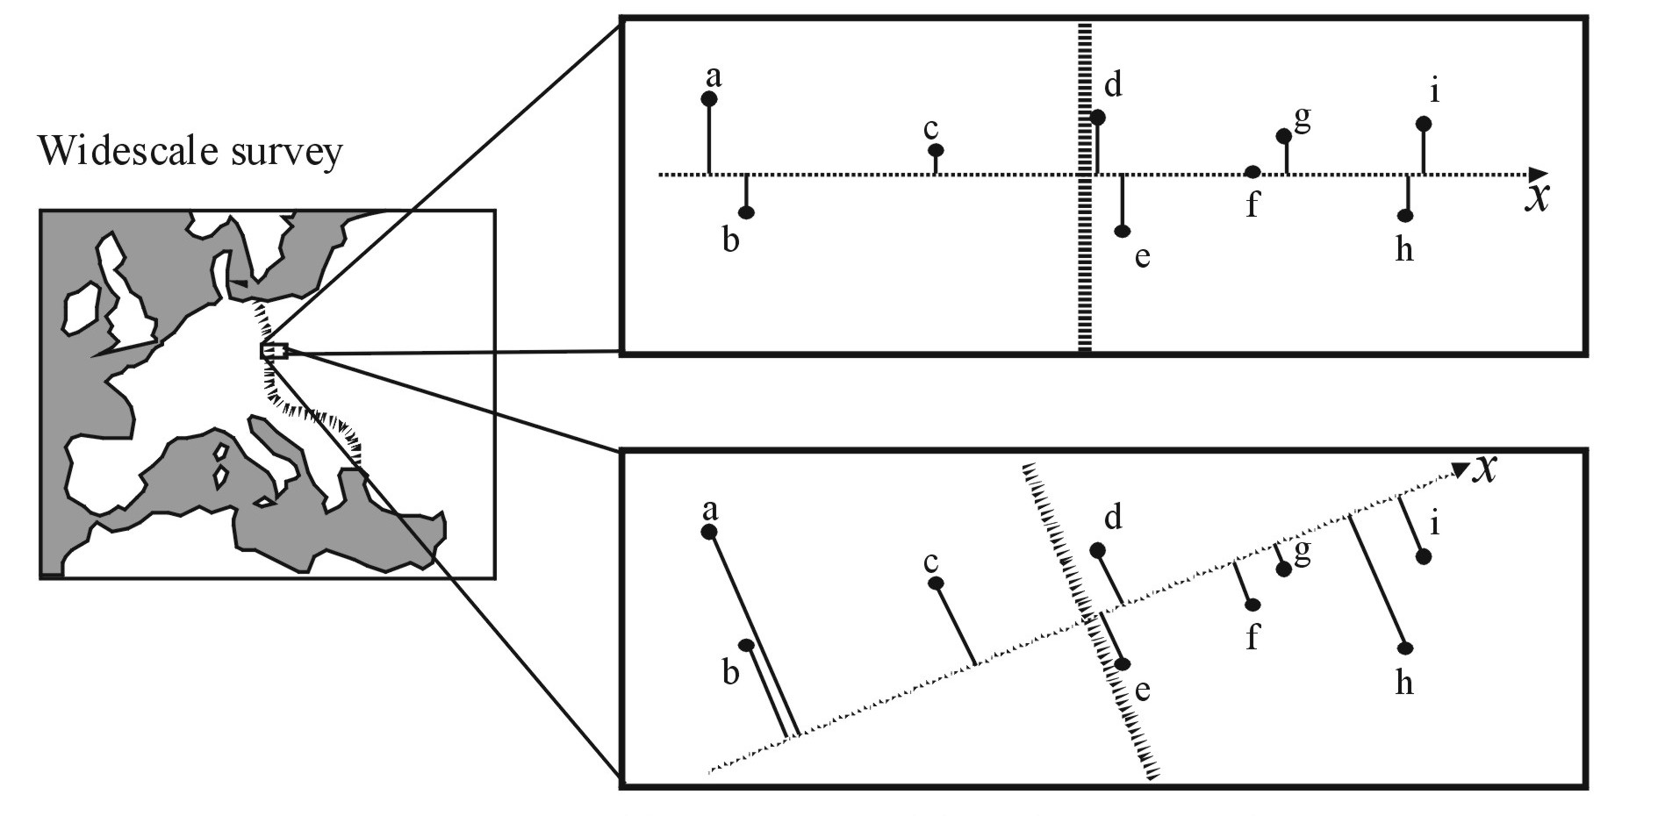
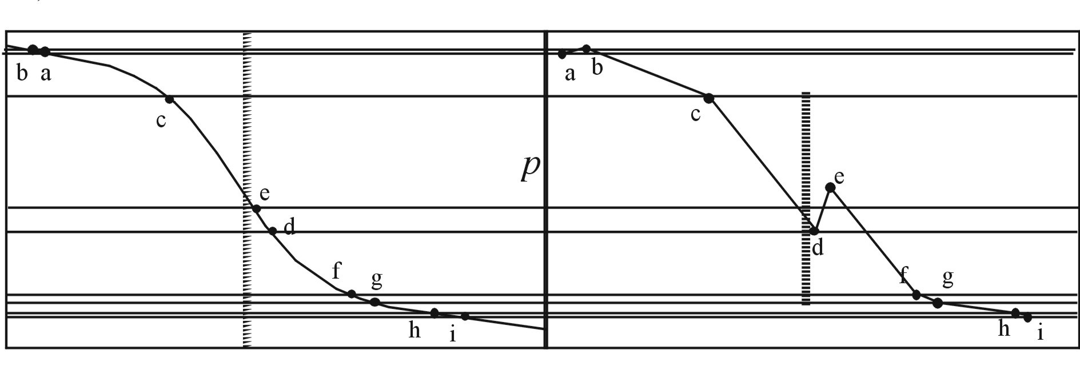
Real local cline
Cline interpolated
from widescale survey

Slide 42
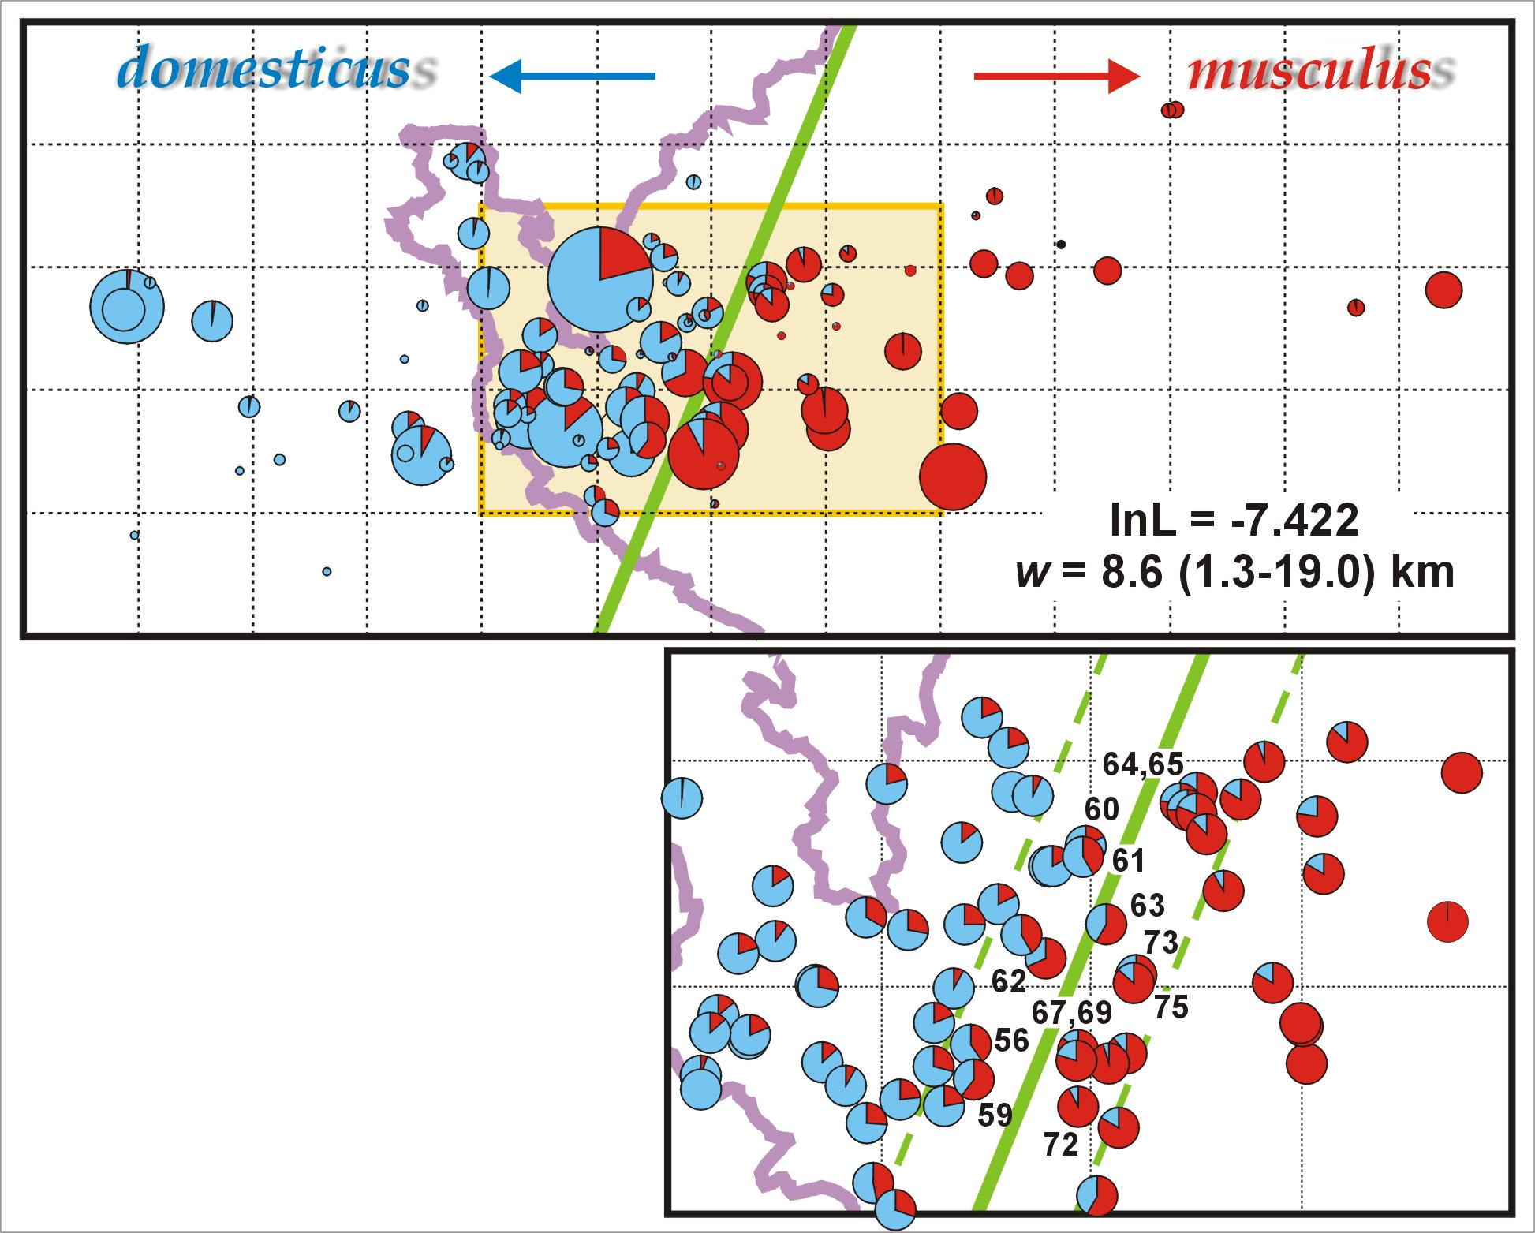
2D → 1D clines

Slide 43
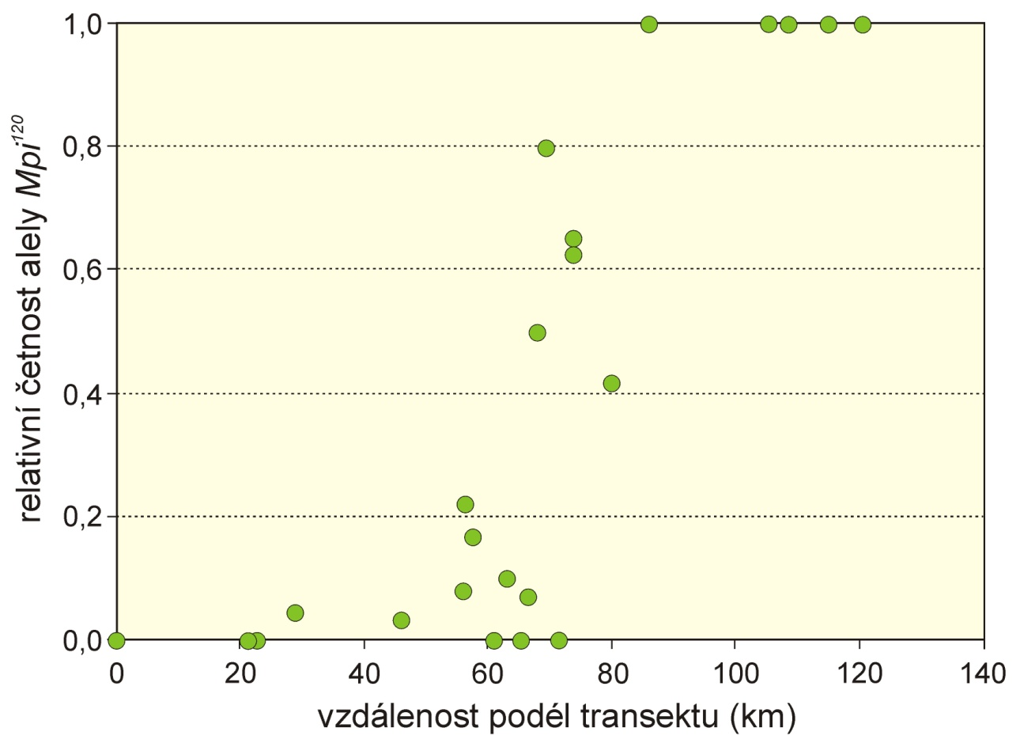
Example: Mpi
šířka (w) = 1/max. slope
střed (c)
fitting: eg. logistic regression × models based on cline theory
sigmoid model: hyperbolic tangent function:

Slide 44
Multiple genes:
1.0
0.8
0.6
Frequency
Δp
0.4
0.2
0.0
c
Distance along transect
„stepped“ model (symetrical, asymmetrical)
linkage disequilibrium resulting from influx of parental allele combinations ⇒
synergistic effect: strenghtening of selection in zone centre ⇒ central step
× introgression tails reflect selection at individual loci

Slide 45
We can estimate some other key evolutionary parametres
from LD and cline parametres:
dispersal:
effective selection:
selection on marker loci:
selection on selected loci:
fitness of hybrids:
number of loci under selection:

Slide 46
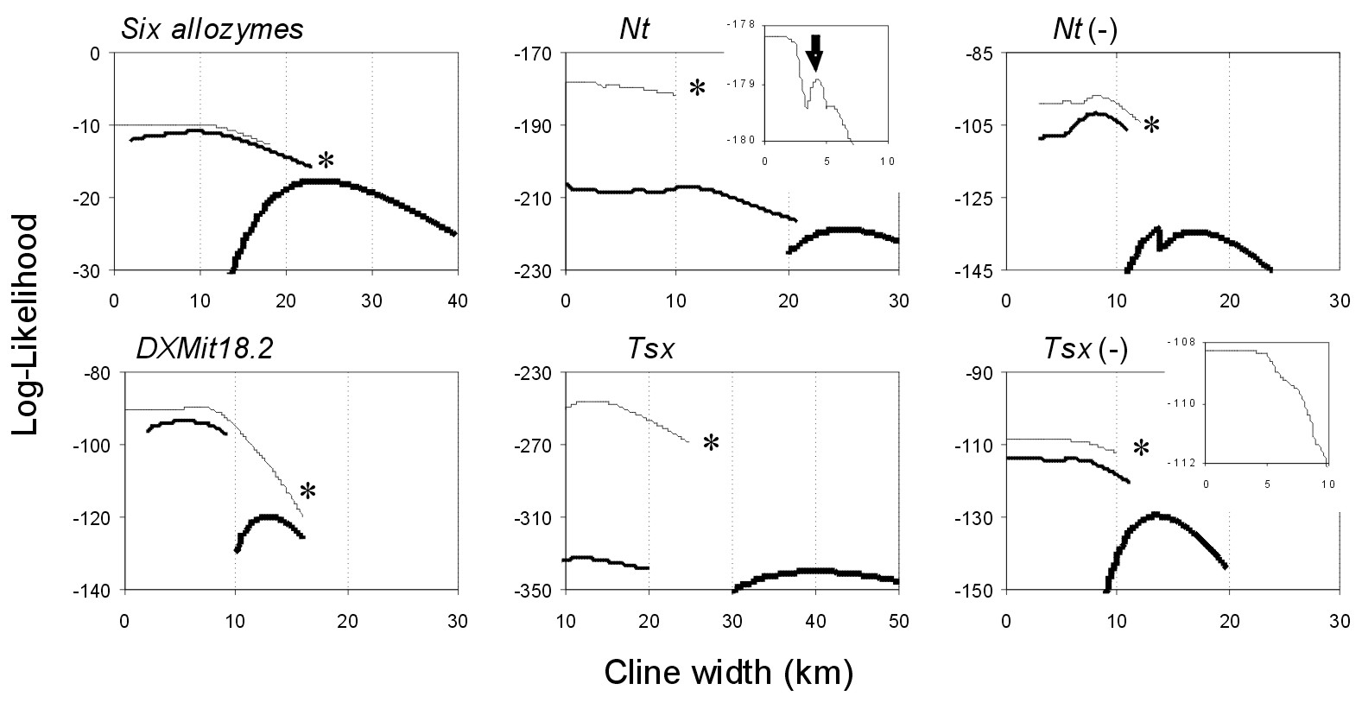
model comparison: LRT (they are nested); d.f. = difference in number
of parametres
likelihood profiles:

Slide 47
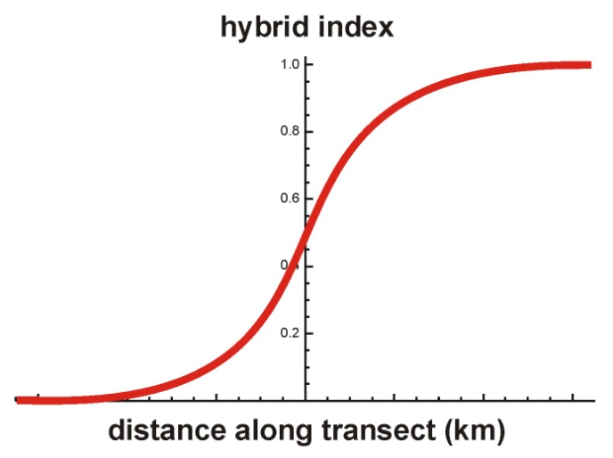
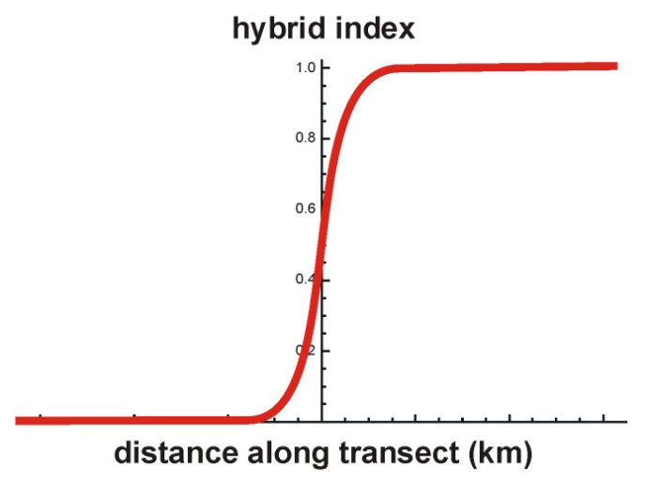
hybrid zone
selected areas
cline width
position on chromosome
centromere
molecular markers

Slide 48
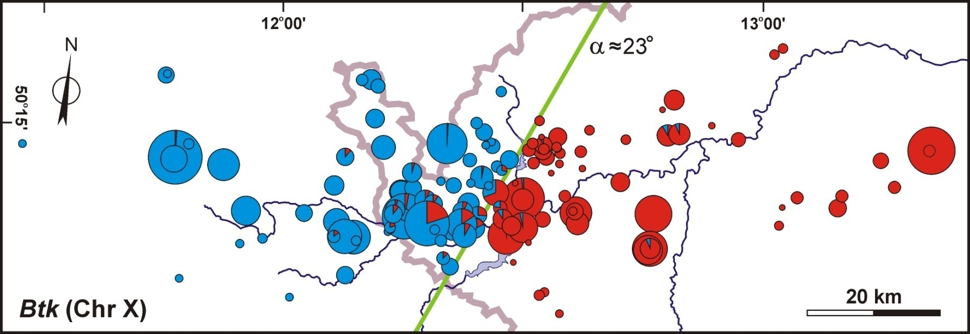
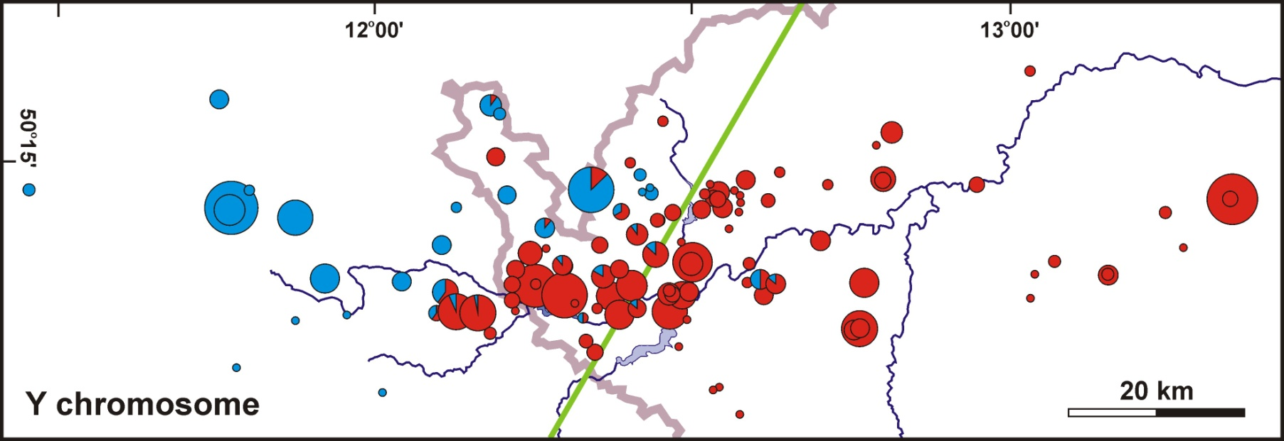
Problems – Y chromosome
>20 km

Slide 49
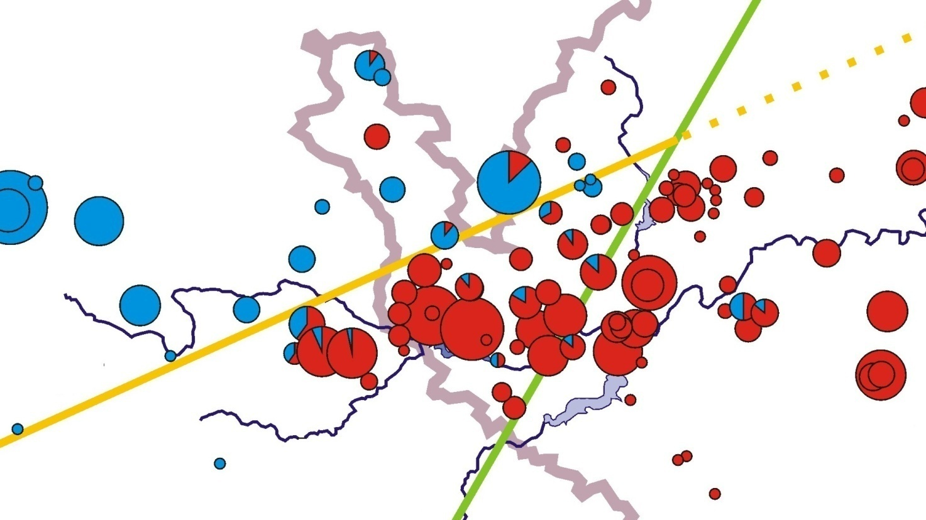
D=44%**
DY_{M}=51%
M=45%***
salient/invagination ≈ 330 km²
Notes:
Interestingly, trapping sex ratio was female biased in both areas without the Y introgression (so that the proportion of males was significantly different from parity) while in the D area with the musculus Y introgression the sex ratio was close to parity and significantly different from the former two. CLICK →

Slide 51
1. musculus Y more successful than domesticus Y on its own genetic background
2. higer proportion of males relative to other areas
Weird behaviour of the Y in the hybrid zone – summary:
Either coincidence, or ...

Slide 52

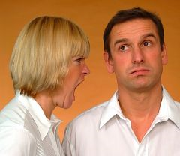
… or genetic conflict between X and Y
and probably some autosomal genes as well
Y
X

Slide 53
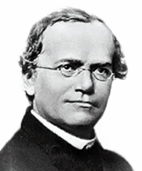
segregation law
Aa
A
a
Gregor Mendel
50%
50%

Slide 54
Intragenomic conflict results in higher proportion of
a genomic element in the next generation
?!
Aa
A
a
Gregor Mendel
„drive“
95%
5%
vychýlení segregačího (transmisního) poměru
= segregation distortion (SD)
= transmission ratio distortion (TRD)

Slide 55
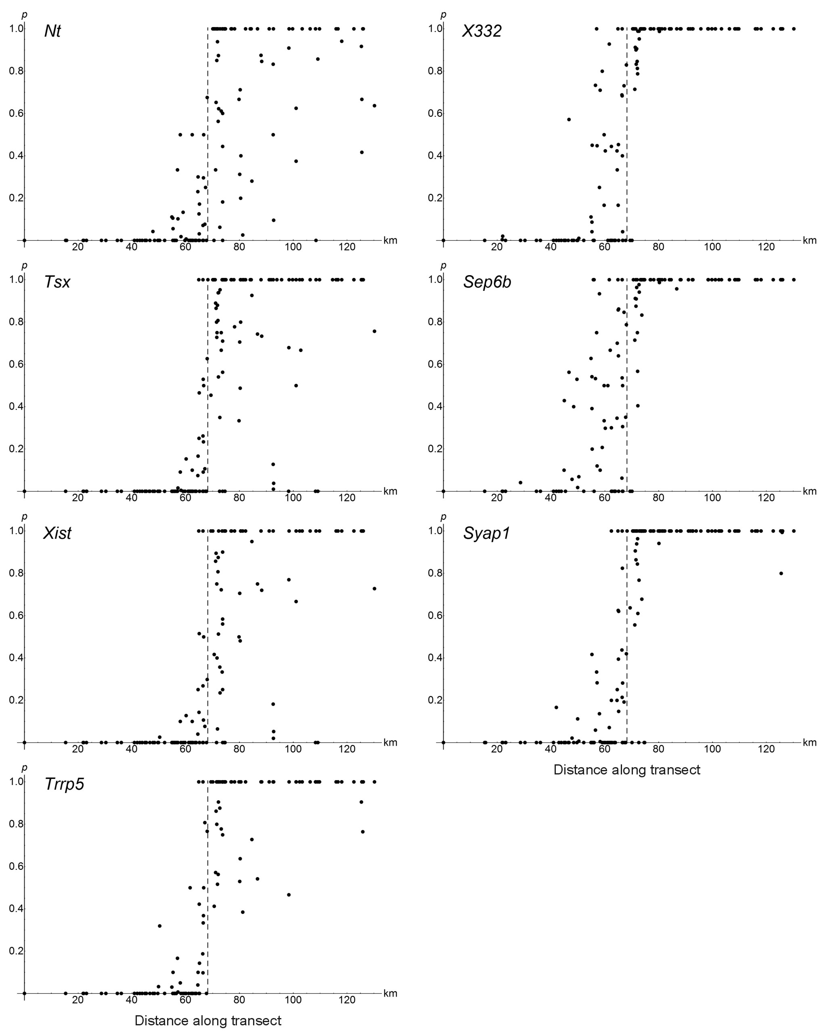
X chromosome

Slide 56
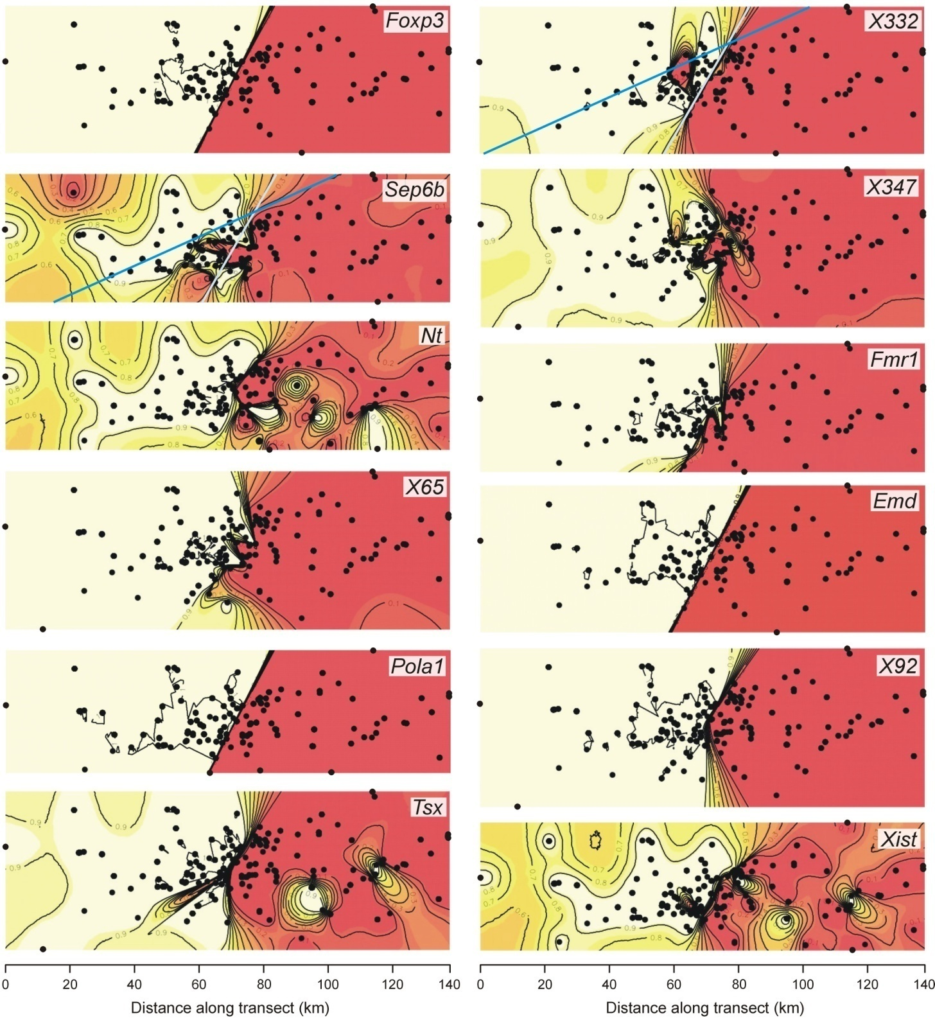
Chr. X - 2D analysis
Geneland

Slide 57
‘Genomic clines’
Z. Gompert & A. Buerkle

Slide 58
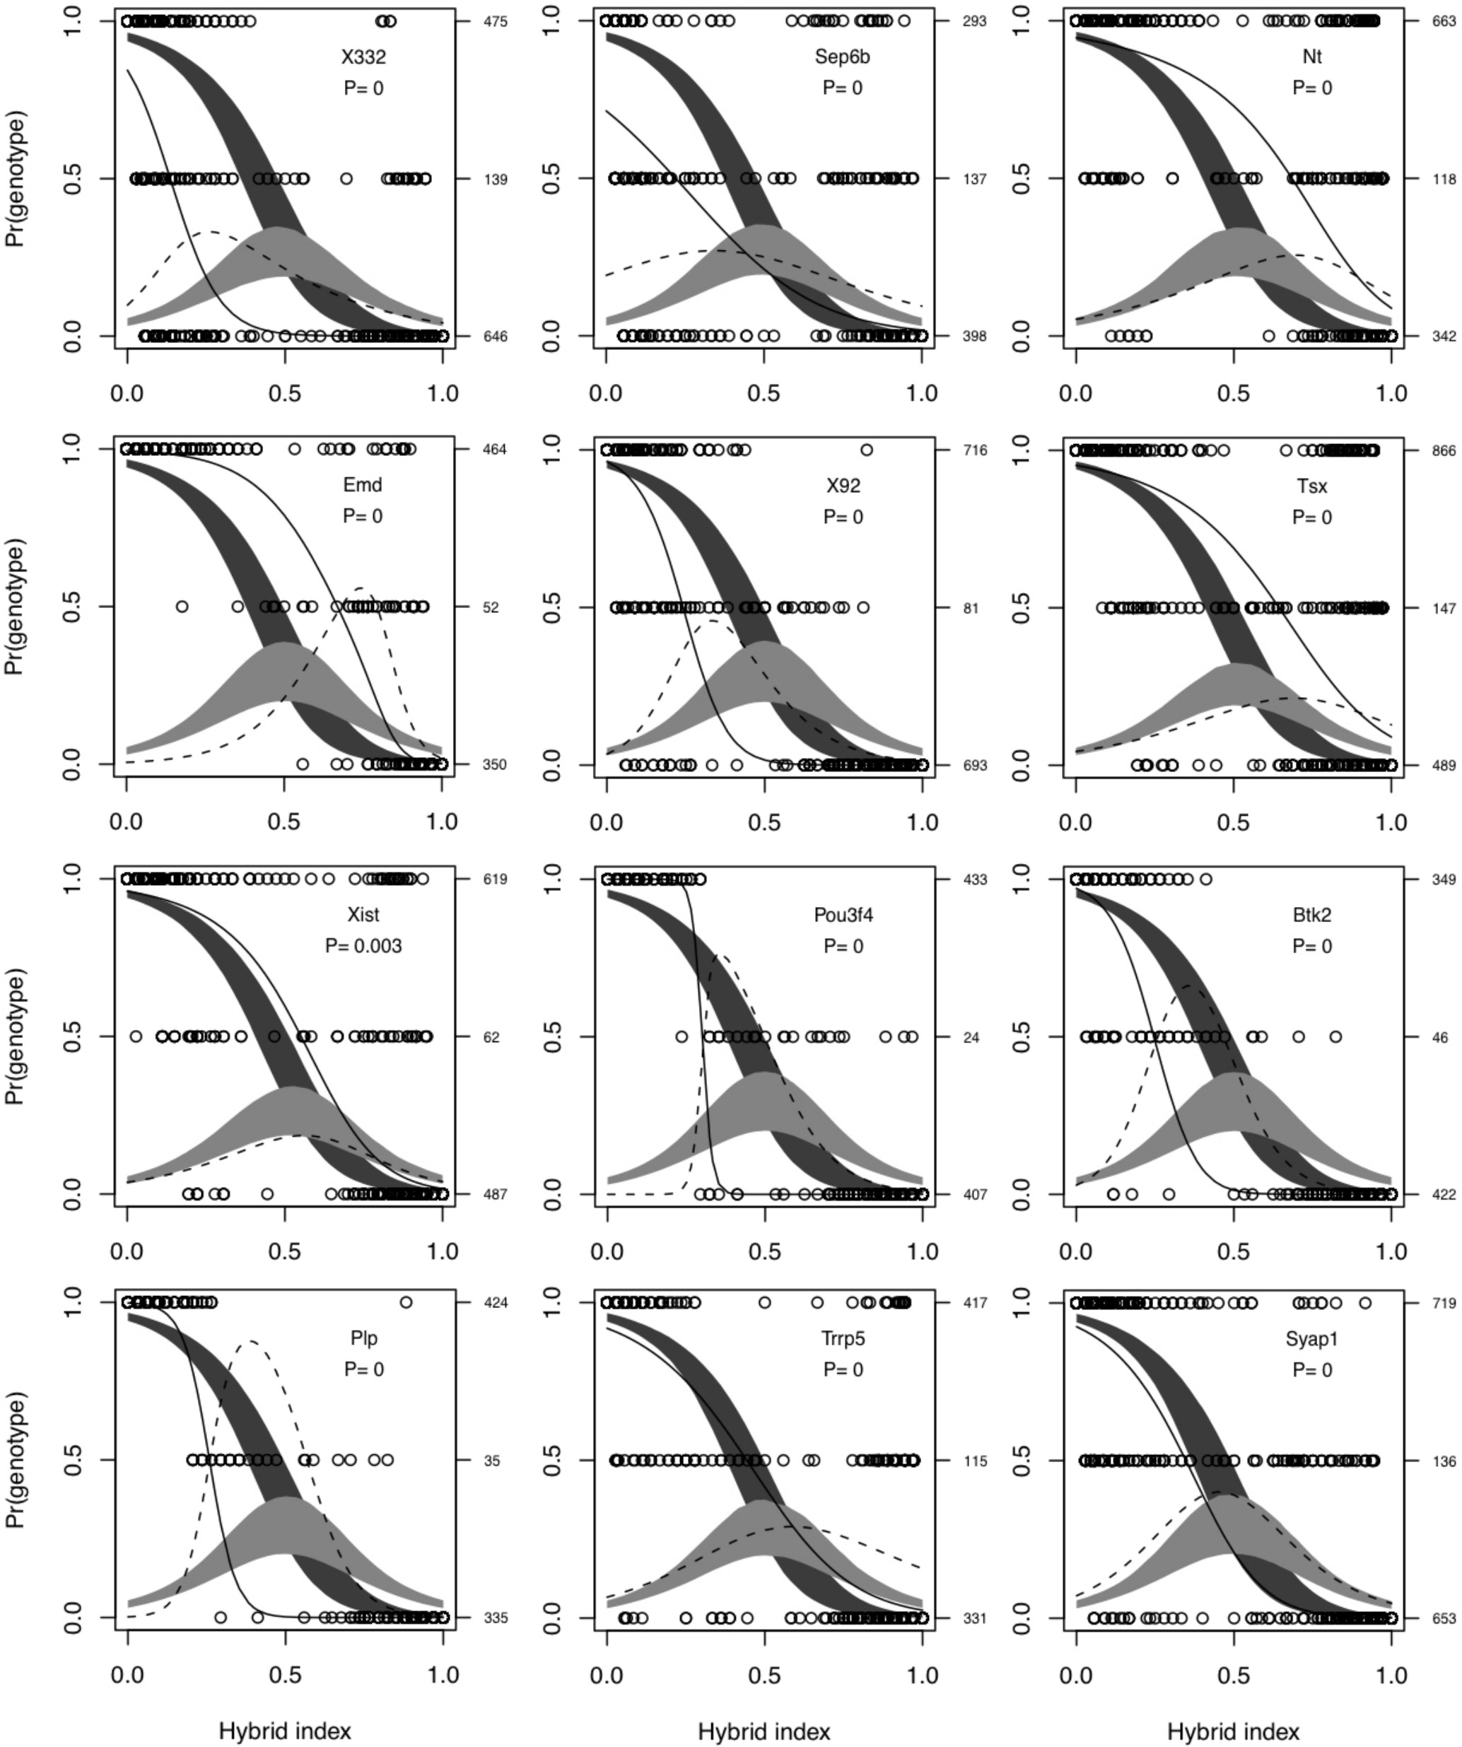


Slide 59

Concordance
analysis:
S.J.E. Baird

Slide 60
very steep cline
strong introgression in both directions
S.J.E. Baird

Slide 61
Concordance
analysis:
introgression to the left
S.J.E. Baird

Slide 62
Concordance
analysis:
introgression to the right
S.J.E. Baird

Slide 63

Proximal marker on the X
blocks around proximal marker
centre of the Y introgression
musculus
domesticus
consensus
barrier
non-introgressed localities
Recombination reduces size of introgressed
block far of the zone centre

Slide 64

Using cline model for analysis of reinforcement
– odour preference in the mouse hybrid zone
reinforcement

Slide 65

Using cline model for analysis of gene expression
in the mouse hybrid zone – asymmetric model

Slide 66


haplotype A
R. A. Fisher
haplotype B
Recombination brings together
DNA of different origin and makes
junctions (breakpoints)
they divide genome into blocks
(chunks, tracts, segments)
recombinant
4 markers
3 junctions
N SNP
N markers

Slide 67

Blocks of Neanderthal DNA found in modern humans can act like a biological clock, because they are fragmented more and more with each generation since interbreeding happened. The blocks of Neanderthal DNA in the Siberian man were on average three times longer than those seen in people alive today. Working backwards, the scientists calculate that Neanderthals contributed to the man’s genetic ancestry somewhere between 7,000 and 13,000 years before he lived.
The findings, published in the journal Nature, suggest that humans and Neanderthals had reproductive sex around 50,000 to 60,000 years ago…
The Guardian Wednesday 22 October 2014
Notes:
Even worse – for these calculation I have assumed a generation time of one year. For longer lived organisms the situation is even worse….

Slide 68

chromosome 12 of Neanderthal
Romania, ∼40 kya, mating before
200–100 years
Siberia, ∼45 kya,
mating before 8000–5000
contemporary China,
54–49 kya

Slide 69
Chromosome 17
MHC!
>600 000 SNPs

Slide 70

Chromozom X

Slide 71




Why hybrid zones? Reproductive barriers and speciation!
Dobzhansky-Muller model
W. Bateson
T. Dobzhansky
H. Muller

Slide 72





„Arms races“ and secondary contact

Slide 73




genetic conflict: “classical” scenario
incompatible!
subpop. 1
arms race
in ancestral
population
continuing
arms race
secondary contact
subpop. 2
MAD = mutually
assured destruction
“speciation genes”
Notes:
Interlaced fingers, braid, fingerloop braiding, twist together

Slide 74



Never bring a knife
to a gunfight!
genetic conflict: alternative scenario
subpop. 1
arms race
in ancestral
population
continuing
arms race
secondary contact
the winner thrives on “naive” genetic background
subpop. 2
“antispeciation
genes”
Notes:
Interlaced fingers, braid, fingerloop braiding, twist together

Slide 75


Why we don’t see this more often?
incompatibility loci
neutral loci
hitchhikers
arms victors
Ticking time-bomb...
Notes:
Interlaced fingers, braid, fingerloop braiding, twist together

Slide 76
Cytonuclear disequilibria
= non/random associations of nuclear and cytoplasmic
(mitochondrial) alleles
3 × 2 table
 | nuclear genotype:
mtDNA: | AA | Aa | aa | total
M | u₁ | v₁ | w₁ | x
m | u₂ | v₂ | w₂ | y
total | u | v | w | 1

Slide 77
No hybridization
Random mating, hybrid swarm
 | nuclear genotype:
mtDNA: | AA | Aa | aa
M | +++ | 0 | 0
m | 0 | 0 | +++
 | nuclear genotype:
mtDNA: | AA | Aa | aa
M | obs=exp | obs=exp | obs=exp
m | obs=exp | obs=exp | obs=exp
Hybridization without apparent
introgression, crossing independent of sex
Hybridization without apparent
introgression, crossing depends on sex
 | nuclear genotype:
mtDNA: | AA | Aa | aa
M | ++ | obs=exp | 0
m | 0 | obs=exp | ++
 | nuclear genotype:
mtDNA: | AA | Aa | aa
M | ++ | ++ | 0
m | 0 | -- | ++

Slide 78
Hybrids mate more often with
less discriminating species
Symmetrical introgression
 | nuclear genotype:
mtDNA: | AA | Aa | aa
M | obs=exp | ++ | --
m | obs=exp | -- | ++
 | nuclear genotype:
mtDNA: | AA | Aa | aa
M | ++ | obs=exp | --
m | -- | obs=exp | ++
Potential introgression,
crossing dependent on sex
 | nuclear genotype:
mtDNA: | AA | Aa | aa
M | ++ | ++ | --
m | 0 | 0 | ++

