Slide 1


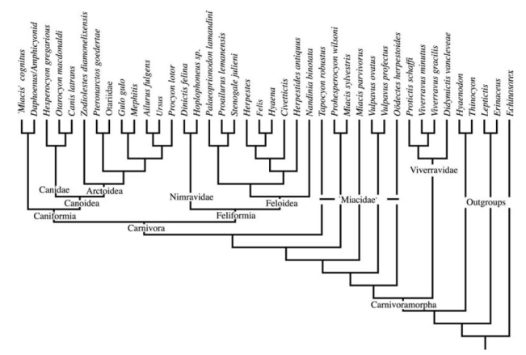
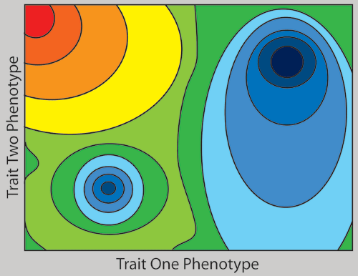
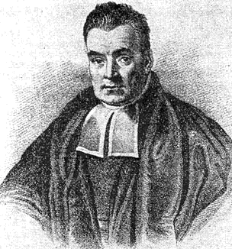
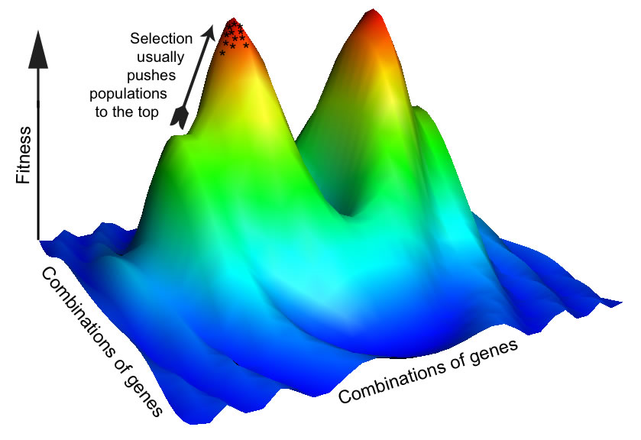
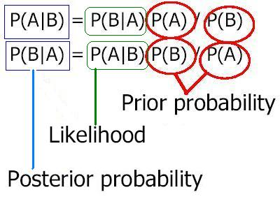

MODULARIZACE VÝUKY EVOLUČNÍ A EKOLOGICKÉ BIOLOGIE
CZ.1.07/2.2.00/15.0204
>gi|5835135|ref|NC_001644.1| Pan paniscus mitochondrion, complete genome GTTTATGTAGCTTACCCCCTTAAAGCAATACACTGAAAATGTTTCGACGGGTTTATATCACCCCATAAAC AAACAGGTTTGGTCCTAGCCTTTCTATTAGCTCTTAGTAAGATTACACATGCAAGCATCCGTCCCGTGAG TCACCCTCTAAATCACCATGATCAAAAGGAACAAGTATCAAGCACACAGCAATGCAGCTCAAGACGCTTA GCCTAGCCACACCCCCACGGGAGACAGCAGTGATAAACCTTTAGCAATAAACGAAAGTTTAACTAAGCCA TACTAACCTCAGGGTTGGTCAATTTCGTGCTAGCCACCGCGGTCACACGATTAACCCAAGTCAATAGAAA CCGGCGTAAAGAGTGTTTTAGATCACCCCCCCCCCAATAAAGCTAAAATTCACCTGAGTTGTAAAAAACT CCAGCTGATACAAAATAAACTACGAAAGTGGCTTTAACACATCTGAACACACAATAGCTAAGACCCAAAC TGGGATTAGATACCCCACTATGCTTAGCCCTAAACTTCAACAGTTAAATTAACAAAACTGCTCGCCAGAA CACTACGAGCCACAGCTTAAAACTCAAAGGACCTGGCGGTGCTTCATATCCCTCTAGAGGAGCCTGTTCT GTAATCGATAAACCCCGATCAACCTCACCGCCTCTTGCTCAGCCTATATACCGCCATCTTCAGCAAACCC TGATGAAGGTTACAAAGTAAGCGCAAGTACCCACGTAAAGACGTTAGGTCAAGGTGTAGCCTATGAGGCG GCAAGAAATGGGCTACATTTTCTACCCCAGAAAATTACGATAACCCTTATGAAACCTAAGGGTCGAAGGT GGATTTAGCAGTAAACTAAGAGTAGAGTGCTTAGTTGAACAGGGCCCTGAAGCGCGTACACACCGCCCGT CACCCTCCTCAAGTATACTTCAAAGGATATTTAACTTAAACCCCTACGCATTTATATAGAGGAGATAAGT CGTAACATGGTAAGTGTACTGGAAAGTGCACTTGGACGAACCAGAGTGTAGCTTAACATAAAGCACCCAA CTTACACTTAGGAGATTTCAACTCAACTTGACCACTCTGAGCCAAACCTAGCCCCAAACCCCCTCCACCC TACTACCAAACAACCTTAACCAAACCATTTACCCAAATAAAGTATAGGCGATAGAAATTGTAAATCGGCG CAATAGATATAGTACCGCAAGGGAAAGATGAAAAATTACACCCAAGCATAATACAGCAAGGACTAACCCC TGTACCTTTTGCATAATGAATTAACTAGAAATAACTTTGCAAAGAGAACTAAAGCCAAGATCCCCGAAAC CAGACGAGCTACCTAAGAACAGCTAAAAGAGCACACCCGTCTATGTAGCAAAATAGTGGGAAGATTTATA GGTAGAGGCGACAAACCTACCGAGCCTGGTGATAGCTGGTTGTCCAAGATAGAATCTTAGTTCAACTTTA AATTTACCTACAGAACCCTCTAAATCCCCCTGTAAATTTAACTGTTAGTCCAAAGAGGAACAGCTCTTTA GACACTAGGAAAAAACCTTATGAAGAGAGTAAAAAATTTAATGCCCATAGTAGGCCTAAAAGCAGCCACC AATTAAGAAAGCGTTCAAGCTCAACACCCACAACCTCAAAAAATCCCAAGCATACAAGCGAACTCCTTAC GCTCAATTGGACCAATCTATTACCCCATAGAAGAGCTAATGTTAGTATAAGTAACATGAAAACATTCTCC TCCGCATAAGCCTACTACAGACCAAAATATTAAACTGACAATTAACAGCCCAATATCTACAATCAACCAA
PHYLOGENETIC ANALYSIS II.

Slide 2


MAXIMUM LIKELIHOOD, mL
(maximální věrohodnost)
15 coin tosses:
→ score TTHHHTHTTTHTHHT
tj. 7× head (H), 8× tail (T)

Slide 3
Likelihood = conditional probability of data (final score) given a hypothesis:
L = Pr(D│H) = Pr(7× head, 8× tail │hypothesis)
Probability of head = p, tail = (1 – p)
Because tosses independent ⇒ probability of final score =
(1 – p)×(1 – p)×p×p×p×(1 – p)×p×(1 – p)×(1 – p)×(1 – p)×p×(1 – p)×p×p×(1 – p) = = p⁷(1-p)⁸
maximum = 0,4666 ≈ 7/15
score TTHHHTHTTTHTHHT [7× head (H), 8× tail (T)]

Slide 4
maxL
maximum value of the likelihood function
Likelihood
maximum likelihood estimate (MLE) of a hypothesis parameter
p
Hypothesis?
Eg. H1 = coin is not „biased“, ie. p = 1/2 ⇒ L = 3,0517.10⁻⁵
H2 = coin is biased so that we get tail in 2/3 cases:
p = 1/3 ⇒ L = 1,7841.10⁻⁵
result of tosses 1,7× more probable with unbiased coin

Slide 5
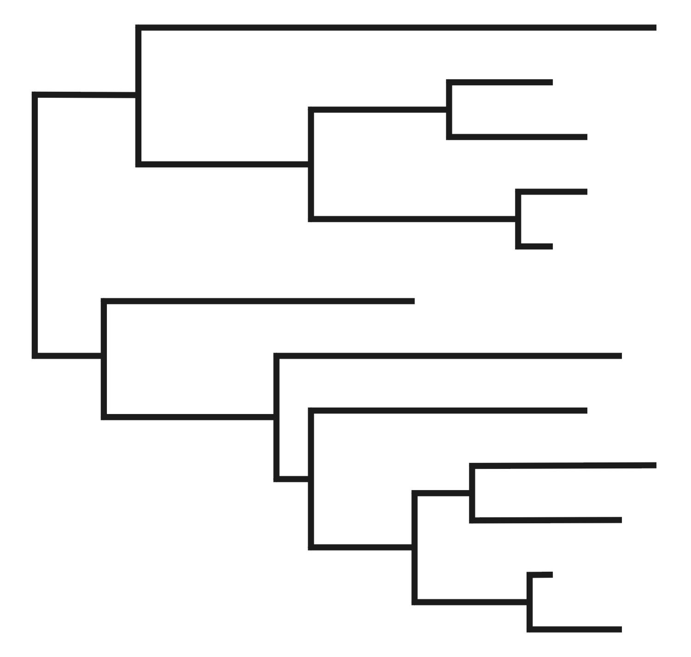
Maximum likelihood in phylogenetic analysis
data:
1 TCAAAAATGGCTTTATTCGCTTAATGCCGTTAACCCTTGCGGGGGCCATG
2 TCCGTGATGGATTTATTTCCGCAATGCCTGTCATCTTATTCTCAAGTATC
3 TTCGTGATGGATTTATTGCAGGTATGCCAGTCATCCTTTTCTCATCTATC
4 TTCGTGACGGGTTTATCTCGGCAATGCCGGTCATCCTATTTTCGAGTATT
tree:
+ evolutionary model θ
topology τ
= hypothesis
branch lengths ν
L = P(D│H): D = sequence matrix (data), H = τ (topology) + ν (branch lenghts) + θ (model)

Slide 6
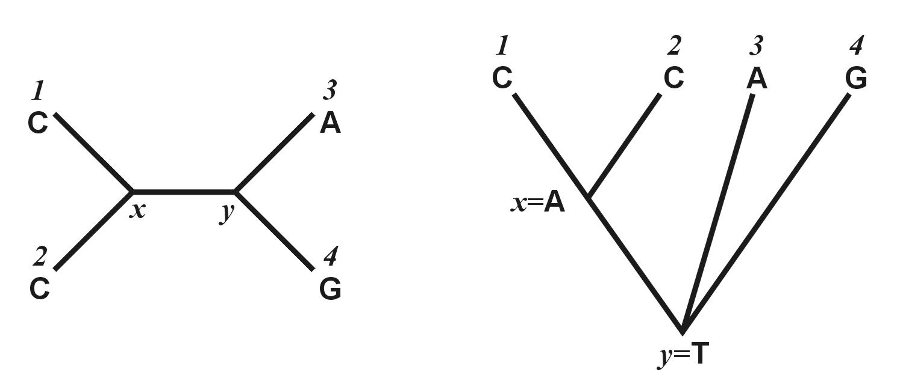
1 j N
1 TCAAAAATGGCTTTATTCGCTTAATGCCGTTAACCCTTGCGGGGGCCATG
2 TCCGTGATGGATTTATTTCCGCAATGCCTGTCATCTTATTCTCAAGTATC
3 TTCGTGATGGATTTATTGCAGGTATGCCAGTCATCCTTTTCTCATCTATC
4 TTCGTGACGGGTTTATCTCGGCAATGCCGGTCATCCTATTTTCGAGTATT
x
y

Slide 7
1 j N
1 TCAAAAATGGCTTTATTCGCTTAATGCCGTTAACCCTTGCGGGGGCCATG
2 TCCGTGATGGATTTATTTCCGCAATGCCTGTCATCTTATTCTCAAGTATC
3 TTCGTGATGGATTTATTGCAGGTATGCCAGTCATCCTTTTCTCATCTATC
4 TTCGTGACGGGTTTATCTCGGCAATGCCGGTCATCCTATTTTCGAGTATT
ν_{i} = branch lengths
ν₂
ν₁
ν₄
x
y
x
ν₅
ν₃
y

Slide 8
1 j N
1 TCAAAAATGGCTTTATTCGCTTAATGCCGTTAACCCTTGCGGGGGCCATG
2 TCCGTGATGGATTTATTTCCGCAATGCCTGTCATCTTATTCTCAAGTATC
3 TTCGTGATGGATTTATTGCAGGTATGCCAGTCATCCTTTTCTCATCTATC
4 TTCGTGACGGGTTTATCTCGGCAATGCCGGTCATCCTATTTTCGAGTATT
ν_{i} = branch lengths
ν₂
x: 4 nucleotides
ν₁
ν₄
x
ν₅
y: 4 nucleotides
4 × 4 = 16 possible scenarios
ν₃
y
L(1) = P(y)×P(y→x)ν₃×P(x→C)ν₁×P(x→C)ν₂×P(y→A)ν₄×P(y→G)ν₅
E.g. L(1; x=A,y=T) = P(T)×P(T→A)ν₃×P(A→C)ν₁×P(A→C)ν₂×P(T→A)ν₄
×P(T→G)ν₅
L(j) = P(scenario 1) + …. + P(scenario 16)

Slide 9


1 j N
1 TCAAAAATGGCTTTATTCGCTTAATGCCGTTAACCCTTGCGGGGGCCATG
2 TCCGTGATGGATTTATTTCCGCAATGCCTGTCATCTTATTCTCAAGTATC
3 TTCGTGATGGATTTATTGCAGGTATGCCAGTCATCCTTTTCTCATCTATC
4 TTCGTGACGGGTTTATCTCGGCAATGCCGGTCATCCTATTTTCGAGTATT
ν_{i} = branch lengths
ν₂
x: 4 nucleotides
ν₁
ν₄
x
ν₅
y: 4 nucleotides
4 × 4 = 16 possible scenarios
ν₃
y
all sites: L = L(1) × L(2) × … × L(j) × … × L(N) =
lnL = lnL(1) + lnL(2) + … + lnL(N) =

Slide 10
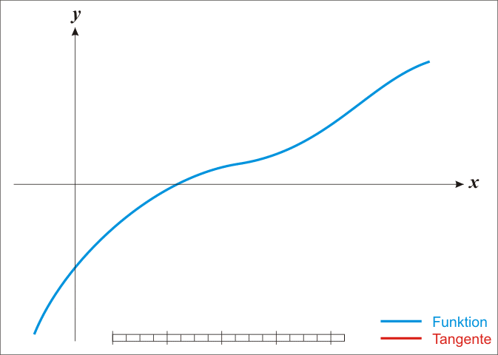
Search for maximum likelihood of the tree
→ eg. Newton (Newton-Raphson) method
https://upload.wikimedia.org/wikipedia/commons/e/e0/NewtonIteration_Ani.gif
Maximum likelihood tree search: heuristic search

Slide 11
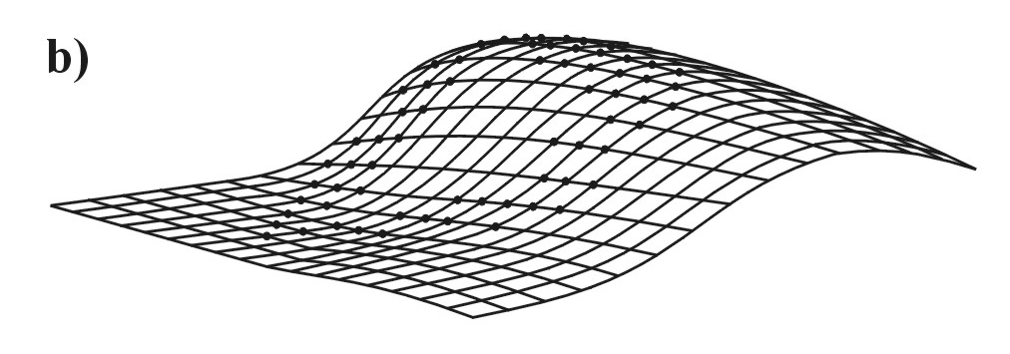
Heuristic search
stepwise addition ... eg. PHYLIP
star decomposition ... eg. MOLPHY; neighbor-joining tree
branch swapping

Slide 12
A
A
Likelihood (ML) and parsimony (MP)
No. changes Parsimony
No. changes Parsimony
A
G

Slide 13
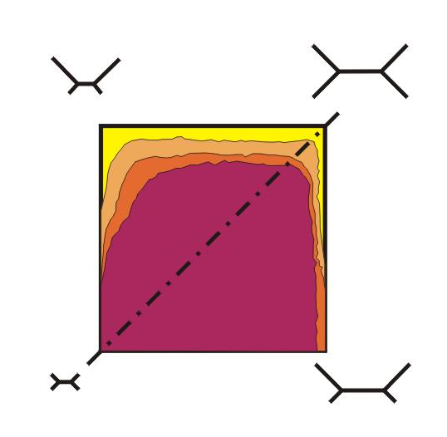
Likelihood and consistency

Slide 14
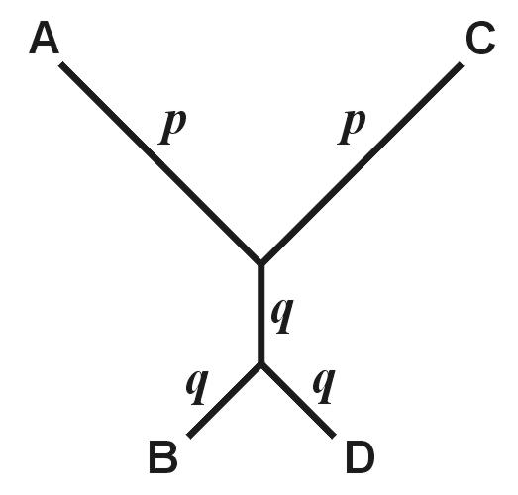
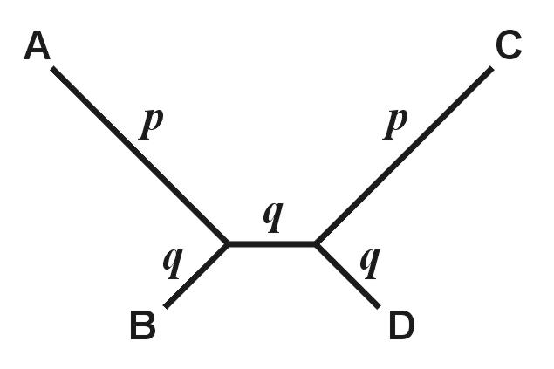
“true”
“wrong”
Farris
(anti-Felsenstein,
inverse Felsenstein)
zone
“long-branch repulsion”

Slide 15
A
C
B
D

Slide 16
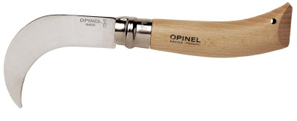


Measuring tree reliability
Resampling methods
without replacement = jackknife
with replacement = bootstrap

Slide 17
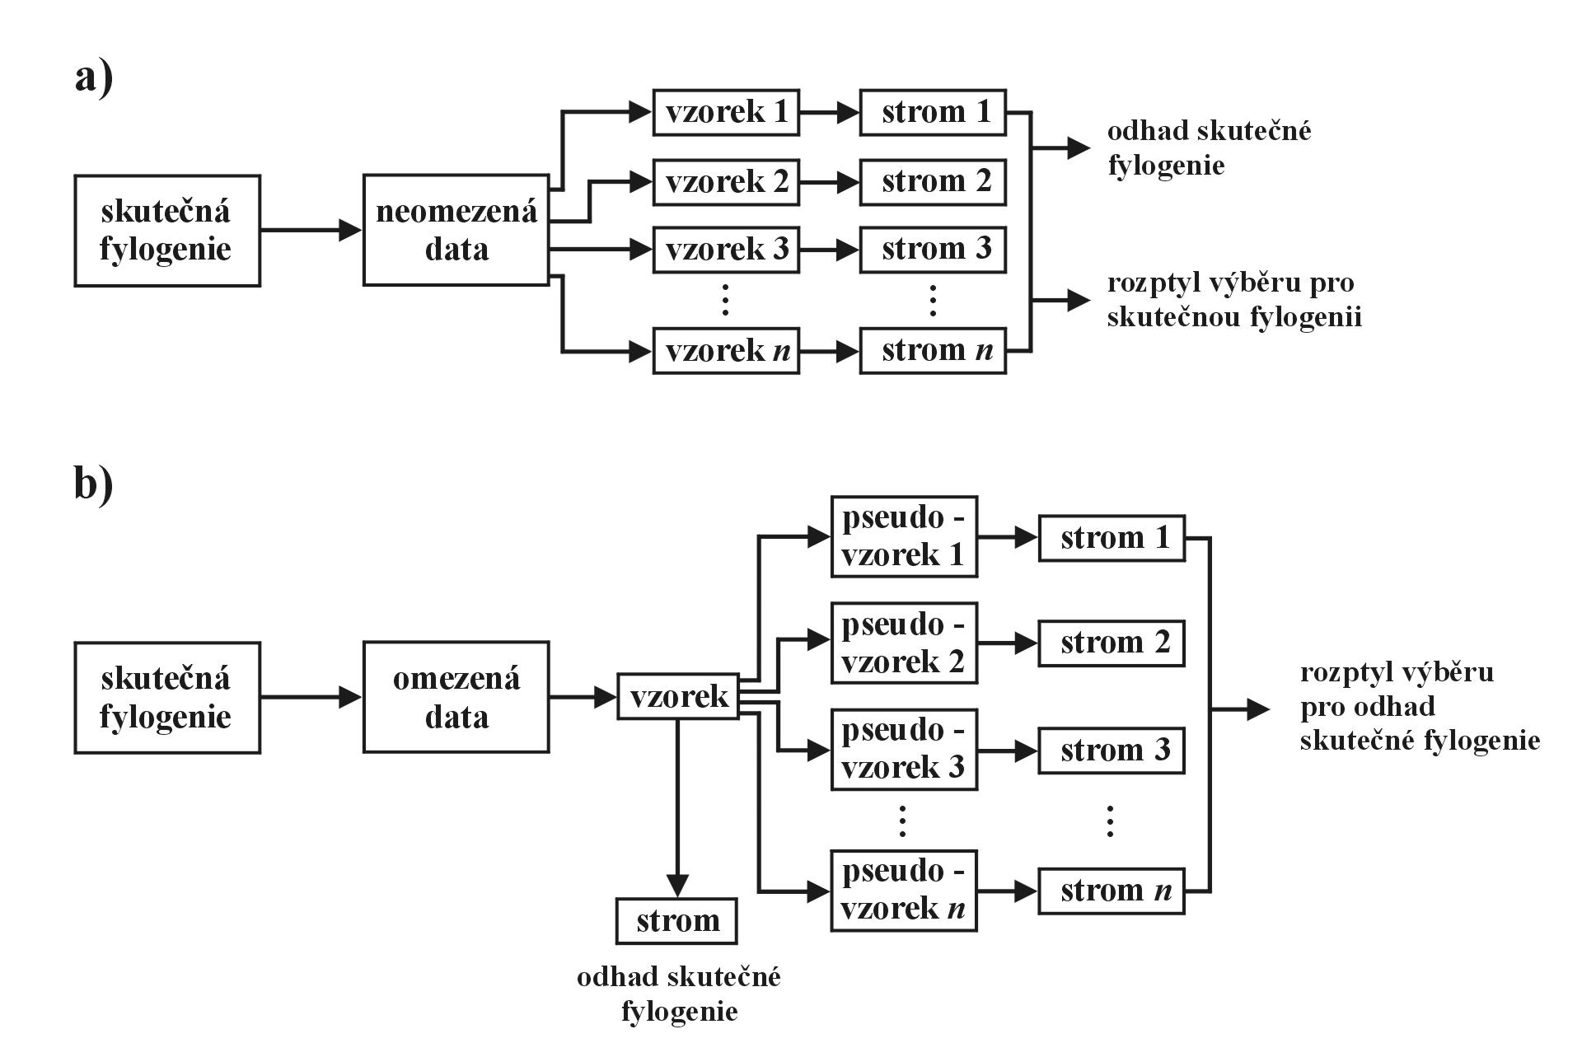
bootstrap:

Slide 18
bootstrap:

Slide 19
bootstrap:

Slide 20
parametric bootstrap: evolutionary model
Bayesian analysis: posterior probabilities

Slide 21
BayesIAN analysis
(Bayesovská analýza)
ML: Probability of data given hypothesis
Bayesian approach:
Conditional probability of hypothesis given data
P(H⏐D)
Example.: set of 100 dice, from which we choose one
we know that of 100 dice, 80 are ‘fair’ and 20 biased for 6
2 throws: 1. throw = 2. throw =
What is the probability our dice is biased?

Slide 22
probability of individual results:
all the same in unbiased dice, varied in biased dice:
 | unbiased | biased
 | 1/6 | 1/21
 | 1/6 | 3/21
 | 1/6 | 3/21
 | 1/6 | 4/21
 | 1/6 | 4/21
 | 1/6 | 6/21

Slide 23
P(H⏐D) is called posterior probability (aposteriorní pravděpodobnost)
posterior probability is a function of likelihood L = P(D⏐H)
and prior probability (apriorní pravděpodobnost) reflecting our
a priori expectation or knowledge
Posterior probability that the coin is biased is given by
the Bayes equation:
likelihood
prior probability
P(D⏐H) × P(H)
P(H⏐D) =
Σ[P(D⏐H_{i})×P(H_{i})]
sum of numerators across all alternative hypotheses
Thomas Bayes

Slide 24
For our example of 2 dice throws:
 | unbiased | biased
 | 1/6 | 1/21
 | 1/6 | 3/21
 | 1/6 | 3/21
 | 1/6 | 4/21
 | 1/6 | 4/21
 | 1/6 | 6/21
prior probability (biased) = 0,2
(20/100 biased dice in the set)
Pr. of getting with unbiased dice:
P = 1/6 × 1/6 = 1/36
Pr. of getting with biased dice:
P = 3/21 × 6/21 = 18/441
P( |biased) × P(biased)
P(biased| ) =
P( |biased) × P(biased) +
P( |fair) × P(fair)
18/441 × 2/10
= = 0,269
18/441 × 2/10 + 1/36 × 8/10

Slide 25

Bayesian method in phylogenetic analysis:
posterior probability
likelihood
prior probability
sum across all hypotheses
(= marginal likelihood)

Slide 26

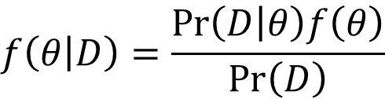
Parameters of Bayesian analysis mostly continuous ⇒
P → probability density functions
either ML estimates → empirical BA
or all combinations → hierarchical BA
prior distribution
likelihood
posterior distribution
$$f\left(θ | D\right)=\frac{Pr\left(D | θ\right)f\left(θ\right)}{Pr\left(D\right)}$$
marginal likelihood
θ = set of (continuous) parameters in the model, including the tree, substitution model parameters, clock rates, etc.

Slide 27
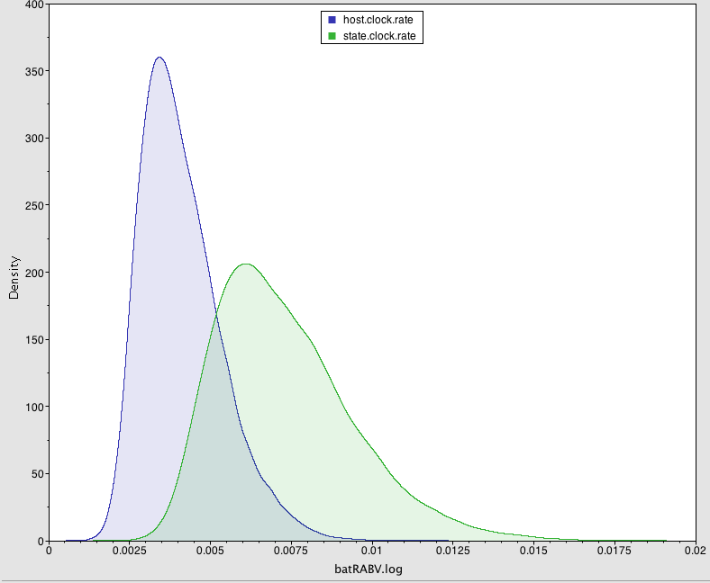
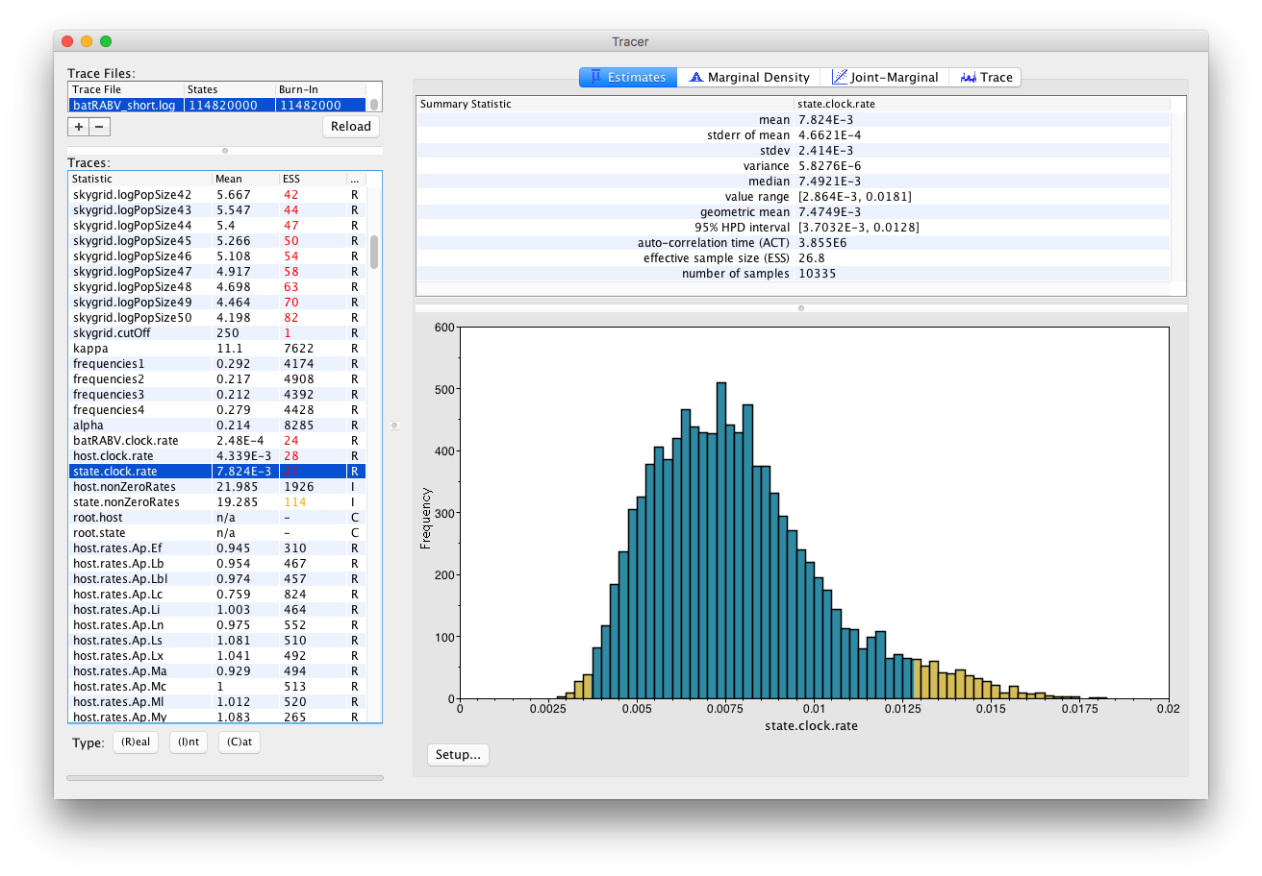
outcome = probability distribution
HPD = highest posterior density

Slide 28
Problem: calculations too complex ⇒ impossible to solve analytically,
only numerically
solution: Monte Carlo methods
random sampling, approximation of reality when sample size high
Markov chain Monte Carlo (MCMC)
Markov process: t₋₁: A → t₀: C → t₊₁: G
Markov property = „memorylessness“
… P same across the whole phylogeny = homogenous Markov process

Slide 30
Metropolis-Hastings algorithm:

Slide 31
Metropolis-Hastings algorithm:
Change of parameter x → x’
if P(x’) > P(x), accep x’
if P(x’) ≤ P(x), calculate R = P(x’)/P(x)
since P(x’) ≤ P(x), R must be ≤ 1
generate random number U from uniform distribution from interval (0, 1)
if R ≥ U, accept x’, if not, retain x

Slide 32
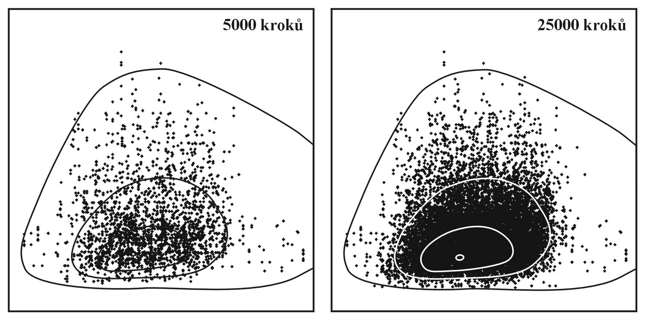
directed movement of robot across arena:
arena „countours“

Slide 33
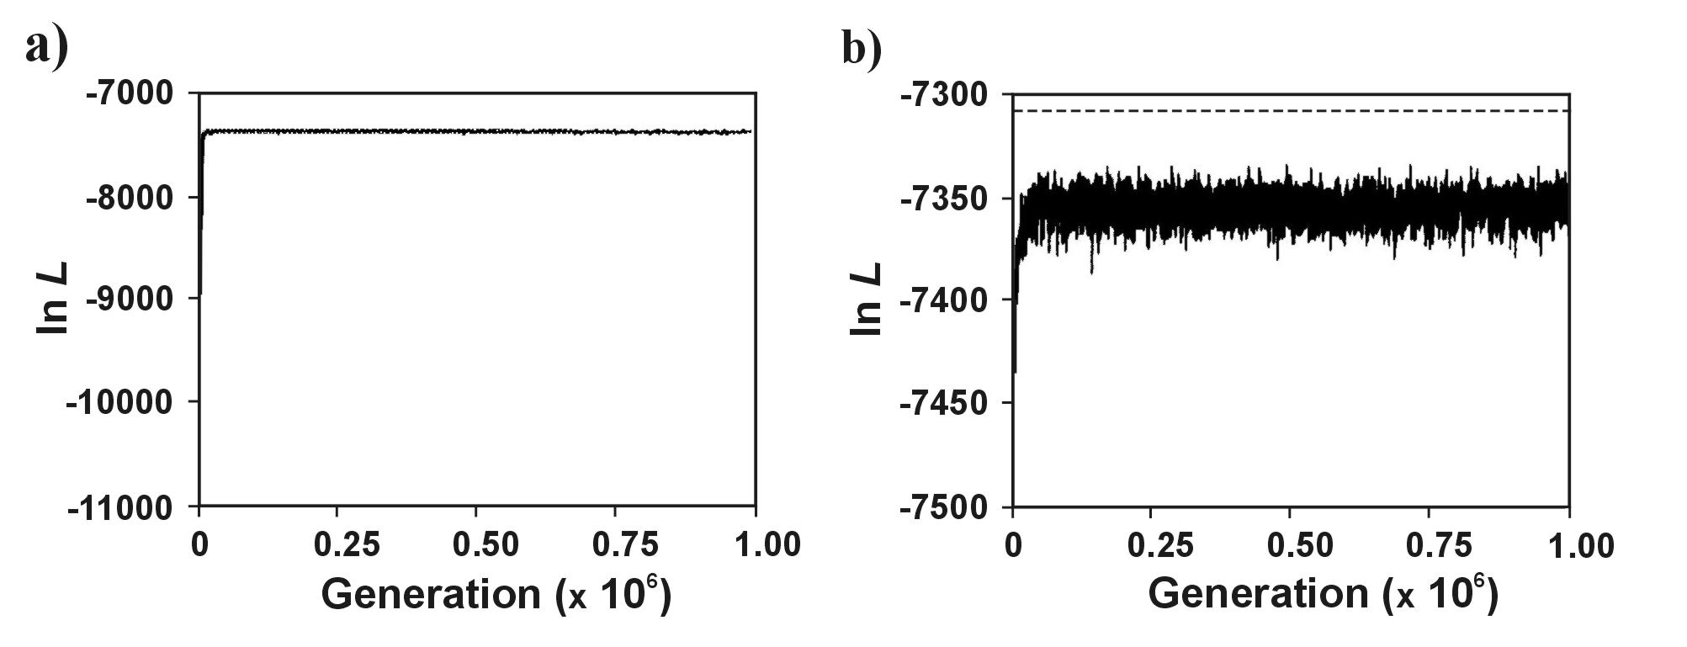
stationary phase (plateau)
“burn-in”

Slide 34
Reversible jump MCMC:
allows changing number of parameters in each MC step
we can use eg. for modelling variation of evolution between sites
in sequences, for choosing models or for making non-homogenous
substitution models (eg. different base composition along branches)
Metropolis coupled MCMC (MCMCMC, MC³):
1 „cold“ chain, 3 „heated“ chains
same starting point, due to stochasticity rapid divergence of „robots“
MrBayes: http://morphbank.ebc.uu.se/mrbayes/

Slide 35
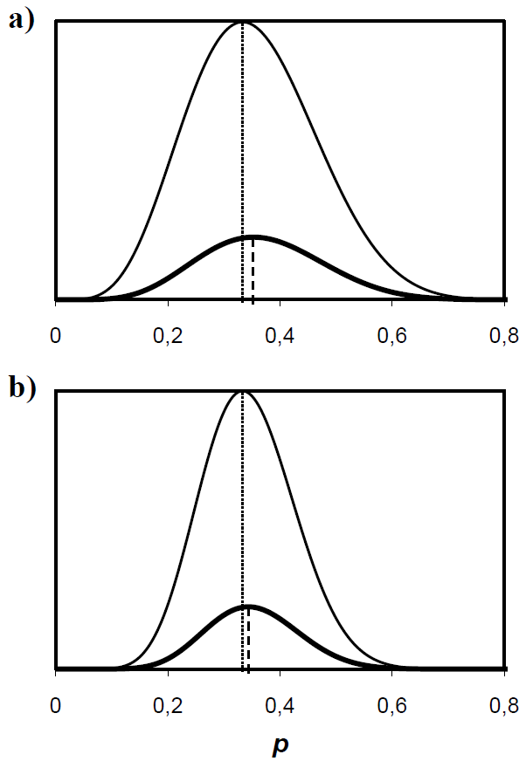
Problem with priors
prior = 0,5
maximum likelihood = 0,333
15 coin tosses
score 5 H : 10 O
due to prior, posterior pr.
shifted to the right
30 coin tosses
score 10 H : 20 O
difference from ML smaller

Slide 36
Which priors to choose?
uniform (min, max)
lognormal (μ, σ)
gamma (α, β)
exponential (λ)
Minimal divergence time Time

Slide 37
Setting priors:
Gamma (α, β)
Density
Hyperparameter
Density
Lognormal (μ, σ)
Parameter

Slide 38
95% highest posterior density (HPD) interval of node heights

Slide 39
Time-trees and phylodynamics
Phylodynamics = synthesis of mathematical epidemiology and statistical
phylogenetics

Slide 40
Hypothesis testing
Test of molecular clock:
Relative rate test (RRT): AC=BC?
Linearized trees
removing significantly different taxa

Slide 41
Relaxed molecular clock
enable changing rates along branches
scaled time
(expected no. substitutions/site)
unscaled time
multiplicator

Slide 42
Consensus trees
source trees
strict consensus
strict consensus tree

Slide 43
majority-rule
source trees
majority-rule consensus

Slide 44
Consensus trees
problem with consensus trees – combined vs.
separate analysis, supermatrix vs. supertree
consensus trees in resampling methods
Bayesian analysis:
consensus tree
maximum a posteriori tree = tree with greatest posterior probability
(i.e. was sampled most often in the MCMC)
maximum credibility tree = tree with the maximum product of the posterior
clade probabilities (BEAST, TreeAnnotator)

Slide 45
Phylogenetic programs
phylogeny inference:
http://evolution.gs.washington.edu/phylip/software.html
PAUP*
PHYLIP
MOLPHY, PHYML, MEGA ... ML
MrBayes, BEAST ... BA
managing trees:
TreeView
FigTree

