Slide 1
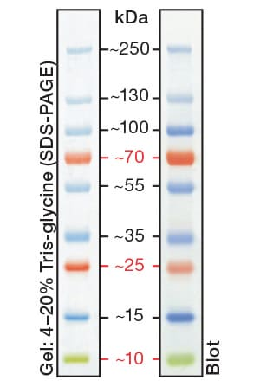
Marker:
Schéma membrán:
Studenti Společné vzorky
1 | 2 | 3 | 4 | 5 | 6 | 7 | 8 | 9 | 10 | 11 | 12 | 13 | 14 | 15
- | M | -K | K | W | R | WR | M | -K | K | W | R | WR | M | -
1 | 2 | 3 | 4 | 5 | 6 | 7 | 8 | 9 | 10 | 11 | 12 | 13 | 14 | 15
M | TCL | IgG | Flag | M | TCL | IgG | Flag | M | -K | K | W | R | WR | M
p-LRP6 ^{1A} |  | LRP6 ^{2A}
Aktivní β-catenin ^{1B} |  | DVL ^{2B}
Aktin beta ^{1C} |  | Tubulin α ^{2C}

Slide 2
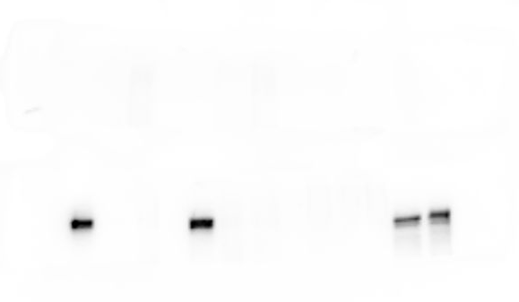
1 | 2 | 3 | 4 | 5 | 6 | 7 | 8 | 9 | 10 | 11 | 12 | 13 | 14 | 15
M | TCL | IgG | Flag | M | TCL | IgG | Flag | M | -K | K | W | R | WR | M
250 kDa
P-LRP6
150-250 kDa
250 kDa
Total-LRP6
150-250 kDa
1 | 2 | 3 | 4 | 5 | 6 | 7 | 8 | 9 | 10 | 11 | 12 | 13 | 14 | 15
M | TCL | IgG | Flag | M | TCL | IgG | Flag | M | -K | K | W | R | WR | M
1A
250 kDa
P-LRP6
150-250 kDa
2A
250 kDa
Total-LRP6
150-250 kDa
Notes:
Fotka: expozice – 1min

Slide 3
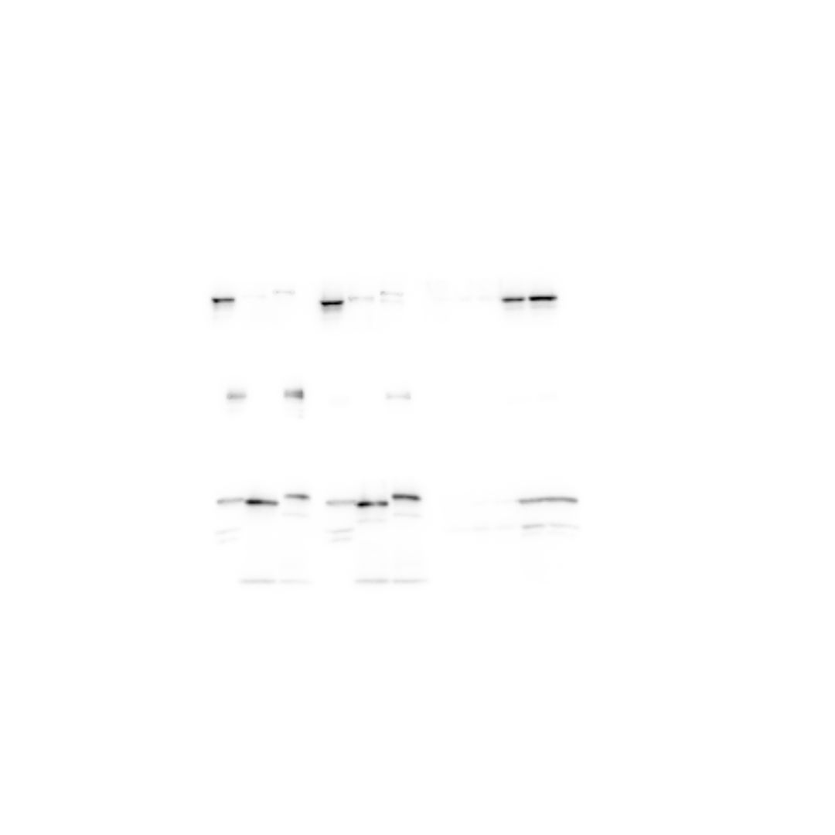
1 | 2 | 3 | 4 | 5 | 6 | 7 | 8 | 9 | 10 | 11 | 12 | 13 | 14 | 15
M | TCL | IgG | Flag | M | TCL | IgG | Flag | M | -K | K | W | R | WR | M
100 kDa
β-catenin
92 kDa
70 kDa
1 | 2 | 3 | 4 | 5 | 6 | 7 | 8 | 9 | 10 | 11 | 12 | 13 | 14 | 15
M | TCL | IgG | Flag | M | TCL | IgG | Flag | M | -K | K | W | R | WR | M
100 kDa
1B
β-catenin
92 kDa
70 kDa
Notes:
Fotka: expozice – 10 sec

Slide 4
1 | 2 | 3 | 4 | 5 | 6 | 7 | 8 | 9 | 10 | 11 | 12 | 13 | 14 | 15
M | TCL | IgG | Flag | M | TCL | IgG | Flag | M | -K | K | W | R | WR | M
100 kDa
DVL2
90–95 kDa
70 kDa
1 | 2 | 3 | 4 | 5 | 6 | 7 | 8 | 9 | 10 | 11 | 12 | 13 | 14 | 15
M | TCL | IgG | Flag | M | TCL | IgG | Flag | M | -K | K | W | R | WR | M
100 kDa
2B
DVL2
90–95 kDa
70 kDa
Notes:
Fotka: expozice – 10 sec

Slide 5
1 | 2 | 3 | 4 | 5 | 6 | 7 | 8 | 9 | 10 | 11 | 12 | 13 | 14 | 15
M | TCL | IgG | Flag | M | TCL | IgG | Flag | M | -K | K | W | R | WR | M
55 kDa
CK1
45 kDa
35 kDa
25 kDa
1 | 2 | 3 | 4 | 5 | 6 | 7 | 8 | 9 | 10 | 11 | 12 | 13 | 14 | 15
M | TCL | IgG | Flag | M | TCL | IgG | Flag | M | -K | K | W | R | WR | M
55 kDa
1C
CK1
45 kDa
35 kDa
25 kDa
Notes:
Fotka: expozice – 10 sec

Slide 6
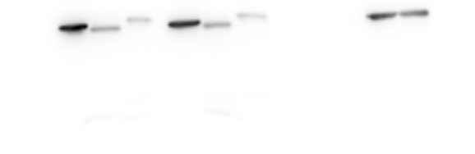
1 | 2 | 3 | 4 | 5 | 6 | 7 | 8 | 9 | 10 | 11 | 12 | 13 | 14 | 15
M | TCL | IgG | Flag | M | TCL | IgG | Flag | M | -K | K | W | R | WR | M
55 kDa
Tubulin α
55 kDa
35 kDa
25 kDa
1 | 2 | 3 | 4 | 5 | 6 | 7 | 8 | 9 | 10 | 11 | 12 | 13 | 14 | 15
M | TCL | IgG | Flag | M | TCL | IgG | Flag | M | -K | K | W | R | WR | M
55 kDa
2C
Tubulin α
55 kDa
35 kDa
25 kDa
Notes:
Fotka: expozice – 3 sec

