Slide 1

Lecture 11. C. elegans genetics and development. dsRNA biology and methods. 6.12.24
Dad … and Mum.

Slide 2
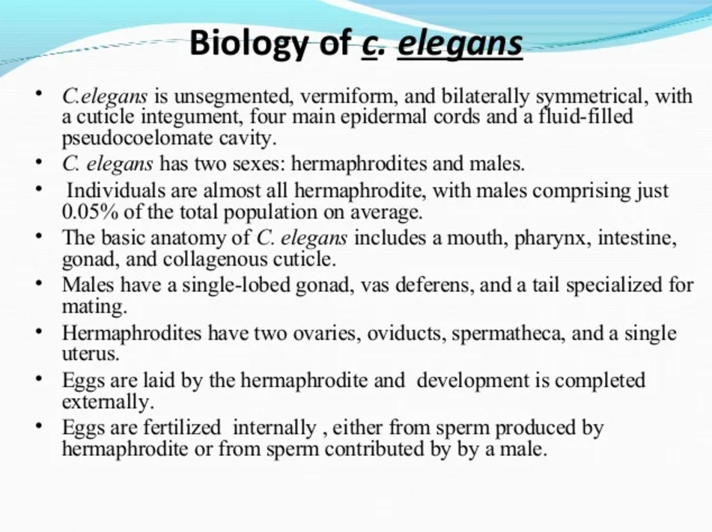

Slide 3
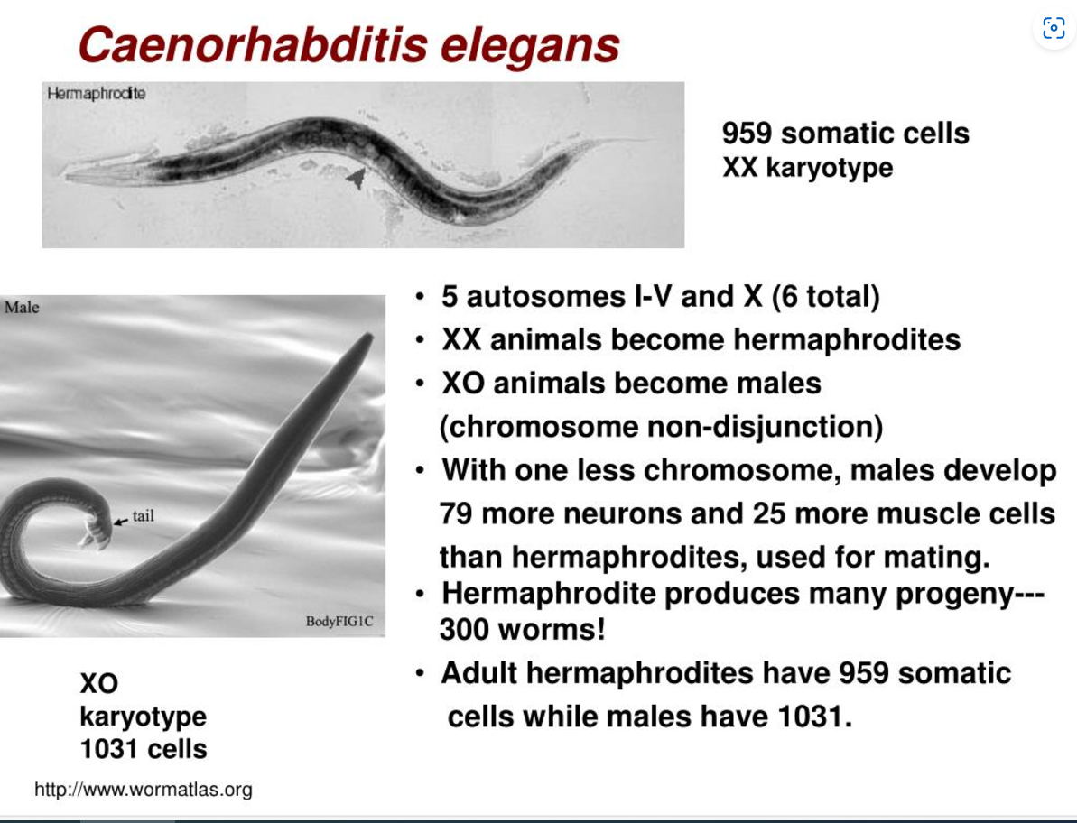

Slide 4
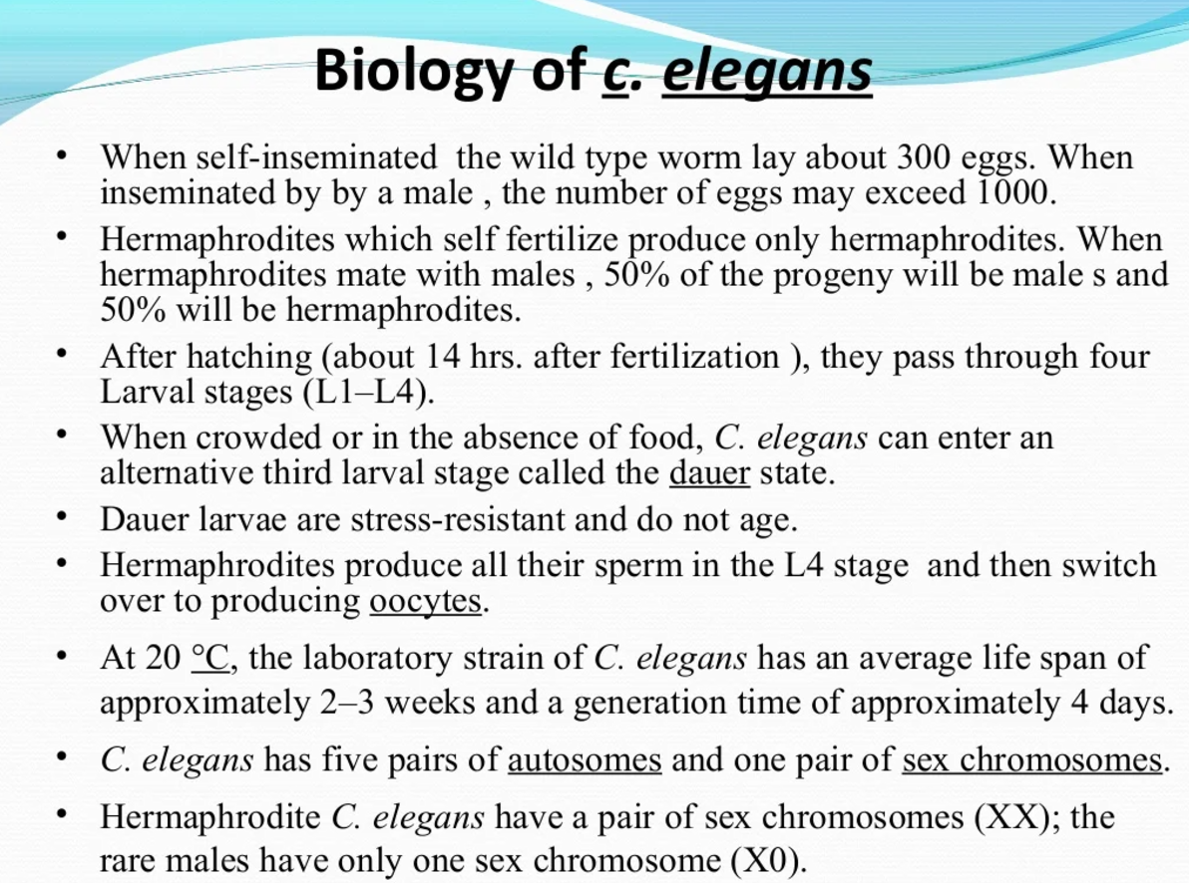

Slide 5
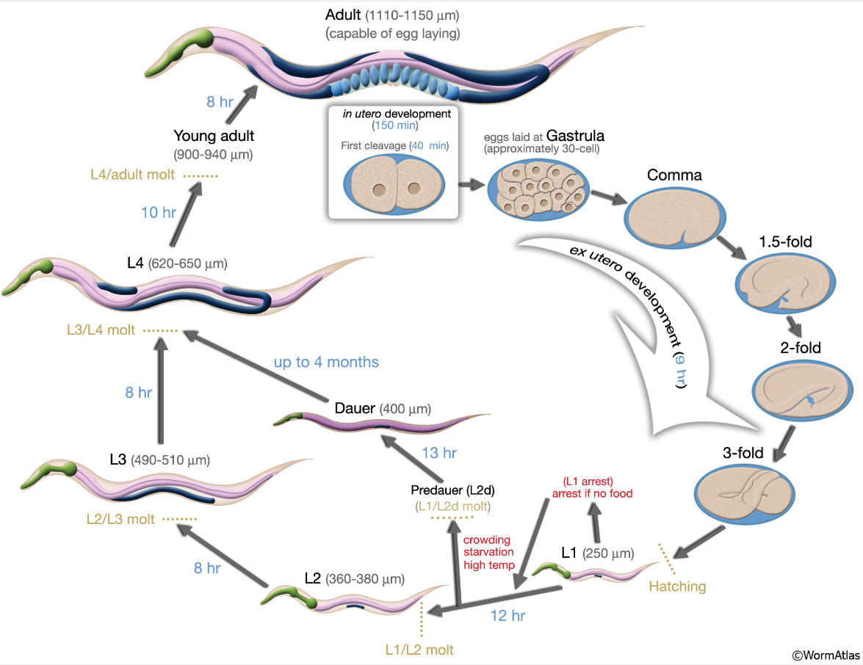

Slide 6
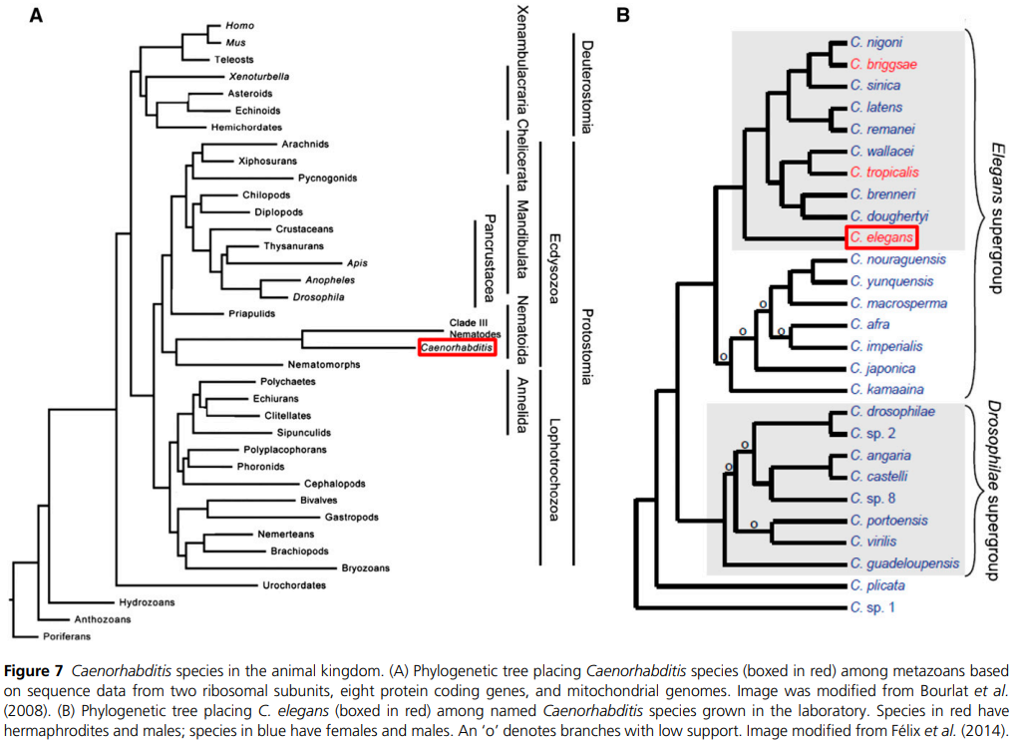
New evolutionary group, Ecdysozoa, links C. elegans to Drosophila as moulting bilaterian invertebrates.

Slide 7
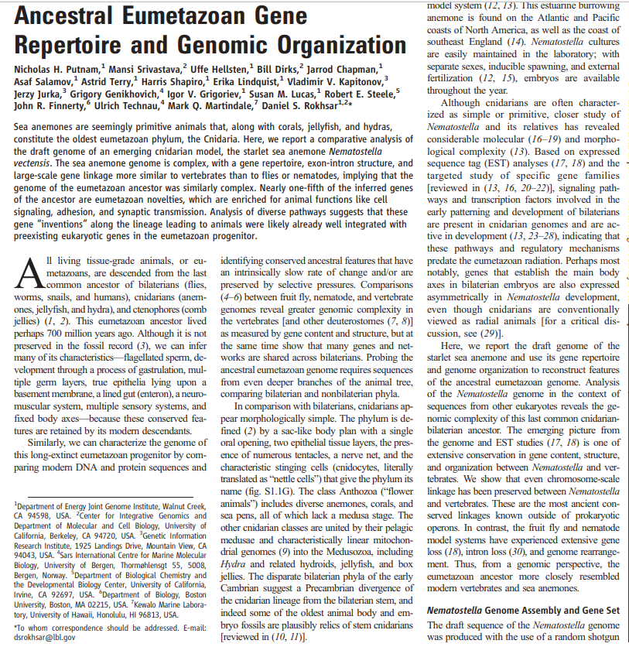
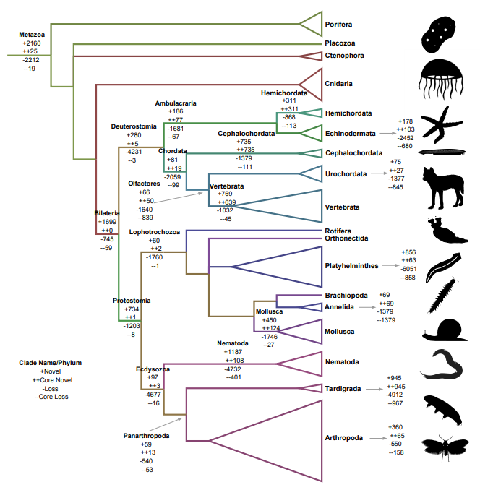
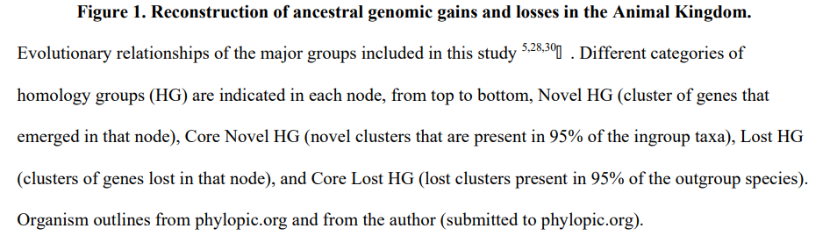
Surprising Ecdysozoan evolutionary gene loss since Nematostella.
Helps explain invertebrate genetic model success; less gene redundancy.

Slide 9
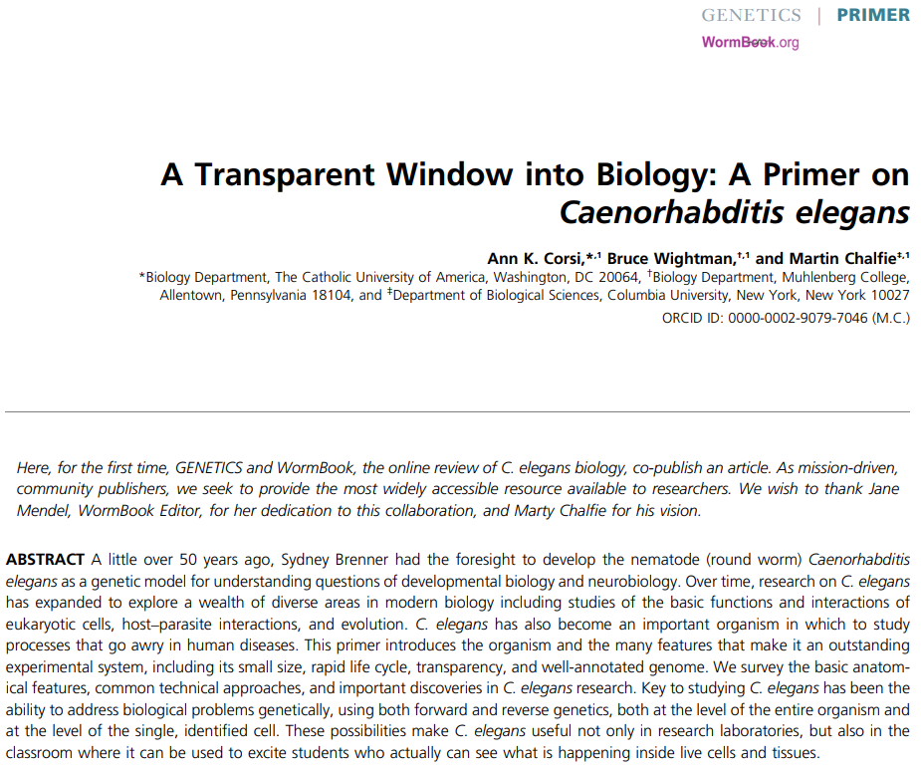

Slide 10
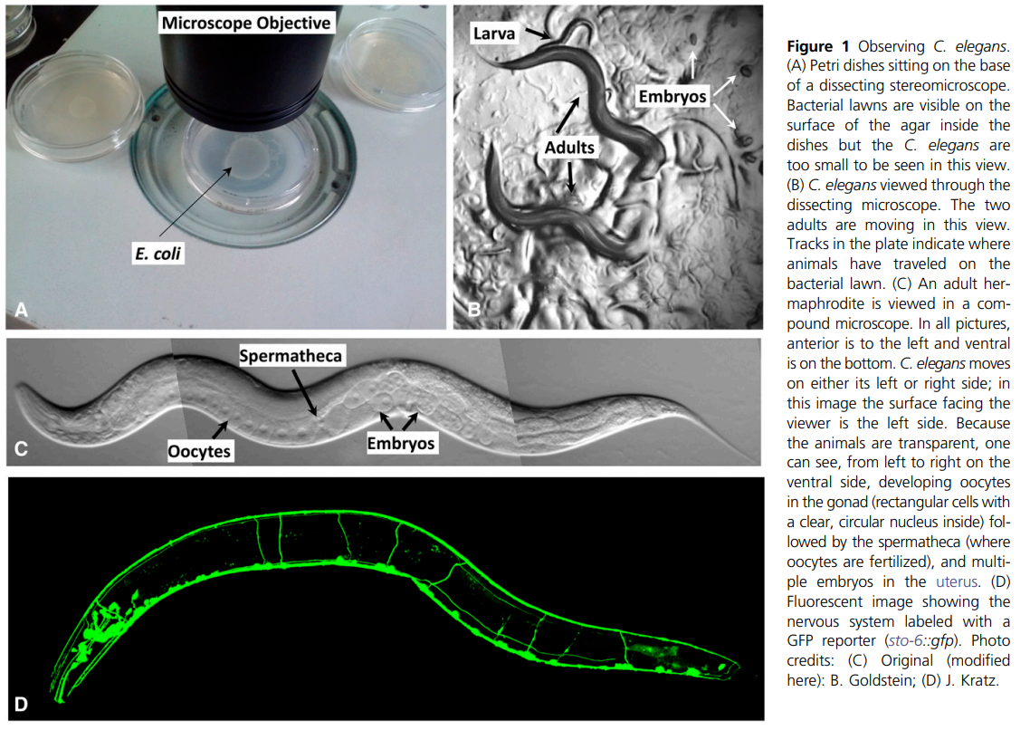

Slide 11
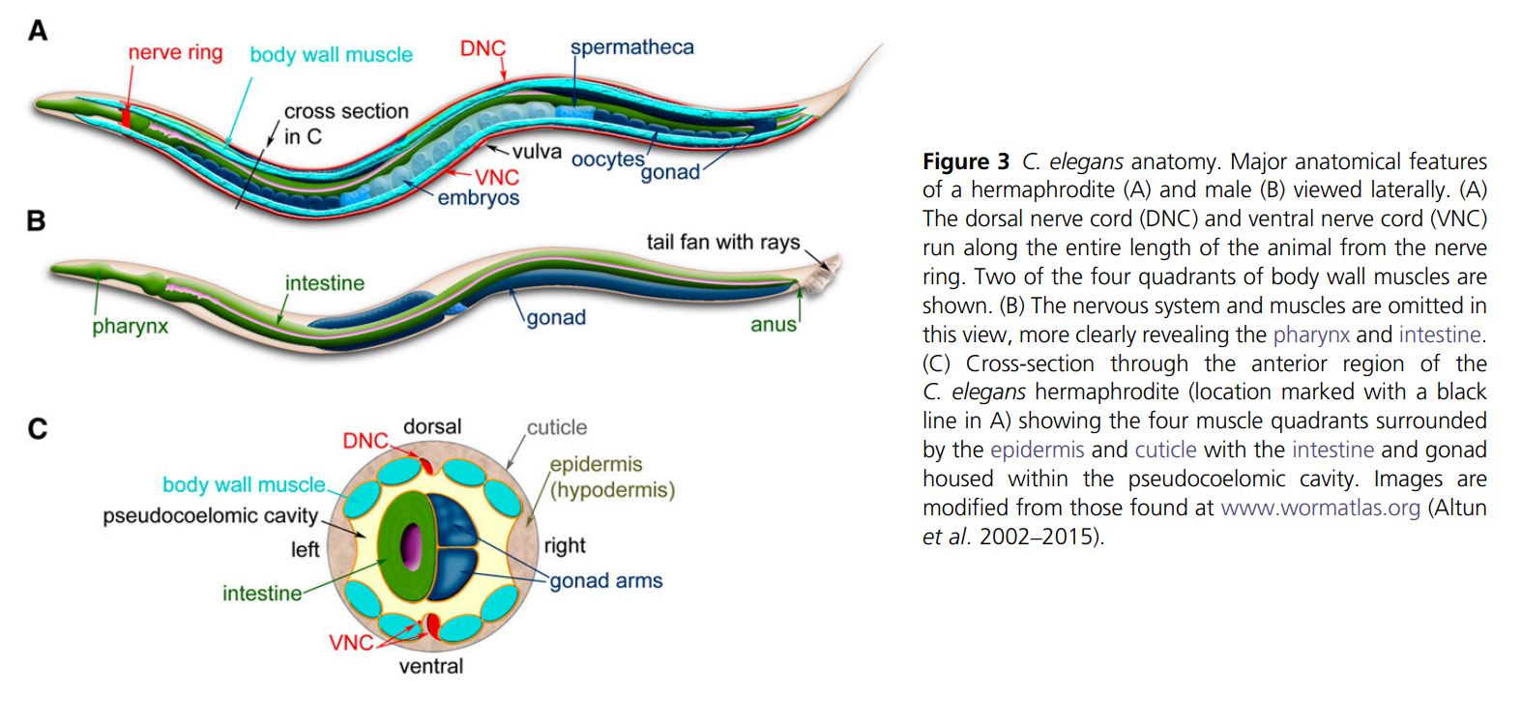

Slide 13
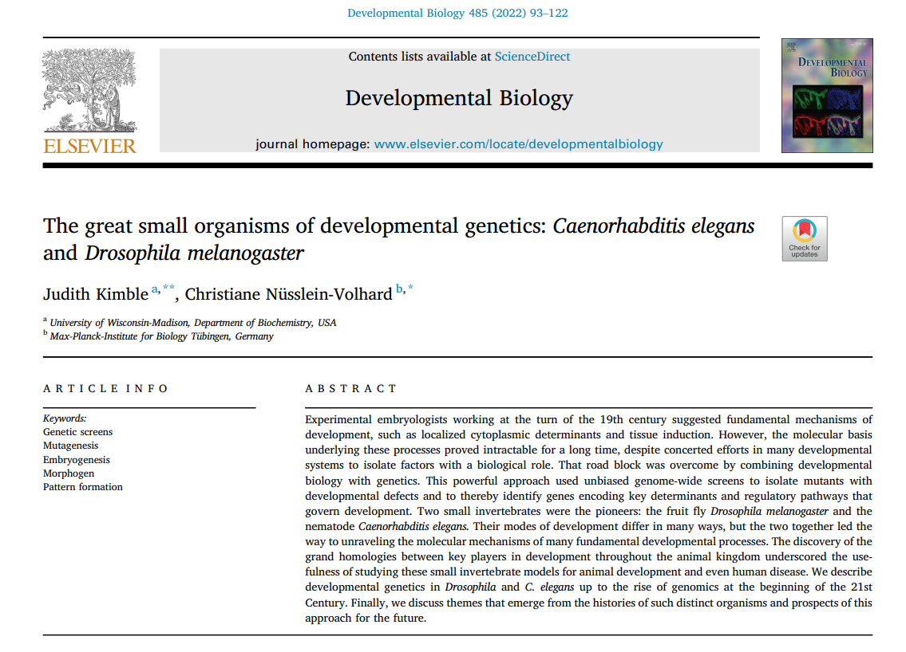

Slide 14
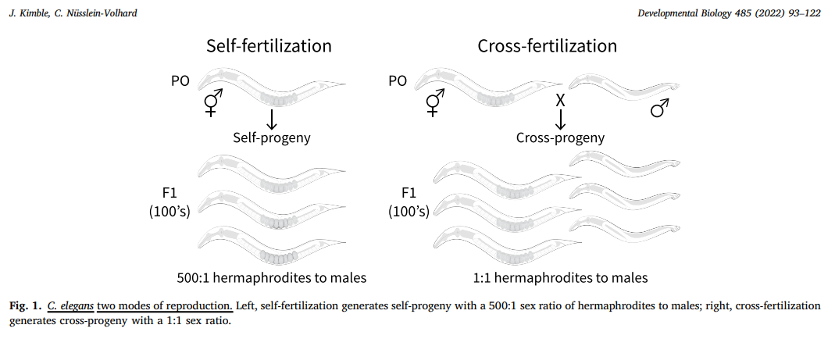

Slide 15
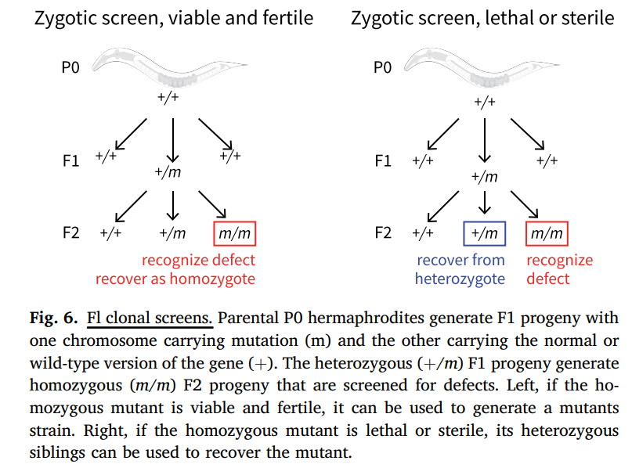

Slide 16
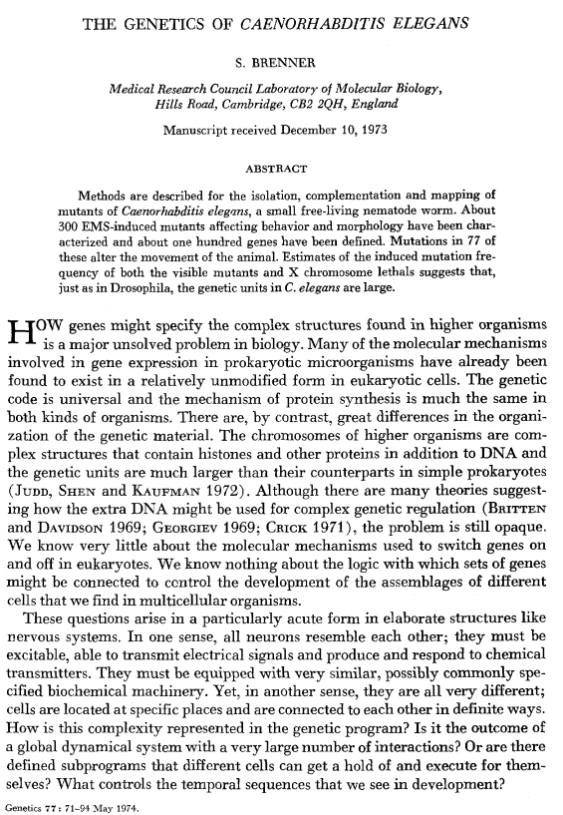
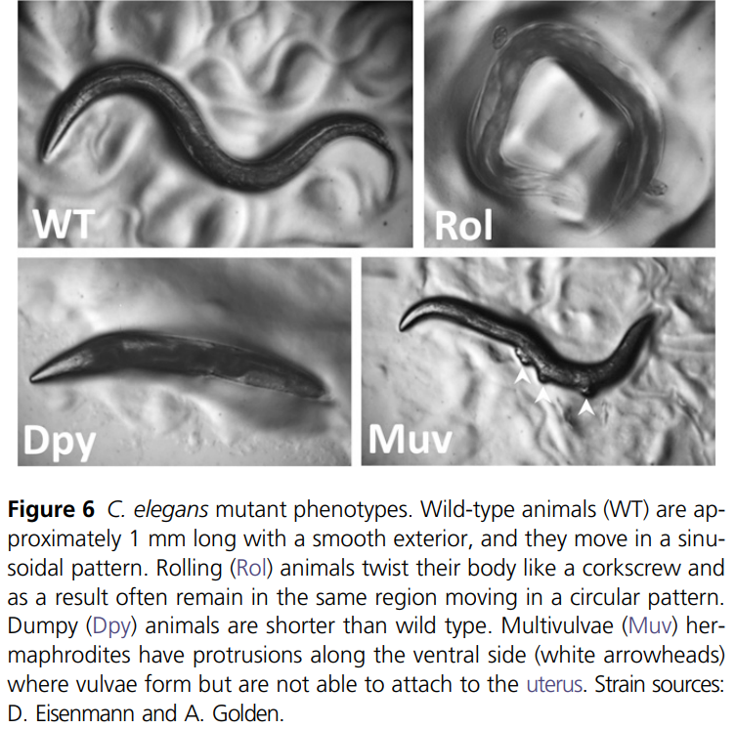

Slide 17
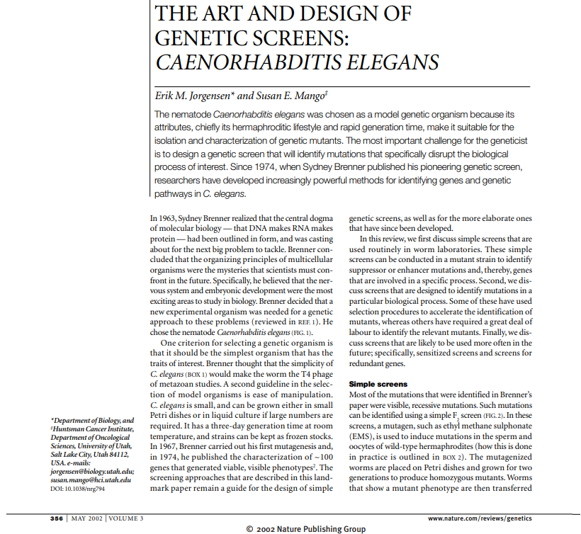
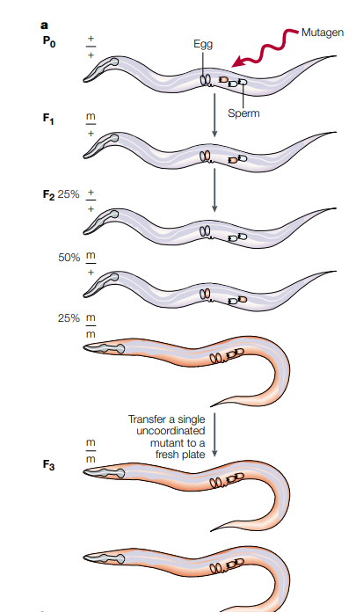
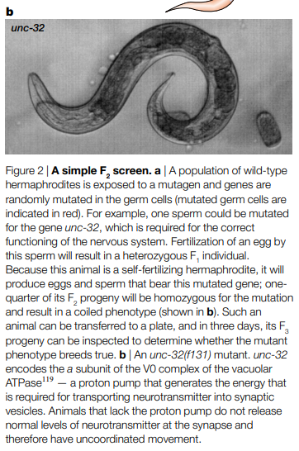

Slide 18
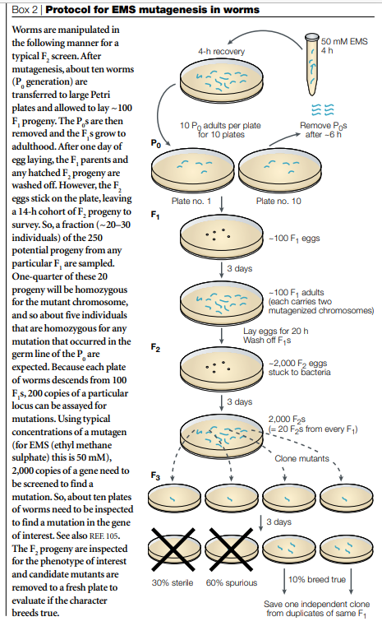

Slide 19
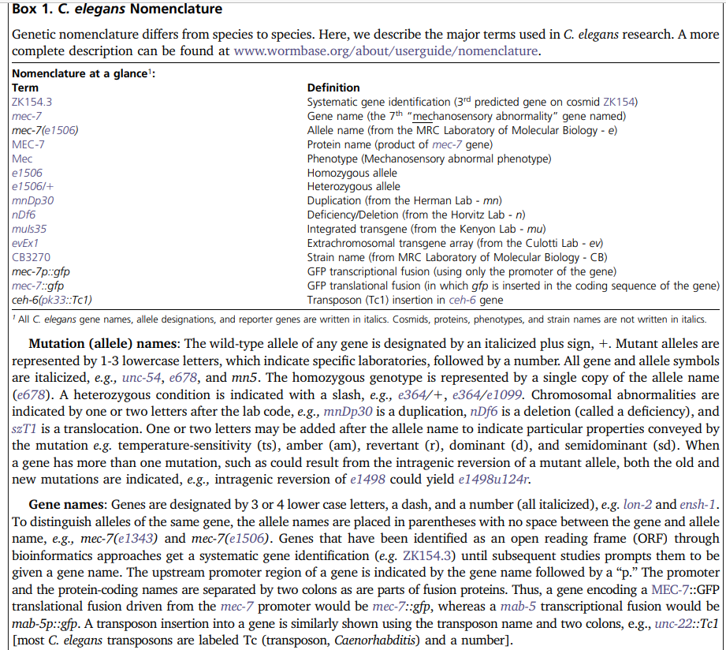

Slide 20
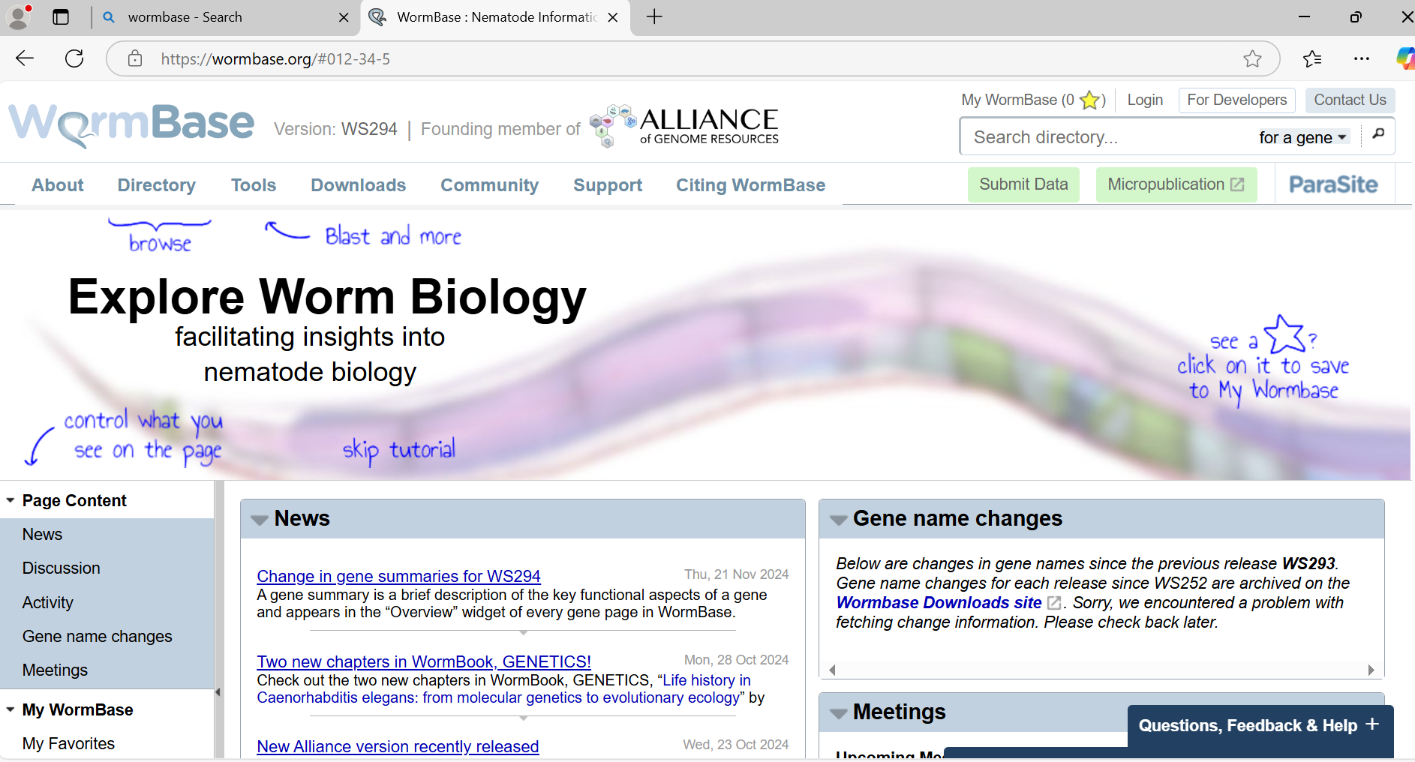

Slide 21
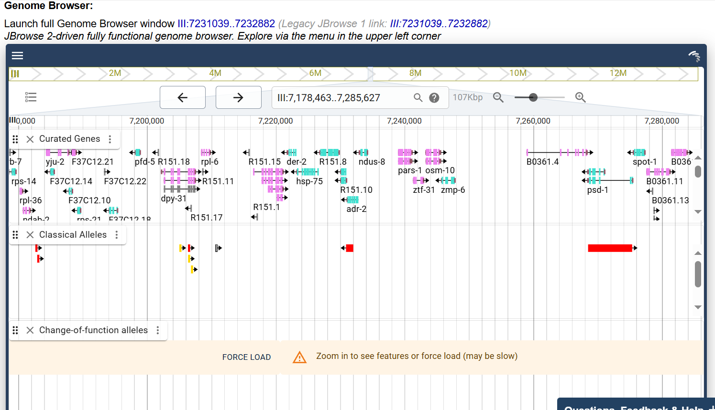

Slide 22
Famous work on cell death and ageing in C. elegans.

Slide 23
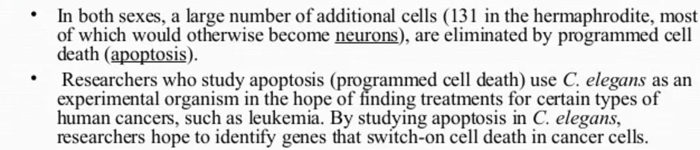
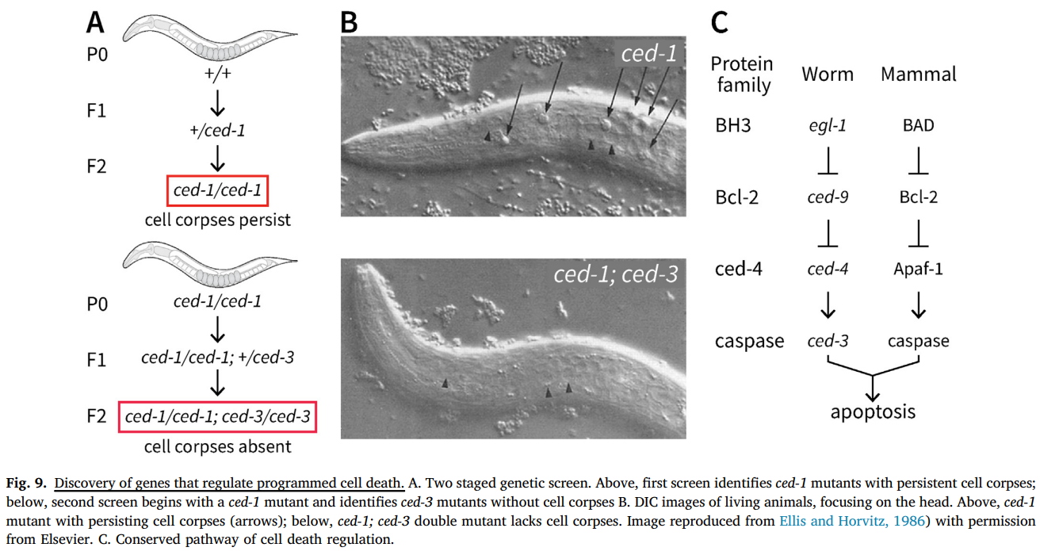
Cell death (ced) genes

Slide 24
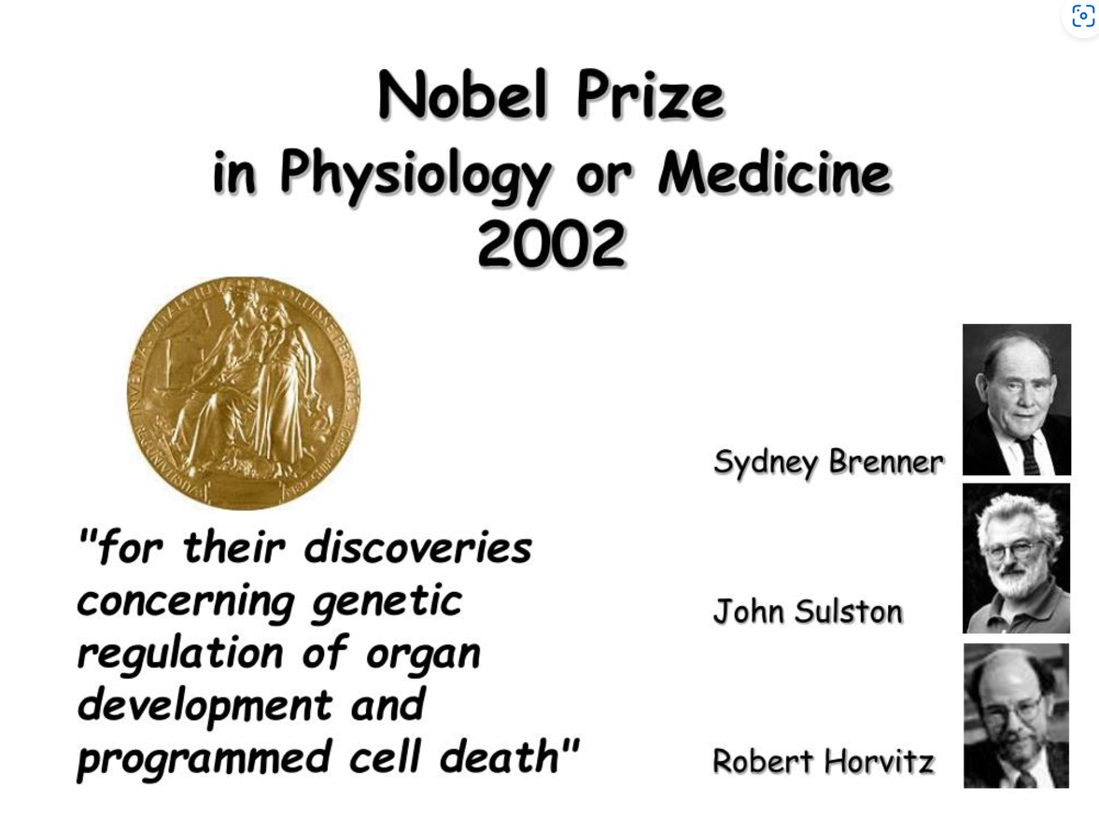
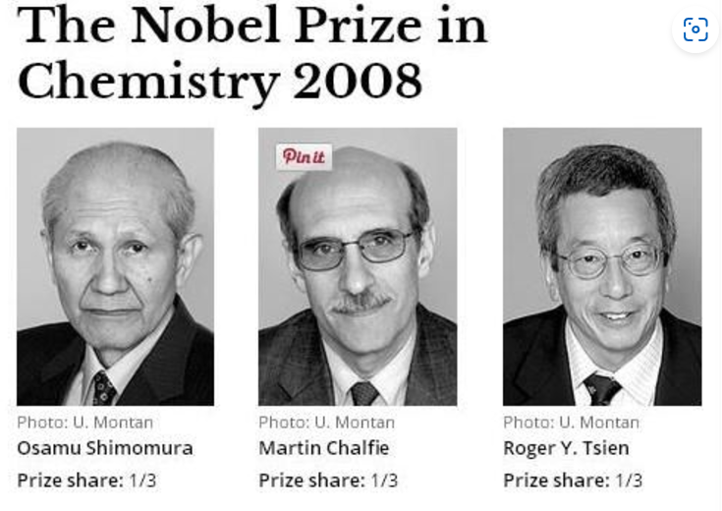

Slide 25
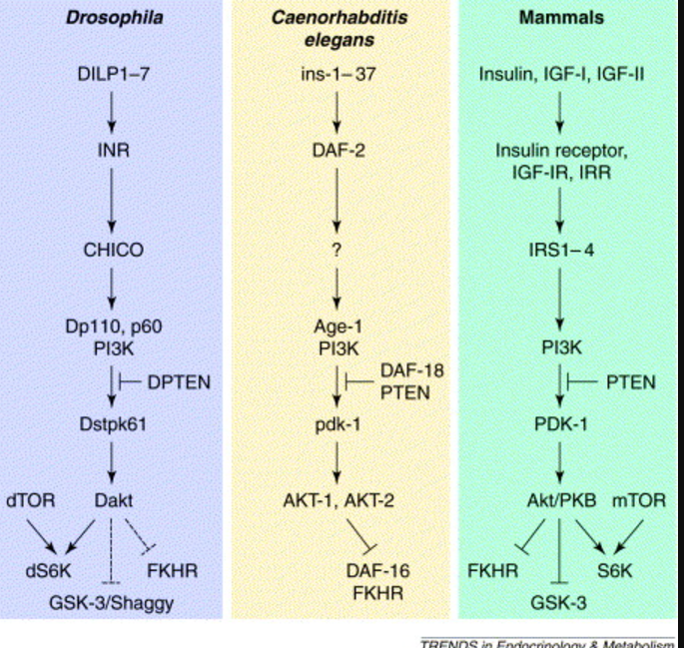
Ageing genes identified in worms are also conserved and encode insulin signaling proteins.
See also, Wormatlas worm ageing movies

Slide 27
Development by a fixed cell lineage and mutants affecting lineages.

Slide 28
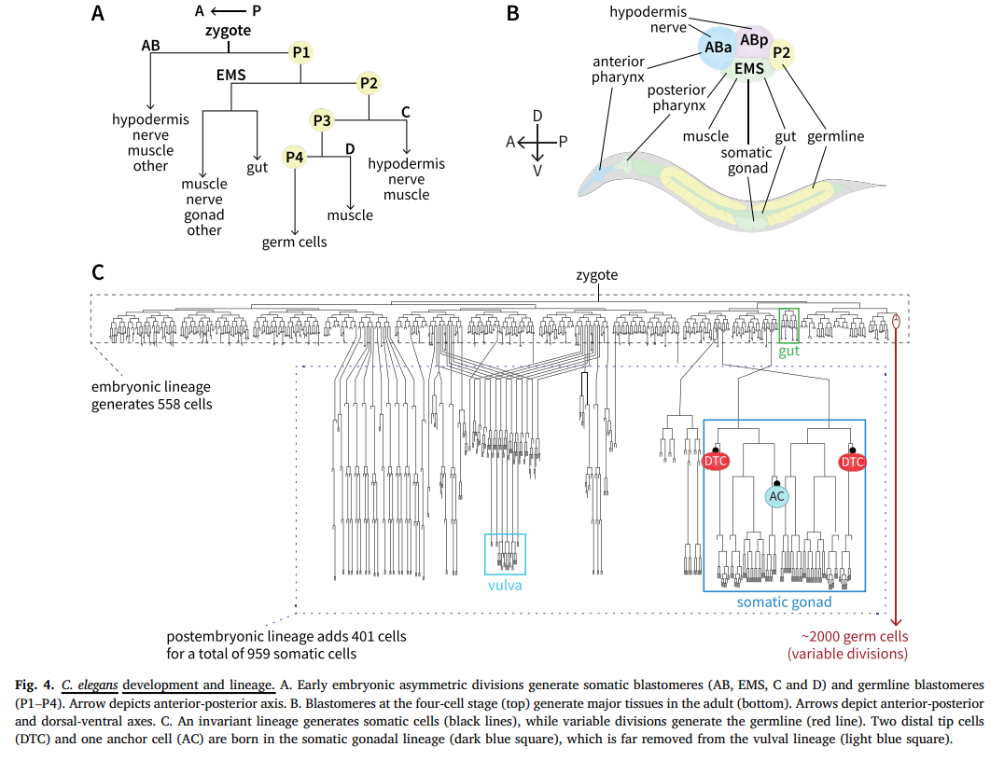

Slide 29
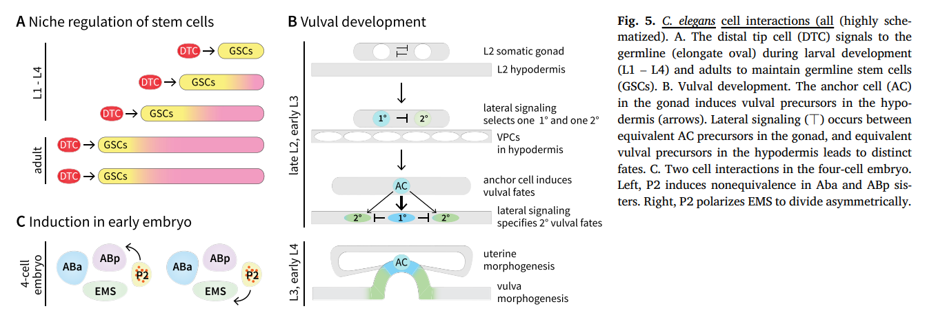

Slide 30
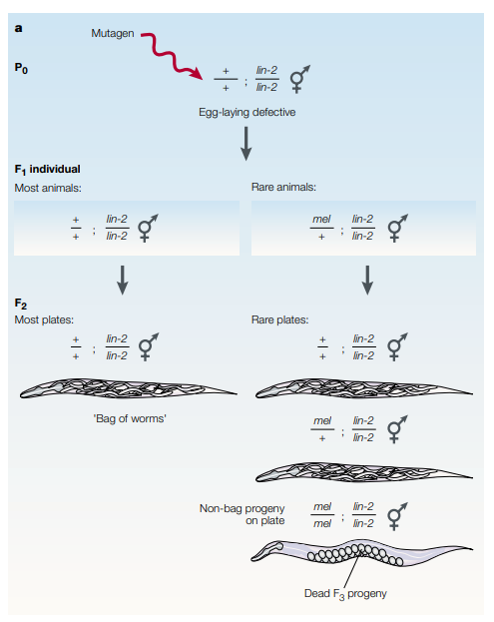
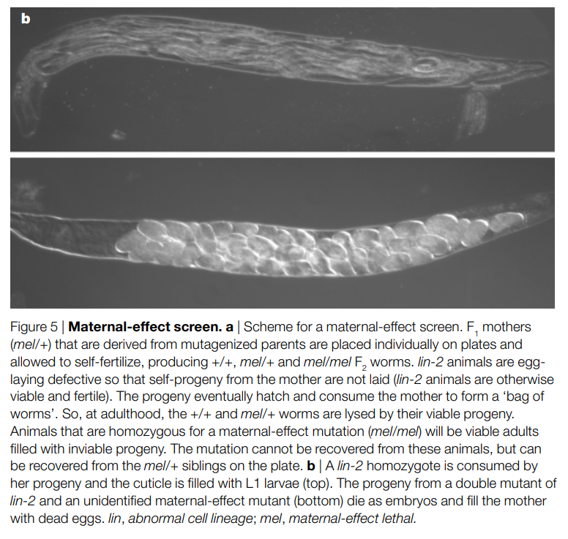
Screen for new maternal-effect lethal, second mutations in surviving F2 worms suppressing the lin-2 “bag of worms” phenotype.

Slide 31
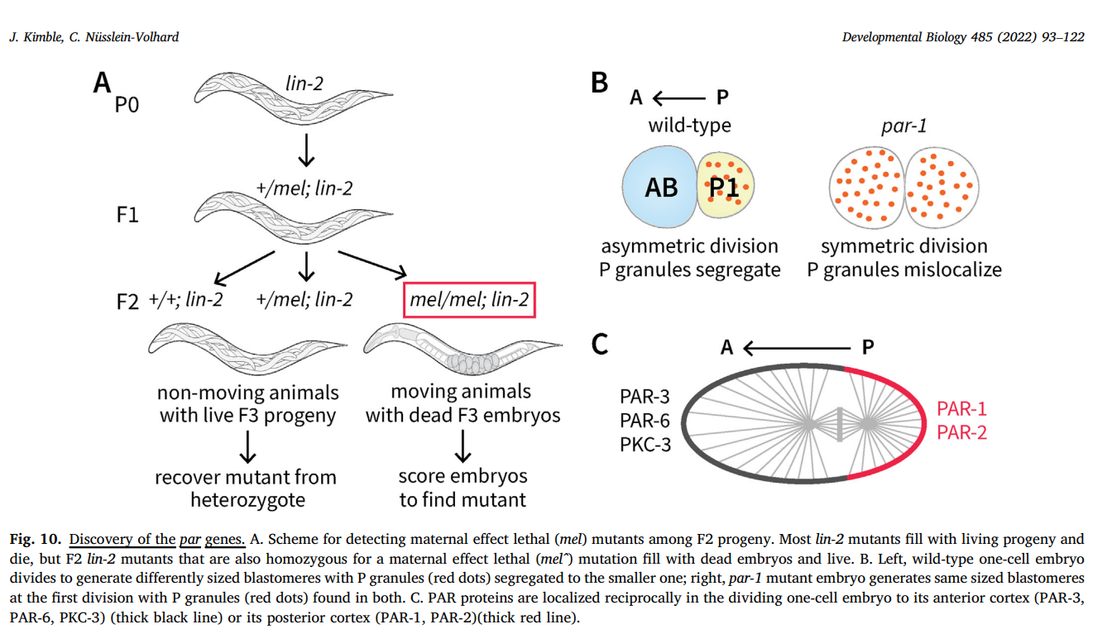

Slide 33
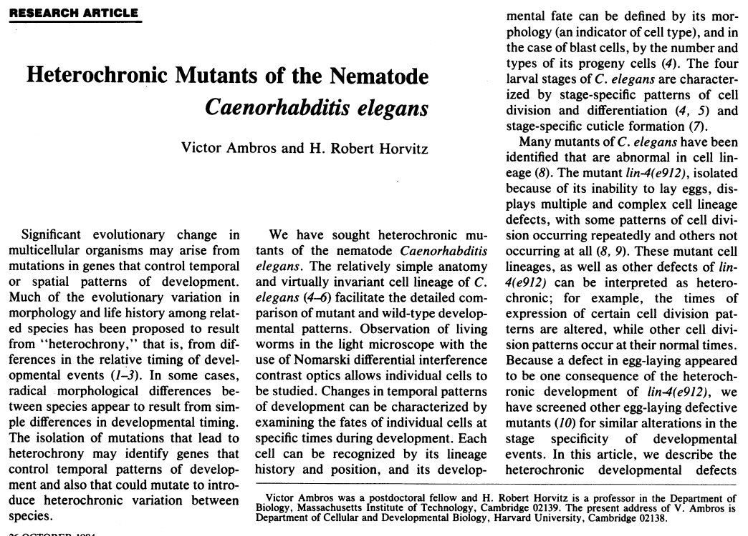

Slide 34
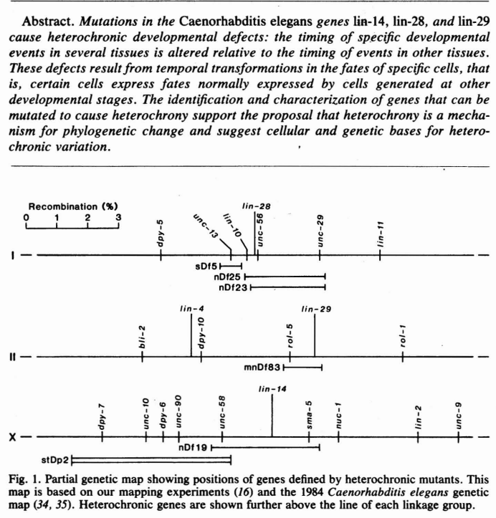

Slide 35
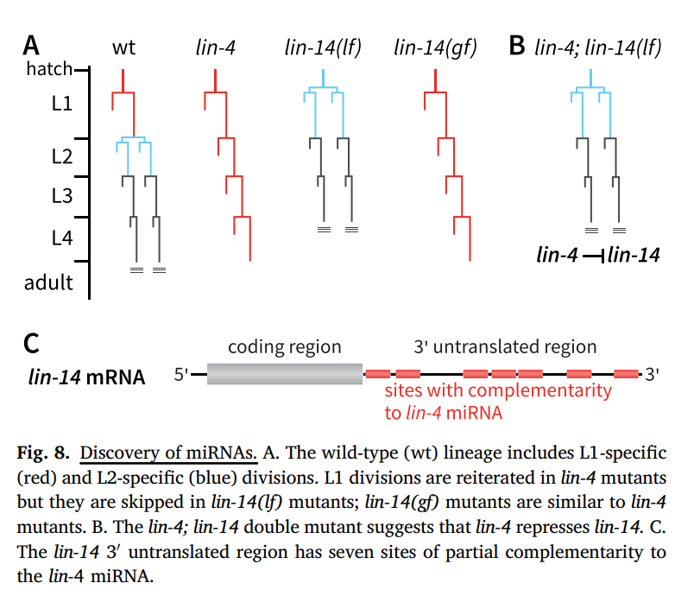

Slide 36
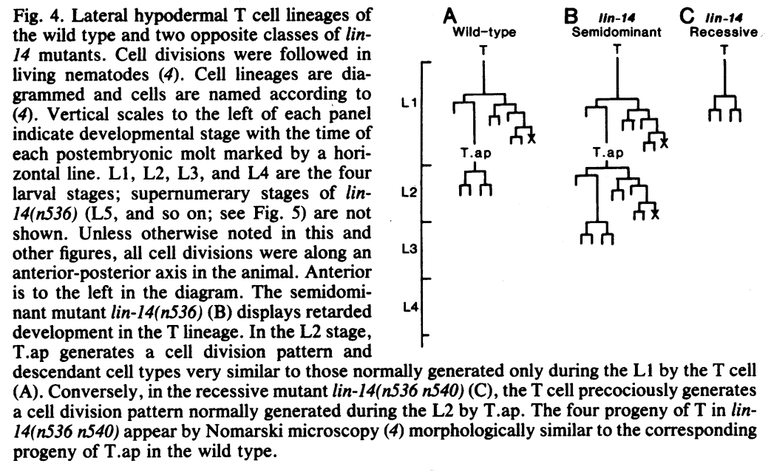

Slide 37
Discovery of microRNA genes.
Ambros and Ruvkun had back to back papers showing lin-4 encodes only a micro RNA (miRNA) and that lin-14 3’UTR is the RNA target for the let-4 miRNA
Later, Reinhart showed let-7 is another miRNA with several targets and Pasquinelli showed broad conservation (with Horvitz and Ruvkun)

Slide 38
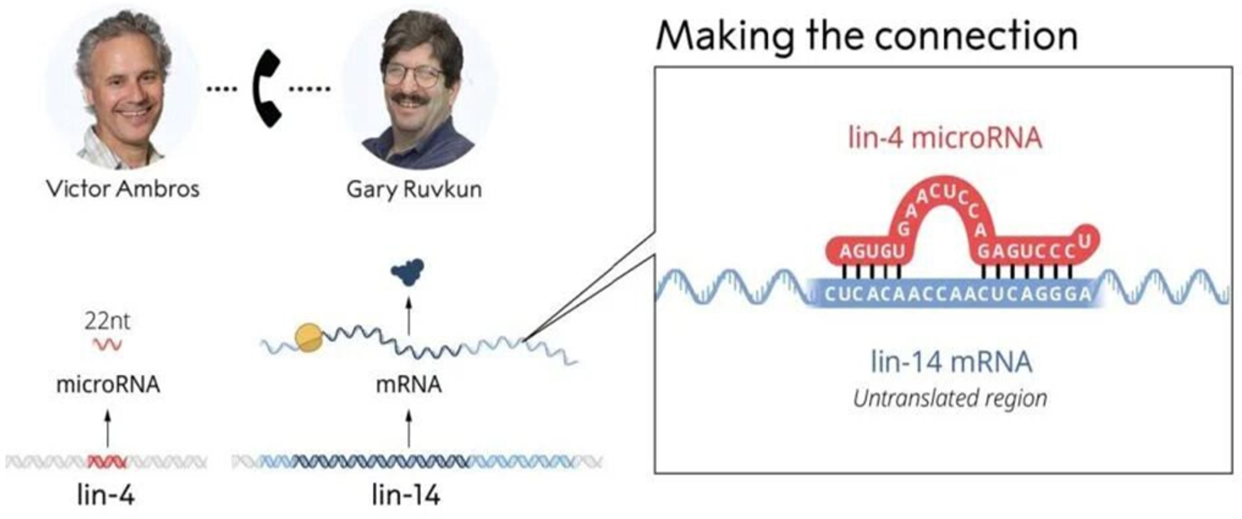

Slide 39
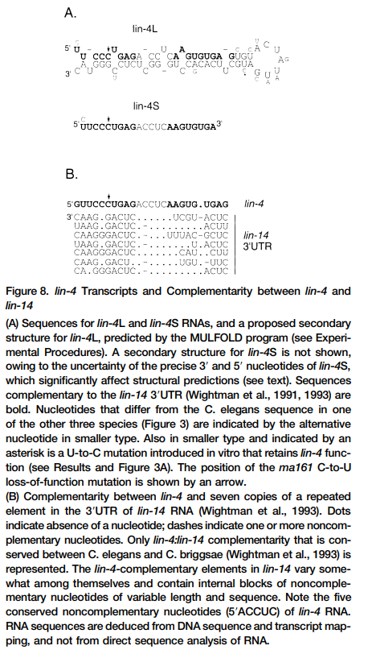
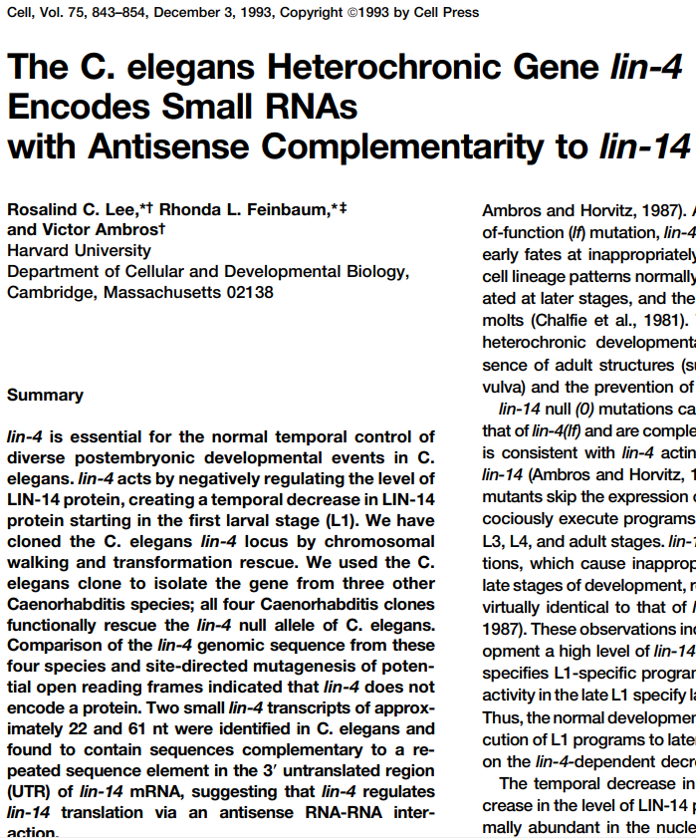

Slide 40
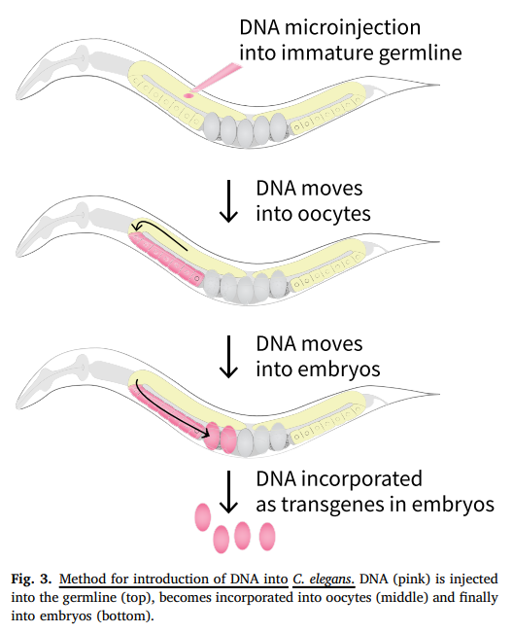
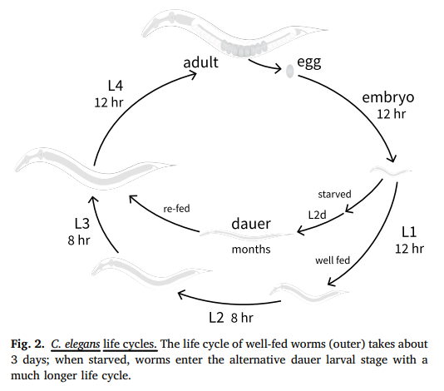

Slide 41
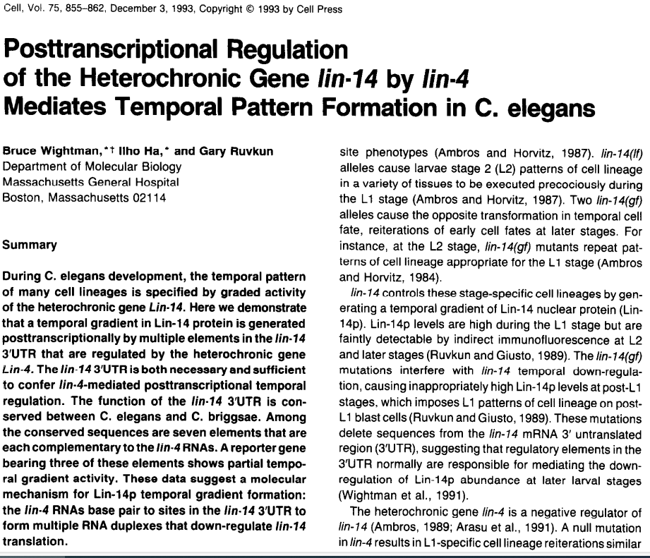
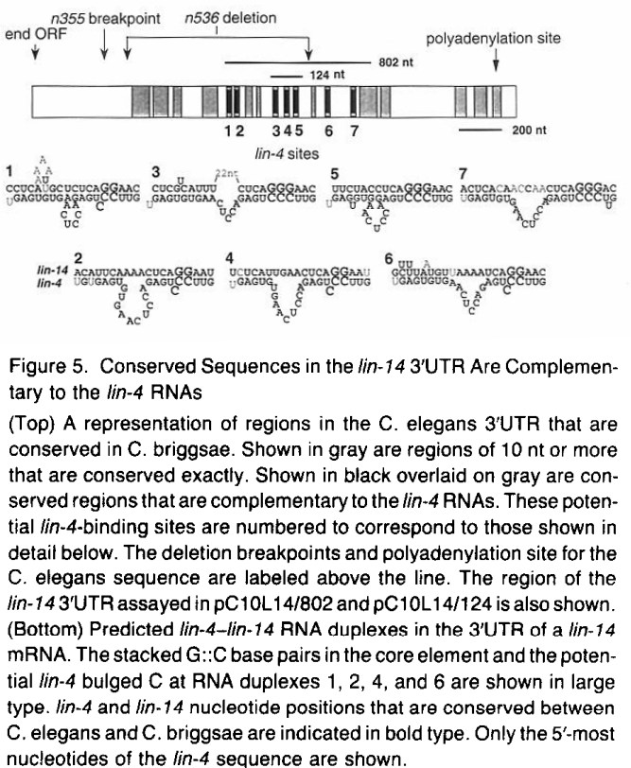
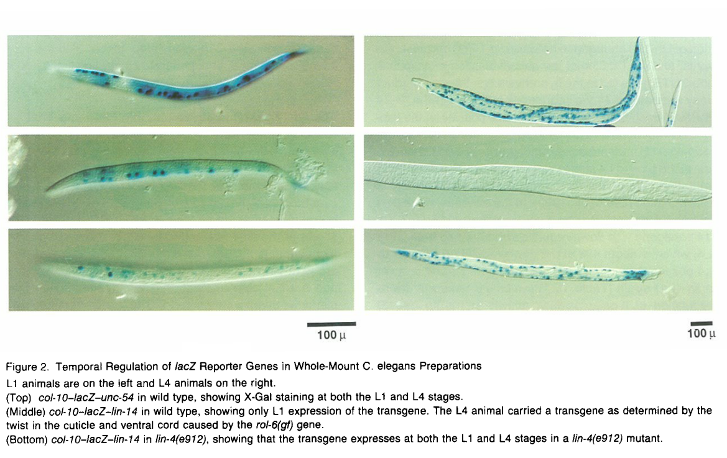

Slide 42
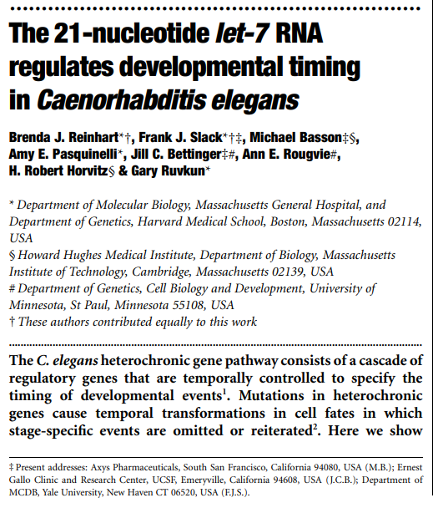
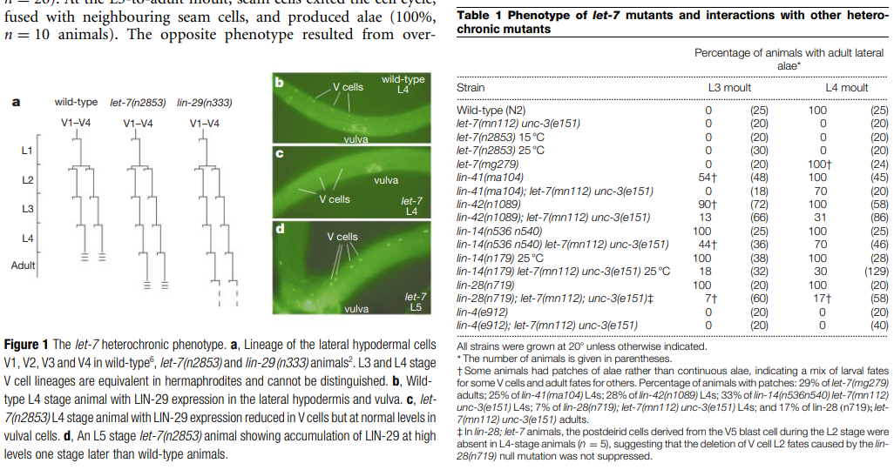
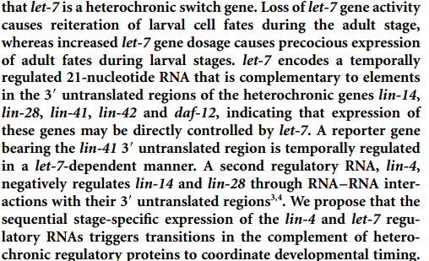

Slide 43
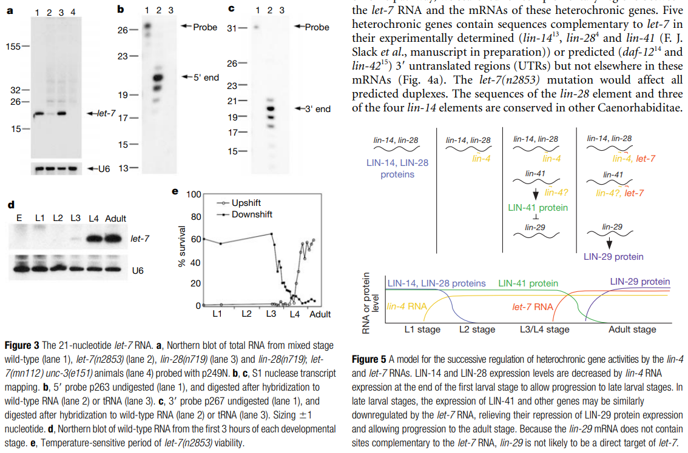

Slide 44
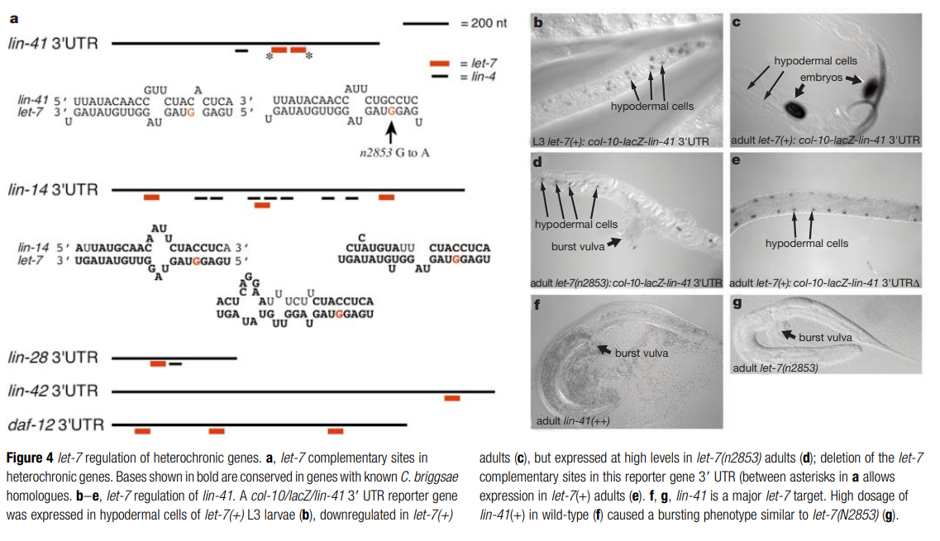

Slide 45



Slide 47

RNA Interference by dsRNA targets silencing to endogenous transcripts.
Later shown that long dsRNA generates small siRNAs that cause gene silencing

Slide 48


Slide 49

ADAR RNA editing enzymes in innate immunity
Liam Keegan

Slide 50

Conversion of adenosine to inosine

Slide 51

Adenosine Deaminases acting on RNA (ADARs) edit A → I in RNA
intron
miRNA
exon
‘site-specific’
‘promiscuous’
ECS
Alu repeat
Notes:
ADARs bind dsRNA
Deaminate specific adenosines to inosine
Can occur in exons (red) when duplexed with introns (black) containing an Editing Complementary Sequence (ECS)
Can also occur in Alu repeat regions (green) in introns or UTRs
Editing can also occur in micro-RNA precursors and can lead to mature micro-RNAs with altered target specificity
Editing at flanking sites can affect processing of micro-RNA transcripts by Drosha & Dicer
Editing within coding sequences is site specific and highly efficient
Editing in noncoding regions is promiscuous

Slide 52
In vitro work in Drosophila S2 cells identified Dicer as nuclease cleaving dsRNA to 21 mers
and RISC Complex and Argonaute proteins as siRNA processor and mediator of siRNA silencing (Hannon and others).

Slide 53


Slide 54


Slide 55


Slide 56


Slide 57


Slide 58
Dicer-like helicase proteins lacking RNAseIII domains are innate immune, cytoplasmic, antiviral dsRNA sensors inducing interferon: RIG I-like receptors (RLRs)

Slide 59


Slide 60


Slide 61


Slide 62



Slide 63




Slide 64
Reading

Slide 67


C. elegans homeobox genes control neuronal terminal identity

Slide 68


Slide 69

C. elegans terminal selector homeobox genes control different aspect of neuron function.

Slide 71



Slide 72


Slide 74


Slide 75


