Slide 1
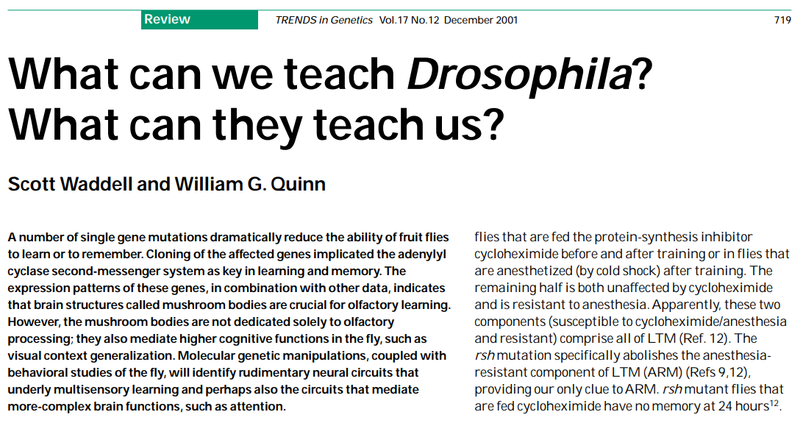
Lecture 10 Internal states, memory and choices, circadian rhythms and sleep. 29.11.24

Slide 2
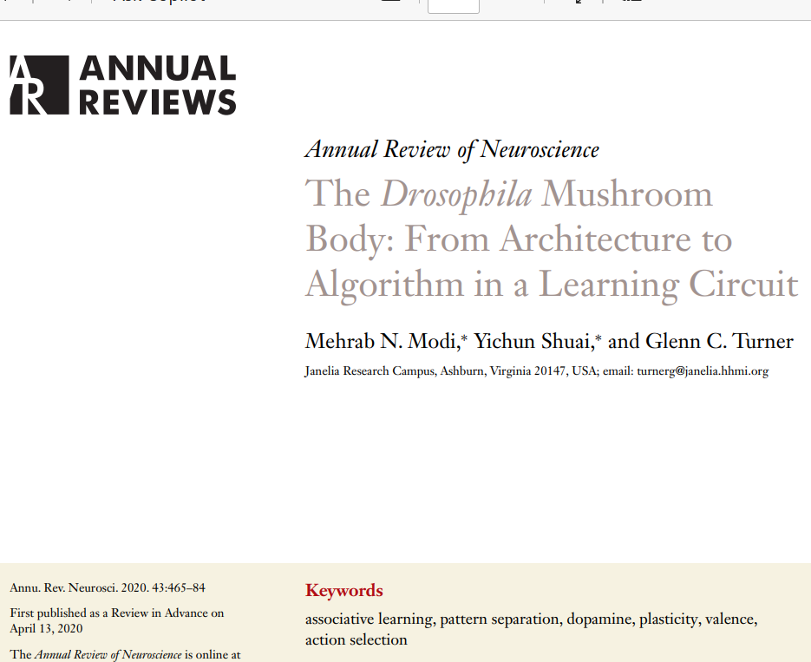

Slide 3
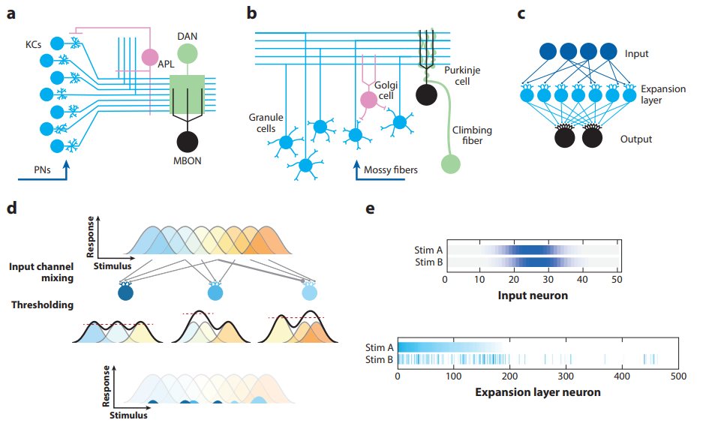
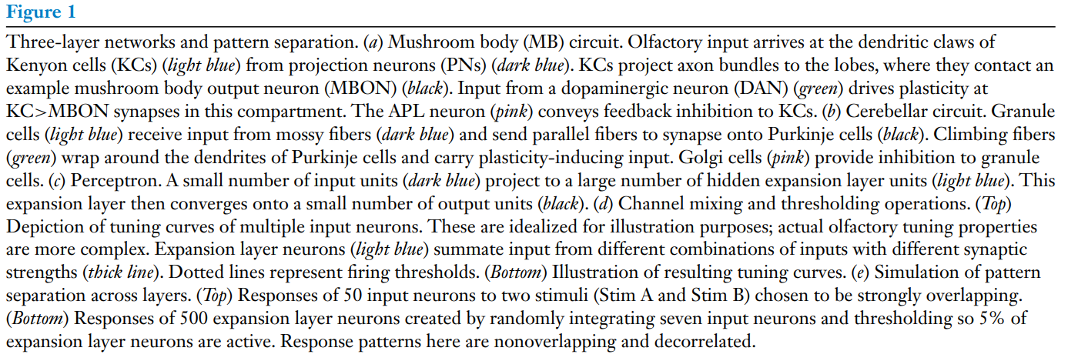
Purkinje was in Prague. Masaryk University was Purkinje University during the Communist period.

Slide 5
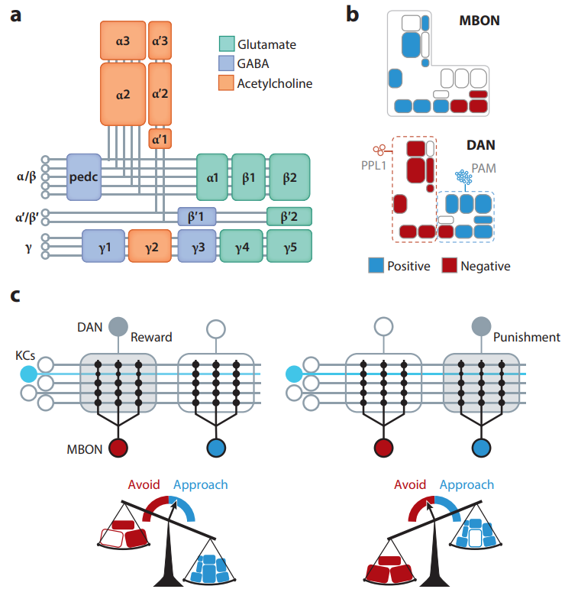
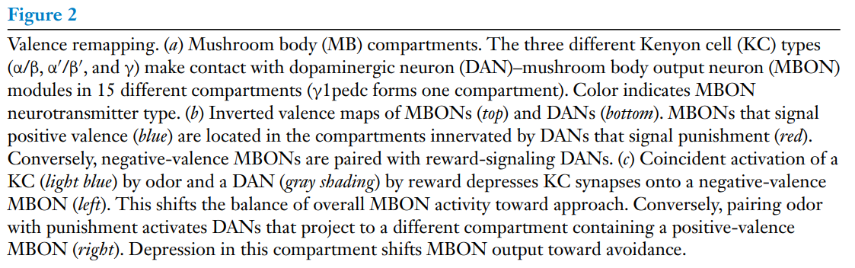

Slide 7
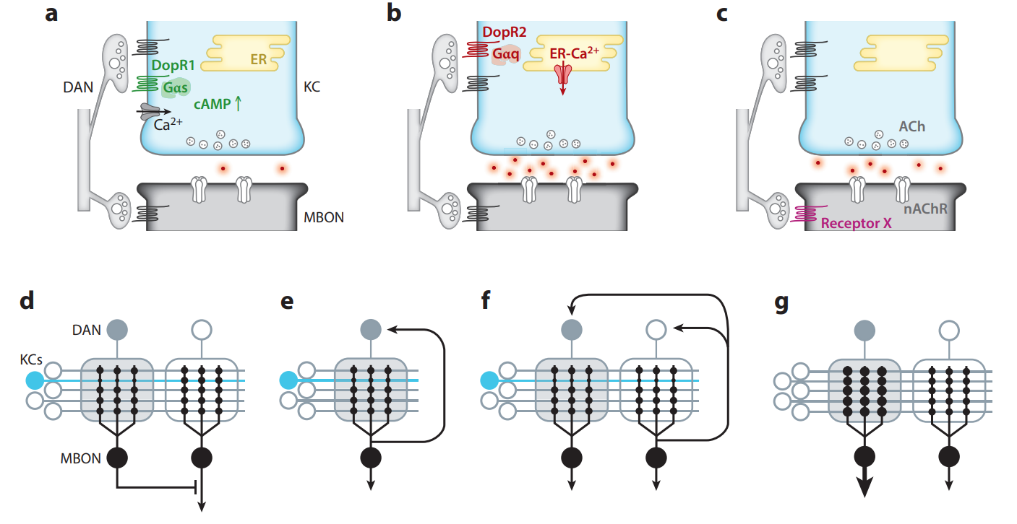
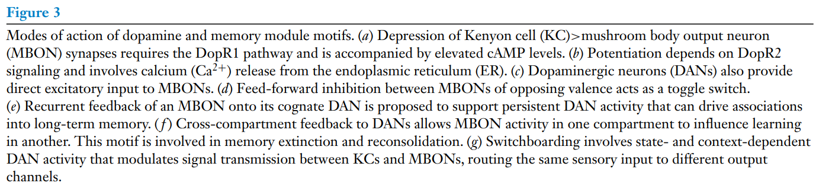

Slide 9
Short term memory (STM) and long term memory (STM), consolidation, reconsolidation or extinction

Slide 10
Sort term memory (STM) and long term memory (STM)
Aversive odor training with 12 electric shocks in 1 minute gives only STM which last for one day.
This is Block Training. Learning is not blocked by protein synthesis inhibitors.
Aversive odor training with spaced electric shocks every 15 seconds or more apart gives LTM which lasts up to 14 days.
This is Spaced Training. LTM is blocked by protein synthesis inhibitors or by anaesthesis, on ice, that stops neuronal signaling. Requires translation regulation of localized transcripts at synapses. Sleep improves LTM.
Why does LTM need the Rest Period between trainings?

Slide 11
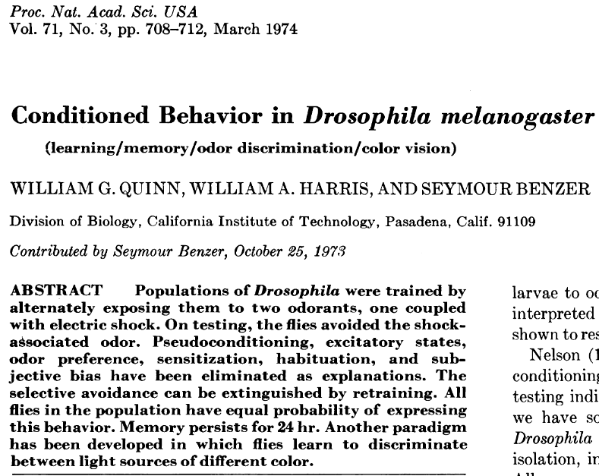
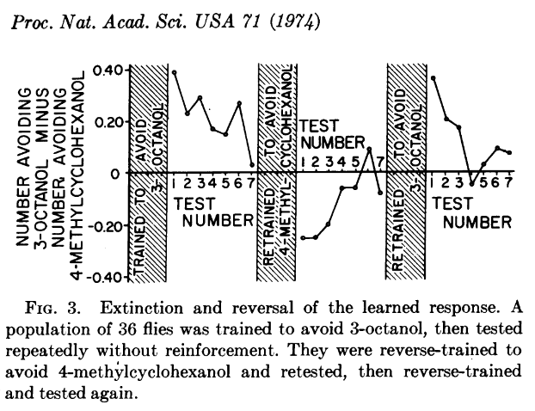
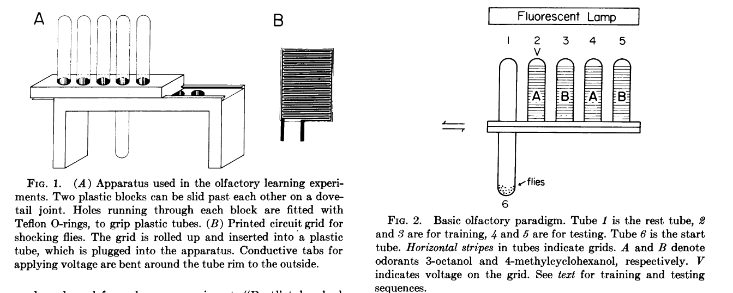
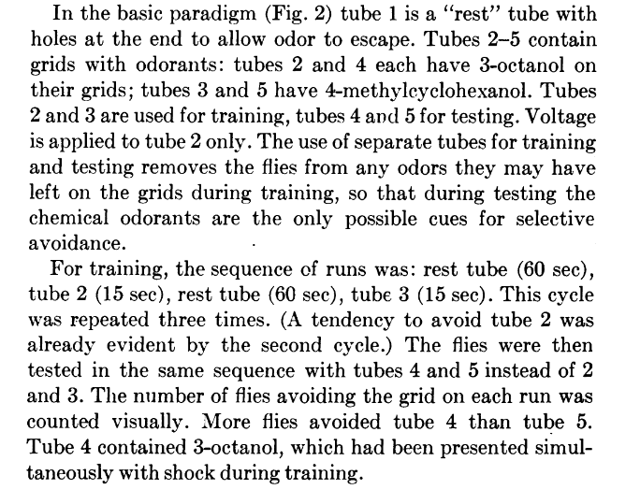
Memory extinction by testing without shock.

Slide 12
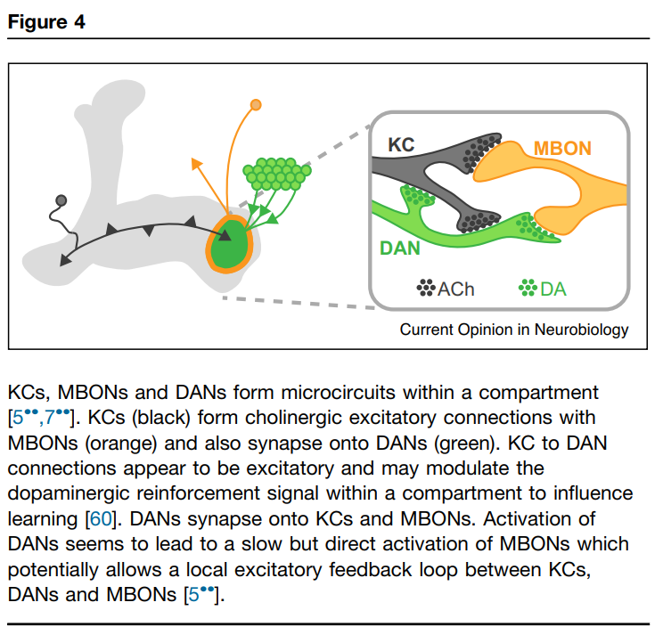
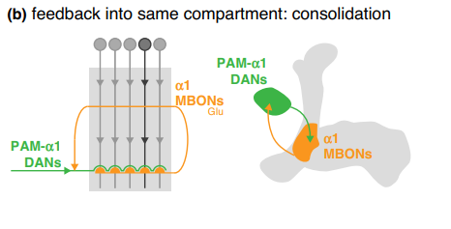
LTM consolidation. Recurrent connections from MBONS to DANS may alter the synaptic microcircuit at the odor cue Kc cell to hold the learned information until protein synthesis consolidates the memory.

Slide 13
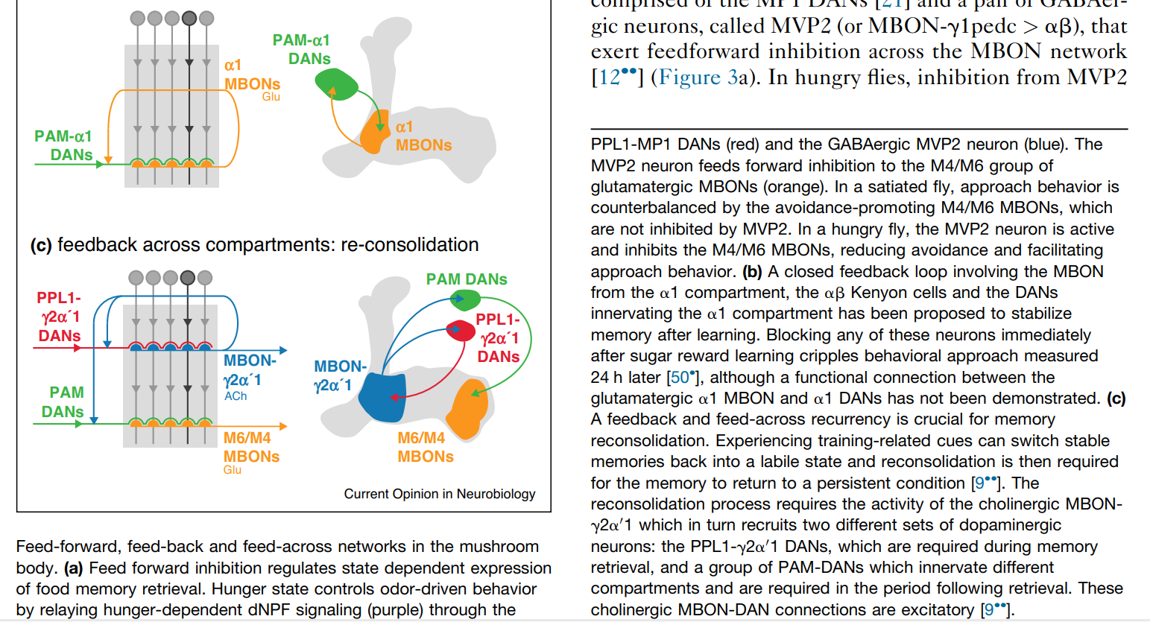
Memory reconsolidation or extinction involve interactions between MB compartments

Slide 15
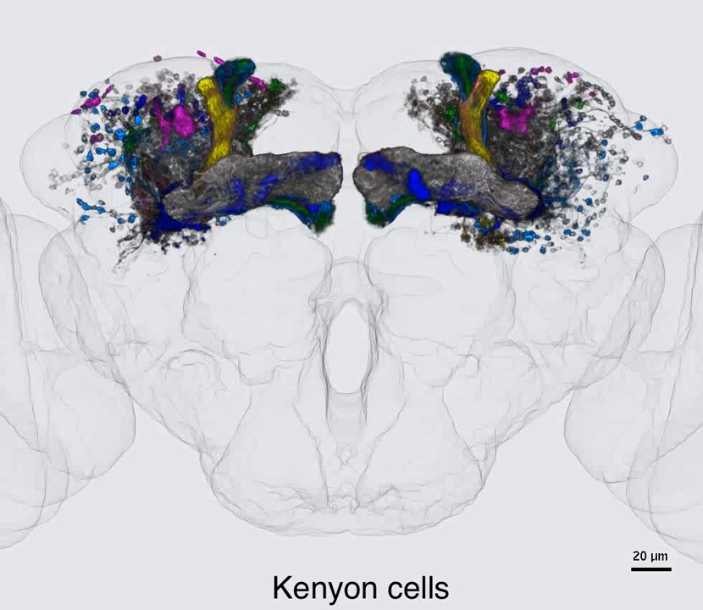
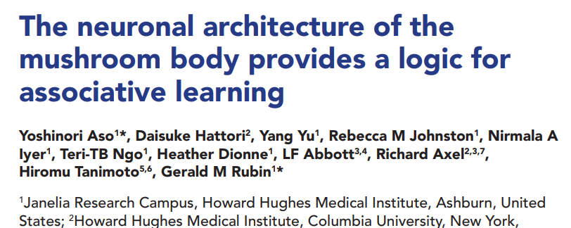

Slide 16
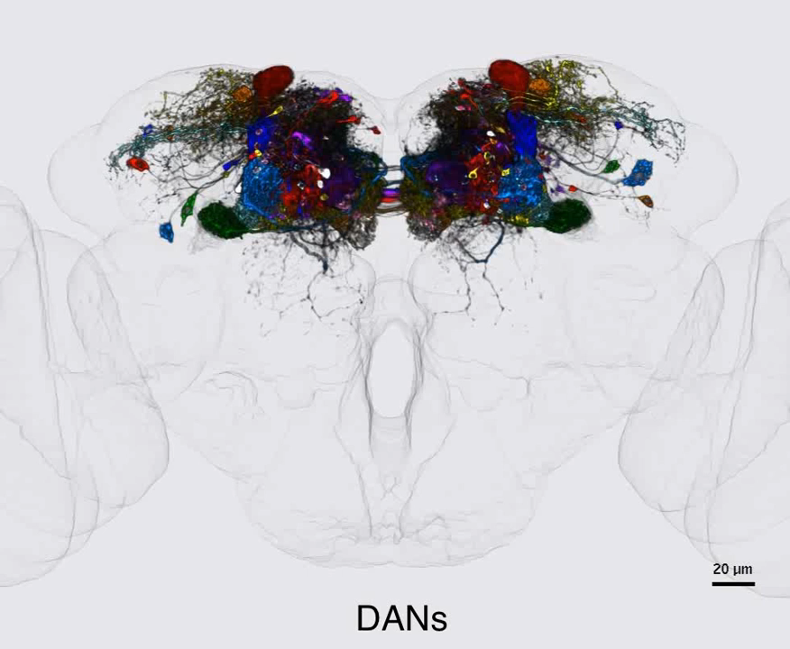
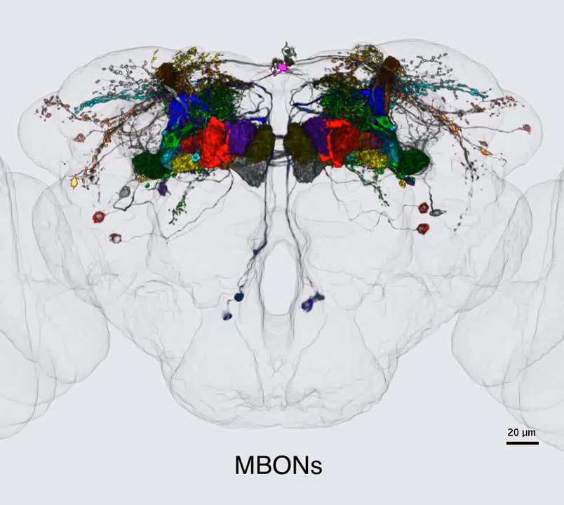

Slide 17
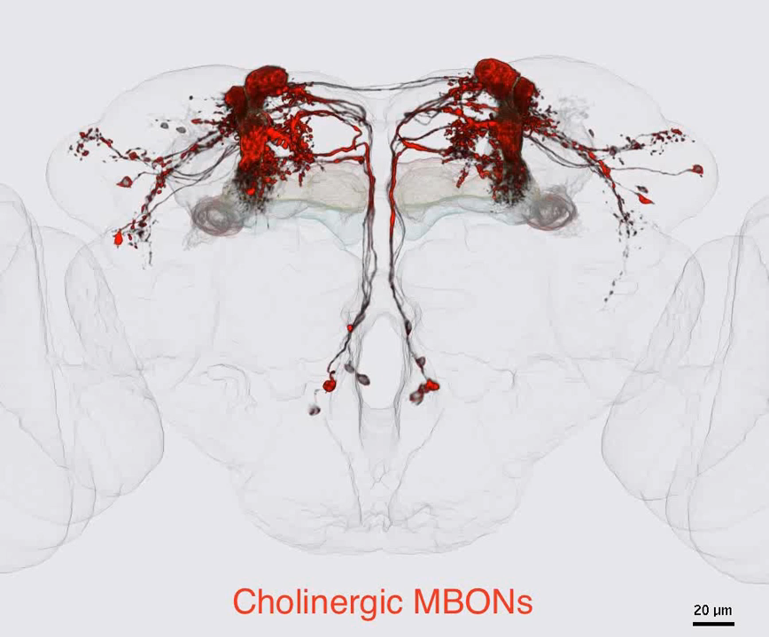

Slide 18
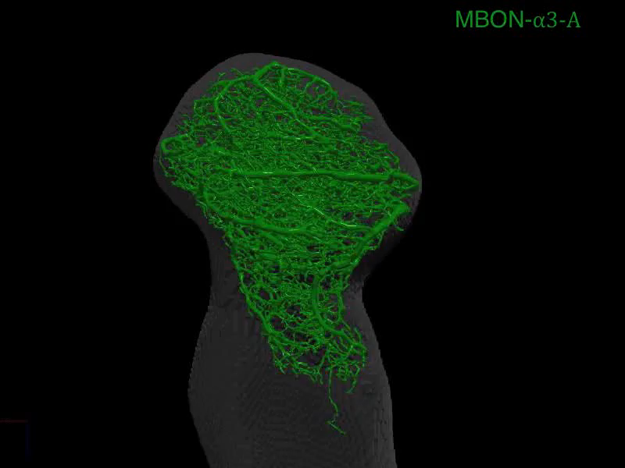

Slide 19
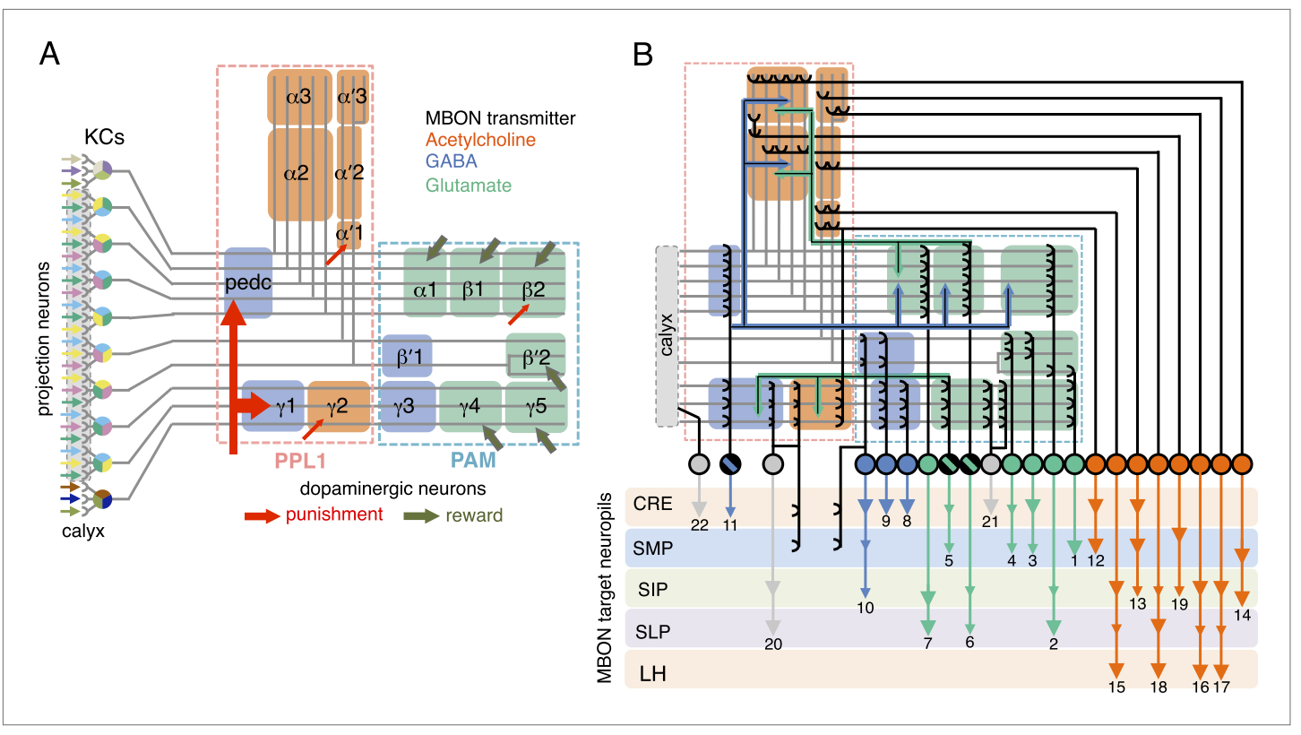
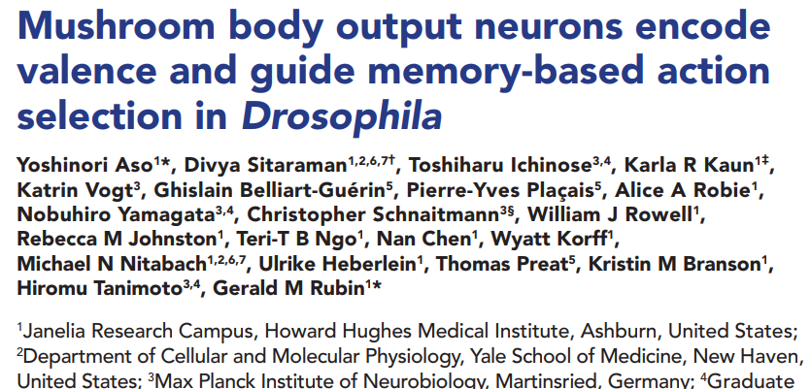

Slide 20
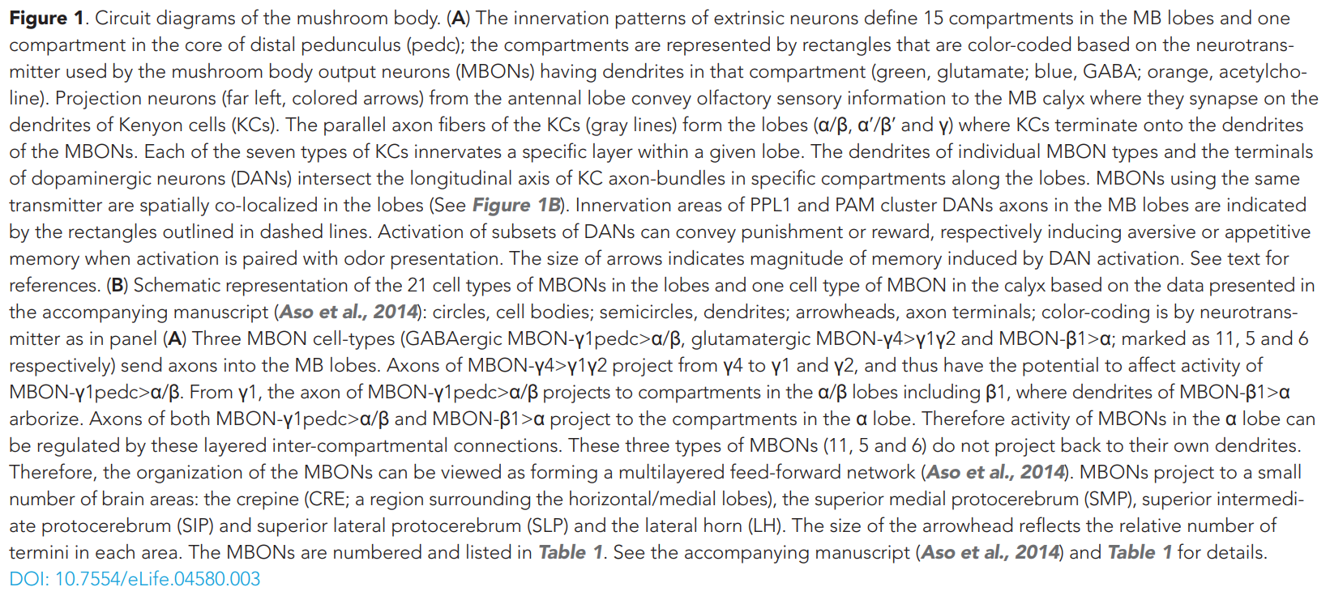

Slide 21
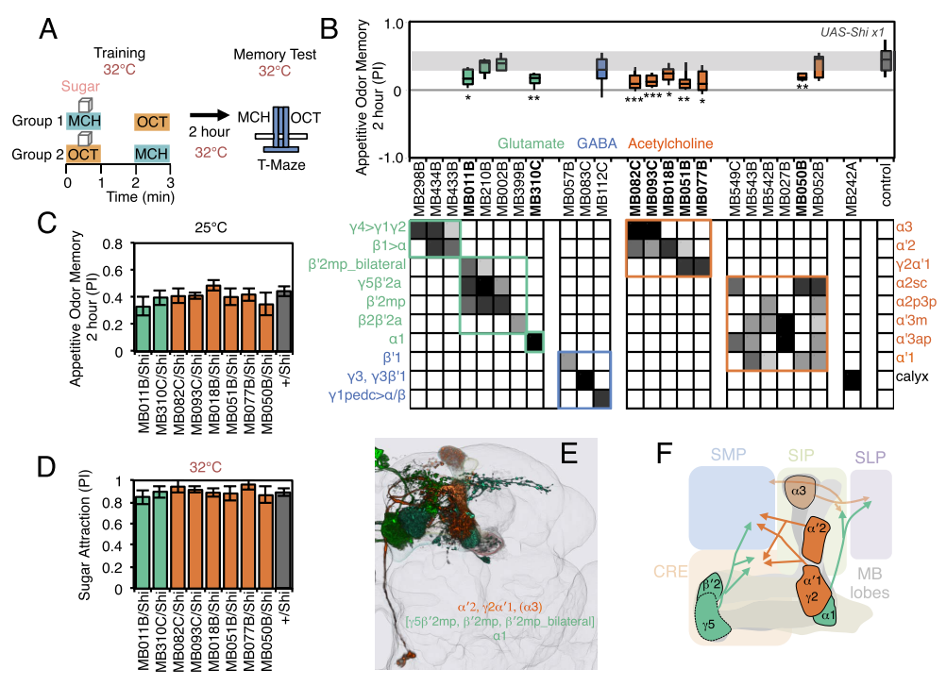

Slide 22
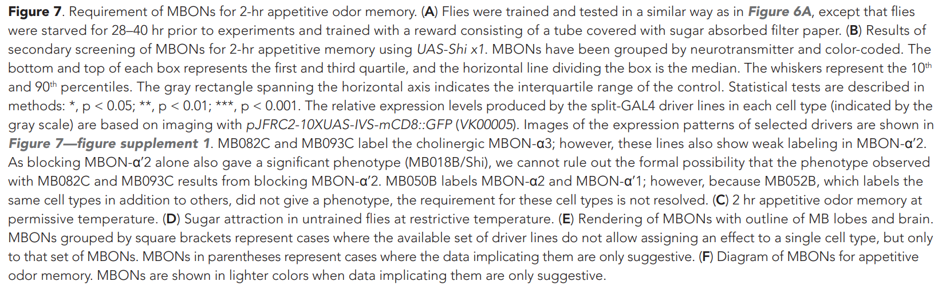

Slide 23
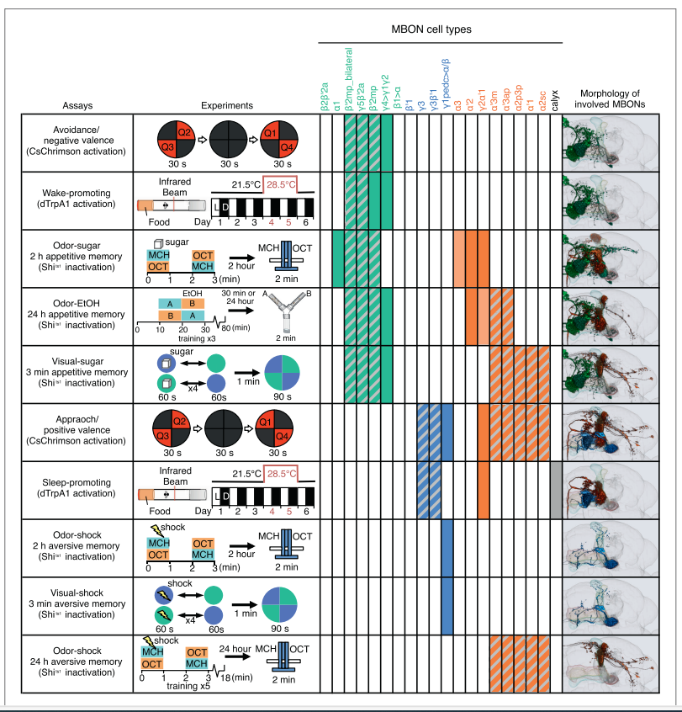
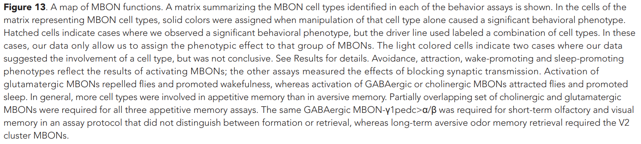

Slide 24
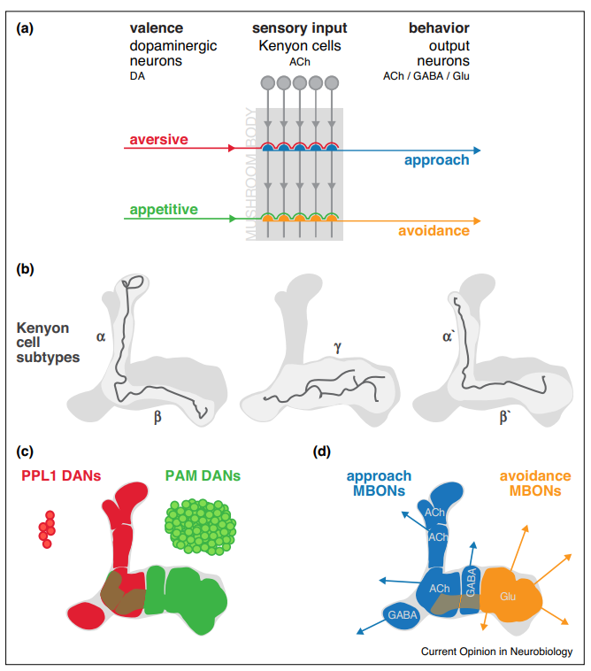
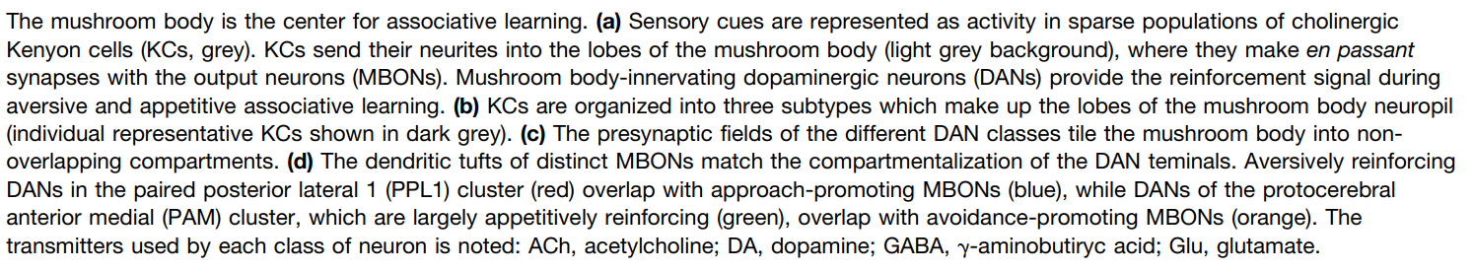

Slide 26
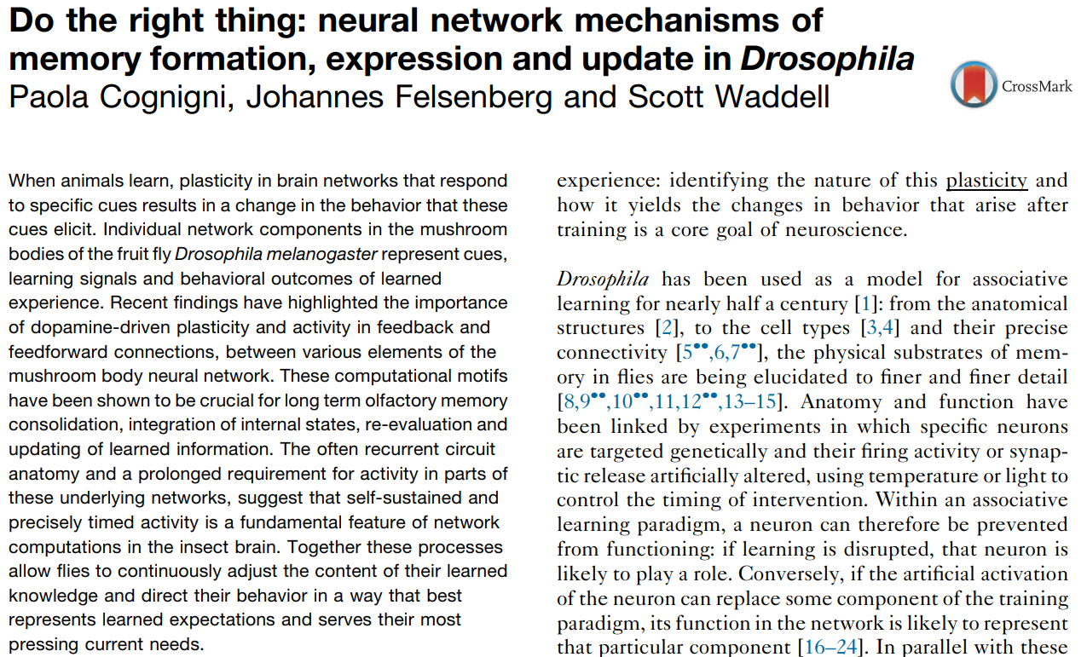
Internal states affect types of learning
Hungry. Thirst. Well fed.
Courting. Mated. Frustrated.
Defeated. Depressed.
Alcoholic. Drug-addicted.
Innate immunity and sleep.
Sociable. Imitating others.

Slide 27
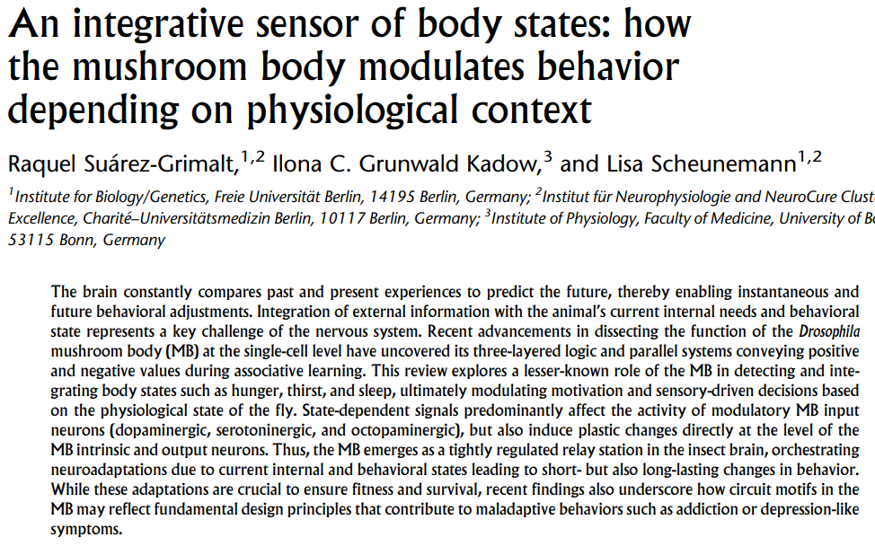
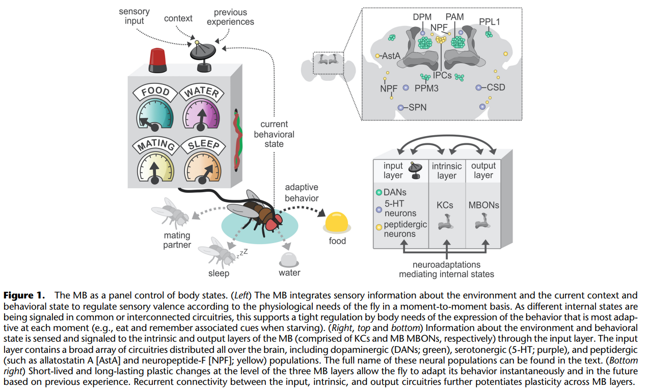

Slide 28
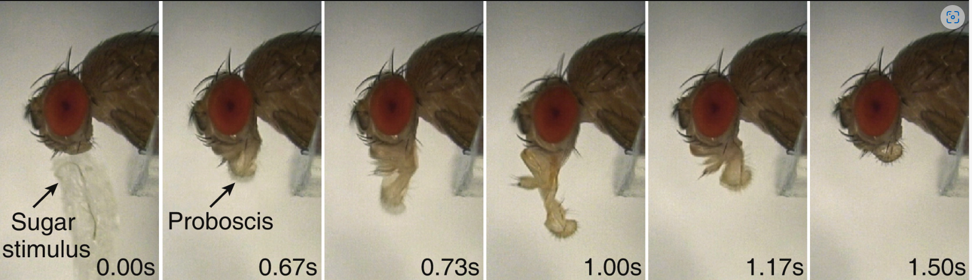
Internal states and types of learning
Hungry. - Approach food odors. Overcome aversion to some odors or to bitter tastes. Flies should be hungry for Appetitive Taste or Odor training.
Thirsty. - Approach food and water.
Well fed. - Think about something other than food, probably mating.
Courting. - Approach conspecifics. Try to mate.
Mated. - Mated females become much more interested in food and reject further courtship. Males learn not to court mated females. Courtship conditioning training.

Slide 29
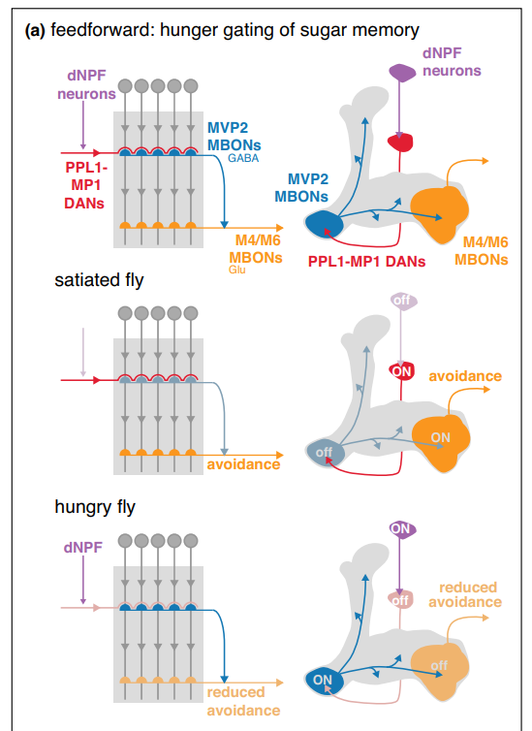

Slide 30
Internal states and types of learning
Well fed. - Think about something other than food, probably mating.
Courting. - Approach conspecifics. Try to mate.
Mated. - Mated females become much more interested in food and reject further courtship. Males learn not to court mated females. This is Courtship conditioning training.

Slide 31
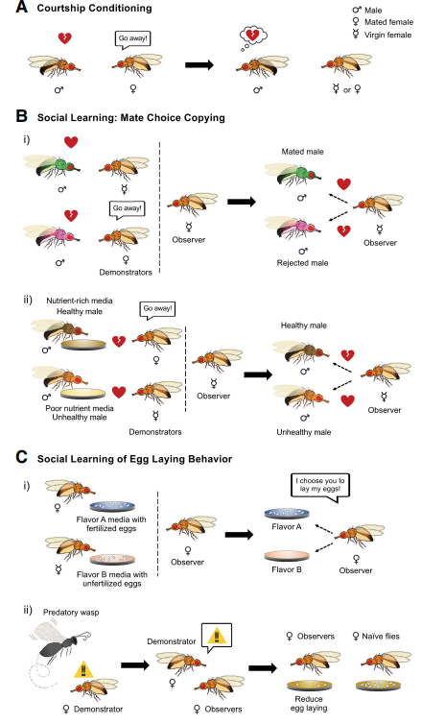
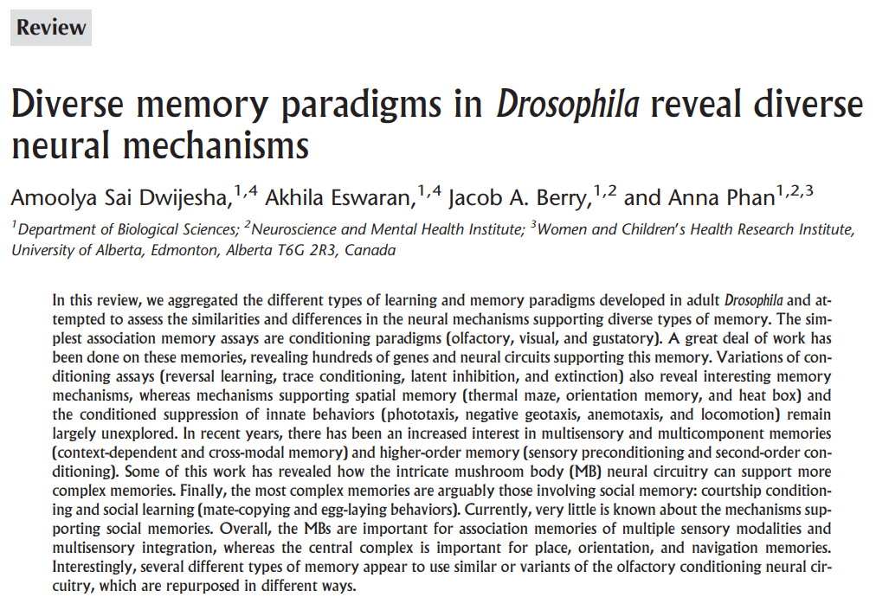
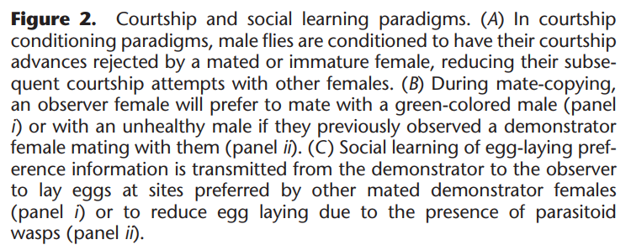

Slide 32
Internal states and types of learning
Sociable. - Flies congregate at food sources.
Females release a pheromone that attracts both males and females. Also, they place this pheromone at egg-laying sites to get more females to lay eggs there. Larvae help each other to soften food.
Imitating others. Surprisingly, flies also learn by watching others.
A demonstrator female mates with a male fly dusted with one color and then rejects a male dusted with another color. The Observer female is likely to copy her.
A demonstrator female lays eggs in one spot and rejects another spot. Observer will likely copy.
A demonstrator female reduces egg laying in the presence of parasitic wasps that lay eggs in larvae. Observer female does the same. May involve some visual communication from the demonstrator female to the observer using the wings.

Slide 33
Innate immunity and sleep.
Flies learn to avoid food that gives them infections.
Sleep is another of the many possible behavioral choices dictated by internal states; sleep need in this case.
Severe hunger suppresses the need for sleep without the buildup of sleep deprivation.
Sleeping flies have reduced responsiveness but wake for food odors if hungry.

Slide 35
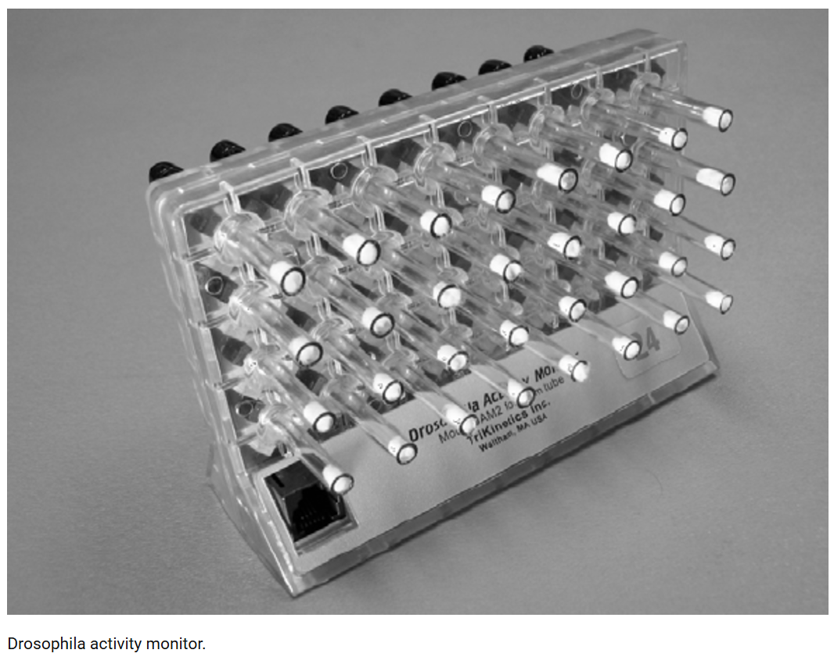
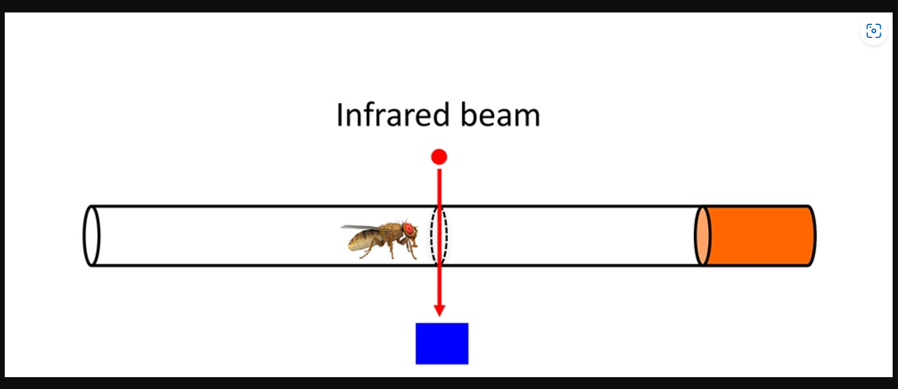
Circadian rhythms
Drosophila Activity Monitor (DAM).
One fly per tube. 32 tubes. Tubes have food, for days to weeks.

Slide 36
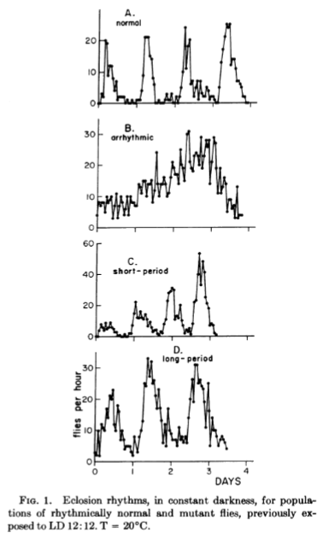
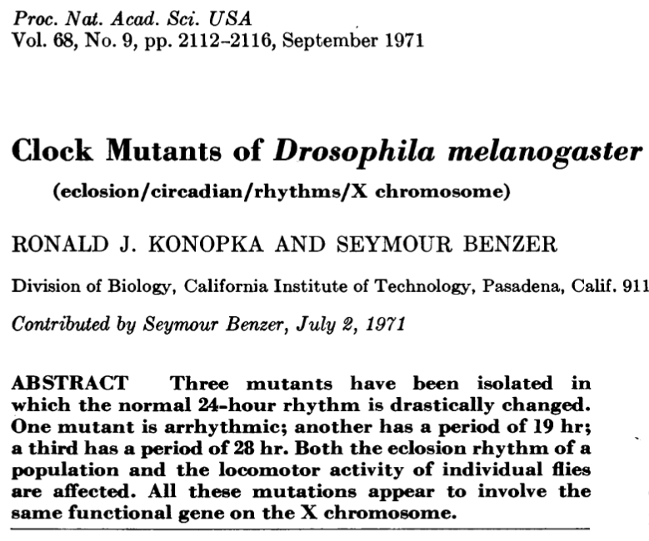
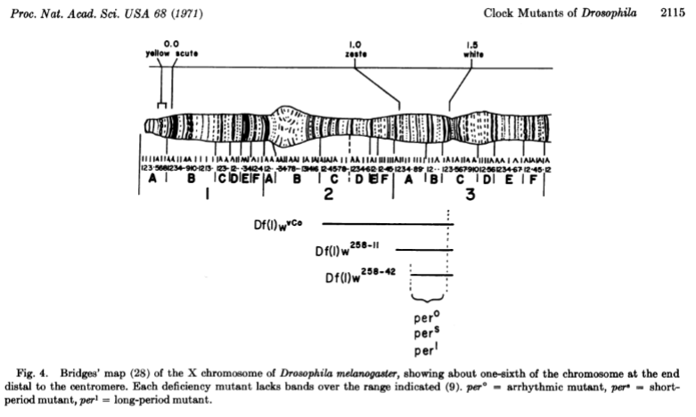

Slide 37
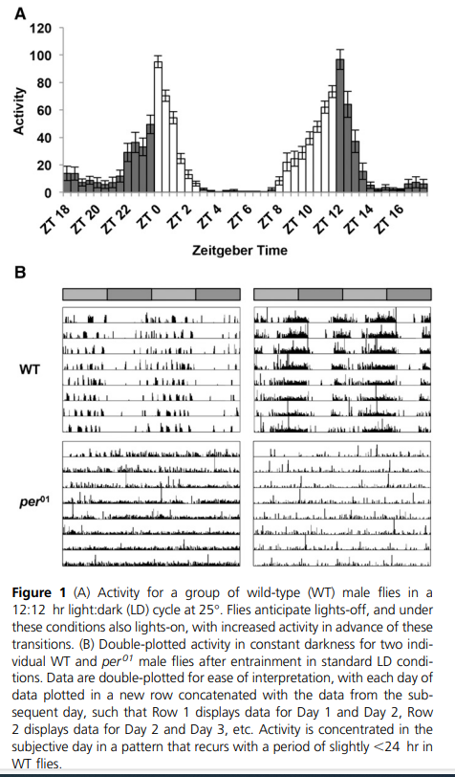

Slide 38
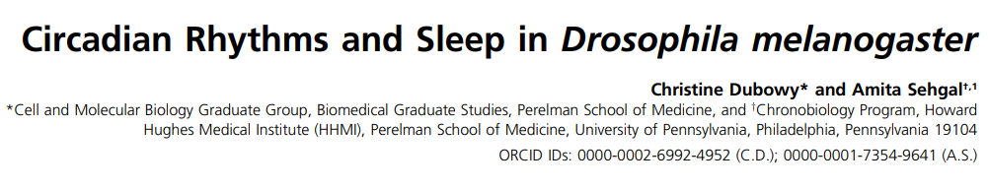
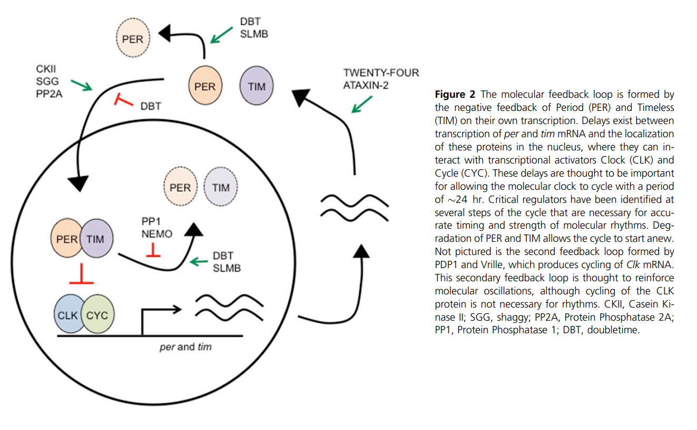

Slide 39
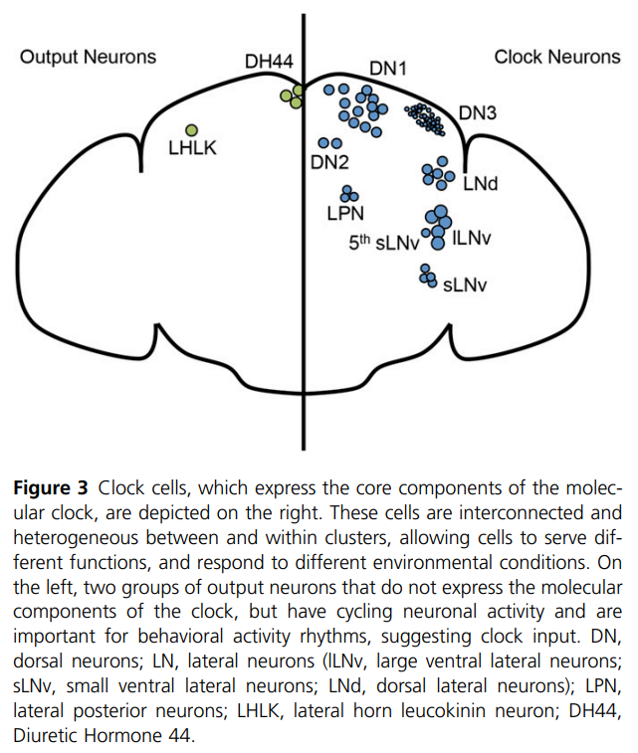

Slide 40
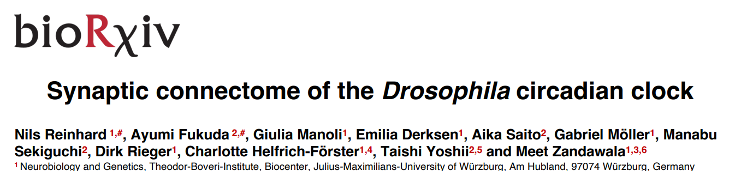
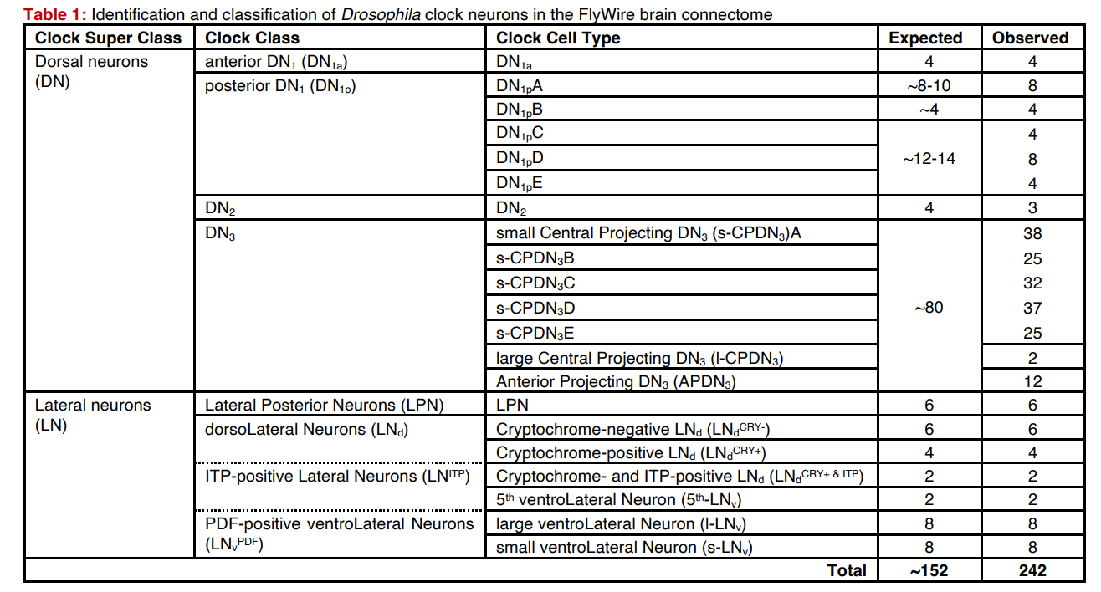

Slide 41
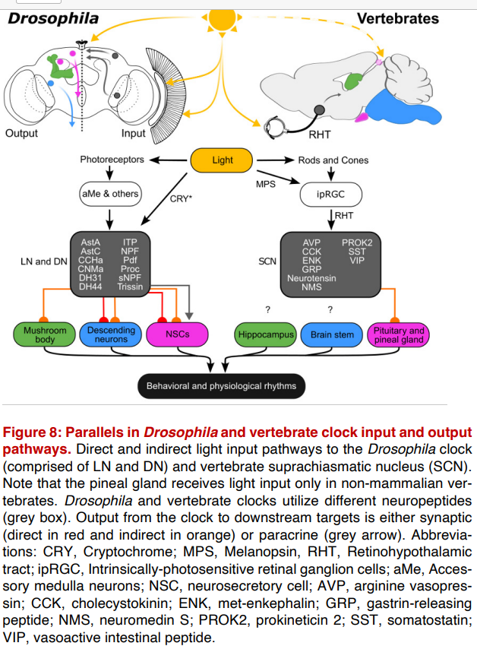

Slide 43

What is sleep for?
Sleep is needed for learning and memory. Rutabaga and dunce learning defects are suppressed by enforced sleep,
A related idea is that sleep is needed for synaptic homeostasis to maintain neuronal plasticity for learning.
CNS proteins may be made during sleep that enable memrory consolidation.

Slide 44

Sleep

Slide 45




Slide 46



Slide 47



Slide 48


Slide 49



Slide 52

ADAR RNA editing enzymes in innate immunity
Liam Keegan

Slide 53

Conversion of adenosine to inosine

Slide 54

Adenosine Deaminases acting on RNA (ADARs) edit A → I in RNA
intron
miRNA
exon
‘site-specific’
‘promiscuous’
ECS
Alu repeat
Notes:
ADARs bind dsRNA
Deaminate specific adenosines to inosine
Can occur in exons (red) when duplexed with introns (black) containing an Editing Complementary Sequence (ECS)
Can also occur in Alu repeat regions (green) in introns or UTRs
Editing can also occur in micro-RNA precursors and can lead to mature micro-RNAs with altered target specificity
Editing at flanking sites can affect processing of micro-RNA transcripts by Drosha & Dicer
Editing within coding sequences is site specific and highly efficient
Editing in noncoding regions is promiscuous

Slide 55

Drosophila Adar mutations on Chr X:
Adar ^{1F4} is a hypomorph and Adar ^{5G1} is a null.
Pallidino et al. Cell 2000

Slide 56
Notes:
56

Slide 57

Drosophila edited transcripts
Notes:
57

Slide 58


Slide 59



Slide 60


Slide 61
Reading
Mainly the Flybook review on sleep from Genetics.
The mushroom body review is also good.

