Slide 1
Lecture 4. Drosophila transgenes and making mosaic flies.
18.10.24

Slide 2
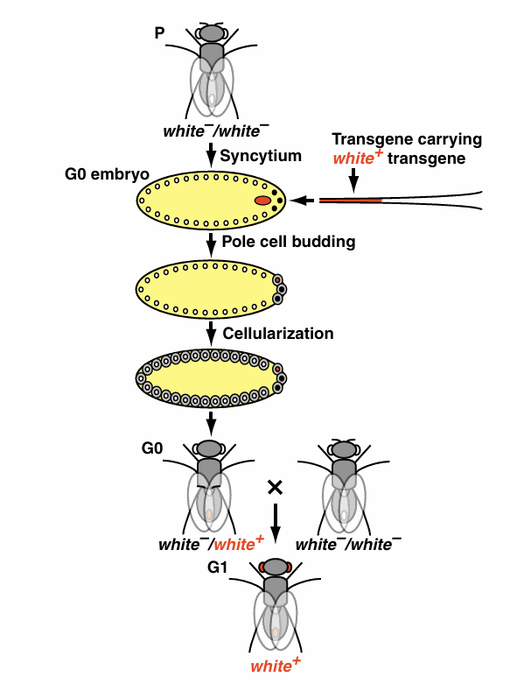
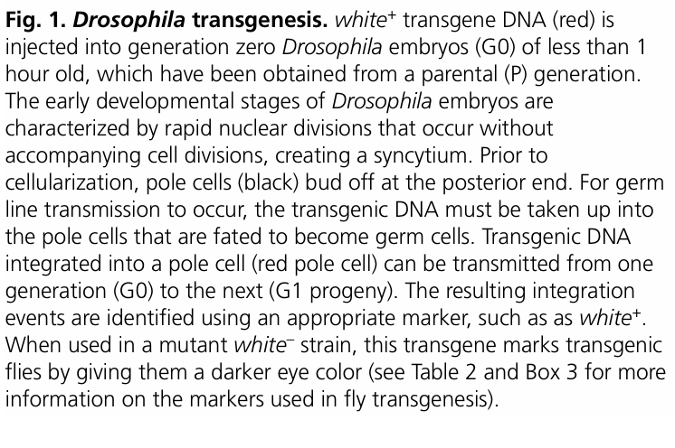
The original Drosophila transformation method. (Rubin, Spradling, Gehring 1980s)

Slide 3
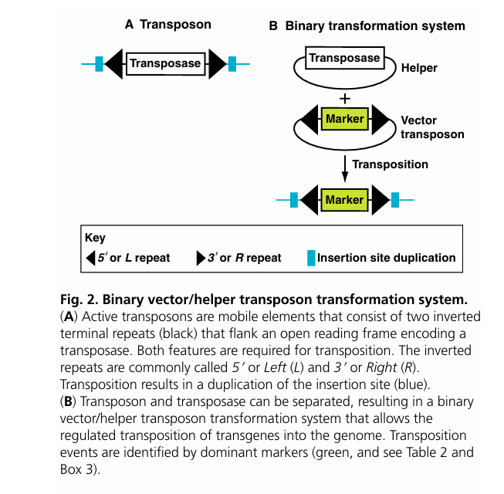

Slide 4
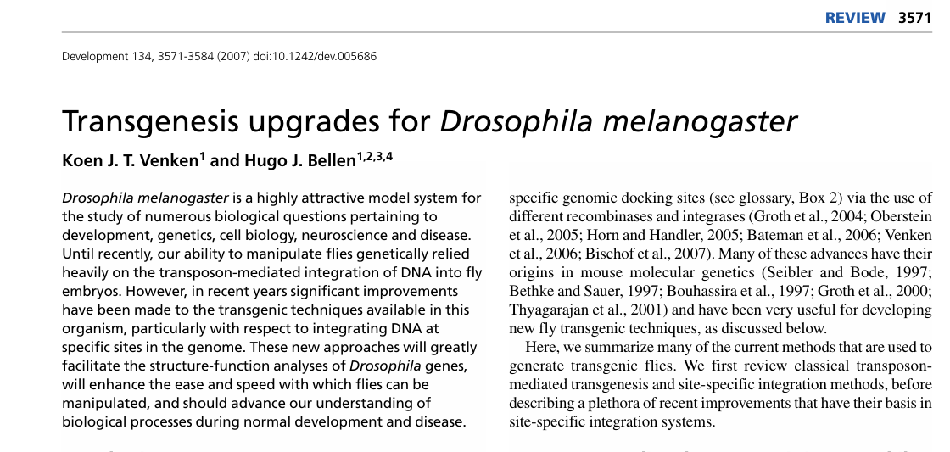

Slide 7
GAL4-UAS binary expression system in flies

Slide 8
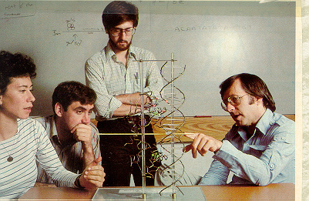
Yeast GAL4 gene encodes a positive regulatory protein that turns on transcription of GAL genes to grow on galactose
Mark Ptashne with graduate students Cynthia Wohlberger, Liam Keegan, Ed Giniger at Harvard, 1982

Slide 10
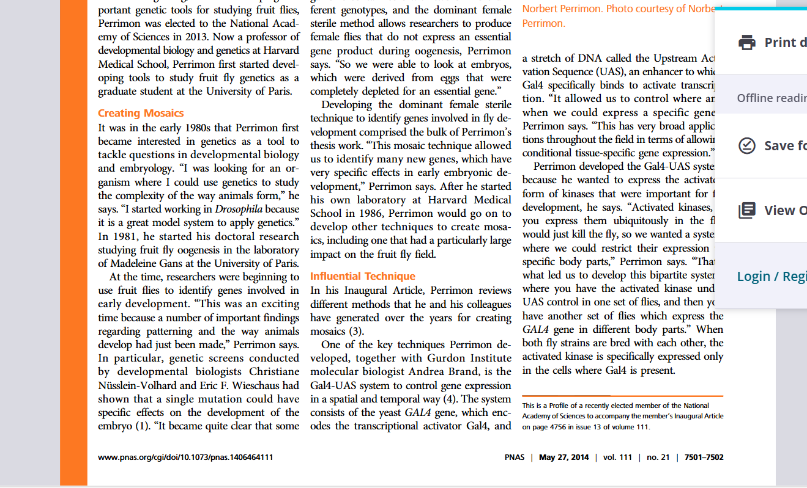

Slide 11
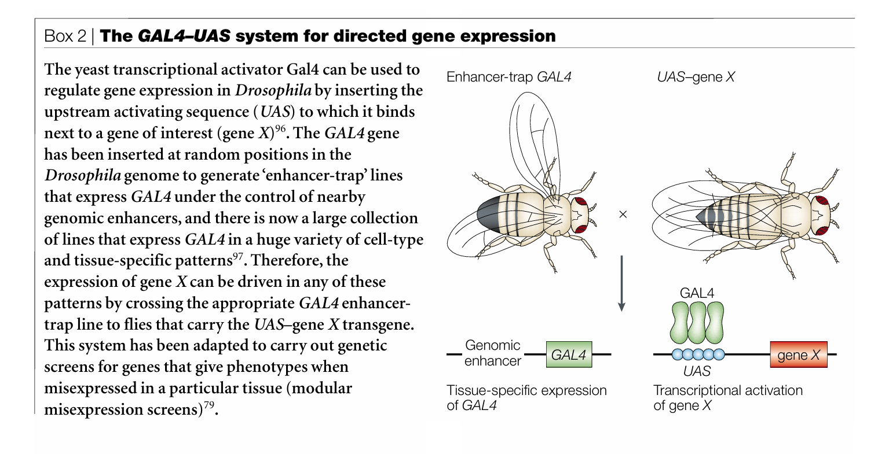

Slide 12
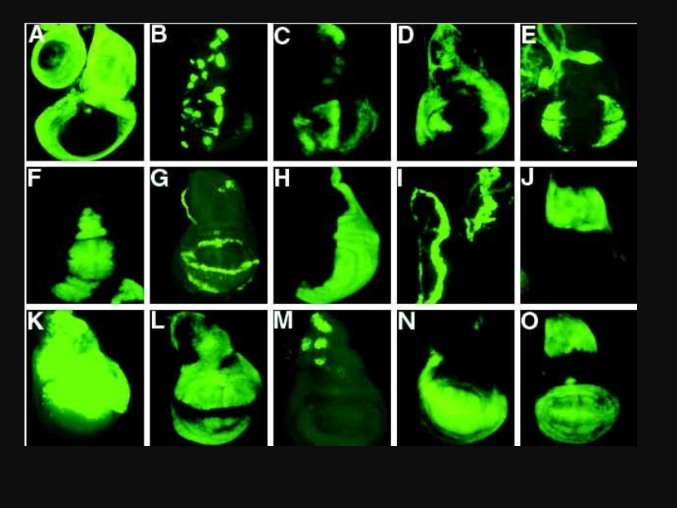
Enhancer trapping. Remobilization of a P-element transgene having promoterless GAL4, using cross to Jumpstarter to supply transposase. Screening for wing imaginal disc expression patterns in new promoterless GAL4 insertion lines

Slide 13
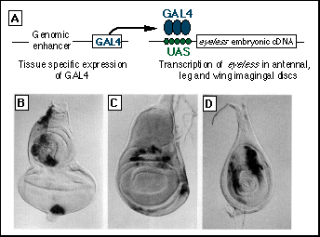
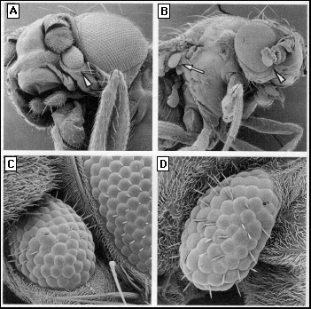
Induction of ectopic eyes by GAL4-targeted expression of the eyeless gene in Drosophila

Slide 14
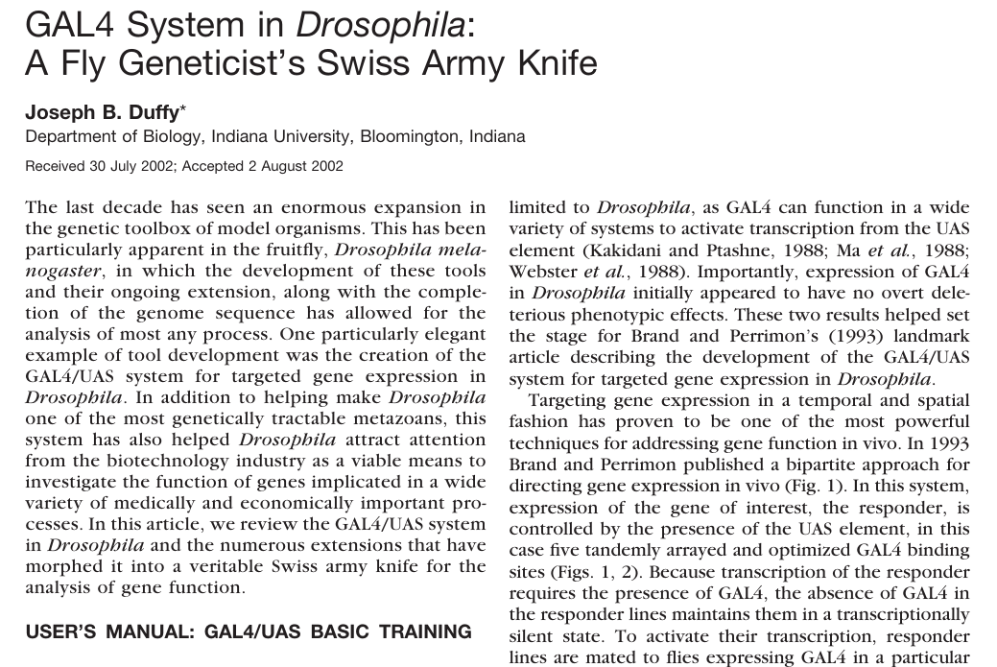
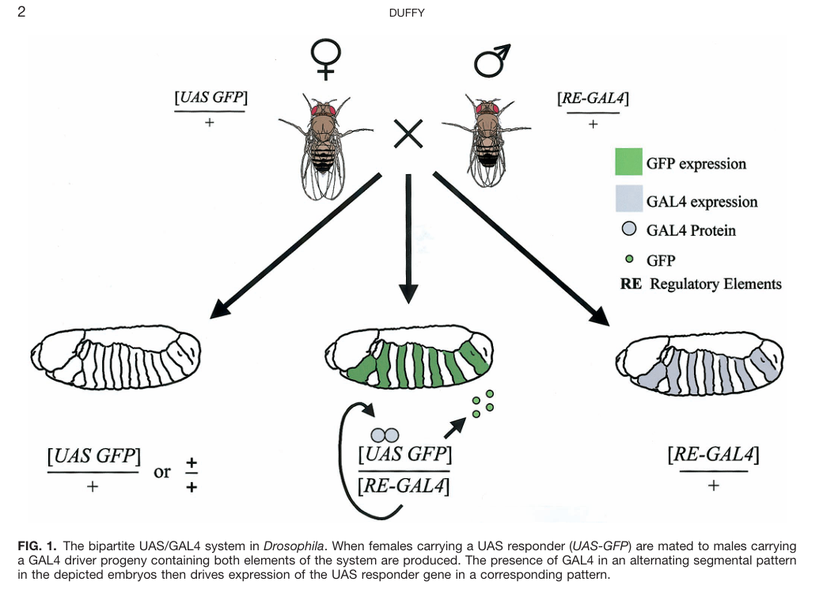

Slide 15
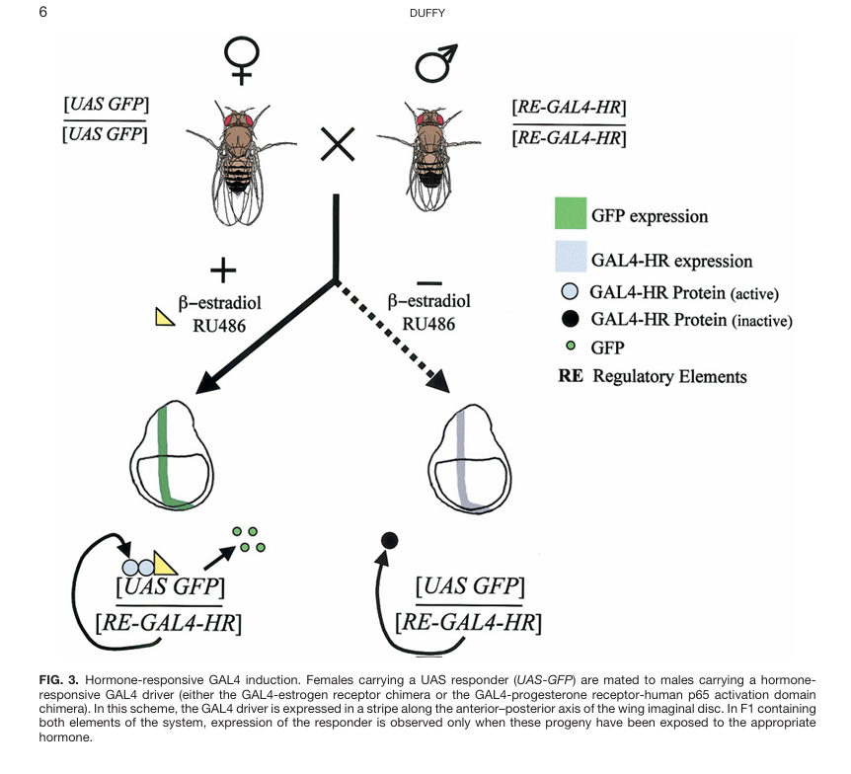
Hormone- activated GAL4, GeneSwitch
G

Slide 16
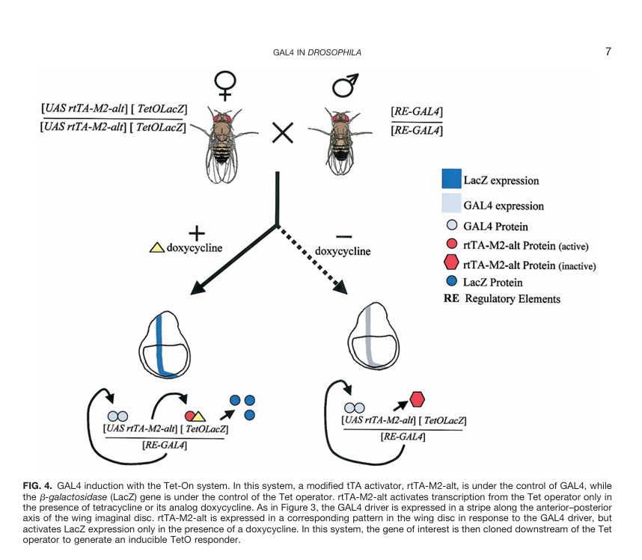
Tet-off

Slide 17
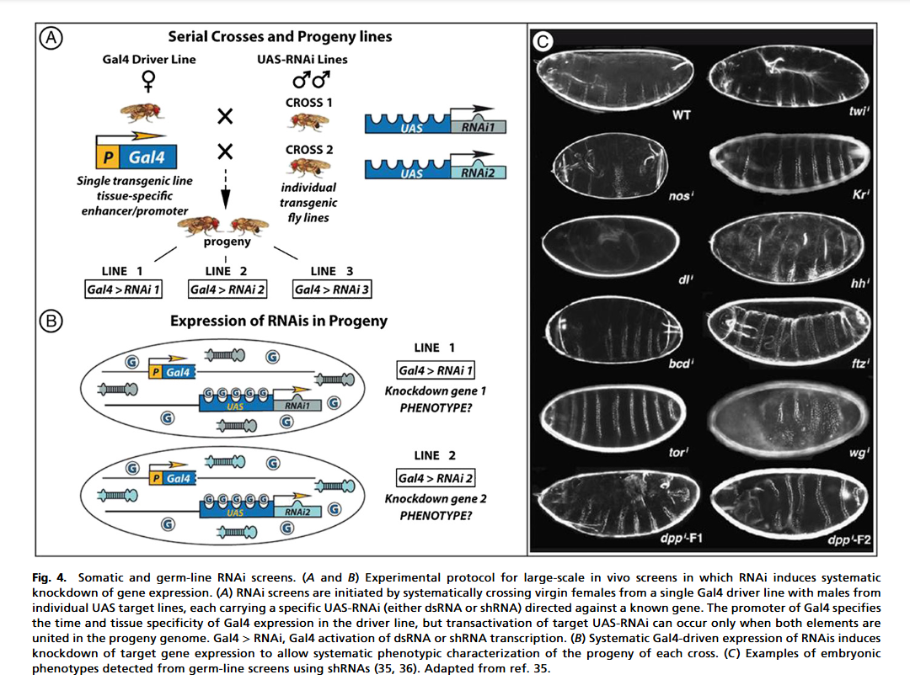
GAL4-driven tissue-targeted RNAi knockdown of gene expression

Slide 19
Why we need to make genetically mosaic animals

Slide 20
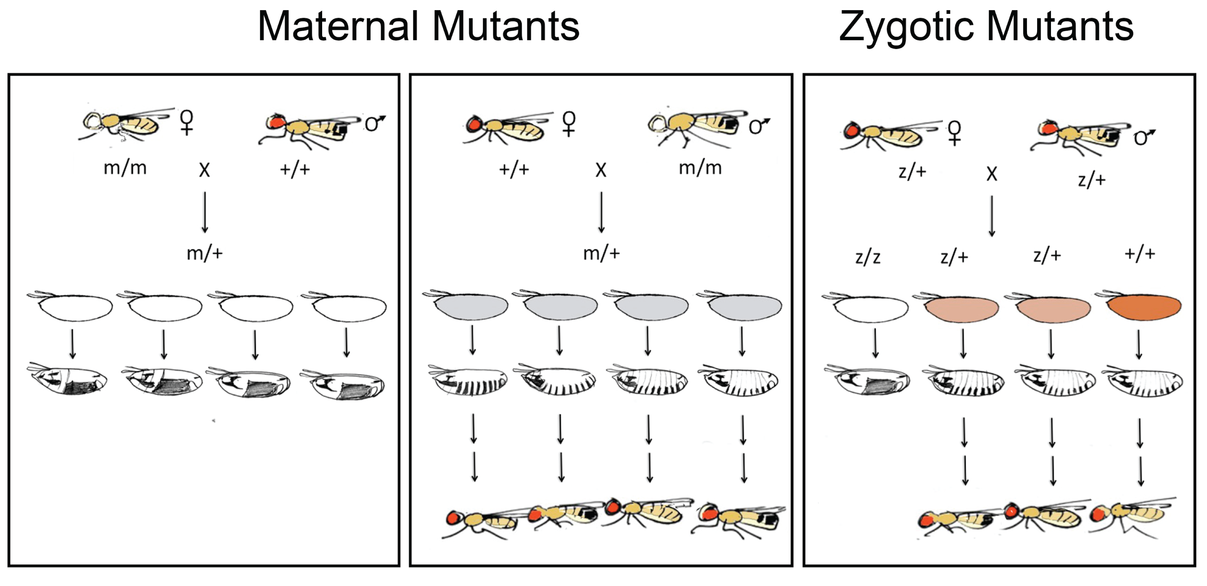
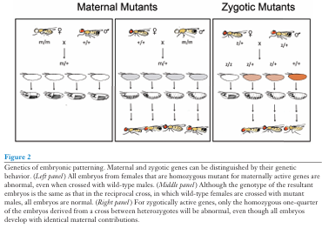
Probably missing many female sterile mutants here because homozygous mothers are not obtainable.

Slide 21
Making mosaics with clones of mutant cells in Drosophila
Many female sterile mutants could have been missed because homozygous mutant mothers cannot be obtained; the homozygous mutant mothers die as embryos or larvae.
Such mutants are zygotic lethals. For zygotic lethals in general, studying their effects in detail requires making mosaic animals having clones of homozygous mutant tissue in heterozygous eggs, embryos, larvae or adult flies (somatic clones).
If the lethal mutant has a female sterile defect because the mutation removes something required in nurse cells or oocytes, then it has to be studied using clones made in the germline (germline clones)

Slide 22
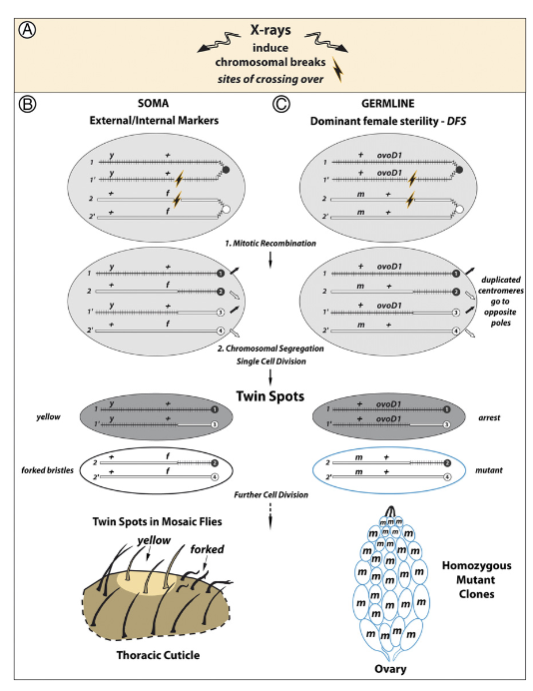
Mitotic recombination Somatic clones. Twin spots on fly cuticle show recessive mutant markers in side-by side clones arising from a single mitotic recombination event (Curt Stern, 1930). Germline clones in ovaries using the dominant female sterile (DFS) mutant OvoD

Slide 23
MR = mitotic recombination to form clones of recombinant cells

Slide 27
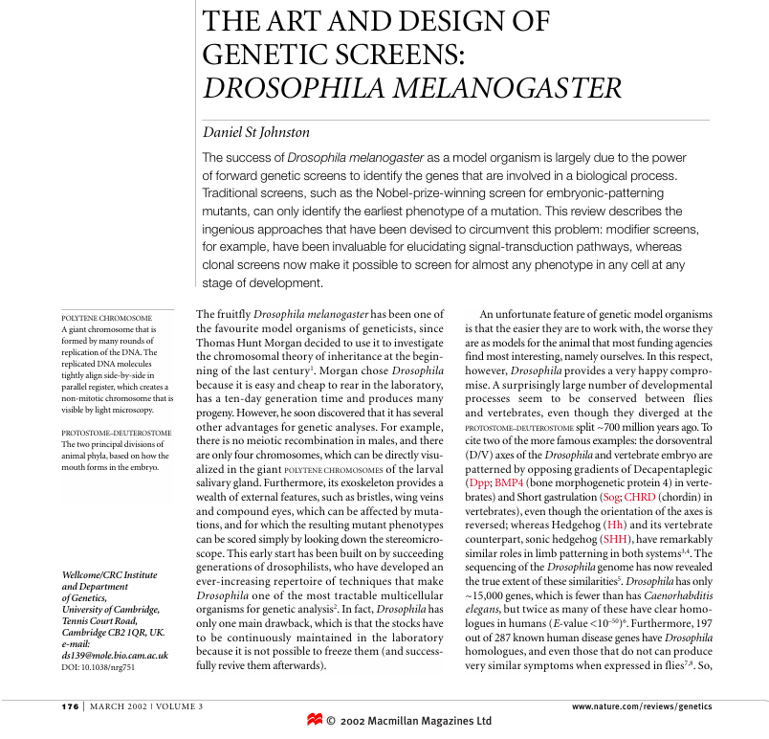

Slide 28
Making somatic clones with Flp/FRT

Slide 29
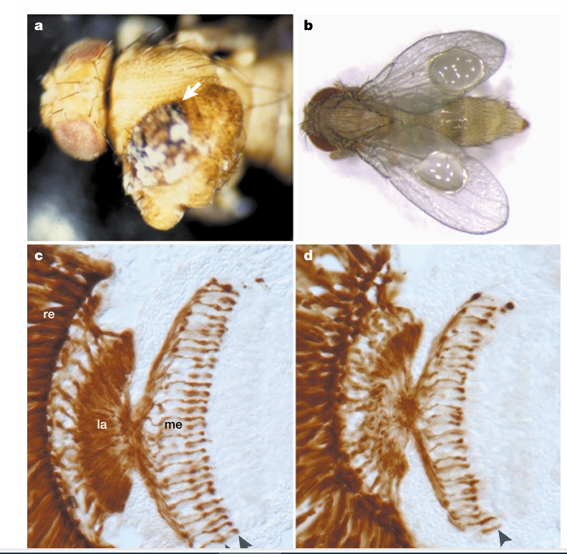
Examples of somatic FRT clones and screens

Slide 30
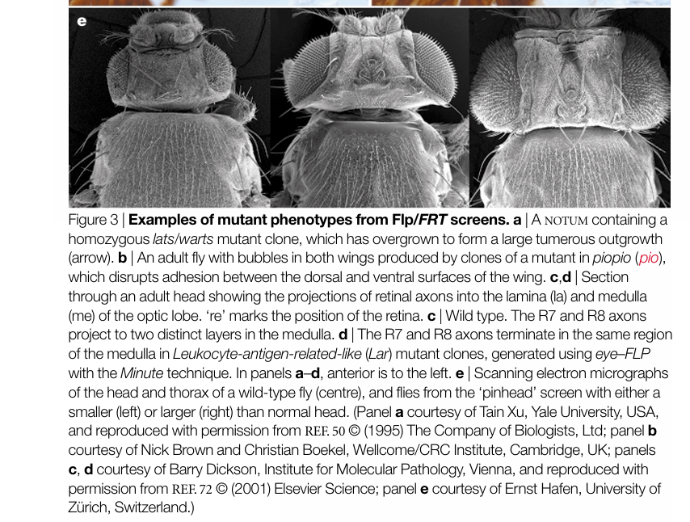

Slide 31
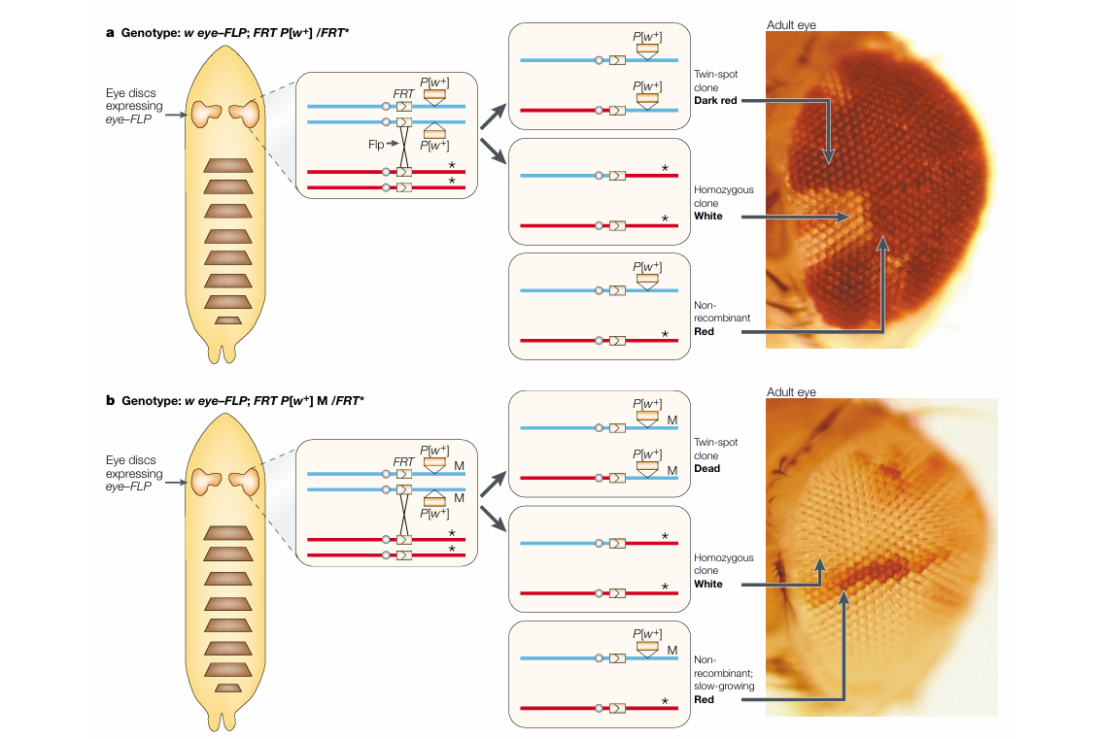

Slide 32
Mosaic Analysis with a Repressible Marker (MARCM) combines Flp/FRT with GAL4/UAS

Slide 33
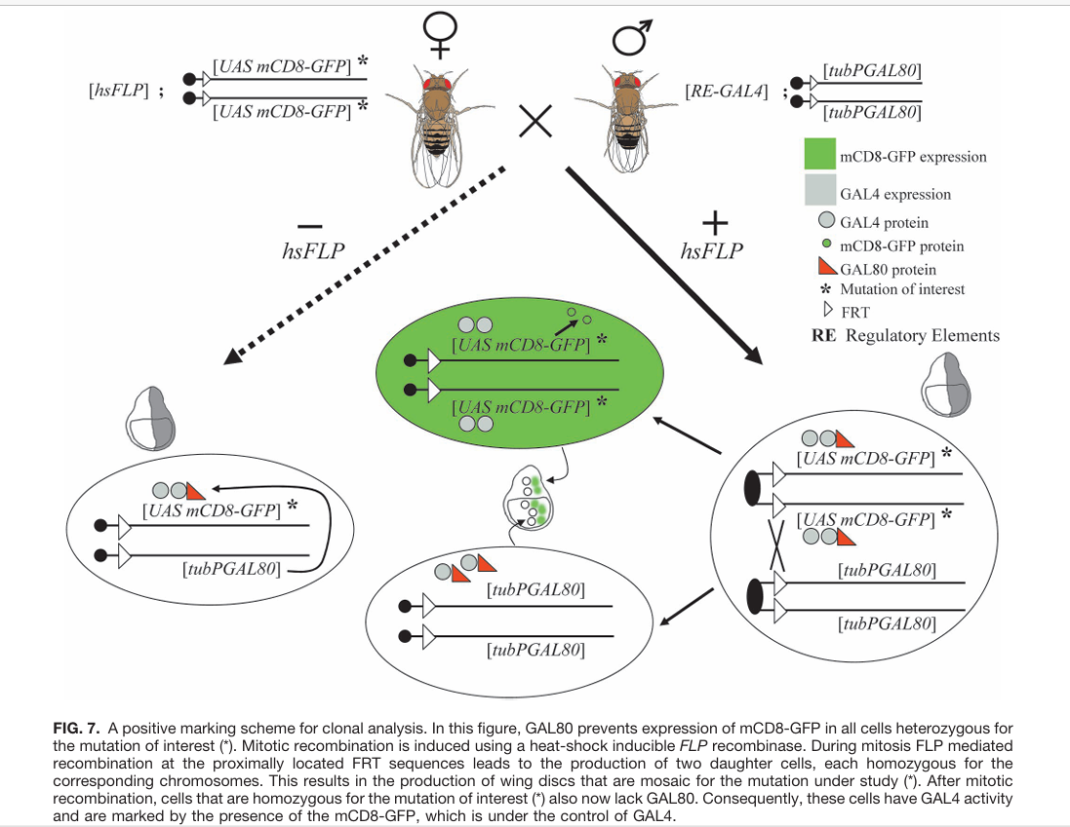
GAL80 removal by Flp away

Slide 34
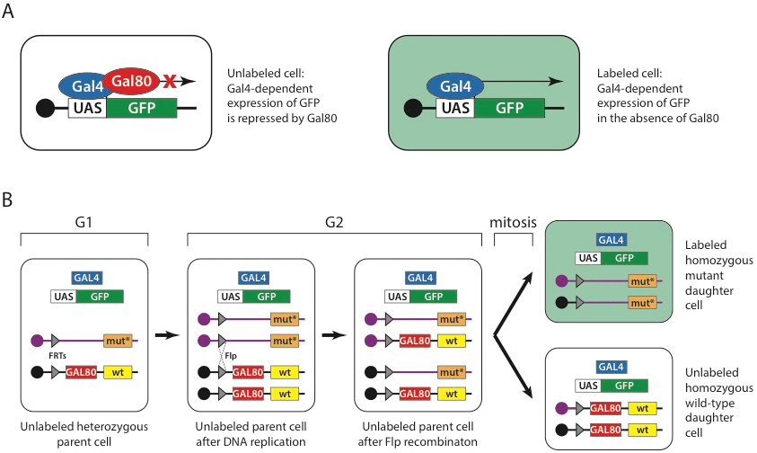

Slide 35
Making germline clones efficiently with Flp/FRT

Slide 36
Probably missing many female sterile mutants here because homozygous mothers are not obtainable.

Slide 37
Mitotic recombination Somatic clones. Twin spots on fly cuticle show recessive mutant markers in side-by side clones arising from a single mitotic recombination event (Curt Stern, 1930). Germline clones in ovaries using the dominant female sterile (DFS) mutant OvoD

Slide 38
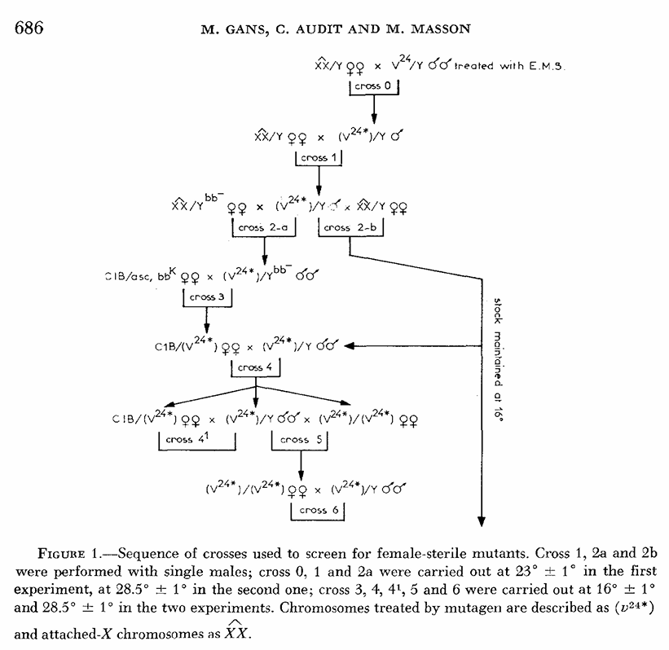
Perrimon came for Madeleine Gans lab in Paris. Screen for female sterile mutants on the X chromosome gave OvoD mutant. Mutagenized X chromosomes were crossed to Compound X, a balancer with fused copies of the X, used to keep stocks of female-lethal or female-sterile mutants. Female sterile mutants on the X chromosome included a dominant female sterile that is now called OvoD

Slide 43
Flp/FRT clones are used to study stem cell maintenance in germline stem cells and in somatic stem cells

Slide 44
Mitotic recombination Somatic clones. Twin spots on fly cuticle show recessive mutant markers in side-by side clones arising from a single mitotic recombination event (Curt Stern, 1930). Germline clones in ovaries using the dominant female sterile (DFS) mutant OvoD

Slide 45
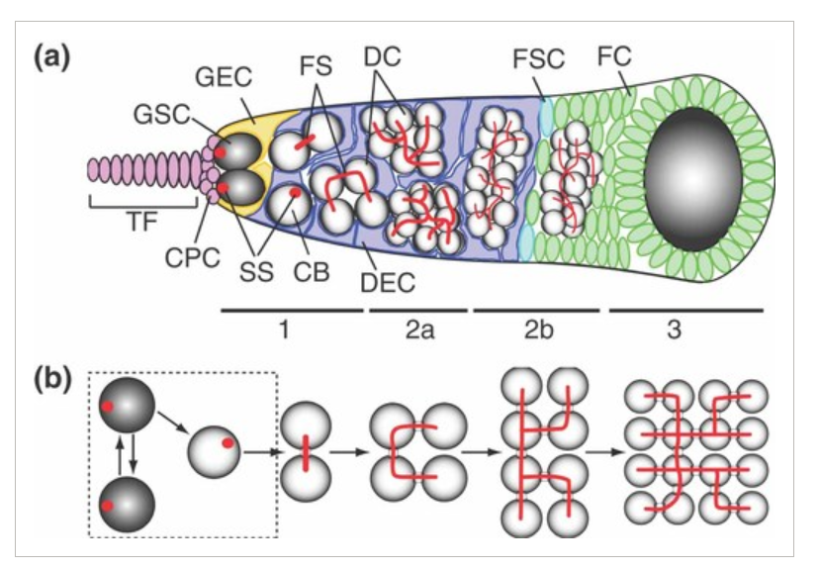
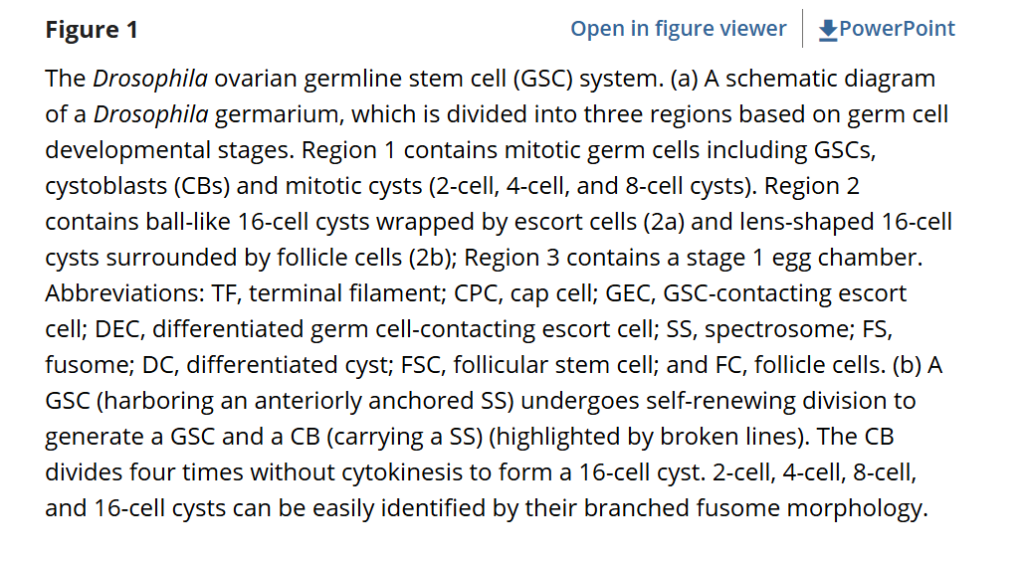

Slide 46
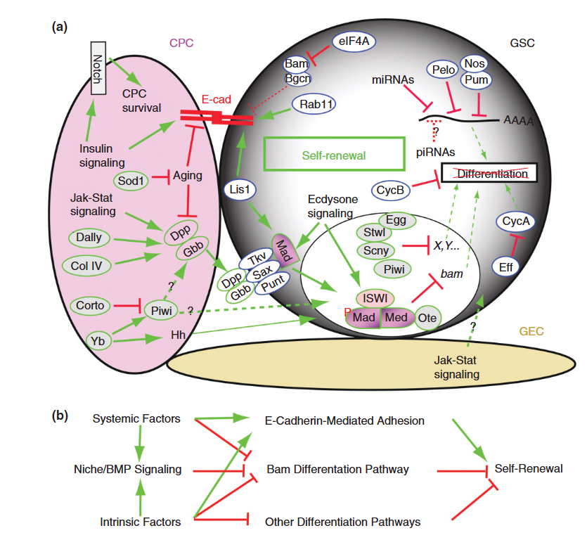

Slide 47
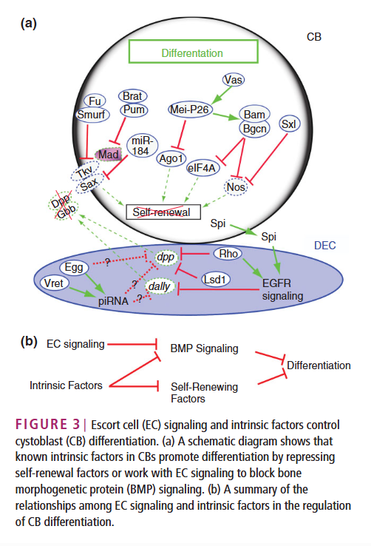

Slide 48
Reading
The art and design of genetic screens: Drosophila melanogaster
D St Johnston - Nature reviews genetics, 2002 - nature.com
[PDF] Creating mosaics in Drosophila
N Perrimon - International Journal of Developmental …, 1998 - genepath.med.harvard.edu
[PDF] GAL4 system in drosophila: A fly geneticist's swiss army knife
JB Duffy - genesis, 2002 - fenix.ciencias.ulisboa.pt

Slide 50
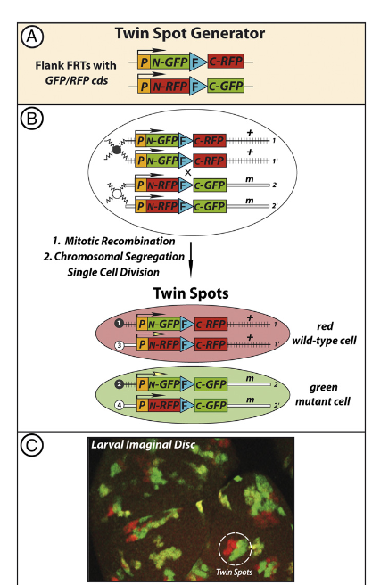
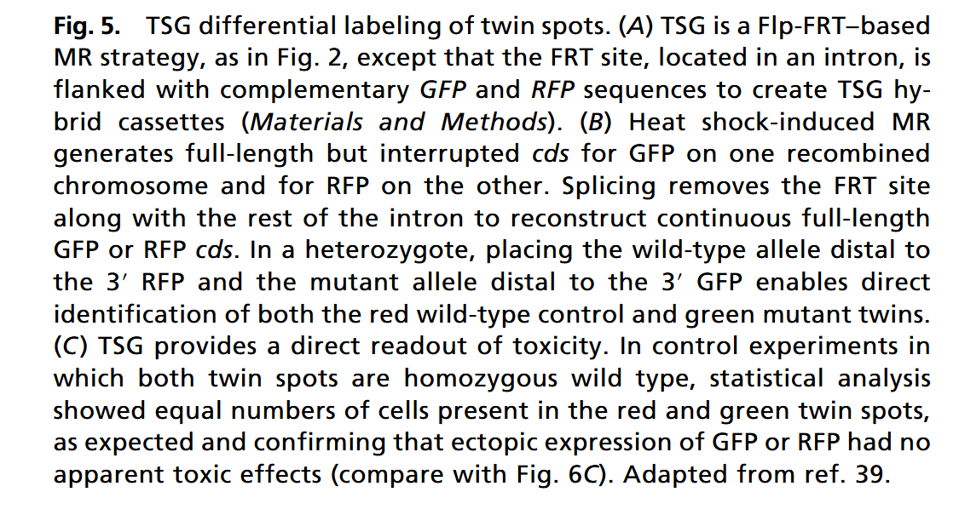

Slide 51
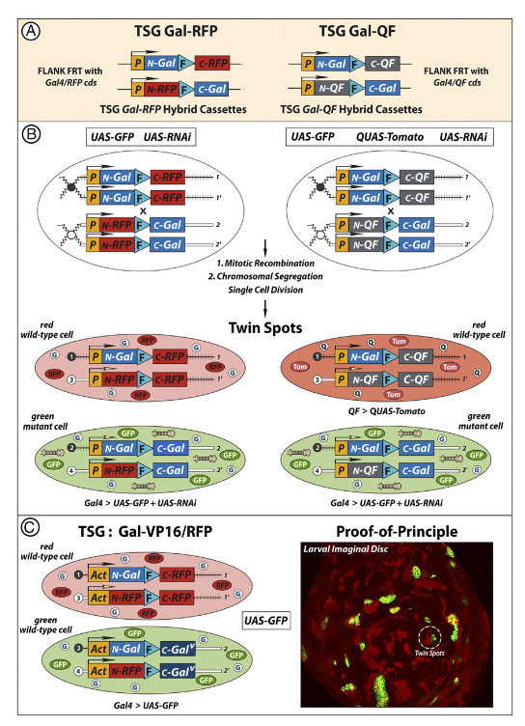

Slide 54
Uses of GAL4 Number 1: The yeast two hybrid system for identification of interacting proteins.
Can be used on a genomic scale to test all proteins against all others. Target protein fused to
DNA-binding domain in cells of one mating type mated to a library of activating region fusion proteins.

Slide 55
Uses of GAL4: GAL4 activates transcription from UAS_{G} in Drosophila. Widely used for targeted protein expression in Drosophila (GAL4-UAS two-component system).

Slide 56
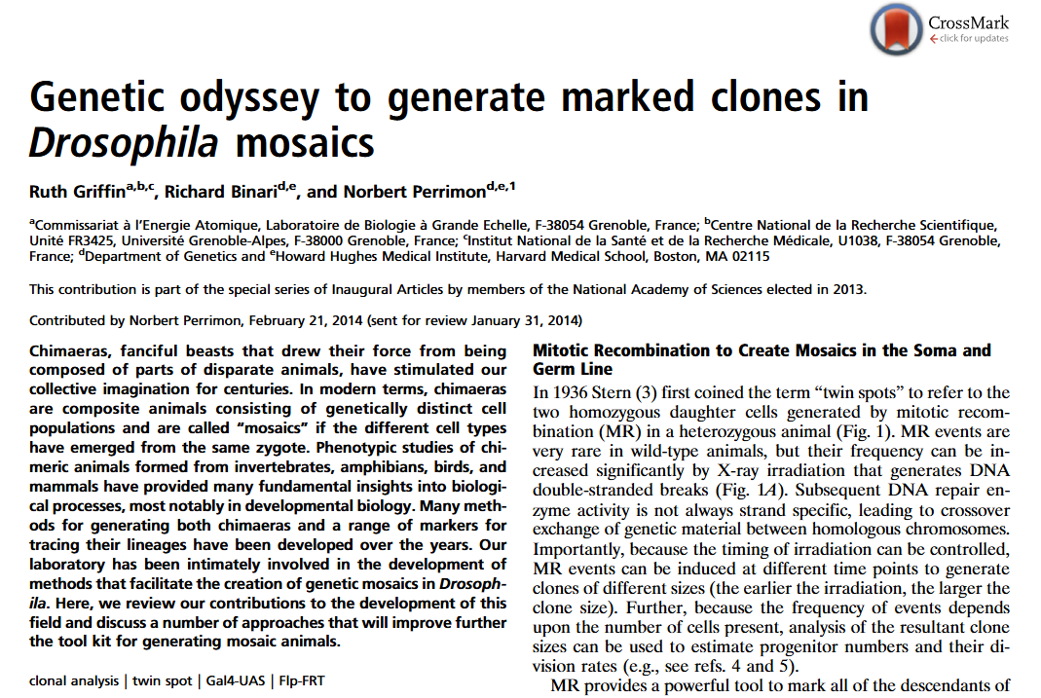

Slide 57
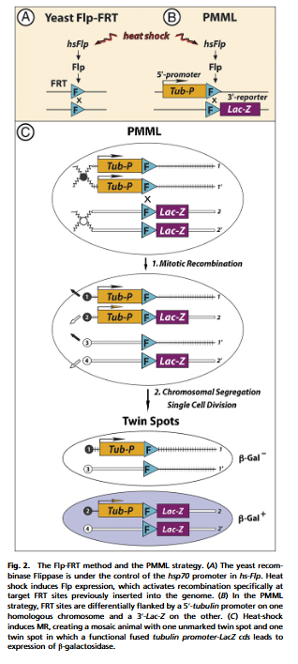

Slide 58
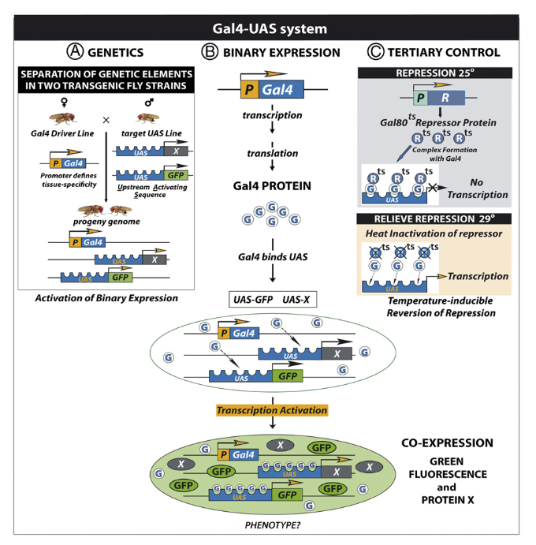

Slide 60
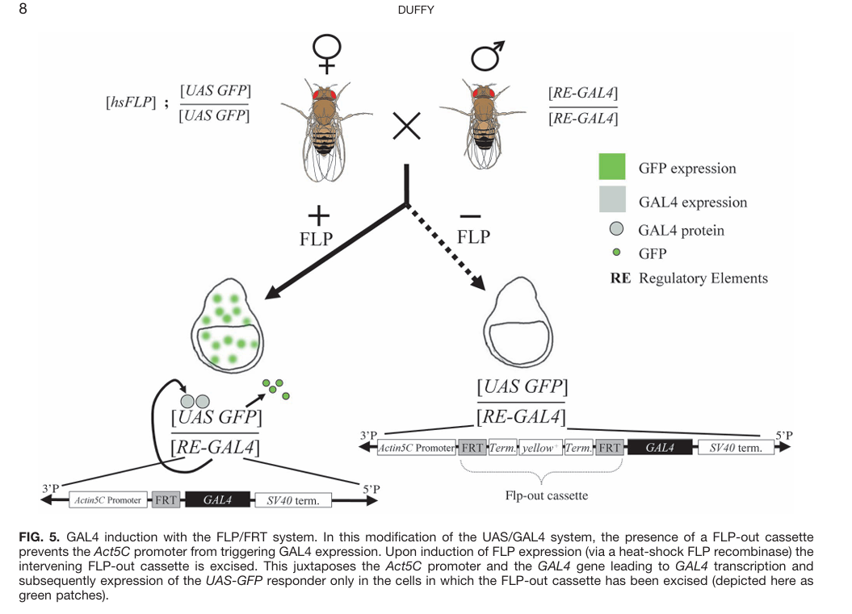
Flp-out, GAL4-on

Slide 61
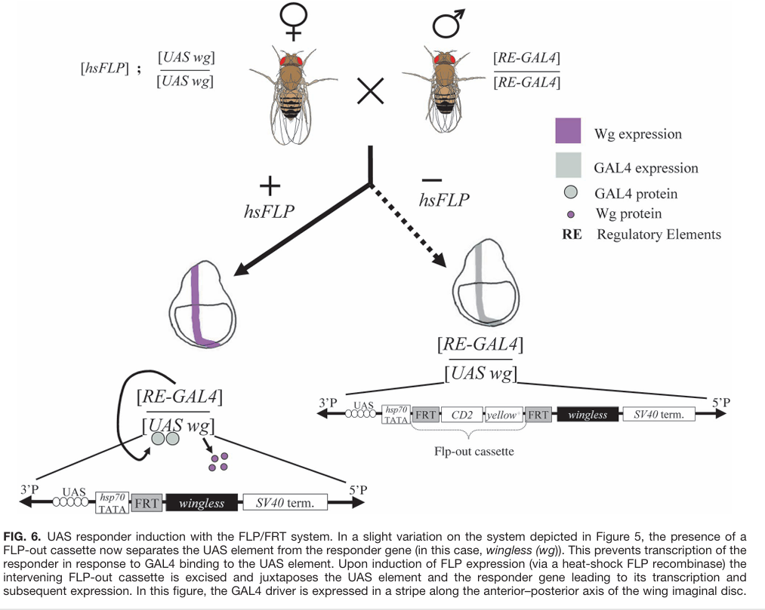
UAS Flp-on

Slide 62
GAL80 removal by Flp away

Slide 64
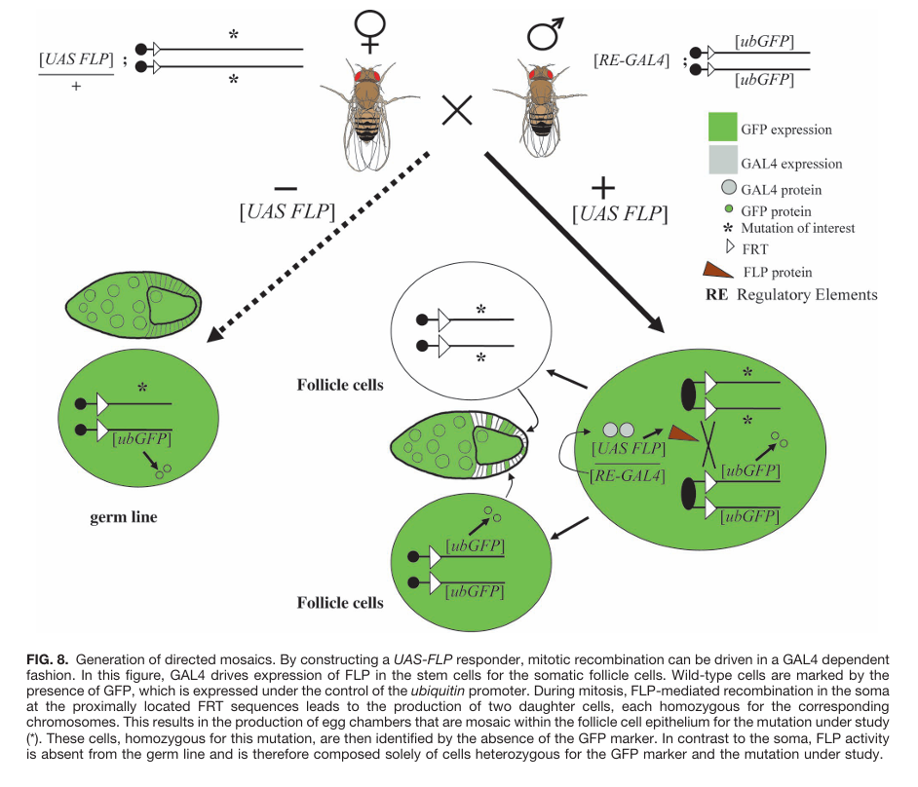
Ey-Flp, directed mosaics

Slide 65
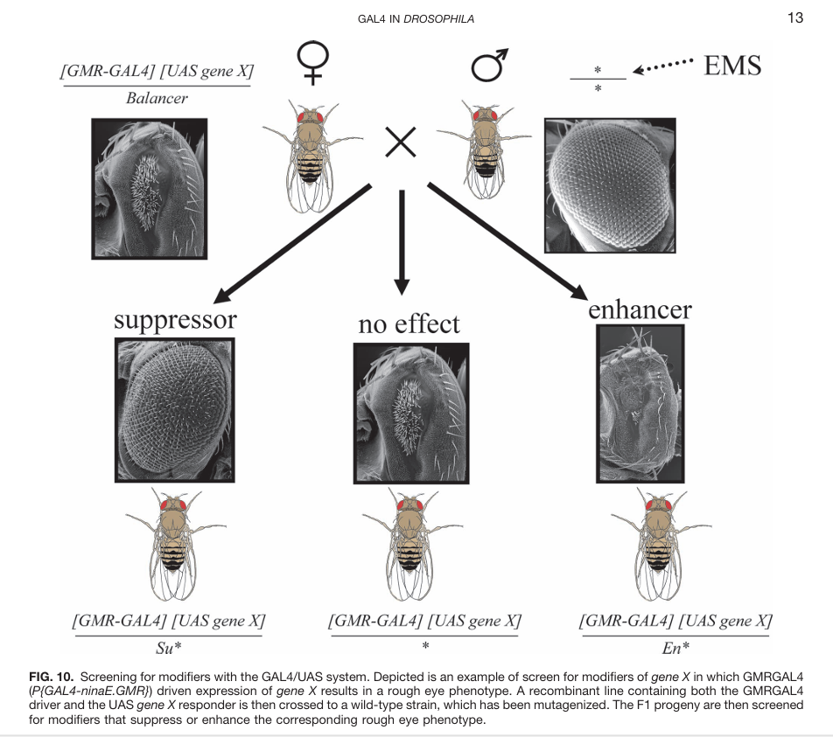
Modifier screen in eyes

