Slide 1
Buněčné dělení, mitóza, meióza
Mgr. Hana Cempírková, Ph.D. Rostlinná embryologie - přednáška

Slide 2
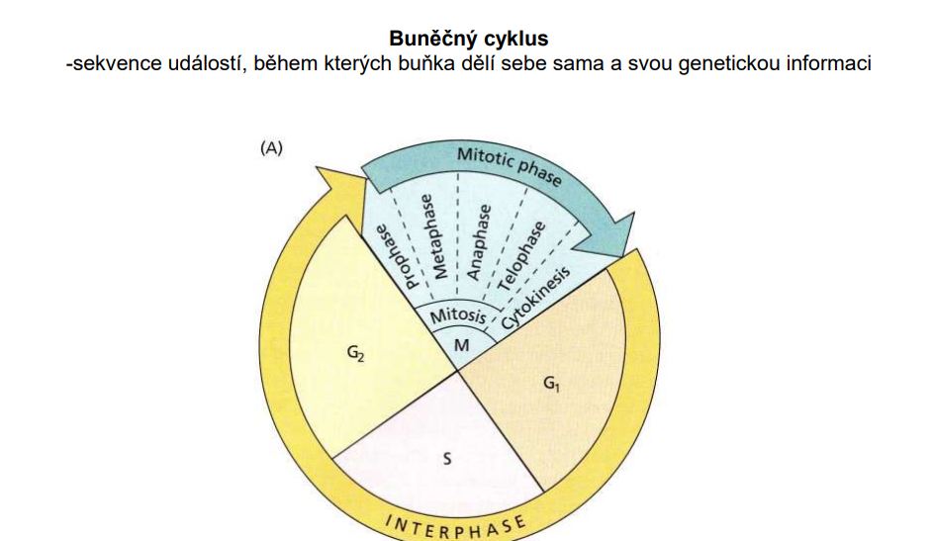

Slide 3
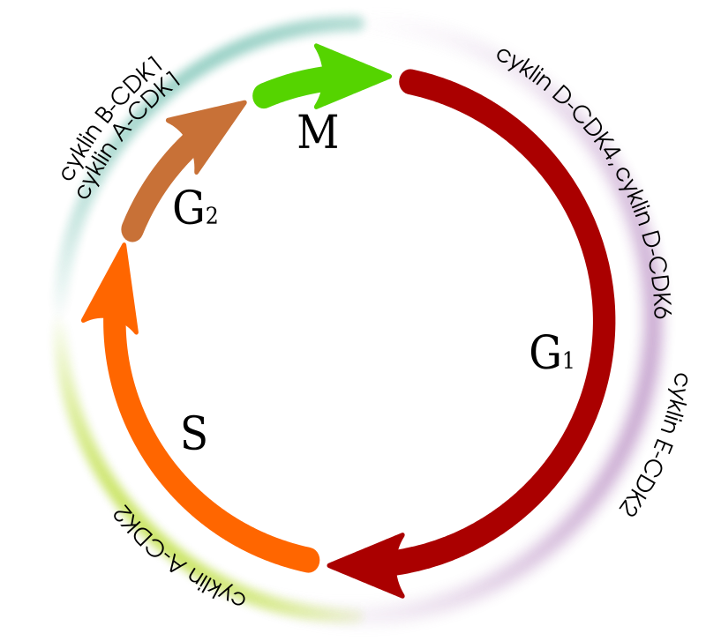
Kontrolní body buněčného cyklu
ověřují, zda byly úspěšně dokončeny všechny procesy probíhající v dané fázi BC, předtím, než buňka postoupí do další fáze

Slide 4
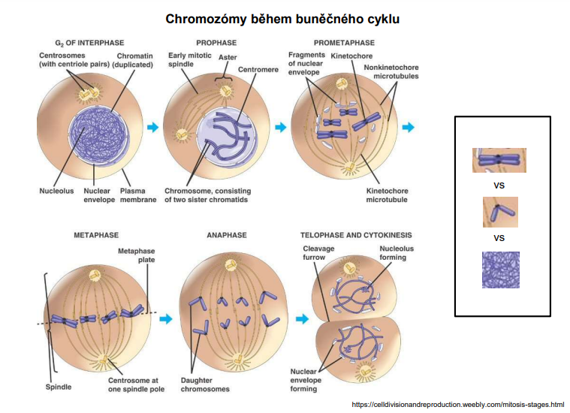

Slide 5
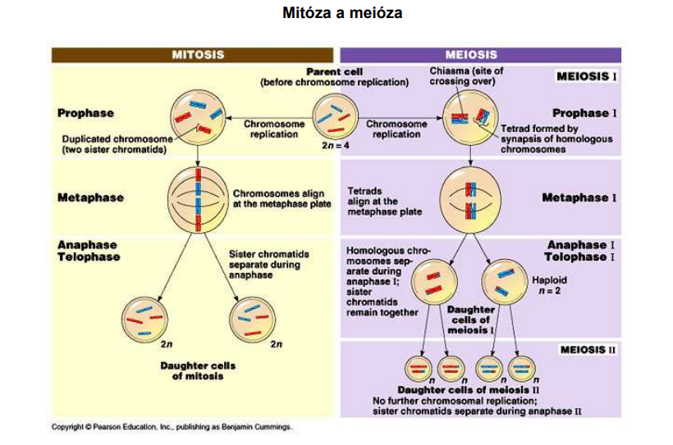

Slide 6
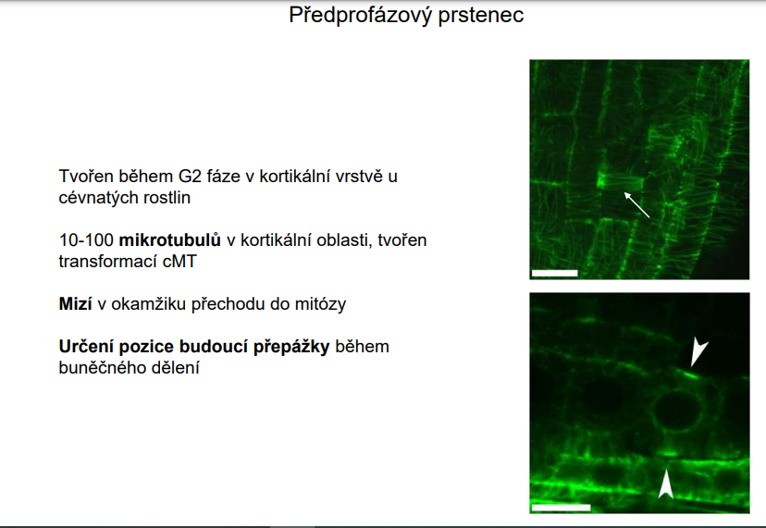

Slide 7
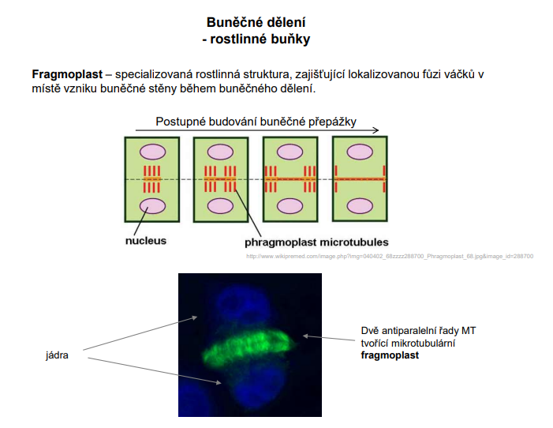

Slide 8
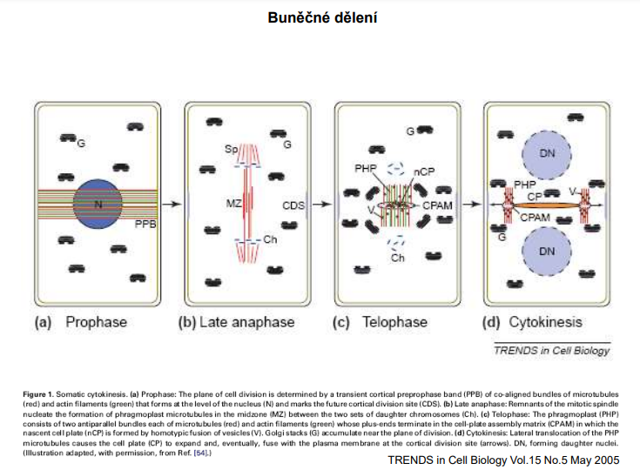

Slide 9
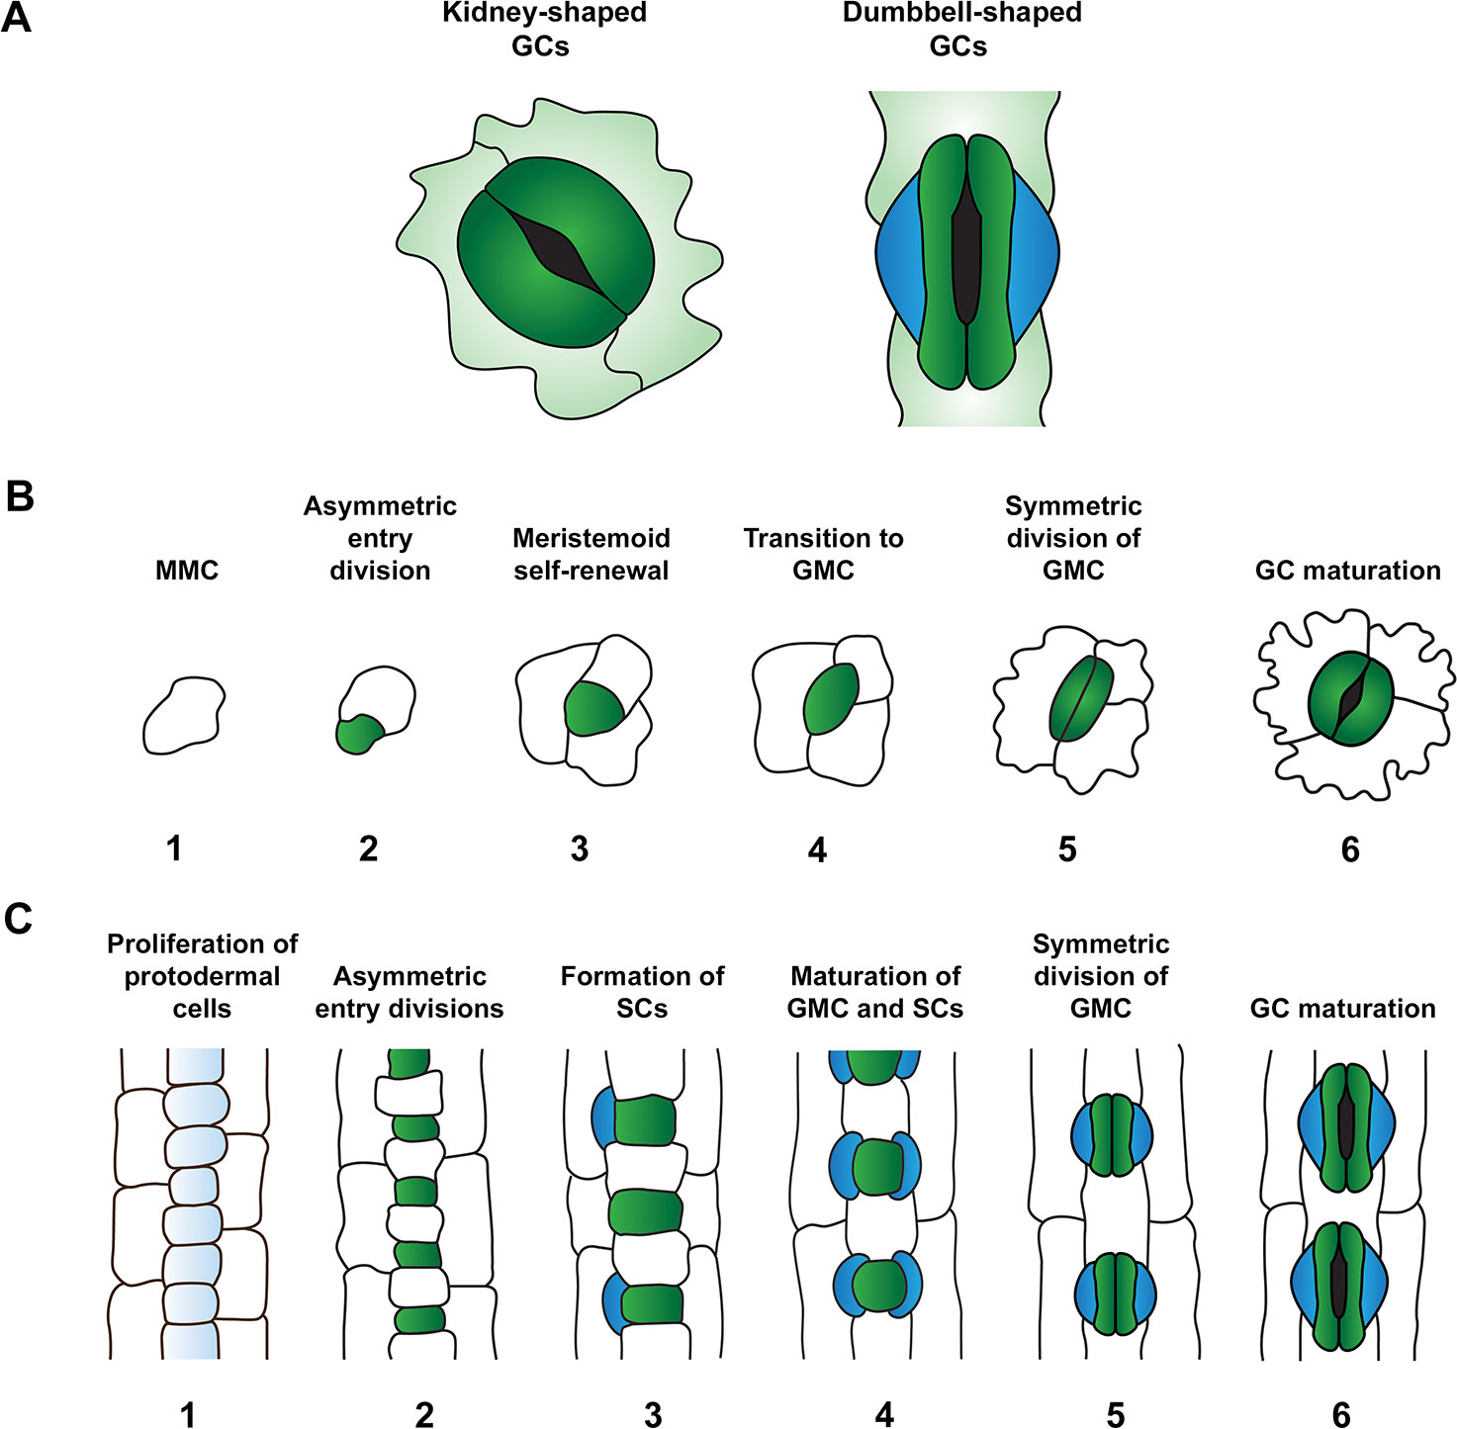
Vznik průduchů
Notes:
Comparison of stomatal morphology and development in the leaves of the eudicot Arabidopsis thaliana and monocot grasses. (A) Comparison of guard cell (GC) morphology: kidney-shaped GCs of A. thaliana (left) and dumbbell-shaped GCs typical of monocot grasses (right). GCs and subsidiary cells (SCs) are depicted in dark green and blue respectively. (B) Stomatal development in A. thaliana. Meristemoid mother cells (MMCs) (1) divide asymmetrically to form meristemoids (green) (2). This process of asymmetric division is repeated in the self-renewing meristemoid phase (3). Note, asymmetric spacing divisions of MMCs occur around this developmental stage, with newly formed satellite meristemoids forming at least one-cell away from pre-existing meristemoids and stomata. Asymmetric divisions are then terminated and meristemoids transition to guard mother cell (GMC) state (4). GMCs undergo a single symmetric division to produce a pair of GCs (5) which mature to define the stomatal aperture amid the tessellated pavement cells of the leaf epidermis (6). (C) Stomatal development in grasses (modelled from barley, Hordeum vulgare). At the beginning of stomatal development, protodermal cells start to proliferate at a faster rate than surrounding cell files (1). Protodermal cells undergo just one round of asymmetric division, generating smaller GMCs (green) and larger epidermal cells (2). GMCs become enlarged and provide cues to induce asymmetric divisions in flanking subsidiary mother cells (SMCs) (3) which result in the production of SCs (blue) (4). Analogous to eudicot stomatal development, GMCs undergo a single symmetric division (5) to produce a pair of daughter cells that differentiate into mature GCs surrounded by columnar pavement cells (6).

Slide 10
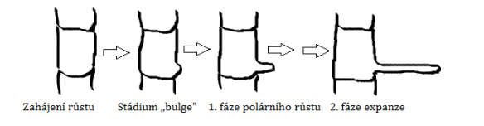
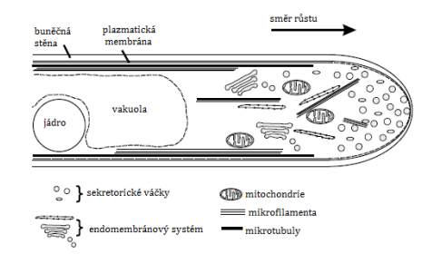
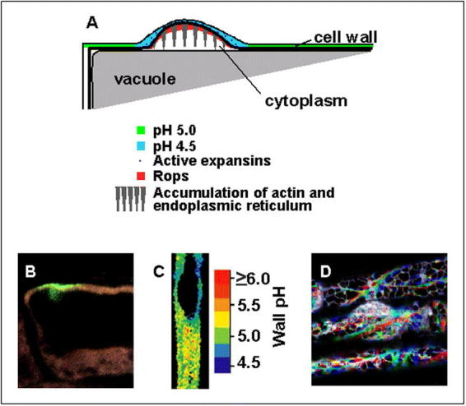
Tvorba kořenových vlásků
„root hair cells“
„non-hair cells“
https://www.ncbi.nlm.nih.gov/pmc/articles/PMC3243358/

Slide 11
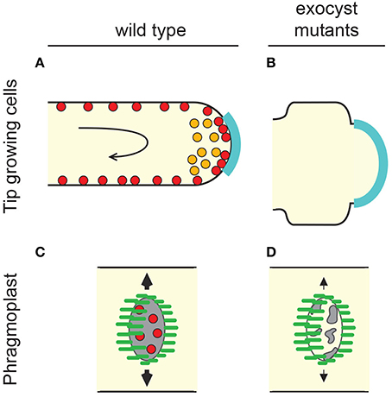
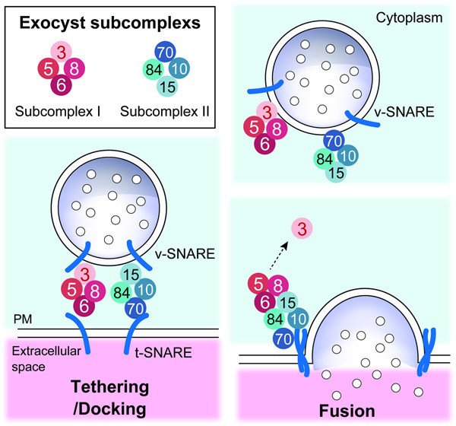
Exocyst
Proteinový komplex důležitý pro regulaci pohybu vezikulů a buněčných signálních cest
Zapojený do transportu vezikulů mezi GA a plasmatickou membránou

Slide 12
https://www.youtube.com/watch?v=4govZdjEBrs&ab_channel=RaghavendraRao
https://www.youtube.com/watch?v=kQu6Yfrr6j0&t=36s&ab_channel=NucleusBiology

