Slide 1
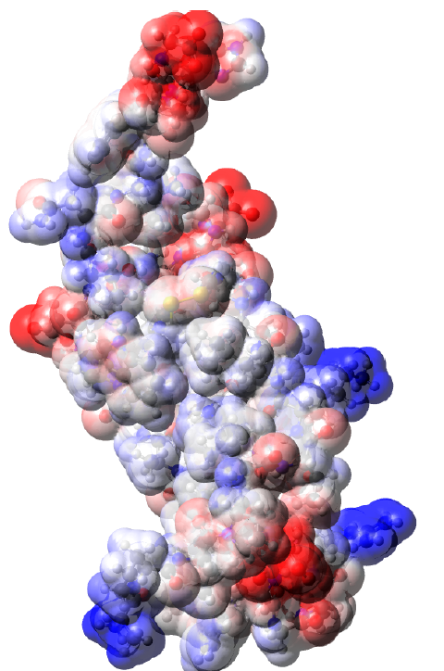
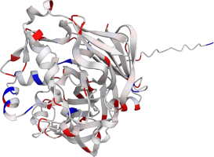


𝛂Charges
Partial atomic charges for AlphaFold structures

Slide 2
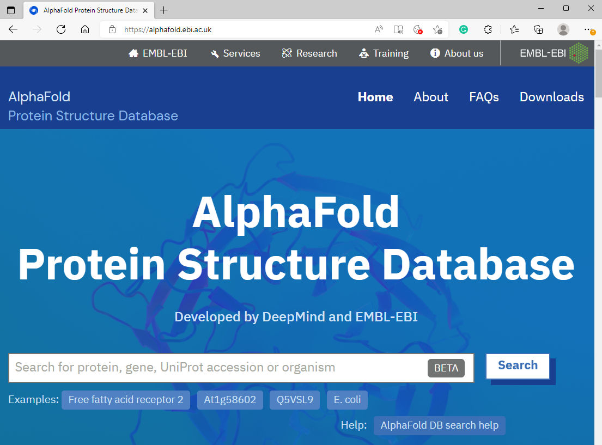
AlphaFoldDB – predicted protein structures
~ 200 M protein structures

Slide 3
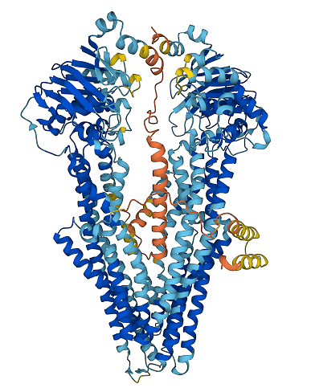
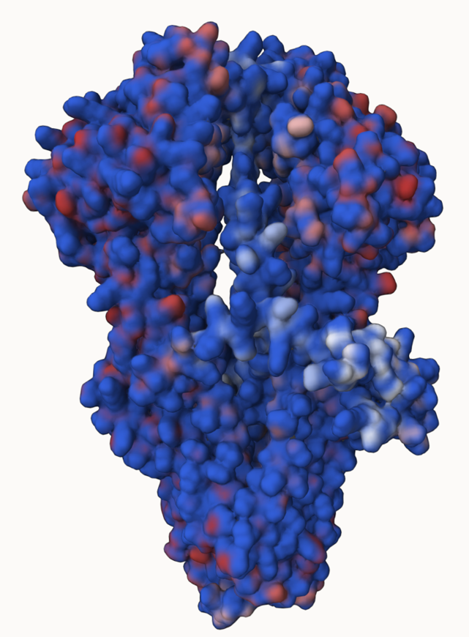
Why partial atomic charges?
They show the chemical properties of the predicted structures
P-glycoprotein

Slide 4
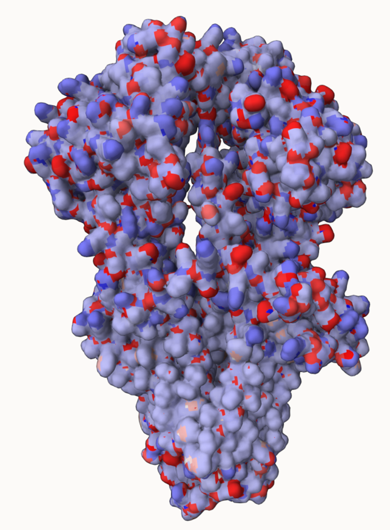
Why partial atomic charges?
They show the chemical properties of the predicted structures
P-glycoprotein

Slide 5
Why partial atomic charges?
They show the chemical properties of the predicted structures
Trans-membrane part
P-glycoprotein

Slide 6
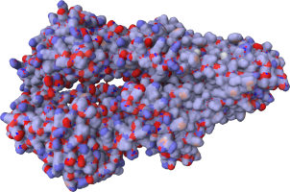
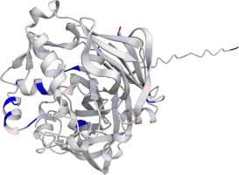

αCharges: Partial atomic charges for AlphaFold structures
Computes charges for AlphaFold2 structures from AlphaFoldDB
Method: SQE+qp, parameterized for (B3LYP/6-31G*/NPA)
Inputs: UniProt ID of AlphaFoldDB molecules
Outputs: plain text, mmCIF, PQR
Visualization: Mol*
Web page: https://alphacharges.ncbr.muni.cz/
Schindler O., Berka K., Cantara A., Křenek A., Tichý D., Raček T., Svobodová R, 2023. αCharges: Partial atomic charges for AlphaFold structures in high quality. Nucleic acids research, 51(W1), W11-W16.

Slide 7
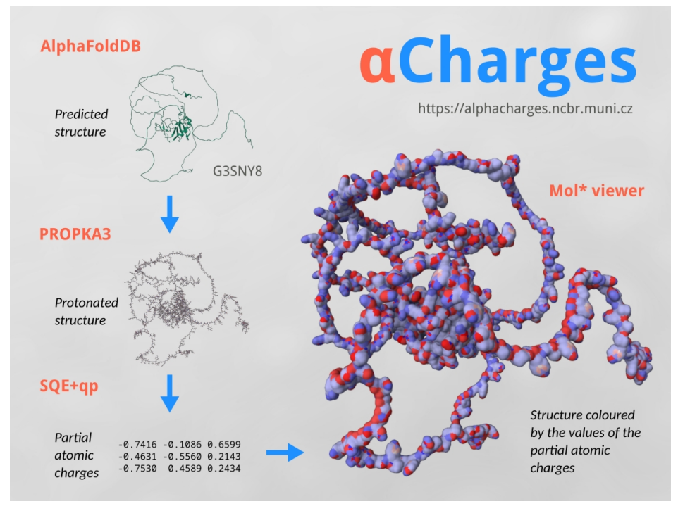
αCharges: Partial atomic charges for AlphaFold structures
pH

Slide 8
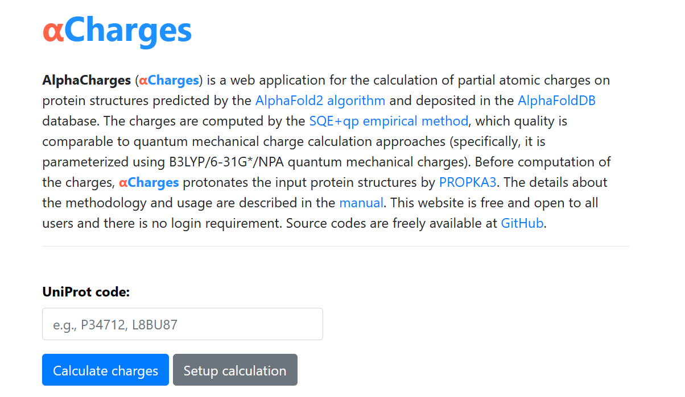

Slide 9
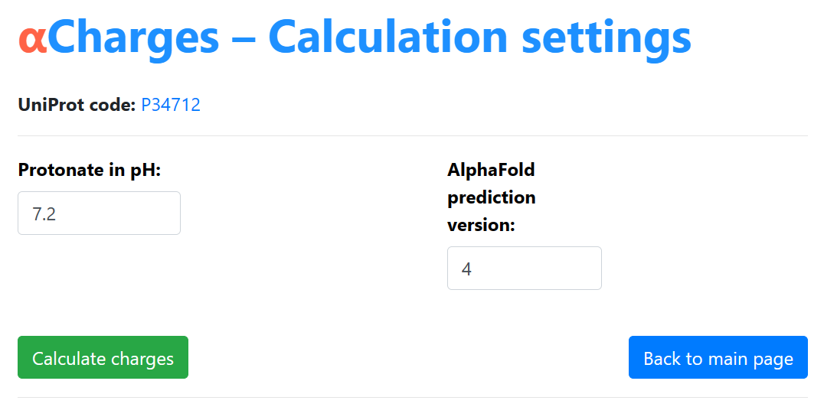

Slide 10

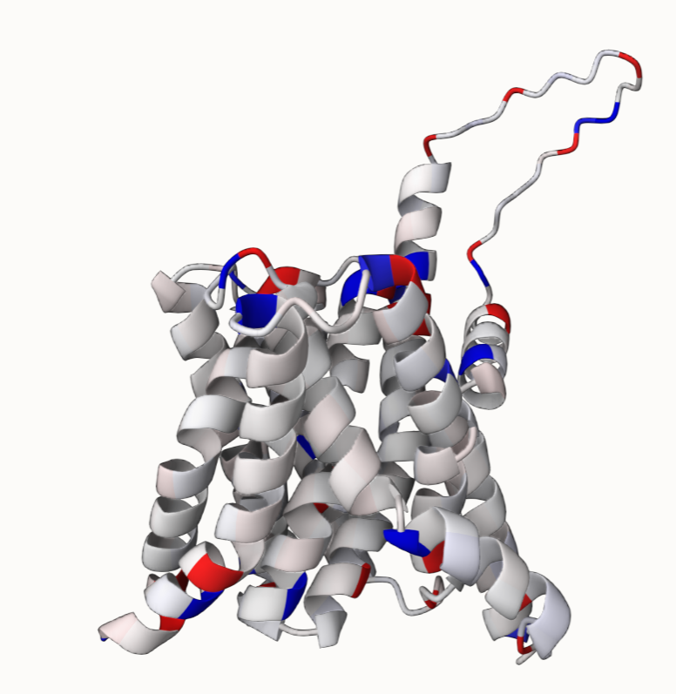
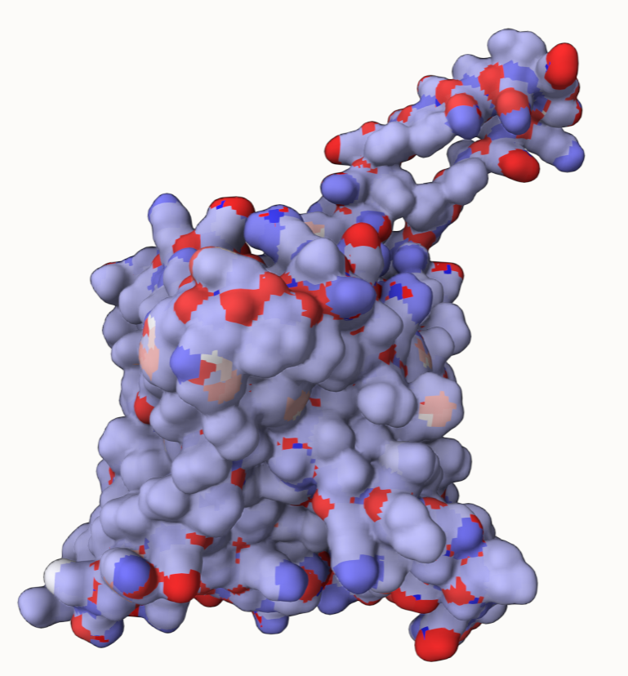
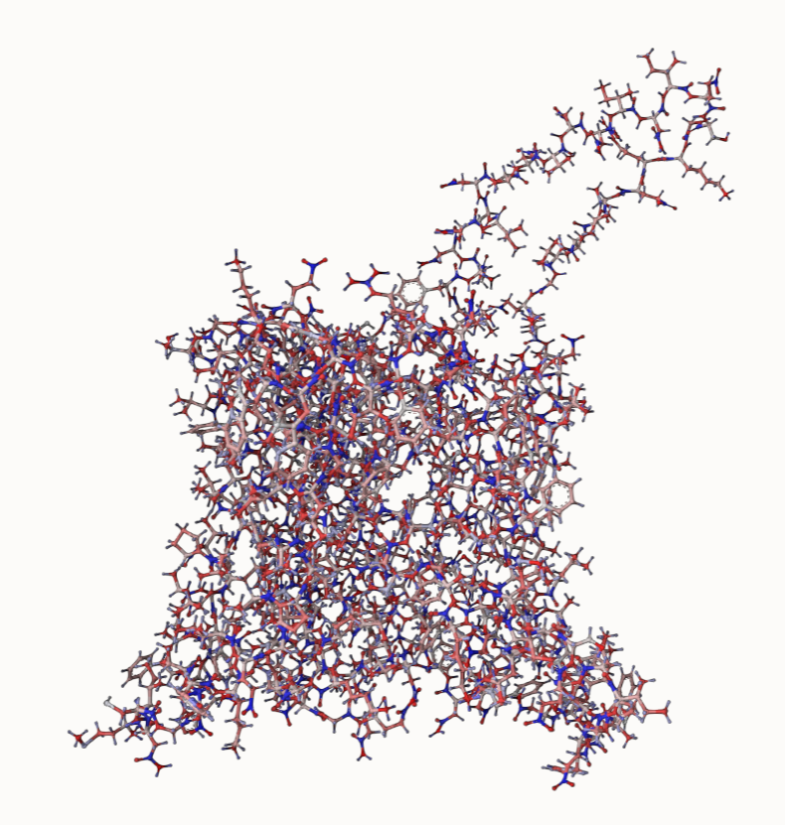
αCharges: visualization
Sehnal D., Bittrich S., Deshpande M., Svobodová R., Berka K., Bazgier V., ... & Rose A. S. (2021). Mol* Viewer: modern web app for 3D visualization and analysis of large biomolecular structures. Nucleic Acids Research, 49(W1), W431-W437.

Slide 11
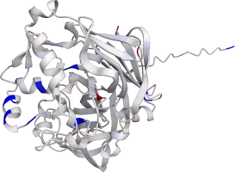
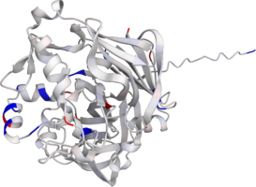
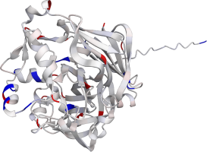
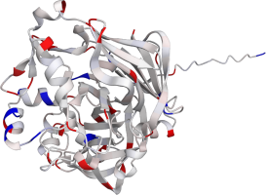

Examples: Pepsin in different pH values
ACTIVE
activity decrease
pH 1
pH 2
pH 3
pH 4
INACTIVE
pH 5
pH 6
pH 7

Slide 12
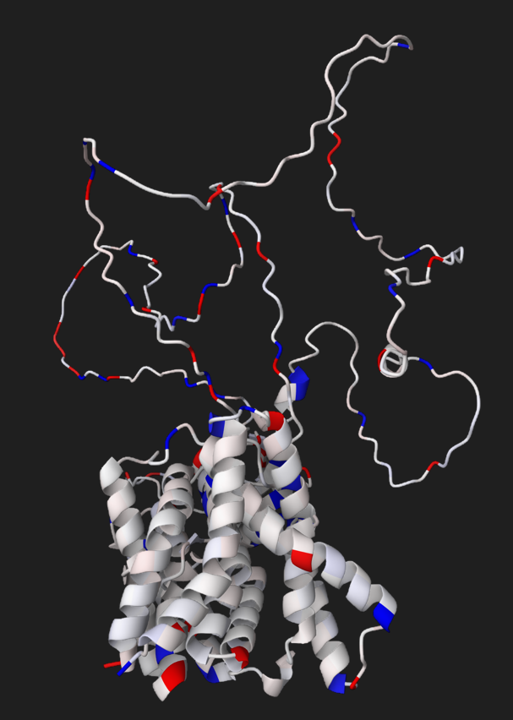
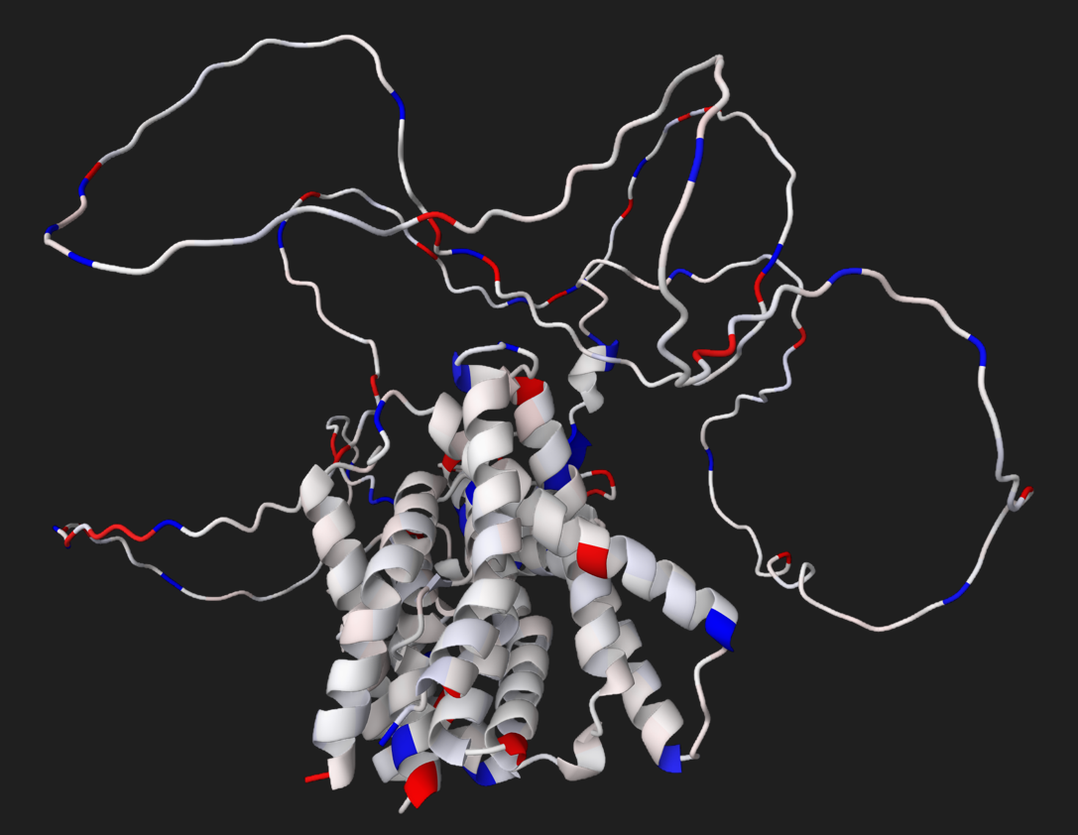
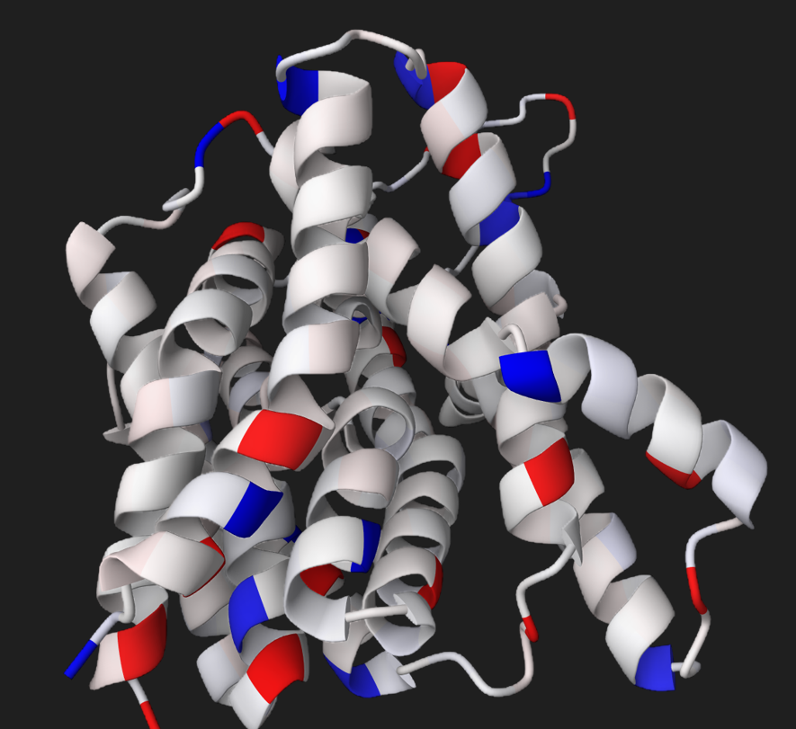
Examples: PIN proteins
PIN3
PIN7
PIN5

Slide 13
Examples: PIN proteins
Legend:
Similar charges
Different charges
PIN3
PIN7
PIN5

