Slide 1
Validation - proteins

Slide 2
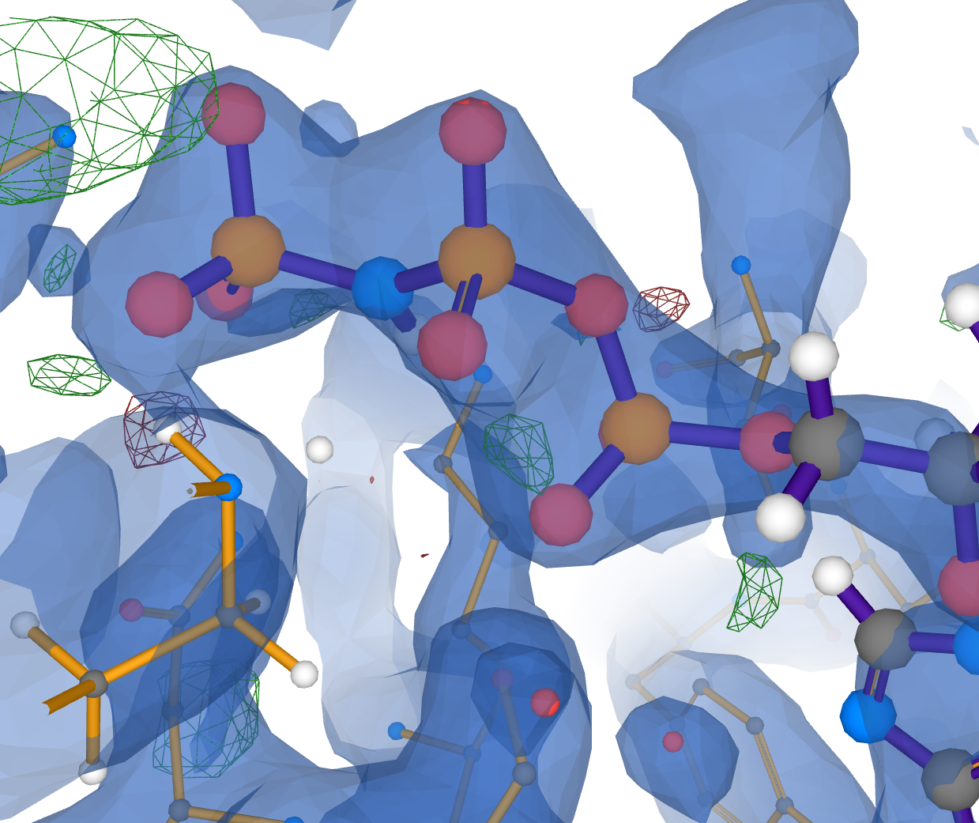
Electron density maps
When looking at PDB structures Electrons Density (ED) maps are more/as important as the 3D atomic model!
ED is a 3D map of where the scattering electron cloud is according to the measured X-ray data.
2Fo-Fc map indicates where electrons are (according to SF and model). Normally colour blue or grey.
Fo-Fc difference map:
  green for positive difference: where the current model fails to place sufficient electrons
  Red for negative difference: where the current model places too many electrons
www.ebi.ac.uk/pdbe/entry/pdb/4z9l/bound/ANP

Slide 3
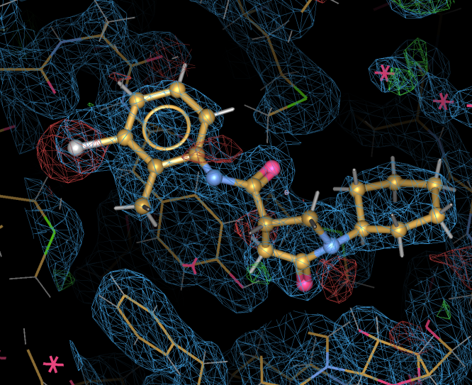
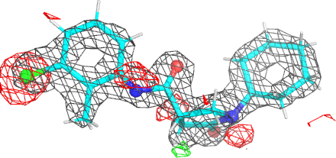
Electron density for a ligand with poor fit
2h7p.pdb: ED around ligand, as visualized in
buster-report
2h7p.pdb: ED visualized in coot
Notice difference density around ligand
2h7p has been obsoleted and replaced 4tzt with really superb ED and ligand fit

Slide 4
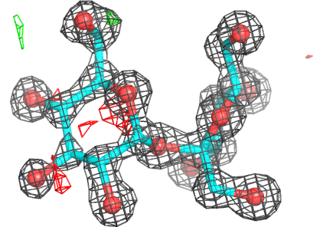
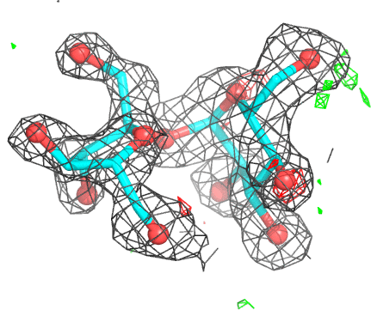
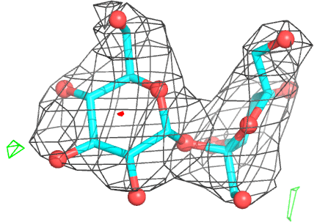
Data resolution affects electron density detail:
Well placed/refined sucrose ligand at different data resolutions:
1ylt 1.2Å resolution
“atomic resolution”
2Fo-Fc ED shows atoms as
Individual blobs. Need higher resolution for hydrogen atoms
2pwe 2.0Å resolution
Typical medium resolution for ligand studies. Can see ring pucker
2qqv 3.0Å resolution
Low resolution. Ligand placement unambiguous but fine detail cannot be seen

Slide 5
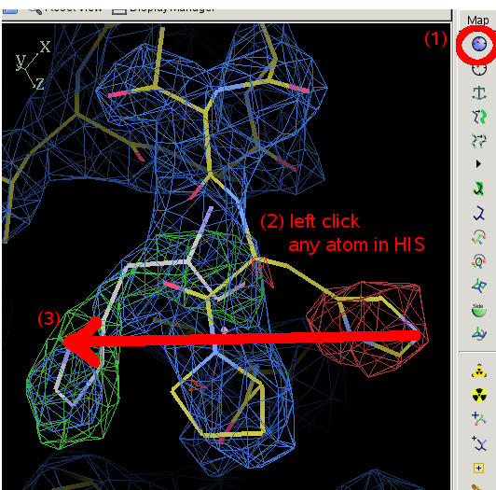
Model improvement
Basically interpret electron density maps in real space to improve model
Initially automated methods (warp/arpwarp) used
But mostly manual corrections to the model are done using the Coot program
Look at Fo-Fc difference map for both negative and positive features
Build into 2Fo-Fc

Slide 6
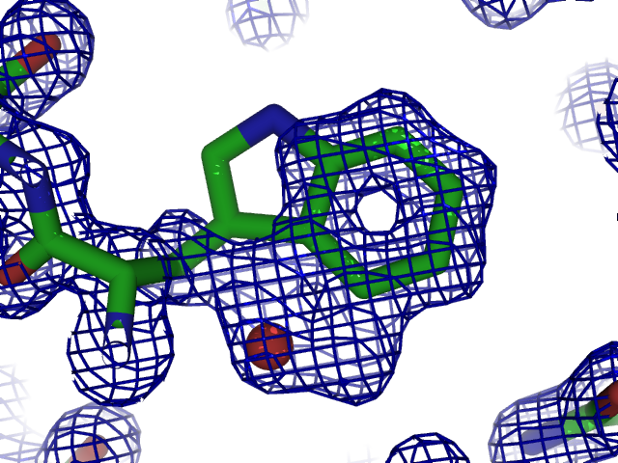
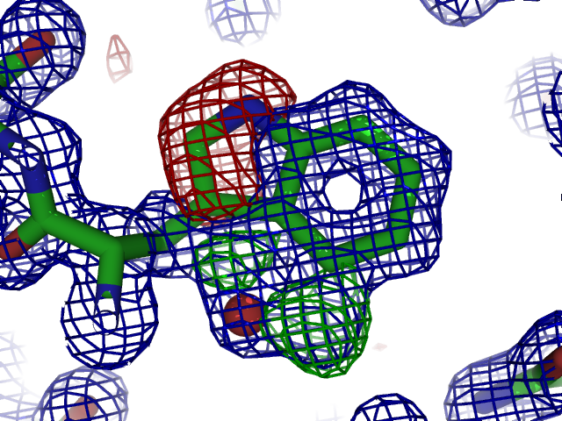
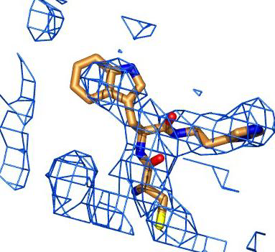
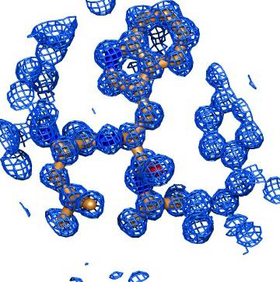
Why do crystallographers make mistakes?
Limitations to the data
  Incomplete
  Weak
  Limited resolution
  Space and time averaged
The human factor
  Subjectivity and bias involved in map interpretation and refinement (even at atomic resolution!)
  Inexperienced people do the work, use of black boxes, …
  Not everybody is a good chemist
  Even experienced people make mistakes
Kleywegt, Acta Cryst. D65, 134 (2009)

Slide 7


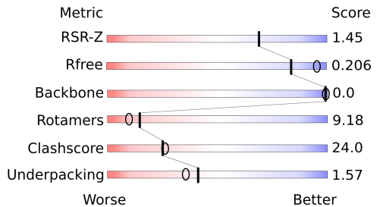
wwPDB X-ray validation pipeline
Distributions
Validation XML file
External reference files
(e.g., Engh & Huber)
Validation pipeline 1.0
MolProbity
Xtriage
EDS
Mogul
Percentiles
PDF maker
PDF report for depositor & referees -
Statistics and plots for the entry, per chain, per residue, and list of unusual features
Deposited data
(coordinates & reflections)
Gore et al., Acta Cryst. D68, 478 (2012)

Slide 8
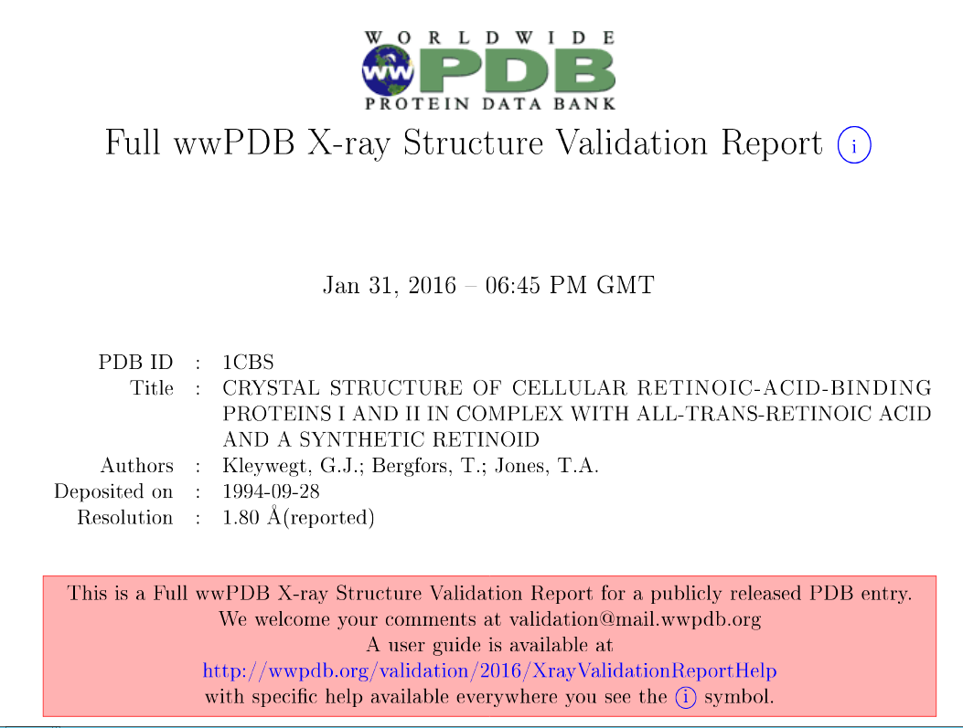
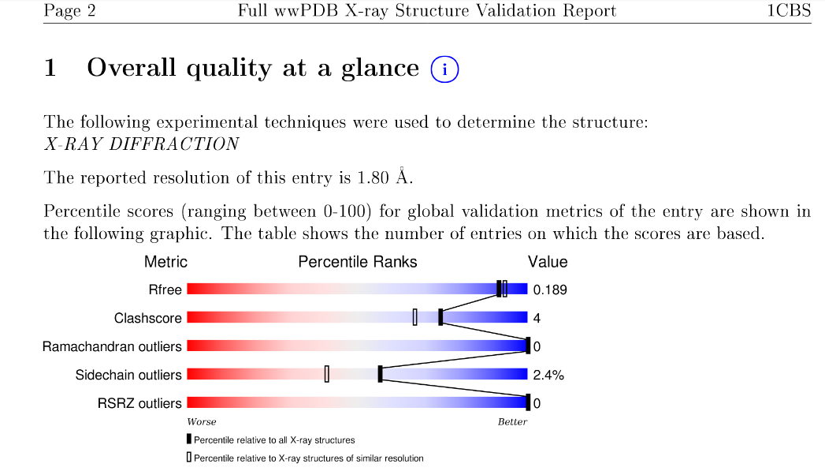
wwPDB validation reports
Pipeline produces PDF report and XML output
Slider graphic useful
Current PDF is “rather verbose”
pdbe.org/valrep/1cbs

Slide 9
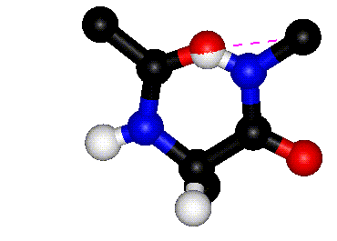
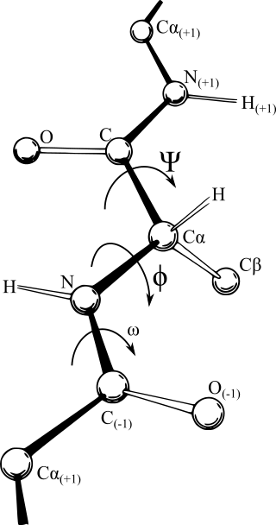
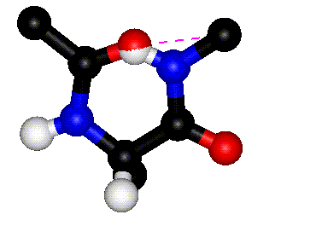
Ramachandran plot
Look at main chain dihedral angles phi and psi
Ramachandran et al. (1963) worked out only certain combinations of phi/psi cause clashes
Rotation around φ with ψ=0º
Rotation around ψ with φ=0º
(Images kindly provided by
David Sanders,
University of Saskatchewan.)
https://en.wikipedia.org/wiki/Ramachandran_plot

Slide 10
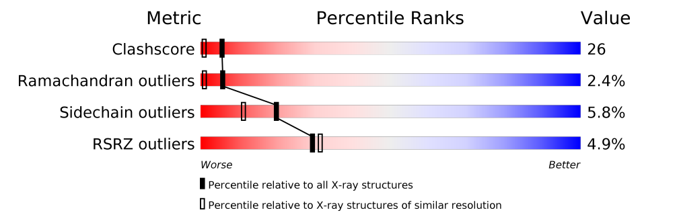
Summary ‘Sliders’ Validation information for users
Atoms bumping into each other
Surprising torsion angles
Atoms not in electron density

Slide 11
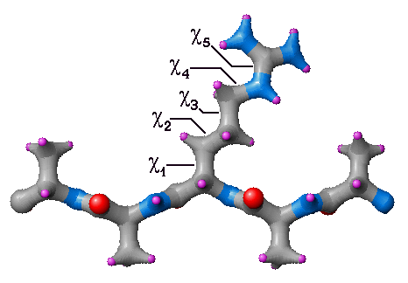
Sidechain outliers
Just like the main chain phi and psi dihedral angles amino acid sides chains have chi angles with have preferred and disallowed regions
The 5 chi angles of an arginine side chain
http://www.ccp14.ac.uk/ccp/web-mirrors/garlic/garlic-1.5/commands/dihedrals.html

Slide 12
Summary ‘Sliders’ Validation information for users
Atoms bumping into each other
Surprising torsion angle
Atoms not in electron density

Slide 13
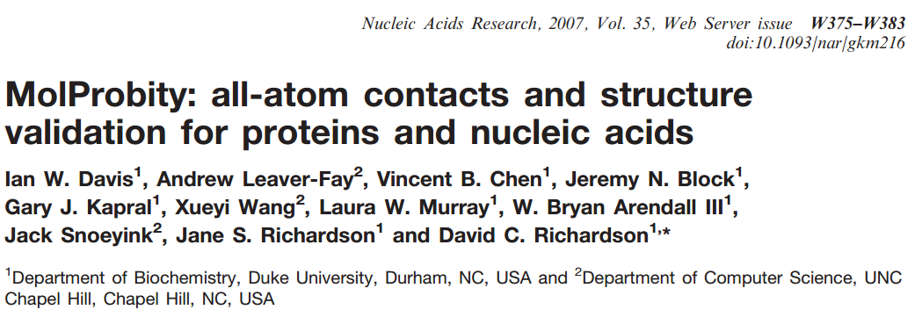
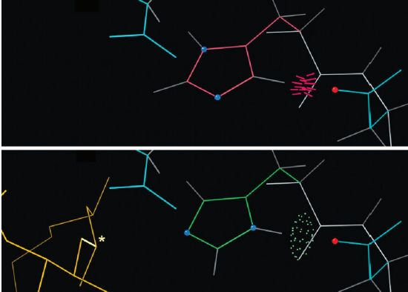
MolProbity – clash score
Idea is to look for bad non-bonded contacts after hydrogen atoms have been added to the model
Very powerful method
Suggests NQH flips
Included in wwPDB validation reports
Or Use from:
  Molprobity web site
  Or within coot
http://molprobity.biochem.duke.edu/

Slide 14
Validation information for users
Summary ‘Sliders’
Atoms bumping into each other
Surprising torsion angles
Atoms not in electron density

Slide 15
Real-space fit
Quantitative, real-space measure of how well a residue fits its local density (Jones et al., 1991)
Express as R-value (RSR) or correlation coefficient (RSCC)
RSR = Σ | ρ_{obs} - ρ_{calc} | / Σ | ρ_{obs} + ρ_{calc} |
Sums extend over all grid points inside a mask around the residue
Notes:
• Jones, T.A., Zou, J.Y., Cowan, S.W. and Kjeldgaard, M. (1991). Improved methods for building protein models in electron density maps and the location of errors in these models. Acta Crystallogr. A47, 110-119.
• http://alpha2.bmc.uu.se/dombo/pics/alwyn_jones.jpg

Slide 16
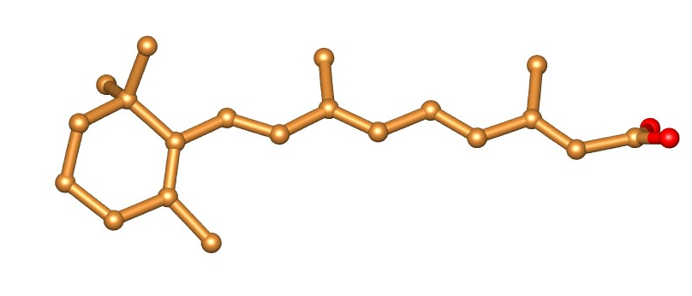
RSR - real-space R-value
RSR = Σ |ρ_{obs} - ρ_{calc}| / Σ |ρ_{obs} + ρ_{calc}|
Example: retinoic acid (REA)
in 1CBS (1.8Å)
pdbe.org/1cbs

Slide 17
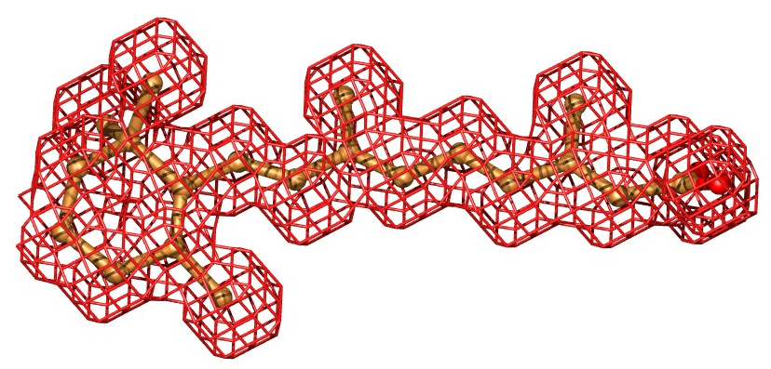
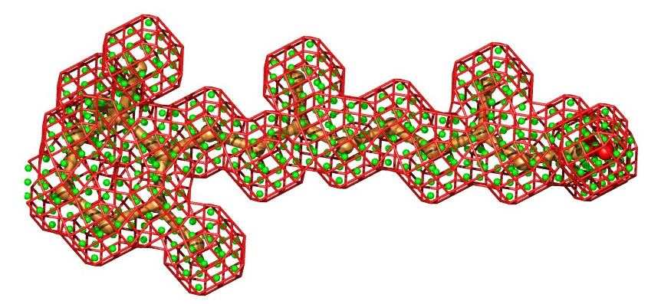
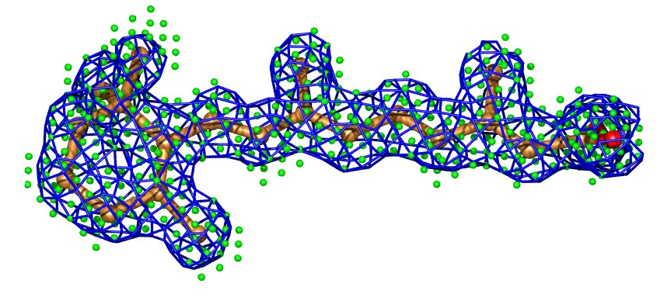
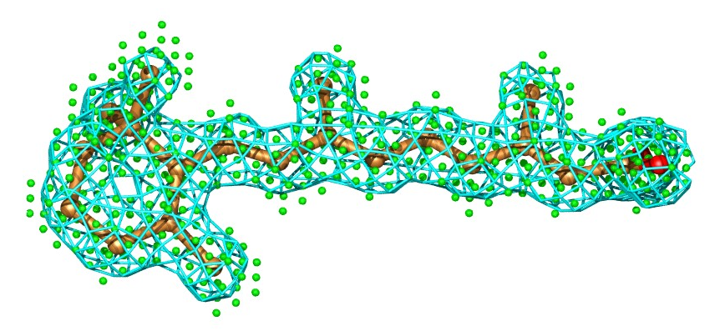
RSR - real-space R-value
Define mask (1.1Å)
~500 Grid points
Observed density
Calculated density
RSR = Σ |ρ_{obs} - ρ_{calc}| / Σ |ρ_{obs} + ρ_{calc}|
pdbe.org/1cbs

Slide 18
RSRZ is reported in Summary ‘Sliders’
Atoms bumping into each other
Surprising torsion angles
Atoms not in electron density

Slide 19
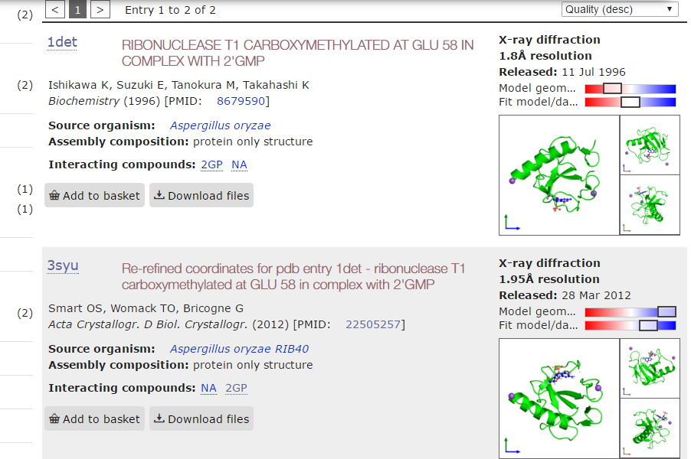
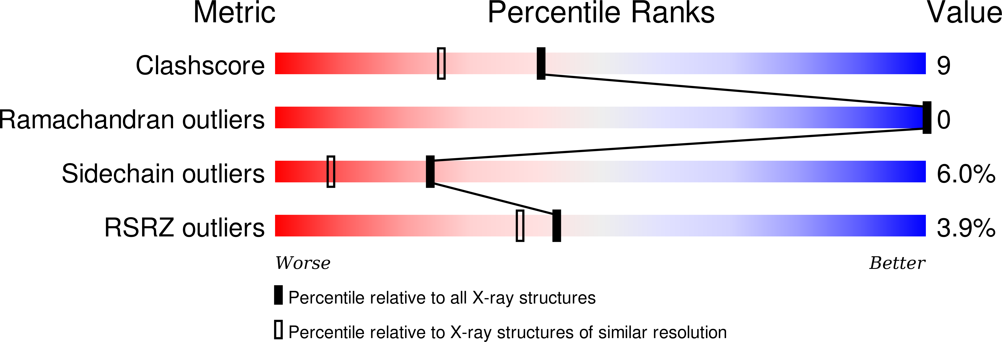
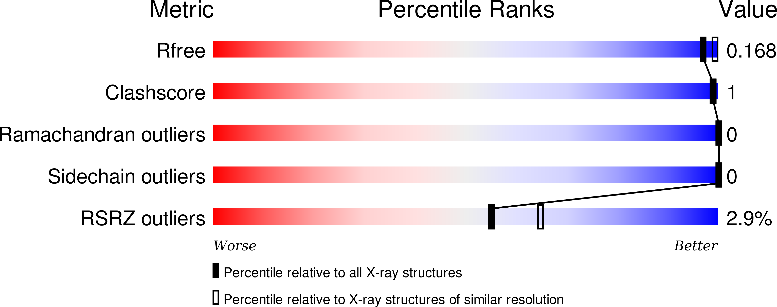
PDBe simplification of validation sliders

Slide 20
“Best molecule” – integration of validation information in PDBe query system
www.ebi.ac.uk/pdbe/entry/search

Slide 21
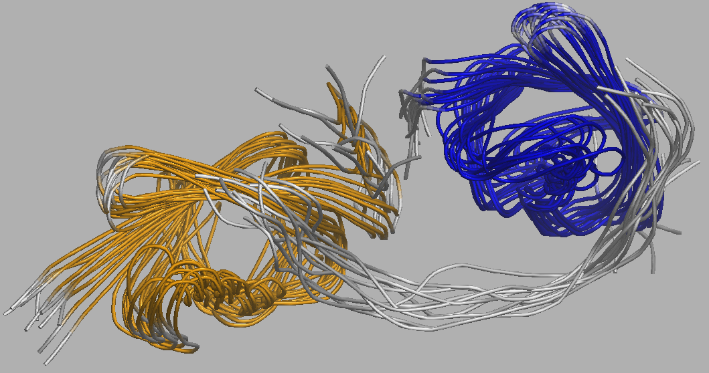
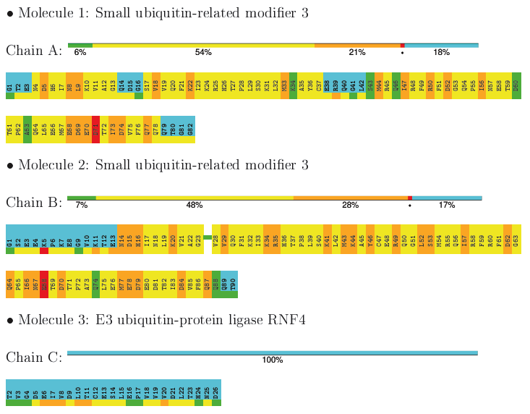
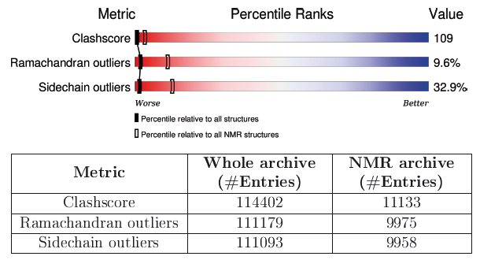
NMR validation
NMR VTF recommendations published
Global quality scores reported for“well-defined residues” only
  As averages over the ensemble
  Medoid model only
Montelione et al., Structure 21, 1563 (2013)
Notes:
NMR entry 2MP2

Slide 22

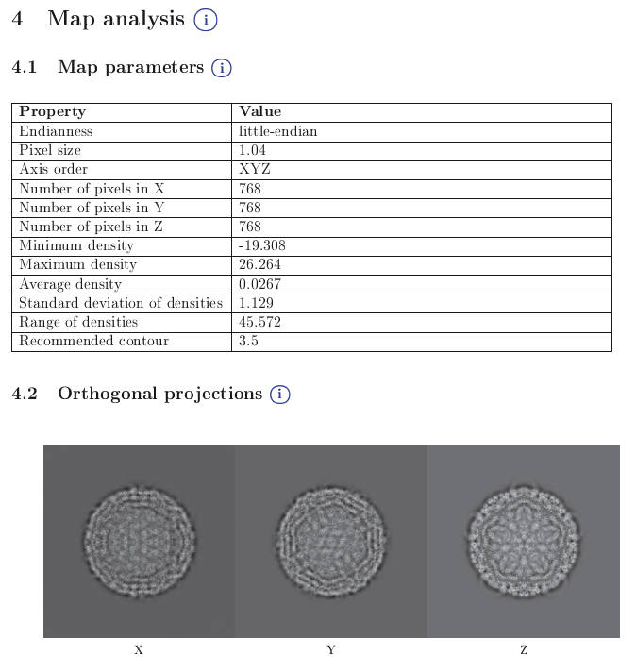
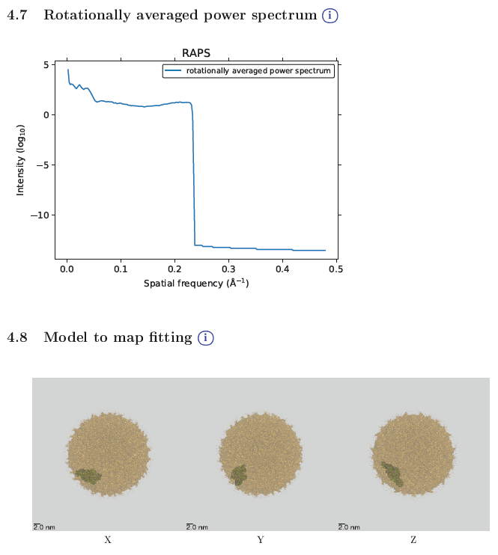
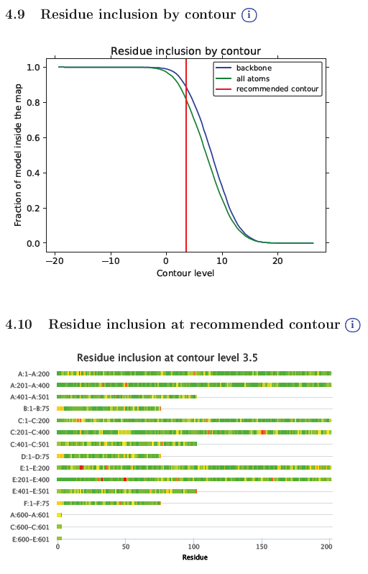
EM validation reports
Prototype EM map-validation reports
  Most of the PDBe “Visual analysis” functionality implemented
Compare to: pdbe.org/emd-8116/analysis
Notes:
PDB 5IRE – EMDB 8116 (Zika virus)
Visual Analysis functionality developed in 2009-2012 BBR with OME/Jason Swedlow

Slide 23

Ligands in proteins
So you have successfully navigated all the hazards so far have great data, well integrated, successful MR, refinement model building, Ramachandran analysis ……
You have density in the active site and the whole point of the structure is to find how the interesting drug candidate ligand binds …….
Here be dragons!

