Slide 1


NMR Spectroscopy Basics
Core Technologies for Education and Innovation in Life Sciences
by
Radovan Fiala, Karel Kubicek, and Pavel Kaderavek
CEITEC, Masaryk University
innocore-project@unitn.it
www.innocore-project.eu
This project received funding by the European Commission under the GA n° 2019-1-IT02-KA203-063391

Slide 2
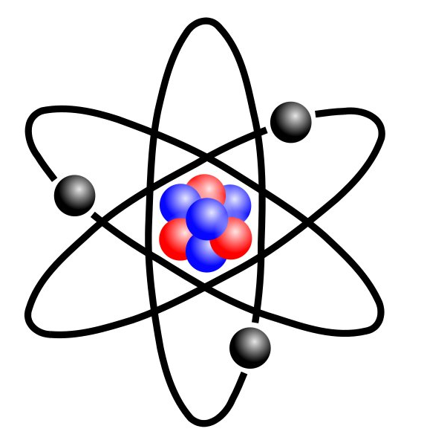
Nuclear spin
Atomic nuclei consist of protons and neutrons (nucleons)
Protons and neutrons have spin ½
Spins tend to compensate each other but often not completely
Resulting spin quantum number of the nucleus is
I = k * ½ k is integer 0, 1, 2 ….
Magnetic spin quantum number – number of possible spin states
m = -I, -I+1, -I+2 ……I-2, I-1, I
Examples
I = ½, m = -½, +½ 2 spin states example: ¹H
I = 1, m = - 1, 0, 1 3 spin states example: ²H
Proton
Neutron

Slide 3
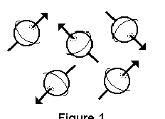
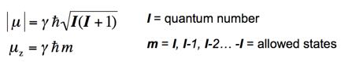
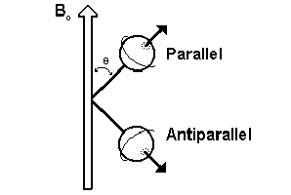
Magnetic moment
Only nuclei with non-zero spins have magnetic moments and are active in NMR
Magnetic moment
ħ=h/2π h Planck’s constant γ magnetogyric ratio, specific to isotopes
Isotopes differ by the number of neutrons and have generally different spins.
In NMR, we refer to isotopes rather than elements, e.g. ¹H (proton) or ¹³C instead of hydrogen and carbon
No magnetic field
In magnetic field B₀

Slide 4
Spins in magnetic field
ΔΕ = hγΒ₀/2π Β₀ external magnetic field
= γΒ₀/2π
h = 6,626.10⁻³⁴ J.s h is Planck’s constant
Magnetogyric ratio, specific for each isotope
For ¹H γ = 42 494 369 s⁻¹.T⁻¹
For 100 MHz resonance frequency you need magnet
Β₀ = 100 s⁻¹ /42.494 s⁻¹.T⁻¹ ≅ 2.35 T
S = 1/2
E
ΔE = hν
B₀
Research grade NMR spectrometers are produced usually with ¹H resonance frequencies in multiples of 100 MHz, currently from 400 MHz up to 1,200 MHz (1.2 GHz), corresponding to magnets from 9.4 T to 28.2 T.
For protein studies, high-field spectrometers with resonance frequencies 600 MHz or higher are commonly used.
On Earth, spins are always subject to a magnetic field, but the magnetic field of Earth is only about 50 µT.

Slide 5
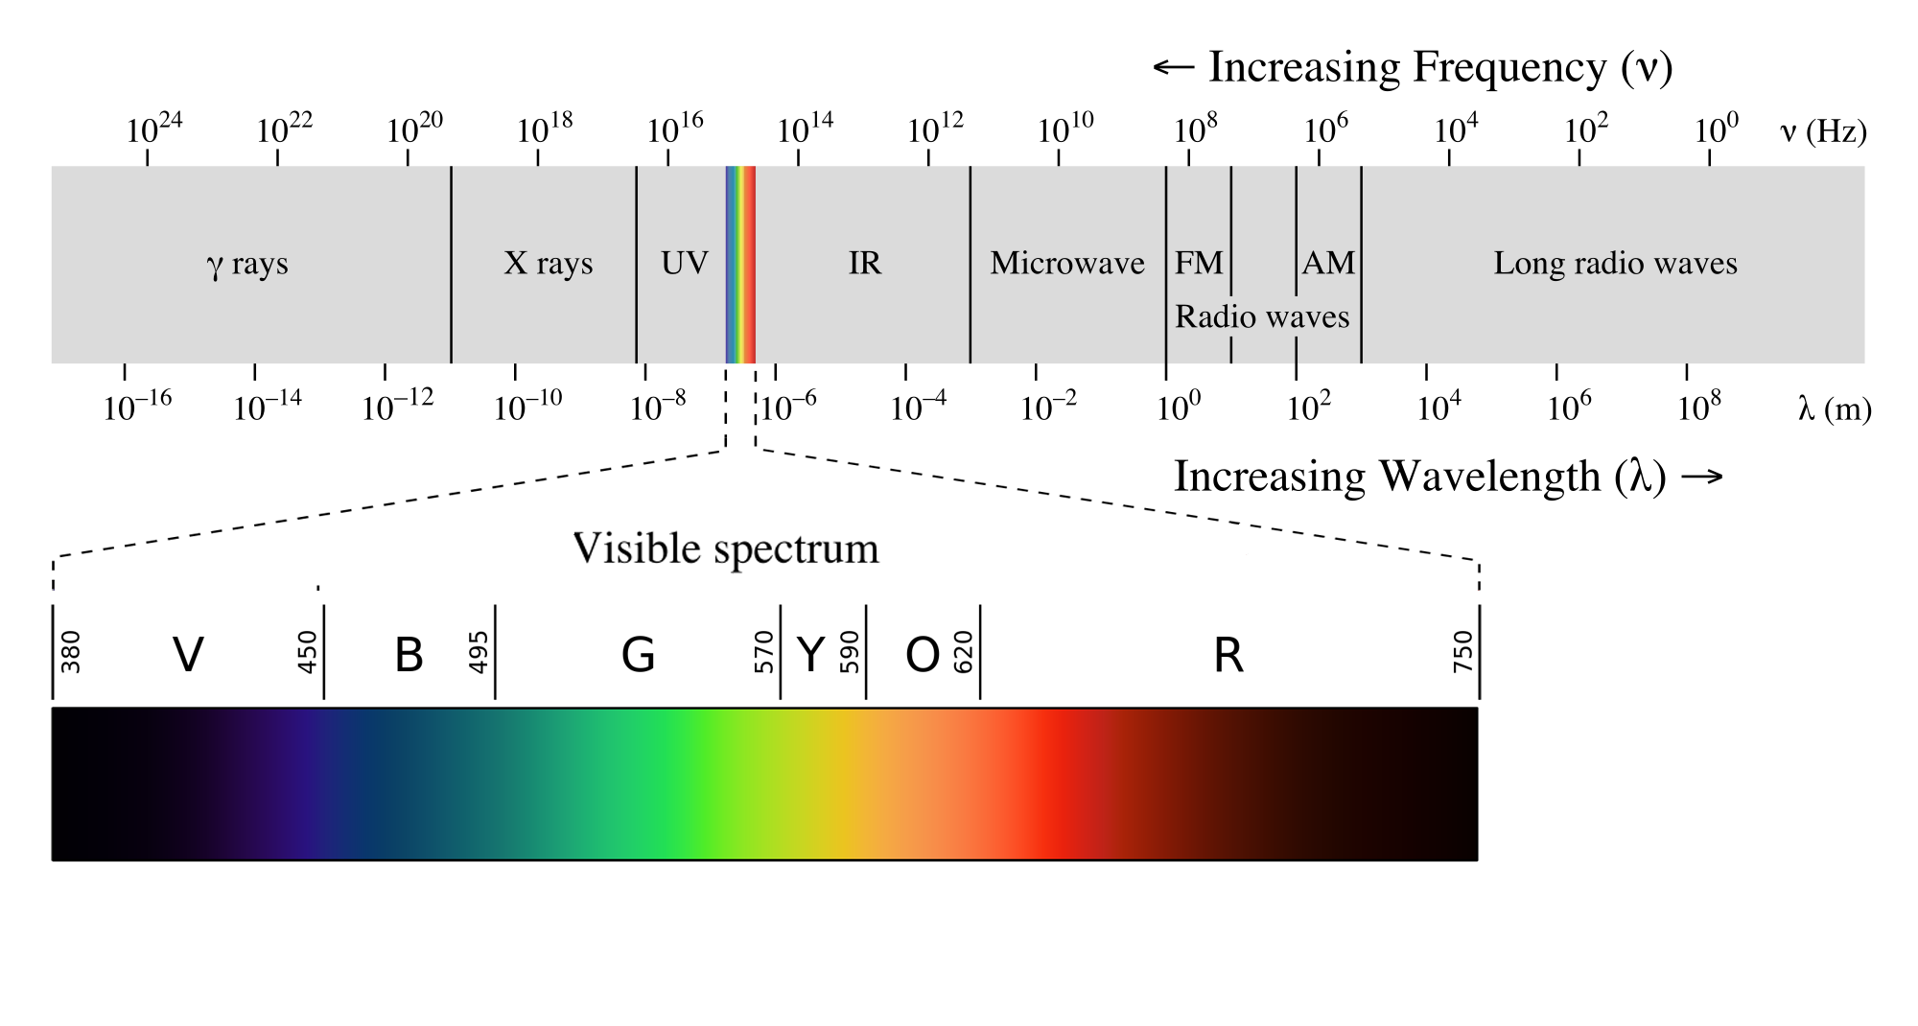
NMR and electromagnetic spectrum
10⁷
Noninvasive
Low sensitivity
NMR

Slide 6
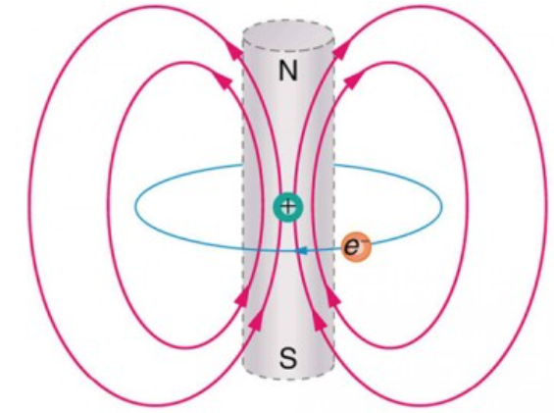
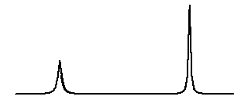
Chemical shift
Nuclei do not experience the external magnetic field B₀ only,
But also the fields of other particles, especially electrons.
Net magnetic field at a nucleus
B = B₀ (1 - σ) σ nuclear shielding
Resonance frequencies differ slightly depending on the location of the nucleus in the molecule.
Resonance frequencies are field dependent, which is impractical – values are not comparable between different spectrometers.
Chemical shift – frequency difference relative to a suitable standard, expressed in ppm.
δ = 10⁶ (υ - υ_{ref}) / υ_{ref}
For 1H, TMS (tetramethylsilane) is a common reference compound
10
5
0
δ

Slide 7
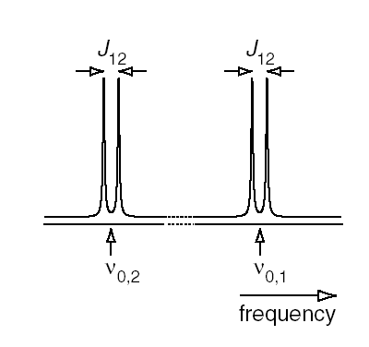
Spin-spin interactions
Dipolar coupling
Direct interaction between nuclear spins
Depends on the orientation of the internuclear vector with respect
to external magnetic field
Important in solid-state spektra
In liquids manifests itself only through relaxation phenomena
Scalar / J-coupling
Interaction of nuclei through the cloud of electrons
Does not depend on the external magnetic field
Causes splitting of signals (doublets for spins ½)
Scalar interaction constant J (in Hz, no dependence on B₀)
S
B₀
θ
r_{is}
I

Slide 8
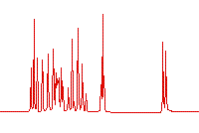
Reaching the resonance - CW
Continuous wave (CW)
Irradiation frequency is changed (swept) over the range. When resonance occurs, the irradiation energy is absorbed which is recorded as a signal. The resulting record of intensities vs. frequency is the spectrum.
To get undistorted spectrum the process must be SLOW (minutes)
frequency sweep
ppm
f₁ Hz f₂
spectrum

Slide 9
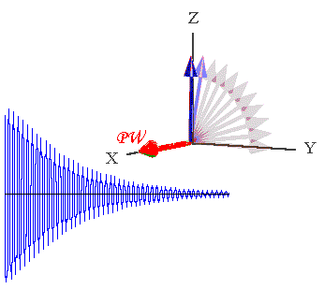
Reaching the resonance - PFT
Pulsed with Fourier Transform
The spin system is irradiated by a single short high intensity pulse. This is equivalent to irradiating a range of frequencies. The shorter and more intense the pulse is, the broader range of frequencies is affected. After the pulse, the response of the spin system is recorded as a function of time. The record is FID (Free Induction Decay). The spectrum is produced by Fourier Transform of an FID.
RF pulse 90°
FT
ppm
t
Spectrum - frequency domain
FID – time domain

Slide 10
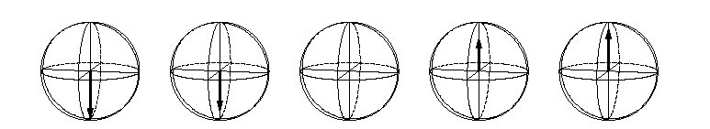
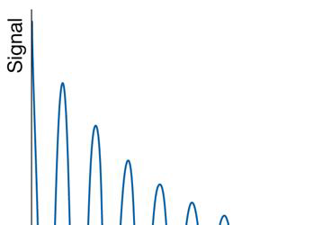
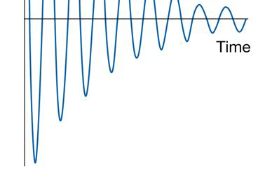
Relaxation
Spin-lattice relaxation - T₁
Transferring the energy into surroundings (solvent/’lattice’). The spin system returns into equilibrium.
Spin-spin relaxation - T₂
The intensity of the signal in FID is dropping with time (Free Induction Decay) due to loss of coherence. The energy is still in the spin system but randomly oriented nuclear magnetic moment average to zero.
Exponential decay
exp(-t/T₂)

Slide 11
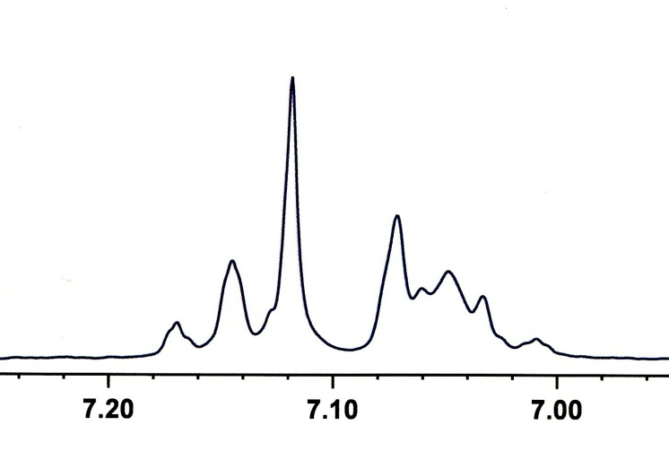
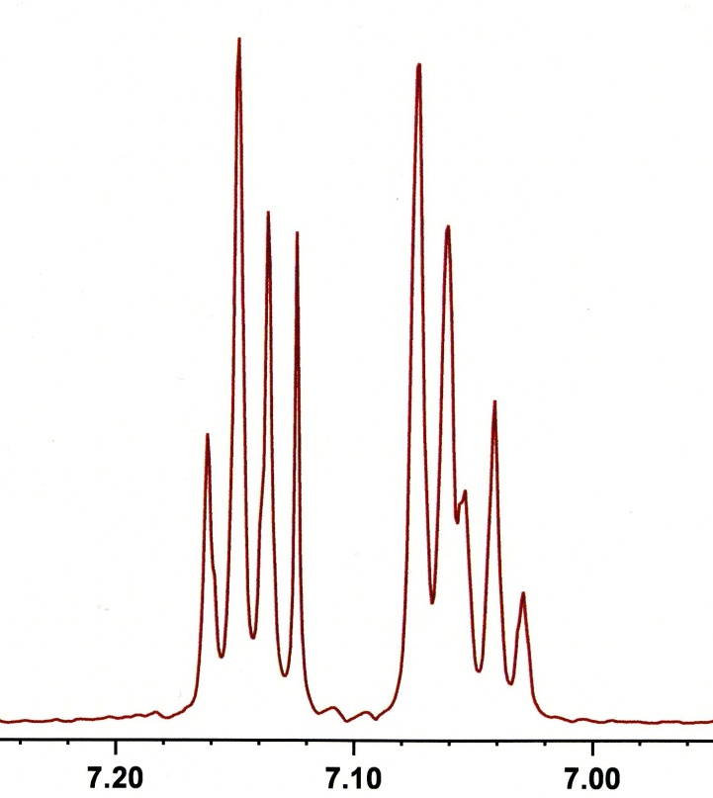
Resolution
Position of signals is given by the chemical shift (relative number)
The with of 1 ppm in Hz (absolute scale) depends on magnetic field:
at 500 MHz, 1 ppm = 500 Hz,
at 1000 MHz, 1 ppm = 1,000 Hz
If the linewidth is the same, signal appear farther from each other at higher field.
Resolution and sensitivity increase linearly with magnetic field
300 MHz
600 MHz
Aromatic part of ethylbenzene spectrum

Slide 12
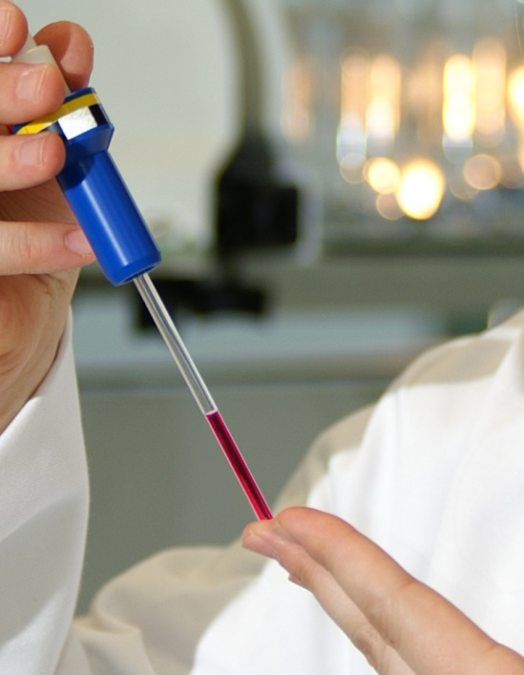
Sensitivity
Energy difference between spin levels are very small.
Boltzmann distribution N_{α} = N_{β} .exp(-ΔE/k_{B}T)
ΔE = hν, h Planck’s constant, k_{B} Boltzmann constant
N_{α}, N_{β} – polulations of the spin states
For protons at 500 MHz and 303 K, the population difference between the ernergy levels is less than 0.01%!
We work with a small fraction od nuclei – sensitivity of NMR is inherently low
For proteins, you need about 0.5 ml of sample with 0.5 mM concentration.
Improving sensitivity by signal accumulation – more scans
Signal-to-noise ratio increases with square root of number of scans: S/N ~ √ns

Slide 13
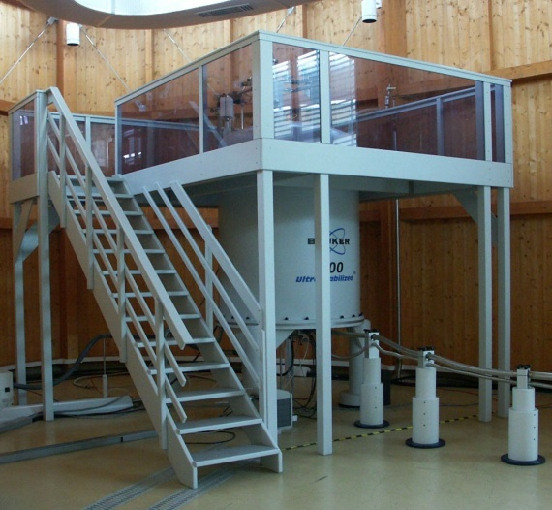
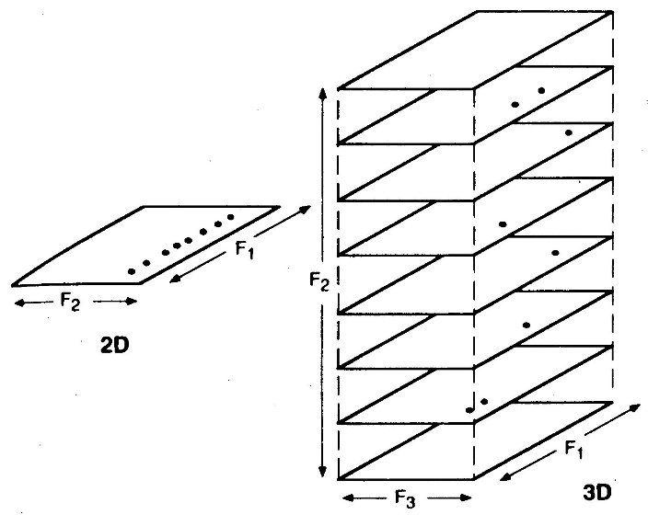
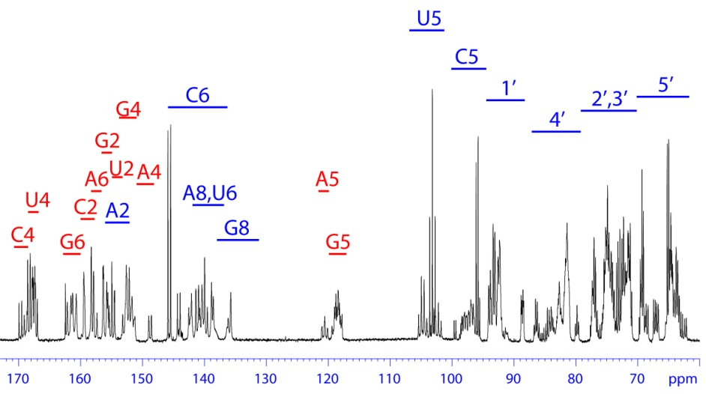
Increasing Resolution
Biopolymers: repetition of identical units (nucleotides, amino acids)
High resolution is needed
High magnetic field
Increasing number of dimensions

Slide 14
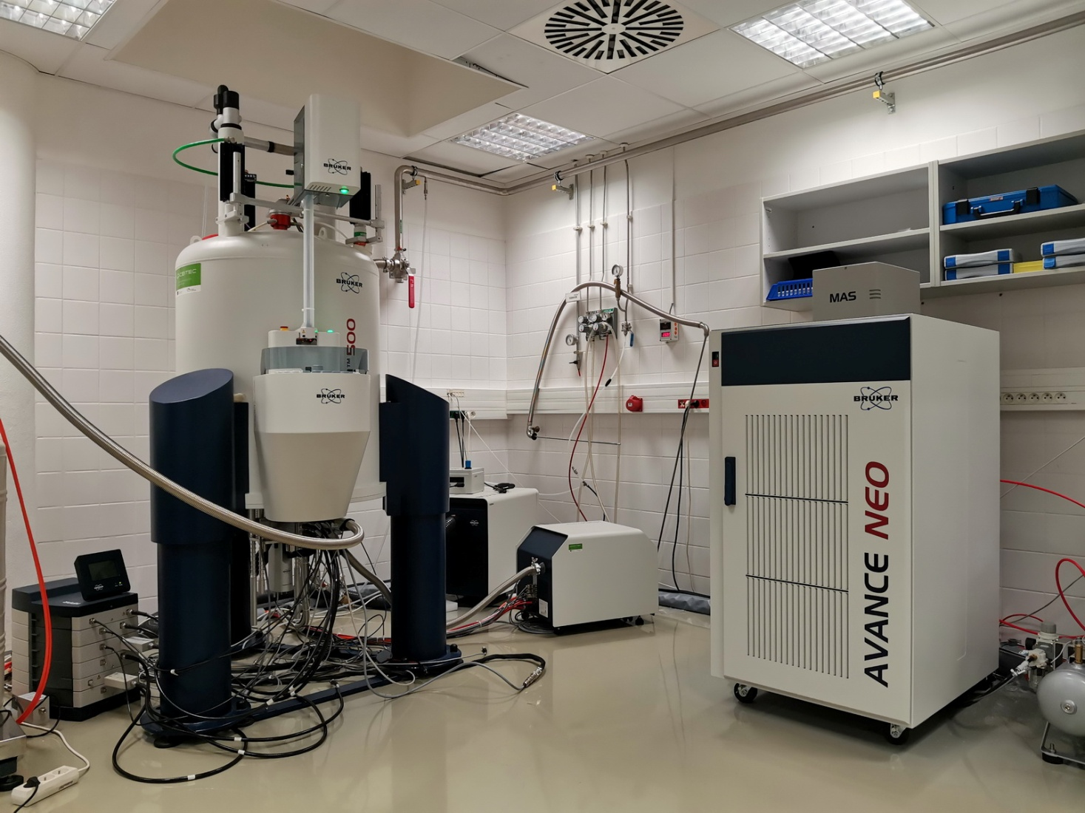
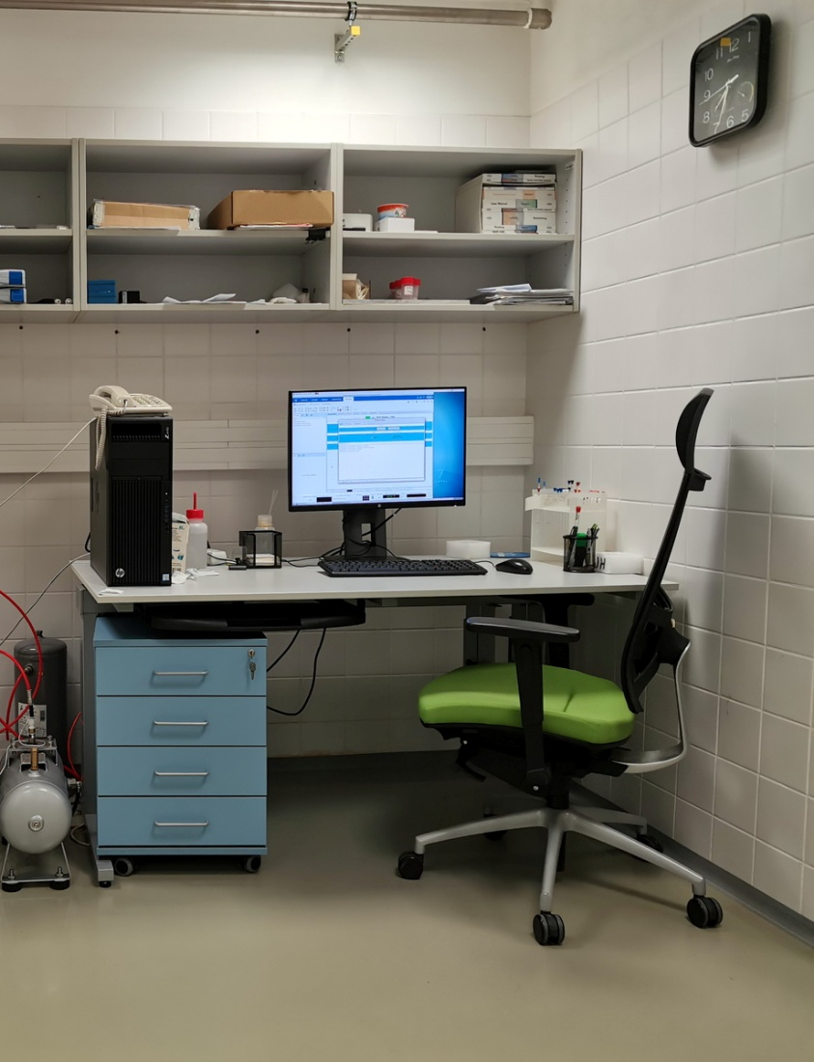
NMR Spectrometer
Major parts
Magnet
VT unit
Probe
Preamplifier
Electronics
Operator’s desk with PC

Slide 15
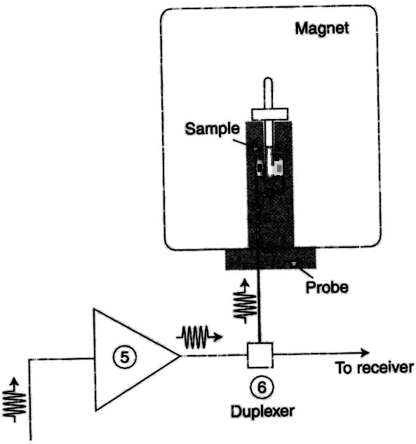
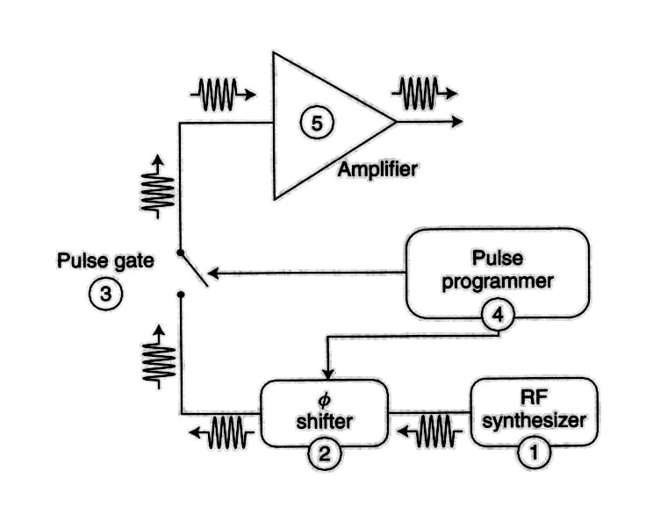
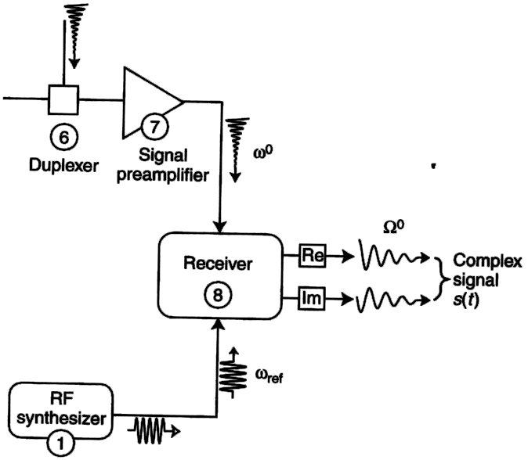
NMR Spectrometer - Scheme
Signal - s_{l}(t)=Σ s_{l}(t)
_{l}

Slide 16
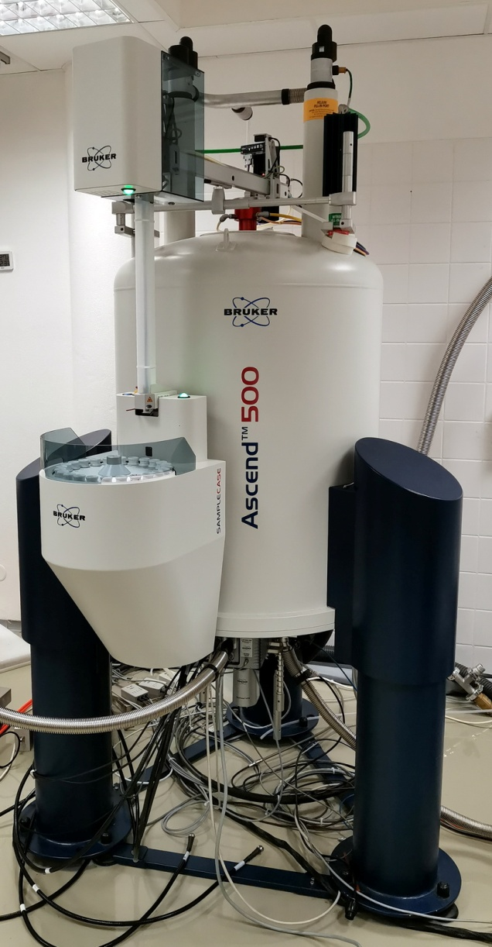
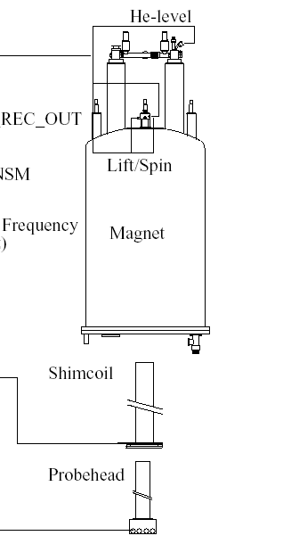
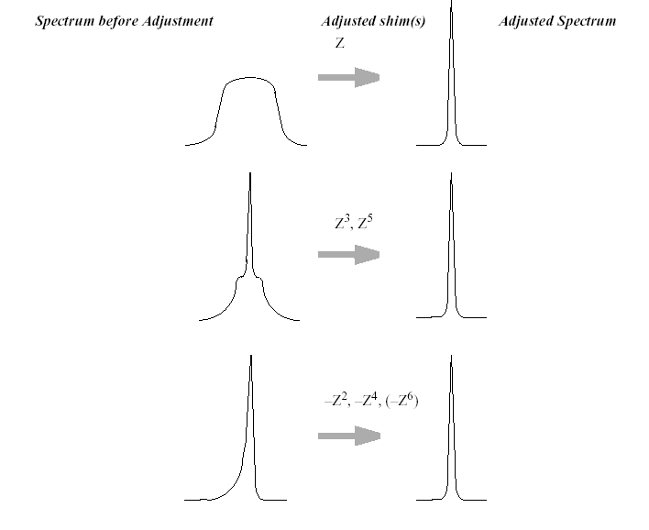
The Magnet
B₀
Adjusting the magnetic field homogeneity

Slide 17
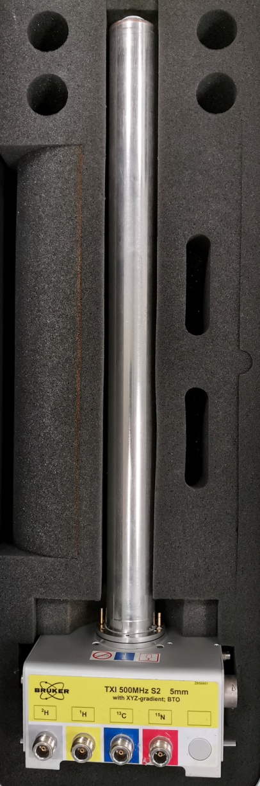
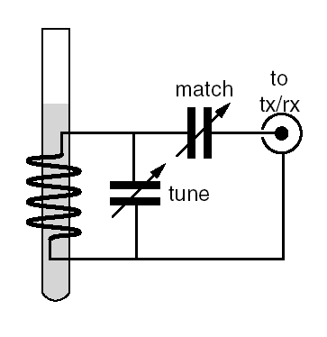
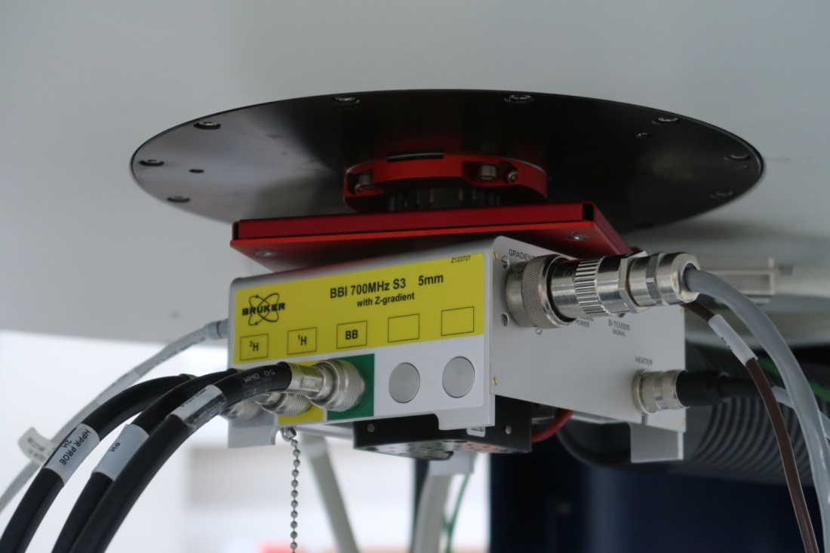
The Probe
Houses the sample
Changes electric current into magnetic field and back.
Must be tuned for best sensitivity
Inverse probes, X-nuclei detection probes
Room temperature probes, cryoprobes

Slide 18
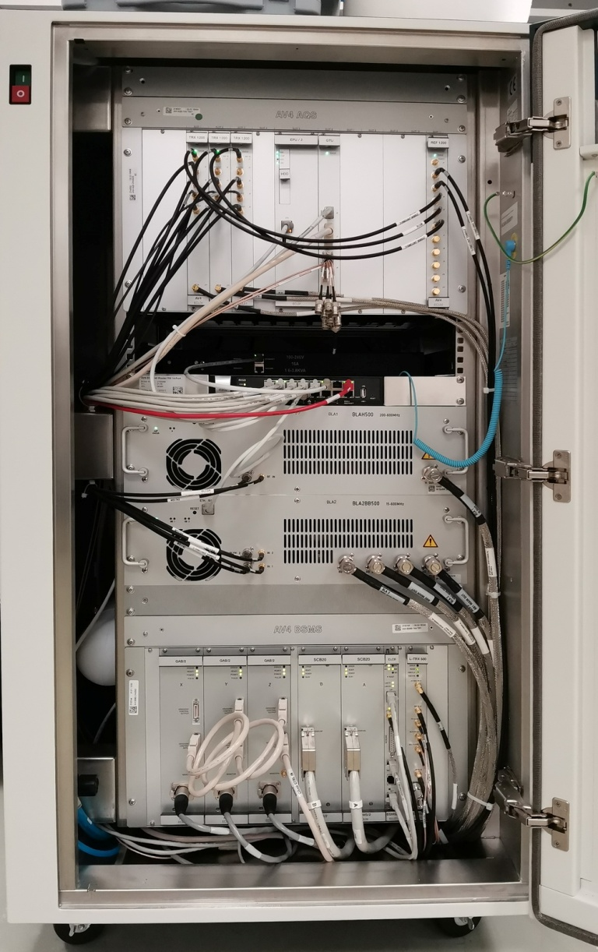
Electronics
Frequency synthesis & signal processing
Computer (real-time control)
Power amplifiers
Magnet control
sample insert & eject
shimming
temperature control

Slide 19
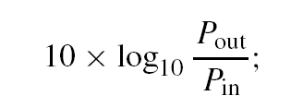
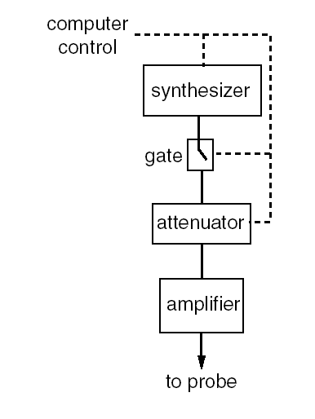
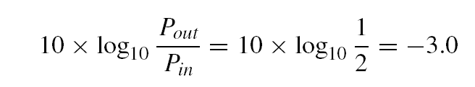
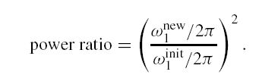
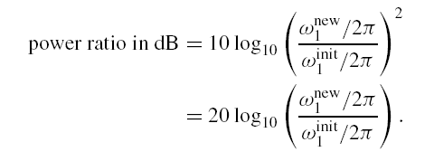
How the NMR Spectrometer Works
Transmitter – power vs. rf field induction
L_{p} =
[dB]
Relative power ratio expressed in decibel
1 dB: P1/P2 = 1.2589254
!!!!!!!!B₁ ~ I ~ P^{1/2} (P=RI²)!!!!!!!!
Relative rf field ratio ex-pressed in decibel
1 dB: ω1/ω2 = 1.120185

Slide 20
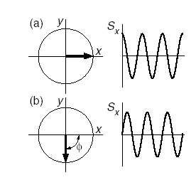
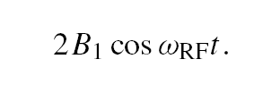
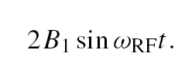
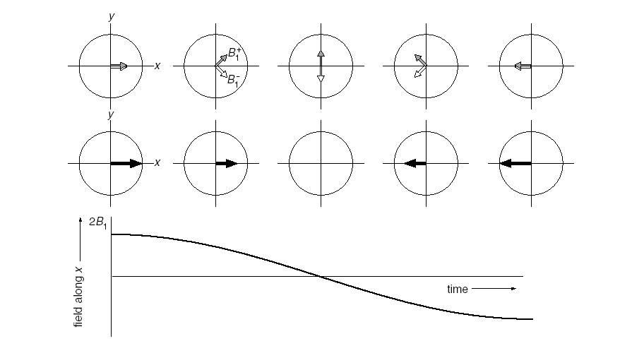
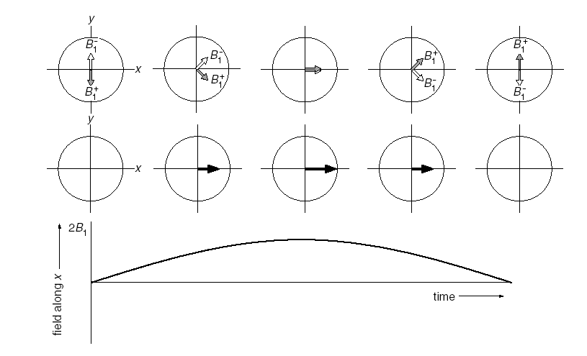
How the NMR Spectrometer Works
Transmitter – phase shifted pulses

Slide 21
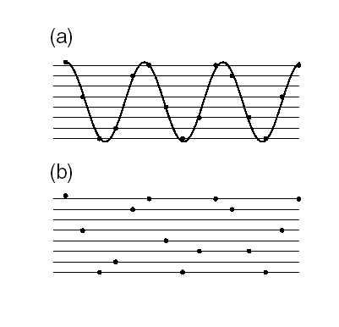
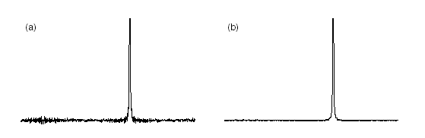
How the NMR Spectrometer Works
3bit A/D converter (8 levels)
2^{n} = 8
A/D converter
n=6 bits
64 levels
n=8 bits
256 levels
A/D converter typically 16 bits
i.e. 65 536 levels
32 bits
i.e. 4 294 967 296 levels

Slide 22
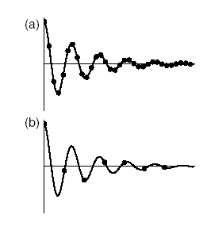


How the NMR Spectrometer Works
A/D converter – sampling frequency
Nyquist frequency
f_{max} = 1 kHz => Δ = 500 μs

Slide 23
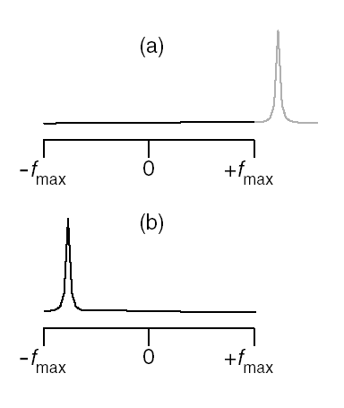
How the NMR Spectrometer Works
A/D-converter – signal folding

Slide 24
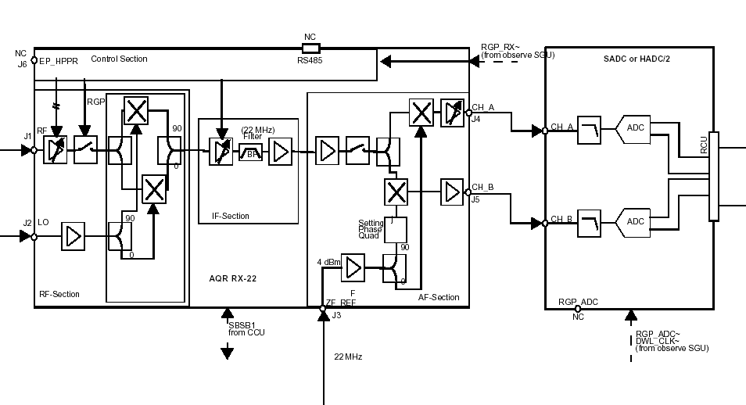
How the NMR Spectrometer Works
Receiver
A/D converters
NMR signal
Local oscilator
Intermediate frequency

Slide 25
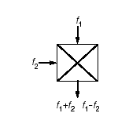
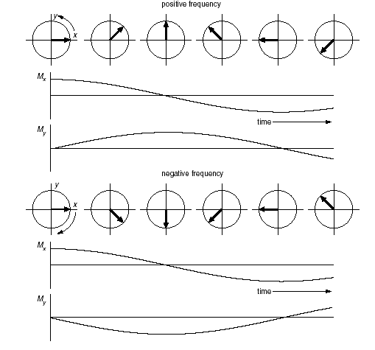
How the NMR Spectrometer Works
Quadrature detection
mixer
(
)
cosA.cosB=1/2(cos(A+B) + cos(A-B))
cosA.sinB=1/2(sin(A+B) - sin(A-B))

Slide 26
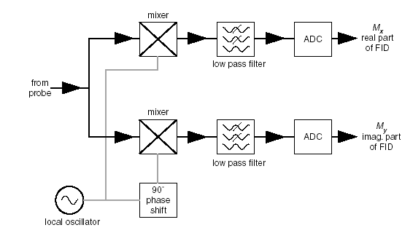
How the NMR Spectrometer Works
Quadrature detection
Intermediate frequence
Frequency ω_{ο}+ω_{rx} removed by filter

Slide 27
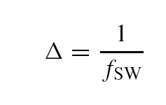

How the NMR Spectrometer Works
Quadrature detection – time vs. frequency
Spectral width f_{sw}
Acqusition time t_{acq}
N – number of acquisition points
Δ – sampling interval

Slide 28

How the NMR Spectrometer Works
Pulse programmer
INEPT with refocusing

Slide 29
How the NMR Spectrometer Works
Pulse programmer
ph1=0 0 0 0 0 0 0 0 2 2 2 2 2 2 2 2
ph2=0 2
ph3=1 1 3 3
ph4=0 2
ph5=0 0 0 0 1 1 1 1 2 2 2 2 3 3 3 3
ph6=0 2 0 2 1 3 1 3
ph31=0 0 2 2 1 1 3 3
;pl1 : f1 channel - power level for pulse (default)
;pl2 : f2 channel - power level for pulse (default)
;pl12: f2 channel - power level for CPD/BB decoupling
;p1 : f1 channel - 90 degree high power pulse
;p2 : f1 channel - 180 degree high power pulse
;p3 : f2 channel - 90 degree high power pulse
;p4 : f2 channel - 180 degree high power pulse
;d1 : relaxation delay; 1-5 * T1
;d3 : 1/(6J(XH)) XH, XH2, XH3 positive
; 1/(4J(XH)) XH only
; 1/(3J(XH)) XH, XH3 positive, XH2 negative
;d4 : 1/(4J(XH))
;d12: delay for power switching [20 usec]
;cnst2: = J(XH)
;cnst11: 6 XH, XH2, XH3 positive
; 4 XH only
; 3 XH, XH3 positive, XH2 negative
;NS: 4 * n, total number of scans: NS * TD0
;DS: 16
;cpd2: decoupling according to sequence defined by cpdprg2
;pcpd2: f2 channel - 90 degree pulse for decoupling sequence
;$Id: ineptrd,v 1.8 2002/06/12 09:05:00 ber Exp $
;ineptrd
;avance-version (02/05/31)
;INEPT for non-selective polarization transfer
;with decoupling during acquisition
#include <Avance.incl>
"p2=p1*2"
"p4=p3*2"
"d3=1s/(cnst2*cnst11)"
"d4=1s/(cnst2*4)"
"d12=20u"
1 ze
2 30m do:f2
d1
d12 pl2:f2
(p3 ph1):f2
d4
(center (p4 ph2):f2 (p2 ph4) )
d4
(p3 ph3):f2 (p1 ph5)
d3
(center (p4 ph2):f2 (p2 ph6) )
d3 pl12:f2
go=2 ph31 cpd2:f2
30m do:f2 mc #0 to 2 F0(zd)
exit
23.10.2012

Slide 30


Examples
1D proton spectrum of a protein
¹H-¹⁵N HSQC of a well folded protein at 293 K
with approximately 155 amino acids, 600MHz
water
¹H 1D, Cavanagh et al., Protein NMR Spectroscopy, 2007

Slide 31
Additional reading
Keeler-2002-Understanding_NMR_Spectroscopy.pdf (cam.ac.uk)
YouTube videos
NMR Spectroscopy Visualized
Introduction to NMR spectroscopy Part 1, Part 2

Slide 32
Core Technologies for Education and Innovation in Life Sciences
The End
Thank you for your attention
Questions, comments?
radovan.fiala@ceitec.muni.cz
innocore-project@unitn.it
www.innocore-project.eu
This project received funding by the European Commission under the GA n° 2019-1-IT02-KA203-063391

