Slide 1
Not So Short Introduction To
TopSpin
Spring 2021
Karel Kubíček
with the help of Pavel Veverka, Magdaléna Krejčíková,
and Radovan Fiala

Slide 2
Disclaimer:
This presentation is intended as a basic introduction to TopSpin 3.2 for those who are not familiar with it and the content wishes to cover initial steps to handle the software, sample and spectrometer properly, be able to acquire simple 1/2D NMR spectra and some hints for processing.
If imprecise or unclear formulations encountered, talk to the authors or to more experienced spectroscopist or facility staff.
Everybody is encouraged to study literature and discuss with more experienced colleagues to clarify all below written and become autonomous NMR operator.

Slide 3
Before the TopSpin runs OR some useful UNIX commands (in blue) and results (in red)
[karelk@nmrcf ~]$ whoami - this command displays who’s logged in
karelk
[karelk@nmrcf ~]$ hostname -a – displays full name of the computer you’re working on
nmrcf.ncbr.muni.cz
[karelk@nmrcf ~]$ quota – displays space available for the current user
Disk quotas for user karelk (uid 16329):
Filesystem blocks quota limit grace files quota limit grace
/dev/nmrspect1/home
25964 500000 600000 1146 0 0
[karelk@nmrcf ~]$ quota -g lrpi – displays space available for the nmr data
Disk quotas for group lrpi (gid 2005):
Filesystem blocks quota limit grace files quota limit grace
/dev/nmrspect1/data1
53431604 100000000 110000000 54667 0 0
[karelk@nmrcf ~]$ pwd – where are you working (print working directory)
/home/karelk
[karelk@nmrcf ~]$ cd /d1/data/karelk/nmr/ - change directory to /d1 …
[karelk@nmrcf nmr]$ pwd
/d1/data/karelk/nmr
This is one of the key directories for your NMR experiments, generally it is as follows:
/<disk>/data/<user>/nmr/<dataset> - the items in <> and italic (can) change depending on spectrometer and user. Datasets are of any name. Think of a good ordering system at the beginning of your NMR experience …

Slide 4
/<disk>/data/<user>/nmr/<dataset>
[karelk@nmrcf nmr]$ cd 130118_700b_Dataset/ - change directory to a Dataset
[karelk@nmrcf 130118_700b_Dataset]$ ls – list directory contents
1 10005 2 3 4 5
[karelk@nmrcf 130118_700b_Dataset]$ grep PUL */acqu – print lines matching a pattern, e.g. PUL – it is useful to see what kind of spectra were measured within the dataset, the output is however not sorted
10005/acqu:##$PULPROG= <c_con_iasq>
1/acqu:##$PULPROG= <zgpr>
2/acqu:##$PULPROG= <hsqcetf3gpsi2>
3/acqu:##$PULPROG= <c_caconcaco2_ct_nove>
4/acqu:##$PULPROG= <hccconhgp3d3>
5/acqu:##$PULPROG= <c_con_iasq>
[karelk@nmrcf 130118_700b_Dataset]$ grep PUL */acqu | sort –n – here it is sorted by number
1/acqu:##$PULPROG= <zgpr>
2/acqu:##$PULPROG= <hsqcetf3gpsi2>
3/acqu:##$PULPROG= <c_caconcaco2_ct_nove>
4/acqu:##$PULPROG= <hccconhgp3d3>
5/acqu:##$PULPROG= <c_con_iasq>
10005/acqu:##$PULPROG= <c_con_iasq>

Slide 5
/<disk>/data/<user>/nmr/<dataset>
[karelk@nmrcf 130118_700b_Dataset]$ cd 1– change directory to Experiment number 1 (ExpNo 1)
[karelk@nmrcf 1]$ ls
acqu acqus audita.txt fid format.temp pdata pulseprogram scon2 shimvalues specpar uxnmr.info uxnmr.par - Note that there are several files and directory pdata.
acqu – contains acquisition parameters prior measurement
acqus – contains info about the parameters as they were at the end of measurement
audita.txt – info about who/where/when ran the measurement
fid – raw one dimensional data
pulseprogram – compiled pulseprogram
pdata – directory containing processed data in different processing number directories (ProcNo, mostly 1)
[karelk@nmrcf 1]$ cd pdata
[karelk@nmrcf pdata]$ ls
1
[karelk@nmrcf pdata]$ cd 1/
[karelk@nmrcf 1]$ ls – 1r and 1i are the real and imaginary part of your processed 1D spectrum
1i 1r assocs auditp.txt outd proc procs thumb.png title
[karelk@nmrcf 1]$ pwd
/d1/data/karelk/nmr/130118_700b_Dataset/1/pdata/1
/<disk>/data/<user>/nmr/<dataset>/<ExpNo>/pdata/<ProcNo>/ - where ExpNo and ProcNo may be integer 1..9999 (may be more but never tested)

Slide 6
/<disk>/data/<user>/nmr/<dataset>
Let’s move back to the Dataset directory and change directory to nD experiment, here ExpNo 2
[karelk@nmrcf 130118_700b_Dataset]$ pwd
/d1/data/karelk/nmr/130118_700b_Dataset
[karelk@nmrcf 130118_700b_Dataset]$ cd 2
[karelk@nmrcf 2]$ ls
acqu acqu2 acqu2s acqus audita.txt cpdprg3 format.temp pdata pulseprogram scon2 ser shimvalues specpar uxnmr.info uxnmr.par
Note that there is similar content as of 1D experiment with two important differences – fid is replaced by ser and as there are two dimensions, there are acqu2 and acqu2s files.
[karelk@nmrcf 2]$ cd pdata/1/
[karelk@nmrcf 1]$ ls – in case of a 2D spectra, the processed data are in 2rr. Practically speaking one can ignore the imaginary files once the spectrum is properly processed and phased. Keeping just the 2rr file saves disk space.
2ii 2ir 2ri 2rr assocs auditp.txt clevels outd proc proc2 proc2s procs thumb.png title
[karelk@nmrcf 1]$ pwd
/d1/data/karelk/nmr/130118_700b_Dataset/2/pdata/1
/<disk>/data/<user>/nmr/<dataset>/<ExpNo>/pdata/<ProcNo>/

Slide 7
/<disk>/data/<user>/nmr/<dataset>
Let’s move back to the Dataset directory and change directory to another nD experiment, this time ExpNo 4 and the pdata to see ProcNos different from 1
[karelk@nmrcf 130118_700b_Dataset]$ pwd
/d1/data/karelk/nmr/130118_700b_Dataset
[karelk@nmrcf 130118_700b_Dataset]$ cd 4/pdata
[karelk@nmrcf pdata]$ ls
13 23 998 999
This is typical content for a 3D dataset where in ExpNo 1 there is the processed 3D, as one has dimensions 1-2-3, ProcNo 13/23 are first planes of the spectral cube in 13/23 direction. 998 and 999 represent that any ProcNo is allowed.
/<disk>/data/<user>/nmr/<dataset>/<ExpNo>/pdata/<ProcNo>/

Slide 8
NMR Acquisition
TopSpin

Slide 9
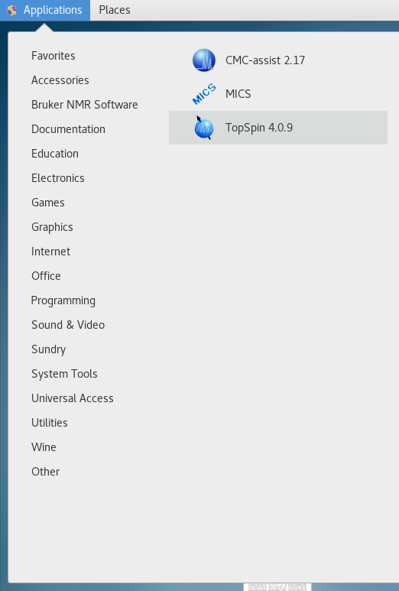
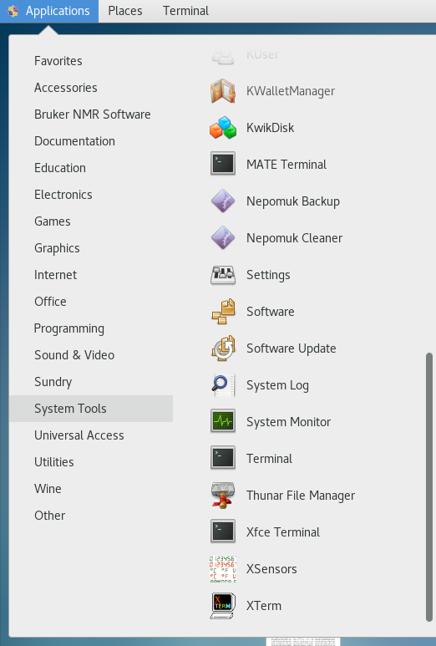
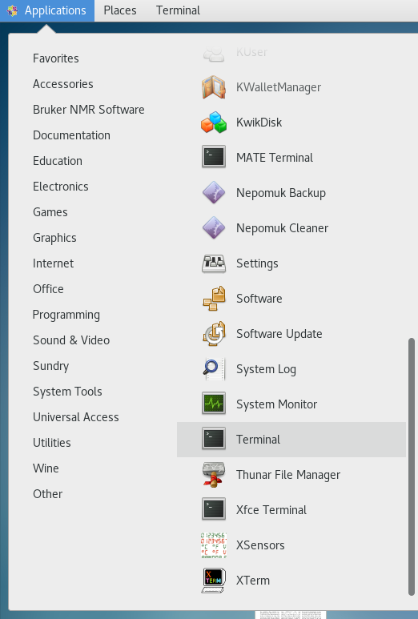
Starting TopSpin – A) Application menu or B) command line
A) Application Menu B) Terminal / command line

Slide 10
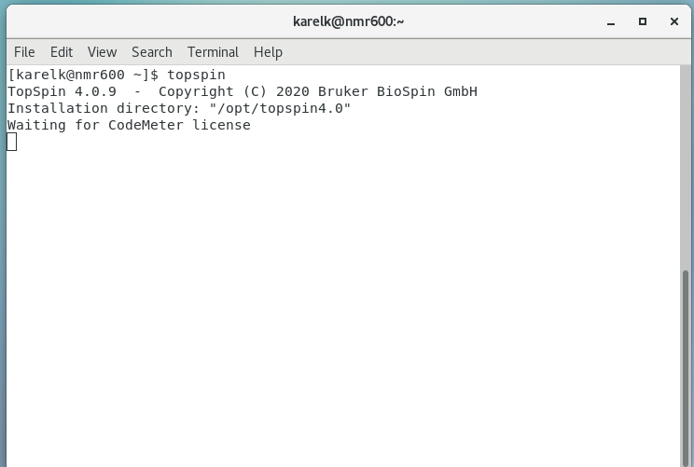
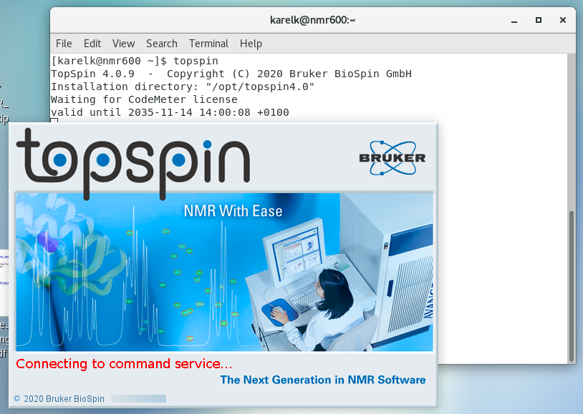
B) Terminal / command line

Slide 11
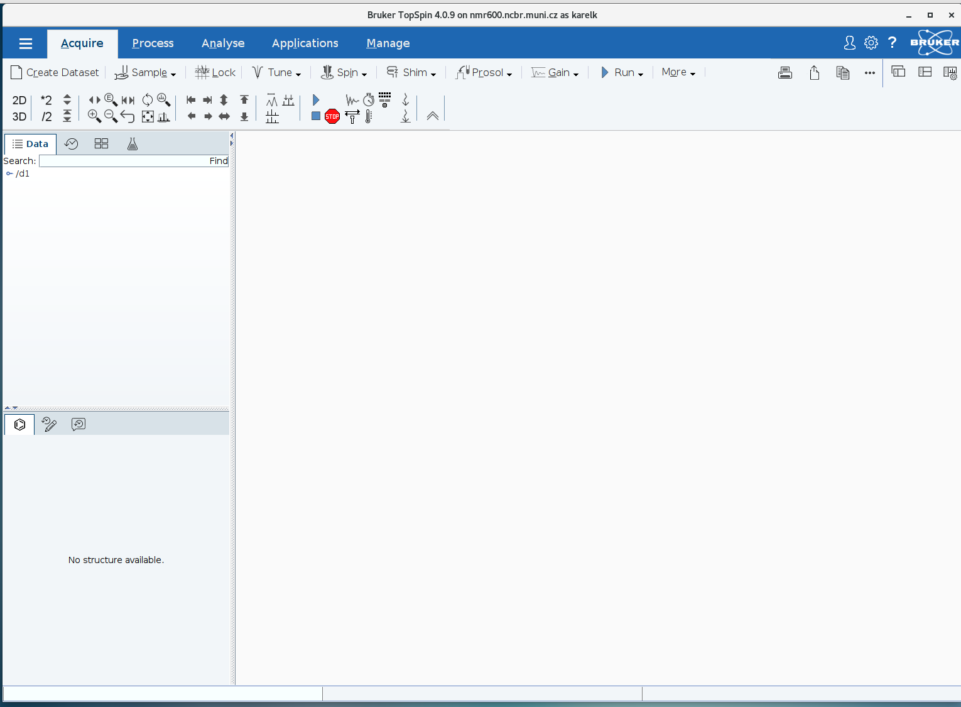
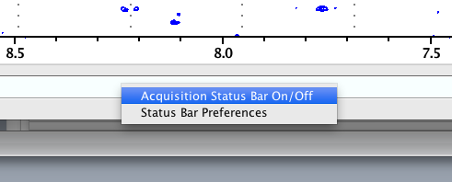
Topspin 4.X – layout description
1 – Menu bar
2 – Spectra navigator
3 – Toolbar
4 – Browser / history
5 – Data/window area
6 – Command line
7– Status panel
1
2
3
4
5
6 / 7
Right mouse click in the status bar area toggles it on/off

Slide 12
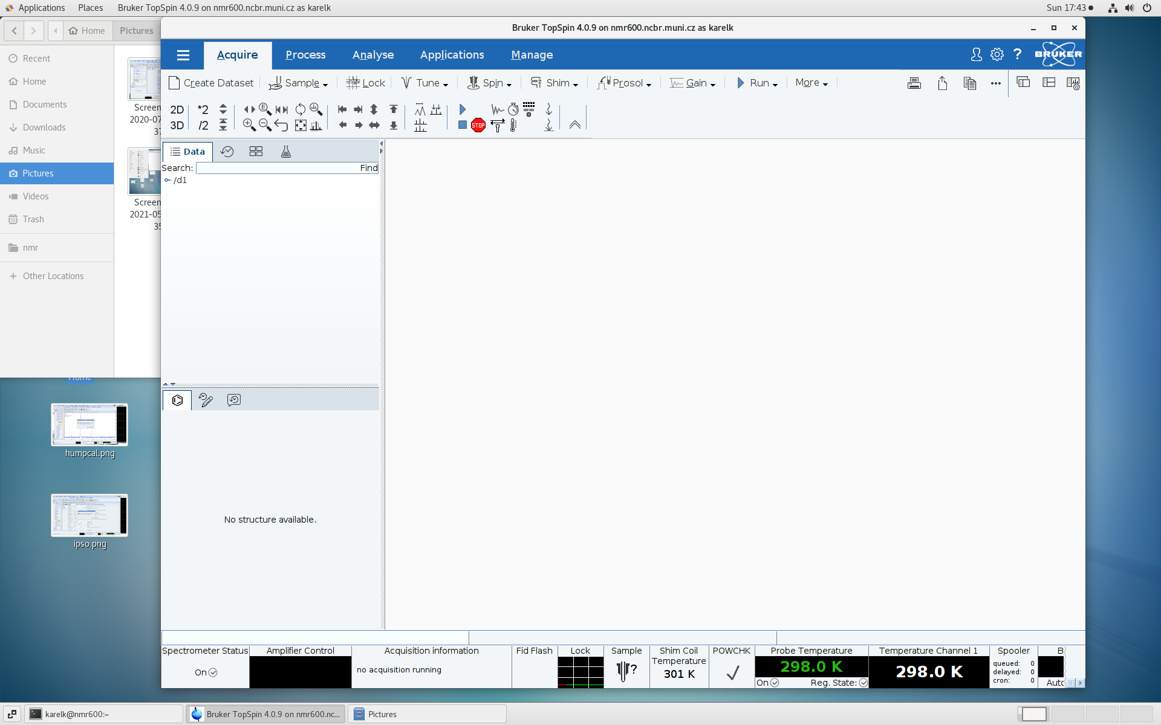
Topspin 4.X – layout description
1 – Menu bar
2 – Spectra navigator
3 – Toolbar
4 – Browser / history
5 – Data/window area
6 – Command line
7– Status panel

Slide 13
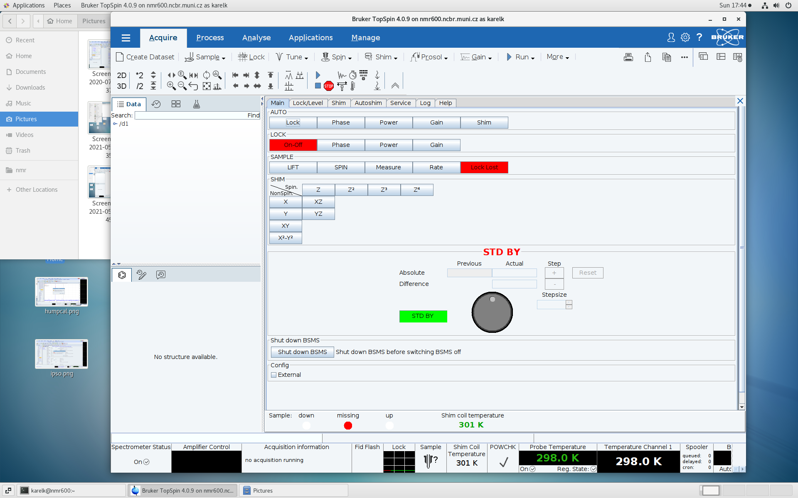
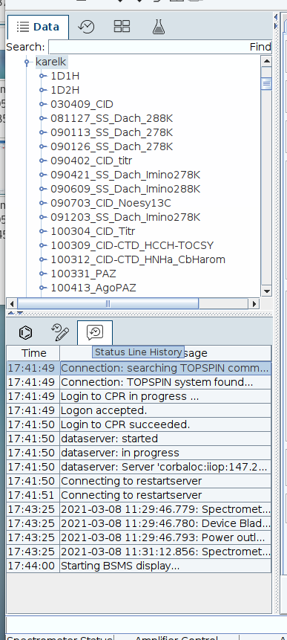
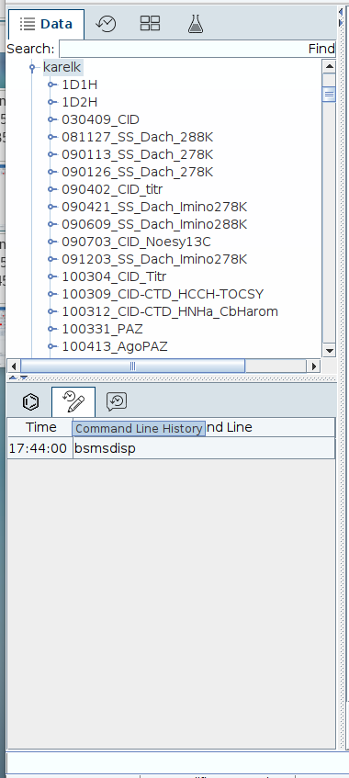
Topspin 4.X – layout description
Browser / history

Slide 14
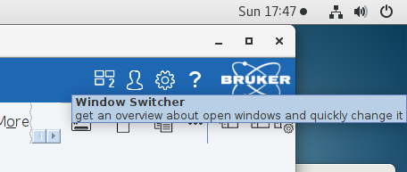
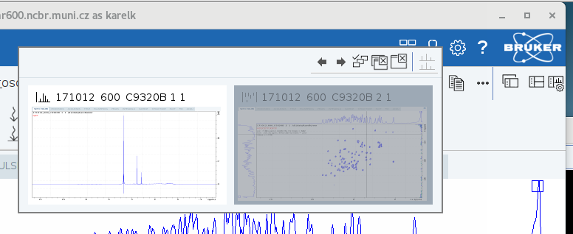

Slide 15
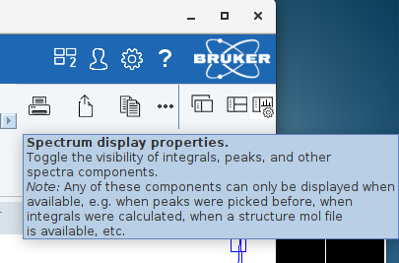
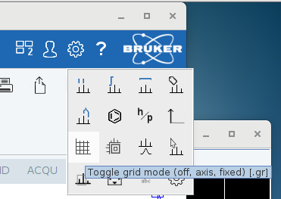

Slide 16
Notes to TopSpin
When you open Topspin for the first time under your own account, you need to set up a few things
Set the path to data
Create directory for your data
Create a dataset in your data directory
Open and customize the status panel
Disable zg safety
Other customizations available – colors, # of command lines, lock grid lines etc.
The preferences are stored in your home directory, e.g.
/home/fiala
In the directory .topspin1
May contain some junk, the essential file is
/home/fiala/.topspin1/prop/globals.prop
If you want to use someone else‘s setup, copy this direktory/file from his/her home directory to your home directory before starting TopSpin

Slide 17
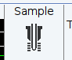
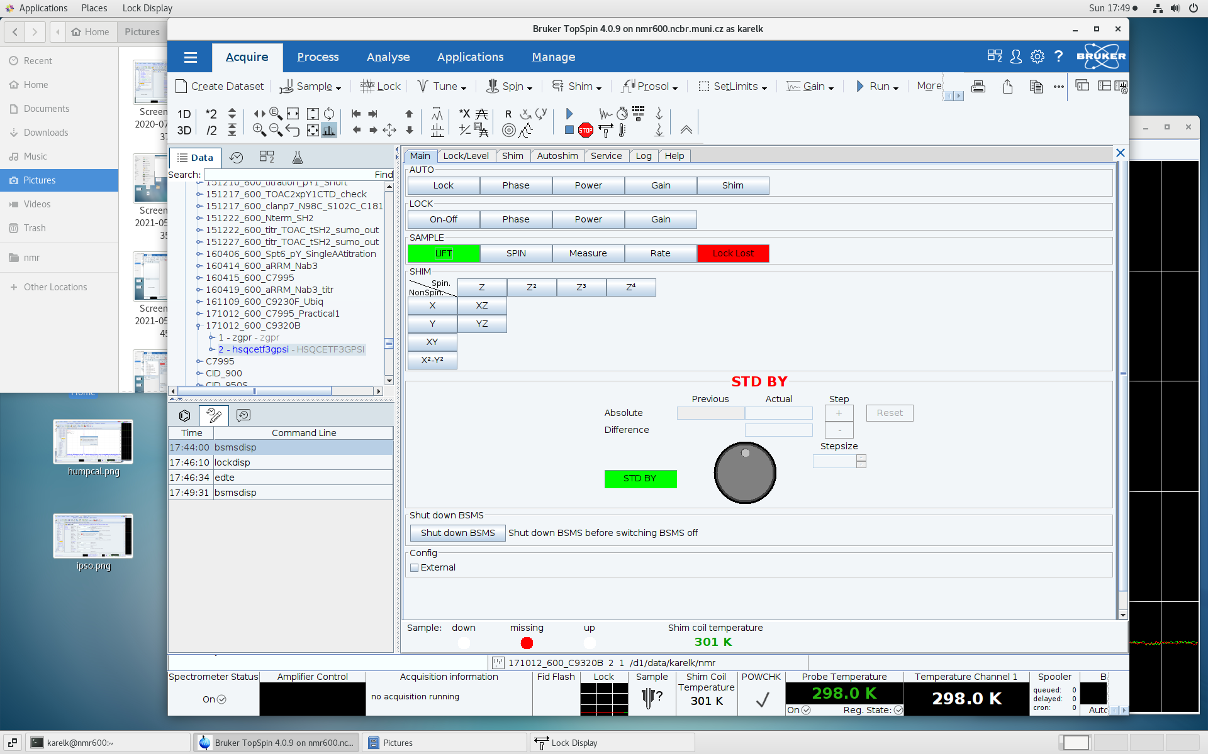

Prior any manipulation with the spectrometer or TopSpin, check the status panel first – namely, what is the acquisition status, temperature and what is the lock signal status.
In case there is a sample of your colleague still in the magnet, take it out from the magnet (vide infra) and take best care about the sample.
Sample status:
down missing up

Slide 18
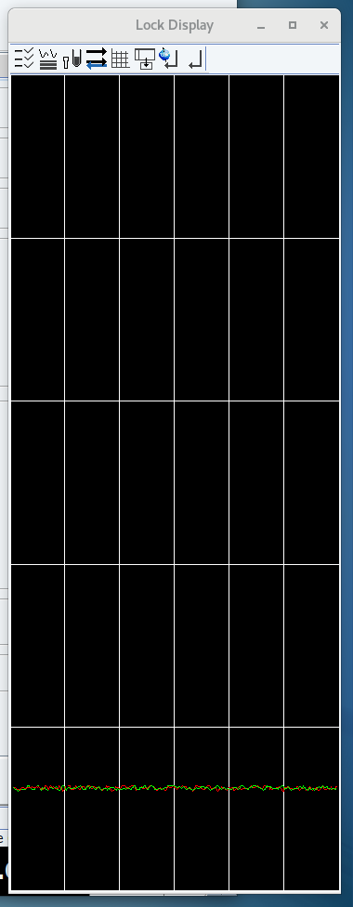
To eject the sample from the magnet – assure yourself there is no acquisition running, the lock is off (no straight line is sweeping the lock window but dispersive sinusoidal curves can be seen in the lower area of the lock window – see the figure on the right) and there is no mechanical obstacle that could prevent sample ejection. Then either type ej on the cl or use the BSMS window to manipulate with the lift.

Slide 19
Ejecting the sample
In the Main panel of the BSMS window (Bruker Smart Matching /Shimming system), click Sample - Lift for turning on the airflow (button turns green)
Sample mail will be set in action and brings the sample down
Spectrometers that have no sample mail will announce the sample ejection by increased airflow and sample „dancing“ on the top of the magnet. In this case, after removing the sample from the magnet, do not forget to switch off the airflow by clicking the Lift button once again (turns grey)

Slide 20
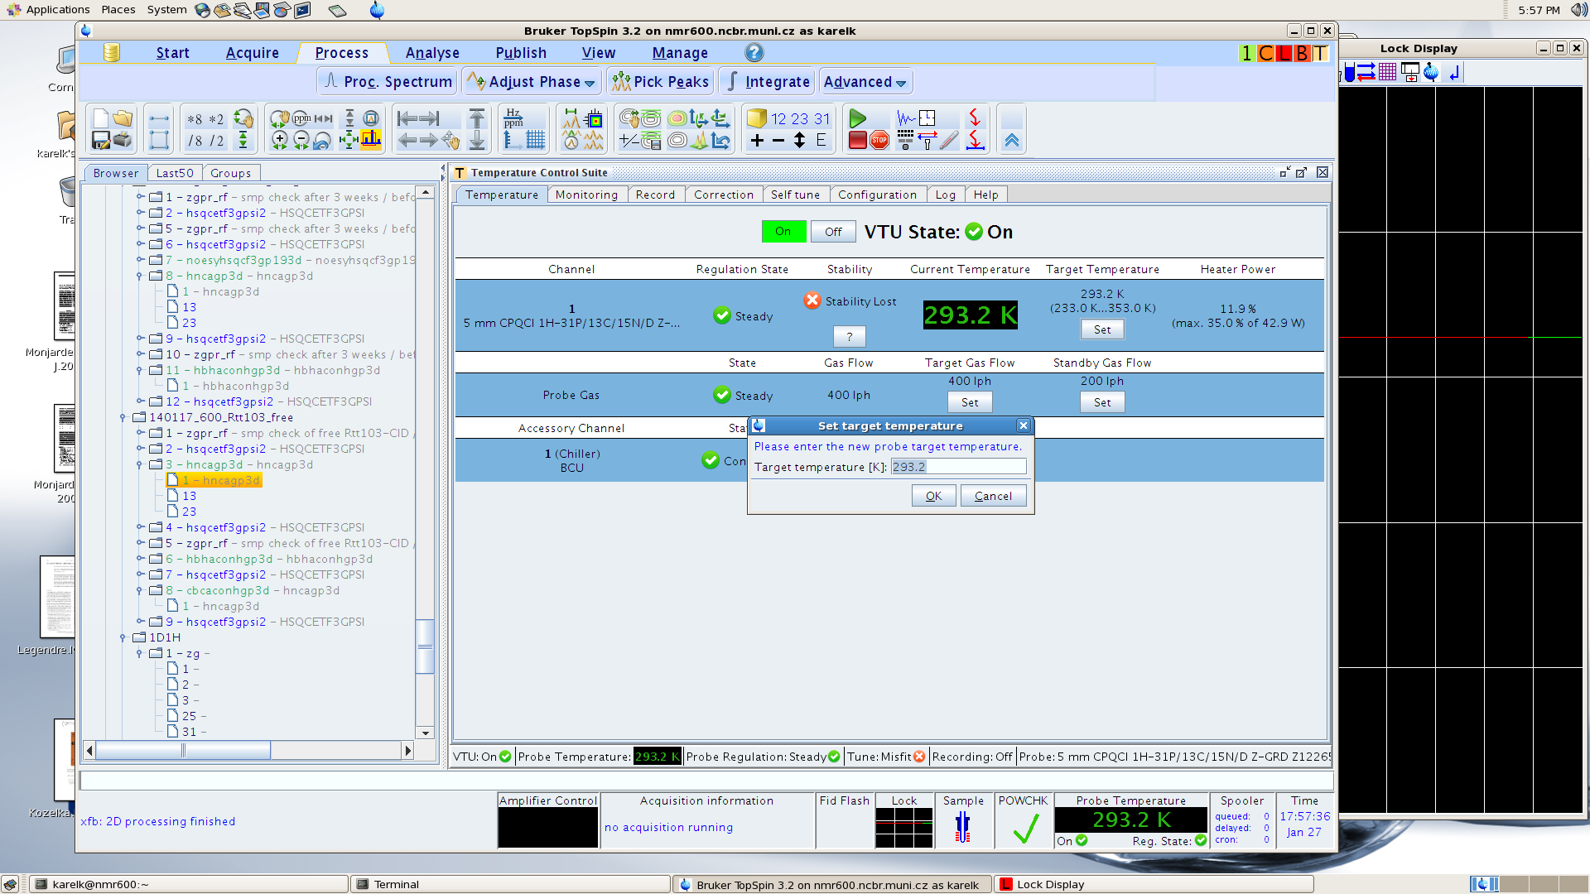
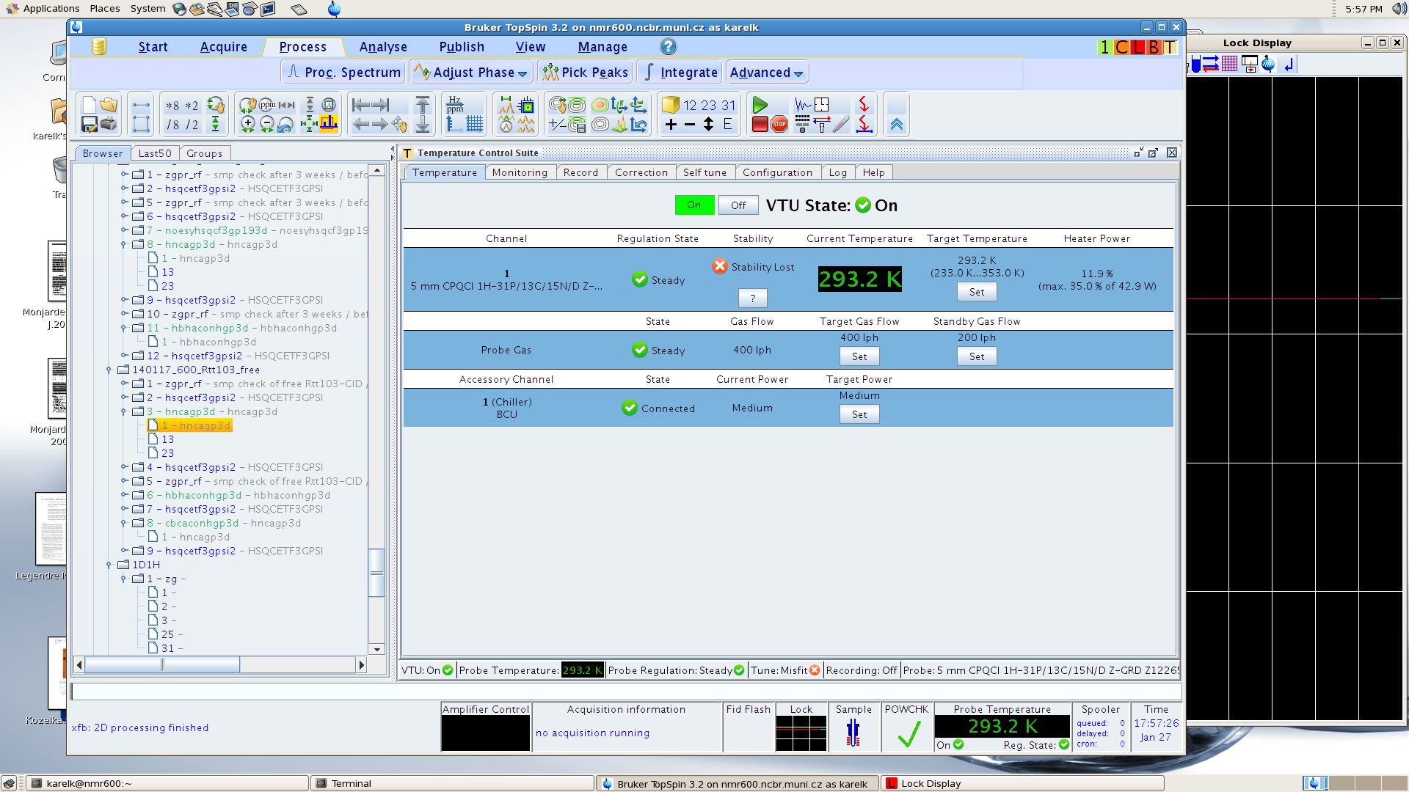
Temperature control
Once there is no sample in the magnet, set the temperature you want for your sample/measurement – this is done by opening the Temperature control window. This can be done by i) double click the Sample Temperature window in the status panel, ii) type edte in the command line (cl). This will open new window called T. Set the temperature and in the monitoring tab check first four check-boxes and control the progress of temperature. As soon as the temperature is stabilized, you may insert your sample into the magnet.

Slide 21
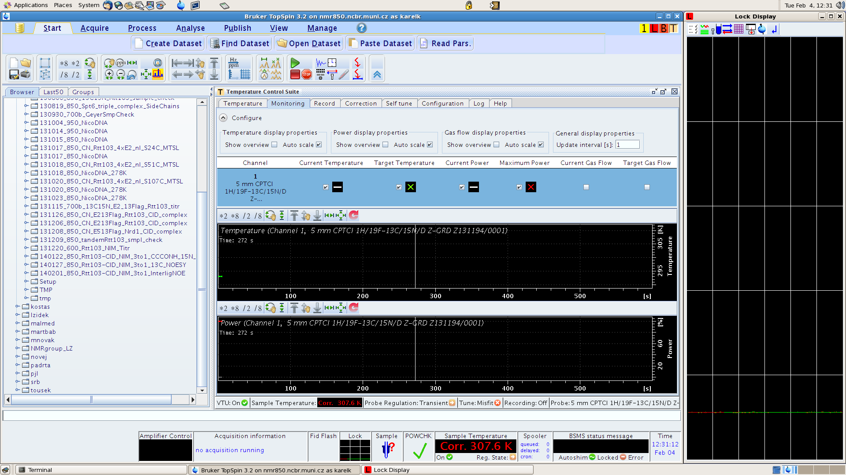
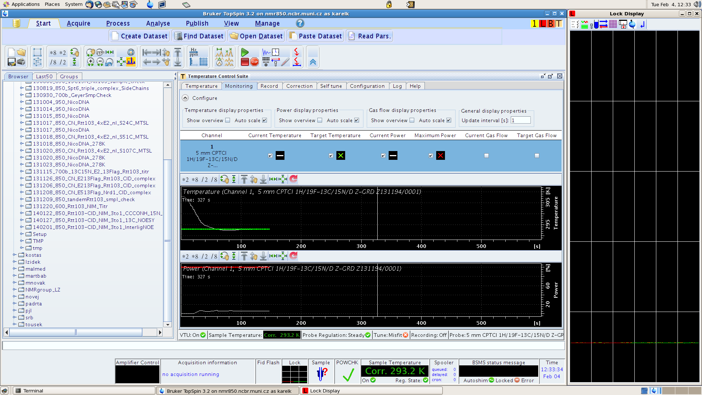

Slide 22
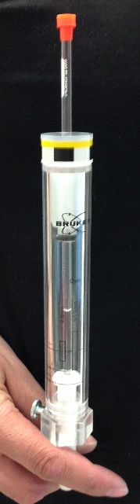
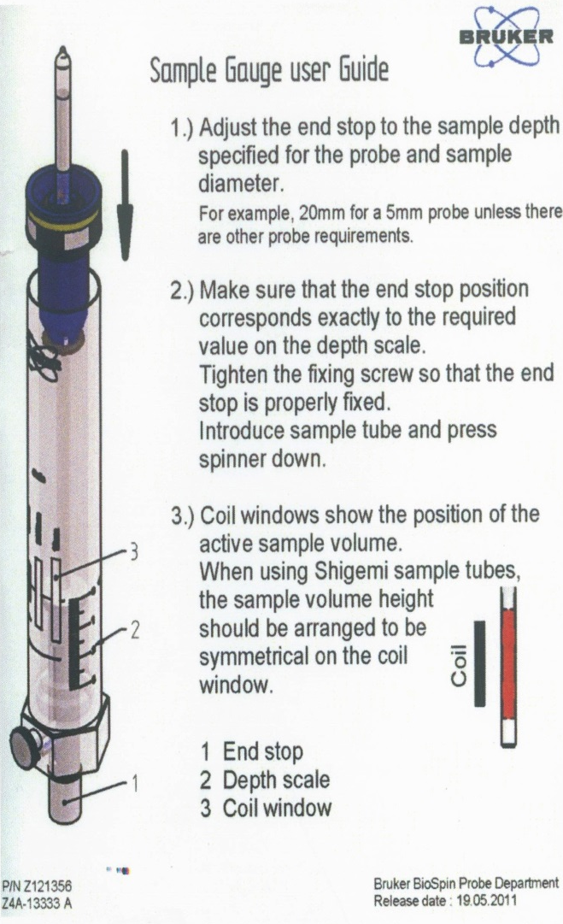
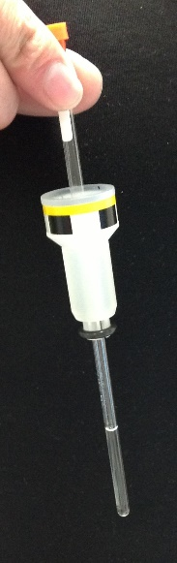
Sample/tube handling
Inserting the tube into the spinner
  Do not push the tube straight down the spinner, the tube may break down
  Screw the tube slowly into the spinner and at the same time gently push the spinner upward the tube
Adjusting/centering the tube in the spinner
  Put the tube with the spinner into a depth gauge and screw the tube until the length of the sample is symmetrical around the middle line crossing the coil-representing boxes

Slide 23
Notes to temperature control
Temperature is maintained by flowing cooled/heated gas around the sample.
Sample temperature may differ from the set temperature (sensor not in the sample, calibration of the sensor itself) – calibration needed
Calibrations based on the change of chemical shift with temperature
Methanol (neat, 4%, 0.2%), 25⁰C and down
Ethylenglycol, 30⁰C and up
NMR thermometer – calibration substance added to buffer, ²H spectra measured during the experiment run, special locking parameters must include the calibration data

Slide 24
Inserting the sample
After the desired temperature is reached, in the Main panel of the BSMS window (Bruker Smart Magnet System), click (skip this in case of sample mail) Sample - Lift for turning on the airflow (button turns green)
Place the sample either into the sample mail or on the top of the magnet bore when „maximum“ airflow is reached
Turn off the airflow by clicking the Lift button again (goes gray again)
For the magnets equipped with
sample mail, place the spinner with
the tube into the sample rack and close it
Wait until the sample is positioned
in the probe

Slide 25
Locking the magnetic field
Locking on the reference nuclei (deuterium)
Once the sample is in the magnet (check Sample status icon on status bar, status LED of the sample mail etc.), usually lock signal appears as red/green signal in dispersion mode. In case you do not see that line – it may indicate that previous user was using different deuterated solvent or there is no ²H in your sample. Undocumented lopo command reads in the lock parameters without engaging the lock.
Type lock on the cl
Note: you may not be able to lock if the field homogeneity is poor. It is a good idea to read in suitable shims before you try to lock (command rsh). If you do not have suitable shims, look for a recent sucrose (for water samples) or lineshape (organic solvents) files.

Slide 26
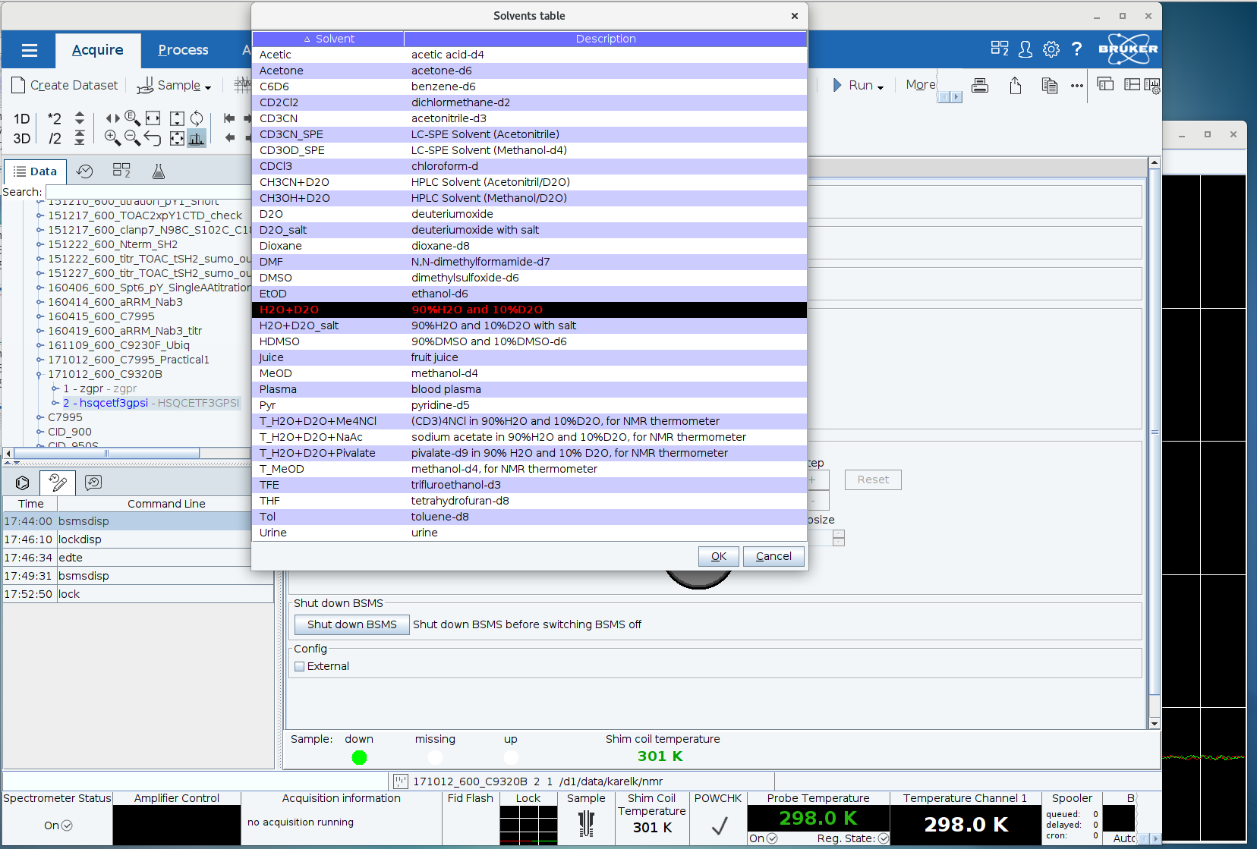
Locking the magnetic field
  Table with solvents will pop up
  Select the right solvent from the table and click the OK-button or double click the solvent of choice

Slide 27
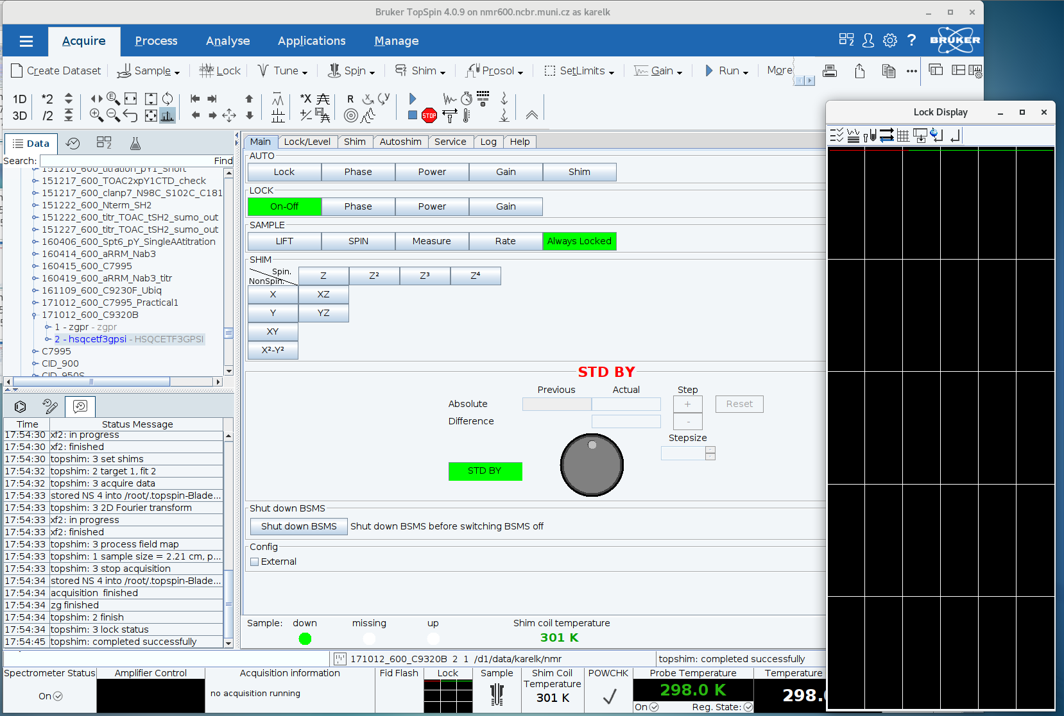

Slide 28
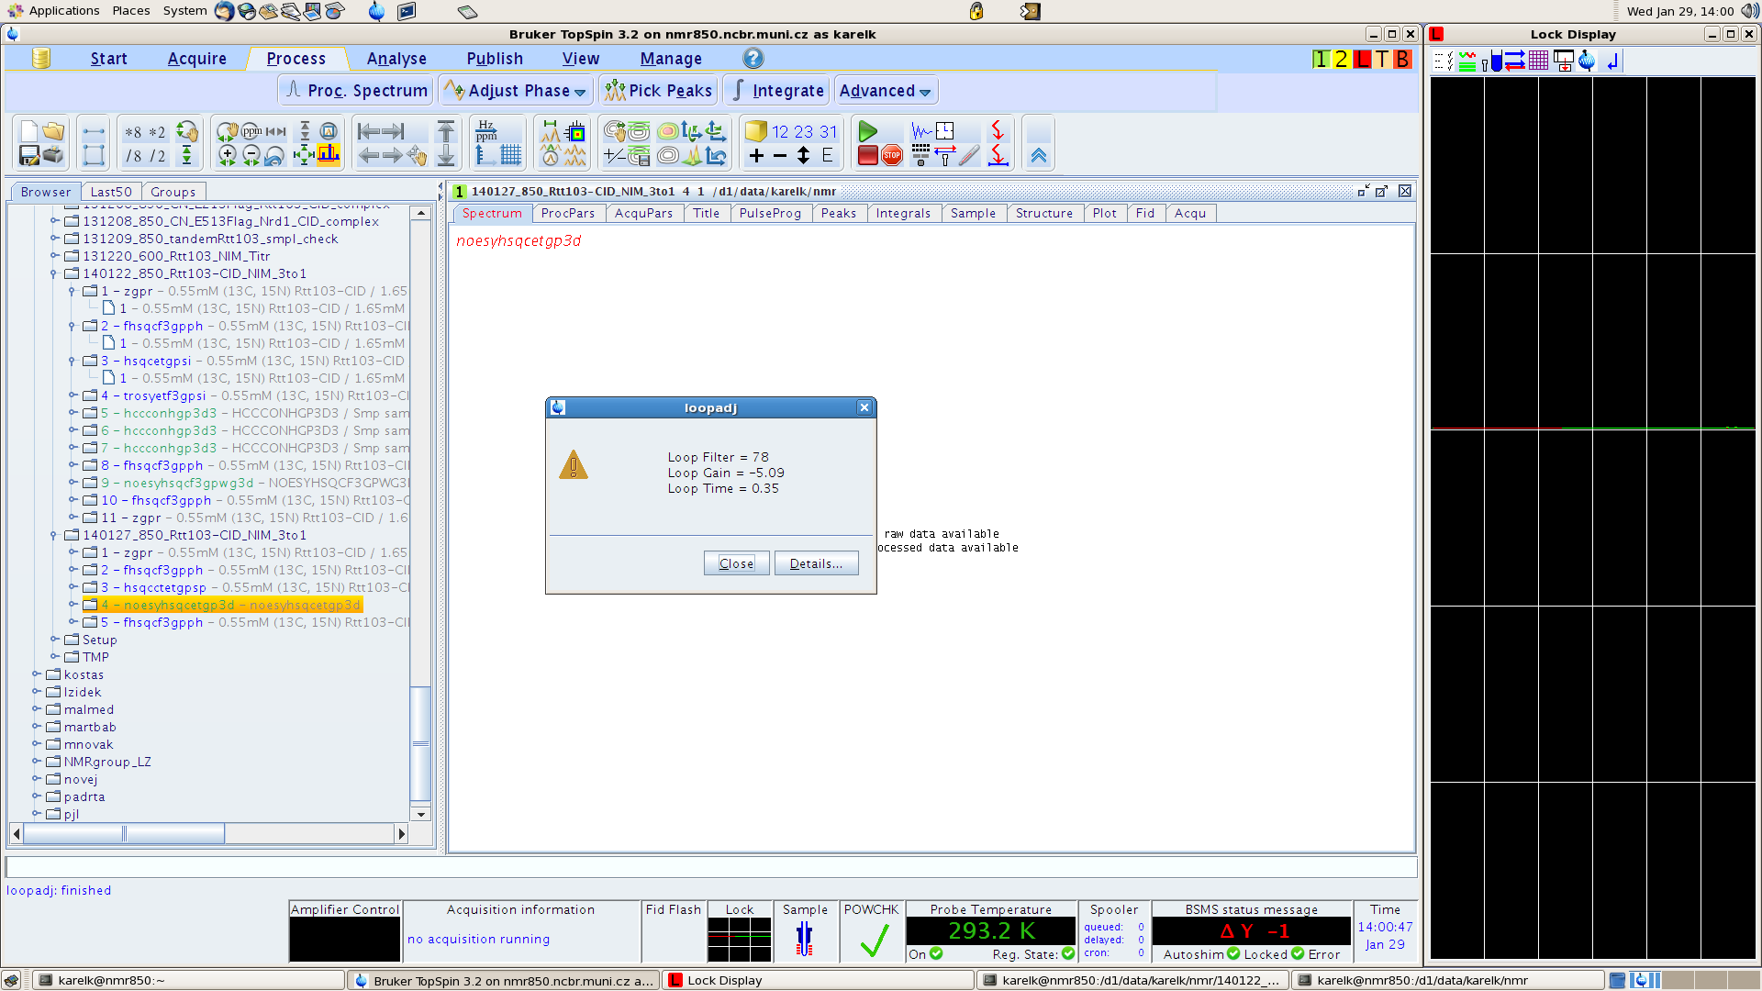
Homogeneity of the field
Adjusting homogeneity of the magnetic field – as the more homogeneous magnetic field results in a narrower lock signal which results in a higher d.c. voltage, one aims for an optimum lock signal by adjusting various shim currents
Shimming options
Manual (in the BSMS display via the Shim tab)
Automatic
  Gradient shimming – Topshim (additional parameters, 3D only works with water samples)
  Simplex (slow, works based on lock level, shims to optimize must be specified in a file)
  Hardware autoshim (Autoshim tab in BSMS), activate before starting long experiments .
As there may be needed to adjust the lock phase, lock gain and other parameters, type loopadj on the cl (optimizes lock phase, lock gain, loop phase, ...) which will take care about all of it. In case there is sufficient lock signal, menu with three lines will appear to confirm everything went smoothly and was set up. Should there be low lock signal, error message will appear.

Slide 29
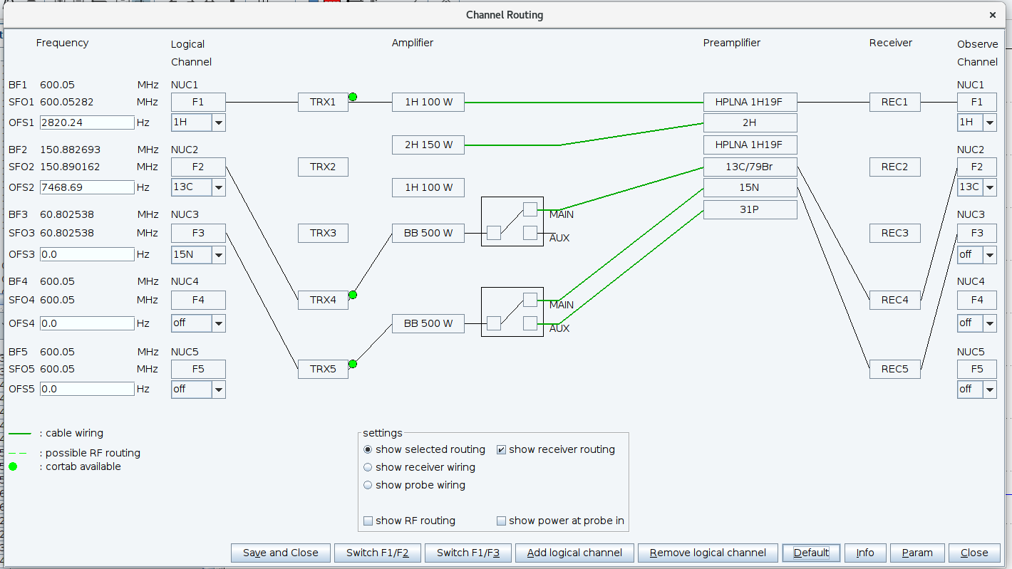
Selecting the nuclei
Prior starting any set up, pulse checks or measurements, make sure the channel routing is correct and all the channels that are going to be measured are active.
To do so, type edasp on the cl
set the desired nuclei from the pop-up menus: typically channel 1 – ¹H, channel 2 - ¹³C, channel 3 – ¹⁵N
Click on Default to set proper routing
for the channels and Save and Close
the settings.

Slide 30
Tunning and matching the probe
  For obtaining optimal signal-to-noise ratio, one needs to tune the probe with the sample inserted. It is done by adjusting two mutually interactive capacitors. One tunes the circuit to the desired resonance frequency (tuning) and the other matches the impedance (matching). Tuning/Matching can be achieved either manually directly on the probehead that is NOT equipped with ATM unit or automatically from a PC in case the probehead IS equipped with the ATM unit. Automatic Tuning/Matching Automatically (atma)
  Start with atma (AutoTuneMatchAuto)on the cl – typically, this will tune the probehead automatically without any human intervention
  Once atma is done, it is recommended to check the tuning manually
  Type atmm (Automatic Tuning/Matching Manual) on the cl – window with a black wobbling curve that needs to be ftuned to the minimum indicated by vertical red line is opened
  The precision of the displayed curve is driven by wobble sweep width. Set it prior wobbling by command wbsw on the cl to 2 MHz or click wbsw icon and set it there.
  N.B. Sometimes the atmm gets stuck when trying to change the sweep width. Using of following command and its option atmm manwbsw has proven to improve the wobble behavior. Again, create own macro or use wkk.

Slide 31
  Tunning and matching the probe
  While tuning the probehead „manually “ with atmm, keep an eye on the lock-level signal. It may drop significantly during the tuning so once finished, run topshim once again. Typically one is tuning the channels starting at lowest frequency (typically, ¹⁵N followed by ¹³C and then ¹H) but in case of (cryo)-probeheads with a new design (lock signal is dropping while tuning/matching) are supposed to be tuned from highest frequencies down (i.e. ¹H->¹³C->¹⁵N). In any case, check the tuning curve of a given nuclei iteratively.
  Tune/match each channel starting from the nuclei with the lowest frequency (on the 850/950MHz spectrometers in reversed order)
  Adjust the displayed sweep width (parameter WBSW (wobble sweep width) in the upper right corner, vide infra)
  Get the minimum of the curve to required position by clicking the arrows that represent expected step of the tune/match
  Start with matching (get the minimum to the bottom), then tune (center the minimum on the reference line). As tune/match are interconnected, the procedure becomes iterative but optimum has to be always reached.
  For samples with high salt [c(NaCl)>=250~300mM], use either shaped NMR-tube or 3mm tube. Both tubes require special rotors and extremely gentle handling!

Slide 32
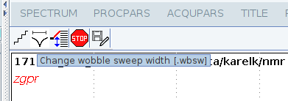


Slide 33

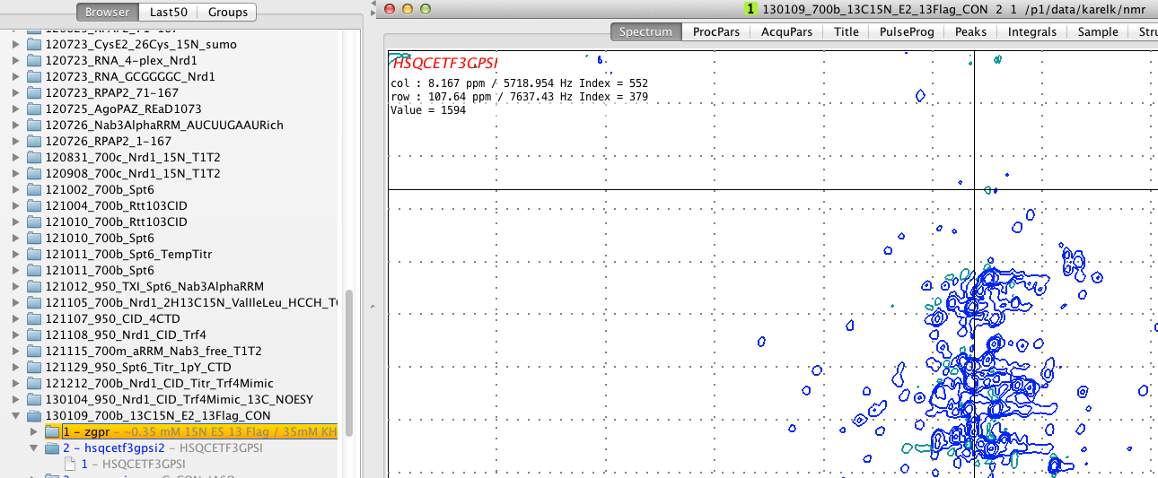
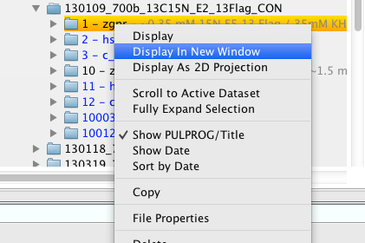
Creating a dataset
Steps involving edasp and atma/atmm require an existing dataset with parameters. Users typically keep in their data-tree directorie Setup/Calibration or something similar. In those dataset one usually doesn‘t change more than power-levels, (de)activates nuclei but not much more ...
If one wants to create a dataset, there are several ways to do it
  Copy an existing dataset you or someone else used previously
    Select a dataset that worked previously, ideally by clicking right button in the browser and open in a new window. Often, different set is selected in browser and different in the window. Always check which spectrum you are working with!!!
  Read in a standard parameter set (rpar)
X

Slide 34
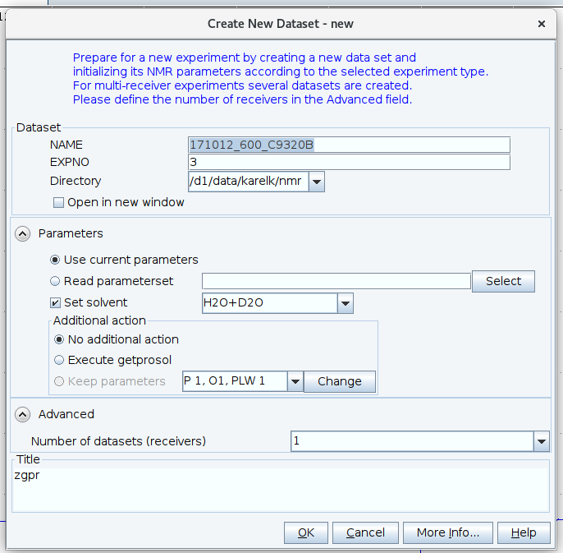

Creating a dataset
    Once being in the right dataset, type edc on cl and set the new destination of the experiment, experimental number, title, user ...
    In case dataset should be copied to the next ExpNo, use command iexpno which will copy the dataset to next ExpNo
  If creating a new dataset, type rpar on cl to read standard dataset parameters of a required pulse sequence
  Type getprosol on cl to set actual pulse calibration. Should calibration of any nuclei vary from the standard ones (typically ¹H), type getprosol 1H 13.55 13W which means that 90° ¹H pulse is 13.55μs@13W taken as reference.
  Modify the rest of the parameters in AcquPars in Data area (TD – number of points collected during FID, DS – number of dummy scans, NS – number of scans, SW – spectral width, O1P – carrier frequency, ...)

Slide 35
Calibration of 90⁰ ¹H pulse
  Automatic calibration
    Type pulsecal on cl – info-panel will pop-up with the length and power of 90⁰ pulse. The parameters will be also automatically updated within the dataset
    Pulsecal gives results reasonable enough to use them for nD experiments or to use them as a starting point for manual calibration
  Manual calibration
    Type p1 on cl, set the pulse length 1 μs and type zgqfp. This will run a macro that is composed of zg (zero go - start an experiment), qsin (multiply resulting FID with QSINE window function) and fp (perform Fourier transformation with phase correction). Alternatively zgefp does the same but instead of qsine exponential window function is used for FID apodization.
    Water-line signal will appear at about ~4.7 ppm. Phase the line to pure absorptive line either manually through Process menu and manual phase adjusting. Phasing window can also invoked by typing .ph. If there are few signals in the spectrum automatic phase correction – apk command will work well. Check also symmetry of the signal and/or any abnormalities of the line-shape. Also measure the LWHH to get an estimate about the quality of the shimming.
    Proton hard pulse (90°or π/2) is strongly dependent on the tube diameter, salt concentration, temperature and solvent used. The pulse-length can be as short as 8μs but can reach ~17μs for high salt samples. As the 90°pulse is usually determined by measuring the 360° since the pulse gives a minimum signal, type p1 on cl and set it to four times the expected length of 90⁰ ¹H hard pulse (i.e. 32 to 68μs). From the knowledge of sine-function one can easily guess whether the signal is longer 360°or shorter.
    Once minimum in 360° is achieved, take one fourth the length of the pulse that gave a zero signal to obtain length for the 90⁰ pulse.
    Samples in organic solvents or D₂O can be calibrated on 180° pulse (first pass through zero).

Slide 36
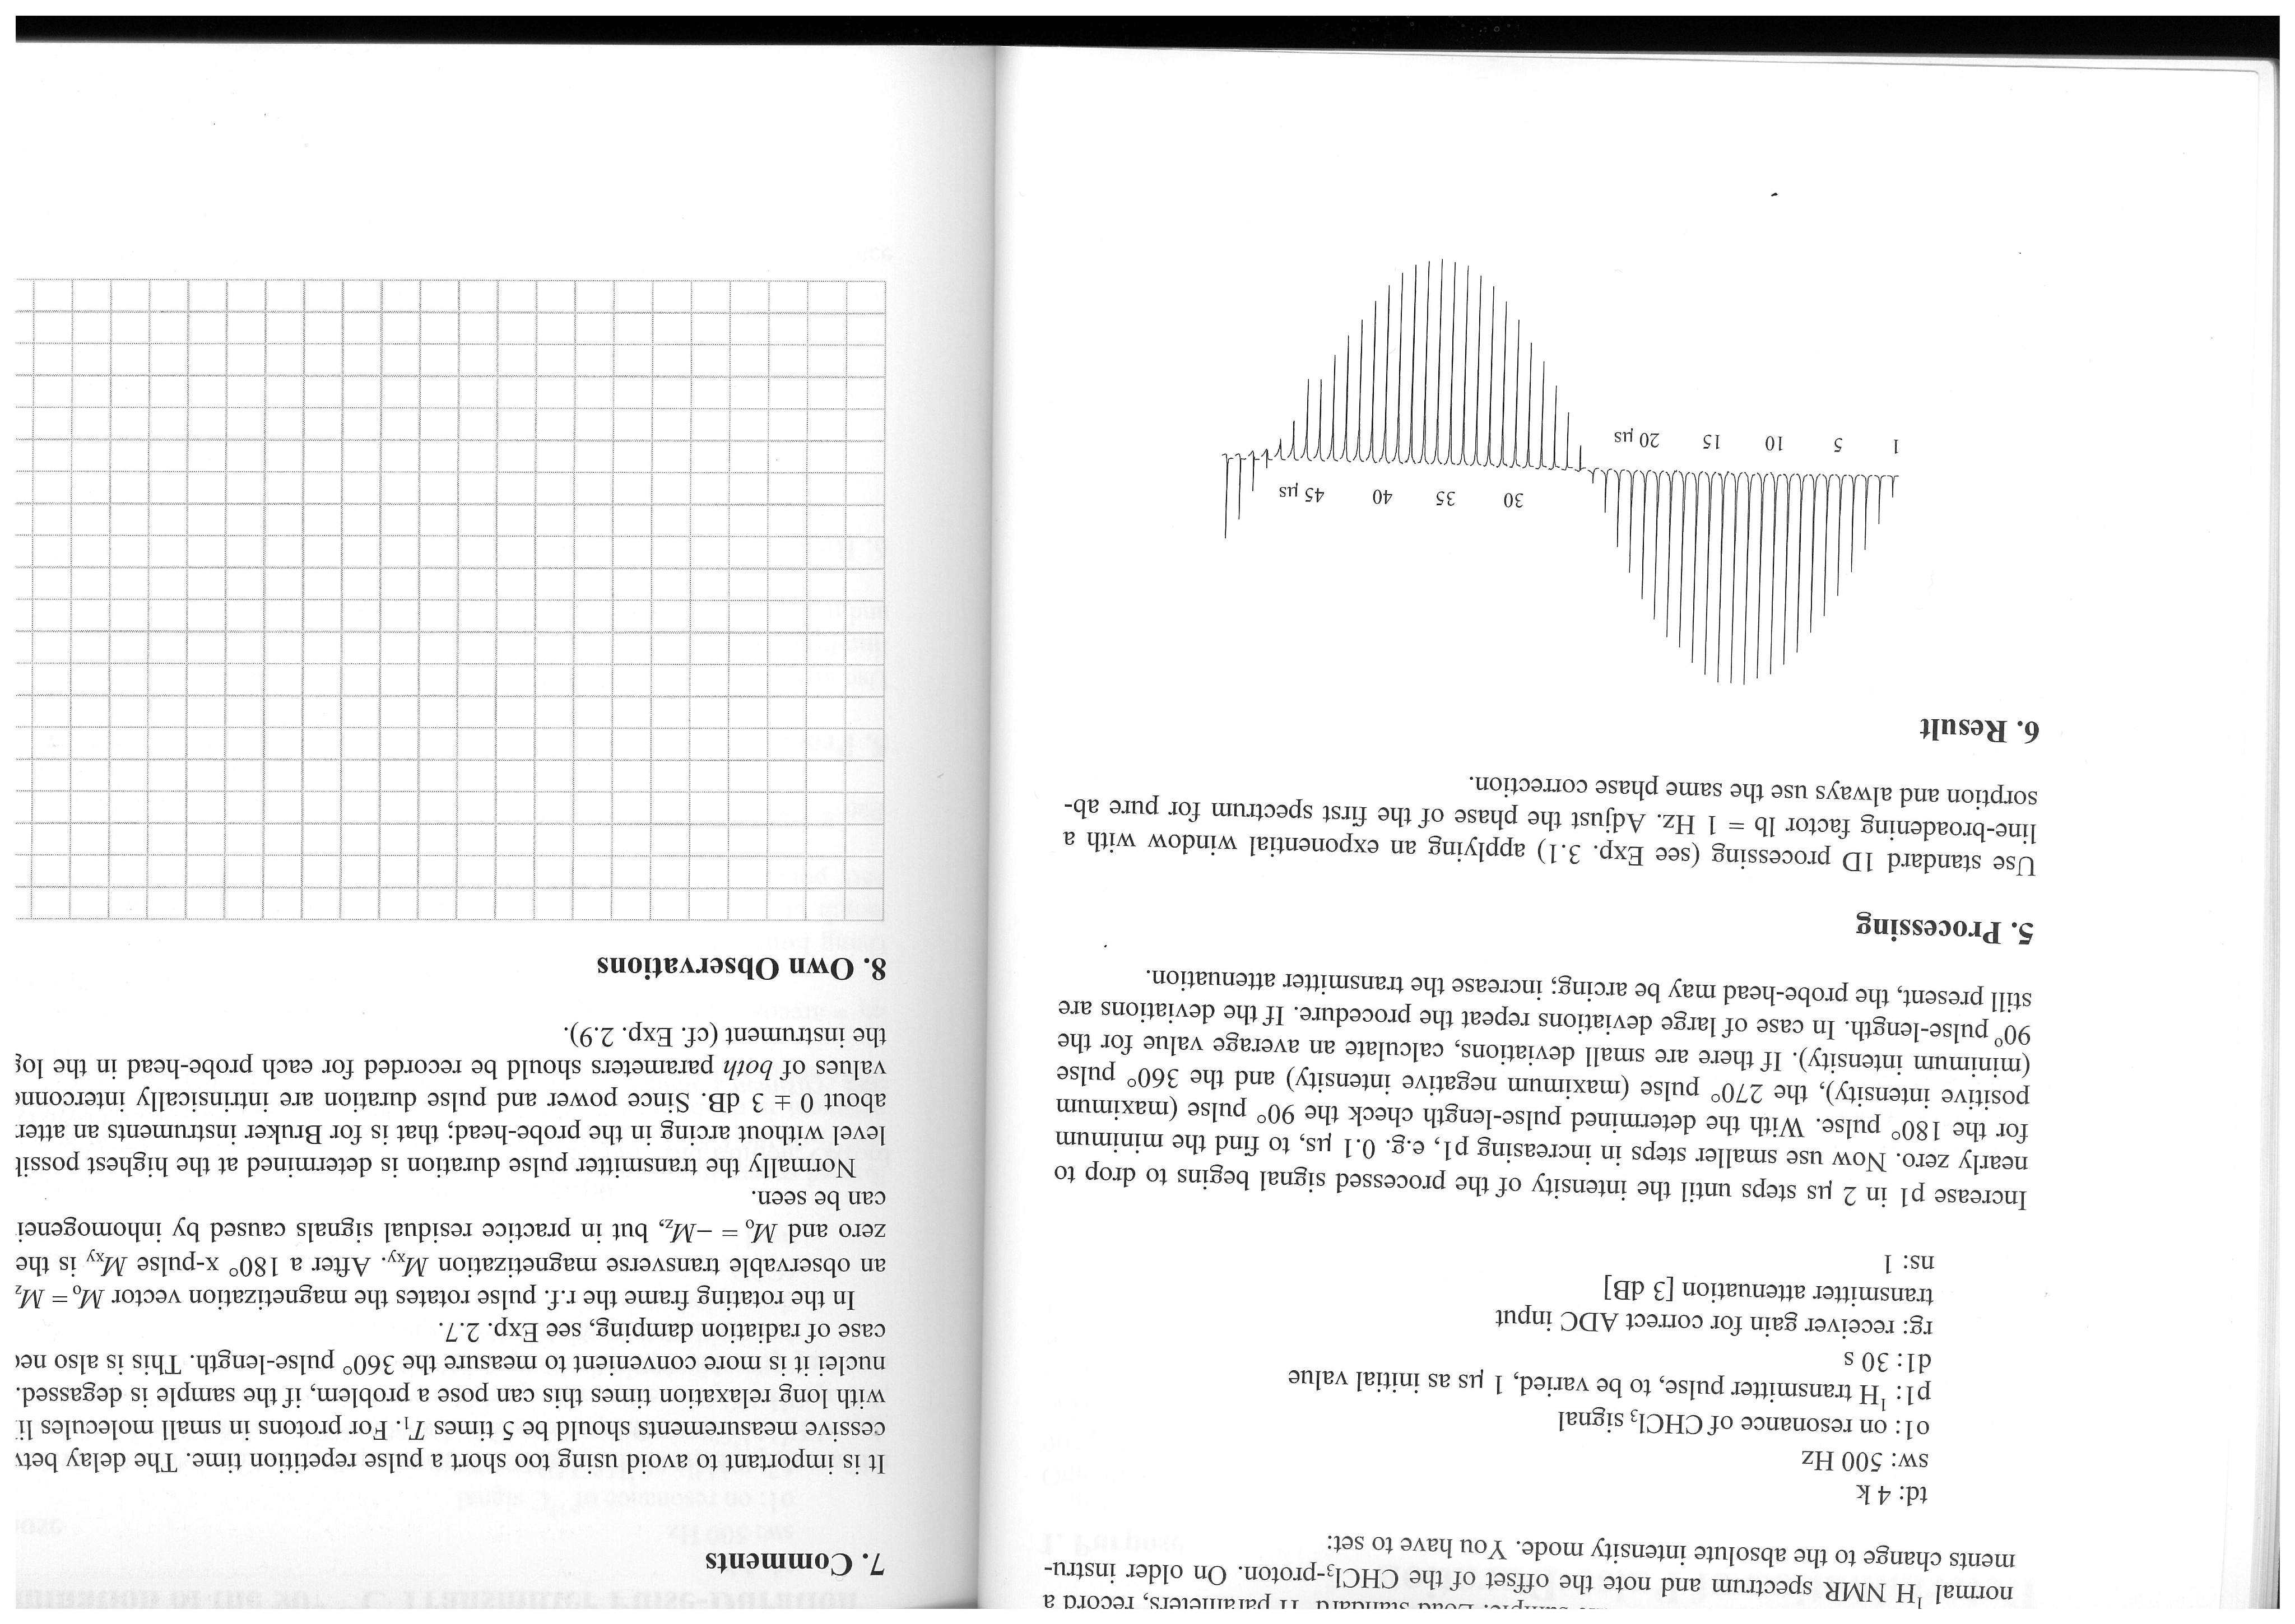
Calibration of 90⁰ ¹H pulse
Another option how to calibrate pulse in to use command paropt, which will pop-up a window where one sets up initial value [of the pulse], increment, and number of increments. Result of such paropt will provide similar output (initial value: 1μs, increment:1μs, number of increments: 50).
p1 duration

Slide 37
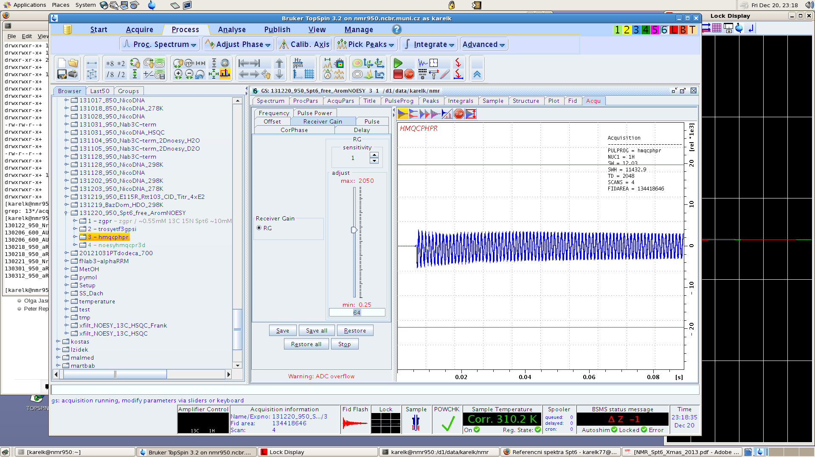
Optimizing acquisition parameters
  Before starting any acquisition, it is wise to check whether all parameters are at their optimum or can be further improved. For the sake of optimization there is command gs (go scan) that will run an “infinite” loop enabling real-time manipulation with pulse-lengths, delays, receiver gain etc. Immediate impact on the FID is observed.
  Start with optimizing receiver gain – either by typing rga prior running gs or manually till ADC overflow disappears*
  The parameters can be adjusted by:
    dragging the slider (not recommended)
    directly typing desired value
    clicking on the slider-scale
    (clicking will be affected by the sensitivity)
    ADC range lines
    *note: cryoprobes tend to give false
    ADC overflow warnings

Slide 38
Optimizing acquisition parameters
  Other parameters that could be set are the exact position of receiver (Offset-tab), phase correction (particularly in case of WATERGATE water suppression; CorPhase) and duration of calculated shaped pulses (Pulse-tab).
  Always check the Warning message and FIDAREA which one wants to reach as low as possible as the signal in biomolecular samples is dominated by water which is supposed to be efficiently suppressed.

Slide 39
Start of the experiment
Duration of the experiment
  Type expt (experimental time) – gives the experimental time, required space on disc for the current dataset
  Type multiexpt – allows to estimate duration of multiple experiments that are in row (e.g. ExpNos 1, 2, 3, 4 ...). Returns the time and date, when the experiments are finished.
Running the experiment
  Type zgqfp – starts and processes 1D experiment (composite macro of zg+qsin+fp) – in case of low concentrated samples, one set number of scans as high as 128 or even 1024. As such experiment takes already a significant amount of time, it is wise to check whether something is being acquired. Either check the on-line Fourier transform in the acquisition window or type tr to transfer the so far acquired data from spectrometer to computer and process them with efp or qsin+fp.
  Type zg – starts the experiment without processing it
  Type stop – immediately stops the experiment
  Type halt – stops the experiment after the current scan

Slide 40
Start of the experiment
In case of an nD experiment follow the same steps as in case of 1D, i.e. first set all parameters properly and check with gs-command that everything is correct and is not hurting sample/probe. Before typing zg, check the duration with expt or multiexpt to see when the experiment is going to finish.
When the experiment is started with the zg-command, wait till the first FID is acquired. In the mean-time check that the temperature and lock are stable and not affected by the running experiment.
Once first FID measured and stored, type rser 1, which will transfer the first FID to ~TEMP directory ExpNo 1, ProcNo 1. Process the FID with qsin+fp and phase it. This will give you a rough information about signal/noise ratio of your experiment – if there is no signal in the firs row, there will be not much signal at the end of the experiment (exceptions are, e.g. HNCACB or DQF COSY, but these are not experiments for beginners:-).

Slide 41
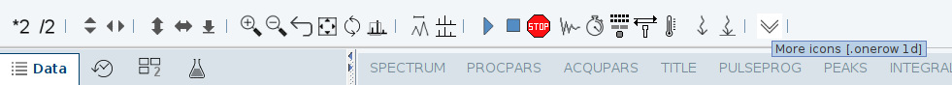
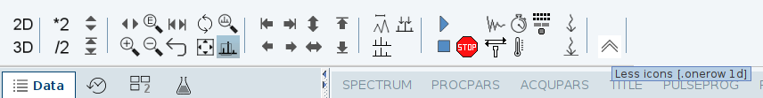
Start of the experiment
Should it be possible to compare the running experiment with previous dataset, store the current ProcNo to ProcNo 2 by typing wrp 2 y – write ProcNo to 2 and if there is already ProcNo 2, yes, overwrite it. Then go to the previous/reference experiment, type again rser 1; qsin; fp, phase the spectrum. Type .md or click the multiple spectra icon and then type rep 2 – read ProcNo 2. Of course one can do all the overlay with mouse only but the clicking may be more time consuming as the directory gets filled with experiments and ~TEMP remains at the top (scrolling up, double-clicks …, keyboard is keyboard:-).

Slide 42
Quick reference:
bsmsdisp – open control panel
ej – eject sample
edte – open temperature control panel
ij – inject sample
lockdisp – display lock window
lock – select solvent for locking the magnet
topshim – automatic shimming
loopadj – adjust lock parameters
edasp – set up spectrometer routing
wbsw – set up wobble sweep width
atma – automatic tuning/matching
atmm – manual -----”-----
edc – copy dataset
iexpno – copy dataset to next ExpNo
rpar – read parameter set
getprosol – set up pulses according to prosol
pulsecal - calibrate ¹H 90° pulse
paropt – optimize parameter (e.g., p1 length)
rga – automatically set up receiver gain
gs – go scan – optimize acquisition parameters
expt – estimate duration of the experiment
multiexpt - ----”---- for multiple expts in row
zg – start acquisition
zgqfp – acquire 1D and apply qsin apodization
qsin – multiply FID with qsin window function
xfb – process 2D
xfb n – process 2D and remove 2ri, 2ir, 2ii
tr – transfer data 1D from spectrometer to PC
edmac name – create or edit macro name
wrp 2 y – write processed data to ProcNo 2 and if exists, overwrite
rser 1 – extract first FID of an nD experiment
.ph – start phase menu
.md – spectra overlay window
apk – automatic phase correction
show – show active processes
curplot – set up printer
print – print spectrum
acqu – switch to acquisition window
ii – if spectrometer doesn’t communicate
ii restart – if ii doesn’t help
stop – stop immediately acquisition, rough
halt – stop it smoothly, recommended
pulse – calculate pulse length based on 90°hard pulse parameters
calcpowlev – similar to pulse

