Slide 1
NMR Sample

Slide 2
Sample quantity
NMR has intrinsic­ally poor sensitivity
Concentration
  Simple spectra (proton 1D) ~ 50 μM
  Multidimensional spectra ~0,5 mM
Sample tubes
  5 mm, 550 μl
  3 mm, 150 μl
  Shigemi 5 mm, 250 μl

Slide 3
Solubility and stability
Aggregation, precipitation
NA better soluble than proteins
NMR measurements long
  Run a control spectrum before and after a long experiment (1D, ¹H-¹⁵N HSQC for labeled proteins)

Slide 4
Molecular weight
Increasing molecular weight
  Complexity of the spectrum – number of lines, overlap
  Increasing linewidths
Remedies
  Isotope labeling
  Multidimensional spectra
  TROSY, MQ

Slide 5
NMR tube
Choice
  Volume
  Quality (geometry)
Cleaning
  High quality tubes are expensive, not for single use!
Drying
  No high temperatures above 50⁰C

Slide 6
Concentration, solvent exchange
Lyophylization
  May harm samples (esp. proteins)
Ultrafiltration
Gel filtration
Ultracentrifugation

Slide 7
Isotope effect, H₂O vs D₂O
No D₂O is 100%
Viscosity
Melting/freezing point of D₂O is 3.8⁰C
pH
  Glass electrode shows 0.4 units difference (7.0 in H₂O, 6.6 in D₂O), pH* value

Slide 8
Sample parameters
pH
Ionic strength
  NMR probes (esp. cryoprobes) do not like high salt concentrations (above 100 mM)
Buffer type
  Preferably buffer with no NMR signals
Concentration
  Oligomerization, precipitation, high viscosity
Temperature
  Sharper lines at higher temperatures, but not for exchangeable protons

Slide 9
Chemical shift reference
Internal
  Add reference compound to the sample
External
  Capillary within the sample tube
Direct
  Reference compound measured together with the sample
Indirect
  Reference compound measured separately or the chemical shift is calculated

Slide 10
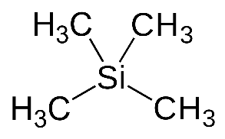
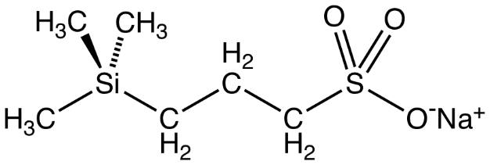
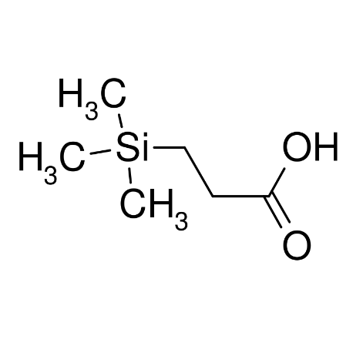
Common reference compounds
Wishart et al. (1995) , J. Biomol. NMR 6, 135-140.
¹H
  TMS 0.00 ppm, not soluble in water
  TSP around 0, varies slightly with pH
  DSS 0.00 ppm
¹³C
  TMS 1.7 ppm, not soluble in water
  TSP around 0, varies slightly with pH
  DSS 0.00
¹⁵N
  NH₃ 0.00 ppm, bio
  CH₃NO₂ (neat) 381.7, chemistry
³¹P
  H₃PO₄
TMS
tetramethylsilane
DSS
Sodium trimethylsilylpropanesulfonate
(dimethyl silapentane sodium sulfonate)
TSP
Trimethylsilylpropanoic acid

Slide 11
Contamination
Paramagnetic contamination
  Broadens the lines, destroys resolution
  Cu ,Mn, Cr, Fe, Co
Microbial contamination
  Bacteria can eat-up your sample
  Work clean, add sodium azide (toxic!), EDTA
  Bacteria do not strive in 100% D₂O

